Slide 1
StarDist Course
Sept 6th, 2024
Todd Fallesen
Chris Hadjigeorgiou

Slide 2
Course Files
FileName | Use | Folder
StarDist_bash_Sept24.sh | Installs StarDist into your working directory on camp | Setup_Scripts
StarDist_Crick_Sept24.yml | The environment file for StarDist, called by StarDist_bash_Sept24.sh | Setup_Scripts
Install_FIJI_w_download.sh | Downloads and installs FIJI into your working directory | Setup_Scripts
GPU_Test.ipynb | Test installation of StarDist | Notebooks
StarDist_Demo_Data_Download.ipynb | Download the test dataset, see what labels look like | Notebooks
StarDist_Training_Demo.ipynb | Demo of how the training works, including augmentation and number of rays. Works on demo data | Notebooks
StarDist_Prediction_Demo.ipynb | Demo of how prediction works. Includes a task on changing models | Notebooks
StarDist_Training_Task.ipynb | Notebook for training your own model. | Notebooks
StarDist_Prediction_Workshop_Model | Notebook for doing prediction and saving predictions and FIJI ROI’s | Notebooks

Slide 3
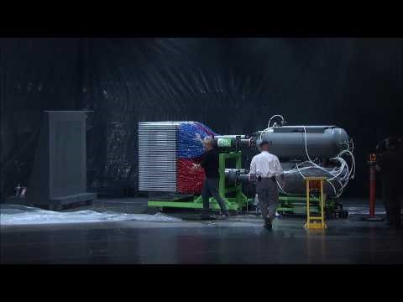
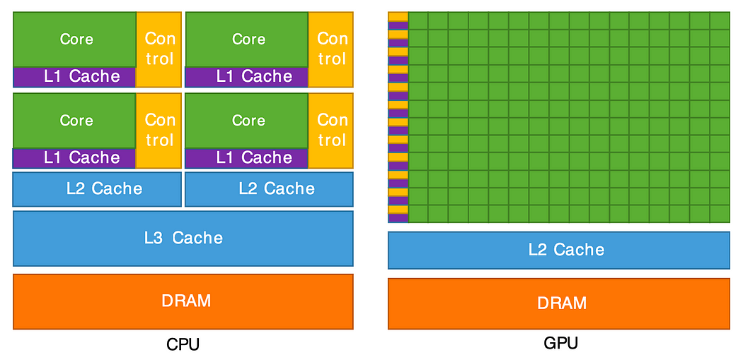
GPU vs CPU
CPUs are the normal processors in your computer. They act in a serial way, doing one task, and then another. They do a variety of tasks incredibly quickly and well, but don’t do multiple tasks well at the same time.
GPUs are dumber and slower, but have many many many processors, so can be faster for simple parallelizable tasks. For things like image analysis, where we can easily parallelize a task (i.e. the same operation on every slice of a Z-stack) GPUs are much faster.
Notes:
#Image from https://medium.com/mlearning-ai/processors-cpu-gpu-fpga-accelerator-8bfc3a73333c

Slide 4
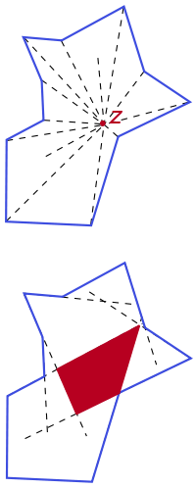
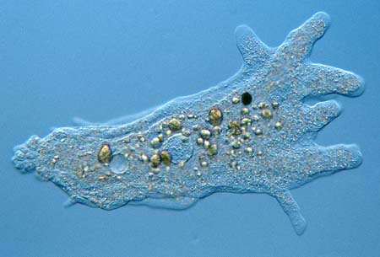
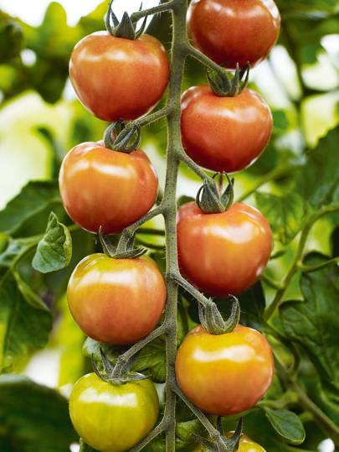
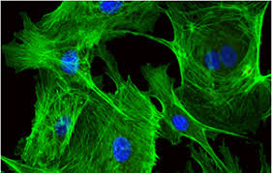
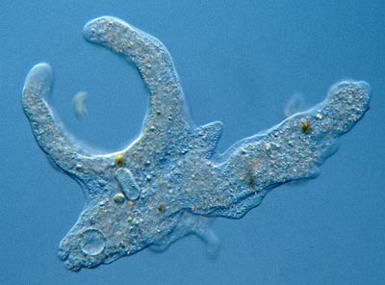
Star-convex?
Stardist can only detect objects that are Star-convex: all the points of the perimeter can be reached by rays emanating from a point somewhere in the object.

Slide 5
Is a pixel in an object
If pixel is in an object, how far to the boundary of the object in which the pixel belongs
Pixels are weighted higher towards the middle of objects
1.) (d_{i,j}) The object probability that a pixel is in an object is calculated for every pixel. The object probability is defined as the normalized distance to the nearest background pixel.
2.) For every pixel the distance to the edge of the object of which it belongs is calculated, along n-rays. This forms a polygon
3.) Polygon proposals are generated from each pixel, but only pixels with a high enough “d” value are considered.
4.) Non-maximum suppression is used to find the final polygons
Notes:
There is a classification of pixels into background and foreground. The value of d is the normalized distance to a background pixel. The higher d is in the middle of an object. Pixels that have a high enough d-value, a star-covex polygon is predicted for each pixel to the object boundary. This is done by following each radial direction until you hit a background pixel, and connecting the dots. In the case that two separate radials hit each other, it’s considered a boundary. As there will be many polygons, the polygon that has the highest probability of existing is kept, and everything else that has a threshold of overlap is suppressed (non-maximal suppression). Completely changing the object direction allows for some overlap

Slide 6
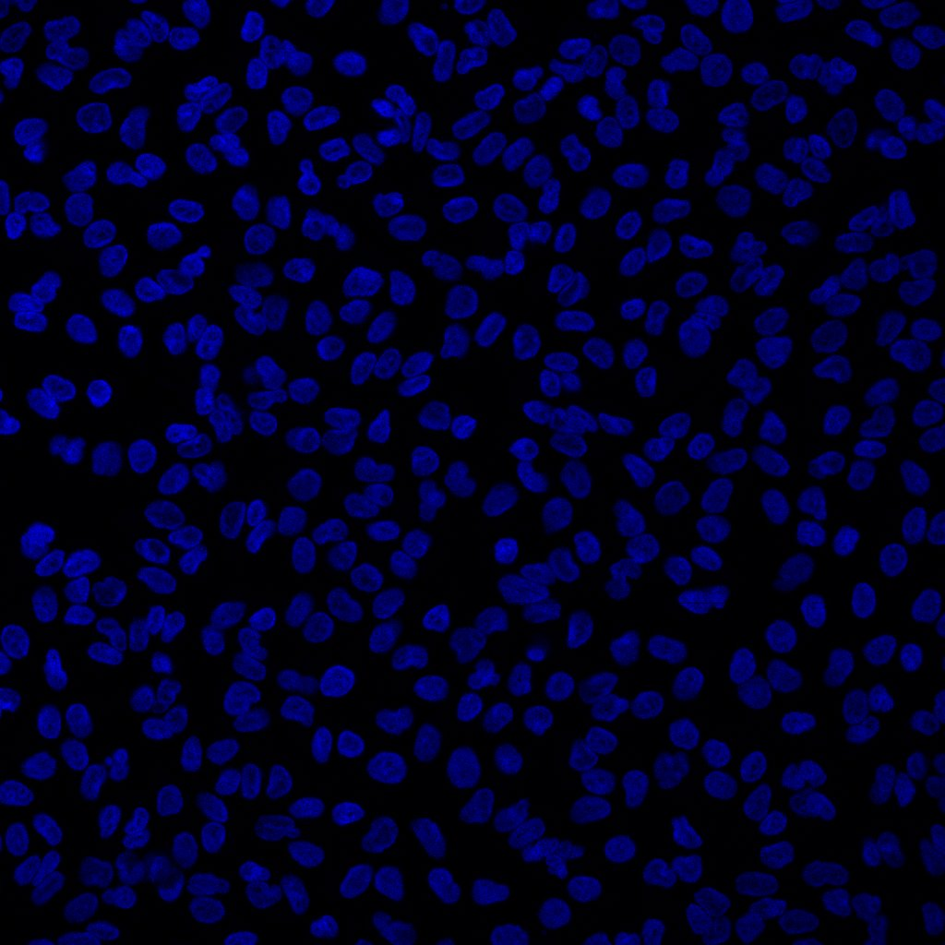
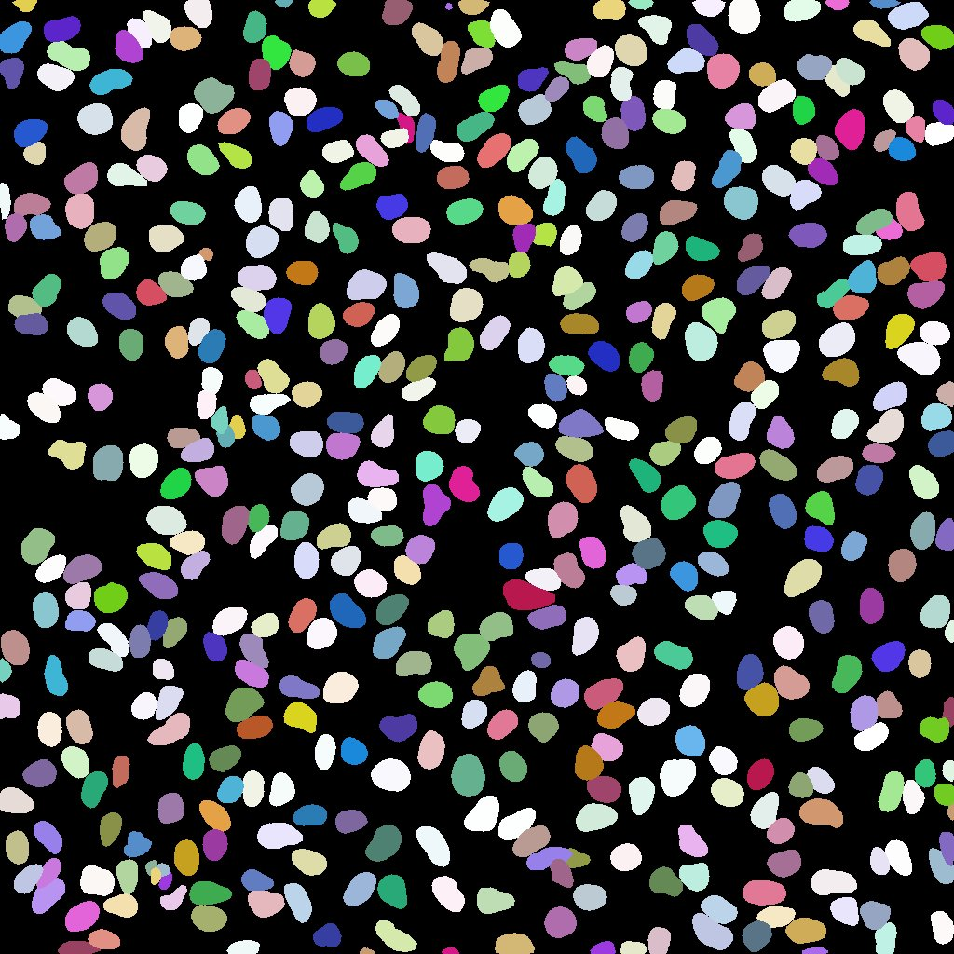
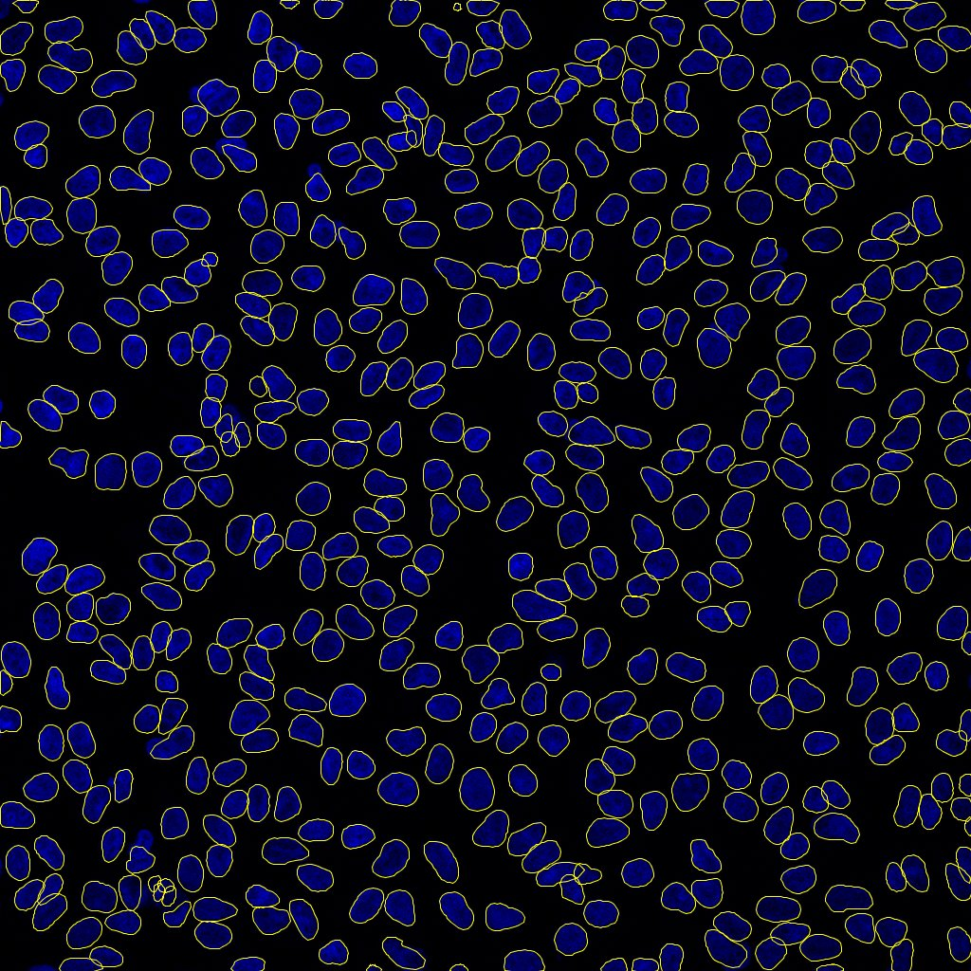
Quick-use FIJI
https://imagej.net/plugins/stardist

Slide 7
To Install FIJI
Save the Install_FIJI_w_download.sh file to a folder where you want to put Fiji on Nemo
Run Install_FIJI_w_download.sh (“./ Install_FIJI_w_download.sh”)
At home directory prompt (~) run “./Run_Fiji.sh”
Other option, download Fiji linux from website, move into a directory on nemo and unzip it

Slide 8
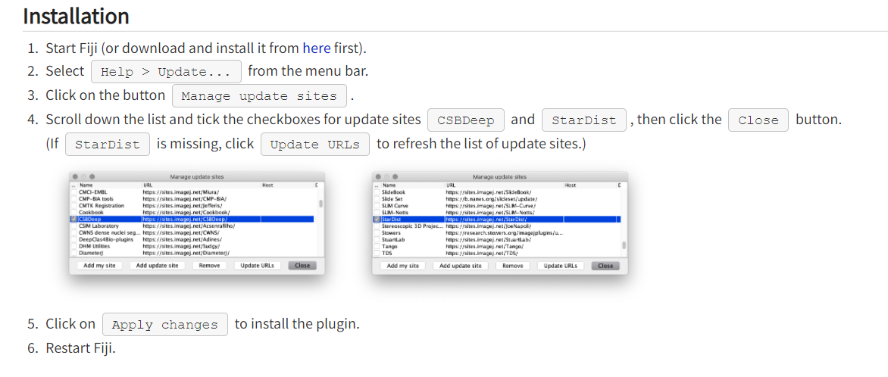
To Install in FIJI
Notes:
https://imagej.net/plugins/stardist

Slide 9
FIJI Demo
Open up FIJI, install StarDist
Also, please install Labkit
Open the file: StarDist_Course_Materials\Example_Data\Crick_Dapi\Full_Size_Unseen\Image_Set_001.tif
Run Stardist on this image (plugins → StarDist→Run)

Slide 10
StarDist in Jupyter Notebooks

Slide 11
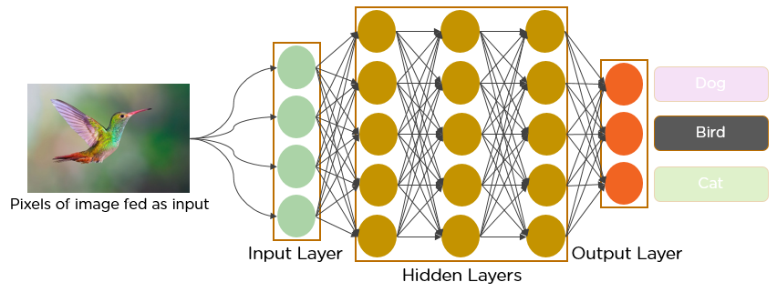
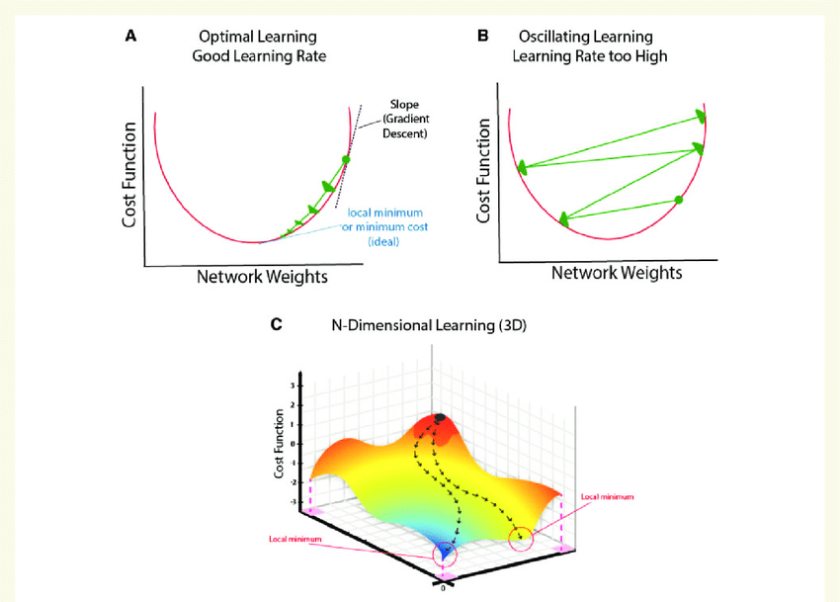
ML Basics
Broadly we want to lower the ‘loss function’. This could be classification error, Mean Squared Error, etc.
The ‘neural network’ is made up of many interconnected nodes, and the data that passes through them is each weighted.
The algorithm evaluates the input data, takes a guess at what the result should be, and compares it to the ‘ground truth’
The algorithm then changes the weights between the neurons of the neural network, and tries again. The rate at which the weights change is the ‘learning rate.’ You want a learning rate that is high enough to converge, but not to high that you get caught in a local minima. Start with the defaults, and change only if needed.
Notes:
https://www.researchgate.net/figure/mpact-of-deep-learning-design-on-learning-effect-of-learning-rate-A-Efficient_fig2_331439931
https://www.analyticsvidhya.com/blog/2021/05/convolutional-neural-networks-cnn/

Slide 12
ML Basics Continued
Overfitting is when we have too many of the same types of objects. We can only then find that type of object, but really well.
Imagine you are training to identify fruit and vegetables. You make a training set of 99 apples and a tomato. You’ll never properly identify tomatoes, and definitely not bananas.
Transfer learning: using another data set as a starting point.
StarDist supports this, but it’s not documented, it’s complicated, and it’s not recommended.

Slide 13
Data set Training:

Slide 14
Data set Training: Making our own models
Jupyter Notebooks/Camp On Demand
Need a GPU to do this, and the notebooks that are downloadable
For 2D data, at least 5-10 image crops with 20 annotated objects
For 3D, less crops, but you’re going through far more slices
Want edge case and weird data, more than once

Slide 15
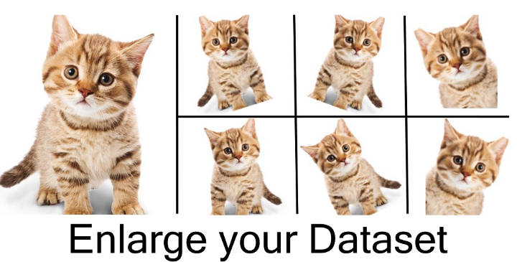
Data set Training: Data Augmentation
Data augmentation is a way to get more training data out of what you have
Augmentation is just rotating, flipping, skewing, transforming the image and the labels in the exact same way.
In our datasets, we always do this. It’s free data.
https://nanonets.com/blog/data-augmentation-how-to-use-deep-learning-when-you-have-limited-data-part-2/

Slide 16
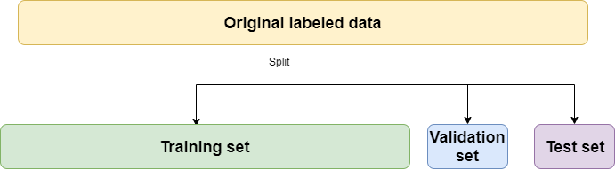
Data set Training: Train/Test Split
https://www.brainstobytes.com/test-training-and-validation-sets/

Slide 17
As mentioned earlier, it is generally better to annotate a variety of image crops as your training data. However, those crops must be big enough to contain entire fully visible objects and provide some context around them. Also make sure that not too many of the annotated objects are touching the border (it’s fine if some do, but it should not be the majority). Example: if you have small cells with a diameter of 20 pixels, it might be sufficient to have annotated images of size 160x160, whereas if your objects have a diameter of 80 pixels, you would need to use larger annotated images e.g. of size 512x512.
The “patch size” is an important parameter for training StarDist, and the size of images used for training affects what an appropriate value for the patch size should be (to maintain compatibility with the neural network architecture). For example, the patch size used for training StarDist must be smaller or equal than the size of the smallest annotated training image. To be on the safe side, ensure that the patch size is divisible by 16 along all dimensions. For example, you can annotate image crops of 300x300 pixels and then use a patch size of 256x256 pixels for training.

Slide 18
Data set Training: Training data for our test
https://github.com/stardist/stardist#annotating-images
The data we are using is right here from the Crick
Input data is 1200x1200
Using 600x600 crops
Everyone needs to label one image for labelling
Data is in StarDist_Course_Materials/Example_Data/Crick_Dapi/Crops

Slide 19
Data set Training: Labelling Images using labkit
Open the cropped image
Open labkit (type in labkit in search bar)
Make sure to NOT “allow overlapping labels”
Save often!
Remove background and foreground labels
Add a new label for each object
Save often!
Typing “s” brings up contrast control
To save the labels, go to “Labelling→ Save Labelling→ label” while in progress.
When finished, save as Tif “Labelling→Save Labelling→Tif”. DO NOT SAVE IN THE SAME FOLDER!!! You’ll overwrite the cropped image

Slide 20
Data set Training: Setting up training data
Training images need to be in a folder called : train
Test images need to be in a folder called : test
This used to be the case, you’ll see the data still labelled like that, but the training function will automatically do a train test split.
In both folders, there need to be folders called : images and masks
Images, and their corresponding masks, have to have EXACTLY the same name.
Remember the test/train split. You might want about 20-30% of your data for testing/validation

Slide 21
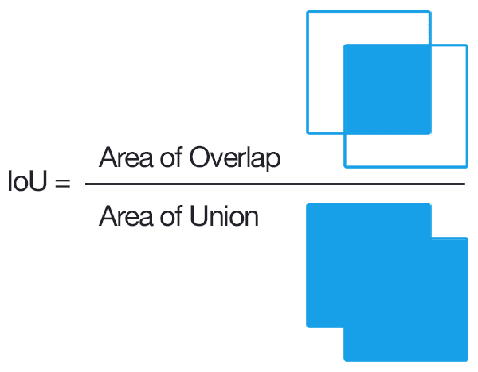
Accuracy
Detected object is considered a true positive (Tp) if the intersection over union (IoU) is higher than some threshold (IoU is the ratio of total overlap of detected object and ground-truth and the total union of area between detected and ground truth)
Unmatched detected objects are false positives (FP)
Unmatched ground truth are false negatives (FN)

Slide 22
Data set Training: Set up training data and run on cluster
We will run the training data on the cluster now to build our own model to run predictions
First we will run through StarDist_Training_Demo.ipynb
You will then change the variables needed to run StarDist_Training_Task.ipynb
You’ll want to change the train_image_path, train_mask_path, model name, number of rays

Slide 23
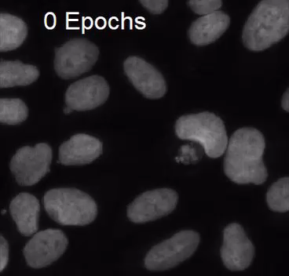
Training over epochs:
An epoch is one complete pass through the training data and updating the model.

Slide 24
Prediction:

Slide 25
Prediction:
Prediction is much easier than training
You can predict on a CPU, but it’s still faster on the GPU
Make sure that the images that you want to predict on are similar to those you trained on
You may have to rescale your images to fit the diameter of the objects you trained on.

Slide 26
Prediction:
Run through the StarDist_Prediction_Demo.ipynb notebook
Switch to the H&E model and predict an H&E image
H&E data is in the StarDist_Course_Materials/Example_Data/HnE_Data folder

Slide 27
Prediction:
Open up StarDist_Prediction_Workshop_Model.ipynb
Use our newly trained model to predict some data from the folder:
StarDist_Course_Materials/Example_Data/Crick_Dapi/Full_Size_Unseen

Slide 28
Other models
Multi-class
H&E
3D

