Slide 1
Introduction to OnDemand
Todd Fallesen
Slides by Vanessa Dao, Chris Hadjigeorgiou

Slide 2
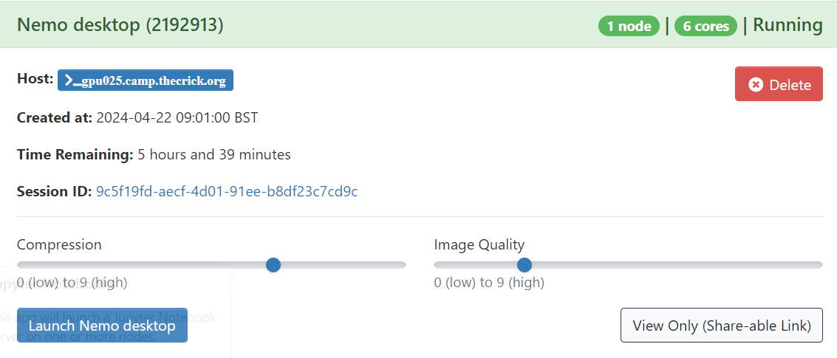
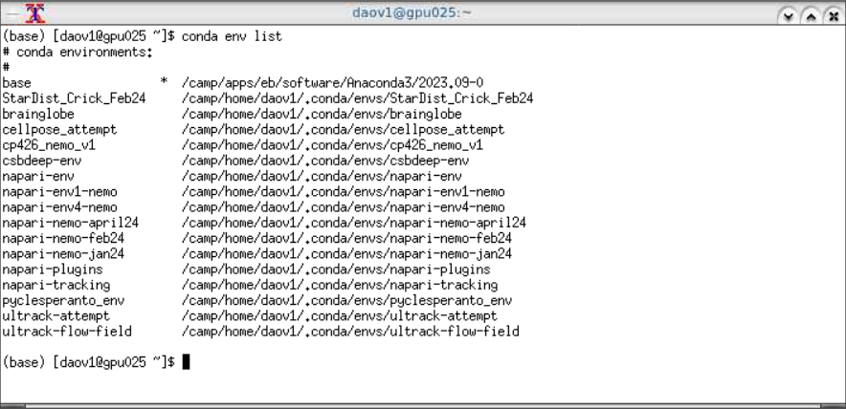
Quick Overview
NEMO
What even is it
How to start jobs
OnDemand desktop
Why it’s great (when not broken)
How to navigate the terminal
Modules
Installing and Launching a Program (FIJI)
Anaconda
Set up Anaconda on OnDemand
Link Jupyter Notebook To Conda Environment
2
Notes:
Please feel free to ask questions

Slide 3
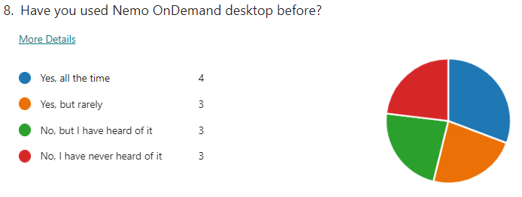





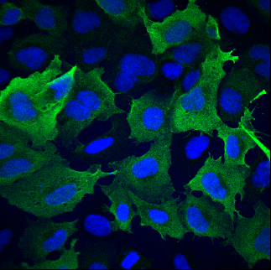

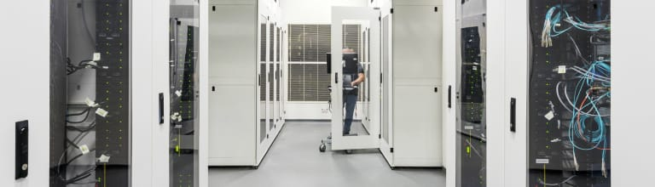
NEMO
NEMO is the Crick’s HPC platform
It is BOTH storage and the computing system
login
web browser
shell terminal command-line
compute nodes
shared data storage (disk)
cores
analysis
Notes:
Network of computers
One computer is a “node” or “server” – all nodes made of same stuff as your laptop/desktop (cores/processors, memory/RAM, disk space/storage)
Multiple ways to access – login node is gateway to cluster
Compute nodes do all the hard work
NEMO is shared so scheduler handles distribution of jobs

Slide 4
Nemo Overview
Nemo is currently composed of:
5 partitions which will be publicly available soon(AMD based):
ncpu: 92 CPU nodes, 256 threads, 2TB RAM
gpu : 40 GPU nodes, 80 threads, 754GB RAM, 4x NVidia V100 GPGPU(32GB RAM)
nhmem: 2 High Memory, 256 threads, 4TB RAM
nint: 4 Interactive nodes, 256 threads, 2TB RAM
vis : 4 Visualization nodes, 48 threads, 376GB RAM, Quadro RTX 5000, only available with srun/salloc
Any user can submit jobs to any queue but each queue has different constraints.
Storage
16+ PB GPFS Filesystem
Networking to each compute and storage
[200/100/56]Gb/s (NDR/HDR/FDR) Infiniband network
40Gb/s Ethernet network

Slide 5
Nemo Access
OnDemand
In your browser go to https://ondemand.nemo.thecrick.org
SSH
For Windows download and install MobaXterm, Powershell or PuTTY. Start a new SSH session and set login.nemo.thecrick.org as host, your Crick username
For Mac/Linux simply open a terminal and use the following: ssh –i $HOME/.ssh/id_rsa username@login.nemo.thecrick.org
Important:
Never share any credentials or the private part of an SSH key. Try to use different keys for different systems and always password protect them. Use SSH agent and password manager for convenience.

Slide 6
OnDemand overview and basics
OnDemand is a web portal for access to HPC resources on CAMP
Provides:
Shell access
File manager – currently limited to personal home directory
Interactive apps
Queue listing/job management
The interface has two main components:
The main window
The dashboard
Notes:
Chris Hadjigeorgiou

Slide 7

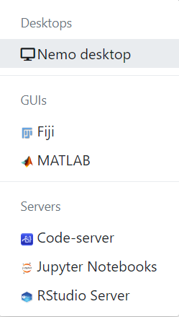
NEMO OnDemand
https://ondemand.nemo.thecrick.org/

Slide 8
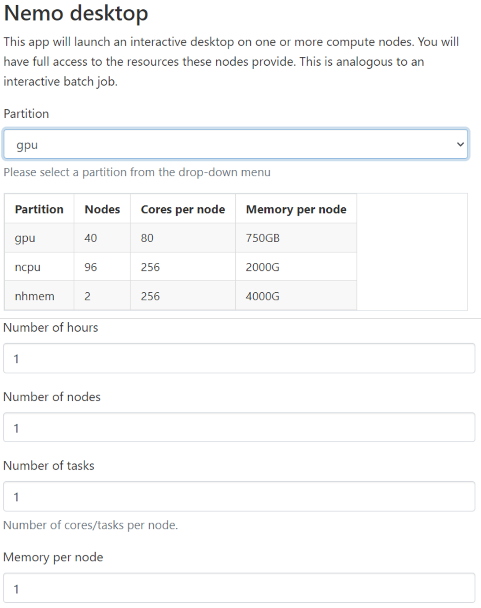
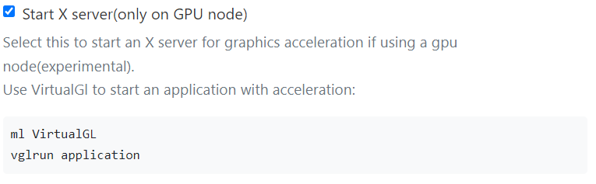
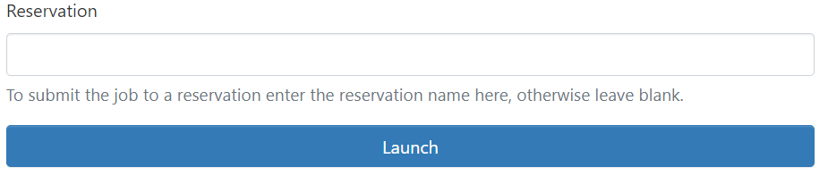
Staring jobs on NEMO
ondemand
Notes:
NEMO has different types of nodes with different types of processors
Time and RAM trade-off or time it takes for job to start – everyone is in a queue
Memory RAM (temp memory for easily accessible data for processor) vs disk space (long term)
RAM depends on task e.g request double than the size of the file for viewing, a lot more for parallel processing

Slide 9
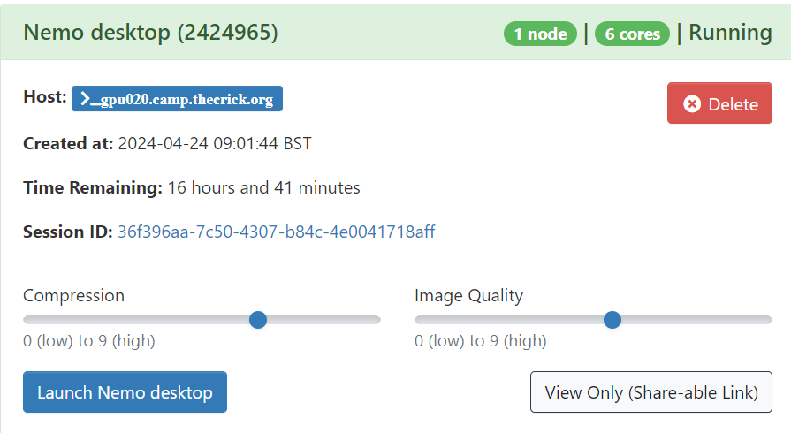
Staring jobs on NEMO
Job ID
Time until job DIES
Click to start

Slide 10
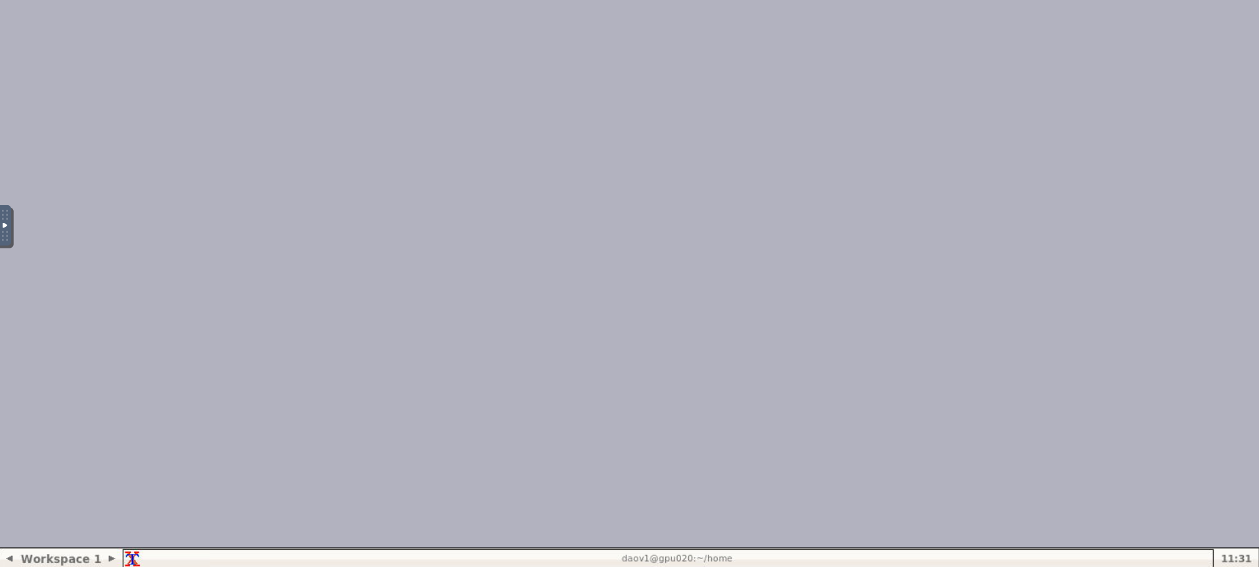
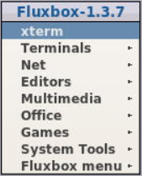
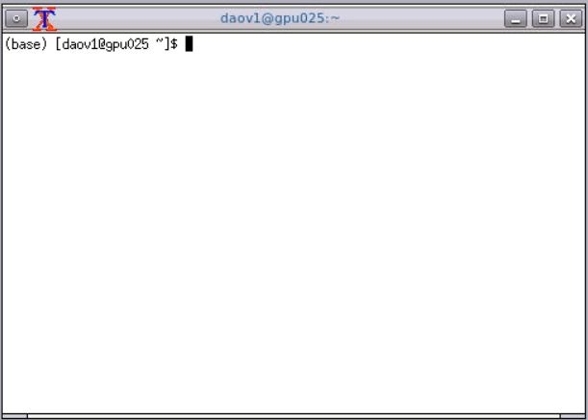
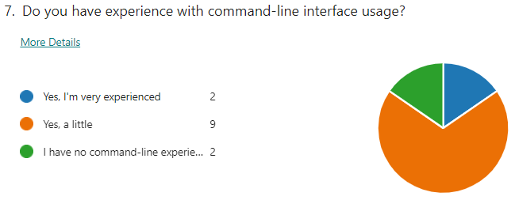
Mastering the VNC
Notes:
Allowed to close and re-launch as many times as you want
So what’s the point of the terminal, what do you do with it?

Slide 11
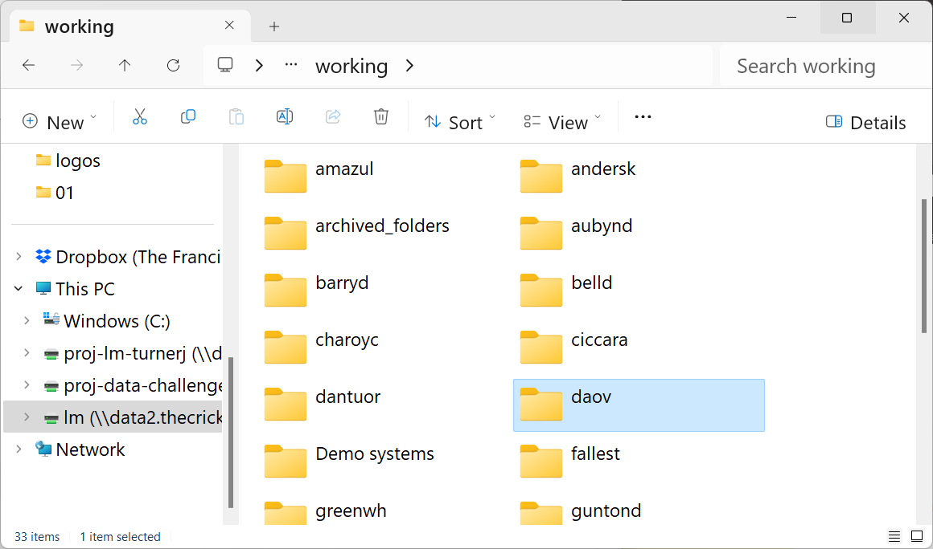
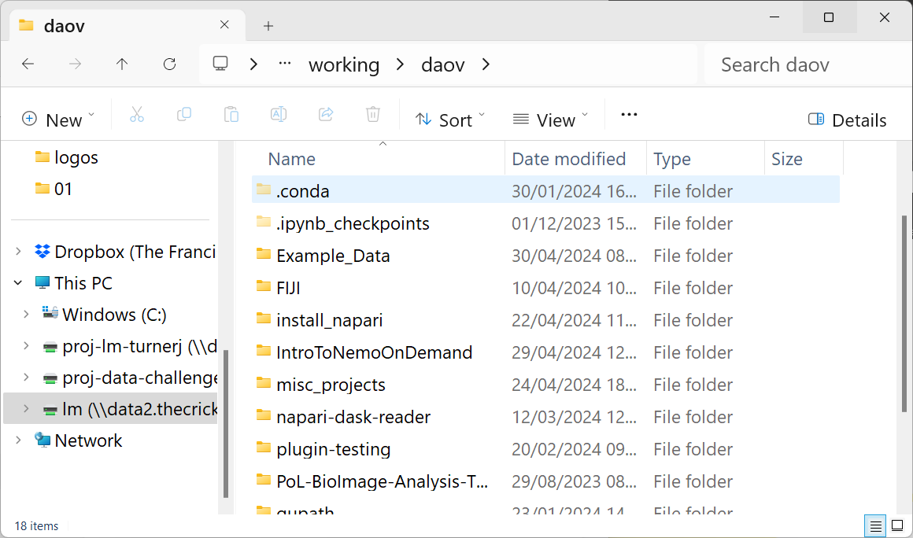
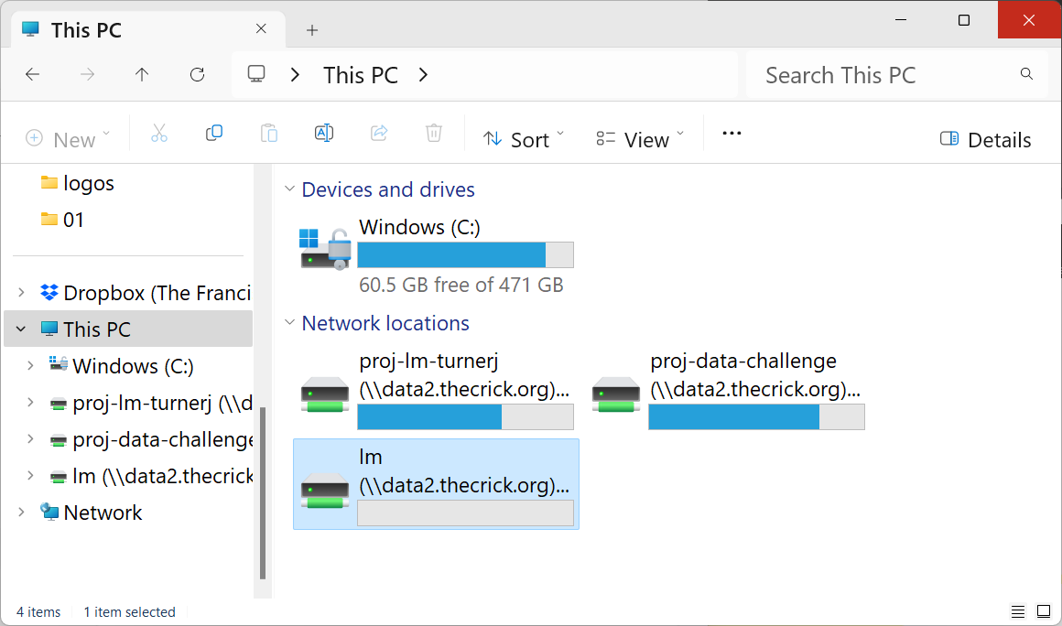
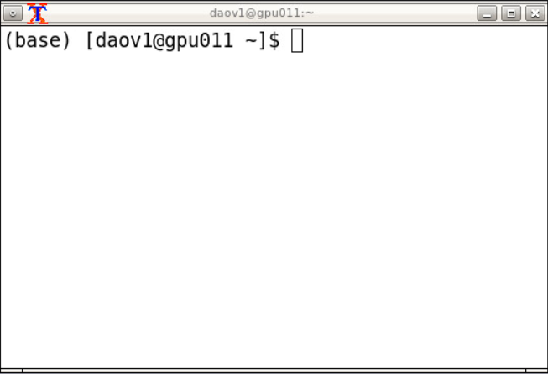
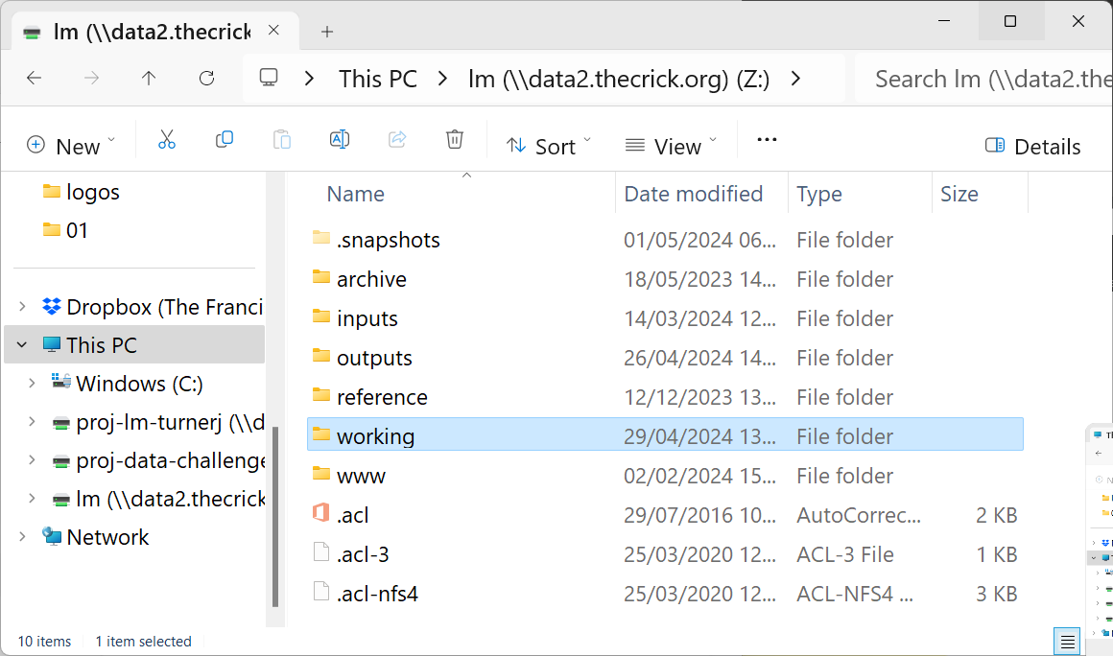
REMEMBER: Nemo is storage too!
command lines!

Slide 12

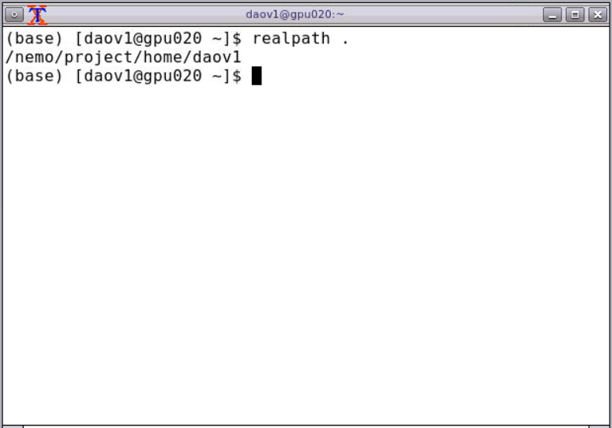
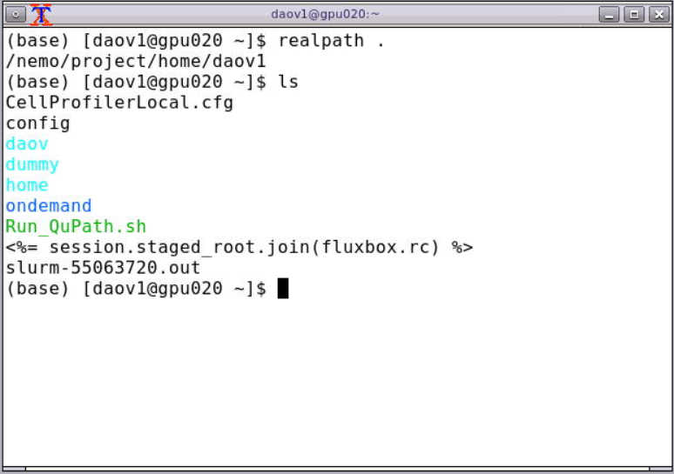
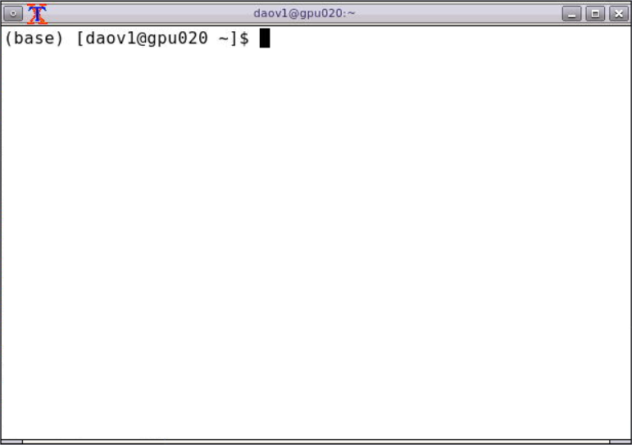
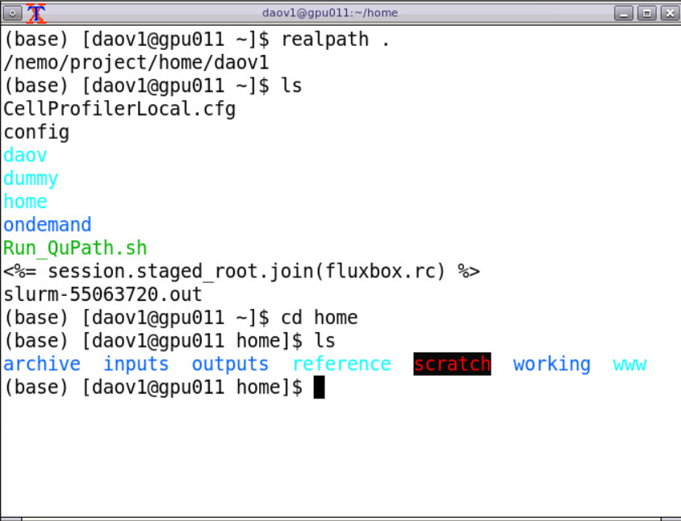



Mastering the terminal
/nemo/project/home/<username>
ondemand
file
home
ondemand
home
soft links folder executable
working
realpath .
ls
ls -a
cd path/to/directory
cd ..
cd $HOME
other lab member
another lab member
your name
your
stuff
Notes:
Terminal allows you to navigate file storage space of NEMO and manipulate files as you would normally (move, rename, create, delete)
- Exactly the same as opening files on laptop
Mention:
Colour of directories

Slide 13
Command line basics
Get directory listing
ls
ls path
Print working directory
pwd
realpath .
Change directory
cd path
cd # without arguments takes you back to your home directory
cd .. # change to the directory one level up

Slide 14
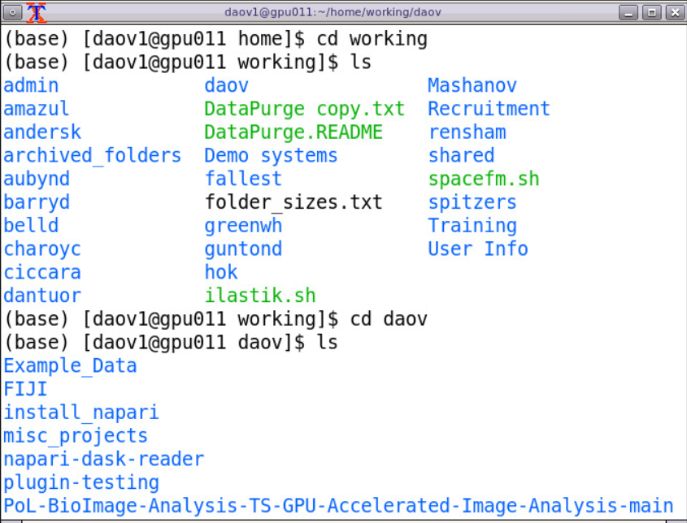
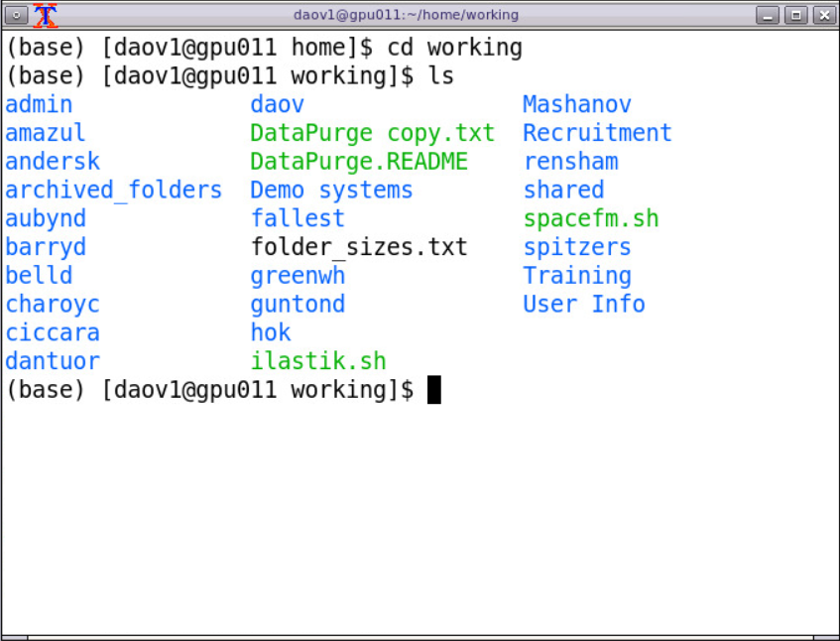

Getting to know the terminal
realpath .
ls
ls -a
cd path/to/directory
cd ..
cd $HOME
Find the path to your folder in your lab space
Notes:
Get them to find the path to their personal folder

Slide 15
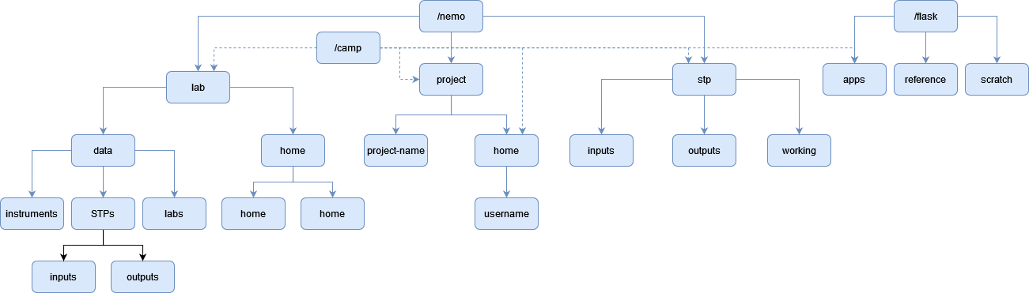
NEMO’s folder structure

Slide 16
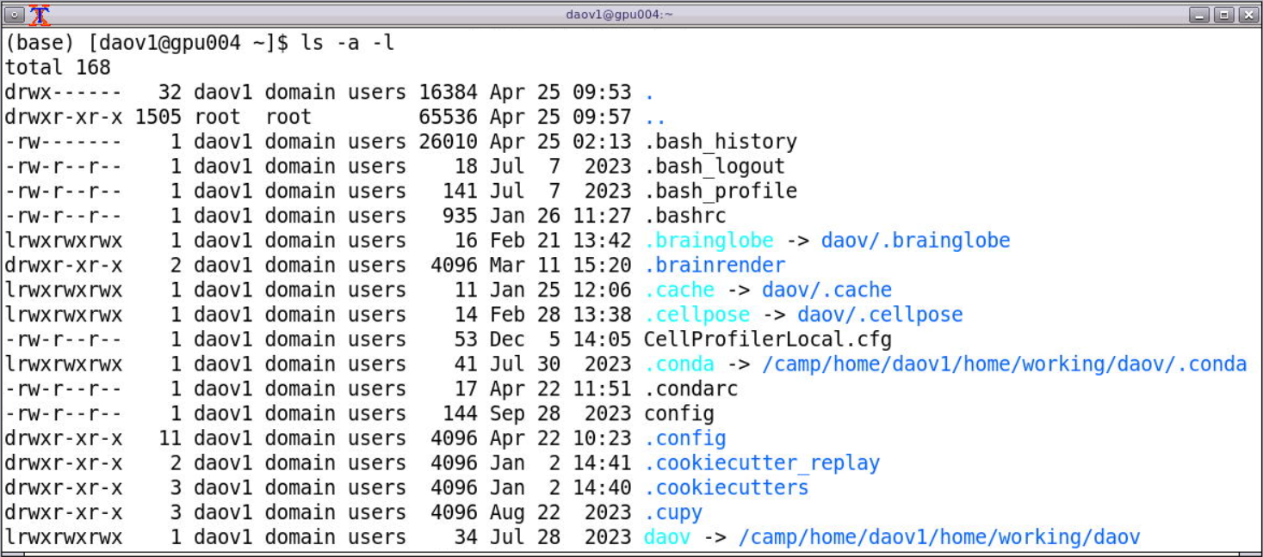
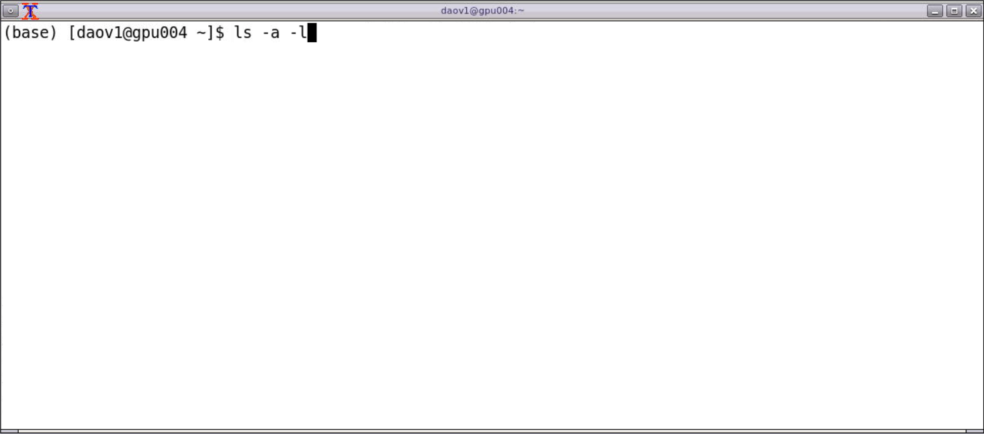
Soft linking
/nemo/project/home/<username>
.conda
home
ondemand
working
realpath .
ls
ls –a
ls –a -l
cd path/to/directory
cd ..
cd $HOME
other lab member
another lab member
your name
.conda
Notes:
Points to emphasise:
Purpose is because home has limited 5GB whereas lab has much more space
Only needs to be done ONCE and then it is always there

Slide 17
Software Modules
Modules are centrally installed software on Nemo available to all users
Accessible through the module(or ml) command
To check if a module is available either of the following can be used:
ml avail software
ml spider software
To load a module:
ml modulename
List currently loaded modules
ml

Slide 18
Software Modules
To remove a module
ml unload modulename
To remove all loaded modules
ml purge
You can also create your own modules or use modules shared by a colleague or different lab/STP. To do so you just need to add the path of the directory which contains those modules:
ml use /path/to/directory

Slide 19
Exercise 1 (ml)
List the SpaceFM module – ml av SpaceFM
Load SpaceFM – ml SpaceFM
Run SpaceFM(Case might be different) - spacefm
Check what modules were loaded - ml
Investigate Nemo’s folder structure
Close SpaceFM
Unload the SpaceFM module – ml unload SpaceFM
Check if any modules are still loaded - ml
Purge all the modules – ml purge
Tip: Some commands can autocomplete using the Tab key, ml can do that with module names

Slide 20
Command line basics
Copy files or directories
cp source destination
cp –R source_directory destination_directory
Move files/directories
mv source destination
Create a new directory
mkdir /path/to/directory # Assumes parent directories already exist
mkdir –p /path/to/new/directory # Creates parent directories if they don’t exist
Print or display a file
cat filename # prints file contents, great for small files
less filename # display the files in an interactive viewer, q to quit
Manual pages
man ls

Slide 21
Fiji
A distribution of ImageJ which includes many useful plugins
You’ll setup a personal Fiji installation for easier plugin management
Start a Remote Desktop session
Open xterm(right click on desktop to open menu)
Copy the fiji app from the training folder to your user folder in your lab
Unzip the file
Unzip fiji_linux64.zip
Go into the directory which was extracted
cd Fiji.app
Launch fiji with ./ImageJ-linux64
https://downloads.imagej.net/fiji/latest/fiji-linux64.zip

Slide 22
Exercise 2 (pwd, ls, cd, cp, df, cat, less, man)
Open a terminal/shell and check which directory you’re currently in
- realpath .
List the files in the directory
ls
Optional - List the hidden files in the directory
ls -a
Go to your lab home or working directory
cd /nemo/lab/<labname>/home/users/<username>
Go back to your own home and copy the fiji file /camp/apps/training/stardist/StarDist_Course_Sept_2024/fiji-linux64.zip to your home
cp /camp/apps/training/stardist/StarDist_Course_Sept_2024/fiji-linux64.zip .
Check how much space you have available in your personal home
df –h $HOME
Unzip FIJI

Slide 23
Launch Fiji in OnDemand (Exercise 3)
We will write a shell script to do this
File should be in home directory
Need to change directory to where you saved the Fiji installation
Need to launch the Fiji app
Use nano, or notepad ++
nano is a quick and easy terminal based text editor
In home directory, type in “nano”
Type in your commands
Cntrl-x will exit, and prompt you to save
Enter “Run_Fiji.sh” as the file name
chmod u+rwx Run_Fiji.sh

Slide 24


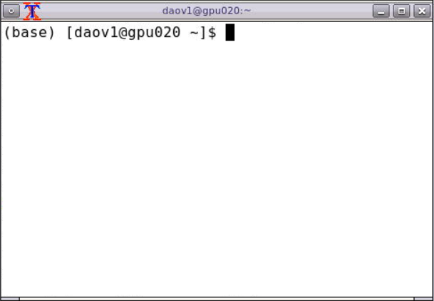



Anaconda
Initialising Anaconda
napari-environment
Package and environment management software
Conda environments are a method for creating an isolated space with different software and their dependencies installed.
Conda environments can also help with reproducibility.
Python 3.9
ml Anaconda3/2023.09-0
conda init bash
ml purge
conda env list
cellprofiler-environment
Python 3.8
stardist-environment
Don’t install anything in your base environment!
Always activate your environment before installing packages!
Python 3.10
Notes:
So many different packages out there to do great things, they do not work together – that’s why Anaconda

Slide 25
Your turn: Soft linking
Check if you already have .conda and .cache in your $HOME directory
cd $HOME ls -a
2. If softlinked .conda and .cache exists then DONE
2. If folder .conda and .cache exists then move to your lab space
If they don’t exist then create in your lab space
mv .conda /path/to/lab/space
mv .cache /path/to/lab/space
mkdir /path/to/lab/space/.conda
mkdir /path/to/lab/space/.cache
realpath .
ls
ls –a
ls –a -l
cd path/to/directory
cd ..
cd $HOME
3. Create the softlink in your $HOME directory
ln –s /path/to/lab/space/.conda .
ln –s /path/to/lab/space/.cache .

Slide 26
Conda initialisation
.conda is the folder where Conda stores environments and packages by default. Conda automatically creates that directory the first time it’s run in your home directory. Since users’ home directories have limited space we create(or move) .conda in their lab folder and use a symbolic link from the personal home directory.
$HOME is an environment variable with the path of your home directory.
Now you can initialize Conda:
conda init

Slide 27
Conda with Jupyter in OnDemand
To integrate conda environments with Jupyter in OnDemand we’ll make use of remote kernels. This only needs to be done once for each environment.
First install the necessary packages inside your conda environment:
conda activate testenv
pip install remote-ikernel ipykernel
Install an ipython kernel (necessary for Jupyter):
python –m ipykernel install --user --name=testenv
Install the remote Jupyter kernel:
python3 -m remote_ikernel manage --add --kernel_cmd="ml purge && conda activate testenv && ipython3 kernel -f {connection_file}" --name=“testenv" --interface=local --workdir="~/" --language=python3
You should be able to launch a kernel now with your conda environment called “Local testenv”

Slide 28
Understanding the commands
Install the remote Jupyter kernel:
python3 -m remote_ikernel manage --add --kernel_cmd="ml purge && conda activate testenv && ipython3 kernel -f {connection_file}" --name=“testenv" --interface=local --workdir="~/" --language=python3
Text in red: launching the python program remote_ikernel manage
Text in green: The commands were adding to each time Jupyter is launched from this environment
Text in purple: The environment name we are adding to Jupyter notebooks
Remote_ikernel manager is the program in python which links environments into Jupyter notebooks, or else they don’t show in juypter

Slide 29
SLURM
Most HPC systems utilise job schedulers to manage how users can access resources.
Nemo uses Slurm for job scheduling on the compute resources.
A number of policies/limits are implemented to allow fair usage by labs/users

Slide 30
SLURM commands
Check your jobs in the queue squeue –u username
Get overall info for all the partitions sinfo
Submit a batch script/job(only for cpu/gpu/hmem partitions) sbatch script.sh
Start an interactive job srun –p int –t 00:10:00 --pty bash

Slide 31
Exercise 4
Copy the sbatch-example-new.sh from the training directory to your home folder
cp /camp/apps/training/stardist/sbatch-example-new.sh $HOME/
Modify it with following(you can edit the file via the OnDemand File explorer):
Change the partition from ncpu to gpu
#SBATCH –-partition=ncpu
Comment out memory per cpu(add another # to line beginning)
##SBATCH –-mem-per-cpu=
Submit the job with sbatch
sbatch sbatch-example-new.sh
Check output with cat or less command
cat slurm-<jobid>.out

