Slide 1

Dynamical Systems for Neuroscience Week 3: Bifurcations
Nicolas Skatchkovsky
22.07.2025

Slide 2
Week 3: Bifurcations in One Dimension and Neural Thresholds
Strogatz Ch. 3
Izhikevich Ch. 2/3
Saddle-node, transcritical, and pitchfork bifurcations
How do saddle-nodes explain spike generation?

Slide 3
Recap

Slide 4
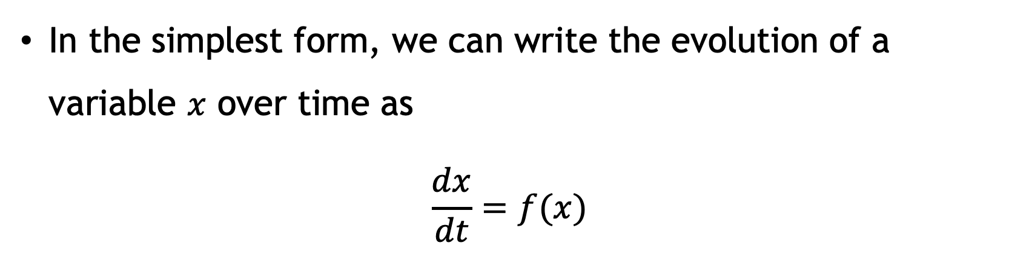
Dynamical systems
They’re deterministic mathematical models involving time
In the simplest form, we can write the evolution of a variable $x$ over time as
$$\frac{dx}{dt}=f(x)$$

Slide 5
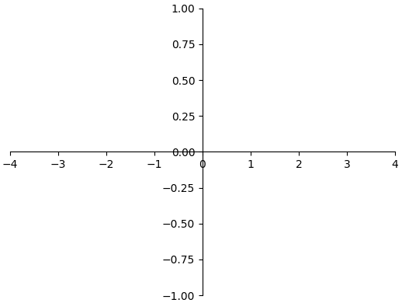

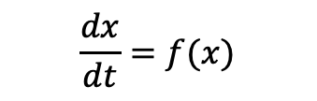
$$\frac{dx}{dt}=f(x)$$
Dynamical System
Example $\frac{dx}{dt}=x$
State space / phase space
(real numbers)

Slide 6
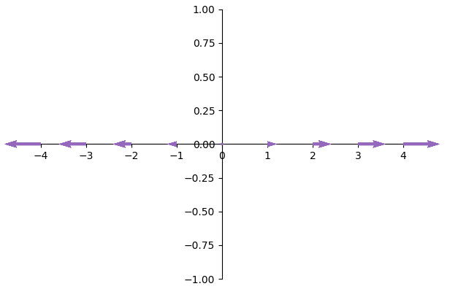


$$\frac{dx}{dt}=f(x)$$
Dynamical System
Example $\frac{dx}{dt}=x$
$$\frac{dx}{dt}$$
Fixed point (derivative is 0)
Unstable
(nearby points do not converge to it)
Vector field / phase portrait
$$x$$
State space / phase space
(real numbers)

Slide 7
Some fixed points are more stable / unstable than others.
A little bit unstable
A little bit stable
Very unstable!
Very stable
The derivative of the function around a fixed point tell us how stable it is
negative derivative = stable
positive derivative = unstable

Slide 8
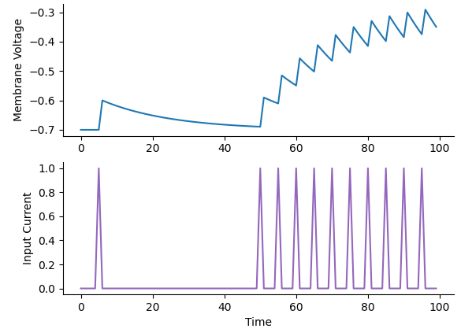

The Leaky Integrate-and-Fire (LIF) model
$$\frac{dV}{dt}=−g_{l}\left(V−E_{l}\right)+I$$

Slide 9
The Newton–Raphson method
Take an initial guess
Get the tangent
Find X-intercept of the tangent
Use this as the next guess, and repeat
Stop when I basically stop moving

Slide 10
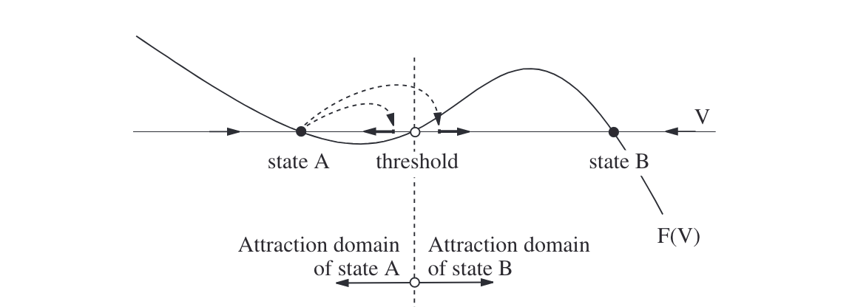
Equilibria as thresholds
In systems having two attractors, unstable equilibria play the role of threshold

Slide 11
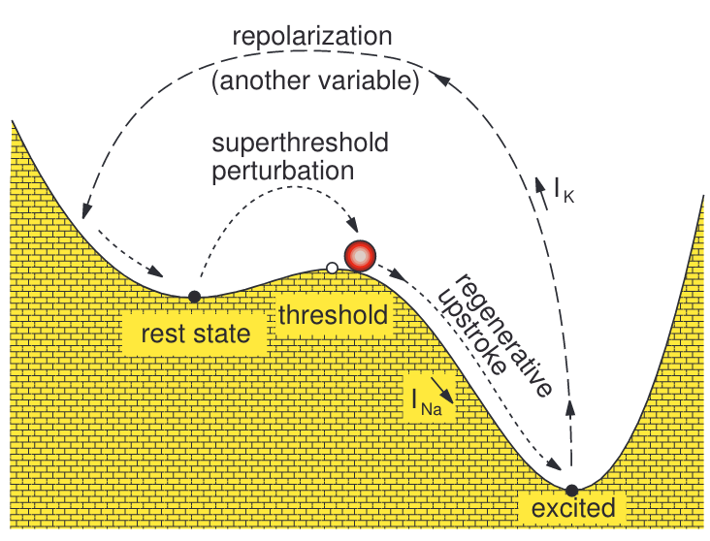
Equilibria as thresholds

Slide 12
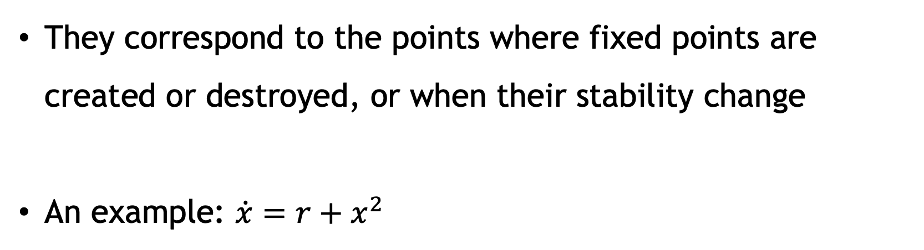
Bifurcations
Bifurcations happen when the parameters of the system change
They correspond to the points where fixed points are created or destroyed, or when their stability change
An example: $\dot{x}=r+x^{2}$

Slide 13
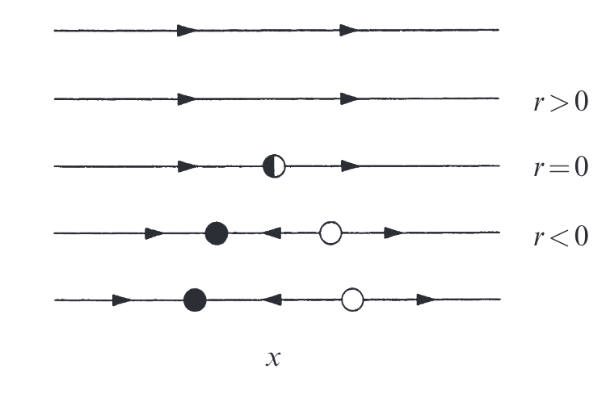
Graphical conventions

Slide 14
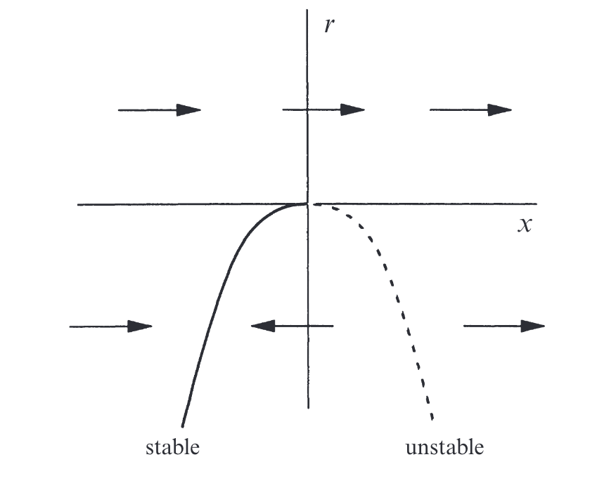
Graphical conventions
This is called a bifurcation diagram

Slide 15
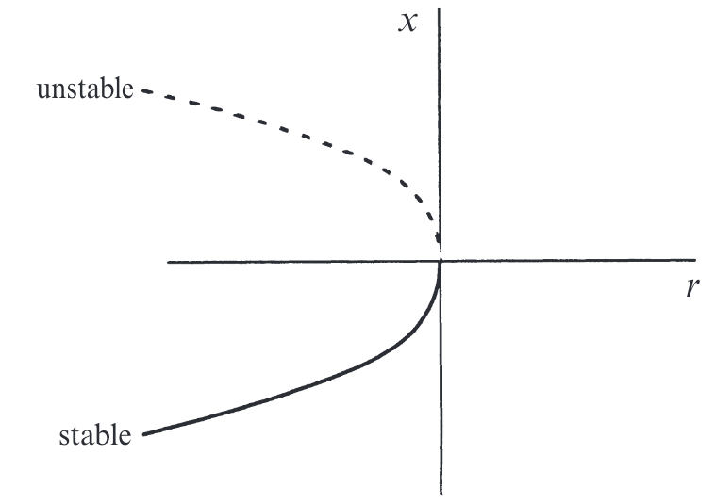
Graphical conventions

Slide 16
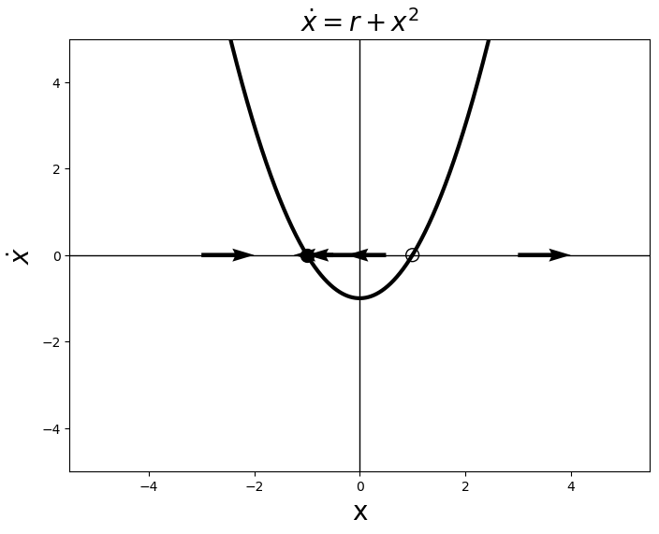
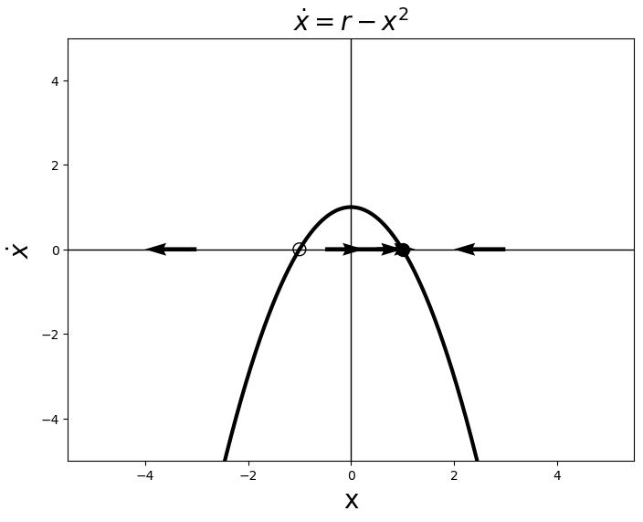
Prototypical saddle-nodes
These two are representatives of all saddle-nodes!
They are known as normal forms

Slide 17
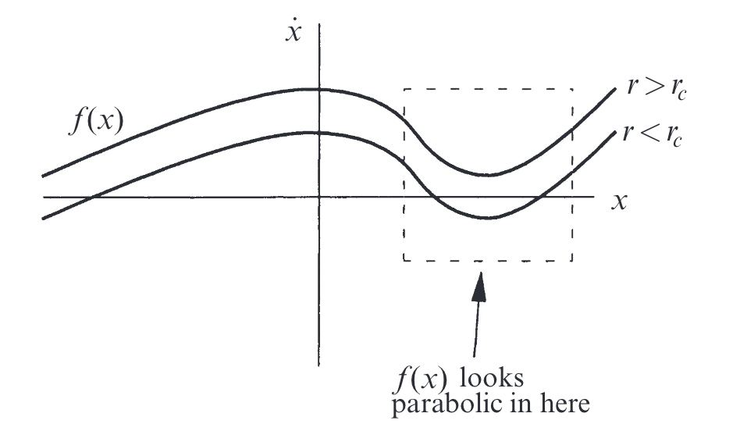
Normal forms

Slide 18

Normal forms
Example: $\dot{x}=r −x −e^{−x}$
For $x$ small, we have
$$\dot{x}≈r −x −\left[1 −x+\frac{x^{2}}{2}\right]$$
$$=r −1 −\frac{x^{2}}{2}$$

Slide 19
Transcritical bifurcations
They are for models that always have fixed points, but that may change their stability

Slide 20
Pitchfork bifurcations
Common in problems that have symmetries
Fixed points tend to appear and disappear in pairs

Slide 21
Supercritical pitchfork bifurcations

Slide 22
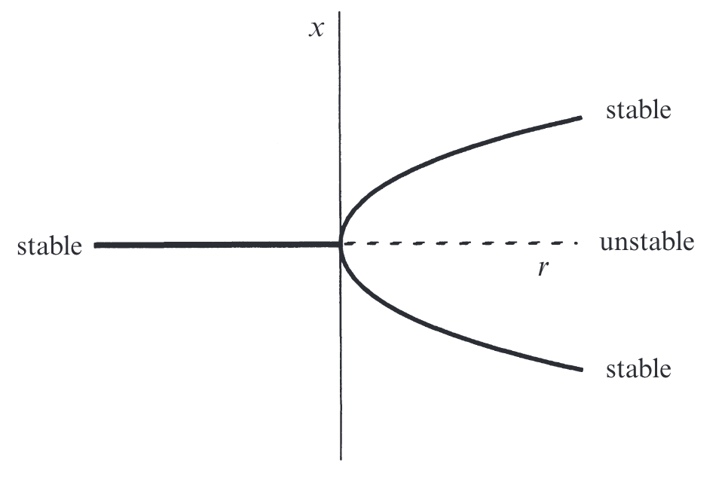
Supercritical pitchfork bifurcations

Slide 23
Subcritical pitchfork bifurcations

Slide 24
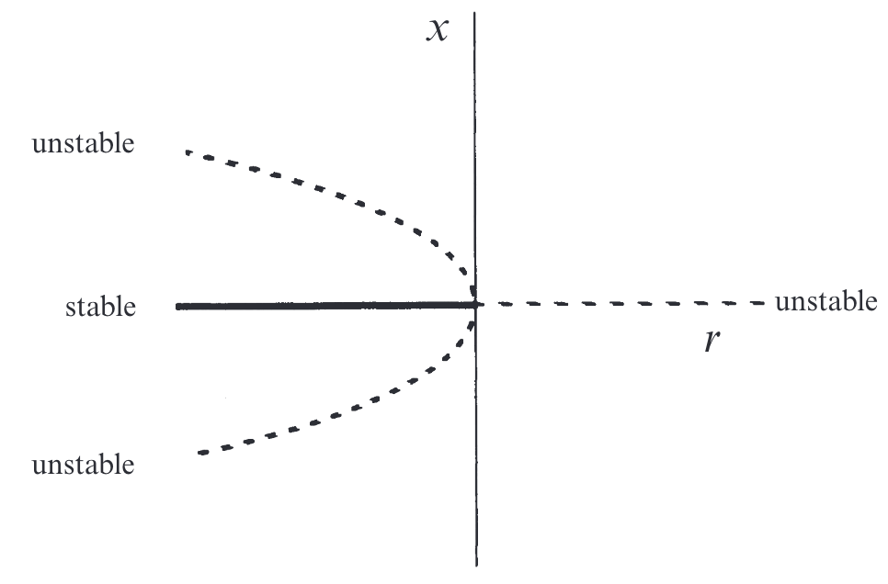
Subcritical pitchfork bifurcations

Slide 25

Imperfect bifurcations and catastrophes
What if we lose the symmetry?
We add an imperfection parameter h
$$\dot{x}=h+rx −x^{3}$$

Slide 26
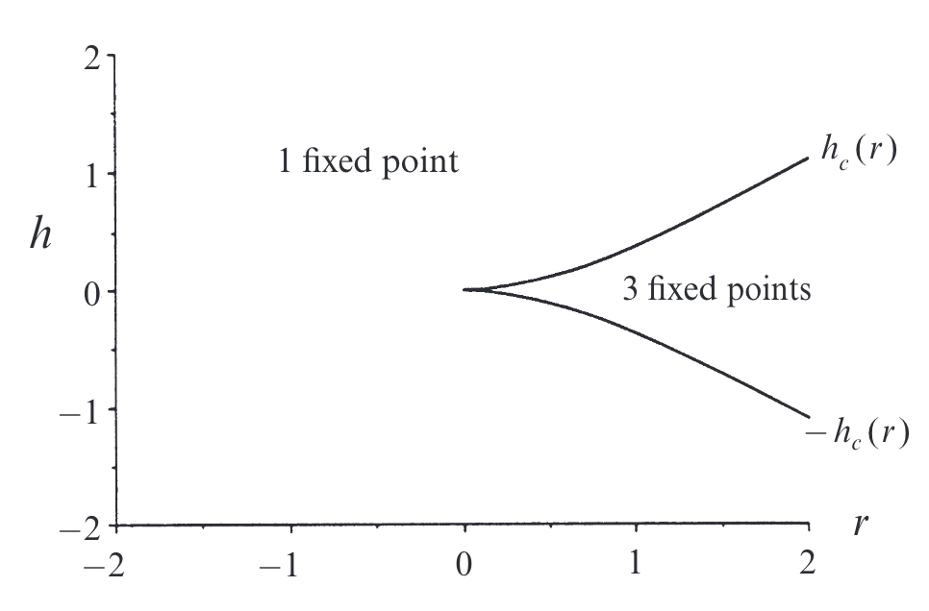
Imperfect bifurcations and catastrophes
This is called a stability diagram

Slide 27
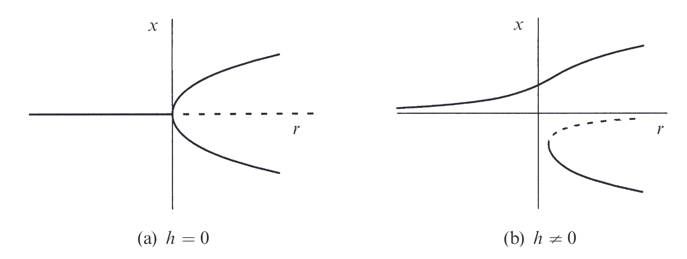
Imperfect bifurcations and catastrophes

Slide 28
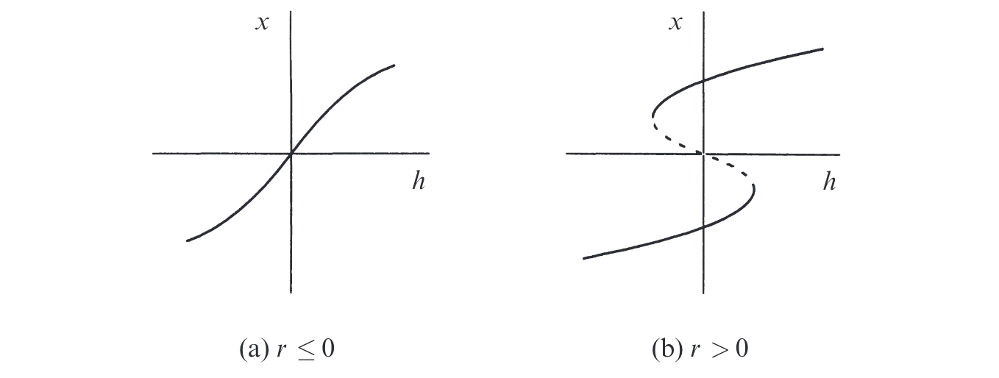
Imperfect bifurcations and catastrophes

Slide 29
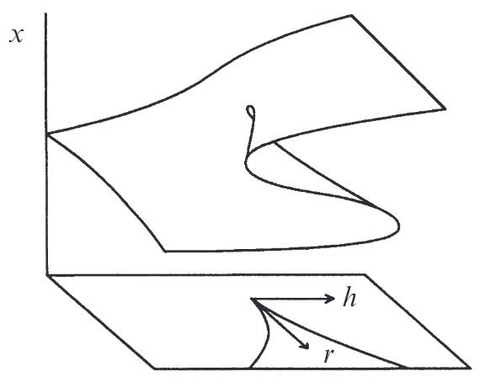
Imperfect bifurcations and catastrophes

Slide 30

Back to neuroscience!

Slide 31
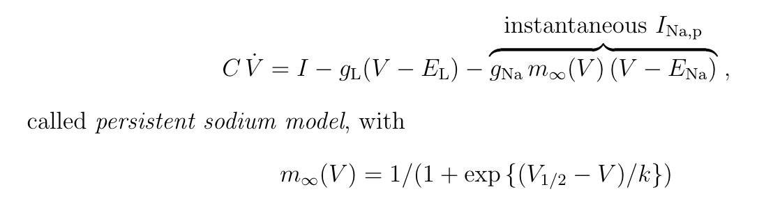
Simplified Hudgkin-Hoxley model

Slide 32
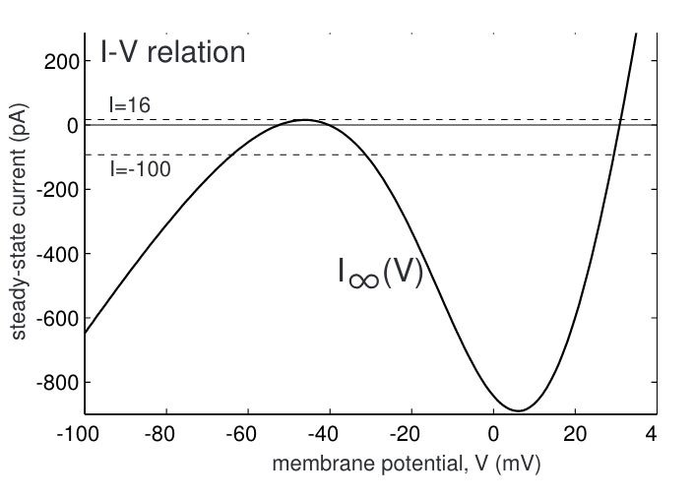
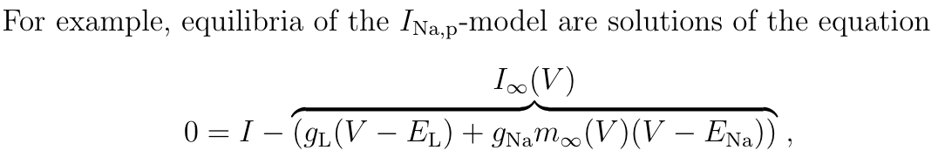
Bifurcation of a persistant Na model

Slide 33
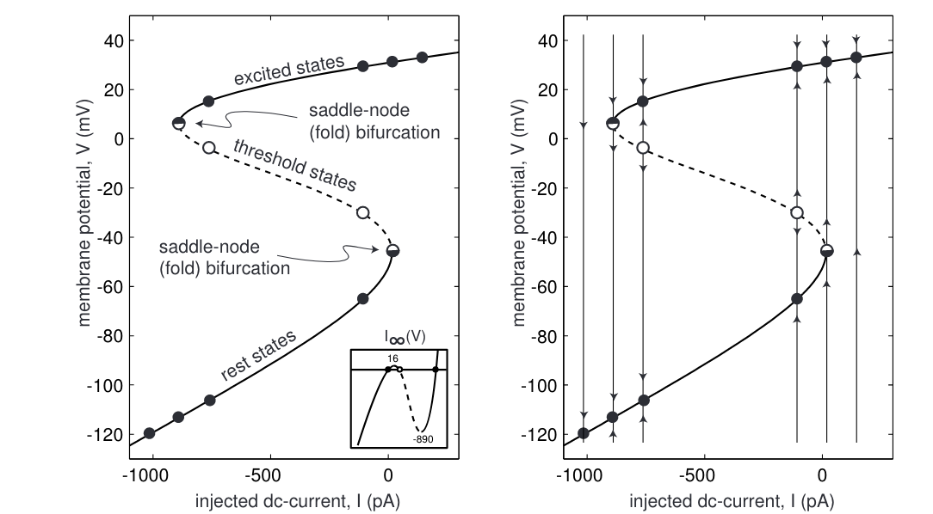
Bifurcation of a persistant Na model

Slide 34
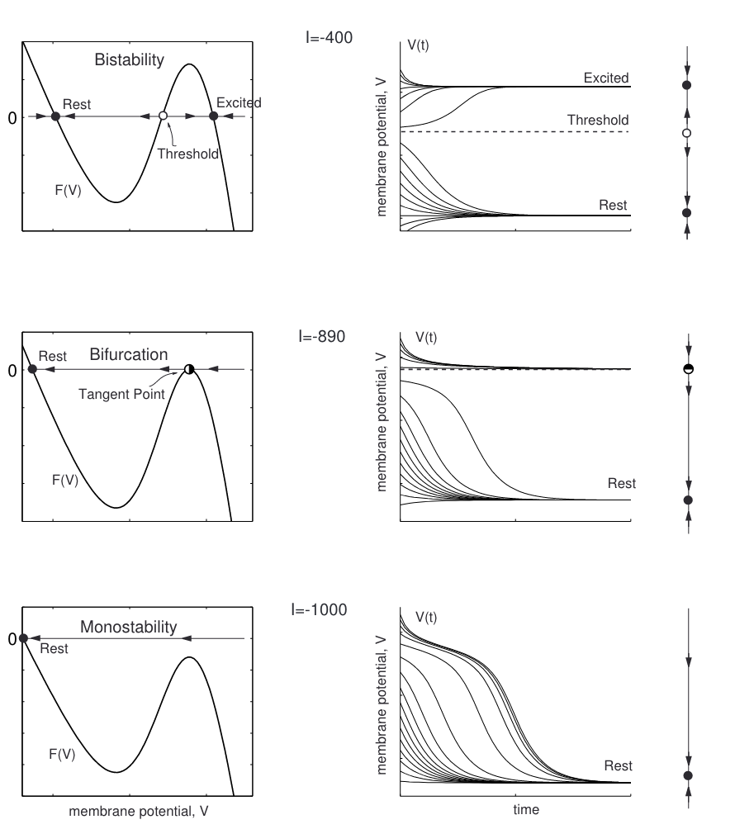
Bifurcation of a persistant Na model

Slide 35
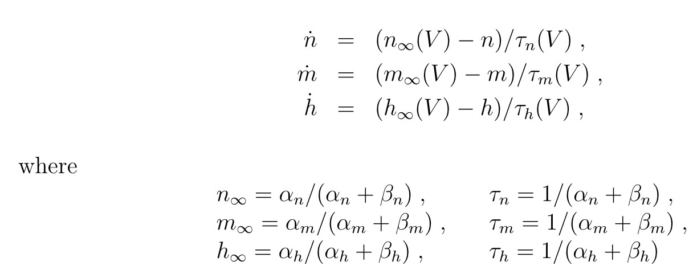
The Hudgkin-Huxley model
It’s essentially the sum of three LIFs

Slide 36
