Slide 1

Dynamical Systems for Neuroscience Week 4: Two-Dimensional Linear Systems
Antonin Blot
30.07.2025

Slide 2
Week 4:Two-Dimensional Linear Systems
Strogatz Ch. 5
Izhikevich Ch. 4 <- non linear
Classification of fixed points using eigenvalues.

Slide 3
Recap

Slide 4
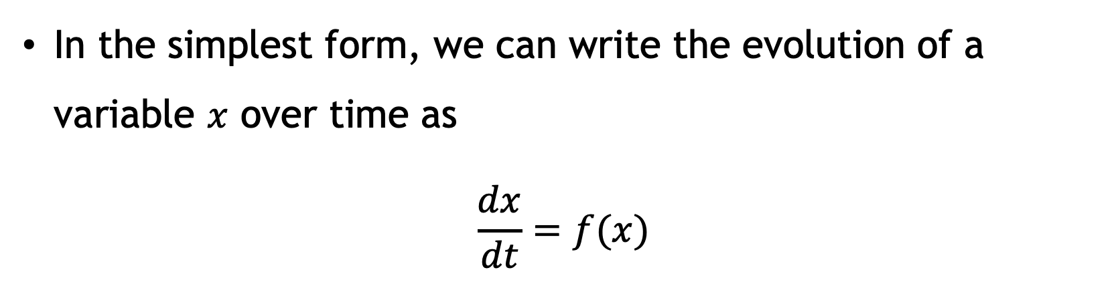
Dynamical systems
They’re deterministic mathematical models involving time
In the simplest form, we can write the evolution of a variable $x$ over time as
$$\frac{dx}{dt}=f(x)$$

Slide 5
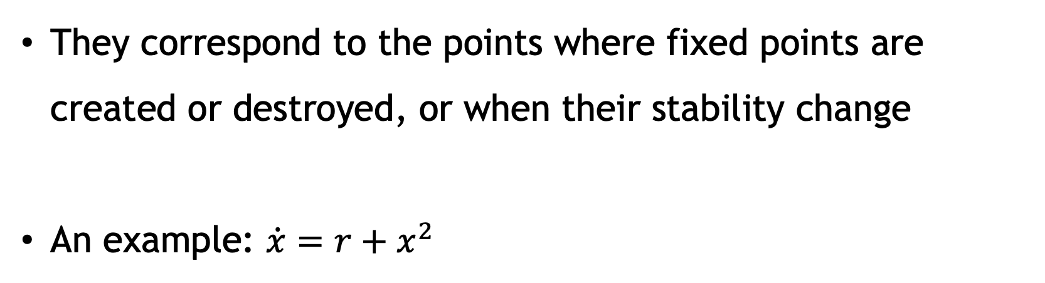
Bifurcations
Bifurcations happen when the parameters of the system change
They correspond to the points where fixed points are created or destroyed, or when their stability change
An example: $\dot{x}=r+x^{2}$

Slide 6
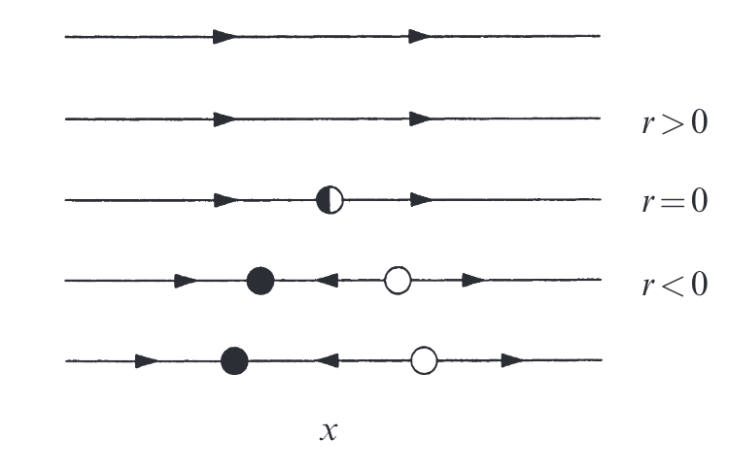
Graphical conventions

Slide 7
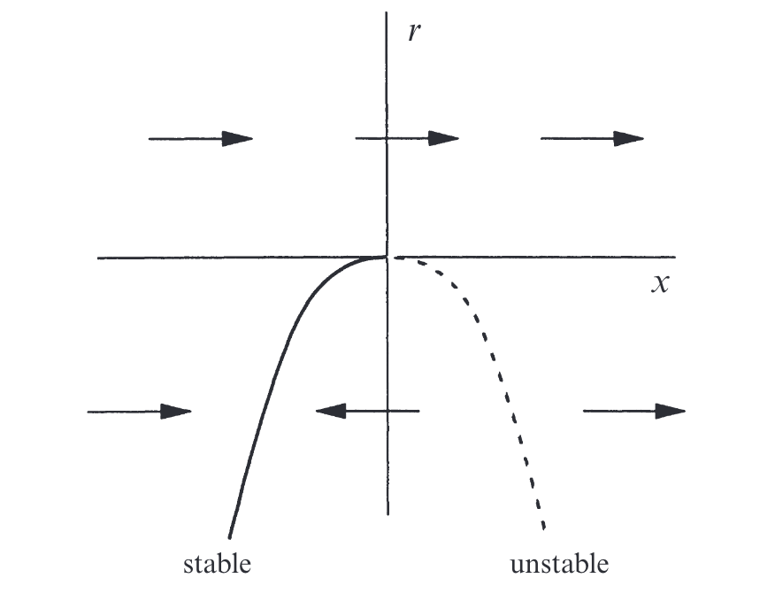
Graphical conventions
This is called a bifurcation diagram

Slide 8
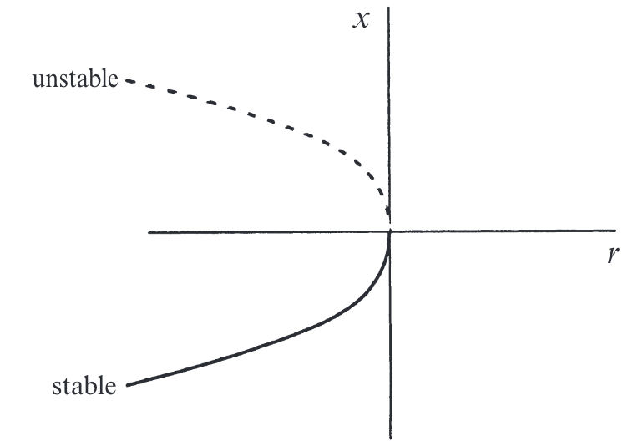
Bifurcation diagram

Slide 9
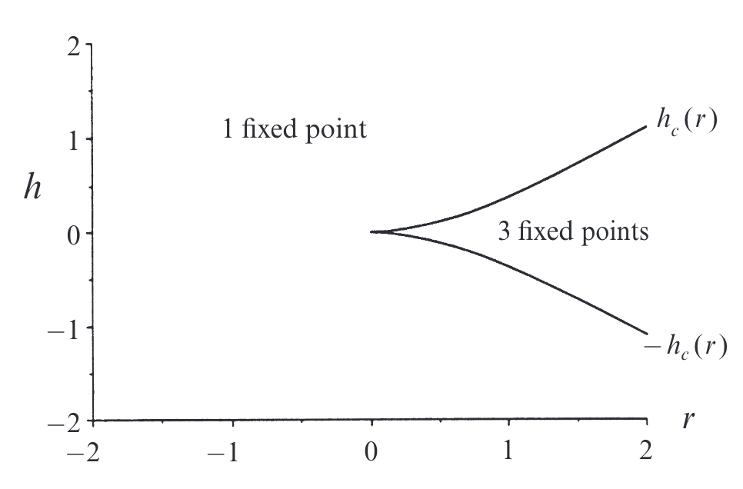

Stability diagram
Multiple parameters (h and r)
$$\dot{x}=h+rx −x^{3}$$

Slide 10
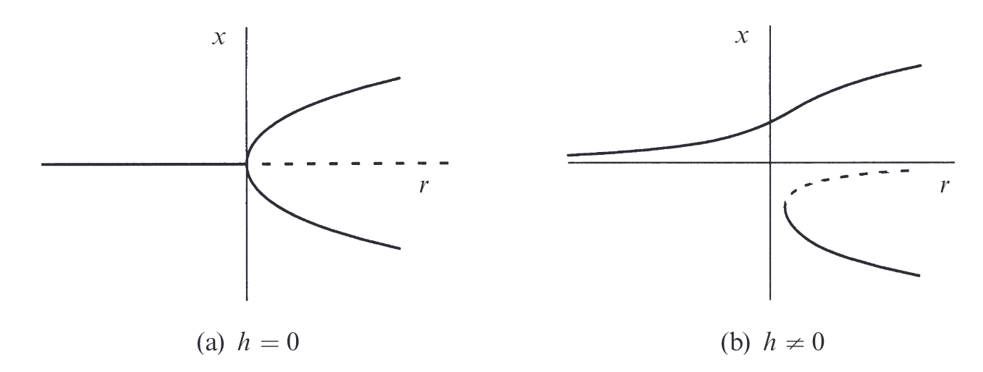
Imperfect bifurcations and catastrophes

Slide 11
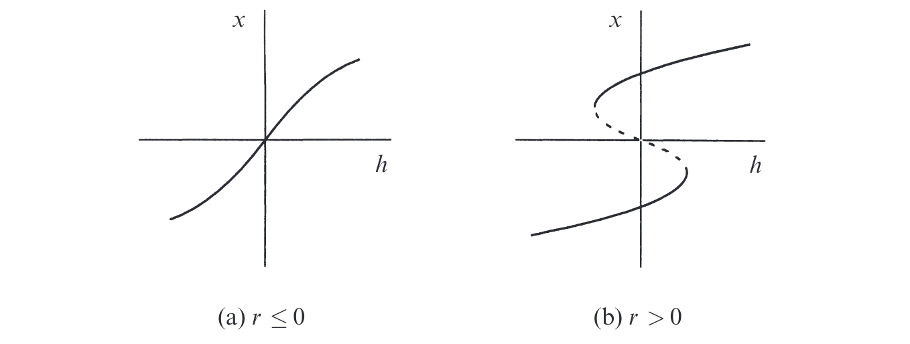
Imperfect bifurcations and catastrophes

Slide 12
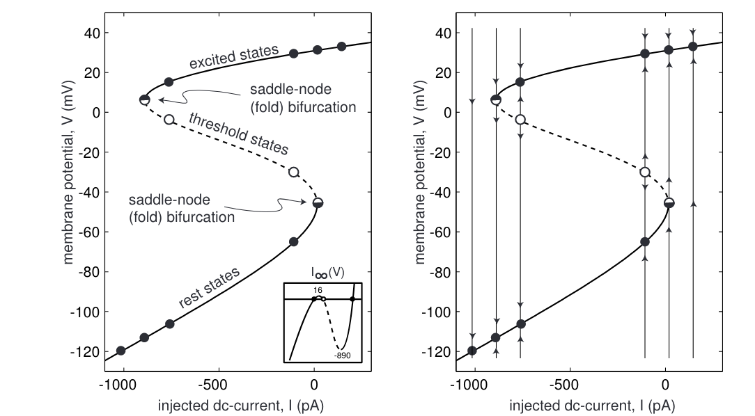
Bifurcation of a persistant Na model

Slide 13
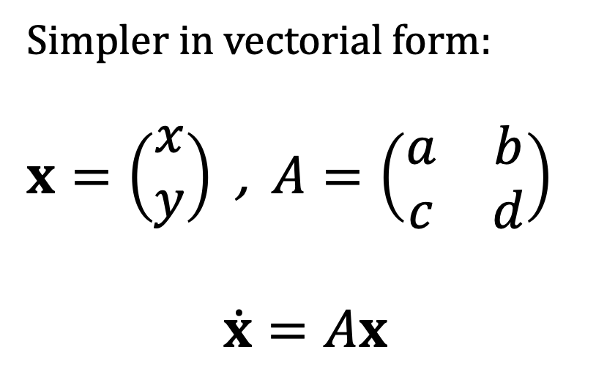
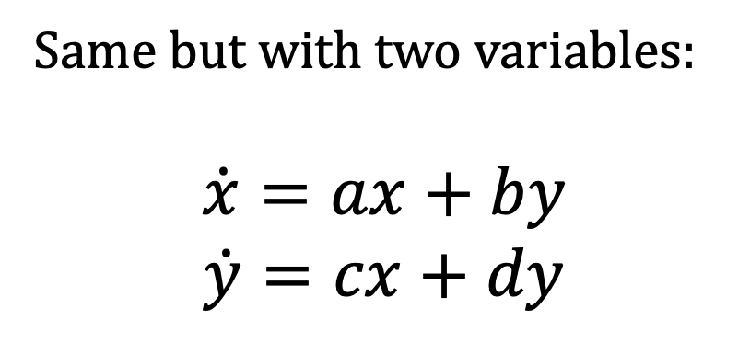
Two-dimensional linear systems
Same but with two variables:
$$\dot{x}=ax+by$$
$$\dot{y}=cx+dy$$
Simpler in vectorial form:
$x=\left(\begin{matrix}x \\ y\end{matrix}\right)$ , $A=\left(\begin{matrix}a & b \\ c & d\end{matrix}\right)$
$$\dot{x}=Ax$$

Slide 14
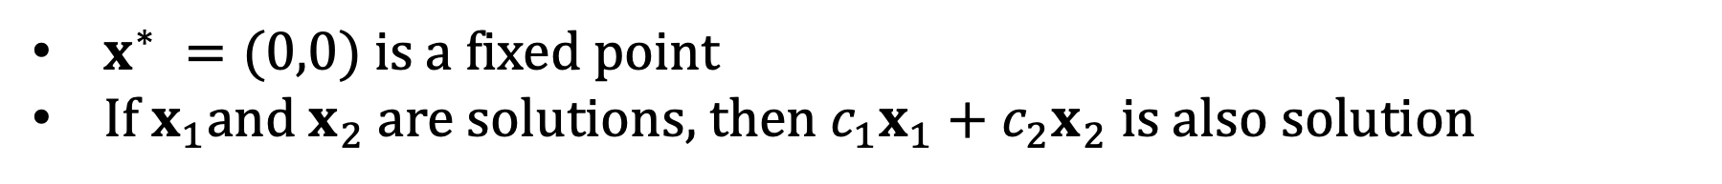
Two-dimensional linear systems
Same but with two variables:
$$\dot{x}=ax+by$$
$$\dot{y}=cx+dy$$
Simpler in vectorial form:
$x=\left(\begin{matrix}x \\ y\end{matrix}\right)$ , $A=\left(\begin{matrix}a & b \\ c & d\end{matrix}\right)$
$$\dot{x}=Ax$$
$x^{∗} =(0,0)$ is a fixed point
If $x_{1}$and $x_{2}$are solutions, then$c_{1}x_{1}+c_{2}x_{2}$is also solution

Slide 15
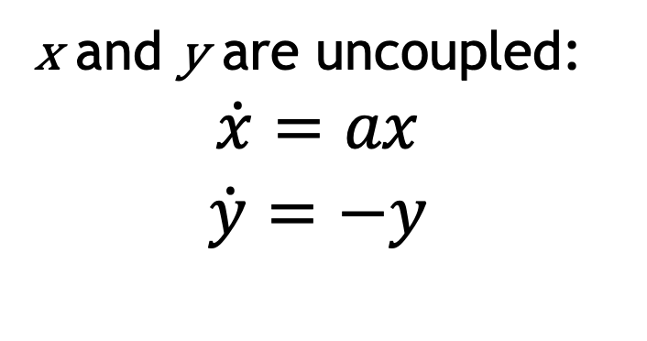

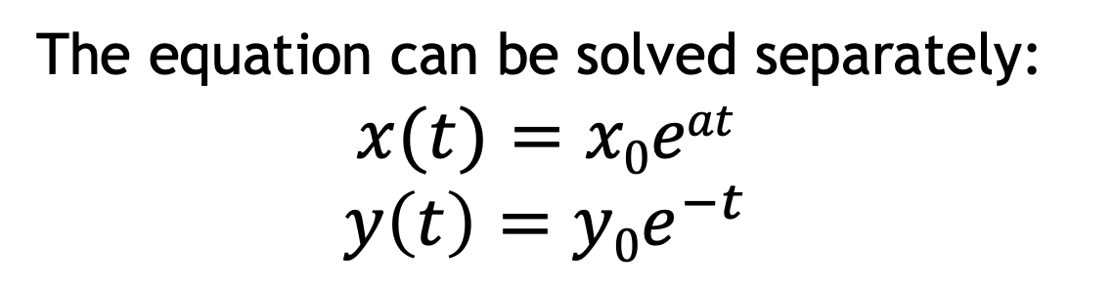
Uncoupled example
Simple example: $\dot{x}=\left(\begin{matrix}a & 0 \\ 0 & −1\end{matrix}\right)x$
x and y are uncoupled:
$$\dot{x}=ax$$
$$\dot{y}=−y$$
The equation can be solved separately:
$$x(t)=x0eat$$
$$y\left(t\right)=y0e^{−t}$$

Slide 16
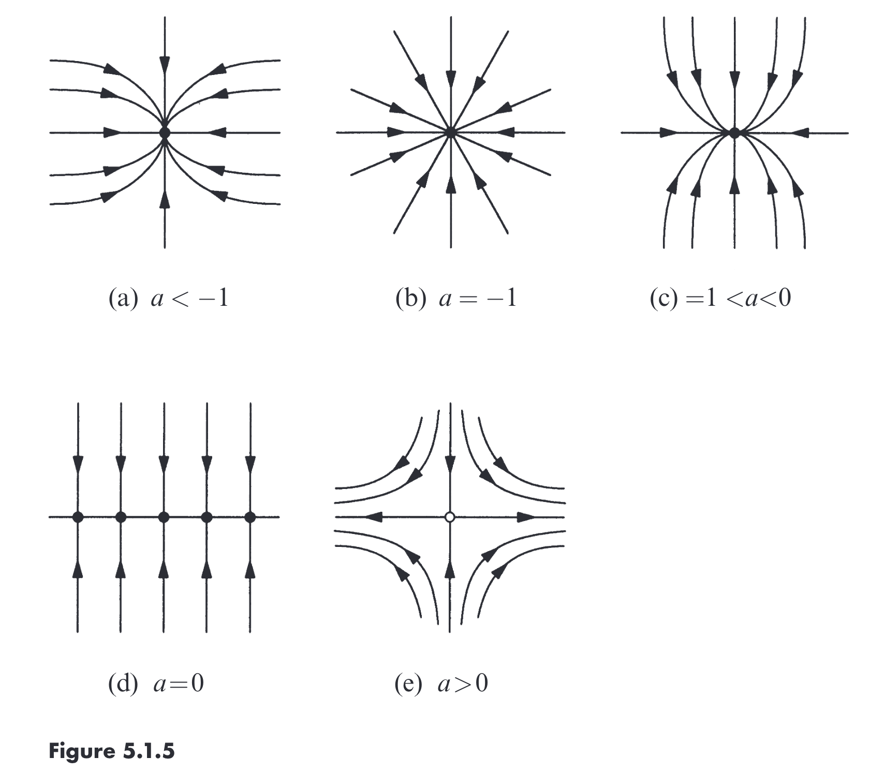
Uncoupled example

Slide 17

Uncoupled example
Attracting fixed point (if you start close to it, you end up there)
Liapunov stable (if you start close to it, you never go far)
= Stable fixed point

Slide 18
Uncoupled example

Slide 19

Uncoupled example
Liapunov stable but not attracting = Neutrally stable point
Line of fixed points

Slide 20
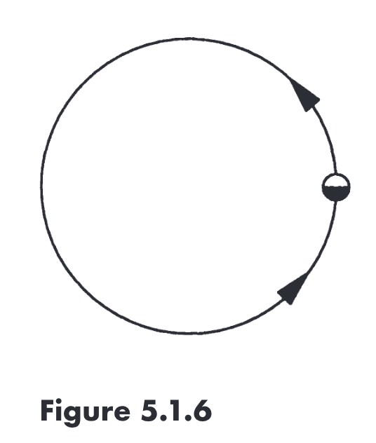
Uncoupled example
Line of fixed points
Attracting but not liapunov stable

Slide 21
Uncoupled example
Line of fixed points

Slide 22


Uncoupled example
Saddle point
Line of fixed points
Unstable manifold
Stable manifold

Slide 23
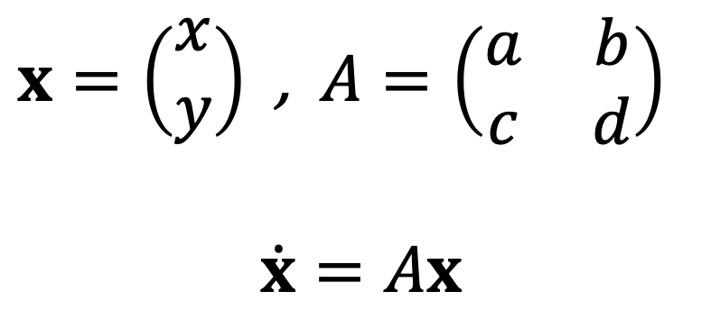
General case
$x=\left(\begin{matrix}x \\ y\end{matrix}\right)$ , $A=\left(\begin{matrix}a & b \\ c & d\end{matrix}\right)$
$$\dot{x}=Ax$$

Slide 24
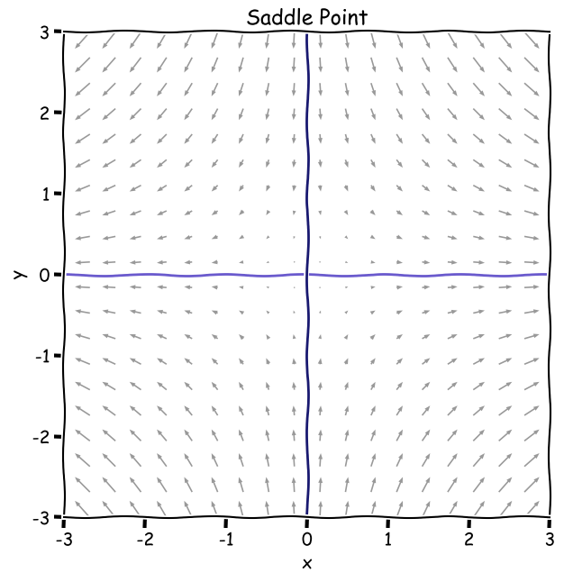



Look for straight line trajectories
$$\dot{x}=ax$$
$$\dot{y}=−y$$
Y-nullcline
$$x(t)=x0eat$$
$$y\left(t\right)=y0e^{−t}$$

Slide 25
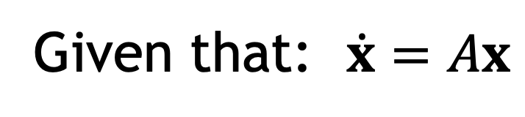
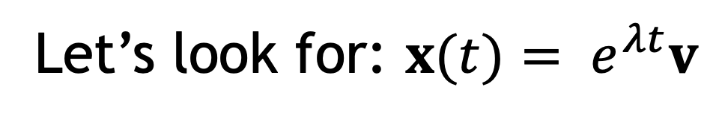
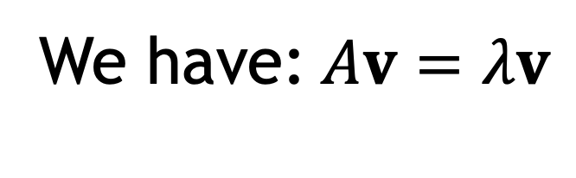
Look for straight line trajectories
Let’s look for: ${x(t)= e}^{λt}v$
Given that: $\dot{x}=Ax$
We have:$Av=λv$

Slide 26
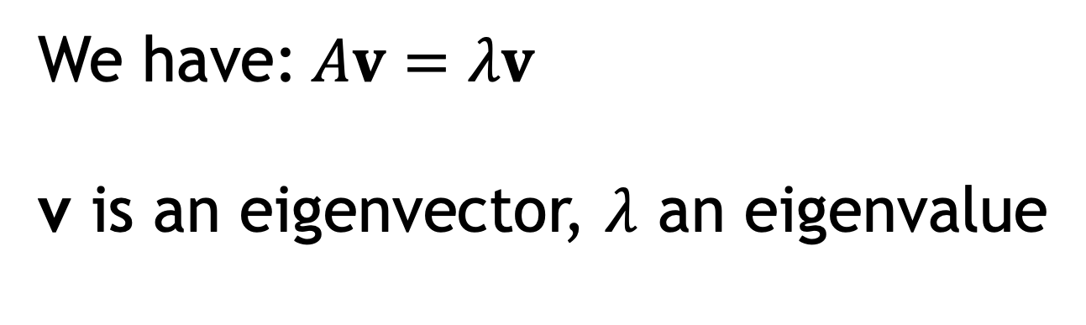
Linear algebra
Let’s look for: ${x(t)= e}^{λt}v$
Given that: $\dot{x}=Ax$
We have:$Av=λv$
v is an eigenvector, $λ$ an eigenvalue

Slide 27
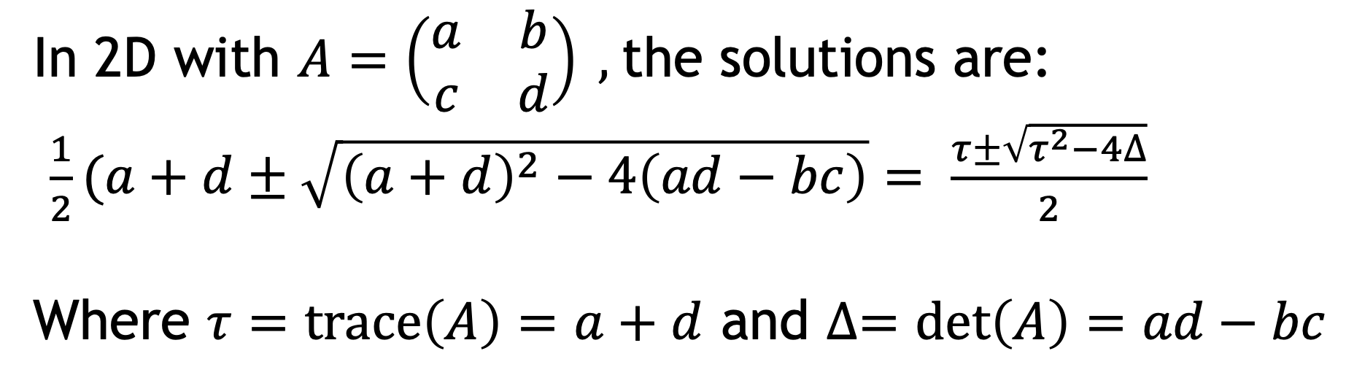
Linear algebra
In general eigenvalues are given by: $det\left(A−λI\right)=0$
In 2D with $A=\left(\begin{matrix}a & b \\ c & d\end{matrix}\right) ,$the solutions are:
$\frac{1}{2}(a+d±\sqrt{{\left(a+d\right)}^{2}−4\left(ad−bc\right)}= \frac{τ±\sqrt{τ^{2}−4∆}}{2}$
Where $τ=trace\left(A\right)=a+d$ and $∆=\det\left(A\right)=ad−bc$

Slide 28
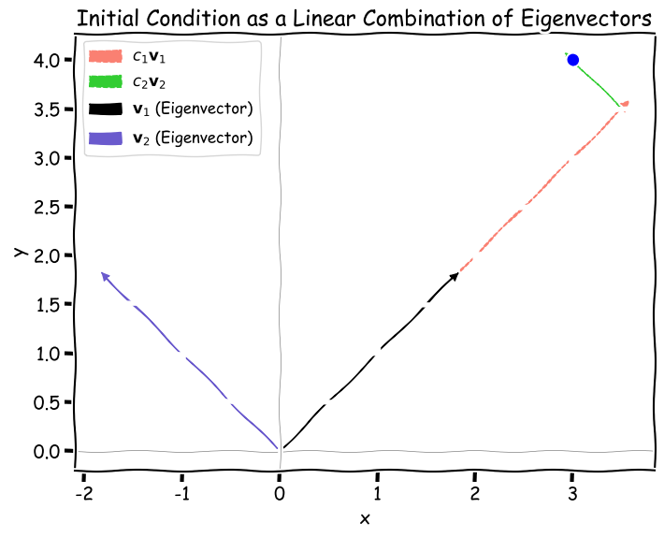
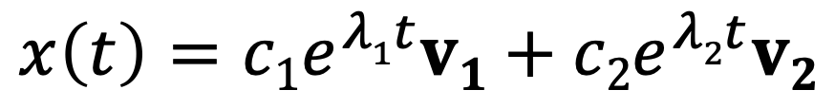
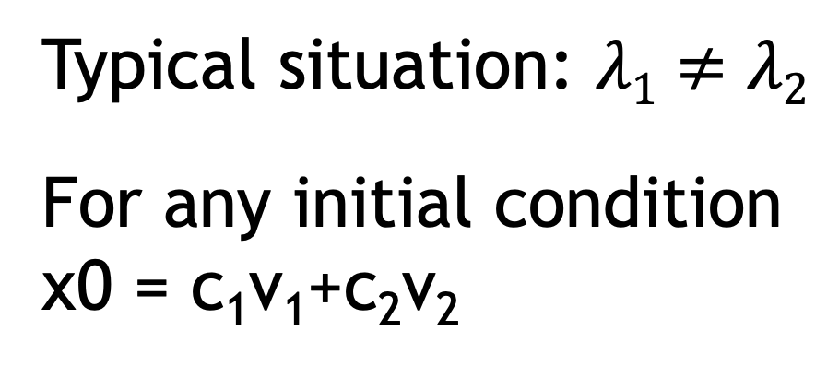
Typical case
Typical situation: $λ1≠λ2$
For any initial condition
x0 = c₁v₁+c₂v₂
$$x\left(t\right)={c1e}^{λ1t}v1+{c2e}^{λ2t}v2$$

Slide 29
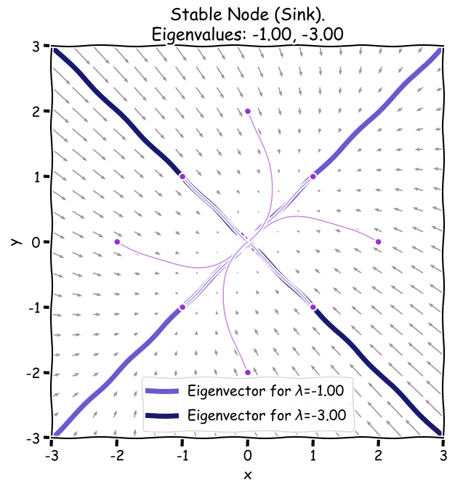
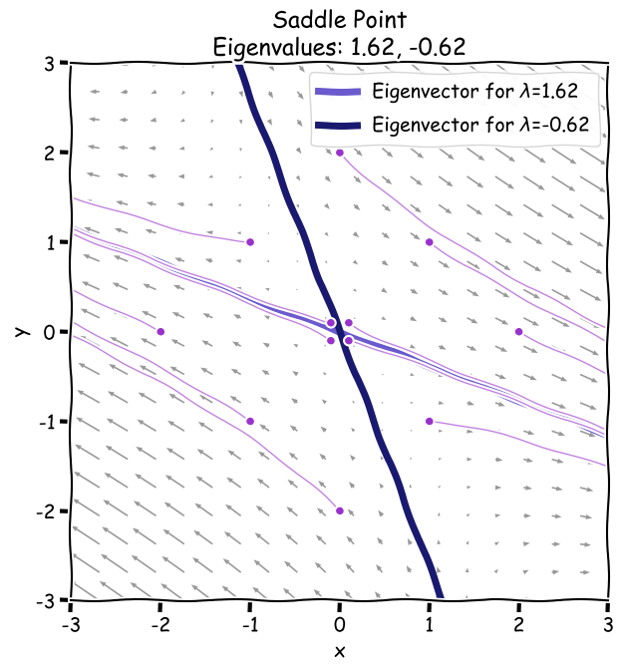
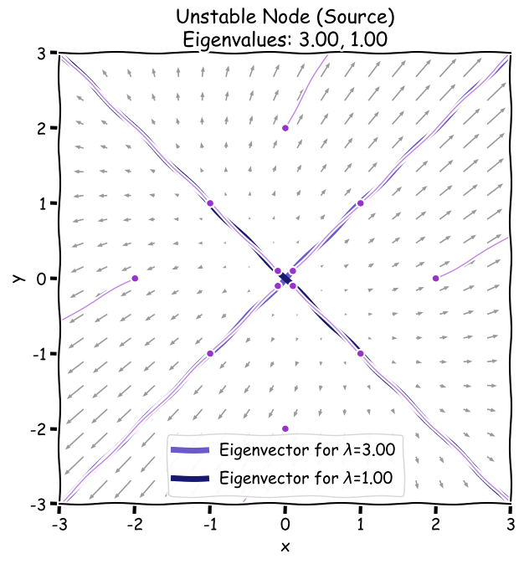
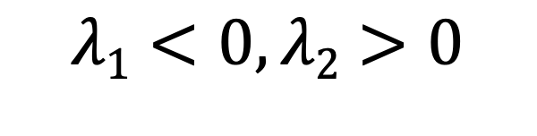
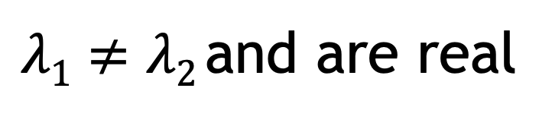
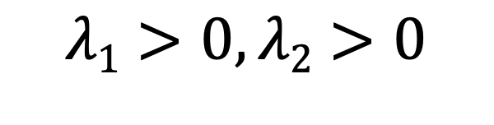
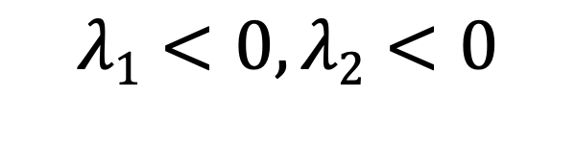
$λ1≠λ2$and are real
Boring reality
$$λ1<0, λ2<0$$
$$λ1<0, λ2>0$$
$$λ1>0, λ2>0$$

Slide 30
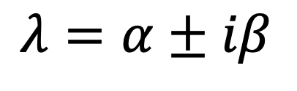
$$λ=α±iβ$$
Funnier complex
$$e^{λt}=e^{(α+iβ)t}=e^{αt}e^{iβt}=e^{αt}(\cos\left(βt\right)+i sin(βt)$$

Slide 31
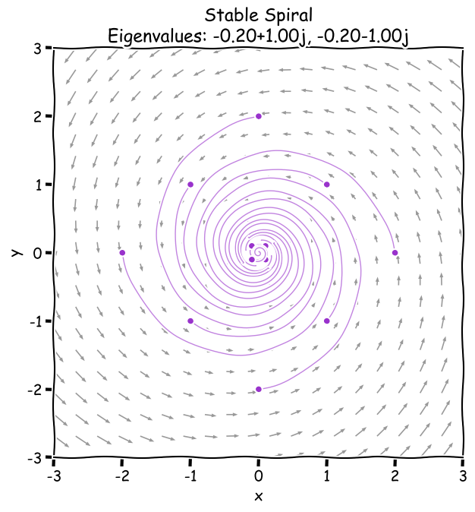
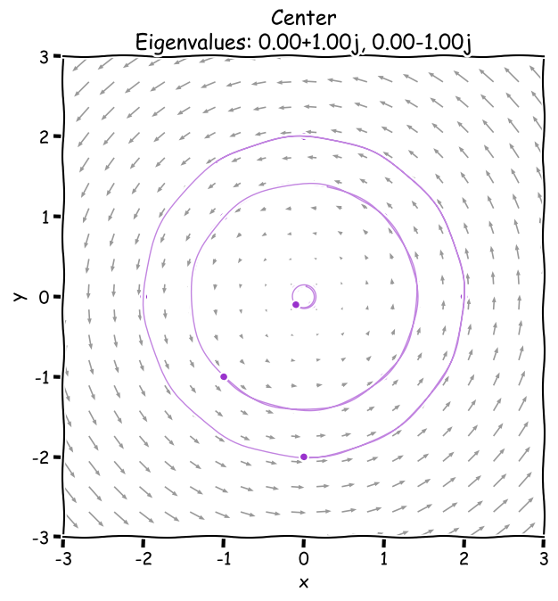
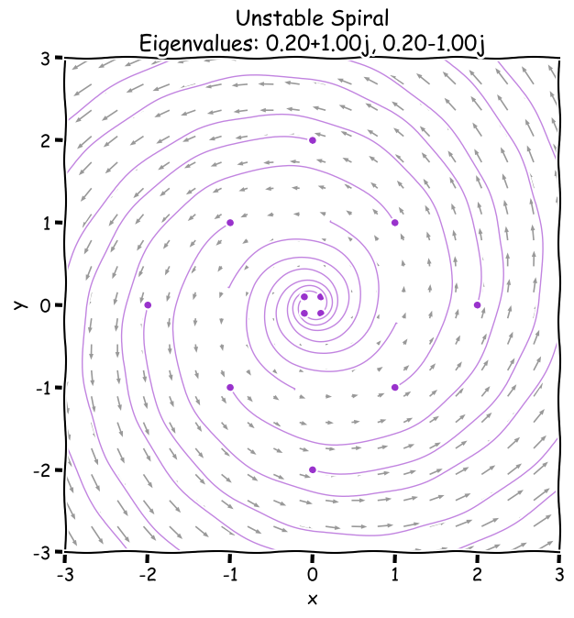



$$λ=α±iβ$$
Funnier complex
$$e^{λt}=e^{(α+iβ)t}=e^{αt}e^{iβt}=e^{αt}(\cos\left(βt\right)+i sin(βt)$$
$$α<0$$
$$α=0$$
$$α>0$$

Slide 32
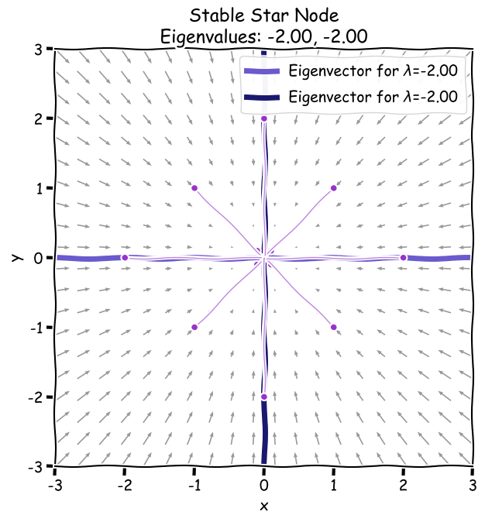
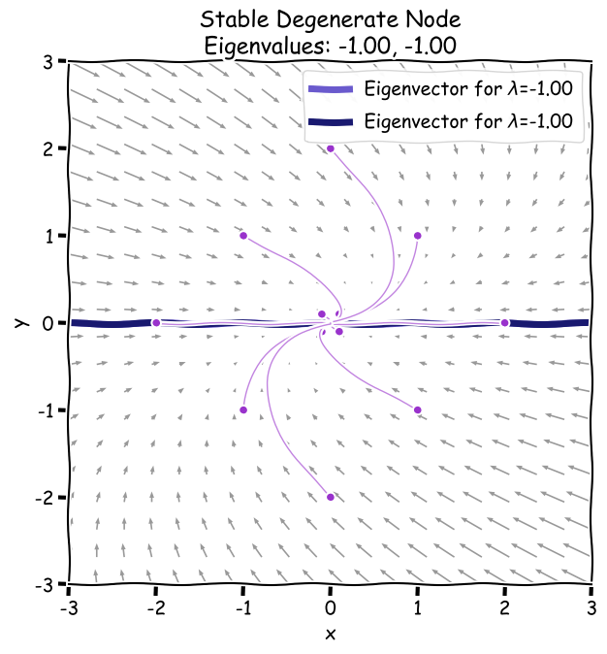
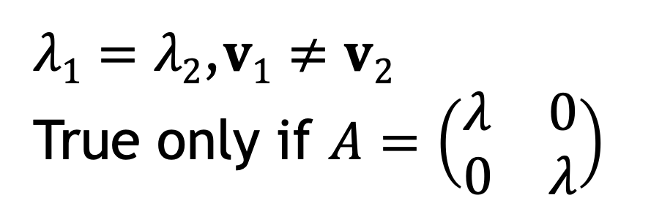
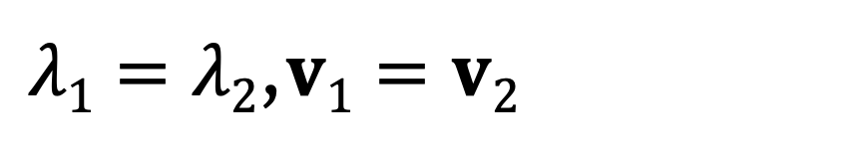
Edge cases
$λ1=λ2$,$v1≠v2$
True only if $A=\left(\begin{matrix}λ & 0 \\ 0 & λ\end{matrix}\right)$
$λ1=λ2$,$v1=v2$

Slide 33
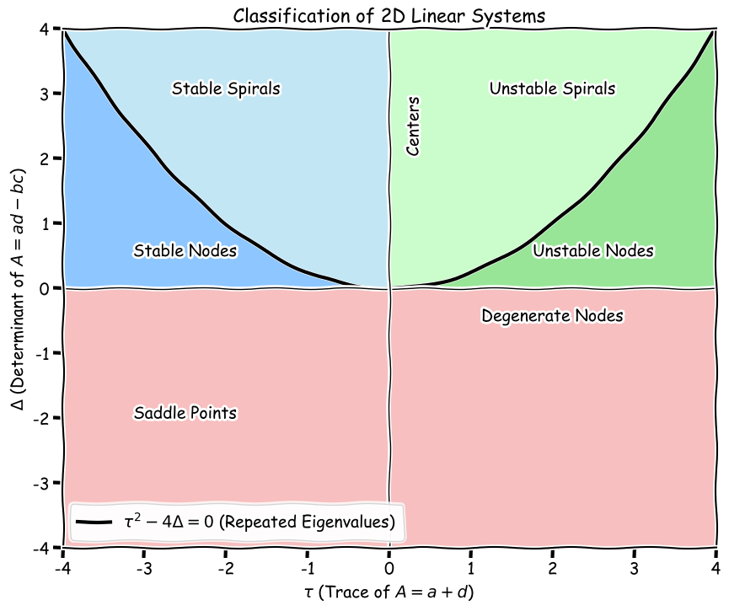
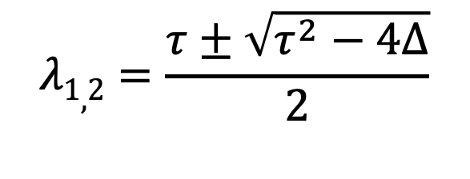
Full classification
$$λ1,2=\frac{τ±\sqrt{τ^{2}−4∆}}{2}$$

Slide 34
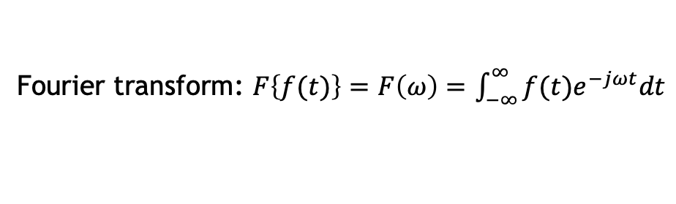
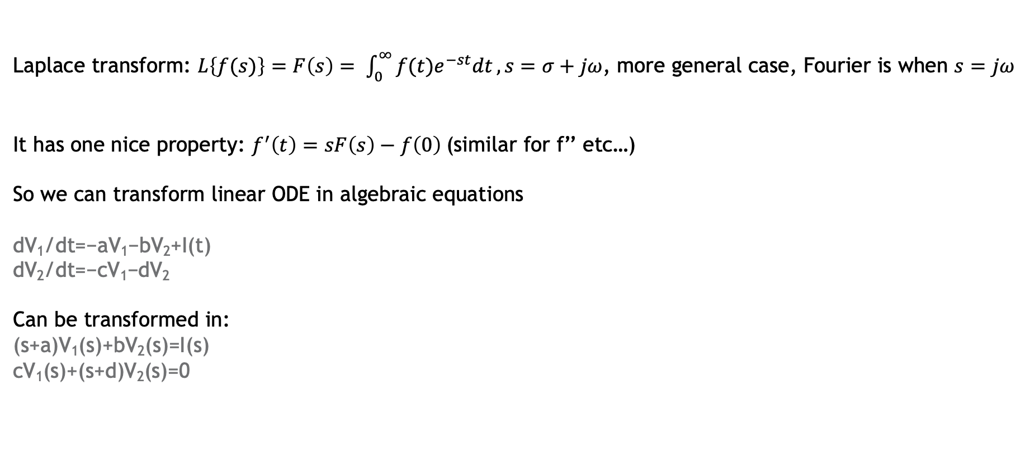
Note of Laplace transform?
Fourier transform: $F\left\{f(t)\right\}=F\left(ω\right)=$ $\int_{−∞}^{∞}{f(t)e^{−jωt}dt}$
Laplace transform: $L\left\{f(s)\right\}=F\left(s\right)= \int_{0}^{∞}{f(t)e^{−st}dt}, s=σ+jω$, more general case, Fourier is when $s=jω$
It has one nice property: $f^{′}\left(t\right)=sF\left(s\right)−f\left(0\right)$(similar for f’’ etc…)
So we can transform linear ODE in algebraic equations
dV₁/dt​​=−aV₁​−bV₂​+I​(t)
dV₂​​/dt=−cV₁​−dV₂​
Can be transformed in:
(s+a)V₁​(s)+bV_{2​}(s)=I​(s)
cV₁​(s)+(s+d)V₂​(s)=0

