Slide 1
Policy Gradients
A subset of policy optimization methods
Liz de Laittre - neuro study group - 3.30.26

Slide 2
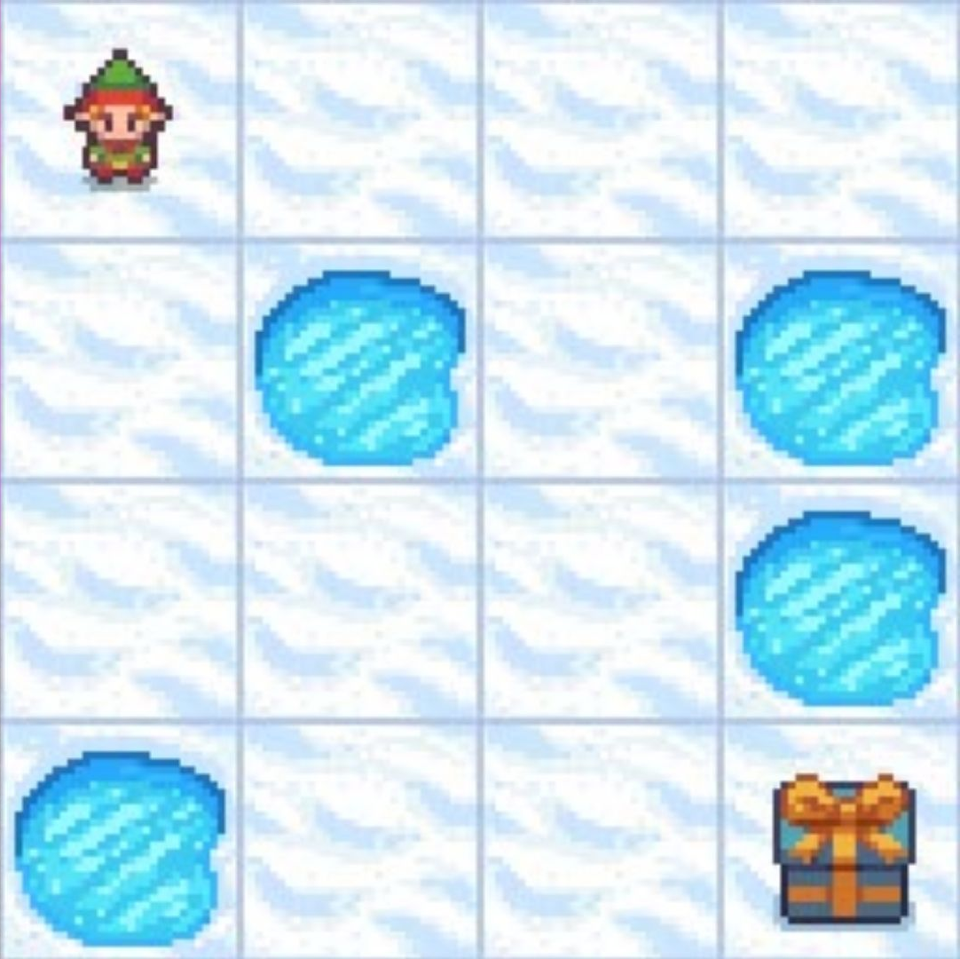
State | Up | Down | Left | Right
1 | 0 | 0 | 0 | 0
2 | 0 | 0 | 0 | 0
3 | 0 | 0 | 0 | 0
4 | 0 | 0 | 0 | 0
5 | 0 | 0 | 0 | 0
… | 0 | 0 | 0 | 0
16 | 0 | 0 | 0 | 0
Notes:
Tabular methods —> discrete states, discrete actions
Actions are both discrete AND unordered
(tabular = table! Tabulate?)
The policy was just argmax over most valuable action (in a given state), which requires iterating over all states
Also our updates were to individual discrete states/actions, which meant that if there are similar actions, we cannot benefit from updating nearby ones (less sample efficient)

Slide 3
Pole
Actions
0.) Do nothing
1.) Move left
2.) Move right
Observations
1.) Cart position
2.) Cart velocity
3.) Pole Angle
4.) Pole velocity
Cart
Reward
For each timestep that the angle of the pole is less than +/- 12 degrees
Notes:
Continuous state space —> no discrete states so we can’t use action-value lookup table, instead need a function over continuous state space
Discrete action space

Slide 4
Pole
Observations
1.) Cart position
2.) Cart velocity
3.) Pole Angle
4.) Pole velocity
Cart
What should our states be?
We no longer have discrete states…
But a continuous 4 dimensional space…

Slide 5
Discrete state
Q Table
Value of each action
Continuous state
Some function
Value of each action

Slide 6
Continuous state space, discrete action space
output is learned Q-value for each action in this state
input is 4D state
State variables
1.) Cart position
2.) Cart velocity
3.) Pole Angle
4.) Pole velocity
Actions
0.) Do nothing
1.) Move left
2.) Move right
We use a deep neural network to approximate this Q-function
Notes:
4D state landscape, mapping that space to a given discrete action, activations would be the value of that action at that point in state space. And then your policy would act on that value outcome, e.g. argmax or random
Goal is to learn the map of action-state to value, aka model of the environment, with a function approximator
Computing this argmax over action

Slide 7
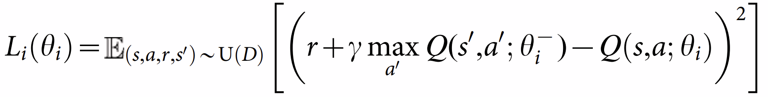
State variables
1.) Cart position
2.) Cart velocity
3.) Pole Angle
4.) Pole velocity
Actions
0.) Do nothing
1.) Move left
2.) Move right
network parameters theta
We use a deep neural network to approximate this Q-function
Notes:
Loss function = updating the weights to approximate this Q value, in a way that maximizes total reward
Note that in computing Q learning, we are learning a deterministic state-action policy, since at every timepoint, the policy is to take the action with the highest value

Slide 8
Continuous state space, continuous action space
outputs define a probability distribution over action space
input is 4D state
State variables
1.) Cart position
2.) Cart velocity
3.) Pole Angle
4.) Pole velocity
Actions
torque joint 1 mean
torque joint 1 std
torque joint 2 mean
…
We use a deep neural network to approximate this Q-function
the policy itself
Notes:
Policy gradient, still using a deep network, but change how we interpret the activations of output neurons, and our loss function, so how we update weights
Instead of updating weights to accurately represent the value of action-state combo (Q-value), you are updating weights to directly maximise total reward under that policy (or something else)
Q-value update is iterative, policy gradient is a gradient method
Stochastic —> probability over actions, way you choose an action at each timestep is sampling from that probability distribution
Discrete or continuous

Slide 9
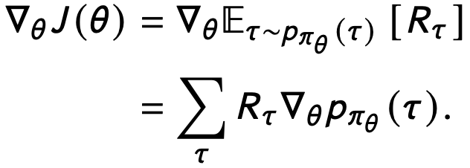
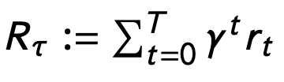
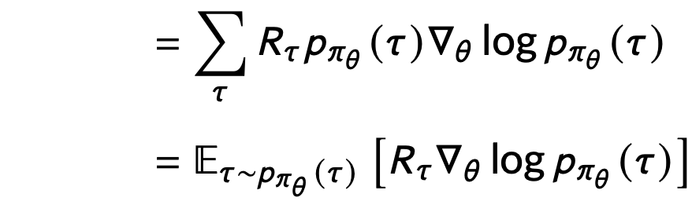
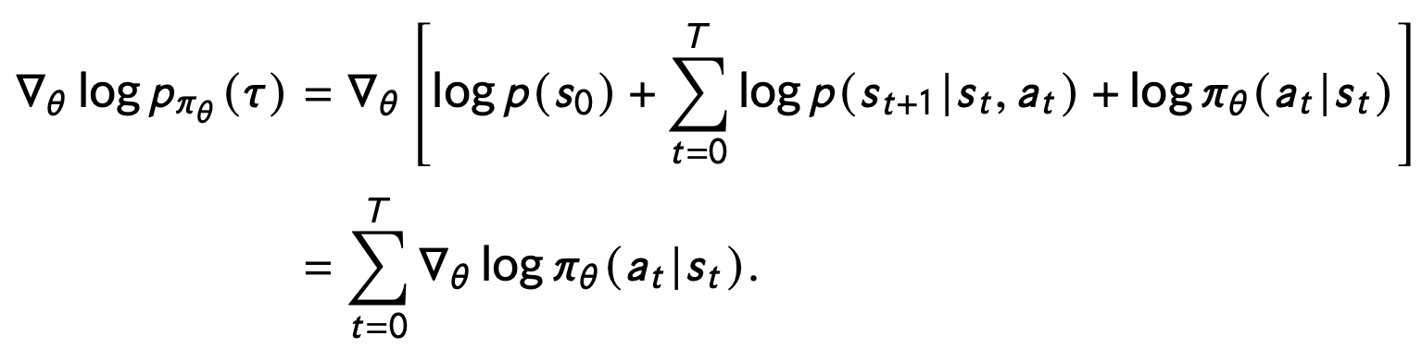
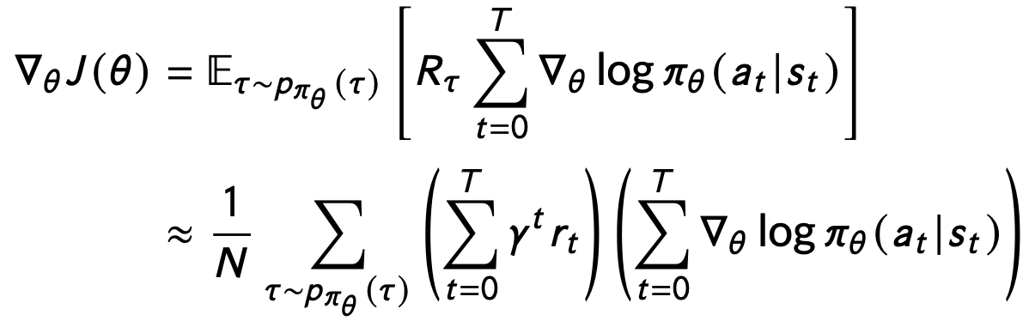
where
J(theta) = total reward for this stationary environment under policy pi with parameters theta
Gradient with respect to the parameters theta
Tau (trajectory through environment) drawn from the distribution of trajectories possible under policy pi
Probability of a trajectory depends on environment as well as the policy
Simplify, since environment does not depend on parameters theta
For stochastic policies, log-likelihood of action probabilities given the state
REINFORCE algorithm: change probability of actions-given-states in the direction that maximally increases total reward
Jensen, 2024 arXiv. An introduction to reinforcement learning for neuroscience
Notes:
—> Gradient with respect to parameters of policy pi (so in theory this could be small number, but usually it’s a neural network)
Stochastic policy, continuous state and action space

Slide 10
Example: 1 dimensional state, 1 dimensional action
probability
Policy gradient defines changes to this surface to maximise reward over all trajectories
action
state

Slide 11
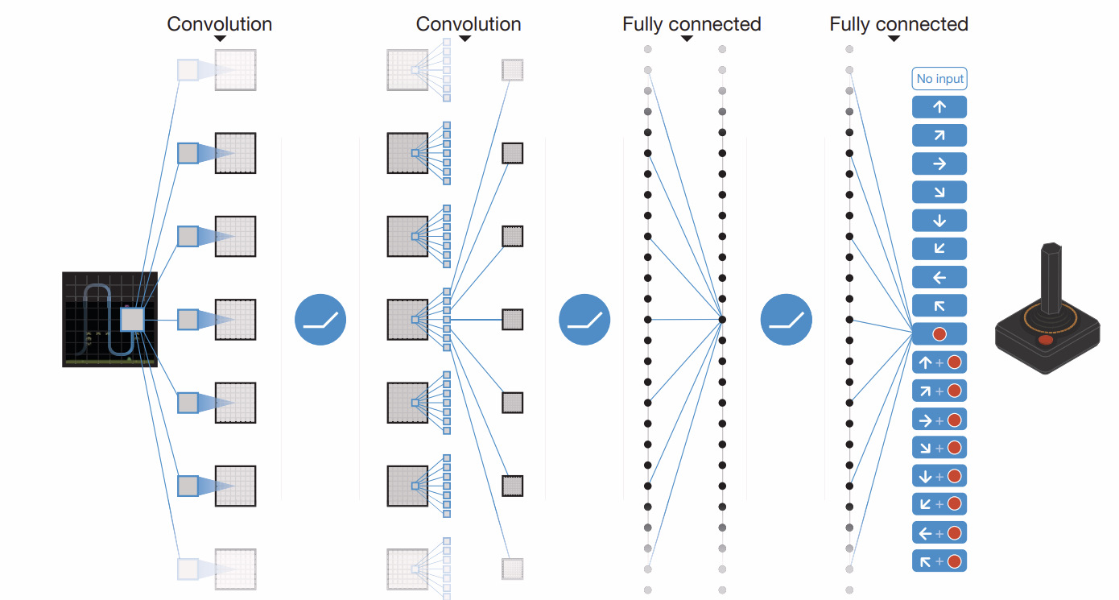

Slide 12
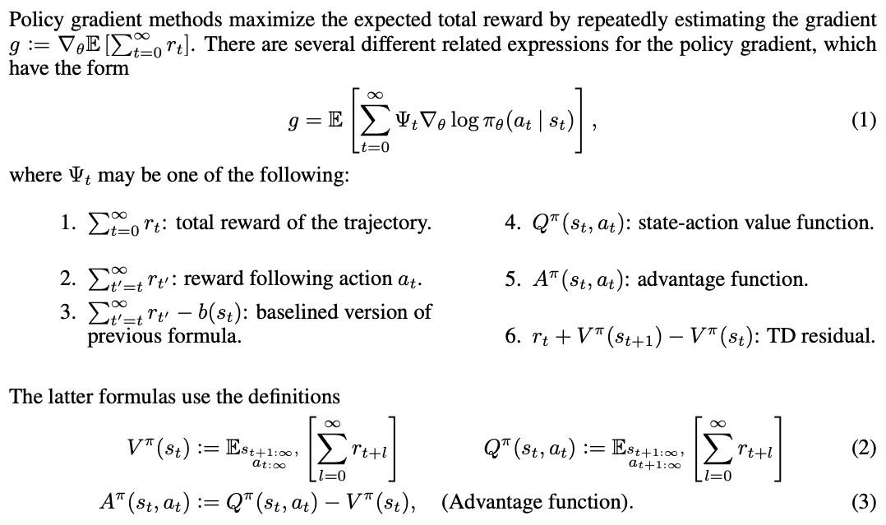
Schulman et al., 2016. ICLR. High-Dimensional Continuous Control Using Generalized Advantage Estimation
…which I found via https://lilianweng.github.io/posts/2018-04-08-policy-gradient/

Slide 13
Applications in robotics and physics simulations
https://openai.com/index/learning-dexterity/
https://gymnasium.farama.org/environments/mujoco/
Notes:
Commentary on why control is difficult
movement command is not exactly what the body does (because of interaction with environment, also execution noise)
Do the thing and see what you did (continuous update) —> sensory-motor delay ~100ms, which matters
Forward models of how motor commands will be enacted, perform updates based on sensory predictions

Slide 14
Human and animal behavior compatible with policy-gradient RL
Bennet, Niv, and Langdon, 2021. COIBS. Value-free reinforcement learning: policy optimization as a minimal model of operant behavior. https://doi.org/10.1016/j.cobeha.2021.04.020
Context-dependent preference learning (?)
Continuous-action learning
Gideah and Pillow, 2025. arXiv. Inferring learning rules during de novo task learning. https://doi.org/10.1101/2025.09.29.679295
Ashwood et al., 2020. arXiv. Inferring learning rules from animal decision-making https://papers.nips.cc/paper_files/paper/2020/hash/234b941e88b755b7a72a1c1dd5022f30-Abstract.html
Notes:
Question mark because their explanation seemed to imply that value-based RL only maps actions to value rather than allowing for state-dependent action-value mapping

Slide 15
Some properties of the policy gradient method
Allows for stochastic policies —> balances exploration and exploitation
Updates generalize to similar solutions (continuous space)
On-policy only
Model-free (no state transition probabilities)

Slide 16
Related topics
Actor-critic methods —> policy gradient and value-based methods
Deep Deterministic Policy Gradient (DDPG)
Proximal Policy Optimization

