Slide 1
Voter Participation in Oakland
By Francis Doran

Slide 2
Purpose
The City of Oakland recently pass the Oakland Fair Elections Act – Democracy Dollars and it is set to launch in 2026.
A similar bill was passed in Seattle and participation rates in the program were very similar to rates of voter participation.
Identifying disparities here will help target them in the implementation of Democracy Dollars.

Slide 3
Methodology
I combined the data from the Census, the American community survey and data for the Oakland Public Ethics Commission. The Oakland Public Ethics Commission provided me with a data set contain the voting history and address of every Oakland registered voter. I geocoded the addresses with the census geocoding api to get the census tract of every voter allowing me to connect it to the Census data.
7/24/2023

Slide 4
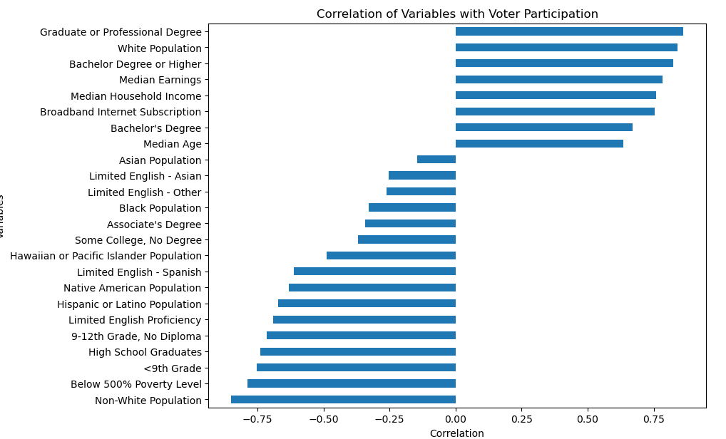
Key Factors to Analyze
Race
Education
Age
Socioeconomic Status
7/24/2023

Slide 5
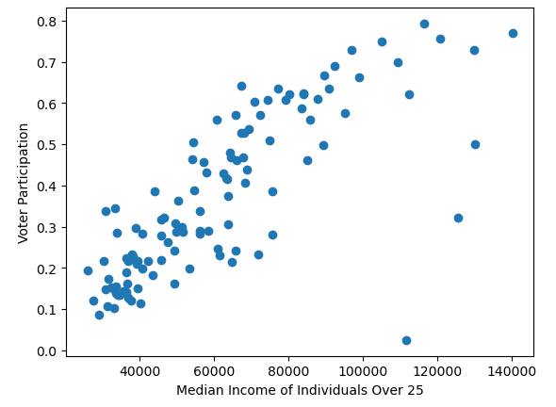
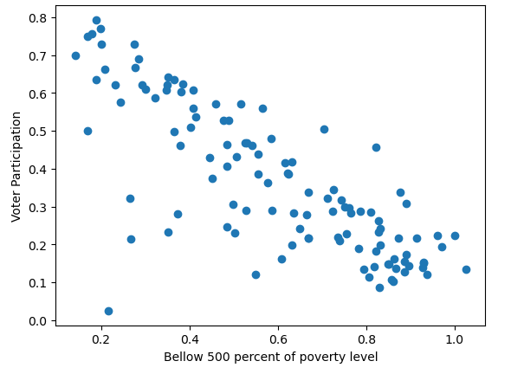
Socioeconomic Status
Strong correlation between socioeconomic status and voter participation when looking at either a high median income or a high poverty level
7/24/2023

Slide 6
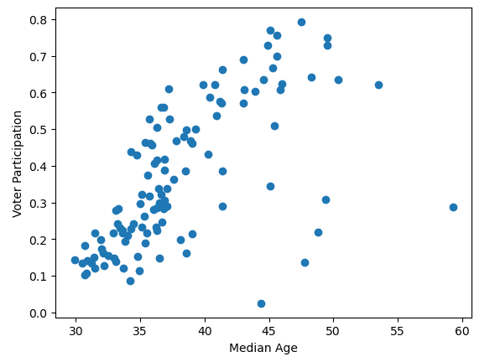
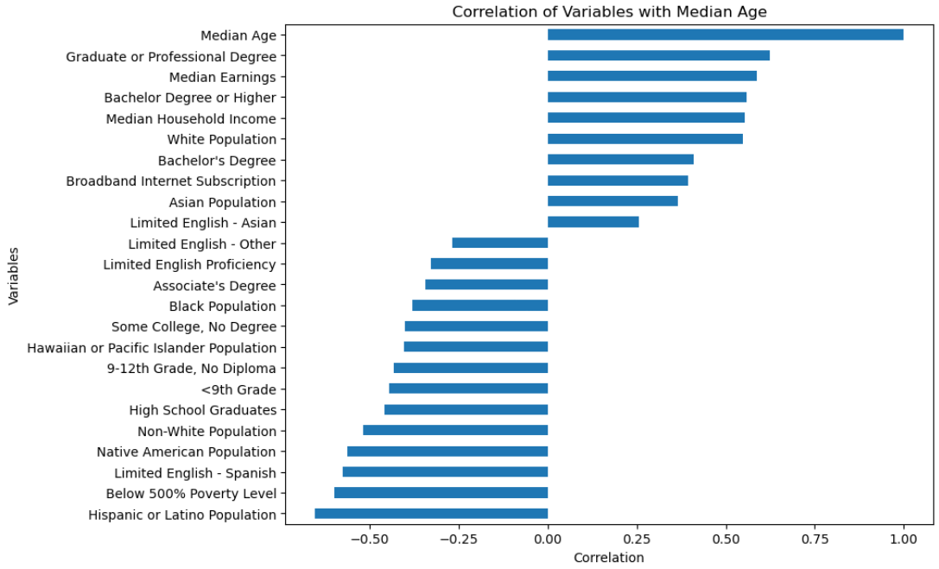
Age
The median age of a tract has moderate correlation with voter participation.
7/24/2023

Slide 7
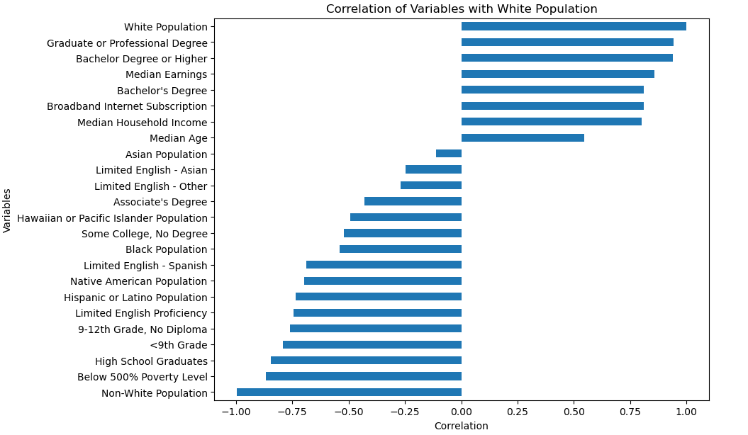
White Population
The white population correlation graph is almost identical to the voter participation correlation graph.
It is highly correlated with the same things as voter participation.
7/24/2023

Slide 8
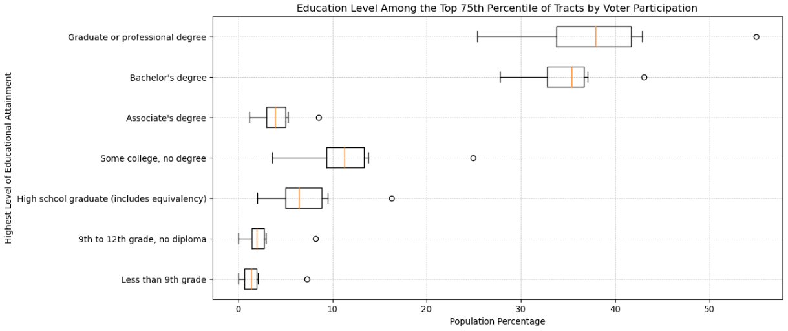
Education and Voter Participation
7/24/2023

Slide 9
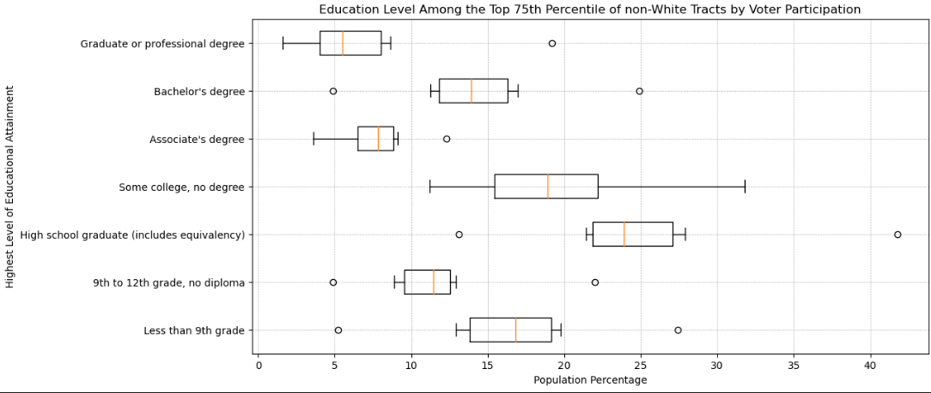
Education and Voter Participation non-White

Slide 10
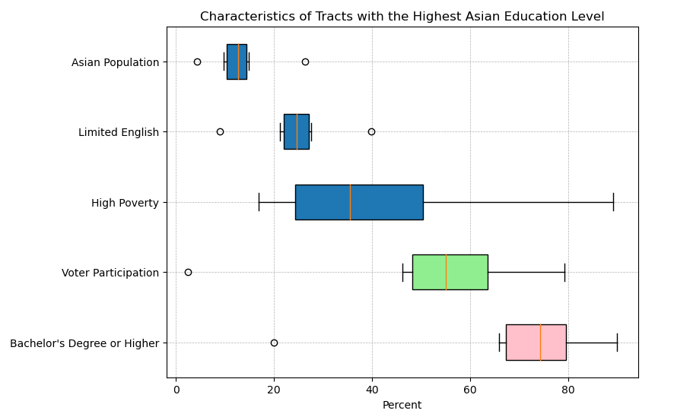
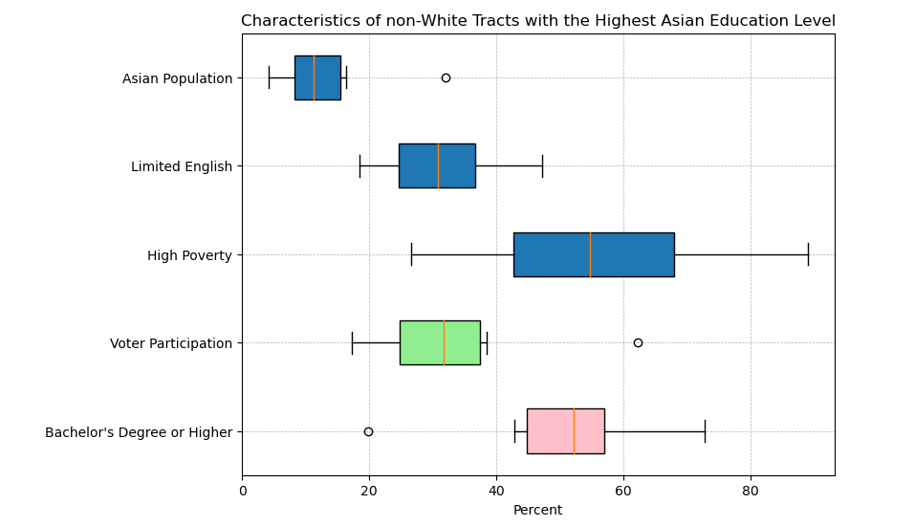
All Tracts vs Non-White Tracts
When comparing the same factors in non-White tracts voter participation goes down significantly.
7/24/2023

Slide 11
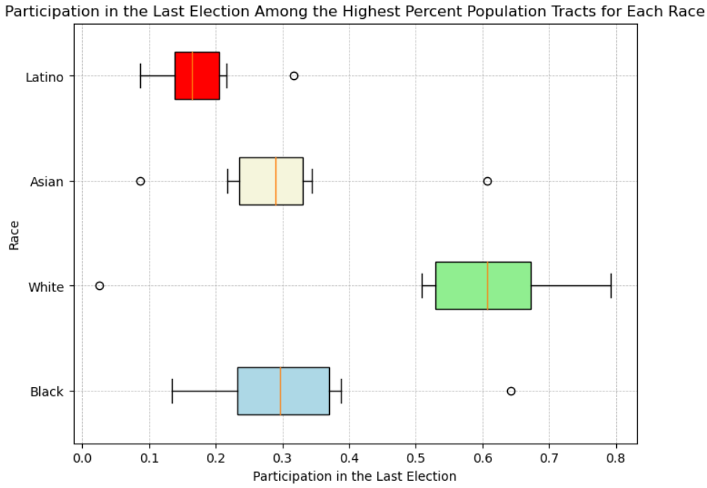
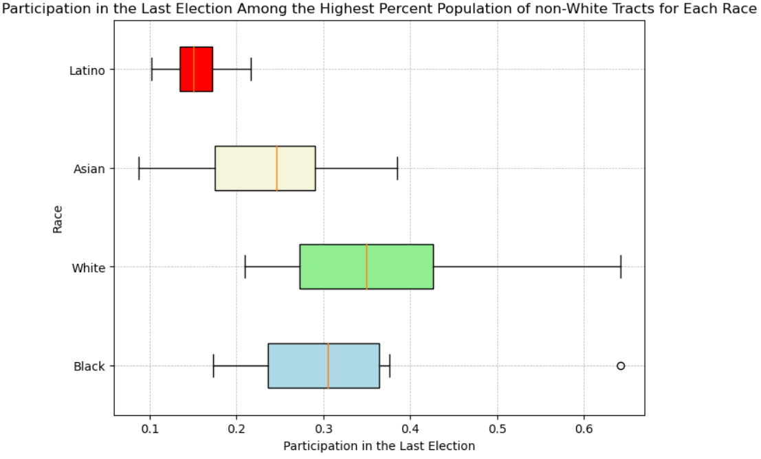
Large Racial Disparities
Racial disparities are very high across domains in Oakland despite having a very diverse population overall. White population are present at a greater rate in all categories which strongly correlate with voter participation.
7/24/2023

Slide 12
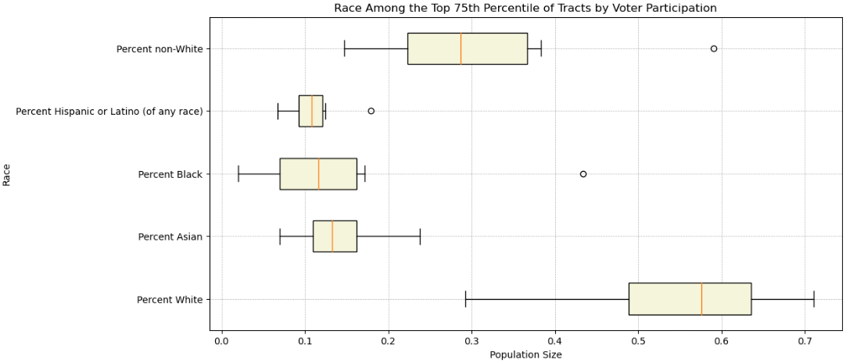
Race
The White population dominates the most participatory tracts.

Slide 13
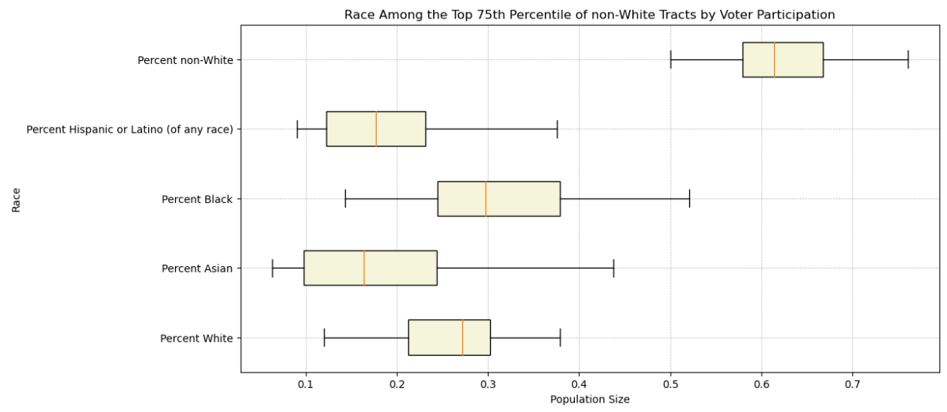
Race
In the top 75th percentile of non-White tracts racial populations are more even.
7/24/2023

Slide 14
Conclusion
Further analysis is required to disentangle the relevant variables but there are clear issues that need to be address in order to ensure an equitable launch of Democracy Dollars.

