Slide 1

FINAL DEFENSE
A Web-Based Booking
Management System
for Iñigos Sports Center
Gilbert D. Lorca · Christian Louis S. Oborza
Ken Paulo A. Olila · Jaycob C. Villapando
STI College Lucena · November 2026
Notes:
Open with the project title and introduce the four proponents.
Recommended flow: problem and value → objectives and scope → technology and Agile method → short system demo → results and limits → questions.
Source: capstone title page and abstract.

Slide 2
Introduction & significance
HOW BOOKINGS ARRIVED
THE OPERATING CHALLENGE
Facebook messages
No single shared schedule
→
Availability took extra coordination to confirm
Phone calls
Booking details could be split across staff channels
Walk-in inquiries
Manual records increased the risk of overlap or lost details
WHY IT MATTERS
IñigoSync brings court availability, bookings and payment records into one system—giving customers online access while staff manage online and walk-in reservations together.
Notes:
Explain that customers contacted the center through messages, calls, or walk-ins, while staff coordinated records manually.
Emphasize the practical value: customers can check and reserve online; staff can see online and walk-in activity in the same system.
Source: capstone Chapter 1, Project Context and Purpose.

Slide 3
Objectives
GENERAL OBJECTIVE
Develop a web-based booking management system that centralizes reservations, court schedules and payment records for Iñigos Sports Center.
SPECIFIC OBJECTIVES
01
Online booking
02
Centralized management
Check availability and reserve a preferred court, date and time.
Manage online and walk-in bookings, schedules and staff records.
03
Payment automation
04
Account security
Connect successful payments with booking confirmation and receipts.
Protect accounts with email verification, role access and session controls.
Notes:
State the general objective in one sentence, then summarize the four specific objectives.
Source: capstone Chapter 1, Objectives.

Slide 4
Scope
Three user roles share one reservation workflow.
CUSTOMERS
STAFF
ADMINISTRATOR
Court details, rates and availability
Online and walk-in bookings
Staff accounts and access
Online reservation and booking status
Court schedules and arrivals
Court listings and operating hours
Payment summary and receipt
Payment and transaction records
Grace-period and booking settings
FAQs and announcements
Receipts and daily reports
Activity monitoring and reports
Notes:
Describe the role-based coverage briefly: customer booking, staff transaction handling, and administrator configuration and monitoring.
Source: capstone Chapter 1, Scope.

Slide 5
Limitations
01
Internet dependent
Customers and staff need a working connection to book, confirm payments and update schedules.
02
Single location
The current configuration is built for Iñigos Sports Center and its operating needs.
03
Sandbox payment testing
PayMongo transactions were simulated in test mode; the results do not establish live-payment performance.
Notes:
Be direct about the operating and evaluation boundaries. PayMongo results are from sandbox transactions only.
Source: capstone Chapter 1, Limitations; Chapter 4, implementation and testing results.

Slide 6
Technology used
CLIENT
BACKEND & DATA
DEPLOYMENT
HTML · CSS
JavaScript
Supabase
PostgreSQL
Hostinger
→
→
Responsive web interface
Backend services and relational data
Web hosting
PAYMENT TESTING
PayMongo test account · sandbox transactions
Notes:
Walk through the stack from browser interface to backend services and database, then hosting.
Clarify that PayMongo was tested in sandbox mode.
Source: capstone Chapter 3, Technical Background; Chapter 4, Results and Discussion.

Slide 7
Methodology
Agile / Scrum · 10–15 day sprints described in the project plan
01
02
03
04
05
Gather needs
Design
Build
Evaluate
Improve
Interview and consult with the client.
Create Figma wireframes and data plans.
Develop features incrementally by sprint.
Test with developers, adviser, client and users.
Fix issues, retest and prepare deployment.
Client and adviser feedback informed the next iteration.
Notes:
Explain that the team followed an iterative Agile approach: requirements, design, incremental development, review, and refinement.
The project plan describes sprint cycles of about 10–15 days.
Source: capstone Chapter 3, Methodology.

Slide 8
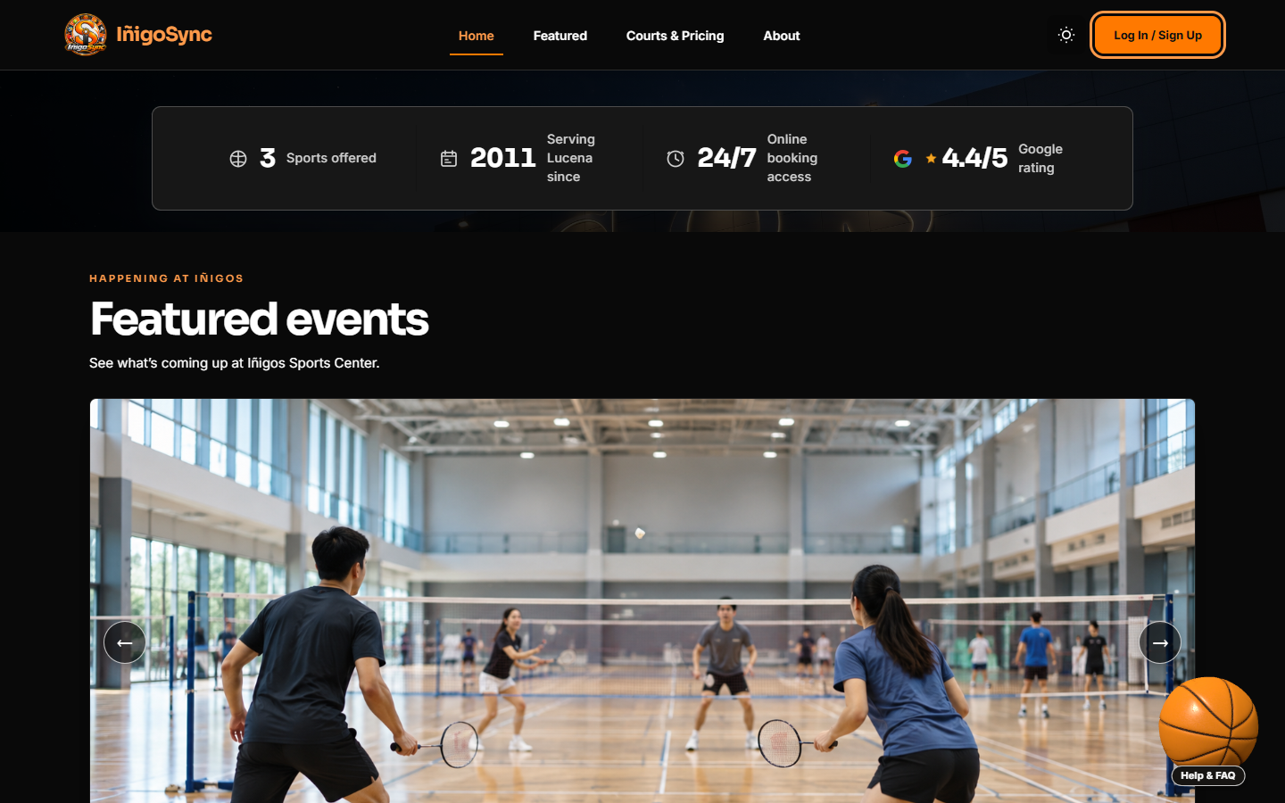
System prototype
Customer-facing landing page and court discovery
SUGGESTED LIVE DEMO
01
Customer: choose a court, date and time; review the booking.
02
Staff: record a walk-in and check the shared schedule.
03
Admin: show court settings and booking activity.
Notes:
Use the customer-facing landing page as the visual starting point. Keep the demonstration focused and short.
Recommended live demo order: customer selects a court and schedule; staff records a walk-in and checks the same schedule; administrator reviews court settings and booking activity.
Source: screenshot from the IñigoSync project; workflow scope from capstone Chapter 1.

Slide 9
Results & discussion
24 / 24
WHAT THE EVIDENCE SHOWS
Customer, staff and administrator workflows were included, from account access through bookings, payment records, receipts and reports.
documented functional test cases marked pass
Testing surfaced navigation, layout, schedule and data issues; revisions and adviser retesting followed.
TC-01 to TC-24
The final client evaluation reported approval of the revised system.
DISCUSSION
The reported tests support the intended booking workflow; sandbox results do not establish production payment performance.
Notes:
Report the exact evidence: Table 12 lists 24 functional cases, TC-01 through TC-24, all marked pass.
Explain that earlier testing identified usability, layout, schedule, and data issues, followed by fixes and adviser retesting.
Important source caveat: the testing section says the team was awaiting the client’s go-signal for deployment, while the implementation section later says launch occurred. Confirm the current deployment status before the defense; this deck does not claim a production launch.
Source: capstone Chapter 4, Testing, Table 12, and Implementation Results.

Slide 10
Questions?
Demo hand-off: customer booking → staff walk-in → admin overview
Iñigos Sports Center · STI College Lucena
Notes:
Invite questions from the panel.
If a live demonstration is part of the defense, use the sequence shown: customer booking → staff walk-in entry → administrator overview.

