Slide 1

16x16 bits High-speed Magnitude Comparator
ENCS-3330
Course project presentation
Prepared by:
Francis Miadi – 1210100
Jouwana Daibes – 1210123
Instructor : Dr. Khader Mohammad
Date : 14/6/2024

Slide 2
Overview About the project
In this project, we built a 16x16 bits High-speed magnitude comparator using the CMOS logic.
Our goal was to get the best Speed, Power, and Area.
2 micron technology was used.
5v DC as our power source
Gates sizing with respect to the inverter
Instancing of 4bits and 8bits comparators
Electric tool and LTspice were used

Slide 3
Main Followed Design Metrics
Speed
Area
Power
Those are our 3 main design metrics that we’ve built our project based on them.
Basically we are building a High-speed comparator, but that does not mean that we ignored the other metrics, each one has been taken care of, but how did we achieve those three at the same time?

Slide 4
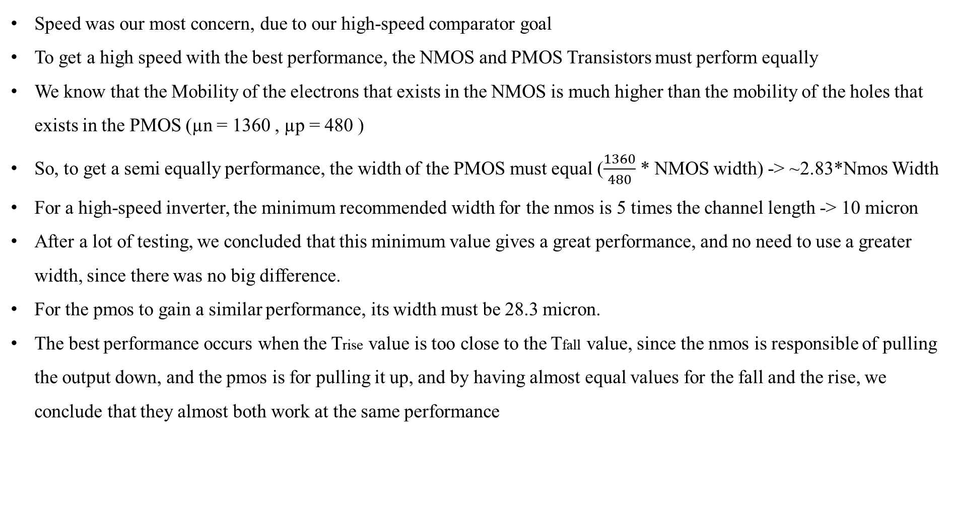
Speed
Speed was our most concern, due to our high-speed comparator goal
To get a high speed with the best performance, the NMOS and PMOS Transistors must perform equally
We know that the Mobility of the electrons that exists in the NMOS is much higher than the mobility of the holes that exists in the PMOS (µn = 1360 , µp = 480 )
So, to get a semi equally performance, the width of the PMOS must equal ($\frac{1360}{480}$ * NMOS width) -> ~2.83*Nmos Width
For a high-speed inverter, the minimum recommended width for the nmos is 5 times the channel length -> 10 micron
After a lot of testing, we concluded that this minimum value gives a great performance, and no need to use a greater width, since there was no big difference.
For the pmos to gain a similar performance, its width must be 28.3 micron.
The best performance occurs when the Trise value is too close to the Tfall value, since the nmos is responsible of pulling the output down, and the pmos is for pulling it up, and by having almost equal values for the fall and the rise, we conclude that they almost both work at the same performance

Slide 5
Area
The smaller the area was, the better the design will be.
But, to get the best performance, we agreed that the nmos width = 10 micron , and the pmos width = 28.3 micron.
We’ve done some tests to check if we can decrease the pmos width without a noticeable change in the performance, And a width of 20 micron for the pmos, was enough to get a very similar performance to the 28.3 micron width performance.
In this way we kept the performance at its best, with a decrease in the needed area ( 8.3 micron for each pmos device).
We also followed and committed to the minimum spacing between the components (devices, wires, vias, and contacts) in the circuit implementing phase, to fit the circuit in the minimum cell size, without violating the design rules for sure.
We didn’t use a pre-built Gate to build a large gate

Slide 6
Power
For our 2 micron technology, and for our high speed goal, the 5V DC was the best power option.
It is a hard process to balance between the speed requirements and the power dissipation especially when designing a high-speed circuit, but we’ve done our best to reduce the power dissipation as much as we could, as follows:
A 2 micron technology might seems a little large, but we’ve chosen this technology to achieve the balance between the high speed and the power consumption, in which:
The larger the technology was, the less the capacitors coupling will be, which will decrease the dynamic power dissipation.
The greater the channel length was, the less the leakage current will be, which will lead to a less static power dissipation.
Also the minimum width for the nmos and the pmos helps in reducing the power consumption, since proper transistor sizing can help in minimizing both dynamic and static power dissipation.

Slide 7
The procedure
Build the inverter with the widths that we‘ve discussed before.
Build all the needed logic gates, with the transistors sizing that is suitable to be driven by our inverter; to get the best performance. ( the inverter is our reference)
Use this gates to build a 4x4 bits magnitude comparator.
Use instances of the comparator in part III, to build a 8x8 bit comparator.
Repeat step IV but using the 8x8 bit comparator to build the final 16x16 comparator.

Slide 8
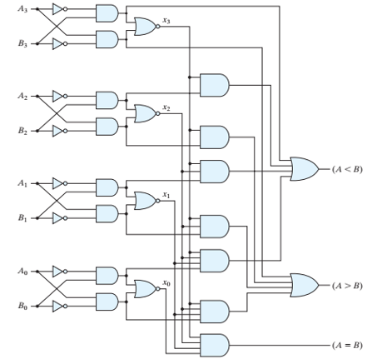
The 4 bits magnitude comparator gate level circuit
The required gates:
Inverter
2-input AND
3-input AND
4-input AND
2-input NOR
4-input OR
2-input OR (for instancing purposes)

Slide 9
Gates sizing and implementing
Gate | NMOS | PMOS
Inverter | 10/2 | 20/2
2-input AND | 20/2 | 20/2
3-input AND | 30/2 | 20/2
4-input AND | 40/2 | 20/2
2-input NOR | 10/2 | 40/2
4-input OR | 10/2 | 80/2
2-input OR | 10/2 | 40/2
NOTE : All the sizes are in micron

Slide 10
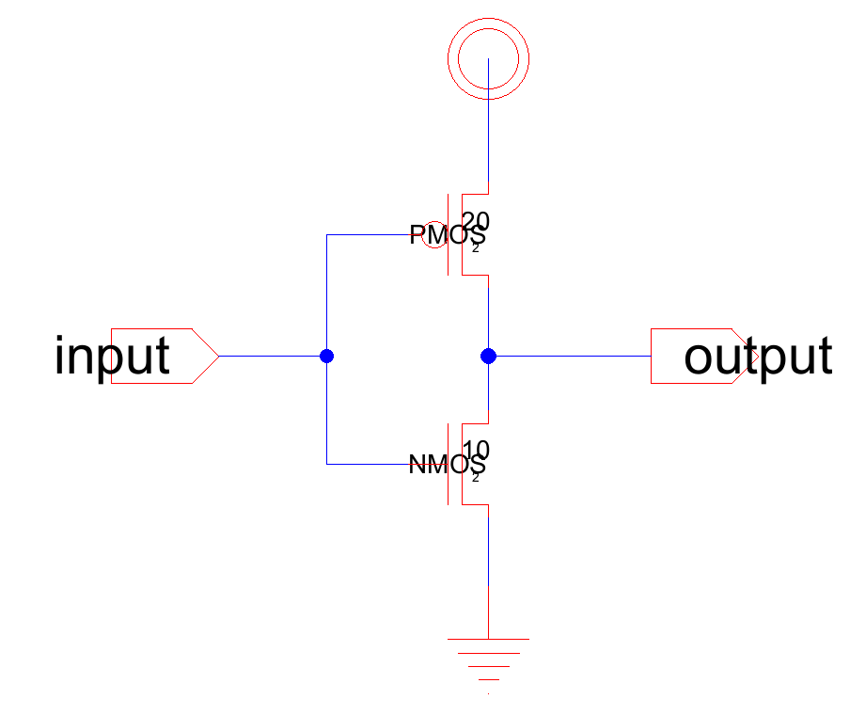
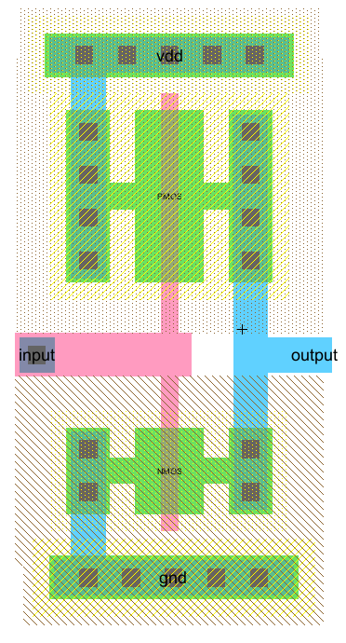
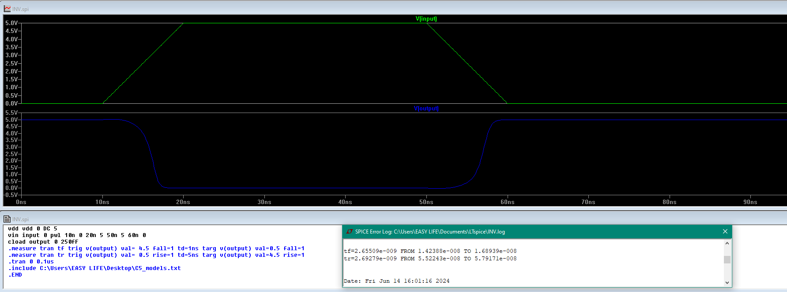
Inverter

Slide 11
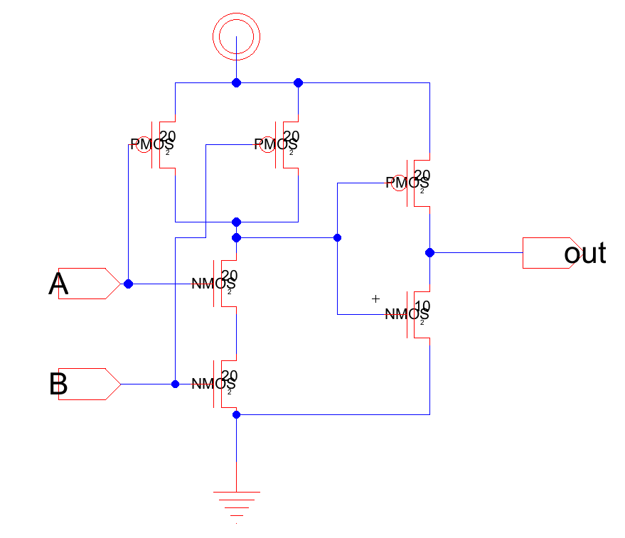
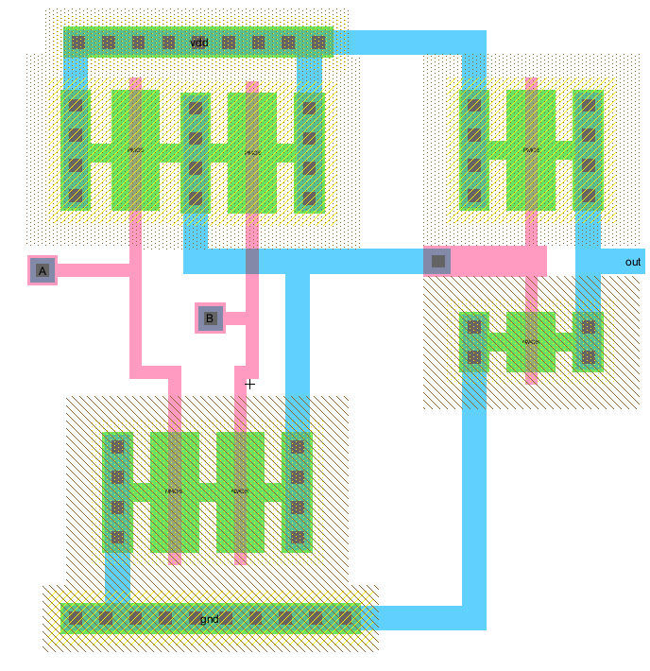
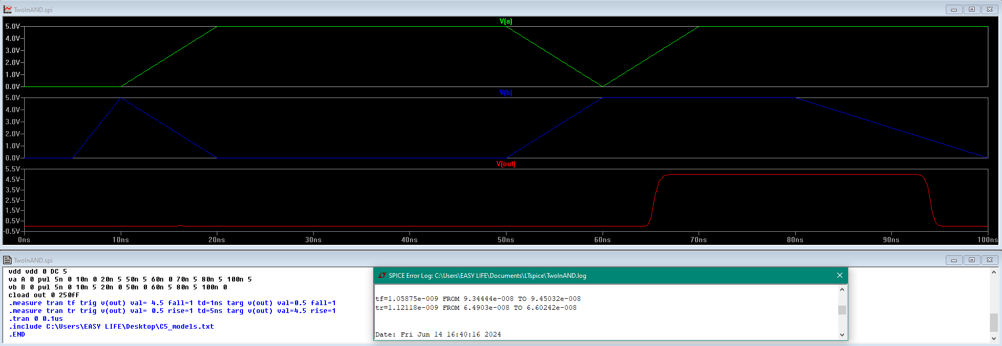
2-input AND

Slide 12
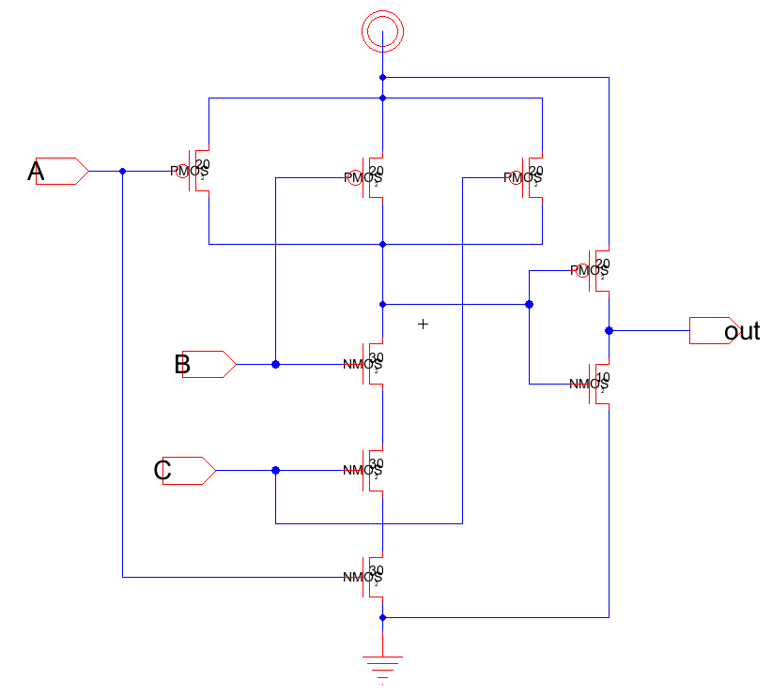
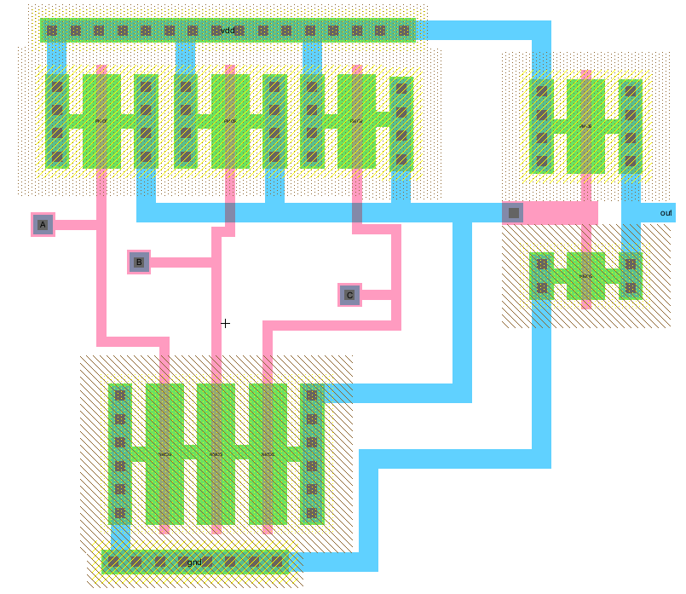
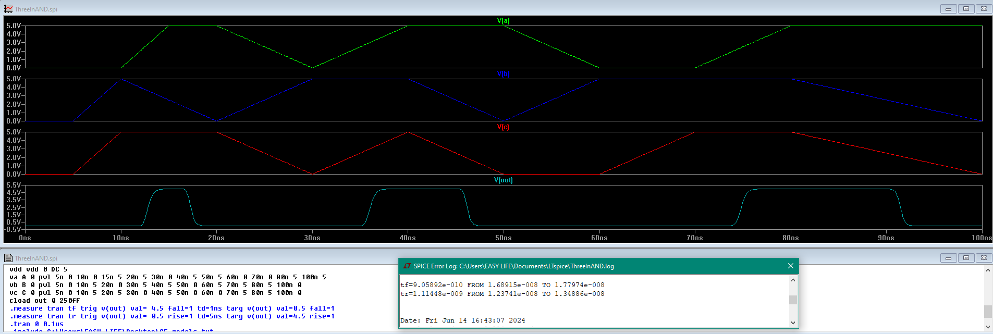
3-input AND

Slide 13
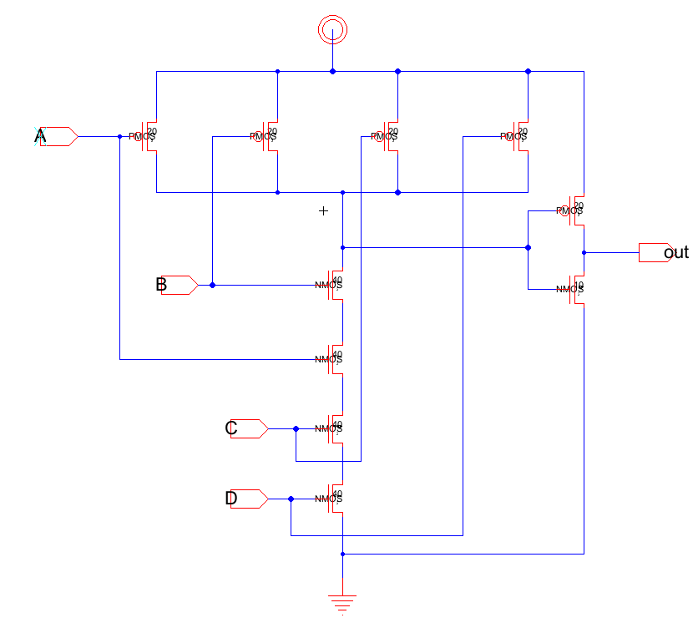
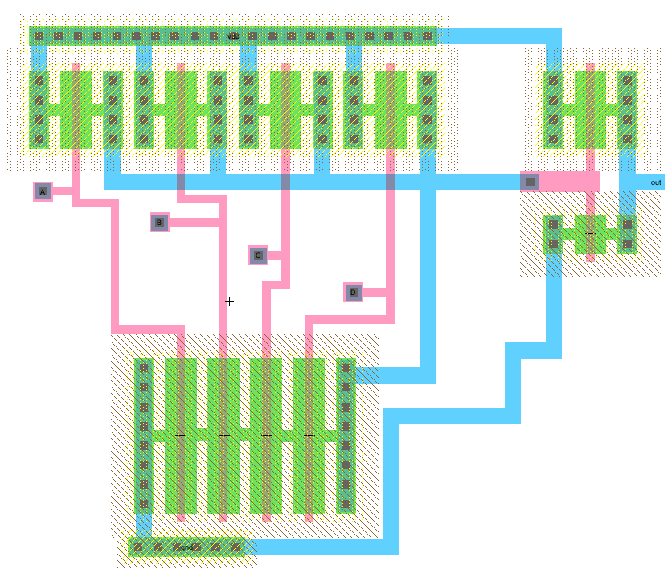
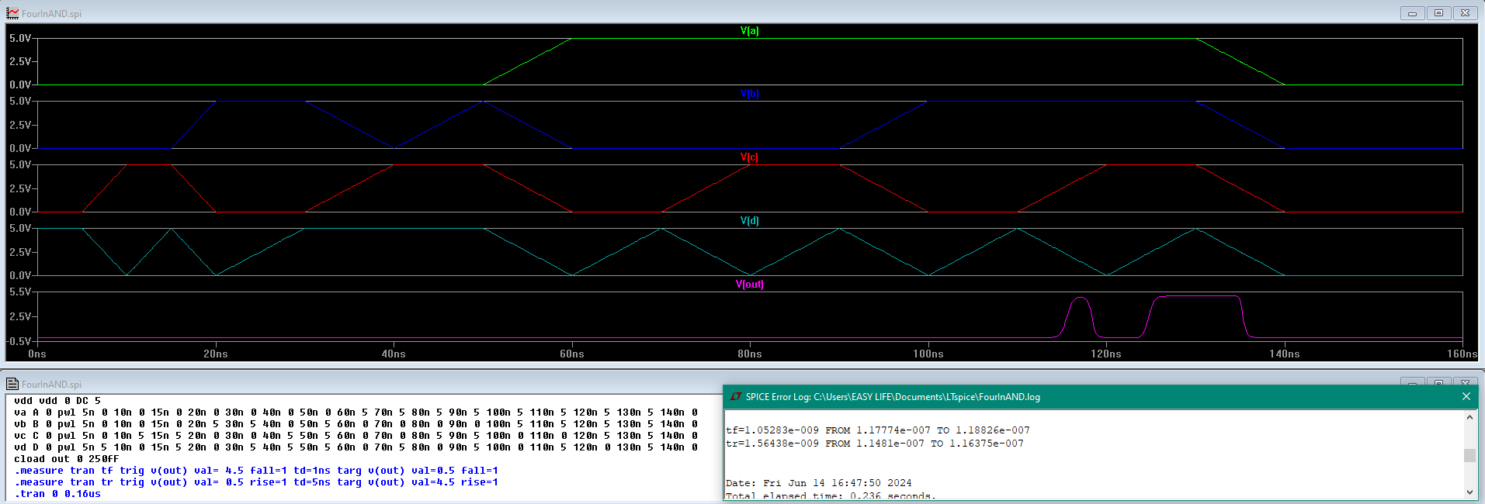
4-input AND

Slide 14
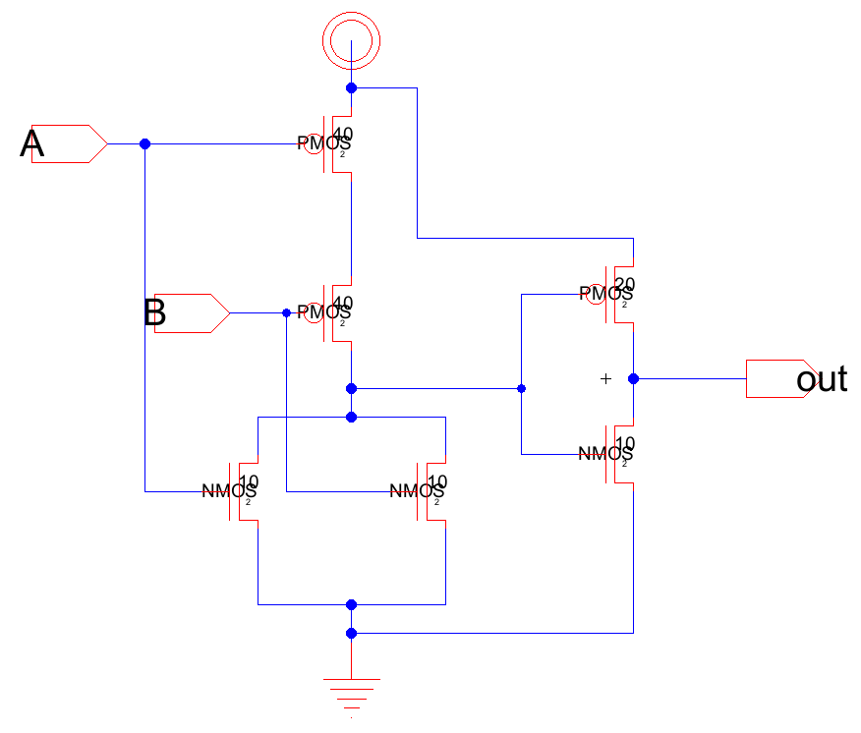
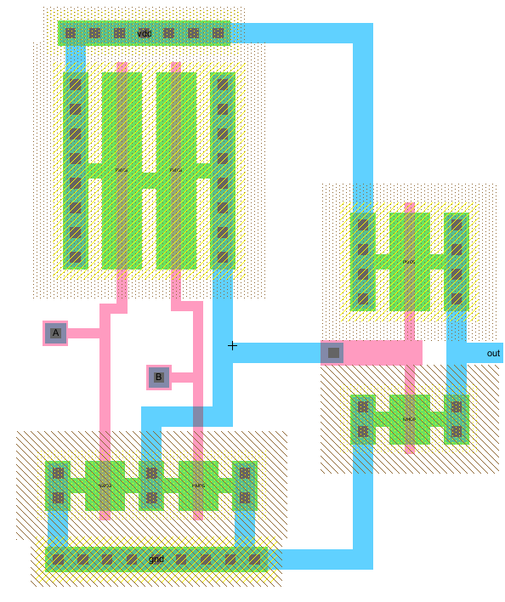
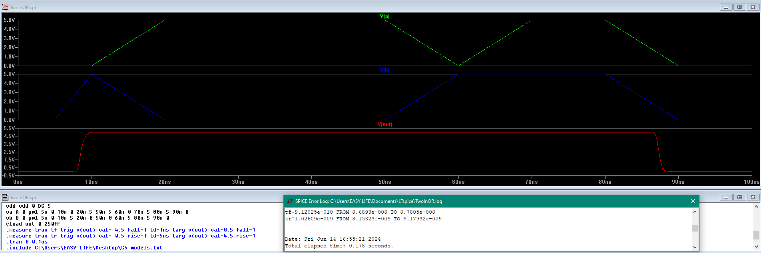
2-input OR

Slide 15
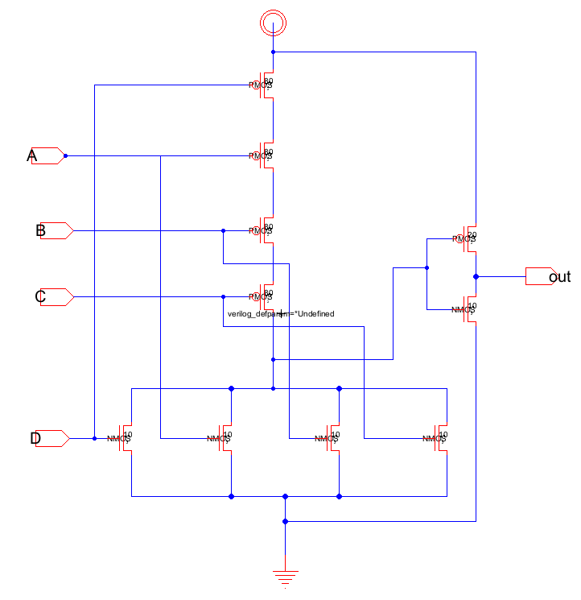
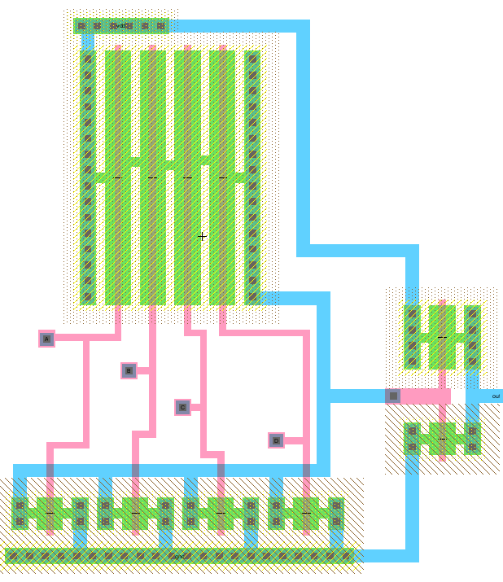
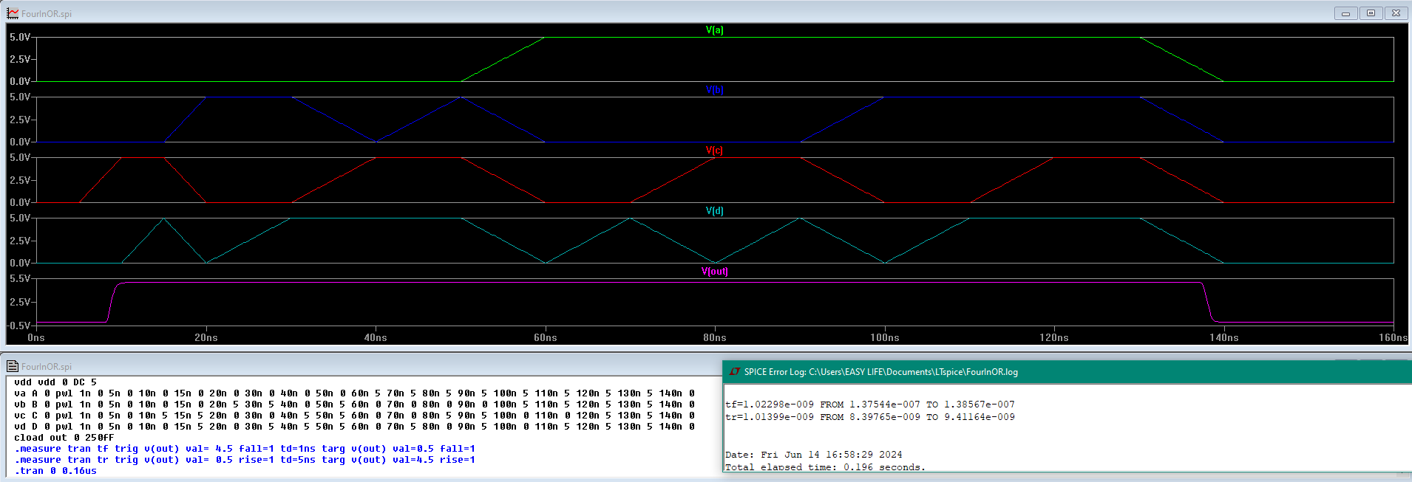
4-input OR

Slide 16
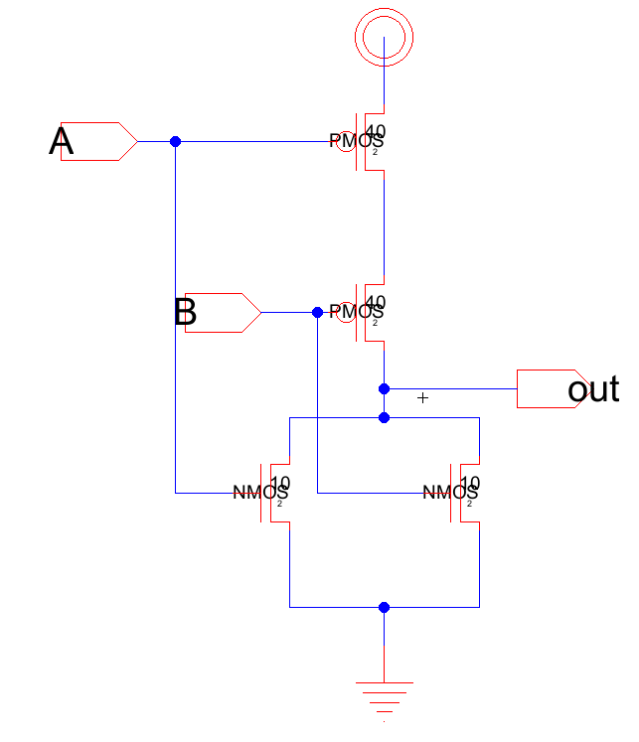
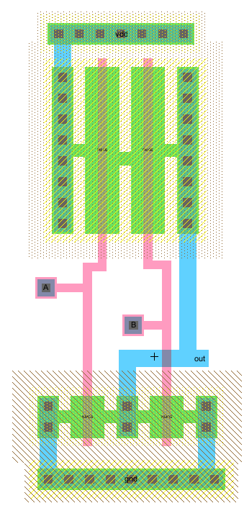
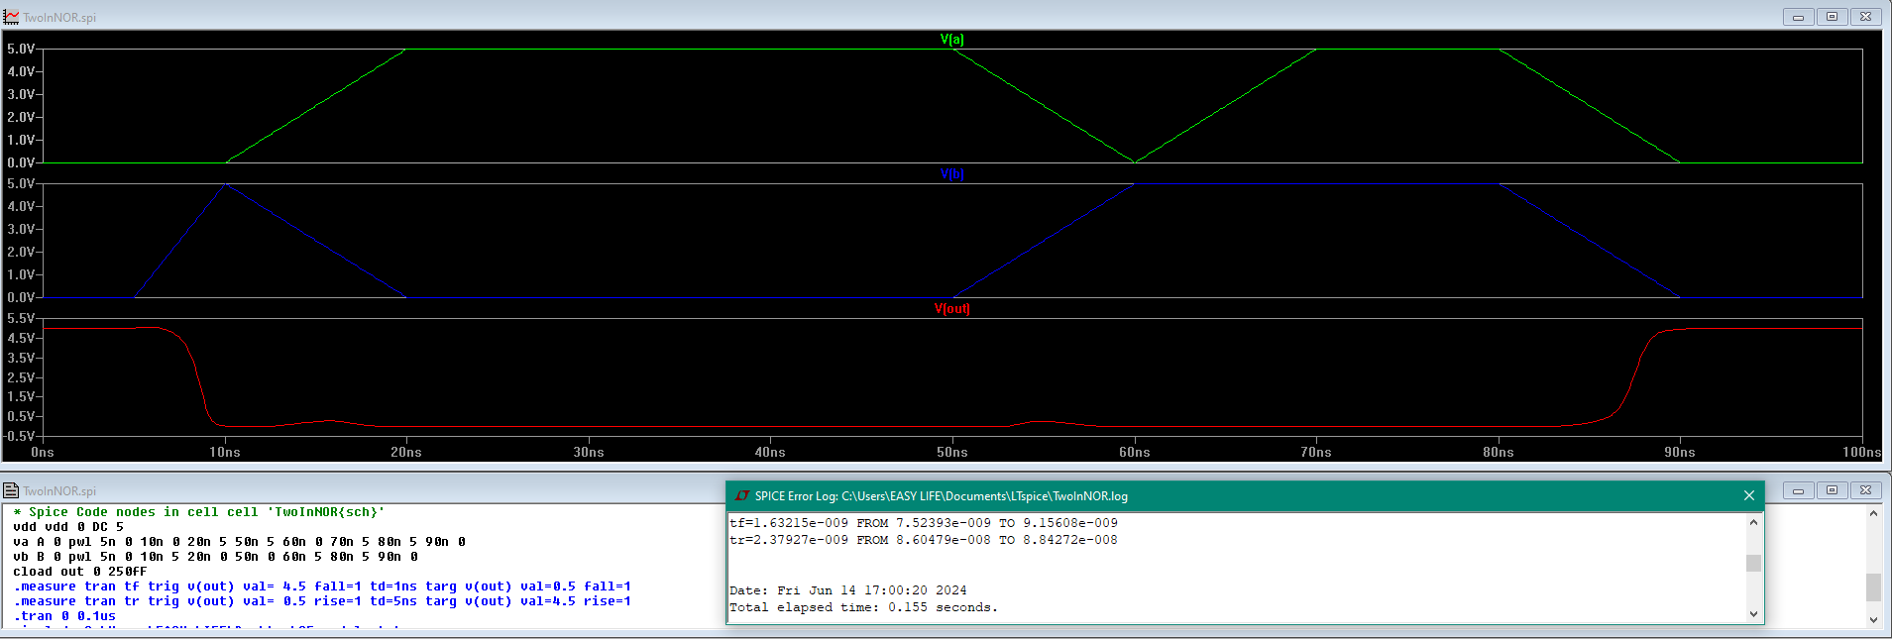
2-input NOR

Slide 17
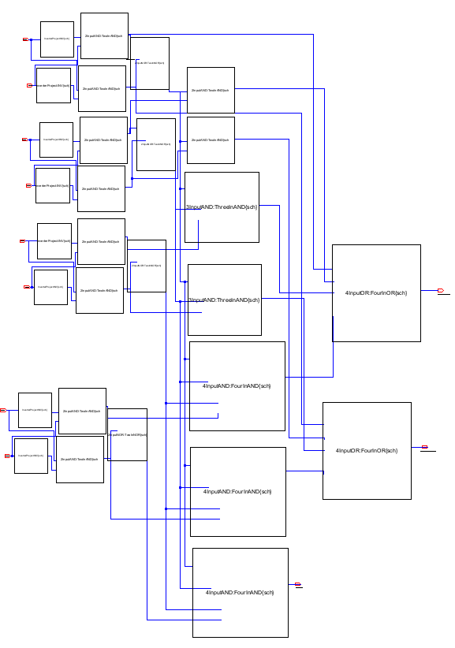
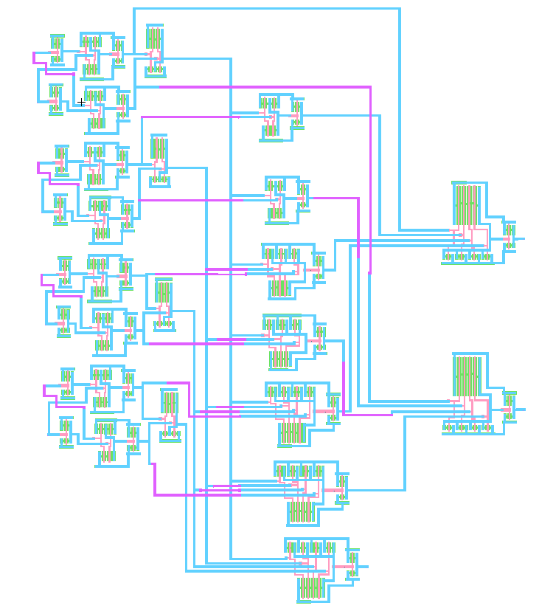
4x4 bits magnitude comparator

Slide 18
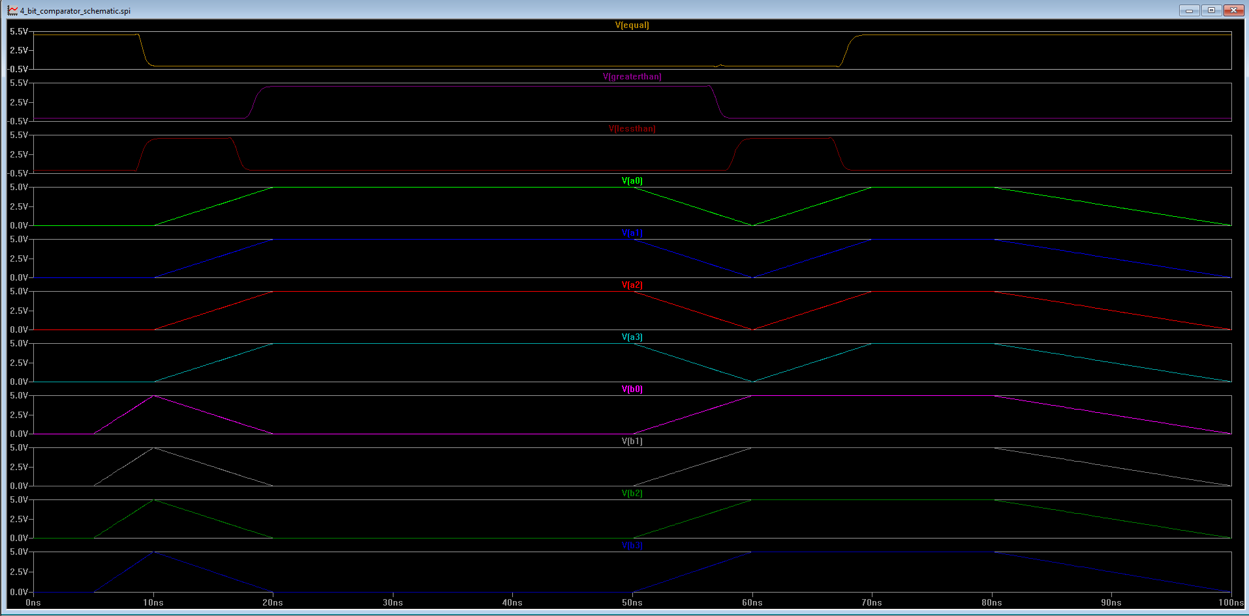
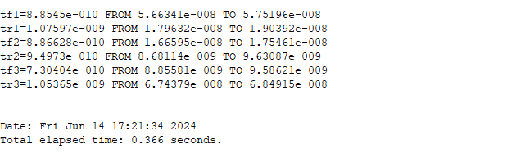
4x4 bits comparator simulation

Slide 19
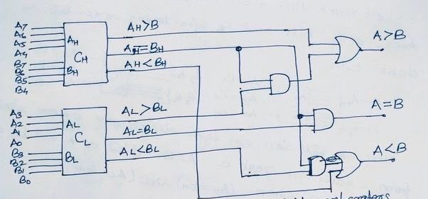
Comparator instancing

Slide 20
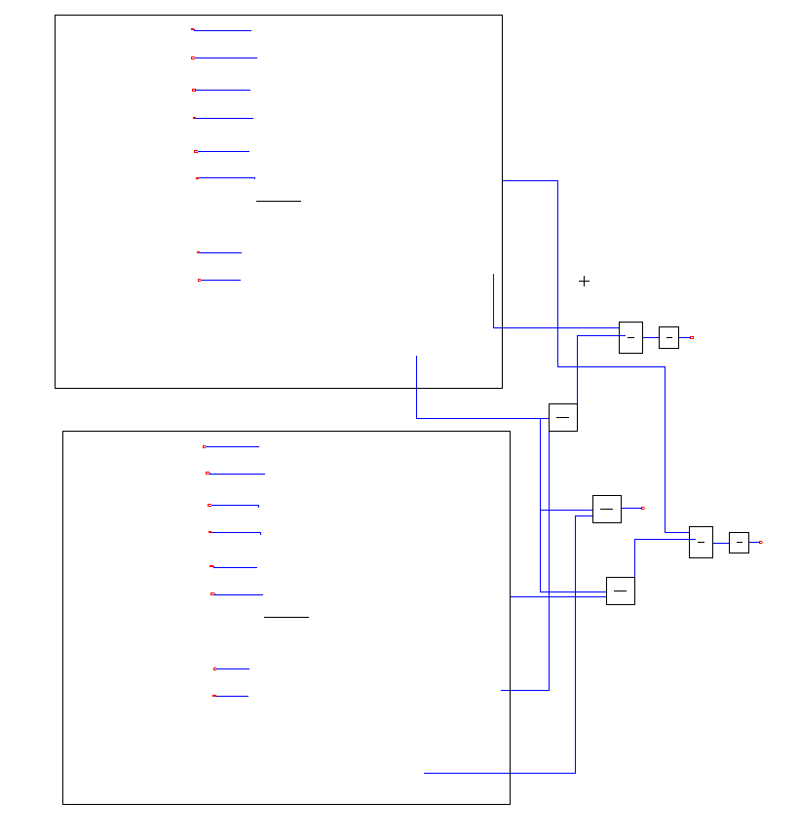
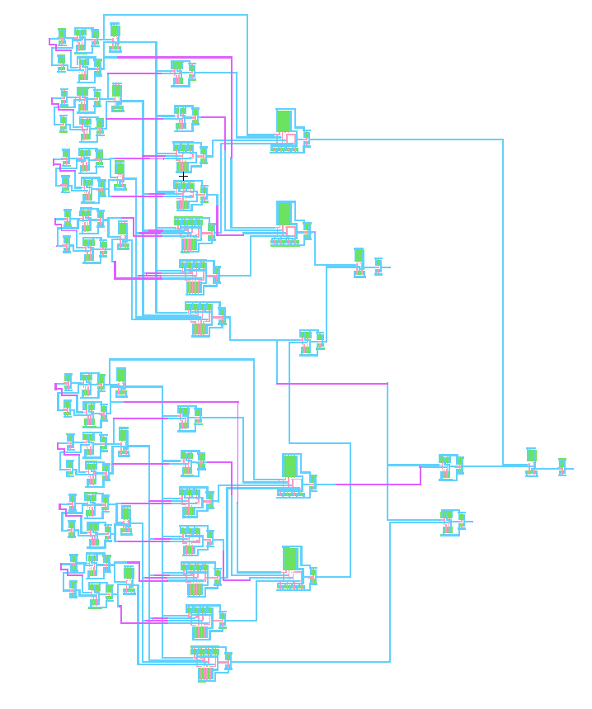
8x8 bits comparator made of two 4x4 bits comparators

Slide 21
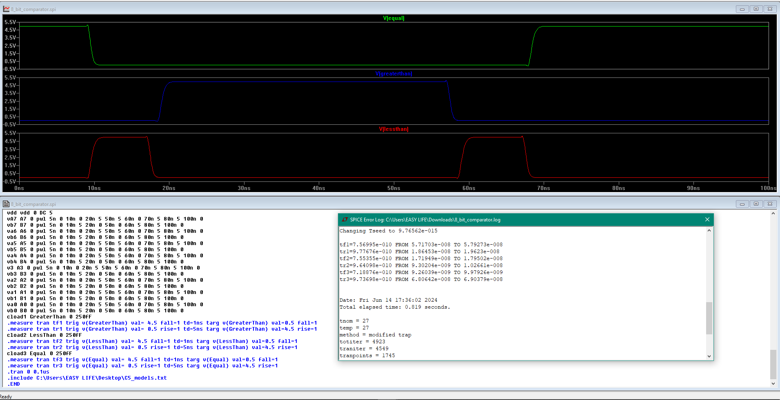
8x8 bits comparator made of two 4x4 bits comparators simulation

Slide 22
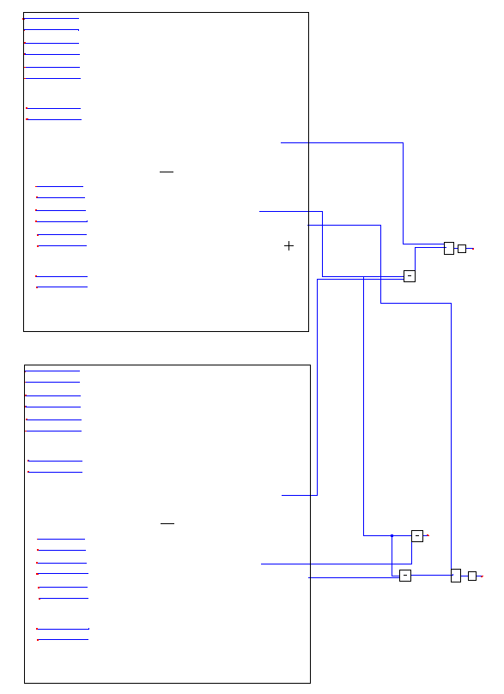
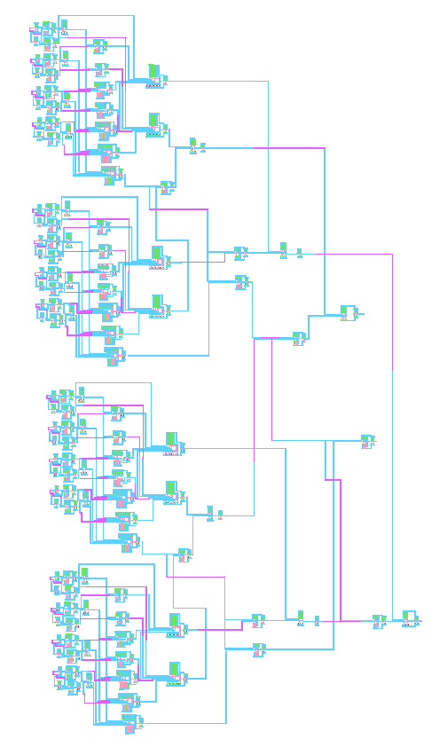
16x16 bits comparator made of two 8x8 bits comparators

Slide 23
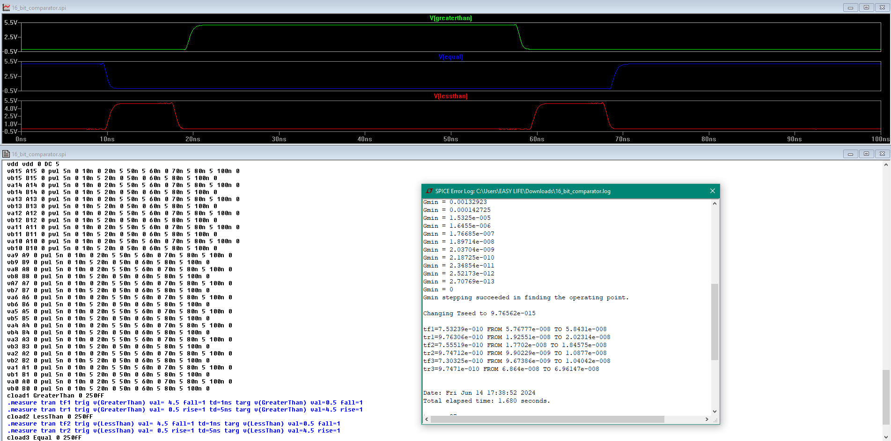
16x16 bits comparator made of two 8x8 bits comparators simulation

Slide 24
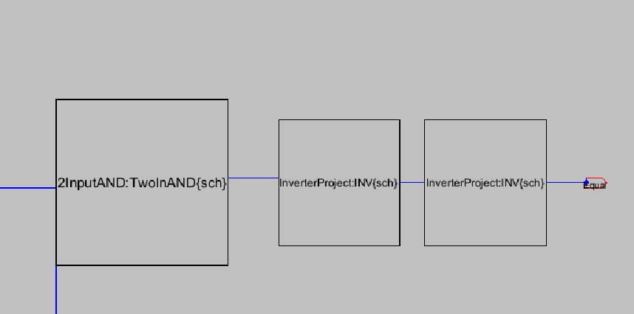
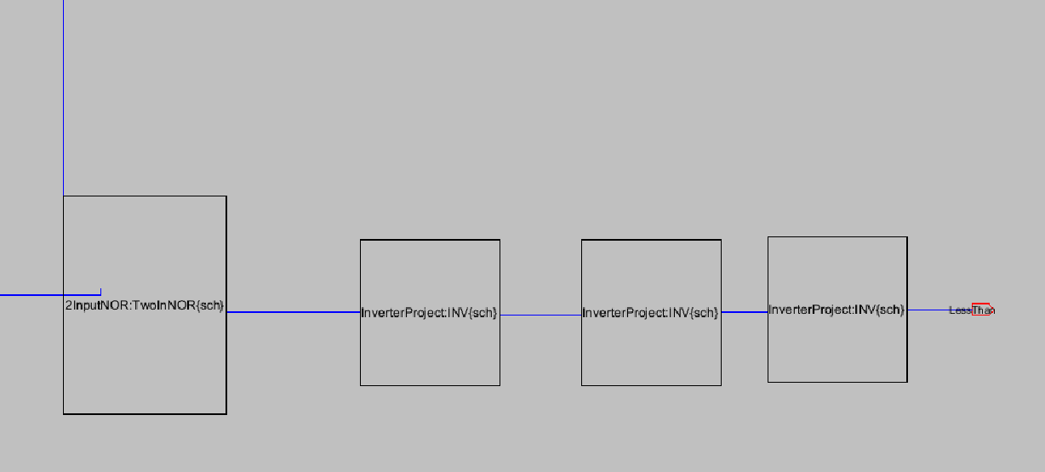
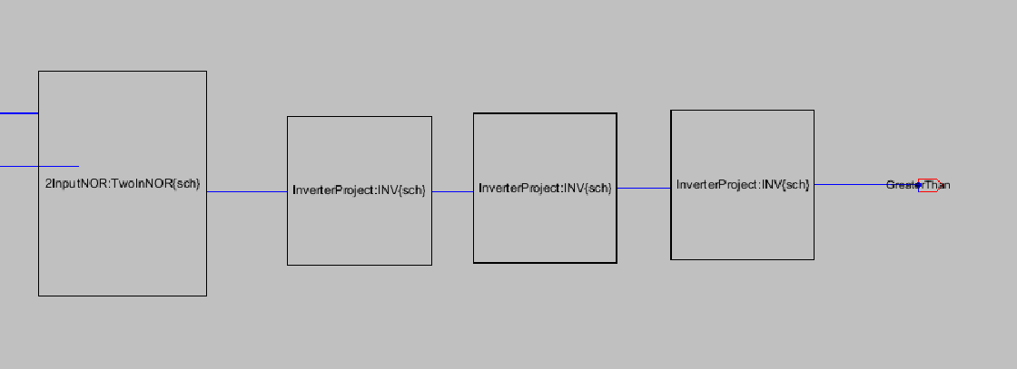
Adding buffers on outputs to enhance performance

Slide 25
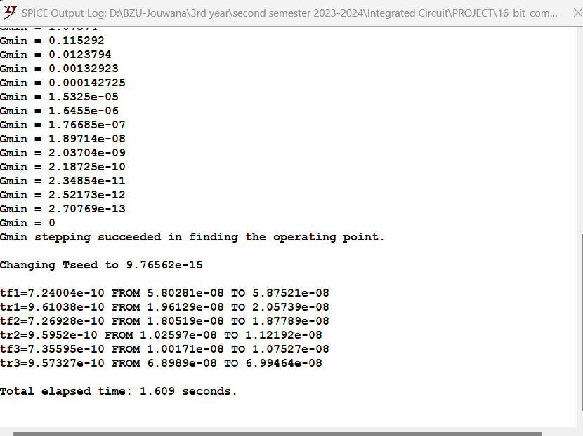
There is no difference in time when adding buffers on outputs. Therefore, they were removed to reduce the number of transistors, area and power while maintaining good speed

Slide 26
Number of transistors
logic | Number of transistors
Inverter | 2
2-input AND | 6
3-input AND | 8
4-input AND | 10
2-input OR | 6
2-input NOR | 4
4-input OR | 10
4 bits comparator | 158
8 bits comparator | 346
16 bits comparator | 722

Slide 27
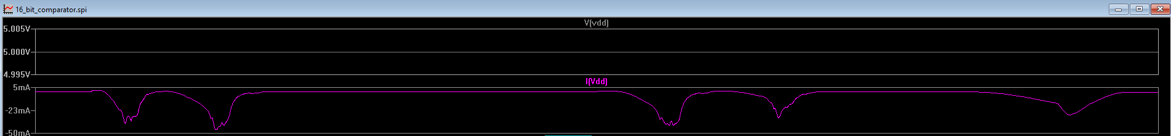
Hand Calculations
Power calculation:
Power = I * V ; from the simulation -> I(max) = 5mA , and our vdd = 5v,
Power = 5m * 5 = 5*10^-3 watt

Slide 28
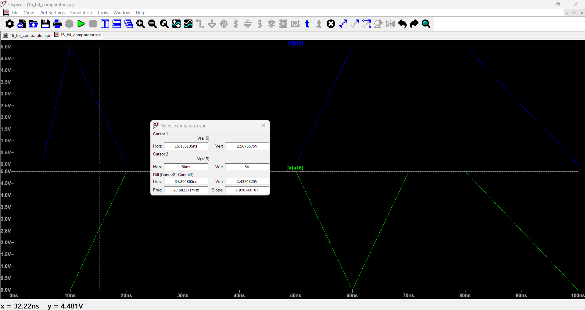
Propagation Delay :
The speed is determined by calculating the propagation delay of each output__GreaterThan, LessThan, and Equal. The propagation delay is
measured by taking the difference between the time when the input reaches 50% of its value and the time when the output reaches 50% of its value.
the time when the input reaches 50% of its value “2.5V” is almost 15ns.

Slide 29
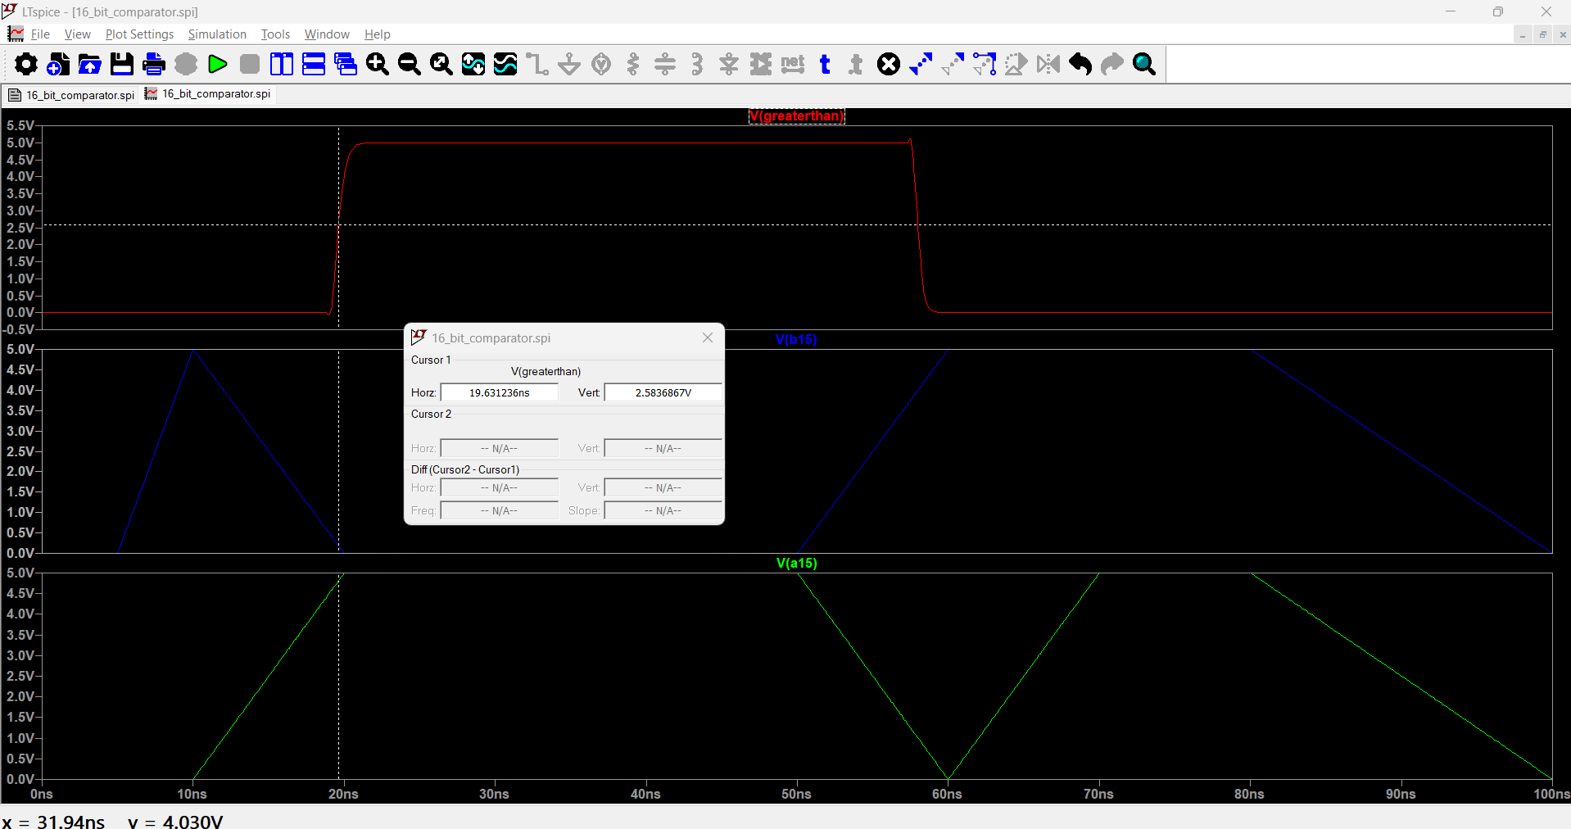
Speed for output GreaterThan A > B
The time when the GreaterThan output reaches 50% of its value is almost 19ns. Hence, the propagation delay is 19ns – 15ns = 4ns.

Slide 30
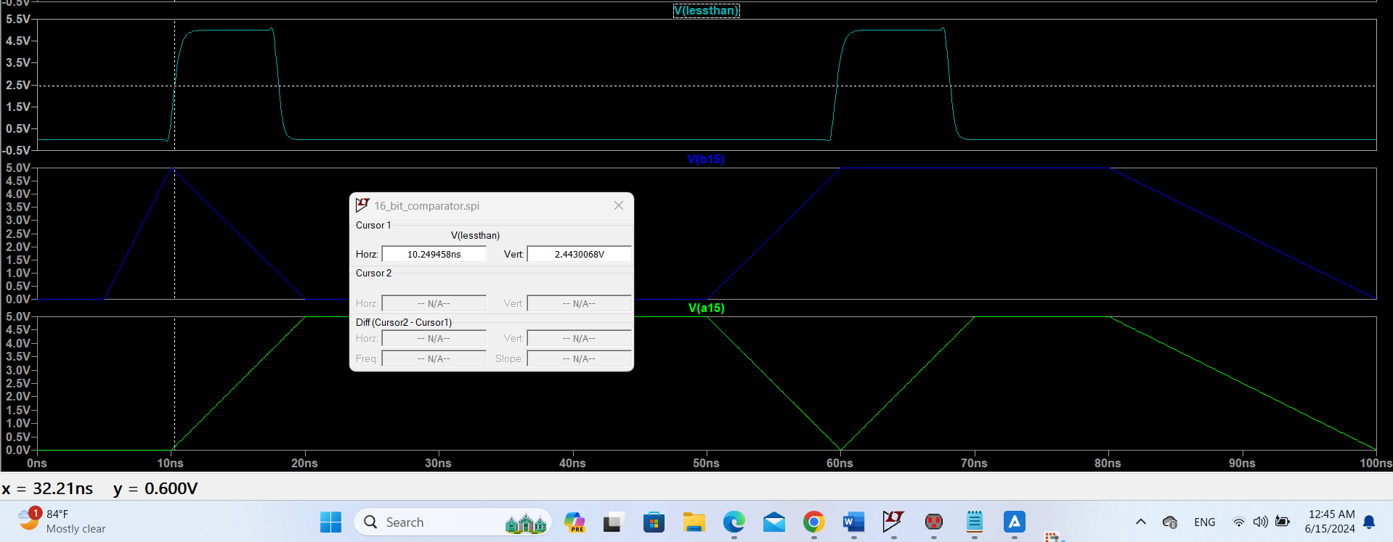
Speed for output LessThan A < B
The time when the LessThan output reaches 50% of its value is almost 10ns. Hence, the propagation delay is 15ns – 10ns = 5ns.

Slide 31
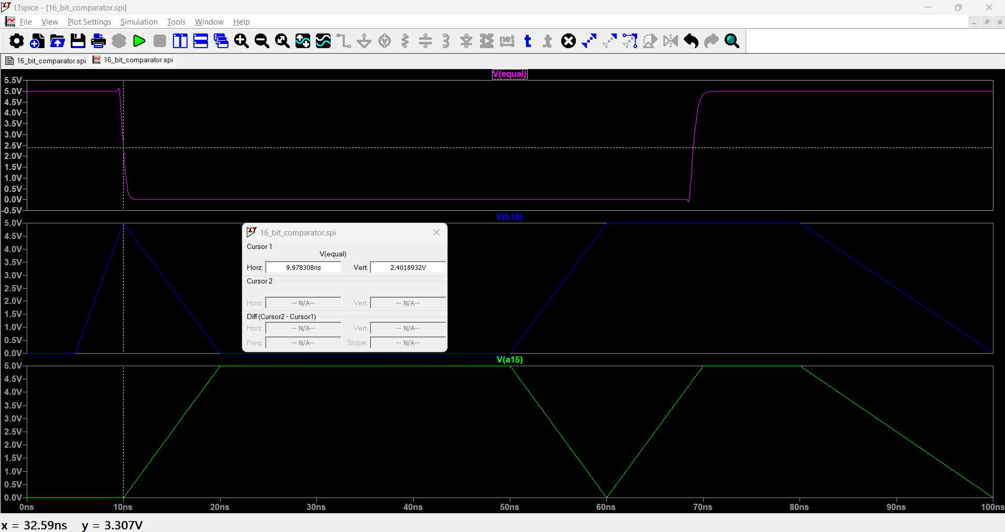
Speed for output Equal A = B
The time when the Equal output reaches 50% of its value is almost 10ns. Hence, the propagation delay is 15ns – 10ns = 5ns.

Slide 32
16x16 comparator speed performance conclusion
Hence, based on the calculated speed for each output: A > B, A < B and A = B, our 16x16 bit comparator appears to be fast, with a speed of 4-5ns.
Delay present in the conventional CMOS magnitude comparator is 13nsec whereas the delay produced by our High-Speed technique for magnitude comparator is 5ns which is our goal.

