Slide 1
Explorer
Portail développeurs Ressources, outils, et aide de la communauté
Marketplace Extension ou enrichissement des services AMPLIFY
APIs produits Documentation des produits Axway de type API, pour la gestion des écosystèmes numériques
Apprendre
Chaîne développeurs Vidéos sur les derniers frameworks, les meilleures pratiques et le code
Blog développeurs En savoir plus sur le développement d’applications mobiles, les APIs et la plate-forme AMPLIFY
Événements développeurs Organiser ou assister à une rencontre
Créer
API Builder Construire des applications mobiles multiplateformes avec Titanium Studio, SDK et CLI App Builder Construire et assembler des API et microservices avec une facilité sans précédent
Integration Builder Construire, déployer et gérer les intégrations en quelques minutes​
Central Controller la gestion de vos API, de vos flux et d’autres artefacts d’intégration
Unified Catalog Découvrir, tester, gérer ou s’abonner aux artefacts d’intégration, à partir d’un catalogue centralisé​
Developer Portal Resources, tools and community help
Marketplace Enhancements or extension for AMPLIFY services
Product APIs Documentation for Axway products with APIs for managing your digital ecosystems
Learn
Developer Channel Videos to keep up with the latest frameworks, best practices, and code
Developer Blog Read about Mobile apps development, APIs and the AMPLIFY platform
Developer Events Attend or host a meetup
Create
API Builder Building cross-platform mobile apps using Titanium Studio, SDK, and CLI​
App Builder Building and assembling APIs and microservices with unprecedented ease
Integration Builder Building, deployment and running of integrations in minutes​
Central Control plane for managing your APIs, flows, and other integration artifacts
Unified Catalog Discover, try, subscribe, and manage integration artifacts from a centralized catalog​
Inverted?

Slide 2
helpGet Help
Documentation Getting started guides, release notes, FAQs and more
Community Find or exchange tips, tricks and best practices
Support Portal Resolve issues, search knowledge base, and download latest product updates
Resources
AMPLIFY Overview open_in_new
Videos open_in_new
Webinars open_in_new
Blogs open_in_new
Asset Library open_in_new
Roadmaps open_in_new
Axway.com open_in_new
Assistance
Documentation Guides de démarrage, Release notes, FAQ et plus encore
Community Trouver ou échanger conseils, astuces et bonnes pratiques
Support Portal Résoudre les problèmes, exploiter la base de connaissances, ou télécharger les dernières mises à jour de produits
Ressources
Présentation d'AMPLIFY
Vidéos
Webinars
Blogs
Bibliothèque Roadmaps
Axway.com
Ou bien: Feuilles de route
Ou bien: Séminaires en ligne

Slide 3
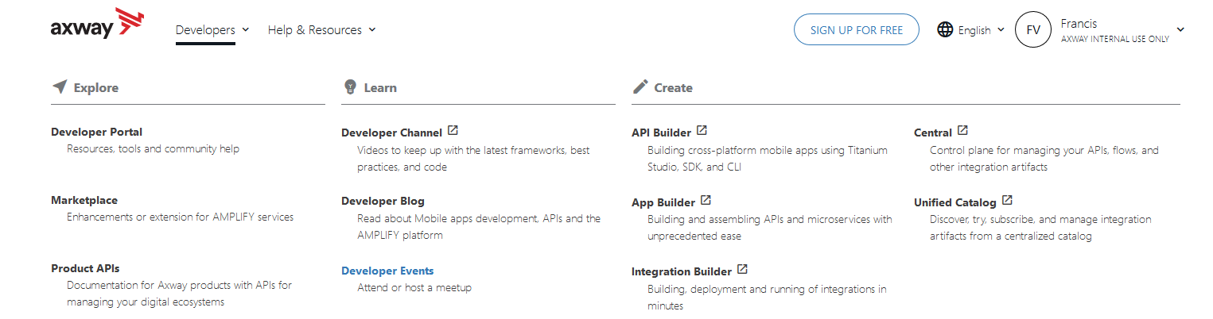
Comments and suggestions
I think it’s a pity to cut the menu in 2
Particularly as both Community and Doc contain a lot of resources for developers
I think everything can fit in nicely if we try
In Create, some are links to cloud products, others point to installation guides. I think this should be clear before you click.

Slide 4
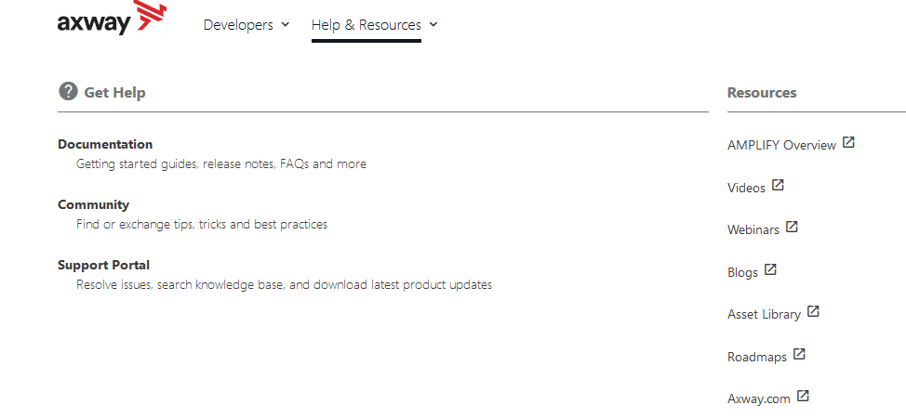
Documentation and Community are of interest to developers too

Slide 5
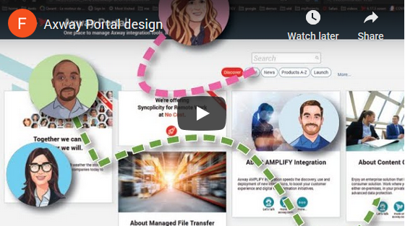
If you are interested in sharing and exchanging on this subject, I have a few ideas.
Below is a design for an exploration portal. I think some ideas merge with the header.
Video (3 minutes)
Ping me any time: Francis Vila
Prototype (requires Axway VPN access): http://10.128.58.228/axwayPlatform/#
Jive page: https://axway.jiveon.com/groups/techpubs/blog/2020/05/04/yet-another-hackathon-submission

Slide 6












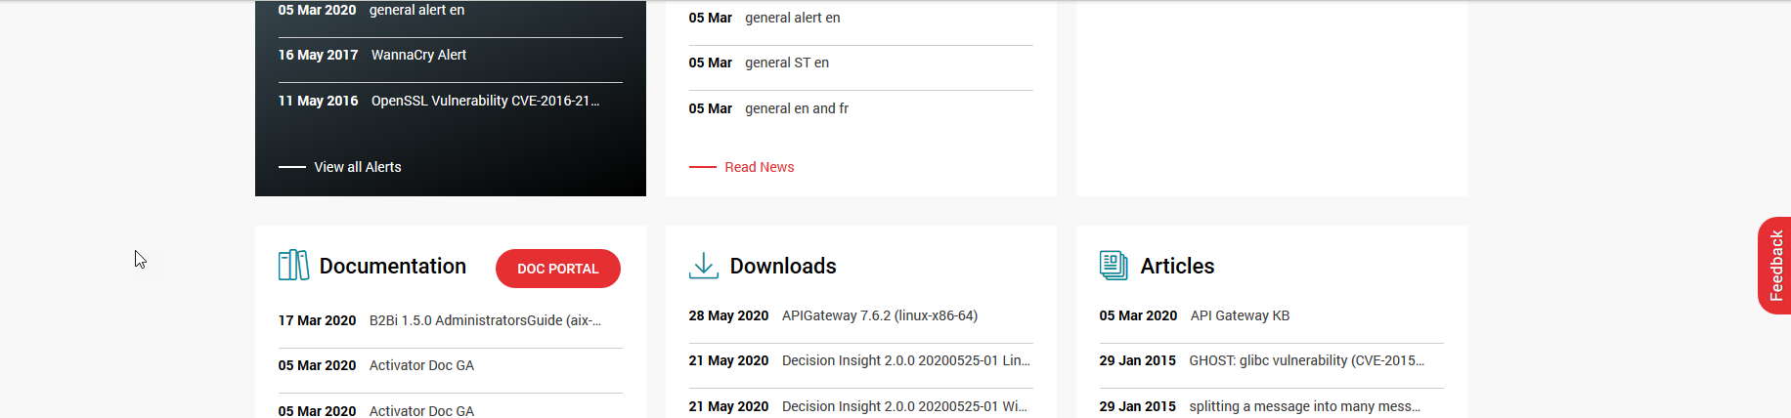
Support Portal
Marketplace
Developer Portal
Integration Builder
Report an issue
AMPLIFY Overview
Tech doc
Developer Channel
Central
Setup your dev tools
Videos
Community
Developer Blogs
Dashboard
Enroll to a training
Webinars
Support Portal
Developer Events
Flow Manager
Find an add-on
Blogs
Axway U
We love developers…
Unified Catalog
More actions…
Asset Library
Syncplicity
Roadmaps
Get started with Axway portals…
More Axway products…
More Resources…

Slide 7


Support Portal
Marketplace
Developer Portal
Integration Builder
Central
Report an issue
AMPLIFY Overview
Tech doc
Developer Channel
App Builder
Dashboard
Start a free trial
Videos
Install guides, used only once
Just installed it, called AppCelerator studio
API Builder
Flow Manager
Enroll to a training
Webinars
Community
Developer Blogs
Support Portal
Developer Events
Create with Axway…
Unified Catalog
Find an add-on
Blogs
Get started with Axway portals…
We love developers…
Syncplicity
More actions…
Asset Library
Manage & Share…
Roadmaps
More Resources…

Slide 8
Support Portal
Marketplace
Developer Portal
Integration Builder
Central
Report an issue
AMPLIFY Overview
Tech doc
Developer Channel
App Builder
Dashboard
Start a free trial
Videos
Community
Developer Blogs
API Builder
Flow Manager
Enroll to a training
Webinars
Why these products and not API Manager, Gateway…
Support Portal
Developer Events
Create with Axway…
Unified Catalog
Find an add-on
Blogs
Get started with Axway portals…
We love developers…
Syncplicity
More actions…
Asset Library
Manage & Share…
Roadmaps
More Resources…
Is it because App Builder comes from Appcelerator?

Slide 9
Support Portal
Marketplace
Developer Portal
Integration Builder
Central
Report an issue
AMPLIFY Overview
Tech doc
Developer Channel
App Builder
Dashboard
Start a free trial
Videos
Community
Developer Blogs
API Builder
Flow Manager
Enroll to a training
Webinars
Support Portal
Developer Events
Create with Axway…
Unified Catalog
Find an add-on
Blogs
Get started with Axway portals…
We love developers…
Syncplicity
More actions…
Asset Library
Manage & Share…
Roadmaps
More Resources…

Slide 10

Support Portal
Marketplace
Developer Portal
Integration Builder
Central
Report an issue
AMPLIFY Overview
Tech doc
Developer Channel
App Builder
Dashboard
Start a free trial
Videos
Community
Developer Blogs
API Builder
Flow Manager
Enroll to a training
Webinars
Support Portal
Developer Events
Unified Catalog
Find an add-on
Blogs
Create with Axway…
Syncplicity
Asset Library
Get started with Axway portals…
We love developers…
More actions…
Roadmaps
Manage & Share…
More Resources…

Slide 11


Support Portal
Integration Builder
Developer Portal
App Builder
Developer Channel
API Builder
Developer Blogs
Create with Axway…
Developer Events

