Slide 1
Explorer
Portail développeurs Ressources, outils, et aide de la communauté
Marketplace Extension ou enrichissement des services AMPLIFY
APIs produits Documentation des produits Axway de type API, pour la gestion des écosystèmes numériques
Apprendre
Chaîne développeurs Vidéos sur les derniers frameworks, les meilleures pratiques et le code
Blog développeurs En savoir plus sur le développement d’applications mobiles, les APIs et la plate-forme AMPLIFY
Événements développeurs Organiser ou assister à une rencontre
Créer
API Builder Construire des applications mobiles multiplateformes avec Titanium Studio, SDK et CLI App Builder Construire et assembler des API et microservices avec une facilité sans précédent
Integration Builder Construire, déployer et gérer les intégrations en quelques minutes​
Central Controller la gestion de vos API, de vos flux et d’autres artefacts d’intégration
Unified Catalog Découvrir, tester, gérer ou s’abonner aux artefacts d’intégration, à partir d’un catalogue centralisé​
Developer Portal Resources, tools and community help
Marketplace Enhancements or extension for AMPLIFY services
Product APIs Documentation for Axway products with APIs for managing your digital ecosystems
Learn
Developer Channel Videos to keep up with the latest frameworks, best practices, and code
Developer Blog Read about Mobile apps development, APIs and the AMPLIFY platform
Developer Events Attend or host a meetup
Create
API Builder Building cross-platform mobile apps using Titanium Studio, SDK, and CLI​
App Builder Building and assembling APIs and microservices with unprecedented ease
Integration Builder Building, deployment and running of integrations in minutes​
Central Control plane for managing your APIs, flows, and other integration artifacts
Unified Catalog Discover, try, subscribe, and manage integration artifacts from a centralized catalog​
Inverted?

Slide 2
helpGet Help
DocumentationGetting started guides, release notes, FAQs and more
CommunityFind or exchange tips, tricks and best practices
Support PortalResolve issues, search knowledge base, and download latest product updates
Resources
AMPLIFY Overviewopen_in_new
Videosopen_in_new
Webinarsopen_in_new
Blogsopen_in_new
Asset Libraryopen_in_new
Roadmapsopen_in_new
Axway.comopen_in_new
Assistance
Documentation Guides de démarrage, Release notes, FAQ et plus encore
Community Trouver ou échanger conseils, astuces et bonnes pratiques
Support Portal Résoudre les problèmes, exploiter la base de connaissances, ou télécharger les dernières mises à jour de produits
Ressources
Présentation d'AMPLIFY
Vidéos
Webinars
Blogs
Bibliothèque Roadmaps
Axway.com
Ou bien: Feuilles de route
Ou bien: Séminaires en ligne

Slide 3
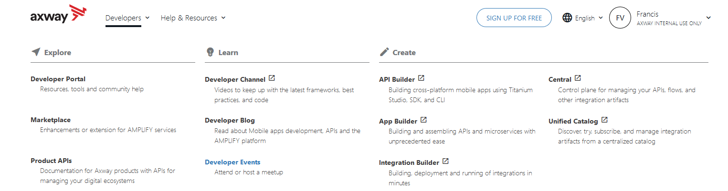
Comments and suggestions
I think it’s a pity to cut the menu in 2
Particularly as both Community and Doc contain a lot of resources for developers
I think everything can fit in nicely with a bit of work
In Create, some are links to cloud products, others point to installation guides. I think this should be clear before you click.

Slide 4
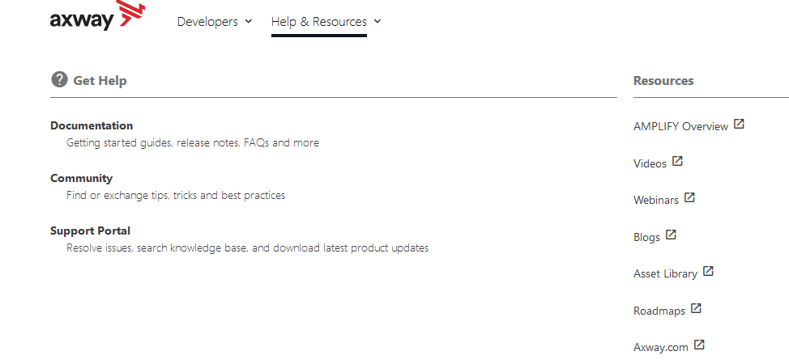
Documentation and Community are of interest to developers too

Slide 5
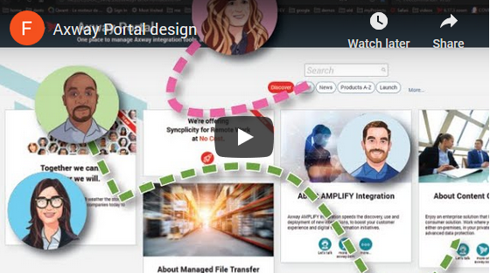
If you are interested in sharing and exchanging on this subject, I have a few ideas.
Below is a design for an exploration portal. I think some ideas merge with the header.
Video (3 minutes)
Ping me any time: Francis Vila
Prototype (requires Axway VPN access): http://10.128.58.228/axwayPlatform/#
Jive page: https://axway.jiveon.com/groups/techpubs/blog/2020/05/04/yet-another-hackathon-submission

