Slide 1
GEN5.4 / EVENT-CONDITIONED RESEARCH
Issuer information cycles are reproducible
E0 constructs the observable news tape before any price, outcome, sentiment, or model join.
Notes:
Opening claim: E0 establishes a leakage-safe construction layer only. It does not claim predictability.
Dialogue reference: D45 — codex://threads/019f741e-615f-7fd0-90f7-edce12b5cb66
[Sources]
- C:/Users/Franc/OneDrive/Documents/Francis/Peltata Project/Time-Series-Modeling-Gen5/docs/GEN5_4_EVENT_CONSTRUCTION_E0_CONTRACT.md
- C:/Users/Franc/OneDrive/Documents/Francis/Peltata Project/Time-Series-Modeling-Gen5/runs/research_workbench/gen54_ml_decision_engine/g54_event_e0_20260726/e0_report.md
[/Sources]

Slide 2
GEN5.4 / E0 CONSTRUCTION
Call it an information cycle—not a semantic event
One observable unit
Why this wording matters
issuer × scheduled 17:30 ET decision
Same-day articles may concern different real-world happenings.
E0 preserves their timestamps and issuer association without pretending they form one coherent semantic story.
That keeps construction observable and postpones interpretation.
All admissible, novel article clusters known for that issuer are aggregated at the decision cutoff.
Notes:
The unit is intentionally operational. Semantic clustering would introduce an additional modeling choice that has not been opened.
Dialogue reference: D45 — codex://threads/019f741e-615f-7fd0-90f7-edce12b5cb66
[Sources]
- C:/Users/Franc/OneDrive/Documents/Francis/Peltata Project/Time-Series-Modeling-Gen5/docs/GEN5_4_EVENT_CONSTRUCTION_E0_CONTRACT.md
[/Sources]

Slide 3
GEN5.4 / E0 CONSTRUCTION
The cutoff makes admissibility a point-in-time fact
Historical E0 uses updated_at; prospective authority must use local receipt time.
article created
article updated
17:30 ET
next open
descriptive only
historical availability
decision cutoff
earliest execution
Maximum update delay: 24h | Backward-only exact-title repeat exclusion: 72h
Notes:
Availability and execution timing are frozen before any price-response theory is opened.
Dialogue reference: D45 — codex://threads/019f741e-615f-7fd0-90f7-edce12b5cb66
[Sources]
- C:/Users/Franc/OneDrive/Documents/Francis/Peltata Project/Time-Series-Modeling-Gen5/docs/GEN5_4_EVENT_CONSTRUCTION_E0_CONTRACT.md
- C:/Users/Franc/OneDrive/Documents/Francis/Peltata Project/Time-Series-Modeling-Gen5/R/gen54_event_construction_e0.R
[/Sources]

Slide 4
GEN5.4 / E0 CONSTRUCTION
Raw-page replay exactly reproduces accepted authority
698
34,871
49,590
49,590
cached raw pages
raw articles
admitted article-issuer associations
exactly reproduced keys
The derived tape can be rebuilt from provider evidence. No derived CSV is trusted as self-authenticating authority.
Notes:
The exact-match gate compares article ID, issuer, decision session, and exact-title cluster ID.
Dialogue reference: D46 — codex://threads/019f741e-615f-7fd0-90f7-edce12b5cb66
[Sources]
- C:/Users/Franc/OneDrive/Documents/Francis/Peltata Project/Time-Series-Modeling-Gen5/runs/research_workbench/gen54_ml_decision_engine/g54_event_e0_20260726/e0_run_spec.csv
- C:/Users/Franc/OneDrive/Documents/Francis/Peltata Project/Time-Series-Modeling-Gen5/runs/research_workbench/gen54_ml_decision_engine/g54_event_e0_20260726/e0_integrity_audit.csv
- C:/Users/Franc/OneDrive/Documents/Francis/Peltata Project/Time-Series-Modeling-Gen5/runs/research_workbench/gen54_ml_decision_engine/g54_event_e0_20260726/e0_report.md
[/Sources]

Slide 5
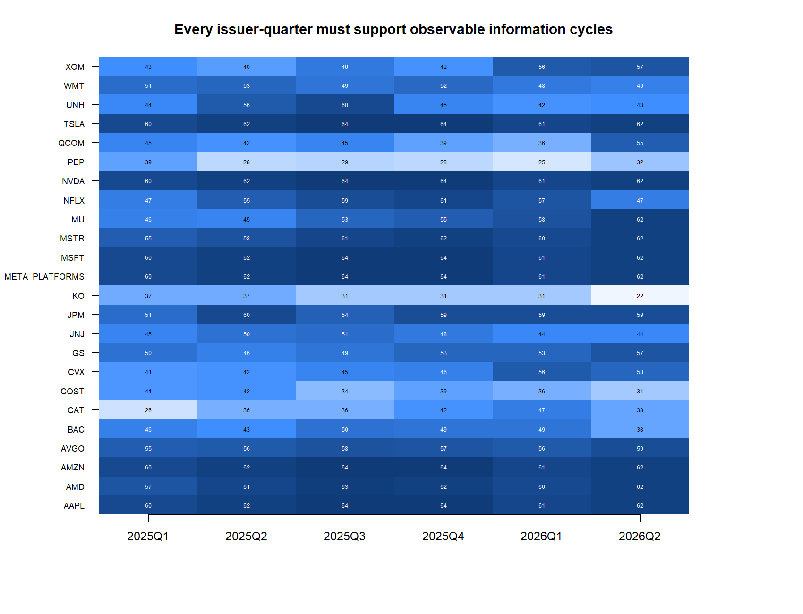
GEN5.4 / E0 CONSTRUCTION
Every issuer-quarter has usable construction support
22
minimum cycles in any issuer-quarter
Gate required ≥5.
Observed panel: 24 issuers × 6 quarters.
Notes:
Coverage is a construction-sufficiency result, not statistical power for a predictive model.
Dialogue reference: D46 — codex://threads/019f741e-615f-7fd0-90f7-edce12b5cb66
[Sources]
- C:/Users/Franc/OneDrive/Documents/Francis/Peltata Project/Time-Series-Modeling-Gen5/runs/research_workbench/gen54_ml_decision_engine/g54_event_e0_20260726/e0_issuer_quarter_coverage.csv
- C:/Users/Franc/OneDrive/Documents/Francis/Peltata Project/Time-Series-Modeling-Gen5/runs/research_workbench/gen54_ml_decision_engine/g54_event_e0_20260726/visuals/e0_issuer_quarter_coverage.png
[/Sources]

Slide 6
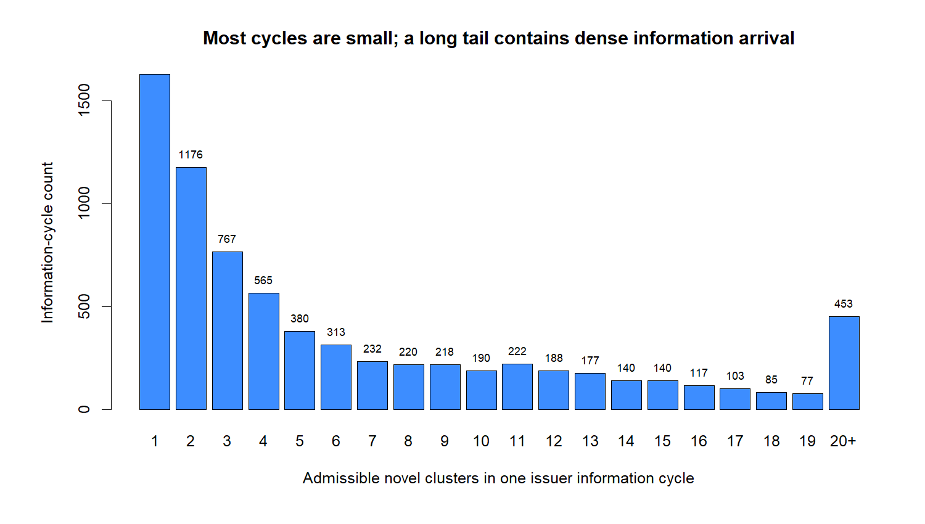
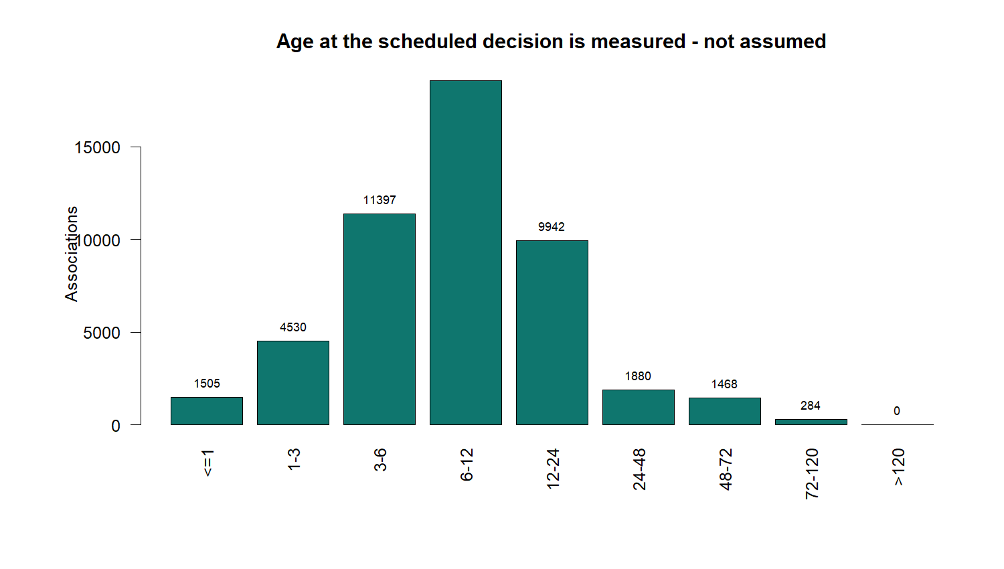
GEN5.4 / E0 CONSTRUCTION
The tape contains both sparse and dense information arrival
Most cycles are small; a long tail is news-dense.
Most admitted associations are 3–24 hours old at decision.
Notes:
These are descriptive construction diagnostics. They do not connect information arrival to later returns.
Dialogue reference: D46 — codex://threads/019f741e-615f-7fd0-90f7-edce12b5cb66
[Sources]
- C:/Users/Franc/OneDrive/Documents/Francis/Peltata Project/Time-Series-Modeling-Gen5/runs/research_workbench/gen54_ml_decision_engine/g54_event_e0_20260726/e0_information_cycles.csv
- C:/Users/Franc/OneDrive/Documents/Francis/Peltata Project/Time-Series-Modeling-Gen5/runs/research_workbench/gen54_ml_decision_engine/g54_event_e0_20260726/e0_admissible_associations.csv
- C:/Users/Franc/OneDrive/Documents/Francis/Peltata Project/Time-Series-Modeling-Gen5/runs/research_workbench/gen54_ml_decision_engine/g54_event_e0_20260726/visuals/e0_cycle_intensity.png
- C:/Users/Franc/OneDrive/Documents/Francis/Peltata Project/Time-Series-Modeling-Gen5/runs/research_workbench/gen54_ml_decision_engine/g54_event_e0_20260726/visuals/e0_article_age_at_decision.png
[/Sources]

Slide 7
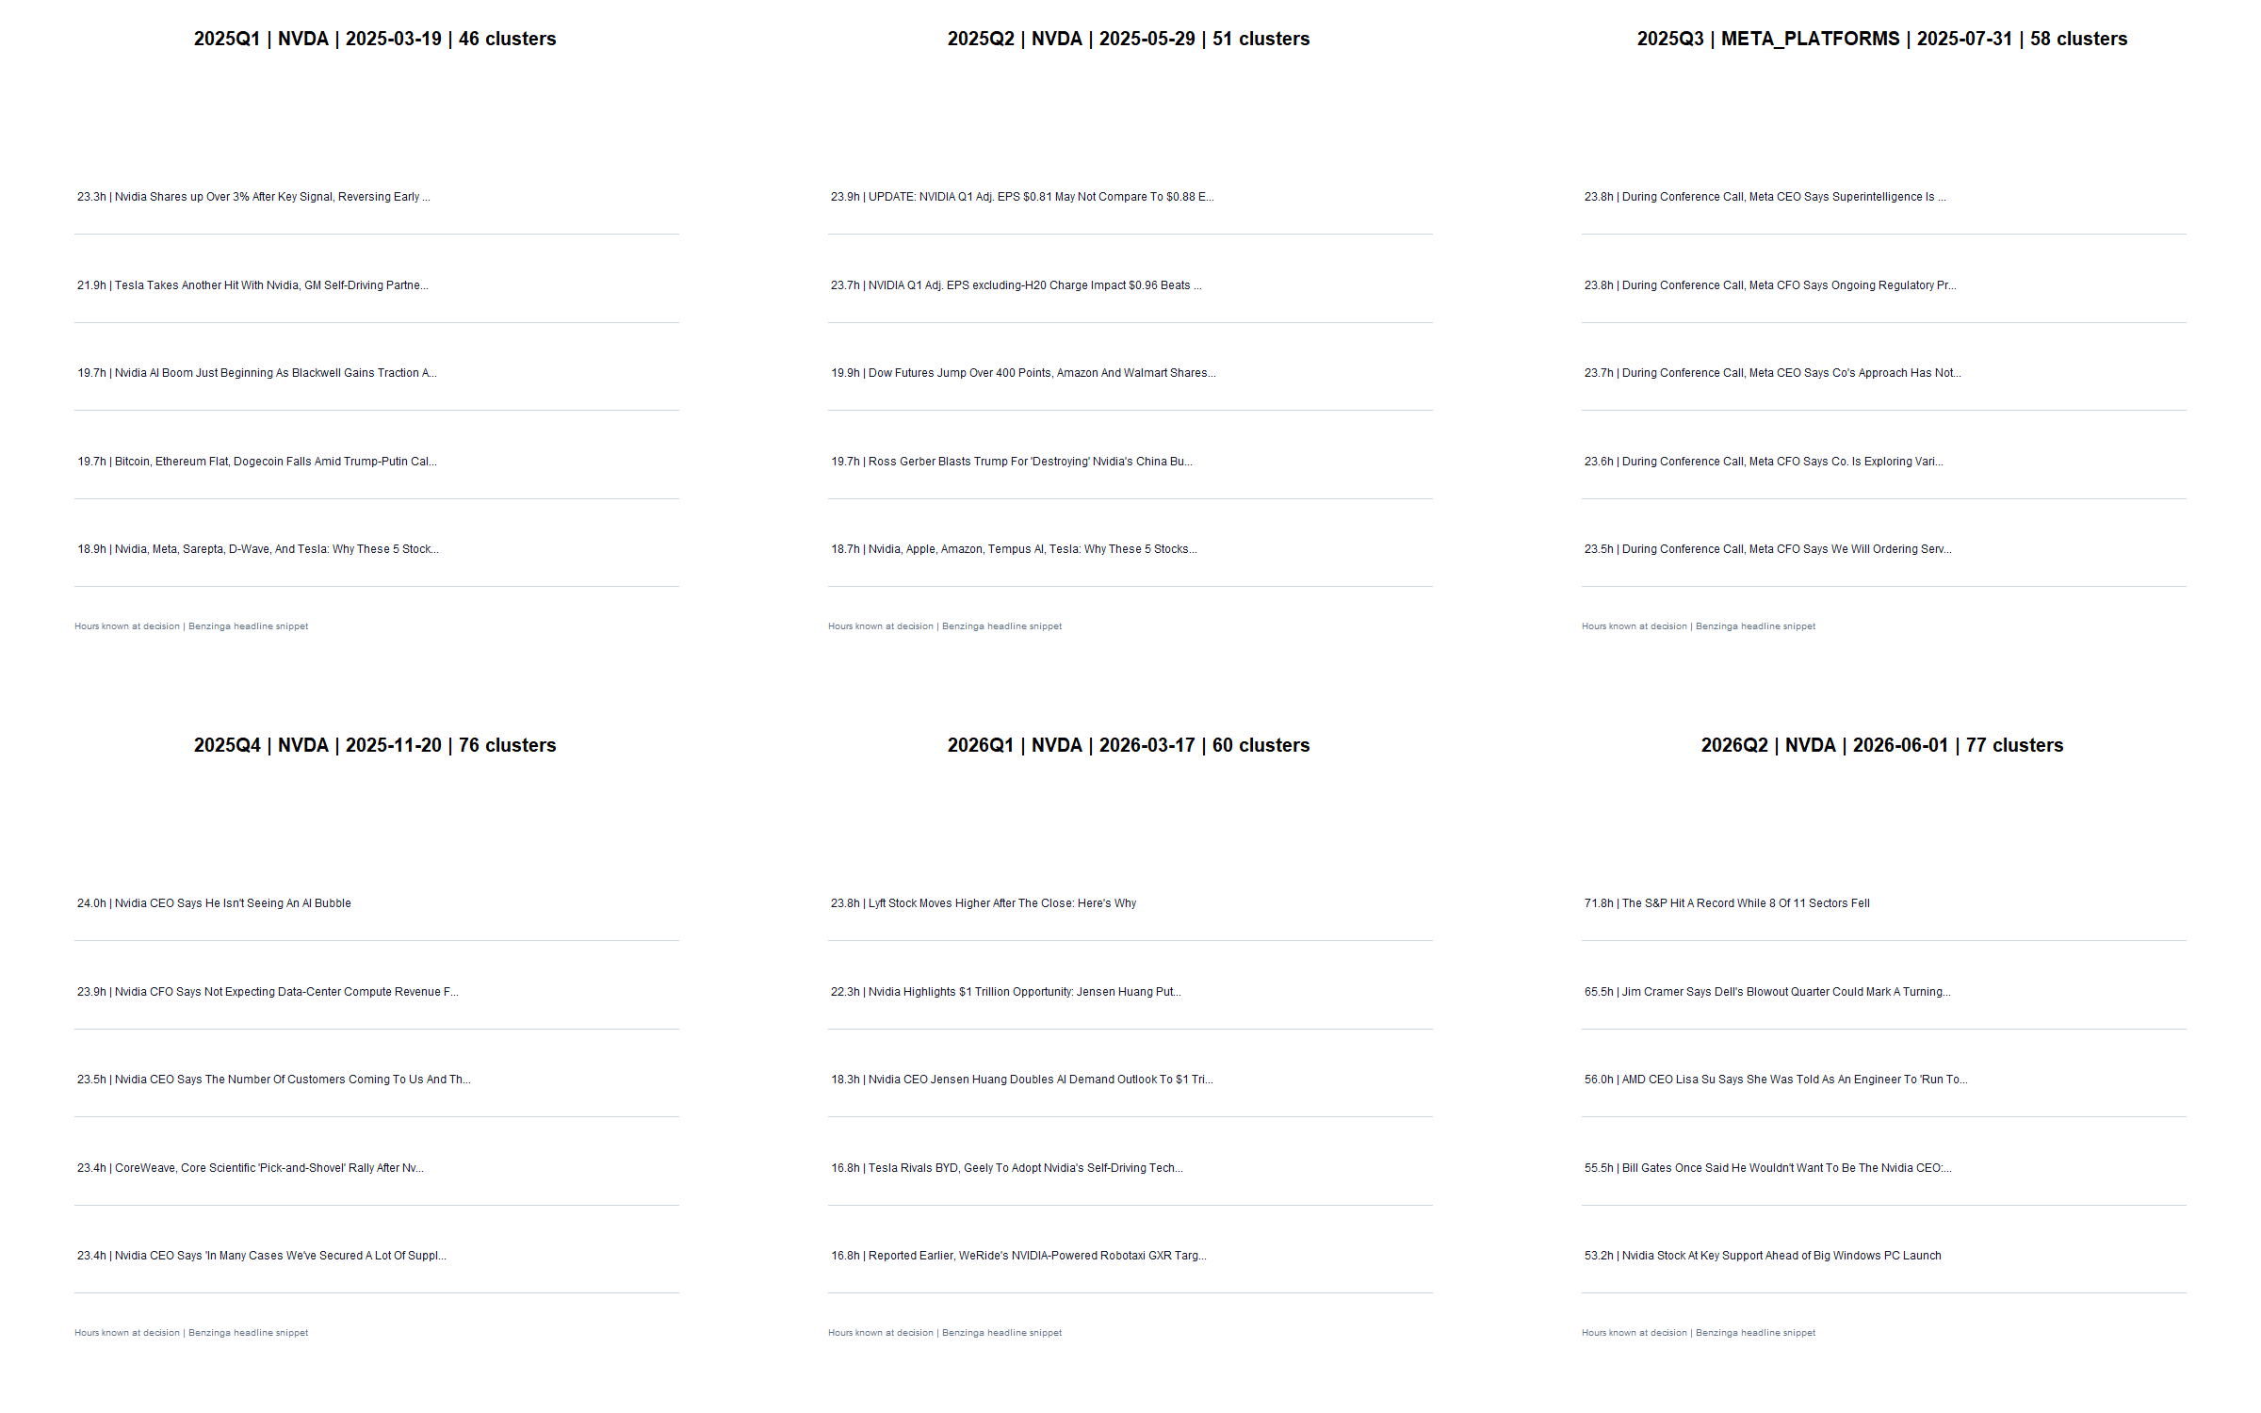
GEN5.4 / E0 CONSTRUCTION
Representative cycles show what the observable unit contains
Notes:
The panels are audit examples selected for visibility, not case studies of successful trades.
Dialogue reference: D46 — codex://threads/019f741e-615f-7fd0-90f7-edce12b5cb66
[Sources]
- C:/Users/Franc/OneDrive/Documents/Francis/Peltata Project/Time-Series-Modeling-Gen5/runs/research_workbench/gen54_ml_decision_engine/g54_event_e0_20260726/e0_representative_cycle_tape.csv
- C:/Users/Franc/OneDrive/Documents/Francis/Peltata Project/Time-Series-Modeling-Gen5/runs/research_workbench/gen54_ml_decision_engine/g54_event_e0_20260726/visuals/e0_representative_cycle_tapes.png
[/Sources]

Slide 8
GEN5.4 / E0 CONSTRUCTION
The source is operationally usable—but not diverse
What E0 proves
100%
Timestamped construction
Issuer association
Coverage across the panel
Deterministic replay
of historical articles in this Alpaca sample are sourced from Benzinga
What E0 does not prove
Source diversity
Cross-provider robustness
Sentiment validity
Predictive value
Notes:
Single-source concentration is a formal limitation. Source identity cannot become a comparative feature in this sample.
Dialogue reference: D46 — codex://threads/019f741e-615f-7fd0-90f7-edce12b5cb66
[Sources]
- C:/Users/Franc/OneDrive/Documents/Francis/Peltata Project/Time-Series-Modeling-Gen5/runs/research_workbench/gen54_ml_decision_engine/g54_event_e0_20260726/e0_source_summary.csv
- C:/Users/Franc/OneDrive/Documents/Francis/Peltata Project/Time-Series-Modeling-Gen5/runs/research_workbench/gen54_ml_decision_engine/g54_event_e0_20260726/e0_report.md
[/Sources]

Slide 9
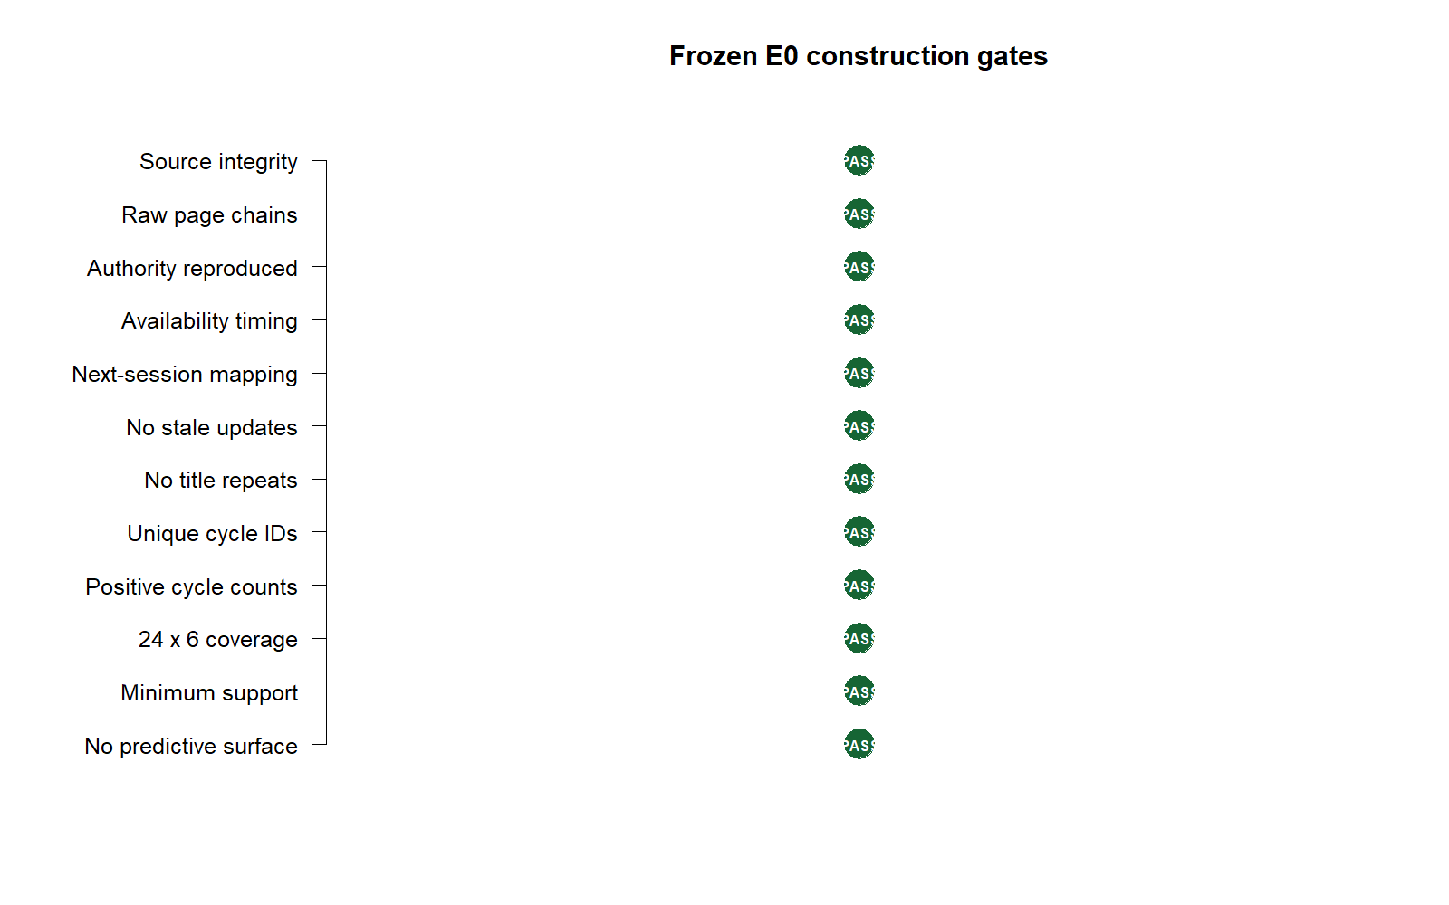
GEN5.4 / E0 CONSTRUCTION
All construction gates pass; prediction remains unopened
Next theory gate
Define exactly one initial-reaction measurement and one prospective confirmation rule.
Only after that contract is agreed should E1 join information cycles to price response.
Still unopened: sentiment, model training, portfolio policy, PnL, or live behavior.
PASS E0 / READY FOR FEATURE THEORY
Notes:
Close on the boundary: E0 authorizes a theory discussion, not a predictive experiment.
Dialogue reference: D46 — codex://threads/019f741e-615f-7fd0-90f7-edce12b5cb66
[Sources]
- C:/Users/Franc/OneDrive/Documents/Francis/Peltata Project/Time-Series-Modeling-Gen5/runs/research_workbench/gen54_ml_decision_engine/g54_event_e0_20260726/e0_integrity_audit.csv
- C:/Users/Franc/OneDrive/Documents/Francis/Peltata Project/Time-Series-Modeling-Gen5/runs/research_workbench/gen54_ml_decision_engine/g54_event_e0_20260726/visuals/e0_gate_summary.png
- C:/Users/Franc/OneDrive/Documents/Francis/Peltata Project/Time-Series-Modeling-Gen5/docs/GEN5_4_EVENT_CONSTRUCTION_E0_CONTRACT.md
[/Sources]

