Slide 1
EDGE DISCOVERY LAB · SECOND SLICE
From four tapes
to 646 paths
1→5
sessions
under the microscope
Does the possible five-session recovery survive contact with the full frozen event surface?
Preserved
All event identities, next-open timing, the four trigger/reclaim groups, and the sealed 2023 endpoint.
DESCRIPTIVE ANATOMY · NO HORIZON SELECTION · NO EDGE CLAIM
Notes:
This slice replaces the four illustrative tapes with the full frozen event surface. Five sessions is the focal question; ten sessions is displayed only to reveal whether the path persists or reverses.
[Sources]
- Local forward-path packet: runs/research_workbench/edge_discovery_lab/edl_ms_01_rule201_forward_path_20260830/report.md
- Local path summary: runs/research_workbench/edge_discovery_lab/edl_ms_01_rule201_forward_path_20260830/forward_path_summary.csv
- Local concentration tables: runs/research_workbench/edge_discovery_lab/edl_ms_01_rule201_forward_path_20260830/symbol_concentration.csv and calendar_concentration.csv
- Intraday branch bookmark: edge_discovery_lab/docs/EDL_MS_01_INTRADAY_BRANCHES.md
[/Sources]

Slide 2
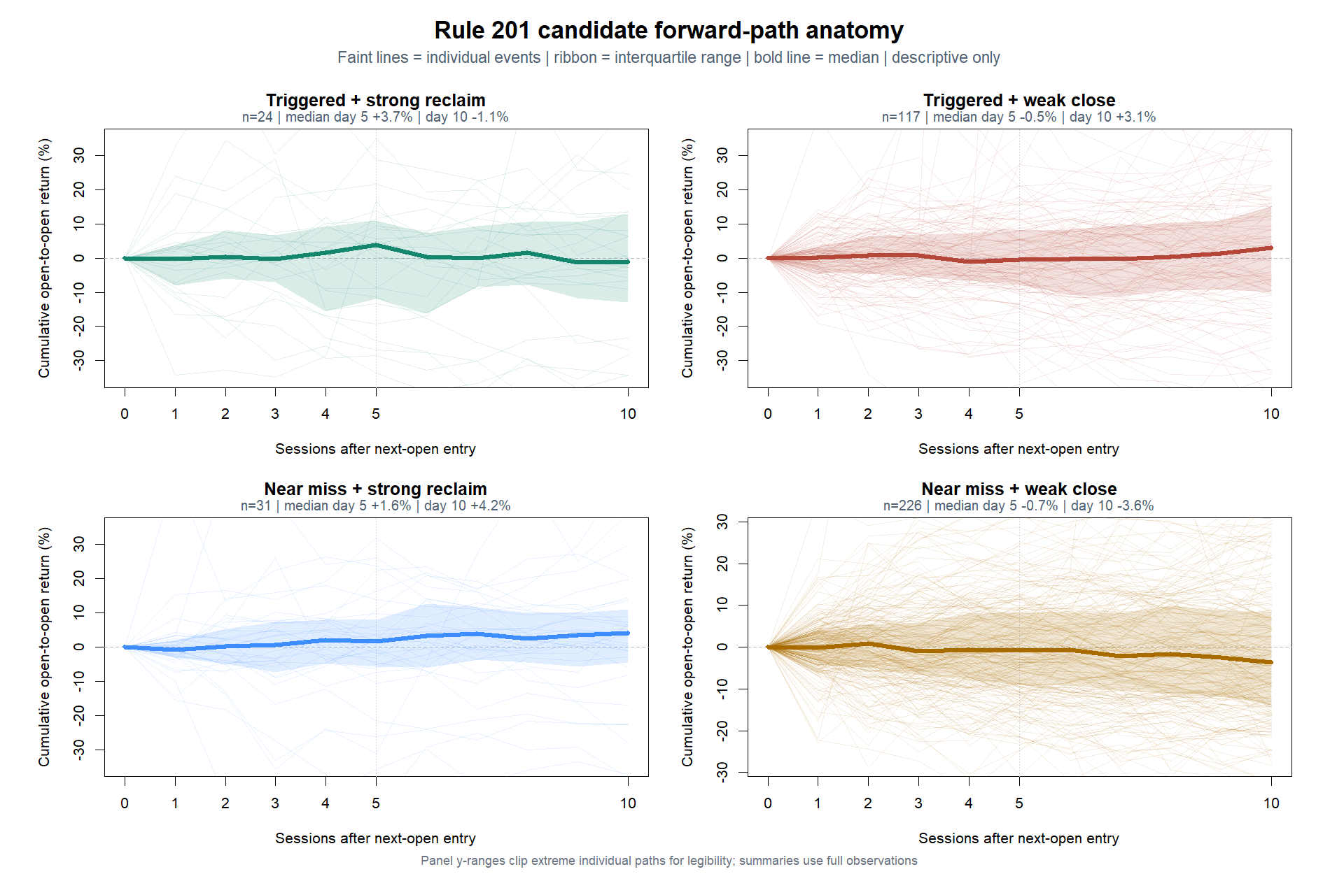
EDGE DISCOVERY LAB · EDL-MS-01 · FORWARD PATH
The five-session hump appears—but only in a small, unstable group
646 frozen events · 2018–2023 TRAIN · next-open clock
02
Notes:
Triggered strong reclaims reach a positive median around session five and then fade. The other categories do not form a clean threshold-by-reclaim ordering. Panel y-ranges clip extreme individual paths for legibility; all summaries use the full observations.
[Sources]
- Local forward-path packet: runs/research_workbench/edge_discovery_lab/edl_ms_01_rule201_forward_path_20260830/report.md
- Local path summary: runs/research_workbench/edge_discovery_lab/edl_ms_01_rule201_forward_path_20260830/forward_path_summary.csv
- Local concentration tables: runs/research_workbench/edge_discovery_lab/edl_ms_01_rule201_forward_path_20260830/symbol_concentration.csv and calendar_concentration.csv
- Intraday branch bookmark: edge_discovery_lab/docs/EDL_MS_01_INTRADAY_BRANCHES.md
[/Sources]

Slide 3
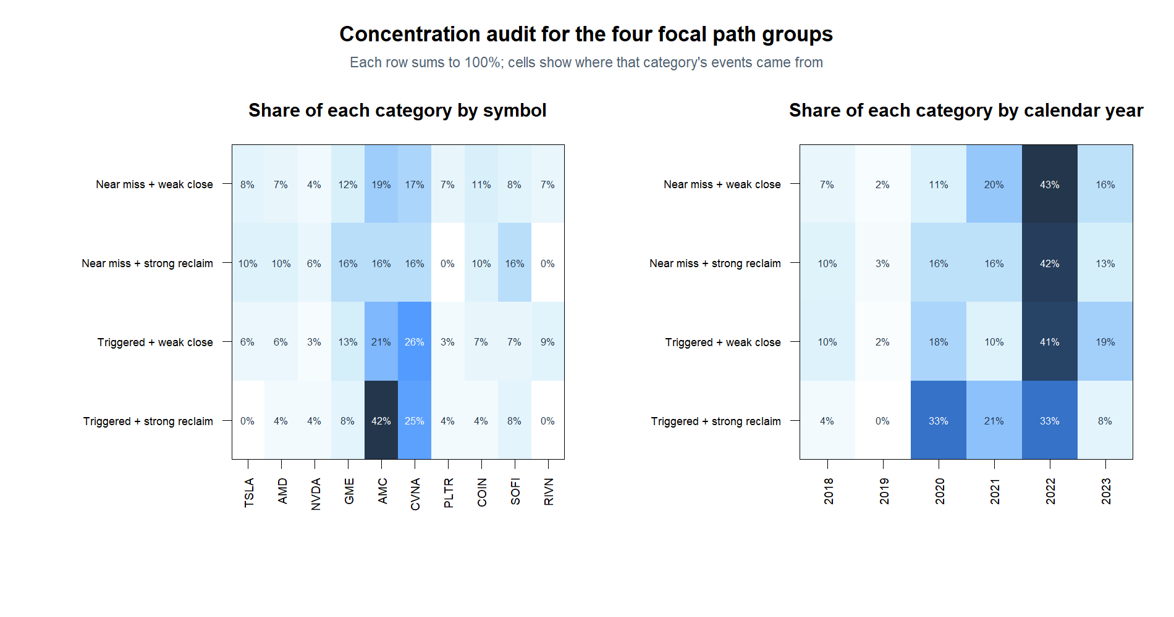
EDGE DISCOVERY LAB · EDL-MS-01 · FORWARD PATH
The most appealing path is also the most concentrated
646 frozen events · 2018–2023 TRAIN · next-open clock
03
Notes:
AMC and CVNA supply 67 percent of the 24 triggered strong-reclaim observations. The two largest years, 2020 and 2022, also supply 67 percent. This is a warning about the discovery surface, not a reason to fit exclusions.
[Sources]
- Local forward-path packet: runs/research_workbench/edge_discovery_lab/edl_ms_01_rule201_forward_path_20260830/report.md
- Local path summary: runs/research_workbench/edge_discovery_lab/edl_ms_01_rule201_forward_path_20260830/forward_path_summary.csv
- Local concentration tables: runs/research_workbench/edge_discovery_lab/edl_ms_01_rule201_forward_path_20260830/symbol_concentration.csv and calendar_concentration.csv
- Intraday branch bookmark: edge_discovery_lab/docs/EDL_MS_01_INTRADAY_BRANCHES.md
[/Sources]

Slide 4
EDGE DISCOVERY LAB · EDL-MS-01 · FORWARD PATH
The recovery clue survives; the proposed interaction does not
WHAT REMAINS INTERESTING
WHY IT STAYS A CLUE
+3.7%
Only 24 observations; the mean is negative and the interquartile band is wide.
triggered/strong median at session five
Two symbols and two calendar years each supply 67% of the group.
The path rises mostly between sessions three and five.
It fades to −1.1% by session ten—consistent with a temporary hump, not persistent drift.
Near-miss strong reclaims and triggered weak closes also rise at later horizons.
READOUT: no clean Rule 201 × reclaim ordering is visible yet
646 frozen events · 2018–2023 TRAIN · next-open clock
04
Notes:
The path anatomy preserves an interesting temporary-recovery shape but weakens the original interaction story. No horizon is selected from this visual.
[Sources]
- Local forward-path packet: runs/research_workbench/edge_discovery_lab/edl_ms_01_rule201_forward_path_20260830/report.md
- Local path summary: runs/research_workbench/edge_discovery_lab/edl_ms_01_rule201_forward_path_20260830/forward_path_summary.csv
- Local concentration tables: runs/research_workbench/edge_discovery_lab/edl_ms_01_rule201_forward_path_20260830/symbol_concentration.csv and calendar_concentration.csv
- Intraday branch bookmark: edge_discovery_lab/docs/EDL_MS_01_INTRADAY_BRANCHES.md
[/Sources]

Slide 5
EDGE DISCOVERY LAB · EDL-MS-01 · FORWARD PATH
Two intraday questions now have separate clocks
A · COMPLETED EVENT
B · LIVE BREACH / RECLAIM
When should the next trade enter?
Can a same-day signal be causal?
Daily trigger and final close-location value are already known.
Threshold is crossed intraday; recovery must be defined only from completed bars.
Future 30-minute study compares next-open with later completed-bar entries.
Final daily close-location value is forbidden until the session ends.
CURRENT STATUS
Daily path anatomy complete · both intraday branches remain unopened
646 frozen events · 2018–2023 TRAIN · next-open clock
05
Notes:
Branch A is the operator's clarification: intraday entry timing after the completed daily event. Branch B is the separate live same-day signal proposed during the huddle. Neither is executed in this slice.
[Sources]
- Local forward-path packet: runs/research_workbench/edge_discovery_lab/edl_ms_01_rule201_forward_path_20260830/report.md
- Local path summary: runs/research_workbench/edge_discovery_lab/edl_ms_01_rule201_forward_path_20260830/forward_path_summary.csv
- Local concentration tables: runs/research_workbench/edge_discovery_lab/edl_ms_01_rule201_forward_path_20260830/symbol_concentration.csv and calendar_concentration.csv
- Intraday branch bookmark: edge_discovery_lab/docs/EDL_MS_01_INTRADAY_BRANCHES.md
[/Sources]

