Slide 1
GEN5.4 • THEORY → MEASUREMENT → MODEL GATE
Cross-sectional asset
selection
A concise pivot deck • leakage-safe POC ladder • first X0/X1 evidence
01
Notes:
OPENING — CROSS-SECTIONAL ASSET SELECTION
Purpose
Record the pivot from a five-name conditional-exposure experiment to a wider cross-sectional ranking question, then document the first leakage-safe universe and measurement packet.
Conversation: codex://threads/019f741e-615f-7fd0-90f7-edce12b5cb66
Find in chat: reset and just like doing the approach from a wider perspective
Related artifact: docs/GEN5_4_CROSS_SECTIONAL_ASSET_SELECTION_POC_PLAN.md
Boundary: research and evidence only; no live authority.

Slide 2
Gen5.4 is widening the question
Rank a broad historical cross-section—without forcing a trade.
The new research question
Model fitting
Can same-date, point-in-time evidence identify which eligible assets will outperform the equal-weight universe over an executable horizon?
waits for
stable primitive evidence
D15/02
Notes:
DECISION D15 — CROSS-SECTIONAL RESET
Decision
Replace the narrow prospective-discovery claim with a pooled cross-sectional question over a frozen, diverse candidate panel.
Why
A wider panel supplies contemporaneous comparisons across assets and groups. It does not manufacture independence across dates or remove survivorship risk.
Conversation: codex://threads/019f741e-615f-7fd0-90f7-edce12b5cb66
Find in chat: 20 or 30 diverse assets
Artifact: docs/GEN5_4_CROSS_SECTIONAL_ASSET_SELECTION_POC_PLAN.md
Status: accepted research direction.

Slide 3
SESSION 5
The narrow basket becomes evidence;
the wider panel becomes the research question.
Universe integrity • relative target • cross-sectional ranks • cash gate • falsification
S5/03
Notes:
SESSION 5 — WIDE-UNIVERSE CROSS-SECTIONAL DESIGN
The prior five-name STOPs remain valid. This session asks a different question: whether relationships repeat across a wider set of contemporaneously eligible assets.
Conversation: codex://threads/019f741e-615f-7fd0-90f7-edce12b5cb66
Find in chat: approach from a wider perspective
Boundary: prior OOS results are not reinterpreted or rescued.

Slide 4
A cross-sectional engine still separates four decisions
1 Exposure permission
2 Asset ranking
Should a long-only portfolio take risk at all?
Which eligible names are strongest relative to the same-date universe?
3 Holding horizon
4 Portfolio policy
Does the score match a next-open, five-session exposure?
Can top-K selection survive turnover, concentration, and costs?
D16/04
Notes:
DECISION D16 — TWO-STAGE LONG-ONLY ARCHITECTURE
Decision
Keep exposure permission separate from cross-sectional asset ranking. Relative winners can still have negative absolute returns.
Why
A ranking model always names a winner. Cash/no-trade must remain a first-class competitor before a relative score becomes a long recommendation.
Conversation: codex://threads/019f741e-615f-7fd0-90f7-edce12b5cb66
Find in chat: Relative outperformance is not automatically a long-entry signal
Status: architecture principle; no portfolio policy is authorized.

Slide 5
The first wide panel is fixed, diverse, and explicitly imperfect
FIRST
SECOND
THIRD
24 ranked stocks
across six groups
6 market/risk anchors
for benchmarks only
Daily eligibility
uses trailing data
Fixed-panel POC: coverage and liquidity are auditable; survivorship remains a declared limitation.
D17/05
Notes:
DECISION D17 — FIXED PANEL AND POINT-IN-TIME ELIGIBILITY
Ranked candidates
24 long-history liquid stocks across semiconductors, platforms/media, high-beta special situations, defensive consumer/health, financials, and energy/industrials.
Context anchors
SPY, QQQ, IWM, SMH, TLT, and GLD are benchmark/context inputs, not ranked candidates.
Daily eligibility
Price at least $5, trailing 60-session median dollar volume at least $20 million, complete backward-looking features, and at least 20 eligible candidates on the same date.
Limitation
The names are frozen and survived into the research era. This is not a complete point-in-time US securities master.
Conversation: codex://threads/019f741e-615f-7fd0-90f7-edce12b5cb66
Find in chat: universe construction
Artifact: C:/Users/Franc/OneDrive/Documents/Francis/Peltata Project/Time-Series-Modeling-Gen5/runs/research_workbench/gen54_ml_decision_engine/g54_xs_20260719x0x1/xs_candidate_registry.csv

Slide 6
The target asks who wins—and whether winning is worth owning
At each after-close decision:
DECIDE
EXECUTE
1. observe through close t
2. screen point-in-time eligibility
3. execute at open t+1
4. measure at open t+6
5. compare with same-date equal weight
after close t
open t+1
hold → measure at open t+6
Primary: h5 relative return. Secondary: raw h5 return. Relative leadership never overrides cash/no-trade.
D18/06
Notes:
DECISION D18 — EXECUTION-ALIGNED CROSS-SECTIONAL TARGET
Primary label
Asset open(t+6) / open(t+1) - 1, minus the same-date equal-weight eligible-universe return over the identical interval.
Secondary control
Raw h5 open-to-open return preserves the absolute long-only question.
Validation
Twenty quarterly OOS authorities from 2020Q1 through 2024Q4; eight preceding TRAIN quarters remain reserved by contract; boundary-crossing labels are excluded.
Conversation: codex://threads/019f741e-615f-7fd0-90f7-edce12b5cb66
Find in chat: primary prediction target
Artifact: C:/Users/Franc/OneDrive/Documents/Francis/Peltata Project/Time-Series-Modeling-Gen5/runs/research_workbench/gen54_ml_decision_engine/g54_xs_20260719x0x1/xs_run_spec.csv

Slide 7
The POC ladder delays complexity until each layer earns it
X0 + X1
X2 + X3
X4 + X5
Universe integrity +
no-model measurement
Pooled linear ranker +
fixed nonlinear challenger
Top-K policy, costs +
fresh forward confirmation
Autonomous boundary: complete X0/X1 only. Model, portfolio policy, and live advice remain closed.
PLAN/07
Notes:
MINIMAL POC LADDER
X0 — Universe integrity
Coverage, role balance, point-in-time eligibility, and survivor limitation.
X1 — No-model measurement
Seven predeclared OHLCV primitives; same-date ranks; h5 relative outcomes; quarterly stability and group-concentration gates.
X2 — Pooled linear ranker
Only after at least two economically distinct primitives pass X1.
X3 — Fixed nonlinear challenger
Only after the linear lane establishes useful ranking and calibration evidence.
X4 — Long-only top-K policy
Add exposure permission, turnover, costs, and concentration without model retuning.
X5 — Fresh forward confirmation
Use 2026Q3 onward; prior windows are development evidence.
Conversation: codex://threads/019f741e-615f-7fd0-90f7-edce12b5cb66
Find in chat: plan a series of minimal proof of concepts

Slide 8
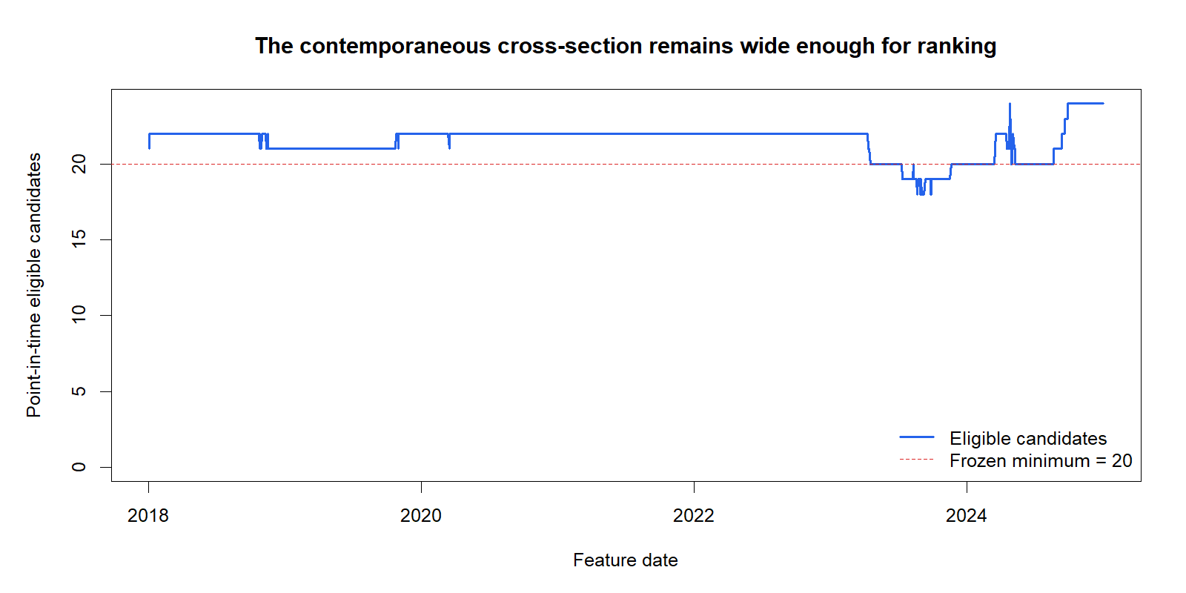
X0 passed: all 24 candidates support the fixed-panel audit
X0/08
Notes:
POC X0 — UNIVERSE INTEGRITY PASS
Evidence
61,620 adjusted-daily SIP bars across 30 declared symbols. All 24 ranked candidates passed the fixed-panel coverage check. The contemporaneous eligible count stayed at or above the frozen minimum after warm-up.
Refresh transparency
The initial cache-only attempt lacked some declared symbols. The affected adjusted-daily histories were refreshed from Alpaca and the packet was rerun before interpretation.
Conversation: codex://threads/019f741e-615f-7fd0-90f7-edce12b5cb66
Find in chat: Do we have enough assets to extract signal from noise
Plots: C:/Users/Franc/OneDrive/Documents/Francis/Peltata Project/Time-Series-Modeling-Gen5/runs/research_workbench/gen54_ml_decision_engine/g54_xs_20260719x0x1/visuals/xs_eligible_count.png and xs_coverage_heatmap.png
Manifest: C:/Users/Franc/OneDrive/Documents/Francis/Peltata Project/Time-Series-Modeling-Gen5/runs/research_workbench/gen54_ml_decision_engine/g54_xs_20260719x0x1/xs_universe_manifest.csv

Slide 9
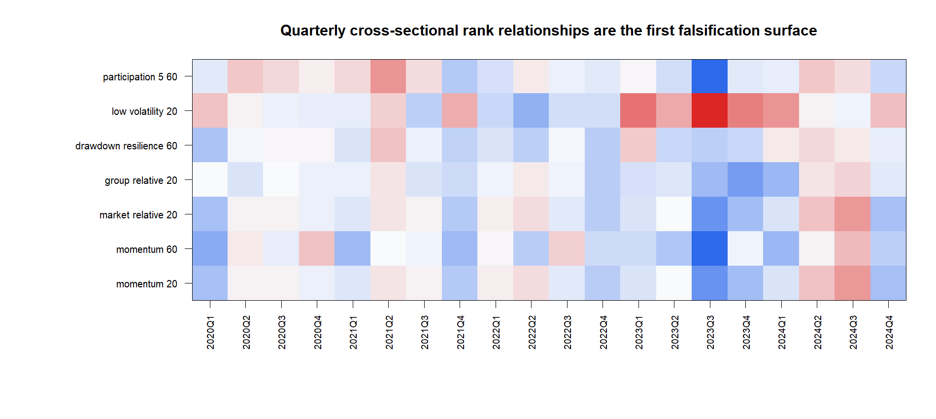
X1 found one stable primitive—not enough for a model
X1/09
Notes:
POC X1 — NO-MODEL MEASUREMENT AUDIT
Frozen primitives
20- and 60-session momentum, market-relative 20-session momentum, group-relative 20-session momentum, 60-session drawdown resilience, low 20-session volatility, and 5-versus-prior-60-session dollar-volume participation.
Pass rule
Positive pooled daily rank IC, positive pooled top-minus-bottom h5 return, at least 12 of 20 positive-IC folds, at least 12 of 20 positive-ordering folds, and no group above 50% of top selections.
Readout
Only group-relative 20-session momentum passed every standalone gate.
Report: C:/Users/Franc/OneDrive/Documents/Francis/Peltata Project/Time-Series-Modeling-Gen5/runs/research_workbench/gen54_ml_decision_engine/g54_xs_20260719x0x1/xs_report.md
Conversation: codex://threads/019f741e-615f-7fd0-90f7-edce12b5cb66
Find in chat: all data that we have available

Slide 10
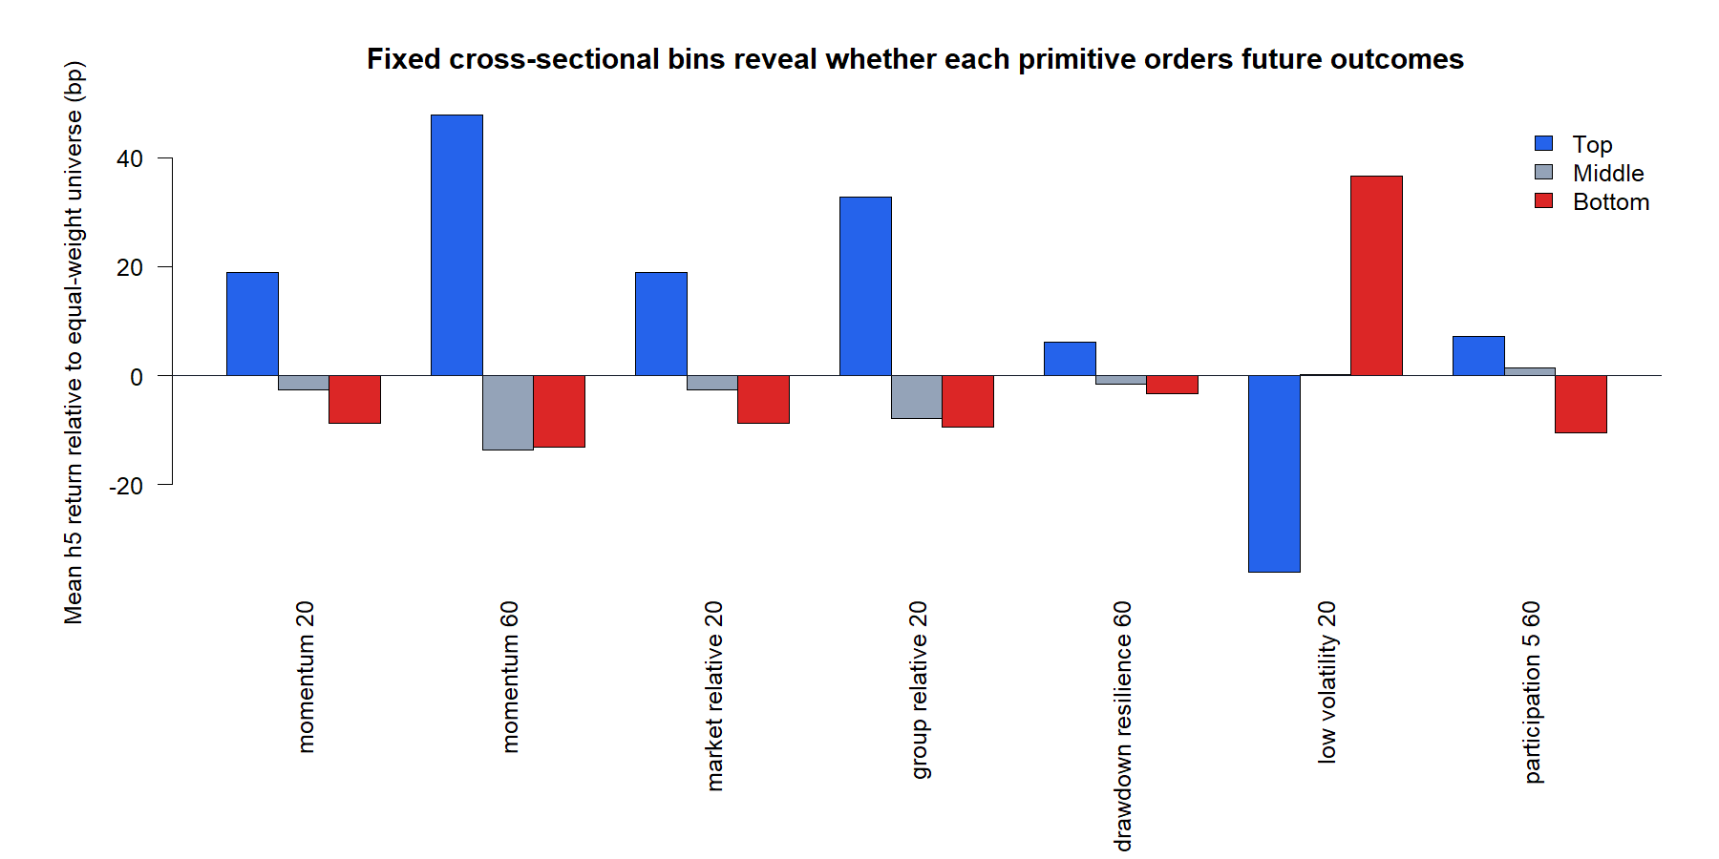
The wider universe solved breadth—not signal quality
OVERALL: STOP BEFORE MODEL FIT
PASS 24 / 24 coverage
PASS 6 / 6 leakage checks
PASS Group-relative 20 only
REVIEW Momentum 60: concentrated
STOP Five remaining primitives
Model fits: 0
D19/10
Notes:
DECISION D19 — X0/X1 STOP BEFORE MODEL FIT
Why STOP
The protocol required at least two economically distinct standalone primitives before combination design. Only group-relative 20-session momentum passed every gate.
Important nuance
Momentum 60 had positive pooled IC, 14/20 positive IC folds, 14/20 positive ordering folds, and +61.0 bp pooled top-minus-bottom separation. It failed the predeclared group-concentration cap: 67.3% versus 50%.
Other readouts
Low-volatility ordering was negative. Participation had negative pooled IC. Widening the cross-section therefore improved measurement legitimacy but did not create a robust multivariate information set.
Conversation: codex://threads/019f741e-615f-7fd0-90f7-edce12b5cb66
Find in chat: autonomously run as large a chunk
Report: C:/Users/Franc/OneDrive/Documents/Francis/Peltata Project/Time-Series-Modeling-Gen5/runs/research_workbench/gen54_ml_decision_engine/g54_xs_20260719x0x1/xs_report.md
Status: STOP_BEFORE_MODEL_FIT; model_fit_count = 0.

Slide 11
Decision record and evidence artifacts
1
D15–D18 — cross-sectional POC charter
docs/GEN5_4_CROSS_SECTIONAL_ASSET_SELECTION_POC_PLAN.md
2
D19 — X0/X1 measurement packet
runs/.../g54_xs_20260719x0x1/xs_report.md
3
GEN5_4_DECISION_DIALOGUE_INDEX.md
Codex deep link, exact Find-in-chat phrases, compact decisions
4
GEN5_1_POC_PROGRESS_LOG.md
Cumulative POC question, artifacts, readout, and STOP state
5
GEN5_4_ML_DECISION_ENGINE_PLAN.md
Prior supervised lineage and wide-pool absolute-target evidence
6
AGENTS.md
WFA-first • explicit as-of • no-trade • no live change
Speaker notes carry conversation bookmarks, decisions, evidence paths, and research boundaries.
IDX/11
Notes:
PROVENANCE INDEX
Conversation: codex://threads/019f741e-615f-7fd0-90f7-edce12b5cb66
Find in chat: slight pivot in direction
Plan: docs/GEN5_4_CROSS_SECTIONAL_ASSET_SELECTION_POC_PLAN.md
Decision index: docs/GEN5_4_DECISION_DIALOGUE_INDEX.md
Progress log: docs/GEN5_1_POC_PROGRESS_LOG.md
Packet: C:/Users/Franc/OneDrive/Documents/Francis/Peltata Project/Time-Series-Modeling-Gen5/runs/research_workbench/gen54_ml_decision_engine/g54_xs_20260719x0x1
Boundary: concise visible narrative; longer decision rationale remains navigable through notes and the dialogue index.

Slide 12
The next gate is information—not a cleverer ranker
FIRST
SECOND
THIRD
Keep the wide panel
and h5 target contract
Accept the X1 STOP;
do not fit one primitive
Add one distinct family
or revise universe logic
Recommended next session: choose one point-in-time feature family that can supply an independent cross-sectional signal.
G/12
Notes:
NEXT OPERATOR GATE — SECOND INDEPENDENT INFORMATION FAMILY
Recommended direction
Keep X0's wide panel, the same-date rank architecture, h5 execution-aligned relative target, and cash/no-trade separation. Do not loosen the concentration cap or fit a model around the single passing primitive.
Candidate next families
1. Point-in-time filing and earnings-change features from an official structured source.
2. Revision-safe macro/credit context shared across the cross-section.
3. A separately justified universe rule with historical membership evidence.
Alpaca boundary
Alpaca adjusted daily bars support the panel. Alpaca does not document the structured fundamentals/estimate-revision surface needed for the strongest first candidate.
Conversation: codex://threads/019f741e-615f-7fd0-90f7-edce12b5cb66
Find in chat: non-price-related data
Status: operator decision required before X2 or a new data-family POC.

