Slide 1
LIT-MR-06.1 | RECENT WIDE ATLAS | 30 JUL 2026
Buy-on-gap on a recent
305-stock panel
Same causal Chapter 4 rule. New 2023–2024 TRAIN window. Eleven rationally constructed sector panels.
Notes:
This deck is a frozen recent-data replication of the causal buy-on-gap textbook exercise. It changes the dates and universe breadth while preserving the strategy mechanics and eight-gate conjunction.
[Sources]
- C:/Users/Franc/OneDrive/Documents/Francis/Trading Literature/Algorithmic Trading - Winning Strategies and Their Rationale 2013.pdf — Example 4.1, printed pp. 93–96; PDF pp. 111–114
- C:\Users\Franc\OneDrive\Documents\Francis\Peltata Project\Time-Series-Modeling-Gen5\literature_studies\docs\GEN5_LIT_MR_06_1_RECENT_WIDE_ATLAS_02_CONTRACT.md

Slide 2
The replication changed dates and breadth—not mechanics
The initial atlas answered whether the rule was implementable. This replication asks whether a much wider, more recent stock panel supplies enough independent events to judge it fairly.
2019–2020
2023–2024
SEALED
Initial TRAIN
15 stocks × 9 sectors; 20-stock control
Recent TRAIN
305-stock union; 11 sector panels
2025–Jun 2026 DEVELOPMENT
queried only after an 8/8 pass
2
Notes:
The initial run used 2019-01-02 through 2020-12-31, with warmup from 2018-08-01. It tested 15 stocks in each of nine sector panels and a separate 20-stock broad control. The recent run uses 2023-01-03 through 2024-12-31 and seals 2025-01-02 through 2026-06-30 unless a TRAIN panel passes all eight gates.
[Sources]
- C:\Users\Franc\OneDrive\Documents\Francis\Peltata Project\Time-Series-Modeling-Gen5\literature_studies\docs\GEN5_LIT_MR_06_1_RECENT_WIDE_ATLAS_02_CONTRACT.md
- C:/Users/Franc/OneDrive/Documents/Francis/Peltata Project/Time-Series-Modeling-Gen5/literature_studies/docs/GEN5_LIT_MR_06_1_CAUSAL_BUY_ON_GAP_POC_CONTRACT.md

Slide 3
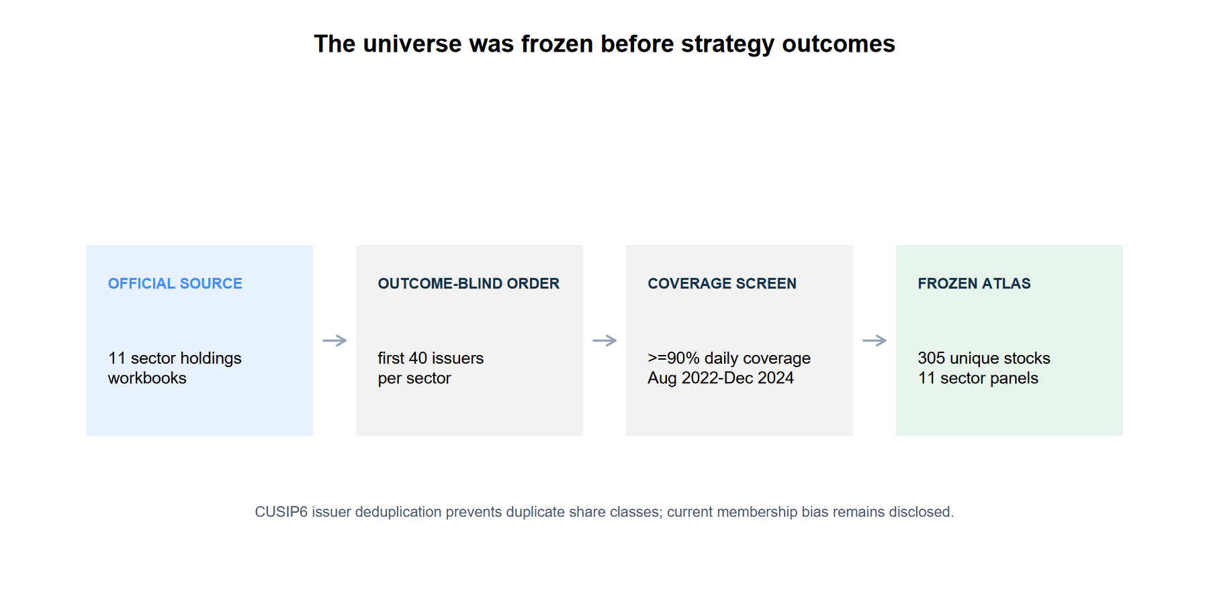
The wide panel was frozen before outcomes
State Street’s eleven Select Sector SPDR holdings files supplied an externally ordered stock registry.
CUSIP6 issuer deduplication removed duplicate share classes. Only the first 40 issuer-ranked candidates per sector were coverage-screened.
We retained the first 30 with at least 90% adjusted-daily coverage—or every eligible issuer when fewer existed. The final union contains 305 unique stocks.
This uses current constituents, so historical membership and survivor bias remain explicit limitations.
3
Notes:
Universe construction was completed and committed before strategy outcomes. Current State Street holdings as of 2026-07-28 provide a reproducible economic-category rationale, but they are not a point-in-time reconstruction of 2023–2024 membership.
[Sources]
- C:\Users\Franc\OneDrive\Documents\Francis\Peltata Project\Time-Series-Modeling-Gen5\literature_studies\registries\gen5_lit_mr_06_1_recent_wide_atlas_02_registry.csv
- C:\Users\Franc\OneDrive\Documents\Francis\Peltata Project\Time-Series-Modeling-Gen5\literature_studies\docs\GEN5_LIT_MR_06_1_RECENT_WIDE_ATLAS_02_CONTRACT.md
- https://www.ssga.com/us/en/institutional/capabilities/equities/sector-investing/select-sector-etfs

Slide 4
The causal rule and eight gates were unchanged
The official open completes the signal but cannot also be an executable fill. Candidate formation remains lagged; the primary entry remains 09:32; unused sleeves remain cash.
09:32
10 / 20 bp
8 / 8
Causal entry
observe first minute; exit at close
Primary / stress round trip
per selected stock
Integrity + evidence + tradability
all required in TRAIN
4
Notes:
The frozen gates remain: integrity, selected-entry coverage, event/day support, positive one-sided uncertainty bound, positive benchmark excess, random-control separation, positive stress return, and concentration control. The source same-open curve remains diagnostic only.
[Sources]
- C:/Users/Franc/OneDrive/Documents/Francis/Trading Literature/Algorithmic Trading - Winning Strategies and Their Rationale 2013.pdf
- C:\Users\Franc\OneDrive\Documents\Francis\Peltata Project\Time-Series-Modeling-Gen5\literature_studies\docs\GEN5_LIT_MR_06_1_RECENT_WIDE_ATLAS_02_CONTRACT.md
- C:/Users/Franc/OneDrive/Documents/Francis/Peltata Project/Time-Series-Modeling-Gen5/literature_studies/presentations/gen5_lit_mr_06_1_buy_on_gap_evidence.pptx — detailed mechanics and gate rationale

Slide 5
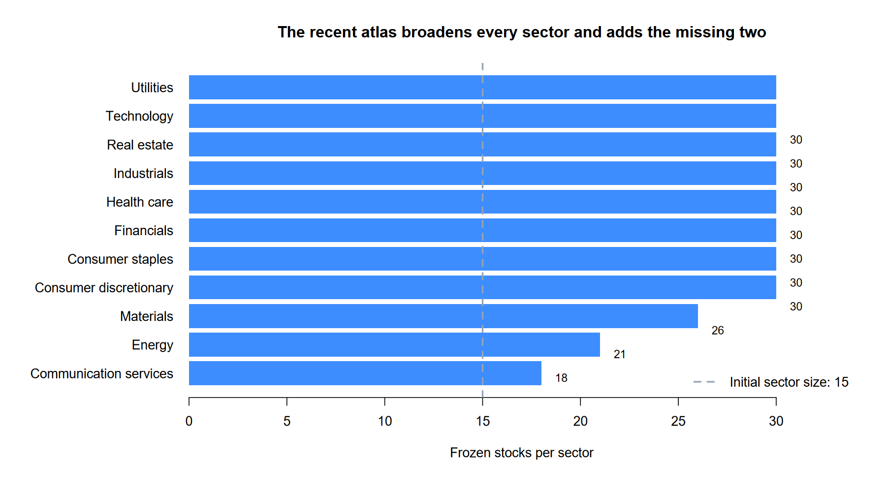
Breadth expanded every sector
The initial atlas used 15 stocks per sector and omitted materials and real estate.
The recent atlas reaches 30 stocks in eight sectors, 26 materials names, 21 energy names, and 18 communication-services names.
All 305 selected stocks achieved 100% adjusted-daily coverage across the frozen coverage window.
ETFs are benchmarks only; this remains a stock strategy.
5
Notes:
The combined WIDE_US panel is the union of the eleven sector panels. Sector ETFs and SPY are used as benchmarks and are not traded by the strategy.
[Sources]
- C:\Users\Franc\OneDrive\Documents\Francis\Peltata Project\Time-Series-Modeling-Gen5\literature_studies\registries\gen5_lit_mr_06_1_recent_wide_atlas_02_registry.csv
- C:\Users\Franc\OneDrive\Documents\Francis\Peltata Project\Time-Series-Modeling-Gen5\literature_studies\docs\GEN5_LIT_MR_06_1_RECENT_WIDE_ATLAS_02_CONTRACT.md

Slide 6
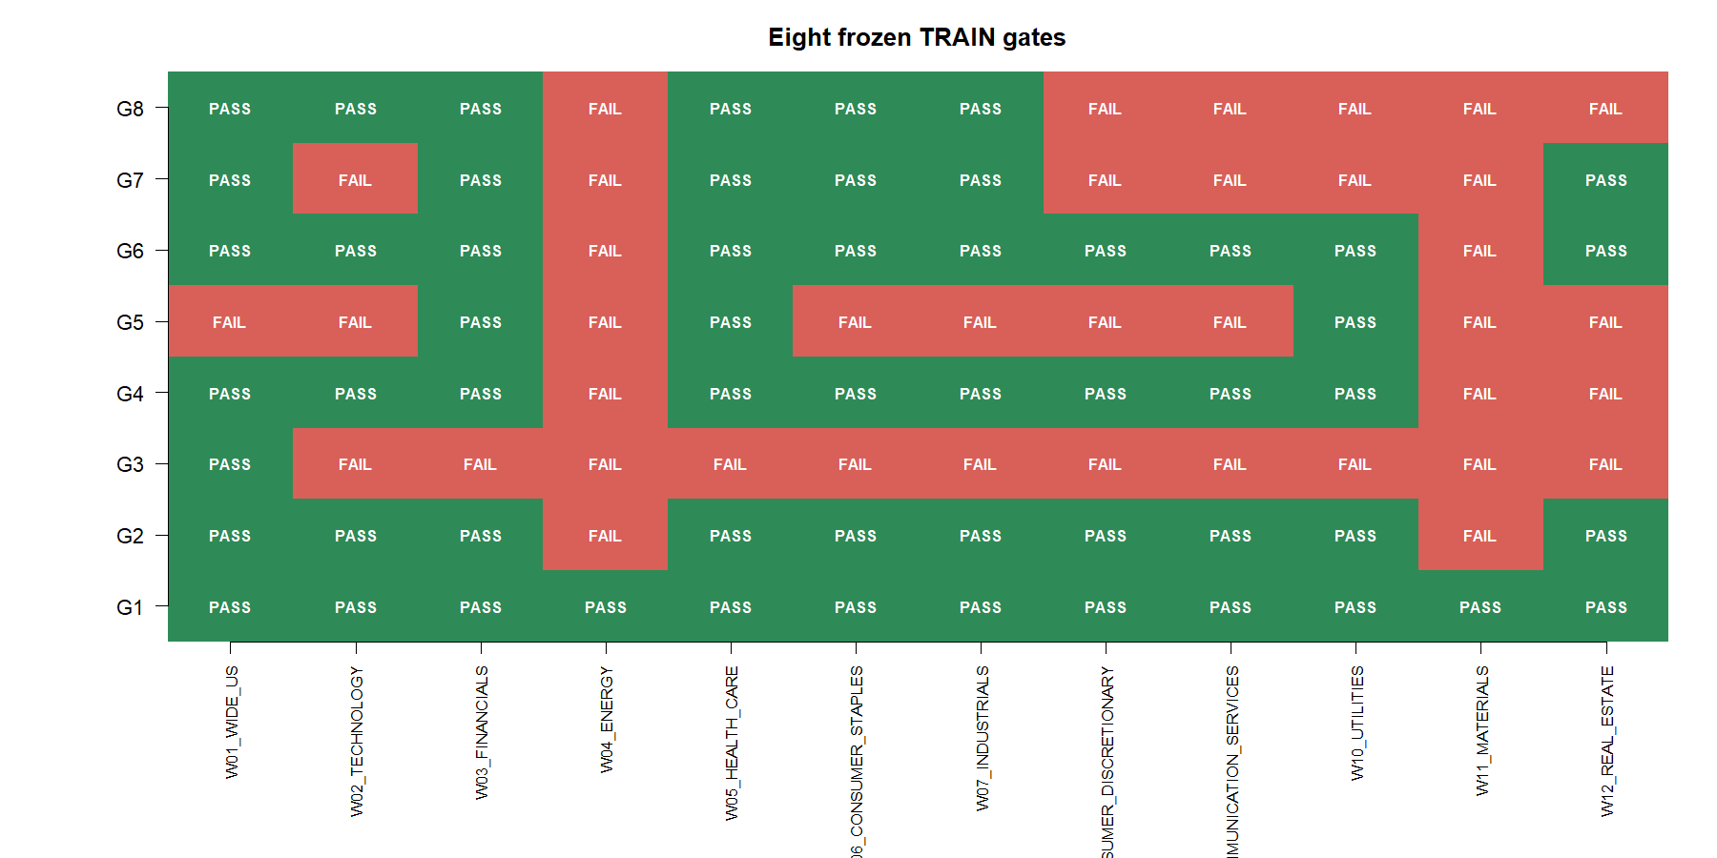
The combined panel reached 7/8 gates—none reached 8/8
6
Notes:
The combined WIDE_US panel passed integrity, coverage, support, benchmark, random-control, stress, and concentration gates. It failed only the positive uncertainty-bound gate. Financials and health care also reached 7/8, but each failed minimum support.
[Sources]
- C:\Users\Franc\OneDrive\Documents\Francis\Peltata Project\Time-Series-Modeling-Gen5\runs\research_workbench\literature_grounded\lit_mr_06_1_recent_wide_atlas_02_20260730/atlas_gates.csv
- C:\Users\Franc\OneDrive\Documents\Francis\Peltata Project\Time-Series-Modeling-Gen5\runs\research_workbench\literature_grounded\lit_mr_06_1_recent_wide_atlas_02_20260730/atlas_summary.csv
- C:\Users\Franc\OneDrive\Documents\Francis\Peltata Project\Time-Series-Modeling-Gen5\literature_studies\docs\GEN5_LIT_MR_06_1_RECENT_WIDE_ATLAS_02_CONTRACT.md

Slide 7
The 305-stock panel produced a disciplined near-pass
The causal primary path selected 190 stock-events across 121 portfolio days. Point estimates were positive, direction prediction improved, and stress costs remained survivable—but uncertainty stayed below the frozen threshold.
+4.12%
56.2%
−2.81 bp
Primary cumulative return
+2.21% under stress costs
Up/down accuracy
54.6% stock-event hit rate
One-sided 90% lower bound
for mean portfolio-day return
7
Notes:
The adjusted Sharpe estimate was 1.316 and maximum drawdown was -2.67%. These are descriptive TRAIN statistics, not an investable claim. The predeclared promotion decision depends on all eight gates, not on a weighted score.
[Sources]
- C:\Users\Franc\OneDrive\Documents\Francis\Peltata Project\Time-Series-Modeling-Gen5\runs\research_workbench\literature_grounded\lit_mr_06_1_recent_wide_atlas_02_20260730/atlas_summary.csv — W01_WIDE_US
- C:\Users\Franc\OneDrive\Documents\Francis\Peltata Project\Time-Series-Modeling-Gen5\runs\research_workbench\literature_grounded\lit_mr_06_1_recent_wide_atlas_02_20260730/portfolio_day_tape.csv — W01_WIDE_US

Slide 8
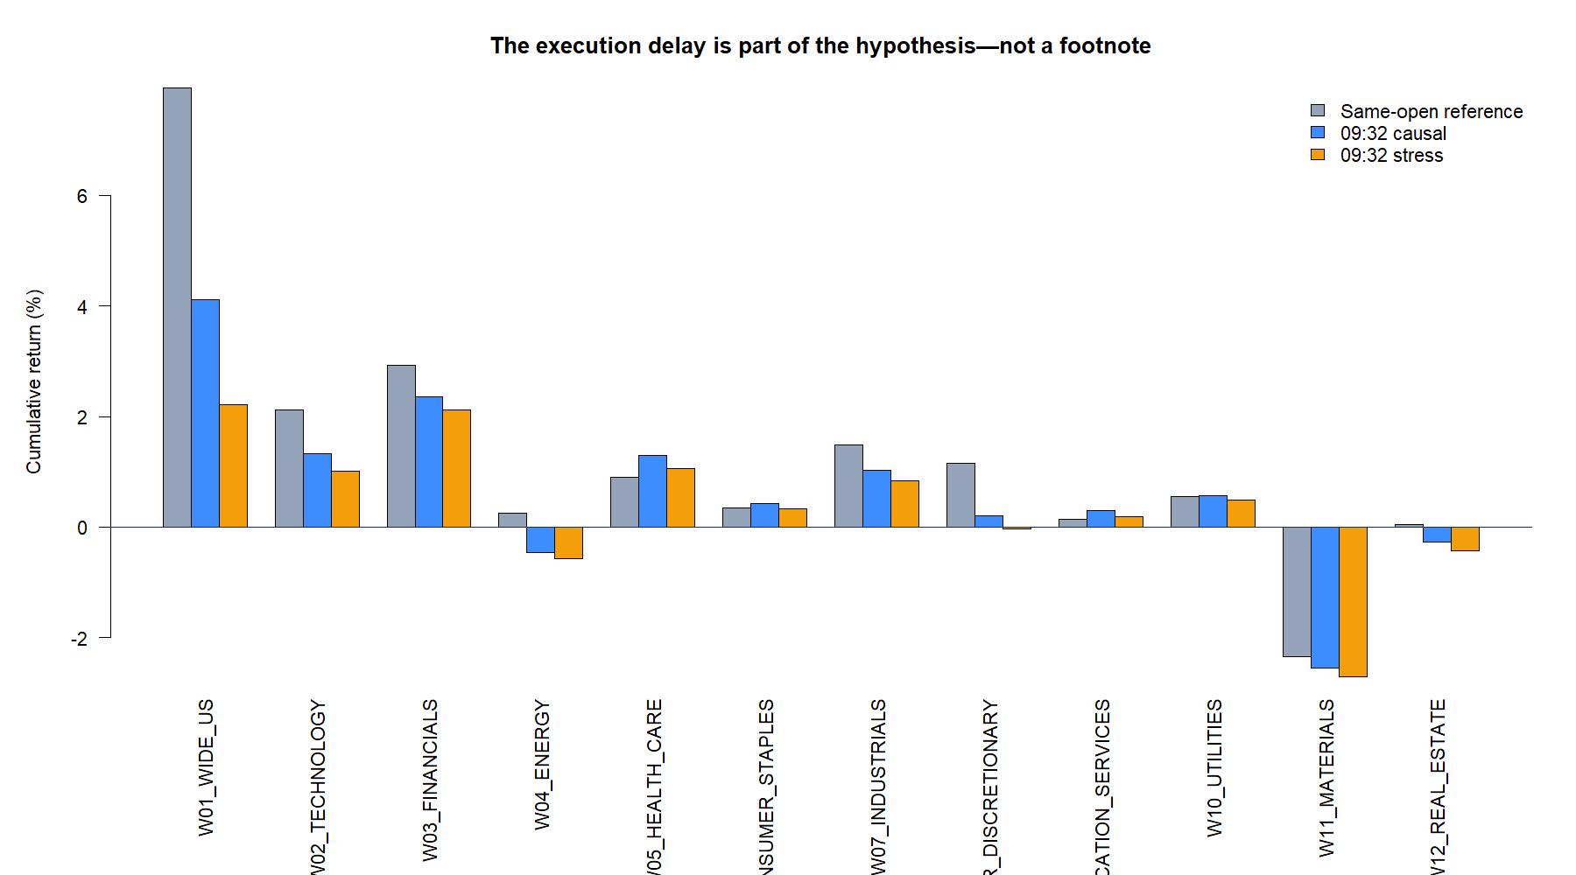
Causal execution stayed positive—but below the source curve
8
Notes:
The noncausal same-open reference gained 7.94%, versus 4.12% for the 09:32 primary path and 2.21% under stress costs. The gap is economically meaningful: execution timing is part of the hypothesis, not a footnote.
[Sources]
- C:\Users\Franc\OneDrive\Documents\Francis\Peltata Project\Time-Series-Modeling-Gen5\runs\research_workbench\literature_grounded\lit_mr_06_1_recent_wide_atlas_02_20260730/atlas_summary.csv — W01_WIDE_US
- C:\Users\Franc\OneDrive\Documents\Francis\Peltata Project\Time-Series-Modeling-Gen5\runs\research_workbench\literature_grounded\lit_mr_06_1_recent_wide_atlas_02_20260730/visuals/mr06_source_vs_causal.png

Slide 9
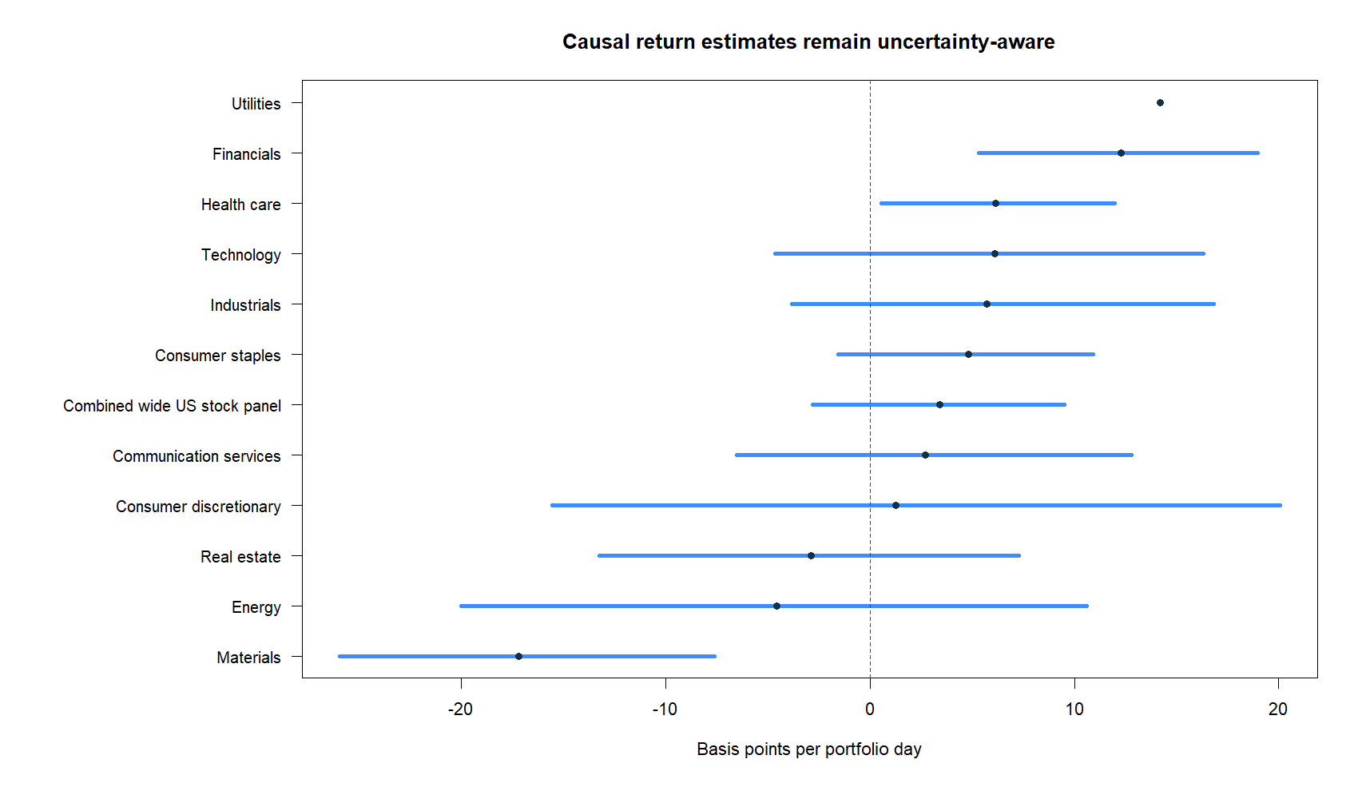
A positive estimate did not clear uncertainty
The wide panel averaged +3.42 bp per active portfolio day after primary costs.
But bootstrap resampling asks a harder question: how low could the repeatable mean plausibly be, given the observed sample?
Its one-sided 90% lower bound was −2.81 bp/day. That does not prove the edge is negative; it means this TRAIN sample cannot rule out a non-positive true mean.
The frozen conjunction therefore stops before DEVELOPMENT.
9
Notes:
A confidence bound is not the same thing as the observed average. The point estimate answers what happened in this sample. The lower bound summarizes estimation uncertainty under the predeclared bootstrap procedure. Gate 5 requires the lower bound to be strictly positive.
[Sources]
- C:\Users\Franc\OneDrive\Documents\Francis\Peltata Project\Time-Series-Modeling-Gen5\runs\research_workbench\literature_grounded\lit_mr_06_1_recent_wide_atlas_02_20260730/atlas_summary.csv
- C:\Users\Franc\OneDrive\Documents\Francis\Peltata Project\Time-Series-Modeling-Gen5\runs\research_workbench\literature_grounded\lit_mr_06_1_recent_wide_atlas_02_20260730/visuals/mr06_return_intervals.png
- C:\Users\Franc\OneDrive\Documents\Francis\Peltata Project\Time-Series-Modeling-Gen5\literature_studies\docs\GEN5_LIT_MR_06_1_RECENT_WIDE_ATLAS_02_CONTRACT.md

Slide 10
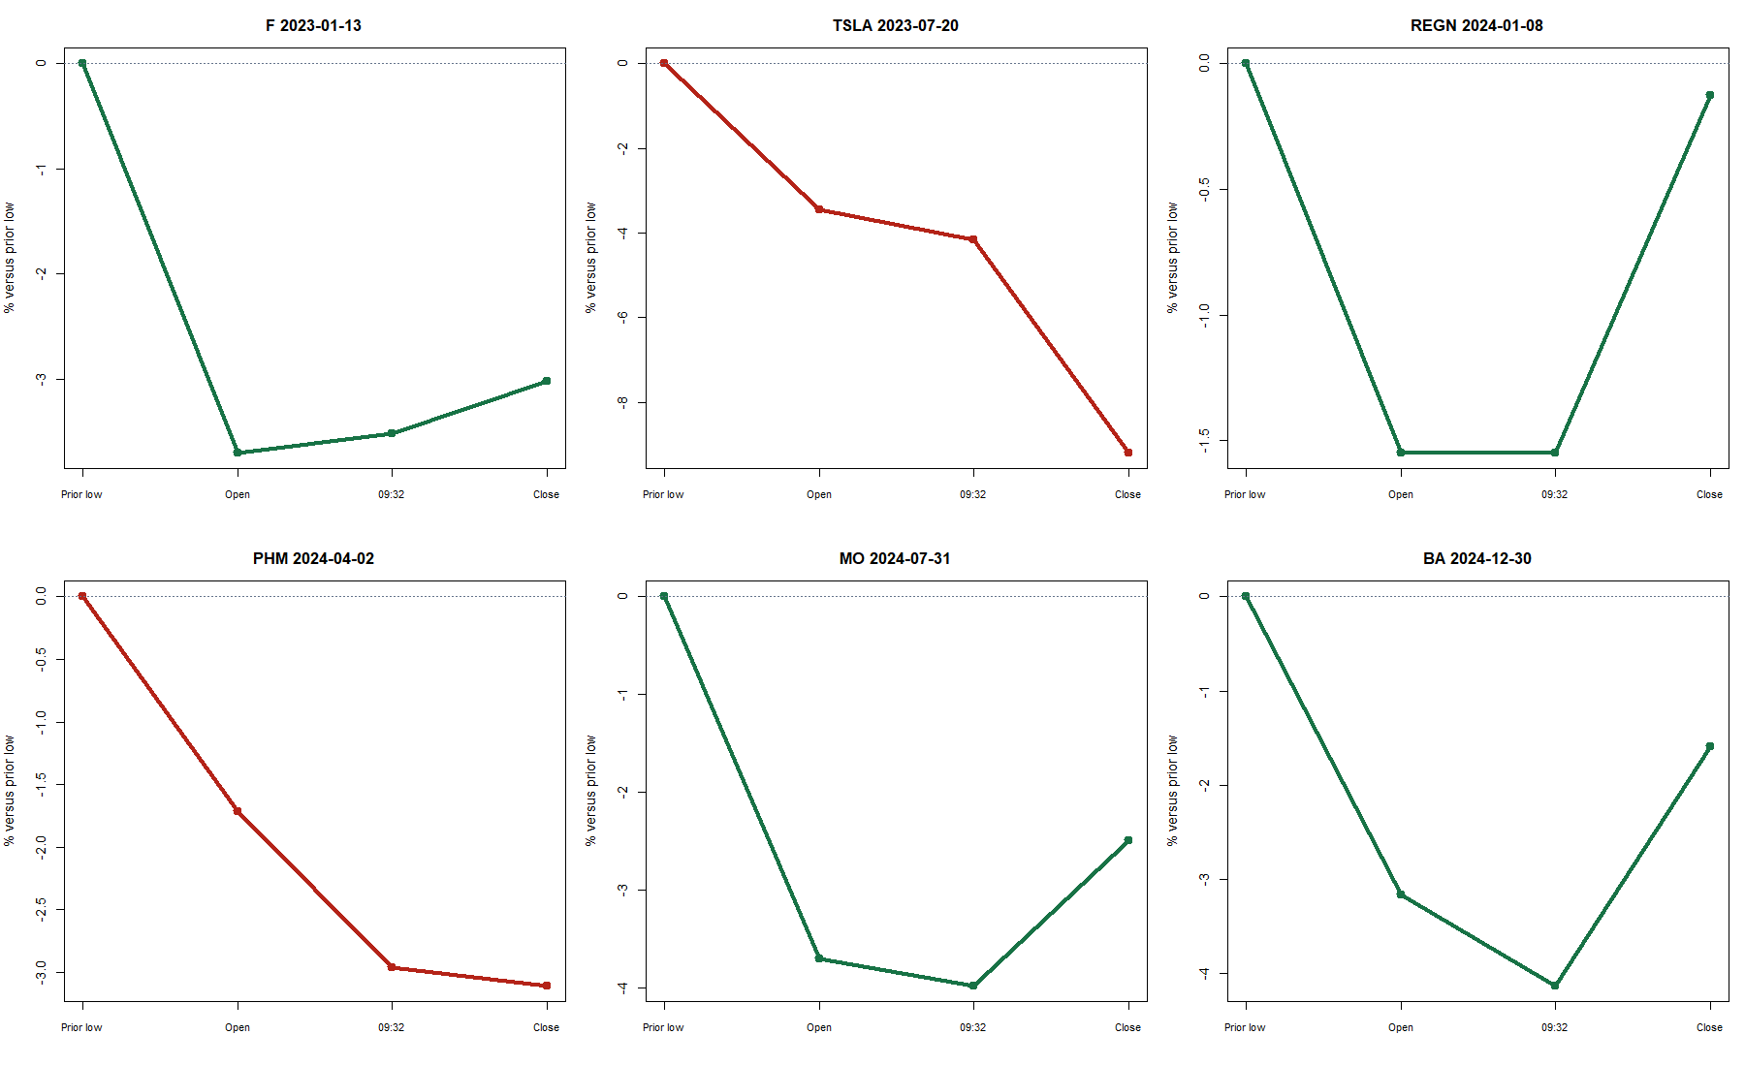
Individual gaps rebound—and sometimes keep falling
10
Notes:
Representative event panels show why average performance and direction accuracy are both useful. The rule often catches an intraday rebound, but it does not prevent a weak open from continuing lower. The strategy is a probabilistic cross-sectional rule, not a deterministic reversal detector.
[Sources]
- C:\Users\Franc\OneDrive\Documents\Francis\Peltata Project\Time-Series-Modeling-Gen5\runs\research_workbench\literature_grounded\lit_mr_06_1_recent_wide_atlas_02_20260730/selected_event_tape.csv
- C:\Users\Franc\OneDrive\Documents\Francis\Peltata Project\Time-Series-Modeling-Gen5\runs\research_workbench\literature_grounded\lit_mr_06_1_recent_wide_atlas_02_20260730/visuals/mr06_representative_events.png

Slide 11
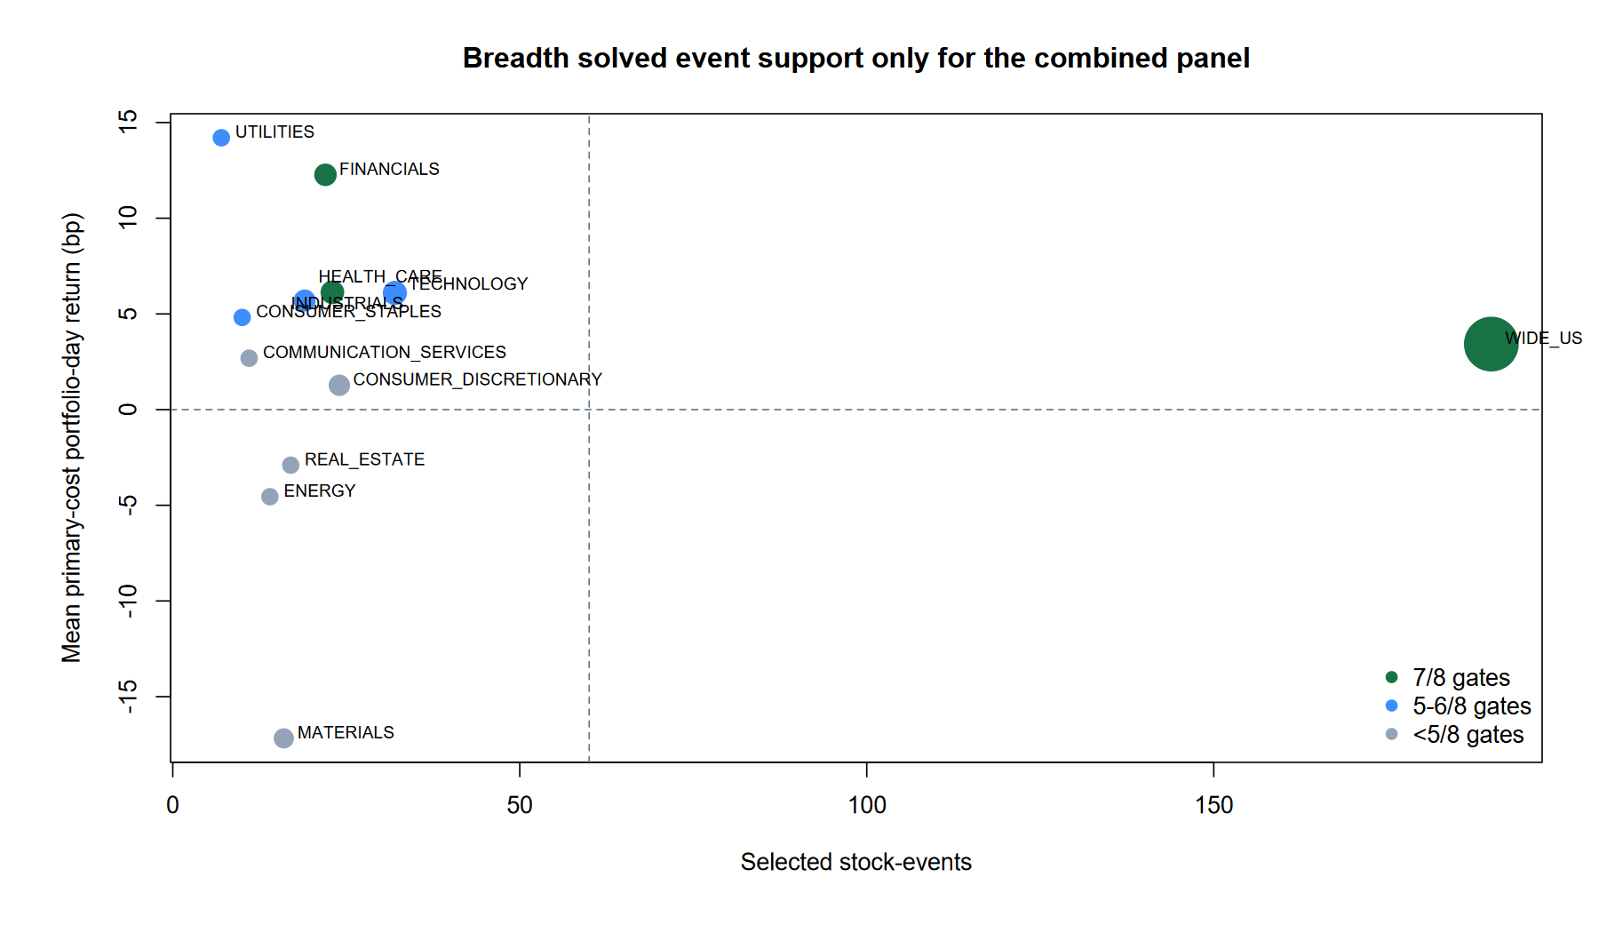
Breadth solved support only in the combined panel
WIDE_US reached 190 selected stock-events and 121 portfolio days—comfortably beyond the frozen support floor.
Every individual sector panel remained below support. Financials had 22 events across 19 days; health care had 23 across 21 days.
Their high average returns are therefore fragile small-sample observations, not nominees.
Energy, materials, and real estate also produced negative mean daily returns.
11
Notes:
The vertical dashed line marks the 60-stock-event support floor. The horizontal line marks zero average return. Bubble size reflects portfolio days. Only the combined panel crosses the support threshold.
[Sources]
- C:\Users\Franc\OneDrive\Documents\Francis\Peltata Project\Time-Series-Modeling-Gen5\runs\research_workbench\literature_grounded\lit_mr_06_1_recent_wide_atlas_02_20260730/atlas_summary.csv
- C:\Users\Franc\OneDrive\Documents\Francis\Peltata Project\Time-Series-Modeling-Gen5\runs\research_workbench\literature_grounded\lit_mr_06_1_recent_wide_atlas_02_20260730/visuals/mr06_recent_support_return_map.png

Slide 12
Sector near-misses remain observations—not nominees
Financials and health care each passed seven gates with positive lower bounds, but both lacked the predeclared event/day support. Promoting them would quietly discard the conjunction after seeing outcomes.
FINANCIALS
HEALTH CARE
0 / 12
+2.35% primary; 19 days
7/8 gates; support failed
+1.29% primary; 21 days
7/8 gates; support failed
Full TRAIN passes
DEVELOPMENT remained sealed
12
Notes:
Financials and health care are useful diagnostics for future hypothesis design, but their small samples make annualized Sharpe figures unstable and easy to over-interpret. This deck does not treat them as sector selection evidence.
[Sources]
- C:\Users\Franc\OneDrive\Documents\Francis\Peltata Project\Time-Series-Modeling-Gen5\runs\research_workbench\literature_grounded\lit_mr_06_1_recent_wide_atlas_02_20260730/atlas_summary.csv — W03_FINANCIALS and W05_HEALTH_CARE
- C:\Users\Franc\OneDrive\Documents\Francis\Peltata Project\Time-Series-Modeling-Gen5\runs\research_workbench\literature_grounded\lit_mr_06_1_recent_wide_atlas_02_20260730/atlas_gates.csv

Slide 13
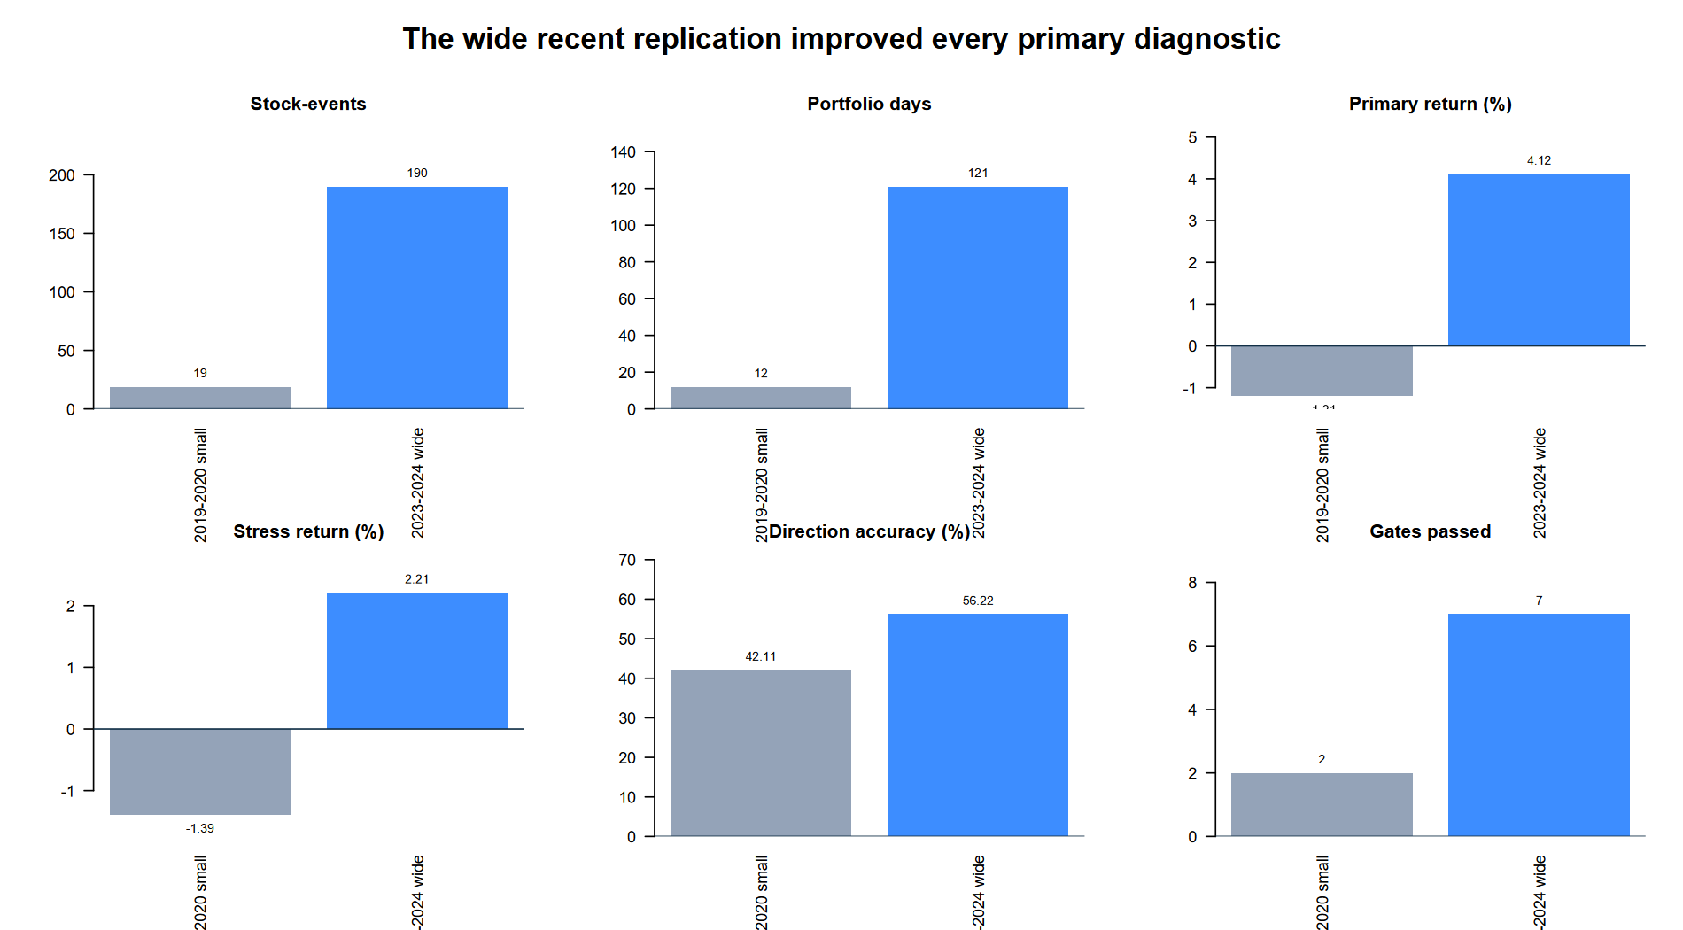
Recent breadth improved every primary diagnostic—but dates also changed
13
Notes:
The initial broad control had 19 selected events across 12 days, lost 1.21% under primary costs, achieved 42.1% direction accuracy, and passed 2/8 gates. The recent wide panel had 190 events across 121 days, gained 4.12%, achieved 56.2% direction accuracy, and passed 7/8. Because both dates and universe breadth changed, this comparison cannot isolate the causal source of improvement.
[Sources]
- C:/Users/Franc/OneDrive/Documents/Francis/Peltata Project/Time-Series-Modeling-Gen5/runs/research_workbench/literature_grounded/lit_mr_06_1_buy_on_gap_20260730_v2/atlas_summary.csv — G01_BROAD_US
- C:\Users\Franc\OneDrive\Documents\Francis\Peltata Project\Time-Series-Modeling-Gen5\runs\research_workbench\literature_grounded\lit_mr_06_1_recent_wide_atlas_02_20260730/atlas_summary.csv — W01_WIDE_US
- C:\Users\Franc\OneDrive\Documents\Francis\Peltata Project\Time-Series-Modeling-Gen5\runs\research_workbench\literature_grounded\lit_mr_06_1_recent_wide_atlas_02_20260730/visuals/mr06_initial_recent_comparison.png

Slide 14
RECENT TEXTBOOK REPLICATION COMPLETE | OOS REMAINS SEALED
This is a promising near-pass.
It is not a promoted strategy.
Broadness fixed support; uncertainty still failed. Preserve the 7/8 result, avoid rescue tuning, and choose the next hypothesis deliberately.
Notes:
The correct decision is STOP for this frozen batch. No DEVELOPMENT outcome was queried. The result is still valuable: a much broader and more recent stock panel materially improved the evidence while preserving the causal implementation.
[Sources]
- C:\Users\Franc\OneDrive\Documents\Francis\Peltata Project\Time-Series-Modeling-Gen5\literature_studies\docs\GEN5_LIT_MR_06_1_RECENT_WIDE_ATLAS_02_CONTRACT.md
- C:\Users\Franc\OneDrive\Documents\Francis\Peltata Project\Time-Series-Modeling-Gen5\runs\research_workbench\literature_grounded\lit_mr_06_1_recent_wide_atlas_02_20260730/run_spec.csv
- C:\Users\Franc\OneDrive\Documents\Francis\Peltata Project\Time-Series-Modeling-Gen5\runs\research_workbench\literature_grounded\lit_mr_06_1_recent_wide_atlas_02_20260730/atlas_gates.csv

