Slide 1
GEN5 / S0A FROZEN EVIDENCE
Positive convergence.
Failed admissibility.
S0
The average moved the expected way.
The controls still rejected the mechanism.
residual
convergence
Frozen verdict: STOP_S0A_RELATIVE_VALUE_MECHANISM
Historical convergence is not historical borrow executability.
DIALOGUE D55
Notes:
Opening: the frozen S0A test is complete. Six conjunctive gates failed, so the positive average does not admit the mechanism.
Dialogue reference: D55 - codex://threads/019f741e-615f-7fd0-90f7-edce12b5cb66
[Sources]
- C:/Users/Franc/OneDrive/Documents/Francis/Peltata Project/Time-Series-Modeling-Gen5/runs/research_workbench/retail_quant_mechanisms/s0_statistical_arbitrage_20260728/s0a_report.md
- C:/Users/Franc/OneDrive/Documents/Francis/Peltata Project/Time-Series-Modeling-Gen5/runs/research_workbench/retail_quant_mechanisms/s0_statistical_arbitrage_20260728/s0a_gate_summary.csv
- C:/Users/Franc/OneDrive/Documents/Francis/Peltata Project/Time-Series-Modeling-Gen5/docs/GEN5_S0_STATISTICAL_ARBITRAGE_ADMISSIBILITY_CONTRACT.md
[/Sources]

Slide 2
TRANSITION / FROZEN VERDICT
Positive is not sufficient.
Controls decide admissibility.
S0
FROZEN STOP
31.69 bp/event was positive. Random selection, control matching, breadth,
and stability still failed.
DIALOGUE D55
Notes:
Verdict transition: a favorable sample average is only one of nine frozen requirements.
Dialogue reference: D55 - codex://threads/019f741e-615f-7fd0-90f7-edce12b5cb66
[Sources]
- C:/Users/Franc/OneDrive/Documents/Francis/Peltata Project/Time-Series-Modeling-Gen5/runs/research_workbench/retail_quant_mechanisms/s0_statistical_arbitrage_20260728/s0a_report.md
- C:/Users/Franc/OneDrive/Documents/Francis/Peltata Project/Time-Series-Modeling-Gen5/runs/research_workbench/retail_quant_mechanisms/s0_statistical_arbitrage_20260728/s0a_gate_summary.csv
- C:/Users/Franc/OneDrive/Documents/Francis/Peltata Project/Time-Series-Modeling-Gen5/docs/GEN5_S0_STATISTICAL_ARBITRAGE_ADMISSIBILITY_CONTRACT.md
[/Sources]

Slide 3
GEN5 / S0A FROZEN EVIDENCE
The frozen timing and claim boundary held
TRAIN-ONLY PAIR MODEL
log(A) = αTRAIN + βTRAIN log(B) + residual
504 sessions
formation close
event close
next open → endpoints
fit relationship;
rank stability
select ≤3 pairs/group;
freeze parameters
|z| ≥ 2 observed;
direction becomes known
enter next open;
measure +5 / +10 / +20
12 / 12 integrity checks passed. No same-close execution. No borrow history was imputed.
DIALOGUE D55
Notes:
Method: 504-session TRAIN, quarter OOS, after-close z-score, next-open entry, and fixed 5/10/20-session endpoints.
Dialogue reference: D55 - codex://threads/019f741e-615f-7fd0-90f7-edce12b5cb66
[Sources]
- C:/Users/Franc/OneDrive/Documents/Francis/Peltata Project/Time-Series-Modeling-Gen5/runs/research_workbench/retail_quant_mechanisms/s0_statistical_arbitrage_20260728/s0a_report.md
- C:/Users/Franc/OneDrive/Documents/Francis/Peltata Project/Time-Series-Modeling-Gen5/runs/research_workbench/retail_quant_mechanisms/s0_statistical_arbitrage_20260728/s0a_gate_summary.csv
- C:/Users/Franc/OneDrive/Documents/Francis/Peltata Project/Time-Series-Modeling-Gen5/docs/GEN5_S0_STATISTICAL_ARBITRAGE_ADMISSIBILITY_CONTRACT.md
[/Sources]

Slide 4
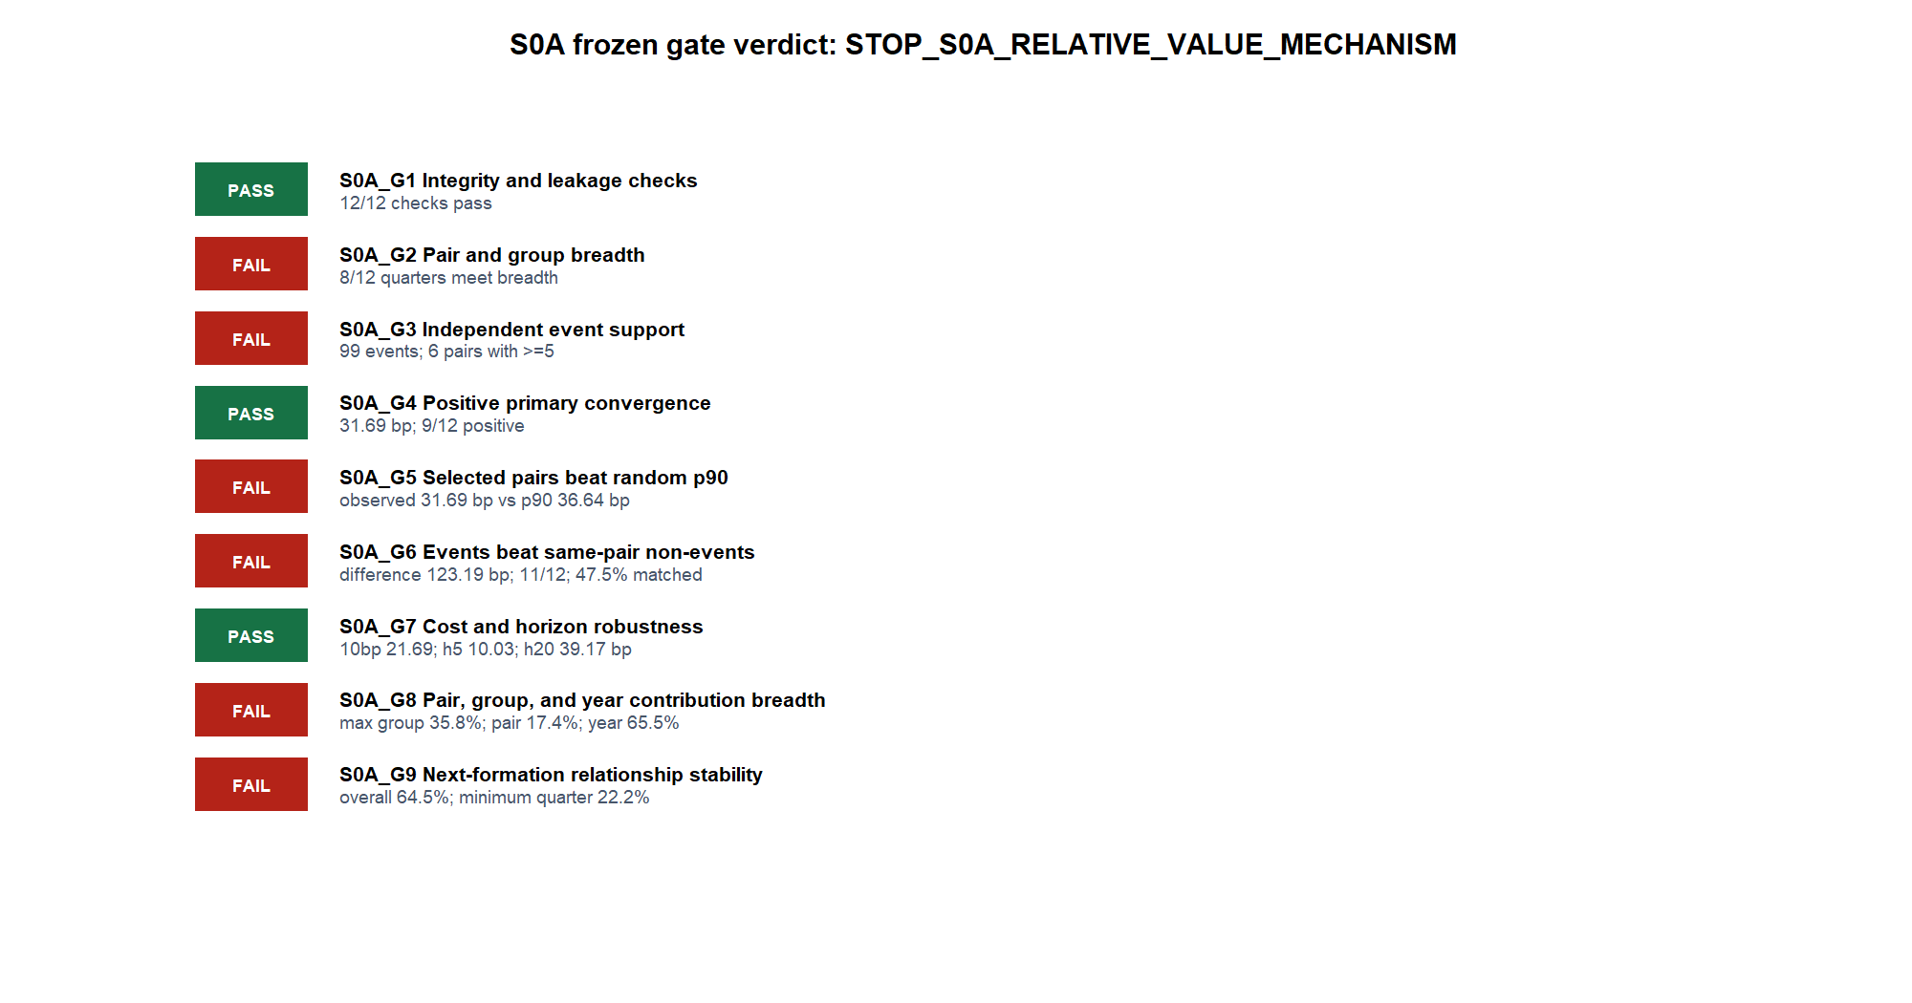
GEN5 / S0A FROZEN EVIDENCE
Six of nine conjunctive gates failed
DIALOGUE D55
Notes:
Gate readout: integrity, positive primary convergence, and cost/horizon robustness passed. Gates 2, 3, 5, 6, 8, and 9 failed.
Dialogue reference: D55 - codex://threads/019f741e-615f-7fd0-90f7-edce12b5cb66
[Sources]
- C:/Users/Franc/OneDrive/Documents/Francis/Peltata Project/Time-Series-Modeling-Gen5/runs/research_workbench/retail_quant_mechanisms/s0_statistical_arbitrage_20260728/s0a_report.md
- C:/Users/Franc/OneDrive/Documents/Francis/Peltata Project/Time-Series-Modeling-Gen5/runs/research_workbench/retail_quant_mechanisms/s0_statistical_arbitrage_20260728/s0a_gate_summary.csv
- C:/Users/Franc/OneDrive/Documents/Francis/Peltata Project/Time-Series-Modeling-Gen5/docs/GEN5_S0_STATISTICAL_ARBITRAGE_ADMISSIBILITY_CONTRACT.md
[/Sources]

Slide 5
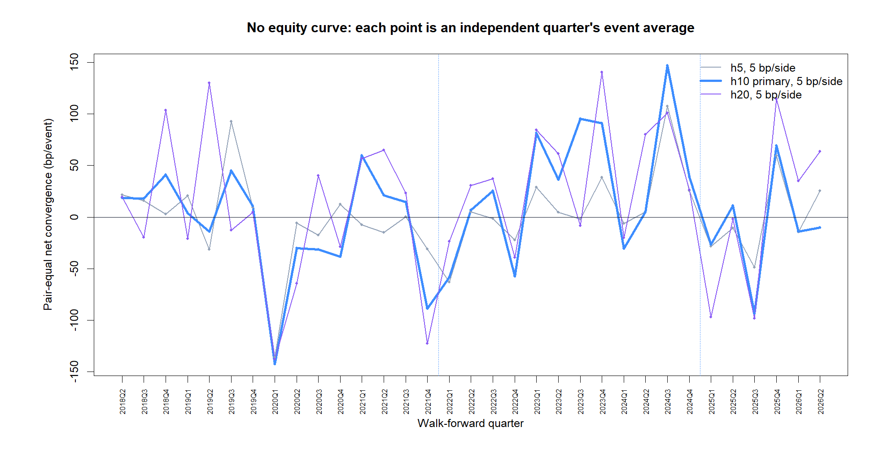
GEN5 / S0A FROZEN EVIDENCE
Positive convergence was real—but not reliably selected
DIALOGUE D55
Notes:
Confirmation: primary h10 net convergence averaged 31.69 bp/event and was positive in 9/12 quarters. This passed G4 but is not sufficient.
Dialogue reference: D55 - codex://threads/019f741e-615f-7fd0-90f7-edce12b5cb66
[Sources]
- C:/Users/Franc/OneDrive/Documents/Francis/Peltata Project/Time-Series-Modeling-Gen5/runs/research_workbench/retail_quant_mechanisms/s0_statistical_arbitrage_20260728/s0a_report.md
- C:/Users/Franc/OneDrive/Documents/Francis/Peltata Project/Time-Series-Modeling-Gen5/runs/research_workbench/retail_quant_mechanisms/s0_statistical_arbitrage_20260728/s0a_gate_summary.csv
- C:/Users/Franc/OneDrive/Documents/Francis/Peltata Project/Time-Series-Modeling-Gen5/docs/GEN5_S0_STATISTICAL_ARBITRAGE_ADMISSIBILITY_CONTRACT.md
[/Sources]

Slide 6
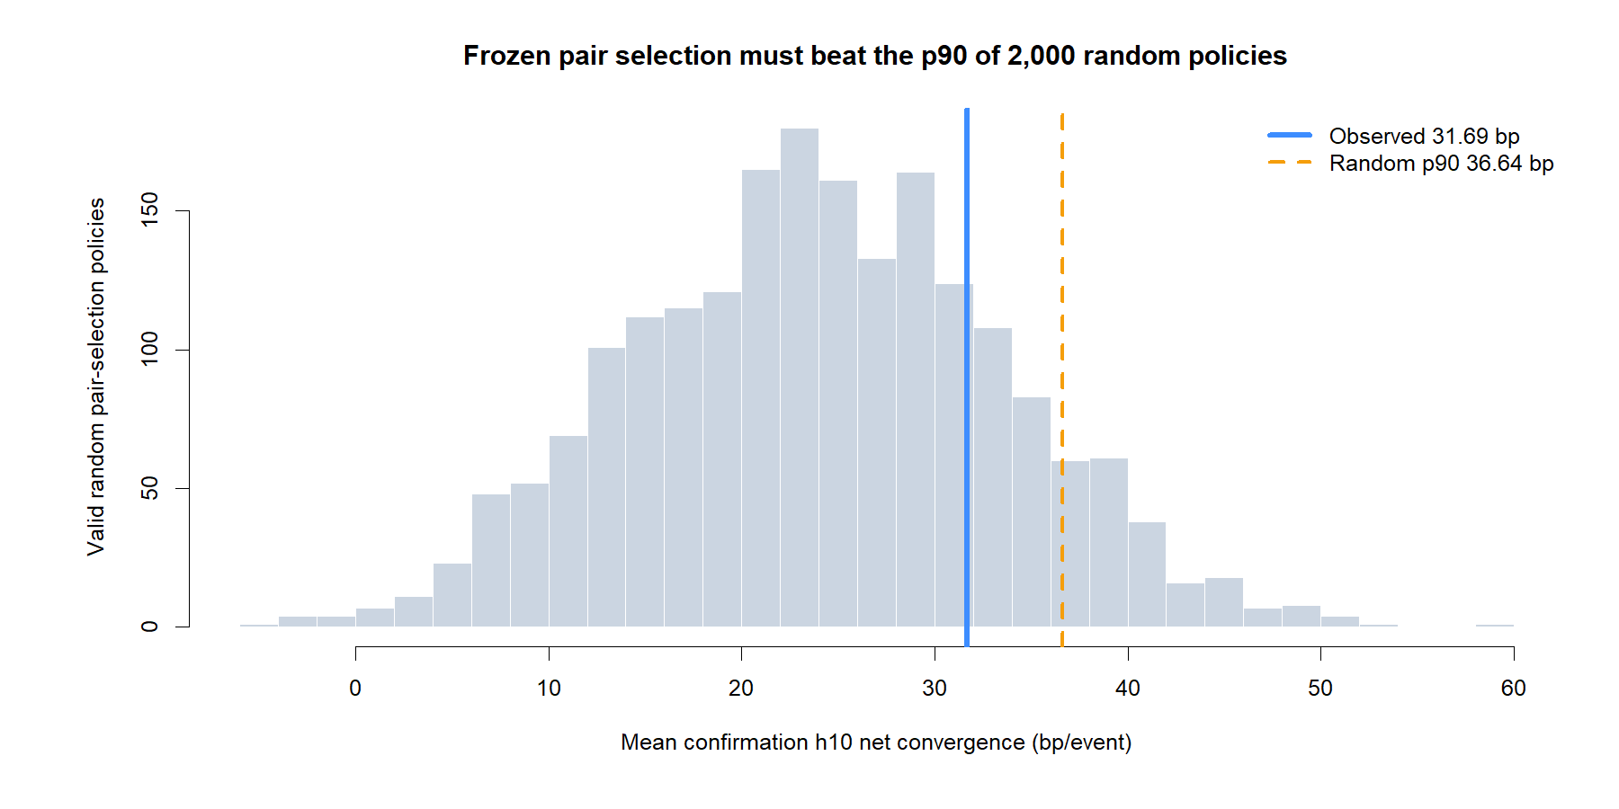
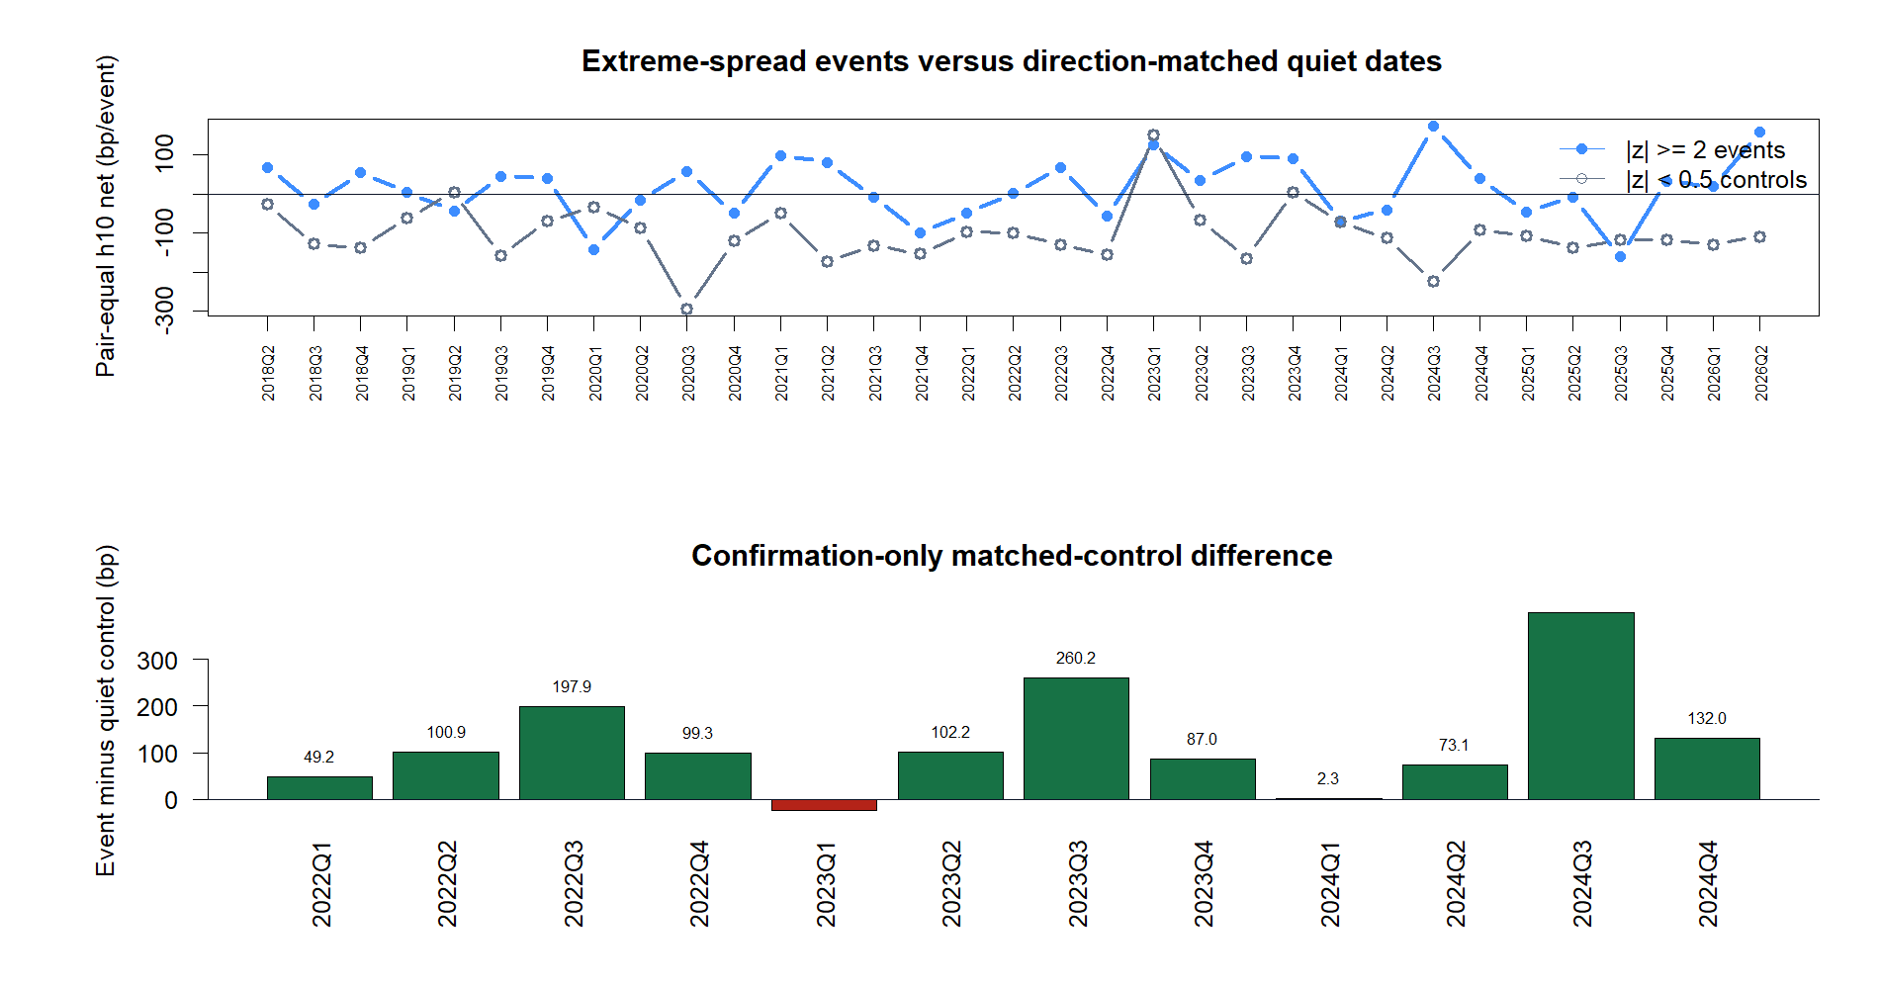
GEN5 / S0A FROZEN EVIDENCE
Both falsification controls reject a clean selection claim
DIALOGUE D55
Notes:
G5 failed because observed selection did not beat the random-policy p90. G6 failed despite a positive event-minus-control difference because only 47.5% of events could be matched to quiet controls.
Dialogue reference: D55 - codex://threads/019f741e-615f-7fd0-90f7-edce12b5cb66
[Sources]
- C:/Users/Franc/OneDrive/Documents/Francis/Peltata Project/Time-Series-Modeling-Gen5/runs/research_workbench/retail_quant_mechanisms/s0_statistical_arbitrage_20260728/s0a_report.md
- C:/Users/Franc/OneDrive/Documents/Francis/Peltata Project/Time-Series-Modeling-Gen5/runs/research_workbench/retail_quant_mechanisms/s0_statistical_arbitrage_20260728/s0a_gate_summary.csv
- C:/Users/Franc/OneDrive/Documents/Francis/Peltata Project/Time-Series-Modeling-Gen5/docs/GEN5_S0_STATISTICAL_ARBITRAGE_ADMISSIBILITY_CONTRACT.md
[/Sources]

Slide 7
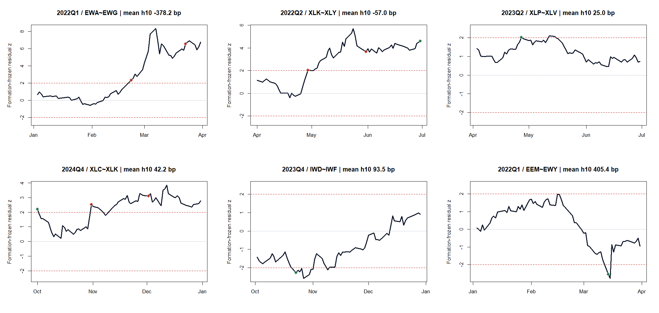
GEN5 / S0A FROZEN EVIDENCE
Representative tapes show convergence and structural breaks
DIALOGUE D55
Notes:
Representative confirmation tapes include strong wins, losses, and relationships that drift rather than mean-revert. Green markers are positive h10 outcomes; red markers are negative.
Dialogue reference: D55 - codex://threads/019f741e-615f-7fd0-90f7-edce12b5cb66
[Sources]
- C:/Users/Franc/OneDrive/Documents/Francis/Peltata Project/Time-Series-Modeling-Gen5/runs/research_workbench/retail_quant_mechanisms/s0_statistical_arbitrage_20260728/s0a_report.md
- C:/Users/Franc/OneDrive/Documents/Francis/Peltata Project/Time-Series-Modeling-Gen5/runs/research_workbench/retail_quant_mechanisms/s0_statistical_arbitrage_20260728/s0a_gate_summary.csv
- C:/Users/Franc/OneDrive/Documents/Francis/Peltata Project/Time-Series-Modeling-Gen5/docs/GEN5_S0_STATISTICAL_ARBITRAGE_ADMISSIBILITY_CONTRACT.md
[/Sources]

Slide 8
TRANSITION / OPERATOR STOP
S0A stops here—
S0B stays closed.
S0
STOP RECORDED
Do not rescue the inspected contract by retuning the ETF panel, formation,
threshold, controls, or confirmation window.
DIALOGUE D55
Notes:
Operator consequence: S0B prospective borrow shadow is not opened because every S0A gate did not pass.
Dialogue reference: D55 - codex://threads/019f741e-615f-7fd0-90f7-edce12b5cb66
[Sources]
- C:/Users/Franc/OneDrive/Documents/Francis/Peltata Project/Time-Series-Modeling-Gen5/runs/research_workbench/retail_quant_mechanisms/s0_statistical_arbitrage_20260728/s0a_report.md
- C:/Users/Franc/OneDrive/Documents/Francis/Peltata Project/Time-Series-Modeling-Gen5/runs/research_workbench/retail_quant_mechanisms/s0_statistical_arbitrage_20260728/s0a_gate_summary.csv
- C:/Users/Franc/OneDrive/Documents/Francis/Peltata Project/Time-Series-Modeling-Gen5/docs/GEN5_S0_STATISTICAL_ARBITRAGE_ADMISSIBILITY_CONTRACT.md
[/Sources]

