Slide 1
SESSION 14
News adds modest uncertainty information
beyond the observable tape.
12/12 conditional quarters | mean rho 0.088 | policies/models zero
S14/01
Notes:
SESSION 14 - NEWS NONREDUNDANCY N1C
Purpose
Test whether the frozen N1B issuer-local news intensity retains future h5 path-volatility ordering after accounting for prior h5 path volatility and current dollar-volume surprise.
Result
Mean fold correlation declines from 0.1073 raw to 0.0878 conditional and remains positive in all 12 quarters. This is stable but modest incremental uncertainty information, not a trade signal.
Conversation: codex://threads/019f741e-615f-7fd0-90f7-edce12b5cb66
Find in chat: Approved, proceed
Decision: D37
[Sources]
- runs/research_workbench/gen54_ml_decision_engine/g54_news_n1c_20260725/n1c_report.md
- docs/GEN5_4_NEWS_NONREDUNDANCY_N1C_CONTRACT.md
[/Sources]

Slide 2
N1C froze the N1B signal and added only two tape controls
FROZEN INPUT
OHLCV CONTROLS
PRIMARY TEST
same N1B rows + news ECDF
same future h5 outcome
prior h5 path volatility
current / prior-60 dollar volume
fold partial Spearman
mean > 0 and >= 8 / 12
Alternate controls, horizons, sentiment, models, exposure, allocation, and PnL: zero.
D37/02
Notes:
DECISION D37 - FROZEN N1C METHOD
Input and outcome
N1C consumes the accepted N1B OOS population without changing its issuer-local TRAIN ECDF news measurement or TRAIN-scaled future h5 path-volatility outcome.
Controls
The prior-volatility control is the backward five-session path ending on the decision session, divided by the issuer-fold TRAIN median. Dollar-volume surprise is log of current adjusted close times volume divided by the median of exactly the prior 60 sessions; the current session is excluded from that baseline.
Statistic
Within each OOS quarter, rank news, outcome, and both controls. Residualize the news and outcome ranks against both control ranks, then correlate the residuals. This is evaluation, not model fitting.
[Sources]
- docs/GEN5_4_NEWS_NONREDUNDANCY_N1C_CONTRACT.md
- runs/research_workbench/gen54_ml_decision_engine/g54_news_n1c_20260725/n1c_report.md
[/Sources]

Slide 3
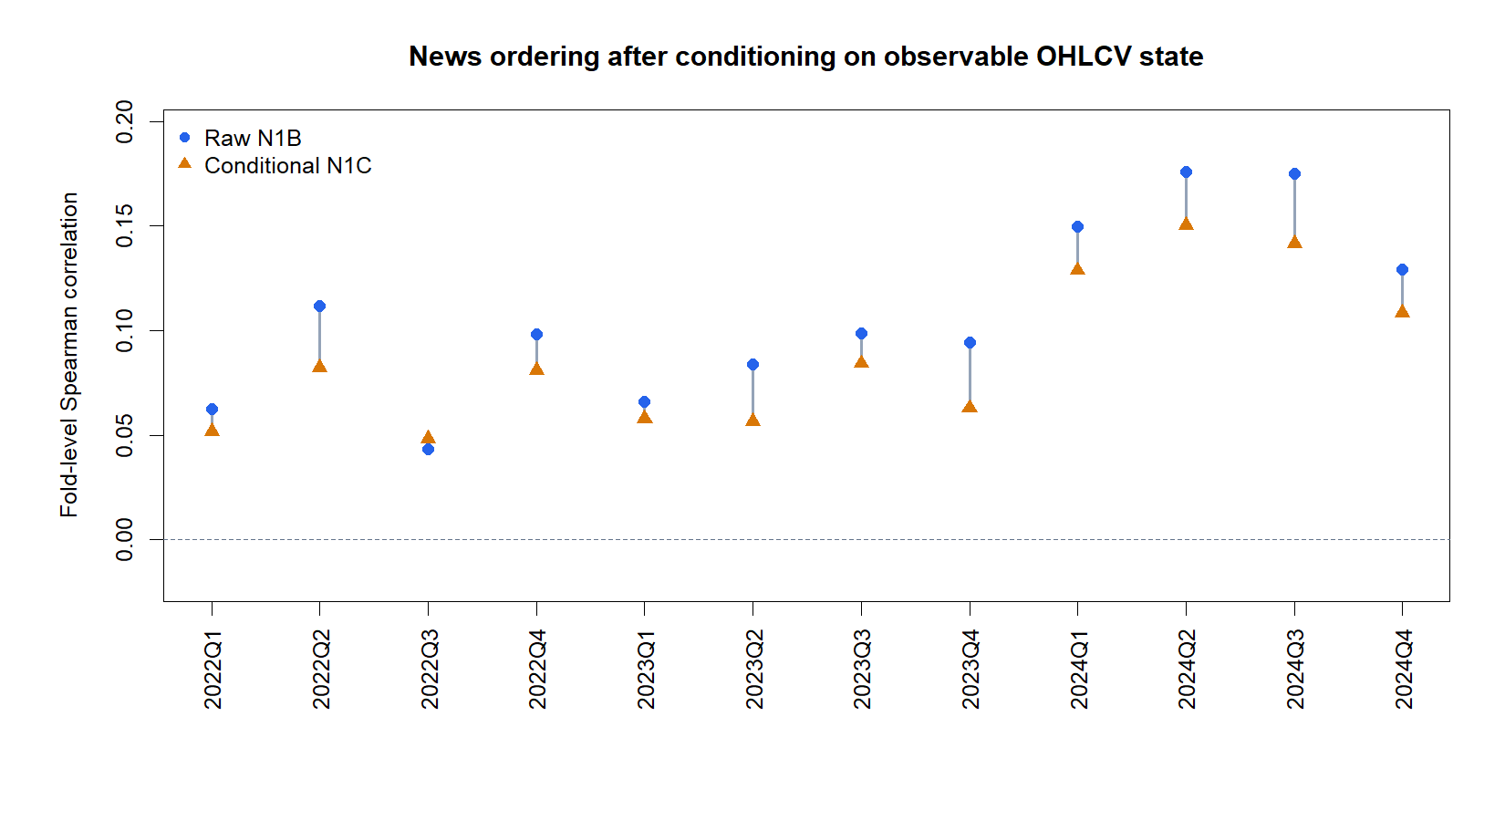
Conditioning trims the effect, but every quarter remains positive
D37/03
Notes:
DECISION D37 - PRIMARY NONREDUNDANCY EVIDENCE
Evidence
Mean raw fold Spearman is 0.1073. Mean conditional fold Spearman is 0.0878, an average attenuation of 0.0195. Conditional correlation is positive in all 12 OOS quarters versus the frozen requirement of at least 8.
Meaning
The two OHLCV controls explain part of the association, as expected, but do not remove its cross-quarter ordering. The magnitude remains modest; stability is the main evidence.
Boundary
Overlapping h5 outcomes make naive row-level significance tests inappropriate. No causal, directional, or trading claim follows.
[Sources]
- runs/research_workbench/gen54_ml_decision_engine/g54_news_n1c_20260725/n1c_report.md
- runs/research_workbench/gen54_ml_decision_engine/g54_news_n1c_20260725/n1c_fold_summary.csv
[/Sources]

Slide 4
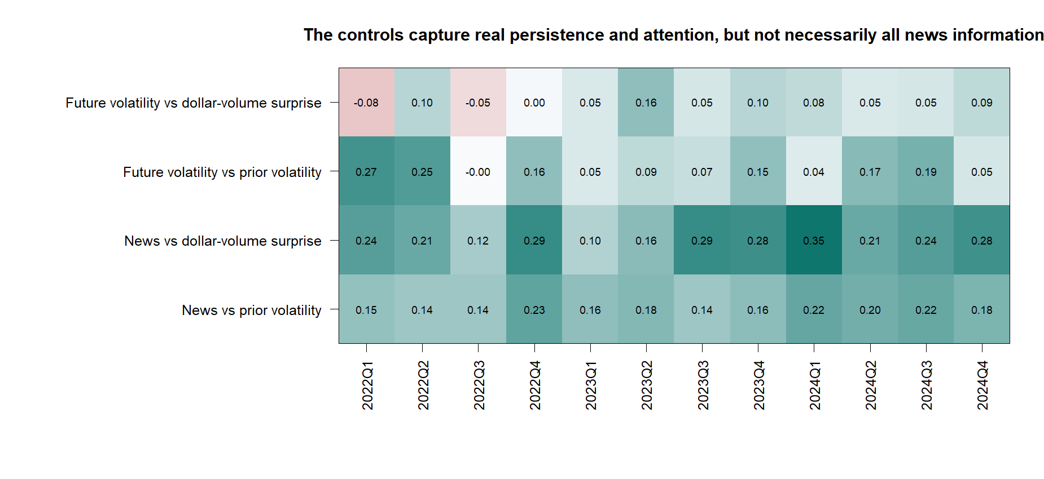
The controls capture real persistence and attention—not the whole relationship
D37/04
Notes:
DECISION D37 - WHAT THE CONTROLS ABSORB
Evidence
News intensity is positively associated with prior volatility and especially with same-day dollar-volume surprise in every quarter. Prior volatility also orders future volatility in most quarters. These are genuine redundancy channels.
Meaning
Conditioning is necessary: raw news counts partly reflect turbulence and attention already visible in the tape. The surviving partial relationship is therefore more informative than the raw relationship alone.
Causal boundary
Same-day volume may partly mediate the same event as news. That is acceptable here because the question is incremental system information, not causal attribution.
[Sources]
- runs/research_workbench/gen54_ml_decision_engine/g54_news_n1c_20260725/n1c_fold_summary.csv
- docs/GEN5_4_NEWS_NONREDUNDANCY_N1C_CONTRACT.md
[/Sources]

Slide 5
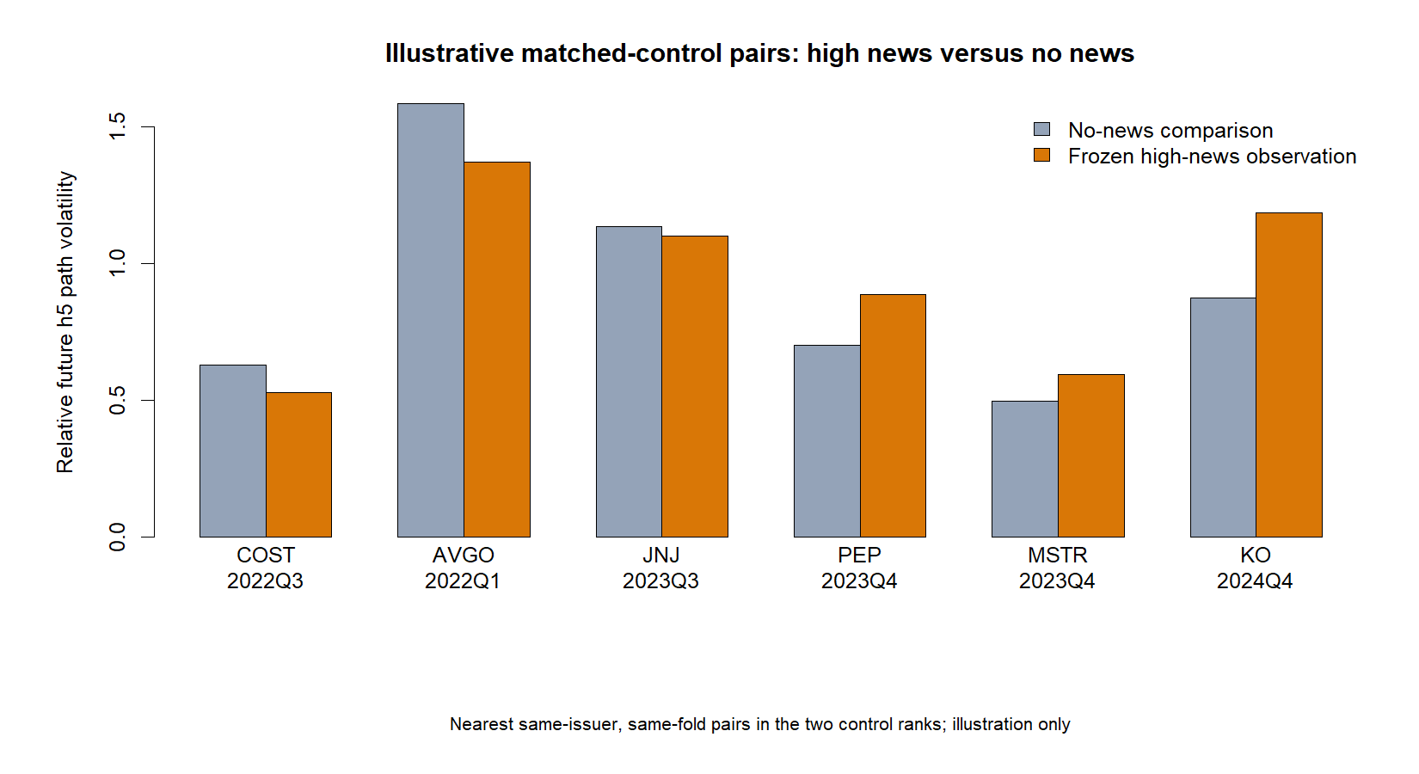
Matched examples reinforce the boundary: this is probabilistic context
D37/05
Notes:
DECISION D37 - HUMAN-FACING MATCHED EXAMPLES
Reading the chart
Each pair contains a frozen high-news observation and the nearest no-news observation for the same issuer and OOS quarter in the two control ranks. The bars show relative future h5 path volatility.
Meaning
Some high-news observations have wider future paths and some do not. These six nearest-control pairs are illustrations of uncertainty context, not independent tests or a deterministic forecast.
Selection boundary
The pair-selection rule affects only the human-facing example surface. It does not enter the N1C statistic or gates.
[Sources]
- runs/research_workbench/gen54_ml_decision_engine/g54_news_n1c_20260725/n1c_report.md
- runs/research_workbench/gen54_ml_decision_engine/g54_news_n1c_20260725/n1c_representative_matched_pairs.csv
[/Sources]

Slide 6
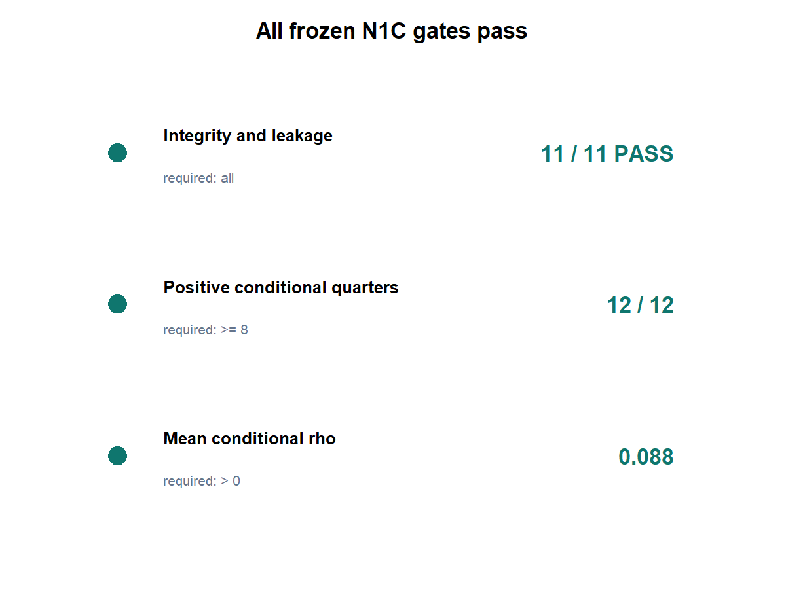
N1C passes nonredundancy; richer representation remains a separate gate
OVERALL: PASS TO MINIMAL
REPRESENTATION DISCUSSION
PASS 11 / 11 integrity checks
PASS 12 / 12 conditional quarters
PASS mean conditional rho 0.088
WATCH modest effect; attenuation 0.020
STOP No causal or directional claim
STOP No model / exposure / allocation / PnL
NEXT Discuss one recency-weighted challenger
D37/06
Notes:
DECISION D37 - PASS_N1C_TO_MINIMAL_REPRESENTATION_DISCUSSION
Authority
All 11 population, timing, TRAIN-support, and leakage checks pass. Every N1B OOS row has both controls. Raw N1B fold correlations reproduce with maximum absolute difference 4.44e-16. There are zero issuer-fold control-support failures.
Decision
All three frozen N1C gates pass. News intensity retains stable incremental uncertainty ordering beyond recent path volatility and current dollar-volume surprise.
Next boundary
Open only a theory-first discussion of one minimal representation challenger. Recency weighting is the leading candidate because information arrival should decay with age, but no challenger is yet authorized. Sentiment, direction, policy, exposure, allocation, PnL, and live advice stay closed.
Conversation: codex://threads/019f741e-615f-7fd0-90f7-edce12b5cb66
Find in chat: Approved, proceed
Decision: D37
[Sources]
- runs/research_workbench/gen54_ml_decision_engine/g54_news_n1c_20260725/n1c_report.md
- runs/research_workbench/gen54_ml_decision_engine/g54_news_n1c_20260725/n1c_leakage_audit.csv
- docs/GEN5_4_NEWS_NONREDUNDANCY_N1C_CONTRACT.md
[/Sources]

