Slide 1
OPERATOR HYPOTHESIS LAB | HYP-MOM SMA FOLLOW-UP
Two clean ideas,
neither earned confirmation
HYP-MOM-02.3 repaired re-entry | HYP-MOM-03.1 pullback reclaim
Notes:
This deck reports the distinct 2016-2020 development gates. Neither candidate advanced, so the context atlas and 2024-2025 confirmation remained unopened.
[Sources]
- C:\Users\Franc\OneDrive\Documents\Francis\Peltata Project\Time-Series-Modeling-Gen5\operator_hypothesis_lab\docs\HYP_MOM_SMA_FOLLOWUP_SERIES_CONTRACT.md
- C:\Users\Franc\OneDrive\Documents\Francis\Peltata Project\Time-Series-Modeling-Gen5\operator_hypothesis_lab\docs\HYP_MOM_02_3_03_1_DEVELOPMENT_RESULTS.md

Slide 2
A provider limitation changed warm-up—not the hypotheses
WHAT ALPACA RETURNED
PRE-OUTCOME AMENDMENT
114 complete 2016-2020 histories
8 incomplete histories
No pre-2016 observations after refresh
No strategy outcome yet computed
Keep 2016-2020 boundary
Use first 220 sessions as warm-up
Start cash on session 221
Change no signal, parent, cost, or gate
Uniform causal warm-up preserves the question; exclusions remain unreplaced.
2
Notes:
The cache limitation was detected and documented before candidate performance. The amendment solves indicator availability without importing a new provider or later evidence.
[Sources]
- C:\Users\Franc\OneDrive\Documents\Francis\Peltata Project\Time-Series-Modeling-Gen5\operator_hypothesis_lab\docs\HYP_MOM_SMA_FOLLOWUP_SERIES_CONTRACT.md
- C:\Users\Franc\OneDrive\Documents\Francis\Peltata Project\Time-Series-Modeling-Gen5\runs\research_workbench\operator_hypothesis_lab\hyp_mom_sma_followup_development_2016_2020_20260810\coverage_preflight.csv
- C:\Users\Franc\OneDrive\Documents\Francis\Peltata Project\Time-Series-Modeling-Gen5\runs\research_workbench\operator_hypothesis_lab\hyp_mom_sma_followup_development_2016_2020_20260810\query_health_preflight.csv

Slide 3
Two candidates attack different failure modes
Every decision uses Close(t); every state change fills at Open(t+1)
HYP-MOM-02.3 | RE-ENTRY REPAIR
HYP-MOM-03.1 | PULLBACK RECLAIM
Initial qualified SMA200 cross
Exit at/below SMA50
Re-enter on SMA50 reclaim above SMA200
Parent: strict 02.2 composite
Price above rising SMA200
Enter on SMA50 reclaim
Exit on SMA50 or permission loss
Parent: fresh-cross 02.1
Full-capital long-only | 5 / 10 bp per side | 500 exposure-matched circular controls
3
Notes:
02.3 asks whether strict lockout is too severe. 03.1 treats the slow average as permission and the fast average as setup/exit. Parent-relative gates prevent a candidate from passing merely because its comparator is different.
[Sources]
- C:\Users\Franc\OneDrive\Documents\Francis\Peltata Project\Time-Series-Modeling-Gen5\operator_hypothesis_lab\docs\HYP_MOM_SMA_FOLLOWUP_SERIES_CONTRACT.md

Slide 4
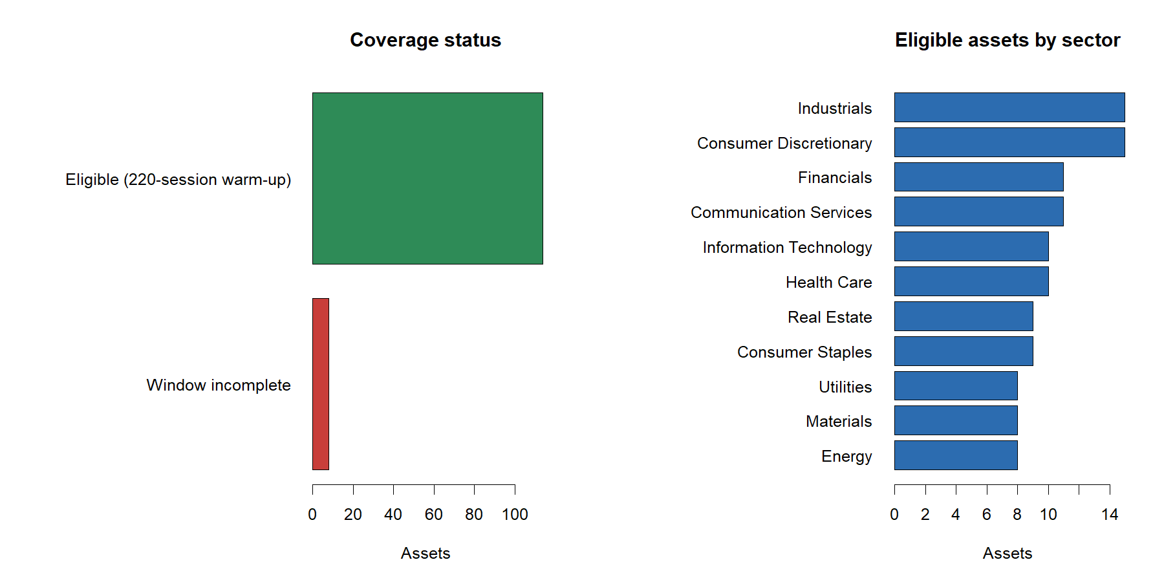
Development coverage: 114 complete names across eleven sectors
4
Notes:
The eight incomplete histories are excluded without replacement. The eligible panel retains broad sector representation.
[Sources]
- C:\Users\Franc\OneDrive\Documents\Francis\Peltata Project\Time-Series-Modeling-Gen5\runs\research_workbench\operator_hypothesis_lab\hyp_mom_sma_followup_development_2016_2020_20260810\coverage.csv

Slide 5
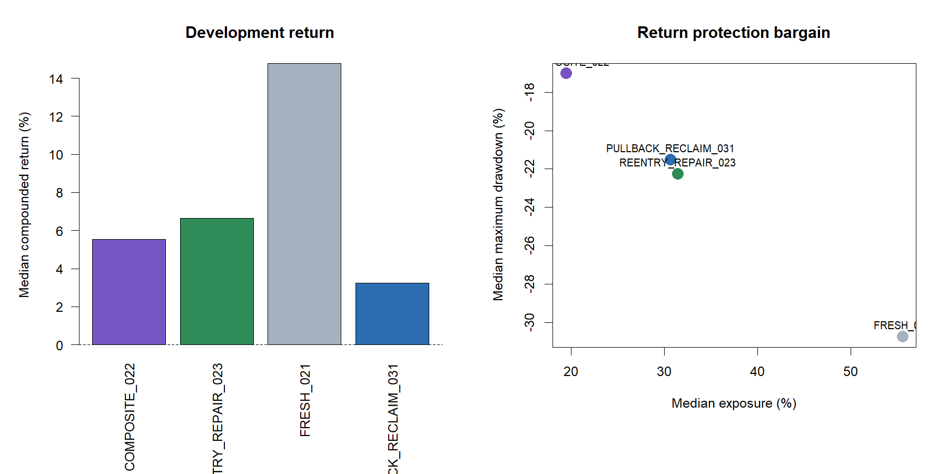
Every policy made money at the median—but timing controls disagreed
5
Notes:
Positive raw returns coexist with negative matched-control excess for every policy. The right panel shows the return/protection bargain but not timing authority.
[Sources]
- C:\Users\Franc\OneDrive\Documents\Francis\Peltata Project\Time-Series-Modeling-Gen5\runs\research_workbench\operator_hypothesis_lab\hyp_mom_sma_followup_development_2016_2020_20260810\variant_panel_summary.csv

Slide 6
02.3 added return and activity—but failed the timing bargain
+3.06 pp
54.4%
-4.40 pp
-11.68 pp
median return change
assets improved
median drawdown change
matched-control excess
versus strict 02.2 parent
just below the 55% gate
worse than parent
actual timing under shifts
Positive in four calendar years | 46.0% max sector contribution share | five gates failed
6
Notes:
Re-entry repaired some opportunity cost, but it also raised exposure, turnover, and drawdown. It did not beat exposure-matched alternative calendars.
[Sources]
- C:\Users\Franc\OneDrive\Documents\Francis\Peltata Project\Time-Series-Modeling-Gen5\runs\research_workbench\operator_hypothesis_lab\hyp_mom_sma_followup_development_2016_2020_20260810\candidate_parent_comparison.csv
- C:\Users\Franc\OneDrive\Documents\Francis\Peltata Project\Time-Series-Modeling-Gen5\runs\research_workbench\operator_hypothesis_lab\hyp_mom_sma_followup_development_2016_2020_20260810\development_gates.csv

Slide 7
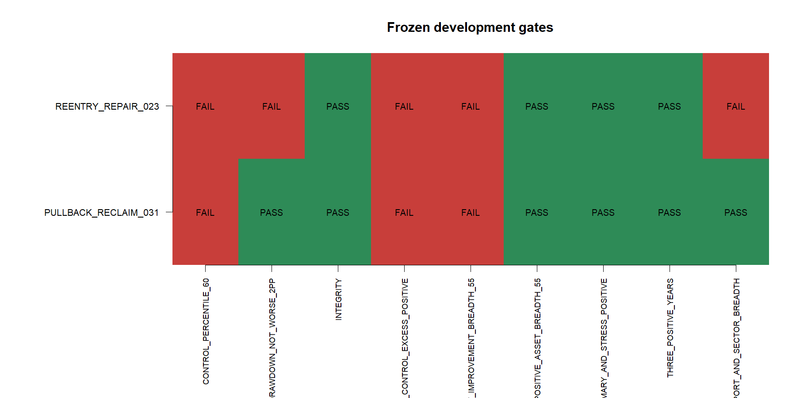
The frozen conjunction stops both candidates
7
Notes:
02.3 passes integrity, positive return/stress, asset breadth, and calendar breadth. 03.1 additionally passes trade/sector breadth and drawdown. Both fail matched controls and parent-improvement breadth.
[Sources]
- C:\Users\Franc\OneDrive\Documents\Francis\Peltata Project\Time-Series-Modeling-Gen5\runs\research_workbench\operator_hypothesis_lab\hyp_mom_sma_followup_development_2016_2020_20260810\development_gates.csv
- C:\Users\Franc\OneDrive\Documents\Francis\Peltata Project\Time-Series-Modeling-Gen5\runs\research_workbench\operator_hypothesis_lab\hyp_mom_sma_followup_development_2016_2020_20260810\nomination.csv

Slide 8
HYP-MOM-02.3 PATH AUDIT
Re-entry sometimes captures recovery—
and sometimes compounds whipsaw
CVX is near the median; NIO and FCX expose the favorable and adverse tails.
8
Notes:
These three roles were selected mechanically after the panel statistics: median parent-relative return change, largest improvement, and largest deterioration.
[Sources]
- C:\Users\Franc\OneDrive\Documents\Francis\Peltata Project\Time-Series-Modeling-Gen5\runs\research_workbench\operator_hypothesis_lab\hyp_mom_sma_followup_development_2016_2020_20260810\representative_tape_manifest.csv

Slide 9
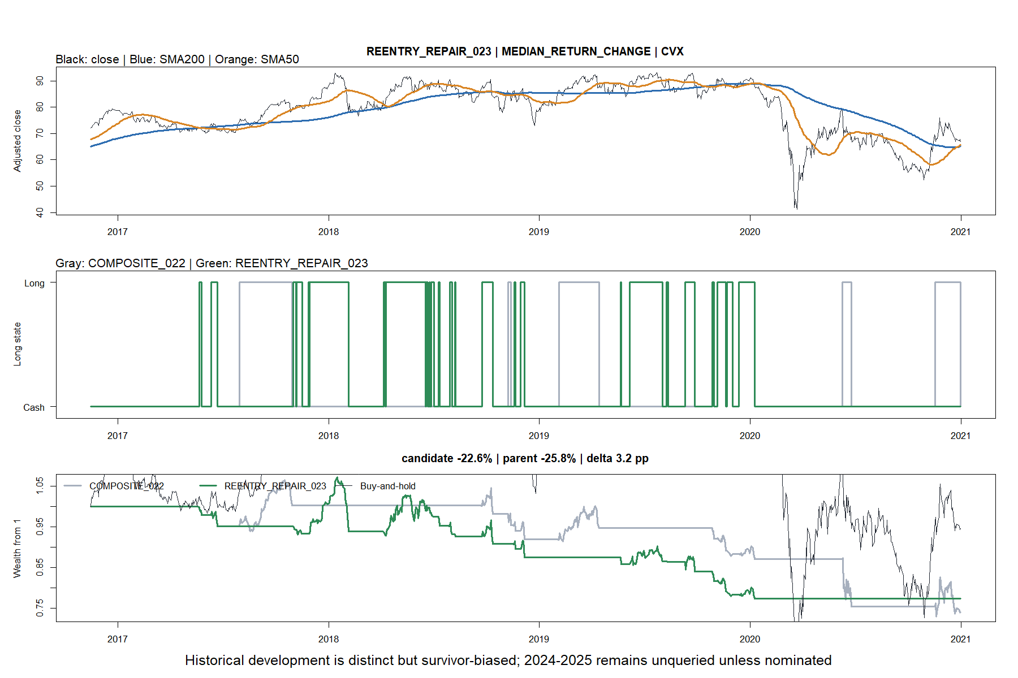
CVX: near the median, repaired re-entry modestly helped
9
Notes:
CVX changed return by +3.21 points and improved drawdown by +3.61 points. It is representative of the median delta, not of an approved asset subset.
[Sources]
- C:\Users\Franc\OneDrive\Documents\Francis\Peltata Project\Time-Series-Modeling-Gen5\runs\research_workbench\operator_hypothesis_lab\hyp_mom_sma_followup_development_2016_2020_20260810\representative_tape_manifest.csv

Slide 10
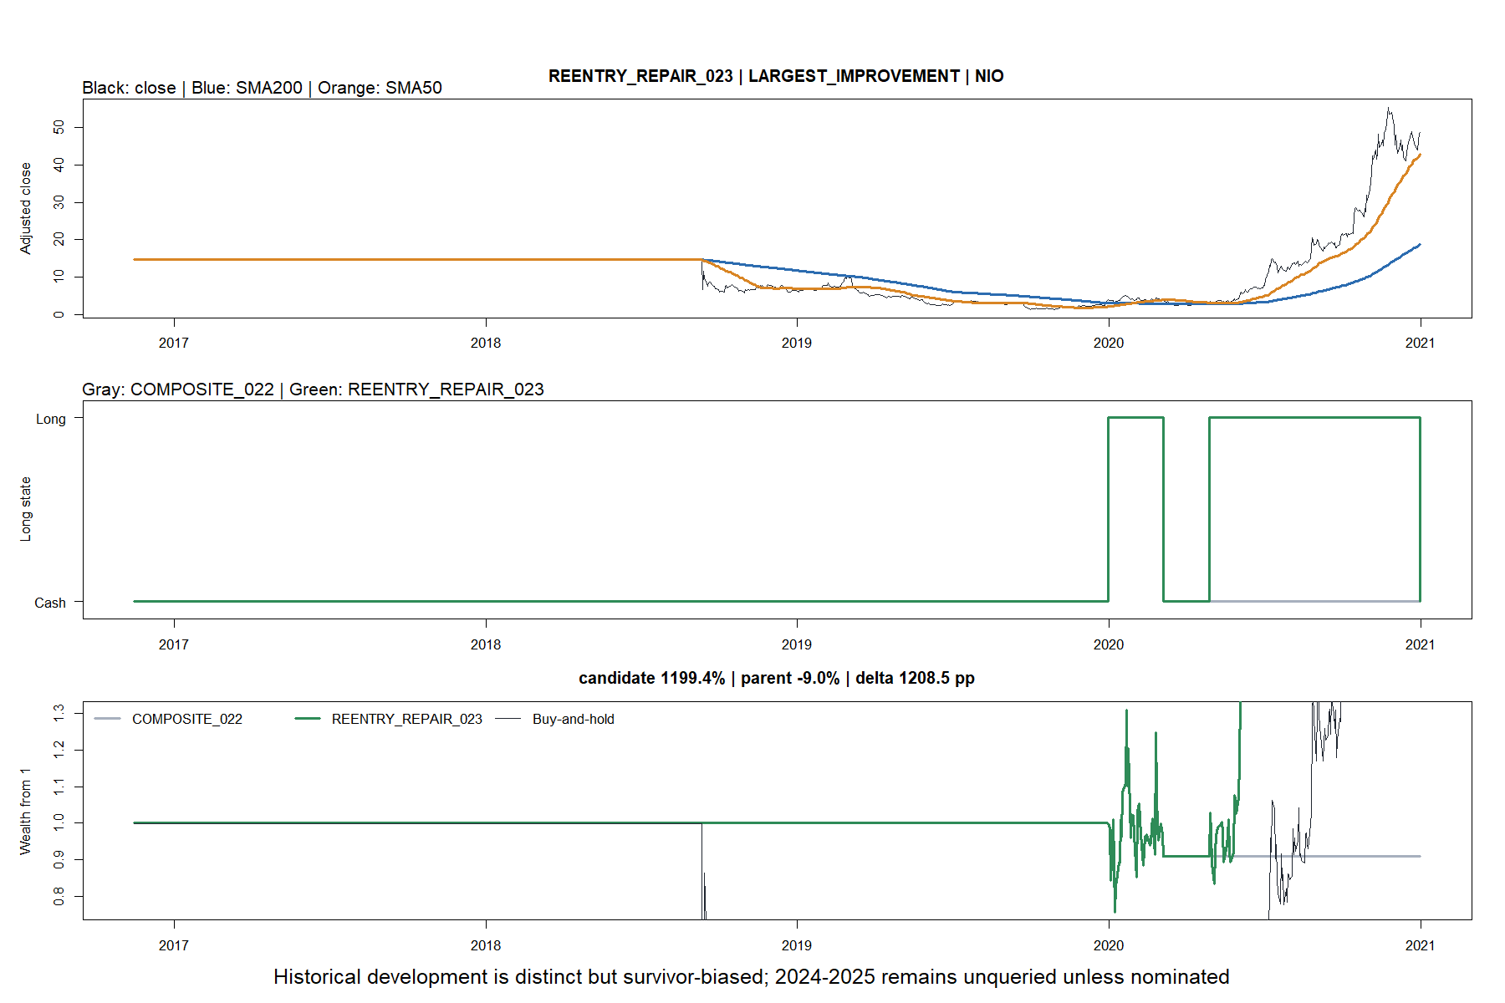
NIO: a huge favorable tail dominates intuition
10
Notes:
NIO is the largest 02.3 improvement, +1,208 points versus the parent. Its scale illustrates why medians, breadth, sector contribution, and matched controls are all required.
[Sources]
- C:\Users\Franc\OneDrive\Documents\Francis\Peltata Project\Time-Series-Modeling-Gen5\runs\research_workbench\operator_hypothesis_lab\hyp_mom_sma_followup_development_2016_2020_20260810\representative_tape_manifest.csv

Slide 11
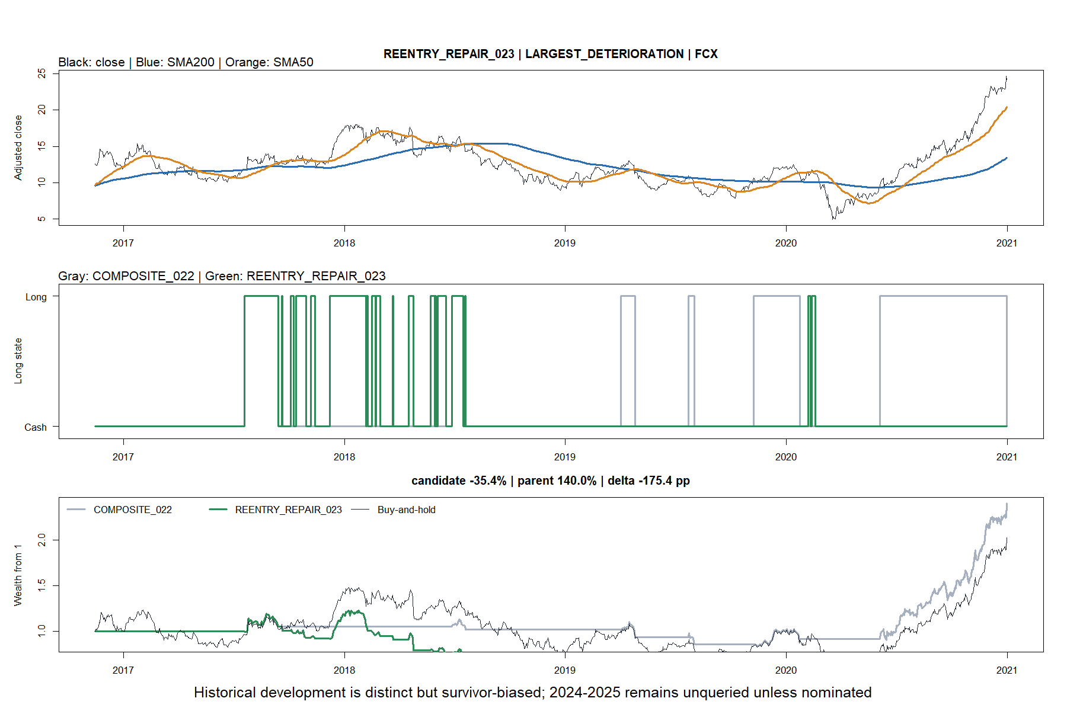
FCX: repeated repair attempts can deepen losses
11
Notes:
FCX is the largest 02.3 deterioration, -175 points versus the parent with a 17.1-point drawdown worsening.
[Sources]
- C:\Users\Franc\OneDrive\Documents\Francis\Peltata Project\Time-Series-Modeling-Gen5\runs\research_workbench\operator_hypothesis_lab\hyp_mom_sma_followup_development_2016_2020_20260810\representative_tape_manifest.csv

Slide 12
HYP-MOM-03.1 PATH AUDIT
A rising slow anchor improves defense—
but gives up too much participation
AMGN is near the median; CPRX and PLUG expose the favorable and adverse tails.
12
Notes:
03.1 improved drawdown and sector breadth, but its median return fell nine points versus fresh 02.1 and its actual timing still ranked below matched shifts.
[Sources]
- C:\Users\Franc\OneDrive\Documents\Francis\Peltata Project\Time-Series-Modeling-Gen5\runs\research_workbench\operator_hypothesis_lab\hyp_mom_sma_followup_development_2016_2020_20260810\candidate_parent_comparison.csv
- C:\Users\Franc\OneDrive\Documents\Francis\Peltata Project\Time-Series-Modeling-Gen5\runs\research_workbench\operator_hypothesis_lab\hyp_mom_sma_followup_development_2016_2020_20260810\representative_tape_manifest.csv

Slide 13
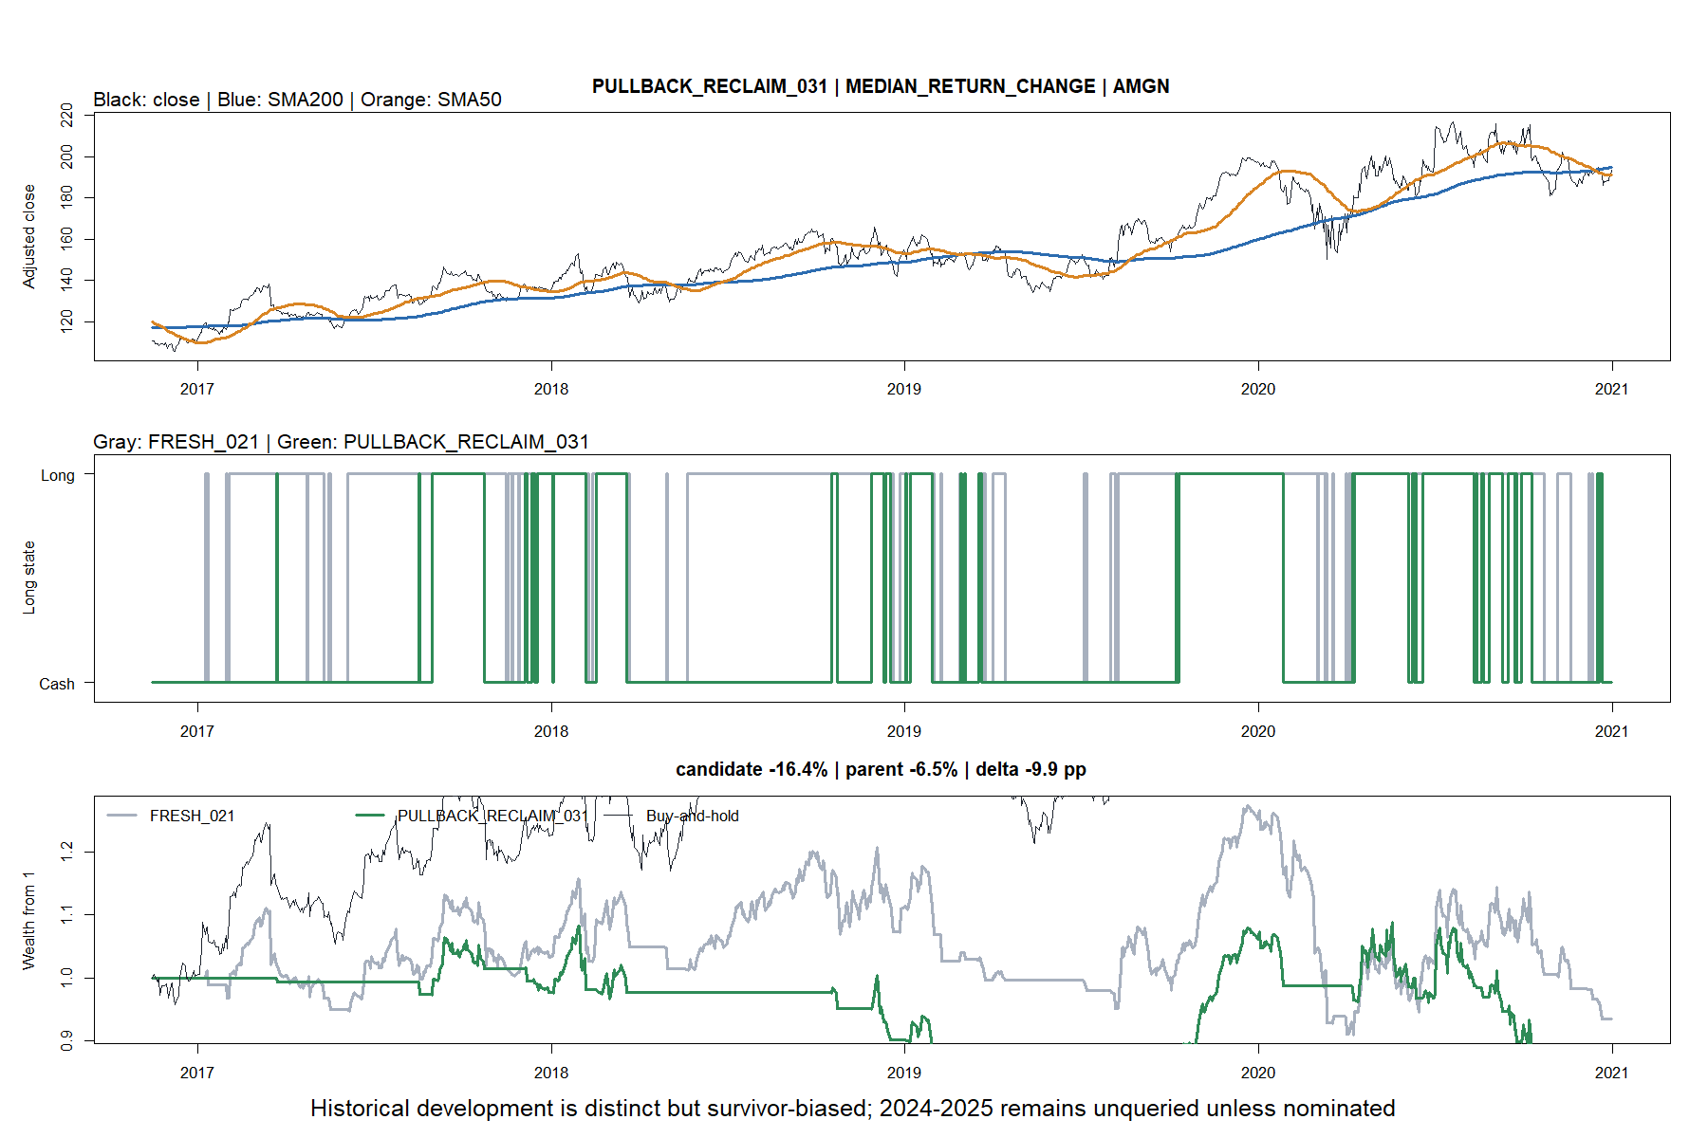
AMGN: the median pullback policy sacrificed return for defense
13
Notes:
AMGN is nearest the median 03.1 return change: -9.91 points versus its parent while drawdown improved 5.39 points.
[Sources]
- C:\Users\Franc\OneDrive\Documents\Francis\Peltata Project\Time-Series-Modeling-Gen5\runs\research_workbench\operator_hypothesis_lab\hyp_mom_sma_followup_development_2016_2020_20260810\representative_tape_manifest.csv

Slide 14
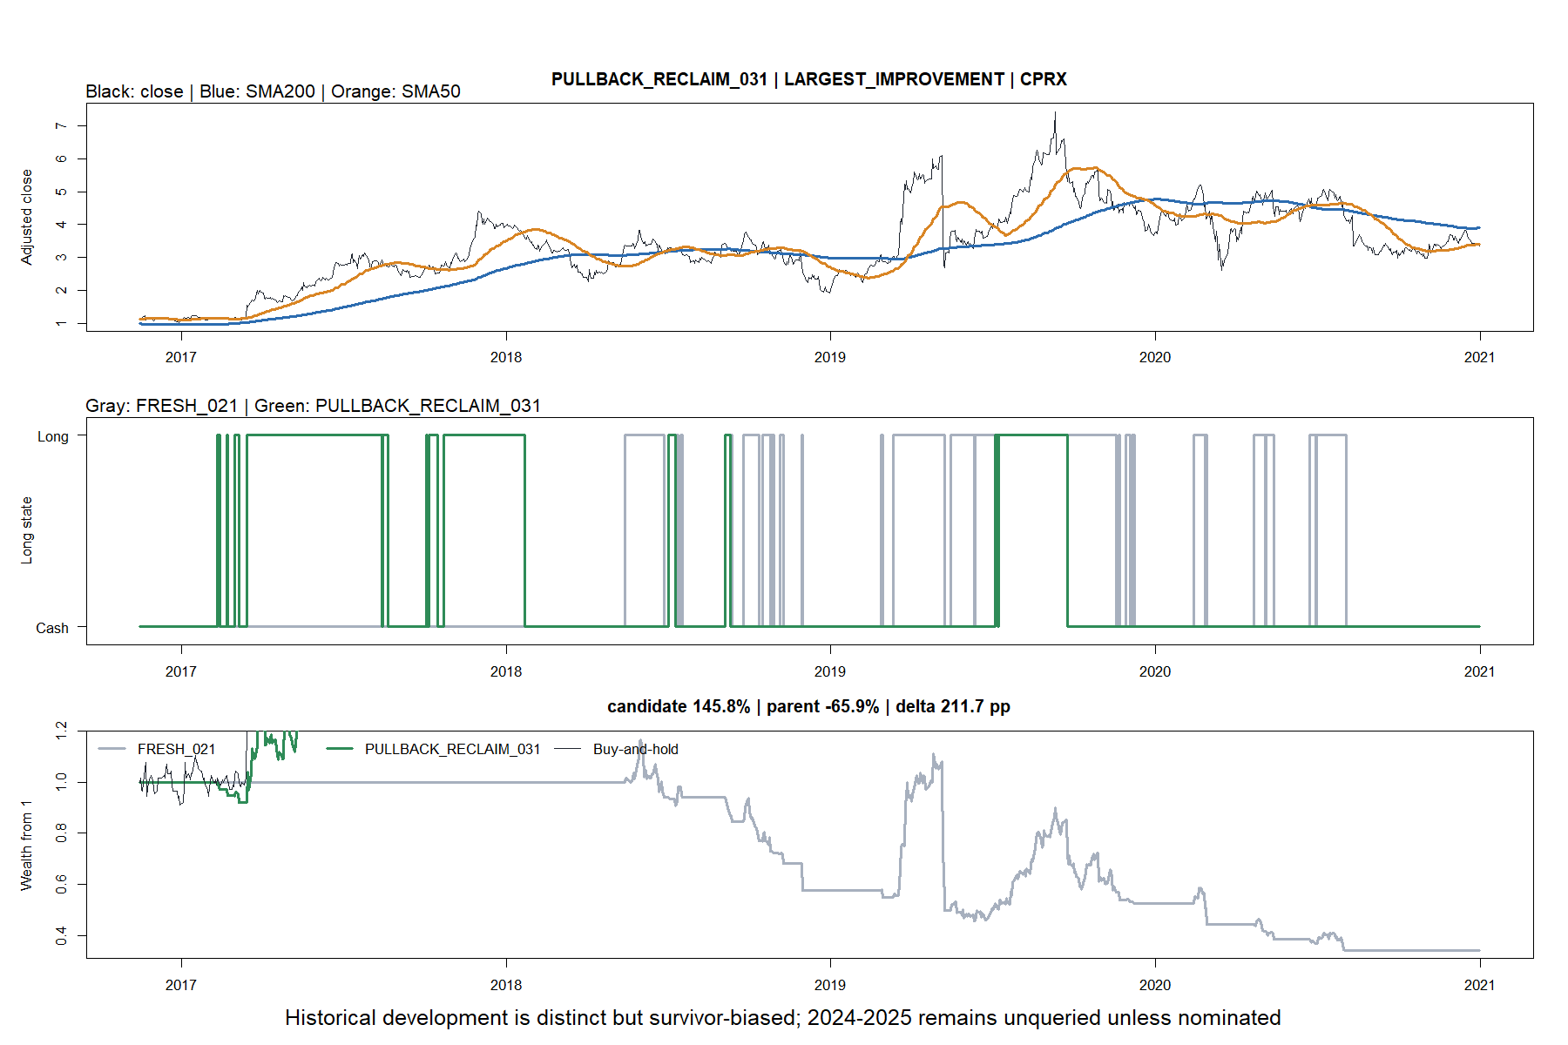
CPRX: the setup can capture a clean trend
14
Notes:
CPRX is the largest 03.1 improvement, +211.7 points with a 39.0-point drawdown improvement. It is a favorable tail, not selection evidence.
[Sources]
- C:\Users\Franc\OneDrive\Documents\Francis\Peltata Project\Time-Series-Modeling-Gen5\runs\research_workbench\operator_hypothesis_lab\hyp_mom_sma_followup_development_2016_2020_20260810\representative_tape_manifest.csv

Slide 15
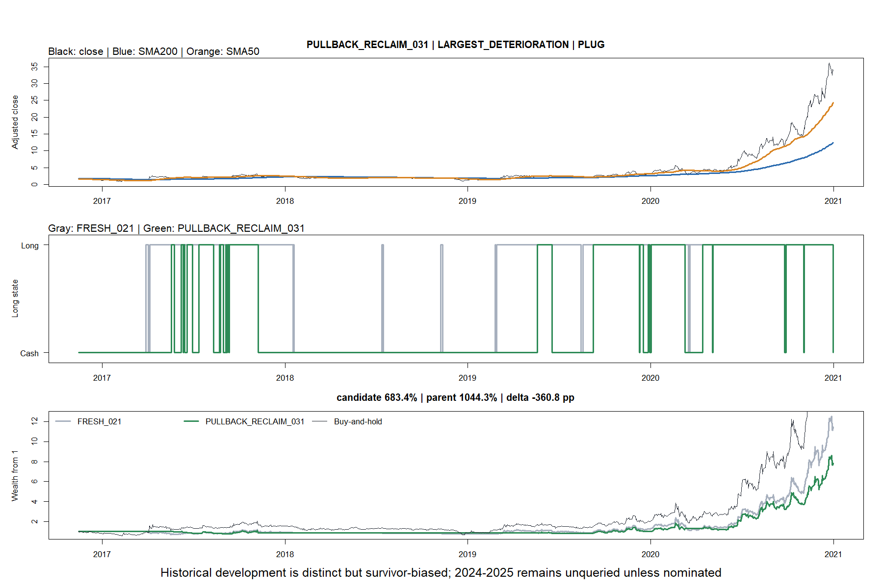
PLUG: defensive timing still missed the explosive path
15
Notes:
PLUG is the largest 03.1 deterioration, -360.8 points versus fresh 02.1, despite improving drawdown by 15.6 points.
[Sources]
- C:\Users\Franc\OneDrive\Documents\Francis\Peltata Project\Time-Series-Modeling-Gen5\runs\research_workbench\operator_hypothesis_lab\hyp_mom_sma_followup_development_2016_2020_20260810\representative_tape_manifest.csv

Slide 16
The series ends at development: no nominee, no confirmation
WHAT THE STUDY SUPPORTS
STOP STATE
Fast exits can reduce drawdown
Re-entry raises participation and risk
Rising-anchor permission is defensive
Matched exposure is an essential control
Neither candidate cleared all gates
Context atlas not run
2024-2025 not queried
2026+ remains sealed
A future lane needs a new causal idea—not softer gates for these two policies.
16
Notes:
Record STOP_NO_DEVELOPMENT_NOMINEE_CONFIRMATION_UNOPENED. Positive raw returns were insufficient because timing controls, parent-relative breadth, and drawdown/sector gates did not clear together.
[Sources]
- C:\Users\Franc\OneDrive\Documents\Francis\Peltata Project\Time-Series-Modeling-Gen5\operator_hypothesis_lab\docs\HYP_MOM_SMA_FOLLOWUP_SERIES_CONTRACT.md
- C:\Users\Franc\OneDrive\Documents\Francis\Peltata Project\Time-Series-Modeling-Gen5\operator_hypothesis_lab\docs\HYP_MOM_02_3_03_1_DEVELOPMENT_RESULTS.md
- C:\Users\Franc\OneDrive\Documents\Francis\Peltata Project\Time-Series-Modeling-Gen5\runs\research_workbench\operator_hypothesis_lab\hyp_mom_sma_followup_development_2016_2020_20260810\nomination.csv
- C:\Users\Franc\OneDrive\Documents\Francis\Peltata Project\Time-Series-Modeling-Gen5\runs\research_workbench\operator_hypothesis_lab\hyp_mom_sma_followup_development_2016_2020_20260810\integrity_checks.csv

