Slide 1
OPERATOR HYPOTHESIS LAB | HYP-MOM-02 ATTRIBUTION
What the faster exit
actually did
Entry confirmation | exit + lockout | re-entry | event-path attribution
Notes:
This deck decomposes the previously bundled HYP-MOM-02.2 rule on the reused 2021-2023 discovery panel. It explains mechanics only; it cannot nominate a strategy.
[Sources]
- C:\Users\Franc\OneDrive\Documents\Francis\Peltata Project\Time-Series-Modeling-Gen5\operator_hypothesis_lab\docs\HYP_MOM_SMA_FOLLOWUP_SERIES_CONTRACT.md
- C:\Users\Franc\OneDrive\Documents\Francis\Peltata Project\Time-Series-Modeling-Gen5\operator_hypothesis_lab\docs\HYP_MOM_02_ATTRIBUTION_ATLAS_01_RESULTS.md

Slide 2
One program, two evidence roles
REUSED-WINDOW ATTRIBUTION
DISTINCT HISTORICAL DEVELOPMENT
119 eligible assets
2021-2023
Five one-change-at-a-time policies
5 / 20 / 60-session event paths
2016-2020
Two predeclared candidates
Nine conjunctive gates
At most one later nominee
Attribution can generate an explanation—not promotion authority.
2
Notes:
The evidence sequence was frozen before development outcomes. Reused discovery isolates components; distinct history decides whether a candidate may advance.
[Sources]
- C:\Users\Franc\OneDrive\Documents\Francis\Peltata Project\Time-Series-Modeling-Gen5\operator_hypothesis_lab\docs\HYP_MOM_SMA_FOLLOWUP_SERIES_CONTRACT.md
- C:\Users\Franc\OneDrive\Documents\Francis\Peltata Project\Time-Series-Modeling-Gen5\runs\research_workbench\operator_hypothesis_lab\hyp_mom_02_attribution_atlas_01_20260810\run_spec.csv

Slide 3
One change at a time separates mechanism from coincidence
SMA_N(t) = (1/N) sum[k=0..N-1] Close(t-k) | every decision uses completed t
ENTRY / EXIT ATTRIBUTION
RE-ENTRY + EVENT ATTRIBUTION
Fresh SMA200 baseline
+ SMA50 entry confirmation only
+ SMA50 exit and lockout only
Full 02.2 composite
Add SMA50 reclaim re-entry
Measure every fresh cross at 5 / 20 / 60 sessions
Report absolute, SPY-relative, sector-relative
Every path starts cash | signal after close | trade next open | 5 / 10 bp per-side costs
3
Notes:
The factorized policies answer which mechanical change produced the observed return/protection difference. Fixed-horizon event paths ask whether the cross predicts direction independent of the strategy state machine.
[Sources]
- C:\Users\Franc\OneDrive\Documents\Francis\Peltata Project\Time-Series-Modeling-Gen5\operator_hypothesis_lab\docs\HYP_MOM_SMA_FOLLOWUP_SERIES_CONTRACT.md
- C:\Users\Franc\OneDrive\Documents\Francis\Peltata Project\Time-Series-Modeling-Gen5\runs\research_workbench\operator_hypothesis_lab\hyp_mom_02_attribution_atlas_01_20260810\run_spec.csv

Slide 4
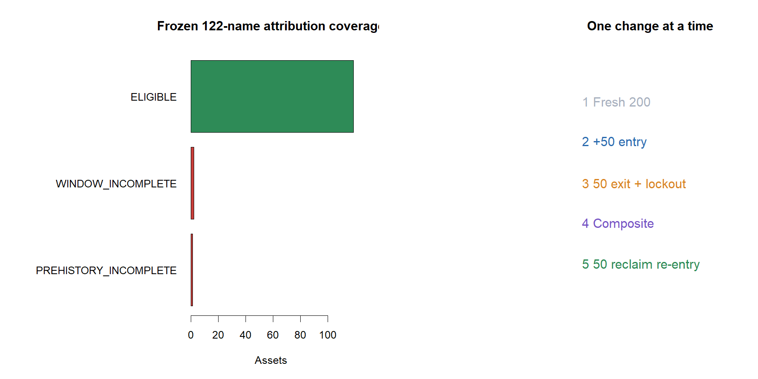
Frozen coverage: 119 of 122 assets; all context series complete
4
Notes:
APHA and SNE had incomplete study windows; LI lacked prehistory. No replacements were introduced.
[Sources]
- C:\Users\Franc\OneDrive\Documents\Francis\Peltata Project\Time-Series-Modeling-Gen5\runs\research_workbench\operator_hypothesis_lab\hyp_mom_02_attribution_atlas_01_20260810\asset_coverage.csv
- C:\Users\Franc\OneDrive\Documents\Francis\Peltata Project\Time-Series-Modeling-Gen5\runs\research_workbench\operator_hypothesis_lab\hyp_mom_02_attribution_atlas_01_20260810\context_coverage.csv

Slide 5
The faster exit—not entry confirmation—did most of the work
+3.85 pp
+9.94 pp
+0.24 pp
-2.07 pp
median return effect
median drawdown effect
entry-confirmation effect
re-entry repair effect
fast exit + lockout vs fresh 02.1
104 / 119 assets improved
after the fast exit was fixed
only 53 / 119 improved
All effects are paired asset-level medians on the reused window.
5
Notes:
The large improvement appears when the SMA50 exit/lockout replaces the SMA200 exit. The entry filter adds little after that; the first re-entry repair gives the improvement back.
[Sources]
- C:\Users\Franc\OneDrive\Documents\Francis\Peltata Project\Time-Series-Modeling-Gen5\runs\research_workbench\operator_hypothesis_lab\hyp_mom_02_attribution_atlas_01_20260810\mechanical_attribution_summary.csv
- C:\Users\Franc\OneDrive\Documents\Francis\Peltata Project\Time-Series-Modeling-Gen5\operator_hypothesis_lab\docs\HYP_MOM_02_ATTRIBUTION_ATLAS_01_RESULTS.md

Slide 6
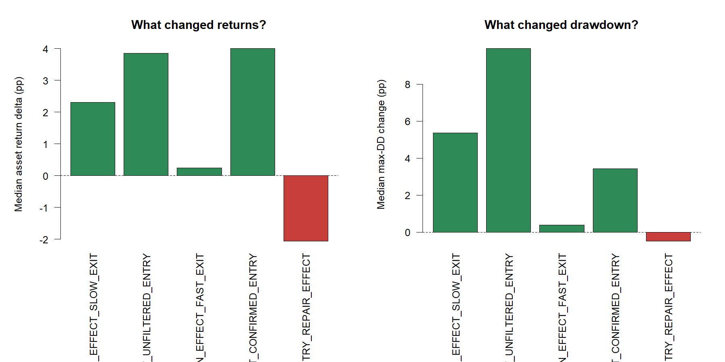
The mechanical decomposition points to exit discipline
6
Notes:
Return and drawdown deltas show the exit/lockout effect dominating entry confirmation. Re-entry repair is adverse at the median.
[Sources]
- C:\Users\Franc\OneDrive\Documents\Francis\Peltata Project\Time-Series-Modeling-Gen5\runs\research_workbench\operator_hypothesis_lab\hyp_mom_02_attribution_atlas_01_20260810\mechanical_attribution_summary.csv

Slide 7
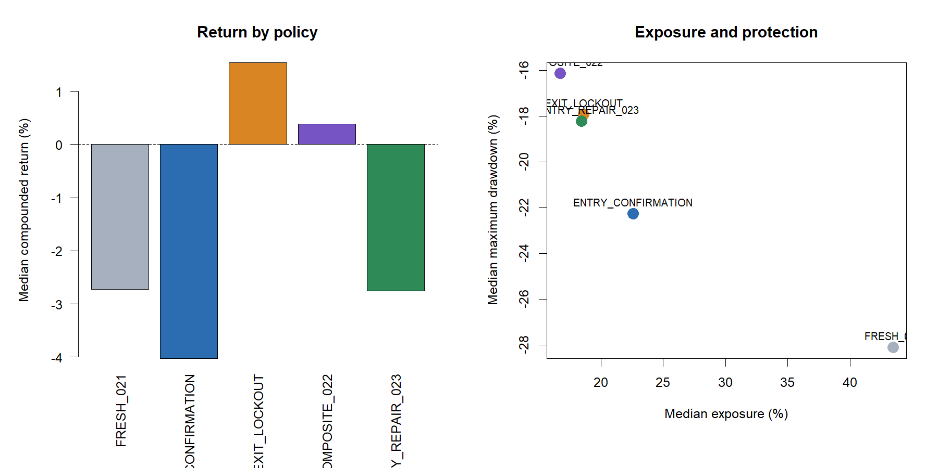
Raw return improves as exposure falls—but timing remains weak
7
Notes:
EXIT_LOCKOUT has the best reused-window median raw return, yet its matched-control excess remains slightly negative. No policy earns selection authority here.
[Sources]
- C:\Users\Franc\OneDrive\Documents\Francis\Peltata Project\Time-Series-Modeling-Gen5\runs\research_workbench\operator_hypothesis_lab\hyp_mom_02_attribution_atlas_01_20260810\variant_panel_summary.csv

Slide 8
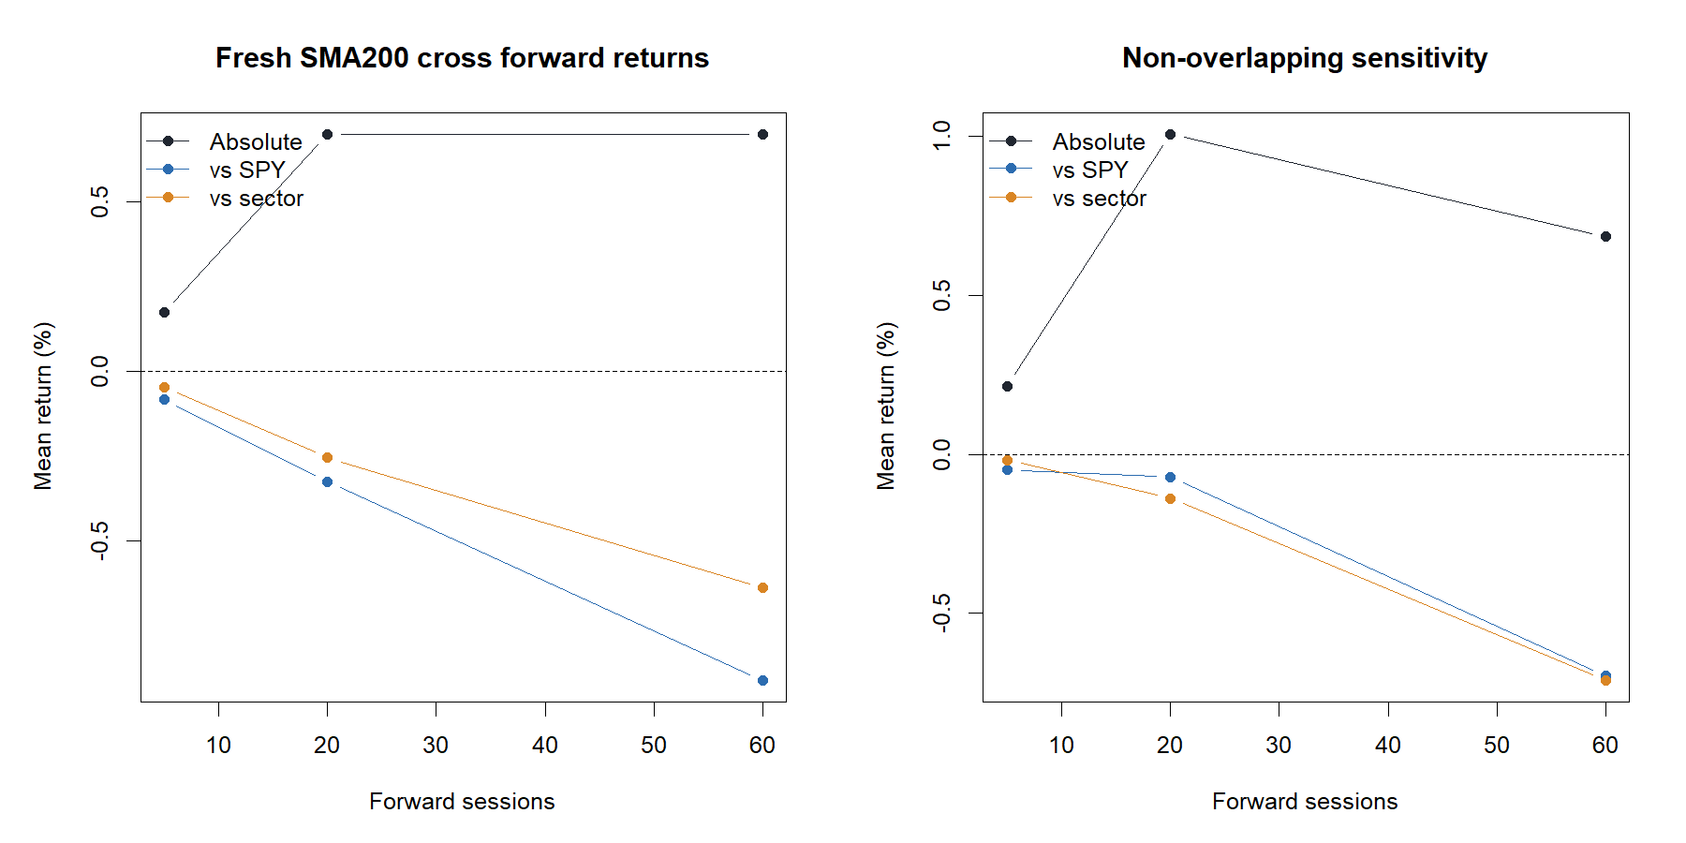
Fresh crosses are mildly positive in absolute terms, not relative terms
8
Notes:
At 5, 20, and 60 sessions, average absolute returns are nonnegative while average SPY-relative returns are negative. Non-overlapping sensitivity does not establish a relative edge.
[Sources]
- C:\Users\Franc\OneDrive\Documents\Francis\Peltata Project\Time-Series-Modeling-Gen5\runs\research_workbench\operator_hypothesis_lab\hyp_mom_02_attribution_atlas_01_20260810\event_summary.csv

Slide 9
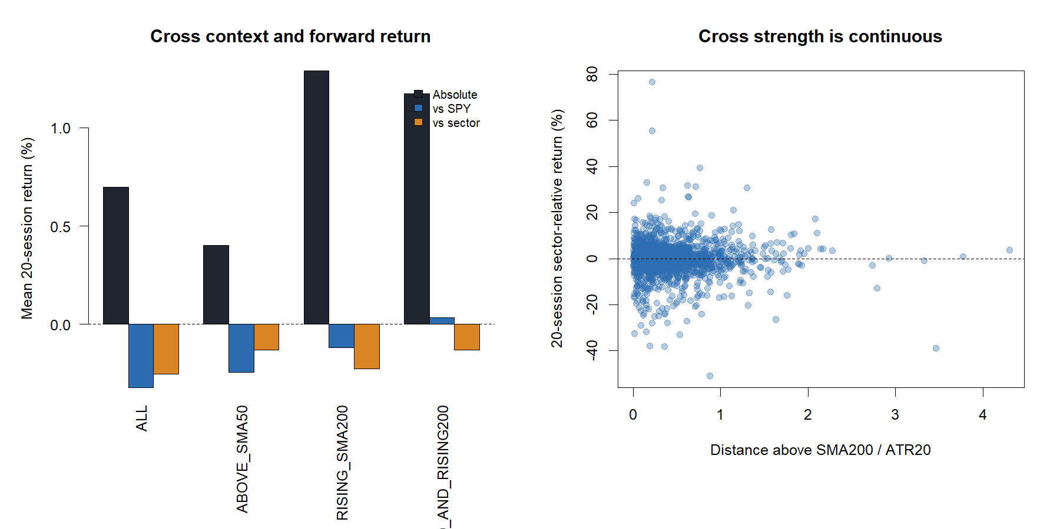
A rising SMA200 is more informative than merely being above SMA50
9
Notes:
The above-SMA50 condition does not improve the 20-session mean. Rising SMA200 is more coherent, but it remains a reused-window diagnostic and cannot create a cutoff or strategy.
[Sources]
- C:\Users\Franc\OneDrive\Documents\Francis\Peltata Project\Time-Series-Modeling-Gen5\runs\research_workbench\operator_hypothesis_lab\hyp_mom_02_attribution_atlas_01_20260810\event_condition_summary.csv

Slide 10
RE-ENTRY PATH AUDIT
A simple repair creates
more chances—and more ways to fail
Three mechanically selected tapes compare repaired re-entry with strict 02.2.
10
Notes:
The tapes are frozen roles: median return change, largest improvement, and largest deterioration. They demonstrate heterogeneity without authorizing asset selection.
[Sources]
- C:\Users\Franc\OneDrive\Documents\Francis\Peltata Project\Time-Series-Modeling-Gen5\runs\research_workbench\operator_hypothesis_lab\hyp_mom_02_attribution_atlas_01_20260810\representative_tape_manifest.csv

Slide 11
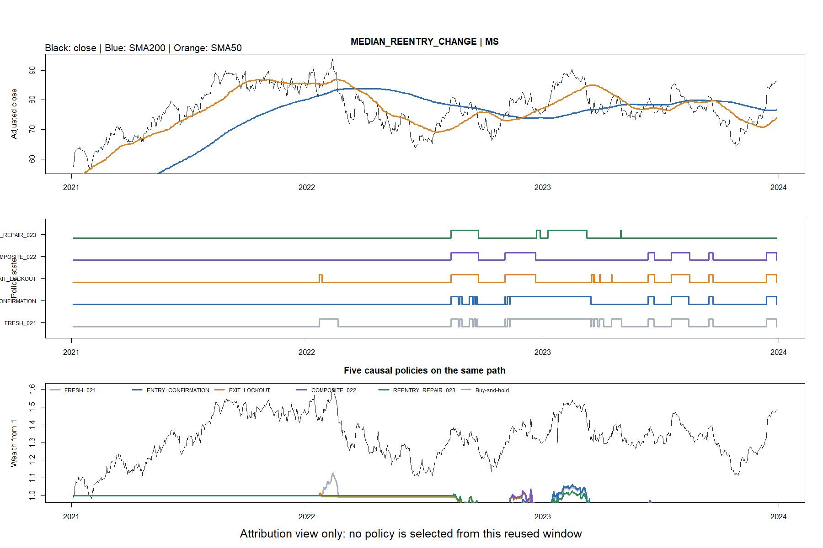
MS: the median repair added exposure but reduced return
11
Notes:
MS is nearest the median return change: repaired re-entry lost 8.57% versus 6.51% for strict 02.2, despite a better drawdown path.
[Sources]
- C:\Users\Franc\OneDrive\Documents\Francis\Peltata Project\Time-Series-Modeling-Gen5\runs\research_workbench\operator_hypothesis_lab\hyp_mom_02_attribution_atlas_01_20260810\representative_tape_manifest.csv

Slide 12
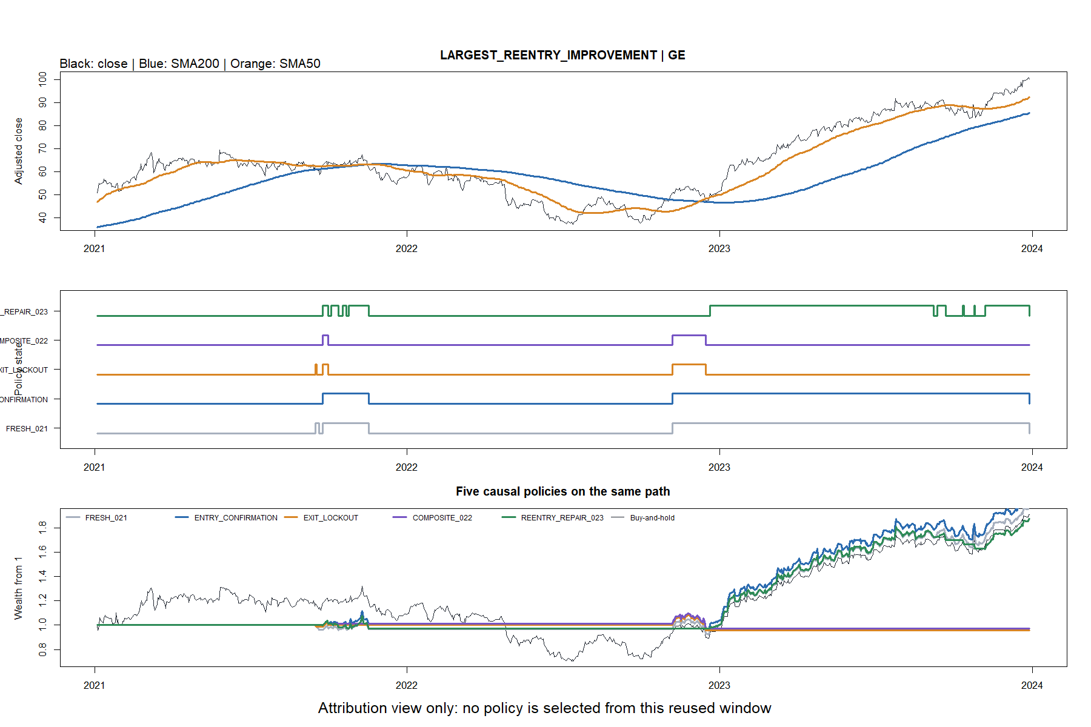
GE: one favorable path cannot define the panel
12
Notes:
GE is the largest repaired-re-entry improvement: +87.44% versus -2.78%. Its favorable sequence is real but outcome-selected only as an audit role.
[Sources]
- C:\Users\Franc\OneDrive\Documents\Francis\Peltata Project\Time-Series-Modeling-Gen5\runs\research_workbench\operator_hypothesis_lab\hyp_mom_02_attribution_atlas_01_20260810\representative_tape_manifest.csv

Slide 13
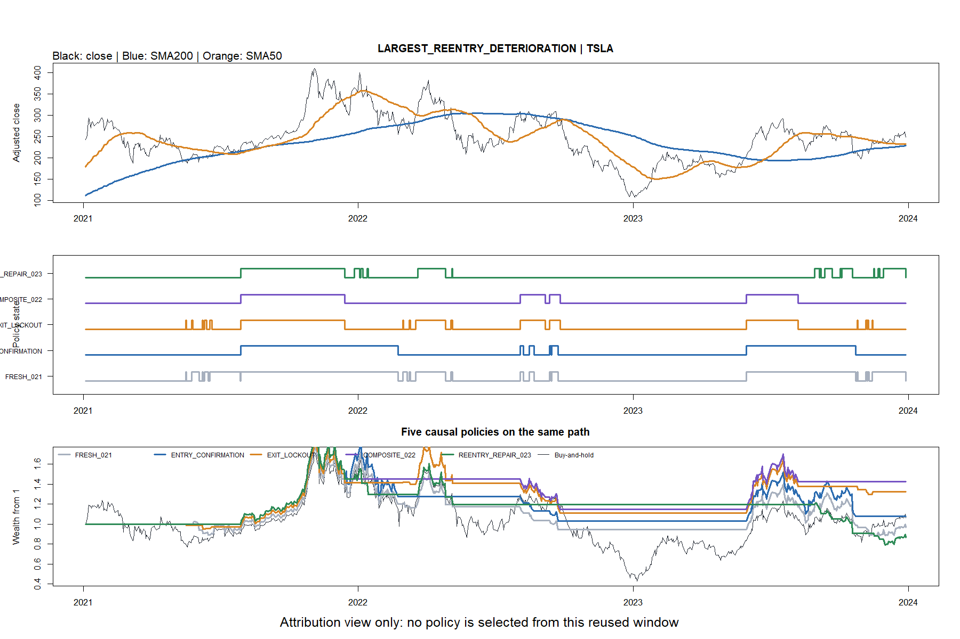
TSLA: repeated re-entry can destroy a prior winner
13
Notes:
TSLA is the largest deterioration: -13.24% under repaired re-entry versus +42.29% under strict 02.2, with much worse drawdown.
[Sources]
- C:\Users\Franc\OneDrive\Documents\Francis\Peltata Project\Time-Series-Modeling-Gen5\runs\research_workbench\operator_hypothesis_lab\hyp_mom_02_attribution_atlas_01_20260810\representative_tape_manifest.csv

Slide 14
Attribution explains the defense—but does not establish alpha
WHAT THE ATLAS SUPPORTS
WHAT IT DOES NOT SUPPORT
Exit/lockout did most of 02.2's work
SMA50 entry confirmation added little
Simple reclaim re-entry deteriorated
Rising SMA200 deserves a distinct question
Optimal SMA lengths
Asset or sector selection
Positive relative timing skill
Portfolio or live authority
Next step: only the already-frozen candidates may face distinct-history gates.
14
Notes:
Record REUSED_WINDOW_ATTRIBUTION_COMPLETE_NO_PROMOTION_AUTHORITY. The companion development deck records whether either candidate earned later evidence.
[Sources]
- C:\Users\Franc\OneDrive\Documents\Francis\Peltata Project\Time-Series-Modeling-Gen5\operator_hypothesis_lab\docs\HYP_MOM_SMA_FOLLOWUP_SERIES_CONTRACT.md
- C:\Users\Franc\OneDrive\Documents\Francis\Peltata Project\Time-Series-Modeling-Gen5\operator_hypothesis_lab\docs\HYP_MOM_02_ATTRIBUTION_ATLAS_01_RESULTS.md
- C:\Users\Franc\OneDrive\Documents\Francis\Peltata Project\Time-Series-Modeling-Gen5\runs\research_workbench\operator_hypothesis_lab\hyp_mom_02_attribution_atlas_01_20260810\integrity_checks.csv

