Slide 1
SESSION 10
N1A passes archive admission;
representation remains unproven.
95,126 articles | 1,904 pages | 9/9 gates | outcomes and models: zero
S10/01
Notes:
SESSION 10 - NEWS ADMISSIBILITY N1A
Purpose
Determine whether Alpaca historical news can support a conservative point-in-time symbol-session event panel before any market outcome is inspected.
Result
All nine frozen hard gates passed. The result admits an N1B theory discussion only; it does not create sentiment, a feature, a signal, or a model.
Conversation: codex://threads/019f741e-615f-7fd0-90f7-edce12b5cb66
Find in chat: This sounds great to me. Proceed.
Artifact: docs/GEN5_4_NEWS_ADMISSIBILITY_N1A_CONTRACT.md
Report: C:/Users/Franc/OneDrive/Documents/Francis/Peltata Project/Time-Series-Modeling-Gen5/runs/research_workbench/gen54_ml_decision_engine/g54_news_n1a_20260721/n1a_report.md

Slide 2
The point-in-time contract was frozen before archive inspection
ARCHIVE
POINT-IN-TIME MAP
ADMISSION
24 candidates, 2020-2024
metadata only
updated_at authority
17:30 cutoff; next-open
72-hour exact titles
nine frozen hard gates
Sentiment, outcomes, OHLCV joins, correlations, and model fits: zero.
D30/02
Notes:
DECISION D30 - FROZEN N1A CONTRACT
Economic role
News is treated first as possible information arrival and uncertainty context, not directional sentiment.
Timing
The archived headline/summary enters at the first scheduled 17:30 America/New_York decision at or after updated_at. Hypothetical execution is the following market session. created_at remains provenance only.
Duplicates
Identical normalized titles within 72 hours are clustered using prior articles only.
Official sources
Historical news: https://docs.alpaca.markets/us/docs/historical-news-data
Endpoint: https://docs.alpaca.markets/us/reference/news-3
Real-time stream: https://docs.alpaca.markets/us/docs/streaming-real-time-news
Conversation: codex://threads/019f741e-615f-7fd0-90f7-edce12b5cb66
Find in chat: This sounds great to me. Proceed.
Contract: docs/GEN5_4_NEWS_ADMISSIBILITY_N1A_CONTRACT.md

Slide 3
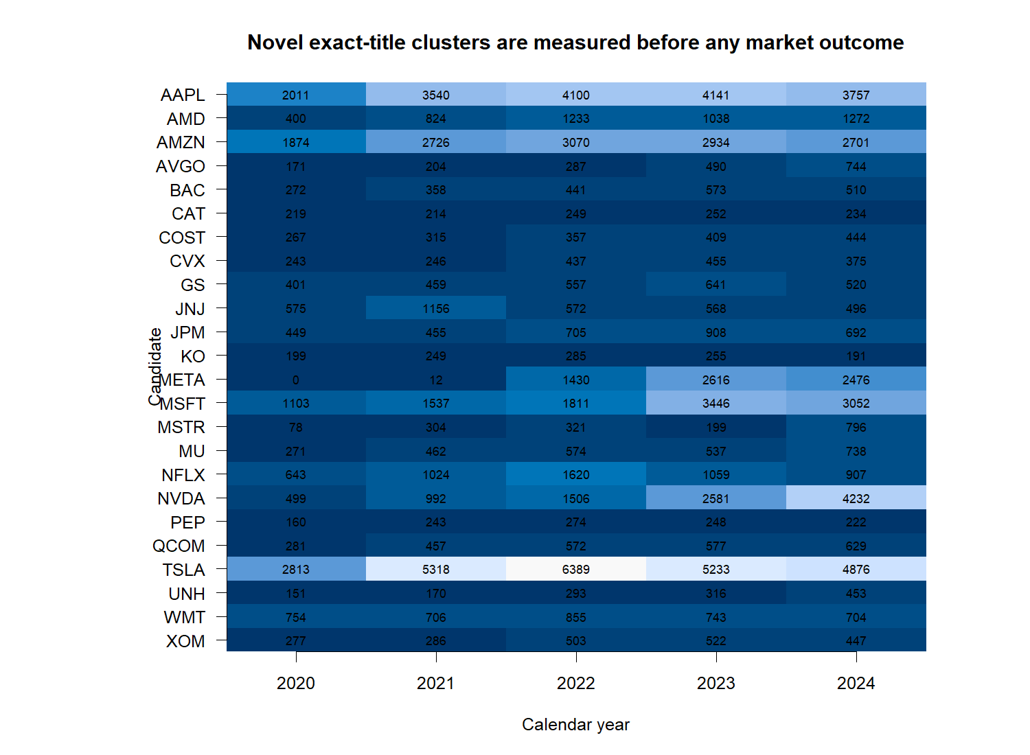
Coverage is broad, but the META history gap is visible
D31/03
Notes:
DECISION D31 - DENSITY GATE PASSES
Evidence
The minimum yearly density result was 23 of 24 candidates meeting at least 20 novel exact-title clusters. All 24 met the threshold from 2022 onward.
Limitation
META has zero qualifying clusters in 2020 and 12 in 2021 under the current symbol key. This is a symbol-history discontinuity, not evidence that the company had no news.
Meaning
The archive is broad enough for measurement design, but N1B must freeze a point-in-time symbol-history treatment before outcome work.
Report: C:/Users/Franc/OneDrive/Documents/Francis/Peltata Project/Time-Series-Modeling-Gen5/runs/research_workbench/gen54_ml_decision_engine/g54_news_n1a_20260721/n1a_report.md
Conversation: codex://threads/019f741e-615f-7fd0-90f7-edce12b5cb66

Slide 4
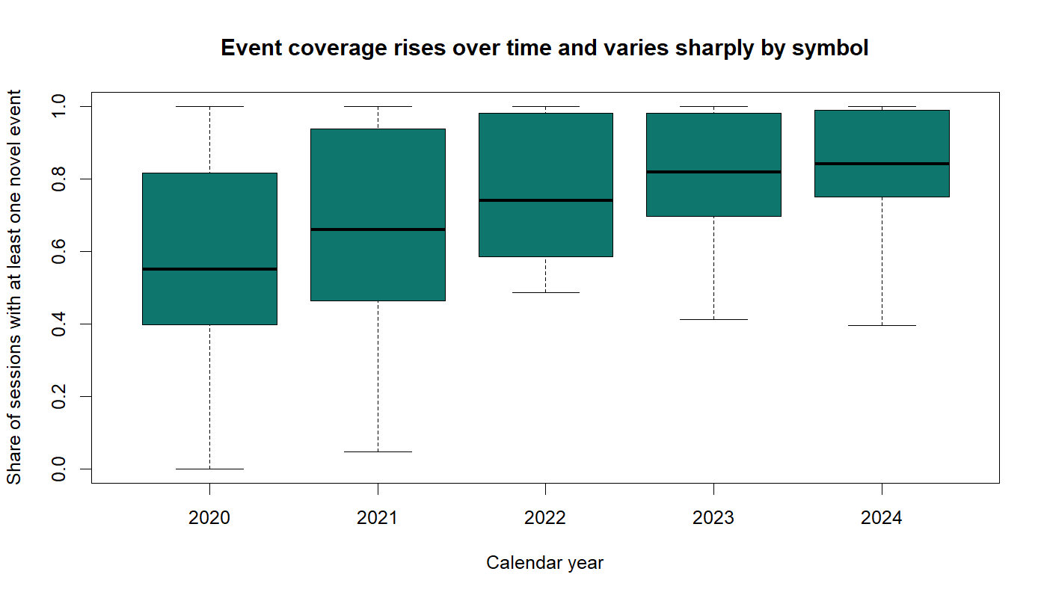
News availability changes materially through time
D31/04
Notes:
DECISION D31 - RAW COUNTS ARE NOT COMPARABLE
Evidence
Event-bearing session shares rise through the archive and vary sharply by symbol. The five most-covered candidates supply 60.15% of all association rows, even though the largest single symbol remains below the frozen 25% cap at 19.29%.
Meaning
Any later news-intensity measure must be normalized inside each symbol using TRAIN data only. A pooled raw article count would mostly encode company popularity and changing vendor coverage.
Boundary
No outcome was joined and no normalization was selected in N1A.
Report: C:/Users/Franc/OneDrive/Documents/Francis/Peltata Project/Time-Series-Modeling-Gen5/runs/research_workbench/gen54_ml_decision_engine/g54_news_n1a_20260721/n1a_report.md

Slide 5
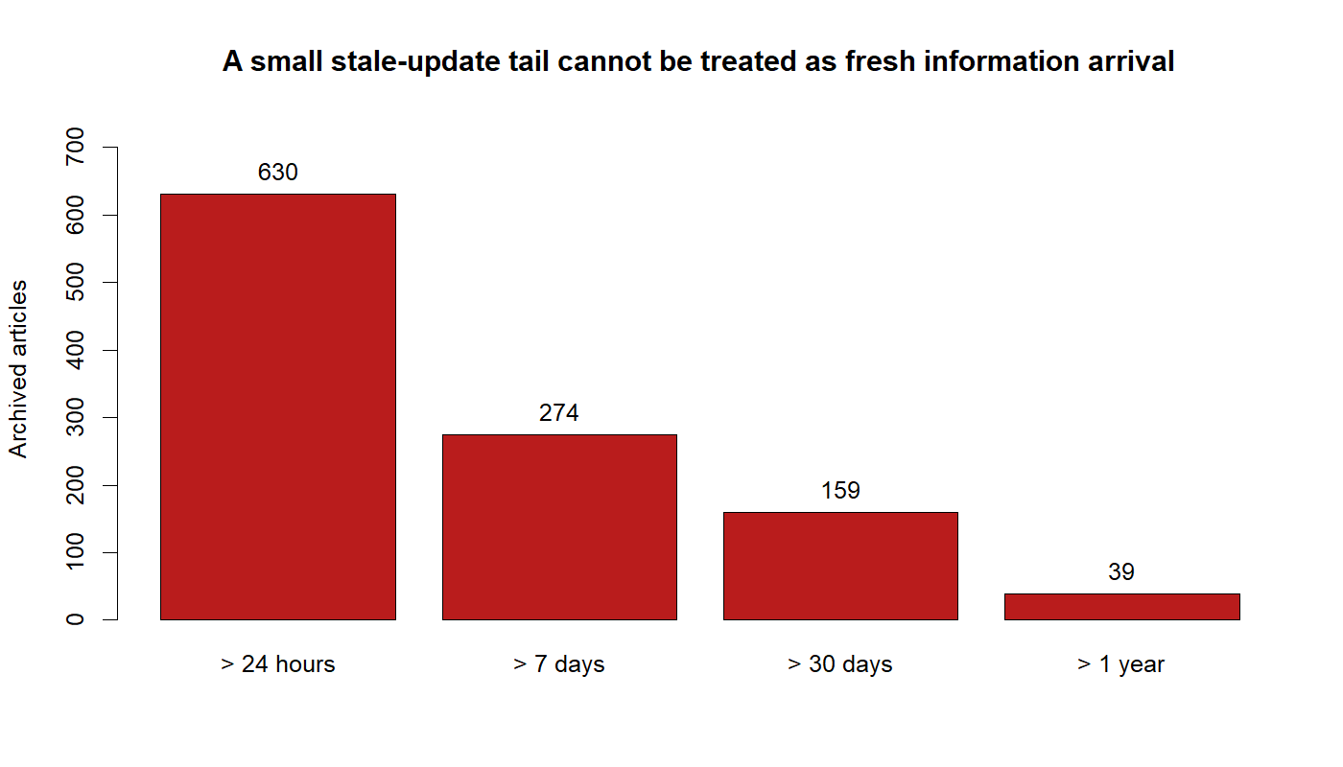
Timestamp-safe does not always mean economically fresh
D31/05
Notes:
DECISION D31 - STALE UPDATE TAIL
Evidence
Most updates are immediate, but 630 articles have creation-to-final-update delays above 24 hours, 159 exceed 30 days, and 39 exceed one year.
Meaning
Assigning these articles at updated_at is leakage-conservative, but an archival backfill or very late edit is not necessarily fresh economic information. N1B needs a frozen stale-update exclusion rule.
No post hoc gate change
The predeclared decision-cycle crossing WARN threshold did not fire. These tail counts are carried forward as a design limitation rather than used to rewrite the N1A verdict.
Report: C:/Users/Franc/OneDrive/Documents/Francis/Peltata Project/Time-Series-Modeling-Gen5/runs/research_workbench/gen54_ml_decision_engine/g54_news_n1a_20260721/n1a_report.md

Slide 6
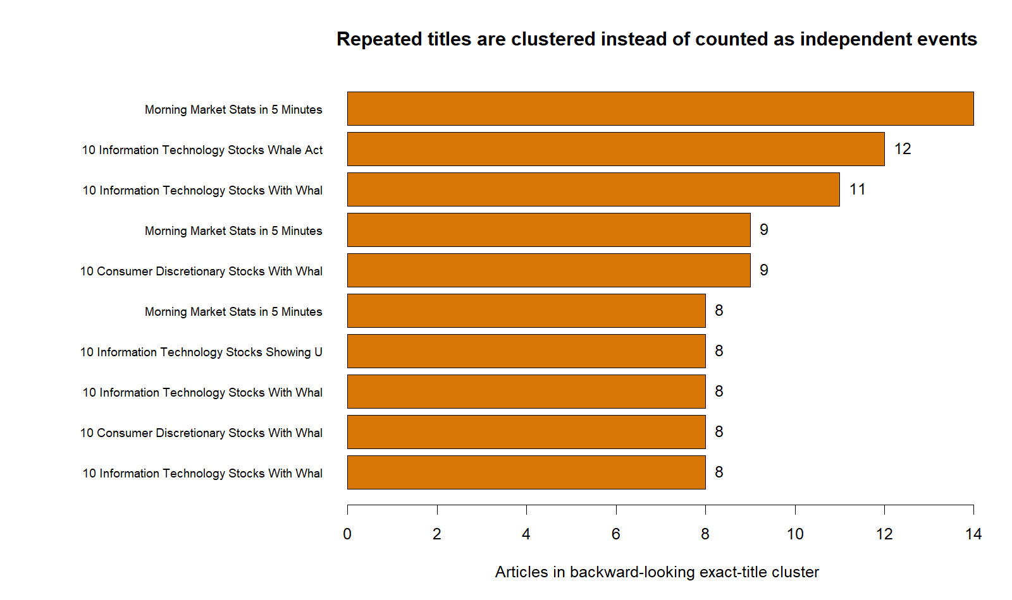
The archive passes; representation remains a separate gate
OVERALL: PASS FOR N1B DISCUSSION
PASS 9 / 9 hard admission gates
PASS 23 / 24 minimum yearly density
WATCH META symbol-history gap
WATCH Top five names: 60.15%
WATCH 630 updates exceed 24 hours
STOP No raw cross-symbol counts
STOP No sentiment / outcomes / models
D31/06
Notes:
DECISION D31 - PASS_N1A_ADMISSIBLE_FOR_N1B_DISCUSSION
Authority
95,126 articles; 1,904 complete HTTP 200 pages; 130,695 candidate associations; 1,258 market sessions; unique IDs; complete required fields; complete decision and execution assignment.
Duplicate control
Backward-looking exact-title repeats are 1.76%. Representative clusters show why multiple headlines cannot be assumed to be independent events.
Next theory gate
Before N1B implementation, freeze:
1. point-in-time treatment of the pre-META symbol history;
2. a stale-update exclusion rule;
3. one symbol-local TRAIN-only intensity normalization;
4. one post-entry uncertainty outcome.
Still closed
Generic sentiment, directional-return prediction, allocation, replay, and model fitting.
Conversation: codex://threads/019f741e-615f-7fd0-90f7-edce12b5cb66
Find in chat: This sounds great to me. Proceed.
Report: C:/Users/Franc/OneDrive/Documents/Francis/Peltata Project/Time-Series-Modeling-Gen5/runs/research_workbench/gen54_ml_decision_engine/g54_news_n1a_20260721/n1a_report.md
Status: PASS_N1A_ADMISSIBLE_FOR_N1B_DISCUSSION.

