Slide 1
LITERATURE-GROUNDED STRATEGY RESEARCH | 1 AUG 2026
LIT-MOM-02.1
opening-gap momentum atlas
Chan's Example 7.1 recapitulated, translated to a causal 09:32 retail fill, and tested unchanged across eight anchors and a 92-instrument atlas.
Notes:
This deck records a textbook-style opening-gap momentum exercise. It is a research POC, not an execution recommendation or production strategy.
[Sources]
- C:/Users/Franc/OneDrive/Documents/Francis/Trading Literature/Algorithmic Trading - Winning Strategies and Their Rationale 2013.pdf - printed pages 156-157; PDF pages 174-175
- C:/Users/Franc/OneDrive/Documents/Francis/Peltata Project/Time-Series-Modeling-Gen5/literature_studies/docs/GEN5_LIT_MOM_02_1_OPENING_GAP_MOMENTUM_CONTRACT.md
- C:/Users/Franc/OneDrive/Documents/Francis/Peltata Project/Time-Series-Modeling-Gen5/literature_studies/docs/GEN5_LIT_MOM_02_1_OPENING_GAP_MOMENTUM_RESULTS.md

Slide 2
Chan combines an opening gap with a prior-range breakout
The open must clear yesterday's high or low by a volatility-scaled buffer. Direction then follows the gap through the same close. The source result is context, not locally reproduced evidence.
FSTX
13% / 1.4
Several futures
EURO STOXX 50 futures
2004-2012 source example
Reported APR / Sharpe
Source reference only
Author tried a broader set
Not a pre-registered one-shot
2
Notes:
Chan reports the EURO STOXX 50 futures result after trying the rule on several futures. Exact continuous-contract roll construction and source data were unavailable, so the reported metrics are not presented as reproduction evidence.
[Sources]
- C:/Users/Franc/OneDrive/Documents/Francis/Trading Literature/Algorithmic Trading - Winning Strategies and Their Rationale 2013.pdf - printed pages 156-157; PDF pages 174-175
- C:/Users/Franc/OneDrive/Documents/Francis/Peltata Project/Time-Series-Modeling-Gen5/literature_studies/docs/GEN5_LIT_MOM_02_1_OPENING_GAP_MOMENTUM_CONTRACT.md

Slide 3
The rule has only one threshold and one volatility estimate
Let sigma(t-1) be the lagged 90-session standard deviation of close-to-close returns. The 0.1 multiplier scales the required gap to the instrument's own recent volatility.
z = 0.1 sigma90
O > Hprev(1+z)
O < Lprev(1-z)
Lagged volatility buffer
No same-day information
Long opening breakout
Hold to today's close
Short opening breakdown
Hold to today's close
3
Notes:
The prior high, prior low, and lagged volatility estimate are all known before the current open. The source-style signal is therefore observable at the opening print, but a fill at that same print is not automatically causal.
[Sources]
- C:/Users/Franc/OneDrive/Documents/Francis/Trading Literature/Algorithmic Trading - Winning Strategies and Their Rationale 2013.pdf - printed pages 156-157; PDF pages 174-175
- C:/Users/Franc/OneDrive/Documents/Francis/Peltata Project/Time-Series-Modeling-Gen5/literature_studies/docs/GEN5_LIT_MOM_02_1_OPENING_GAP_MOMENTUM_CONTRACT.md

Slide 4
The printed return line reverses the strategy sign
The prose, long/short labels, and rising source equity curve imply position x (close-open)/open. The printed line uses open-close. We preserve that literal sign only as an audit diagnostic.
Printed
Implemented
Transparent
position x (O-C) / O
Opposite of the narrative
position x (C-O) / O
Long profits when price rises
Both versions retained
No silent correction
4
Notes:
This is a source-code sign inconsistency, not a judgment call about the test result. The narrative-consistent sign is primary; the literal printed sign remains in the output for traceability.
[Sources]
- C:/Users/Franc/OneDrive/Documents/Francis/Trading Literature/Algorithmic Trading - Winning Strategies and Their Rationale 2013.pdf - printed pages 156-157; PDF pages 174-175
- C:/Users/Franc/OneDrive/Documents/Francis/Peltata Project/Time-Series-Modeling-Gen5/literature_studies/docs/GEN5_LIT_MOM_02_1_OPENING_GAP_MOMENTUM_CONTRACT.md
- C:/Users/Franc/OneDrive/Documents/Francis/Peltata Project/Time-Series-Modeling-Gen5/literature_studies/docs/GEN5_LIT_MOM_02_1_OPENING_GAP_MOMENTUM_RESULTS.md

Slide 5
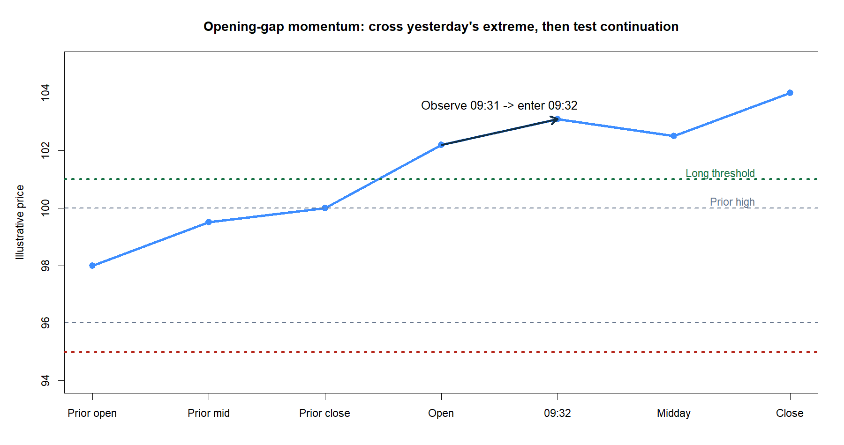
A tradable test must separate the opening signal from the fill
Source-style accounting uses the same opening print both to trigger and to enter.
Our primary retail translation:
- observe the completed 09:31 ET auction/minute;
- enter at the adjusted-SIP 09:32 bar open;
- exit at the adjusted daily close;
- charge 10 bp round trip, then 20 bp stress.
This deliberately prices the delay required to know the signal.
5
Notes:
The 09:32 entry is a conservative one-minute causal translation. The same-open return remains descriptive because it cannot be assumed fillable after the opening condition is known.
[Sources]
- C:/Users/Franc/OneDrive/Documents/Francis/Peltata Project/Time-Series-Modeling-Gen5/literature_studies/docs/GEN5_LIT_MOM_02_1_OPENING_GAP_MOMENTUM_CONTRACT.md
- C:/Users/Franc/OneDrive/Documents/Francis/Peltata Project/Time-Series-Modeling-Gen5/runs/research_workbench/literature_grounded/lit_mom_02_1_opening_gap_atlas_01_20260801/visuals/mom02_mechanics.png
- C:/Users/Franc/OneDrive/Documents/Francis/Peltata Project/Time-Series-Modeling-Gen5/docs/GEN5_4_DECISION_DIALOGUE_INDEX.md - D97

Slide 6
The breadth expansion was frozen before any outcome was inspected
TRAIN is 2017-2020. DEVELOPMENT is conditional on a complete TRAIN pass. CONFIRMATION begins in 2024 and remains sealed. The wide atlas changes only the universe, not the rule or gates.
8 anchors
92 instruments
OOS conditional
FEZ, SPY, QQQ, IWM
TLT, GLD, USO, UUP
Nine justified categories
ETFs plus stock challengers
No TRAIN nominee, no query
2024+ stays sealed
6
Notes:
The small POC is evaluated first. The predeclared atlas is then run unchanged as a breadth demonstration. No instrument, cost, threshold, or gate is edited after seeing results.
[Sources]
- C:/Users/Franc/OneDrive/Documents/Francis/Peltata Project/Time-Series-Modeling-Gen5/literature_studies/docs/GEN5_LIT_MOM_02_1_OPENING_GAP_MOMENTUM_CONTRACT.md
- C:/Users/Franc/OneDrive/Documents/Francis/Peltata Project/Time-Series-Modeling-Gen5/literature_studies/registries/gen5_lit_mom_02_1_opening_gap_atlas_registry.csv
- C:/Users/Franc/OneDrive/Documents/Francis/Peltata Project/Time-Series-Modeling-Gen5/runs/research_workbench/literature_grounded/lit_mom_02_1_opening_gap_atlas_01_20260801/run_spec.csv

Slide 7
Eight conjunctive gates ask different questions about tradability
A full pass requires every gate. The scheme is intentionally transparent: some gates are hard data/support checks, while others are statistical or economic evidence. Near-passes are diagnoses, not nominations.
G1-G3
G4-G7
G8
Integrity, >=95% entry coverage
Events, direction, years
Accuracy, positive mean
Bootstrap and sign-flip evidence
Positive 20 bp stress path
At least 3 positive years
7
Notes:
G1-G3 protect data integrity and minimum support. G4-G7 ask whether direction and payoff exceed simple nulls. G8 asks whether the already-small edge survives a deliberately harsher cost assumption and persists across years.
[Sources]
- C:/Users/Franc/OneDrive/Documents/Francis/Peltata Project/Time-Series-Modeling-Gen5/literature_studies/docs/GEN5_LIT_MOM_02_1_OPENING_GAP_MOMENTUM_CONTRACT.md
- C:/Users/Franc/OneDrive/Documents/Francis/Peltata Project/Time-Series-Modeling-Gen5/literature_studies/docs/GEN5_LIT_MOM_02_1_OPENING_GAP_MOMENTUM_RESULTS.md

Slide 8
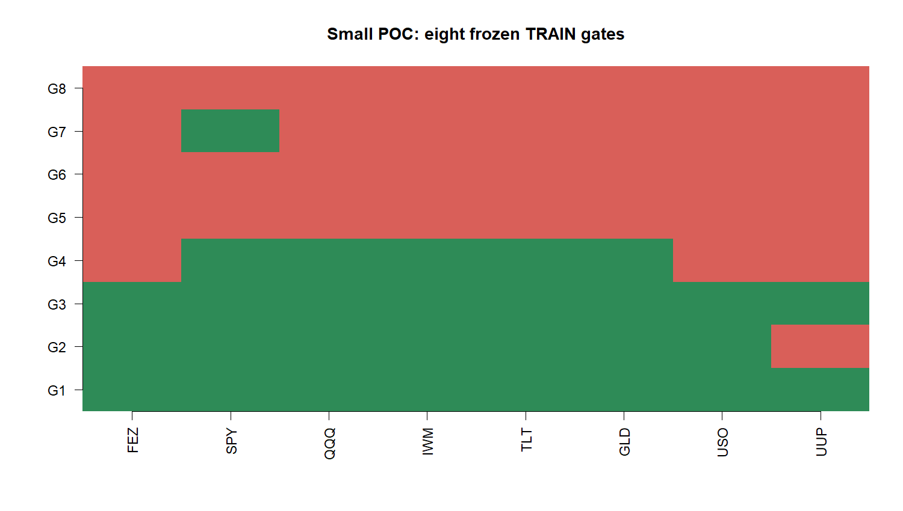
The eight-instrument POC produced no complete TRAIN pass
8
Notes:
SPY reached five of eight gates, the best among the anchors, but its primary-cost mean was -4.25 bp per event. All eight failed the complete conjunction.
[Sources]
- C:/Users/Franc/OneDrive/Documents/Francis/Peltata Project/Time-Series-Modeling-Gen5/literature_studies/docs/GEN5_LIT_MOM_02_1_OPENING_GAP_MOMENTUM_RESULTS.md
- C:/Users/Franc/OneDrive/Documents/Francis/Peltata Project/Time-Series-Modeling-Gen5/runs/research_workbench/literature_grounded/lit_mom_02_1_opening_gap_atlas_01_20260801/train_small_poc_summary.csv
- C:/Users/Franc/OneDrive/Documents/Francis/Peltata Project/Time-Series-Modeling-Gen5/runs/research_workbench/literature_grounded/lit_mom_02_1_opening_gap_atlas_01_20260801/visuals/mom02_small_poc_gate_heatmap.png

Slide 9
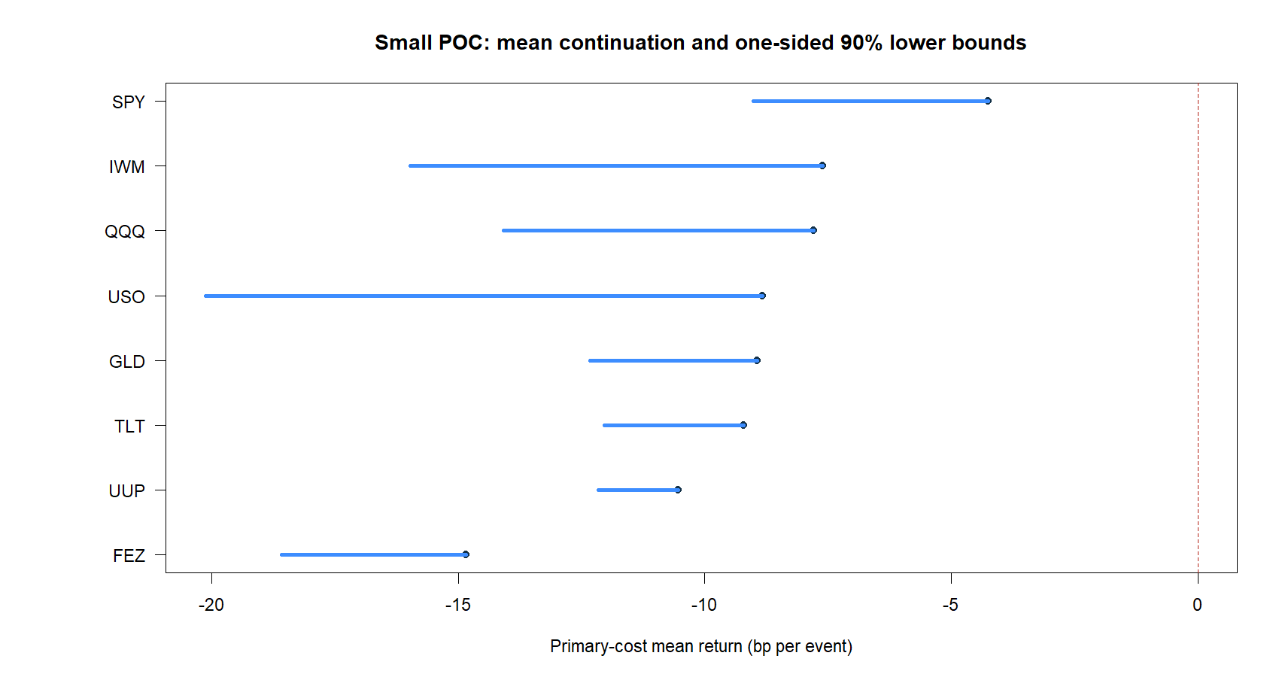
Every anchor's primary-cost estimate was negative
9
Notes:
The intervals show estimation uncertainty, but the more immediate issue is economic scale: every point estimate is below zero after the frozen 10 bp round-trip cost.
[Sources]
- C:/Users/Franc/OneDrive/Documents/Francis/Peltata Project/Time-Series-Modeling-Gen5/literature_studies/docs/GEN5_LIT_MOM_02_1_OPENING_GAP_MOMENTUM_RESULTS.md
- C:/Users/Franc/OneDrive/Documents/Francis/Peltata Project/Time-Series-Modeling-Gen5/runs/research_workbench/literature_grounded/lit_mom_02_1_opening_gap_atlas_01_20260801/train_small_poc_summary.csv
- C:/Users/Franc/OneDrive/Documents/Francis/Peltata Project/Time-Series-Modeling-Gen5/runs/research_workbench/literature_grounded/lit_mom_02_1_opening_gap_atlas_01_20260801/visuals/mom02_small_poc_return_intervals.png

Slide 10
UNCHANGED WIDE ATLAS | NINE PREDECLARED CATEGORIES
0 / 8 pass.
Widen without rescuing.
Ninety-two instruments now receive the same 0.1 x sigma90 rule, 09:32 entry, costs, dates, and eight gates. Breadth can reveal heterogeneity; it cannot rewrite the hypothesis.
Notes:
This transition marks the predeclared breadth stage. The small POC's failure does not cause any parameter relaxation or special asset selection.
[Sources]
- C:/Users/Franc/OneDrive/Documents/Francis/Peltata Project/Time-Series-Modeling-Gen5/literature_studies/docs/GEN5_LIT_MOM_02_1_OPENING_GAP_MOMENTUM_CONTRACT.md
- C:/Users/Franc/OneDrive/Documents/Francis/Peltata Project/Time-Series-Modeling-Gen5/literature_studies/registries/gen5_lit_mom_02_1_opening_gap_atlas_registry.csv
- C:/Users/Franc/OneDrive/Documents/Francis/Peltata Project/Time-Series-Modeling-Gen5/literature_studies/docs/GEN5_LIT_MOM_02_1_OPENING_GAP_MOMENTUM_RESULTS.md

Slide 11
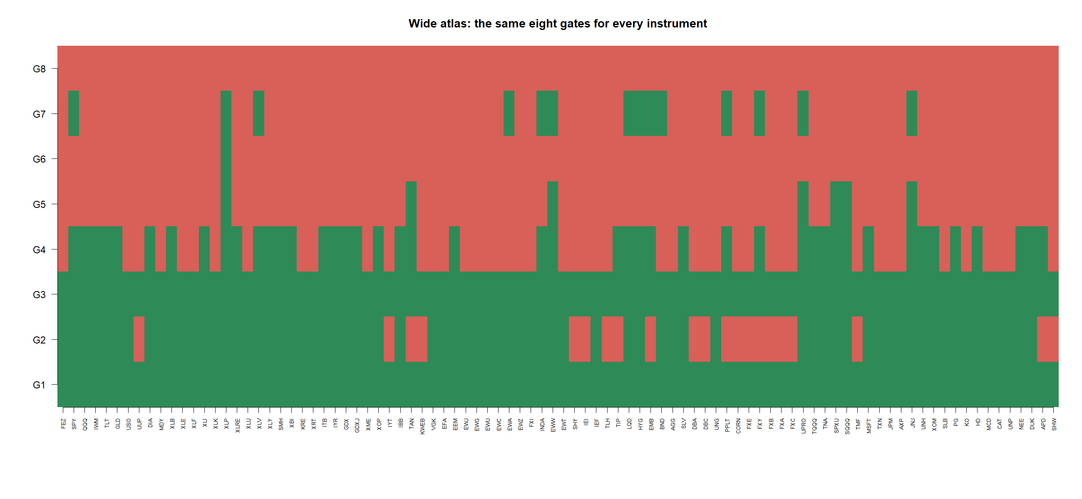
The 92-instrument atlas also produced zero complete passes
11
Notes:
All 92 passed integrity and minimum event support. Seventy-one passed 09:32 entry coverage, 45 exceeded 50% direction accuracy, seven had a positive primary mean, one passed the bootstrap lower bound, and none passed stress durability.
[Sources]
- C:/Users/Franc/OneDrive/Documents/Francis/Peltata Project/Time-Series-Modeling-Gen5/literature_studies/docs/GEN5_LIT_MOM_02_1_OPENING_GAP_MOMENTUM_RESULTS.md
- C:/Users/Franc/OneDrive/Documents/Francis/Peltata Project/Time-Series-Modeling-Gen5/runs/research_workbench/literature_grounded/lit_mom_02_1_opening_gap_atlas_01_20260801/train_atlas_gates.csv
- C:/Users/Franc/OneDrive/Documents/Francis/Peltata Project/Time-Series-Modeling-Gen5/runs/research_workbench/literature_grounded/lit_mom_02_1_opening_gap_atlas_01_20260801/visuals/mom02_atlas_gate_heatmap.png

Slide 12
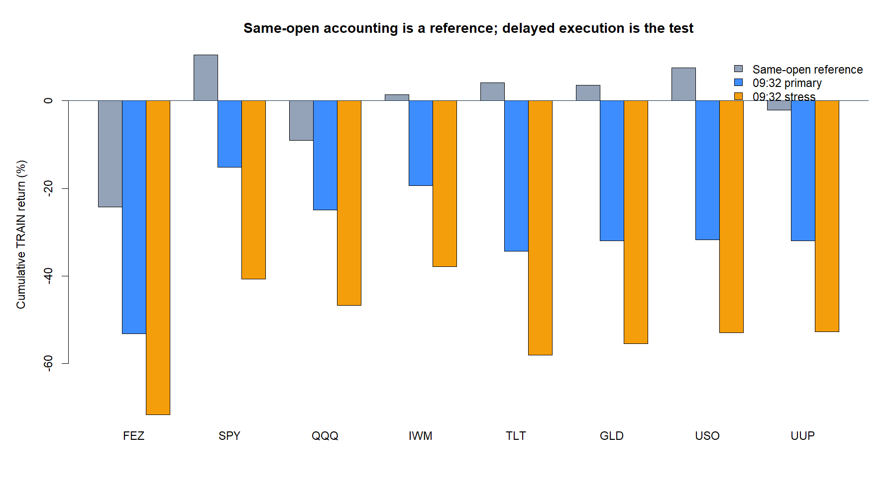
A tiny gross continuation effect did not clear retail cost scale
12
Notes:
Across 28,189 valid atlas events, causal gross continuation averaged +0.48 bp per event. The frozen 10 bp cost converts that to -9.52 bp. Same-open accounting is shown only to isolate the effect of causal timing and costs.
[Sources]
- C:/Users/Franc/OneDrive/Documents/Francis/Peltata Project/Time-Series-Modeling-Gen5/literature_studies/docs/GEN5_LIT_MOM_02_1_OPENING_GAP_MOMENTUM_RESULTS.md
- C:/Users/Franc/OneDrive/Documents/Francis/Peltata Project/Time-Series-Modeling-Gen5/runs/research_workbench/literature_grounded/lit_mom_02_1_opening_gap_atlas_01_20260801/train_event_tape.csv
- C:/Users/Franc/OneDrive/Documents/Francis/Peltata Project/Time-Series-Modeling-Gen5/runs/research_workbench/literature_grounded/lit_mom_02_1_opening_gap_atlas_01_20260801/visuals/mom02_source_vs_causal.png

Slide 13
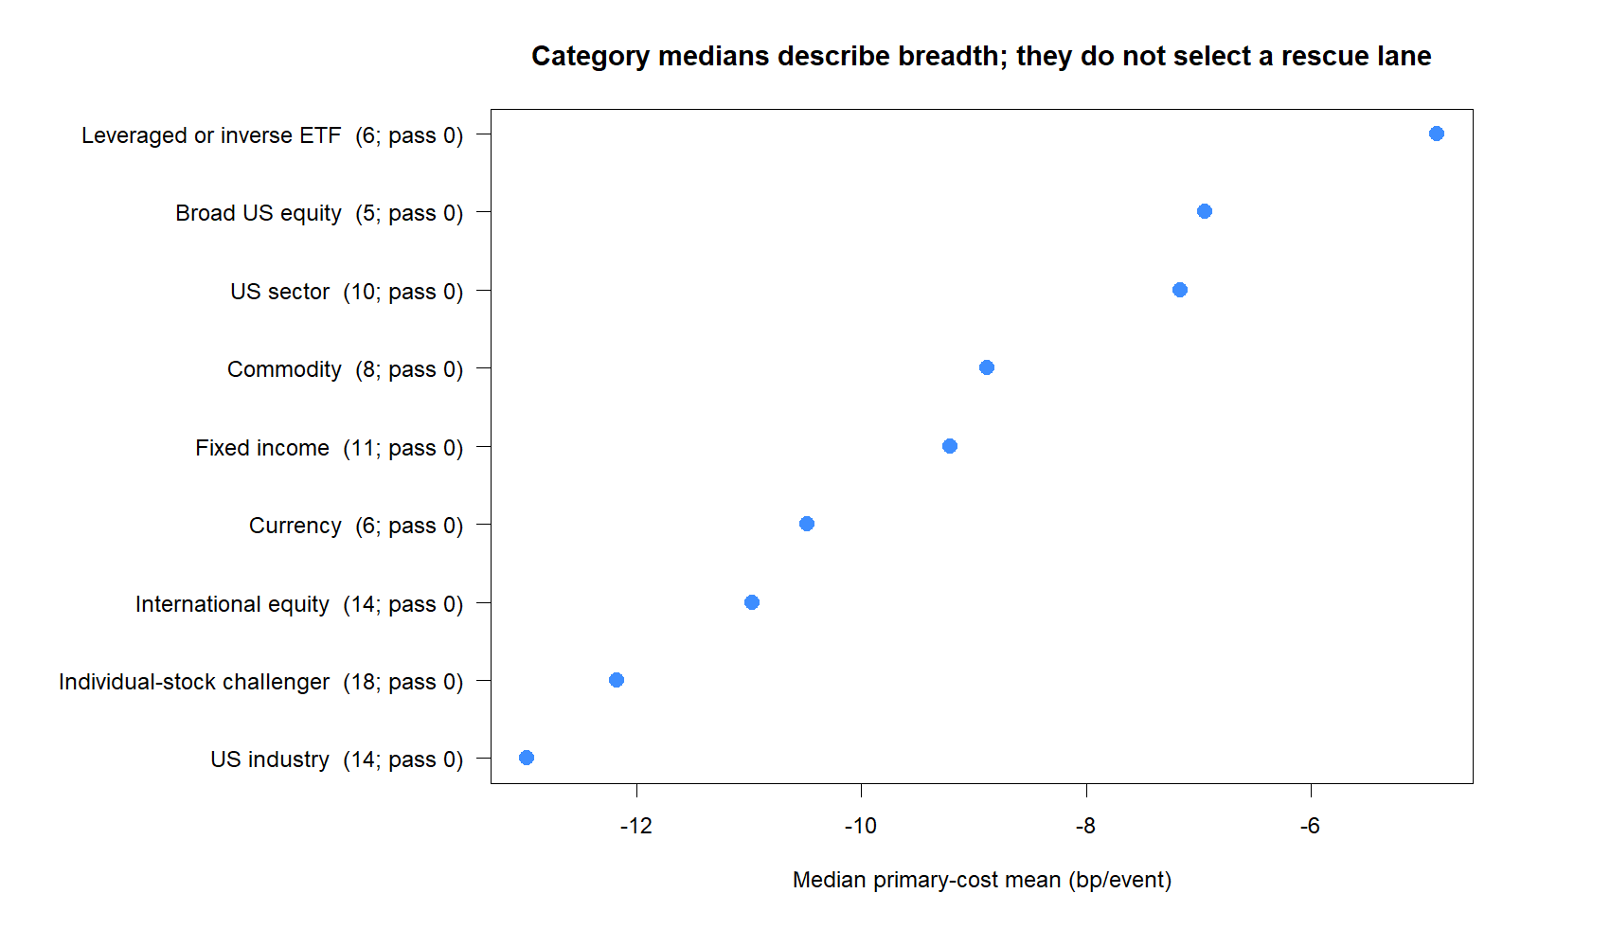
Every predeclared category had a negative median estimate
13
Notes:
Leveraged or inverse ETFs had the least-negative category median at -4.88 bp per event. US industries were worst at -12.98 bp. These medians are descriptive and do not authorize category-specific retuning.
[Sources]
- C:/Users/Franc/OneDrive/Documents/Francis/Peltata Project/Time-Series-Modeling-Gen5/literature_studies/docs/GEN5_LIT_MOM_02_1_OPENING_GAP_MOMENTUM_RESULTS.md
- C:/Users/Franc/OneDrive/Documents/Francis/Peltata Project/Time-Series-Modeling-Gen5/runs/research_workbench/literature_grounded/lit_mom_02_1_opening_gap_atlas_01_20260801/train_category_summary.csv
- C:/Users/Franc/OneDrive/Documents/Francis/Peltata Project/Time-Series-Modeling-Gen5/runs/research_workbench/literature_grounded/lit_mom_02_1_opening_gap_atlas_01_20260801/visuals/mom02_category_summary.png

Slide 14
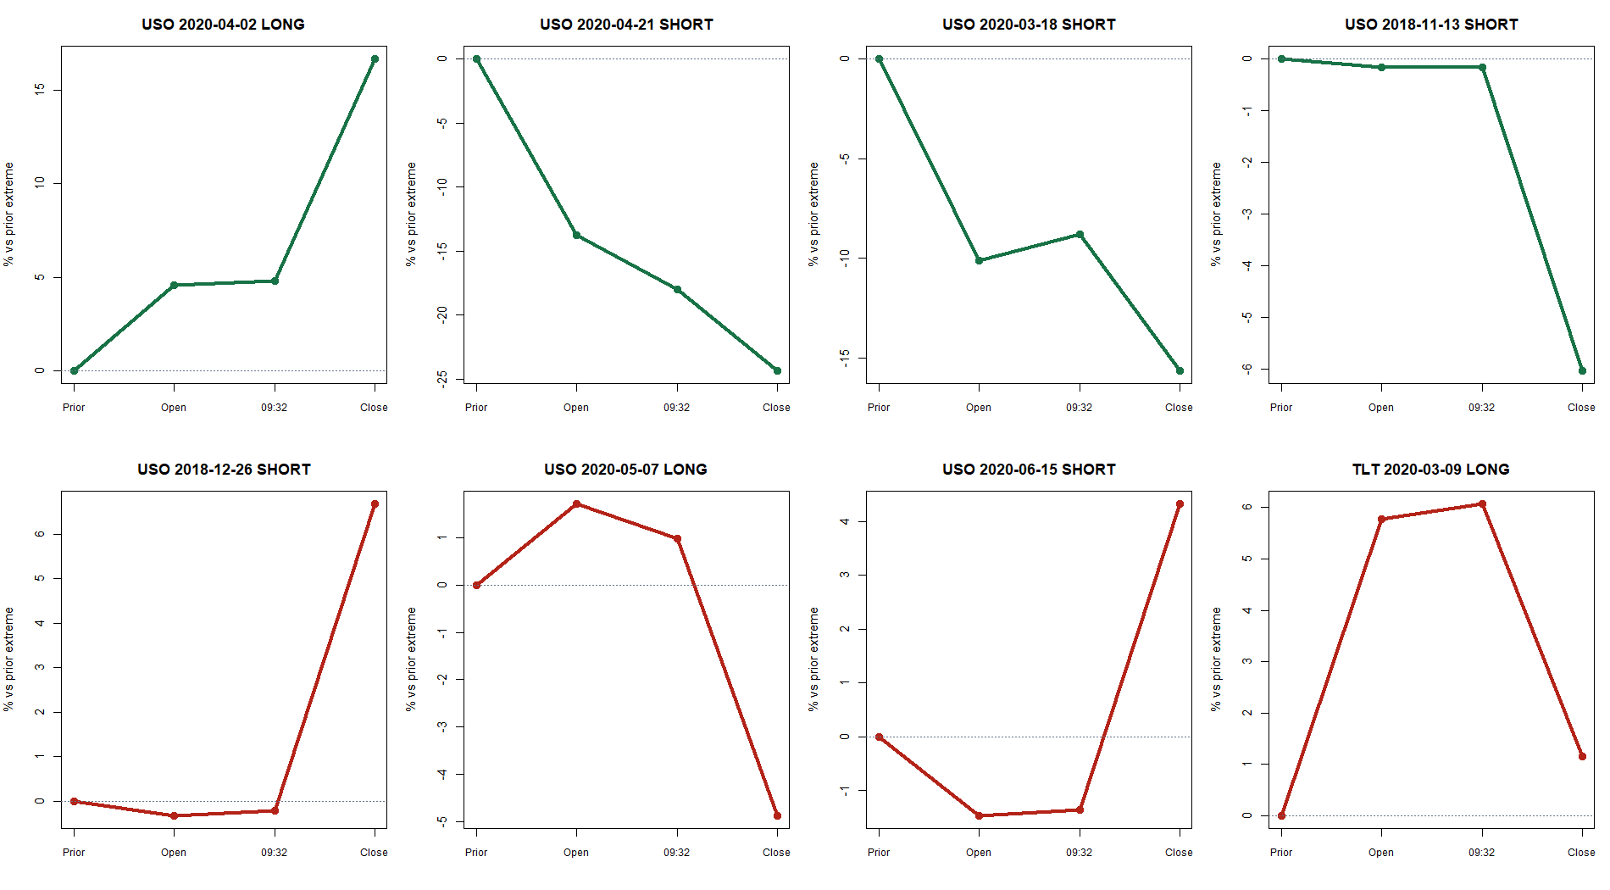
Representative events show both continuation and post-gap reversal
14
Notes:
These panels are selected mechanically from the most positive and most negative event returns, not as proof of a usable strategy. They make the causal delay visible: price can continue between the open and 09:32, or reverse after entry.
[Sources]
- C:/Users/Franc/OneDrive/Documents/Francis/Peltata Project/Time-Series-Modeling-Gen5/literature_studies/docs/GEN5_LIT_MOM_02_1_OPENING_GAP_MOMENTUM_RESULTS.md
- C:/Users/Franc/OneDrive/Documents/Francis/Peltata Project/Time-Series-Modeling-Gen5/runs/research_workbench/literature_grounded/lit_mom_02_1_opening_gap_atlas_01_20260801/train_event_tape.csv
- C:/Users/Franc/OneDrive/Documents/Francis/Peltata Project/Time-Series-Modeling-Gen5/runs/research_workbench/literature_grounded/lit_mom_02_1_opening_gap_atlas_01_20260801/visuals/mom02_representative_events.png

Slide 15
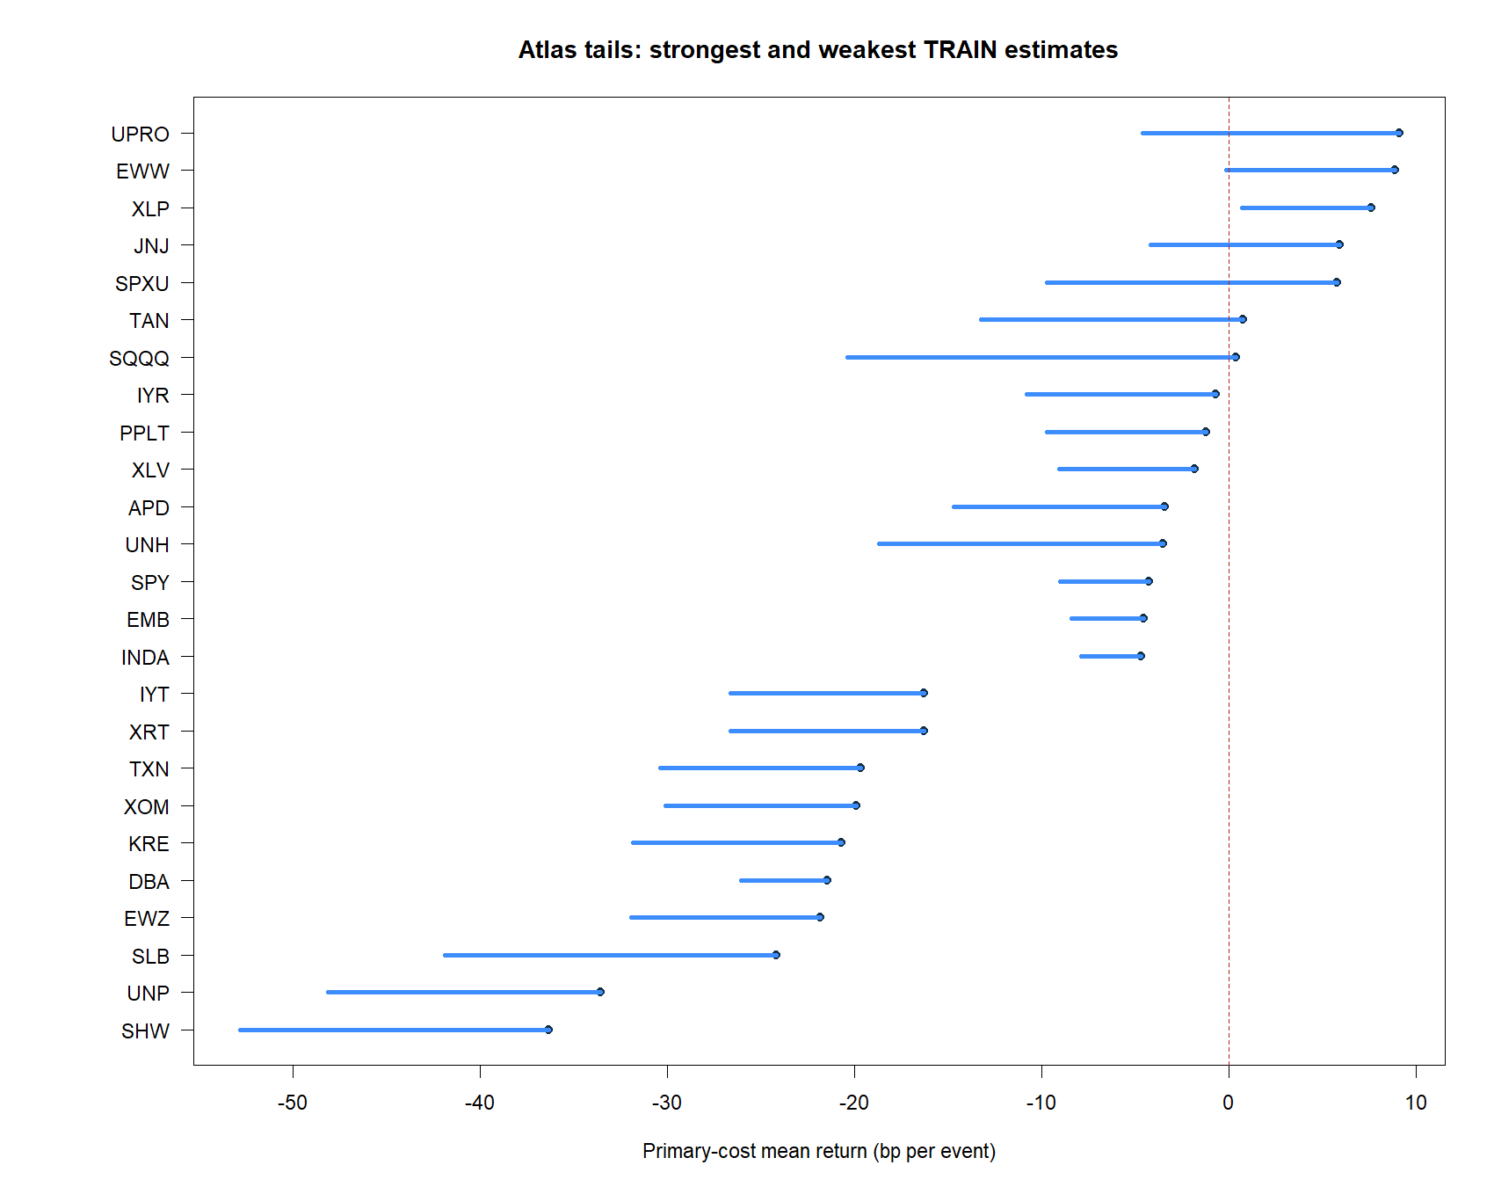
XLP reached 7/8 gates; the stress failure still closes the lane
15
Notes:
XLP had 201 valid events, 54.7% direction accuracy, +7.61 bp primary mean, and a +0.71 bp one-sided bootstrap lower bound. But its 20 bp stress cumulative return was -5.49%, so G8 fails. Inspecting DEVELOPMENT now would convert a transparent near-miss into post-hoc selection.
[Sources]
- C:/Users/Franc/OneDrive/Documents/Francis/Peltata Project/Time-Series-Modeling-Gen5/literature_studies/docs/GEN5_LIT_MOM_02_1_OPENING_GAP_MOMENTUM_RESULTS.md
- C:/Users/Franc/OneDrive/Documents/Francis/Peltata Project/Time-Series-Modeling-Gen5/runs/research_workbench/literature_grounded/lit_mom_02_1_opening_gap_atlas_01_20260801/train_atlas_summary.csv
- C:/Users/Franc/OneDrive/Documents/Francis/Peltata Project/Time-Series-Modeling-Gen5/runs/research_workbench/literature_grounded/lit_mom_02_1_opening_gap_atlas_01_20260801/visuals/mom02_atlas_return_tails.png

Slide 16
OPENING-GAP MOMENTUM ATLAS COMPLETE | RESEARCH DECISION
The rule is clear.
The TRAIN edge is not.
Record STOP_LIT_MOM_02_1_OPENING_GAP_NO_TRAIN_NOMINEE. Do not open DEVELOPMENT or 2024+ CONFIRMATION. A future revisit must be a new, prospectively frozen substantive variant.
Notes:
The result is a clean null, not a failed exercise. We recapitulated the source, exposed a printed sign discrepancy, built a causal retail translation, and tested a broad predeclared atlas without rescuing a near-miss.
[Sources]
- C:/Users/Franc/OneDrive/Documents/Francis/Peltata Project/Time-Series-Modeling-Gen5/literature_studies/docs/GEN5_LIT_MOM_02_1_OPENING_GAP_MOMENTUM_RESULTS.md
- C:/Users/Franc/OneDrive/Documents/Francis/Peltata Project/Time-Series-Modeling-Gen5/literature_studies/docs/GEN5_LIT_MOM_02_1_OPENING_GAP_MOMENTUM_CONTRACT.md
- C:/Users/Franc/OneDrive/Documents/Francis/Peltata Project/Time-Series-Modeling-Gen5/docs/GEN5_4_DECISION_DIALOGUE_INDEX.md - D97
- C:/Users/Franc/OneDrive/Documents/Francis/Peltata Project/Time-Series-Modeling-Gen5/runs/research_workbench/literature_grounded/lit_mom_02_1_opening_gap_atlas_01_20260801/lit_mom_02_1_report.md

