Slide 1
LITERATURE-GROUNDED STRATEGY RESEARCH | 31 JUL 2026
LIT-MOM-01.1
stock breadth atlas
Twenty-two stocks. Eleven sectors. One unchanged Chapter 6 horizon screen per stock—and no permission to select a winner after outcomes.
Notes:
This deck widens the completed interday-momentum textbook exercise without changing its mechanics. It is a finite breadth replication, not a stock-selection model or portfolio.
[Sources]
- C:/Users/Franc/OneDrive/Documents/Francis/Trading Literature/Algorithmic Trading - Winning Strategies and Their Rationale 2013.pdf — printed pages 135–139; PDF pages 153–157
- C:/Users/Franc/OneDrive/Documents/Francis/Peltata Project/Time-Series-Modeling-Gen5/literature_studies/docs/GEN5_LIT_MOM_01_1_STOCK_ATLAS_01_CONTRACT.md
- C:/Users/Franc/OneDrive/Documents/Francis/Peltata Project/Time-Series-Modeling-Gen5/literature_studies/docs/GEN5_LIT_MOM_01_1_STOCK_ATLAS_01_RESULTS.md

Slide 2
Breadth asks whether a mechanism recurs—not which stock wins
Every identity was frozen before outcomes. Each stock runs its own TRAIN selector; every complete passer receives its one OOS replay. Attractive failures stay visible.
22 stocks
49 cells each
0 portfolios
Exactly two per sector
Large, liquid U.S. names
Same L,H grid
Same deterministic selector
No OOS ranking
No capital allocation
2
Notes:
The unit of evidence is one stock. The atlas cannot choose a common horizon, delete weak stocks, rank the best OOS path, or pool returns after inspection.
[Sources]
- C:/Users/Franc/OneDrive/Documents/Francis/Peltata Project/Time-Series-Modeling-Gen5/literature_studies/docs/GEN5_LIT_MOM_01_1_STOCK_ATLAS_01_CONTRACT.md
- C:/Users/Franc/OneDrive/Documents/Francis/Peltata Project/Time-Series-Modeling-Gen5/literature_studies/registries/gen5_lit_mom_01_1_stock_atlas_01_registry.csv
- C:/Users/Franc/OneDrive/Documents/Francis/Peltata Project/Time-Series-Modeling-Gen5/runs/research_workbench/literature_grounded/lit_mom_01_1_stock_atlas_01_20260731/stock_atlas_01_registry.csv

Slide 3
Sector balance reduces taste-driven sampling
The panel deliberately avoids concentrating on high-beta technology or meme stocks. Within each sector, the pair spans different subindustries or economic-cycle exposures where practical.
11 sectors
2 roles
Known bias
Broad U.S. equity taxonomy
Two stocks in each
Stable compounder
Cyclical complement
Static July 2026 survivors
Not point-in-time membership
3
Notes:
The registry was justified by sector breadth, subindustry contrast, liquidity, public history, and symbol continuity. Because membership is defined in July 2026, the atlas is not an investable historical universe.
[Sources]
- C:/Users/Franc/OneDrive/Documents/Francis/Peltata Project/Time-Series-Modeling-Gen5/literature_studies/registries/gen5_lit_mom_01_1_stock_atlas_01_registry.csv
- C:/Users/Franc/OneDrive/Documents/Francis/Peltata Project/Time-Series-Modeling-Gen5/literature_studies/docs/GEN5_LIT_MOM_01_1_STOCK_ATLAS_01_CONTRACT.md
- C:/Users/Franc/OneDrive/Documents/Francis/Peltata Project/Time-Series-Modeling-Gen5/runs/research_workbench/literature_grounded/lit_mom_01_1_stock_atlas_01_20260731/stock_atlas_01_coverage.csv

Slide 4
Each stock repeats Chan's two-stage logic
First compare its own past L-session return with its next H-session return on sparse TRAIN anchors. Then freeze one admissible row and trade daily overlapping 1/H sleeves with next-open execution.
Past return
Future return
Sleeve exposure
C(t)/C(t-L) − 1
Predictor sign and magnitude
C(t+H)/C(t) − 1
Sparse inference outcome
(1/H) Σ sign[Rpast]
Bounded long/short position
4
Notes:
The sparse correlation rows diagnose the proposed time-series-momentum relation; daily overlapping sleeves describe the traded implementation. They answer related but different questions.
[Sources]
- C:/Users/Franc/OneDrive/Documents/Francis/Trading Literature/Algorithmic Trading - Winning Strategies and Their Rationale 2013.pdf — printed pages 135–139; PDF pages 153–157
- C:/Users/Franc/OneDrive/Documents/Francis/Peltata Project/Time-Series-Modeling-Gen5/literature_studies/docs/GEN5_LIT_MOM_01_1_INTERDAY_TIME_SERIES_MOMENTUM_POC_CONTRACT.md
- C:/Users/Franc/OneDrive/Documents/Francis/Peltata Project/Time-Series-Modeling-Gen5/runs/research_workbench/literature_grounded/lit_mom_01_1_stock_atlas_01_20260731/stock_atlas_01_horizon_screen.csv

Slide 5
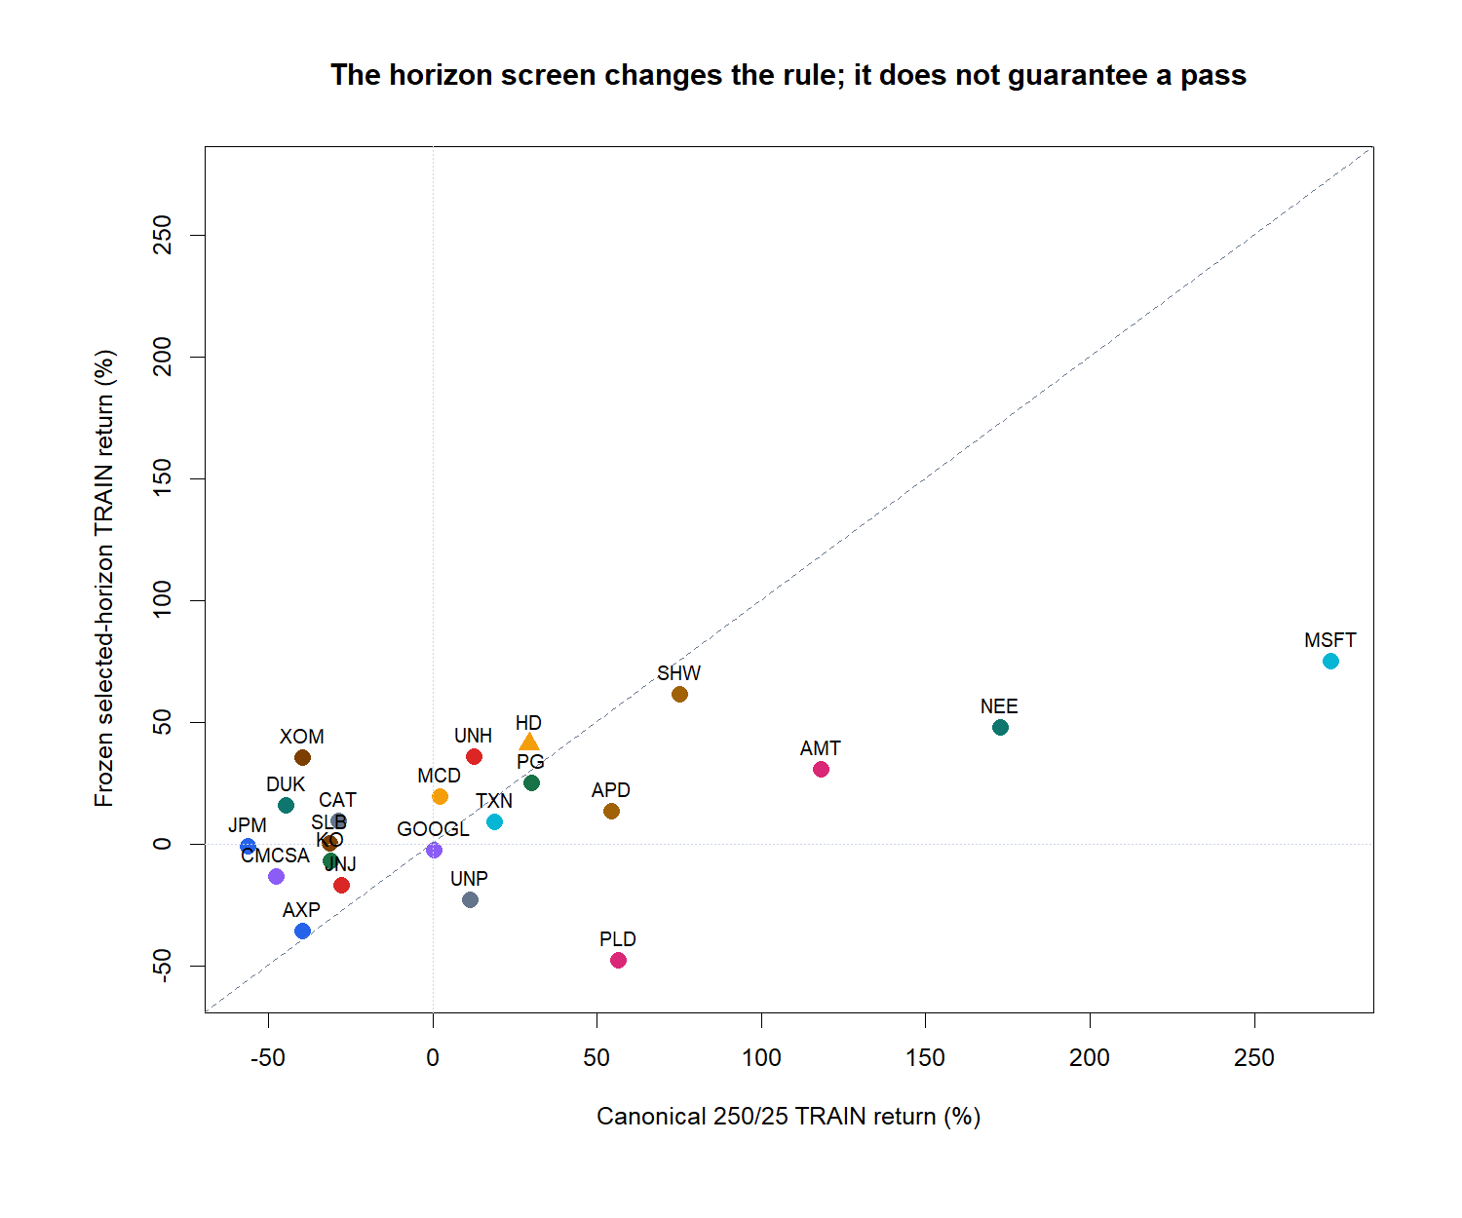
250/25 stays canonical; the TRAIN selector still governs
Chan's worked TU example uses a 250-session lookback and 25-session hold after inspecting the horizon table.
For each stock:
• report 250/25 beside the result;
• select only inside TRAIN;
• require H ≥ 5 and ≥20 sparse pairs;
• rank admissible rows by Pearson t-statistic;
• never substitute a better-looking row after OOS.
A selector can improve a backtest without validating the mechanism.
5
Notes:
The scatter shows that the selected horizon changes the rule and often changes return materially. It does not guarantee admissible correlation evidence or a six-gate pass.
[Sources]
- C:/Users/Franc/OneDrive/Documents/Francis/Trading Literature/Algorithmic Trading - Winning Strategies and Their Rationale 2013.pdf — printed pages 137–139; PDF pages 155–157
- C:/Users/Franc/OneDrive/Documents/Francis/Peltata Project/Time-Series-Modeling-Gen5/literature_studies/docs/GEN5_LIT_MOM_01_1_STOCK_ATLAS_01_CONTRACT.md
- C:/Users/Franc/OneDrive/Documents/Francis/Peltata Project/Time-Series-Modeling-Gen5/runs/research_workbench/literature_grounded/lit_mom_01_1_stock_atlas_01_20260731/stock_atlas_01_train_summary.csv
- C:/Users/Franc/OneDrive/Documents/Francis/Peltata Project/Time-Series-Modeling-Gen5/runs/research_workbench/literature_grounded/lit_mom_01_1_stock_atlas_01_20260731/visuals/stock_atlas_01_canonical_comparison.png

Slide 6
The literature supplies the mechanism; Gen5 supplies the gates
The six gates are conjunctive research controls. They prevent a visually attractive equity curve from substituting for integrity, source-style correlation evidence, support, prediction, cost-aware P&L, or time stability.
G1–G2
G3–G4
G5–G6
Integrity and causal timing
Admissible positive correlation
Sparse-pair and sleeve support
Direction accuracy > 50%
Net return and adjusted Sharpe > 0
Stress return and ≥3 positive years
6
Notes:
Chan motivates the horizon screen and sleeve strategy. The exact support thresholds, costs, evidence windows, and six-gate conjunction are Gen5 project design and must not be attributed to the author.
[Sources]
- C:/Users/Franc/OneDrive/Documents/Francis/Peltata Project/Time-Series-Modeling-Gen5/literature_studies/docs/GEN5_LIT_MOM_01_1_STOCK_ATLAS_01_CONTRACT.md
- C:/Users/Franc/OneDrive/Documents/Francis/Peltata Project/Time-Series-Modeling-Gen5/literature_studies/docs/GEN5_LITERATURE_SOURCE_LEDGER.md
- C:/Users/Franc/OneDrive/Documents/Francis/Peltata Project/Time-Series-Modeling-Gen5/runs/research_workbench/literature_grounded/lit_mom_01_1_stock_atlas_01_20260731/stock_atlas_01_train_gates.csv

Slide 7
More stocks create more chances to fool ourselves
Twenty-two independent 49-cell screens mean 1,078 related TRAIN comparisons. Nominal p-values are admission diagnostics—not family-wise proof. The protected OOS replay remains the falsification surface.
1,078
nominal p
all passers OOS
TRAIN horizon cells
22 × 49
Useful local diagnostic
Not multiplicity-adjusted truth
No best-stock selection
No hidden attrition
7
Notes:
The atlas does not claim 22 independent discovery tests or correct the nominal p-values into posterior probabilities. Its defense is predeclared identities, transparent gates, and mandatory OOS for every TRAIN passer.
[Sources]
- C:/Users/Franc/OneDrive/Documents/Francis/Peltata Project/Time-Series-Modeling-Gen5/literature_studies/docs/GEN5_LIT_MOM_01_1_STOCK_ATLAS_01_CONTRACT.md
- C:/Users/Franc/OneDrive/Documents/Francis/Peltata Project/Time-Series-Modeling-Gen5/literature_studies/docs/GEN5_LIT_MOM_01_1_STOCK_ATLAS_01_RESULTS.md
- C:/Users/Franc/OneDrive/Documents/Francis/Peltata Project/Time-Series-Modeling-Gen5/runs/research_workbench/literature_grounded/lit_mom_01_1_stock_atlas_01_20260731/stock_atlas_01_horizon_screen.csv

Slide 8
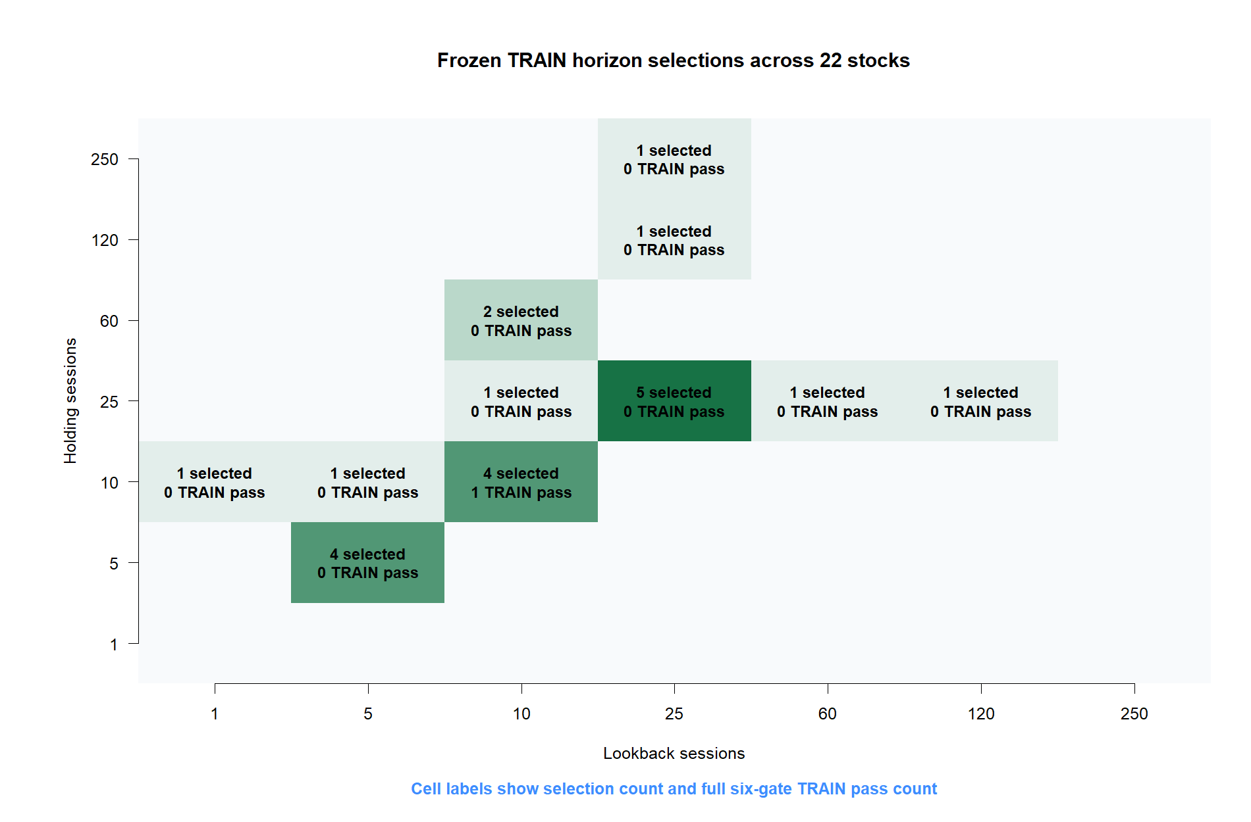
TRAIN selected many horizons—but only HD's 10/10 cleared all gates
8
Notes:
The most common selected rows were 25/25, 10/10, and 5/5. Selection frequency is descriptive. Only HD at 10/10 passed the entire conjunction.
[Sources]
- C:/Users/Franc/OneDrive/Documents/Francis/Peltata Project/Time-Series-Modeling-Gen5/runs/research_workbench/literature_grounded/lit_mom_01_1_stock_atlas_01_20260731/stock_atlas_01_train_summary.csv
- C:/Users/Franc/OneDrive/Documents/Francis/Peltata Project/Time-Series-Modeling-Gen5/runs/research_workbench/literature_grounded/lit_mom_01_1_stock_atlas_01_20260731/stock_atlas_01_horizon_screen.csv
- C:/Users/Franc/OneDrive/Documents/Francis/Peltata Project/Time-Series-Modeling-Gen5/runs/research_workbench/literature_grounded/lit_mom_01_1_stock_atlas_01_20260731/visuals/stock_atlas_01_selected_horizons.png

Slide 9
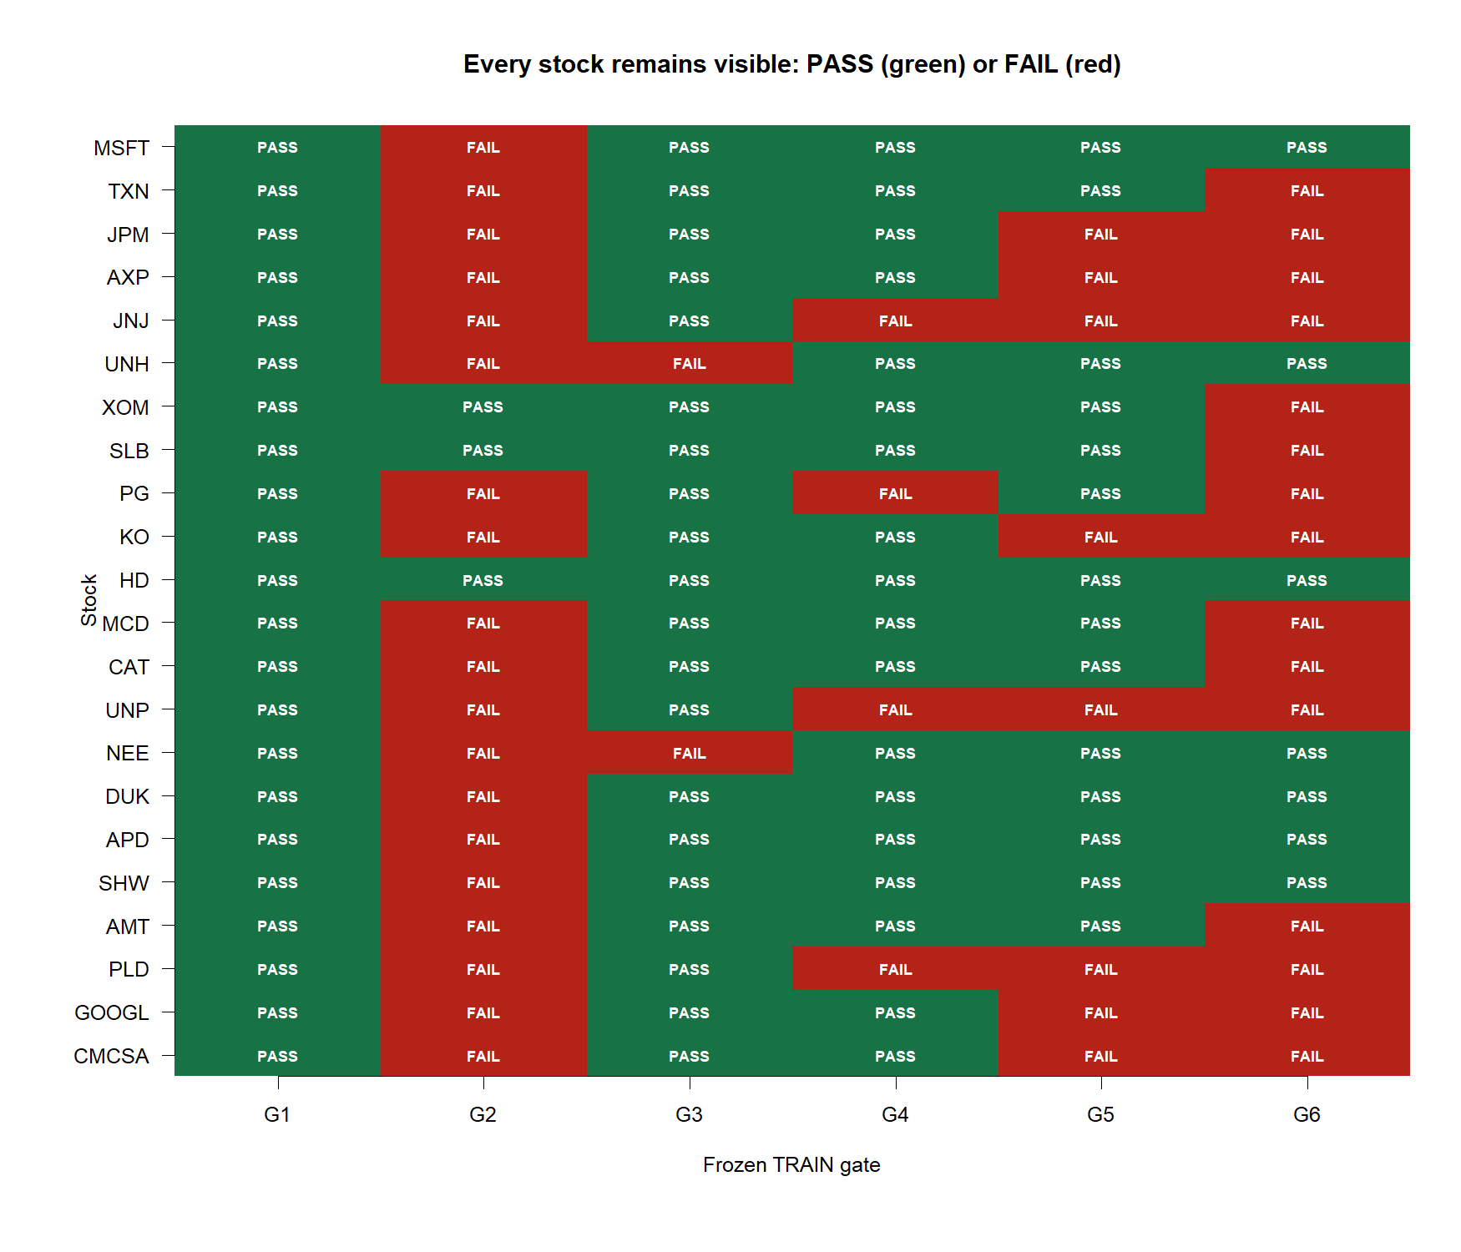
The horizon-screen gate—not P&L—was the dominant TRAIN stop
9
Notes:
G1 passed 22/22, G2 3/22, G3 20/22, G4 18/22, G5 14/22, and G6 7/22. HD alone passed all six. The conjunction prevents outcome-driven promotion of a profitable but mechanistically unsupported backtest.
[Sources]
- C:/Users/Franc/OneDrive/Documents/Francis/Peltata Project/Time-Series-Modeling-Gen5/literature_studies/docs/GEN5_LIT_MOM_01_1_STOCK_ATLAS_01_RESULTS.md
- C:/Users/Franc/OneDrive/Documents/Francis/Peltata Project/Time-Series-Modeling-Gen5/runs/research_workbench/literature_grounded/lit_mom_01_1_stock_atlas_01_20260731/stock_atlas_01_train_gates.csv
- C:/Users/Franc/OneDrive/Documents/Francis/Peltata Project/Time-Series-Modeling-Gen5/runs/research_workbench/literature_grounded/lit_mom_01_1_stock_atlas_01_20260731/visuals/stock_atlas_01_gate_matrix.png

Slide 10
ONE AUTHORIZED OOS REPLAY | 2021–2023
HD 10/10 enters
DEVELOPMENT alone
The identity, horizon, long/short sleeve rule, costs, and evidence dates are frozen. The other 21 stocks stop in TRAIN; 2024+ CONFIRMATION stays sealed.
Notes:
HD passed with TRAIN correlation 0.1833, nominal p=0.0679, 61.0% direction accuracy, +41.00% primary return, and +33.44% stress return. That earned one replay, not a discovery claim.
[Sources]
- C:/Users/Franc/OneDrive/Documents/Francis/Peltata Project/Time-Series-Modeling-Gen5/literature_studies/docs/GEN5_LIT_MOM_01_1_STOCK_ATLAS_01_RESULTS.md
- C:/Users/Franc/OneDrive/Documents/Francis/Peltata Project/Time-Series-Modeling-Gen5/runs/research_workbench/literature_grounded/lit_mom_01_1_stock_atlas_01_20260731/stock_atlas_01_train_summary.csv
- C:/Users/Franc/OneDrive/Documents/Francis/Peltata Project/Time-Series-Modeling-Gen5/runs/research_workbench/literature_grounded/lit_mom_01_1_stock_atlas_01_20260731/stock_atlas_01_run_spec.csv

Slide 11
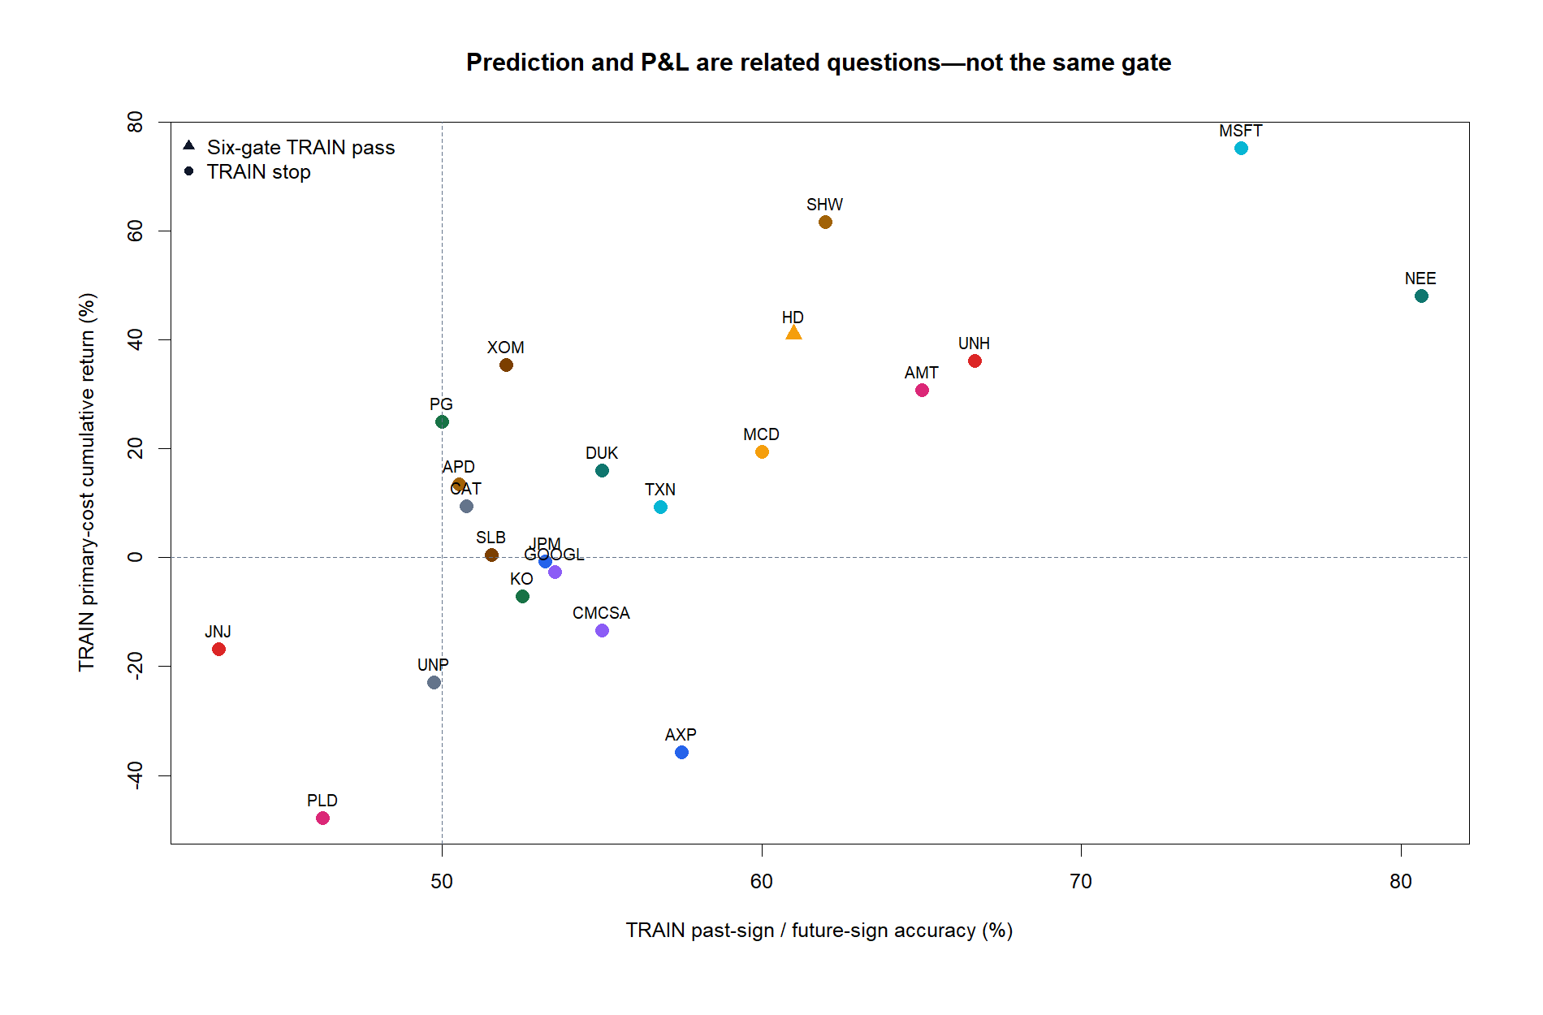
Prediction and P&L were already different questions in TRAIN
11
Notes:
MSFT is the clearest warning: 75.0% sign accuracy and +75.16% return, yet its selected correlation was slightly negative and nominal p was 0.916. HD is the only triangle because it alone passed every gate.
[Sources]
- C:/Users/Franc/OneDrive/Documents/Francis/Peltata Project/Time-Series-Modeling-Gen5/literature_studies/docs/GEN5_LIT_MOM_01_1_STOCK_ATLAS_01_RESULTS.md
- C:/Users/Franc/OneDrive/Documents/Francis/Peltata Project/Time-Series-Modeling-Gen5/runs/research_workbench/literature_grounded/lit_mom_01_1_stock_atlas_01_20260731/stock_atlas_01_train_summary.csv
- C:/Users/Franc/OneDrive/Documents/Francis/Peltata Project/Time-Series-Modeling-Gen5/runs/research_workbench/literature_grounded/lit_mom_01_1_stock_atlas_01_20260731/visuals/stock_atlas_01_train_evidence.png

Slide 12
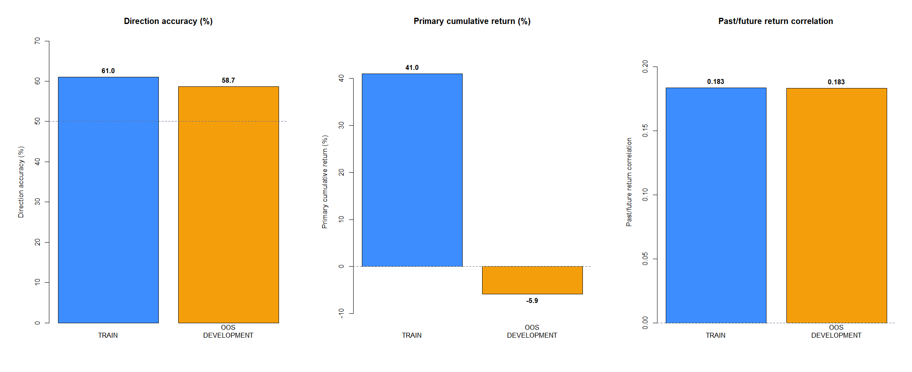
HD retained directional evidence—but not economic continuity
12
Notes:
HD's sparse-pair correlation stayed near 0.183 and direction accuracy remained above chance at 58.67%. Primary cumulative return reversed from +41.00% to -5.86%. Nominal OOS p was 0.116, and none of the four descriptive continuity flags passed jointly.
[Sources]
- C:/Users/Franc/OneDrive/Documents/Francis/Peltata Project/Time-Series-Modeling-Gen5/literature_studies/docs/GEN5_LIT_MOM_01_1_STOCK_ATLAS_01_RESULTS.md
- C:/Users/Franc/OneDrive/Documents/Francis/Peltata Project/Time-Series-Modeling-Gen5/runs/research_workbench/literature_grounded/lit_mom_01_1_stock_atlas_01_20260731/stock_atlas_01_development_summary.csv
- C:/Users/Franc/OneDrive/Documents/Francis/Peltata Project/Time-Series-Modeling-Gen5/runs/research_workbench/literature_grounded/lit_mom_01_1_stock_atlas_01_20260731/visuals/stock_atlas_01_train_to_development.png

Slide 13
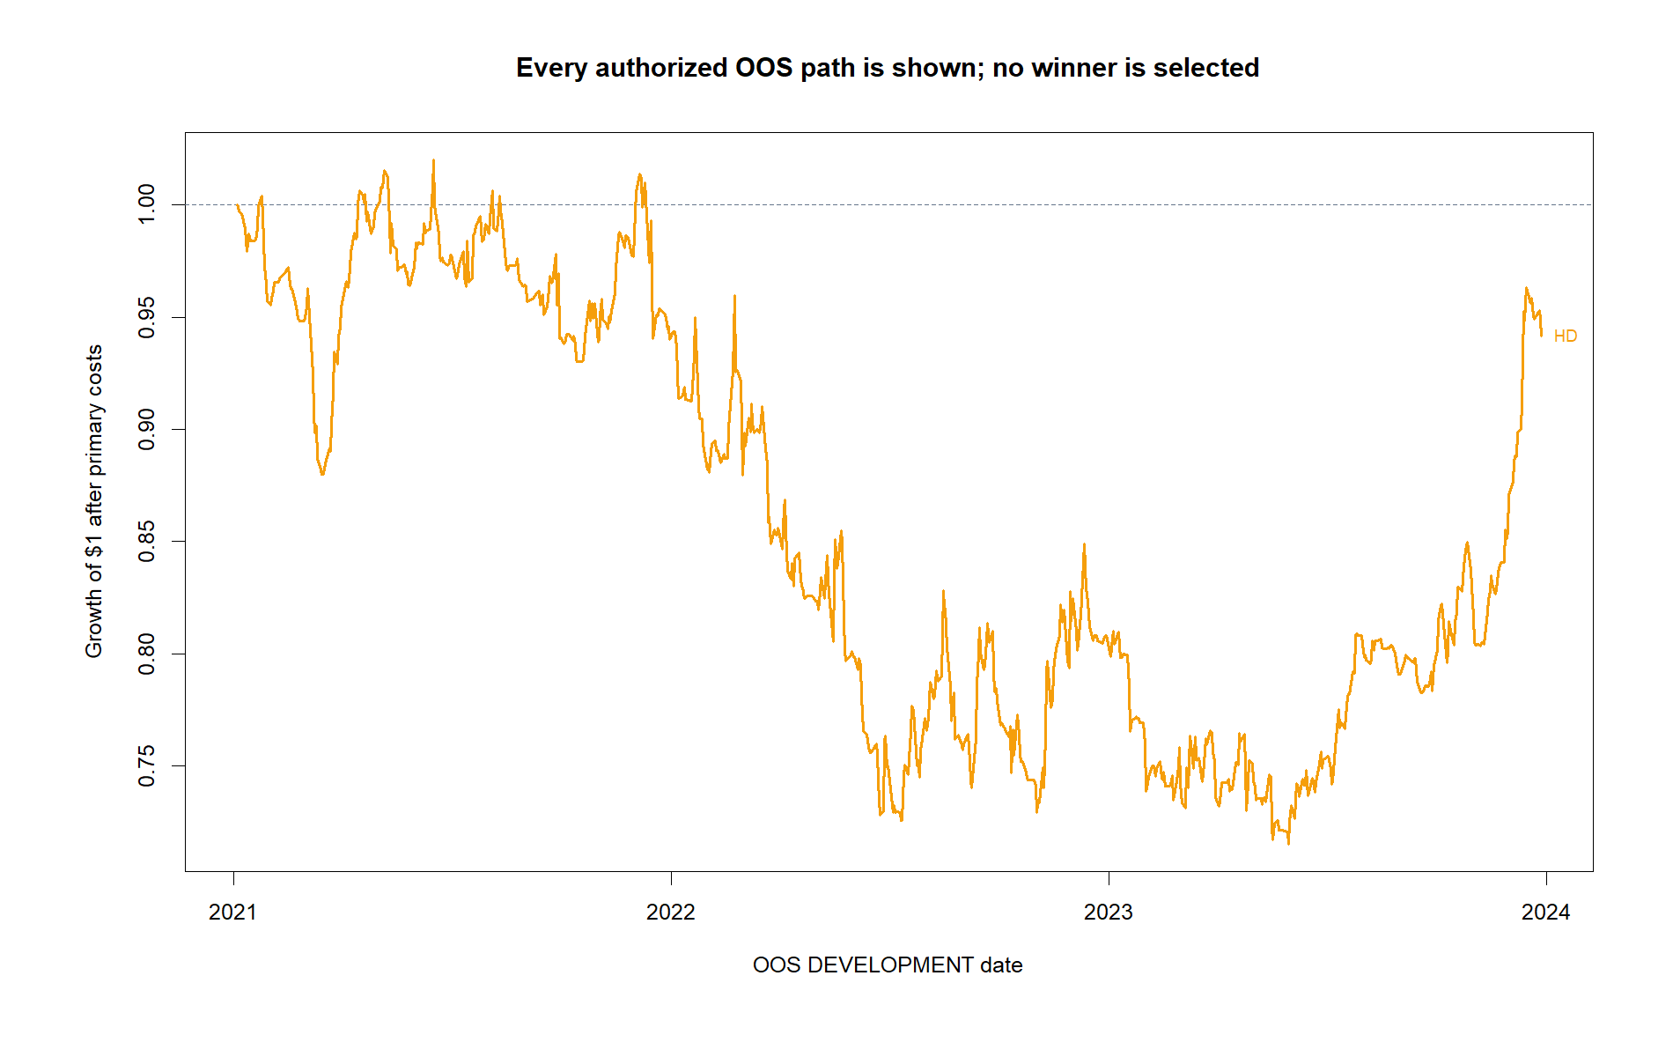
The OOS path fell nearly 30% before a late recovery
13
Notes:
HD finished at -5.86% after primary costs with adjusted Sharpe -0.03 and maximum drawdown -29.94%; stress return was -9.82%. Long sleeves averaged +0.45%, while short sleeves averaged -0.68% with only 44.8% direction accuracy.
[Sources]
- C:/Users/Franc/OneDrive/Documents/Francis/Peltata Project/Time-Series-Modeling-Gen5/literature_studies/docs/GEN5_LIT_MOM_01_1_STOCK_ATLAS_01_RESULTS.md
- C:/Users/Franc/OneDrive/Documents/Francis/Peltata Project/Time-Series-Modeling-Gen5/runs/research_workbench/literature_grounded/lit_mom_01_1_stock_atlas_01_20260731/stock_atlas_01_development_primary_bars.csv
- C:/Users/Franc/OneDrive/Documents/Francis/Peltata Project/Time-Series-Modeling-Gen5/runs/research_workbench/literature_grounded/lit_mom_01_1_stock_atlas_01_20260731/stock_atlas_01_development_sleeves.csv
- C:/Users/Franc/OneDrive/Documents/Francis/Peltata Project/Time-Series-Modeling-Gen5/runs/research_workbench/literature_grounded/lit_mom_01_1_stock_atlas_01_20260731/visuals/stock_atlas_01_development_paths.png

Slide 14
BREADTH EXERCISE COMPLETE | RESEARCH DECISION
The signal classified.
The strategy did not pay.
Record the sole honest OOS result and stop before CONFIRMATION. Do not rescue the atlas by choosing an attractive TRAIN failure, dropping shorts, retuning horizons, or pooling stocks.
Notes:
The atlas is a useful negative result. It shows that sparse directional correlation can survive while the traded overlapping-sleeve strategy loses money, especially on the short side. Any long-only variant, cross-sectional selector, common-horizon model, or portfolio would require a new frozen hypothesis.
[Sources]
- C:/Users/Franc/OneDrive/Documents/Francis/Peltata Project/Time-Series-Modeling-Gen5/literature_studies/docs/GEN5_LIT_MOM_01_1_STOCK_ATLAS_01_RESULTS.md
- C:/Users/Franc/OneDrive/Documents/Francis/Peltata Project/Time-Series-Modeling-Gen5/literature_studies/docs/GEN5_LIT_MOM_01_1_STOCK_ATLAS_01_CONTRACT.md
- C:/Users/Franc/OneDrive/Documents/Francis/Peltata Project/Time-Series-Modeling-Gen5/runs/research_workbench/literature_grounded/lit_mom_01_1_stock_atlas_01_20260731/stock_atlas_01_report.md

