Slide 1
OPERATOR HYPOTHESIS LAB
Can six simple features rank next quarter?
HYP-MOM-04.1 · Regularized Trend-State Quartile
Notes:
This deck follows the question from frozen design through the TRAIN stop.
[Sources]
- HYP_MOM_04_1_REGULARIZED_TREND_STATE_QUARTILE_CONTRACT.md
- HYP_MOM_04_1_REGULARIZED_TREND_STATE_QUARTILE_RESULTS.md
[/Sources]

Slide 2
Ridge answers the prediction question more directly than PCA
PCA asks: what varies together?
It compresses correlated features without looking at next-quarter return. A high-variance component need not be predictive, and component meaning may drift across samples.
Ridge asks: what predicts, with restraint?
It estimates a signed linear ranking while shrinking unstable coefficients. Time-ordered validation—not pooled fit—decides whether the relationship travels forward.
2
Notes:
PCA remains useful for state description; it was not the best primary method for this supervised ranking question.
[Sources]
- HYP-MOM-04.1 contract, Research question and Ridge model sections
[/Sources]
Chat reference: Codex task 019f741e-615f-7fd0-90f7-edce12b5cb66, 2026-08-10 plain-English Ridge explanation; decision index D113.

Slide 3
Ridge turns six clues into one restrained score
Think of it as a scoring rule
Each feature receives a weight. Add the six weighted clues to produce one stock score.
A higher score means “more likely to beat peers next quarter”—not a guaranteed return.
Why ‘Ridge’ matters
Ordinary regression can chase noisy relationships. Ridge charges a penalty for large weights:
error + λ × Σ weight²
Larger λ means more restraint.
3
Notes:
Ridge predicts a continuous relative-return score; it is not a direct up/down classifier.
The penalty shrinks feature weights toward zero, especially when predictors overlap or the sample is small.
[Sources]
- HYP-MOM-04.1 frozen contract, sections ‘Frozen features’ and ‘Ridge model and TRAIN selection’.
- Codex task 019f741e-615f-7fd0-90f7-edce12b5cb66, operator question and plain-English Ridge explanation on 2026-08-10; indexed in GEN5_4_DECISION_DIALOGUE_INDEX.md at D113.
[/Sources]

Slide 4
Three evidence layers ask progressively harder questions
Pooled TRAIN
Forward folds
OOS lock
Can one formula describe all 15 TRAIN quarters after seeing them together?
Fit only earlier quarters. Does its ranking work in genuinely later TRAIN quarters?
Only if every TRAIN gate passes may the untouched 2021–2023 period be queried.
4
Notes:
Pooled fit measures association within the complete TRAIN sample. It is useful, but the same rows help estimate and judge the coefficients.
Expanding validation is the transfer test: learn from earlier quarters and score later TRAIN quarters.
OOS remains untouched until all frozen TRAIN gates pass.
[Sources]
- HYP-MOM-04.1 frozen contract, ‘Evidence sequence and data boundary’ and ‘TRAIN nomination gates’.
- Codex task 019f741e-615f-7fd0-90f7-edce12b5cb66, plain-English pooled-versus-chronological explanation on 2026-08-10; indexed in GEN5_4_DECISION_DIALOGUE_INDEX.md at D113.
[/Sources]

Slide 5
The evidence boundary was frozen before any outcome was visible
2016
2017–2020
2021–2023
Warm-up
Indicators only. No target or selection authority.
TRAIN
15 signal quarters. Fit, validate, gate, then freeze.
OOS lock
Accessible only if every TRAIN gate passes.
5
Notes:
The TRAIN runner could query only through 2020-12-31. This is a structural boundary, not an analyst promise.
[Sources]
- HYP-MOM-04.1 contract, Evidence sequence and data boundary
[/Sources]

Slide 6
Three features capture persistent trend
12–1 momentum
log(C[t−21] / C[t−252]) Skips the most recent month to reduce short-run reversal contamination.
Sector-relative 126
Asset six-month log return minus the same-sector cross-sectional mean.
Slow slope / ATR
(SMA200[t] − SMA200[t−20]) / ATR20[t] Trend direction scaled to the asset's own movement.
6
Notes:
Each input uses only completed adjusted closes as of the quarter-end signal date.
[Sources]
- HYP-MOM-04.1 contract, Frozen features 1–3
[/Sources]

Slide 7
Three features describe extension, volatility, and trend location
20-session extension
Current log price as a z-score of its last 20 closes. Theory sign: negative.
Volatility ratio
RV20 / RV126 Asks whether short-run volatility has expanded relative to the slower state.
252-session high proximity
C[t] / max252(C) Measures whether price is near its one-year high.
7
Notes:
These are compact state descriptors—not six independent trading strategies.
[Sources]
- HYP-MOM-04.1 contract, Frozen features 4–6
[/Sources]

Slide 8
Relative return is the target
Target
Next-quarter first-open to last-open return minus equal-weight eligible-universe return. A positive target means the stock beat its contemporaneous cross-section.
Preprocessing
Within each signal quarter: z = Φ⁻¹((rank − 0.5) / n) TRAIN pooled center and scale are then frozen for later scoring.
8
Notes:
Cross-sectional rank-normalization reduces scale dominance and remains causal because it uses only that quarter's contemporaneous panel.
[Sources]
- HYP-MOM-04.1 contract, Causal observation and return timing; Frozen preprocessing
[/Sources]

Slide 9
Seven gates stand between an attractive TRAIN fit and OOS access
G1 · Integrity
Dates, bars, registry, target timing
G2 · Support
≥12 quarters; ≥20 assets
G3 · Forward IC
>0 mean; ≥60% positive
G4 · Q4 excess
>0 mean; ≥60% positive
G5 · Ordering
Mean Q4 − Q1 > 0
G6 · Permutation
Observed ≥ 90th percentile
G7 · Breadth
Largest sector ≤ 35%
OOS lock
All seven—or no query
9
Notes:
G3 is deliberately independent of the full-sample quartile chart. That separation becomes decisive.
[Sources]
- HYP-MOM-04.1 contract, TRAIN nomination gates
[/Sources]

Slide 10
The refreshed TRAIN panel retained broad cross-sectional support
Coverage
Eight later-history identities lacked the full 2016–2020 range and were excluded without replacement. All 15 causal integrity checks passed.
114
1,693
111–114
eligible identities
asset-quarter rows
assets per quarter
10
Notes:
The bounded network refresh reproduced the cached panel and outcome exactly.
[Sources]
- hyp_mom_04_1_train_run_spec.csv
- hyp_mom_04_1_train_integrity.csv
- hyp_mom_04_1_train_coverage.csv
[/Sources]

Slide 11
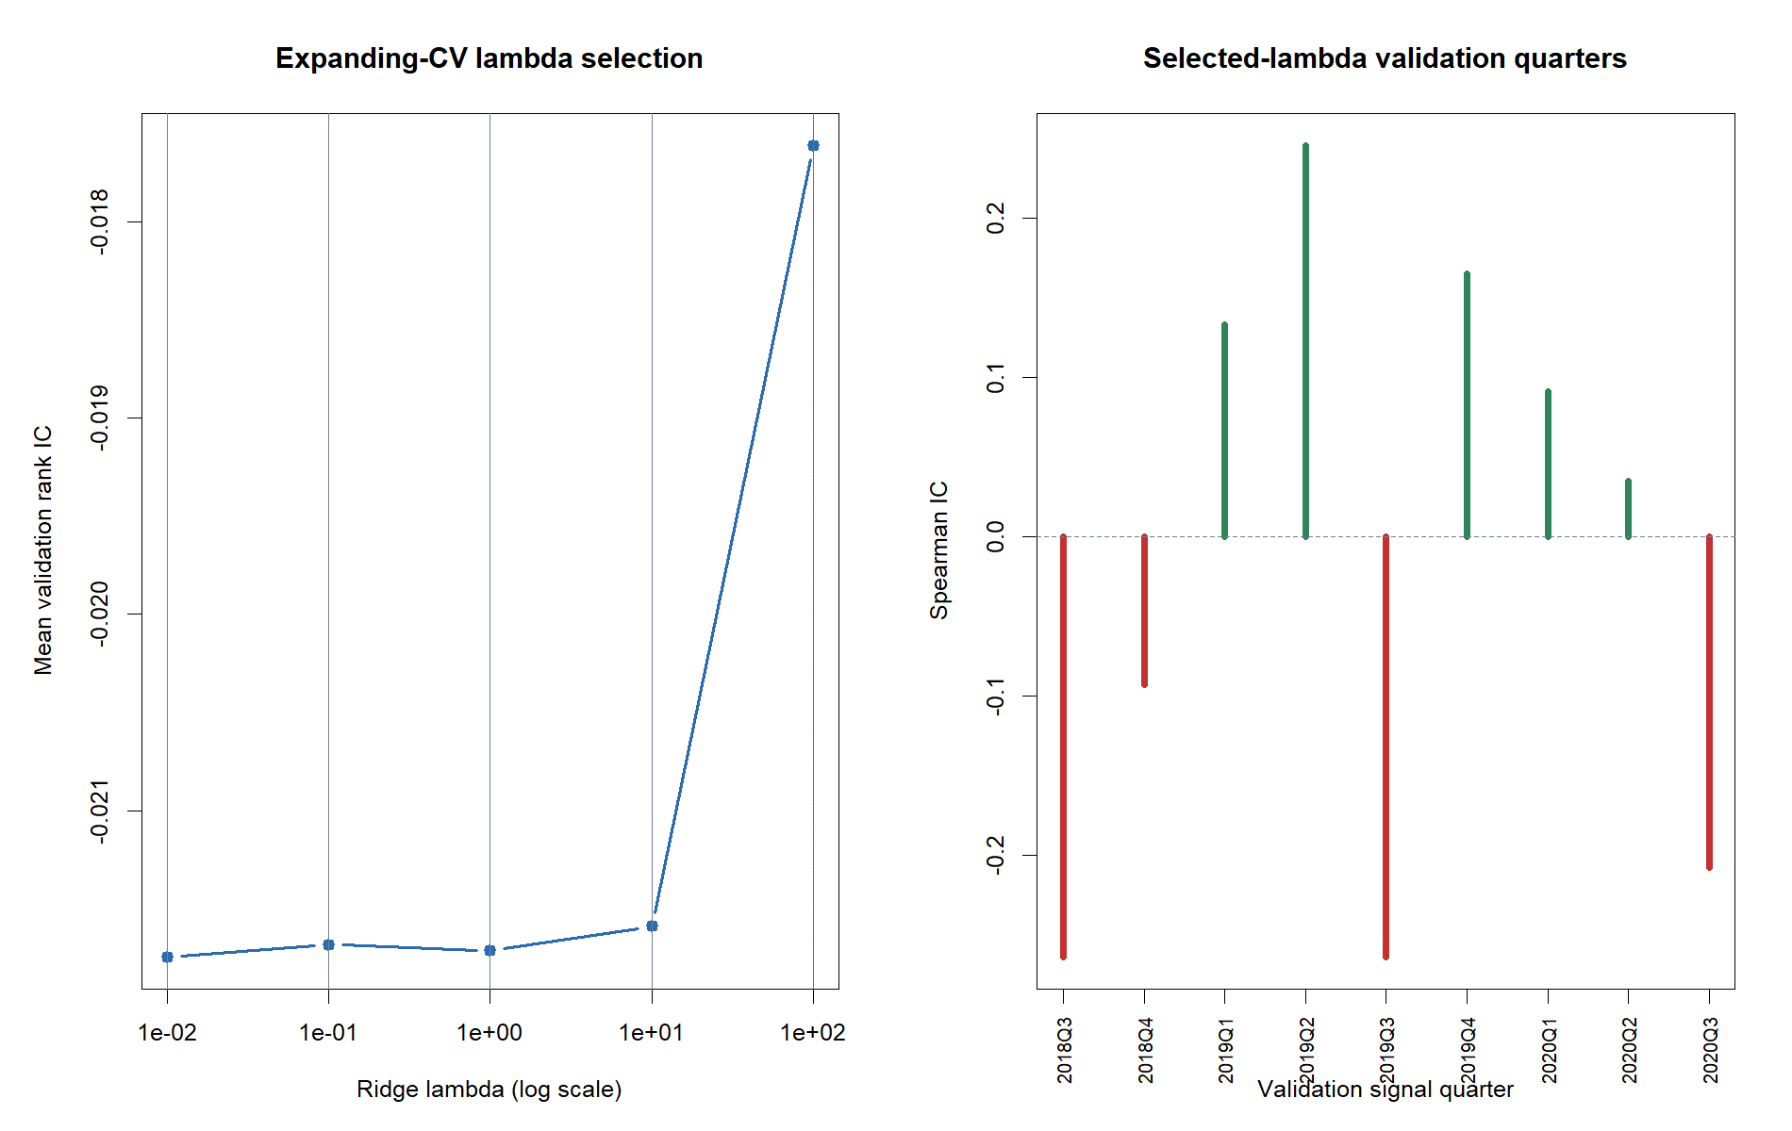
Every ridge penalty stayed negative
Selected: λ = 100
The one-standard-error rule preferred the strongest shrinkage. Mean forward rank IC still ended at −0.0176. Regularization reduced variance; it could not create temporal stability.
11
Notes:
The one-standard-error rule correctly preferred the most regularized model, but regularization could not turn the forward relationship positive.
[Sources]
- hyp_mom_04_1_train_cv_summary.csv
[/Sources]

Slide 12
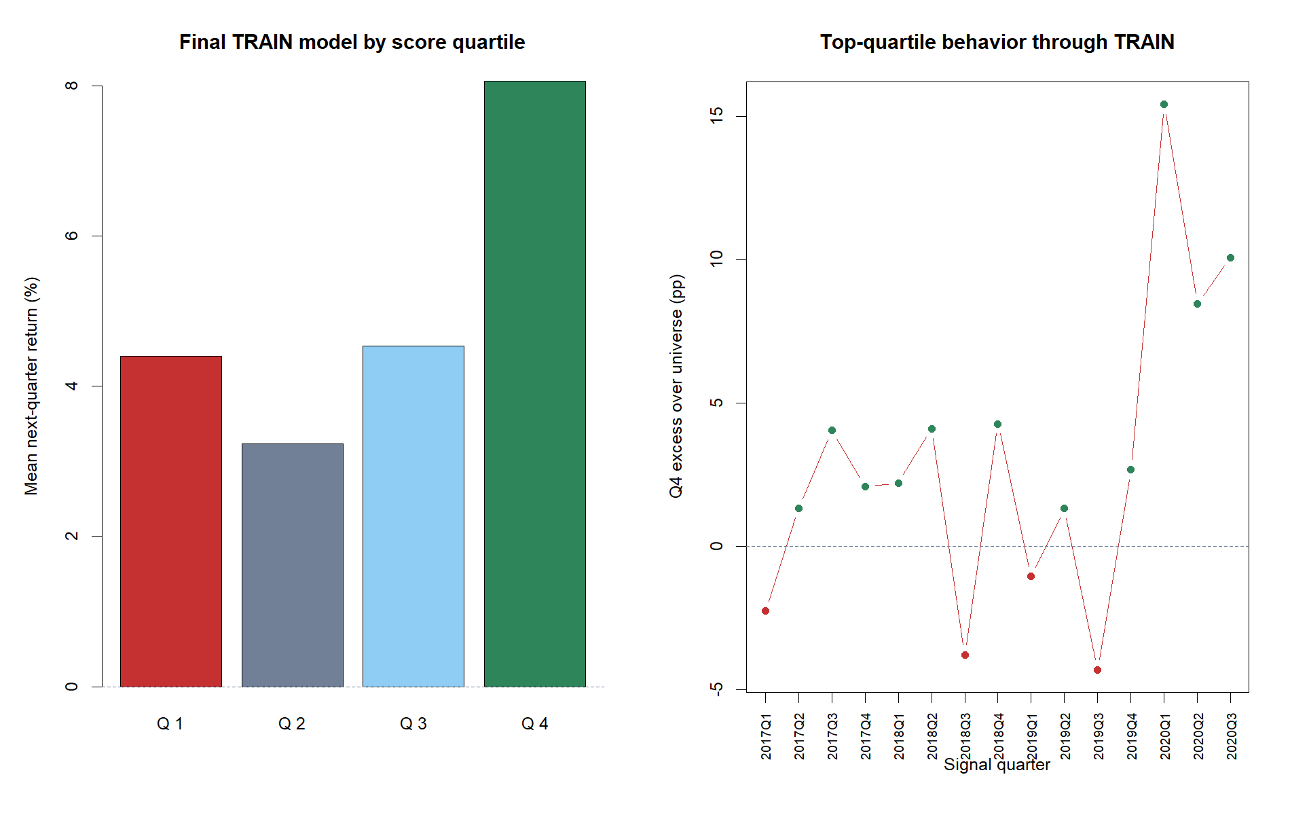
Pooled fit did not travel
Two views of TRAIN
Full fit: +2.98 pp mean Q4 excess. Expanding validation: 5 / 9 positive IC quarters. The same feature set can look ordered in pooled data while failing chronological transport.
12
Notes:
The failure is temporal instability, not insufficient cross-sectional sample size.
[Sources]
- hyp_mom_04_1_train_cv_details.csv
[/Sources]
Chat reference: Codex task 019f741e-615f-7fd0-90f7-edce12b5cb66, 2026-08-10 explanation of why pooled fit did not override chronological failure; decision index D113.

Slide 13
Pooled TRAIN looked compelling—and that is why the gate mattered
Full-sample association
After fitting all 15 TRAIN quarters, the top score quartile separated strongly. Those same rows helped estimate the coefficients, so this is descriptive fit, not forward evidence.
+2.98 pp
+3.64 pp
98.8th
Q4 excess / quarter
Q4 minus Q1
permutation percentile
13
Notes:
Permutation significance asks whether the pooled mapping contains structure. It does not prove that coefficients learned earlier transport to the next quarter.
[Sources]
- hyp_mom_04_1_train_quarter_summary.csv
- hyp_mom_04_1_train_block_bootstrap.csv
- hyp_mom_04_1_train_permutation.csv
[/Sources]

Slide 14
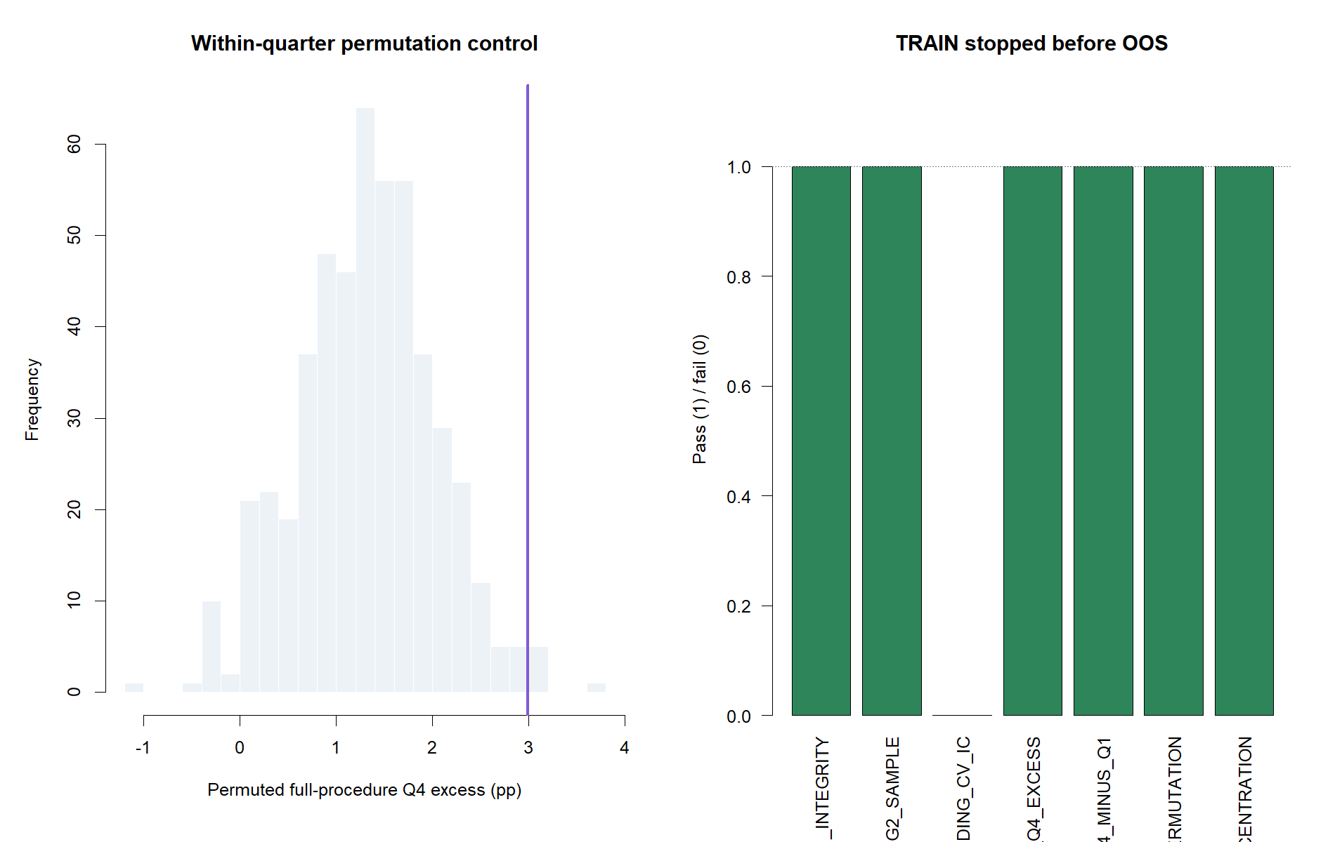
One failed gate kept OOS sealed
6 / 7 passed
Integrity, support, pooled separation, permutation, and sector breadth all passed. G3 failed: −0.0176 mean forward IC and 55.6% positive quarters. A conjunction is not a vote.
14
Notes:
The failed G3 gate overrides attractive G4–G6 pooled evidence by design.
[Sources]
- hyp_mom_04_1_train_gates.csv
[/Sources]
Chat reference: Codex task 019f741e-615f-7fd0-90f7-edce12b5cb66, 2026-08-10 explanation of the conjunction gate and OOS lock; decision index D113.

Slide 15
The fixed-sign composite is interesting—but it is a new question
What caught our eye
The predeclared, non-learned composite averaged +0.041 rank IC across all 15 TRAIN quarters.
It was positive in 9 / 15 quarters and its top quartile beat the universe by +1.74 pp on average.
That is more stable-looking than the fitted ridge replay.
Why we still stop
The composite was declared as a diagnostic comparator, not the nomination policy. It was not given its own expanding selection gate.
Testing it later requires a new identifier, frozen contract, and evidence-boundary decision before any 2021+ query.
15
Notes:
This is the one serious next question suggested by the lane; it is not a post-hoc rescue of 04.1.
[Sources]
- hyp_mom_04_1_train_theory_quarter_summary.csv
- HYP-MOM-04.1 results, Feature-level interpretation
[/Sources]

Slide 16
DECISION
Stop before OOS.
Pooled structure ≠ temporal transport
2021–2023 was not queried
No strategy authority created
Notes:
The lane succeeded methodologically: it exposed a seductive pooled fit and stopped it before retrospective OOS could influence the model.
[Sources]
- HYP_MOM_04_1_REGULARIZED_TREND_STATE_QUARTILE_RESULTS.md
- hyp_mom_04_1_train_gates.csv
[/Sources]

