Slide 1
OPERATOR HYPOTHESIS LAB
Broad universe, same causal stop
HYP-MOM-04.1 deployment cohort audit + Ridge TRAIN | August 2026
Notes:
This deck records the fixed September 2020 SPY deployment cohort and the unchanged HYP-MOM-04.1 Ridge TRAIN result.
Chat decision reference: D117 in docs/GEN5_4_DECISION_DIALOGUE_INDEX.md.
[Sources]
- operator_hypothesis_lab/docs/HYP_MOM_04_1_DEPLOYMENT_UNIVERSE_DATA_AUDIT_CONTRACT.md
- runs/research_workbench/operator_hypothesis_lab/hyp_mom_04_1_deployment_universe_data_audit_20260811/REPORT.md
- runs/research_workbench/operator_hypothesis_lab/hyp_mom_04_1_deployment_universe_train_20260811/hyp_mom_04_1_train_run_spec.csv
[/Sources]

Slide 2
The evidence boundary stayed causal from source to STOP
SOURCE
TRAIN
OOS
September 2020 SPY
Public before 2021. Full filed cohort; no outcome-based replacements.
2016–2020 only
Audit first, then six features and the original seven Ridge gates.
Still sealed
2021–2023 bars were available only after every TRAIN gate passed.
2
Notes:
The December 2020 SPY report was filed in February 2021 and was therefore inadmissible. The September 2020 report was filed in November 2020 and was public before OOS.
[Sources]
- SEC Form N-PORT accession 0001752724-20-236128: https://www.sec.gov/Archives/edgar/data/884394/000175272420236128/0001752724-20-236128-index.htm
- SEC Form N-PORT data sets: https://www.sec.gov/data-research/sec-markets-data/form-n-port-data-sets
- operator_hypothesis_lab/docs/HYP_MOM_04_1_DEPLOYMENT_UNIVERSE_DATA_AUDIT_CONTRACT.md
[/Sources]

Slide 3
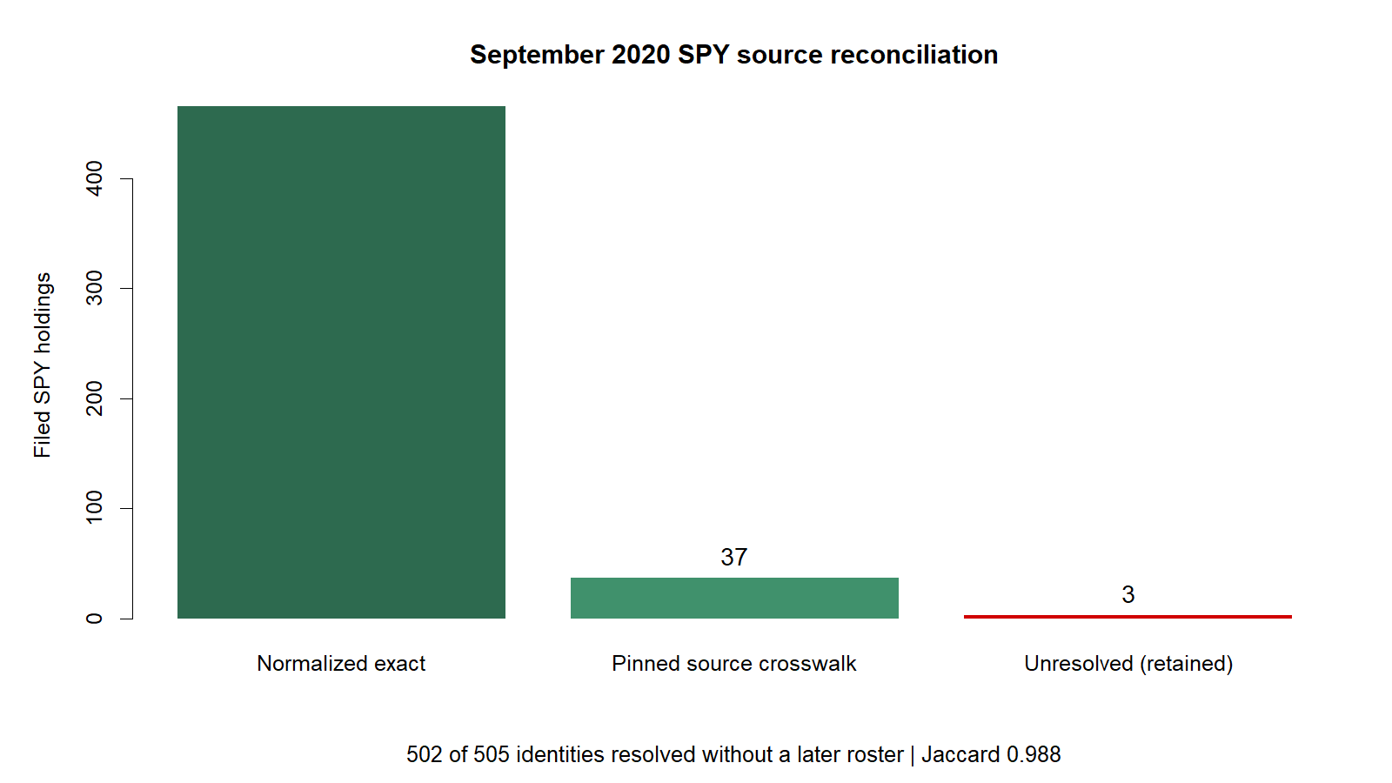
The source cohort was pre-OOS
The cohort is deployment-date-conditioned
It is not historical S&P membership. We retained all 505 filed equities, reconciled only against a pre-cutoff roster, and left three late-September additions unresolved instead of using a later source.
3
Notes:
465 identities matched by deterministic legal-name normalization. A pinned crosswalk resolved 37 contemporaneous aliases/share classes using filing title and CUSIP. Three filing rows remained unresolved and stayed in the denominator.
[Sources]
- runs/research_workbench/operator_hypothesis_lab/hyp_mom_04_1_deployment_universe_data_audit_20260811/source_reconciliation_summary.csv
- runs/research_workbench/operator_hypothesis_lab/hyp_mom_04_1_deployment_universe_data_audit_20260811/filing_identity_sector_reconciliation.csv
- operator_hypothesis_lab/registries/hyp_mom_04_1_spy_2020_09_source_crosswalk.csv
- Wikipedia revision 980783480: https://en.wikipedia.org/w/index.php?oldid=980783480
[/Sources]

Slide 4
All nine data gates passed without later membership
Gate result
Roster timing, identity, agreement, sector breadth, provider history, exact TRAIN retention, and the 2021 boundary all passed conjunctively.
505
502
481
Filed equities
Resolved pre-OOS
Exact TRAIN histories
4
Notes:
Observed identity completeness was 99.41%, roster Jaccard 98.82%, sector coverage 99.41%, provider representation 99.41%, and exact TRAIN retention 95.25%.
[Sources]
- runs/research_workbench/operator_hypothesis_lab/hyp_mom_04_1_deployment_universe_data_audit_20260811/universe_gate_matrix.csv
- runs/research_workbench/operator_hypothesis_lab/hyp_mom_04_1_deployment_universe_data_audit_20260811/train_coverage_summary.csv
[/Sources]

Slide 5
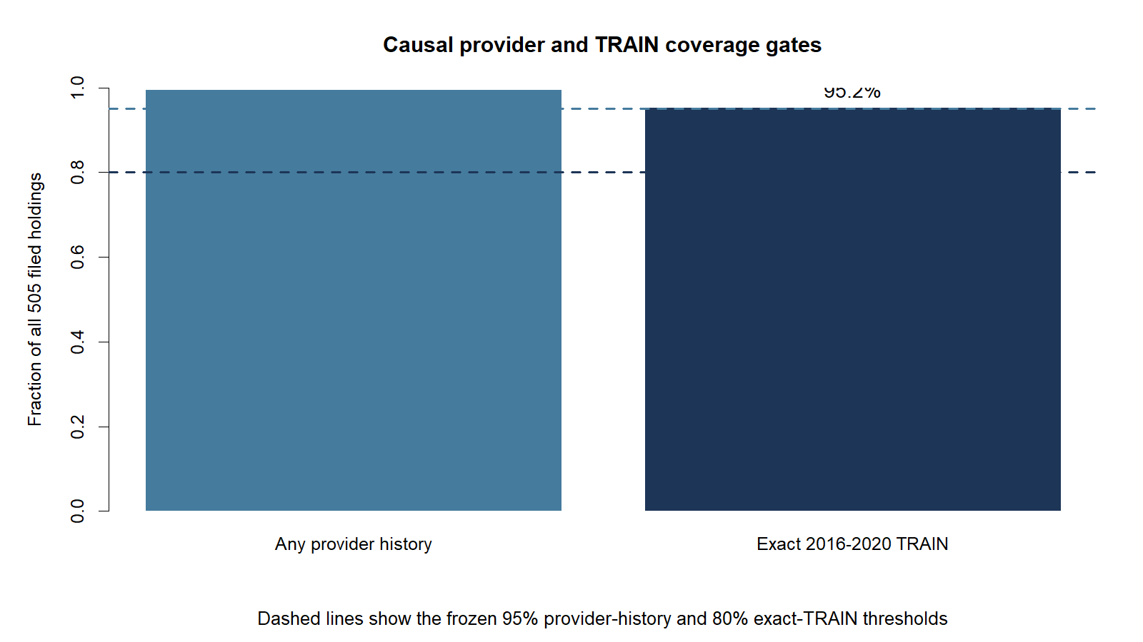
Exact TRAIN coverage passed
Exact coverage was intentionally strict
A stock needed every SPY session from January 2016 through December 2020. Twenty-one partial histories and three unresolved identities were retained in the ledger but excluded from model fitting—without replacements.
5
Notes:
481 of 505 filed holdings had every required adjusted daily bar. The model registry therefore used 481 names across at least ten sectors.
[Sources]
- runs/research_workbench/operator_hypothesis_lab/hyp_mom_04_1_deployment_universe_data_audit_20260811/train_coverage_ledger.csv
- runs/research_workbench/operator_hypothesis_lab/hyp_mom_04_1_deployment_universe_data_audit_20260811/universe_gate_matrix.csv
[/Sources]

Slide 6
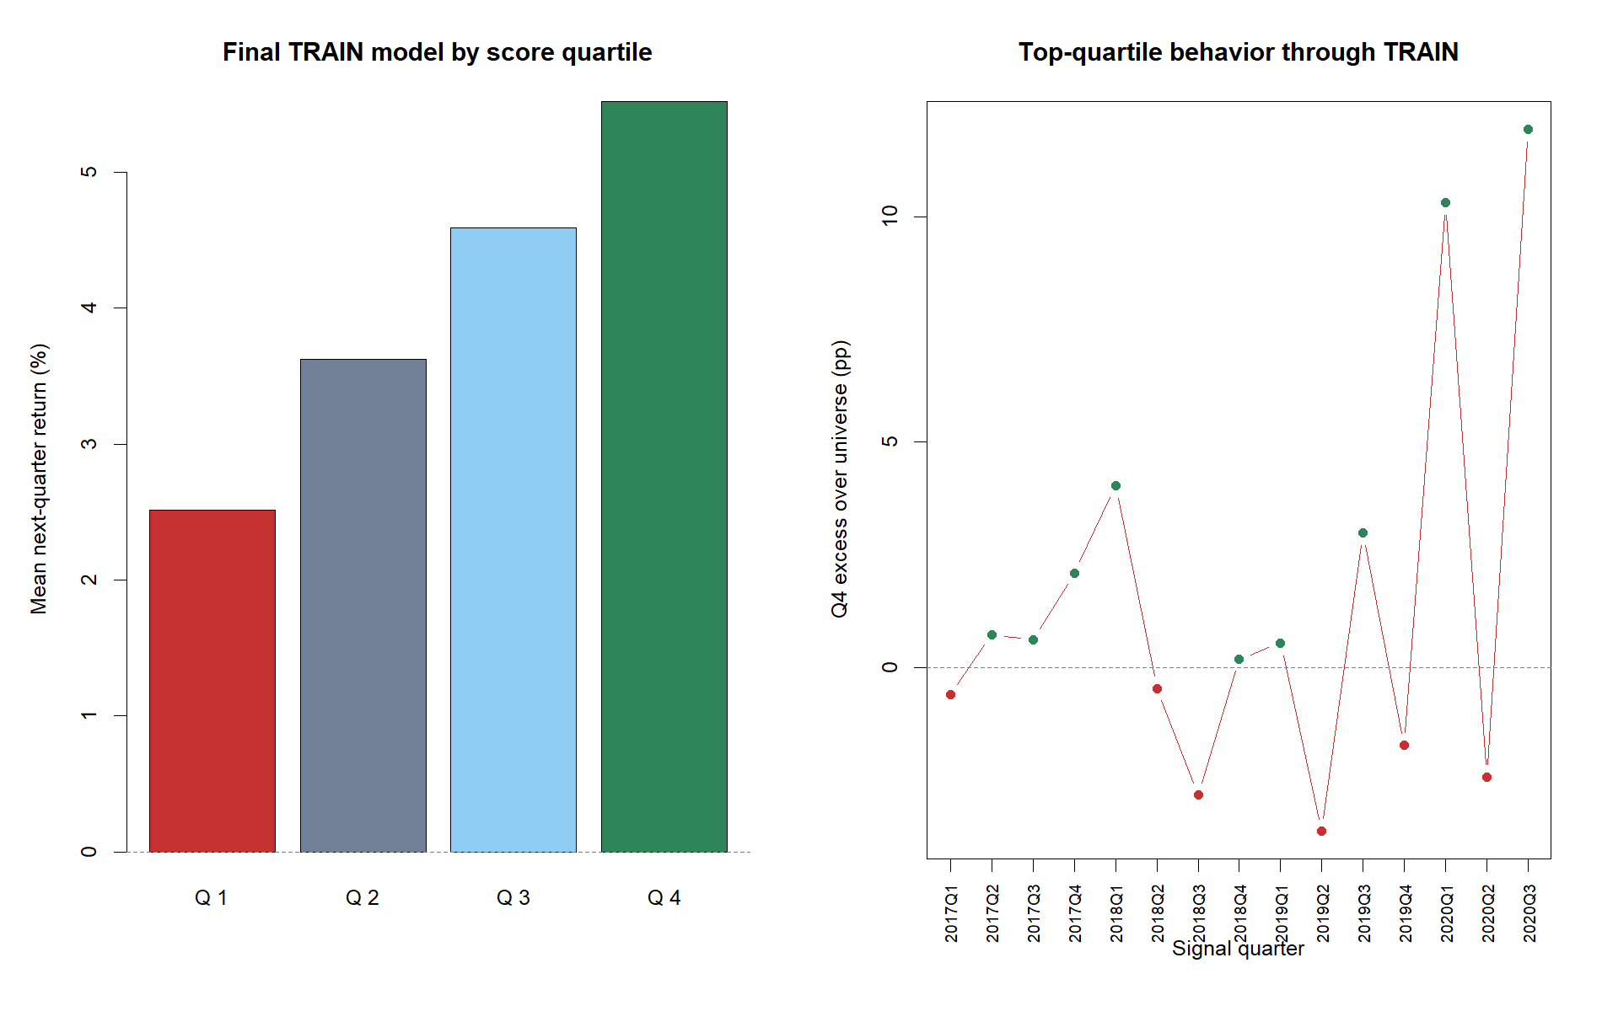
The pooled TRAIN fit looked attractive
+1.45 pp
Mean top-quartile excess
+3.01 pp
Mean Q4 minus Q1
100th pct
Permutation rank
6
Notes:
These are pooled TRAIN descriptions after fitting on all 15 TRAIN quarters. The permutation result says the association is hard to reproduce after shuffling labels inside quarters; it does not prove temporal transport.
[Sources]
- runs/research_workbench/operator_hypothesis_lab/hyp_mom_04_1_deployment_universe_train_20260811/hyp_mom_04_1_train_quarter_summary.csv
- runs/research_workbench/operator_hypothesis_lab/hyp_mom_04_1_deployment_universe_train_20260811/hyp_mom_04_1_train_permutation.csv
[/Sources]

Slide 7
Held-out quarters ranked backward—the model must stop
Expanding CV asked whether earlier quarters could rank the next three quarters.
−0.0623
4 / 9
Mean held-out IC
Positive quarters
7
Notes:
G3 required positive mean held-out rank IC and at least 60% positive validation quarters. The observed mean was -0.0623 and only 4 of 9 quarters were positive. Six other gates passed; gates are conjunctive.
The contrast is especially instructive in 2020Q3: the final all-TRAIN fit described that quarter strongly, but the earlier-only model ranked it at -0.2905. This is why pooled fit cannot override chronological validation.
[Sources]
- runs/research_workbench/operator_hypothesis_lab/hyp_mom_04_1_deployment_universe_train_20260811/hyp_mom_04_1_train_cv_details.csv
- runs/research_workbench/operator_hypothesis_lab/hyp_mom_04_1_deployment_universe_train_20260811/hyp_mom_04_1_train_gates.csv
[/Sources]

Slide 8
DECISION
STOP is the result
No 2021–2023 bars queried
No OOS portfolio exists
Preserve HYP-MOM-04.1 unchanged
Notes:
The deployment cohort solved the data-feasibility problem but did not solve temporal generalization. That is useful evidence, not a failed implementation.
Any simpler feature-sign composite, reduced feature set, or rolling model would be a new lane frozen before later outcomes—not a repair under HYP-MOM-04.1.
[Sources]
- runs/research_workbench/operator_hypothesis_lab/hyp_mom_04_1_deployment_universe_train_20260811/hyp_mom_04_1_train_run_spec.csv
- operator_hypothesis_lab/docs/HYP_MOM_04_1_DEPLOYMENT_UNIVERSE_RESULTS.md
[/Sources]

