Slide 1
RETROSPECTIVE ATTRIBUTION | 114 HISTORIES | 2021-2023 | CONFIRMATION SEALED
LIT-MOM-01.2 / AUDIT 01
Did the long-only strategy add timing value beyond simply owning rising assets?
Notes:
This deck audits the encouraging raw LIT-MOM-01.2 atlas result. The question is no longer whether some paths made money; it is whether the selected timing policy added value beyond exposure, arbitrary timing, fixed horizons, and broad-market beta.
[Sources]
- C:/Users/Franc/OneDrive/Documents/Francis/Peltata Project/Time-Series-Modeling-Gen5/literature_studies/docs/GEN5_LIT_MOM_01_2_AUDIT_01_EXPOSURE_SELECTION_CONTRACT.md
- C:\Users\Franc\OneDrive\Documents\Francis\Peltata Project\Time-Series-Modeling-Gen5\runs\research_workbench\literature_grounded\lit_mom_01_2_audit_01_exposure_selection_20260802/audit01_batch_summary.csv
- C:\Users\Franc\OneDrive\Documents\Francis\Peltata Project\Time-Series-Modeling-Gen5\runs\research_workbench\literature_grounded\lit_mom_01_2_audit_01_exposure_selection_20260802/audit01_diagnostic_scorecard.csv

Slide 2
Positive paths are not yet evidence of timing alpha
A long-only policy can profit because the asset rose, because it happened to be invested at favorable times, or because the TRAIN-selected horizon carried genuine timing information. Audit 01 separates those explanations.
EXPOSURE
TIMING
SELECTION
Buy-and-hold + matched participation
Was being long enough?
1,000 matched random schedules
Was our calendar special?
Fixed 250/25 + fixed 60/5
Did TRAIN choice help?
2
Notes:
The earlier atlas was correctly bookmarked as worthy of further inquiry. This audit supplies the missing attribution layer. Each comparator removes a different easy explanation for positive raw returns; failure at one layer cannot be repaired by success at an easier layer.
[Sources]
- C:/Users/Franc/OneDrive/Documents/Francis/Peltata Project/Time-Series-Modeling-Gen5/literature_studies/docs/GEN5_LIT_MOM_01_2_AUDIT_01_EXPOSURE_SELECTION_CONTRACT.md
- C:/Users/Franc/OneDrive/Documents/Francis/Peltata Project/Time-Series-Modeling-Gen5/literature_studies/docs/GEN5_LIT_MOM_01_2_SINGLE_POSITION_RETROSPECTIVE_RESULTS.md

Slide 3
The frozen ladder asks progressively harder questions
All policies use adjusted daily bars, causal next-open entries, current-equity compounding, and 5 bp per side. The selected strategy is unchanged; only comparators are added.
LEVEL 1
LEVEL 2
LEVEL 3
Buy-and-hold
Full-period market exposure
Exposure-matched controls
Constant exposure + H-blocks
Timing + selection
Random calendars and fixed L/H
3
Notes:
The ladder includes six comparators: buy-and-hold; constant exposure equal to actual calendar participation; consecutive always-long H-blocks; 1,000 matched random non-overlapping schedules; fixed 250/25; and fixed 60/5. SPY regression and sector-cluster bootstrap are supporting diagnostics.
[Sources]
- C:/Users/Franc/OneDrive/Documents/Francis/Peltata Project/Time-Series-Modeling-Gen5/literature_studies/docs/GEN5_LIT_MOM_01_2_AUDIT_01_EXPOSURE_SELECTION_CONTRACT.md
- C:/Users/Franc/OneDrive/Documents/Francis/Peltata Project/Time-Series-Modeling-Gen5/literature_studies/R/gen5_lit_mom_01_2_audit_01_exposure_selection.R

Slide 4
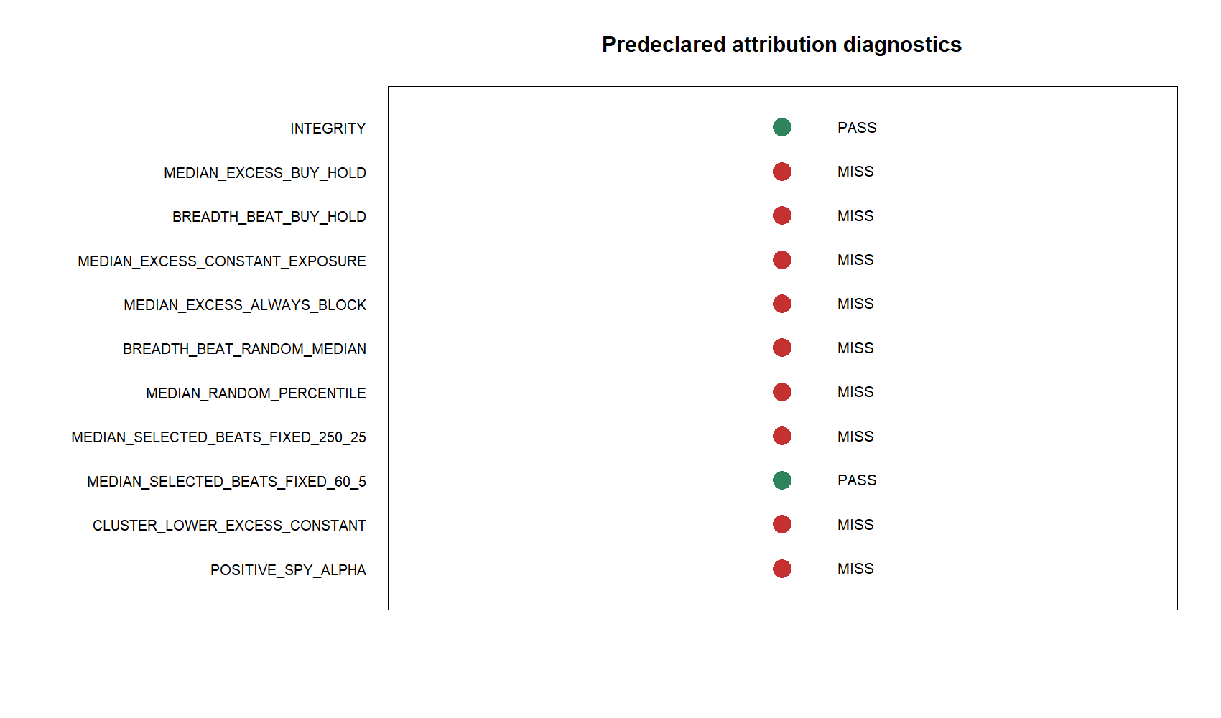
A result must survive the harder comparator, not just the easier one
Selected return - buy-and-hold
asks whether timing beat simple ownership.
Selected return - constant exposure
asks whether signals beat the same average market participation.
Selected percentile among 1,000 matched random schedules
asks whether the observed calendar beat chance.
Selected return - fixed horizon
asks whether TRAIN horizon selection added value.
SPY alpha
asks what remained after broad-market co-movement.
4
Notes:
The comparators are intentionally nested. For example, beating cash is weaker than beating buy-and-hold; beating buy-and-hold can still be explained by different exposure; beating matched exposure can still be explained by arbitrary calendars; and apparent alpha can still be unstable across sectors. Audit 01 freezes an eleven-line scorecard before interpreting results.
[Sources]
- C:/Users/Franc/OneDrive/Documents/Francis/Peltata Project/Time-Series-Modeling-Gen5/literature_studies/docs/GEN5_LIT_MOM_01_2_AUDIT_01_EXPOSURE_SELECTION_CONTRACT.md
- C:\Users\Franc\OneDrive\Documents\Francis\Peltata Project\Time-Series-Modeling-Gen5\runs\research_workbench\literature_grounded\lit_mom_01_2_audit_01_exposure_selection_20260802/audit01_diagnostic_scorecard.csv

Slide 5
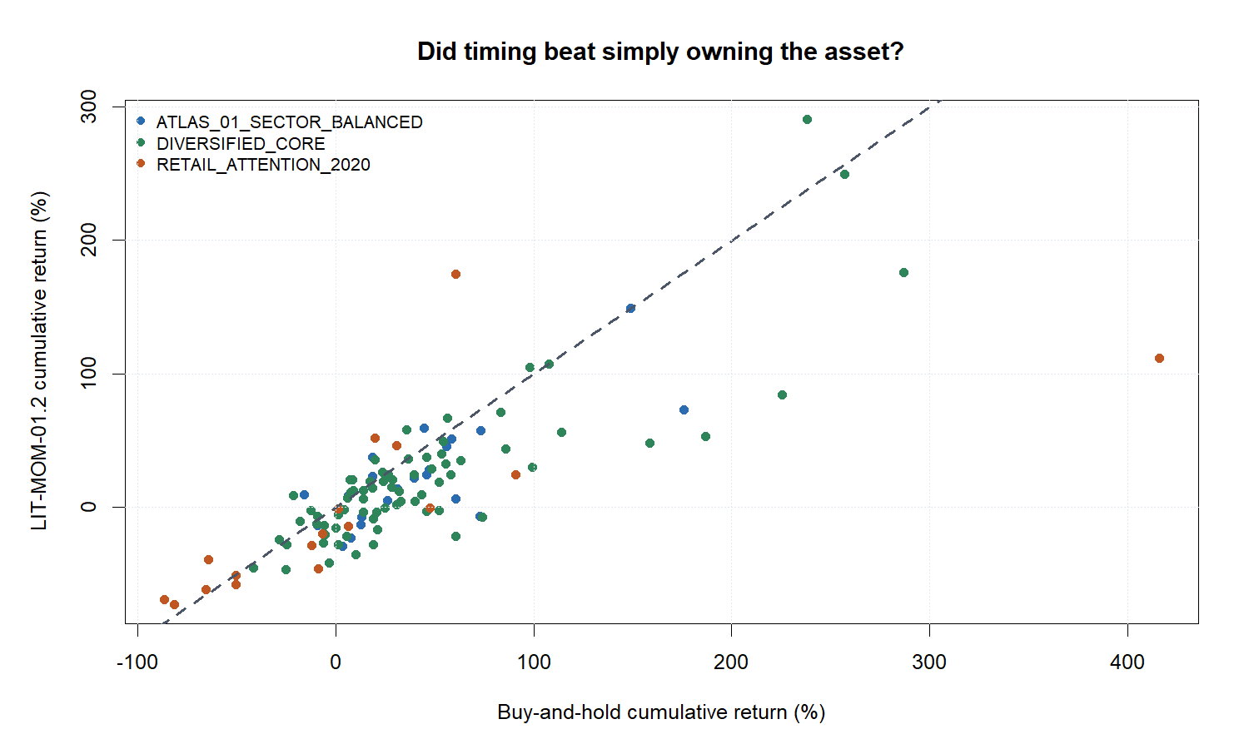
Only 30 of 113 stocks beat buy-and-hold
5
Notes:
Median selected return was +9.59%, but median buy-and-hold was +23.46%. Median excess was -13.31 percentage points, and only 30 of 113 stocks beat buy-and-hold. The sector-cluster 90% interval for median excess was entirely negative: -20.02 to -7.30 percentage points. This is strong evidence that positive raw paths were not enough.
[Sources]
- C:\Users\Franc\OneDrive\Documents\Francis\Peltata Project\Time-Series-Modeling-Gen5\runs\research_workbench\literature_grounded\lit_mom_01_2_audit_01_exposure_selection_20260802/audit01_asset_summary.csv
- C:\Users\Franc\OneDrive\Documents\Francis\Peltata Project\Time-Series-Modeling-Gen5\runs\research_workbench\literature_grounded\lit_mom_01_2_audit_01_exposure_selection_20260802/audit01_batch_summary.csv
- C:\Users\Franc\OneDrive\Documents\Francis\Peltata Project\Time-Series-Modeling-Gen5\runs\research_workbench\literature_grounded\lit_mom_01_2_audit_01_exposure_selection_20260802/audit01_sector_cluster_bootstrap.csv
- C:\Users\Franc\OneDrive\Documents\Francis\Peltata Project\Time-Series-Modeling-Gen5\runs\research_workbench\literature_grounded\lit_mom_01_2_audit_01_exposure_selection_20260802\visuals/audit01_strategy_vs_buy_hold.png

Slide 6
ATTRIBUTION STEP 2 | SAME 2021-2023 WINDOW | NO NEW FILTERS
Now hold exposure opportunity constant
A fairer timing question is not merely 'did the strategy beat cash?' It is 'did its signals outperform a policy with the same opportunity to be long?'
Notes:
Buy-and-hold uses more exposure than the strategy, so it is informative but not sufficient. The next comparisons preserve the strategy's observed participation or its selected holding-block length while removing the signal calendar.
[Sources]
- C:/Users/Franc/OneDrive/Documents/Francis/Peltata Project/Time-Series-Modeling-Gen5/literature_studies/docs/GEN5_LIT_MOM_01_2_AUDIT_01_EXPOSURE_SELECTION_CONTRACT.md

Slide 7
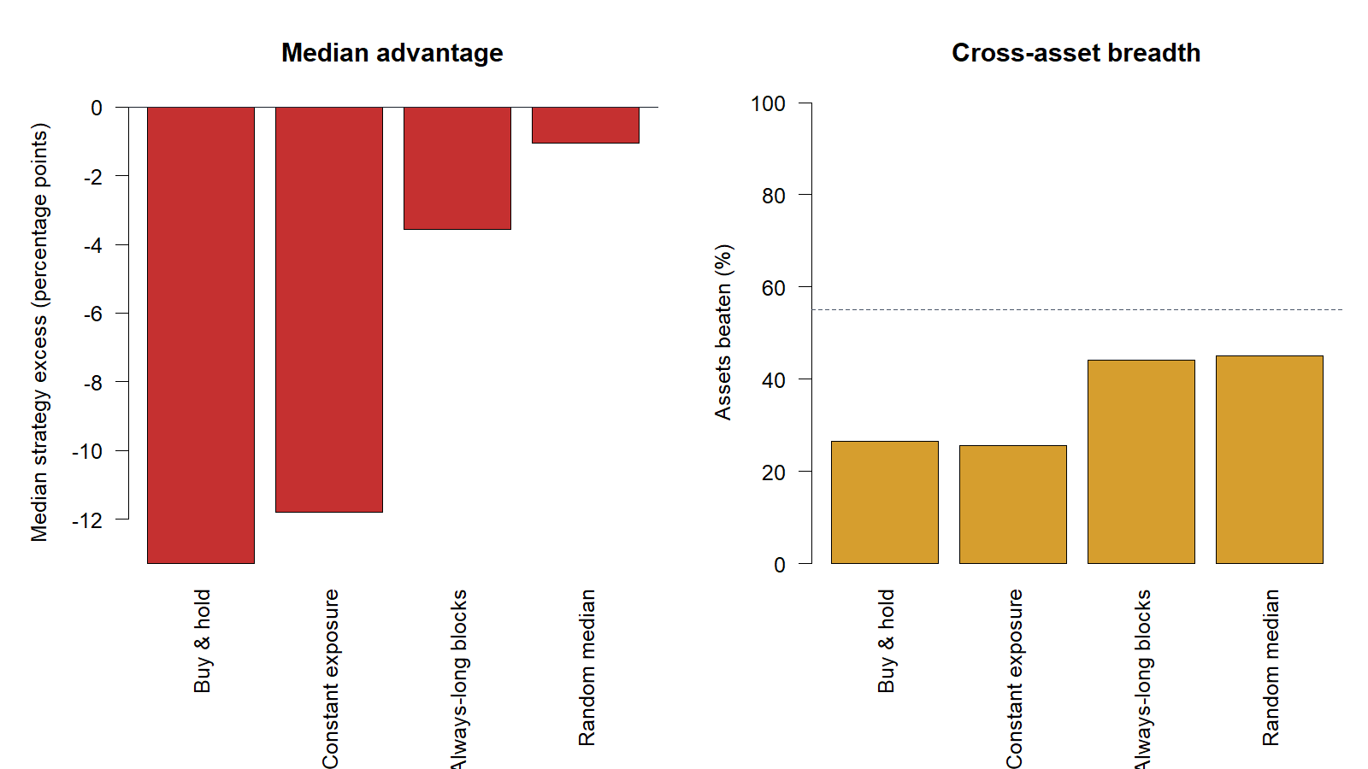
Matching exposure did not rescue the timing claim
The selected policy trailed constant exposure by a median 11.81 percentage points and trailed consecutive always-long H-blocks by 3.56 points. Only 29 of 113 stocks beat constant exposure.
29 / 113
-11.81 pp
BEAT CONSTANT EXPOSURE
25.7% of stocks
MEDIAN EXCESS
vs matched participation
7
Notes:
The constant-exposure policy applies the selected strategy's average calendar participation every day, so it keeps comparable broad-market opportunity without using the signal calendar. The selected policy's median excess was -11.81 percentage points; the sector-cluster 90% interval was -18.86 to -7.95. The always-long block comparison was weaker but still negative at the median, with an interval spanning zero.
[Sources]
- C:\Users\Franc\OneDrive\Documents\Francis\Peltata Project\Time-Series-Modeling-Gen5\runs\research_workbench\literature_grounded\lit_mom_01_2_audit_01_exposure_selection_20260802/audit01_asset_summary.csv
- C:\Users\Franc\OneDrive\Documents\Francis\Peltata Project\Time-Series-Modeling-Gen5\runs\research_workbench\literature_grounded\lit_mom_01_2_audit_01_exposure_selection_20260802/audit01_batch_summary.csv
- C:\Users\Franc\OneDrive\Documents\Francis\Peltata Project\Time-Series-Modeling-Gen5\runs\research_workbench\literature_grounded\lit_mom_01_2_audit_01_exposure_selection_20260802/audit01_sector_cluster_bootstrap.csv
- C:\Users\Franc\OneDrive\Documents\Francis\Peltata Project\Time-Series-Modeling-Gen5\runs\research_workbench\literature_grounded\lit_mom_01_2_audit_01_exposure_selection_20260802\visuals/audit01_baseline_scorecard.png

Slide 8
ATTRIBUTION STEP 3 | 1,000 RANDOM SCHEDULES PER ASSET
Now test the calendar and the horizon choice directly
If the signal dates matter, they should beat random non-overlapping schedules with the same H, trade count, costs, and compounding. If TRAIN selection matters, it should beat fixed source-style horizons.
Notes:
The matched-random test selects an eligible start phase and then draws the same number of non-overlapping H-session blocks. It preserves holding length, trade count, costs, and compounding while removing momentum timing. The fixed-horizon tests preserve execution but remove per-asset TRAIN selection.
[Sources]
- C:/Users/Franc/OneDrive/Documents/Francis/Peltata Project/Time-Series-Modeling-Gen5/literature_studies/docs/GEN5_LIT_MOM_01_2_AUDIT_01_EXPOSURE_SELECTION_CONTRACT.md
- C:/Users/Franc/OneDrive/Documents/Francis/Peltata Project/Time-Series-Modeling-Gen5/literature_studies/R/gen5_lit_mom_01_2_audit_01_exposure_selection.R

Slide 9
Matched random schedules isolate timing value
Each asset receives 1,000 seeded schedules. Every schedule uses the selected H, the observed trade count, non-overlapping blocks, identical costs, and current-equity compounding. Only the calendar is randomized.
MATCH
REMOVE
PASS
H + trade count
Participation structure retained
Momentum signal dates
Calendar chosen at random
Median percentile >= 60%
and >= 60% of assets above median
9
Notes:
The random schedules use a deterministic seed so the audit is reproducible. The integrity audit confirms exactly 1,000 simulations per asset, non-overlap, matching H, matching trade count, and exclusion of 2024+ confirmation data.
[Sources]
- C:/Users/Franc/OneDrive/Documents/Francis/Peltata Project/Time-Series-Modeling-Gen5/literature_studies/docs/GEN5_LIT_MOM_01_2_AUDIT_01_EXPOSURE_SELECTION_CONTRACT.md
- C:/Users/Franc/OneDrive/Documents/Francis/Peltata Project/Time-Series-Modeling-Gen5/literature_studies/R/gen5_lit_mom_01_2_audit_01_exposure_selection.R
- C:\Users\Franc\OneDrive\Documents\Francis\Peltata Project\Time-Series-Modeling-Gen5\runs\research_workbench\literature_grounded\lit_mom_01_2_audit_01_exposure_selection_20260802/audit01_integrity_audit.csv

Slide 10
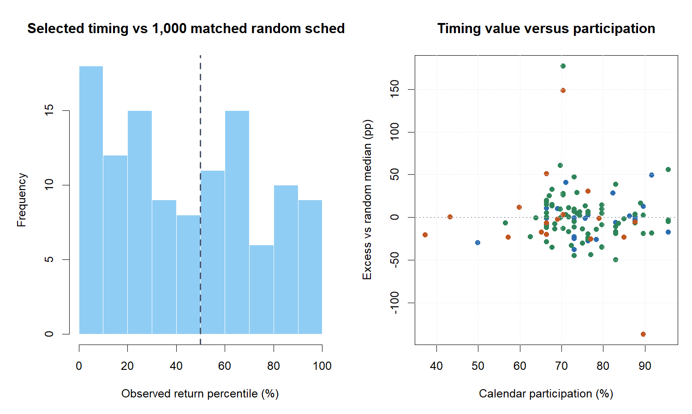
Observed timing was ordinary relative to matched random calendars
10
Notes:
The median observed-return percentile was 48.6%, essentially the middle of the random distribution. Only 51 of 113 stocks beat their random median. The right panel shows no persuasive relationship between calendar participation and timing value. This comparator directly rejects the claim that the selected signal dates were unusually valuable in the inspected window.
[Sources]
- C:\Users\Franc\OneDrive\Documents\Francis\Peltata Project\Time-Series-Modeling-Gen5\runs\research_workbench\literature_grounded\lit_mom_01_2_audit_01_exposure_selection_20260802/audit01_asset_summary.csv
- C:\Users\Franc\OneDrive\Documents\Francis\Peltata Project\Time-Series-Modeling-Gen5\runs\research_workbench\literature_grounded\lit_mom_01_2_audit_01_exposure_selection_20260802/audit01_batch_summary.csv
- C:\Users\Franc\OneDrive\Documents\Francis\Peltata Project\Time-Series-Modeling-Gen5\runs\research_workbench\literature_grounded\lit_mom_01_2_audit_01_exposure_selection_20260802\visuals/audit01_random_timing.png

Slide 11
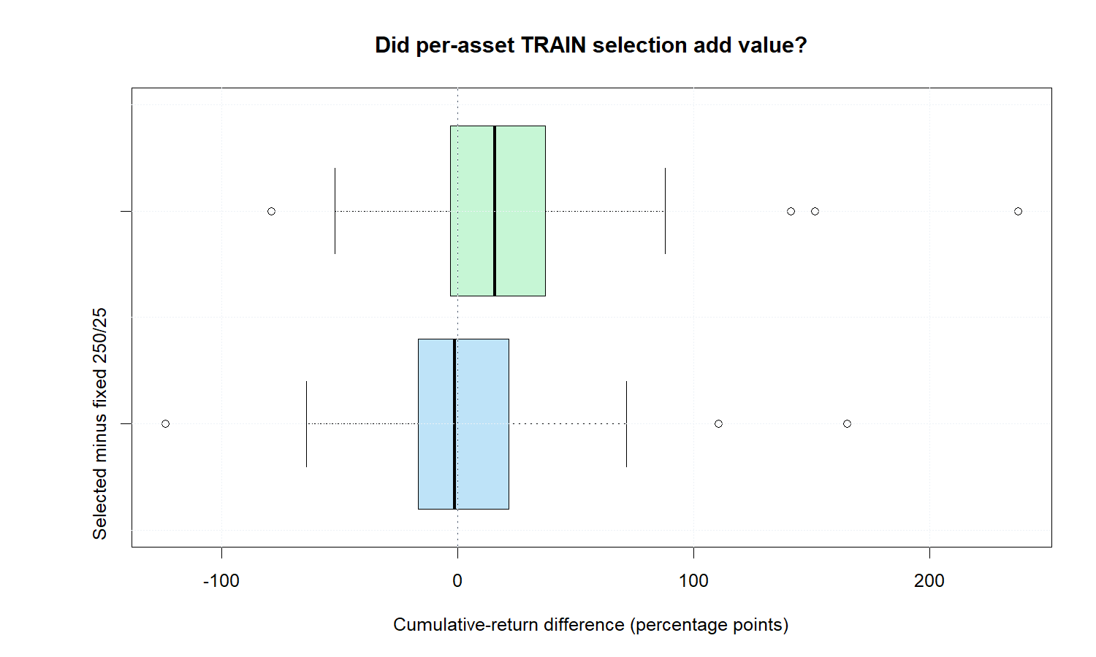
TRAIN selection beat 60/5, but not the canonical 250/25
11
Notes:
Per-asset TRAIN selection exceeded fixed 60/5 by a median 15.77 percentage points, with a sector-cluster 90% interval of 10.54 to 26.70. It trailed fixed 250/25 by a median 1.25 points, and that interval crossed zero. Thus selection provides evidence only against the intentionally different 60/5 tutorial horizon, not against Chan's canonical 250/25 benchmark.
[Sources]
- C:\Users\Franc\OneDrive\Documents\Francis\Peltata Project\Time-Series-Modeling-Gen5\runs\research_workbench\literature_grounded\lit_mom_01_2_audit_01_exposure_selection_20260802/audit01_asset_summary.csv
- C:\Users\Franc\OneDrive\Documents\Francis\Peltata Project\Time-Series-Modeling-Gen5\runs\research_workbench\literature_grounded\lit_mom_01_2_audit_01_exposure_selection_20260802/audit01_batch_summary.csv
- C:\Users\Franc\OneDrive\Documents\Francis\Peltata Project\Time-Series-Modeling-Gen5\runs\research_workbench\literature_grounded\lit_mom_01_2_audit_01_exposure_selection_20260802/audit01_sector_cluster_bootstrap.csv
- C:\Users\Franc\OneDrive\Documents\Francis\Peltata Project\Time-Series-Modeling-Gen5\runs\research_workbench\literature_grounded\lit_mom_01_2_audit_01_exposure_selection_20260802\visuals/audit01_horizon_selection.png

Slide 12
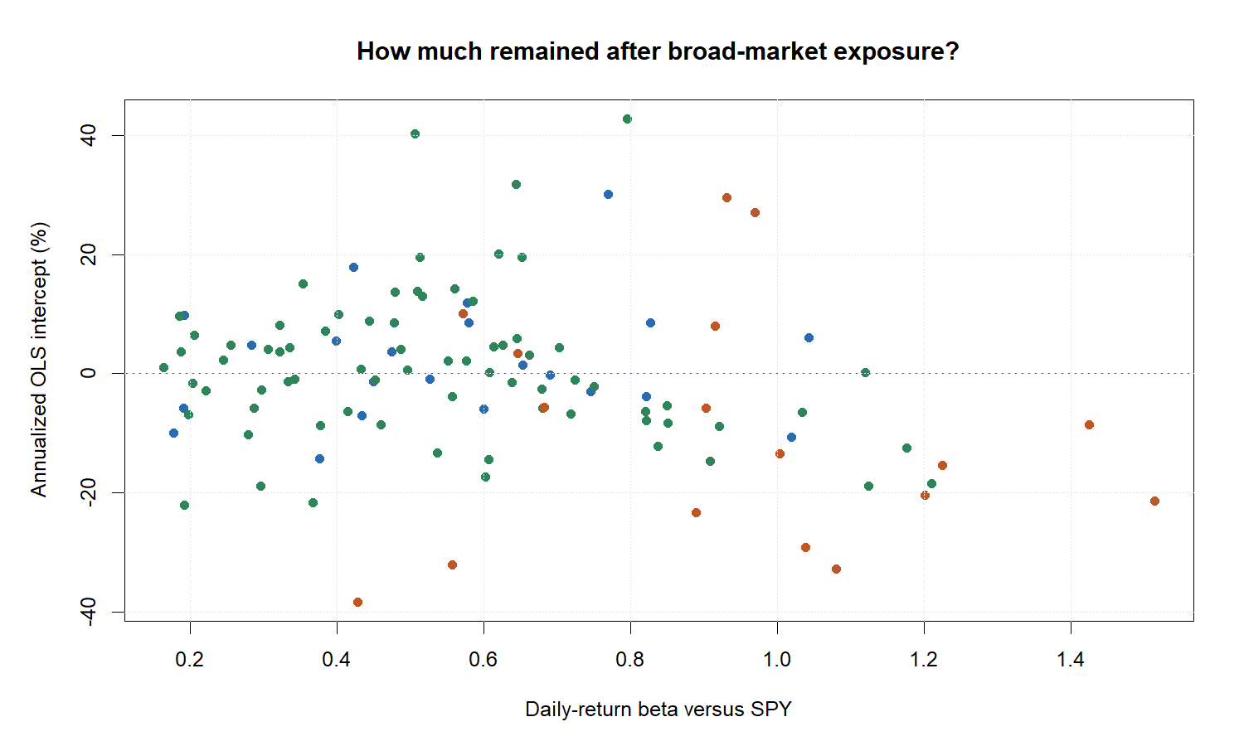
Broad-market regression found no cross-sectional alpha majority
12
Notes:
Median daily-return beta versus SPY was 0.576. Median annualized OLS intercept was -0.92%, and only 54 of 113 stocks had positive estimated alpha. This single-factor regression is diagnostic rather than a complete asset-pricing model, but it supplies no evidence that a majority of paths retained positive return after broad-market co-movement.
[Sources]
- C:\Users\Franc\OneDrive\Documents\Francis\Peltata Project\Time-Series-Modeling-Gen5\runs\research_workbench\literature_grounded\lit_mom_01_2_audit_01_exposure_selection_20260802/audit01_asset_summary.csv
- C:\Users\Franc\OneDrive\Documents\Francis\Peltata Project\Time-Series-Modeling-Gen5\runs\research_workbench\literature_grounded\lit_mom_01_2_audit_01_exposure_selection_20260802/audit01_batch_summary.csv
- C:\Users\Franc\OneDrive\Documents\Francis\Peltata Project\Time-Series-Modeling-Gen5\runs\research_workbench\literature_grounded\lit_mom_01_2_audit_01_exposure_selection_20260802\visuals/audit01_beta_alpha.png

Slide 13
DESCRIPTIVE ONLY | MINIMUM 100 TRADES + 20 ASSETS PER CELL
Environment can explain behavior; it cannot retroactively validate timing
We can ask where executed trades were stronger, provided we keep the answer descriptive and refuse to turn the same inspected cells into new filters.
Notes:
Four descriptors were frozen before result interpretation: SPY 60-session trend, SPY 20-session realized volatility relative to its TRAIN median, sector-ETF 60-session trend, and asset-minus-sector 60-session relative strength. Supported cells require at least 100 trades and 20 assets.
[Sources]
- C:/Users/Franc/OneDrive/Documents/Francis/Peltata Project/Time-Series-Modeling-Gen5/literature_studies/docs/GEN5_LIT_MOM_01_2_AUDIT_01_EXPOSURE_SELECTION_CONTRACT.md
- C:\Users\Franc\OneDrive\Documents\Francis\Peltata Project\Time-Series-Modeling-Gen5\runs\research_workbench\literature_grounded\lit_mom_01_2_audit_01_exposure_selection_20260802/audit01_environment_summary.csv

Slide 14
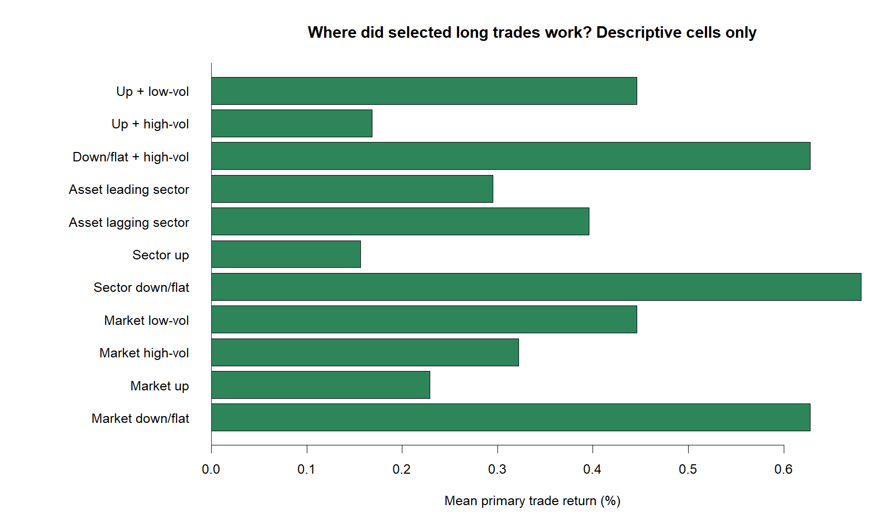
Trades were stronger in market and sector down/flat states
14
Notes:
Mean executed-trade return was +0.63% when the SPY 60-session trend was non-positive versus +0.23% when positive. It was +0.68% when the sector trend was non-positive versus +0.16% when positive. These differences contradict a simple 'the strategy only worked in risk-on markets' story. They remain conditional descriptions: no multiplicity adjustment, no causal claim, and no authorization to add a regime filter.
[Sources]
- C:\Users\Franc\OneDrive\Documents\Francis\Peltata Project\Time-Series-Modeling-Gen5\runs\research_workbench\literature_grounded\lit_mom_01_2_audit_01_exposure_selection_20260802/audit01_environment_summary.csv
- C:\Users\Franc\OneDrive\Documents\Francis\Peltata Project\Time-Series-Modeling-Gen5\runs\research_workbench\literature_grounded\lit_mom_01_2_audit_01_exposure_selection_20260802\visuals/audit01_environment.png

Slide 15
The frozen audit passes only 2 of 11 diagnostics
Integrity passed, and selected horizons beat fixed 60/5. Every attribution diagnostic that could support incremental timing alpha missed its frozen threshold.
2 / 11
0 / 7
DIAGNOSTICS PASSED
Integrity + vs fixed 60/5
ATTRIBUTION PASSES
Exposure, timing, selection, alpha
15
Notes:
The scorecard was frozen before comparative outcomes were interpreted. It passes integrity and median selected-versus-fixed-60/5. It misses buy-and-hold breadth and magnitude, constant-exposure breadth and magnitude, matched-random breadth and percentile, fixed-250/25 comparison, and the positive-alpha majority. The conservative conclusion follows the predeclared ladder rather than a post-hoc narrative.
[Sources]
- C:\Users\Franc\OneDrive\Documents\Francis\Peltata Project\Time-Series-Modeling-Gen5\runs\research_workbench\literature_grounded\lit_mom_01_2_audit_01_exposure_selection_20260802/audit01_diagnostic_scorecard.csv
- C:\Users\Franc\OneDrive\Documents\Francis\Peltata Project\Time-Series-Modeling-Gen5\runs\research_workbench\literature_grounded\lit_mom_01_2_audit_01_exposure_selection_20260802/audit01_batch_summary.csv
- C:\Users\Franc\OneDrive\Documents\Francis\Peltata Project\Time-Series-Modeling-Gen5\runs\research_workbench\literature_grounded\lit_mom_01_2_audit_01_exposure_selection_20260802\visuals/audit01_diagnostic_scorecard.png

Slide 16
The encouraging result was worth auditing - and the audit changed the conclusion
16
Notes:
What survives: the implementation is causal, long-only, reproducible, and broad; the raw atlas result was genuinely interesting enough to merit attribution; and the environment table suggests counter-cyclical behavior worth understanding. What does not survive: a claim that TRAIN-selected momentum timing added value in 2021-2023. The correct bookmark is methodological progress and a useful falsification, not a candidate ready for factor sharpening.
[Sources]
- C:\Users\Franc\OneDrive\Documents\Francis\Peltata Project\Time-Series-Modeling-Gen5\runs\research_workbench\literature_grounded\lit_mom_01_2_audit_01_exposure_selection_20260802/audit01_report.md
- C:\Users\Franc\OneDrive\Documents\Francis\Peltata Project\Time-Series-Modeling-Gen5\runs\research_workbench\literature_grounded\lit_mom_01_2_audit_01_exposure_selection_20260802/audit01_batch_summary.csv
- C:\Users\Franc\OneDrive\Documents\Francis\Peltata Project\Time-Series-Modeling-Gen5\runs\research_workbench\literature_grounded\lit_mom_01_2_audit_01_exposure_selection_20260802/audit01_environment_summary.csv
- C:\Users\Franc\OneDrive\Documents\Francis\Peltata Project\Time-Series-Modeling-Gen5\runs\research_workbench\literature_grounded\lit_mom_01_2_audit_01_exposure_selection_20260802\visuals/audit01_strategy_vs_buy_hold.png

Slide 17
AUDIT 01 | 2 OF 11 PASSED | CONFIRMATION EXCLUDED | NO LIVE OR PORTFOLIO AUTHORITY
STOP LIT-MOM-01.2 here: no incremental timing evidence in the inspected window.
Do not mine filters from 2021-2023. Preserve 2024+ confirmation data and reopen only with a separately justified hypothesis or a new operator-approved lane.
Notes:
Audit 01 fulfills the requested buy-and-hold and environment attribution. The result is a high-value STOP: the strategy's positive raw return did not survive harder comparators. A future lane could use theory-first, predeclared environmental hypotheses and untouched data, but this deck does not authorize that work.
[Sources]
- C:\Users\Franc\OneDrive\Documents\Francis\Peltata Project\Time-Series-Modeling-Gen5\runs\research_workbench\literature_grounded\lit_mom_01_2_audit_01_exposure_selection_20260802/audit01_report.md
- C:/Users/Franc/OneDrive/Documents/Francis/Peltata Project/Time-Series-Modeling-Gen5/literature_studies/docs/GEN5_LIT_MOM_01_2_AUDIT_01_EXPOSURE_SELECTION_CONTRACT.md
- C:/Users/Franc/OneDrive/Documents/Francis/Peltata Project/Time-Series-Modeling-Gen5/docs/GEN5_1_POC_PROGRESS_LOG.md
- C:/Users/Franc/OneDrive/Documents/Francis/Peltata Project/Time-Series-Modeling-Gen5/docs/GEN5_4_DECISION_DIALOGUE_INDEX.md

