Slide 1
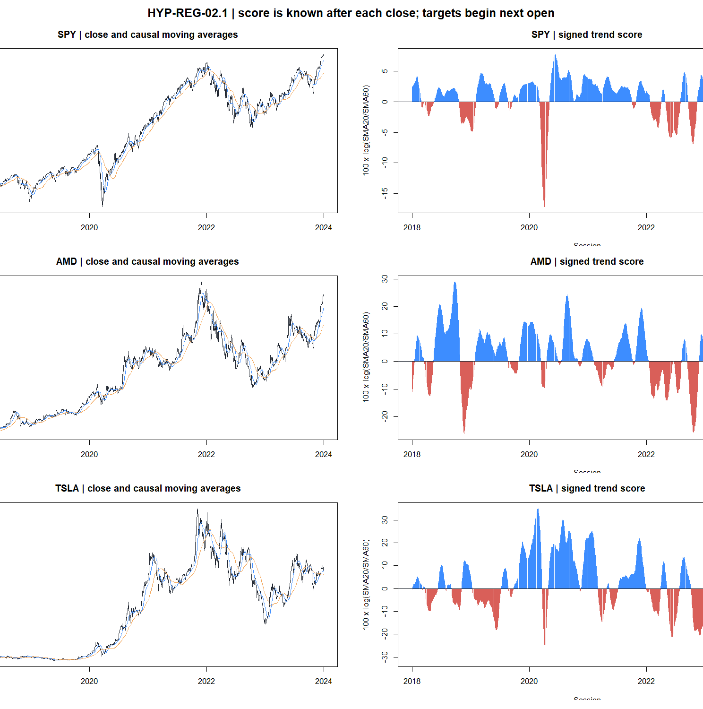
HYP-REG-02.1
The simple 20/60 trend score failed as a direction sensor
A strategy-independent diagnostic across 26 assets · 2018–2023 development evidence
STOP · joint ATR% audit not run
1
Notes:
Open with the outcome and boundary: this is a clean falsification of one direction sensor, not a rejection of trend trading or of the accepted volatility-magnitude diagnostic.
[Sources]
- docs/GEN5_HYP_REG_02_TREND_DIRECTION_DIAGNOSTIC_CONTRACT.md
- C:/Users/Franc/OneDrive/Documents/Francis/Peltata Project/Time-Series-Modeling-Gen5/runs/research_workbench/operator_hypothesis_lab/hyp_reg_02_1_trend_direction_20260814/hyp_reg_02_report.md

Slide 2
The sensor asks a narrower question than a strategy
CAUSAL ESTIMAND
At close t
Next open → exit open
Tₜ = log(SMA₂₀,ₜ / SMA₆₀,ₜ)
Rₜ,ₕ = log(Oₜ₊₁₊ₕ / Oₜ₊₁)
Tₜ ≥ 0 predicts UP
Tₜ < 0 predicts DOWN
H = 5, 20, 63 sessions
non-overlapping samples
Forward returns are labels for sensor validation—not a simulated trade, portfolio, or P&L path.
2
Notes:
The score is available after close t. The first price in the target is the next open, so same-bar information cannot leak into the target. Chat decision reference: D129.
[Sources]
- docs/GEN5_HYP_REG_02_TREND_DIRECTION_DIAGNOSTIC_CONTRACT.md
- docs/GEN5_4_DECISION_DIALOGUE_INDEX.md#d129--validate-trend-direction-before-combining-it-with-volatility

Slide 3
Seven gates guard against an attractive but brittle score
VALIDATION DESIGN
Association
Classification
Stability
G2 · positive rank correlation
G3 · cross-asset breadth
G5 · top-minus-bottom quintile
G4 · balanced accuracy
UP recall > 50%
DOWN recall > 50%
G6 · positive in ≥4/6 years
G7 · ≥90th circular-control percentile
G1 · exact data integrity
Conditional rule
Only a 7 / 7 pass opens the exact join to HYP-REG-01.1 ATR% states.
3
Notes:
The gates test different failure modes. Association alone is insufficient if the sign rule cannot recognize down moves or the evidence is temporally unstable.
[Sources]
- docs/GEN5_HYP_REG_02_TREND_DIRECTION_DIAGNOSTIC_CONTRACT.md
- C:/Users/Franc/OneDrive/Documents/Francis/Peltata Project/Time-Series-Modeling-Gen5/runs/research_workbench/operator_hypothesis_lab/hyp_reg_02_1_trend_direction_20260814/hyp_reg_02_gates.csv

Slide 4
Only integrity passed
HEADLINE RESULT
The causal alignment is consistently inverse—not a marginal miss around zero.
−0.048
−0.166
−0.155
H5 median Spearman
2 / 26 assets positive
H20 median Spearman
3 / 26 assets positive
H63 median Spearman
6 / 26 assets positive
1 / 7 gates
ATR% joint audit: NOT RUN
2024+ SEALED
4
Notes:
Median Spearman is computed per asset on deterministic horizon-spaced samples, then summarized across all 26 assets.
[Sources]
- C:/Users/Franc/OneDrive/Documents/Francis/Peltata Project/Time-Series-Modeling-Gen5/runs/research_workbench/operator_hypothesis_lab/hyp_reg_02_1_trend_direction_20260814/hyp_reg_02_panel_summary.csv
- C:/Users/Franc/OneDrive/Documents/Francis/Peltata Project/Time-Series-Modeling-Gen5/runs/research_workbench/operator_hypothesis_lab/hyp_reg_02_1_trend_direction_20260814/hyp_reg_02_gates.csv
- C:/Users/Franc/OneDrive/Documents/Francis/Peltata Project/Time-Series-Modeling-Gen5/runs/research_workbench/operator_hypothesis_lab/hyp_reg_02_1_trend_direction_20260814/hyp_reg_02_run_spec.csv

Slide 5
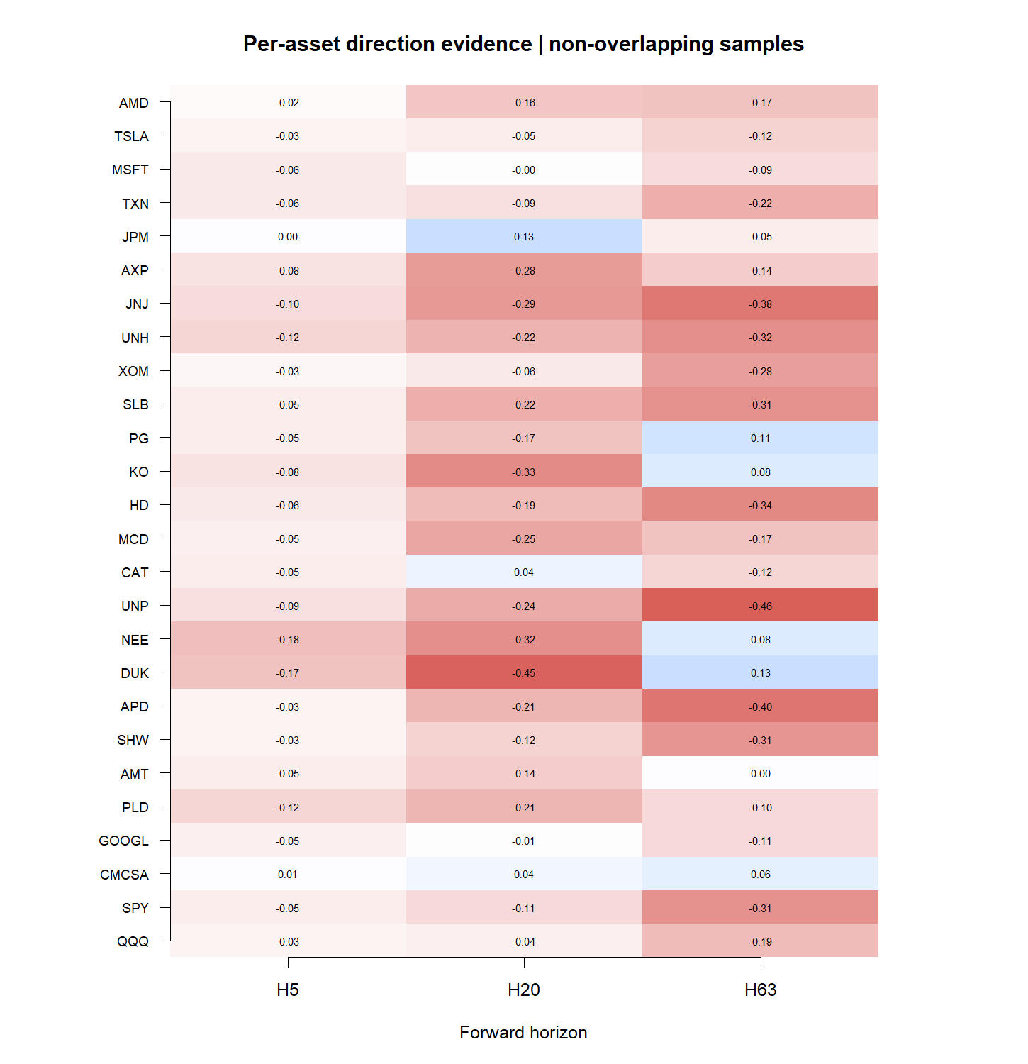
Negative direction evidence dominates the panel
CROSS-ASSET BREADTH
H20
3 / 26
positive assets
H63
6 / 26
positive assets
Red means a higher score preceded a lower return.
5
Notes:
The result is broad rather than driven by one high-beta name. The heatmap uses the fixed primary score and non-overlapping samples only.
[Sources]
- C:/Users/Franc/OneDrive/Documents/Francis/Peltata Project/Time-Series-Modeling-Gen5/runs/research_workbench/operator_hypothesis_lab/hyp_reg_02_1_trend_direction_20260814/hyp_reg_02_asset_summary.csv

Slide 6
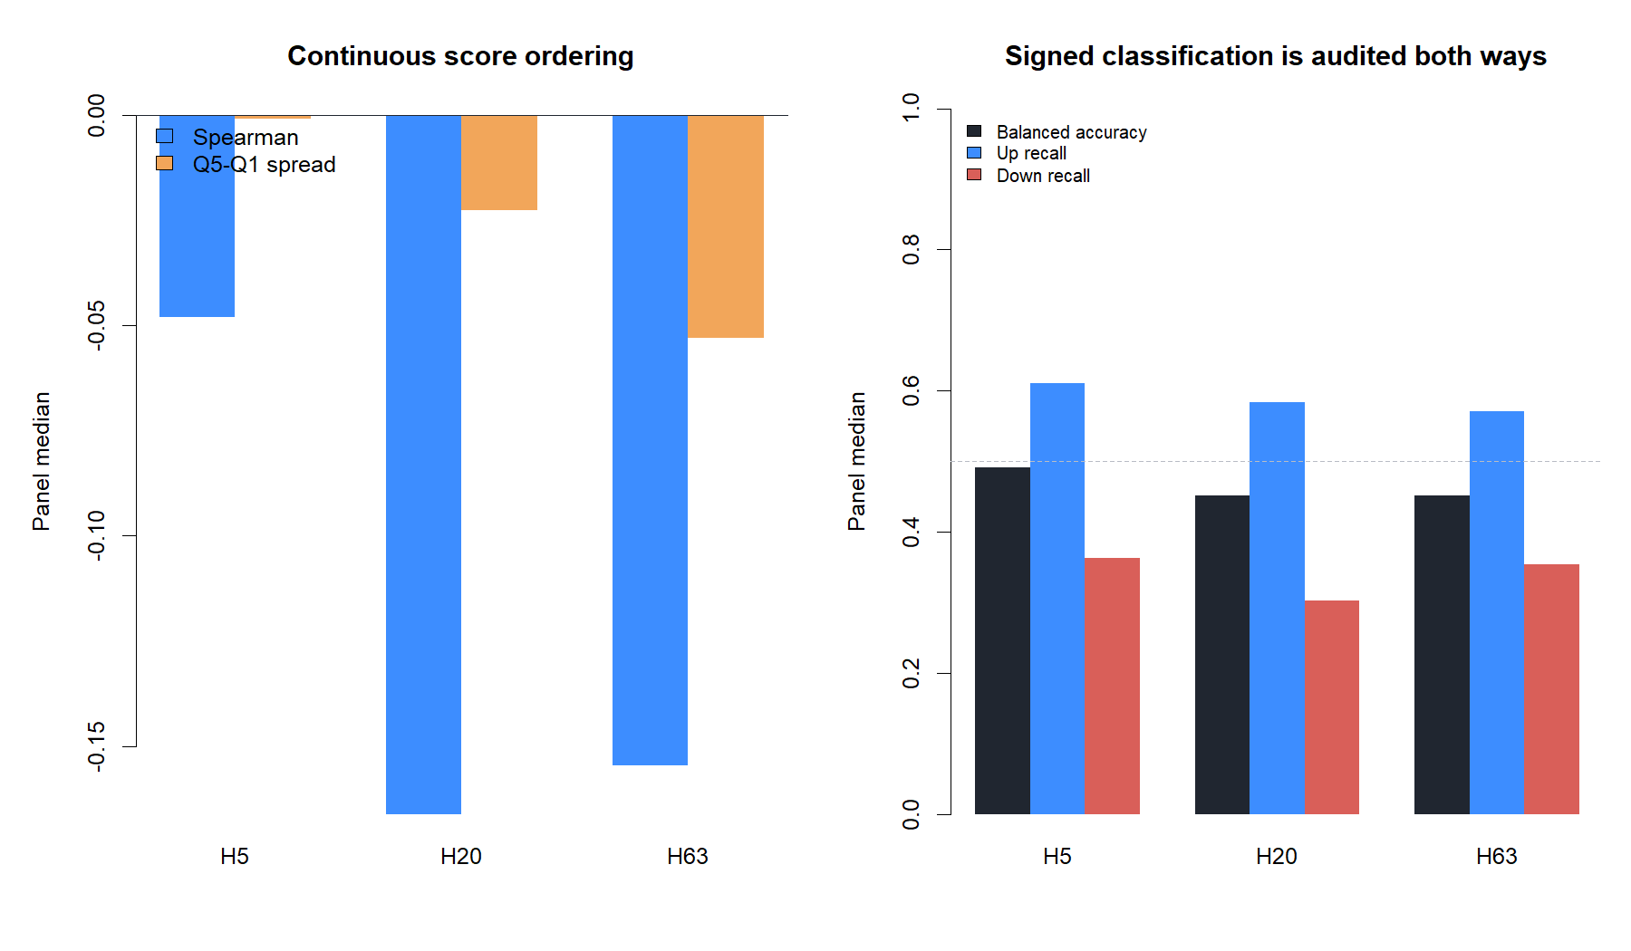
The sign rule recognizes rallies but misses declines
UP VS DOWN AUDIT
UP recall
58.3% / 57.1%
DOWN recall
30.4% / 35.4%
H20 / H63
6
Notes:
Balanced accuracy gives positive and negative targets equal weight. It prevents a mostly-UP classifier from looking useful merely because equities have positive drift.
[Sources]
- C:/Users/Franc/OneDrive/Documents/Francis/Peltata Project/Time-Series-Modeling-Gen5/runs/research_workbench/operator_hypothesis_lab/hyp_reg_02_1_trend_direction_20260814/hyp_reg_02_panel_summary.csv

Slide 7
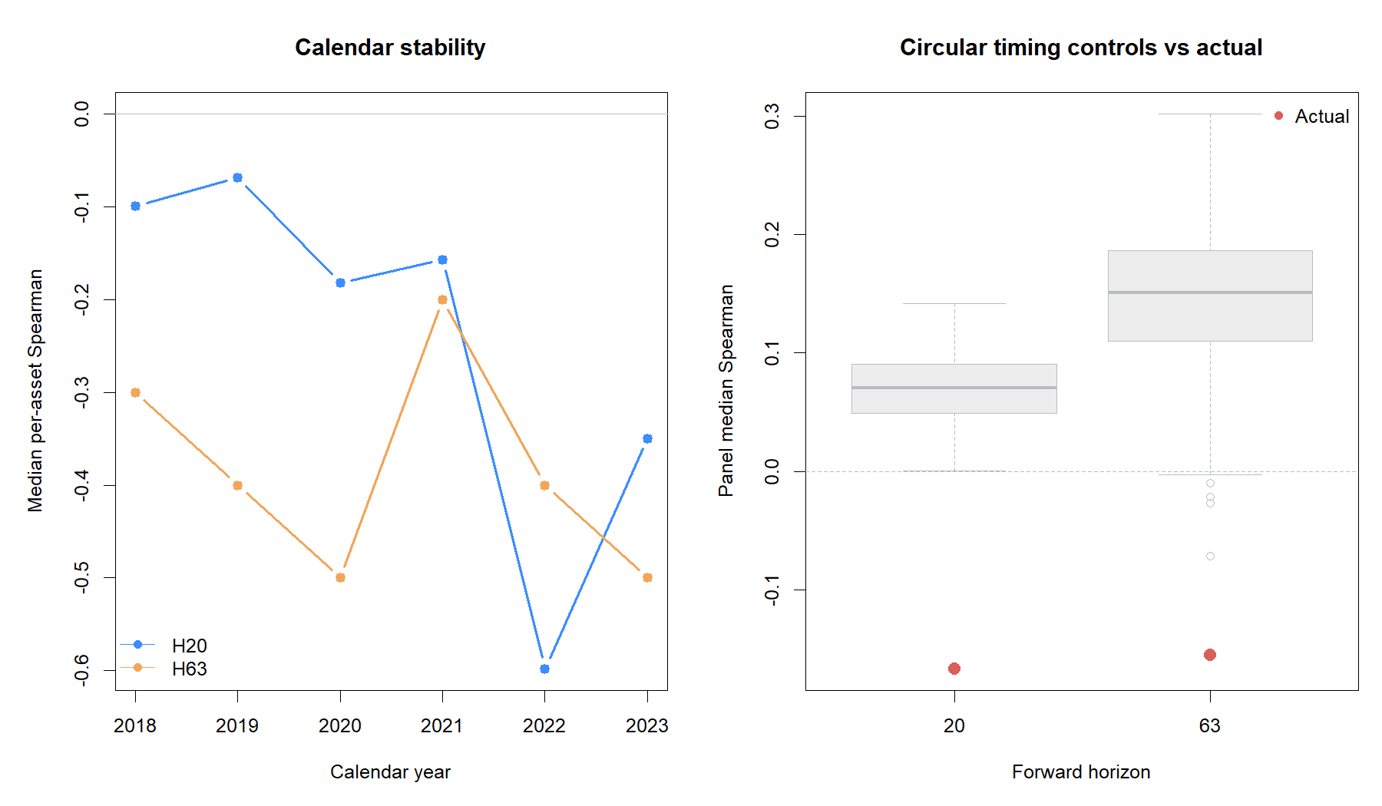
Time stability and timing controls both reject the score
FALSIFICATION CHECKS
0 / 6
positive panel years
at H20 and H63
0th
percentile vs 200
circular controls
H20 and H63
7
Notes:
Circular shifts preserve each asset-year's score distribution but move it to different dates. The actual timing alignment falls below every control draw at both principal horizons.
[Sources]
- C:/Users/Franc/OneDrive/Documents/Francis/Peltata Project/Time-Series-Modeling-Gen5/runs/research_workbench/operator_hypothesis_lab/hyp_reg_02_1_trend_direction_20260814/hyp_reg_02_calendar_panel.csv
- C:/Users/Franc/OneDrive/Documents/Francis/Peltata Project/Time-Series-Modeling-Gen5/runs/research_workbench/operator_hypothesis_lab/hyp_reg_02_1_trend_direction_20260814/hyp_reg_02_circular_controls.csv
- C:/Users/Franc/OneDrive/Documents/Francis/Peltata Project/Time-Series-Modeling-Gen5/runs/research_workbench/operator_hypothesis_lab/hyp_reg_02_1_trend_direction_20260814/hyp_reg_02_circular_readout.csv

Slide 8
Keep the volatility sensor; set this direction sensor down
DECISION BOUNDARY
STOP
What we do not do next
HYP-REG-02.1 failed six of seven gates.
Flip the score sign after seeing an inverse result
Tune moving-average lengths on this window
Run the conditional ATR% state map anyway
The accepted HYP-REG-01.1 ATR% magnitude classifier is unaffected.
Open the sealed 2024+ interval
A contrarian direction hypothesis would be a new theory-first lane—not a rescue edit.
8
Notes:
Close by preserving the learning: the magnitude sensor remains valid, while this particular scale-free trend direction sensor is rejected. Any inverse/mean-reversion interpretation needs a separately approved contract and fresh evidence boundary.
[Sources]
- operator_hypothesis_lab/docs/HYP_REG_02_1_TREND_DIRECTION_DIAGNOSTIC_RESULTS.md
- docs/GEN5_4_DECISION_DIALOGUE_INDEX.md#d129--validate-trend-direction-before-combining-it-with-volatility

