Slide 1
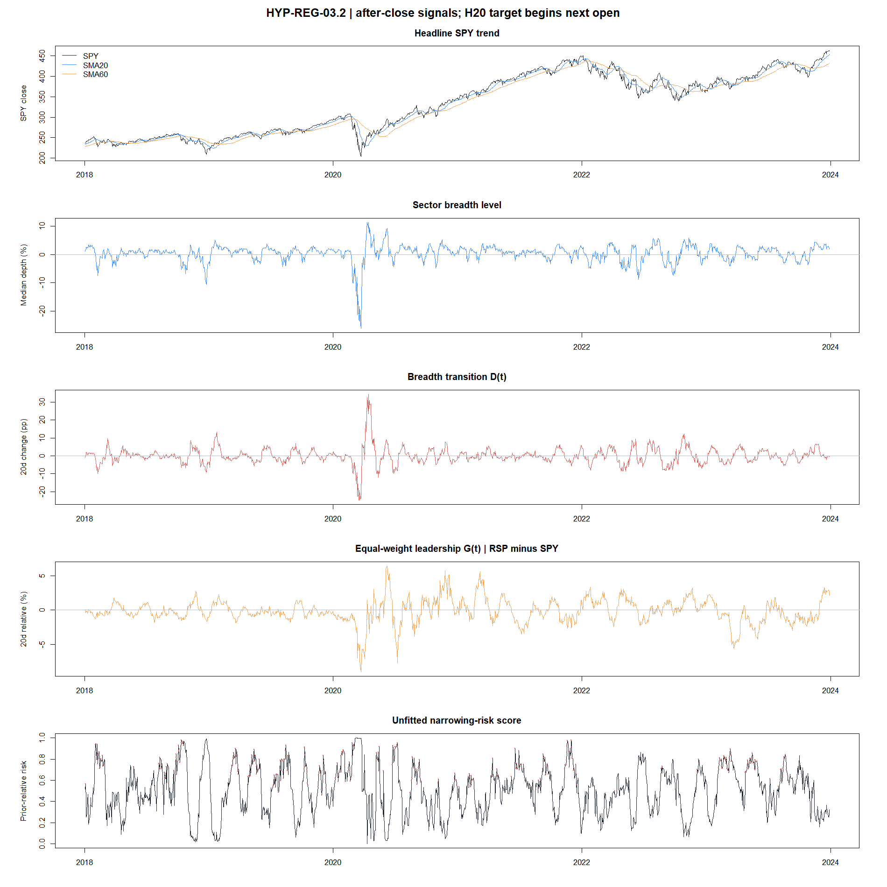
HYP-REG-03.2
Breadth narrowing did not become a reliable warning state
Ten-sector breadth transition + RSP/SPY leadership · causal daily diagnostic · 2018–2023
STOP · 1 of 8 gates passed
1
Notes:
Lead with the decision. The refined state was a sensible causal hypothesis, but its frozen evidence was too weak and unstable to join ATR or gate a strategy.
[Sources]
- docs/GEN5_HYP_REG_03_2_BREADTH_TRANSITION_DIVERGENCE_CONTRACT.md
- operator_hypothesis_lab/docs/HYP_REG_03_2_BREADTH_TRANSITION_DIVERGENCE_RESULTS.md
- C:/Users/Franc/OneDrive/Documents/Francis/Peltata Project/Time-Series-Modeling-Gen5/runs/research_workbench/operator_hypothesis_lab/hyp_reg_03_2_breadth_transition_20260814/hyp_reg_03_2_gates.csv

Slide 2
HYP-REG-03.2
We tested deterioration beneath a still-rising index
The motivating failure mode
Breadth transition
SPY can grind upward while participation and equal-weight leadership decay. A price-only trend label may miss that narrowing.
Are ten sectors collectively strengthening or weakening?
Leadership transition
Is equal-weight RSP improving or losing ground versus SPY?
Visible SPY trend
Only evaluate divergence while SPY SMA20 / SMA60 trend is nonnegative.
NARROWING = breadth weakening AND RSP/SPY weakening
2
Notes:
This is a cross-sectional market-internals approach. It refines the prior breadth POC by asking specifically about transition and divergence rather than treating breadth level as a universal trend classifier.
[Sources]
- https://www.reddit.com/r/algotrading/comments/1rvfy12/comment/oawke1k/
- https://www.spglobal.com/spdji/en/research/article/worth-the-weight/
- https://www.sciencedirect.com/science/article/pii/S1386418115000609
- docs/GEN5_HYP_REG_03_2_BREADTH_TRANSITION_DIVERGENCE_CONTRACT.md
- docs/GEN5_4_DECISION_DIALOGUE_INDEX.md#d131

Slide 3
FROZEN MECHANICS
The construction is simple, causal, and asset-scaled
For sector i after close t
qᵢ,ₜ = log(Cᵢ,ₜ / SMA₂₀,ᵢ,ₜ)
Breadth level
Bₜ = medianᵢ(qᵢ,ₜ)
typical sector depth
Breadth transition
Dₜ = Bₜ − Bₜ₋₂₀
negative means weakening
Leadership transition
Gₜ = Δ₂₀ log(RSPₜ / SPYₜ)
negative means narrowing leadership
Risk score
Nₜ = 1 − [pct(Dₜ)+pct(Gₜ)] / 2
prior-252 percentiles only
signal at close t → tradeable target begins next open → log(SPY openₜ₊₂₁ / openₜ₊₁)
3
Notes:
The score is deliberately unfitted. Percentiles use only the preceding 252 observations and exclude the current row. The sole target is the next-open to twenty-sessions-later SPY return.
[Sources]
- docs/GEN5_HYP_REG_03_2_BREADTH_TRANSITION_DIVERGENCE_CONTRACT.md
- C:/Users/Franc/OneDrive/Documents/Francis/Peltata Project/Time-Series-Modeling-Gen5/runs/research_workbench/operator_hypothesis_lab/hyp_reg_03_2_breadth_transition_20260814/hyp_reg_03_2_daily_signal.csv

Slide 4
INFERENCE DESIGN
Eight gates make a persuasive story difficult to fake
1
Integrity
2
State effect
causal timing + sufficient data
≥100/state, ≤−0.75 pp return, ≥+10 pp DOWN
3
Continuous ordering
4
Offset stability
correct Spearman signs + AUC ≥ 0.55
≥14 of ≥15 valid H20 offsets directional
5
Temporal halves
6
Calendar stability
both halves jointly directional
≥4 of 6 years jointly directional
7
Circular control
8
Semantic validity
return ≤10th; DOWN ≥90th percentile
future breadth and leadership continue weakening
All eight were required. No rescue tuning after seeing the result.
4
Notes:
The gates distinguish a visually appealing divergence narrative from stable predictive evidence. Daily observations are used for effect sizes, while offset, half-period, year, and circular controls test dependence and transport.
[Sources]
- docs/GEN5_HYP_REG_03_2_BREADTH_TRANSITION_DIVERGENCE_CONTRACT.md
- C:/Users/Franc/OneDrive/Documents/Francis/Peltata Project/Time-Series-Modeling-Gen5/runs/research_workbench/operator_hypothesis_lab/hyp_reg_03_2_breadth_transition_20260814/hyp_reg_03_2_gates.csv
- C:/Users/Franc/OneDrive/Documents/Francis/Peltata Project/Time-Series-Modeling-Gen5/runs/research_workbench/operator_hypothesis_lab/hyp_reg_03_2_breadth_transition_20260814/hyp_reg_03_2_offset_summary.csv
- C:/Users/Franc/OneDrive/Documents/Francis/Peltata Project/Time-Series-Modeling-Gen5/runs/research_workbench/operator_hypothesis_lab/hyp_reg_03_2_breadth_transition_20260814/hyp_reg_03_2_circular_control.csv

Slide 5
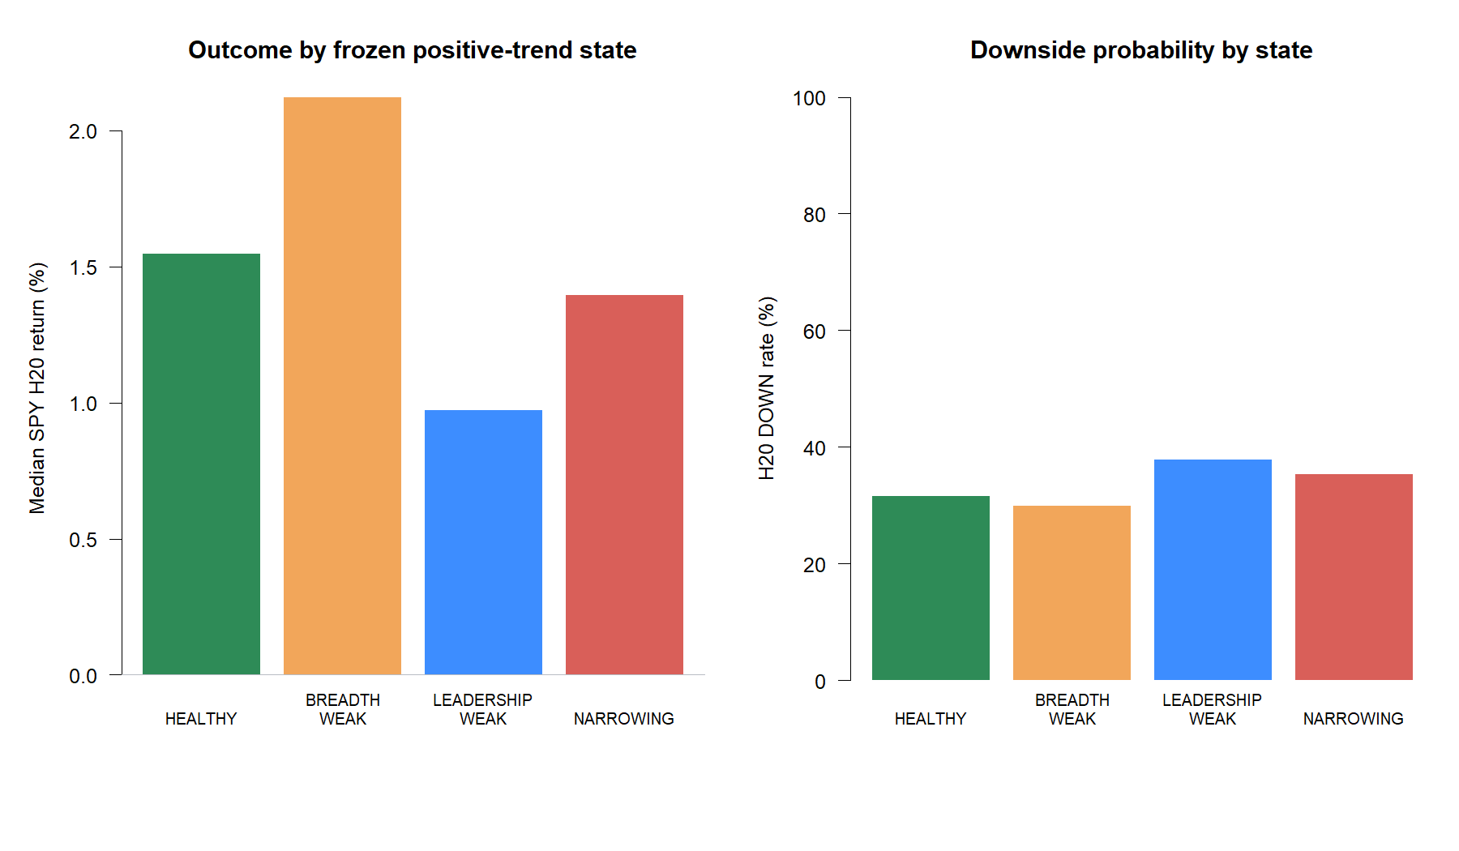
HEADLINE STATE RESULT
Narrowing was only slightly worse than healthy breadth
−0.15 pp
NARROWING minus HEALTHY return
+3.80 pp
NARROWING minus HEALTHY DOWN rate
401 / 174
NARROWING / HEALTHY observations
Gate required ≤−0.75 pp and ≥+10 pp.
5
Notes:
Narrowing had a +1.39% median H20 return and 35.41% DOWN rate; healthy breadth had +1.55% and 31.61%. The direction is plausible, but the magnitude is far below the frozen gate.
[Sources]
- C:/Users/Franc/OneDrive/Documents/Francis/Peltata Project/Time-Series-Modeling-Gen5/runs/research_workbench/operator_hypothesis_lab/hyp_reg_03_2_breadth_transition_20260814/hyp_reg_03_2_state_summary.csv
- C:/Users/Franc/OneDrive/Documents/Francis/Peltata Project/Time-Series-Modeling-Gen5/runs/research_workbench/operator_hypothesis_lab/hyp_reg_03_2_breadth_transition_20260814/hyp_reg_03_2_gates.csv
- operator_hypothesis_lab/docs/HYP_REG_03_2_BREADTH_TRANSITION_DIVERGENCE_RESULTS.md

Slide 6
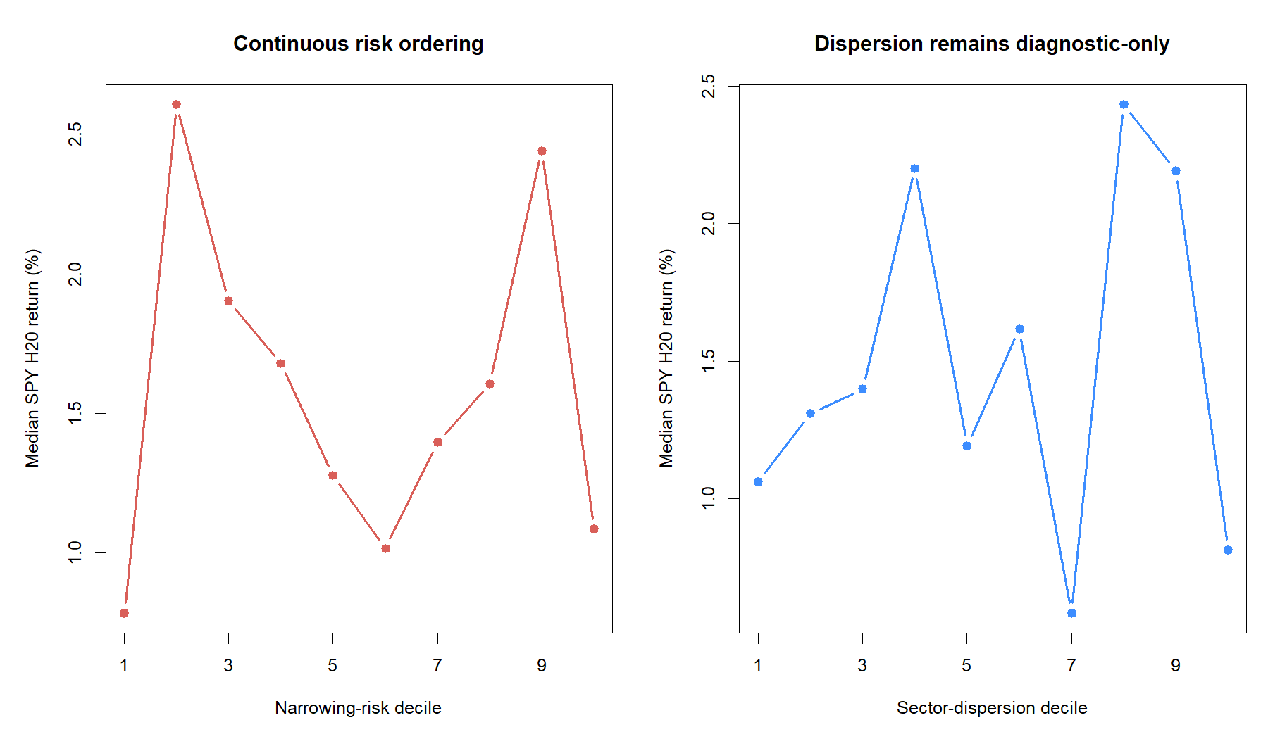
CONTINUOUS DIAGNOSTIC
The continuous score did not order future risk
ρ = −0.030
risk-score Spearman
AUC = 0.527
DOWN discrimination
Theory-only clue
Leadership-weak alone looked descriptively worse than the joint NARROWING state. We do not promote that post-hoc variant.
6
Notes:
A useful risk score should show monotone worsening or at least correct rank association. Here the decile pattern is jagged, Spearman is near zero, and DOWN AUC is only marginally above chance. The leadership-only state is recorded solely as a future theory clue.
[Sources]
- C:/Users/Franc/OneDrive/Documents/Francis/Peltata Project/Time-Series-Modeling-Gen5/runs/research_workbench/operator_hypothesis_lab/hyp_reg_03_2_breadth_transition_20260814/hyp_reg_03_2_continuous_summary.csv
- C:/Users/Franc/OneDrive/Documents/Francis/Peltata Project/Time-Series-Modeling-Gen5/runs/research_workbench/operator_hypothesis_lab/hyp_reg_03_2_breadth_transition_20260814/hyp_reg_03_2_state_summary.csv
- operator_hypothesis_lab/docs/HYP_REG_03_2_BREADTH_TRANSITION_DIVERGENCE_RESULTS.md

Slide 7
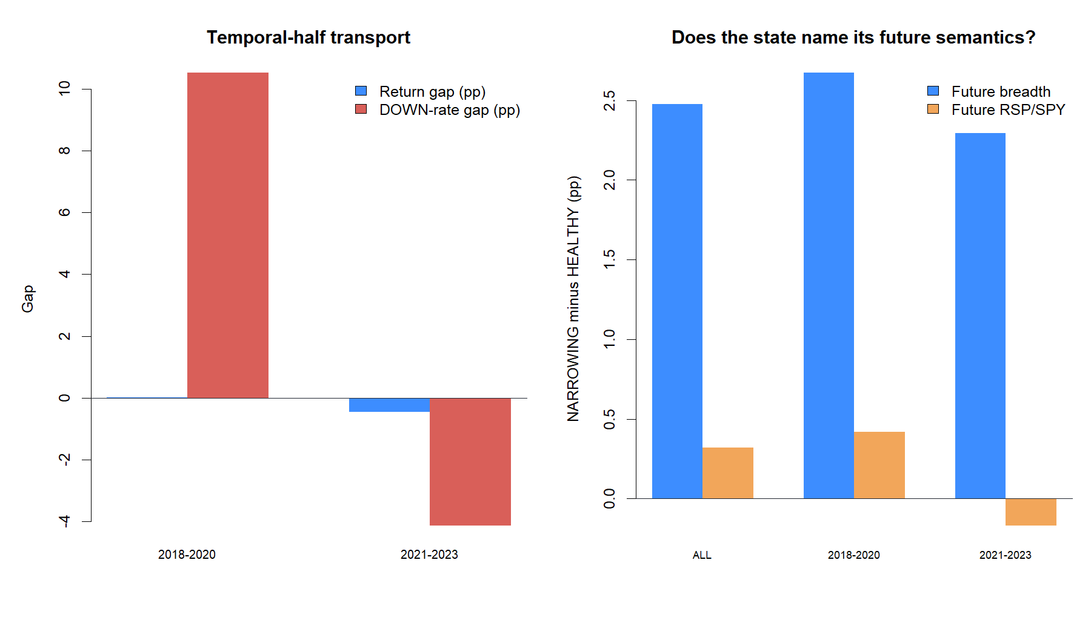
TRANSPORT + SEMANTICS
The strongest falsification: narrowing often preceded recovery
7 / 20
offsets jointly directional
2 / 6
years jointly directional
State-name failure
After NARROWING, breadth changed +2.47 pp and RSP/SPY +0.32 pp versus HEALTHY—rebound, not continued decay.
7
Notes:
This is more informative than a weak return gap alone. The state frequently identified an already-advanced weakening episode near exhaustion. It therefore failed its own semantic target, especially for future breadth.
[Sources]
- C:/Users/Franc/OneDrive/Documents/Francis/Peltata Project/Time-Series-Modeling-Gen5/runs/research_workbench/operator_hypothesis_lab/hyp_reg_03_2_breadth_transition_20260814/hyp_reg_03_2_temporal_summary.csv
- C:/Users/Franc/OneDrive/Documents/Francis/Peltata Project/Time-Series-Modeling-Gen5/runs/research_workbench/operator_hypothesis_lab/hyp_reg_03_2_breadth_transition_20260814/hyp_reg_03_2_semantic_summary.csv
- C:/Users/Franc/OneDrive/Documents/Francis/Peltata Project/Time-Series-Modeling-Gen5/runs/research_workbench/operator_hypothesis_lab/hyp_reg_03_2_breadth_transition_20260814/hyp_reg_03_2_offset_summary.csv
- operator_hypothesis_lab/docs/HYP_REG_03_2_BREADTH_TRANSITION_DIVERGENCE_RESULTS.md

Slide 8
DECISION BOUNDARY
Keep breadth as a measurement family; retire this state
1 / 8
What carries forward
gates passed
Cross-sectional breadth and leadership are distinct from index price.
The present 20-day sign-defined state is too weak and unstable.
STOP_BREADTH_TRANSITION_
GATES_FAILED_NO_JOINT_FILTER
Its rebound behavior suggests it detects exhaustion as often as propagation.
Do not join it to ATR, gate a strategy, tune thresholds, or open 2024+.
A future attempt needs a newly frozen persistence or recovery hypothesis.
2024+ remained sealed
A clean negative result narrows the design space without spending confirmation data.
8
Notes:
Close with the scope boundary. This is not evidence against all breadth filters; it is evidence against this precise combination of sector-breadth transition, RSP/SPY transition, twenty-day signs, and an unfitted percentile score.
[Sources]
- operator_hypothesis_lab/docs/HYP_REG_03_2_BREADTH_TRANSITION_DIVERGENCE_RESULTS.md
- docs/GEN5_HYP_REG_03_2_BREADTH_TRANSITION_DIVERGENCE_CONTRACT.md
- docs/GEN5_1_POC_PROGRESS_LOG.md
- docs/GEN5_4_DECISION_DIALOGUE_INDEX.md#d131
- https://www.spglobal.com/spdji/en/research/article/worth-the-weight/
- https://www.sciencedirect.com/science/article/pii/S1386418115000609

