Slide 1
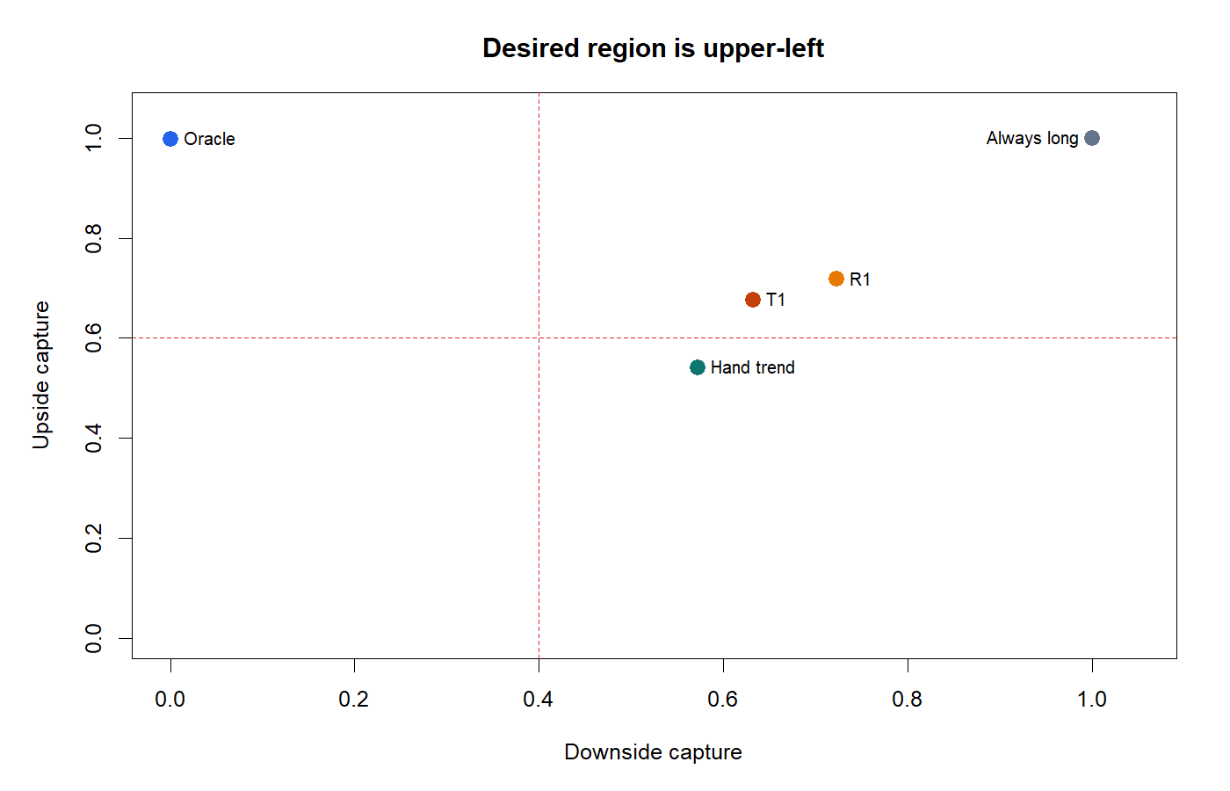
MOMENTUM PREDICTOR SERIES · THROUGH HYP-IMOM-04.1 CAL-A02
Momentum prediction
under falsification
Twelve market tests · daily and 30-minute
No deployable trading policy opened
TWELVE MARKET TESTS STOP · SYNTHETIC CONTROLS PASSED
Notes:
The evidence series now includes CAL-A02, which removed the crossover-entry constraint and asked a direct long/cash question. The primary ridge policy stopped; 2024+ remains sealed.
[Sources]
- C:/Users/Franc/OneDrive/Documents/Francis/Peltata Project/Time-Series-Modeling-Gen5/operator_hypothesis_lab/docs/HYP_IMOM_04_1_CAL_A02_TSLA_DIRECT_EXPOSURE_RESULTS.md
- C:/Users/Franc/OneDrive/Documents/Francis/Peltata Project/Time-Series-Modeling-Gen5/docs/GEN5_1_POC_PROGRESS_LOG.md
- C:/Users/Franc/OneDrive/Documents/Francis/Peltata Project/Time-Series-Modeling-Gen5/runs/research_workbench/operator_hypothesis_lab/hyp_imom_04_1_cal_a02_tsla_direct_exposure_20260823/visuals/him042_capture_map.png

Slide 2
Twelve tests narrowed the momentum story before strategy
EVIDENCE LADDER
Each pivot changed one scientific question while preserving causal timing, fresh DEVELOPMENT evidence, multiplicity control, and sealed confirmation data.
01.3 · SPY horizon surface: no search-adjusted cell
01.2 · 30-minute path quality: path best for 0/26
01.4 · 92-asset transport: zero FDR survivors
01.3 · Same slot: every panel contrast was negative
01.5 · Daily path quality: drift best for 77/91
Five QQQ stories + two TSLA calibrations · all stopped
2
Notes:
The final ladder slot groups five QQQ questions and two explicitly outcome-aware TSLA calibrations. CAL-A02 changed the action surface from crossover permission to direct next-session long/cash exposure.
[Sources]
- C:/Users/Franc/OneDrive/Documents/Francis/Peltata Project/Time-Series-Modeling-Gen5/docs/GEN5_1_POC_PROGRESS_LOG.md
- C:/Users/Franc/OneDrive/Documents/Francis/Peltata Project/Time-Series-Modeling-Gen5/operator_hypothesis_lab/docs/HYP_IMOM_04_1_CAL_A02_TSLA_DIRECT_EXPOSURE_RESULTS.md

Slide 3
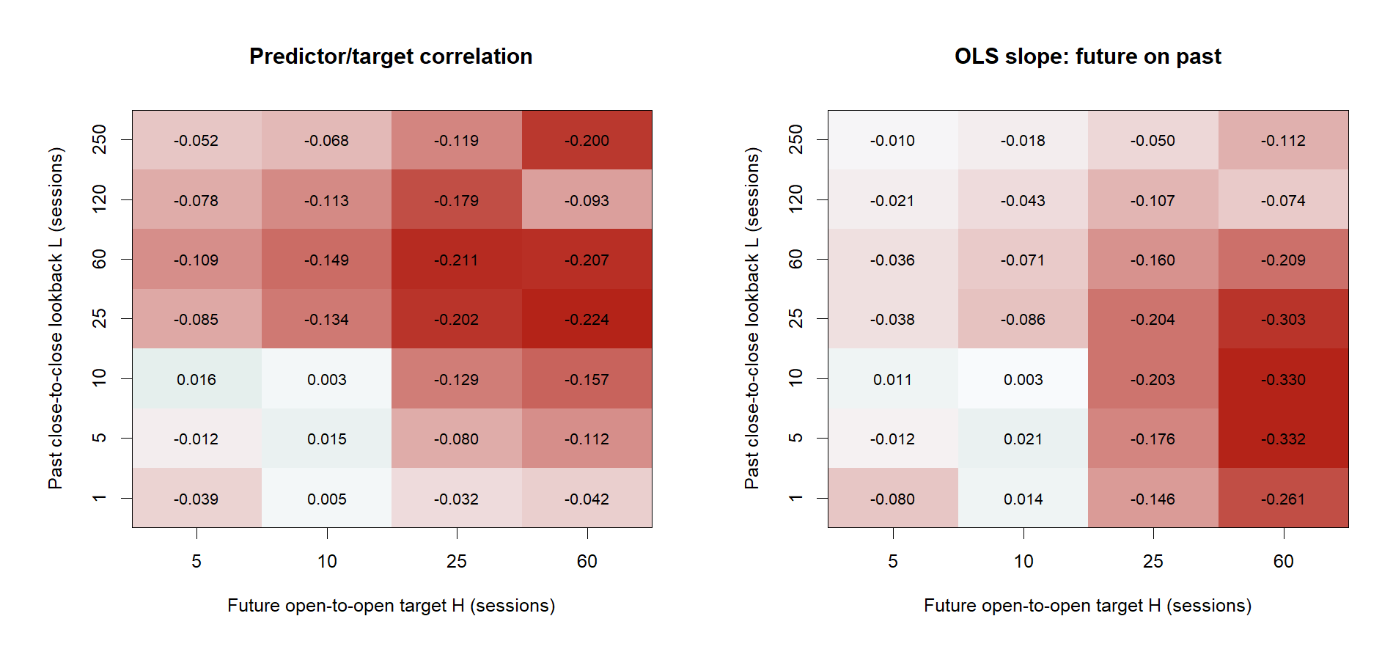
PHASE 1 · DAILY OWN-RETURN
Does raw continuation
survive direct prediction?
Start with SPY, then demand transport across a frozen 92-asset atlas.
TESTS 01.3–01.4 · STRATEGY CLOSED
Notes:
The first phase asks the Chan-style predictor question directly, before entry rules, overlapping sleeves, transaction costs, or portfolio construction.
[Sources]
- C:\Users\Franc\OneDrive\Documents\Francis\Peltata Project\Time-Series-Modeling-Gen5\literature_studies\docs\GEN5_LIT_MOM_01_3_SPY_HORIZON_SURFACE_RESULTS.md
- C:\Users\Franc\OneDrive\Documents\Francis\Peltata Project\Time-Series-Modeling-Gen5\literature_studies\docs\GEN5_LIT_MOM_01_4_MULTI_MARKET_PREDICTOR_ATLAS_RESULTS.md

Slide 4
SPY's horizon surface was reversal-shaped, not continuation-shaped
DAILY
Largest rho was +0.0162 versus a +0.1771 search-adjusted p90 threshold; canonical 250/25 rho was −0.1186.
4
Notes:
The 2017–2023 sandbox contained 1,699 common anchors across 28 frozen predictor-target cells. The best observed correlation was far inside the maximum-statistic null surface; 250/25 was negative rather than weakly positive.
[Sources]
- C:\Users\Franc\OneDrive\Documents\Francis\Peltata Project\Time-Series-Modeling-Gen5\literature_studies\docs\GEN5_LIT_MOM_01_3_SPY_HORIZON_SURFACE_RESULTS.md
- C:\Users\Franc\OneDrive\Documents\Francis\Peltata Project\Time-Series-Modeling-Gen5\runs\research_workbench\literature_grounded\lit_mom_01_3_spy_horizon_surface_20260821\visuals\mom013_surface_heatmaps.png

Slide 5
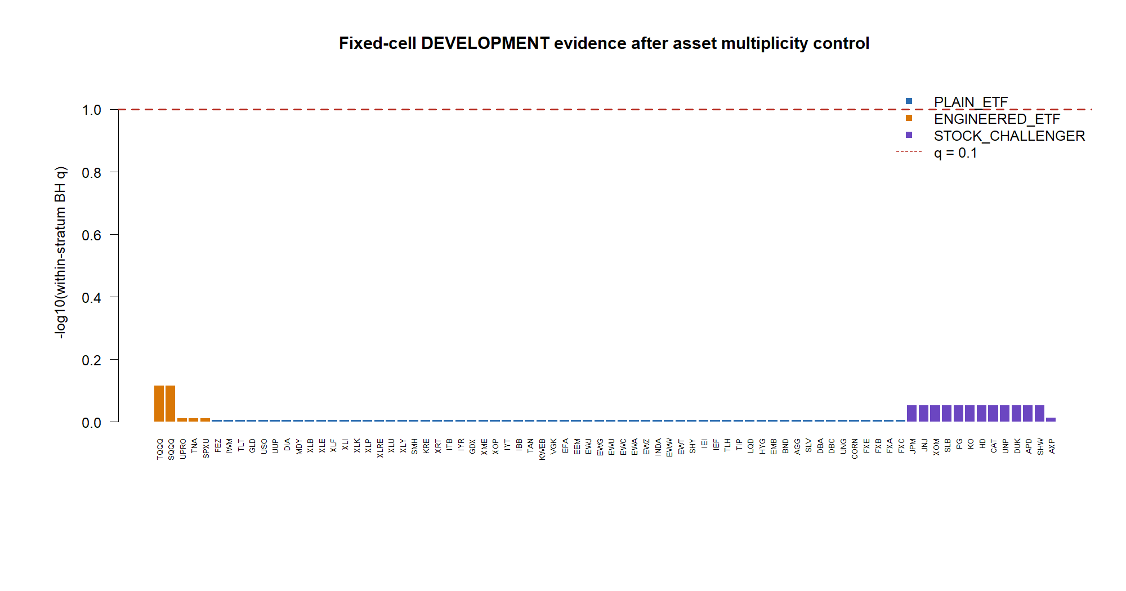
Breadth did not rescue the daily own-return clue
TRANSPORT
Seventy-nine fixed nominees produced 19 positive DEVELOPMENT rhos—and zero within-stratum BH q ≤ 0.10 survivors.
5
Notes:
All 92 assets were eligible. Positive TRAIN nominees received exactly one fixed DEVELOPMENT test. Plain ETFs, engineered ETFs, and stocks all failed their predeclared within-stratum multiplicity gate.
[Sources]
- C:\Users\Franc\OneDrive\Documents\Francis\Peltata Project\Time-Series-Modeling-Gen5\literature_studies\docs\GEN5_LIT_MOM_01_4_MULTI_MARKET_PREDICTOR_ATLAS_RESULTS.md
- C:\Users\Franc\OneDrive\Documents\Francis\Peltata Project\Time-Series-Modeling-Gen5\runs\research_workbench\literature_grounded\lit_mom_01_4_multi_market_predictor_atlas_20260821\visuals\mom014_development_fdr.png

Slide 6
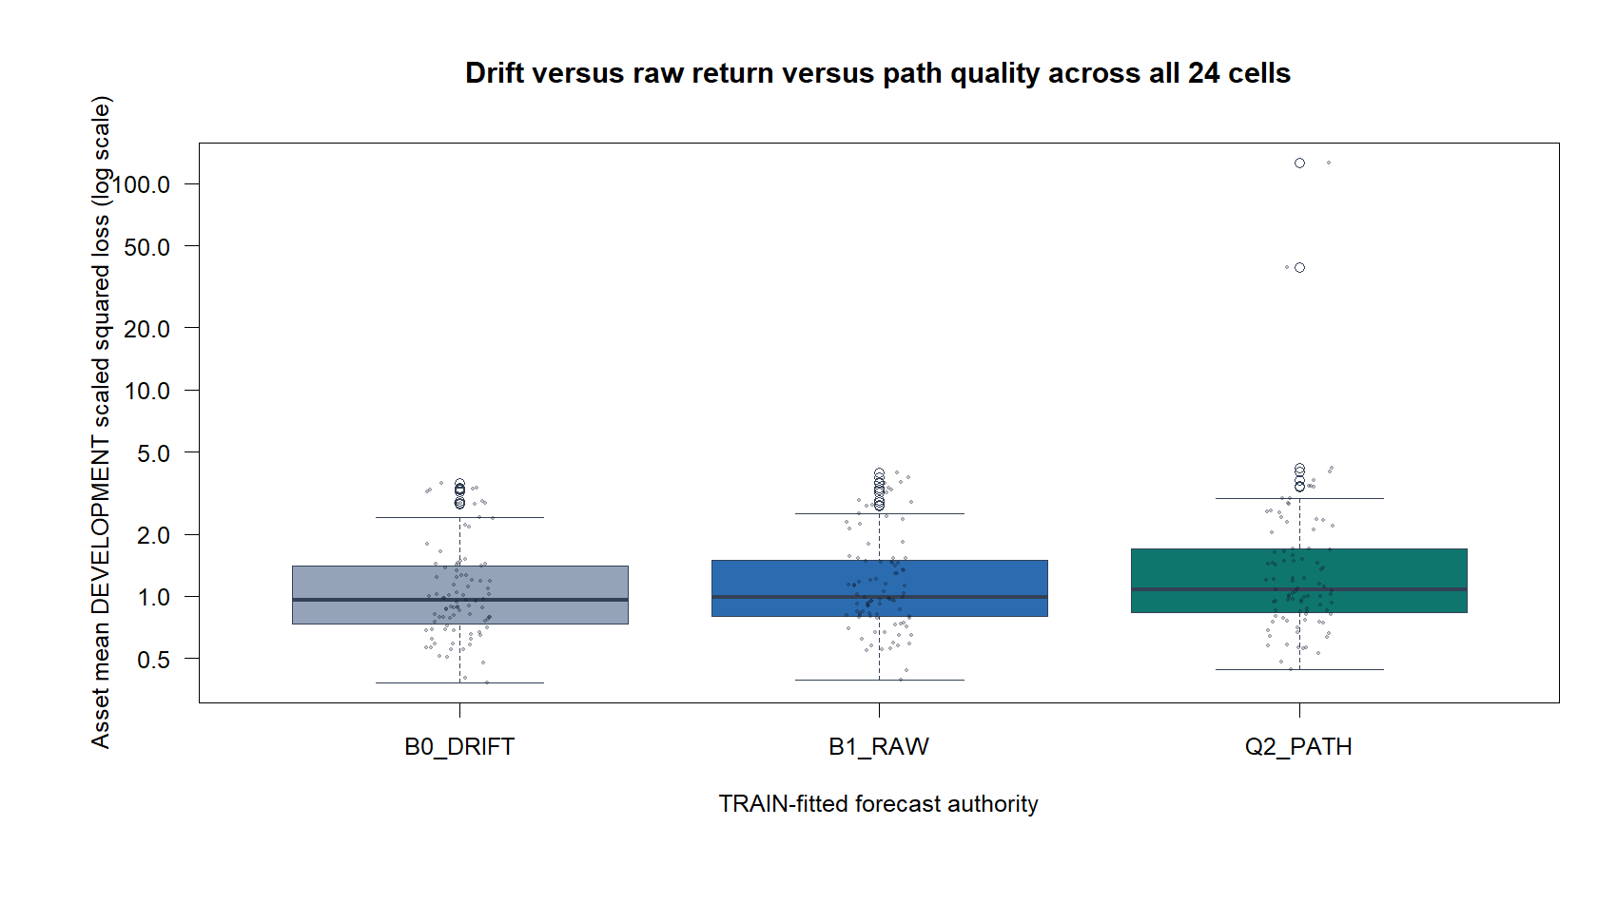
PHASE 2 · PATH QUALITY
Does a coherent path
forecast better than its endpoint?
Add causal path coherence and shock concentration—then compare them with drift and raw return.
DAILY + 30-MINUTE · TESTS 01.5 AND 01.2
Notes:
The second phase follows the intuition pump: perhaps two equal trailing returns should imply different futures when one arose smoothly and the other from a shock. The test requires that extra description to improve proper forecast loss, not merely look appealing on a chart.
[Sources]
- C:\Users\Franc\OneDrive\Documents\Francis\Peltata Project\Time-Series-Modeling-Gen5\literature_studies\docs\GEN5_LIT_MOM_01_5_PATH_QUALITY_FORECAST_COMPARISON_RESULTS.md
- C:\Users\Franc\OneDrive\Documents\Francis\Peltata Project\Time-Series-Modeling-Gen5\literature_studies\docs\GEN5_LIT_IMOM_01_2_30MIN_PATH_QUALITY_FORECAST_COMPARISON_RESULTS.md

Slide 7
Path quality lost to a constant-drift forecast on most daily assets
DAILY
Across 91 eligible assets and 2,184 cells, drift was lowest-loss for 77 assets, raw return for 13, and path quality for one.
7
Notes:
The intercept-only drift baseline is deliberately hard to beat: it asks whether recent path information improves the average future-return forecast. SQQQ failed the frozen full-rank gate at L250; all its partial cells were discarded.
[Sources]
- C:\Users\Franc\OneDrive\Documents\Francis\Peltata Project\Time-Series-Modeling-Gen5\literature_studies\docs\GEN5_LIT_MOM_01_5_PATH_QUALITY_FORECAST_COMPARISON_RESULTS.md
- C:\Users\Franc\OneDrive\Documents\Francis\Peltata Project\Time-Series-Modeling-Gen5\runs\research_workbench\literature_grounded\lit_mom_01_5_path_quality_forecast_comparison_20260821\visuals\mom015_model_loss_comparison.png

Slide 8
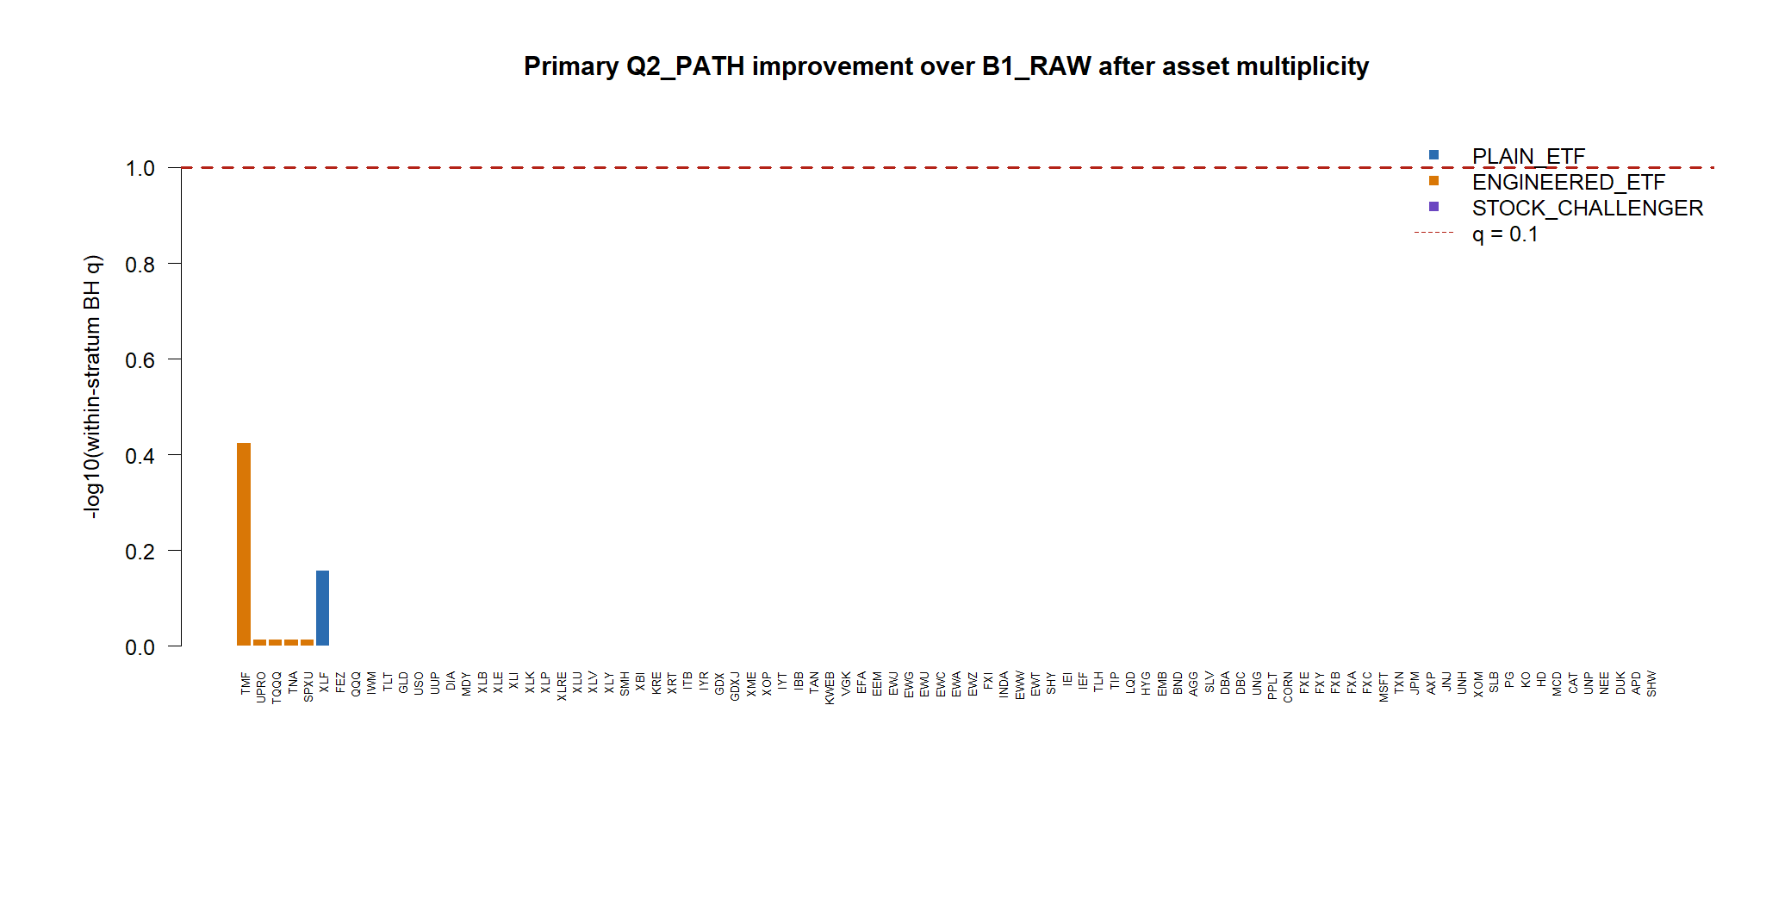
Isolated path wins vanished under asset-level multiplicity control
MULTIPLICITY
Path beat raw return in 14/90 assets, but no controlled clue survived; the minimum D21 BH q was 0.3765.
8
Notes:
A few point estimates looked better, but the family-level question was whether any asset carried stable incremental path-quality information after multiplicity. The answer was no.
[Sources]
- C:\Users\Franc\OneDrive\Documents\Francis\Peltata Project\Time-Series-Modeling-Gen5\literature_studies\docs\GEN5_LIT_MOM_01_5_PATH_QUALITY_FORECAST_COMPARISON_RESULTS.md
- C:\Users\Franc\OneDrive\Documents\Francis\Peltata Project\Time-Series-Modeling-Gen5\runs\research_workbench\literature_grounded\lit_mom_01_5_path_quality_forecast_comparison_20260821\visuals\mom015_primary_fdr.png

Slide 9
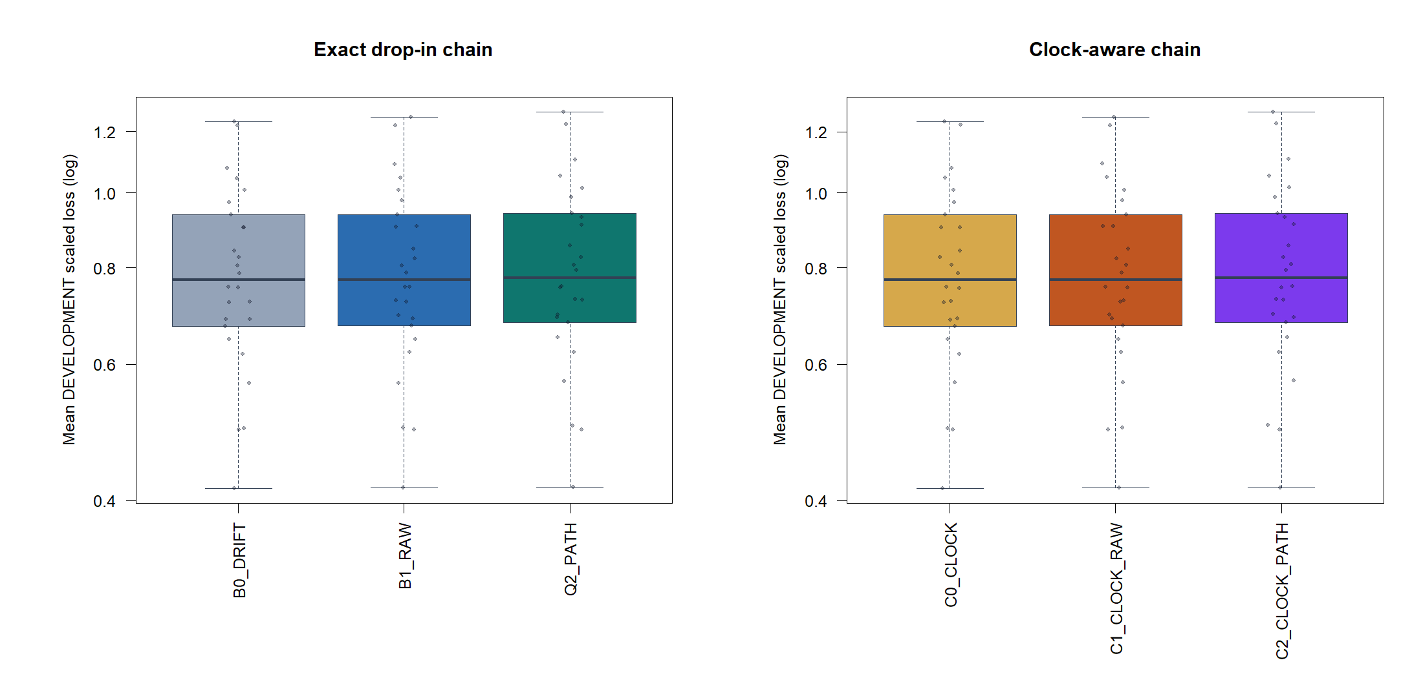
A 30-minute drop-in preserved the ranking: baseline, raw, then path
30-MINUTE
All 26 instruments and 624 cells were eligible; the baseline was lowest-loss for 21/26 and path quality for 0/26.
9
Notes:
The hypothesis was transported in bar units rather than rescaled to preserve daily calendar durations. Both the exact drop-in and clock-aware chains produced the same model ranking.
[Sources]
- C:\Users\Franc\OneDrive\Documents\Francis\Peltata Project\Time-Series-Modeling-Gen5\literature_studies\docs\GEN5_LIT_IMOM_01_2_30MIN_PATH_QUALITY_FORECAST_COMPARISON_RESULTS.md
- C:\Users\Franc\OneDrive\Documents\Francis\Peltata Project\Time-Series-Modeling-Gen5\runs\research_workbench\literature_grounded\lit_imom_01_2_30min_path_quality_forecast_comparison_20260821\visuals\imom012_model_loss_comparison.png

Slide 10
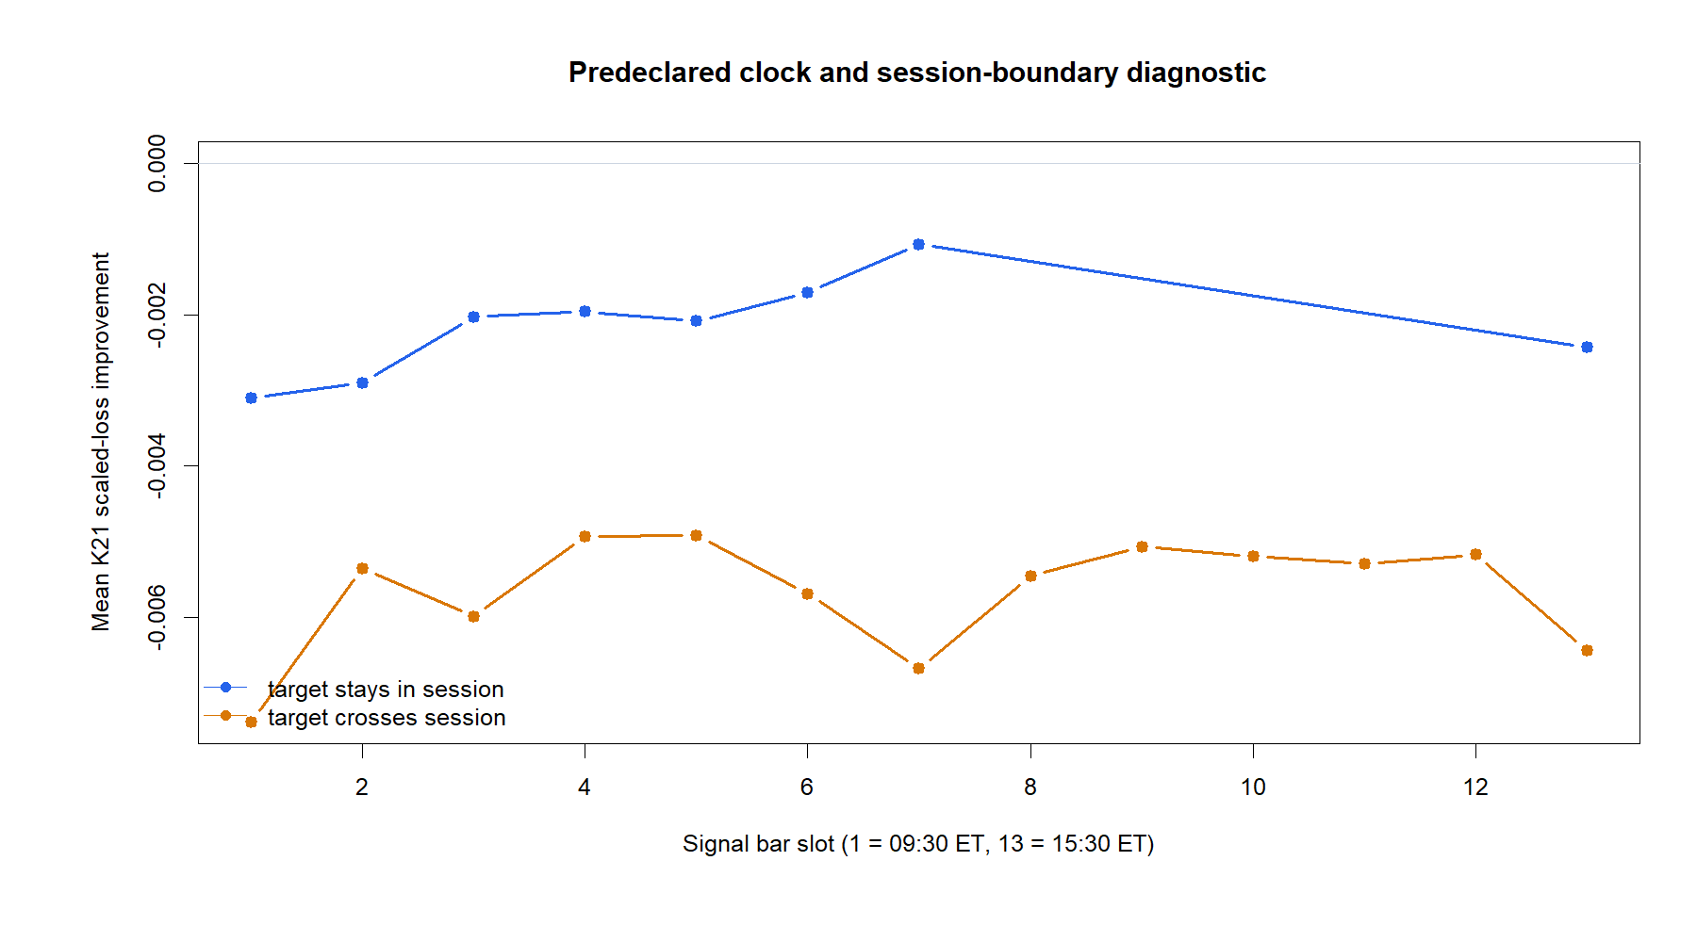
Intraday slot and session boundaries did not hide a rescue
DIAGNOSTIC
Every L/H cell median and every predeclared slot/session-crossing path diagnostic was negative.
10
Notes:
The diagnostic separates targets that remain within a session from targets that cross a session boundary. Neither location produced positive path-quality improvement.
[Sources]
- C:\Users\Franc\OneDrive\Documents\Francis\Peltata Project\Time-Series-Modeling-Gen5\literature_studies\docs\GEN5_LIT_IMOM_01_2_30MIN_PATH_QUALITY_FORECAST_COMPARISON_RESULTS.md
- C:\Users\Franc\OneDrive\Documents\Francis\Peltata Project\Time-Series-Modeling-Gen5\runs\research_workbench\literature_grounded\lit_imom_01_2_30min_path_quality_forecast_comparison_20260821\visuals\imom012_slot_diagnostic.png

Slide 11
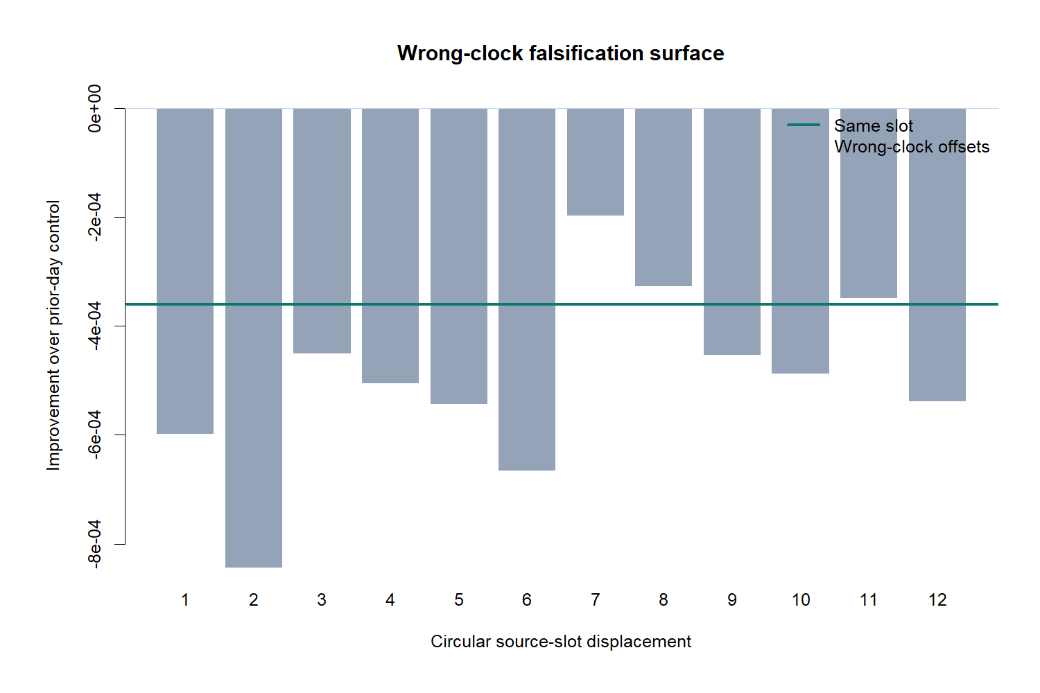
PHASE 3 · CLOCK-SPECIFIC RECURRENCE
Does relative momentum
repeat by clock time?
Replace generic trend with a narrower market-microstructure story—and demand wrong-clock specificity.
LIT-IMOM-01.3 · 2024+ SEALED
Notes:
The final phase introduces a distinct recurrence mechanism: a stock's relative move in one 30-minute slot may repeat in that same slot on the next session. The placebo surface asks whether the named clock alignment is actually special.
[Sources]
- C:\Users\Franc\OneDrive\Documents\Francis\Peltata Project\Time-Series-Modeling-Gen5\literature_studies\docs\GEN5_LIT_IMOM_01_3_SAME_SLOT_RELATIVE_MOMENTUM_RESULTS.md

Slide 12
Same-slot momentum asked for recurrence—not generic intraday trend
LIT-IMOM-01.3 · DESIGN
For each stock and 30-minute slot k, use yesterday's SPY-relative return in slot k to forecast today's relative return in the same slot. The target must improve on clock seasonality and prior-day momentum.
xₜ,ₖ = rstockₜ₋₁,ₖ − rSPYₜ₋₁,ₖ
yₜ,ₖ = rstockₜ,ₖ − rSPYₜ,ₖ
CLOCK → PRIOR DAY → SAME SLOT → WRONG CLOCK
Fresh DEVELOPMENT only · equal-weight 22-stock panel · 12 circular wrong-clock offsets · no target-slot selection · 2024+ sealed.
12
Notes:
The same-slot term enters only after the clock baseline and the prior-day relative-return challenger. Twelve circular source-slot displacements provide a direct placebo test of clock specificity.
[Sources]
- C:\Users\Franc\OneDrive\Documents\Francis\Peltata Project\Time-Series-Modeling-Gen5\literature_studies\docs\GEN5_LIT_IMOM_01_3_SAME_SLOT_RELATIVE_MOMENTUM_RESULTS.md
- C:\Users\Franc\OneDrive\Documents\Francis\Peltata Project\Time-Series-Modeling-Gen5\runs\research_workbench\literature_grounded\lit_imom_01_3_same_slot_relative_momentum_20260821\run_spec.json

Slide 13
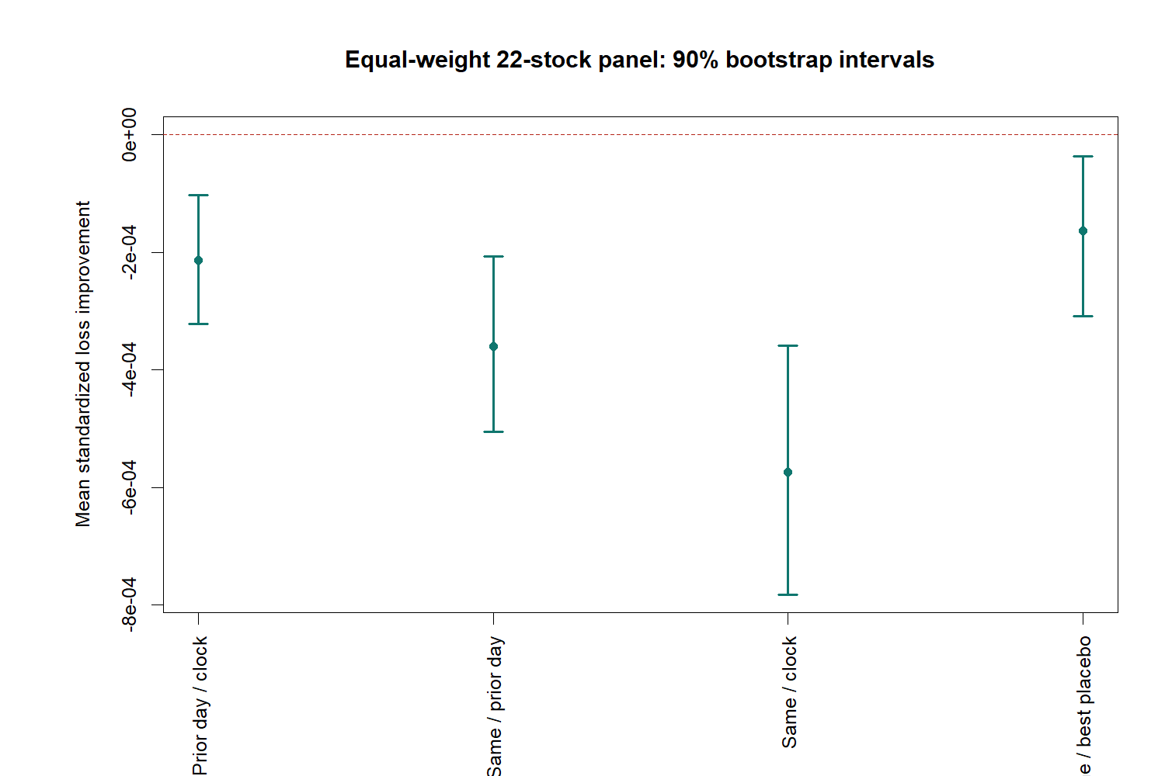
Every panel-level same-slot contrast was negative
DEVELOPMENT
All four 90% intervals lie below zero: same slot worsened loss versus clock, prior day, and the best wrong-clock placebo.
13
Notes:
The panel contrasts are the primary evidence. G10, S21, S20, and the specificity contrast U were all negative, with strictly negative 90% bootstrap intervals.
[Sources]
- C:\Users\Franc\OneDrive\Documents\Francis\Peltata Project\Time-Series-Modeling-Gen5\literature_studies\docs\GEN5_LIT_IMOM_01_3_SAME_SLOT_RELATIVE_MOMENTUM_RESULTS.md
- C:\Users\Franc\OneDrive\Documents\Francis\Peltata Project\Time-Series-Modeling-Gen5\runs\research_workbench\literature_grounded\lit_imom_01_3_same_slot_relative_momentum_20260821\visuals\imom013_panel_intervals.png

Slide 14
The named clock alignment was no better than displaced placebos
FALSIFICATION
Same-slot improvement was −0.000360; wrong-clock offset 7 was less negative at −0.000197.
14
Notes:
A genuine recurring clock mechanism should make displacement zero stand out. It did not: the best displaced alignment was less harmful than the named same-slot alignment.
[Sources]
- C:\Users\Franc\OneDrive\Documents\Francis\Peltata Project\Time-Series-Modeling-Gen5\literature_studies\docs\GEN5_LIT_IMOM_01_3_SAME_SLOT_RELATIVE_MOMENTUM_RESULTS.md
- C:\Users\Franc\OneDrive\Documents\Francis\Peltata Project\Time-Series-Modeling-Gen5\runs\research_workbench\literature_grounded\lit_imom_01_3_same_slot_relative_momentum_20260821\visuals\imom013_wrong_clock_surface.png

Slide 15
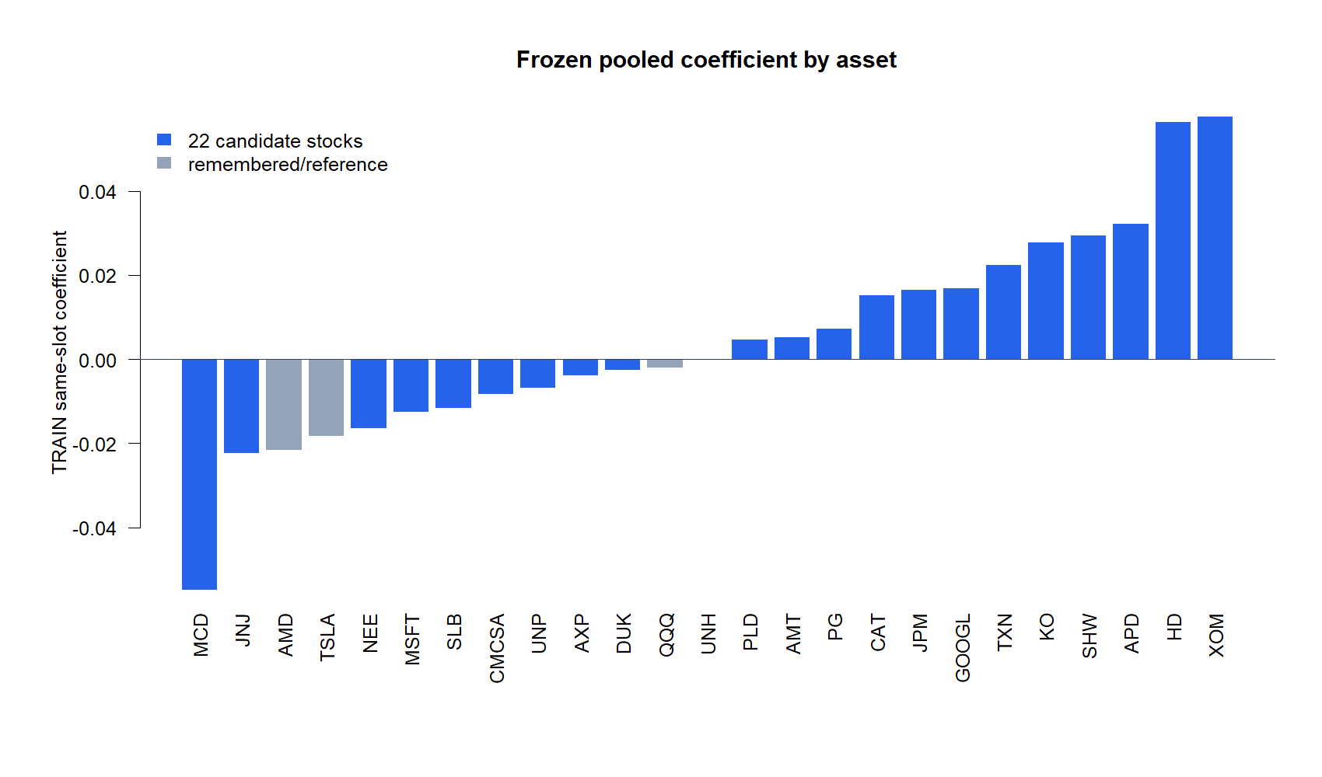
A positive TRAIN coefficient was common—and still not predictive enough
BREADTH
Thirteen of 22 candidate coefficients were positive in TRAIN; same slot was lowest-loss for only 5/22 in DEVELOPMENT; 0 survived.
15
Notes:
This diagnostic explains why the hypothesis could feel plausible during discovery. Positive fitted recurrence was common in TRAIN, but it did not transport into broad DEVELOPMENT forecast improvement or FDR-controlled candidates.
[Sources]
- C:\Users\Franc\OneDrive\Documents\Francis\Peltata Project\Time-Series-Modeling-Gen5\literature_studies\docs\GEN5_LIT_IMOM_01_3_SAME_SLOT_RELATIVE_MOMENTUM_RESULTS.md
- C:\Users\Franc\OneDrive\Documents\Francis\Peltata Project\Time-Series-Modeling-Gen5\runs\research_workbench\literature_grounded\lit_imom_01_3_same_slot_relative_momentum_20260821\visuals\imom013_same_slot_coefficients.png

Slide 16
Three increasingly specific momentum stories failed
DECISION
These were rigorous falsifications—not evidence that every possible momentum mechanism is absent.
Raw own-return continuation failed SPY search adjustment and cross-market FDR transport.
Path coherence added no stable forecast skill at daily or 30-minute resolution.
Clock-specific recurrence lost to seasonality, prior-day momentum, and wrong-clock controls.
STOP: preserve 2024+ and do not rescue these specifications by mining horizons, assets, slots, baselines, or policies.
16
Notes:
Close with the positive learning: simple price-path descriptions repeatedly failed to add robust conditional forecast information. A next hypothesis should introduce a distinct, predeclared causal mechanism rather than relax these stopped specifications.
[Sources]
- C:\Users\Franc\OneDrive\Documents\Francis\Peltata Project\Time-Series-Modeling-Gen5\literature_studies\docs\GEN5_LIT_MOM_01_3_SPY_HORIZON_SURFACE_RESULTS.md
- C:\Users\Franc\OneDrive\Documents\Francis\Peltata Project\Time-Series-Modeling-Gen5\literature_studies\docs\GEN5_LIT_MOM_01_4_MULTI_MARKET_PREDICTOR_ATLAS_RESULTS.md
- C:\Users\Franc\OneDrive\Documents\Francis\Peltata Project\Time-Series-Modeling-Gen5\literature_studies\docs\GEN5_LIT_MOM_01_5_PATH_QUALITY_FORECAST_COMPARISON_RESULTS.md
- C:\Users\Franc\OneDrive\Documents\Francis\Peltata Project\Time-Series-Modeling-Gen5\literature_studies\docs\GEN5_LIT_IMOM_01_2_30MIN_PATH_QUALITY_FORECAST_COMPARISON_RESULTS.md
- C:\Users\Franc\OneDrive\Documents\Francis\Peltata Project\Time-Series-Modeling-Gen5\literature_studies\docs\GEN5_LIT_IMOM_01_3_SAME_SLOT_RELATIVE_MOMENTUM_RESULTS.md
- C:\Users\Franc\OneDrive\Documents\Francis\Peltata Project\Time-Series-Modeling-Gen5\docs\GEN5_1_POC_PROGRESS_LOG.md

Slide 17
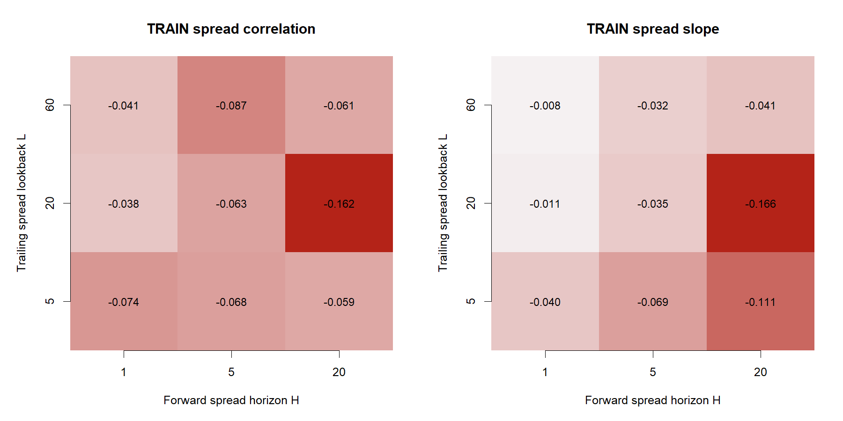
PHASE 4 · WITHIN-UNIVERSE LEADERSHIP
Does Nasdaq-100 leadership
persist?
Compare QQQ with the same universe through pre-change QQEW—before strategy or confirmation.
HYP-MOM-07.1 · TRAIN ONLY · DEVELOPMENT SEALED
Notes:
This phase removes broad market direction from both predictor and target. QQQ is compared with QQEW, which tracked the equal-weight Nasdaq-100 through the registered evidence window.
[Sources]
- C:/Users/Franc/OneDrive/Documents/Francis/Peltata Project/Time-Series-Modeling-Gen5/operator_hypothesis_lab/docs/HYP_MOM_07_1_QQQ_EQUAL_WEIGHT_LEADERSHIP_CONTRACT.md
- https://indexes.nasdaq.com/Index/Overview/NDXE
- https://www.ftportfolios.com/retail/etf/etfsummary.aspx?Ticker=QQEW
- C:/Users/Franc/OneDrive/Documents/Francis/Peltata Project/Time-Series-Modeling-Gen5/runs/research_workbench/operator_hypothesis_lab/hyp_mom_07_1_qqq_equal_weight_leadership_20260822/visuals/hm071_train_surface.png

Slide 18
Every frozen leadership cell pointed away from persistence
TRAIN
All nine correlations were negative; least-negative L20/H1 rho was −0.0382 across 986 common anchors.
18
Notes:
The 2017-2020 TRAIN panel crossed lookbacks 5, 20, and 60 with forward horizons 1, 5, and 20. Every correlation and every slope was negative, so the registered positive-persistence mechanism had no candidate cell.
[Sources]
- C:/Users/Franc/OneDrive/Documents/Francis/Peltata Project/Time-Series-Modeling-Gen5/operator_hypothesis_lab/docs/HYP_MOM_07_1_QQQ_EQUAL_WEIGHT_LEADERSHIP_RESULTS.md
- C:/Users/Franc/OneDrive/Documents/Francis/Peltata Project/Time-Series-Modeling-Gen5/runs/research_workbench/operator_hypothesis_lab/hyp_mom_07_1_qqq_equal_weight_leadership_20260822/hm071_train_surface.csv
- C:/Users/Franc/OneDrive/Documents/Francis/Peltata Project/Time-Series-Modeling-Gen5/runs/research_workbench/operator_hypothesis_lab/hyp_mom_07_1_qqq_equal_weight_leadership_20260822/visuals/hm071_train_surface.png

Slide 19
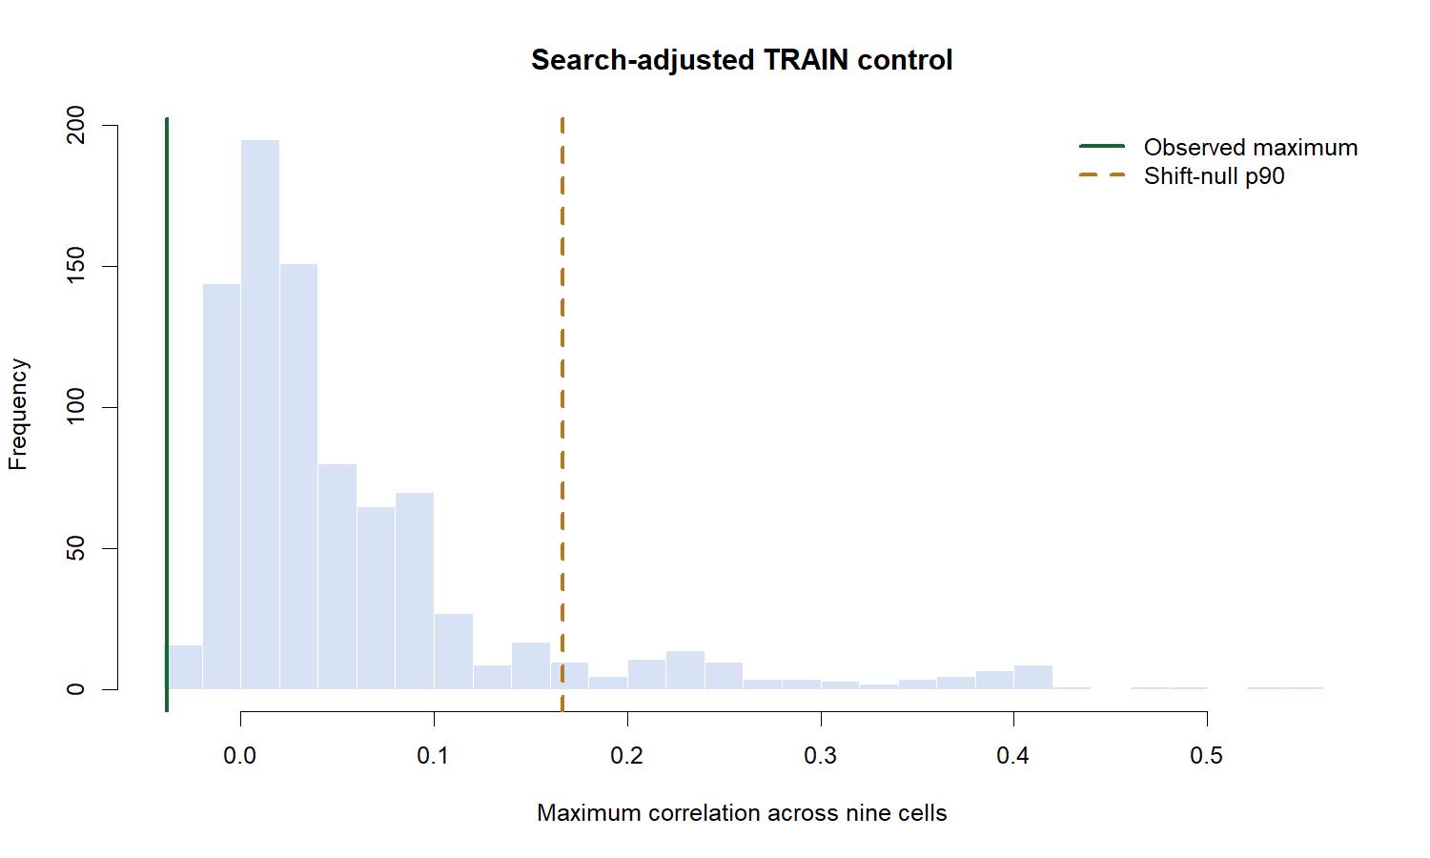
The best observed cell missed every search-adjusted hurdle
FALSIFICATION
Observed maximum −0.0382 versus shift-null p90 +0.1663; empirical upper-tail probability was 1.000.
19
Notes:
The global control enumerated 867 admissible joint circular shifts and retained each shift's best correlation across the nine-cell surface. The observed maximum was below the entire positive search hurdle and had the wrong sign.
[Sources]
- C:/Users/Franc/OneDrive/Documents/Francis/Peltata Project/Time-Series-Modeling-Gen5/operator_hypothesis_lab/docs/HYP_MOM_07_1_QQQ_EQUAL_WEIGHT_LEADERSHIP_RESULTS.md
- C:/Users/Franc/OneDrive/Documents/Francis/Peltata Project/Time-Series-Modeling-Gen5/runs/research_workbench/operator_hypothesis_lab/hyp_mom_07_1_qqq_equal_weight_leadership_20260822/hm071_train_decision.csv
- C:/Users/Franc/OneDrive/Documents/Francis/Peltata Project/Time-Series-Modeling-Gen5/runs/research_workbench/operator_hypothesis_lab/hyp_mom_07_1_qqq_equal_weight_leadership_20260822/visuals/hm071_train_search_control.png

Slide 20
QQQ leadership persistence stopped before DEVELOPMENT
DECISION
The source was valid; the registered persistence mechanism was not.
QQQ and QQEW supplied 1,259 aligned daily sessions; the pre-change proxy audit passed 5/5.
Every TRAIN cell was negative, so no lookback or horizon earned nomination.
A wrong-sign reversal follow-up is bookmarked under a fresh future contract; this identifier remains stopped.
STOP: do not invert the sign, mine nearby windows, or reinterpret this wrong-sign surface as a reversal strategy.
20
Notes:
The negative QQQ-minus-QQEW surface is preserved as an unexpected finding. A later reversal question may investigate it independently, but it cannot be obtained by flipping this stopped persistence hypothesis.
[Sources]
- C:/Users/Franc/OneDrive/Documents/Francis/Peltata Project/Time-Series-Modeling-Gen5/operator_hypothesis_lab/docs/HYP_MOM_07_1_QQQ_EQUAL_WEIGHT_LEADERSHIP_RESULTS.md
- C:/Users/Franc/OneDrive/Documents/Francis/Peltata Project/Time-Series-Modeling-Gen5/literature_studies/docs/GEN5_QQQ_MINIMAL_HYPOTHESIS_SLATE.md
- C:/Users/Franc/OneDrive/Documents/Francis/Peltata Project/Time-Series-Modeling-Gen5/docs/GEN5_1_POC_PROGRESS_LOG.md

Slide 21
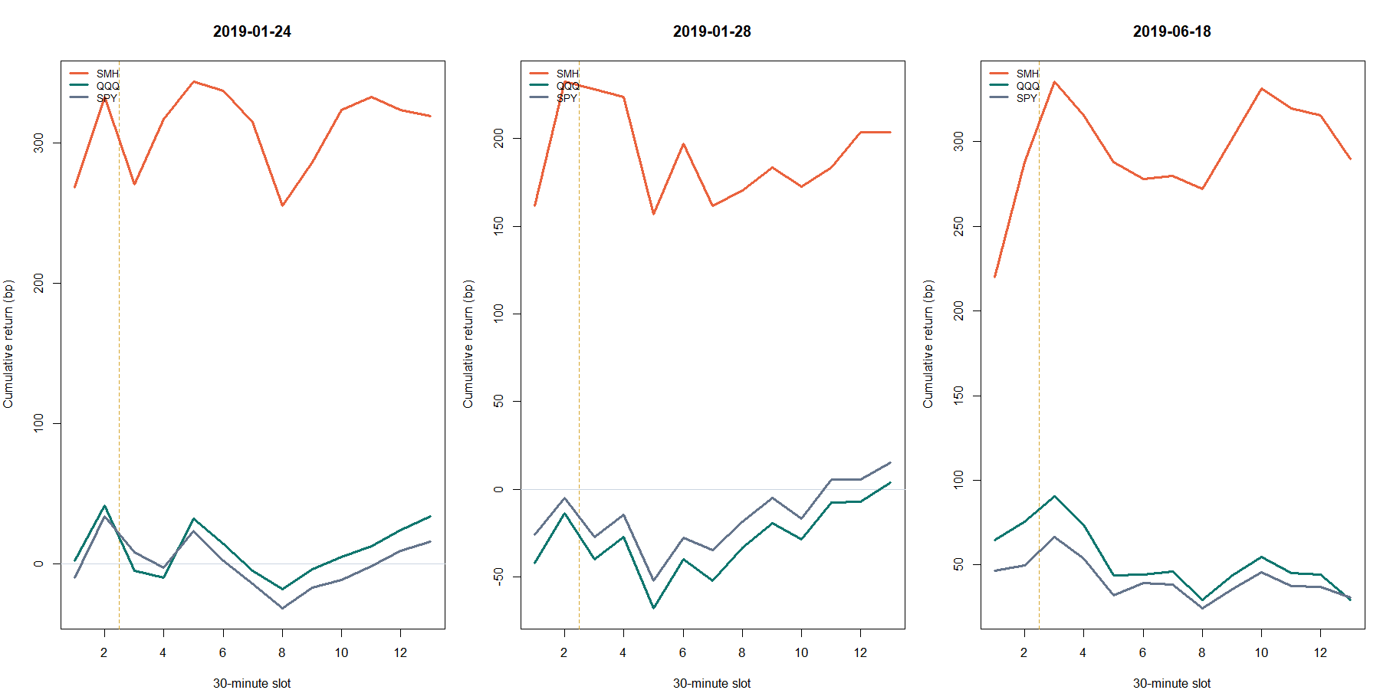
PHASE 5 · CROSS-ASSET INTRADAY TRANSMISSION
Do semiconductors
lead QQQ after 10:30?
Use first-hour SMH leadership to forecast QQQ-minus-SPY through the same session's close.
HYP-IMOM-03.1 · TRAIN ONLY · DEVELOPMENT SEALED
Notes:
This phase changes from same-universe daily leadership to a causal cross-asset intraday transmission question. The three panels illustrate the fixed observation and target clock; they are not selected profitable trades.
[Sources]
- C:/Users/Franc/OneDrive/Documents/Francis/Peltata Project/Time-Series-Modeling-Gen5/operator_hypothesis_lab/docs/HYP_IMOM_03_1_SMH_TO_QQQ_FIRST_HOUR_LEAD_LAG_CONTRACT.md
- C:/Users/Franc/OneDrive/Documents/Francis/Peltata Project/Time-Series-Modeling-Gen5/runs/research_workbench/operator_hypothesis_lab/hyp_imom_03_1_smh_qqq_lead_lag_20260822/him031_report.md
- C:/Users/Franc/OneDrive/Documents/Francis/Peltata Project/Time-Series-Modeling-Gen5/runs/research_workbench/operator_hypothesis_lab/hyp_imom_03_1_smh_qqq_lead_lag_20260822/visuals/him031_representative_event_tapes.png

Slide 22
The clock was fixed before outcomes were read
HYP-IMOM-03.1 · DESIGN
Measure SMH-minus-QQQ from 09:30 to 10:30 ET. After that bar closes, forecast QQQ-minus-SPY from the next bar's open through the regular-session close.
xₜ = rSMHₜ,first hour − rQQQₜ,first hour
yₜ = rQQQₜ,remainder − rSPYₜ,remainder
FIRST HOUR → NEXT-BAR OPEN → SESSION CLOSE
TRAIN 2018–2020 · weekday + QQQ/SPY controls · prior-session wrong-clock placebo · 2021+ sealed
22
Notes:
The predictor is fully known at 10:30 ET and the target begins at the next bar's open, so signal and target do not overlap. Expanding folds score 2019 and 2020 without training on the scored year.
[Sources]
- C:/Users/Franc/OneDrive/Documents/Francis/Peltata Project/Time-Series-Modeling-Gen5/operator_hypothesis_lab/docs/HYP_IMOM_03_1_SMH_TO_QQQ_FIRST_HOUR_LEAD_LAG_CONTRACT.md
- C:/Users/Franc/OneDrive/Documents/Francis/Peltata Project/Time-Series-Modeling-Gen5/operator_hypothesis_lab/R/gen5_hyp_imom_03_1_smh_qqq_lead_lag.R

Slide 23
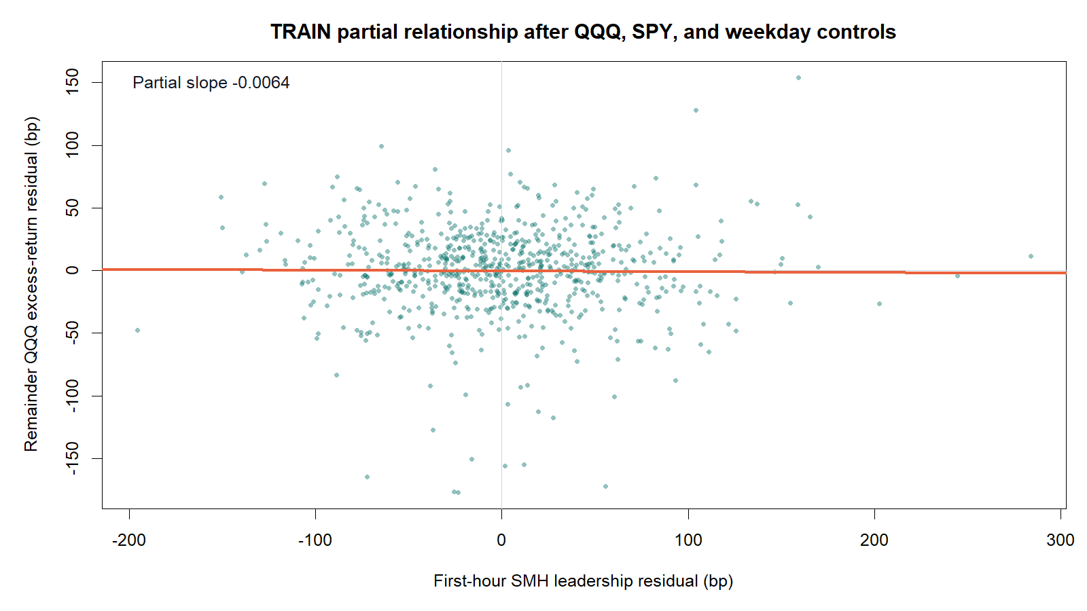
Controlled semiconductor leadership was flat to slightly negative
TRAIN
Partial slope −0.0064 after weekday, QQQ, and SPY first-hour controls across 751 TRAIN sessions.
23
Notes:
The partial slope is the coefficient on first-hour SMH-minus-QQQ leadership after controlling for weekday and both QQQ and SPY first-hour returns. The registered mechanism required a positive coefficient.
[Sources]
- C:/Users/Franc/OneDrive/Documents/Francis/Peltata Project/Time-Series-Modeling-Gen5/runs/research_workbench/operator_hypothesis_lab/hyp_imom_03_1_smh_qqq_lead_lag_20260822/him031_train_coefficients.csv
- C:/Users/Franc/OneDrive/Documents/Francis/Peltata Project/Time-Series-Modeling-Gen5/runs/research_workbench/operator_hypothesis_lab/hyp_imom_03_1_smh_qqq_lead_lag_20260822/him031_train_gates.csv
- C:/Users/Franc/OneDrive/Documents/Francis/Peltata Project/Time-Series-Modeling-Gen5/runs/research_workbench/operator_hypothesis_lab/hyp_imom_03_1_smh_qqq_lead_lag_20260822/visuals/him031_train_partial_relationship.png

Slide 24
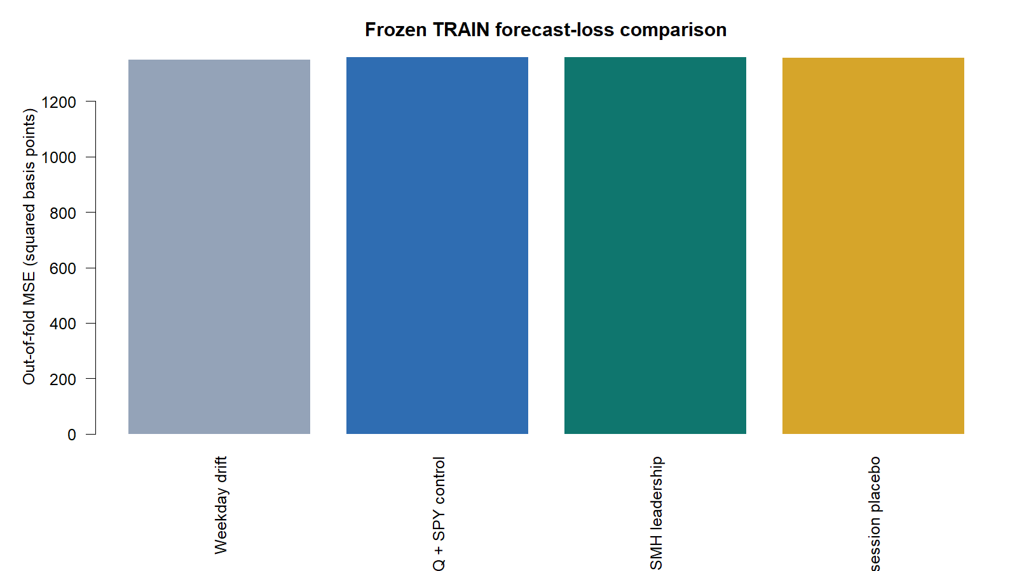
Adding SMH leadership did not improve frozen forecast loss
FALSIFICATION
LEADER MSE 1.360170e−05 versus 1.360170e−05 control; wrong-clock placebo was lower and bootstrap P(improvement) = 0.514.
24
Notes:
The LEADER model was effectively tied with its own-market control on MSE, slightly better on MAE, and worse than the prior-session wrong-clock placebo. A 2,000-replicate stationary bootstrap did not establish positive loss improvement.
[Sources]
- C:/Users/Franc/OneDrive/Documents/Francis/Peltata Project/Time-Series-Modeling-Gen5/runs/research_workbench/operator_hypothesis_lab/hyp_imom_03_1_smh_qqq_lead_lag_20260822/him031_train_model_metrics.csv
- C:/Users/Franc/OneDrive/Documents/Francis/Peltata Project/Time-Series-Modeling-Gen5/runs/research_workbench/operator_hypothesis_lab/hyp_imom_03_1_smh_qqq_lead_lag_20260822/him031_train_loss_improvement.csv
- C:/Users/Franc/OneDrive/Documents/Francis/Peltata Project/Time-Series-Modeling-Gen5/runs/research_workbench/operator_hypothesis_lab/hyp_imom_03_1_smh_qqq_lead_lag_20260822/him031_train_gates.csv
- C:/Users/Franc/OneDrive/Documents/Francis/Peltata Project/Time-Series-Modeling-Gen5/runs/research_workbench/operator_hypothesis_lab/hyp_imom_03_1_smh_qqq_lead_lag_20260822/visuals/him031_train_model_loss.png

Slide 25
SMH-to-QQQ lead-lag stopped before DEVELOPMENT
DECISION
The source and clock were valid; the proposed transmission mechanism was not.
Exact SMH/QQQ/SPY calendars supplied 751 TRAIN sessions and 503 expanding-fold scores.
Leadership beta was −0.00635; four of six TRAIN gates failed and the wrong-clock placebo was better.
2021–2022 DEVELOPMENT and 2023 confirmation remain unread; QQQ-S3 is next.
STOP: do not mine nearby clocks, swap semiconductor ETFs, condition on large moves, or invert the sign under this identifier.
25
Notes:
The implementation and data audit passed, but the proposed cross-asset lead-lag did not. Four of six frozen TRAIN gates failed, so neither DEVELOPMENT nor confirmation was constructed. The next authorized slate item is the daily QQQ-versus-SPY relative-trend question.
[Sources]
- C:/Users/Franc/OneDrive/Documents/Francis/Peltata Project/Time-Series-Modeling-Gen5/operator_hypothesis_lab/docs/HYP_IMOM_03_1_SMH_TO_QQQ_FIRST_HOUR_LEAD_LAG_RESULTS.md
- C:/Users/Franc/OneDrive/Documents/Francis/Peltata Project/Time-Series-Modeling-Gen5/runs/research_workbench/operator_hypothesis_lab/hyp_imom_03_1_smh_qqq_lead_lag_20260822/him031_train_decision.csv
- C:/Users/Franc/OneDrive/Documents/Francis/Peltata Project/Time-Series-Modeling-Gen5/literature_studies/docs/GEN5_QQQ_MINIMAL_HYPOTHESIS_SLATE.md
- C:/Users/Franc/OneDrive/Documents/Francis/Peltata Project/Time-Series-Modeling-Gen5/docs/GEN5_1_POC_PROGRESS_LOG.md

Slide 26
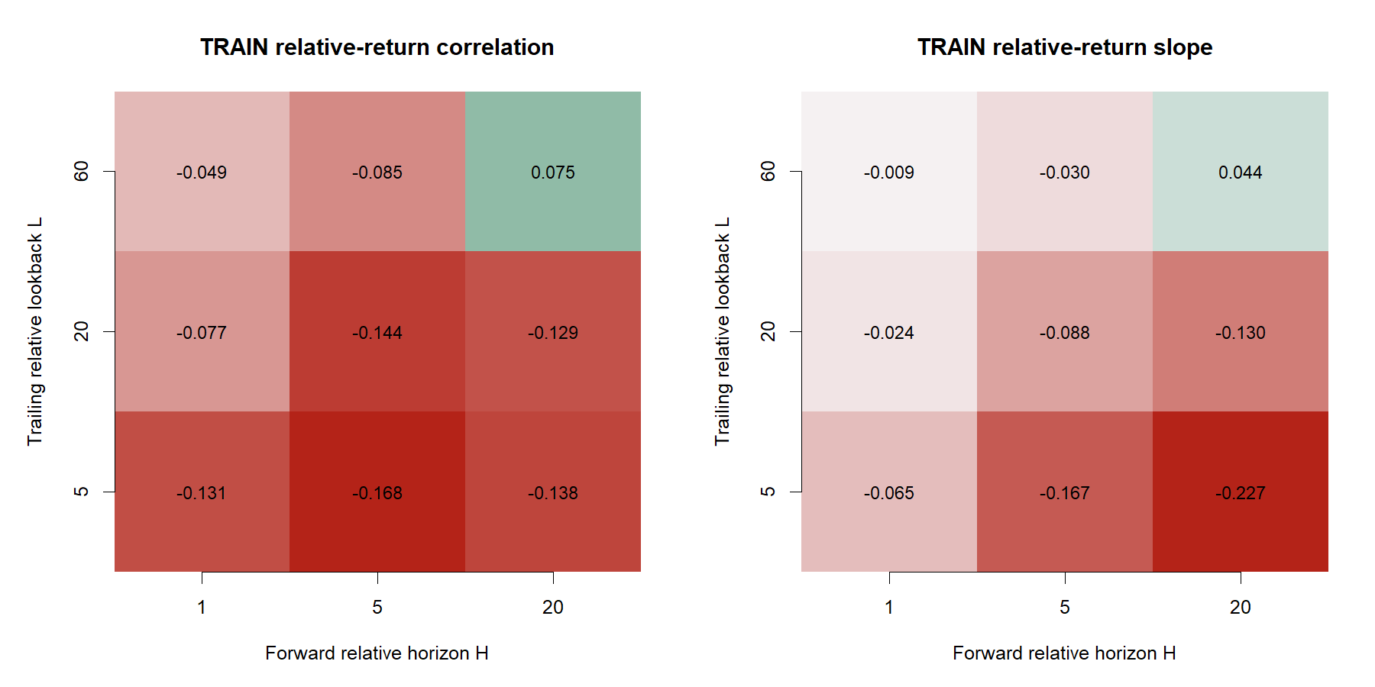
PHASE 6 · DAILY RELATIVE STYLE LEADERSHIP
Does QQQ leadership
over SPY persist?
Remove broad-market direction from predictor and target—then demand search-adjusted evidence.
HYP-MOM-08.1 · TRAIN ONLY · DEVELOPMENT SEALED
Notes:
This phase changes from same-session cross-asset transmission to daily style-relative continuation. Both predictor and target are QQQ return minus SPY return, so broad-market direction is removed by construction.
[Sources]
- C:/Users/Franc/OneDrive/Documents/Francis/Peltata Project/Time-Series-Modeling-Gen5/operator_hypothesis_lab/docs/HYP_MOM_08_1_QQQ_SPY_RELATIVE_STRENGTH_CONTRACT.md
- C:/Users/Franc/OneDrive/Documents/Francis/Peltata Project/Time-Series-Modeling-Gen5/runs/research_workbench/operator_hypothesis_lab/hyp_mom_08_1_qqq_spy_relative_strength_20260822/hm081_report.md
- C:/Users/Franc/OneDrive/Documents/Francis/Peltata Project/Time-Series-Modeling-Gen5/runs/research_workbench/operator_hypothesis_lab/hyp_mom_08_1_qqq_spy_relative_strength_20260822/visuals/hm081_train_surface.png

Slide 27
Eight of nine relative-strength cells pointed away from persistence
TRAIN
Only L60/H20 was positive: rho +0.0752 across 986 common anchors; every shorter cell was negative.
27
Notes:
The registered grid used lookbacks 5, 20, and 60 sessions and horizons 1, 5, and 20 sessions. Eight correlations and eight slopes were negative. The single positive correlation was the longest lookback and longest horizon.
[Sources]
- C:/Users/Franc/OneDrive/Documents/Francis/Peltata Project/Time-Series-Modeling-Gen5/runs/research_workbench/operator_hypothesis_lab/hyp_mom_08_1_qqq_spy_relative_strength_20260822/hm081_train_surface.csv
- C:/Users/Franc/OneDrive/Documents/Francis/Peltata Project/Time-Series-Modeling-Gen5/runs/research_workbench/operator_hypothesis_lab/hyp_mom_08_1_qqq_spy_relative_strength_20260822/hm081_train_coverage.csv
- C:/Users/Franc/OneDrive/Documents/Francis/Peltata Project/Time-Series-Modeling-Gen5/runs/research_workbench/operator_hypothesis_lab/hyp_mom_08_1_qqq_spy_relative_strength_20260822/visuals/hm081_train_surface.png

Slide 28
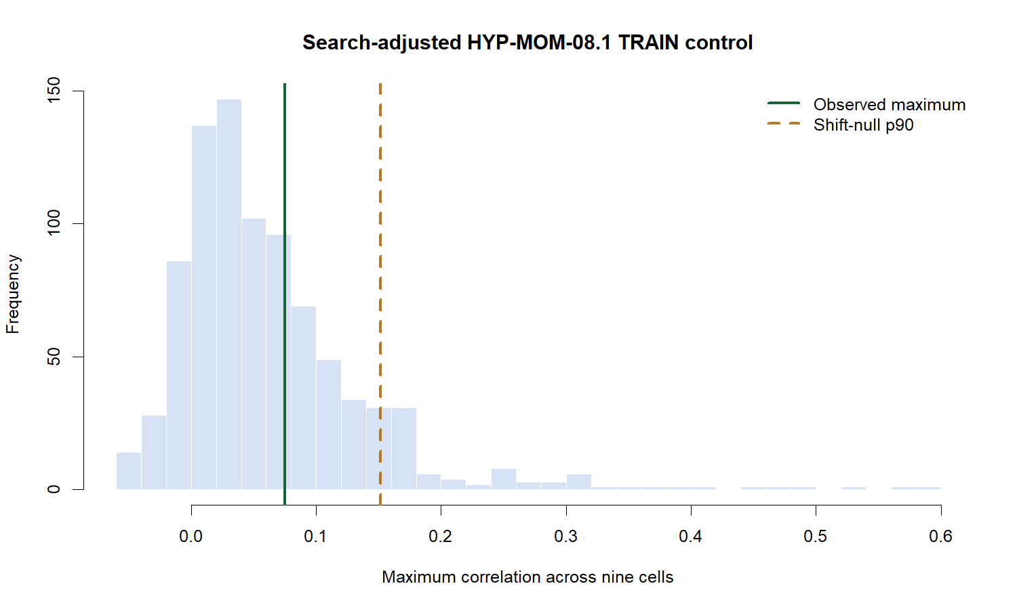
The lone positive cell missed the search-adjusted hurdle
FALSIFICATION
Observed maximum +0.0752 versus shift-null p90 +0.1514; empirical upper-tail probability was 0.321.
28
Notes:
Every eligible joint circular shift preserved the QQQ/SPY relative-return structure while displacing predictor from target by at least 60 sessions. Each shifted sample contributed its maximum across all nine cells, controlling the frozen search family.
[Sources]
- C:/Users/Franc/OneDrive/Documents/Francis/Peltata Project/Time-Series-Modeling-Gen5/runs/research_workbench/operator_hypothesis_lab/hyp_mom_08_1_qqq_spy_relative_strength_20260822/hm081_train_shift_maxima.csv
- C:/Users/Franc/OneDrive/Documents/Francis/Peltata Project/Time-Series-Modeling-Gen5/runs/research_workbench/operator_hypothesis_lab/hyp_mom_08_1_qqq_spy_relative_strength_20260822/hm081_train_decision.csv
- C:/Users/Franc/OneDrive/Documents/Francis/Peltata Project/Time-Series-Modeling-Gen5/runs/research_workbench/operator_hypothesis_lab/hyp_mom_08_1_qqq_spy_relative_strength_20260822/visuals/hm081_train_search_control.png

Slide 29
QQQ-versus-SPY persistence stopped before DEVELOPMENT
DECISION
Removing broad-market direction changed the question, but not the outcome.
QQQ and SPY supplied 1,259 exact adjusted-daily sessions and 986 common TRAIN anchors.
Eight of nine cells were negative; lone-positive L60/H20 missed the family-wise hurdle.
2021–2023 DEVELOPMENT and 2024–2025 confirmation remain unread; volume confirmation is next.
STOP: do not select L60/H20, invert wrong-sign cells, beta-residualize after inspection, or mine nearby windows.
29
Notes:
The historical source and exact requested range were valid. The health WARN reflects the intentionally bounded TRAIN query ending in 2020, not missing requested bars. The search-adjusted TRAIN rule failed, so DEVELOPMENT and confirmation were never constructed. QQQ-S5 volume-confirmed continuation is the next authorized slate item.
[Sources]
- C:/Users/Franc/OneDrive/Documents/Francis/Peltata Project/Time-Series-Modeling-Gen5/operator_hypothesis_lab/docs/HYP_MOM_08_1_QQQ_SPY_RELATIVE_STRENGTH_RESULTS.md
- C:/Users/Franc/OneDrive/Documents/Francis/Peltata Project/Time-Series-Modeling-Gen5/runs/research_workbench/operator_hypothesis_lab/hyp_mom_08_1_qqq_spy_relative_strength_20260822/hm081_train_decision.csv
- C:/Users/Franc/OneDrive/Documents/Francis/Peltata Project/Time-Series-Modeling-Gen5/literature_studies/docs/GEN5_QQQ_MINIMAL_HYPOTHESIS_SLATE.md
- C:/Users/Franc/OneDrive/Documents/Francis/Peltata Project/Time-Series-Modeling-Gen5/docs/GEN5_1_POC_PROGRESS_LOG.md

Slide 30
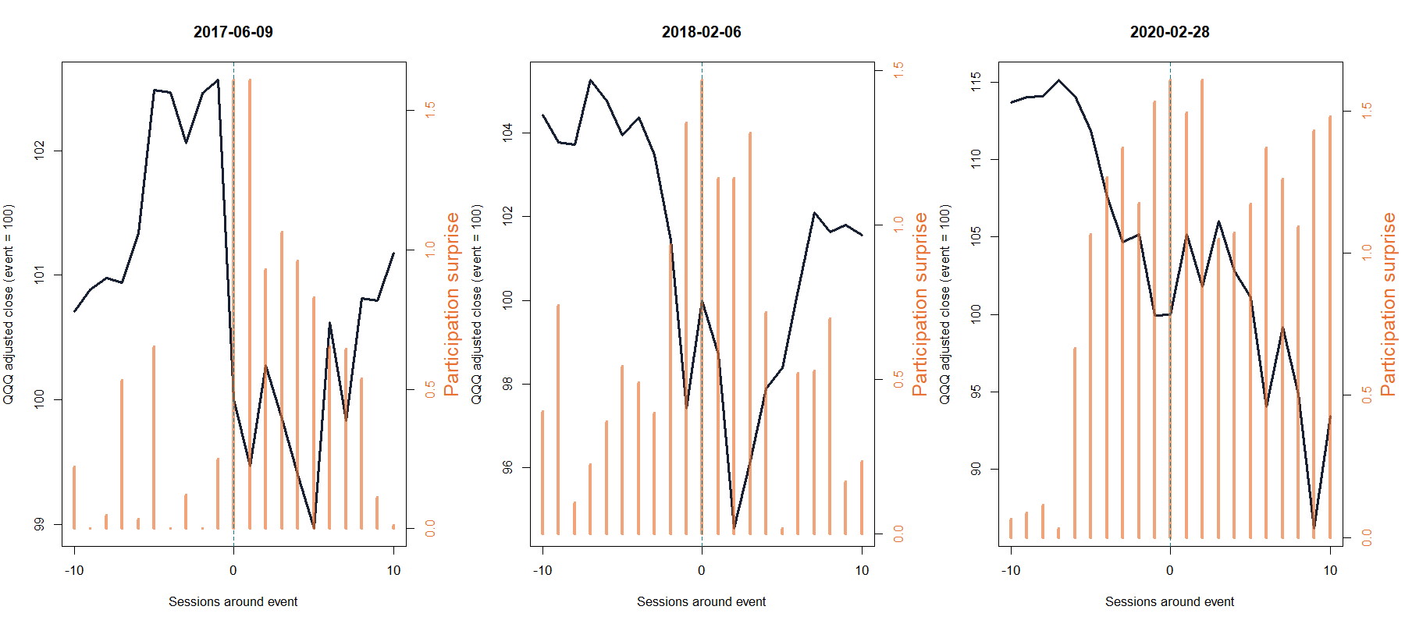
PHASE 7 · PARTICIPATION-CONDITIONED CONTINUATION
Does heavy QQQ participation
confirm continuation?
Condition recent return on a causal dollar-volume surprise—then require incremental, search-adjusted evidence.
HYP-MOM-09.1 · TRAIN ONLY · DEVELOPMENT SEALED
Notes:
This phase changes from relative style leadership to participation-conditioned own-return continuation. The event panels show representative high-participation episodes; they are behavioral context, not selected targets or strategy examples.
[Sources]
- C:/Users/Franc/OneDrive/Documents/Francis/Peltata Project/Time-Series-Modeling-Gen5/operator_hypothesis_lab/docs/HYP_MOM_09_1_QQQ_VOLUME_CONFIRMED_CONTINUATION_CONTRACT.md
- C:/Users/Franc/OneDrive/Documents/Francis/Peltata Project/Time-Series-Modeling-Gen5/runs/research_workbench/operator_hypothesis_lab/hyp_mom_09_1_qqq_volume_confirmed_continuation_20260822/hm091_train_participation_audit.csv
- C:/Users/Franc/OneDrive/Documents/Francis/Peltata Project/Time-Series-Modeling-Gen5/runs/research_workbench/operator_hypothesis_lab/hyp_mom_09_1_qqq_volume_confirmed_continuation_20260822/visuals/hm091_train_participation_events.png

Slide 31
The interaction was defined before outcomes were read
HYP-MOM-09.1 · DESIGN
Compare adjusted dollar volume with the median of the strictly prior 60 sessions. Ask whether participation changes the forward content of signed QQQ return after return, volume surprise, and move size are controlled.
Pₜ = clip₊[log(DVₜ / median(DVₜ₋₆₀:ₜ₋₁))], cap log(5)
Iᴸₜ = Rᴸₜ × mean(Pₜ₋ᴸ₊₁:ₜ)
Yᴴₜ = log(openₜ₊₁₊ᴴ / openₜ₊₁)
TRAIN 2017–2020 · L,H ∈ {1,5,20} · partial interaction correlation · 867 joint shifts · 2021+ sealed
31
Notes:
The current date is excluded from its own 60-session dollar-volume reference. The registered interaction must add information after intercept, signed return, positive participation surprise, and absolute return are removed. Targets start at the next open.
[Sources]
- C:/Users/Franc/OneDrive/Documents/Francis/Peltata Project/Time-Series-Modeling-Gen5/operator_hypothesis_lab/docs/HYP_MOM_09_1_QQQ_VOLUME_CONFIRMED_CONTINUATION_CONTRACT.md
- C:/Users/Franc/OneDrive/Documents/Francis/Peltata Project/Time-Series-Modeling-Gen5/runs/research_workbench/operator_hypothesis_lab/hyp_mom_09_1_qqq_volume_confirmed_continuation_20260822/hm091_frozen_contract.csv

Slide 32
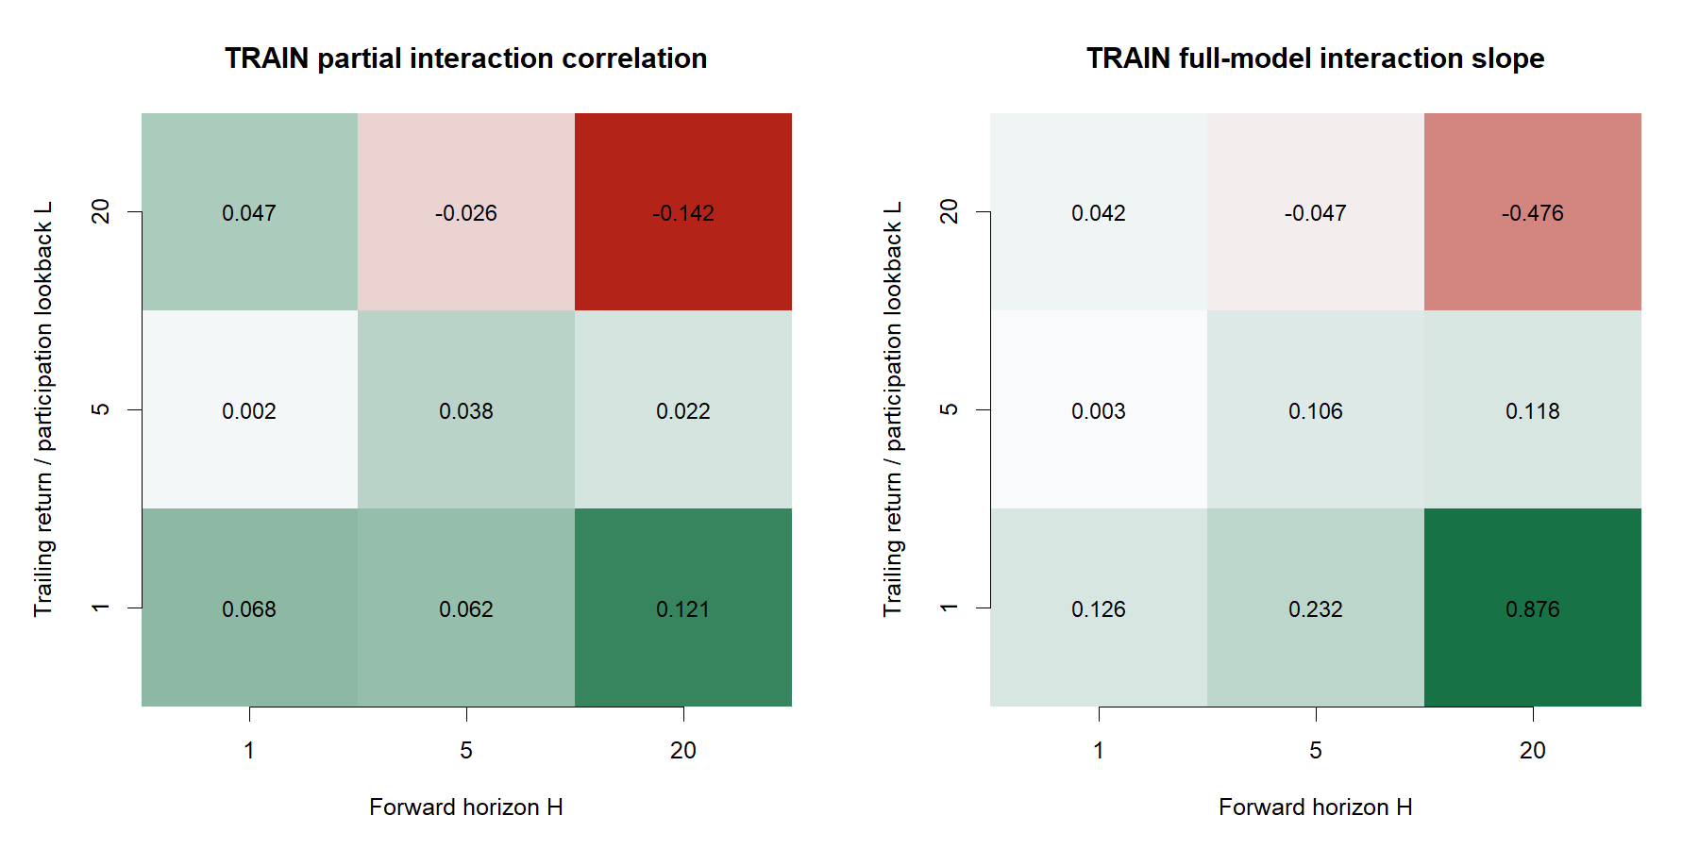
The interaction peak was isolated, not stable
TRAIN
Best L1/H20 partial rho +0.1205; L20/H20 was −0.1420 across the same 986 anchors.
32
Notes:
The registered grid crossed return and participation lookbacks 1, 5, and 20 sessions with forward horizons 1, 5, and 20. The maximum positive cell used the shortest lookback and longest horizon, while the longest-longest cell was materially negative.
[Sources]
- C:/Users/Franc/OneDrive/Documents/Francis/Peltata Project/Time-Series-Modeling-Gen5/runs/research_workbench/operator_hypothesis_lab/hyp_mom_09_1_qqq_volume_confirmed_continuation_20260822/hm091_train_surface.csv
- C:/Users/Franc/OneDrive/Documents/Francis/Peltata Project/Time-Series-Modeling-Gen5/runs/research_workbench/operator_hypothesis_lab/hyp_mom_09_1_qqq_volume_confirmed_continuation_20260822/hm091_train_coverage.csv
- C:/Users/Franc/OneDrive/Documents/Francis/Peltata Project/Time-Series-Modeling-Gen5/runs/research_workbench/operator_hypothesis_lab/hyp_mom_09_1_qqq_volume_confirmed_continuation_20260822/visuals/hm091_train_surface.png

Slide 33
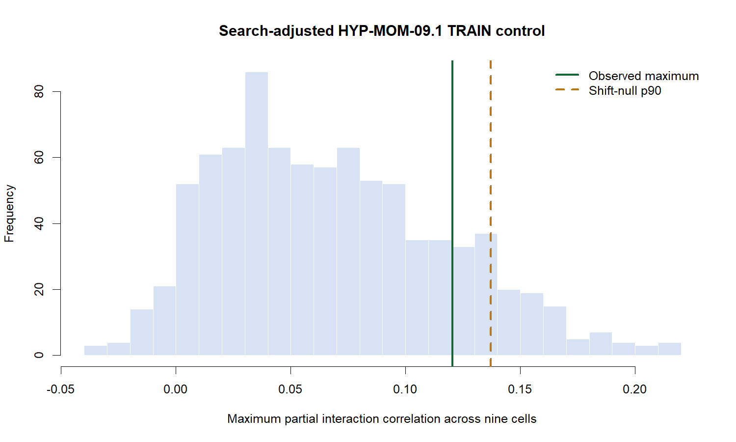
The best interaction still missed the search-adjusted hurdle
FALSIFICATION
Observed maximum +0.1205 versus shift-null p90 +0.1372; empirical upper-tail probability was 0.167.
33
Notes:
Every admissible joint circular shift displaced the three target horizons from the feature rows by at least 60 anchors. Each shift contributed its maximum across all nine cells, preserving the full registered search family. The observed peak did not clear the p90 threshold.
[Sources]
- C:/Users/Franc/OneDrive/Documents/Francis/Peltata Project/Time-Series-Modeling-Gen5/runs/research_workbench/operator_hypothesis_lab/hyp_mom_09_1_qqq_volume_confirmed_continuation_20260822/hm091_train_shift_maxima.csv
- C:/Users/Franc/OneDrive/Documents/Francis/Peltata Project/Time-Series-Modeling-Gen5/runs/research_workbench/operator_hypothesis_lab/hyp_mom_09_1_qqq_volume_confirmed_continuation_20260822/hm091_train_decision.csv
- C:/Users/Franc/OneDrive/Documents/Francis/Peltata Project/Time-Series-Modeling-Gen5/runs/research_workbench/operator_hypothesis_lab/hyp_mom_09_1_qqq_volume_confirmed_continuation_20260822/visuals/hm091_train_search_control.png

Slide 34
Volume-confirmed continuation stopped before DEVELOPMENT
DECISION
Participation changed the model, but not enough to earn later evidence.
QQQ supplied 1,259 adjusted-daily sessions; all 8 source gates passed and 986 TRAIN anchors were common.
Best L1/H20 partial rho +0.1205 missed p90 +0.1372, so no cell earned nomination.
2021–2023 DEVELOPMENT and 2024–2025 confirmation remain unread; QQQ breadth still needs point-in-time membership.
STOP: do not swap volume definitions, threshold big moves, condition on positive days, change assets, or mine nearby windows.
34
Notes:
The historical-range health WARN was harmless because every requested session through 2020 was already cached. The frozen TRAIN gate failed, so no nominee, DEVELOPMENT calculation, strategy result, or confirmation read exists. QQQ breadth remains distinct but data-authority constrained.
[Sources]
- C:/Users/Franc/OneDrive/Documents/Francis/Peltata Project/Time-Series-Modeling-Gen5/operator_hypothesis_lab/docs/HYP_MOM_09_1_QQQ_VOLUME_CONFIRMED_CONTINUATION_RESULTS.md
- C:/Users/Franc/OneDrive/Documents/Francis/Peltata Project/Time-Series-Modeling-Gen5/runs/research_workbench/operator_hypothesis_lab/hyp_mom_09_1_qqq_volume_confirmed_continuation_20260822/hm091_report.md
- C:/Users/Franc/OneDrive/Documents/Francis/Peltata Project/Time-Series-Modeling-Gen5/literature_studies/docs/GEN5_QQQ_MINIMAL_HYPOTHESIS_SLATE.md
- C:/Users/Franc/OneDrive/Documents/Francis/Peltata Project/Time-Series-Modeling-Gen5/docs/GEN5_1_POC_PROGRESS_LOG.md

Slide 35
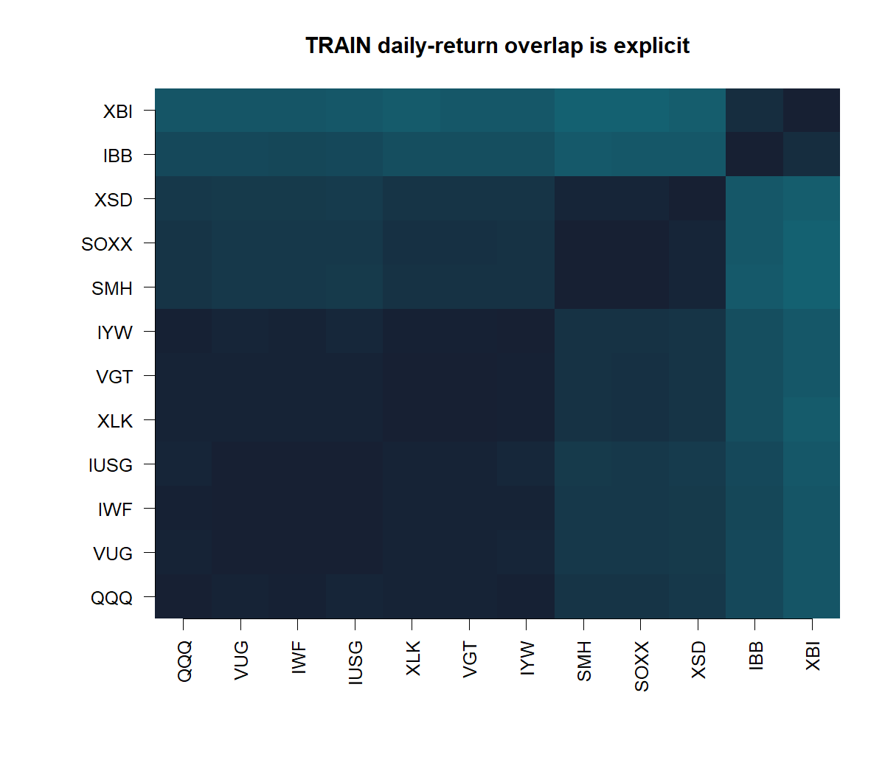
PHASE 8 · CROSS-SECTIONAL ETF LEADERSHIP
Do relative ETF leaders
keep leading?
Rank a frozen 12-fund growth/technology basket after removing its same-date common return—and expose overlap explicitly.
HYP-MOM-10.1 · TRAIN ONLY · DEVELOPMENT SEALED
Notes:
[Sources]
- operator_hypothesis_lab/docs/HYP_MOM_10_1_QQQ_ADJACENT_ETF_CROSS_SECTIONAL_MOMENTUM_RESULTS.md
- runs/research_workbench/operator_hypothesis_lab/hyp_mom_10_1_qqq_adjacent_etf_cross_sectional_momentum_20260822/visuals/hm101_train_overlap.png

Slide 36
The rank question was frozen before outcomes were read
HYP-MOM-10.1 · DESIGN
Rank each ETF by trailing return after subtracting the basket's same-date common return. Ask whether that ordering predicts next-open-to-later-open relative return without treating overlapping funds as independent evidence.
Xⱼ,ₜ,ᴸ = Rⱼ,ₜ,ᴸ − meanⱼ(Rⱼ,ₜ,ᴸ)
Yⱼ,ₜ,ᴴ = Fⱼ,ₜ,ᴴ − meanⱼ(Fⱼ,ₜ,ᴴ)
RANK IC → TOP 3 − BOTTOM 3 → LEAVE ONE SLEEVE OUT
TRAIN 2017–2020 · L ∈ {5,20,60} · H ∈ {1,5,20} · 867 joint shifts · 2021+ sealed
36
Notes:
[Sources]
- operator_hypothesis_lab/docs/HYP_MOM_10_1_QQQ_ADJACENT_ETF_CROSS_SECTIONAL_MOMENTUM_CONTRACT.md

Slide 37
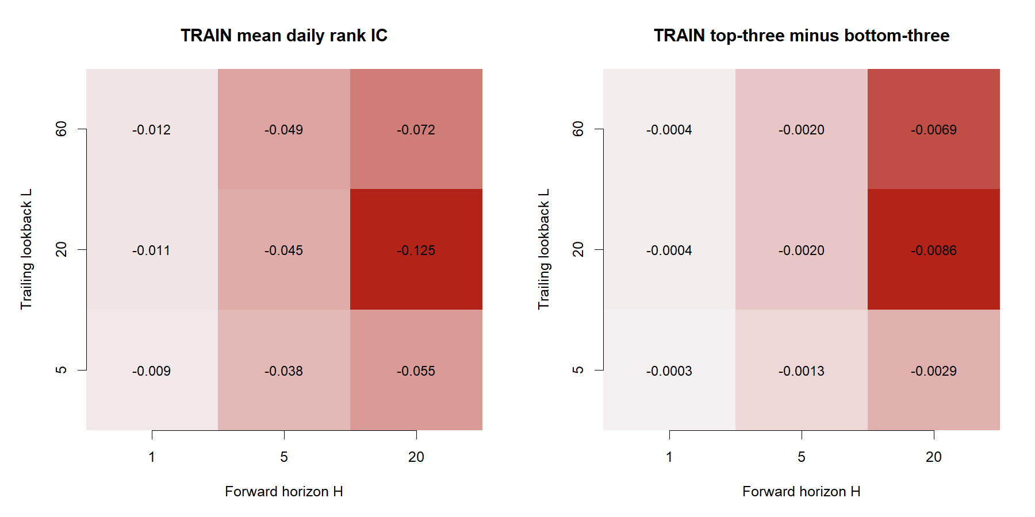
Every registered relative-leadership cell was negative
TRAIN
Best L5/H1 mean rank IC −0.0093; L20/H20 was −0.1246 across the same 986 dates.
37
Notes:
[Sources]
- operator_hypothesis_lab/docs/HYP_MOM_10_1_QQQ_ADJACENT_ETF_CROSS_SECTIONAL_MOMENTUM_RESULTS.md
- runs/research_workbench/operator_hypothesis_lab/hyp_mom_10_1_qqq_adjacent_etf_cross_sectional_momentum_20260822/visuals/hm101_train_surface.png

Slide 38
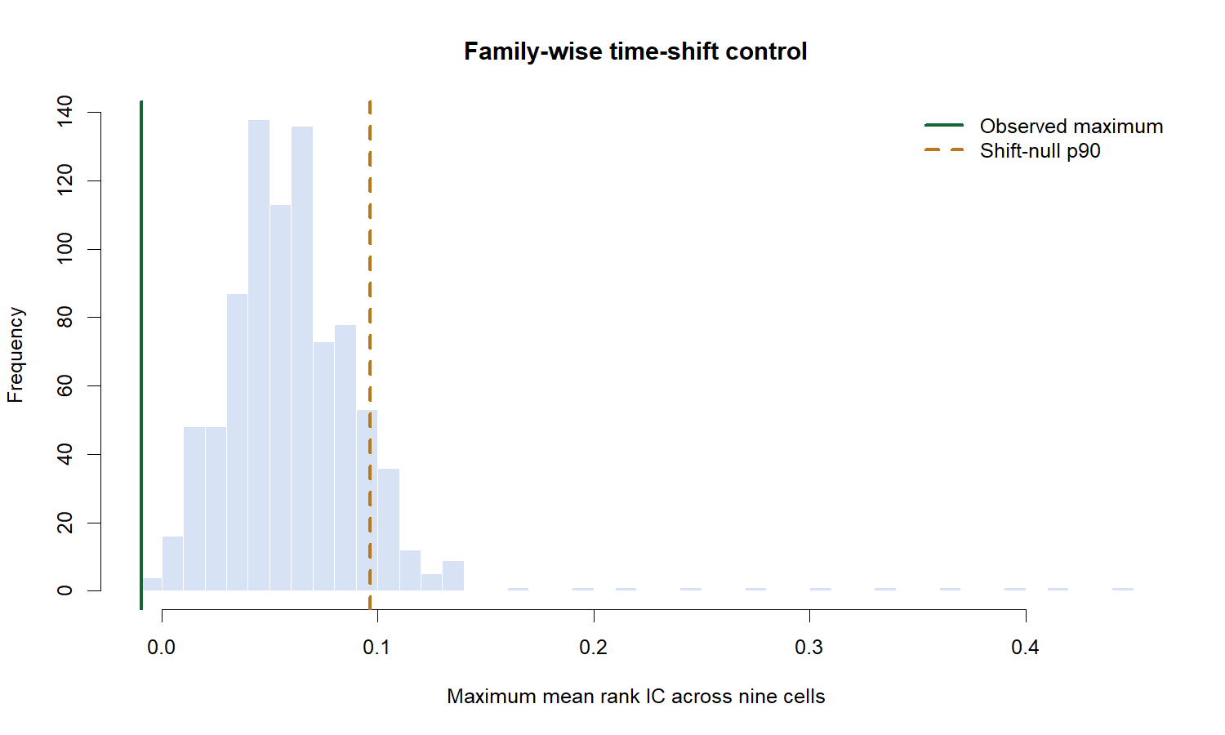
The best cell sat below every search-adjusted hurdle
FALSIFICATION
Observed maximum −0.0093 versus shift-null p90 +0.0966; randomized-rank upper-tail probability was 0.944.
38
Notes:
[Sources]
- operator_hypothesis_lab/docs/HYP_MOM_10_1_QQQ_ADJACENT_ETF_CROSS_SECTIONAL_MOMENTUM_RESULTS.md
- runs/research_workbench/operator_hypothesis_lab/hyp_mom_10_1_qqq_adjacent_etf_cross_sectional_momentum_20260822/visuals/hm101_train_search_control.png

Slide 39
Cross-sectional ETF continuation stopped before DEVELOPMENT
DECISION
The basket was valid; relative continuation was not.
Twelve frozen ETFs supplied 1,259 TRAIN sessions and 986 common anchor dates; all integrity gates passed.
All nine rank ICs and top-minus-bottom orderings were negative; mean pairwise daily-return correlation was 0.866.
2021–2023 DEVELOPMENT and 2024–2025 confirmation remain unread; QQQ breadth still needs point-in-time membership.
STOP: do not invert the sign, drop weak sleeves, swap ETFs, mine nearby horizons, or call correlated funds independent evidence.
39
Notes:
[Sources]
- operator_hypothesis_lab/docs/HYP_MOM_10_1_QQQ_ADJACENT_ETF_CROSS_SECTIONAL_MOMENTUM_RESULTS.md
- runs/research_workbench/operator_hypothesis_lab/hyp_mom_10_1_qqq_adjacent_etf_cross_sectional_momentum_20260822/hm101_report.md

Slide 40
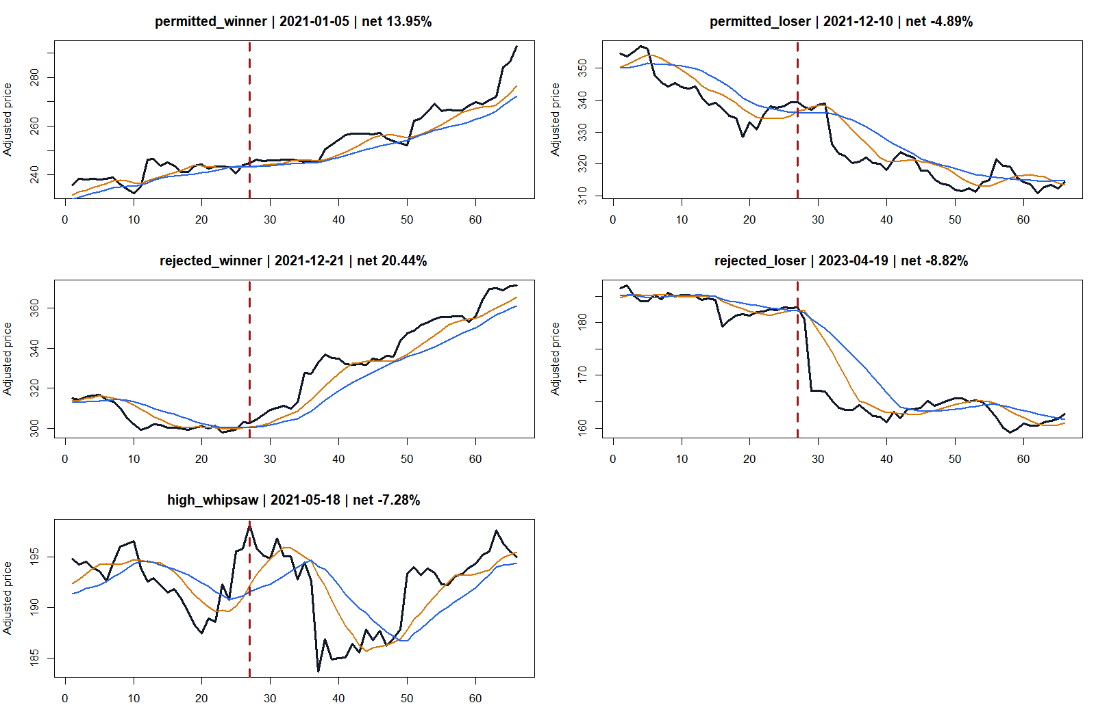
PHASE 9 · CONDITIONAL INTRADAY PERMISSION
Can a simple model
permit the right crosses?
Keep TSLA's 30-minute SMA8/SMA14 entries and exits fixed—then ask which completed crosses can survive costs.
HYP-IMOM-04.1 · OUTCOME-AWARE CALIBRATION · 2024+ SEALED
Notes:
TSLA was an acknowledged remembered winner from the earlier intraday study, so this phase is explicitly outcome-aware calibration. The trade panels show why a remembered asset-level winner is not the same thing as a known feature-level permission mechanism.
[Sources]
- C:/Users/Franc/OneDrive/Documents/Francis/Peltata Project/Time-Series-Modeling-Gen5/operator_hypothesis_lab/docs/HYP_IMOM_04_1_TSLA_30MIN_SMA_PERMISSION_POSITIVE_CONTROL_RESULTS.md
- C:/Users/Franc/OneDrive/Documents/Francis/Peltata Project/Time-Series-Modeling-Gen5/runs/research_workbench/operator_hypothesis_lab/hyp_imom_04_1_tsla_30min_sma_permission_positive_control_20260823/visuals/him041_representative_trade_tapes.png

Slide 41
One ledger carried six features and three fixed gates
HYP-IMOM-04.1 · CAL-A01 DESIGN
Every fresh parent crossover kept its original next-bar entry, exit, and costs. Completed-bar features could suppress an entry, but never create a new one or change the parent trade.
T trend · V ATR% · I impulse
W whipsaw · P participation · M market
T∧V · I∧W · T∧P
727 parent events · 637 complete-feature events · 12 expanding quarters · 200 random permissions · 200 familywise session shifts · 2024+ sealed
41
Notes:
All nine candidates shared one complete-case event ledger. Monotone thresholds were fitted inside expanding TRAIN data only. The familywise control compared the observed winner with the best of all nine variants in each shifted world.
[Sources]
- C:/Users/Franc/OneDrive/Documents/Francis/Peltata Project/Time-Series-Modeling-Gen5/operator_hypothesis_lab/docs/HYP_IMOM_04_1_TSLA_30MIN_SMA_PERMISSION_POSITIVE_CONTROL_PLAN.md
- C:/Users/Franc/OneDrive/Documents/Francis/Peltata Project/Time-Series-Modeling-Gen5/runs/research_workbench/operator_hypothesis_lab/hyp_imom_04_1_tsla_30min_sma_permission_positive_control_20260823/him041_run_spec.csv

Slide 42
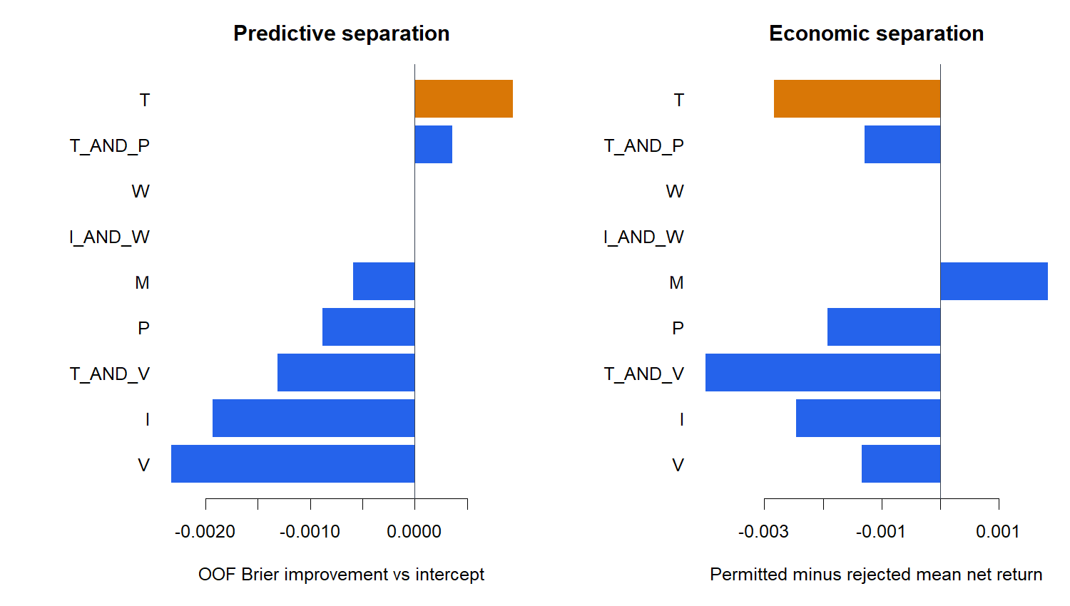
The engine recovered all nine plants; TSLA did not separate
SYNTHETIC PASS · MARKET STOP
Synthetic recovery 9/9. Nominal T Brier gain +0.000943; permitted mean +0.028% versus +0.312% when rejected.
42
Notes:
The synthetic suite established that the implementation could recover each registered univariate and interaction mechanism. In TSLA, prior-day trend was the nominal proper-score winner, but it selected economically weaker trades.
[Sources]
- C:/Users/Franc/OneDrive/Documents/Francis/Peltata Project/Time-Series-Modeling-Gen5/operator_hypothesis_lab/docs/HYP_IMOM_04_1_TSLA_30MIN_SMA_PERMISSION_POSITIVE_CONTROL_RESULTS.md
- C:/Users/Franc/OneDrive/Documents/Francis/Peltata Project/Time-Series-Modeling-Gen5/runs/research_workbench/operator_hypothesis_lab/hyp_imom_04_1_tsla_30min_sma_permission_positive_control_20260823/him041_synthetic_recovery.csv
- C:/Users/Franc/OneDrive/Documents/Francis/Peltata Project/Time-Series-Modeling-Gen5/runs/research_workbench/operator_hypothesis_lab/hyp_imom_04_1_tsla_30min_sma_permission_positive_control_20260823/him041_model_metrics.csv
- C:/Users/Franc/OneDrive/Documents/Francis/Peltata Project/Time-Series-Modeling-Gen5/runs/research_workbench/operator_hypothesis_lab/hyp_imom_04_1_tsla_30min_sma_permission_positive_control_20260823/visuals/him041_feature_atlas.png

Slide 43
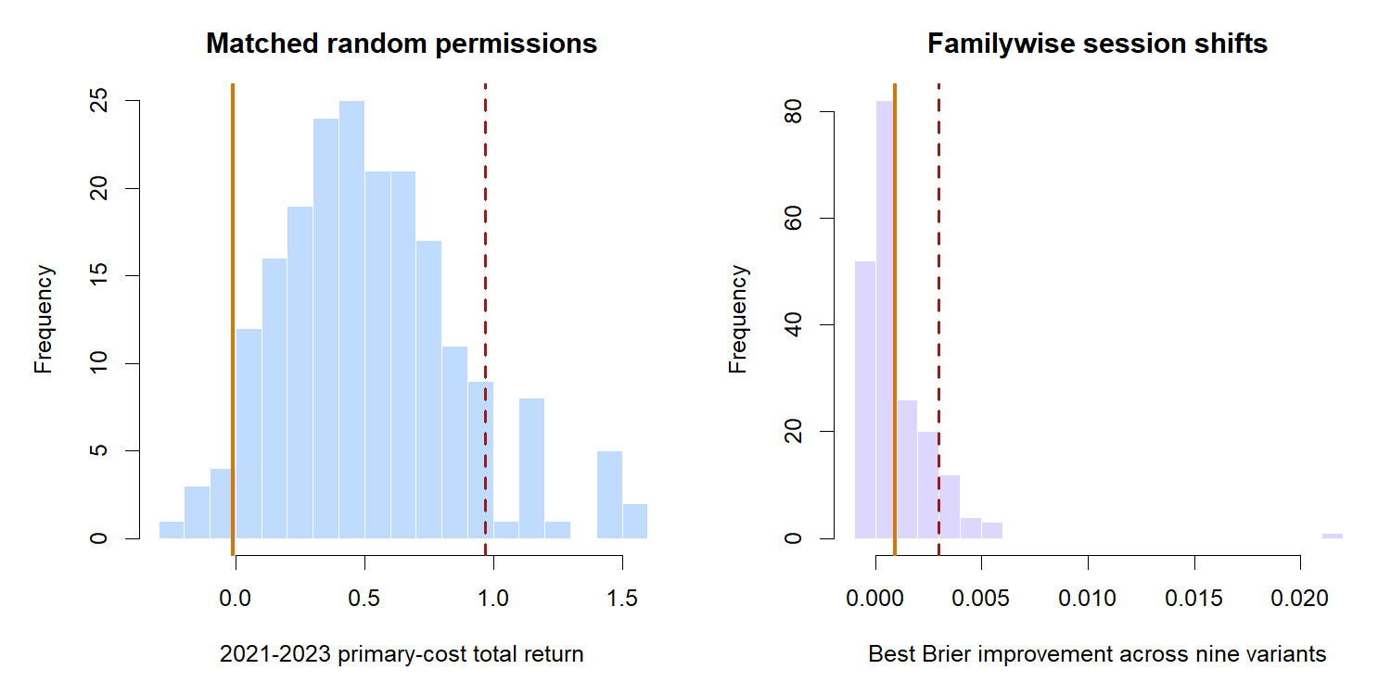
The nominal winner was ordinary under falsification
MULTIPLICITY
Selected return −1.19% ranked at 3.5% of matched random permissions; Brier gain ranked at 66.5% of familywise shifts.
43
Notes:
The left control asks whether any equally sparse random subset of parent trades would have done better. The right control refits all nine variants after session shifts and records the best Brier improvement in each shifted world.
[Sources]
- C:/Users/Franc/OneDrive/Documents/Francis/Peltata Project/Time-Series-Modeling-Gen5/operator_hypothesis_lab/docs/HYP_IMOM_04_1_TSLA_30MIN_SMA_PERMISSION_POSITIVE_CONTROL_RESULTS.md
- C:/Users/Franc/OneDrive/Documents/Francis/Peltata Project/Time-Series-Modeling-Gen5/runs/research_workbench/operator_hypothesis_lab/hyp_imom_04_1_tsla_30min_sma_permission_positive_control_20260823/him041_matched_random_permission_controls.csv
- C:/Users/Franc/OneDrive/Documents/Francis/Peltata Project/Time-Series-Modeling-Gen5/runs/research_workbench/operator_hypothesis_lab/hyp_imom_04_1_tsla_30min_sma_permission_positive_control_20260823/him041_familywise_session_shift_controls.csv
- C:/Users/Franc/OneDrive/Documents/Francis/Peltata Project/Time-Series-Modeling-Gen5/runs/research_workbench/operator_hypothesis_lab/hyp_imom_04_1_tsla_30min_sma_permission_positive_control_20260823/visuals/him041_falsification_controls.png

Slide 44
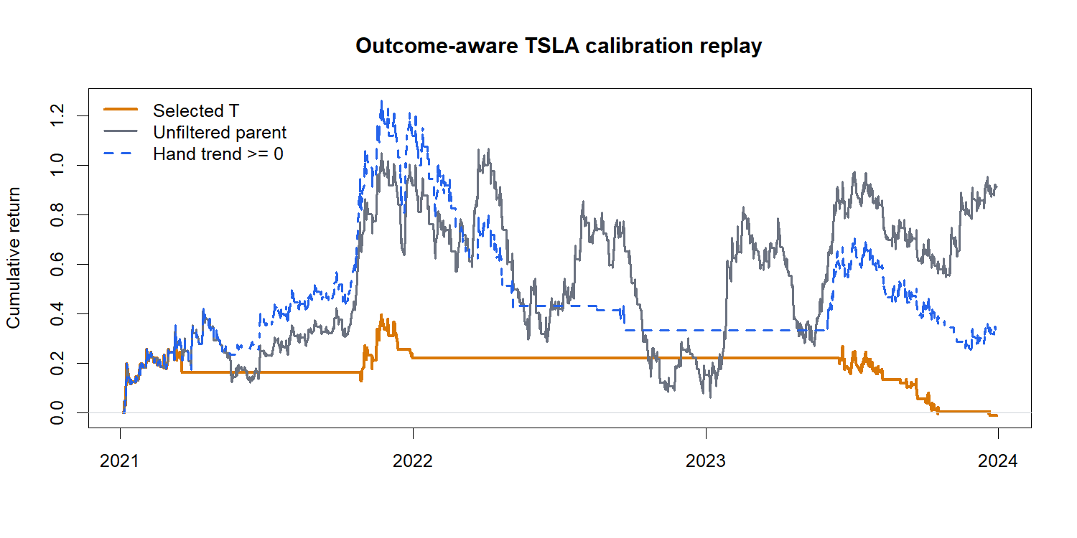
Filtering reduced turnover—and removed the profitable exposure
POLICY REPLAY
2021–2023 at 10 bp/side: selected T −1.19%, hand trend gate +34.00%, unfiltered TSLA parent +91.32%.
44
Notes:
The selected model cut exposure to 9.6% and mean annual turnover to 48.4x, but its gross gain of 14.1% became a loss after primary costs. The unchanged parent was unusually profitable in this reused period, yet the feature model removed rather than concentrated that profitable exposure.
[Sources]
- C:/Users/Franc/OneDrive/Documents/Francis/Peltata Project/Time-Series-Modeling-Gen5/operator_hypothesis_lab/docs/HYP_IMOM_04_1_TSLA_30MIN_SMA_PERMISSION_POSITIVE_CONTROL_RESULTS.md
- C:/Users/Franc/OneDrive/Documents/Francis/Peltata Project/Time-Series-Modeling-Gen5/runs/research_workbench/operator_hypothesis_lab/hyp_imom_04_1_tsla_30min_sma_permission_positive_control_20260823/him041_policy_summary.csv
- C:/Users/Franc/OneDrive/Documents/Francis/Peltata Project/Time-Series-Modeling-Gen5/runs/research_workbench/operator_hypothesis_lab/hyp_imom_04_1_tsla_30min_sma_permission_positive_control_20260823/visuals/him041_policy_equity_curves.png

Slide 45
TSLA permission stopped before fresh transport
DECISION
The engine was valid; the market permission mechanism was not.
All 727 parent events reproduced exactly; every one of the nine planted synthetic mechanisms was recovered.
T improved OOF Brier by 0.000943 but missed familywise p90, retained 20.1%, and selected weaker trades.
Only 3/8 calibration gates passed; 2024+ remains unread. Any new outcome-aware attempt becomes CAL-A02.
STOP: do not change feature windows, directions, thresholds, combinations, labels, costs, or open 2024+ under CAL-A01.
45
Notes:
CAL-A01 ends with a synthetic-engine PASS and a TSLA market-calibration STOP. This result does not authorize fresh transport. Any further iteration must be separately logged as CAL-A02 and remain explicitly outcome-aware.
[Sources]
- C:/Users/Franc/OneDrive/Documents/Francis/Peltata Project/Time-Series-Modeling-Gen5/operator_hypothesis_lab/docs/HYP_IMOM_04_1_TSLA_30MIN_SMA_PERMISSION_POSITIVE_CONTROL_RESULTS.md
- C:/Users/Franc/OneDrive/Documents/Francis/Peltata Project/Time-Series-Modeling-Gen5/runs/research_workbench/operator_hypothesis_lab/hyp_imom_04_1_tsla_30min_sma_permission_positive_control_20260823/him041_calibration_gates.csv
- C:/Users/Franc/OneDrive/Documents/Francis/Peltata Project/Time-Series-Modeling-Gen5/docs/GEN5_1_POC_PROGRESS_LOG.md

Slide 46
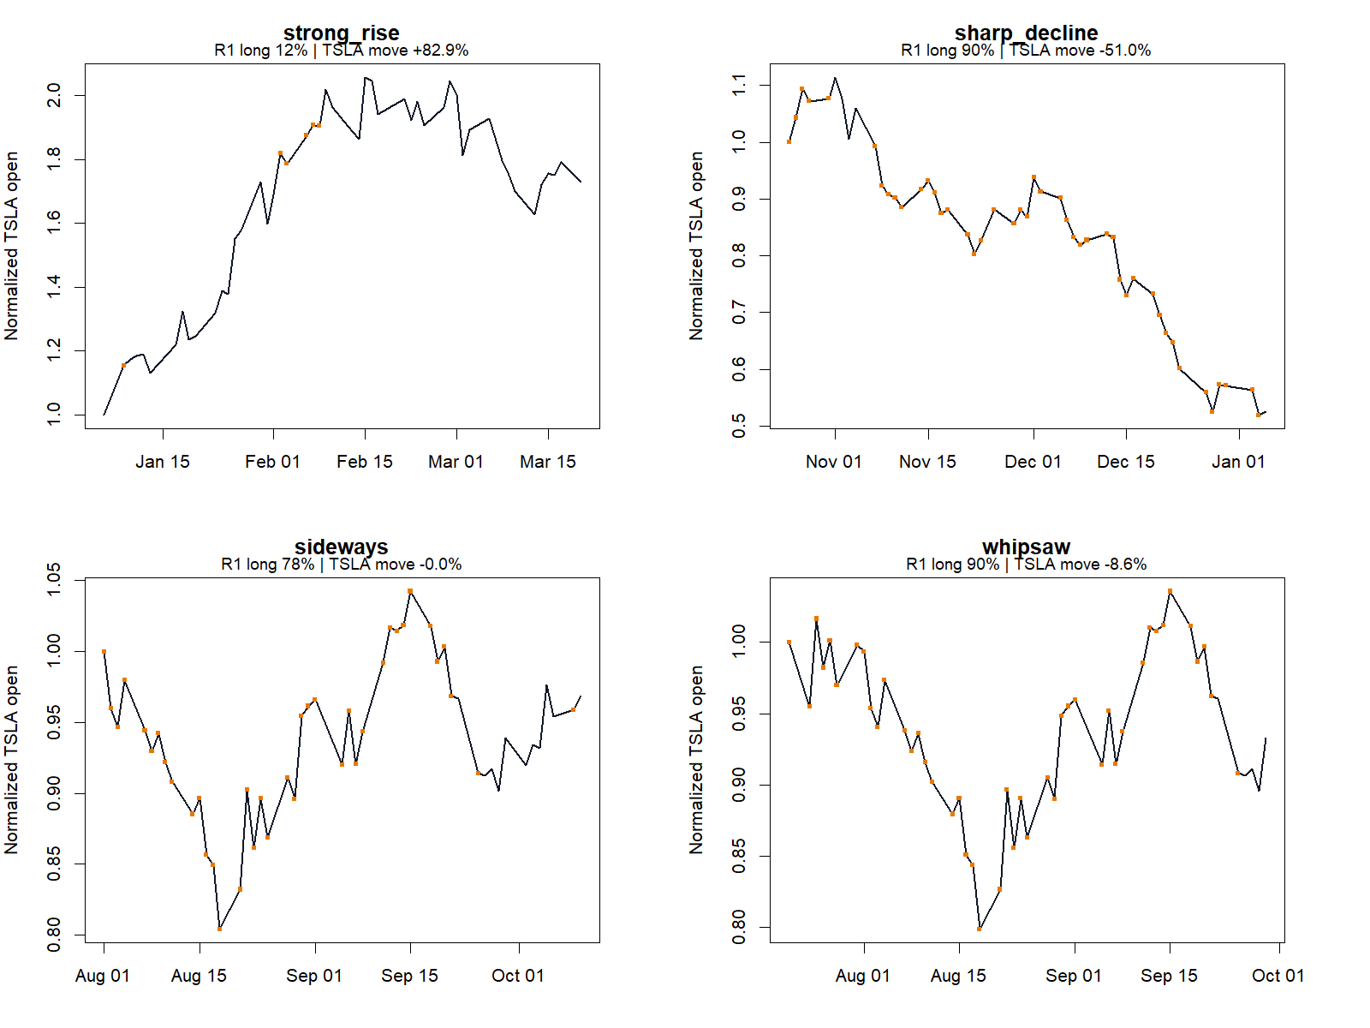
PHASE 10 · DIRECT INTRADAY EXPOSURE
Can state features hold TSLA
only when it helps?
Completed-session features choose the next open-to-open long/cash state—without requiring a crossover event.
HYP-IMOM-04.1 · CAL-A02 · 2024+ SEALED
Notes:
CAL-A02 tests the user's desired action pattern directly: hold TSLA during favorable states and otherwise remain in cash. The representative tapes expose where the learned state did and did not align with price behavior.
[Sources]
- C:/Users/Franc/OneDrive/Documents/Francis/Peltata Project/Time-Series-Modeling-Gen5/operator_hypothesis_lab/docs/HYP_IMOM_04_1_CAL_A02_TSLA_DIRECT_EXPOSURE_RESULTS.md
- C:/Users/Franc/OneDrive/Documents/Francis/Peltata Project/Time-Series-Modeling-Gen5/runs/research_workbench/operator_hypothesis_lab/hyp_imom_04_1_cal_a02_tsla_direct_exposure_20260823/visuals/him042_representative_exposure_tapes.png

Slide 47
Direct exposure removed the crossover action constraint
HYP-IMOM-04.1 · CAL-A02 DESIGN
Completed session t features set the position at the next open. The target is the following open-to-open log return; consecutive long decisions stay invested and pay costs only on transitions.
Trend · path quality · volatility quality
Participation · QQQ/SMH confirmation
R1 ridge primary · T1 depth-two diagnostic
1,380 sessions · 746 OOF · 12 quarters · 200 target shifts · 200 matched permissions · 2024+ sealed
47
Notes:
R1 is the prespecified primary model with TRAIN-only standardization and chronological lambda selection. T1 is a prespecified shallow diagnostic, but CAL-A02 did not register separate tree-specific policy-inference gates.
[Sources]
- C:/Users/Franc/OneDrive/Documents/Francis/Peltata Project/Time-Series-Modeling-Gen5/operator_hypothesis_lab/docs/HYP_IMOM_04_1_CAL_A02_TSLA_DIRECT_EXPOSURE_PLAN.md
- C:/Users/Franc/OneDrive/Documents/Francis/Peltata Project/Time-Series-Modeling-Gen5/runs/research_workbench/operator_hypothesis_lab/hyp_imom_04_1_cal_a02_tsla_direct_exposure_20260823/him042_run_spec.csv

Slide 48
The ridge captured upside and downside almost equally
CAPTURE
R1 held 72.1% of intervals: 71.8% upside capture and 72.2% downside capture. The desired upper-left region remained empty.
48
Notes:
The primary policy was active often enough to capture most upside, but it was not selective: it also captured nearly the same share of downside. The oracle confirms the accounting and policy engine can express the intended upper-left behavior.
[Sources]
- C:/Users/Franc/OneDrive/Documents/Francis/Peltata Project/Time-Series-Modeling-Gen5/operator_hypothesis_lab/docs/HYP_IMOM_04_1_CAL_A02_TSLA_DIRECT_EXPOSURE_RESULTS.md
- C:/Users/Franc/OneDrive/Documents/Francis/Peltata Project/Time-Series-Modeling-Gen5/runs/research_workbench/operator_hypothesis_lab/hyp_imom_04_1_cal_a02_tsla_direct_exposure_20260823/him042_policy_summary.csv
- C:/Users/Franc/OneDrive/Documents/Francis/Peltata Project/Time-Series-Modeling-Gen5/runs/research_workbench/operator_hypothesis_lab/hyp_imom_04_1_cal_a02_tsla_direct_exposure_20260823/him042_oracle_accounting.csv
- C:/Users/Franc/OneDrive/Documents/Francis/Peltata Project/Time-Series-Modeling-Gen5/runs/research_workbench/operator_hypothesis_lab/hyp_imom_04_1_cal_a02_tsla_direct_exposure_20260823/visuals/him042_capture_map.png

Slide 49
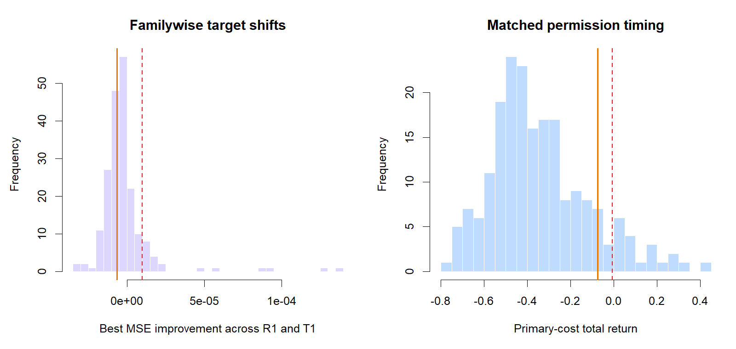
Primary forecast lost to drift and timing controls
FALSIFICATION
R1 MSE improvement −0.00000639; 36.5th percentile of familywise target shifts. Matched timing ranked 87th, below p90.
49
Notes:
The ridge forecast was worse than the intercept-only TRAIN drift baseline. Its policy replay was better than many matched circular permissions, but did not clear the frozen 90th-percentile bar.
[Sources]
- C:/Users/Franc/OneDrive/Documents/Francis/Peltata Project/Time-Series-Modeling-Gen5/operator_hypothesis_lab/docs/HYP_IMOM_04_1_CAL_A02_TSLA_DIRECT_EXPOSURE_RESULTS.md
- C:/Users/Franc/OneDrive/Documents/Francis/Peltata Project/Time-Series-Modeling-Gen5/runs/research_workbench/operator_hypothesis_lab/hyp_imom_04_1_cal_a02_tsla_direct_exposure_20260823/him042_model_metrics.csv
- C:/Users/Franc/OneDrive/Documents/Francis/Peltata Project/Time-Series-Modeling-Gen5/runs/research_workbench/operator_hypothesis_lab/hyp_imom_04_1_cal_a02_tsla_direct_exposure_20260823/him042_familywise_target_shift_controls.csv
- C:/Users/Franc/OneDrive/Documents/Francis/Peltata Project/Time-Series-Modeling-Gen5/runs/research_workbench/operator_hypothesis_lab/hyp_imom_04_1_cal_a02_tsla_direct_exposure_20260823/him042_matched_permission_controls.csv
- C:/Users/Franc/OneDrive/Documents/Francis/Peltata Project/Time-Series-Modeling-Gen5/runs/research_workbench/operator_hypothesis_lab/hyp_imom_04_1_cal_a02_tsla_direct_exposure_20260823/visuals/him042_falsification_controls.png

Slide 50
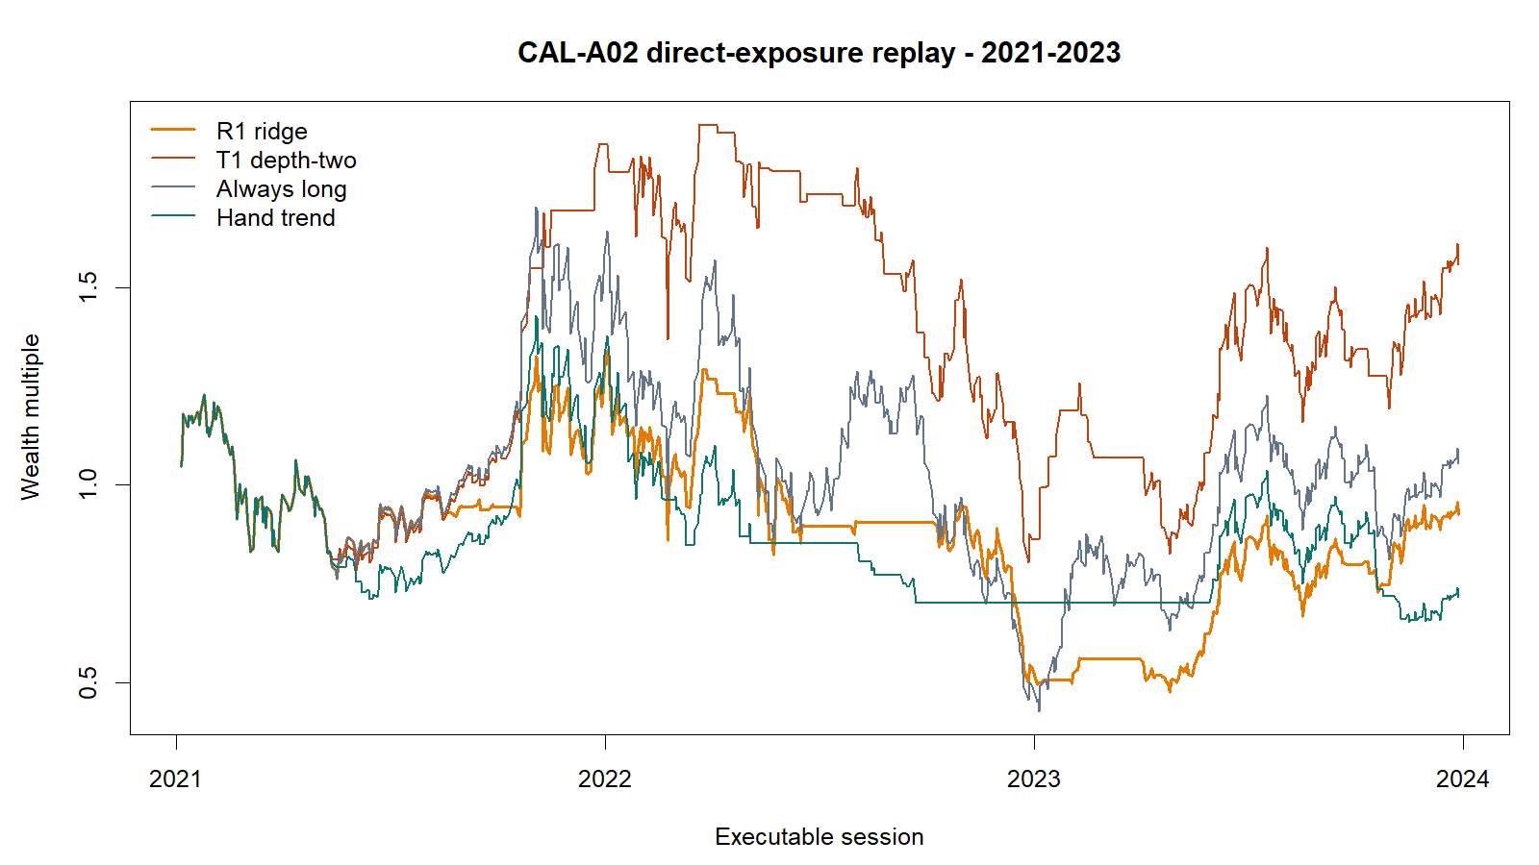
The primary lost; the tree exposed a nonlinear clue
POLICY REPLAY
At 10 bp/side: R1 −7.48%, always long +5.54%, T1 +55.68%—but T1 had 6/12 positive quarters and 63.2% downside capture.
50
Notes:
The depth-two diagnostic generated a large positive replay despite worse MSE, but its gains were concentrated and its root feature changed across folds. Because tree-specific economic inference was not preregistered, this is a hypothesis-generating clue only.
[Sources]
- C:/Users/Franc/OneDrive/Documents/Francis/Peltata Project/Time-Series-Modeling-Gen5/operator_hypothesis_lab/docs/HYP_IMOM_04_1_CAL_A02_TSLA_DIRECT_EXPOSURE_RESULTS.md
- C:/Users/Franc/OneDrive/Documents/Francis/Peltata Project/Time-Series-Modeling-Gen5/runs/research_workbench/operator_hypothesis_lab/hyp_imom_04_1_cal_a02_tsla_direct_exposure_20260823/him042_policy_summary.csv
- C:/Users/Franc/OneDrive/Documents/Francis/Peltata Project/Time-Series-Modeling-Gen5/runs/research_workbench/operator_hypothesis_lab/hyp_imom_04_1_cal_a02_tsla_direct_exposure_20260823/him042_policy_quarterly_returns.csv
- C:/Users/Franc/OneDrive/Documents/Francis/Peltata Project/Time-Series-Modeling-Gen5/runs/research_workbench/operator_hypothesis_lab/hyp_imom_04_1_cal_a02_tsla_direct_exposure_20260823/him042_tree_structure_ledger.csv
- C:/Users/Franc/OneDrive/Documents/Francis/Peltata Project/Time-Series-Modeling-Gen5/runs/research_workbench/operator_hypothesis_lab/hyp_imom_04_1_cal_a02_tsla_direct_exposure_20260823/visuals/him042_direct_exposure_equity_curves.png

Slide 51
Direct exposure stopped before fresh transport
DECISION
The policy engine was expressive; the learned state boundary was not reliable.
Source timing, embargo, both synthetic plants, and all four oracle-accounting checks passed.
R1 was worse than drift, lost after costs, and captured upside and downside at nearly the same rate.
Only 5/11 gates passed. T1 is a CAL-A03 clue, not a survivor; 2024+ remains unread.
STOP: do not tune CAL-A02 or open 2024+. Any nonlinear tail-capture question requires a separately frozen CAL-A03.
51
Notes:
CAL-A02 ends with a primary-model STOP. The positive tree replay is deliberately separated from confirmation language; a follow-up would require a new frozen question, controls targeted to tree policy selection, and the same sealed 2024+ boundary.
[Sources]
- C:/Users/Franc/OneDrive/Documents/Francis/Peltata Project/Time-Series-Modeling-Gen5/operator_hypothesis_lab/docs/HYP_IMOM_04_1_CAL_A02_TSLA_DIRECT_EXPOSURE_RESULTS.md
- C:/Users/Franc/OneDrive/Documents/Francis/Peltata Project/Time-Series-Modeling-Gen5/runs/research_workbench/operator_hypothesis_lab/hyp_imom_04_1_cal_a02_tsla_direct_exposure_20260823/him042_calibration_gates.csv
- C:/Users/Franc/OneDrive/Documents/Francis/Peltata Project/Time-Series-Modeling-Gen5/docs/GEN5_1_POC_PROGRESS_LOG.md

