Slide 1
DAILY CONTINUATION
From return geometry to a continuation hypothesis
A descriptive microscope before a trading rule
TSLA origin • 30-asset catalog • 129-instrument transport • post-2023 sealed
1
Notes:
This new research volume preserves the weaker but coherent momentum/continuation line separately from the rebound proto-strategy. It summarizes only already-computed 2018-2023 evidence.
[Sources]
- operator_hypothesis_lab/docs/TSLA_CUMULATIVE_RETURN_HORIZON_GRID_2018_2023.md
- operator_hypothesis_lab/docs/OWN_ASSET_RETURN_GEOMETRY_ATLAS_2018_2023.md
- operator_hypothesis_lab/docs/RETURN_GEOMETRY_WIDE_ATLAS_2018_2023.md
[/Sources]

Slide 2
EVIDENCE BOUNDARY
Continuation is a behavioral lead—not a strategy
OBSERVED
Positive-prior dependence changes with state
sideways / low-vol differ from trending
CONTRAST
Efficient trending paths lean toward exhaustion
same method, opposite slope sign
DOES NOT EARN
A chosen horizon or executable rule
next-open, baseline, and fresh data unresolved
Registry status
BEHAV-MOM-01 is worth preserving and discussing. Its current status is DESCRIPTIVE_BEHAVIORAL_LEAD.
Return geometry | daily continuation microscope | 2026-08-28
2
Notes:
The line has enough structure to deserve a name and a separate research volume. It has not earned expectancy, a representative cell, a next-open rule, or an OOS query.
[Sources]
- operator_hypothesis_lab/registries/proto_strategy_ledger.xlsx
- operator_hypothesis_lab/docs/RETURN_GEOMETRY_WIDE_ATLAS_2018_2023.md
[/Sources]

Slide 3
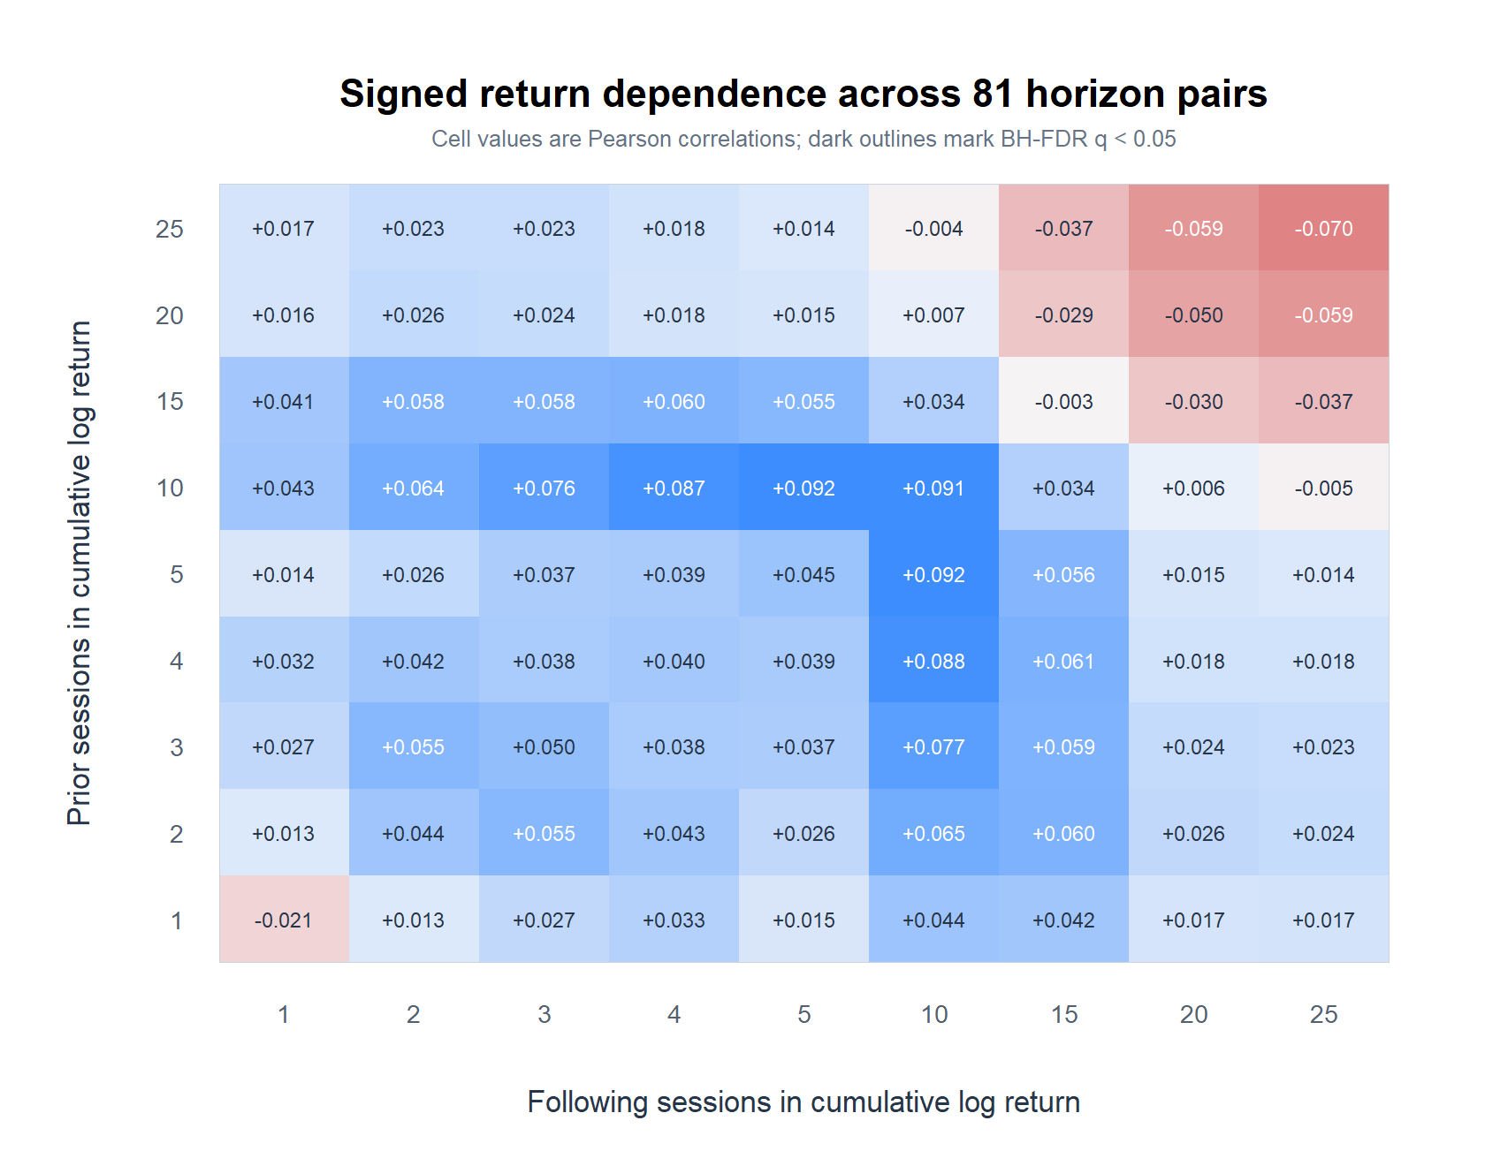
TSLA ORIGIN
A weak 5–10-session continuation ridge appears
TSLA | cumulative close-to-close log returns | 2018–2023
3
Notes:
The strongest TSLA cell is about +0.092 near the 5-to-10-session ridge, but the maximum explains less than one percent of variance and no signed-return or direction cell survives the complete 81-cell scan.
[Sources]
- operator_hypothesis_lab/docs/TSLA_CUMULATIVE_RETURN_HORIZON_GRID_2018_2023.md
- runs/research_workbench/operator_hypothesis_lab/tsla_cumulative_return_horizon_grid_20260825/visuals/tsla_cumulative_return_pearson_heatmap.png
[/Sources]

Slide 4
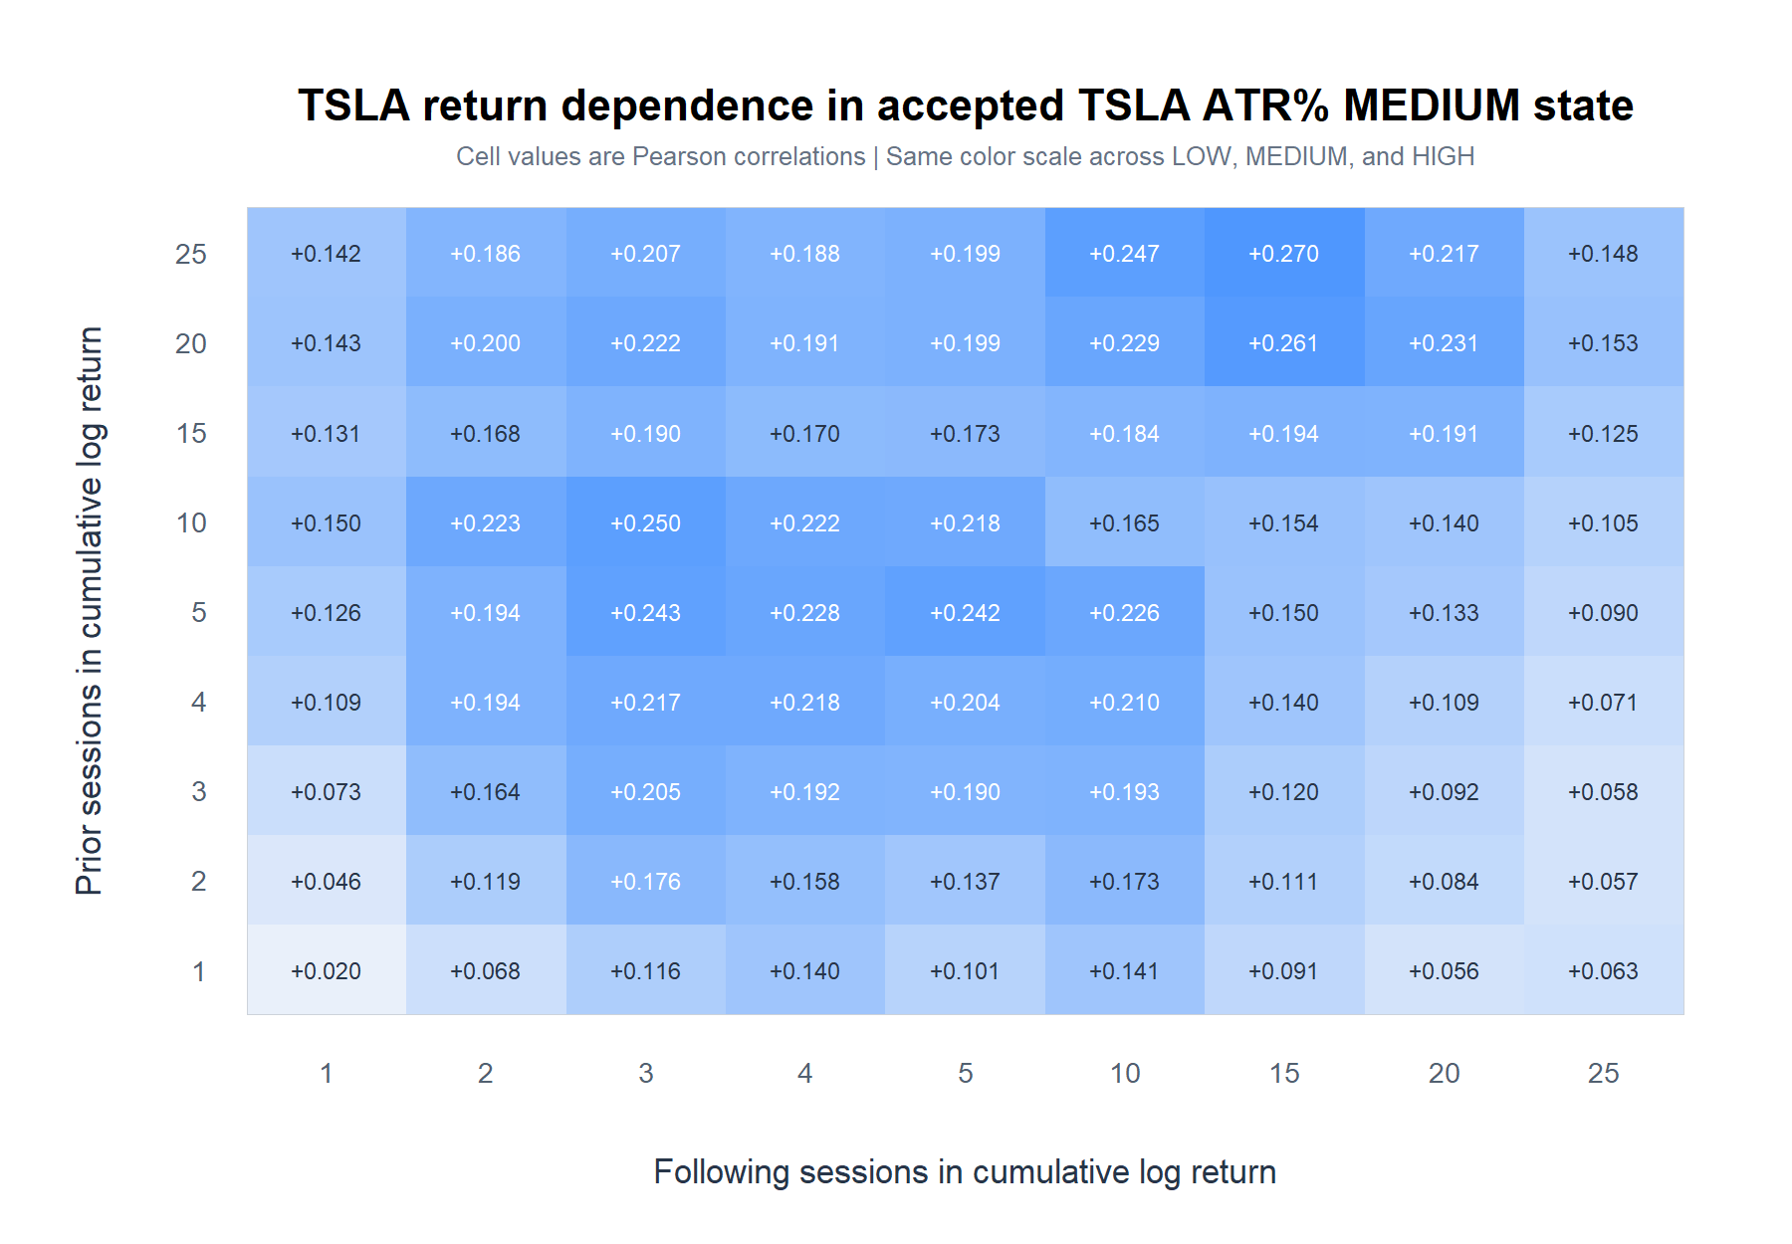
VOLATILITY STATE
Medium ATR sharpens TSLA's continuation surface
TSLA | accepted causal ATR% state | 2018–2023
4
Notes:
All 81 medium-ATR cells are positive. Three medium-state cells survive the stricter 486-test BH family, while the high-ATR surface is predominantly negative. This is a state discriminator, not a trading permission rule.
[Sources]
- operator_hypothesis_lab/docs/TSLA_ATRP_CONDITIONED_RETURN_HORIZON_GRID_2018_2023.md
- runs/research_workbench/operator_hypothesis_lab/tsla_atrp_conditioned_return_horizon_grid_20260825/visuals/tsla_atrp_medium_pearson_heatmap.png
[/Sources]

Slide 5
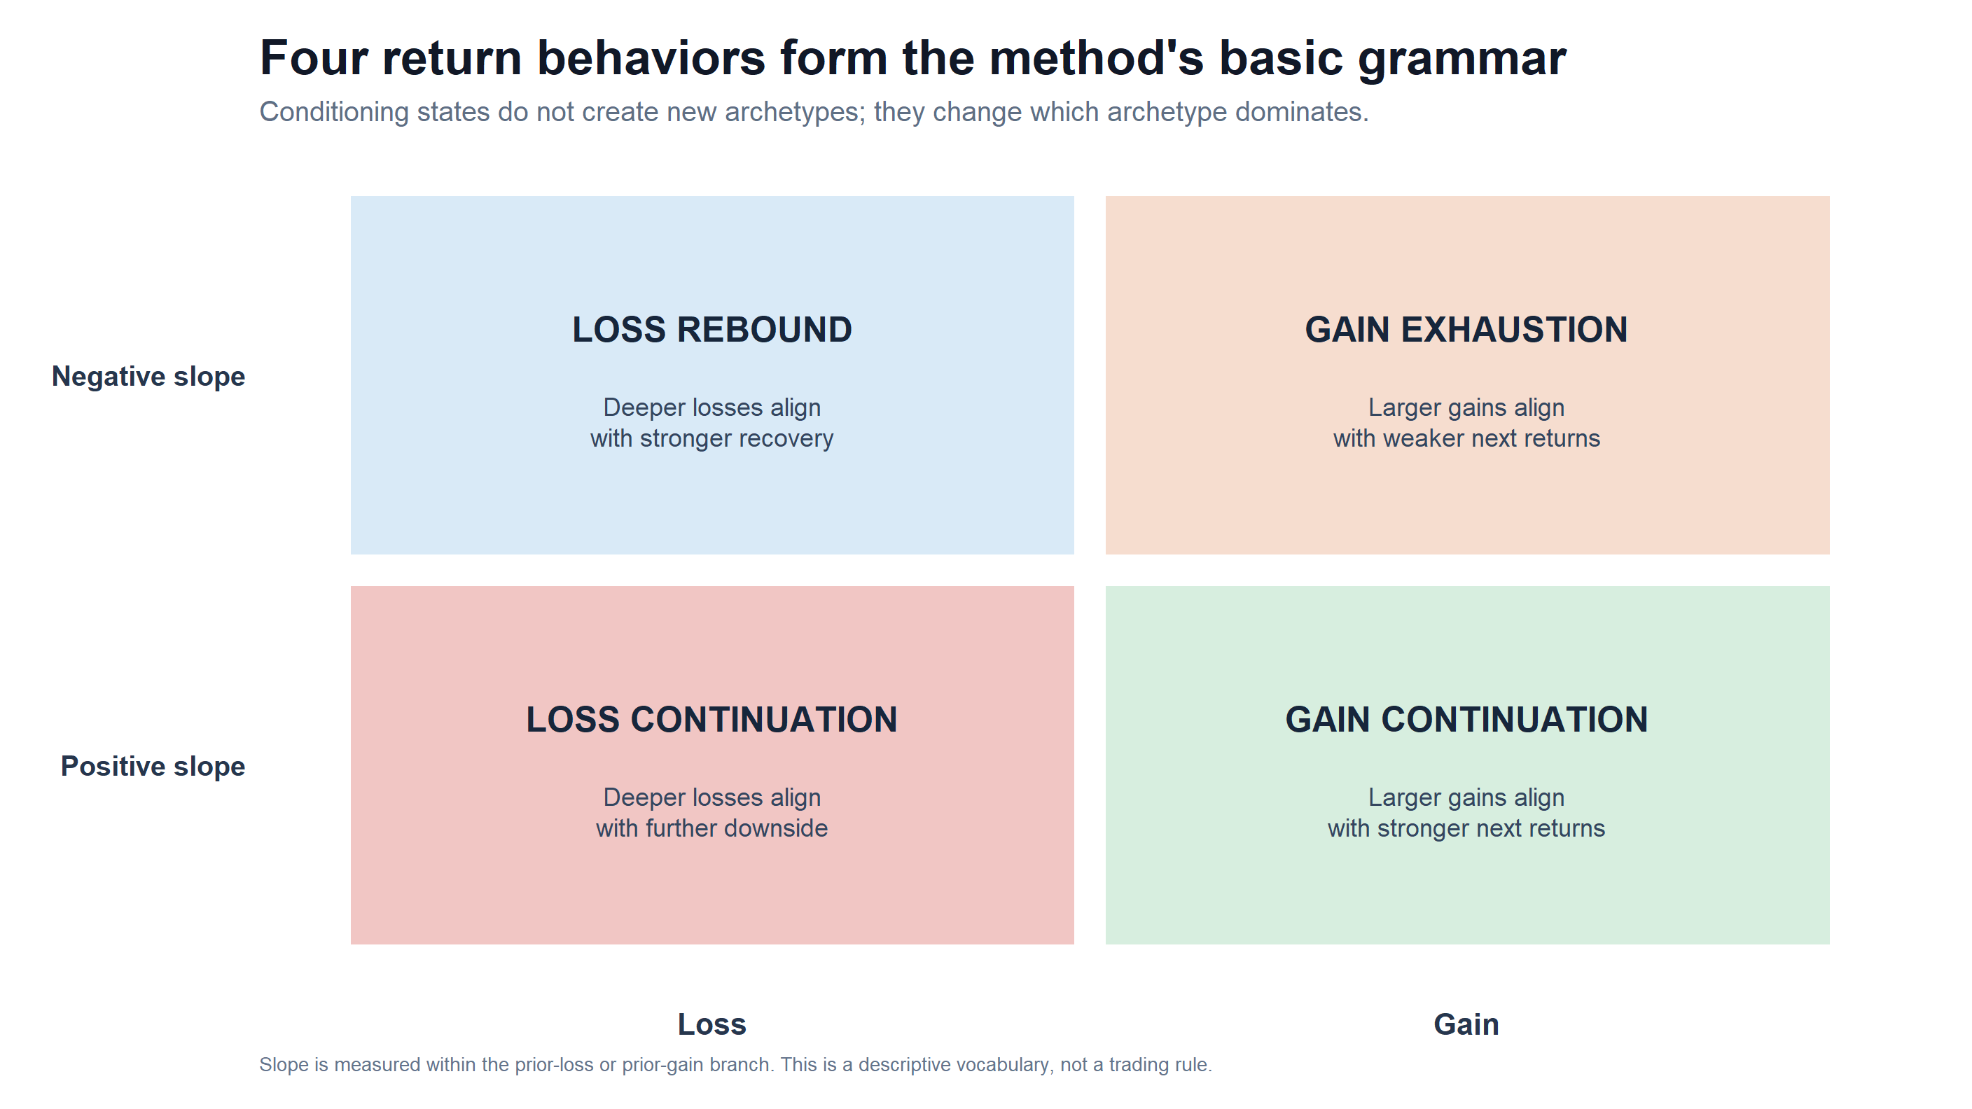
METHOD GRAMMAR
Continuation sits inside a four-behavior grammar
Return geometry | positive and negative prior branches
5
Notes:
Prior-return sign and within-branch slope define the behavior. This prevents us from treating every interesting state as a new strategy: continuation and exhaustion are opposite shapes within the same positive-prior branch.
[Sources]
- operator_hypothesis_lab/docs/OWN_ASSET_RETURN_GEOMETRY_ATLAS_2018_2023.md
- runs/research_workbench/operator_hypothesis_lab/return_geometry_behavior_catalog_20260826/visuals/behavior_archetype_grammar.png
[/Sources]

Slide 6
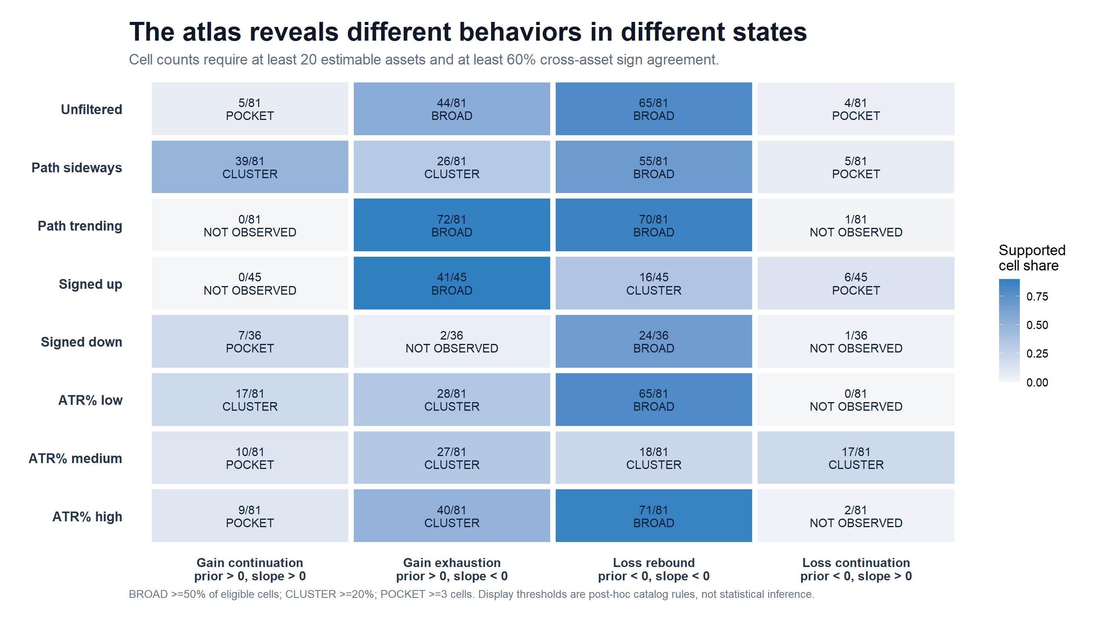
30-ASSET CATALOG
Sideways paths carry the largest continuation cluster
30 assets | fixed 9 x 9 microscope | equal-asset support
6
Notes:
Under the post-hoc display vocabulary, gain continuation appears in 39 of 81 path-sideways cells and 17 of 81 low-ATR cells, but in zero of 81 path-trending cells. Trending and signed-up states instead favor gain exhaustion.
[Sources]
- operator_hypothesis_lab/docs/OWN_ASSET_RETURN_GEOMETRY_ATLAS_2018_2023.md
- runs/research_workbench/operator_hypothesis_lab/return_geometry_behavior_catalog_20260826/visuals/behavior_state_catalog.png
[/Sources]

Slide 7
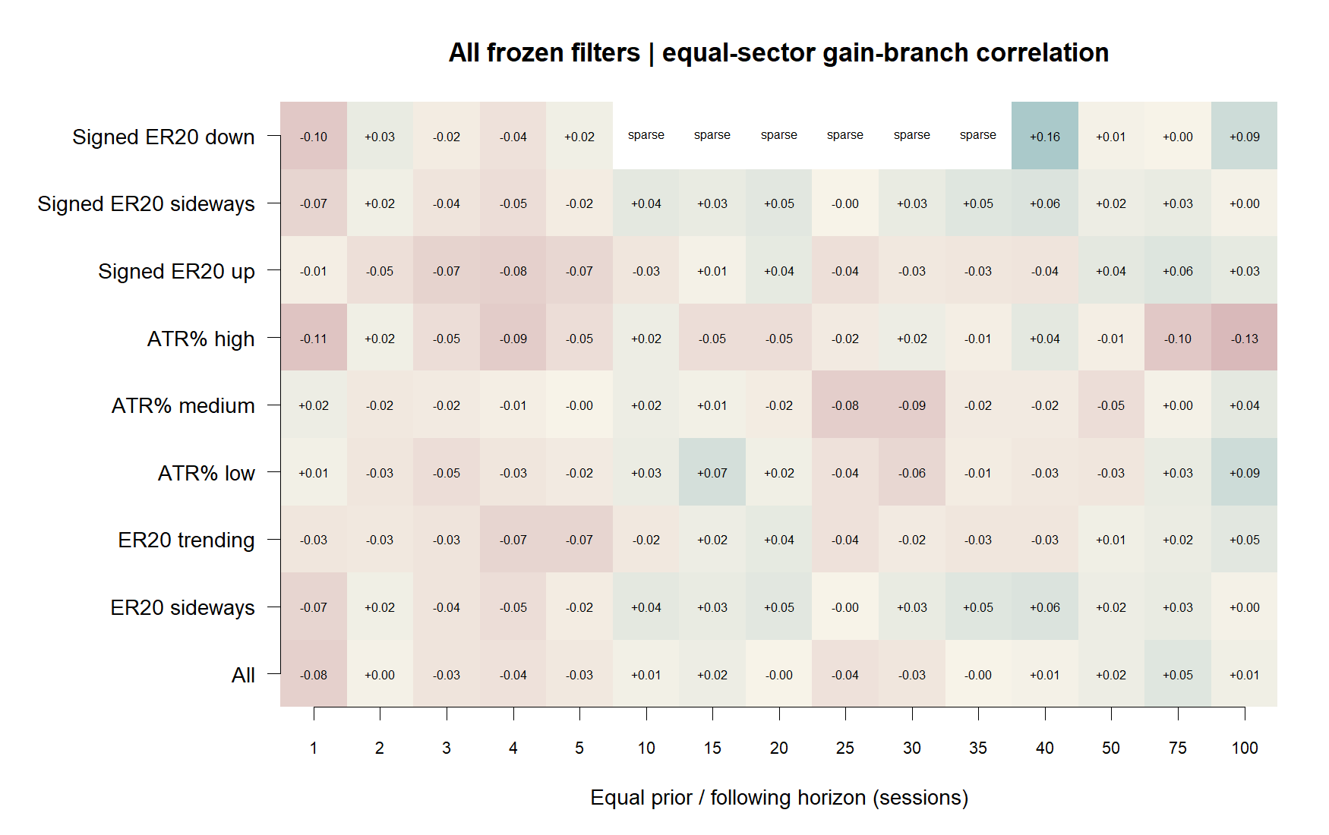
129-INSTRUMENT ATLAS
Breadth preserves a small state contrast
129 instruments | equal-sector gain branch | 2018–2023
7
Notes:
Across the full 15-by-15 atlas, ER20-sideways gain cells have median correlation +0.027 and positive sign in 81.8 percent of cells. ER20-trending cells have median -0.028 and positive sign in only 27.6 percent. The separation is broad but small.
[Sources]
- operator_hypothesis_lab/docs/RETURN_GEOMETRY_WIDE_ATLAS_2018_2023.md
- runs/research_workbench/operator_hypothesis_lab/return_geometry_wide_atlas_full_vocabulary_20260827/visuals/all_states_equal_sector_gain_diagonal.png
[/Sources]

Slide 8
EVIDENCE SYNTHESIS
A coherent discriminator is still not a trading rule
TSLA
Weak 5–10-session ridge
0 / 81 aggregate cells survive BH
30 ASSETS
Sideways continuation cluster
39 / 81 versus 0 / 81 trending
129 INSTRUMENTS
Broad state-sign contrast
+0.027 sideways vs −0.028 trending median
STATUS
Preserve BEHAV-MOM-01 as a behavioral lead. Do not select a cell or open post-2023 data before a narrative-first rule is frozen.
Return geometry | continuation evidence status
8
Notes:
This is a real research milestone: the continuation line is no longer a vague intuition. It is a broad but small conditional shape. The evidence boundary remains important because the same research history discovered and summarized it.
[Sources]
- operator_hypothesis_lab/docs/TSLA_CUMULATIVE_RETURN_HORIZON_GRID_2018_2023.md
- operator_hypothesis_lab/docs/OWN_ASSET_RETURN_GEOMETRY_ATLAS_2018_2023.md
- operator_hypothesis_lab/docs/RETURN_GEOMETRY_WIDE_ATLAS_2018_2023.md
[/Sources]

Slide 9
NEXT FROZEN GATE
The next move is a narrative choice—not more feature mining
BEHAVIOR
Name the state-dependent continuation lead
complete for 2018–2023
CANDIDATE
Choose one representative contrast before calculating
one state, one horizon, one baseline
EDGE
Require next-open value on fresh data
later—not yet earned
Recommended huddle
Decide whether to freeze sideways continuation alone or the direct sideways-versus-trending contrast. Keep the 30-minute lane design-only until its clock contract is explicit.
Return geometry | continuation research roadmap
9
Notes:
The next discussion should select the economic claim before its test. A reasonable default is the direct contrast: after a positive prior return, continuation should be stronger in ER20-sideways than ER20-trending. The horizon and failure rule must then be frozen without scanning the inspected grid again. The planned 30-minute lane remains unopened until sessions, overnight returns, and daily-filter timing are specified.
[Sources]
- operator_hypothesis_lab/docs/RETURN_GEOMETRY_DAILY_CONTINUATION_MICROSCOPE_2018_2023.md
- operator_hypothesis_lab/registries/proto_strategy_ledger.xlsx
[/Sources]

Slide 10
STATE CONTRAST
Sideways versus trending: the approved comparison
A paired descriptive contrast—not a strategy test
Positive-prior branch • 15 × 15 horizons • 88-stock equal-sector core • post-2023 sealed
10
Notes:
The operator selected the direct ER20-sideways versus ER20-trending comparison for fuller context. This section re-expresses the already-computed 2018-2023 atlas; it does not recompute returns, select a horizon, or test a trading rule.
[Sources]
- operator_hypothesis_lab/docs/RETURN_GEOMETRY_DAILY_CONTINUATION_MICROSCOPE_2018_2023.md
- runs/research_workbench/operator_hypothesis_lab/return_geometry_continuation_state_contrast_20260828/run_spec.csv
[/Sources]

Slide 11
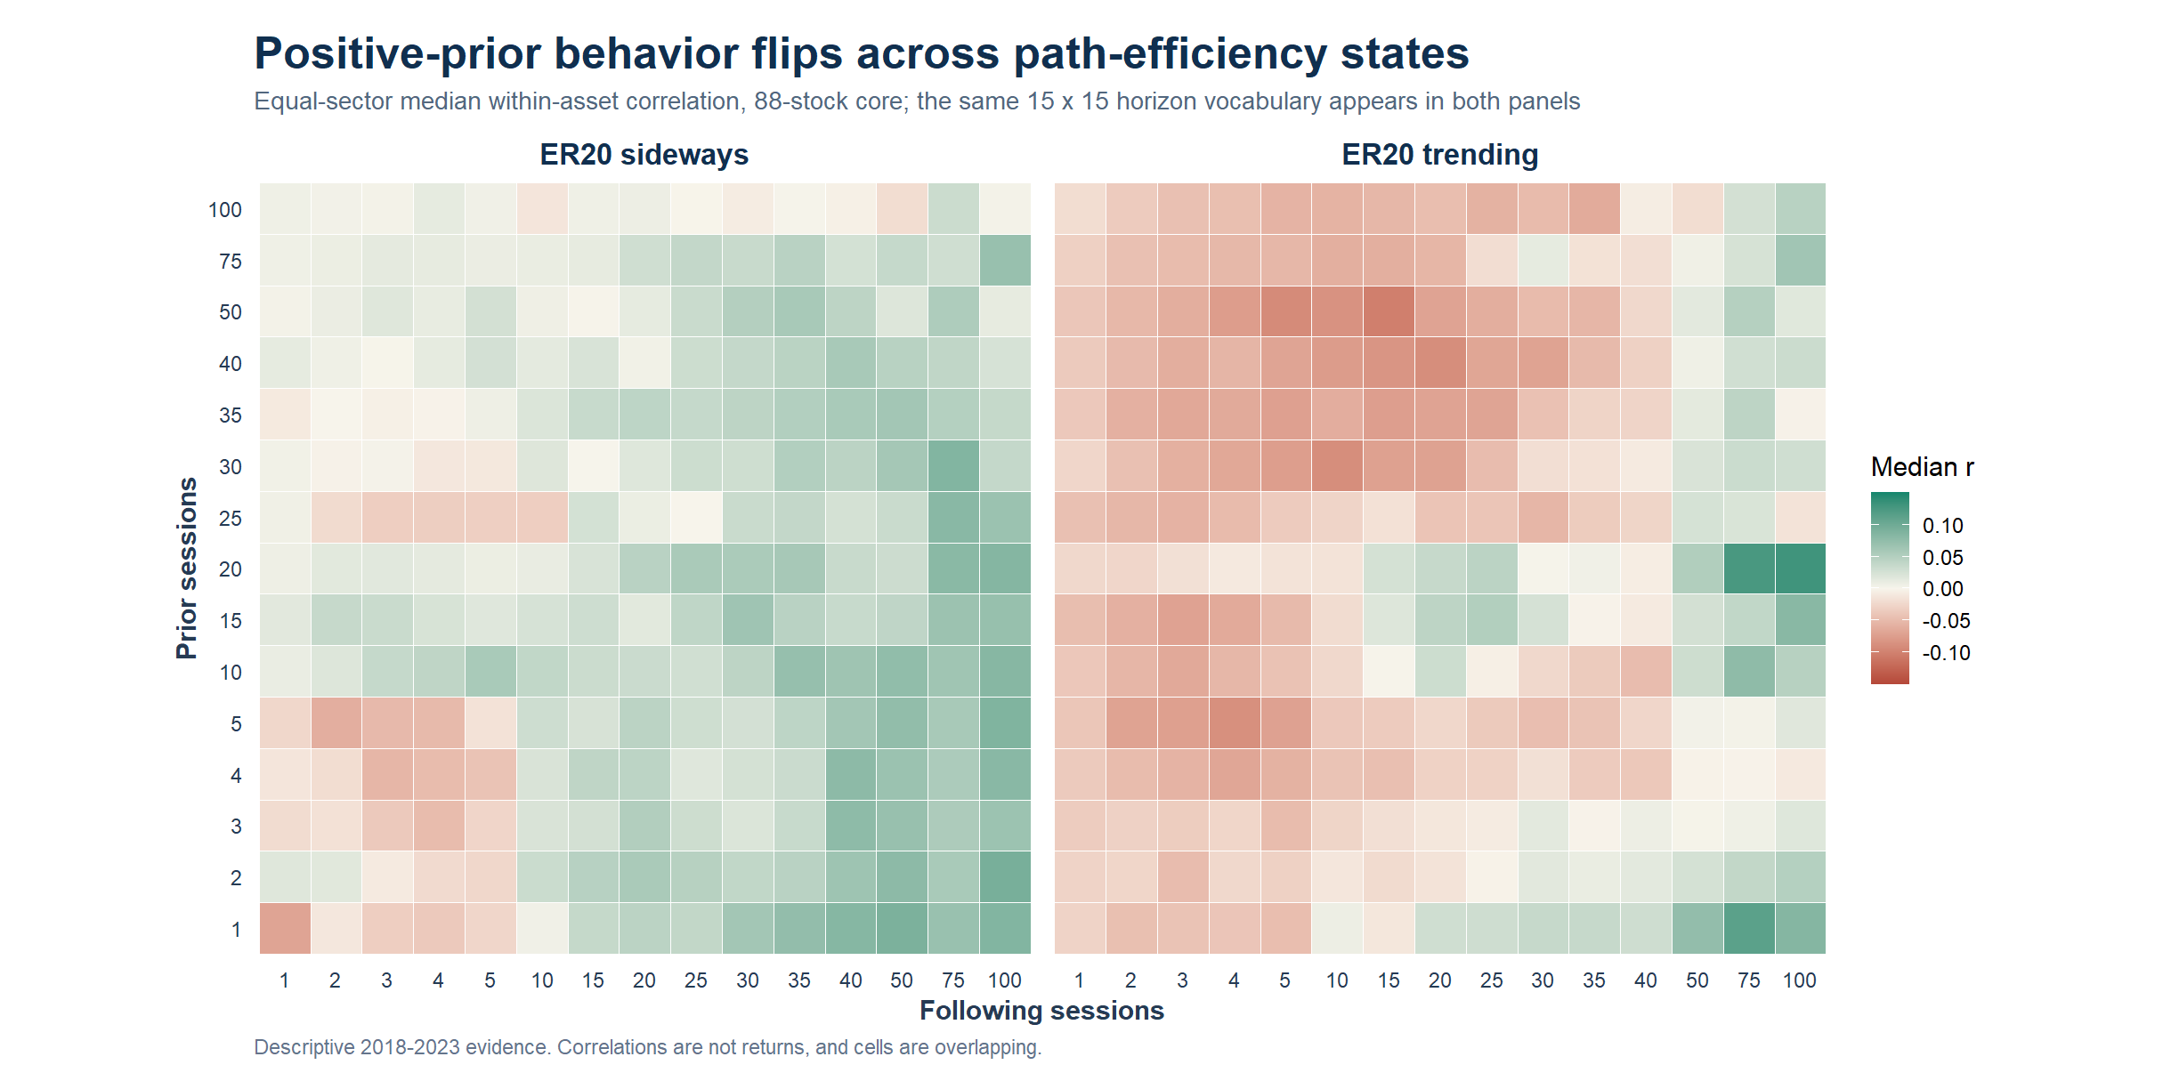
STATE SURFACES
Sideways looks continuation-shaped; trending often does not
88-stock core | paired positive-prior branch | equal-sector medians
11
Notes:
Across all 225 cells, the median equal-sector positive-prior correlation is +0.027 in ER20-sideways and -0.028 in ER20-trending. Both use the identical asset core, horizon vocabulary, and causal state timing.
[Sources]
- runs/research_workbench/operator_hypothesis_lab/return_geometry_continuation_state_contrast_20260828/contrast_summary.csv
- runs/research_workbench/operator_hypothesis_lab/return_geometry_continuation_state_contrast_20260828/visuals/sideways_vs_trending_positive_branch_heatmaps.png
[/Sources]

Slide 12
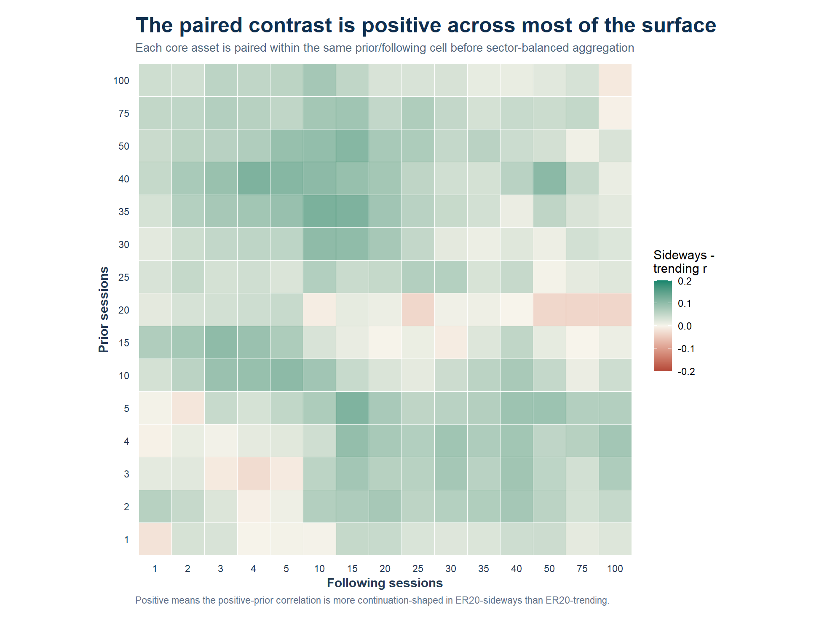
PAIRED CONTRAST
Sideways wins 92.9% of paired horizon cells
Sideways r minus trending r | paired within asset and horizon cell
12
Notes:
Each asset is paired inside the same prior/following horizon cell before sector aggregation. The all-surface median paired contrast is +0.048, and 209 of 225 cells are positive. The contrast is a difference in correlations, not a return or spread trade.
[Sources]
- runs/research_workbench/operator_hypothesis_lab/return_geometry_continuation_state_contrast_20260828/equal_sector_paired_cell_summary.csv
- runs/research_workbench/operator_hypothesis_lab/return_geometry_continuation_state_contrast_20260828/visuals/sideways_minus_trending_paired_heatmap.png
[/Sources]

Slide 13
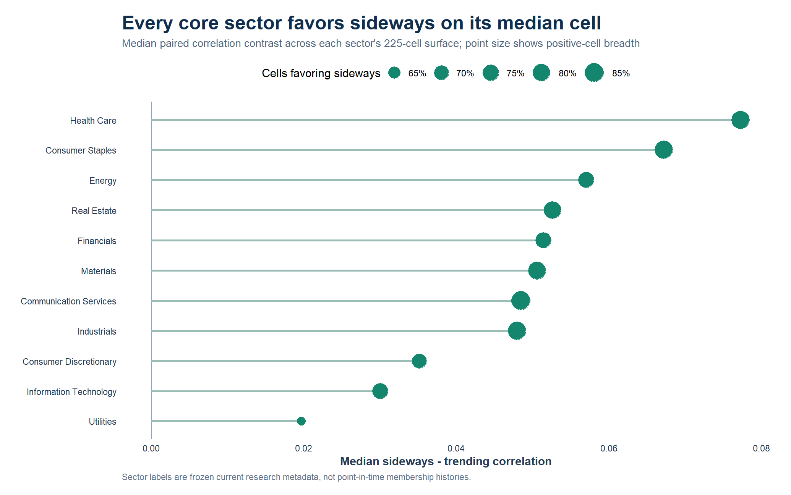
SECTOR CONTEXT
All 11 sectors favor sideways on their median cell
Frozen current GICS labels | eight stocks per sector | 225 cells
13
Notes:
Every core sector has a positive median paired contrast across its 225-cell surface. The median contrast ranges from about +0.020 in Utilities to +0.077 in Health Care. Positive-cell breadth ranges from 62.2 to 85.8 percent, so the shape is broad but not uniform.
[Sources]
- runs/research_workbench/operator_hypothesis_lab/return_geometry_continuation_state_contrast_20260828/sector_surface_summary.csv
- runs/research_workbench/operator_hypothesis_lab/return_geometry_continuation_state_contrast_20260828/visuals/sideways_advantage_by_sector.png
[/Sources]

Slide 14
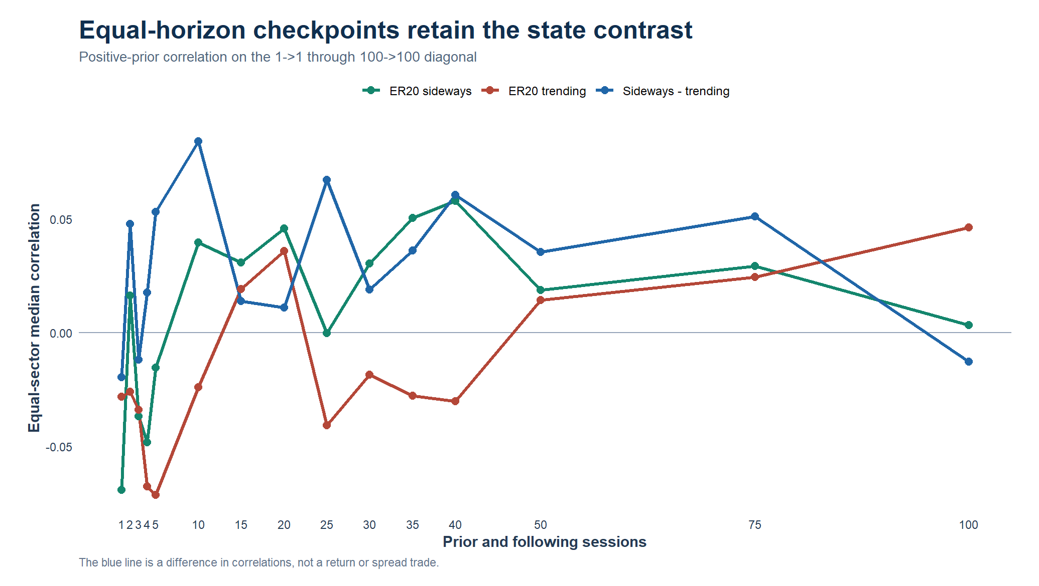
EXCEPTIONS
The state contrast has clear exceptions
Equal-horizon diagonal | context for non-uniformity | no cell selection
14
Notes:
The diagonal is mostly positive but not monotone. The paired contrast is negative at 1-to-1 and 100-to-100, while its largest equal-horizon value occurs at 10-to-10. Across the full grid, 16 cells do not favor sideways; exceptions cluster at micro horizons and several 20-prior / long-forward combinations. These are context, not permission to choose 10-to-10.
[Sources]
- runs/research_workbench/operator_hypothesis_lab/return_geometry_continuation_state_contrast_20260828/equal_sector_paired_diagonal.csv
- runs/research_workbench/operator_hypothesis_lab/return_geometry_continuation_state_contrast_20260828/visuals/sideways_vs_trending_diagonal.png
[/Sources]

Slide 15
CONTRAST READOUT
The state discriminator is broad but still descriptive
SURFACE
Paired median contrast
+0.048; 92.9% of cells positive
BREADTH
All sector medians favor sideways
62.2%–85.8% positive-cell breadth
LIMITS
Sixteen cells break the pattern
Micro, prior-20/long-forward, 100→100
STATUS
BEHAV-MOM-01 remains a behavioral lead. Do not select a horizon or open a next-open rule, baseline, or post-2023 confirmation yet.
Return geometry | ER20 state contrast | 2018–2023
15
Notes:
The approved comparison strengthened the behavioral description: sideways and trending are not merely different-looking heatmaps; their paired difference is positive across most cells and every sector's median surface. The magnitude remains small and the same research history discovered the contrast, so the lane stops before horizon choice or trading translation.
[Sources]
- runs/research_workbench/operator_hypothesis_lab/return_geometry_continuation_state_contrast_20260828/report.md
- runs/research_workbench/operator_hypothesis_lab/return_geometry_continuation_state_contrast_20260828/contrast_summary.csv
- operator_hypothesis_lab/docs/RETURN_GEOMETRY_DAILY_CONTINUATION_MICROSCOPE_2018_2023.md
[/Sources]

Slide 16
OPEN-TO-OPEN
A descriptive state contrast becomes an executable rule
Signal at the close; trade at the next open; three frozen holds
R20 > 0 • ER20 < 0.30 • 5 / 10 / 20 sessions • 10 bp • post-2023 sealed
16
Notes:
This section translates the descriptive ER20-sideways continuation lead into the simplest executable daily rule. The 20-session prior window is aligned with ER20; 5, 10, and 20 held sessions are frozen diagnostics rather than an optimized horizon search.
[Sources]
- runs/research_workbench/operator_hypothesis_lab/return_geometry_continuation_next_open_rule_20260829/run_spec.csv
- operator_hypothesis_lab/docs/RETURN_GEOMETRY_DAILY_CONTINUATION_MICROSCOPE_2018_2023.md
[/Sources]

Slide 17
FROZEN RULE
The first executable rule is deliberately literal
SIGNAL
Positive R20 in ER20 sideways
R20 > 0; ER20 < 0.30 at close t
EXECUTION
Next-open entry; fixed exit
5 / 10 / 20 held sessions; 10 bp
CONTROLS
Four matched reference rules
Trending +R20; +R20; sideways; drift
STATUS
Frozen before calculation. No horizon selection, post-2023 confirmation, portfolio replay, or 30-minute data is opened.
Daily adjusted bars | 129 instruments | 88-stock equal-sector core
17
Notes:
The primary rule is known at completed close t and enters at open t+1. One position is allowed per asset, rule, and horizon; intervening signals are ignored until the exit open. All controls use the same execution and non-overlap convention.
[Sources]
- runs/research_workbench/operator_hypothesis_lab/return_geometry_continuation_next_open_rule_20260829/run_spec.csv
- runs/research_workbench/operator_hypothesis_lab/return_geometry_continuation_next_open_rule_20260829/construction_checks.csv
[/Sources]

Slide 18
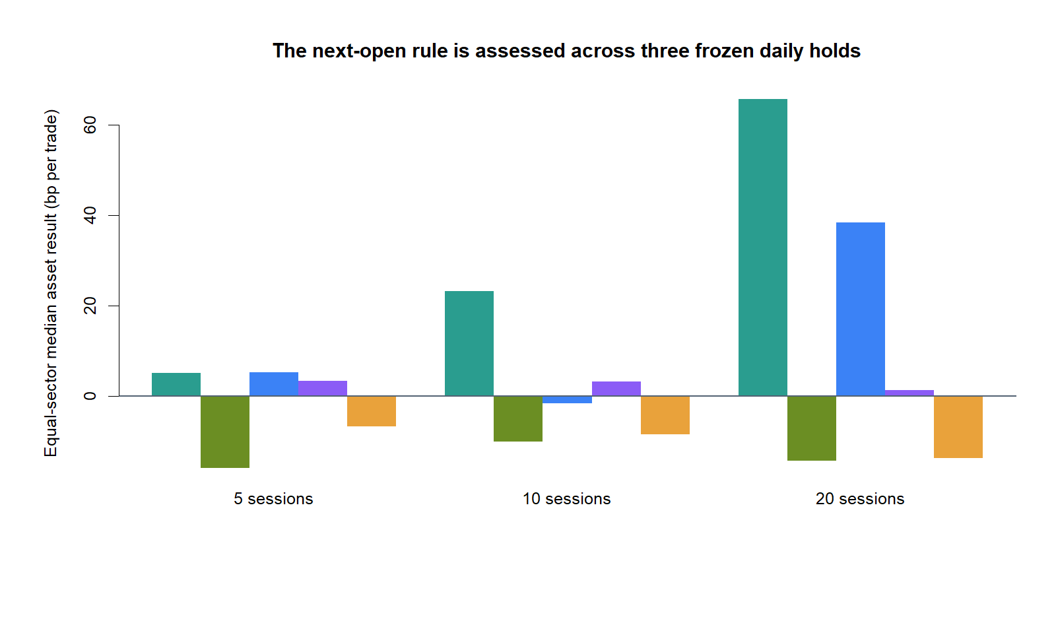
HORIZON READOUT
Positive returns do not beat ordinary drift
Equal-sector median asset | net of 10 bp | 11 sectors
18
Notes:
The primary rule has positive equal-sector median net returns of +0.05%, +0.23%, and +0.66% over 5, 10, and 20 sessions. It nevertheless trails unconditional same-horizon drift by 16, 10, and 14 basis points per trade. Positive R20 adds little versus the positive-only control and detracts versus sideways-state-only.
[Sources]
- runs/research_workbench/operator_hypothesis_lab/return_geometry_continuation_next_open_rule_20260829/equal_sector_horizon_summary.csv
- runs/research_workbench/operator_hypothesis_lab/return_geometry_continuation_next_open_rule_20260829/visuals/equal_sector_horizon_comparison.png
[/Sources]

Slide 19
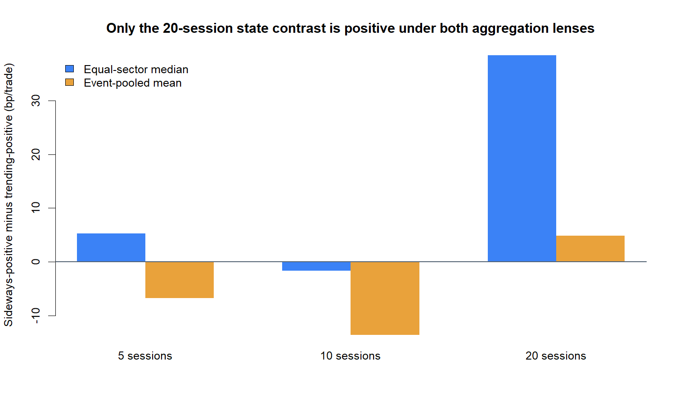
WEIGHTING SENSITIVITY
Only 20 sessions beats trending under both lenses
Sideways-positive minus trending-positive | bp per trade
19
Notes:
The executable state contrast is sensitive to aggregation at 5 sessions and negative under both lenses at 10. At 20 sessions it is positive under both: about +38 basis points under equal-sector median aggregation and +5 basis points event-pooled. This is a descriptive robustness clue, not horizon-selection permission.
[Sources]
- runs/research_workbench/operator_hypothesis_lab/return_geometry_continuation_next_open_rule_20260829/aggregation_lens_summary.csv
- runs/research_workbench/operator_hypothesis_lab/return_geometry_continuation_next_open_rule_20260829/visuals/sideways_vs_trending_executable_returns.png
[/Sources]

Slide 20
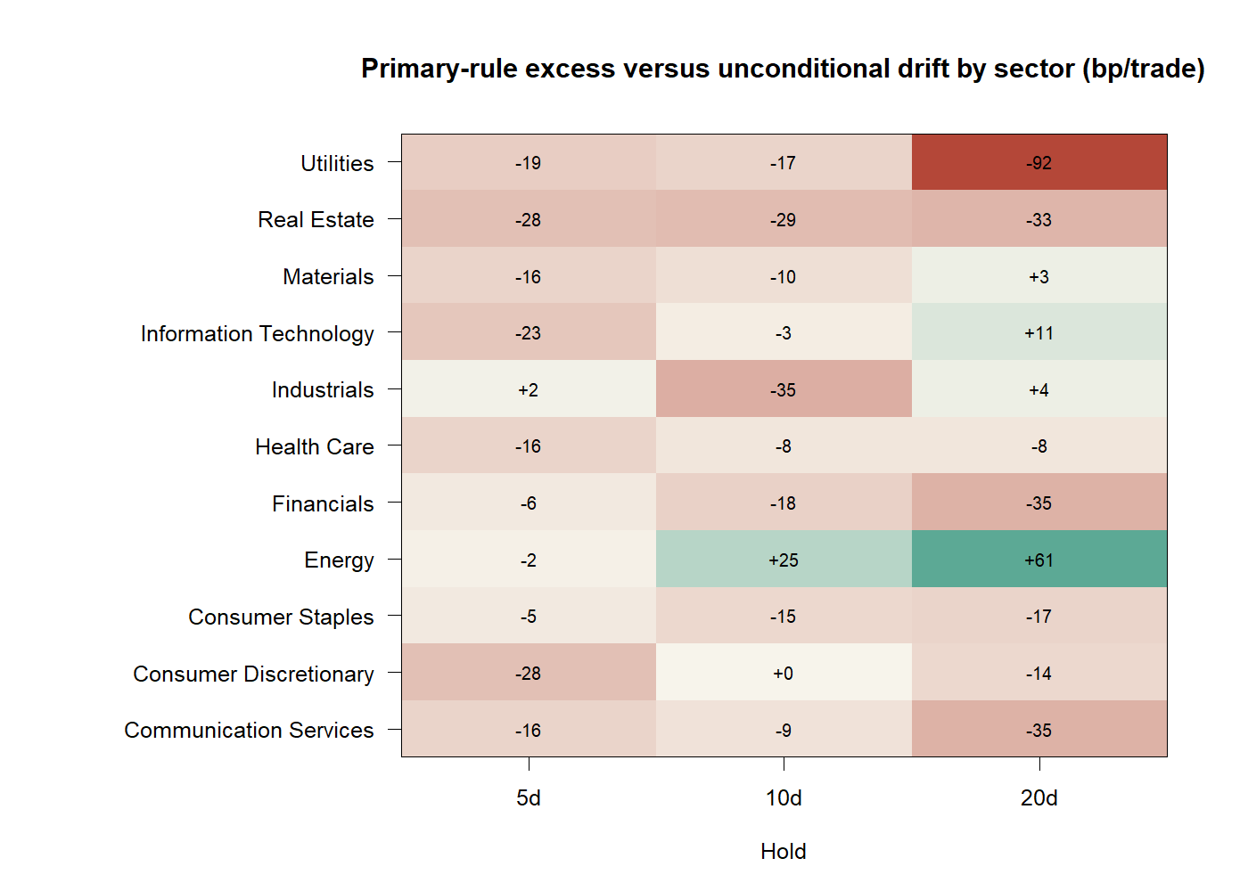
SECTOR BREADTH
Excess versus drift is negative in most sectors
Primary net return minus unconditional same-horizon drift | bp/trade
20
Notes:
Only 1 of 11 sectors has positive median excess at 5 sessions, 2 at 10, and 4 at 20. Energy is the clearest positive exception at longer holds; Utilities and Real Estate remain negative. The breadth does not support an asset-agnostic rule.
[Sources]
- runs/research_workbench/operator_hypothesis_lab/return_geometry_continuation_next_open_rule_20260829/core_sector_horizon_summary.csv
- runs/research_workbench/operator_hypothesis_lab/return_geometry_continuation_next_open_rule_20260829/visuals/sector_excess_heatmap.png
[/Sources]

Slide 21
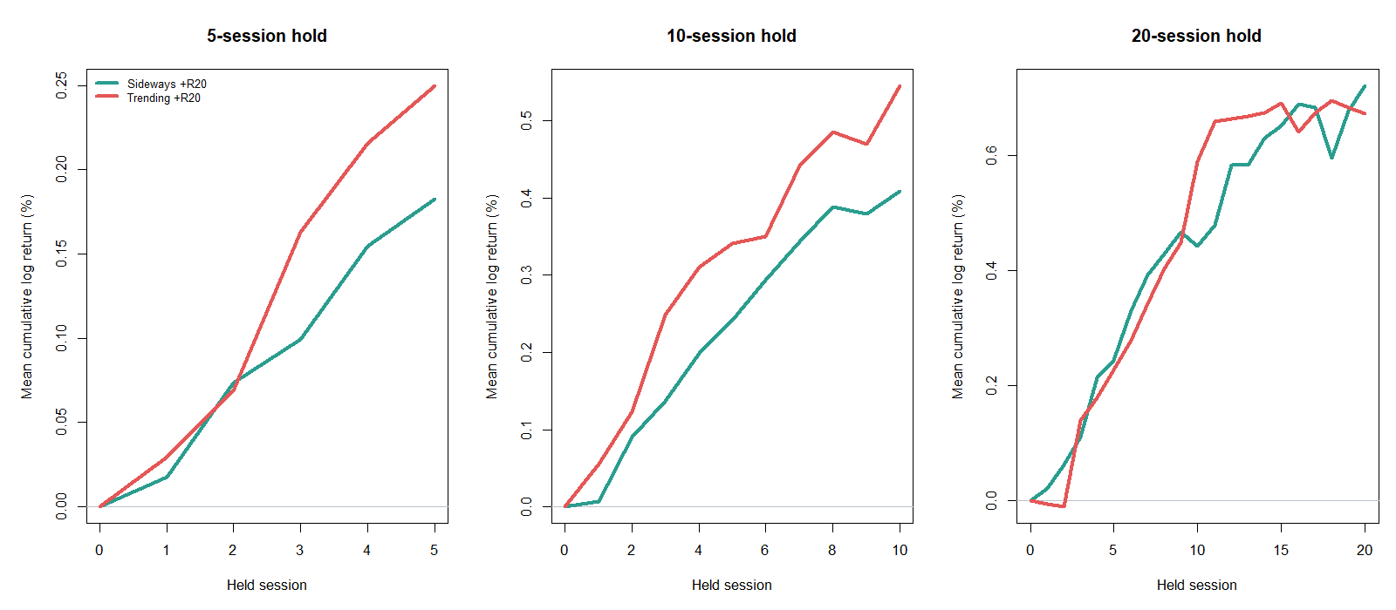
PATH SHAPE
Trending leads early; sideways catches up by 20
Event-pooled mean path | state-qualified positive-R20 trades
21
Notes:
Event-pooled trade paths show trending-positive entries ahead through the 5- and 10-session holds. The paths converge near the end of the 20-session hold, where sideways-positive finishes modestly ahead. This timing shape helps explain why the correlation surface did not translate cleanly at shorter horizons.
[Sources]
- runs/research_workbench/operator_hypothesis_lab/return_geometry_continuation_next_open_rule_20260829/trade_path_summary.csv
- runs/research_workbench/operator_hypothesis_lab/return_geometry_continuation_next_open_rule_20260829/visuals/sideways_vs_trending_trade_paths.png
[/Sources]

Slide 22
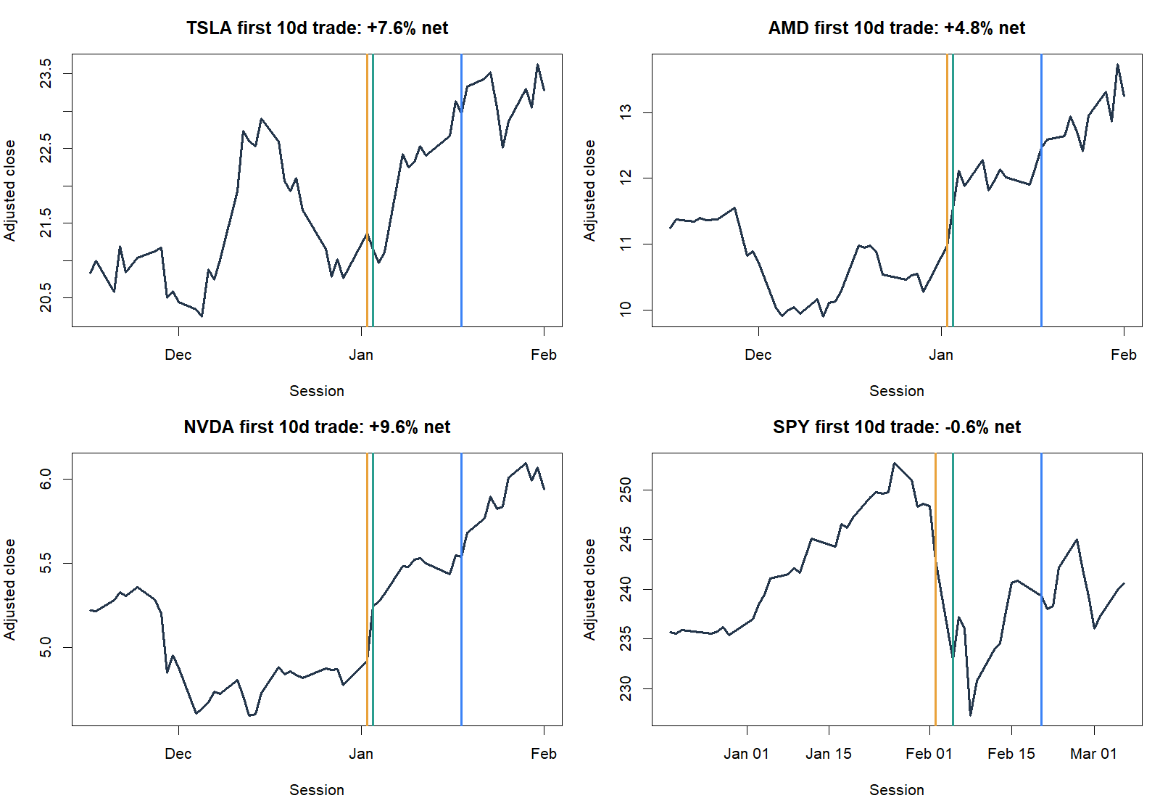
TRADE TAPES
Winners coexist with weak aggregate results
First eligible 10-session event | deterministic, not outcome-selected
22
Notes:
The first eligible 10-session event is shown for TSLA, AMD, NVDA, and SPY. TSLA, AMD, and NVDA happen to be profitable while SPY is slightly negative. These deterministic examples make the mechanics concrete but do not override the weak aggregate baseline comparison.
[Sources]
- runs/research_workbench/operator_hypothesis_lab/return_geometry_continuation_next_open_rule_20260829/trade_ledger.csv
- runs/research_workbench/operator_hypothesis_lab/return_geometry_continuation_next_open_rule_20260829/visuals/representative_primary_trade_tapes.png
[/Sources]

Slide 23
EXECUTABLE READOUT
The rule earns context—not horizon selection
BASELINE
Rule trails unconditional drift
−16 / −10 / −14 bp at 5 / 10 / 20
STATE
Only 20d survives both lenses
+38 bp equal-sector; +5 bp pooled
SIGN
R20 > 0 adds no value vs sideways-only
−7 / −9 / −14 bp at 5 / 10 / 20
STATUS
Raw net returns are positive at all holds, but no horizon earns promotion. Stop before selecting 20d, changing thresholds, or opening OOS.
2018–2023 TRAIN | descriptive mechanics | no OOS opened
23
Notes:
The minimal rule translated cleanly into next-open mechanics but did not beat unconditional drift at any frozen hold. The 20-session sideways-versus-trending contrast deserves context because it is positive under both aggregation lenses, yet the positive-return condition itself underperforms sideways-state-only. The correct status is a transparent TRAIN stop before horizon selection or OOS—not an edge claim and not a dead-end verdict on all continuation ideas.
[Sources]
- runs/research_workbench/operator_hypothesis_lab/return_geometry_continuation_next_open_rule_20260829/report.md
- runs/research_workbench/operator_hypothesis_lab/return_geometry_continuation_next_open_rule_20260829/equal_sector_horizon_summary.csv
- runs/research_workbench/operator_hypothesis_lab/return_geometry_continuation_next_open_rule_20260829/aggregation_lens_summary.csv
- operator_hypothesis_lab/docs/RETURN_GEOMETRY_DAILY_CONTINUATION_MICROSCOPE_2018_2023.md
[/Sources]

Slide 24
SIGN ATTRIBUTION
The 20-session clue changes identity
One frozen horizon separates continuation from rebound
Sideways all • sideways +R20 • sideways −R20 • trending all • drift
24
Notes:
The prior slice found that a positive-return condition did not add value inside the ER20-sideways state. This section freezes the data-informed 20-session horizon and separates prior-return sign from state so that continuation and rebound cannot be conflated.
[Sources]
- runs/research_workbench/operator_hypothesis_lab/return_geometry_continuation_20d_attribution_20260829/run_spec.csv
- operator_hypothesis_lab/docs/RETURN_GEOMETRY_DAILY_CONTINUATION_MICROSCOPE_2018_2023.md
[/Sources]

Slide 25
FROZEN BRANCHES
Four branches isolate state from prior-return sign
SIDEWAYS ALL
Any R20 in ER20 sideways
ER20 < 0.30 at completed close t
SIDEWAYS +R20
Continuation branch
R20 > 0 and ER20 < 0.30
SIDEWAYS −R20
Rebound branch
R20 < 0 and ER20 < 0.30
TRENDING ALL
Any R20 with ER20 ≥ 0.30. All branches share the same non-overlap, next-open execution and unconditional 20-day drift baseline.
Next-open mechanics | 20 held sessions | 10 bp | 2018–2023 TRAIN
25
Notes:
Signal information is available at completed close t; entry is open t+1 and exit is the open after 20 held sessions. One position is permitted per asset and branch, and intervening signals are ignored until exit. The two sign-qualified branches overlap the sideways-all branch by design; they are attribution lenses, not an additive decomposition.
[Sources]
- runs/research_workbench/operator_hypothesis_lab/return_geometry_continuation_20d_attribution_20260829/run_spec.csv
- runs/research_workbench/operator_hypothesis_lab/return_geometry_continuation_20d_attribution_20260829/construction_checks.csv
[/Sources]

Slide 26
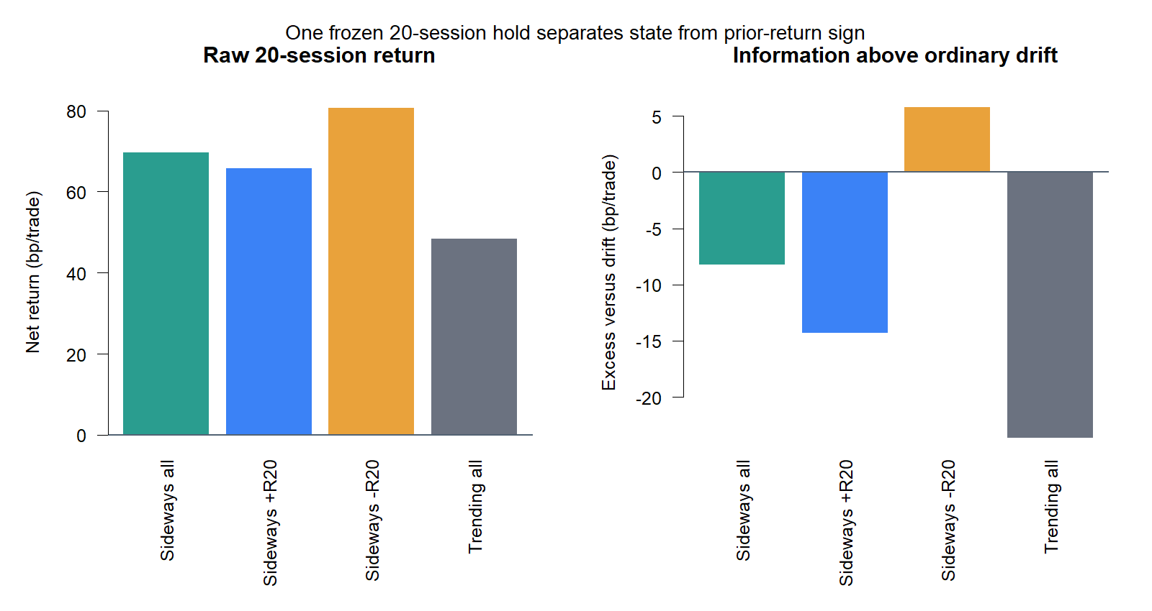
BRANCH ATTRIBUTION
Only the negative-prior branch clears ordinary drift
Equal-sector median asset | net of 10 bp | unconditional 20d drift
26
Notes:
The negative-prior sideways branch produces +0.807% net per trade and exceeds the same-asset unconditional drift baseline by about 5.8 basis points. Sideways-all, sideways-positive, and trending-all all trail drift. That result falsifies the original positive-return continuation interpretation at this frozen horizon.
[Sources]
- C:/Users/Franc/OneDrive/Documents/Francis/Peltata Project/Time-Series-Modeling-Gen5/runs/research_workbench/operator_hypothesis_lab/return_geometry_continuation_20d_attribution_20260829/equal_sector_rule_summary.csv
- C:/Users/Franc/OneDrive/Documents/Francis/Peltata Project/Time-Series-Modeling-Gen5/runs/research_workbench/operator_hypothesis_lab/return_geometry_continuation_20d_attribution_20260829/visuals/equal_sector_branch_attribution.png
[/Sources]

Slide 27
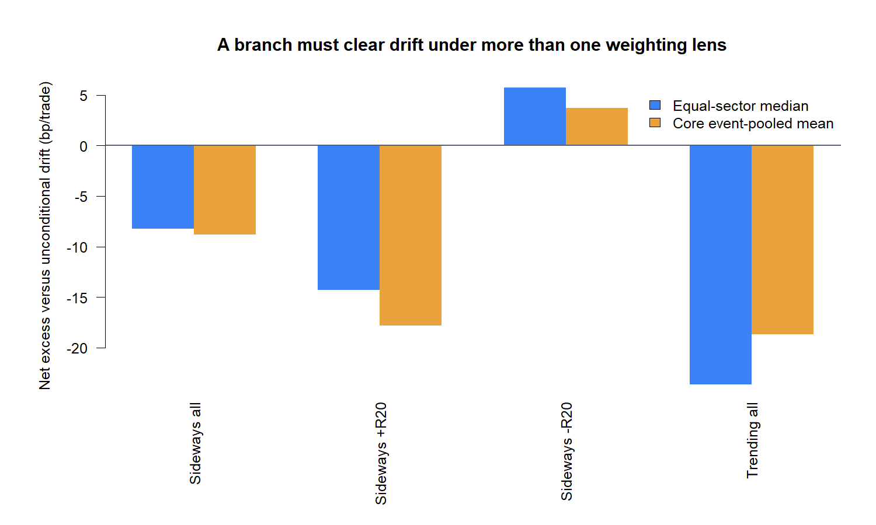
WEIGHTING ROBUSTNESS
The rebound readout survives both weighting lenses
Excess versus same-asset drift | bp per trade
27
Notes:
Only sideways-negative is above drift under both primary lenses: roughly +5.8 basis points equal-sector and +3.7 basis points event-pooled. Sideways-positive is about 15 to 19 basis points worse than sideways-negative, so the result is not merely a small continuation effect hidden by weighting.
[Sources]
- C:/Users/Franc/OneDrive/Documents/Francis/Peltata Project/Time-Series-Modeling-Gen5/runs/research_workbench/operator_hypothesis_lab/return_geometry_continuation_20d_attribution_20260829/equal_sector_rule_summary.csv
- C:/Users/Franc/OneDrive/Documents/Francis/Peltata Project/Time-Series-Modeling-Gen5/runs/research_workbench/operator_hypothesis_lab/return_geometry_continuation_20d_attribution_20260829/core_event_pooled_rule_summary.csv
- C:/Users/Franc/OneDrive/Documents/Francis/Peltata Project/Time-Series-Modeling-Gen5/runs/research_workbench/operator_hypothesis_lab/return_geometry_continuation_20d_attribution_20260829/pairwise_readout.csv
- C:/Users/Franc/OneDrive/Documents/Francis/Peltata Project/Time-Series-Modeling-Gen5/runs/research_workbench/operator_hypothesis_lab/return_geometry_continuation_20d_attribution_20260829/visuals/branch_excess_both_lenses.png
[/Sources]

Slide 28
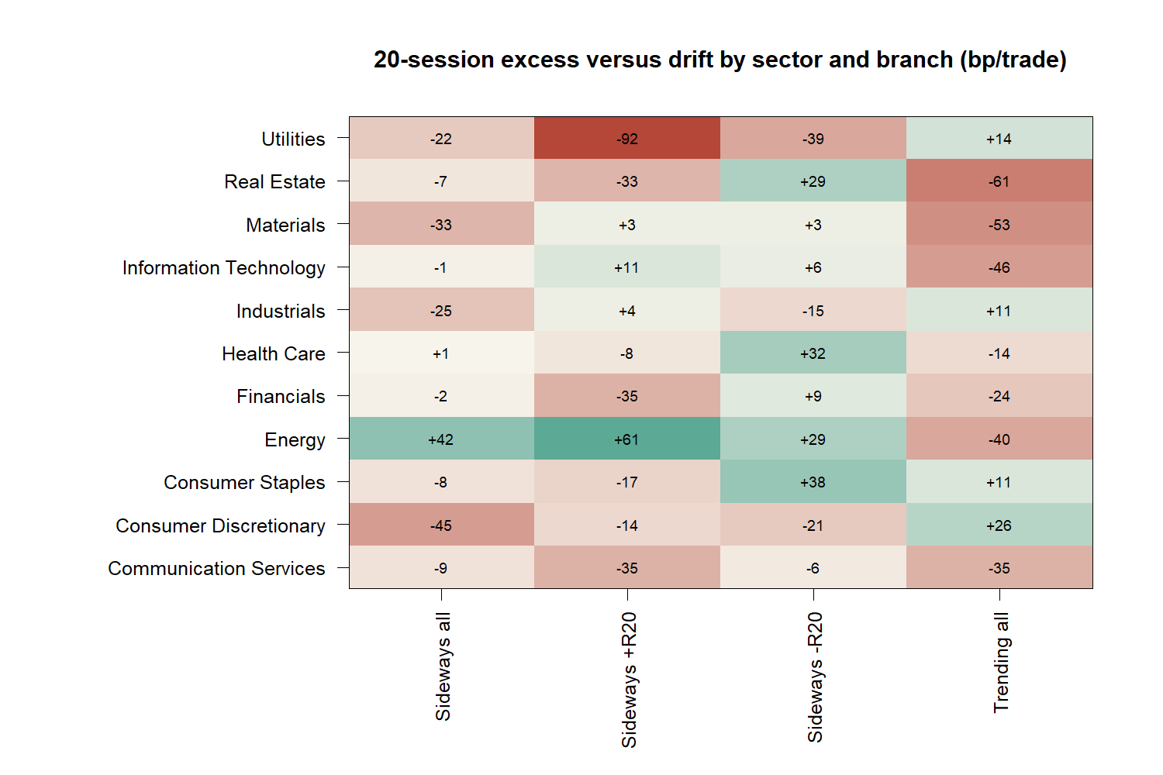
SECTOR BREADTH
The negative branch clears drift in 7 of 11 sectors
Sector median branch return minus same-asset drift | bp/trade
28
Notes:
The negative-prior sideways branch has positive median excess in seven of eleven sectors: Real Estate, Materials, Information Technology, Health Care, Financials, Energy, and Consumer Staples. Four sectors remain negative, so breadth is meaningful but incomplete and does not establish an asset-agnostic edge.
[Sources]
- C:/Users/Franc/OneDrive/Documents/Francis/Peltata Project/Time-Series-Modeling-Gen5/runs/research_workbench/operator_hypothesis_lab/return_geometry_continuation_20d_attribution_20260829/core_sector_rule_summary.csv
- C:/Users/Franc/OneDrive/Documents/Francis/Peltata Project/Time-Series-Modeling-Gen5/runs/research_workbench/operator_hypothesis_lab/return_geometry_continuation_20d_attribution_20260829/visuals/sector_branch_excess_heatmap.png
[/Sources]

Slide 29
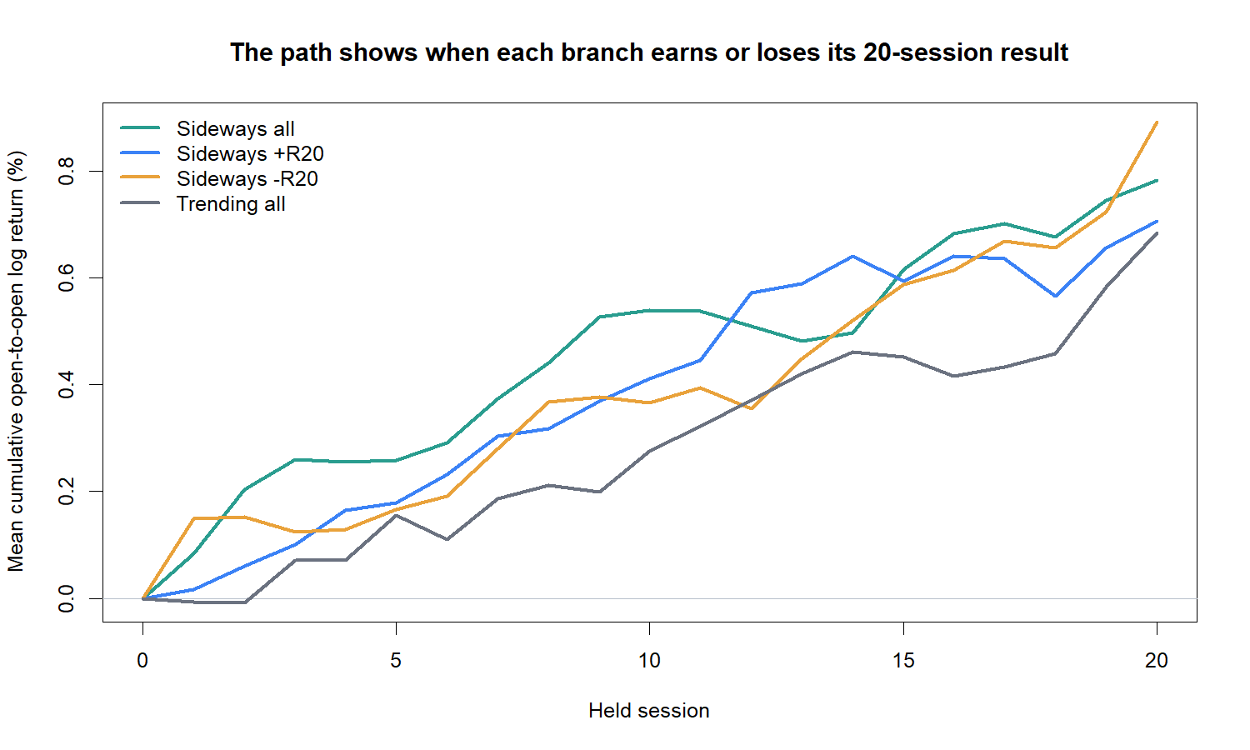
PATH SHAPE
The negative branch finishes strongest—but late
Core event-pooled mean path | 20-session executable trades
29
Notes:
The core event-pooled negative-prior path finishes highest. Much of its final separation appears late in the hold, including a visible last-session step. This is a useful fragility cue: the average result may depend on slow recovery or terminal-period behavior rather than a smooth, immediately deployable rebound.
[Sources]
- C:/Users/Franc/OneDrive/Documents/Francis/Peltata Project/Time-Series-Modeling-Gen5/runs/research_workbench/operator_hypothesis_lab/return_geometry_continuation_20d_attribution_20260829/trade_path_summary.csv
- C:/Users/Franc/OneDrive/Documents/Francis/Peltata Project/Time-Series-Modeling-Gen5/runs/research_workbench/operator_hypothesis_lab/return_geometry_continuation_20d_attribution_20260829/visuals/branch_trade_paths.png
[/Sources]

Slide 30
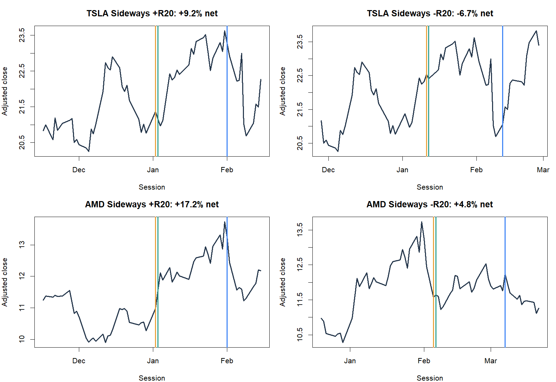
TRADE TAPES
Individual paths keep the modest aggregate honest
First eligible sign-qualified 20d events | deterministic, not outcome-selected
30
Notes:
The first eligible positive- and negative-prior events for TSLA and AMD are shown without outcome selection. The examples contain both strong and weak outcomes. Their purpose is to make timing and state assignment concrete; they do not override the cross-asset aggregate.
[Sources]
- C:/Users/Franc/OneDrive/Documents/Francis/Peltata Project/Time-Series-Modeling-Gen5/runs/research_workbench/operator_hypothesis_lab/return_geometry_continuation_20d_attribution_20260829/trade_ledger.csv
- C:/Users/Franc/OneDrive/Documents/Francis/Peltata Project/Time-Series-Modeling-Gen5/runs/research_workbench/operator_hypothesis_lab/return_geometry_continuation_20d_attribution_20260829/visuals/representative_sign_branch_trade_tapes.png
[/Sources]

Slide 31
MECHANISM READOUT
Continuation is falsified; a rebound lead remains
ATTRIBUTION
+R20 trails −R20
−15 bp equal-sector; −19 bp pooled
BASELINE
−R20 is the only branch above drift
+5.8 bp equal-sector; +3.7 bp pooled
BREADTH
Not a single-sector artifact
7 of 11 sector medians clear drift
STATUS
TRAIN mechanism attribution complete. Keep continuation stopped; treat rebound as a separate lead. No rule selection, OOS, portfolio replay, or 30-minute expansion yet.
Frozen 20d attribution | 88-stock equal-sector core | post-2023 sealed
31
Notes:
This slice changes the interpretation rather than rescuing the original hypothesis. Positive prior return does not explain the 20-session sideways-state result. Negative prior return does, modestly, under both primary weighting lenses and across seven sector medians. Because the horizon was learned from the same TRAIN surface, the rebound branch remains a development lead only and should receive a separately predeclared rule before any sealed-data test.
[Sources]
- C:/Users/Franc/OneDrive/Documents/Francis/Peltata Project/Time-Series-Modeling-Gen5/runs/research_workbench/operator_hypothesis_lab/return_geometry_continuation_20d_attribution_20260829/report.md
- C:/Users/Franc/OneDrive/Documents/Francis/Peltata Project/Time-Series-Modeling-Gen5/runs/research_workbench/operator_hypothesis_lab/return_geometry_continuation_20d_attribution_20260829/equal_sector_rule_summary.csv
- C:/Users/Franc/OneDrive/Documents/Francis/Peltata Project/Time-Series-Modeling-Gen5/runs/research_workbench/operator_hypothesis_lab/return_geometry_continuation_20d_attribution_20260829/core_event_pooled_rule_summary.csv
- C:/Users/Franc/OneDrive/Documents/Francis/Peltata Project/Time-Series-Modeling-Gen5/runs/research_workbench/operator_hypothesis_lab/return_geometry_continuation_20d_attribution_20260829/pairwise_readout.csv
- operator_hypothesis_lab/docs/RETURN_GEOMETRY_DAILY_CONTINUATION_MICROSCOPE_2018_2023.md
[/Sources]

