Slide 1
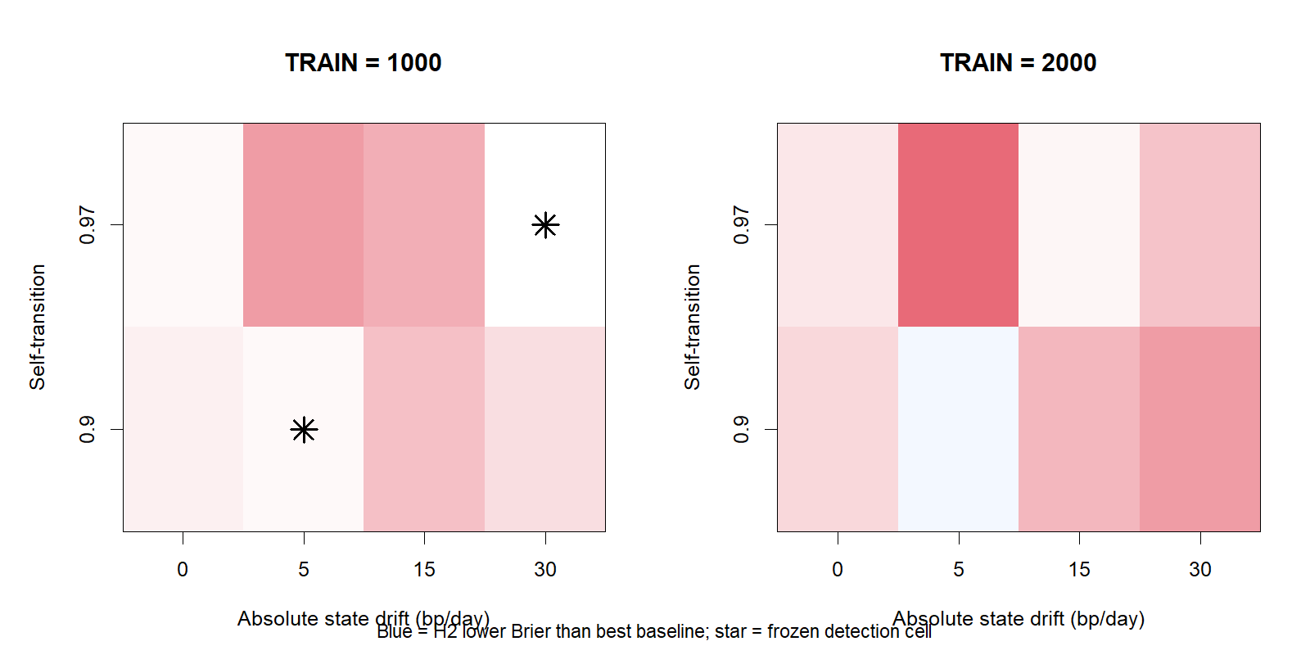
LIT-REG-02.2 · FORECAST-FIRST DIRECTIONAL HMM
Fresh forecast skill passed.
Robustness remained sparse.
24-case confirmation · 64-case frontier · financial-shaped stress
No market or strategy data
COMPLETE — MARKET NOT OPENED
Notes:
Open with both halves of the conclusion. The fresh positive control passed, but the broader power map and stress test constrained the claim.
COMPLETE refers only to completion of the synthetic evidence ladder.
[Sources]
- literature_studies/docs/GEN5_LIT_REG_02_2_DIRECTIONAL_FORECAST_RESULTS.md
- runs/research_workbench/literature_studies/lit_reg_02_2_directional_forecast_frontier_20260819/report.md

Slide 2
The scientific target changed; the 02.1 STOP did not
A hidden state can be useful machinery even when its daily hard label is imperfect.
02.1 · decoding-first
02.2 · forecast-first
• Can H2 recover the planted state every day?
• Hard-state and transition-tail gates were conjunctive.
• Result: 6/8 gates; STOP preserved.
• Do soft H20 probabilities improve proper scores?
• State recovery remains diagnostic, not promotional.
• Fresh seeds and a stronger B2 prevent retrospective rescue.
Same model. New scientific estimand. New contract. No reinterpretation of old evidence.
2
Notes:
Explain that changing the evaluation target is substantive enough to require decimal version 02.2.
The prior failure is neither erased nor counted as negative market-direction evidence.
[Sources]
- literature_studies/docs/GEN5_LIT_REG_02_2_DIRECTIONAL_FORECAST_DECISION.md
- literature_studies/docs/GEN5_LIT_REG_02_1_DIRECTIONAL_HMM_STAGE_A_RESULTS.md

Slide 3
H2 turns uncertain states into an H20 probability
Frozen challengers
rₜ = α[Sₜ] + φ[Sₜ] · rₜ₋₁ + σ[Sₜ] · εₜ
P(Sₜ = j | Sₜ₋₁ = i) = Aᵢⱼ
B0 TRAIN H20 base rate
B1 one-state Gaussian AR(1)
B2 λ=1 ridge logistic
r1 · r5 · r20 · vol20
O1 planted-state oracle
Primary causal target
P(rₜ₊₁ + … + rₜ₊₂₀ > 0 | information through t)
B2 asks whether hidden states add value beyond a direct, compact return-history forecast.
3
Notes:
H2 is still the same package-native Markov-switching AR(1). Only the evaluation hierarchy changed.
B2 has a fixed feature set and fixed ridge penalty; no feature or penalty search occurred.
[Sources]
- literature_studies/docs/GEN5_LIT_REG_02_2_DIRECTIONAL_FORECAST_POC_CONTRACT.md
- literature_studies/registries/gen5_lit_reg_02_2_directional_forecast_model_registry.csv
- literature_studies/docs/GEN5_LITERATURE_SOURCE_LEDGER.md

Slide 4
Fresh confirmation had to pass before the frontier could open
1 · Fresh confirmation
2 · Detection frontier
3 · Financial stress
4 · Market evidence
24 new seeds
8 conjunctive gates
64 unread cases
signal × persistence × history
10 Student-t/GARCH cases
Gaussian H2 misspecified
Still closed
new contract required
The first run’s schema-only row-binding failure changed no seed, fit, score, gate, or verdict; the complete rerun is authoritative.
4
Notes:
The frontier and stress stages were structurally sealed until Stage A passed all eight gates.
The reporter-only rerun is disclosed because auditability matters even when the scientific calculations did not change.
[Sources]
- literature_studies/docs/GEN5_LIT_REG_02_2_DIRECTIONAL_FORECAST_POC_CONTRACT.md
- runs/research_workbench/literature_studies/lit_reg_02_2_directional_forecast_frontier_20260819/reporter_rerun_note.txt

Slide 5
All eight fresh forecast-confirmation gates passed
Gate
Status
Observed evidence
A1
PASS
24/24 valid H2 and B2 fits
A2
PASS
causal append difference = 0
A3
PASS
exact parameter, probability, filter, and score replay
A4
PASS
Brier lower than B0/B1/B2; 17/18/16 wins; upper90 < 0
A5
PASS
log loss lower than B0/B1/B2; 17/18/16 wins; upper90 < 0
A6
PASS
calibration intercept 0.098; slope 0.725; sharpness 0.133
A7
PASS
oracle remained better; every probability and score finite
A8
PASS
fresh-seed integrity and B2 causal-origin audit
Fresh confirmation was genuinely stronger than 02.1: new seeds, more cases, and a direct ridge challenger.
5
Notes:
This is the confirmatory teaching result. Every criterion was fixed before the 24 cases were generated.
The confidence-bound requirement prevents a small mean improvement driven by a few large wins from passing alone.
[Sources]
- runs/research_workbench/literature_studies/lit_reg_02_2_directional_forecast_frontier_20260819/stage_a_gates.csv
- runs/research_workbench/literature_studies/lit_reg_02_2_directional_forecast_frontier_20260819/stage_a_skill_details.csv

Slide 6
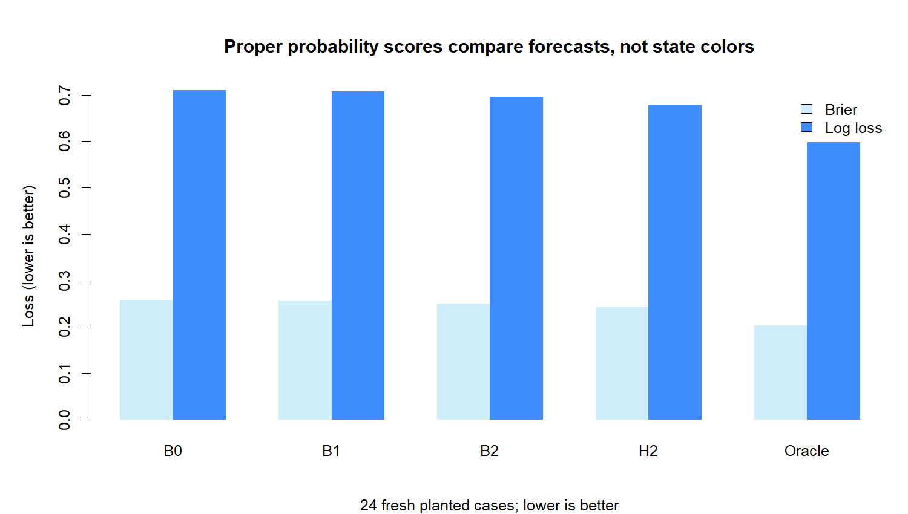
H2 beat every frozen non-oracle forecast on fresh cases
0.2422
H2 mean Brier
0.6771
H2 mean log loss
16 / 24
wins vs stronger B2
6
Notes:
Lower Brier and log loss are better. H2 also beat B0 and B1 in 17 and 18 cases respectively.
The oracle remains clearly better, showing that the fitted model did not recover all planted information.
[Sources]
- runs/research_workbench/literature_studies/lit_reg_02_2_directional_forecast_frontier_20260819/stage_a_case_summary.csv
- runs/research_workbench/literature_studies/lit_reg_02_2_directional_forecast_frontier_20260819/stage_a_forecast_scores.png

Slide 7
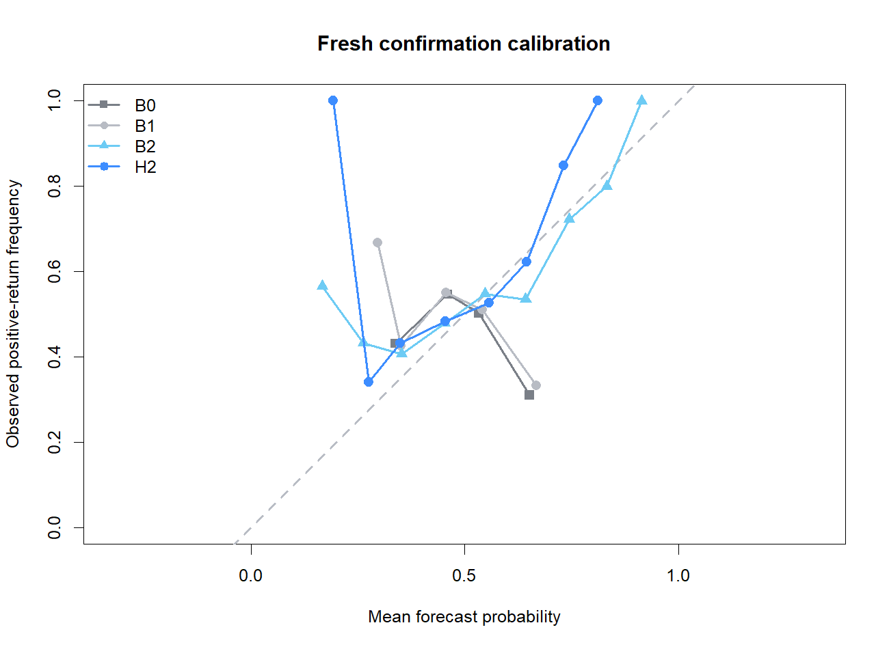
The probabilities were informative, but somewhat too extreme
Pooled H2 calibration
intercept +0.098
slope 0.725
sharpness 0.133
Slope < 1 means H2 separated probabilities more aggressively than outcomes justified.
The positive intercept means it modestly underpredicted the positive event overall.
Both stayed inside the frozen teaching bounds.
7
Notes:
Calibration asks whether predicted probabilities match observed frequencies, not merely whether the 50 percent label was correct.
The bounds were frozen at intercept ±0.50 and slope 0.50–1.50.
[Sources]
- runs/research_workbench/literature_studies/lit_reg_02_2_directional_forecast_frontier_20260819/stage_a_calibration.csv
- literature_studies/docs/GEN5_LIT_REG_02_2_DIRECTIONAL_FORECAST_POC_CONTRACT.md

Slide 8
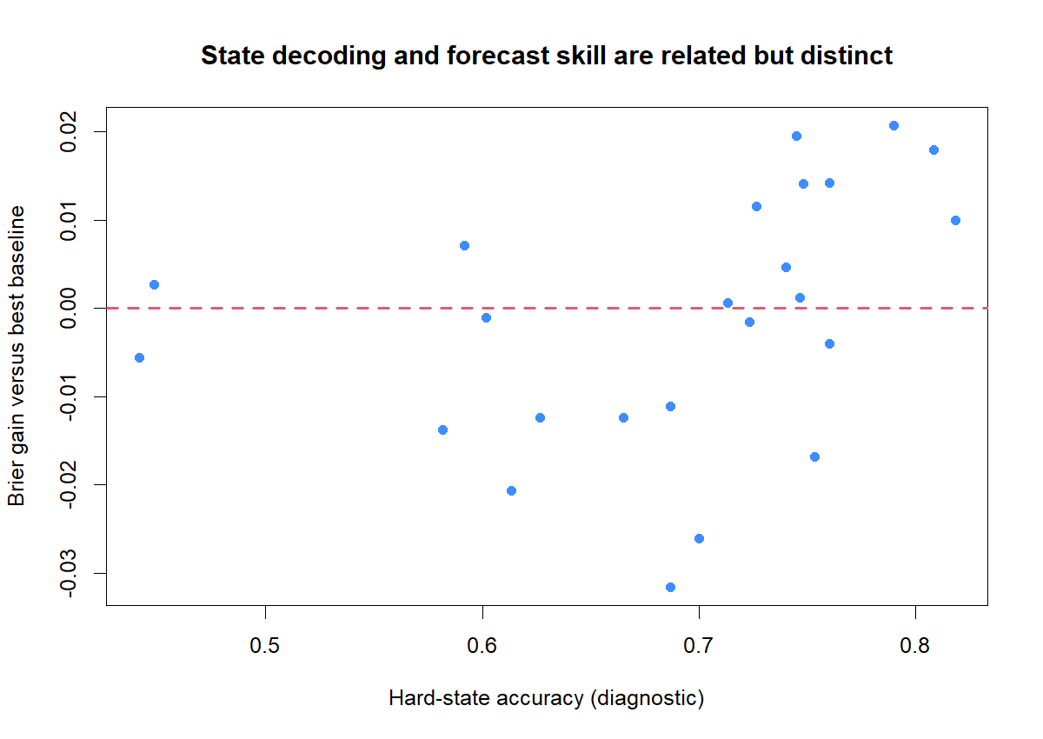
Forecast skill did not require an 85% hard-state hit rate
71.8%
median hard-state accuracy
Some cases gained probability skill with mediocre labels; others decoded states reasonably well without beating the strongest baseline.
Soft probabilities and hard colors answer different questions.
8
Notes:
The dashed horizontal line is zero Brier gain versus the best named baseline in that case.
State accuracy remains useful for mechanism interpretation, but it no longer overrides the proper forecast scores.
[Sources]
- runs/research_workbench/literature_studies/lit_reg_02_2_directional_forecast_frontier_20260819/stage_a_case_summary.csv
- runs/research_workbench/literature_studies/lit_reg_02_2_directional_forecast_frontier_20260819/stage_a_state_vs_skill.png

Slide 9
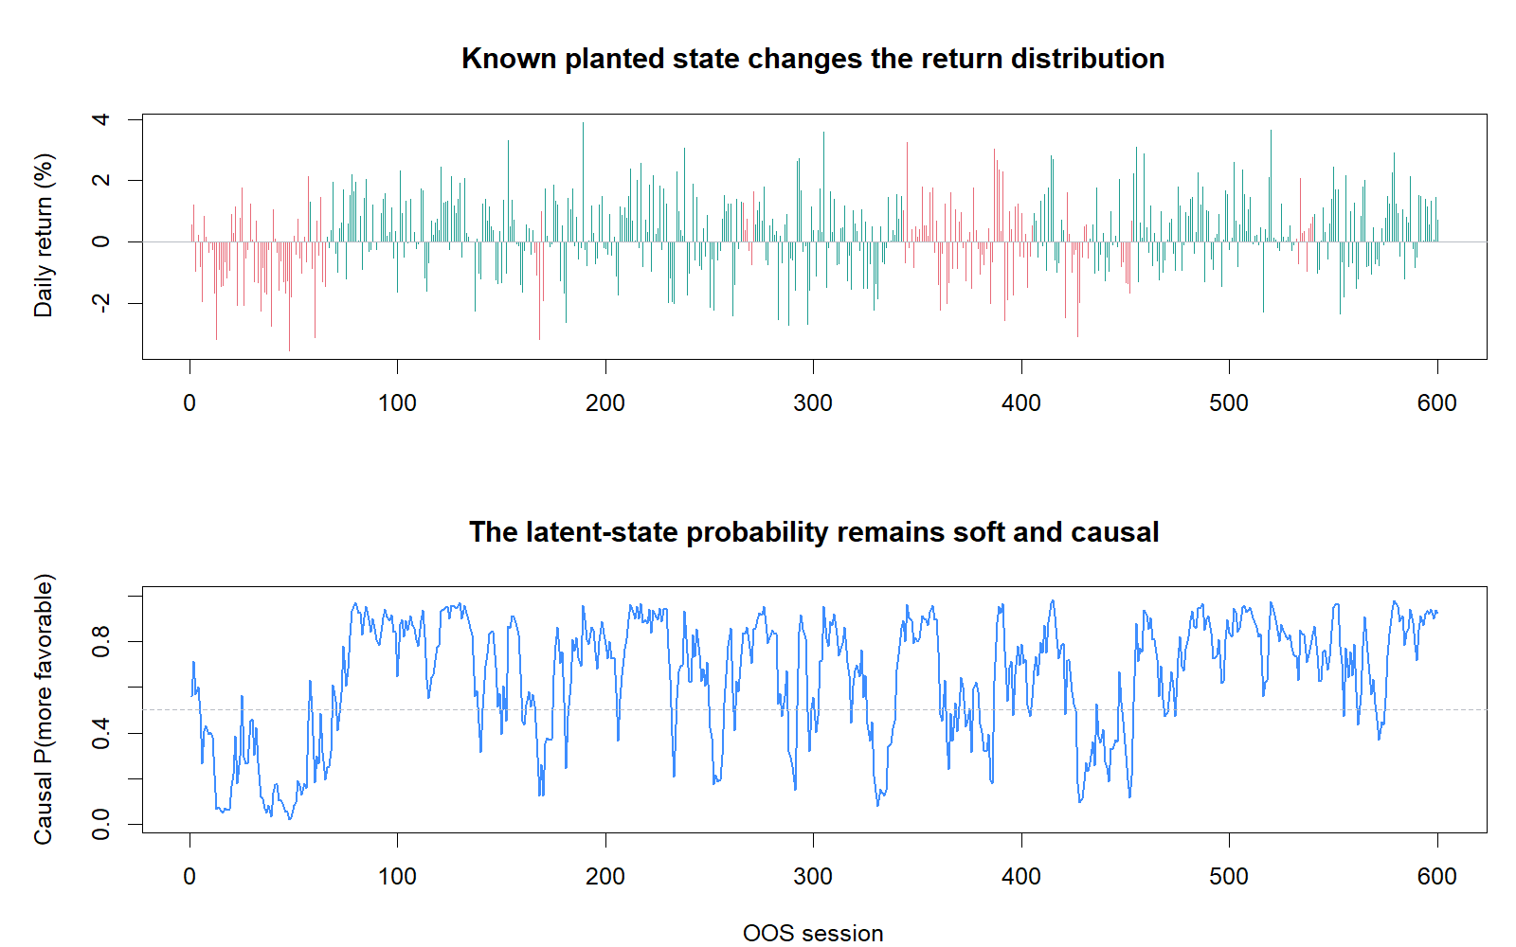
The causal tape expresses uncertainty instead of revising history
What to notice
• Return distributions overlap even when the state is known.
• Probability moves gradually and remains uncertain near switches.
• Appending later observations changes no earlier filtered value.
append difference = 0
9
Notes:
This is a representative teaching case, not a cherry-picked market tape.
The probability is filtered causally; it is not a smoothed hindsight probability.
[Sources]
- runs/research_workbench/literature_studies/lit_reg_02_2_directional_forecast_frontier_20260819/stage_a_representative_probability_tape.csv
- runs/research_workbench/literature_studies/lit_reg_02_2_directional_forecast_frontier_20260819/stage_a_causality_replay_checks.csv

Slide 10
The broader forecast frontier was sparse and non-monotonic
2 / 16
formal detection cells
0 / 4
null cells detected
More drift, persistence, or history did not produce a smooth improvement.
Do not treat the starred cells as chosen parameters.
10
Notes:
Blue indicates positive mean Brier gain against the per-case best named baseline; red indicates loss.
The formal cell rule used mean H2 improvement versus each named baseline plus at least three joint replicate wins.
[Sources]
- runs/research_workbench/literature_studies/lit_reg_02_2_directional_forecast_frontier_20260819/stage_b_frontier_summary.csv
- literature_studies/docs/GEN5_LIT_REG_02_2_DIRECTIONAL_FORECAST_POC_CONTRACT.md

Slide 11
Two formal detections do not make a stable boundary
TRAIN
Persistence
Drift
Joint wins
Gain vs per-case best
1,000
0.90
5 bp
3 / 4
−0.00093
1,000
0.97
30 bp
3 / 4
+0.00025
Why can a formal cell have negative gain versus “best”?
The contract compares H2 with each deployable baseline across the cell and requires 3/4 joint wins. The diagnostic “per-case best” composite chooses B0, B1, or B2 after seeing each replicate. It is intentionally harsher—and the negative value reveals one large losing replicate and weak stability.
11
Notes:
The 5 bp cell passed the literal frozen definition, but the ex-post composite diagnostic shows why it should not be celebrated.
With four replicates per cell, the map is characterization evidence, not a smooth estimate of power.
[Sources]
- runs/research_workbench/literature_studies/lit_reg_02_2_directional_forecast_frontier_20260819/stage_b_frontier_summary.csv
- literature_studies/docs/GEN5_LIT_REG_02_2_DIRECTIONAL_FORECAST_RESULTS.md

Slide 12
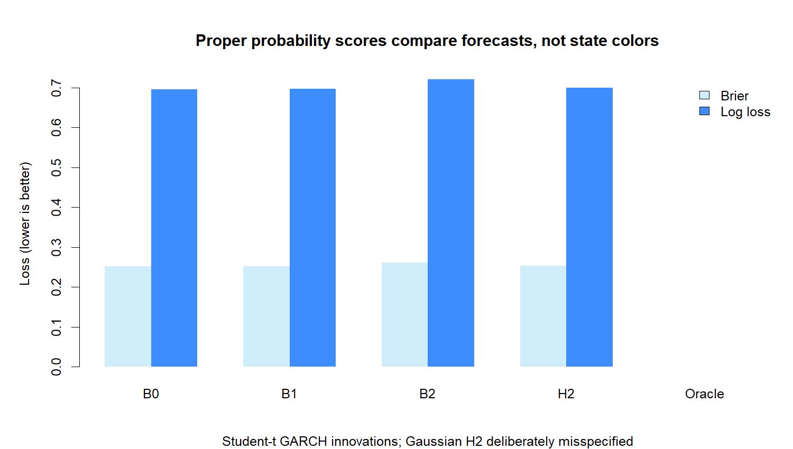
Financial-shaped noise erased the average edge
Mean Brier
H2 0.2532
B0 0.2517
B1 0.2519
B2 0.2616
H2 still beat B2 in 8/10 cases, but trailed the simpler B0 and B1 on average.
The Gaussian H2 was deliberately misspecified; this is a robustness boundary, not market evidence.
12
Notes:
The same pattern held for mean log loss: H2 0.6998 versus B0 0.6965 and B1 0.6971.
Stage C had no promotion gate; it was designed to reveal degradation under heavy tails and volatility clustering.
[Sources]
- runs/research_workbench/literature_studies/lit_reg_02_2_directional_forecast_frontier_20260819/stage_c_case_summary.csv
- literature_studies/docs/GEN5_LIT_REG_02_2_DIRECTIONAL_FORECAST_POC_CONTRACT.md

Slide 13
Preserve the mechanism clue—and the robustness warning
H2 can add synthetic H20 probability information.
This specification is not ready for market or strategy contact.
Preserve
Still closed
• fresh 8/8 confirmation pass
• skill versus stronger B2
• zero null-cell detections
• causal and deterministic machinery
• market and residual data
• strategy thresholds and returns
• combined volatility-direction filter
• live advice or execution
Next discussion: denser predeclared replication or a real-residual semi-synthetic bridge—not retrospective parameter selection.
13
Notes:
Close by separating the positive scientific result from any claim of deployability.
Neither proposed next path is authorized by this deck; each requires a new frozen contract.
[Sources]
- literature_studies/docs/GEN5_LIT_REG_02_2_DIRECTIONAL_FORECAST_RESULTS.md
- runs/research_workbench/literature_studies/lit_reg_02_2_directional_forecast_frontier_20260819/verdict.txt

