Slide 1
GEN5 / FROZEN T1 EVIDENCE
T1 stops at the
mechanism gate
T1
5 / 9
gates pass
A valid monthly trend test produced useful defense,
not reliable asset-selection edge.
STOP_T1_TREND_PERSISTENCE
DIALOGUE D51
Notes:
Opening result. The implementation honored the frozen contract and produced valid evidence, but the primary persistence and exposure-matched return gates failed.
Dialogue reference: D51 - codex://threads/019f741e-615f-7fd0-90f7-edce12b5cb66
[Sources]
- C:/Users/Franc/OneDrive/Documents/Francis/Peltata Project/Time-Series-Modeling-Gen5/docs/GEN5_T1_MULTI_ASSET_TREND_POC_CONTRACT.md
- C:/Users/Franc/OneDrive/Documents/Francis/Peltata Project/Time-Series-Modeling-Gen5/runs/research_workbench/retail_quant_mechanisms/t1_multi_asset_trend_20260727/t1_report.md
[/Sources]

Slide 2
GEN5 / T1 MULTI-ASSET TREND EVIDENCE
The experiment stayed exactly frozen
SIGNAL
12-month asset log return − 12-month BIL log return > 0
Month-end close
17:30 ET
Following open
Next following open
observe completed month
compute ON / OFF
rebalance 14 fixed sleeves
measure monthly result
Equal 1/14 sleeves • OFF to BIL • 5 bp primary / 10 bp stress • no fitting, scaling, ranking, leverage, or same-close execution
DIALOGUE D50-D51
Notes:
T1 used the predeclared universe, signal, timing, fixed-sleeve portfolio, controls, cost assumptions, windows, and nine gates. Nothing was optimized after seeing outcomes.
Dialogue reference: D50-D51 - codex://threads/019f741e-615f-7fd0-90f7-edce12b5cb66
[Sources]
- C:/Users/Franc/OneDrive/Documents/Francis/Peltata Project/Time-Series-Modeling-Gen5/docs/GEN5_T1_MULTI_ASSET_TREND_POC_CONTRACT.md
- C:/Users/Franc/OneDrive/Documents/Francis/Peltata Project/Time-Series-Modeling-Gen5/runs/research_workbench/retail_quant_mechanisms/t1_multi_asset_trend_20260727/t1_frozen_contract.csv
[/Sources]

Slide 3
GEN5 / T1 MULTI-ASSET TREND EVIDENCE
All fifteen histories match the reference calendar
2,638
15 / 15
0
10 / 10
sessions per symbol
complete symbols
missing sessions
integrity checks
2016-01-04 → 2026-07-01
Every risk ETF and BIL has the same first session, last session, and reference-session count.
The generic workbench keeps a WARN because the calendar request starts on a holiday and ends before the run date. The T1-specific session audit proves there are no missing or extra market sessions; the raw warning remains visible.
DIALOGUE D51
Notes:
The generic workbench warning is a calendar-boundary artifact, not partial market history. T1 retains the raw warning while separately proving exact reference-session coverage for all fifteen symbols.
Dialogue reference: D51 - codex://threads/019f741e-615f-7fd0-90f7-edce12b5cb66
[Sources]
- C:/Users/Franc/OneDrive/Documents/Francis/Peltata Project/Time-Series-Modeling-Gen5/runs/research_workbench/retail_quant_mechanisms/t1_multi_asset_trend_20260727/t1_integrity_audit.csv
- C:/Users/Franc/OneDrive/Documents/Francis/Peltata Project/Time-Series-Modeling-Gen5/runs/research_workbench/retail_quant_mechanisms/t1_multi_asset_trend_20260727/t1_session_coverage_audit.csv
- C:/Users/Franc/OneDrive/Documents/Francis/Peltata Project/Time-Series-Modeling-Gen5/runs/research_workbench/retail_quant_mechanisms/t1_multi_asset_trend_20260727/t1_workbench_query_health.csv
[/Sources]

Slide 4
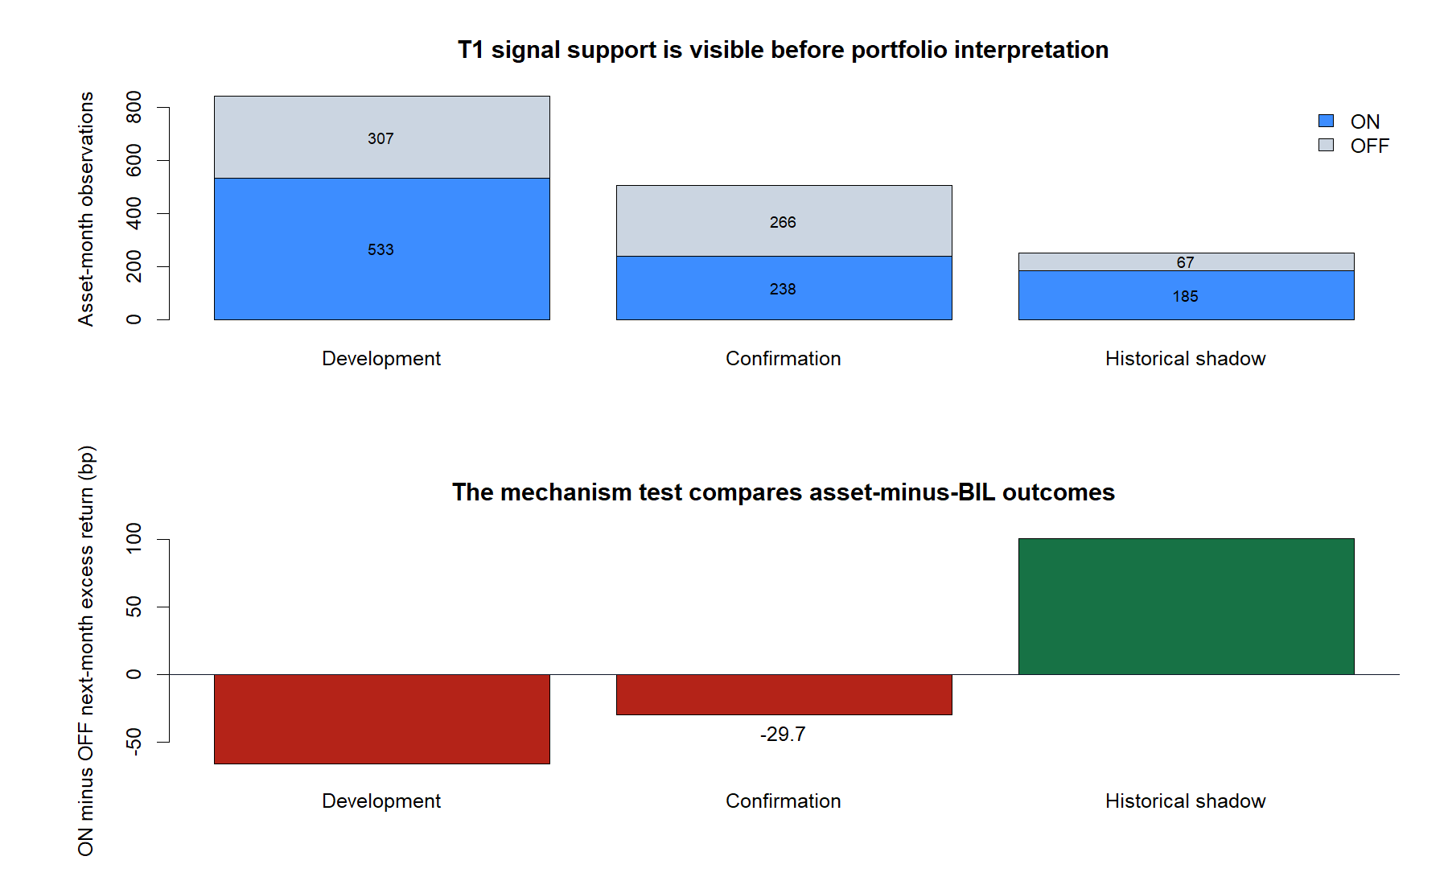
GEN5 / T1 MULTI-ASSET TREND EVIDENCE
The persistence mechanism failed in confirmation
−29.7 bp
confirmation ON − OFF
next-month excess return
The failure is not caused by an empty state:
238 ON observations
266 OFF observations
across 2022–2024.
G2 FAIL
DIALOGUE D51
Notes:
The primary mechanism gate asks whether ON observations subsequently beat OFF observations relative to BIL. In confirmation, the sign is negative despite adequate support in both states.
Dialogue reference: D51 - codex://threads/019f741e-615f-7fd0-90f7-edce12b5cb66
[Sources]
- C:/Users/Franc/OneDrive/Documents/Francis/Peltata Project/Time-Series-Modeling-Gen5/runs/research_workbench/retail_quant_mechanisms/t1_multi_asset_trend_20260727/t1_signal_support.csv
- C:/Users/Franc/OneDrive/Documents/Francis/Peltata Project/Time-Series-Modeling-Gen5/runs/research_workbench/retail_quant_mechanisms/t1_multi_asset_trend_20260727/t1_measurement_pooled.csv
- C:/Users/Franc/OneDrive/Documents/Francis/Peltata Project/Time-Series-Modeling-Gen5/runs/research_workbench/retail_quant_mechanisms/t1_multi_asset_trend_20260727/visuals/t1_signal_support.png
[/Sources]

Slide 5
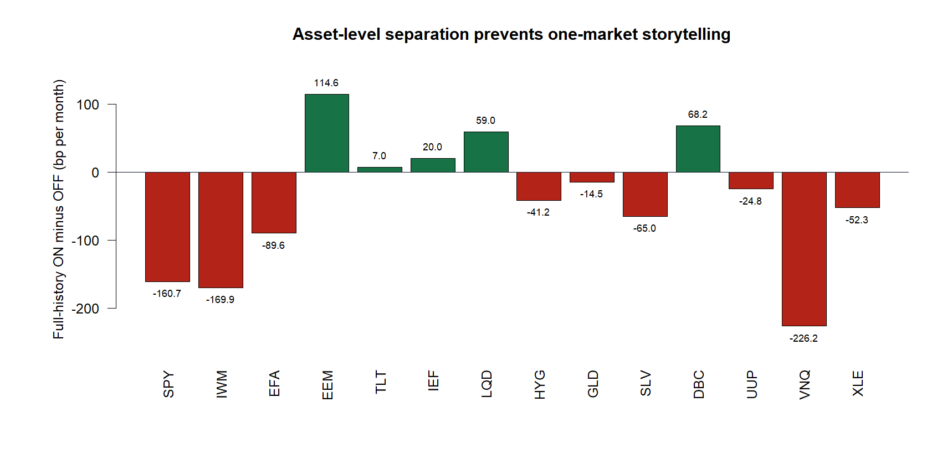
GEN5 / T1 MULTI-ASSET TREND EVIDENCE
The failure is broad, not one unlucky sleeve
5 / 14
assets with positive
full-history separation
Positive:
EEM TLT IEF
LQD DBC
Frozen gate: at least 8 / 14
DIALOGUE D51
Notes:
Only five frozen risk assets show positive full-history state separation. The result therefore cannot be attributed to one isolated bad asset or rescued by deleting weak sleeves after inspection.
Dialogue reference: D51 - codex://threads/019f741e-615f-7fd0-90f7-edce12b5cb66
[Sources]
- C:/Users/Franc/OneDrive/Documents/Francis/Peltata Project/Time-Series-Modeling-Gen5/runs/research_workbench/retail_quant_mechanisms/t1_multi_asset_trend_20260727/t1_measurement_by_asset.csv
- C:/Users/Franc/OneDrive/Documents/Francis/Peltata Project/Time-Series-Modeling-Gen5/runs/research_workbench/retail_quant_mechanisms/t1_multi_asset_trend_20260727/visuals/t1_asset_separation.png
[/Sources]

Slide 6
TRANSITION / MECHANISM VERSUS RISK SHAPING
Defense is real.
It is not selection alpha.
≠
risk control
≠ alpha
T1 reduced risky exposure in damaging periods.
But the asset-specific trend choices did not beat a control
with the same aggregate risky exposure.
DIALOGUE D51
Notes:
This is the central interpretive distinction. A strategy can reduce drawdown by spending less time in risk assets even when its asset-specific signal adds no selection value.
Dialogue reference: D51 - codex://threads/019f741e-615f-7fd0-90f7-edce12b5cb66
[Sources]
- C:/Users/Franc/OneDrive/Documents/Francis/Peltata Project/Time-Series-Modeling-Gen5/runs/research_workbench/retail_quant_mechanisms/t1_multi_asset_trend_20260727/t1_report.md
- C:/Users/Franc/OneDrive/Documents/Francis/Peltata Project/Time-Series-Modeling-Gen5/runs/research_workbench/retail_quant_mechanisms/t1_multi_asset_trend_20260727/t1_gate_summary.csv
[/Sources]

Slide 7
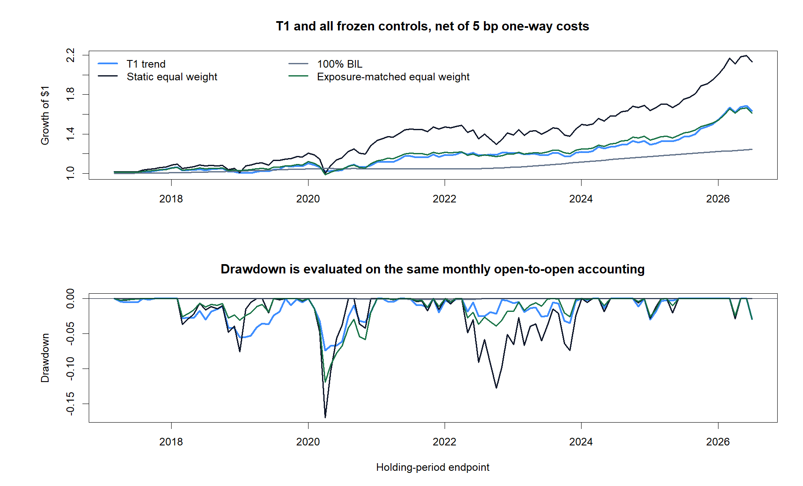
GEN5 / T1 MULTI-ASSET TREND EVIDENCE
T1 cut drawdown—but trailed the exposure-matched control
3.29%
T1 CAGR
−3.51%
T1 max drawdown
3.88%
exposure-matched CAGR
T1 disadvantage: −0.59 pp
Static EW drawdown: −12.79%
Drawdown reduction: 72.5%
DIALOGUE D51
Notes:
The portfolio-level defense is economically visible: T1's maximum drawdown is much smaller than static equal weight. The exposure-matched control, however, compounds faster, so the frozen asset-selection gate fails.
Dialogue reference: D51 - codex://threads/019f741e-615f-7fd0-90f7-edce12b5cb66
[Sources]
- C:/Users/Franc/OneDrive/Documents/Francis/Peltata Project/Time-Series-Modeling-Gen5/runs/research_workbench/retail_quant_mechanisms/t1_multi_asset_trend_20260727/t1_primary_confirmation_metrics.csv
- C:/Users/Franc/OneDrive/Documents/Francis/Peltata Project/Time-Series-Modeling-Gen5/runs/research_workbench/retail_quant_mechanisms/t1_multi_asset_trend_20260727/visuals/t1_equity_drawdown.png
[/Sources]

Slide 8
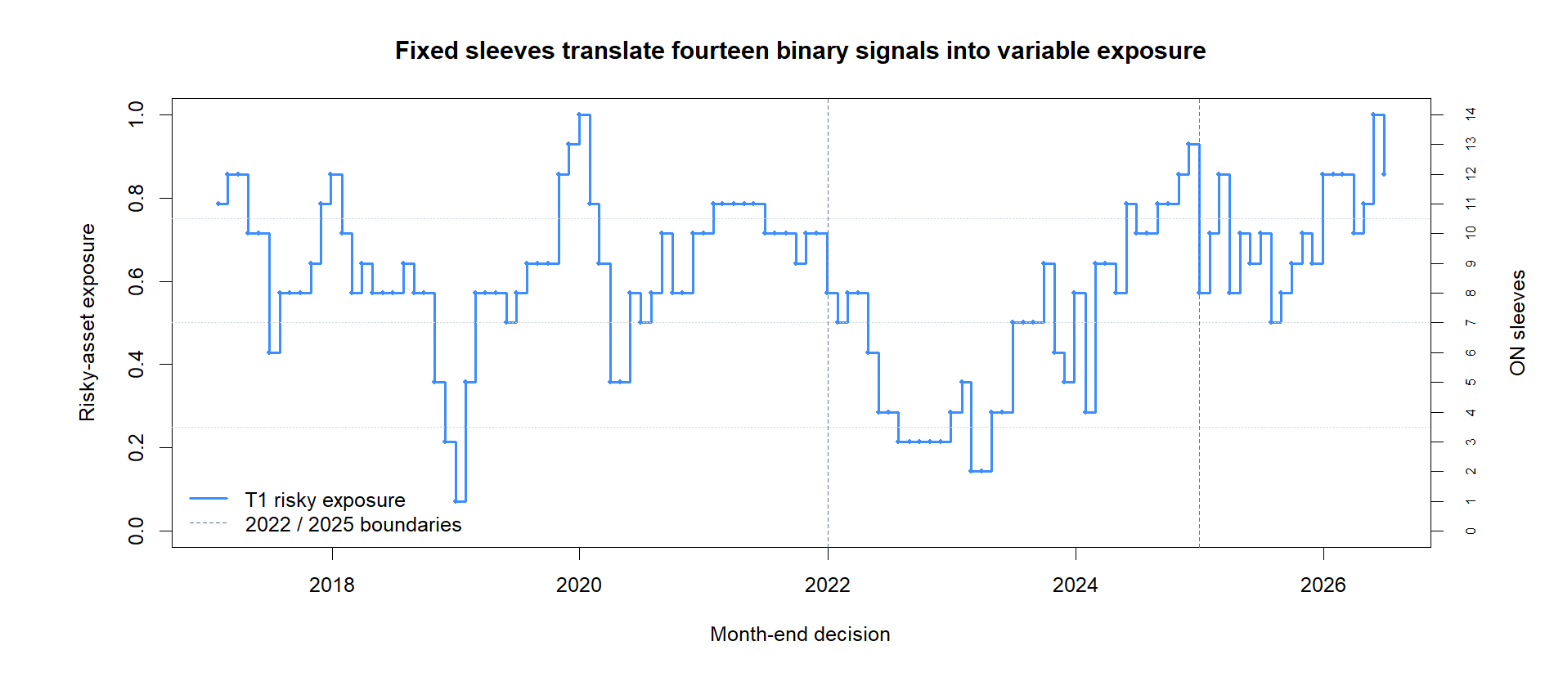
GEN5 / T1 MULTI-ASSET TREND EVIDENCE
The exposure tape shows what the rule actually did
47.2%
mean risky exposure
in confirmation
OFF sleeves moved to BIL.
Fourteen binary sleeves therefore created variable portfolio exposure.
Measure exposure separately from selection.
DIALOGUE D51
Notes:
The fixed binary sleeves produce continuous portfolio-level risky exposure because different assets switch at different dates. That makes the exposure-matched control essential.
Dialogue reference: D51 - codex://threads/019f741e-615f-7fd0-90f7-edce12b5cb66
[Sources]
- C:/Users/Franc/OneDrive/Documents/Francis/Peltata Project/Time-Series-Modeling-Gen5/runs/research_workbench/retail_quant_mechanisms/t1_multi_asset_trend_20260727/t1_primary_replay.csv
- C:/Users/Franc/OneDrive/Documents/Francis/Peltata Project/Time-Series-Modeling-Gen5/runs/research_workbench/retail_quant_mechanisms/t1_multi_asset_trend_20260727/visuals/t1_risky_exposure_tape.png
[/Sources]

Slide 9
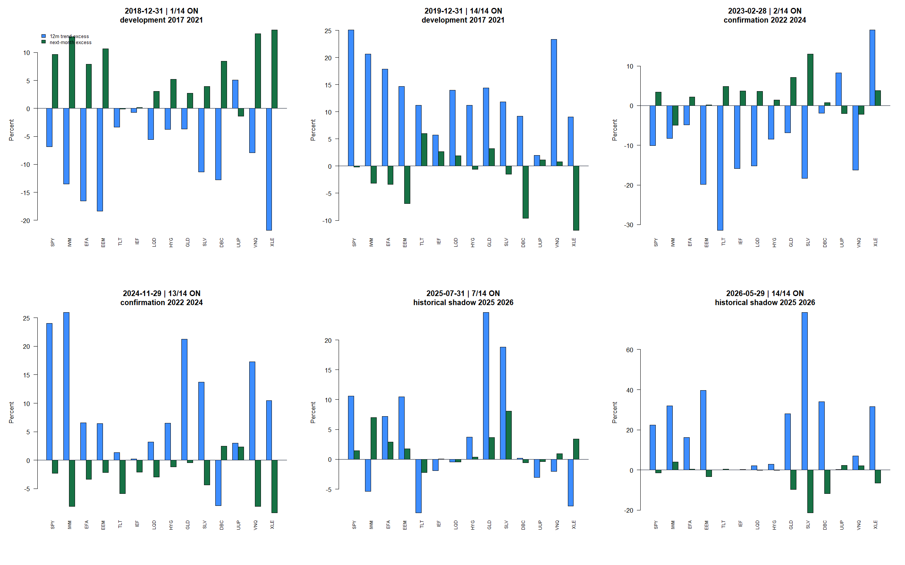
GEN5 / T1 MULTI-ASSET TREND EVIDENCE
Representative decisions make the timing inspectable
DIALOGUE D51
Notes:
These panels expose signal formation, the BIL-relative hurdle, and next-open execution on representative ON and OFF decisions. They provide a human check against same-close leakage or hidden timing assumptions.
Dialogue reference: D51 - codex://threads/019f741e-615f-7fd0-90f7-edce12b5cb66
[Sources]
- C:/Users/Franc/OneDrive/Documents/Francis/Peltata Project/Time-Series-Modeling-Gen5/runs/research_workbench/retail_quant_mechanisms/t1_multi_asset_trend_20260727/t1_observation_panel.csv
- C:/Users/Franc/OneDrive/Documents/Francis/Peltata Project/Time-Series-Modeling-Gen5/runs/research_workbench/retail_quant_mechanisms/t1_multi_asset_trend_20260727/visuals/t1_representative_decision_tapes.png
[/Sources]

Slide 10
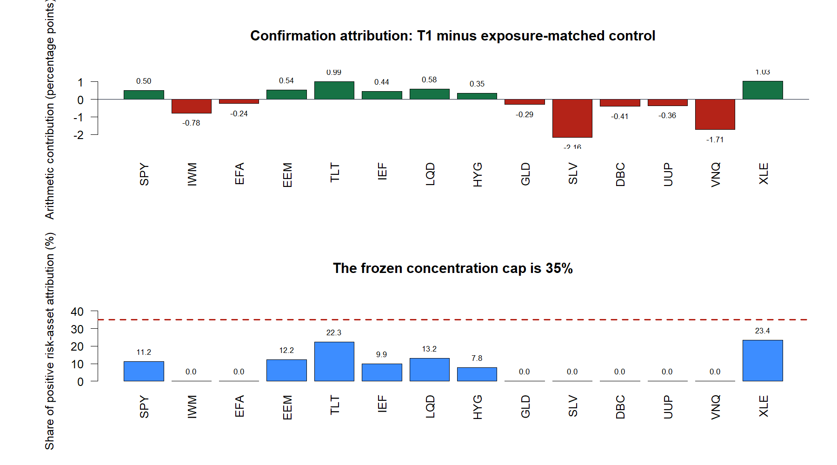
GEN5 / T1 MULTI-ASSET TREND EVIDENCE
No single winner rescues the aggregate result
23.4%
largest positive
contribution share
Frozen cap: 35%
G7 passes.
Diversification does not rescue a negative aggregate advantage.
DIALOGUE D51
Notes:
Concentration control passes: no asset contributes more than 35% of positive arithmetic advantage. That verifies diversification but cannot rescue the failed aggregate exposure-matched comparison.
Dialogue reference: D51 - codex://threads/019f741e-615f-7fd0-90f7-edce12b5cb66
[Sources]
- C:/Users/Franc/OneDrive/Documents/Francis/Peltata Project/Time-Series-Modeling-Gen5/runs/research_workbench/retail_quant_mechanisms/t1_multi_asset_trend_20260727/t1_attribution_summary.csv
- C:/Users/Franc/OneDrive/Documents/Francis/Peltata Project/Time-Series-Modeling-Gen5/runs/research_workbench/retail_quant_mechanisms/t1_multi_asset_trend_20260727/visuals/t1_asset_attribution.png
[/Sources]

Slide 11
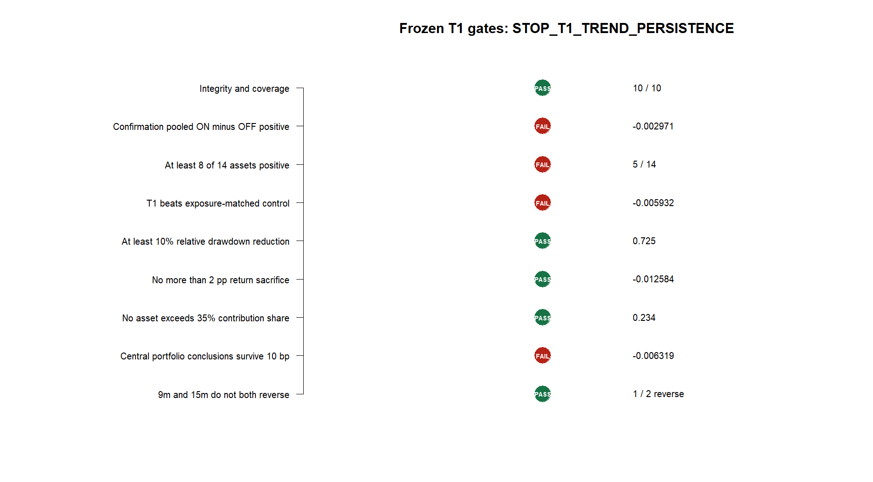
GEN5 / T1 MULTI-ASSET TREND EVIDENCE
Five gates pass; four mechanism gates stop T1
5 / 9
frozen gates pass
FAILED
confirmation ON−OFF sign
asset breadth
exposure-matched return
10 bp central conclusion
What survives: the fixed-sleeve measurement architecture and the exposure-matched control.
Next operator discussion: M1 cross-sectional momentum—not a T1 rescue.
STOP_T1_TREND_PERSISTENCE
DIALOGUE D51
Notes:
T1 stops because the frozen mechanism gates fail, not because the run was invalid. The next serious avenue is a separately frozen cross-sectional momentum discussion, which asks a different ranking question rather than retuning T1.
Dialogue reference: D51 - codex://threads/019f741e-615f-7fd0-90f7-edce12b5cb66
[Sources]
- C:/Users/Franc/OneDrive/Documents/Francis/Peltata Project/Time-Series-Modeling-Gen5/runs/research_workbench/retail_quant_mechanisms/t1_multi_asset_trend_20260727/t1_gate_summary.csv
- C:/Users/Franc/OneDrive/Documents/Francis/Peltata Project/Time-Series-Modeling-Gen5/runs/research_workbench/retail_quant_mechanisms/t1_multi_asset_trend_20260727/visuals/t1_gate_summary.png
- C:/Users/Franc/OneDrive/Documents/Francis/Peltata Project/Time-Series-Modeling-Gen5/docs/GEN5_RETAIL_QUANT_MECHANISM_POC_ATLAS.md
[/Sources]

