Slide 1
Gen5.4
ML decision engine
Research only
Incremental build log: supervised feature and label proof before model fitting.
No model fit
No live bridge change
No allocation evidence
ML-P0 packet: adjusted daily OHLCV -> features through close t -> next-open h3 label.

Slide 2
GEN5.4 ML DECISION ENGINE
The PCA work taught us where to aim the ML fork
-
PCA states contained useful exposure information, especially in state-only diagnostics.
OHLCV feature table
-
The same states still overparticipated in 2022 and missed too much early upside in rebound windows.
Supervised h3 label
-
Gen5.4 asks the daily exposure question directly instead of routing through a technical strategy first.
Daily long/flat policy
The first build proves the first two boxes only.

Slide 3
GEN5.4 ML DECISION ENGINE
ML-P0 succeeds only if the table is boringly correct
USABLE LABELED ROWS
SELECTED FEATURES
LEAKAGE AUDIT
22,440
40
All PASS
Rows eligible after fold and horizon filters.
PCA-inspired plus explicit OHLCV additions.
TRAIN labels stay inside TRAIN; OOS labels stay inside OOS.
-
Features are known after close t.
-
The h3 label ends at close three sessions later.
-
Hypothetical execution starts at next open.
-
Rows without a complete horizon are excluded from the proof table.

Slide 4
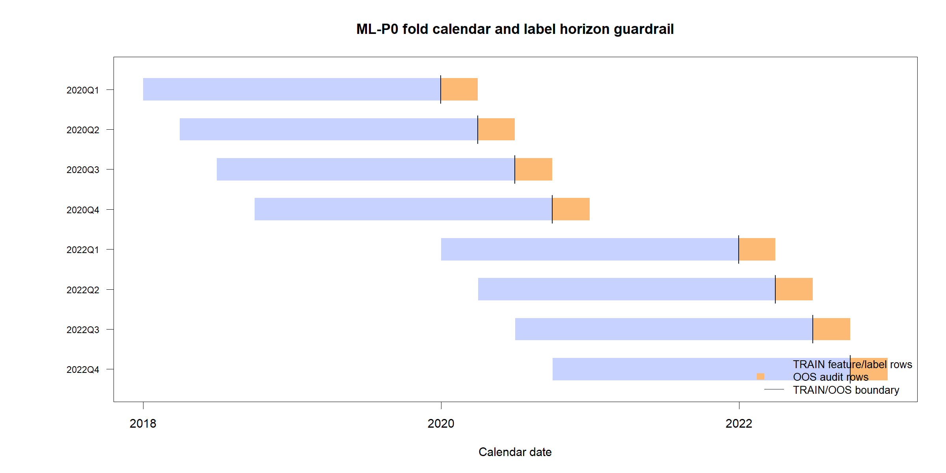
GEN5.4 ML DECISION ENGINE
The fold calendar makes the leakage rule visible
Why it matters
A TRAIN example is not eligible unless its future h3 label finishes before the TRAIN/OOS boundary. OOS labels are allowed for inspection, but they never feed model fitting or threshold choice.

Slide 5
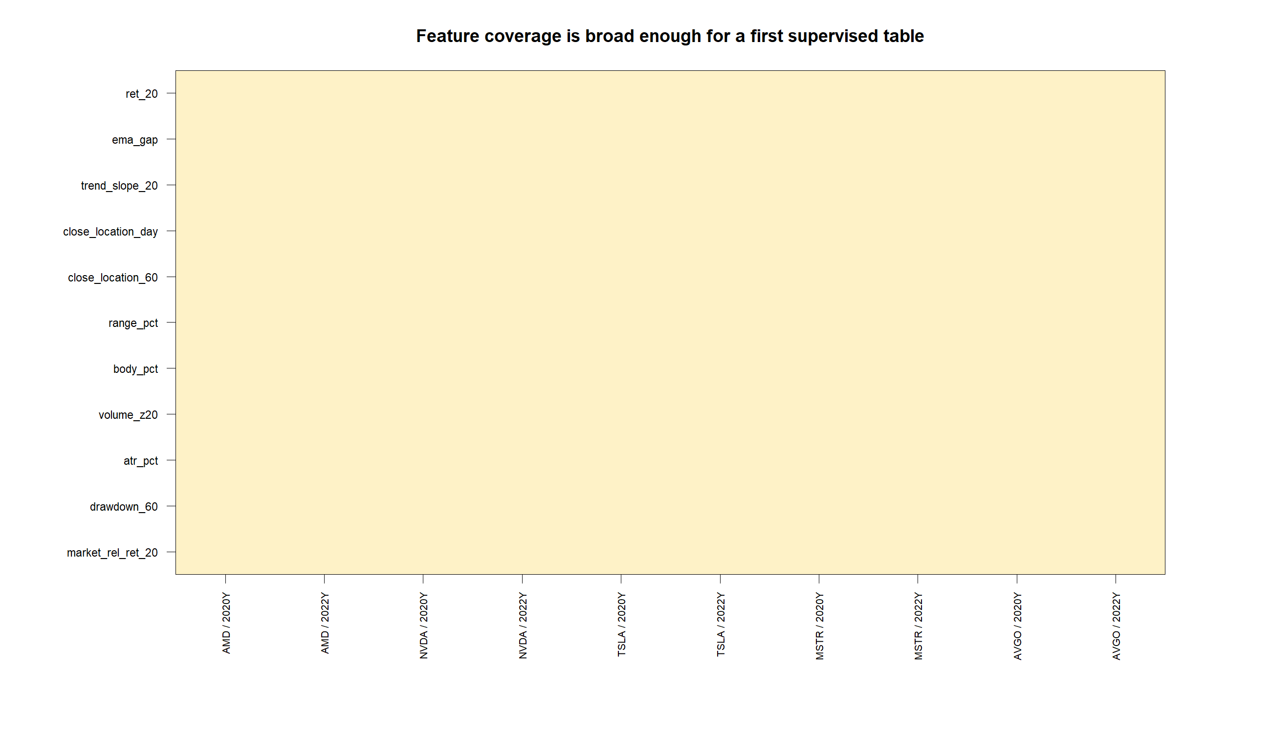
GEN5.4 ML DECISION ENGINE
OHLCV adds information that close-to-close would discard
The first feature table is complete enough to model from.
-
Candle body, wick, gap, range, and volume features are populated across both windows.
-
This does not prove alpha. It proves the supervised surface is technically usable.

Slide 6
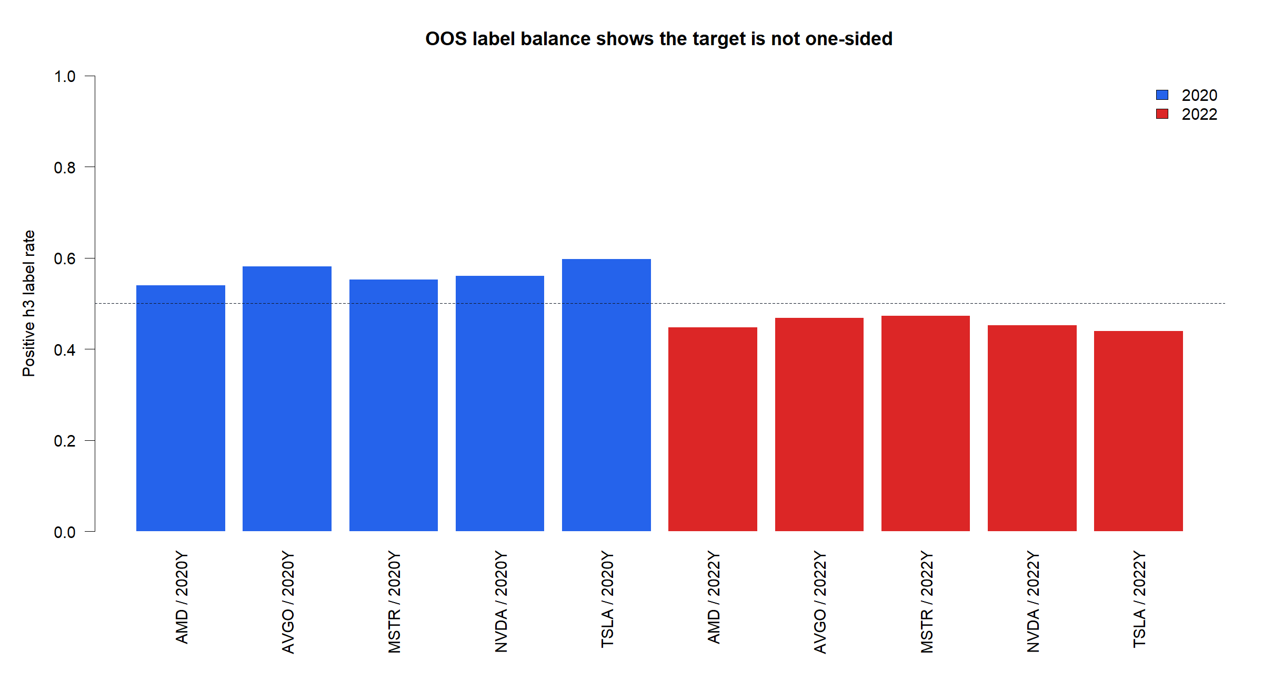
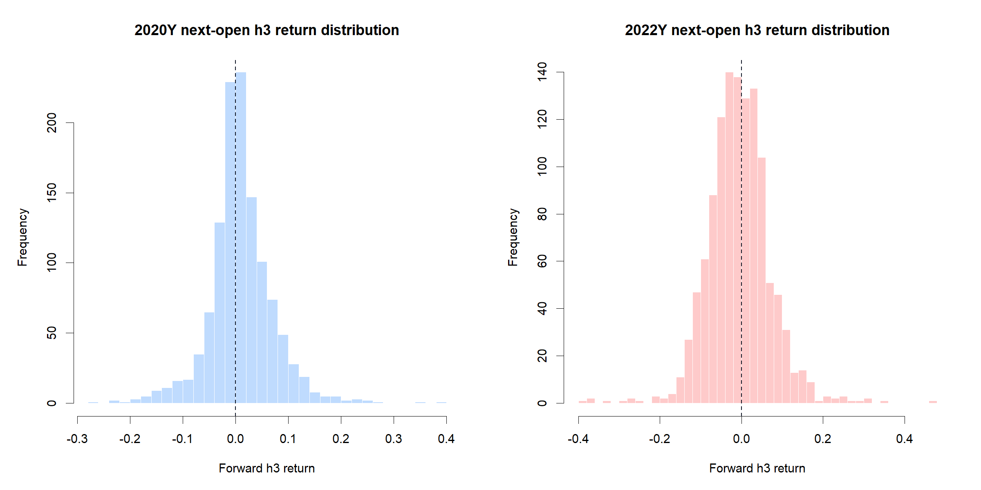
GEN5.4 ML DECISION ENGINE
The h3 target is balanced enough for a first model test
Mean OOS positive-label rate: 2020 56.6%; 2022 45.6%. Mean OOS h3 return: 2020 1.0%; 2022 -0.6%.

Slide 7
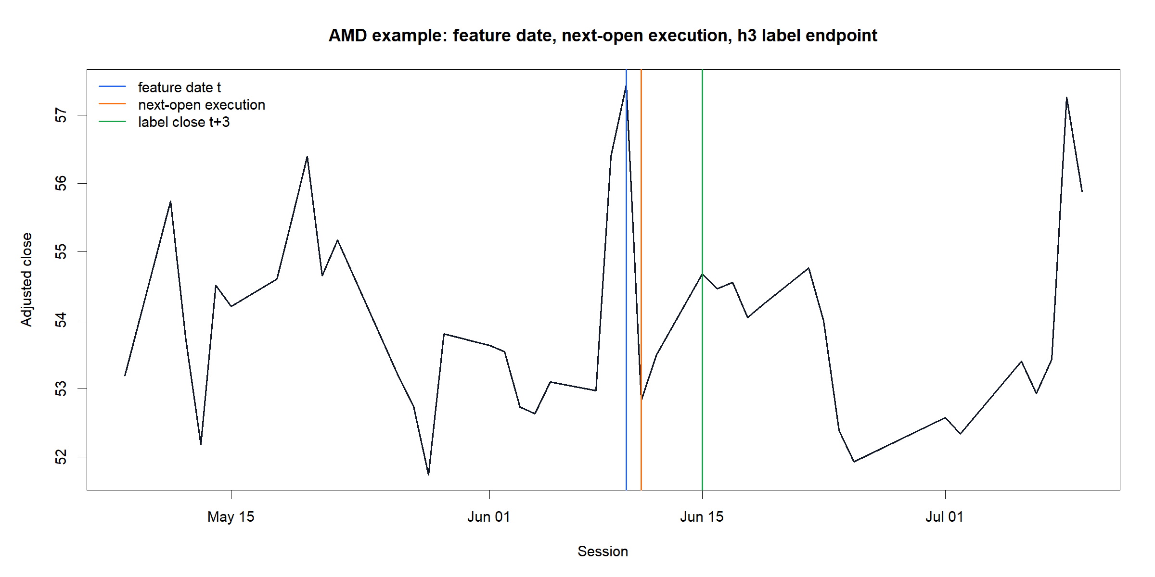
GEN5.4 ML DECISION ENGINE
The label matches how an after-close system would trade
Read the markers left to right
Blue is the feature date. Orange is the next open, where a future model would act. Green is the close three sessions later, where the label is measured.

Slide 8
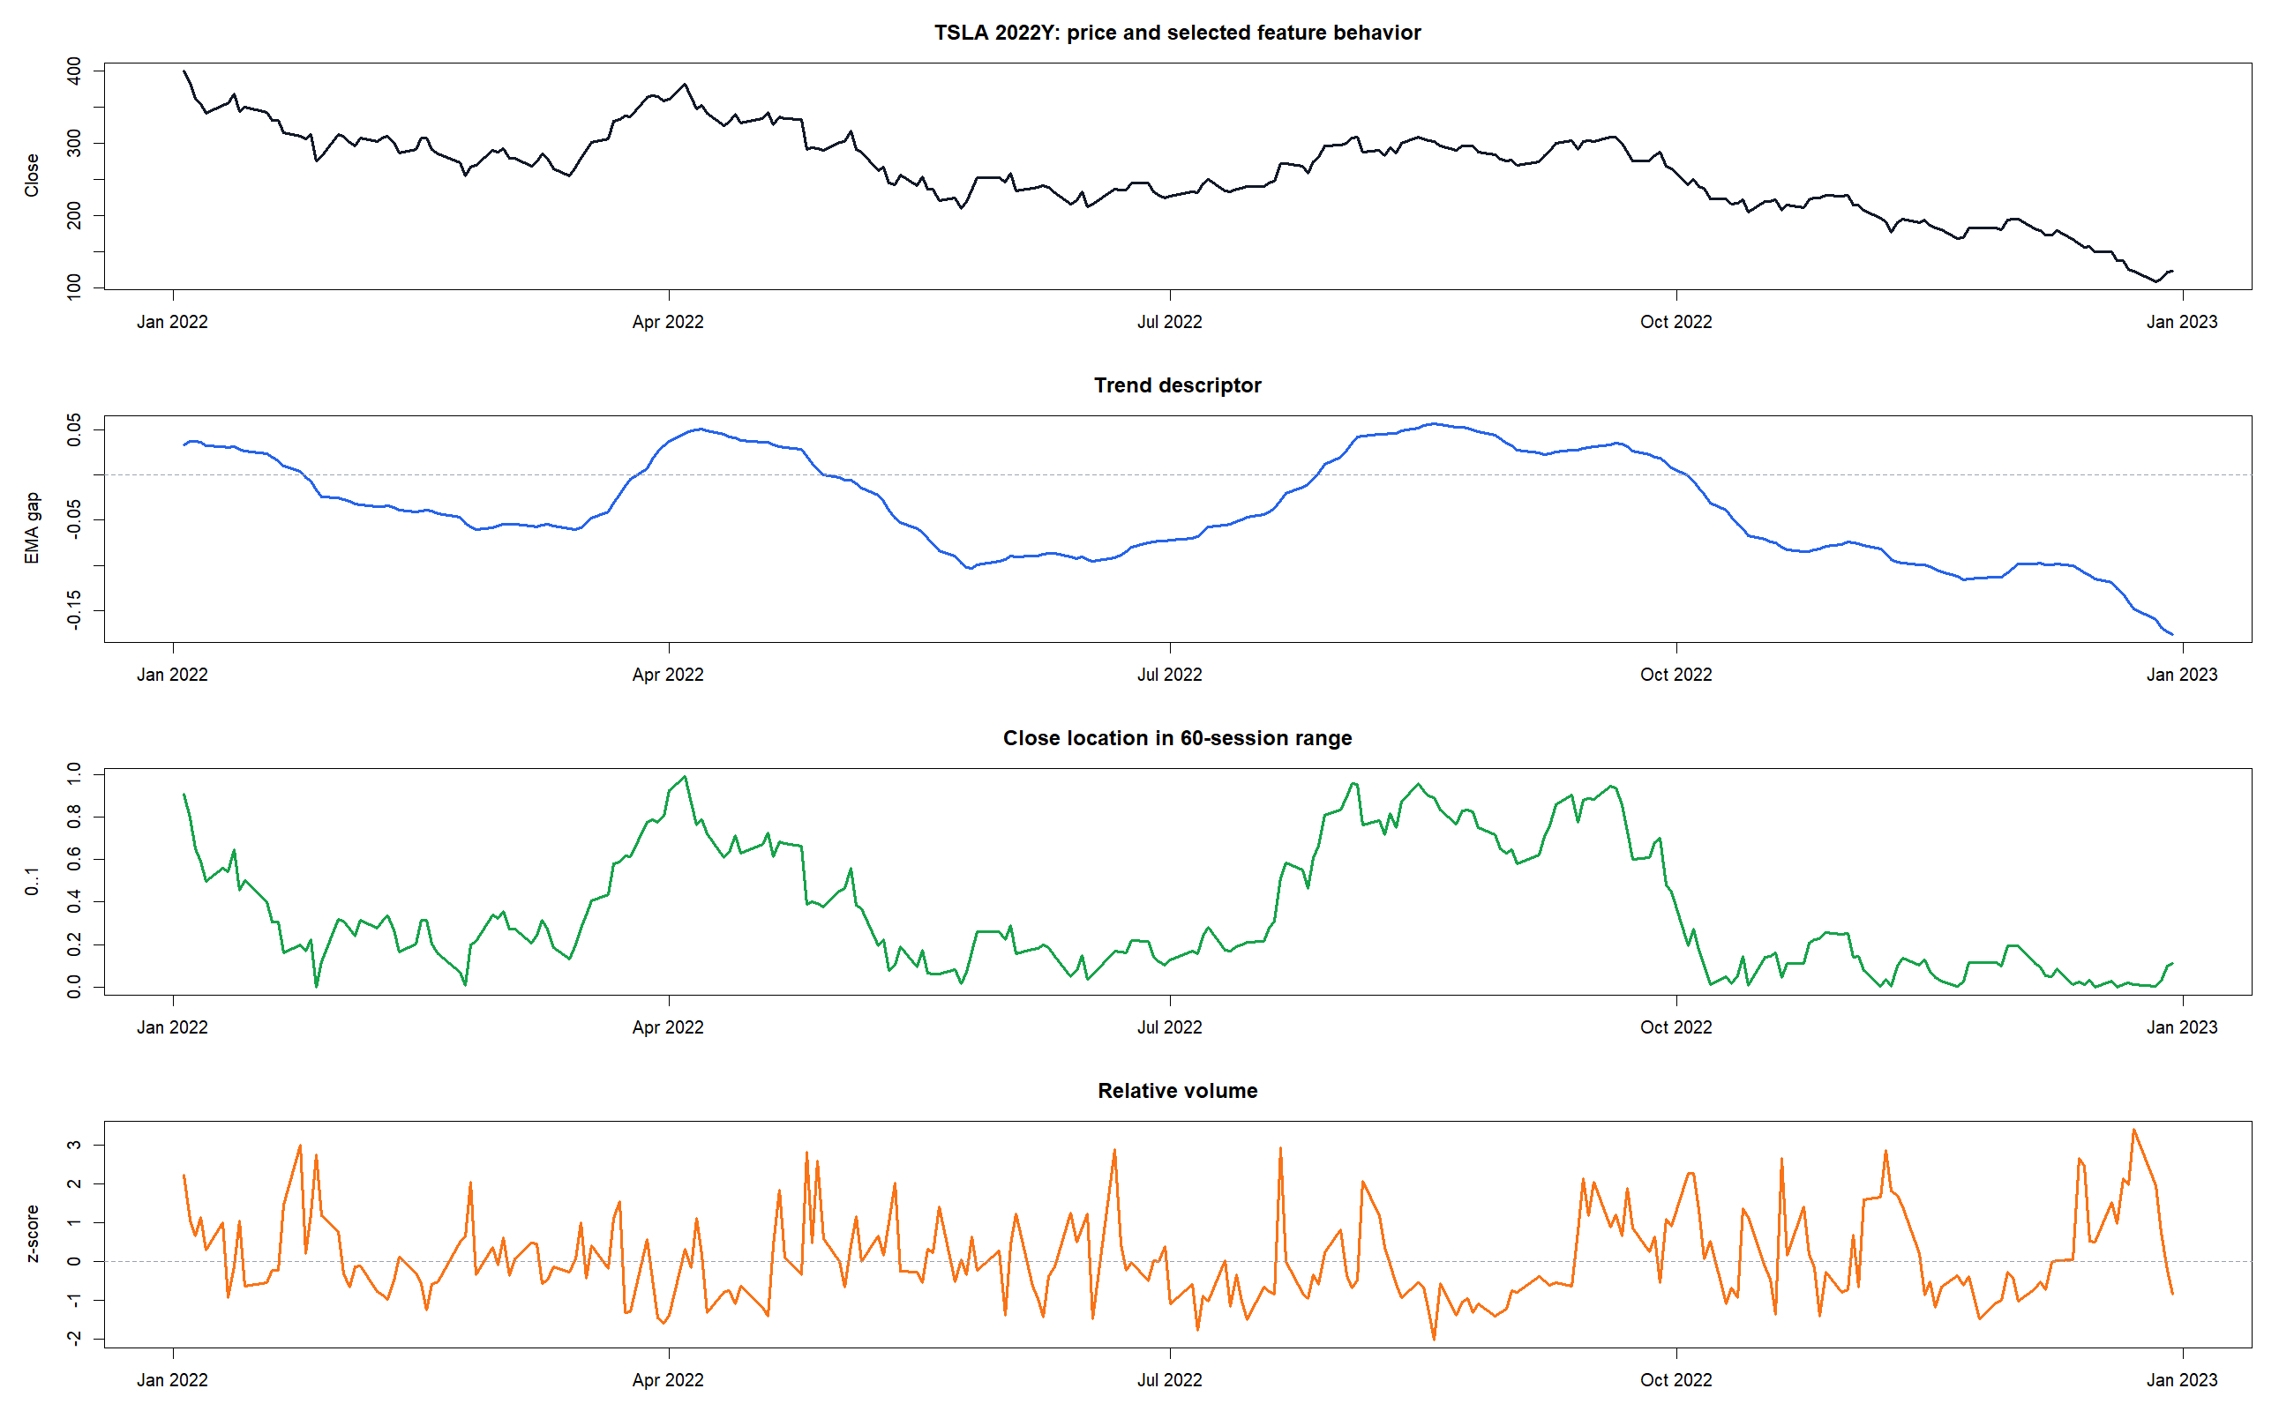
GEN5.4 ML DECISION ENGINE
Feature strips give us a human audit of what the model will see
This is still pre-model evidence.
The plot checks that trend, range location, and volume features move in recognizable ways around a hard 2022 tape. The next step is to ask whether a model can combine these signals better than hand-coded states.

Slide 9
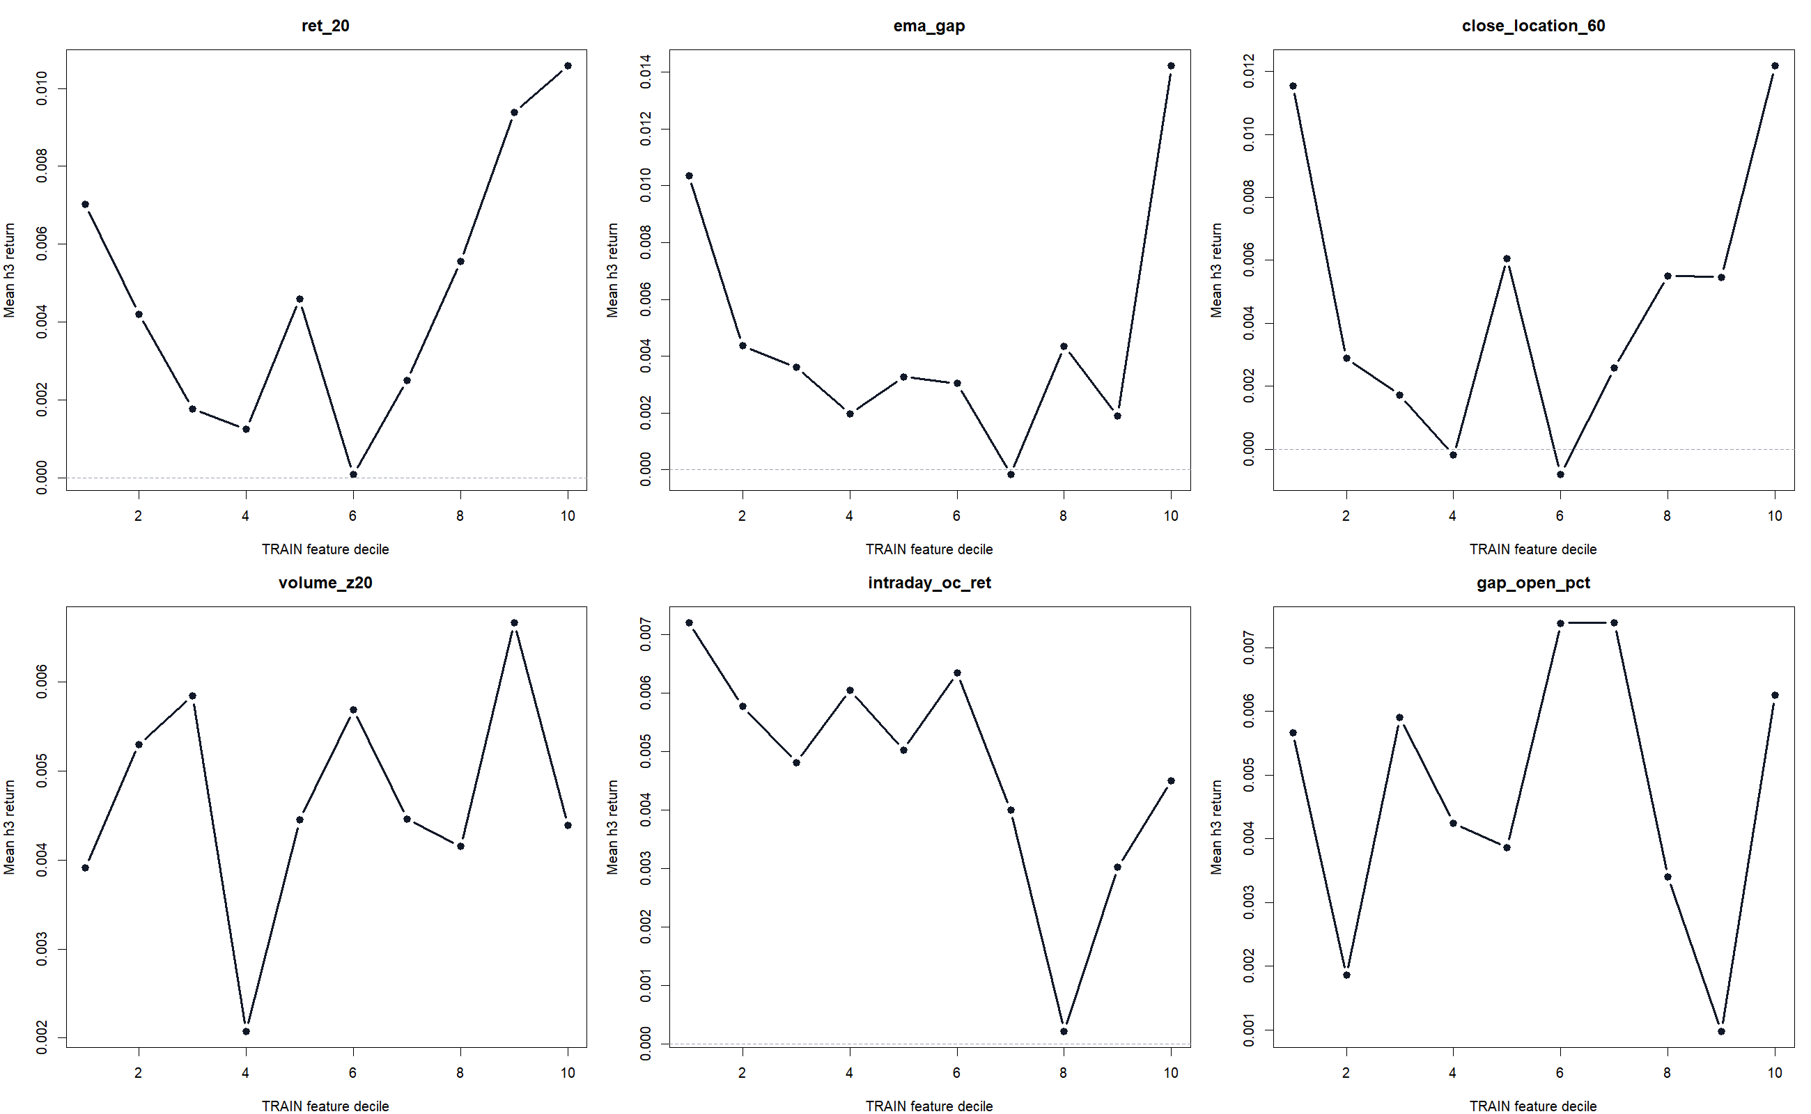
GEN5.4 ML DECISION ENGINE
A univariate audit gives early clues without pretending to be a model
What to look for
Smooth monotonic lines would be encouraging. Noisy or nonmonotonic lines are not fatal, because the first real ML test will learn interactions, but they tell us whether individual features carry any visible directional information.

Slide 10
GEN5.4 ML DECISION ENGINE
The next build tests a deliberately simple model
ML-P0 passed the table-quality gate. ML-P1 asks whether a plain GLM can turn that table into coherent daily long/flat behavior.
Still research only
-
Fit only on TRAIN rows using frozen transforms.
GLM is the plumbing baseline before XGBoost.
-
Predict OOS h3 probability after each close.
-
Replay long/flat decisions with fixed thresholds.
-
Compare probability traces, trade tapes, equity, and equal-weight basket hold.

Slide 11
Transition
The deck now moves from table safety to model behavior
ML-P1
GLM replay
ML-P1 fits a GLM on TRAIN rows, freezes the model, predicts OOS h3 probability, and replays fixed-threshold long/flat decisions. This is a diagnostic model, not an allocation claim.

Slide 12
GEN5.4 ML DECISION ENGINE
The GLM baseline became defensive, not participatory
2020 ACTIVE
2020 EXPOSURE
2022 ACTIVE
LEAKAGE AUDIT
8.0%
27.6%
-42.4%
All PASS
Basket hold 214.0%
Stayed flat 68.3% of decision rows.
Basket hold -54.2%
TRAIN fit only; OOS prediction only.
The first GLM replay proves the mechanics, but not the alpha thesis. It missed most of the 2020 rally and was useful mainly as partial 2022 defense.

Slide 13
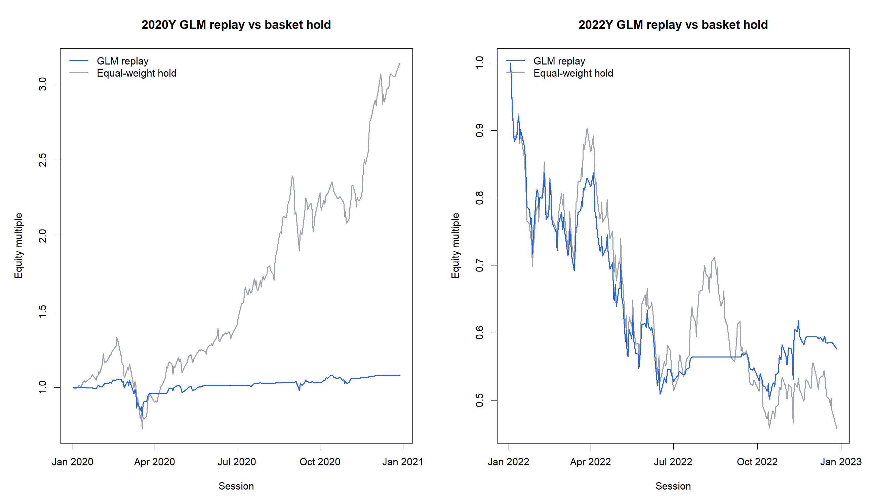
GEN5.4 ML DECISION ENGINE
The equity curve shows the same participation problem we have been chasing
Interpretation
In 2020, the model stayed too cautious while the basket compounded aggressively. In 2022, the model preserved capital relative to the falling basket, but it was still not cleanly risk-off.

Slide 14
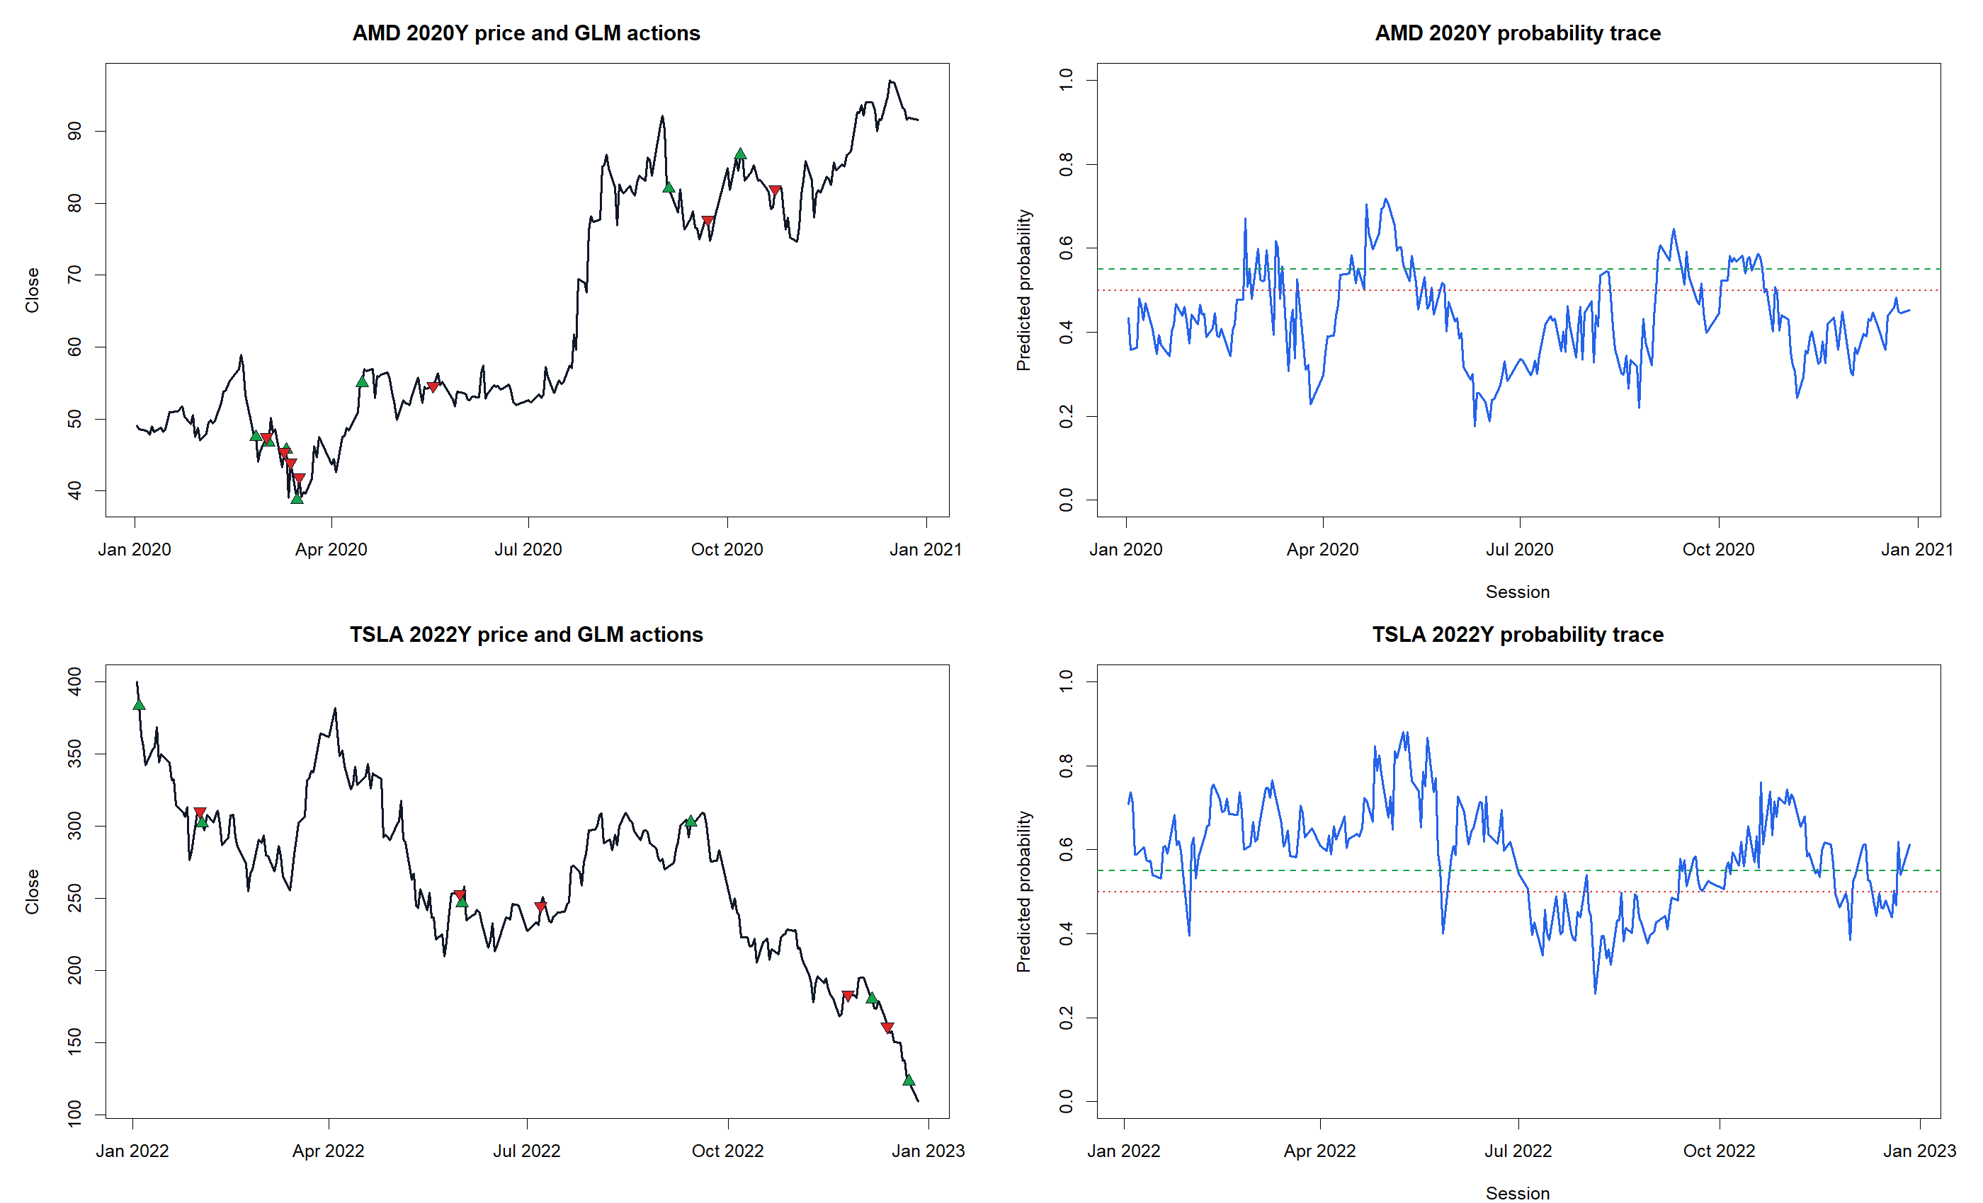
GEN5.4 ML DECISION ENGINE
Probability trade tapes show what the policy actually did
What this reveals
The probability trace is now an inspectable decision surface. We can see whether missed upside comes from low predicted probabilities, high thresholds, or replay mechanics.

Slide 15
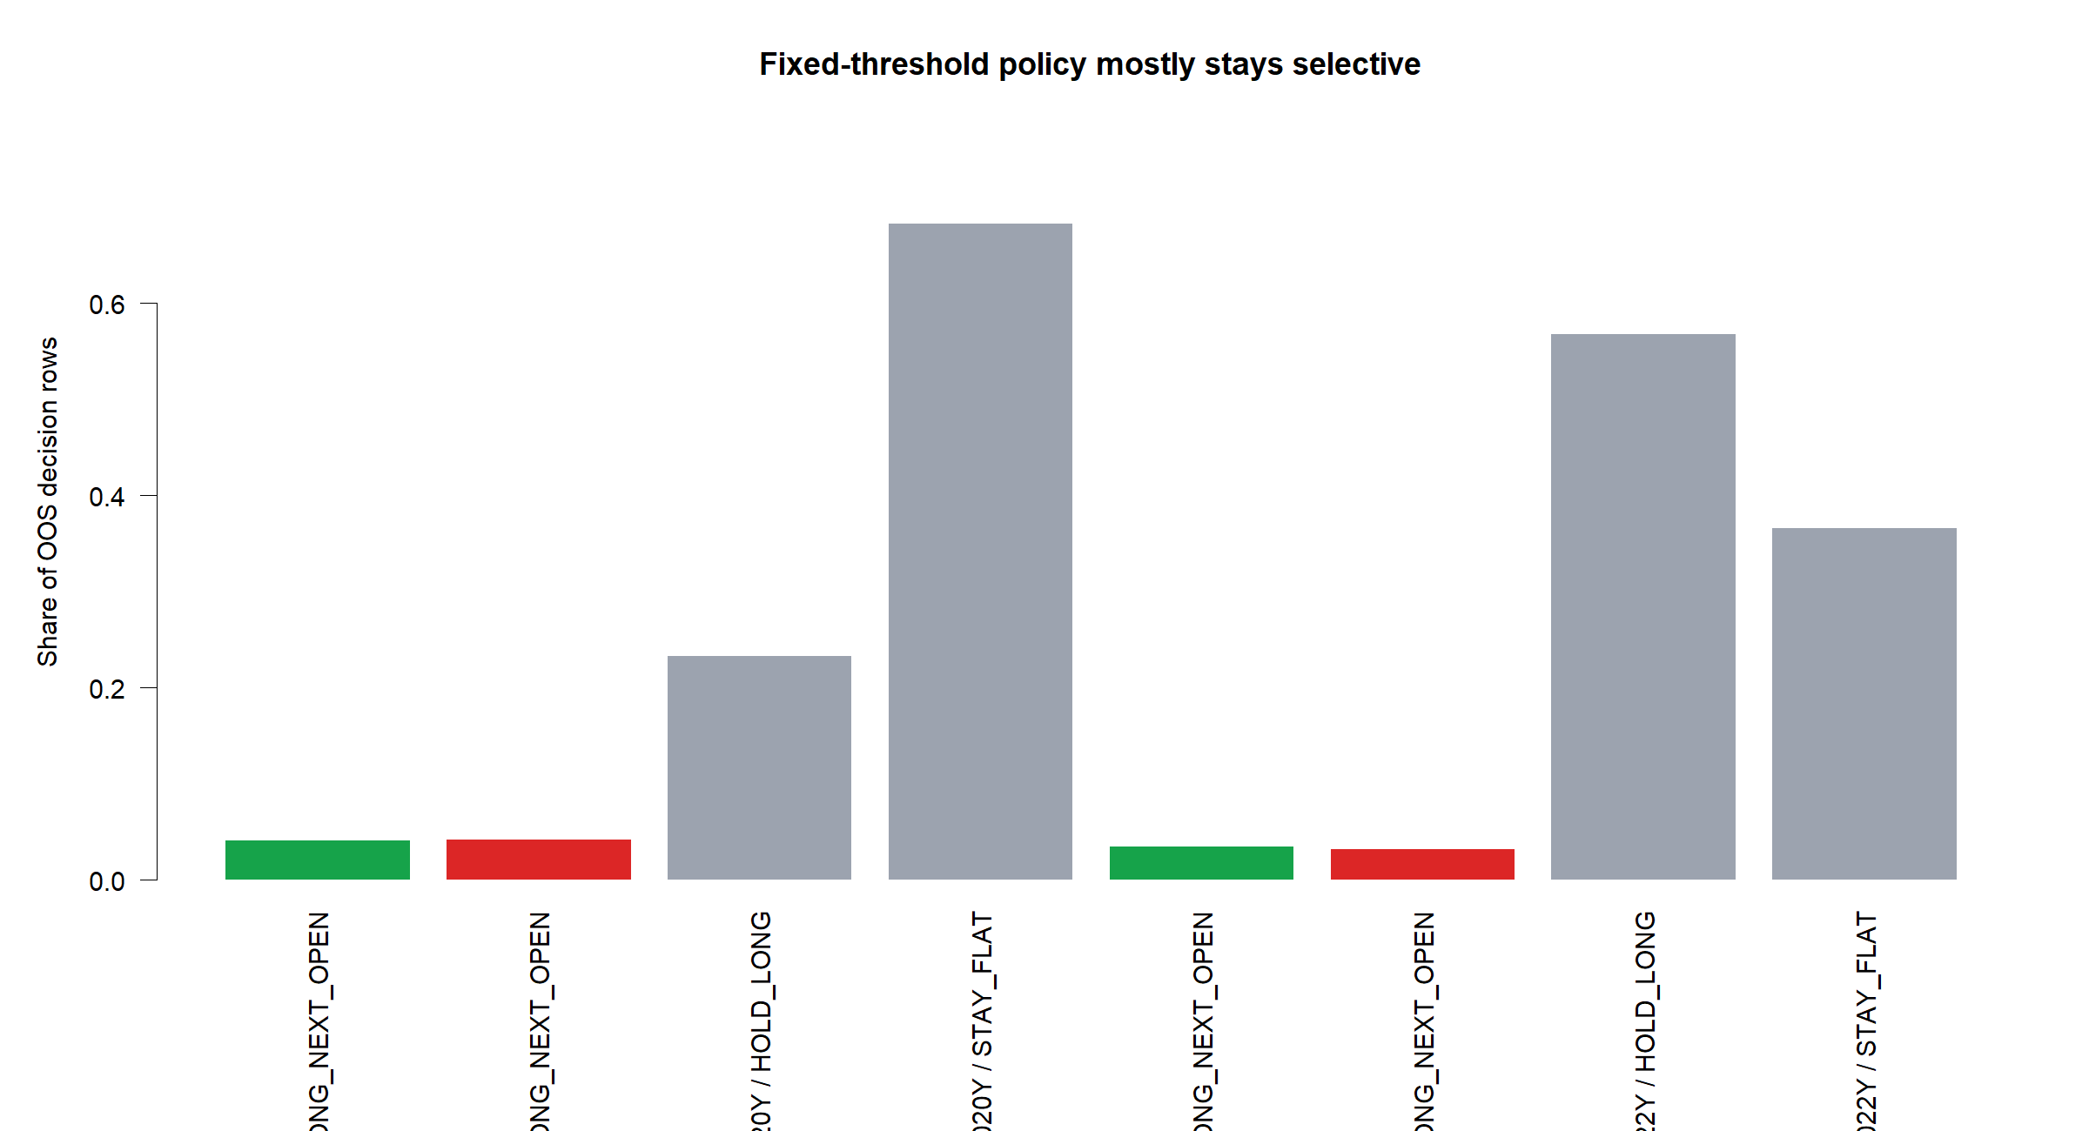
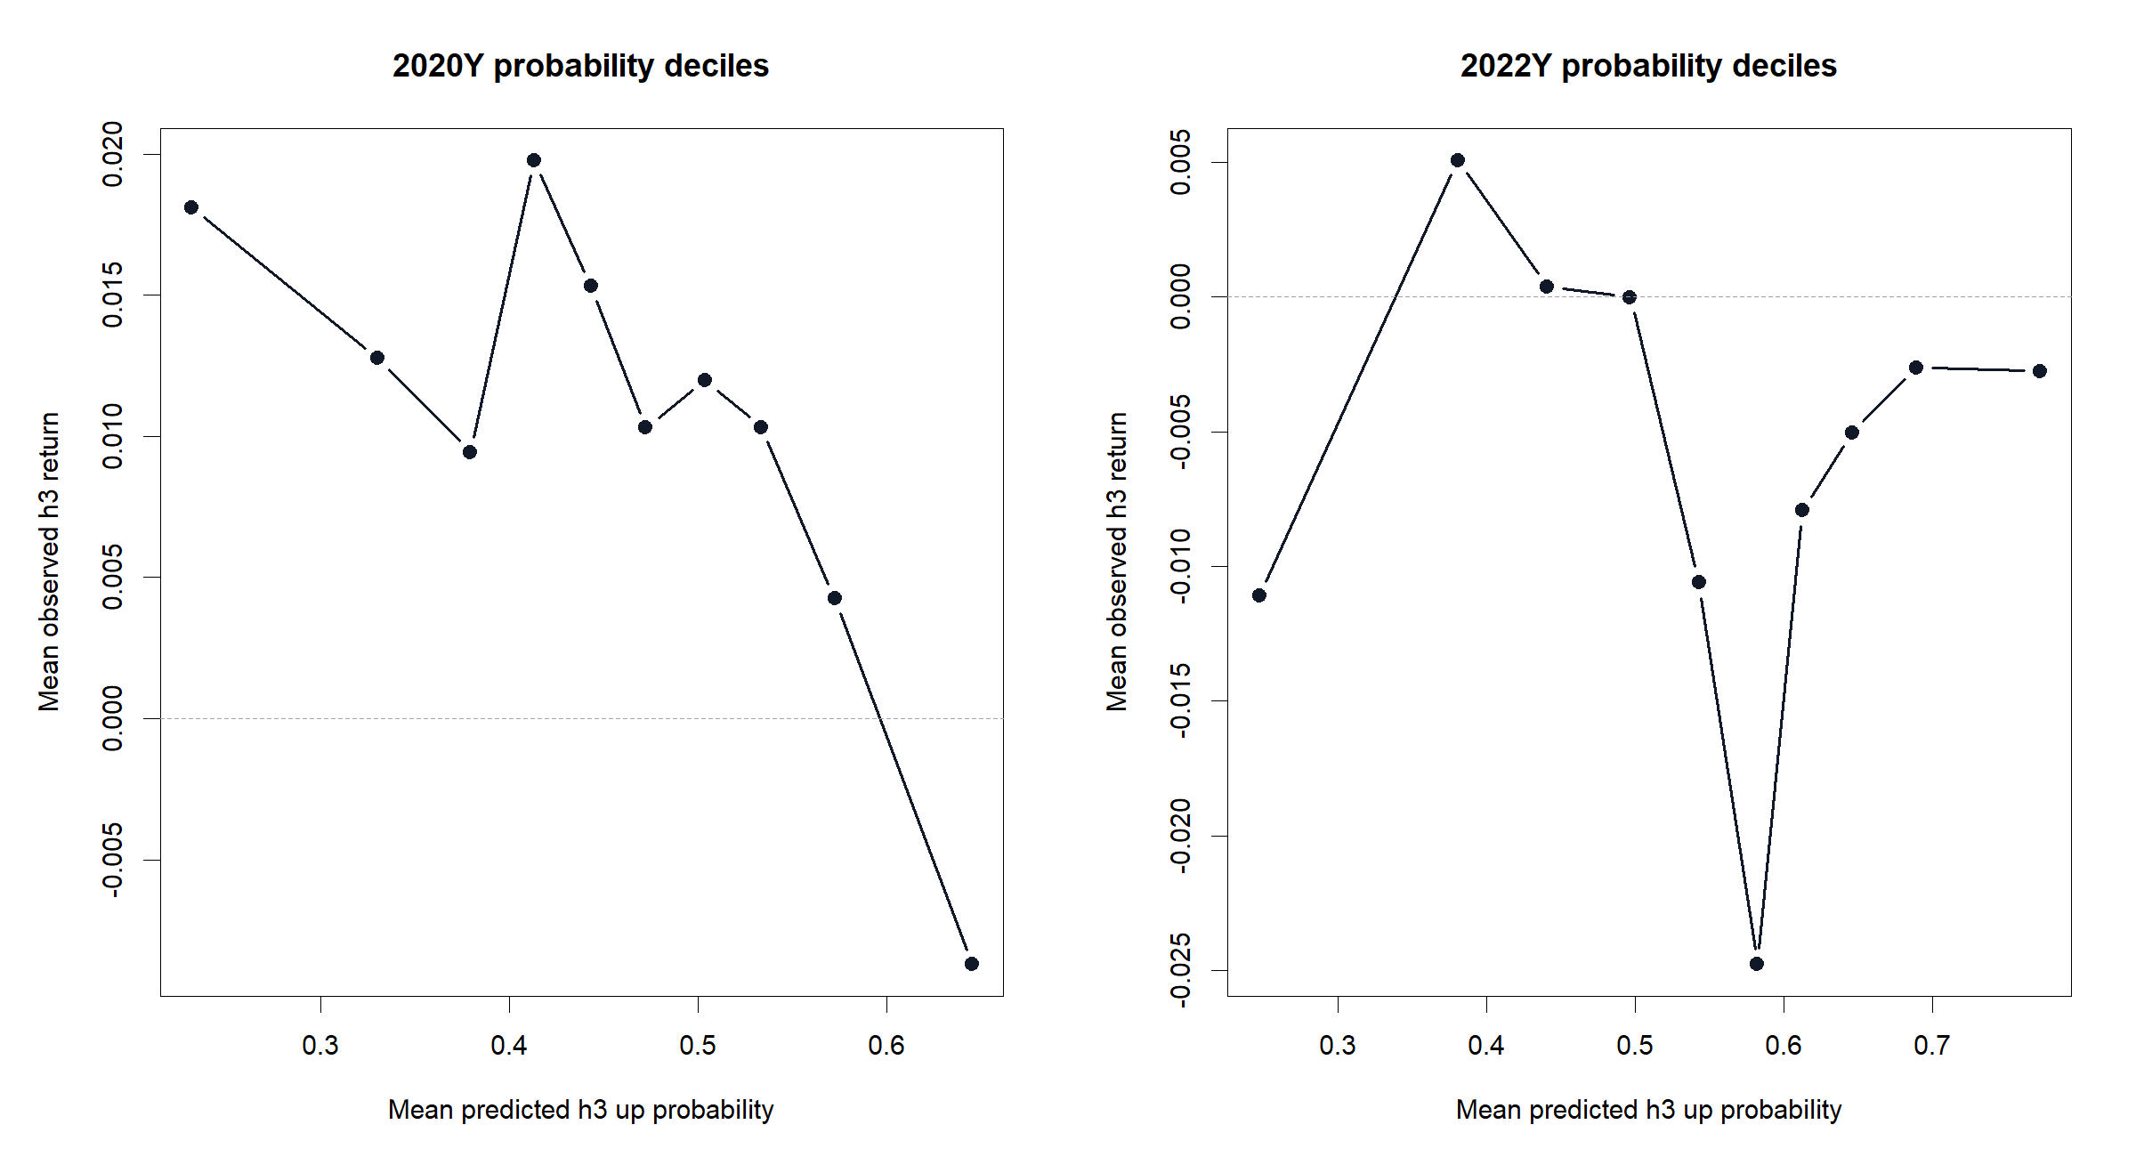
GEN5.4 ML DECISION ENGINE
The diagnostics point to threshold and calibration questions
Fixed thresholds are intentionally crude. The next improvement should be TRAIN-only threshold selection and probability calibration, not a rush to a more complex model.

Slide 16
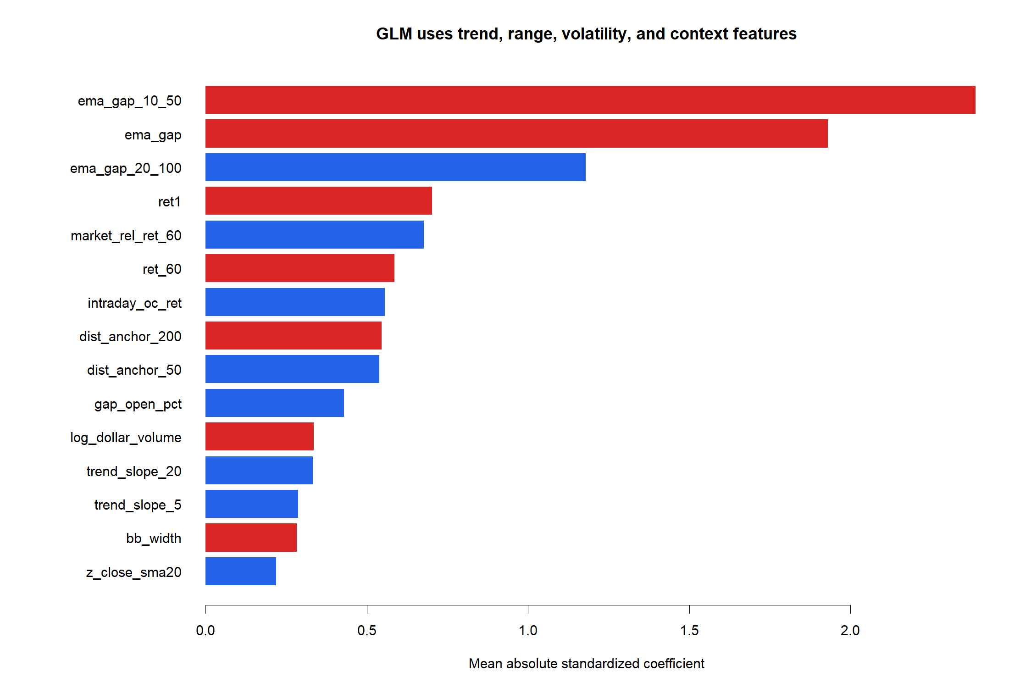
GEN5.4 ML DECISION ENGINE
The coefficient audit keeps the simple model explainable
Why GLM still earns its keep
Even when performance is underwhelming, coefficients expose what the model is leaning on. That makes GLM a useful diagnostic bridge before XGBoost.

Slide 17
GEN5.4 ML DECISION ENGINE
The next slice should improve the decision policy before model complexity
ML-P1 worked mechanically and exposed a familiar failure mode: too little upside participation in 2020, partial defense in 2022.
-
Add TRAIN-only threshold selection or calibration before XGBoost.
-
Compare fixed thresholds against a more permissive participation policy.
-
Keep probability trade tapes as the required visual audit for every ML replay.
-
Only then add XGBoost as a nonlinear challenger.

Slide 18
Transition
Threshold policy is the first decision layer to audit
ML-P1b
Threshold diagnostic
ML-P1b keeps the GLM fixed and changes only the rule that converts probability into long/flat exposure. Thresholds are chosen before OOS replay using TRAIN data only.

Slide 19
GEN5.4 ML DECISION ENGINE
The participation policy helped, but not enough
POLICIES TESTED
GUARDRAILS
2020 GRID RETURN
2022 QUANTILE RETURN
3
All PASS
30.0%
-39.5%
Fixed, TRAIN quantile, and TRAIN forward-return grid.
Fit and policy selection stay inside TRAIN.
Fixed was 8.0%; basket hold was 214.0%.
Fixed was -42.4%; basket hold was -54.2%.
The grid policy raised 2020 exposure and return, which confirms threshold choice matters. It still left most of the high-beta rally unowned, so the problem is not just the original 0.55 / 0.50 cutoff.

Slide 20
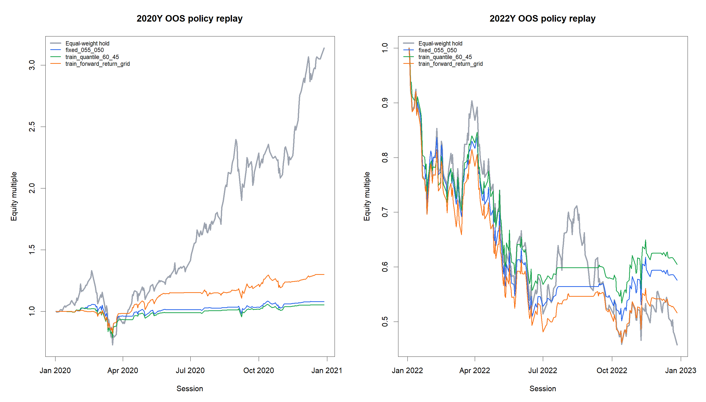
GEN5.4 ML DECISION ENGINE
The equity curves show a better but still underpowered rally response
What changed
The TRAIN grid policy lifted 2020 exposure from 27.6% to 34.8% and return from 8.0% to 30.0%. It still lagged the basket by -184.0%.

Slide 21
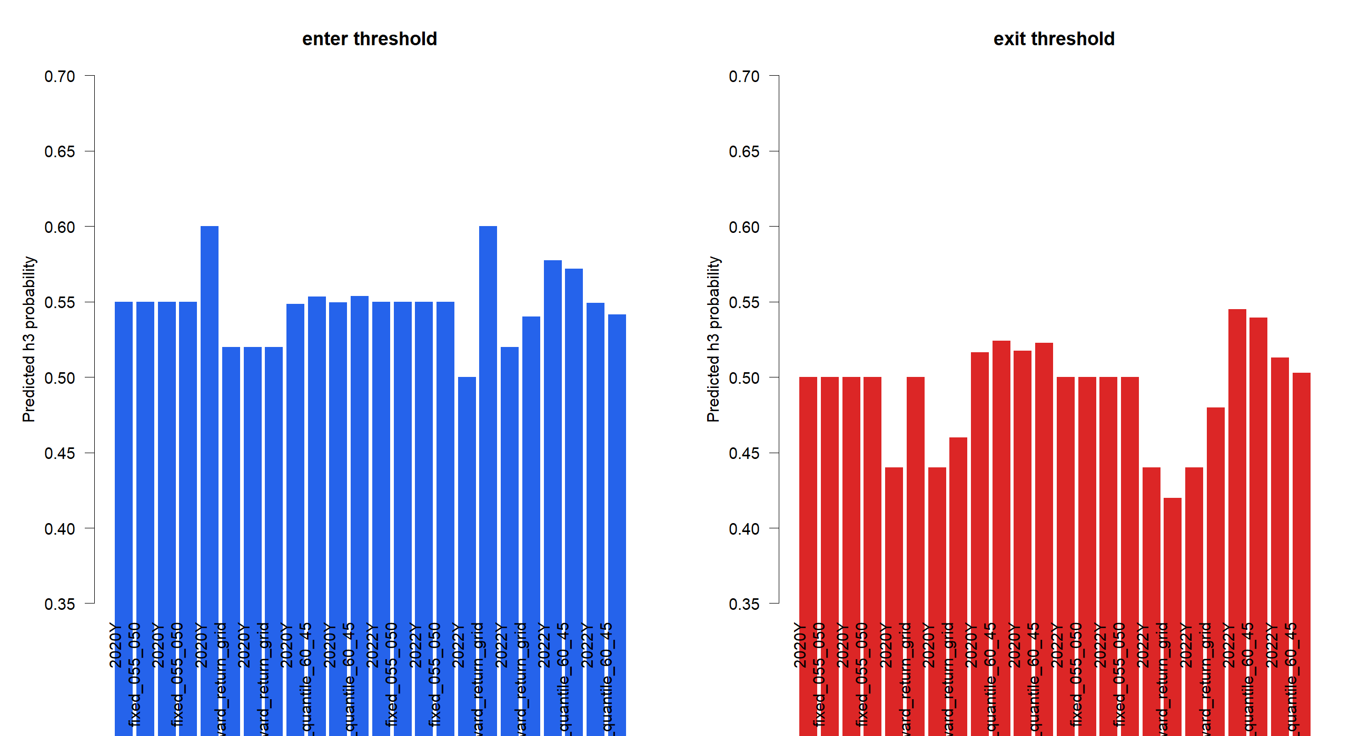
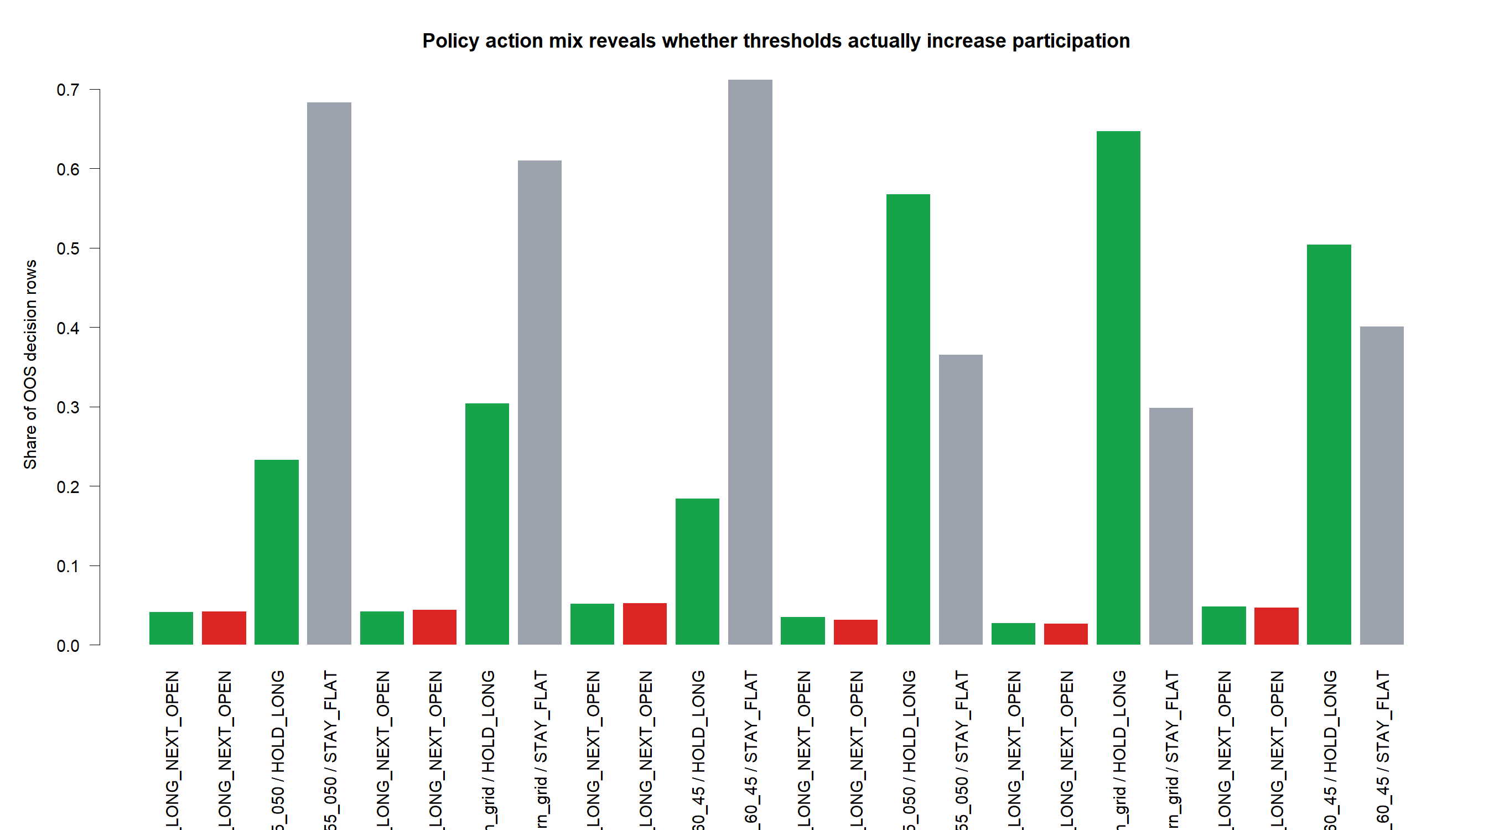
GEN5.4 ML DECISION ENGINE
The selected thresholds explain the behavior change
The grid policy's average TRAIN entry threshold was 0.54, with a TRAIN proxy exposure target around 69.7%. That made it more permissive in 2020, but also more exposed in 2022.

Slide 22
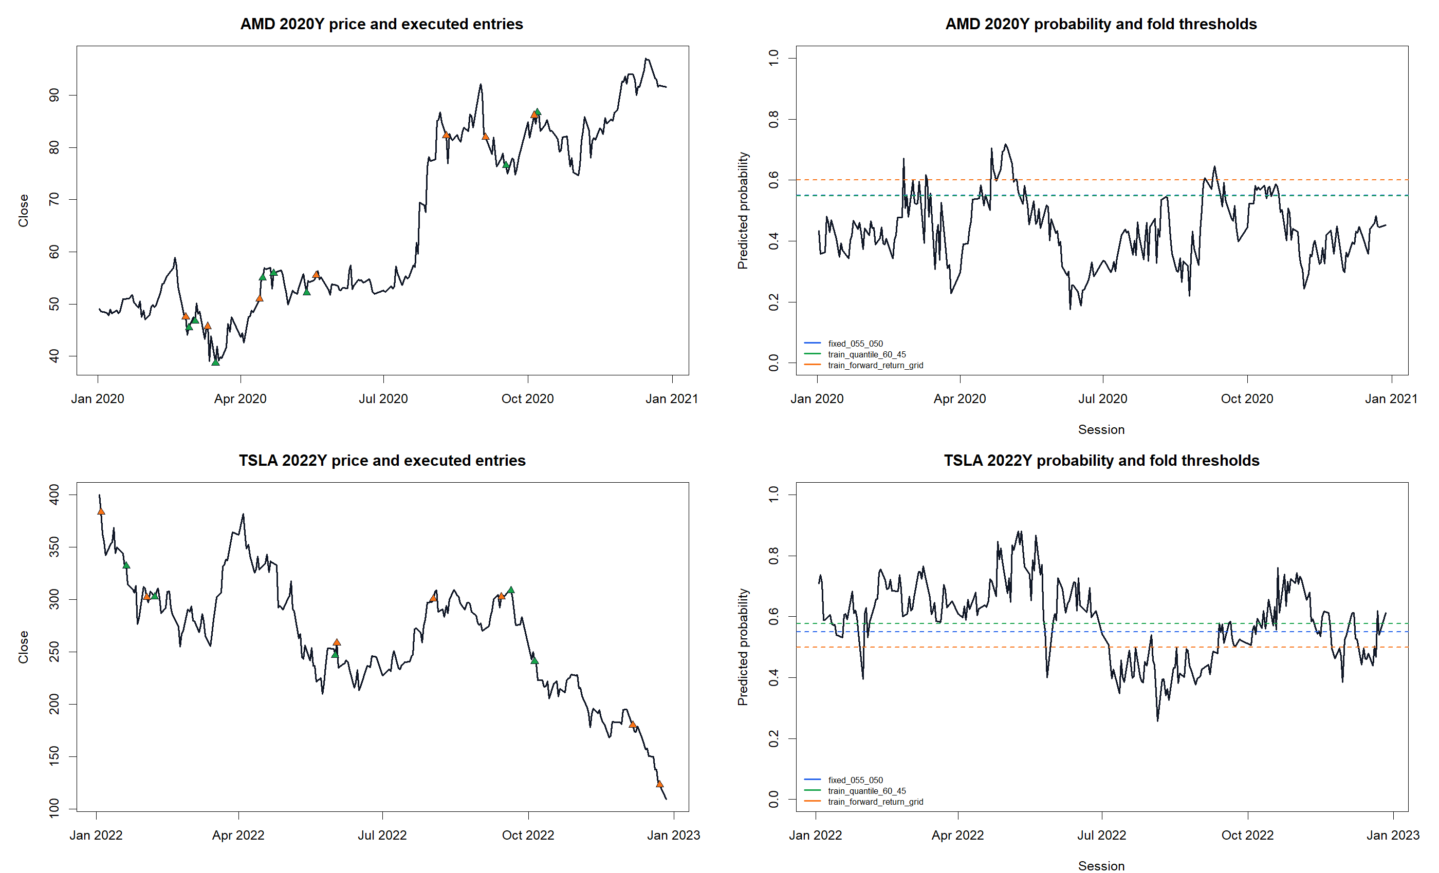
GEN5.4 ML DECISION ENGINE
Probability tapes show that the model rarely loved the rally early enough
Why this matters
Lowering thresholds creates more entries, but the probability trace still spends long rally stretches below the entry line. The next question is whether calibration, labels, or model class can rank those days better.

Slide 23
GEN5.4 ML DECISION ENGINE
The next ML slice should test probability quality, not just more exposure
ML-P1b showed that threshold policy is real, but it did not close the alpha gap. The forward-return grid made the model participate more, yet still undercaptured 2020 and weakened 2022 defense.
-
Keep the continuous annual replay and policy audit as the required ML comparison surface.
-
Next test should compare label horizons or probability calibration before adding XGBoost.
-
If XGBoost comes next, it should be judged on better ranking and timing, not merely higher exposure.
-
Watch the 2022 tradeoff: grid exposure rose to 67.4% while return fell to -48.4%.

Slide 24
Transition
The next question is whether the label itself is too blunt
ML-P1c
Label horizon
ML-P1c compares h1, h3, and h5 next-open labels while keeping the GLM, feature set, TRAIN-only policy selection, and continuous annual replay surface fixed.

Slide 25
GEN5.4 ML DECISION ENGINE
The one-day label improved participation, but not enough
GUARDRAILS
2020 H1 RETURN
2020 H3 RETURN
2020 H5 RETURN
All PASS
54.0%
30.0%
9.6%
Fit, labels, and policy selection stay inside TRAIN.
Basket hold was 225.2%.
Same policy surface returned 30.0%.
Longer label fell back to 9.6%.
h1 is the best GLM horizon in the 2020 rally, lifting the TRAIN-grid lane to 54.0%. That is real improvement, but it still leaves most of the basket rally uncaptured.

Slide 26
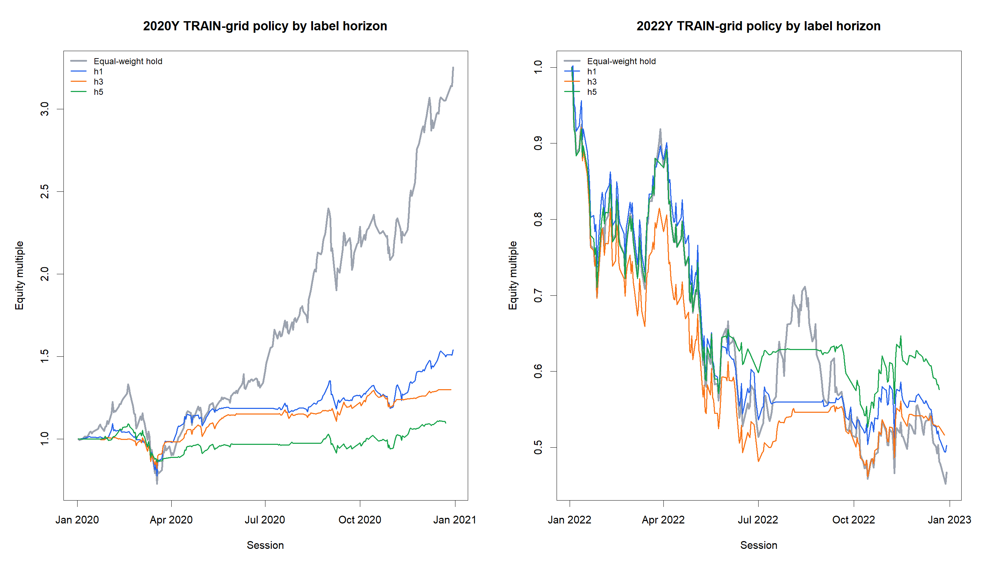
GEN5.4 ML DECISION ENGINE
The equity curves show why h1 is useful but not sufficient
What changed
h1 had the strongest 2020 participation at 43.0% exposure and 54.0% return. In 2022, no horizon solved defense: h1 returned -49.7%, h3 -48.4%, and h5 -42.4%.

Slide 27
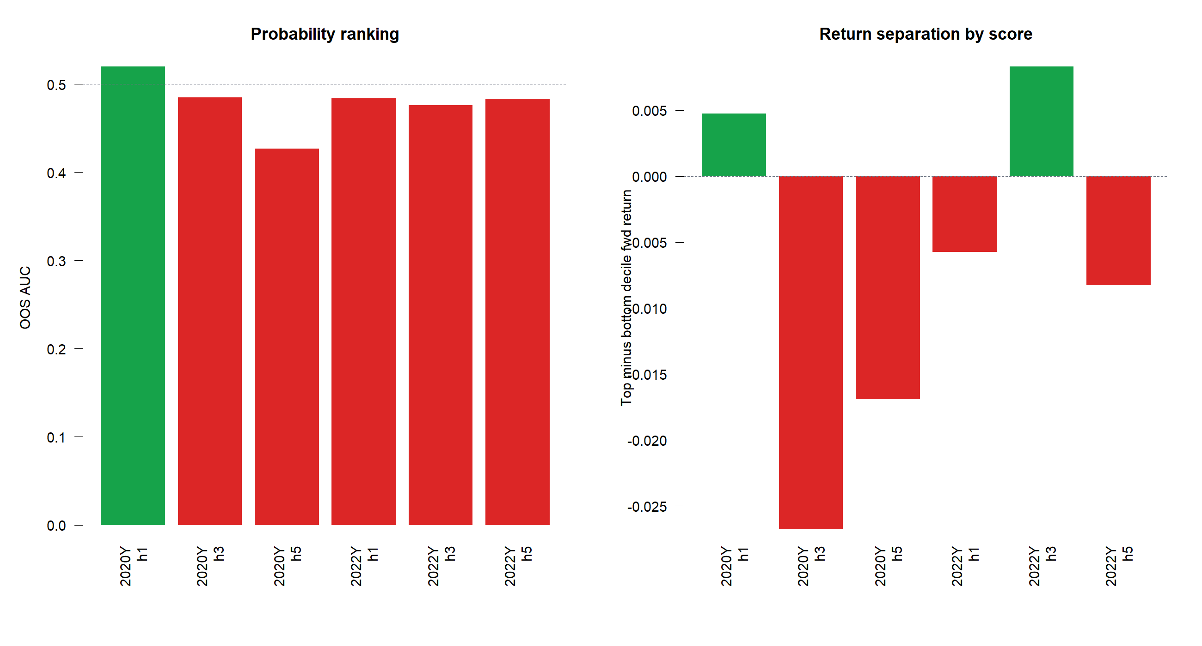
GEN5.4 ML DECISION ENGINE
The ranking audit argues against more GLM-only tinkering
What it means
The best 2020 AUC was h1 at 0.520. h3 was 0.485 and h5 was 0.427. That is weak ranking, not just a threshold issue.

Slide 28
GEN5.4 ML DECISION ENGINE
This is a clean gate into XGBoost rather than an excuse to keep circling
The GLM path has now answered the basic plumbing questions: features and labels are leakage-safe, replay works, thresholds matter, and h1 is the strongest horizon so far. The remaining obstacle is probability ranking quality.
-
Keep h1 as the first XGBoost challenger label unless a calibration-only check is explicitly useful.
-
Do not run a broad GLM threshold search; P1b already showed the limit of exposure tuning.
-
Judge XGBoost on ranking, timing, replay return versus basket hold, drawdown, and probability tapes.
-
If XGBoost cannot improve ranking, backtrack to feature design rather than deeper model knobs.

Slide 29
Transition
The first nonlinear challenger tests XGBoost
ML-P2
XGBoost challenger
ML-P2 keeps the h1 label, feature table, TRAIN-only threshold selection, and annual replay fixed. Only the model class changes: GLM control versus conservative XGBoost.

Slide 30
GEN5.4 ML DECISION ENGINE
GLM is a straight-line lens; XGBoost is a conditional lens
The GLM asks whether a mostly linear combination of today’s features predicts a favorable next-open h1 outcome.
XGBoost can learn conditional pockets, thresholds, and interactions without us hand-writing every combination.
-
Good for proving the plumbing and exposing simple directional effects.
-
Can express rules like momentum only matters with supportive market context.
-
Can average away useful conditions when a feature is good in one regime and bad in another.
-
Must be judged carefully, because extra flexibility can overfit if we start tuning too many knobs.

Slide 31
GEN5.4 ML DECISION ENGINE
XGBoost improved the replay, but it still did not beat the 2020 basket
GUARDRAILS
2020 XGB
2022 XGB
2020 EXPOSURE
All PASS
108.9%
-37.8%
42.3%
Fit, params, and thresholds stay inside TRAIN.
GLM was 54.0%; basket hold was 225.2%.
GLM was -49.7%; basket hold was -53.3%.
XGB used less exposure than GLM at 43.0%.
This is encouraging because the nonlinear model improved return with less 2020 exposure and better 2022 defense. It is not a victory lap: 2020 still lagged basket hold by a lot.

Slide 32
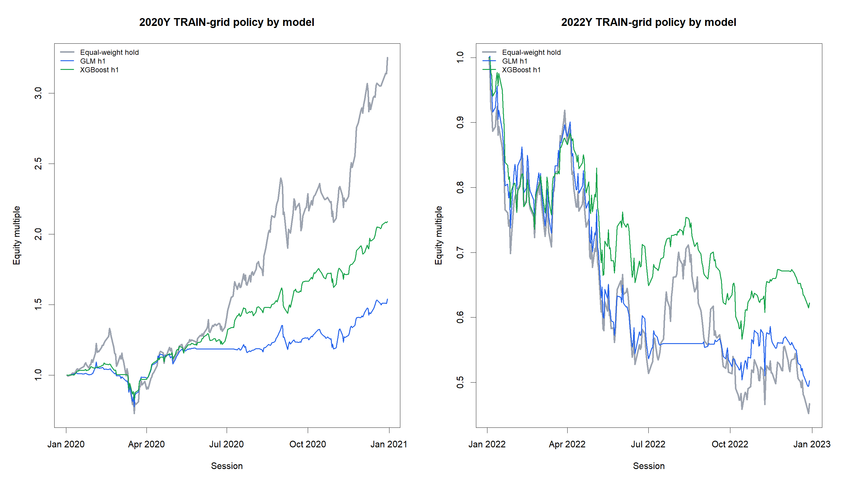
GEN5.4 ML DECISION ENGINE
The equity curves show useful improvement, not a solved system
What changed
XGBoost lifted 2020 return from 54.0% to 108.9% and improved 2022 from -49.7% to -37.8%. Equal-weight hold remains the hurdle in strong bull windows.

Slide 33
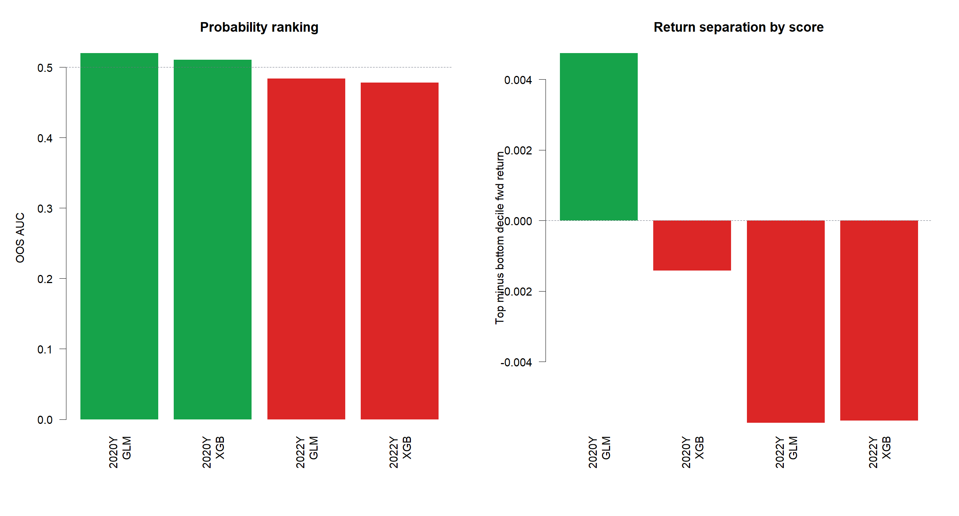
GEN5.4 ML DECISION ENGINE
The ranking audit gives a caution flag
Why this is nuanced
XGBoost improved replay, but its 2020 AUC was 0.510 versus GLM at 0.520. The gain may come from threshold-crossing timing and drawdown behavior rather than cleaner global ranking.

Slide 34
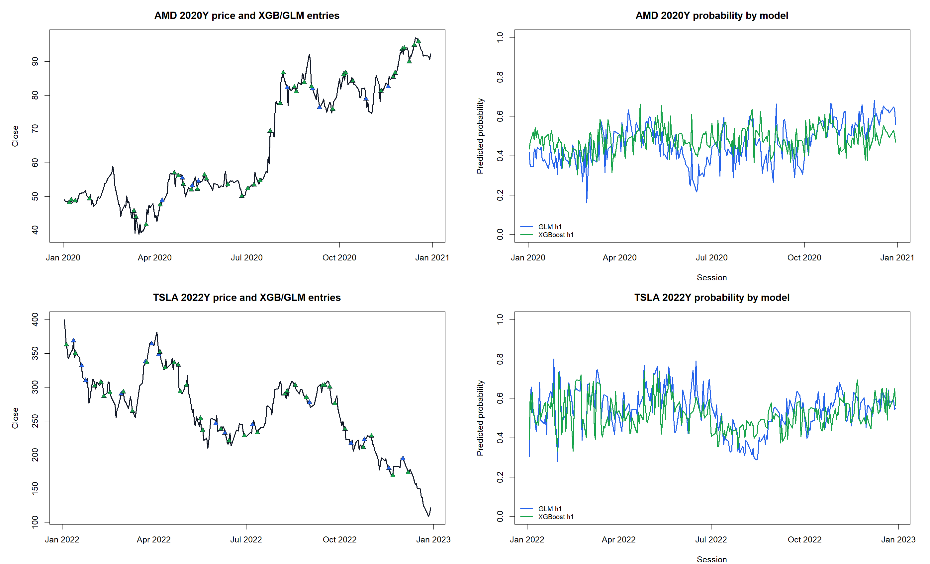
GEN5.4 ML DECISION ENGINE
Probability tapes are now the most important audit surface
What to inspect
The key question is whether XGBoost changes entries and exits in places that make intuitive market sense. The tapes show a less linear probability trace and a different set of entry timings.

Slide 35
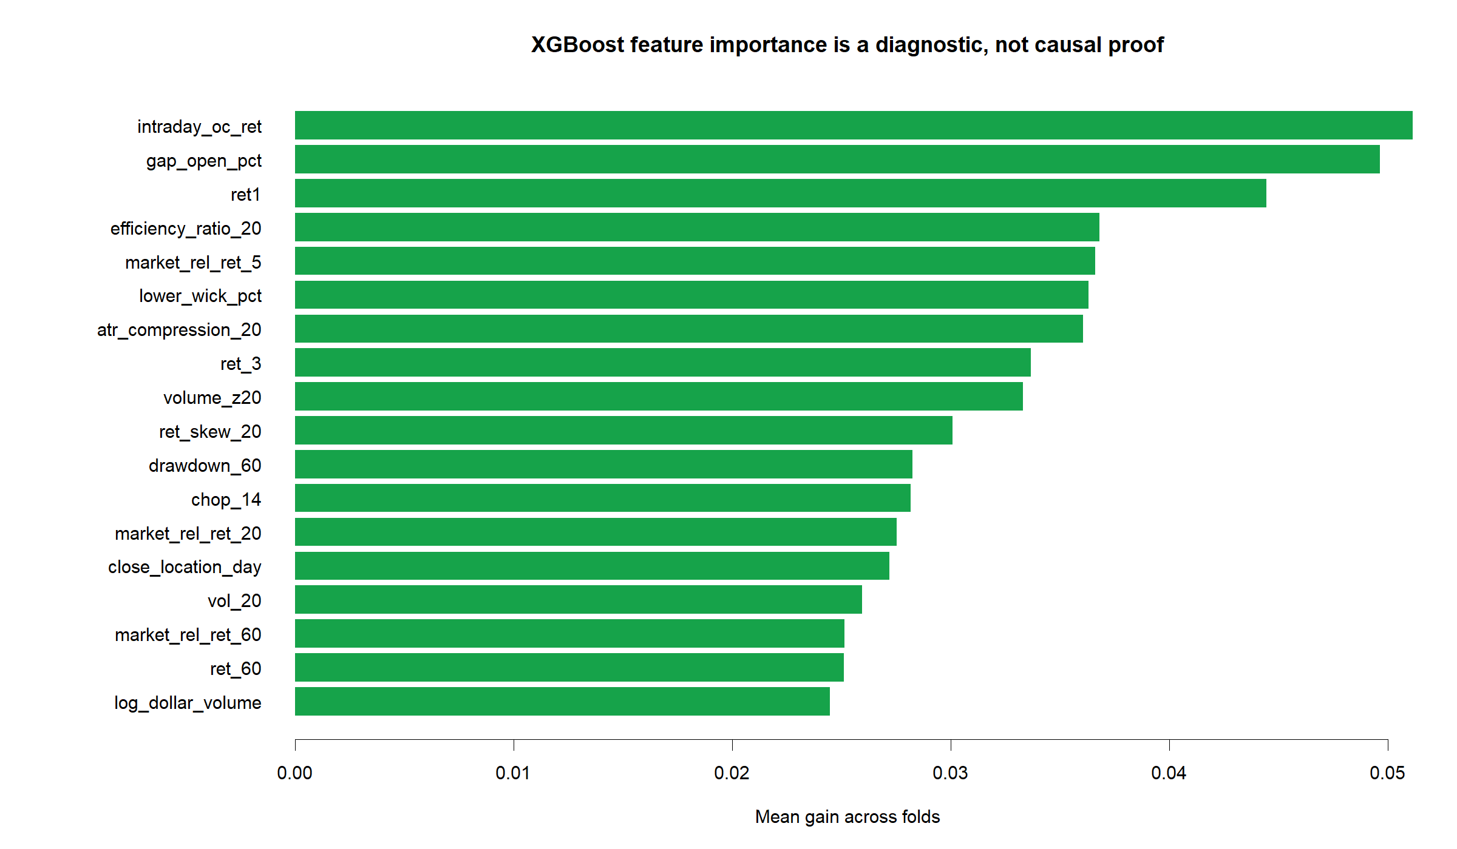
GEN5.4 ML DECISION ENGINE
The feature-importance audit points back to OHLCV structure
Interpret carefully
The top split-gain feature in this first run was gap_open_pct. Importance is not causality, but it tells us XGBoost is using candle structure, gaps, short returns, compression, and market-relative features rather than only long trend memory.

Slide 36
GEN5.4 ML DECISION ENGINE
The next gate is small XGBoost tuning, not a large search
ML-P2 earned a cautious follow-up because replay improved in both windows under fixed model settings. The ranking audit keeps us honest: this is not yet proof that the model has solved alpha.
-
Run one small TRAIN-only XGBoost parameter slice: depth, rounds, and minimum child weight.
-
Keep h1, features, annual replay, thresholds, benchmark, and probability tapes fixed.
-
Watch 2022: XGBoost AUC was 0.478, so defense may still be fragile.
-
If small tuning does not improve ranking or timing, return to feature design instead of widening model knobs.

Slide 37
Transition
Now we ask whether
XGBoost was undertuned
ML-P2b
Small TRAIN grid
ML-P2b keeps the ML-P2 surface fixed and changes only XGBoost depth, rounds, and minimum child weight. Parameters are selected inside each TRAIN fold before OOS replay.

Slide 38
GEN5.4 ML DECISION ENGINE
The TRAIN grid wanted the most flexible candidate
GUARDRAILS
SELECTED CANDIDATE
DEPTH / ROUNDS
MIN CHILD
All PASS
d4 r100
4 / 100
5
Parameter and threshold choices stay inside TRAIN.
Unique parameter candidate selected across folds.
Depth and boosting rounds selected by TRAIN proxy evidence.
Minimum child weight selected by TRAIN proxy evidence.
Every tested fold selected the same aggressive candidate: depth 4, 100 rounds, min_child_weight 5. That is a useful diagnostic, but it has to earn its keep OOS.

Slide 39
GEN5.4 ML DECISION ENGINE
The selected grid did not improve OOS replay
2020 FIXED XGB
2020 SELECTED
2022 FIXED XGB
2022 SELECTED
108.9%
78.1%
-37.8%
-41.7%
Basket hold was 225.2%.
Fixed XGB was 108.9%.
Basket hold was -53.3%.
Fixed XGB was -37.8%.
The selected grid was worse than the fixed XGBoost control in both windows under the same TRAIN forward-return policy. This argues against widening model knobs before improving features or labels.

Slide 40
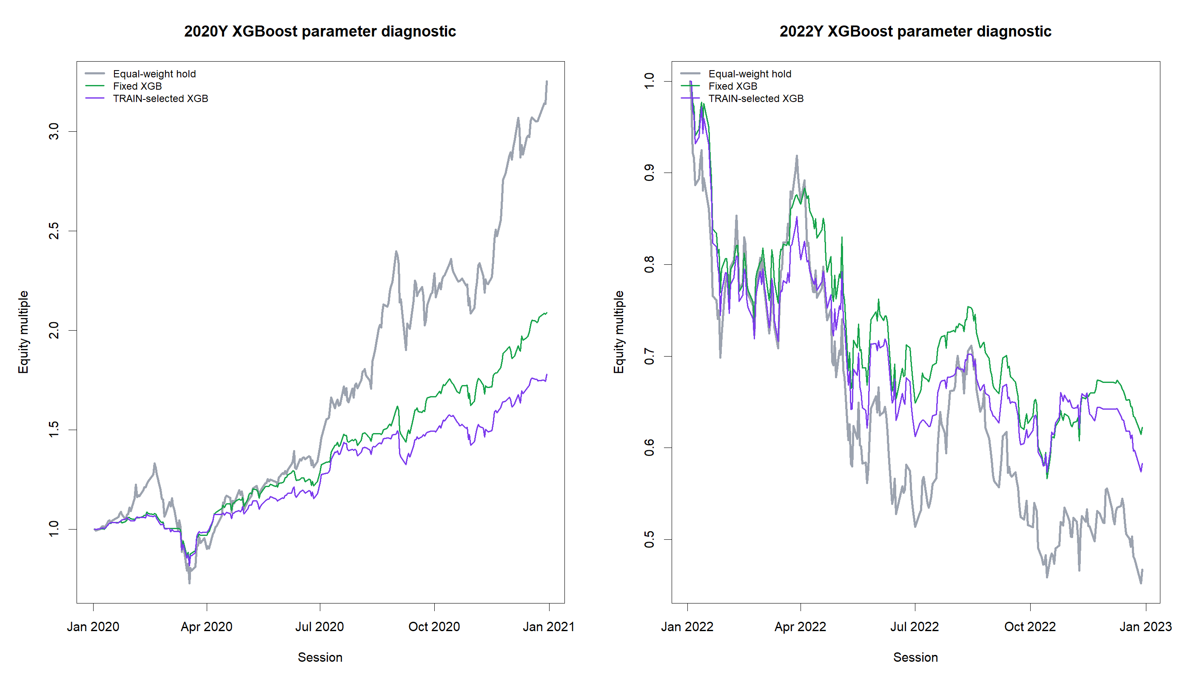
GEN5.4 ML DECISION ENGINE
The equity curves show tuning did not solve the core tradeoff
What changed
The TRAIN-selected candidate returned 78.1% in 2020 versus fixed XGB 108.9%, and -41.7% in 2022 versus fixed XGB -37.8%. It did not close the bull-window gap.

Slide 41
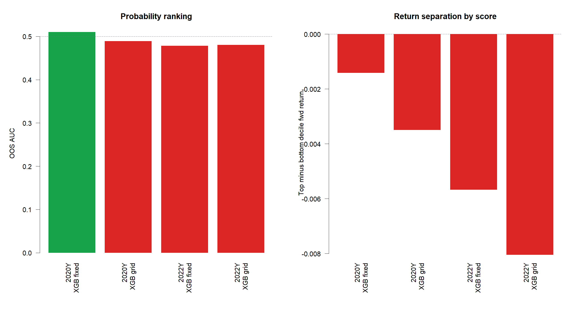
GEN5.4 ML DECISION ENGINE
Ranking quality got weaker, not stronger
Readout
The selected-grid 2020 AUC was 0.489 versus fixed XGB 0.510. In 2022, selected-grid AUC was 0.481 and top-minus-bottom return separation stayed negative.

Slide 42
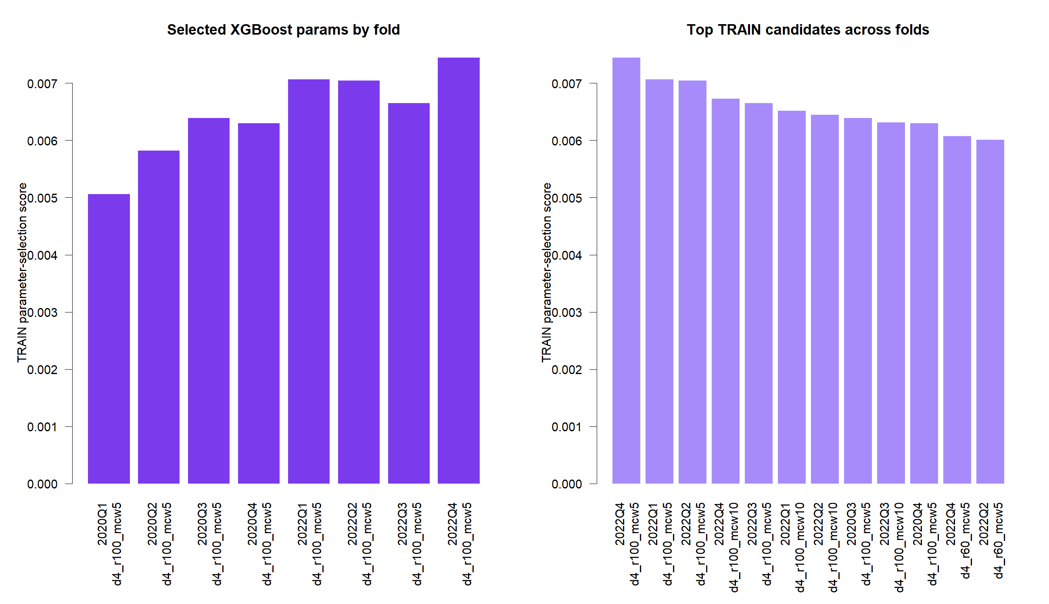
GEN5.4 ML DECISION ENGINE
The parameter audit is a stop sign for knob-chasing
Implication
The TRAIN proxy consistently prefers more flexible trees, but OOS evidence does not reward that flexibility. The next productive slice should target signal definition: richer feature design, alternative labels, or probability calibration with a specific hypothesis.

Slide 43
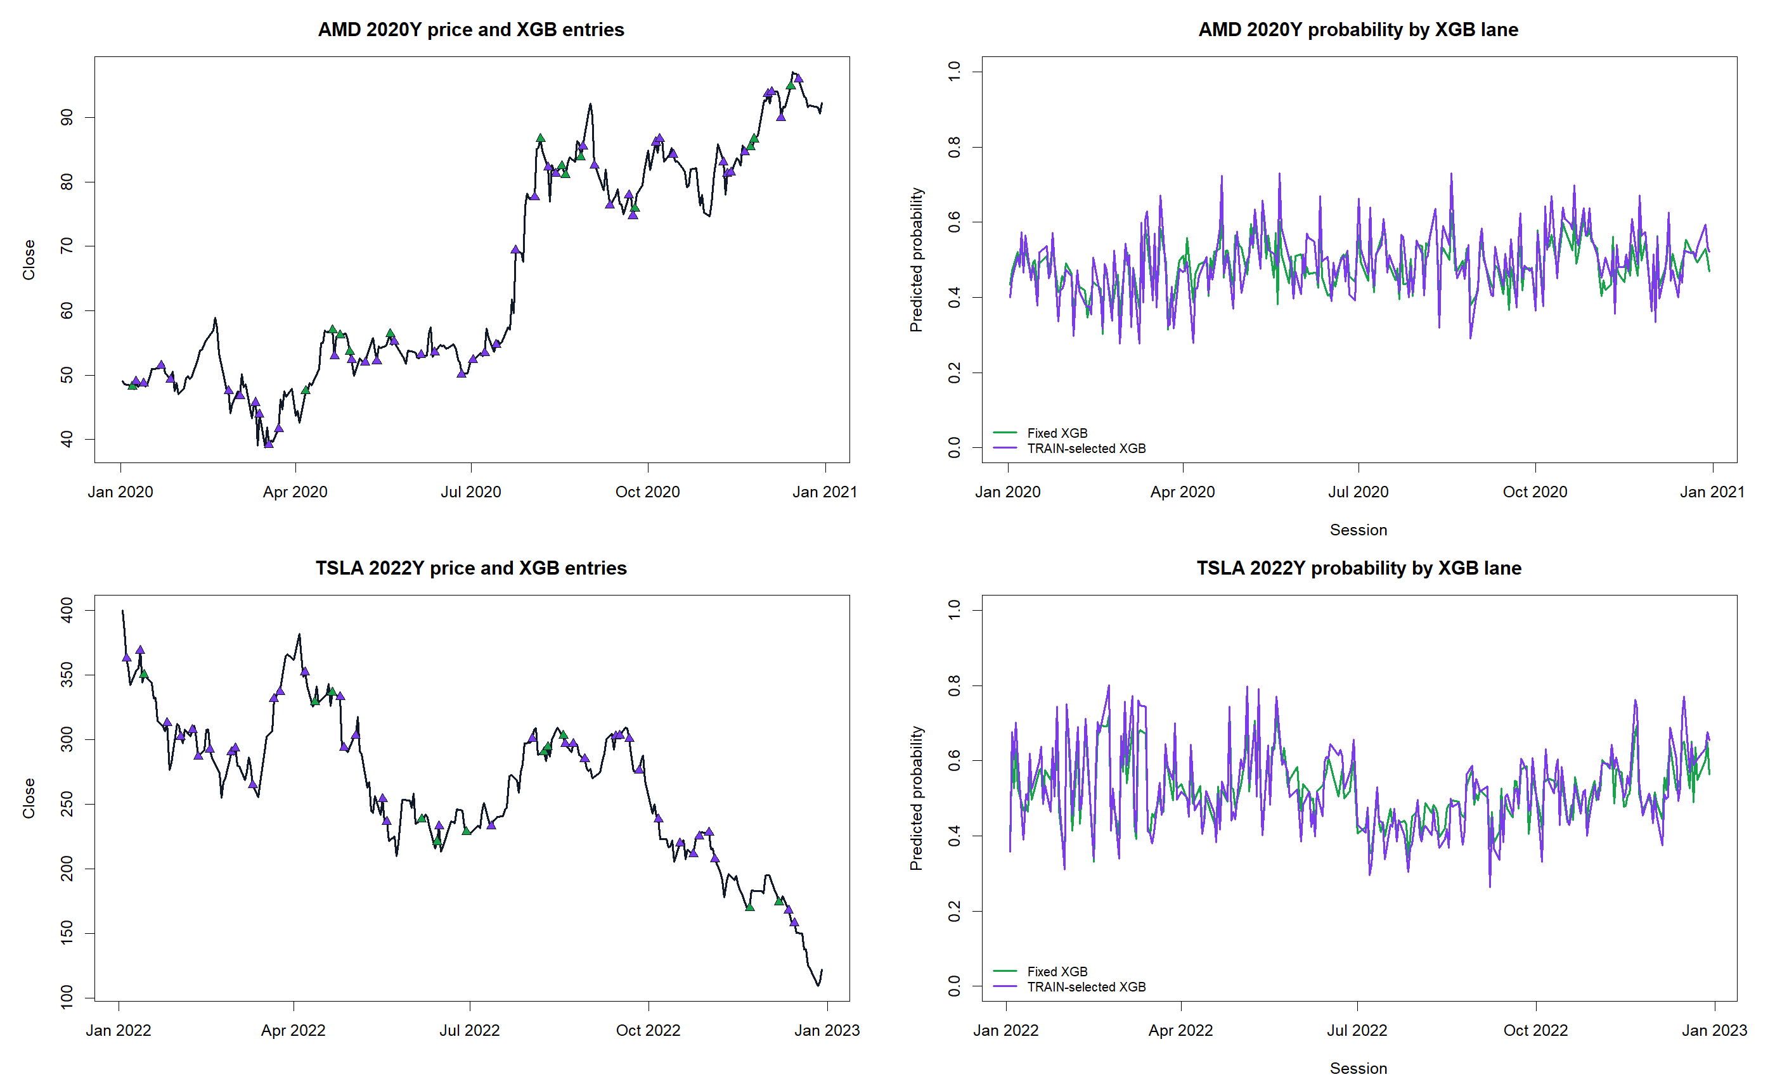
GEN5.4 ML DECISION ENGINE
Probability tapes confirm the model is still noisy near the boundary
What to inspect
The selected grid changes probability texture, but it still spends too much time around the threshold rather than cleanly separating high-participation and risk-off periods.

Slide 44
GEN5.4 ML DECISION ENGINE
The next ML gate should return to features and labels
ML-P2b answered the narrow tuning question: small TRAIN-only XGBoost parameter selection did not improve OOS ranking or replay versus the fixed control.
-
Do not broaden XGBoost search yet; that would mostly increase overfit surface area.
-
Next high-signal slice: feature-family ablation or richer supervised labels, still under annual continuity replay.
-
Keep XGBoost as the nonlinear model class, but make the input/target question sharper.
-
Live advice remains walled off; this is research-only evidence.

Slide 45
Transition
Now we test what information the model sees
ML-P3
Feature sets
ML-P3 keeps seeded XGBoost, h1 labels, TRAIN-only threshold selection, annual replay, and benchmark comparison fixed. Only feature-set membership changes.

Slide 46
GEN5.4 ML DECISION ENGINE
The four feature sets ask a ladder of questions
GUARDRAILS
ASSET ONLY
RELATIVE
FULL COMPACT
All PASS
37
40
76
Model, label, replay, and policy are fixed.
Own-tape OHLCV features only.
Asset plus context-relative returns.
Own tape plus direct context plus relative strength.
The point is not to add features for their own sake. The point is to ask whether direct market context, relative strength, or compact combined context improves replay and ranking together.

Slide 47
GEN5.4 ML DECISION ENGINE
Relative strength still led 2020 replay; asset-only defended 2022 best
2020 RELATIVE
2020 ASSET-ONLY
2022 ASSET-ONLY
2022 RELATIVE
108.9%
81.1%
-33.2%
-37.8%
Basket hold was 225.2%.
Relative-strength was 108.9%.
Basket hold was -53.3%.
Asset-only was -33.2%.
This is an informative split: relative strength captures more upside in the bull window, while asset-only sheds more damage in the bear window. Direct context did not improve replay in this first slice.

Slide 48
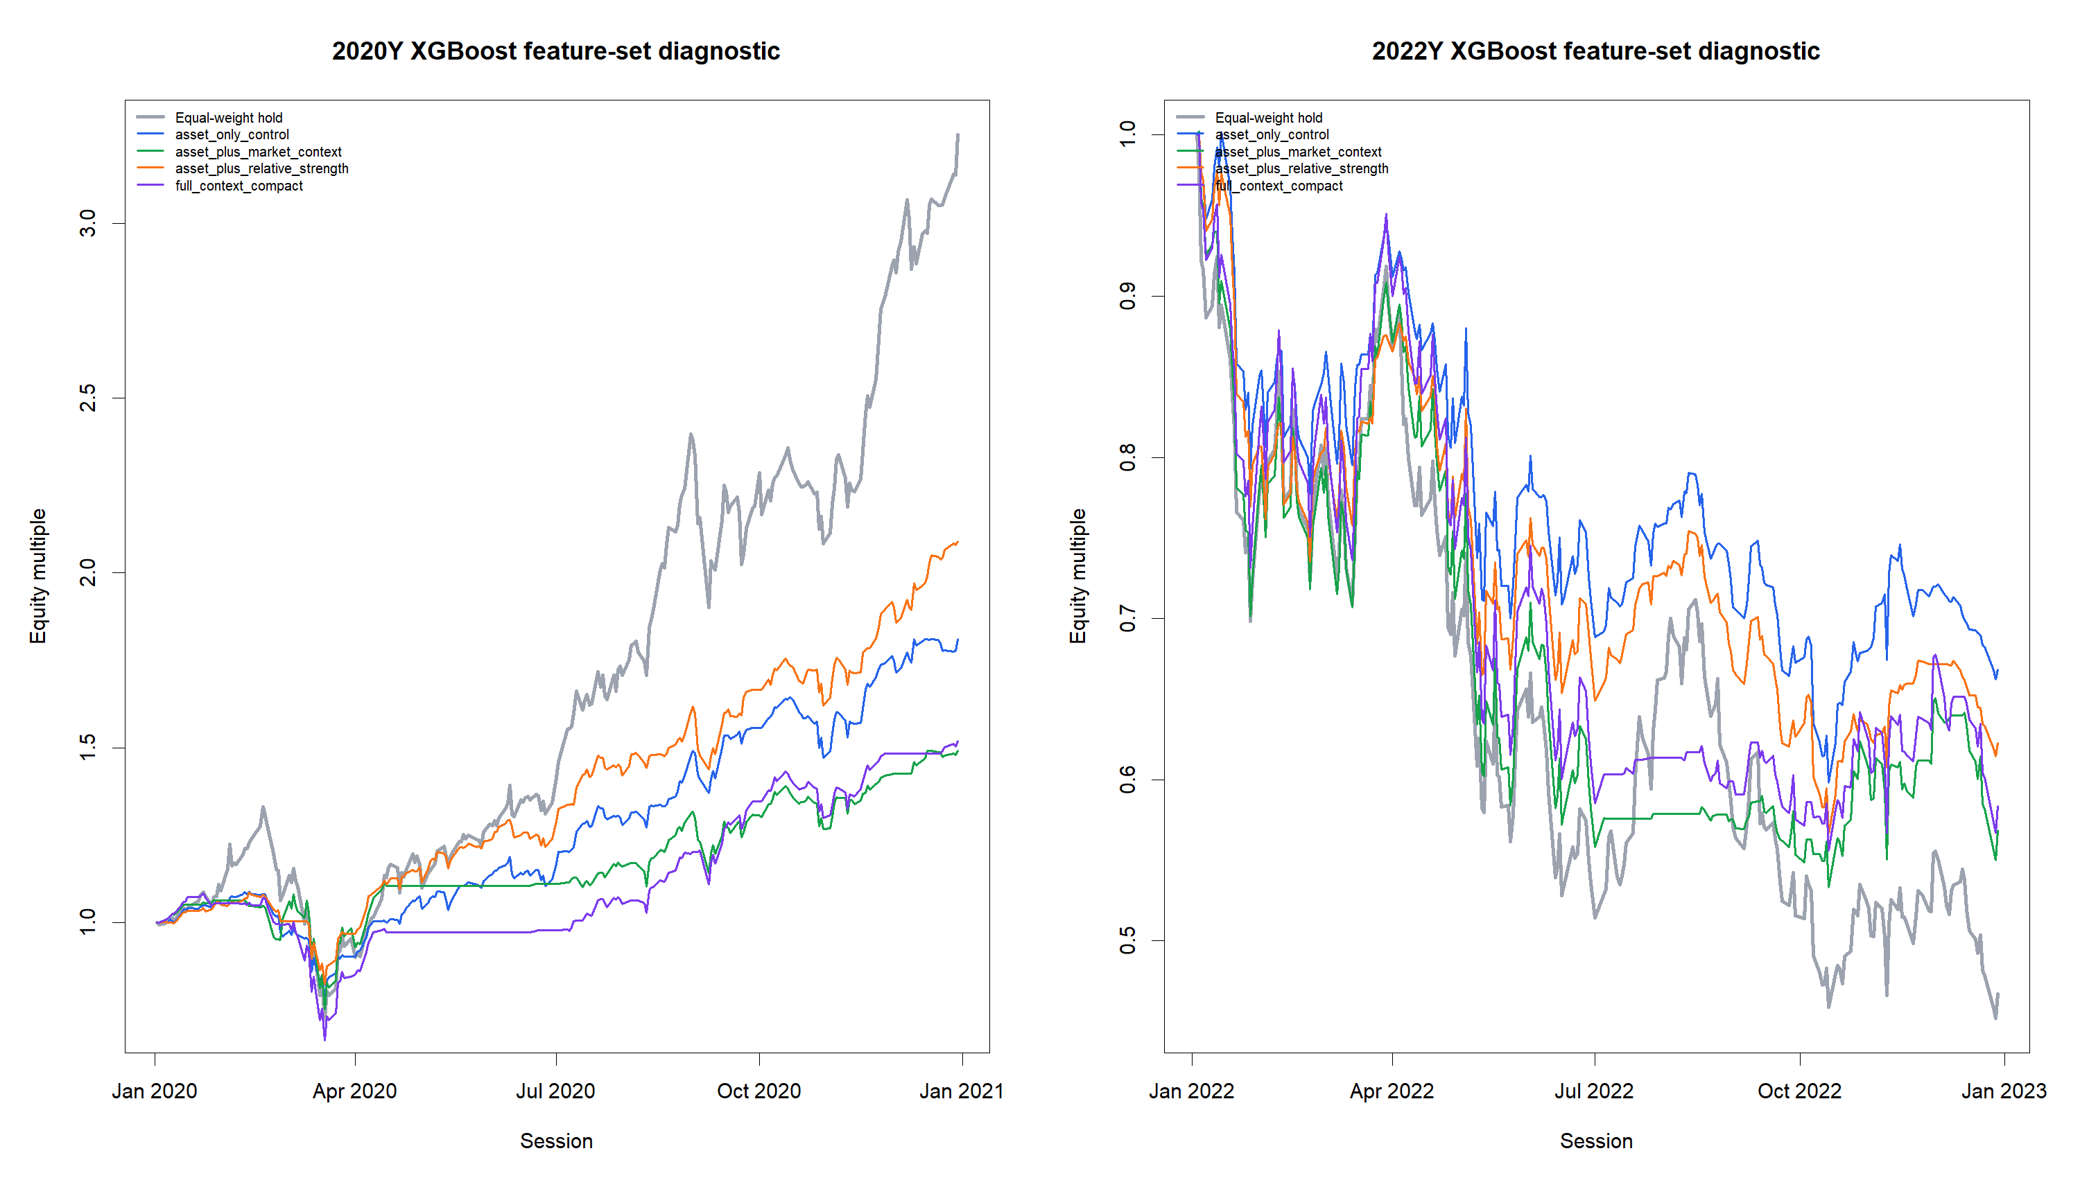
GEN5.4 ML DECISION ENGINE
The equity curves show context can add noise before it adds edge
What changed
Direct market context returned 49.3% in 2020, and full compact returned 51.9%. Both lagged relative strength at 108.9%. In 2022, asset-only was the best defender at -33.2%.

Slide 49
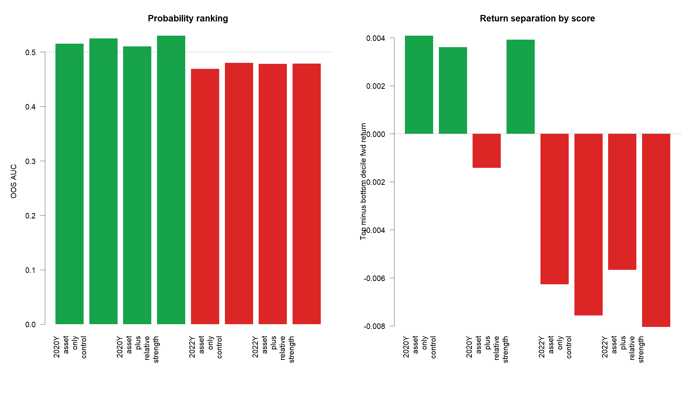
GEN5.4 ML DECISION ENGINE
Ranking improved a little in 2020, but replay did not follow
Readout
The best 2020 AUC was 0.530 from full context compact. But 2022 AUC stayed below 0.50 for all sets, and top-minus-bottom separation remained negative in 2022.

Slide 50
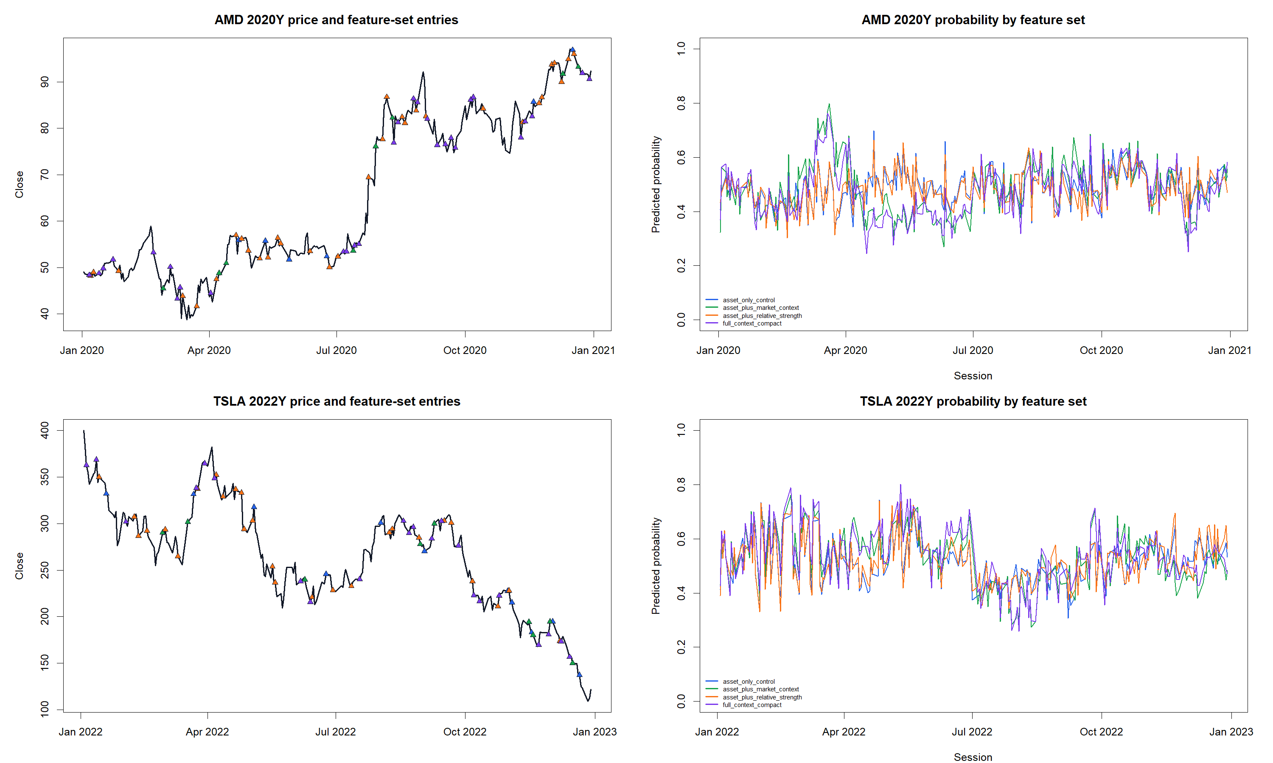
GEN5.4 ML DECISION ENGINE
Probability tapes remain the human sanity check
What to inspect
The tapes show whether a feature set changes entries in market-intuitive places, or merely changes probability texture near the threshold. For now, more context did not automatically mean better trade behavior.

Slide 51
GEN5.4 ML DECISION ENGINE
The next feature slice should be smaller, not wider
ML-P3 says the current relative-strength feature surface remains useful, but direct context features are not yet cleanly tradeable. The next feature-engineering step should explain why context helped ranking a little without improving replay.
-
Keep relative strength as the control feature set for the next ML slice.
-
Test context features one family at a time: trend, volatility/stress, drawdown, or breadth.
-
Alternatively test a label/policy calibration slice if the operator wants to focus on threshold behavior.
-
Do not promote direct context broadly until it improves replay and ranking together.

Slide 52
Transition
Now we test what future the model is asked to predict
ML-P4
Label horizons
ML-P4 repeats the ML-P3 feature-set surface across h1, h5, and h10 labels. The replay still rescores daily, so this isolates the label horizon before adding minimum-hold rules.

Slide 53
GEN5.4 ML DECISION ENGINE
Longer labels changed the tradeoff, not the answer
GUARDRAILS
BEST 2020
BEST 2022
BEST 2022 AUC
All PASS
h1 rel
h10 asset
0.552
Child packets and parent stitch passed.
108.9% active return.
-28.6% active return.
h10 / relative strength.
The longer horizons did not create a cleaner high-conviction trader. They mostly lowered 2020 upside capture, while helping some 2022 ranking and defense diagnostics.

Slide 54
GEN5.4 ML DECISION ENGINE
The 2020 upside control is still h1 relative strength
H1 RELATIVE
H5 RELATIVE
H10 RELATIVE
H5 MARKET
108.9%
61.9%
50.8%
63.7%
Basket hold was 225.2%.
Exposure was 59.0%.
Exposure was 55.2%.
h1 market was 49.3%.
There is one useful nuance: h5 improved the direct-market-context lane versus its own h1 result. But the best bull-window replay still came from the shorter h1 relative-strength label.

Slide 55
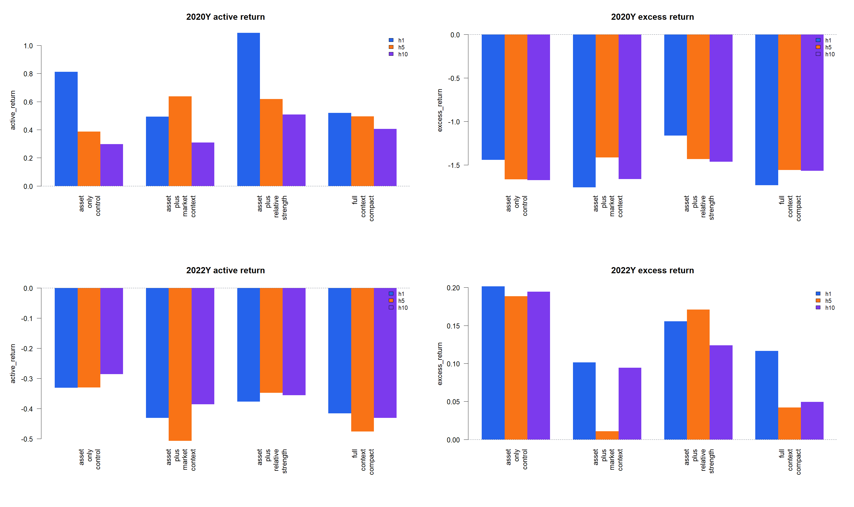
GEN5.4 ML DECISION ENGINE
The return matrix shows the horizon tradeoff
Readout
For 2020, h1 relative strength returned 108.9%, while h5/h10 relative strength returned 61.9% and 50.8%. For 2022, h10 asset-only defended best at -28.6%, versus h1 asset-only at -33.2%.

Slide 56
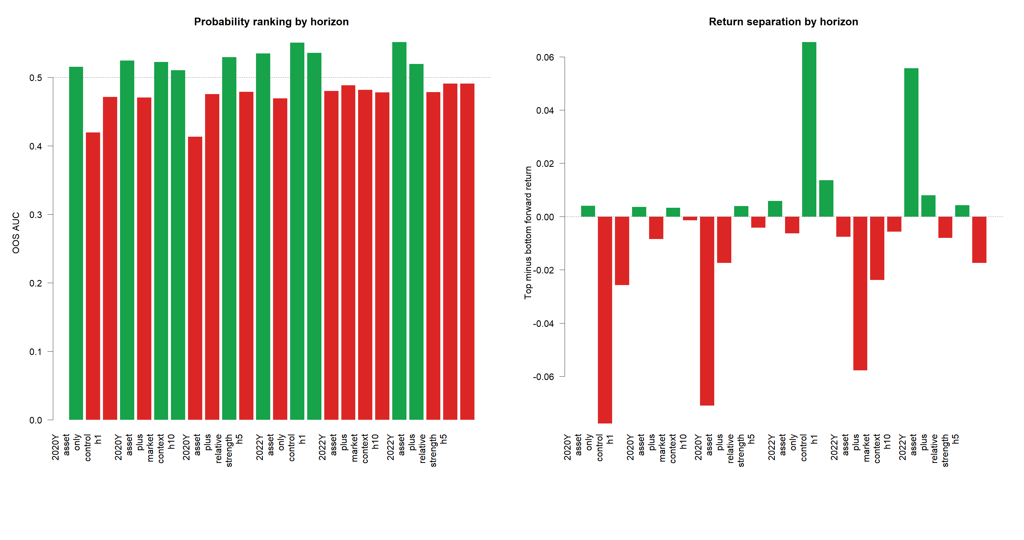
GEN5.4 ML DECISION ENGINE
Ranking hints that longer labels may help risk-off separation
What changed
h5 and h10 improved several 2022 AUC and top-minus-bottom diagnostics, especially asset-only and relative-strength variants. But in 2020, longer labels often ranked the rally poorly.

Slide 57
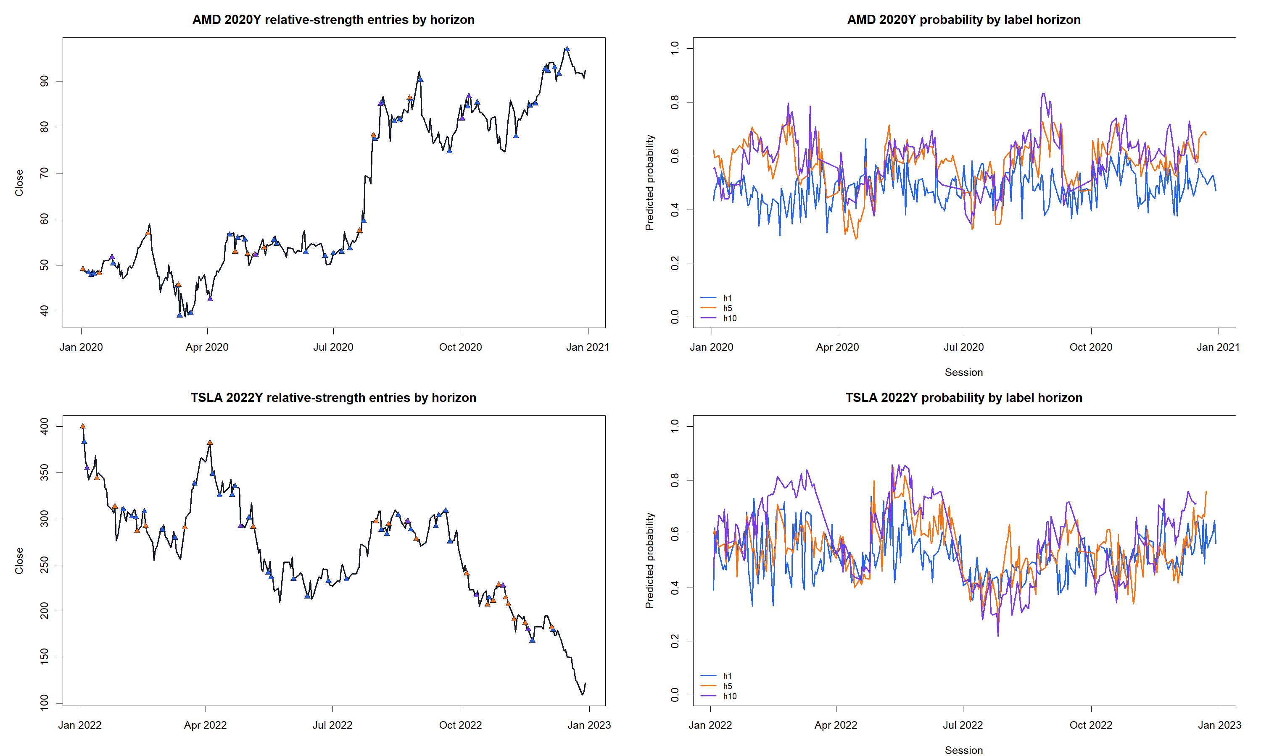
GEN5.4 ML DECISION ENGINE
Probability tapes show why horizon alone is not enough
Next gate
Longer labels create smoother probability texture in places, but they do not automatically align entries with the major 2020 upside. If we pursue h5/h10, the next test should add minimum-hold or benchmark-relative labels deliberately.

Slide 58
GEN5.4 ML DECISION ENGINE
Keep h1 as the upside control and test one sharper idea next
ML-P4 pushes back on the simple conviction hypothesis. Longer labels can help defense diagnostics, but they do not solve high-beta upside capture under daily rescore replay.
-
Keep h1 plus relative strength as the control lane for bullish participation.
-
If testing longer labels again, pair h5/h10 with a minimum-hold replay rule rather than daily churn.
-
A strong alternative is benchmark-relative h5: predict asset return over market/context, not just positive absolute return.
-
Do not promote h5/h10 solely from this slice.

Slide 59
Transition
Now we test the habitat the ML engine trains and trades in
ML-P5
Universe architecture
ML-P5 keeps seeded XGBoost, h1 labels, TRAIN-only threshold selection, daily rescore replay, and equal-weight benchmarks fixed. The new question is whether live basket, research pool, and context breadth change the engine's behavior.

Slide 60
GEN5.4 ML DECISION ENGINE
The screen separates basket, context, and research-pool questions
CONDITIONS
WINDOWS
FEATURE SETS
GUARDRAILS
17
5
4
All PASS
5 basket archetypes across context modes.
Annual stitched windows from 2020Y through 2024Y.
Asset-only, direct context, relative strength, and full compact.
Research-only packet; no live bridge change.
The important design point: broad-pool transfer trains on a larger labeled research pool but replays only the declared target live basket. Broad-pool traded makes the large research pool itself the traded basket.

Slide 61
GEN5.4 ML DECISION ENGINE
The engine is still better at defense than upside capture
2020 MEAN ALPHA
2022 MEAN ALPHA
BEST ROW
BEST FEATURE MEAN
-40.5 pp
4.8 pp
31.6 pp
-18.3 pp
Mean active 24.1% versus benchmark 64.6%.
Mean active -19.6% versus benchmark -24.3%.
2022Y / high beta 5 broad pool transfer.
asset only control
The screen did not discover a universal alpha engine. It mostly rediscovered a familiar profile: useful risk-off behavior in 2022, but underparticipation in high-beta bull windows.

Slide 62
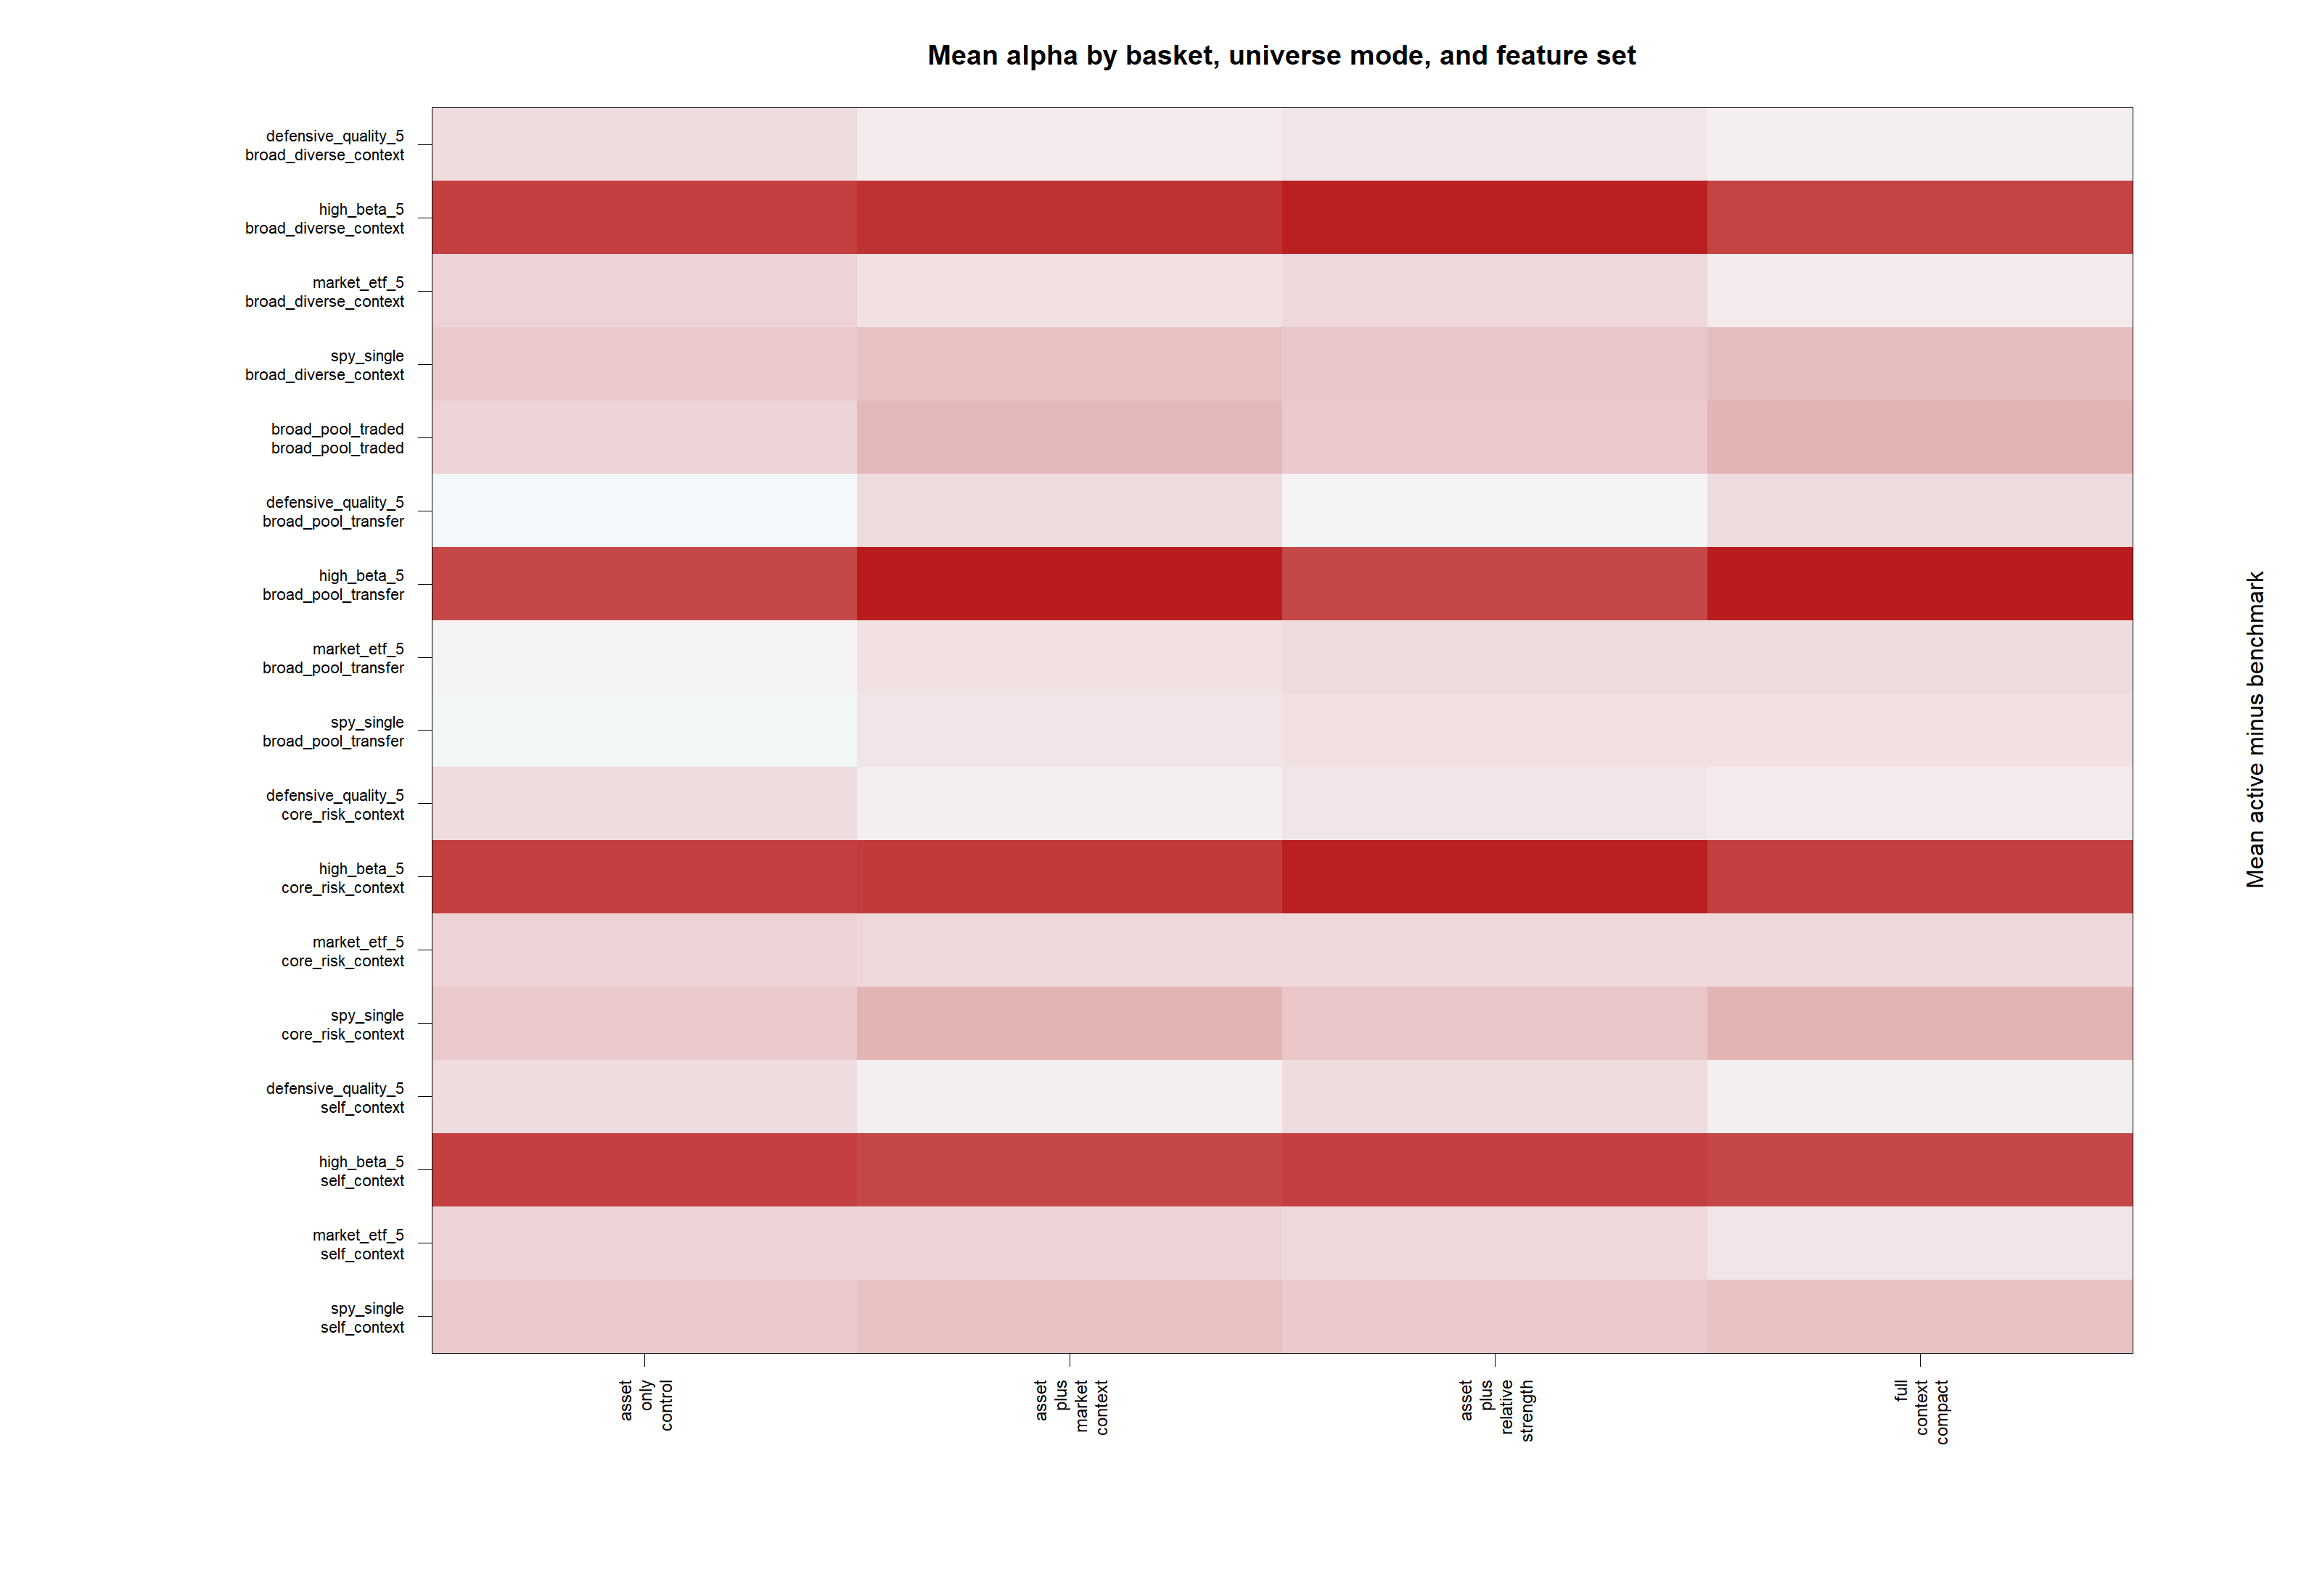
GEN5.4 ML DECISION ENGINE
The alpha heatmap shows the habitat problem at a glance
Readout
High-beta rows remain the weakest on mean alpha. Defensive, ETF, and SPY transfer rows are closer to neutral. Broad-pool transfer is interesting, but it is not a cure-all: high-beta transfer averaged -55.2 pp.

Slide 63
GEN5.4 ML DECISION ENGINE
Broad-pool transfer helps in pockets, especially defense
HIGH-BETA TRANSFER
ETF TRANSFER
SPY TRANSFER
BROAD TRADED
-55.2 pp
-5.9 pp
-4.5 pp
-15.3 pp
Self-context averaged -50.1 pp.
Best broad-transfer pockets appeared in 2020 and 2022.
Single-symbol transfer was surprisingly competitive.
Trading the whole broad pool did not solve alpha.
The clearest positive row was high beta 5 broad pool transfer / asset plus relative strength in 2022Y with 31.6 pp alpha. That is useful evidence, but it is mostly defensive selectivity rather than proof of broad upside capture.

Slide 64
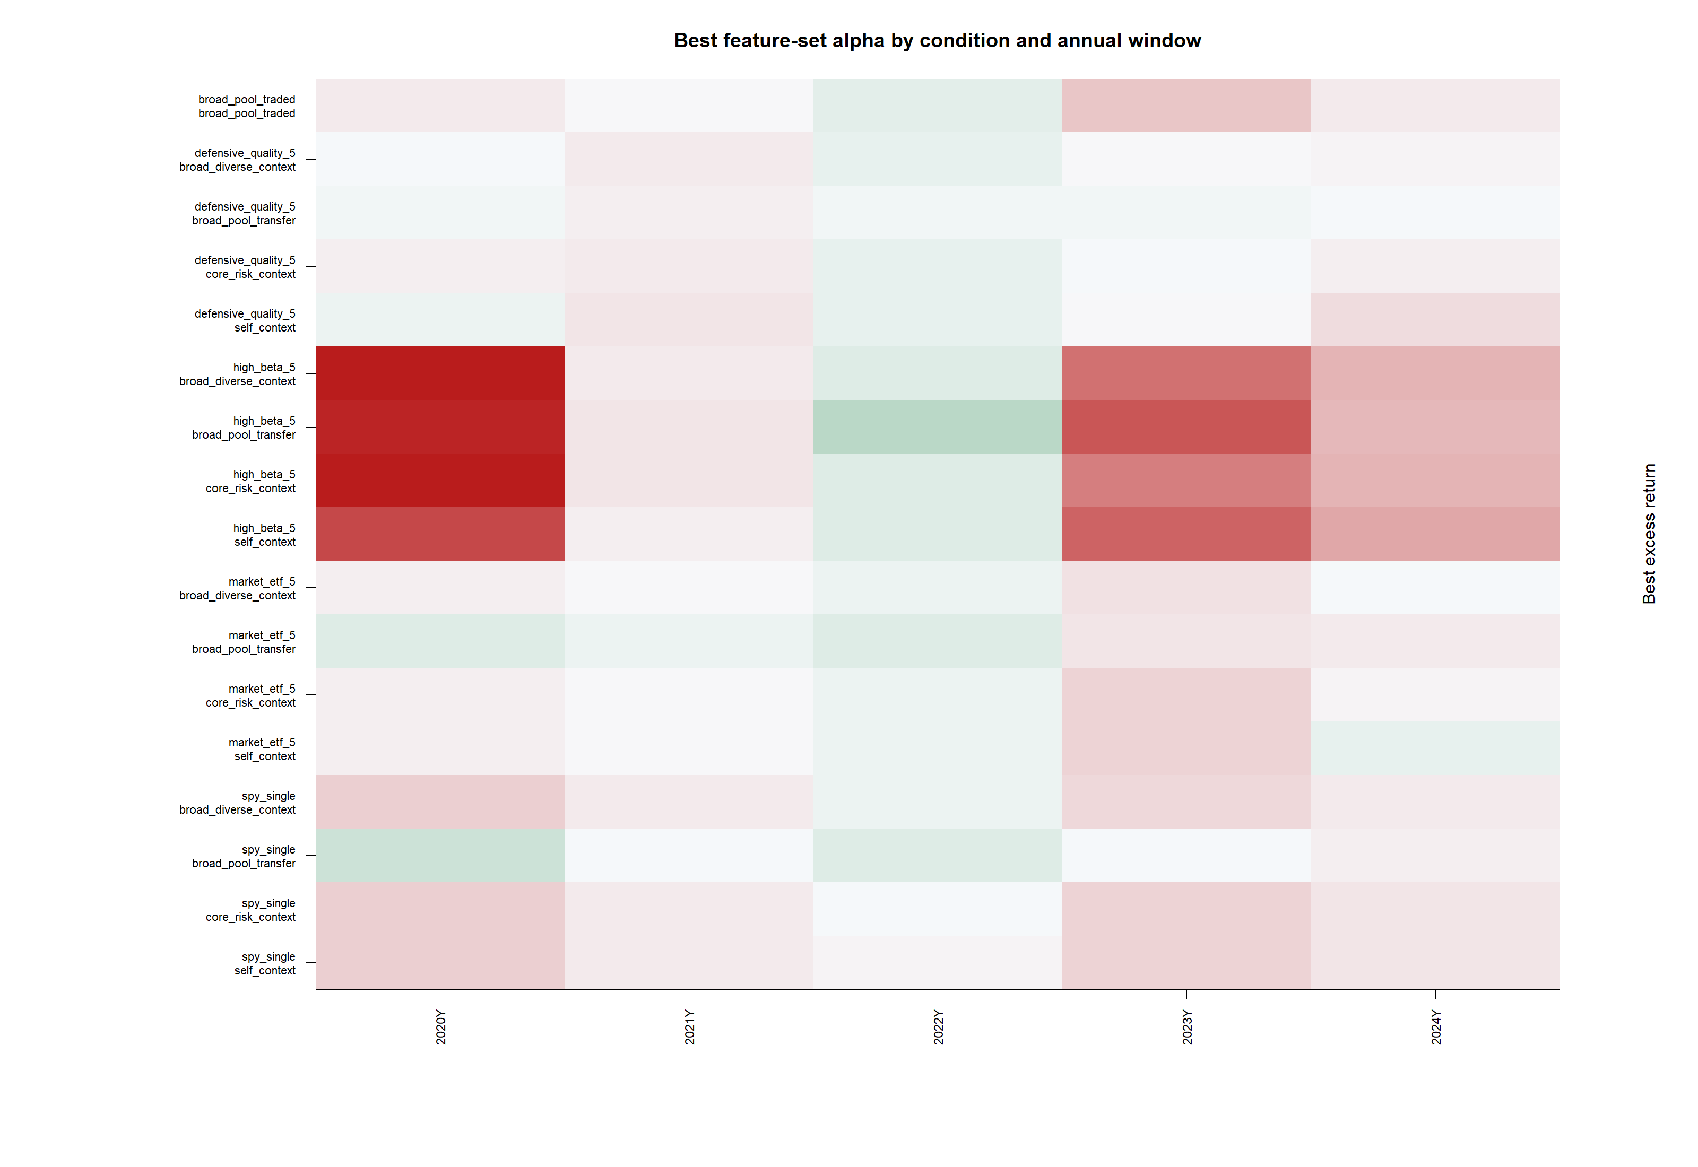
GEN5.4 ML DECISION ENGINE
The window matrix explains why the averages are sobering
Pattern
Most rows improve during the 2022 drawdown and lag during 2020, 2023, and 2024. That is the signature of a timing/risk filter, not yet a high-beta alpha capture engine.

Slide 65
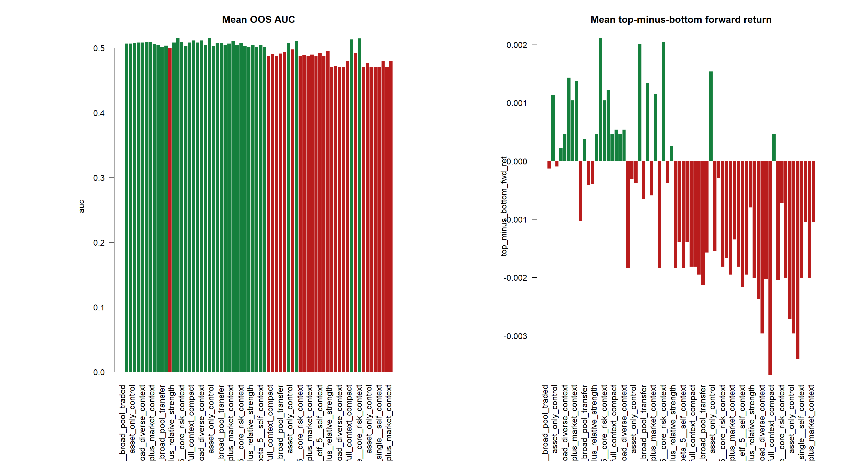
GEN5.4 ML DECISION ENGINE
Ranking diagnostics are mixed, so replay gains need visual audit
Readout
The best mean AUC row reached 0.561, but top-minus-bottom forward-return separation was inconsistent. Replay can improve through threshold timing even when global ranking is weak, so tapes remain mandatory.

Slide 66
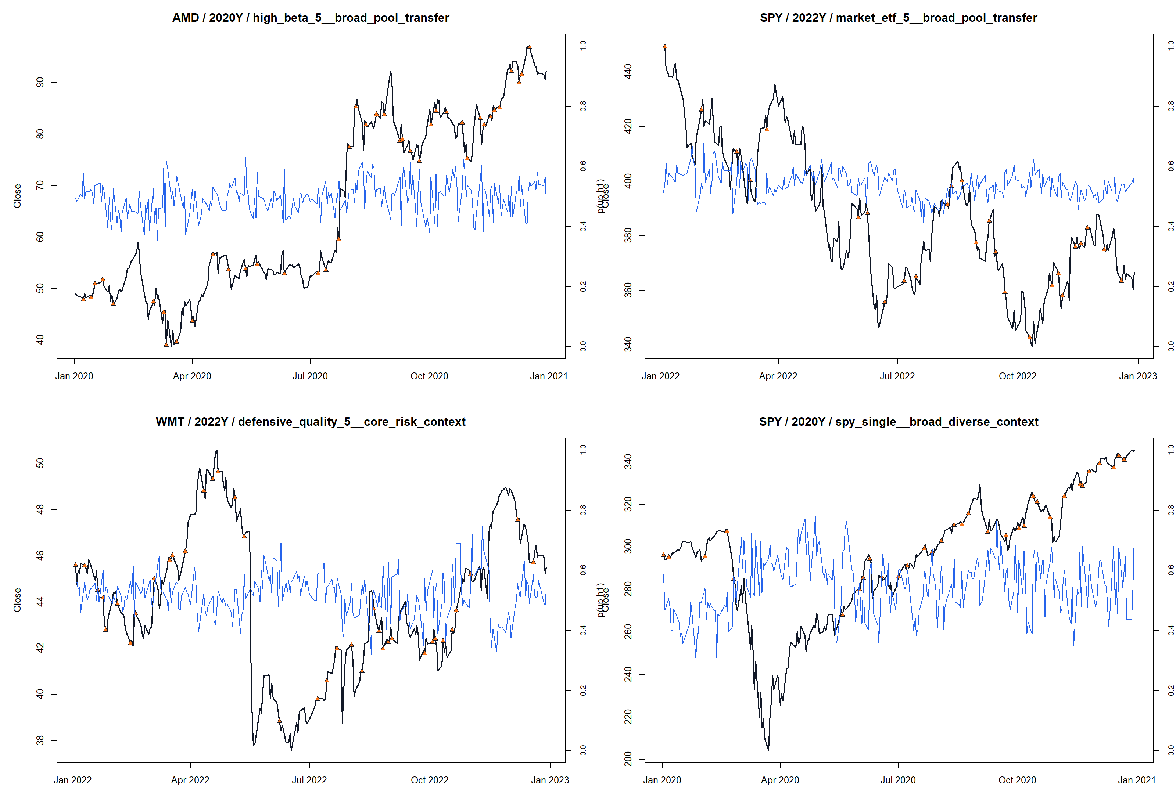
GEN5.4 ML DECISION ENGINE
Probability tapes show what the architecture changed
Human audit
The tape examples show probabilities moving, but not yet cleanly enough to own sustained high-beta uptrends. The next narrow slice should target the objective, not simply add more symbols.

Slide 67
GEN5.4 ML DECISION ENGINE
The next ML question should be about alpha objective, not size
ML-P5 says universe architecture matters, but broadening context or research symbols is not sufficient by itself. The current engine looks most useful as a risk filter and weakest as a bull-market participation engine.
-
Keep broad-pool transfer as a contender for SPY/ETF timing and drawdown defense.
-
Do not blindly enlarge context universes; broader context helped pockets but did not solve high-beta alpha.
-
Next high-signal slice: benchmark-relative labels or upside-capture objectives, still with h1 relative-strength as the control.
-
Keep all outputs research-only; no live advice or allocation promotion.

Slide 68
Transition
Now we ask what a high-quality bullish swing setup should look like
ML-P6
Swing feature audit
ML-P6 pauses model tuning. It starts with the trade shape we actually want: sustained relative upside with manageable interruption risk, observed through a small set of interpretable features.

Slide 69
GEN5.4 ML DECISION ENGINE
The targets describe swing quality, not just tomorrow's direction
ABSOLUTE H10
RELATIVE H10
QUALITY H10
PATH TEST
Return
52.5%
Upside - MAE
35.4%
Next-open entry through close ten sessions later.
Asset beats the equal-weight SPY / QQQ / SMH context over the same horizon.
Forward return penalized by the worst intrahorizon adverse excursion.
Reaches +8% before -5% within ten sessions; diagnostic only.
The primary candidate is relative h10. It asks whether a position is likely to outperform the market-and-sector backdrop, which is closer to the alpha question than a bare positive-return label.

Slide 70
GEN5.4 ML DECISION ENGINE
Four lenses describe a bullish swing setup without a strategy rule
LEADERSHIP
TREND HEALTH
PULLBACK
RISK-ON
Lead
Healthy
Disciplined
Support
Relative strength, distance from highs, sector / market leadership.
Trend consistency, efficiency, and moving-average posture.
ATR-scaled depth, volume behavior, recovery, and breakout posture.
Breadth, return, volatility, drawdown, and dispersion.
The audit evaluates 34 finite features across AMD, NVDA, TSLA, MSTR, and AVGO, with a broader risk-aware context. It does not choose a model or a live policy.

Slide 71
GEN5.4 ML DECISION ENGINE
Feature judgment stays inside TRAIN
WINDOWS
FOLD ROWS
FEATURE AUDIT
GUARDRAILS
5 annual
54,625
Fold-local
All PASS
2020Y through 2024Y; each with eight-quarter TRAIN and quarterly authorities.
Usable h10 label rows across TRAIN and OOS fold partitions.
Deciles and correlations are recalculated separately inside each authority's TRAIN rows.
No horizon spillover, no OOS feature selection, and no live-bridge change.
OOS rows show whether the target is sufficiently populated and well-formed. They do not decide which feature or target wins. That distinction is what keeps this exploration from quietly becoming a hindsight feature search.

Slide 72
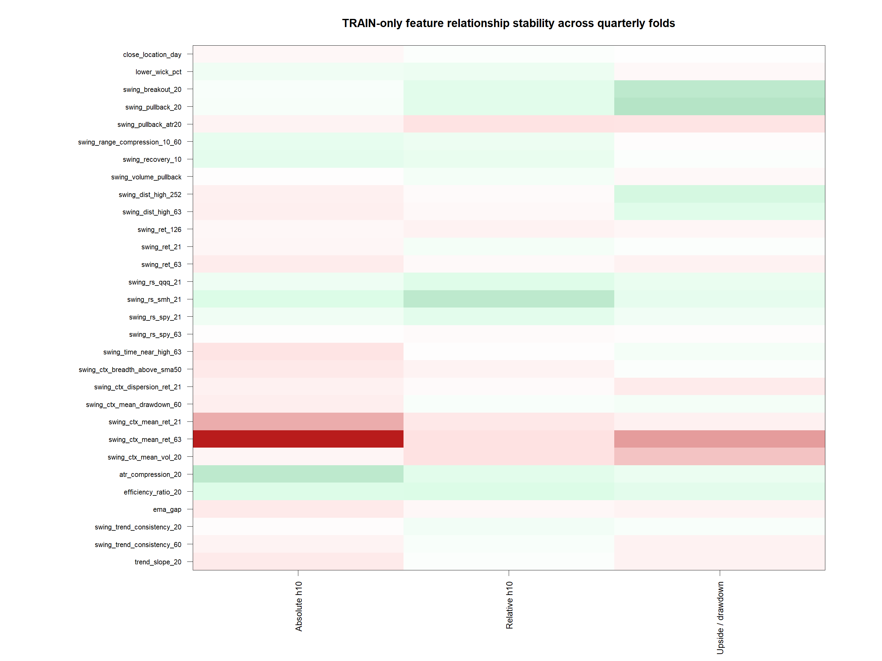
GEN5.4 ML DECISION ENGINE
No single feature is strong enough to claim victory on its own
Readout
swing rs smh 21 has the largest median TRAIN-fold relationship to relative h10 return (0.063), still small. That is honest evidence: retain a compact set of complementary clues and make the next model test earn its complexity.

Slide 73
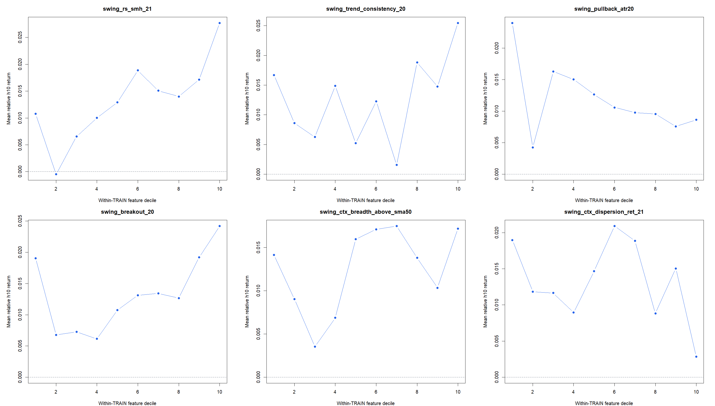
GEN5.4 ML DECISION ENGINE
The decile view reveals shape, not a blanket buy signal
How to read it
The panels average within-TRAIN deciles across quarterly folds. Semiconductor-relative leadership and fresh-breakout posture slope upward more plausibly than several raw trend measures. Pullback depth is not a simple monotonic buy-the-dip story.

Slide 74
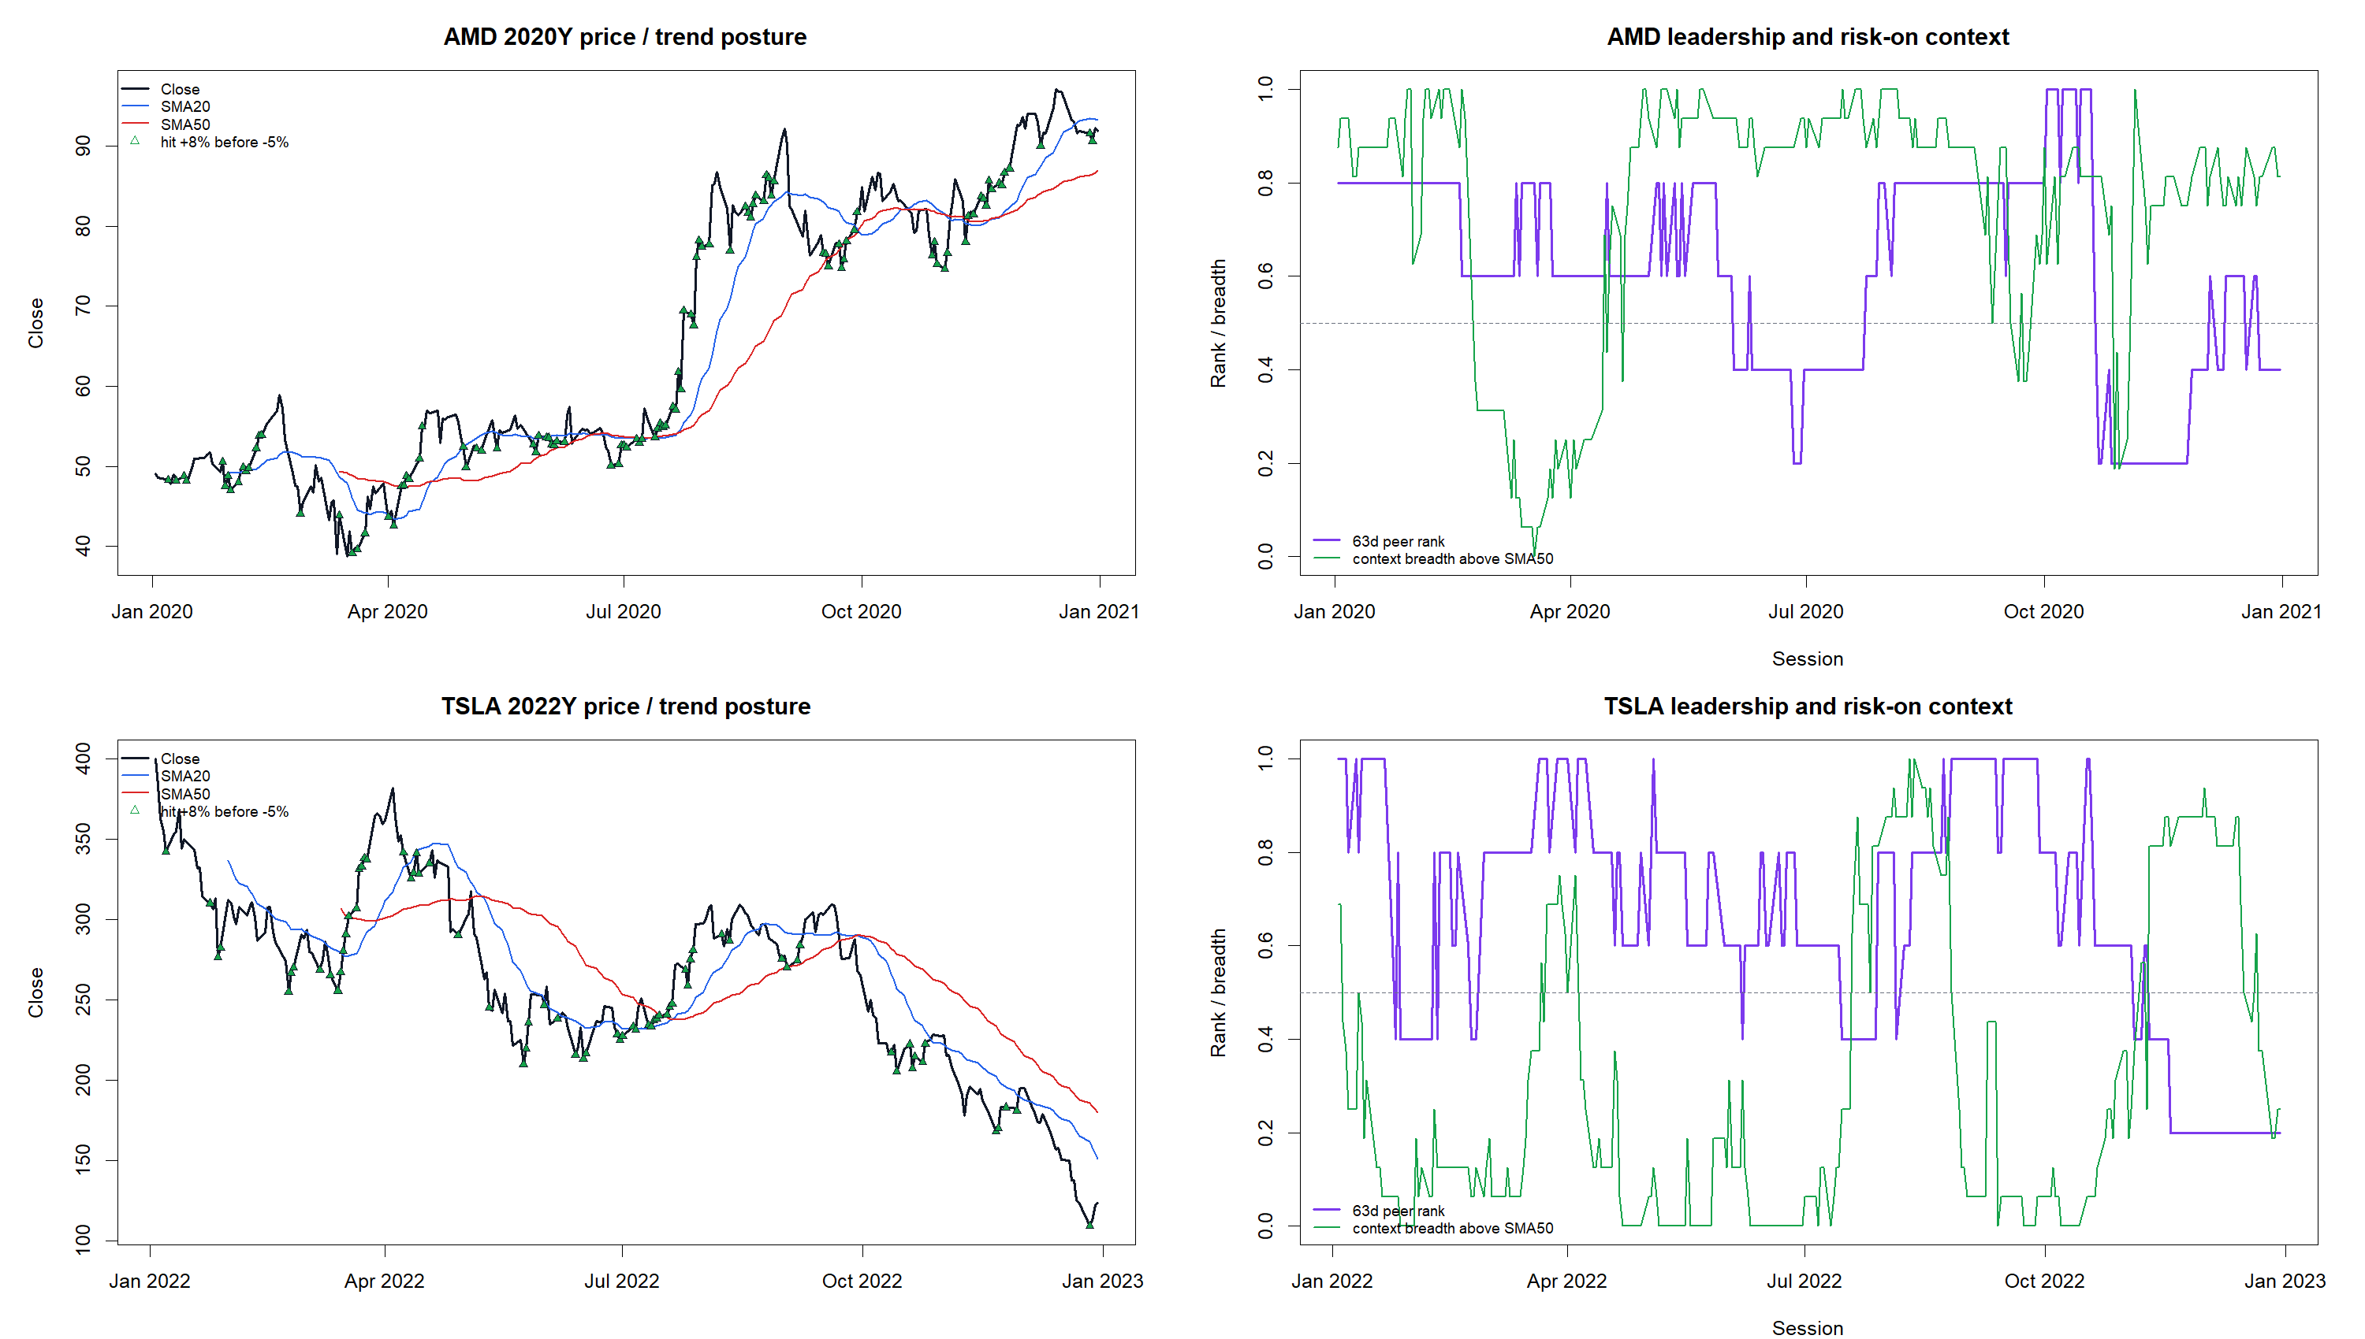
GEN5.4 ML DECISION ENGINE
Price examples keep the features grounded in actual market behavior
Why these two
AMD 2020 shows leadership and breadth interacting during a powerful advance. TSLA 2022 shows why price above moving averages alone is not enough: leadership can remain high while the broader context deteriorates. These are feature diagnostics, not trading signals.

Slide 75
GEN5.4 ML DECISION ENGINE
The next slice is a small model test with an explicit alpha objective
ML-P6 establishes the ingredients and the safety boundary. It does not yet establish that the ingredients form a useful predictive model or beat benchmark.
-
Keep relative h10 as the primary candidate target; retain absolute h10 as the existing control.
-
Predeclare a compact swing-feature set instead of searching the entire 34-feature surface.
-
Use the same seeded XGBoost, TRAIN-only policy selection, annual continuity replay, benchmarks, and trade tapes.
-
Promote nothing unless replay and ranking improve across multiple windows; the live bridge stays frozen.

Slide 76
GEN5.4 ML DECISION ENGINE
ML-P7: the swing target test is complete
We held the seeded XGBoost, TRAIN-only policy selection, daily next-open replay, and equal-weight basket benchmark fixed. Only the target and feature set moved.
-
Target: absolute h1 control versus benchmark-relative h10 challenger.
-
Features: established relative-control surface versus 12 predeclared swing features.
-
Scope: five annual windows, eight-quarter TRAIN, quarterly authorities stitched for annual review.

Slide 77
GEN5.4 ML DECISION ENGINE
None of the four lanes cleared the mean-alpha gate
Mean OOS excess return versus equal-weight basket hold
Absolute h1 + compact swing: -6.6 pp
Absolute h1 + existing control: -6.8 pp
Relative h10 + compact swing: -9.4 pp
Relative h10 + existing control: -6.2 pp
This is a clean negative result, not a reason to tune harder. The relative-h10 existing-control lane was least negative overall, but did not establish alpha.

Slide 78
GEN5.4 ML DECISION ENGINE
The audit question has shifted from model choice to participation
Every lane defended the falling 2022 basket; relative h10 + existing control led at +9.1 pp excess. Yet every lane lagged during the bullish 2020, 2021, 2023, and 2024 windows.
-
Audit whether calibrated probabilities separate favorable from unfavorable days.
-
Audit exposure and trade tapes for late entry, early exit, and avoidable flat periods.
-
Audit symbol concentration before changing labels, features, or model knobs again.

