Slide 1
LIT-MR-04.1 + LIT-MR-05.1 | 29 JUL 2026
Kalman filtering
pairs and triplets
A source-grounded textbook exercise in dynamic regression: estimate a changing hedge ratio, trade only causal innovations, and keep prediction evidence separate from estimator elegance.
Notes:
This deck works Chan's Kalman-filter example as a student exercise, then extends the same scalar-observation filter from one regressor to two. It is not framed as an alpha claim.
[Sources]
- C:/Users/Franc/OneDrive/Documents/Francis/Trading Literature/Algorithmic Trading - Winning Strategies and Their Rationale 2013.pdf — printed pp. 75-82; PDF pp. 93-100
- C:/Users/Franc/OneDrive/Documents/Francis/Peltata Project/Time-Series-Modeling-Gen5/docs/GEN5_LIT_MR_04_1_KALMAN_PAIR_POC_CONTRACT.md
- C:/Users/Franc/OneDrive/Documents/Francis/Peltata Project/Time-Series-Modeling-Gen5/docs/GEN5_LIT_MR_05_1_KALMAN_TRIPLET_POC_CONTRACT.md
- C:/Users/Franc/OneDrive/Documents/Francis/Peltata Project/Time-Series-Modeling-Gen5/docs/GEN5_4_DECISION_DIALOGUE_INDEX.md — D89

Slide 2
Kalman removes the rolling window's hard memory cutoff
A 20-session regression forgets day 21 all at once. A Kalman filter carries the state forward and lets new observations revise it recursively—but smoother memory is not the same thing as better prediction.
ROLL 20
KALMAN
CAUTION
Refit on a fixed recent sample
Abrupt inclusion and exclusion
Predict → observe → update
Uncertainty governs the adjustment
A changing hedge ratio is an estimator
Mean reversion still needs future evidence
2
Notes:
Chan motivates Kalman filtering as an alternative to moving-window regression because a rolling window imposes an arbitrary cutoff. Recursive weighting removes the cutoff, but it does not prove that forecast errors are transitory.
Chan's source example reports 26.2% APR and 2.4 Sharpe in sample. Those figures are context only; the Gen5 interval is not tuned to reproduce them.
[Sources]
- C:/Users/Franc/OneDrive/Documents/Francis/Trading Literature/Algorithmic Trading - Winning Strategies and Their Rationale 2013.pdf — printed pp. 75 and 81; PDF pp. 93 and 99
- C:/Users/Franc/OneDrive/Documents/Francis/Peltata Project/Time-Series-Modeling-Gen5/docs/GEN5_LITERATURE_SOURCE_LEDGER.md

Slide 3
Two state-space equations turn a fixed regression into a moving one
The observation equation explains today's response price. The state equation says the slope and intercept may drift. The innovation measures what yesterday's state failed to predict.
y = xθ + ε
θₜ = θₜ₋₁ + ω
z = e / √S
Observation equation
θ contains slope(s) and intercept
Random-walk state equation
Q controls how fast coefficients may move
Standardized pre-update innovation
Signal first; posterior update second
3
Notes:
For the pair, y is EWC and x is [EWA, 1]. For the triplet, x is [EWA, IGE, 1]. Before seeing y_t, the filter predicts theta_t and P_t. The innovation e_t = y_t - x_t theta_(t|t-1), with variance S_t = x_t P_(t|t-1) x_t' + R.
The Kalman gain K_t = P_(t|t-1) x_t' / S_t updates theta_(t|t) = theta_(t|t-1) + K_t e_t.
[Sources]
- C:/Users/Franc/OneDrive/Documents/Francis/Trading Literature/Algorithmic Trading - Winning Strategies and Their Rationale 2013.pdf — equations 3.7-3.13, printed pp. 76-77; PDF pp. 94-95
- C:/Users/Franc/OneDrive/Documents/Francis/Peltata Project/Time-Series-Modeling-Gen5/docs/GEN5_LIT_MR_04_1_KALMAN_PAIR_POC_CONTRACT.md
- C:/Users/Franc/OneDrive/Documents/Francis/Peltata Project/Time-Series-Modeling-Gen5/docs/GEN5_LIT_MR_05_1_KALMAN_TRIPLET_POC_CONTRACT.md

Slide 4
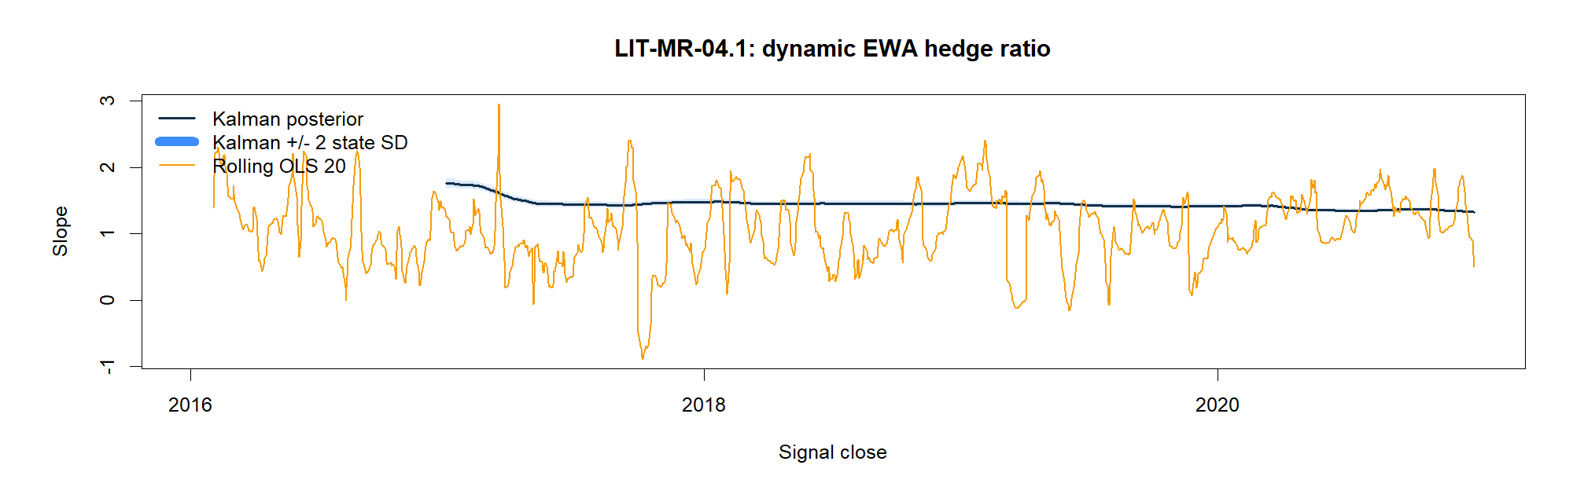
The Kalman slope moves smoothly; rolling OLS jumps
4
Notes:
The pair is frozen as EWC ~ EWA. The Kalman EWA slope begins near 1.76 after the 252-session warm-up and ends near 1.33. Its mean absolute daily change is 0.00077, versus 0.0871 for rolling OLS.
Smoothness is the intended estimator behavior, not a performance result. The 20-session OLS coefficient can change sharply as observations enter and leave the window.
[Sources]
- C:/Users/Franc/OneDrive/Documents/Francis/Trading Literature/Algorithmic Trading - Winning Strategies and Their Rationale 2013.pdf — printed pp. 75-78; PDF pp. 93-96
- C:/Users/Franc/OneDrive/Documents/Francis/Peltata Project/Time-Series-Modeling-Gen5/runs/research_workbench/literature_grounded/lit_mr_04_1_05_1_kalman_textbook_20260729/mr04_coefficient_metrics.csv
- C:/Users/Franc/OneDrive/Documents/Francis/Peltata Project/Time-Series-Modeling-Gen5/runs/research_workbench/literature_grounded/lit_mr_04_1_05_1_kalman_textbook_20260729/mr04_state_path.csv

Slide 5
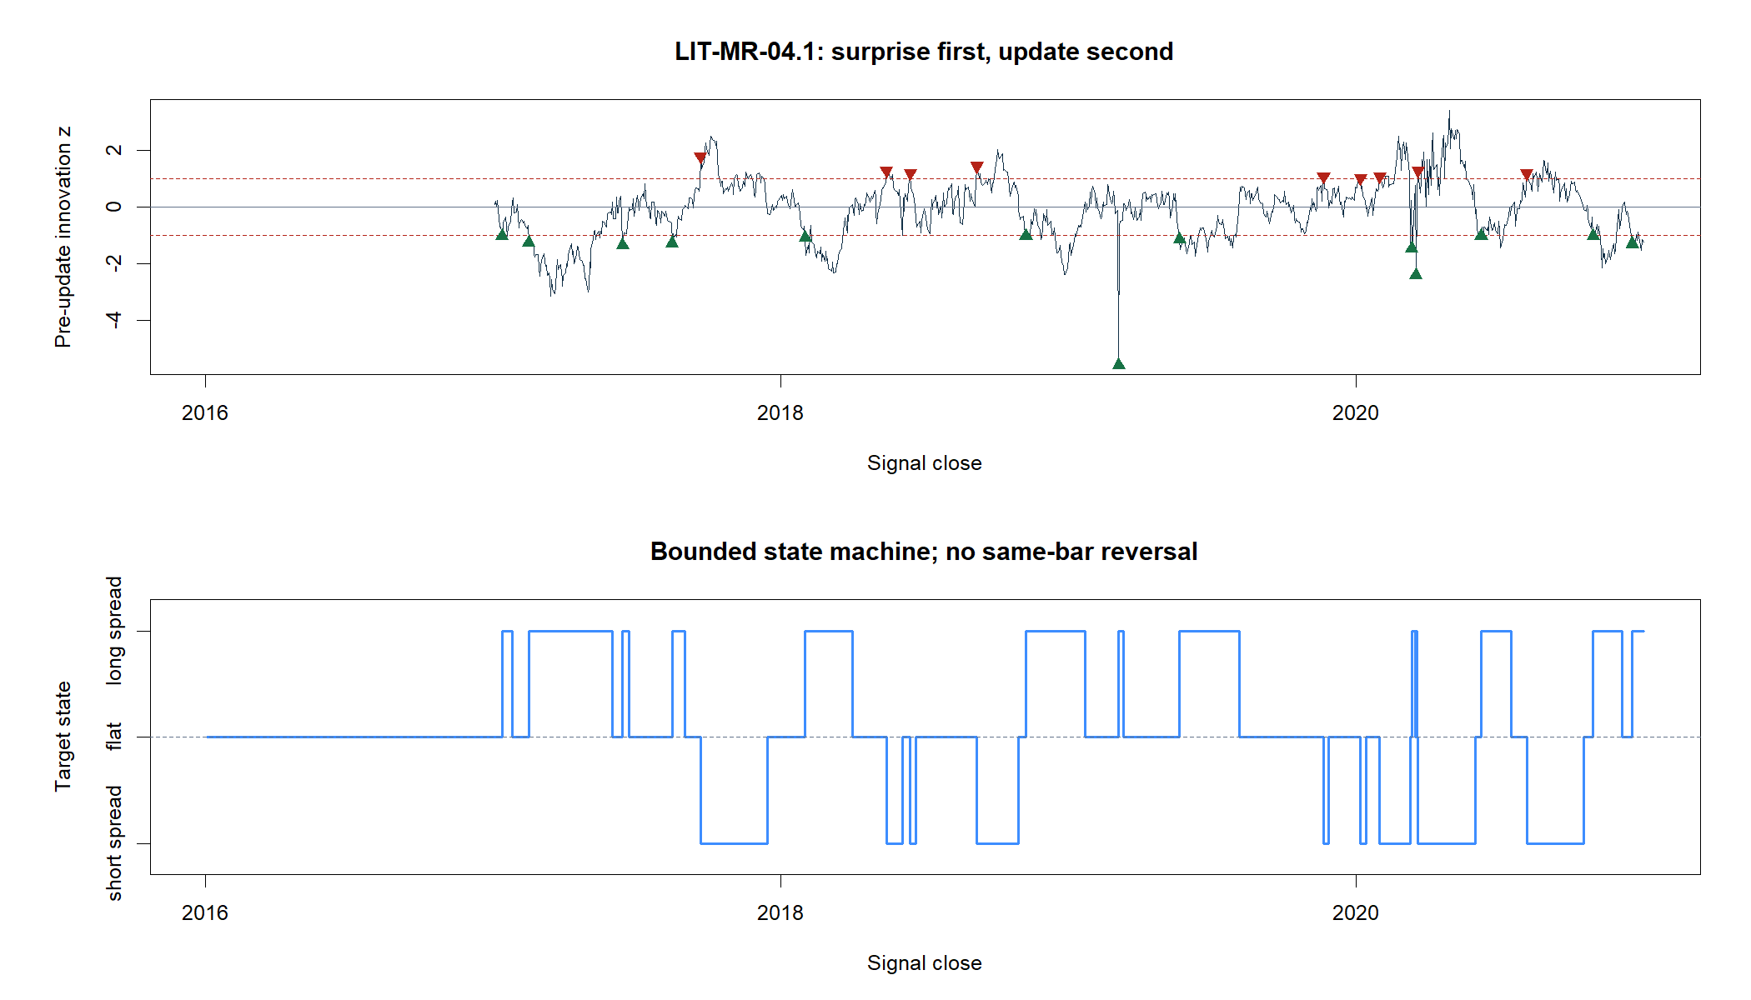
The signal is the surprise before the state learns from it
5
Notes:
Entry occurs when the pre-update standardized innovation is below -1 or above +1. Exit occurs on the zero crossing. The state machine prohibits same-bar reversal.
The posterior residual is mechanically smaller because the filter has already used y_t to update theta. Treating that residual as convergence evidence would be circular. Gen5 therefore tests the pre-update z-score against a future five-session fixed-posterior-vector return.
[Sources]
- C:/Users/Franc/OneDrive/Documents/Francis/Trading Literature/Algorithmic Trading - Winning Strategies and Their Rationale 2013.pdf — printed pp. 76-81; PDF pp. 94-99
- C:/Users/Franc/OneDrive/Documents/Francis/Peltata Project/Time-Series-Modeling-Gen5/docs/GEN5_LIT_MR_04_1_KALMAN_PAIR_POC_CONTRACT.md
- C:/Users/Franc/OneDrive/Documents/Francis/Peltata Project/Time-Series-Modeling-Gen5/runs/research_workbench/literature_grounded/lit_mr_04_1_05_1_kalman_textbook_20260729/mr04_state_path.csv
- C:/Users/Franc/OneDrive/Documents/Francis/Peltata Project/Time-Series-Modeling-Gen5/runs/research_workbench/literature_grounded/lit_mr_04_1_05_1_kalman_textbook_20260729/mr04_forward_convergence.csv

Slide 6
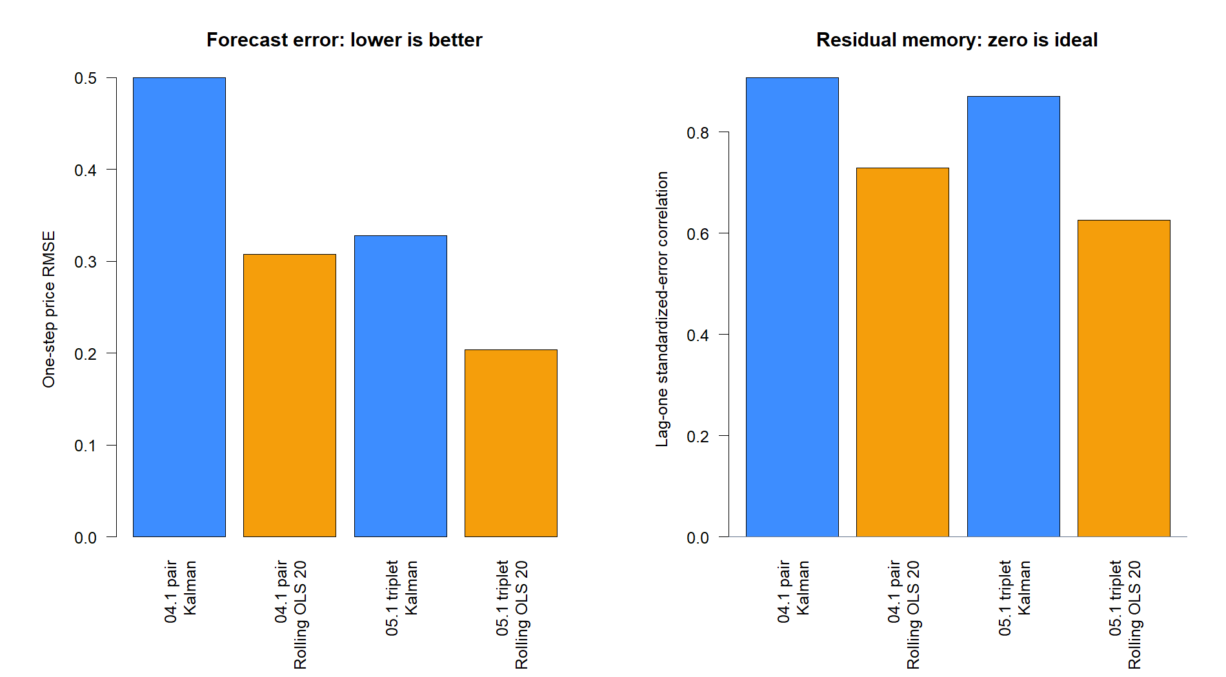
Source fidelity still requires a scale-aware causal translation
Chan fixes δ = 0.0001 and Ve = 0.001, and explicitly notes hindsight.
Gen5 keeps δ, but learns R from a 252-session TRAIN warm-up and sets Q = δ/(1−δ) · diag(diag(P₀)).
That preserves the random-walk state while respecting price scale. It also exposes an honest lesson: rolling OLS had lower one-step RMSE; Kalman mainly bought smoother coefficients.
6
Notes:
Chan parameterizes Vw as delta/(1-delta) times the identity and uses Ve=0.001. A fixed observation variance has units of price squared, so it is not scale invariant. The Gen5 translation estimates R and P0 once from TRAIN warm-up, then freezes Q and R.
Pair RMSE: Kalman 0.5003 versus rolling OLS 0.3078. Triplet RMSE: Kalman 0.3280 versus rolling OLS 0.2039. Kalman standardized-error lag-one correlation is also high (0.908 pair; 0.871 triplet), so the innovation is not white noise. These are diagnostics, not hidden gates.
[Sources]
- C:/Users/Franc/OneDrive/Documents/Francis/Trading Literature/Algorithmic Trading - Winning Strategies and Their Rationale 2013.pdf — printed pp. 77-78; PDF pp. 95-96
- C:/Users/Franc/OneDrive/Documents/Francis/Peltata Project/Time-Series-Modeling-Gen5/docs/GEN5_LIT_MR_04_1_KALMAN_PAIR_POC_CONTRACT.md
- C:/Users/Franc/OneDrive/Documents/Francis/Peltata Project/Time-Series-Modeling-Gen5/docs/GEN5_LIT_MR_05_1_KALMAN_TRIPLET_POC_CONTRACT.md
- C:/Users/Franc/OneDrive/Documents/Francis/Peltata Project/Time-Series-Modeling-Gen5/runs/research_workbench/literature_grounded/lit_mr_04_1_05_1_kalman_textbook_20260729/mr04_calibration.csv
- C:/Users/Franc/OneDrive/Documents/Francis/Peltata Project/Time-Series-Modeling-Gen5/runs/research_workbench/literature_grounded/lit_mr_04_1_05_1_kalman_textbook_20260729/mr05_calibration.csv

Slide 7
Pair: strong TRAIN mechanics stopped on one support gate
EWC ~ EWA passed integrity, filter, sign, return, uncertainty, random-sign, and future-convergence gates. It completed 21 trades—not the frozen 24—so DEVELOPMENT remained sealed.
7 / 8
+67.8 bp
−0.157
TRAIN gates passed
21 trades: 12 long, 9 short
Mean net trade return
90% lower bound +42.3 bp
Forward-five correlation
90% upper bound −0.0436
7
Notes:
The pair returned +14.21% cumulatively after 5 bp turnover costs on TRAIN, with -5.41% maximum drawdown and 0.716 autocorrelation-adjusted Sharpe. Mean completed-trade return was +67.76 bp and hit rate 90.5%.
The STOP is deliberate. A 21-trade near miss is informative but does not authorize changing the threshold after inspection or opening OOS.
[Sources]
- C:/Users/Franc/OneDrive/Documents/Francis/Peltata Project/Time-Series-Modeling-Gen5/runs/research_workbench/literature_grounded/lit_mr_04_1_05_1_kalman_textbook_20260729/mr04_train_summary.csv
- C:/Users/Franc/OneDrive/Documents/Francis/Peltata Project/Time-Series-Modeling-Gen5/runs/research_workbench/literature_grounded/lit_mr_04_1_05_1_kalman_textbook_20260729/mr04_train_gates.csv
- C:/Users/Franc/OneDrive/Documents/Francis/Peltata Project/Time-Series-Modeling-Gen5/docs/GEN5_LIT_MR_04_1_KALMAN_PAIR_POC_CONTRACT.md

Slide 8
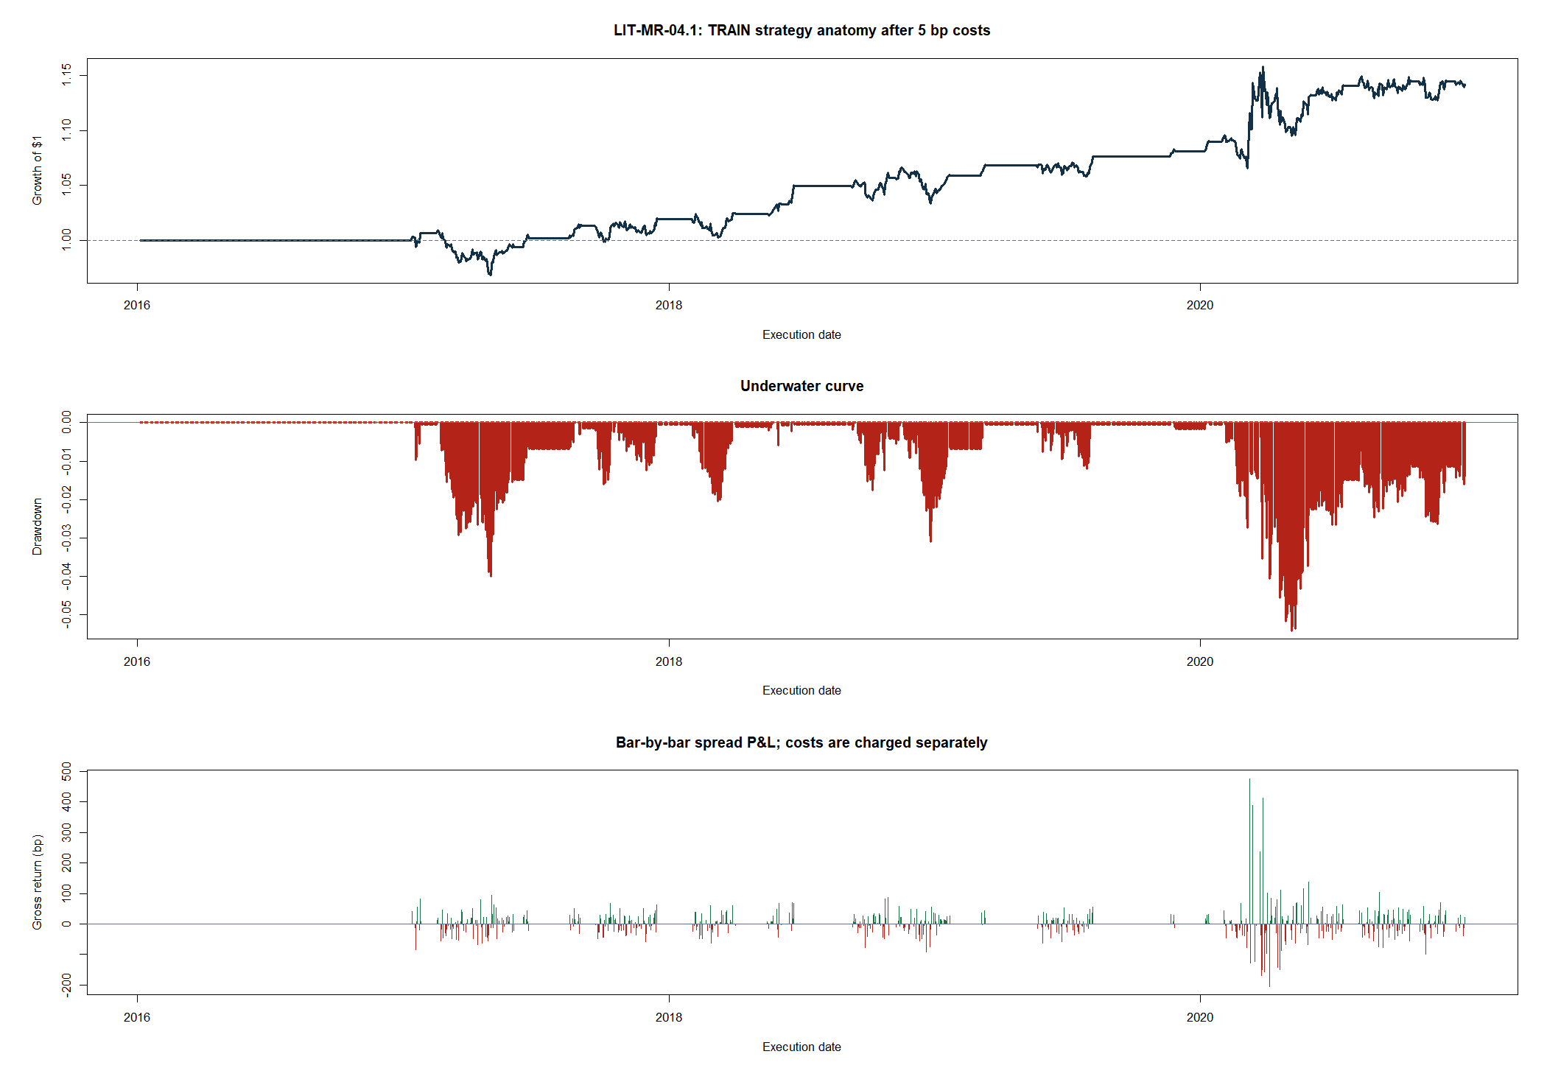
Pair gains were real inside TRAIN—but never earned OOS
8
Notes:
The top panel compounds next-open-to-next-open bar returns after primary costs; the middle panel shows drawdown; the bottom panel shows gross bar-level spread P&L.
The bar-level spread-direction hit rate was 53.5%. The same position state predicted EWC's absolute up/down move only 47.6% of the time. Relative-spread success and absolute-direction prediction are different estimands.
[Sources]
- C:/Users/Franc/OneDrive/Documents/Francis/Peltata Project/Time-Series-Modeling-Gen5/runs/research_workbench/literature_grounded/lit_mr_04_1_05_1_kalman_textbook_20260729/mr04_train_replay.csv
- C:/Users/Franc/OneDrive/Documents/Francis/Peltata Project/Time-Series-Modeling-Gen5/runs/research_workbench/literature_grounded/lit_mr_04_1_05_1_kalman_textbook_20260729/mr04_train_summary.csv
- C:/Users/Franc/OneDrive/Documents/Francis/Peltata Project/Time-Series-Modeling-Gen5/runs/research_workbench/literature_grounded/lit_mr_04_1_05_1_kalman_textbook_20260729/visuals/mr04_strategy_anatomy.png

Slide 9
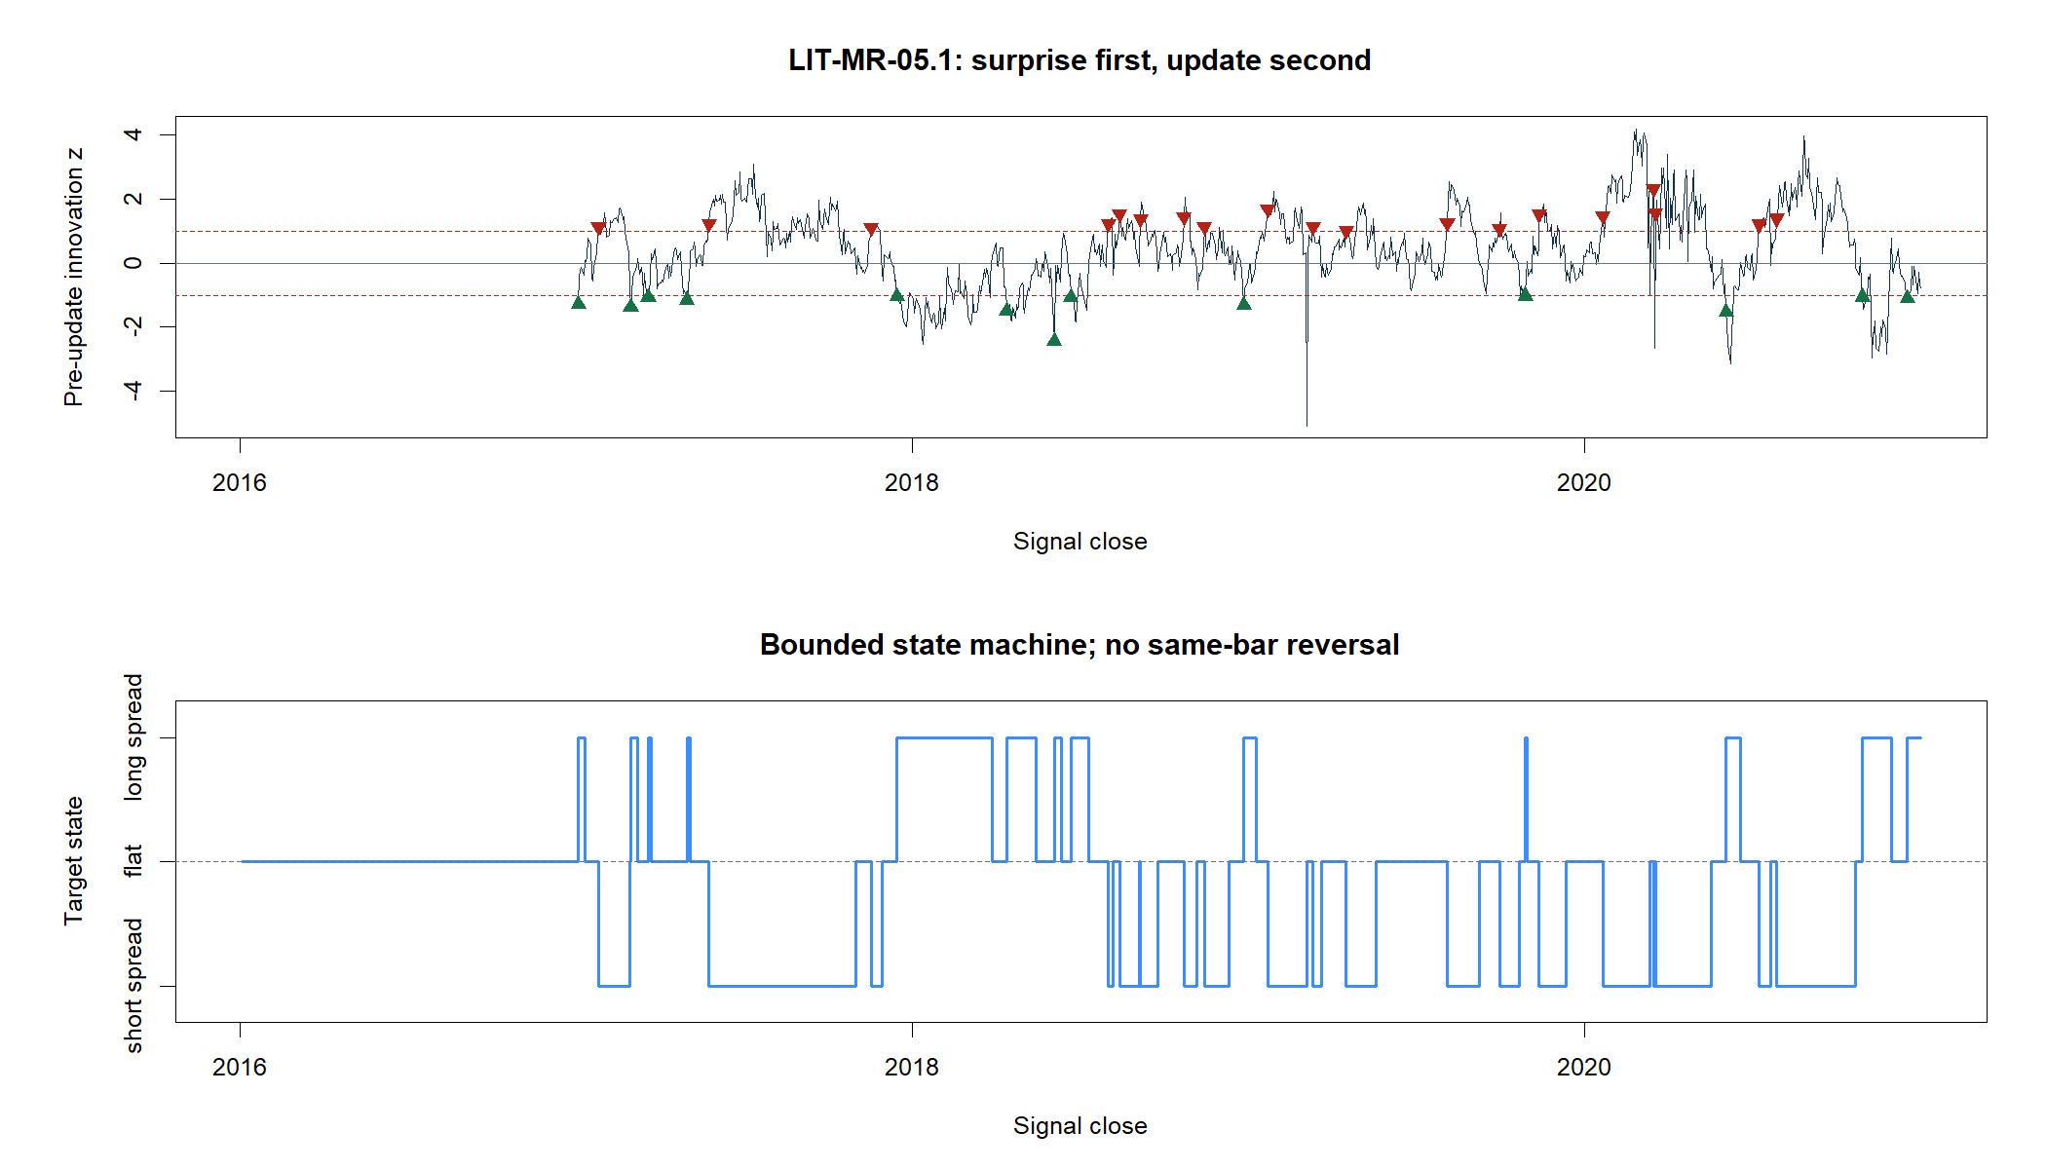
The triplet is an asymmetric dynamic regression—not Johansen
Adding IGE changes xₜ to [EWA, IGE, 1] and the state to [βEWA, βIGE, α].
The orientation stays frozen as EWC ~ EWA + IGE. Choosing a different response would estimate a different conditional equation.
That is fundamentally unlike Johansen, which estimates a cointegrating subspace. The pair's filter structure passed, so this second textbook exercise could run even though the pair did not earn OOS.
9
Notes:
Chan's printed Kalman example is a pair. The two-regressor extension is Gen5 design. It uses the same scalar-observation state-space recursion, not a time-varying Johansen rank estimator.
IGE was predeclared as a natural-resource factor that might absorb commodity-sensitive variation shared by Australia and Canada. No alternate response orientation or triplet search was run.
[Sources]
- C:/Users/Franc/OneDrive/Documents/Francis/Trading Literature/Algorithmic Trading - Winning Strategies and Their Rationale 2013.pdf — printed pp. 75-82; PDF pp. 93-100
- C:/Users/Franc/OneDrive/Documents/Francis/Peltata Project/Time-Series-Modeling-Gen5/docs/GEN5_LIT_MR_05_1_KALMAN_TRIPLET_POC_CONTRACT.md
- C:/Users/Franc/OneDrive/Documents/Francis/Peltata Project/Time-Series-Modeling-Gen5/docs/GEN5_4_DECISION_DIALOGUE_INDEX.md — D89
- C:/Users/Franc/OneDrive/Documents/Francis/Peltata Project/Time-Series-Modeling-Gen5/runs/research_workbench/literature_grounded/lit_mr_04_1_05_1_kalman_textbook_20260729/mr05_state_path.csv

Slide 10
Dynamic coefficients become trades only after price normalization
Posterior slope(s) known after close t define a share vector. At the next open, multiply by prices, gross-normalize to one, execute, and rehedge daily while the bounded state remains active.
PAIR
TRIPLET
COSTS
Long spread ∝ [1, −β]
Dollar legs ∝ [P_EWC, −βP_EWA]
Long spread ∝ [1, −β₁, −β₂]
Response plus two dynamic hedges
5 bp turnover; 10 bp stress
100 bp annual short-leg stress
10
Notes:
The signal is calculated after close t. The posterior slopes are then known and used for the next-open hedge. Daily rehedging makes coefficient movement economically real through turnover.
The pair and triplet both use +/-1 innovation entries, zero-crossing exits, no same-bar reversal, next-open execution, gross normalization, 5 bp primary turnover cost, 10 bp stress cost, and 100 bp annualized short-leg borrow stress.
[Sources]
- C:/Users/Franc/OneDrive/Documents/Francis/Trading Literature/Algorithmic Trading - Winning Strategies and Their Rationale 2013.pdf — printed pp. 80-81; PDF pp. 98-99
- C:/Users/Franc/OneDrive/Documents/Francis/Peltata Project/Time-Series-Modeling-Gen5/docs/GEN5_LIT_MR_04_1_KALMAN_PAIR_POC_CONTRACT.md
- C:/Users/Franc/OneDrive/Documents/Francis/Peltata Project/Time-Series-Modeling-Gen5/docs/GEN5_LIT_MR_05_1_KALMAN_TRIPLET_POC_CONTRACT.md

Slide 11
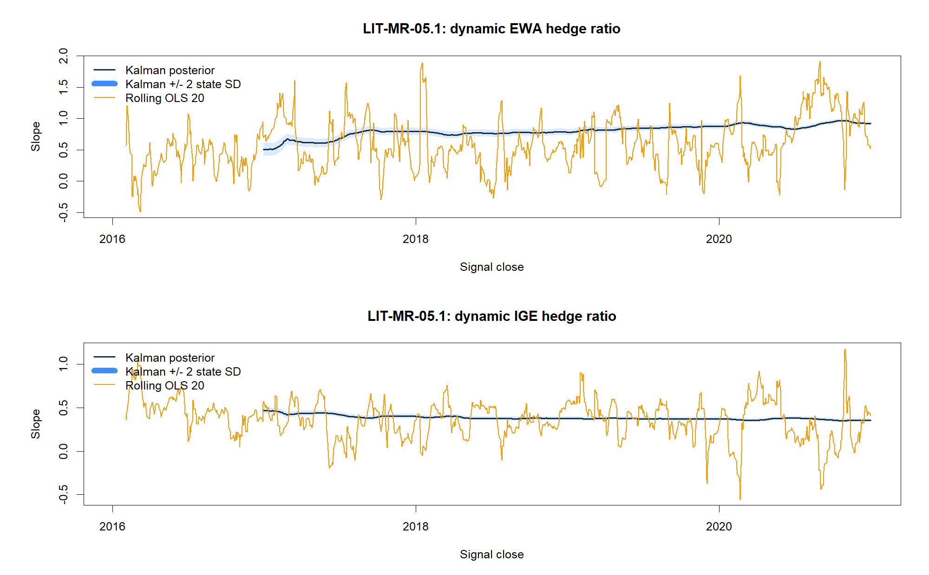
Two regressors evolve slowly—and independently
11
Notes:
The EWA slope moves from about 0.507 to 0.919; the IGE slope moves from about 0.466 to 0.357. Their mean absolute daily changes are 0.00123 and 0.00037, versus 0.0823 and 0.0423 for rolling OLS.
The slow coefficient paths show the imposed state memory. They do not establish that residual shocks are profitable; that remains a separate future-return and strategy question.
[Sources]
- C:/Users/Franc/OneDrive/Documents/Francis/Peltata Project/Time-Series-Modeling-Gen5/runs/research_workbench/literature_grounded/lit_mr_04_1_05_1_kalman_textbook_20260729/mr05_coefficient_metrics.csv
- C:/Users/Franc/OneDrive/Documents/Francis/Peltata Project/Time-Series-Modeling-Gen5/runs/research_workbench/literature_grounded/lit_mr_04_1_05_1_kalman_textbook_20260729/mr05_state_path.csv
- C:/Users/Franc/OneDrive/Documents/Francis/Peltata Project/Time-Series-Modeling-Gen5/docs/GEN5_LIT_MR_05_1_KALMAN_TRIPLET_POC_CONTRACT.md

Slide 12
Triplet: convergence appeared, but return uncertainty did not
EWC ~ EWA + IGE passed structure, two-sided support, positive mean, and robust forward convergence. Its return interval crossed zero and the mean failed the randomized-direction control.
6 / 8
+3.6 bp
q05 −20.3
TRAIN gates passed
31 trades: 12 long, 19 short
Mean net trade return
71.0% hit; +0.71% cumulative
Return bootstrap lower bound
Random-sign p90 was +9.65 bp
12
Notes:
The triplet's forward-five correlation was -0.0932 with a 90% upper bound of -0.0034, so convergence passed. But the trade-return lower bound was -20.26 bp and the observed +3.57 bp mean did not exceed the random-sign p90 of +9.65 bp.
The strategy's primary cumulative return was +0.71%, stress return -3.79%, maximum drawdown -4.94%, and autocorrelation-adjusted Sharpe 0.083. DEVELOPMENT remained sealed.
[Sources]
- C:/Users/Franc/OneDrive/Documents/Francis/Peltata Project/Time-Series-Modeling-Gen5/runs/research_workbench/literature_grounded/lit_mr_04_1_05_1_kalman_textbook_20260729/mr05_train_summary.csv
- C:/Users/Franc/OneDrive/Documents/Francis/Peltata Project/Time-Series-Modeling-Gen5/runs/research_workbench/literature_grounded/lit_mr_04_1_05_1_kalman_textbook_20260729/mr05_train_gates.csv
- C:/Users/Franc/OneDrive/Documents/Francis/Peltata Project/Time-Series-Modeling-Gen5/docs/GEN5_LIT_MR_05_1_KALMAN_TRIPLET_POC_CONTRACT.md

Slide 13
TEXTBOOK EXERCISE COMPLETE | CONFIRMATION REMAINS SEALED
We learned the filter.
We did not promote a strategy.
The pair produced a compelling TRAIN near miss; the triplet showed weak economics despite convergence. Preserve both STOPs, keep 2021–2023 strategy outcomes unopened, and move to the next textbook concept without rescue tuning.
Notes:
The exercise achieved its educational purpose: the state-space equations, causal innovation, gain update, dynamic hedge ratios, uncertainty, executable weights, and evaluation layers are now concrete.
The correct research close is not that Kalman filtering failed. The estimator worked structurally. The conclusion is narrower: neither frozen trading interpretation earned conditional OOS under the predeclared gates.
[Sources]
- C:/Users/Franc/OneDrive/Documents/Francis/Peltata Project/Time-Series-Modeling-Gen5/runs/research_workbench/literature_grounded/lit_mr_04_1_05_1_kalman_textbook_20260729/kalman_textbook_report.md
- C:/Users/Franc/OneDrive/Documents/Francis/Peltata Project/Time-Series-Modeling-Gen5/docs/GEN5_LIT_MR_04_1_KALMAN_PAIR_POC_CONTRACT.md
- C:/Users/Franc/OneDrive/Documents/Francis/Peltata Project/Time-Series-Modeling-Gen5/docs/GEN5_LIT_MR_05_1_KALMAN_TRIPLET_POC_CONTRACT.md
- C:/Users/Franc/OneDrive/Documents/Francis/Peltata Project/Time-Series-Modeling-Gen5/docs/GEN5_4_DECISION_DIALOGUE_INDEX.md — D89

