Slide 1
LITERATURE-GROUNDED STRATEGY RESEARCH | 31 JUL 2026
LIT-MOM-01.1
point-in-time high-beta atlas
Ninety-nine SPHB constituents frozen in October 2016. One unchanged Chapter 6 test per stock—and no survivor-only rewrite after outcomes.
Notes:
This deck tests the existing interday-momentum mechanism on a point-in-time high-beta universe. It is not a stock-selection model, portfolio, or long-only redesign.
[Sources]
- C:/Users/Franc/OneDrive/Documents/Francis/Trading Literature/Algorithmic Trading - Winning Strategies and Their Rationale 2013.pdf — printed pages 135–139; PDF pages 153–157
- https://www.sec.gov/Archives/edgar/data/1378872/000119312517002614/d269293dncsr.htm
- C:/Users/Franc/OneDrive/Documents/Francis/Peltata Project/Time-Series-Modeling-Gen5/literature_studies/docs/GEN5_LIT_MOM_01_1_STOCK_ATLAS_02_HIGH_BETA_2016_CONTRACT.md
- C:/Users/Franc/OneDrive/Documents/Francis/Peltata Project/Time-Series-Modeling-Gen5/literature_studies/docs/GEN5_LIT_MOM_01_1_STOCK_ATLAS_02_HIGH_BETA_2016_RESULTS.md

Slide 2
High beta was the universe hypothesis—not an outcome filter
Every identity came from the October 31, 2016 SPHB filing before TRAIN. Each coverage-eligible stock runs the same selector; every complete six-gate passer receives one OOS replay.
99 filing names
49 cells each
0 replacements
Point-in-time high-beta label
No fame-based sampling
Same L,H grid
Same deterministic selector
Acquisitions stay visible
No successor repair
2
Notes:
The full filing panel is the denominator. Missing or truncated historical symbols receive explicit coverage STOPs rather than deletion or replacement.
[Sources]
- C:/Users/Franc/OneDrive/Documents/Francis/Peltata Project/Time-Series-Modeling-Gen5/literature_studies/registries/gen5_lit_mom_01_1_stock_atlas_02_high_beta_2016_registry.csv
- C:/Users/Franc/OneDrive/Documents/Francis/Peltata Project/Time-Series-Modeling-Gen5/literature_studies/docs/GEN5_LIT_MOM_01_1_STOCK_ATLAS_02_HIGH_BETA_2016_CONTRACT.md
- https://www.sec.gov/Archives/edgar/data/1378872/000119312517002614/d269293dncsr.htm

Slide 3
The 2016 SEC filing gives us a causal universe—and its biases
SPHB's actual holdings are stronger evidence than remembering which stocks later looked volatile. The filing also reveals a large Energy and Financials concentration that must remain part of the interpretation.
99 holdings
57 names
15 STOPs
SEC Schedule of Investments
31 October 2016
Energy + Financials
Concentrated before testing
Incomplete TRAIN history
Still in the audit
3
Notes:
The source reports 32 Financials and 25 Energy holdings. This pre-existing composition can shape any batch-level pattern and prevents a clean causal claim about beta alone.
[Sources]
- https://www.sec.gov/Archives/edgar/data/1378872/000119312517002614/d269293dncsr.htm
- C:/Users/Franc/OneDrive/Documents/Francis/Peltata Project/Time-Series-Modeling-Gen5/literature_studies/registries/gen5_lit_mom_01_1_stock_atlas_02_high_beta_2016_registry.csv
- C:/Users/Franc/OneDrive/Documents/Francis/Peltata Project/Time-Series-Modeling-Gen5/runs/research_workbench/literature_grounded/lit_mom_01_1_stock_atlas_02_high_beta_2016_20260731/high_beta_2016_coverage.csv

Slide 4
High beta amplifies movement; it does not guarantee persistence
Beta asks how strongly a stock co-moves with the market. Time-series momentum asks whether the stock's own past return predicts its next return. A volatile amplifier may trend—or reverse.
β = Cov/Var
r(past,future)
Different claims
Cov(rᵢ,rSPY) / Var(rSPY)
Market sensitivity
Own trailing versus forward return
Persistence hypothesis
High beta ≠ positive momentum
Test both explicitly
4
Notes:
The pre-TRAIN beta estimate is descriptive only. It validates the panel's intended identity but never selects or deletes a filing constituent.
[Sources]
- C:/Users/Franc/OneDrive/Documents/Francis/Peltata Project/Time-Series-Modeling-Gen5/literature_studies/docs/GEN5_LIT_MOM_01_1_STOCK_ATLAS_02_HIGH_BETA_2016_CONTRACT.md
- C:/Users/Franc/OneDrive/Documents/Francis/Peltata Project/Time-Series-Modeling-Gen5/literature_studies/docs/GEN5_LIT_MOM_01_1_STOCK_ATLAS_02_HIGH_BETA_2016_RESULTS.md
- C:/Users/Franc/OneDrive/Documents/Francis/Peltata Project/Time-Series-Modeling-Gen5/runs/research_workbench/literature_grounded/lit_mom_01_1_stock_atlas_02_high_beta_2016_20260731/high_beta_2016_coverage.csv

Slide 5
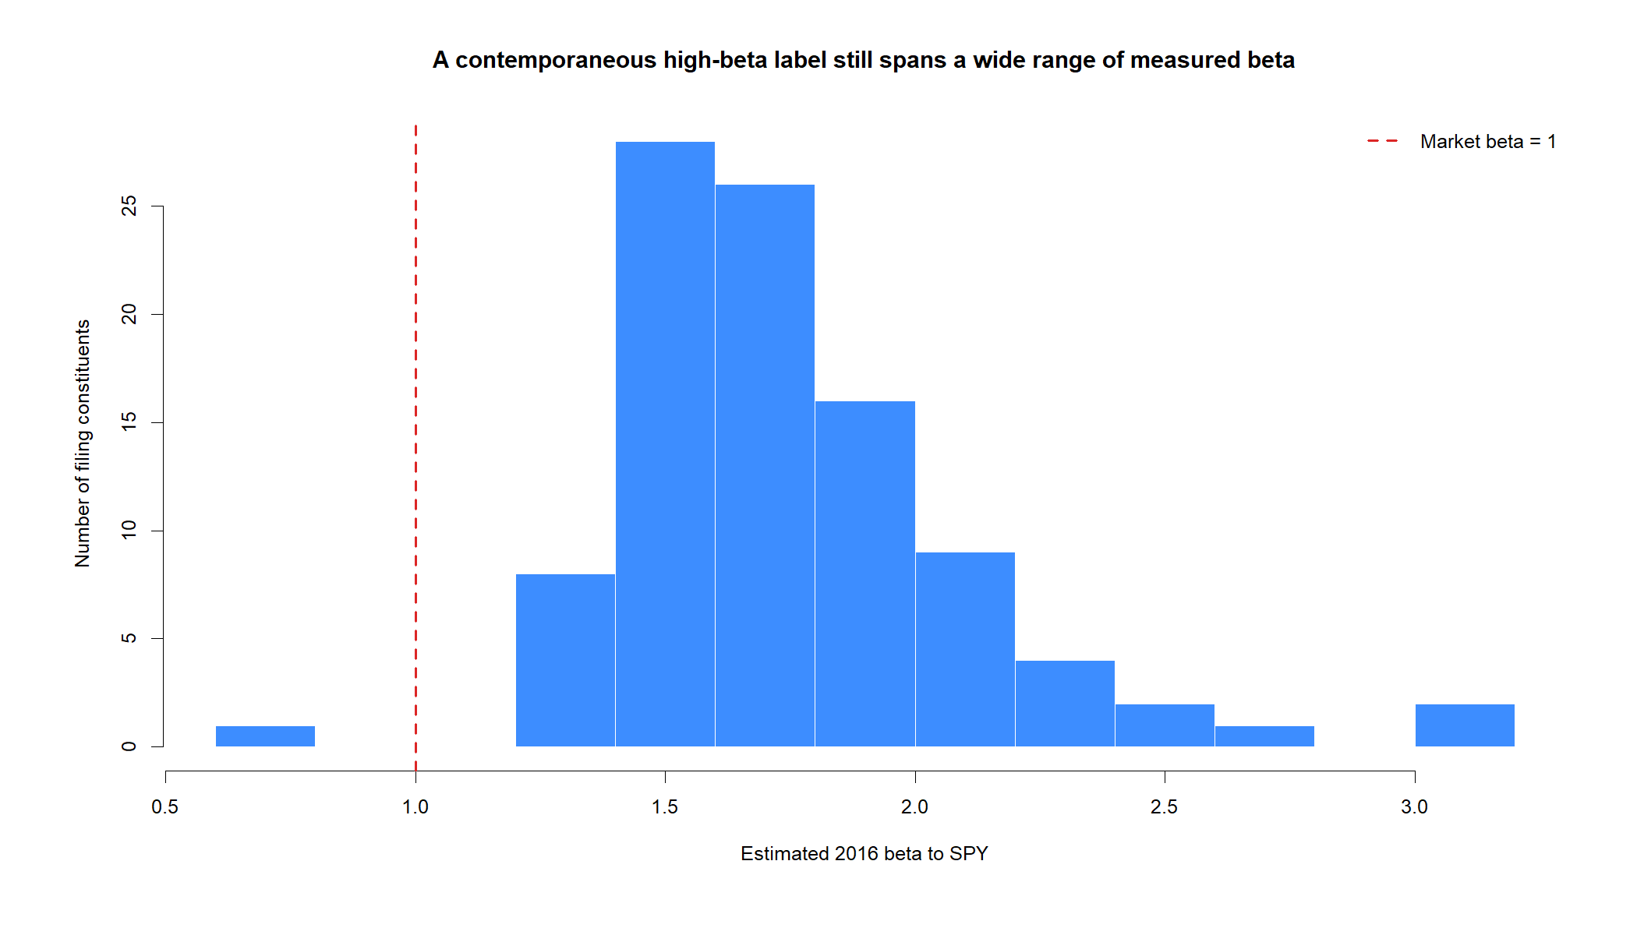
The source label checks out—but still does not test momentum
Using only adjusted daily returns before TRAIN:
• 97 of 99 names have a finite 2016 beta estimate;
• median beta is 1.70;
• mean beta is 1.75;
• 96 of 97 estimates exceed 1.
This confirms a high-sensitivity panel. It does not establish that trailing return sign predicts the future.
5
Notes:
Beta is estimated as covariance of stock and SPY log returns divided by SPY return variance, using dates from January 4 through December 30, 2016. It is not the selector.
[Sources]
- C:/Users/Franc/OneDrive/Documents/Francis/Peltata Project/Time-Series-Modeling-Gen5/literature_studies/docs/GEN5_LIT_MOM_01_1_STOCK_ATLAS_02_HIGH_BETA_2016_CONTRACT.md
- C:/Users/Franc/OneDrive/Documents/Francis/Peltata Project/Time-Series-Modeling-Gen5/literature_studies/docs/GEN5_LIT_MOM_01_1_STOCK_ATLAS_02_HIGH_BETA_2016_RESULTS.md
- C:/Users/Franc/OneDrive/Documents/Francis/Peltata Project/Time-Series-Modeling-Gen5/runs/research_workbench/literature_grounded/lit_mom_01_1_stock_atlas_02_high_beta_2016_20260731/high_beta_2016_coverage.csv
- C:/Users/Franc/OneDrive/Documents/Francis/Peltata Project/Time-Series-Modeling-Gen5/runs/research_workbench/literature_grounded/lit_mom_01_1_stock_atlas_02_high_beta_2016_20260731/visuals/high_beta_2016_beta_distribution.png

Slide 6
Historical-symbol attrition stays in the denominator
Corporate actions and provider symbol history reduce what a retail researcher can replay. Coverage is checked before performance; a truncated DEVELOPMENT window is never accepted as a substitute.
84 / 99
11 pass
10 OOS
Exact warm-up + TRAIN
Eligible for the horizon screen
All six TRAIN gates
No weighted near-passes
Exact DEVELOPMENT coverage
XEC stops after acquisition
6
Notes:
Fifteen registry names lack exact warm-up-plus-TRAIN coverage. XEC passes TRAIN but stops before OOS because its series ends in September 2021.
[Sources]
- C:/Users/Franc/OneDrive/Documents/Francis/Peltata Project/Time-Series-Modeling-Gen5/literature_studies/docs/GEN5_LIT_MOM_01_1_STOCK_ATLAS_02_HIGH_BETA_2016_CONTRACT.md
- C:/Users/Franc/OneDrive/Documents/Francis/Peltata Project/Time-Series-Modeling-Gen5/literature_studies/docs/GEN5_LIT_MOM_01_1_STOCK_ATLAS_02_HIGH_BETA_2016_RESULTS.md
- C:/Users/Franc/OneDrive/Documents/Francis/Peltata Project/Time-Series-Modeling-Gen5/runs/research_workbench/literature_grounded/lit_mom_01_1_stock_atlas_02_high_beta_2016_20260731/high_beta_2016_coverage.csv
- C:/Users/Franc/OneDrive/Documents/Francis/Peltata Project/Time-Series-Modeling-Gen5/runs/research_workbench/literature_grounded/lit_mom_01_1_stock_atlas_02_high_beta_2016_20260731/visuals/high_beta_2016_coverage.png

Slide 7
More TRAIN passers do not mean high beta caused momentum
Eighty-four independent 49-cell screens create 4,116 related comparisons. The 13.1% full-pass rate exceeds the static atlas's 4.5%, but the panels differ in composition and historical validity.
4,116 cells
13.1%
all passers OOS
84 × 49 TRAIN rows
Nominal local p-values
11 / 84 full TRAIN passes
Descriptive enrichment
No best-stock selection
No hidden attrition
7
Notes:
The batch-level pass-rate difference is descriptive. Sector concentration, survivor treatment, and universe construction differ from Stock Atlas 01, so the comparison cannot isolate beta causally.
[Sources]
- C:/Users/Franc/OneDrive/Documents/Francis/Peltata Project/Time-Series-Modeling-Gen5/literature_studies/docs/GEN5_LIT_MOM_01_1_STOCK_ATLAS_02_HIGH_BETA_2016_RESULTS.md
- C:/Users/Franc/OneDrive/Documents/Francis/Peltata Project/Time-Series-Modeling-Gen5/runs/research_workbench/literature_grounded/lit_mom_01_1_stock_atlas_02_high_beta_2016_20260731/high_beta_2016_horizon_screen.csv
- C:/Users/Franc/OneDrive/Documents/Francis/Peltata Project/Time-Series-Modeling-Gen5/runs/research_workbench/literature_grounded/lit_mom_01_1_stock_atlas_02_high_beta_2016_20260731/high_beta_2016_train_summary.csv

Slide 8
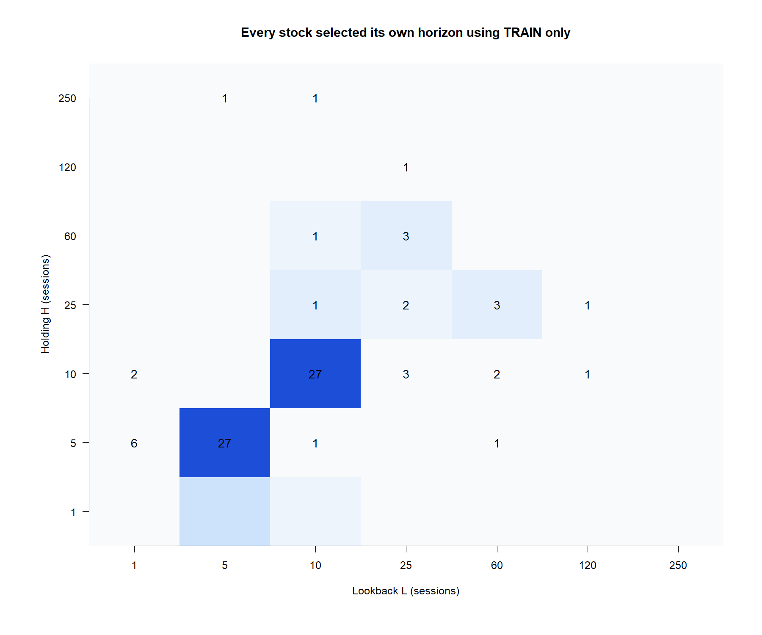
Short 5- and 10-session holds dominated the TRAIN nominations
8
Notes:
Ten of eleven six-gate passers selected either 5/5 or 10/10; HP selected 1/10. Every horizon was selected within that stock's TRAIN data only.
[Sources]
- C:/Users/Franc/OneDrive/Documents/Francis/Peltata Project/Time-Series-Modeling-Gen5/literature_studies/docs/GEN5_LIT_MOM_01_1_STOCK_ATLAS_02_HIGH_BETA_2016_RESULTS.md
- C:/Users/Franc/OneDrive/Documents/Francis/Peltata Project/Time-Series-Modeling-Gen5/runs/research_workbench/literature_grounded/lit_mom_01_1_stock_atlas_02_high_beta_2016_20260731/high_beta_2016_train_summary.csv
- C:/Users/Franc/OneDrive/Documents/Francis/Peltata Project/Time-Series-Modeling-Gen5/runs/research_workbench/literature_grounded/lit_mom_01_1_stock_atlas_02_high_beta_2016_20260731/visuals/high_beta_2016_selected_horizons.png

Slide 9
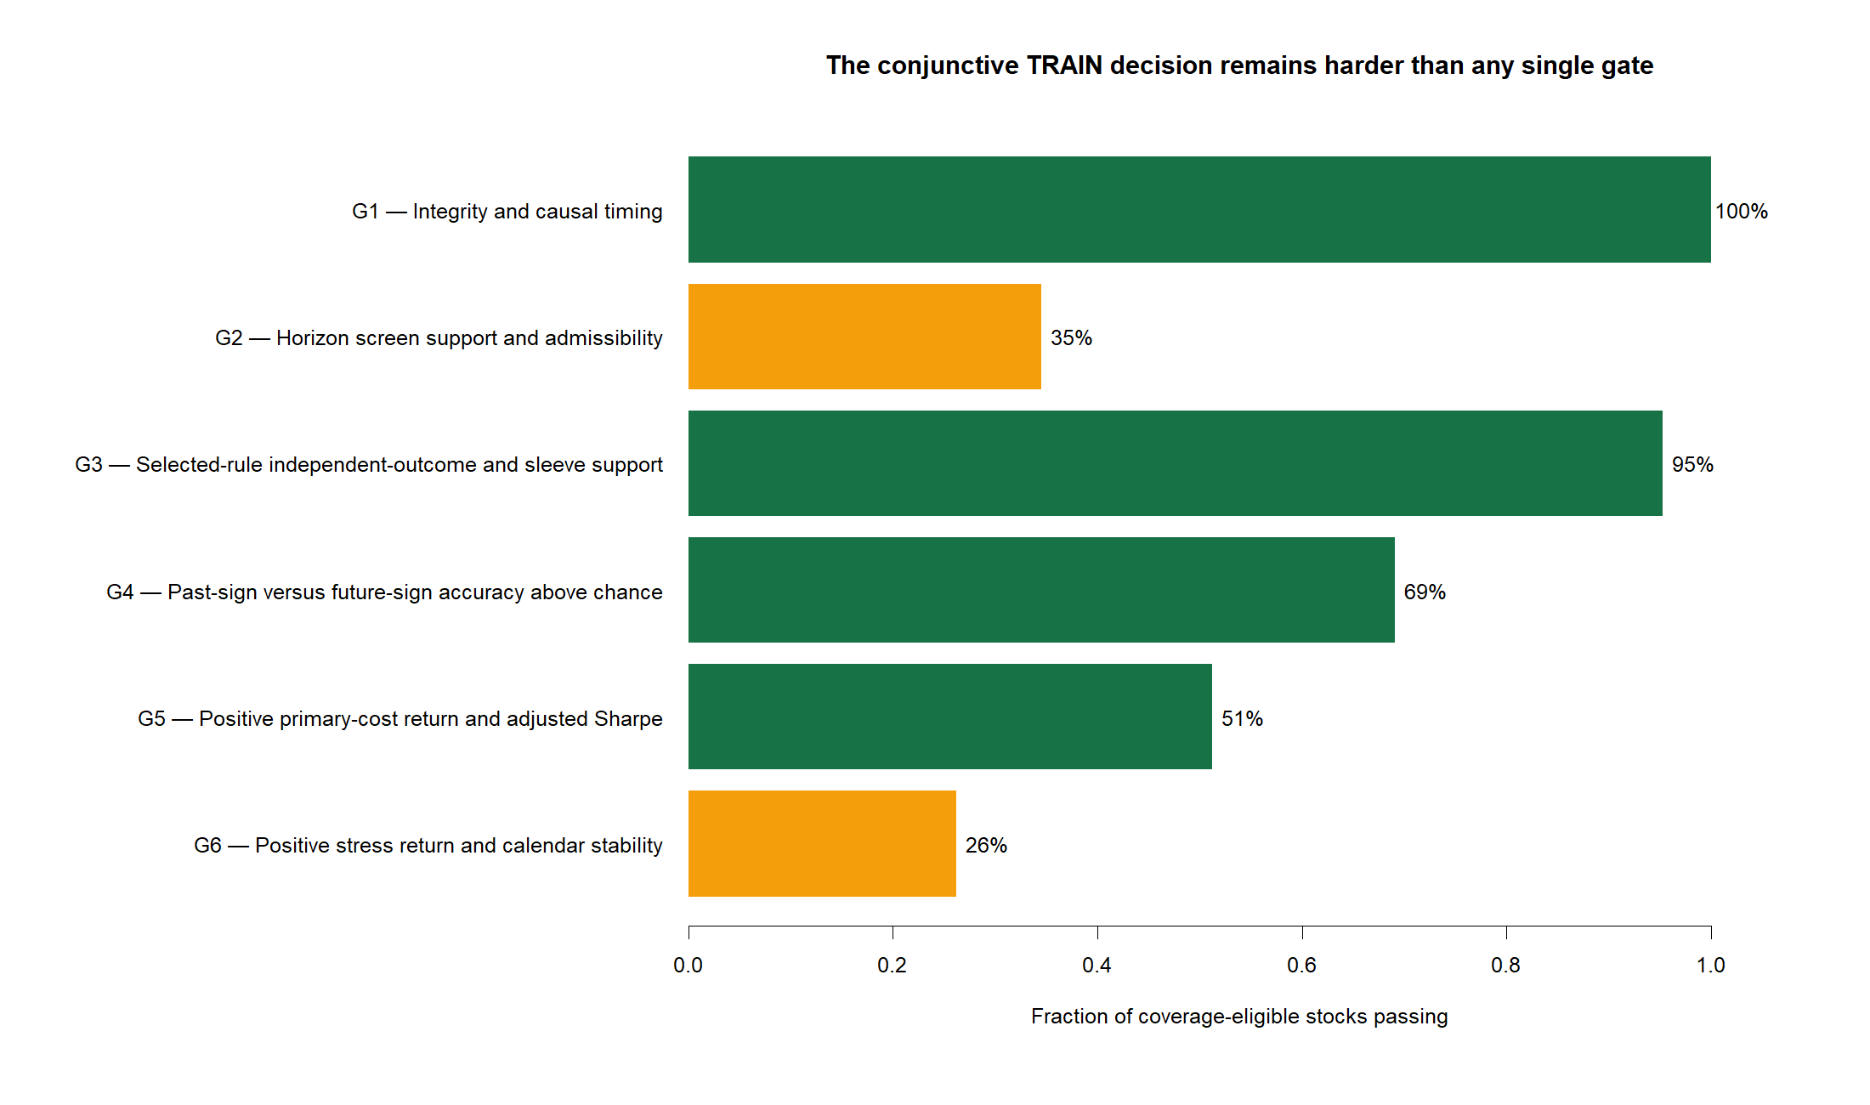
G2 and G6 remained the tight research screens
9
Notes:
G1 passed 84/84, G2 29/84, G3 80/84, G4 58/84, G5 43/84, and G6 22/84. Eleven passed the complete conjunction.
[Sources]
- C:/Users/Franc/OneDrive/Documents/Francis/Peltata Project/Time-Series-Modeling-Gen5/literature_studies/docs/GEN5_LIT_MOM_01_1_STOCK_ATLAS_02_HIGH_BETA_2016_RESULTS.md
- C:/Users/Franc/OneDrive/Documents/Francis/Peltata Project/Time-Series-Modeling-Gen5/runs/research_workbench/literature_grounded/lit_mom_01_1_stock_atlas_02_high_beta_2016_20260731/high_beta_2016_train_gates.csv
- C:/Users/Franc/OneDrive/Documents/Francis/Peltata Project/Time-Series-Modeling-Gen5/runs/research_workbench/literature_grounded/lit_mom_01_1_stock_atlas_02_high_beta_2016_20260731/visuals/high_beta_2016_gate_rates.png

Slide 10
TEN COMPLETE OOS REPLAYS | 2021–2023
11 pass TRAIN.
0 finish OOS positive.
XEC stops on coverage after acquisition. The other ten retain their own frozen horizon, symmetric long/short sleeves, costs, and evidence dates; 2024+ stays sealed.
Notes:
This transition separates TRAIN nomination from OOS falsification. All complete passers are shown; none is dropped or pooled.
[Sources]
- C:/Users/Franc/OneDrive/Documents/Francis/Peltata Project/Time-Series-Modeling-Gen5/literature_studies/docs/GEN5_LIT_MOM_01_1_STOCK_ATLAS_02_HIGH_BETA_2016_RESULTS.md
- C:/Users/Franc/OneDrive/Documents/Francis/Peltata Project/Time-Series-Modeling-Gen5/runs/research_workbench/literature_grounded/lit_mom_01_1_stock_atlas_02_high_beta_2016_20260731/high_beta_2016_train_summary.csv
- C:/Users/Franc/OneDrive/Documents/Francis/Peltata Project/Time-Series-Modeling-Gen5/runs/research_workbench/literature_grounded/lit_mom_01_1_stock_atlas_02_high_beta_2016_20260731/high_beta_2016_development_summary.csv

Slide 11
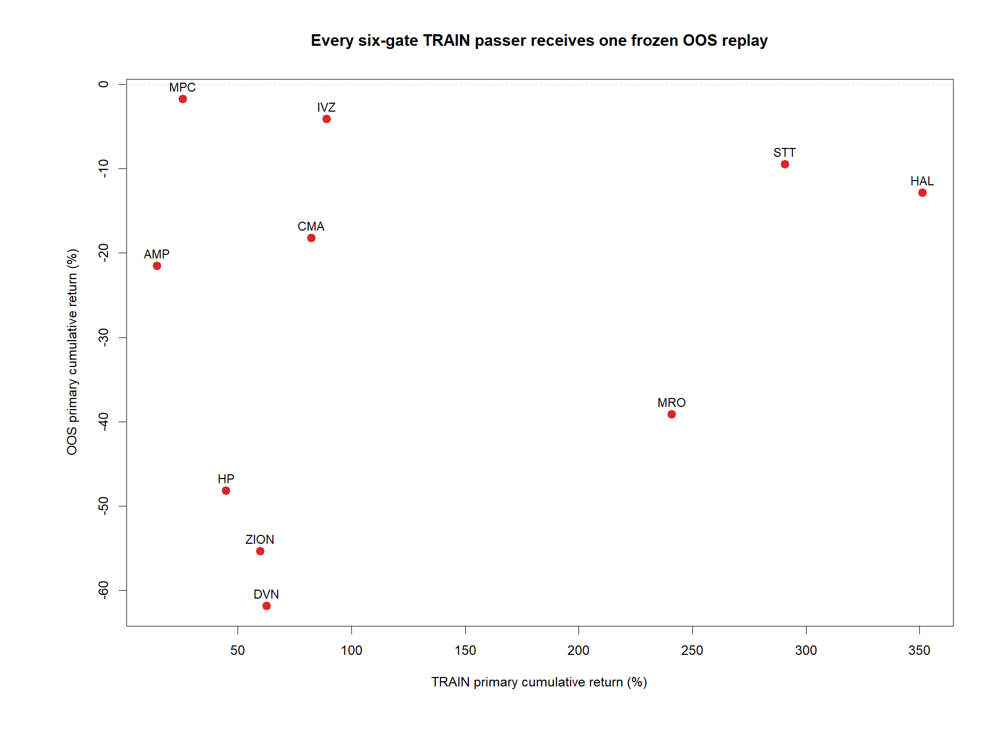
TRAIN enrichment disappeared when the frozen rules met 2021–2023
11
Notes:
All ten points fall below zero OOS. Mean primary return is -27.25%, median is -19.87%, and none remains positive under stress costs.
[Sources]
- C:/Users/Franc/OneDrive/Documents/Francis/Peltata Project/Time-Series-Modeling-Gen5/literature_studies/docs/GEN5_LIT_MOM_01_1_STOCK_ATLAS_02_HIGH_BETA_2016_RESULTS.md
- C:/Users/Franc/OneDrive/Documents/Francis/Peltata Project/Time-Series-Modeling-Gen5/runs/research_workbench/literature_grounded/lit_mom_01_1_stock_atlas_02_high_beta_2016_20260731/high_beta_2016_development_summary.csv
- C:/Users/Franc/OneDrive/Documents/Francis/Peltata Project/Time-Series-Modeling-Gen5/runs/research_workbench/literature_grounded/lit_mom_01_1_stock_atlas_02_high_beta_2016_20260731/visuals/high_beta_2016_train_to_development.png

Slide 12
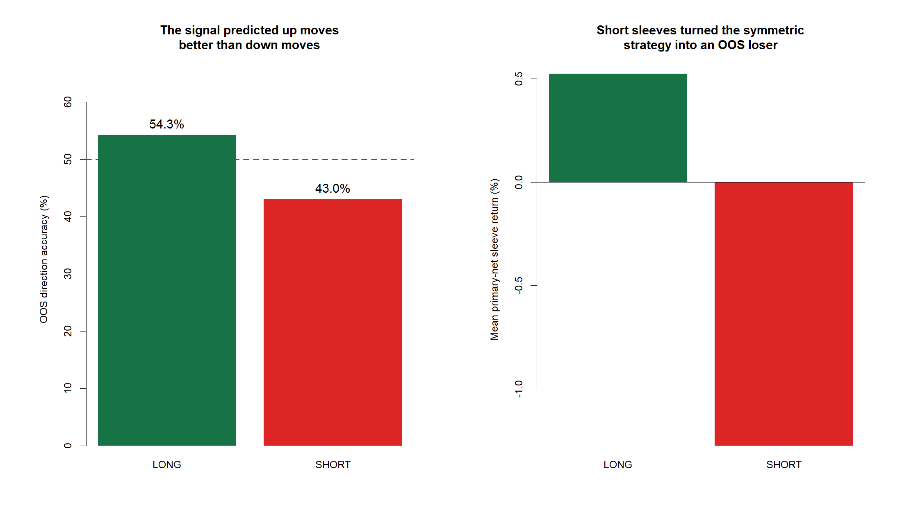
The signal predicted up moves better than down moves
12
Notes:
Across ten complete OOS replays, 4,066 long sleeves were 54.28% correct and averaged +0.53% net; 3,362 short sleeves were 43.04% correct and averaged -1.28%. Nine stocks beat 50% on long calls; none did on shorts.
[Sources]
- C:/Users/Franc/OneDrive/Documents/Francis/Peltata Project/Time-Series-Modeling-Gen5/literature_studies/docs/GEN5_LIT_MOM_01_1_STOCK_ATLAS_02_HIGH_BETA_2016_RESULTS.md
- C:/Users/Franc/OneDrive/Documents/Francis/Peltata Project/Time-Series-Modeling-Gen5/runs/research_workbench/literature_grounded/lit_mom_01_1_stock_atlas_02_high_beta_2016_20260731/high_beta_2016_development_summary.csv
- C:/Users/Franc/OneDrive/Documents/Francis/Peltata Project/Time-Series-Modeling-Gen5/runs/research_workbench/literature_grounded/lit_mom_01_1_stock_atlas_02_high_beta_2016_20260731/high_beta_2016_development_sleeves.csv
- C:/Users/Franc/OneDrive/Documents/Francis/Peltata Project/Time-Series-Modeling-Gen5/runs/research_workbench/literature_grounded/lit_mom_01_1_stock_atlas_02_high_beta_2016_20260731/visuals/high_beta_2016_direction_asymmetry.png

Slide 13
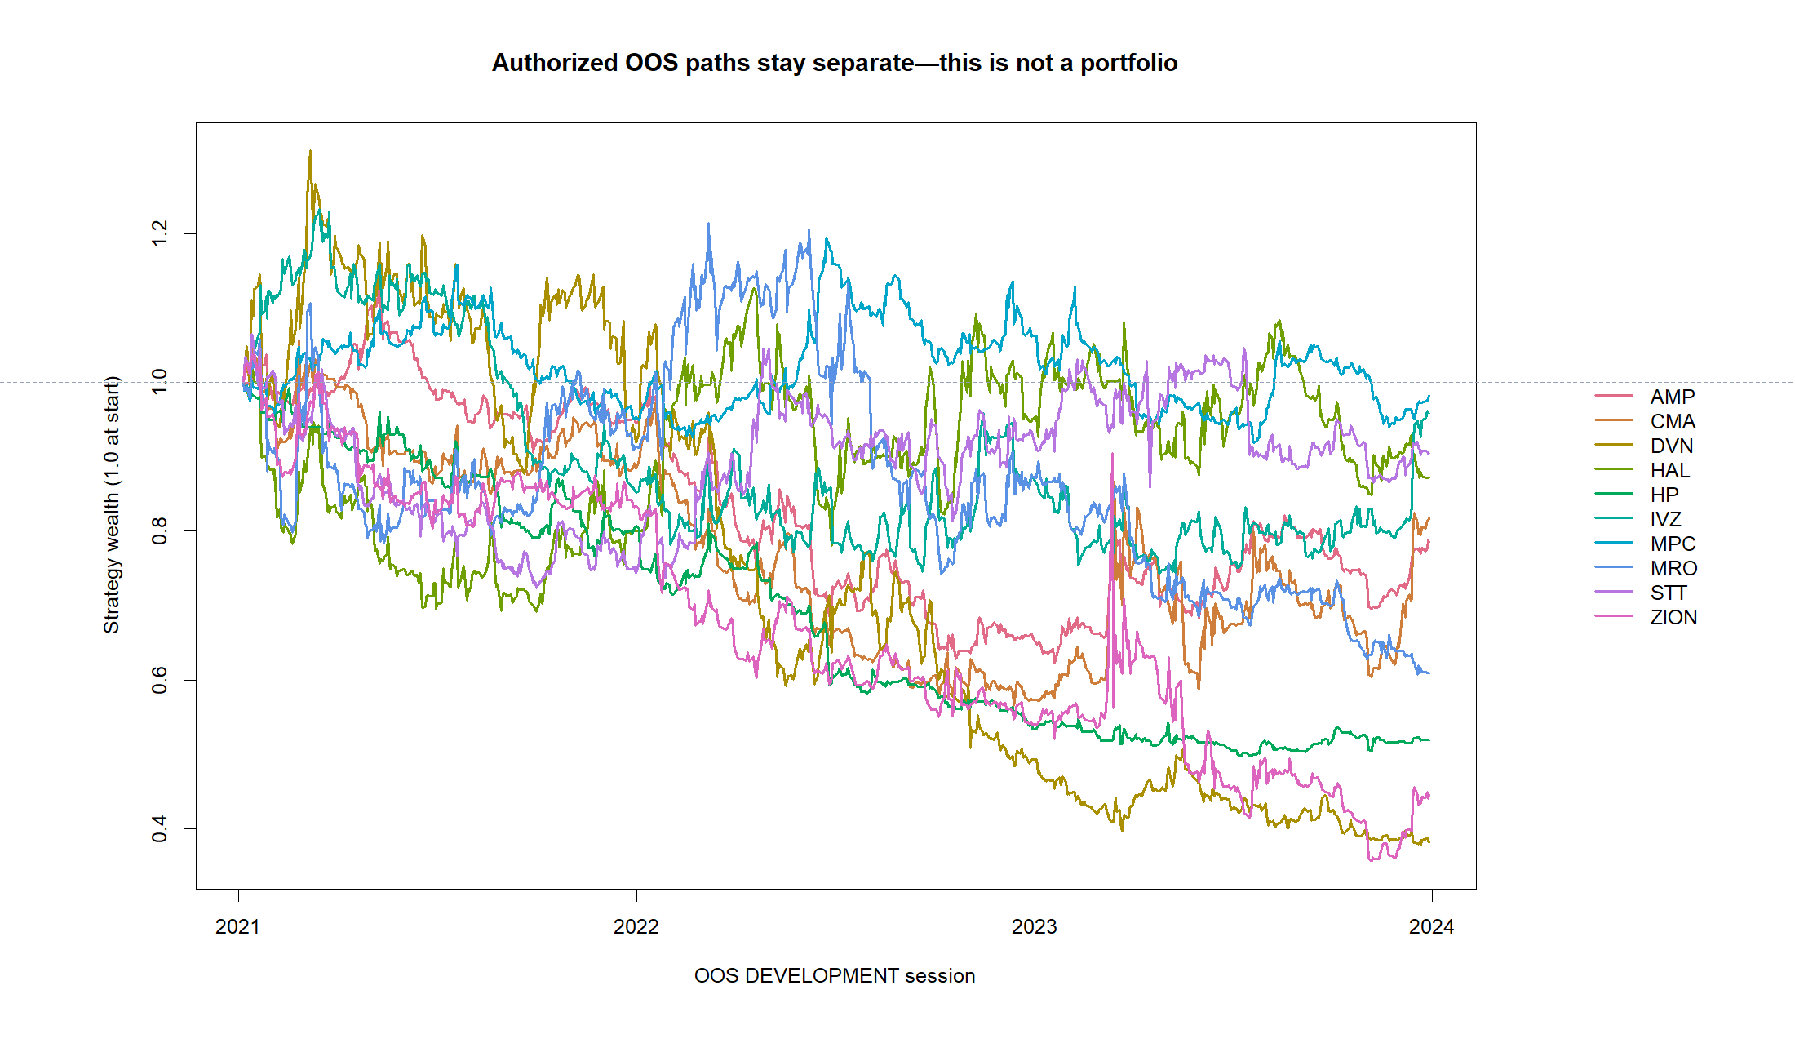
All ten complete OOS paths finished below 1.0
13
Notes:
The paths remain separate because this batch is not a portfolio. Primary returns range from -1.76% for MPC to -61.84% for DVN.
[Sources]
- C:/Users/Franc/OneDrive/Documents/Francis/Peltata Project/Time-Series-Modeling-Gen5/literature_studies/docs/GEN5_LIT_MOM_01_1_STOCK_ATLAS_02_HIGH_BETA_2016_RESULTS.md
- C:/Users/Franc/OneDrive/Documents/Francis/Peltata Project/Time-Series-Modeling-Gen5/runs/research_workbench/literature_grounded/lit_mom_01_1_stock_atlas_02_high_beta_2016_20260731/high_beta_2016_development_primary_bars.csv
- C:/Users/Franc/OneDrive/Documents/Francis/Peltata Project/Time-Series-Modeling-Gen5/runs/research_workbench/literature_grounded/lit_mom_01_1_stock_atlas_02_high_beta_2016_20260731/high_beta_2016_development_summary.csv
- C:/Users/Franc/OneDrive/Documents/Francis/Peltata Project/Time-Series-Modeling-Gen5/runs/research_workbench/literature_grounded/lit_mom_01_1_stock_atlas_02_high_beta_2016_20260731/visuals/high_beta_2016_development_paths.png

Slide 14
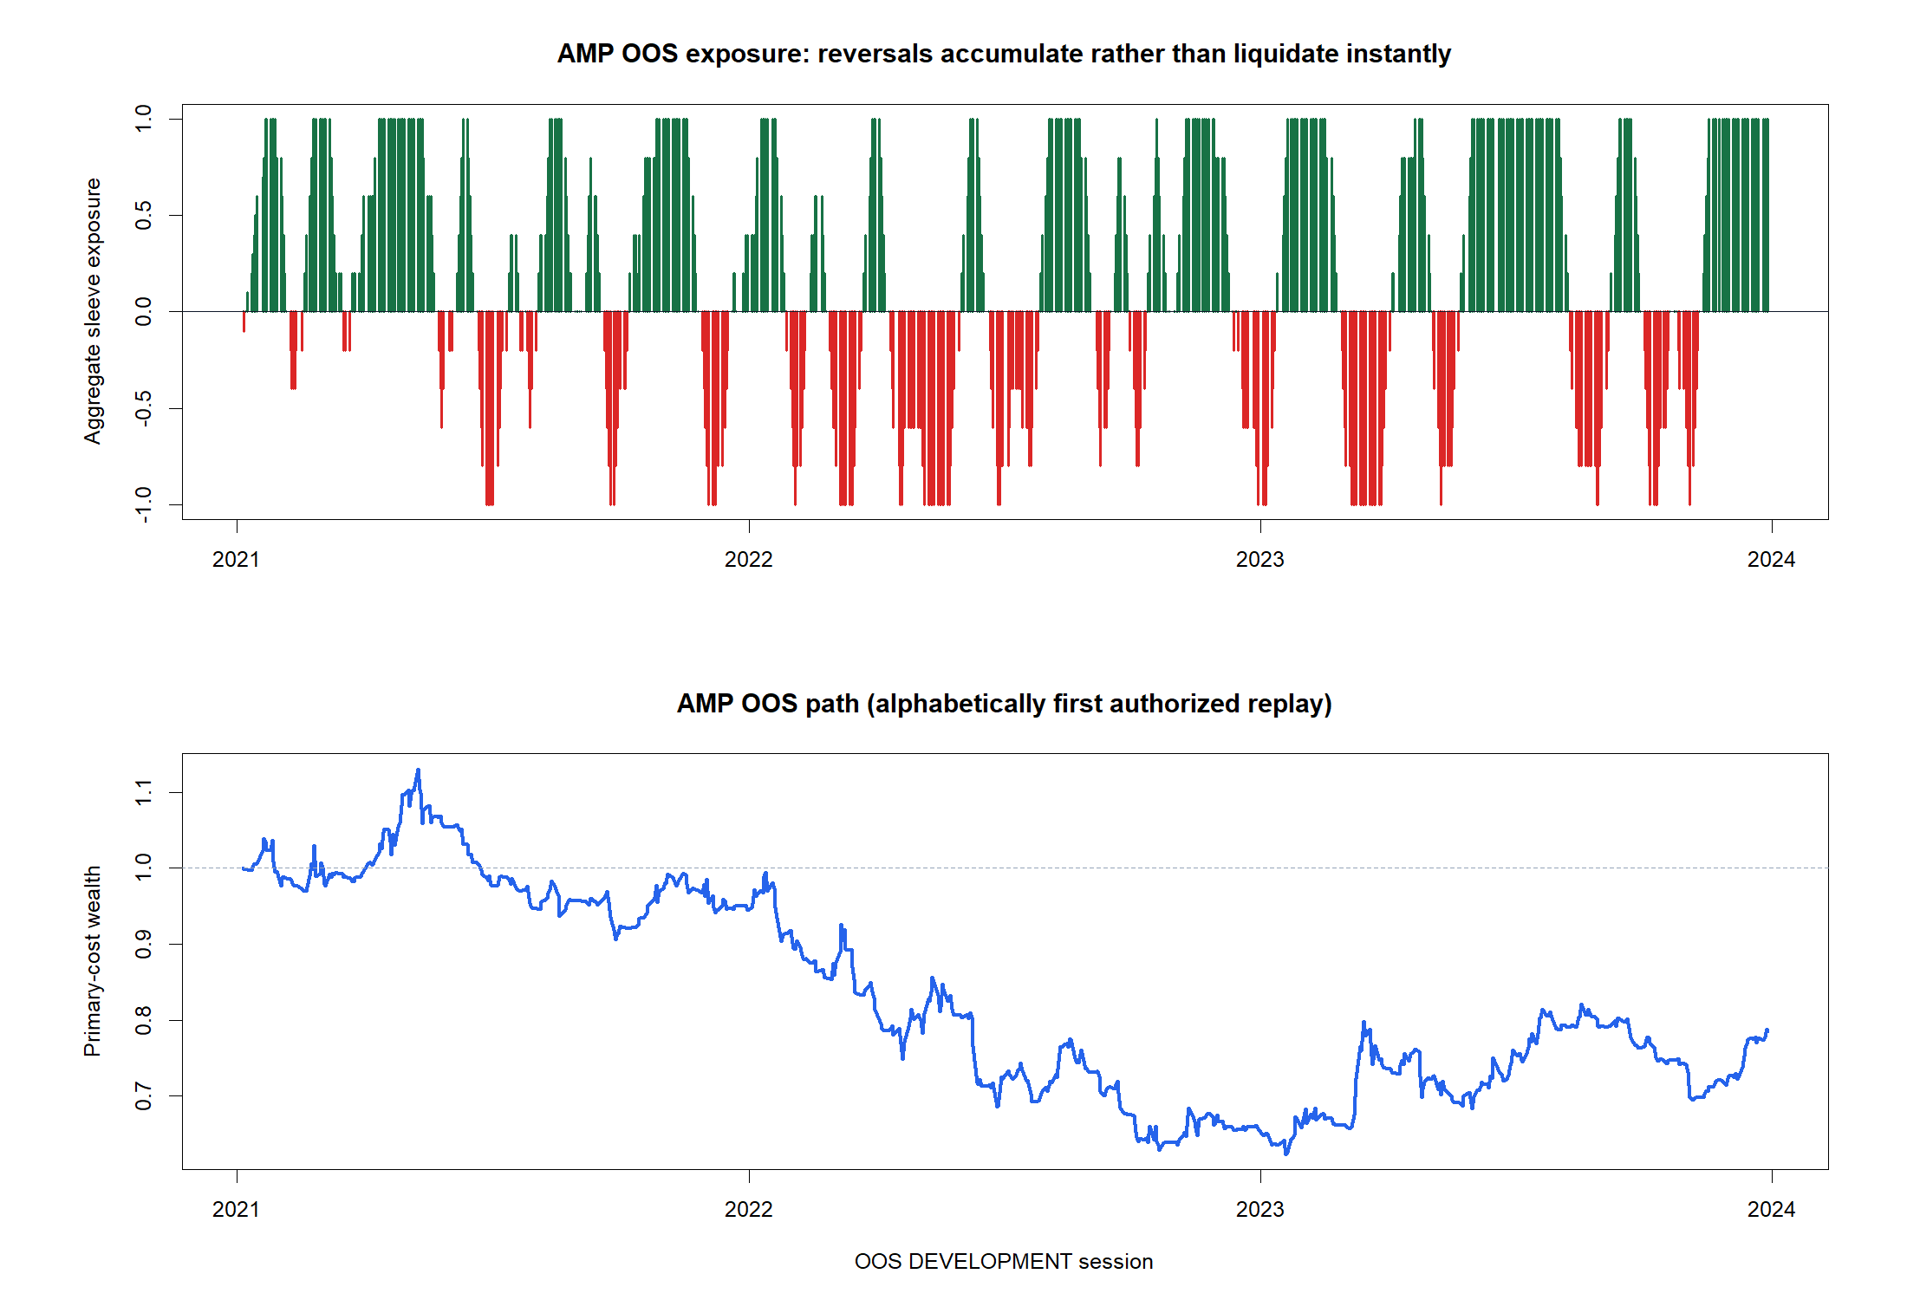
AMP shows how reversals change new sleeves—not the entire position
14
Notes:
AMP is selected alphabetically, not because of its outcome. Each new daily signal starts one 1/H sleeve; existing opposing sleeves remain until their scheduled exits, so exposure transitions gradually.
[Sources]
- C:/Users/Franc/OneDrive/Documents/Francis/Peltata Project/Time-Series-Modeling-Gen5/literature_studies/docs/GEN5_LIT_MOM_01_1_INTERDAY_TIME_SERIES_MOMENTUM_POC_CONTRACT.md
- C:/Users/Franc/OneDrive/Documents/Francis/Peltata Project/Time-Series-Modeling-Gen5/literature_studies/docs/GEN5_LIT_MOM_01_1_STOCK_ATLAS_02_HIGH_BETA_2016_RESULTS.md
- C:/Users/Franc/OneDrive/Documents/Francis/Peltata Project/Time-Series-Modeling-Gen5/runs/research_workbench/literature_grounded/lit_mom_01_1_stock_atlas_02_high_beta_2016_20260731/high_beta_2016_development_primary_bars.csv
- C:/Users/Franc/OneDrive/Documents/Francis/Peltata Project/Time-Series-Modeling-Gen5/runs/research_workbench/literature_grounded/lit_mom_01_1_stock_atlas_02_high_beta_2016_20260731/visuals/high_beta_2016_representative_tape.png

Slide 15
POINT-IN-TIME BREADTH COMPLETE | RESEARCH DECISION
High beta enriched TRAIN.
It did not rescue OOS.
Record all ten negative replays and stop before CONFIRMATION. The long/short asymmetry is a useful diagnosis—not permission to delete shorts after seeing OOS.
Notes:
Record OOS_DEVELOPMENT_COMPLETE_LIT_MOM_01_1_STOCK_ATLAS_02_HIGH_BETA_2016 and recommend STOP. A long-only translation would be a new substantive variant requiring a fresh contract and untouched evidence.
[Sources]
- C:/Users/Franc/OneDrive/Documents/Francis/Peltata Project/Time-Series-Modeling-Gen5/literature_studies/docs/GEN5_LIT_MOM_01_1_STOCK_ATLAS_02_HIGH_BETA_2016_RESULTS.md
- C:/Users/Franc/OneDrive/Documents/Francis/Peltata Project/Time-Series-Modeling-Gen5/literature_studies/docs/GEN5_LIT_MOM_01_1_STOCK_ATLAS_02_HIGH_BETA_2016_CONTRACT.md
- C:/Users/Franc/OneDrive/Documents/Francis/Peltata Project/Time-Series-Modeling-Gen5/runs/research_workbench/literature_grounded/lit_mom_01_1_stock_atlas_02_high_beta_2016_20260731/high_beta_2016_report.md

