Slide 1
GEN5.4 • OPTIONS DATA POC
Options implied move
O0 reconstruction proof
A leakage-safe plumbing gate ended in a useful STOP
July 26, 2026
Notes:
SESSION 14 — OPTIONS IMPLIED-MOVE O0
Purpose
Test whether the existing Alpaca account can reproducibly reconstruct a fixed-time, same-strike, same-expiry ATM straddle before any outcome join or model.
Find in chat: One thing that I would like to test is options data
Boundary: reconstruction only; no sentiment, future outcome, model, policy, PnL, allocation, or live change.
Conversation: codex://threads/019f741e-615f-7fd0-90f7-edce12b5cb66
[Sources]
- C:/Users/Franc/OneDrive/Documents/Francis/Peltata Project/Time-Series-Modeling-Gen5/docs/GEN5_4_OPTIONS_IMPLIED_MOVE_O0_O1_CONTRACT.md
- C:/Users/Franc/OneDrive/Documents/Francis/Peltata Project/Time-Series-Modeling-Gen5/runs/research_workbench/gen54_ml_decision_engine/g54_options_o0_20260726/o0_report.md
[/Sources]

Slide 2
What an ATM straddle can—and cannot—tell us
The first professional question is measurement integrity—not prediction.
Observable
Economic role
Not identified
Call price + put price
at one strike, expiry,
and decision timestamp
A forward-risk price mixing
expected variability, event risk,
risk premia, and microstructure
Not pure sentiment.
Not expected return direction.
Not automatically tradeable alpha.
D40
2
Notes:
DECISION D40 — FORWARD-RISK MEASUREMENT, NOT SENTIMENT
Question
What is the minimal professional interpretation of an ATM straddle before outcome analysis?
Decision
Treat the normalized call-plus-put price as an asset-specific forward-risk measurement. Do not label it sentiment or directional conviction.
Why
Option prices jointly reflect expected variability, jump/event risk, risk premia, supply and demand, and microstructure. A useful measurement need not identify each component, but its interpretation must remain narrower than its data.
Find in chat: whereas pulling from quantitative data
Conversation: codex://threads/019f741e-615f-7fd0-90f7-edce12b5cb66
[Sources]
- https://docs.alpaca.markets/us/docs/historical-option-data
- C:/Users/Franc/OneDrive/Documents/Francis/Peltata Project/Time-Series-Modeling-Gen5/docs/GEN5_4_OPTIONS_IMPLIED_MOVE_O0_O1_CONTRACT.md
[/Sources]

Slide 3
O0 froze the construction before inspecting outcomes
1
2
3
4
Raw spot
→
Expiry
→
Strike
→
Measure
15:45 ET
15Min VWAP
Nearest 30 DTE
inside 21–45
Nearest listed
call/put pair
(C + P) / spot
× √(30 / DTE)
Pass gate: ≥90% valid matched sessions for each of SPY, QQQ, and IWM.
D40
3
Notes:
DECISION D40 — FROZEN O0 CONTRACT
Scope
SPY, QQQ, and IWM. After-close 17:30 ET authority. Expiry nearest 30 calendar days inside 21–45 DTE. Strike nearest raw underlying 15:45 ET VWAP. Both option legs must share strike, expiry, and timestamp. The feature is normalized to 30 days.
Promotion
At least 90% matched-pair coverage for every ETF plus timestamp, feed, provenance, and leakage integrity.
Prohibited rescues
No missing-leg interpolation, one-sided substitution, timestamp mixing, DTE-window loosening, outcome join, or model.
Find in chat: What would a minimal POC look like for options
Conversation: codex://threads/019f741e-615f-7fd0-90f7-edce12b5cb66
[Sources]
- https://docs.alpaca.markets/us/reference/optionbars
- https://docs.alpaca.markets/us/reference/get-options-contracts
- C:/Users/Franc/OneDrive/Documents/Francis/Peltata Project/Time-Series-Modeling-Gen5/docs/GEN5_4_OPTIONS_IMPLIED_MOVE_O0_O1_CONTRACT.md
[/Sources]

Slide 4
The account proved access—but only on a narrow indicative lane
The endpoint behavior changed the admissible proof before any statistical test.
5,456
INDICATIVE
5 SESSIONS
active immutable
contract definitions
feed authorized
OPRA returned 403
July 20–24, 2026
no expired-catalog claim
D41
4
Notes:
DECISION D41 — ACCOUNT CAPABILITY NARROWS O0
Evidence
Paper-host contract retrieval passed; 5,456 immutable active definitions were admitted. The feed-selectable snapshot probe returned HTTP 403 for OPRA and HTTP 200 for indicative. Historical bars use the account-default feed because that endpoint currently rejects a feed query parameter.
History limitation
The paper contract endpoint returned no expired contracts for the probe date. O0 was therefore frozen to July 20–24, 2026, when the selected August 21 expiries remained active at retrieval. This avoids fabricating or applying current mutable metadata historically.
Meaning
This is a retail-accessible indicative-feed plumbing proof, not OPRA-quality or February-2024 backfill evidence.
Find in chat: available timeframe from Alpaca is short
Conversation: codex://threads/019f741e-615f-7fd0-90f7-edce12b5cb66
[Sources]
- https://docs.alpaca.markets/us/docs/about-market-data-api
- https://docs.alpaca.markets/us/docs/historical-option-data
- C:/Users/Franc/OneDrive/Documents/Francis/Peltata Project/Time-Series-Modeling-Gen5/runs/research_workbench/gen54_ml_decision_engine/g54_options_o0_20260726/o0_data_health.csv
- C:/Users/Franc/OneDrive/Documents/Francis/Peltata Project/Time-Series-Modeling-Gen5/runs/research_workbench/gen54_ml_decision_engine/g54_options_o0_20260726/o0_feed_entitlement.csv
[/Sources]

Slide 5
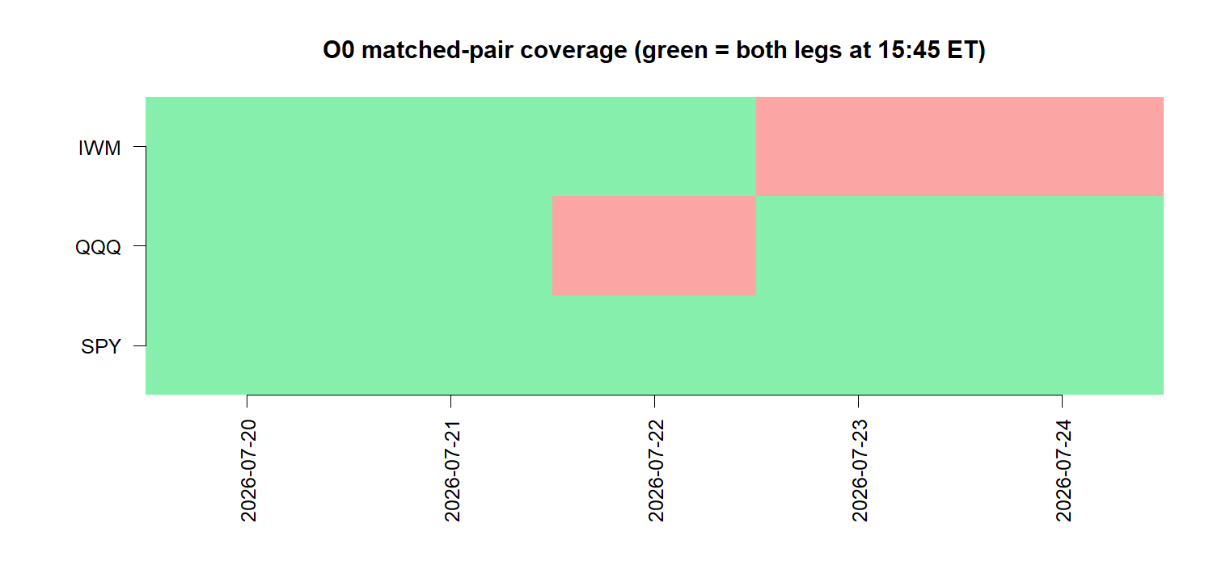
Matched-pair coverage failed for QQQ and IWM
SPY
5 / 5
PASS
QQQ
4 / 5
STOP
IWM
3 / 5
STOP
Missing final bars—not contract matching—caused the stop.
D42
5
Notes:
DECISION D42 — STOP O0 RECONSTRUCTION
Coverage
SPY passed at 5/5. QQQ stopped at 4/5 because its July 22 call had no 15:45 bar. IWM stopped at 3/5 because the July 23 put and July 24 call had no 15:45 bar.
Diagnosis
Underlying final bars were complete at 15/15 and same-strike same-expiry definitions were complete at 15/15. The failure is option-leg bar sparsity on the indicative feed at the frozen timestamp.
Gate logic
The contract required at least 90% for every ETF. QQQ at 80% and IWM at 60% cannot be averaged away by SPY's 100%.
Find in chat: Proceed, then let's also document in a new slide deck
Conversation: codex://threads/019f741e-615f-7fd0-90f7-edce12b5cb66
[Sources]
- C:/Users/Franc/OneDrive/Documents/Francis/Peltata Project/Time-Series-Modeling-Gen5/runs/research_workbench/gen54_ml_decision_engine/g54_options_o0_20260726/o0_coverage_summary.csv
- C:/Users/Franc/OneDrive/Documents/Francis/Peltata Project/Time-Series-Modeling-Gen5/runs/research_workbench/gen54_ml_decision_engine/g54_options_o0_20260726/o0_implied_move_measure.csv
- C:/Users/Franc/OneDrive/Documents/Francis/Peltata Project/Time-Series-Modeling-Gen5/runs/research_workbench/gen54_ml_decision_engine/g54_options_o0_20260726/visuals/o0_pair_coverage.png
[/Sources]

Slide 6
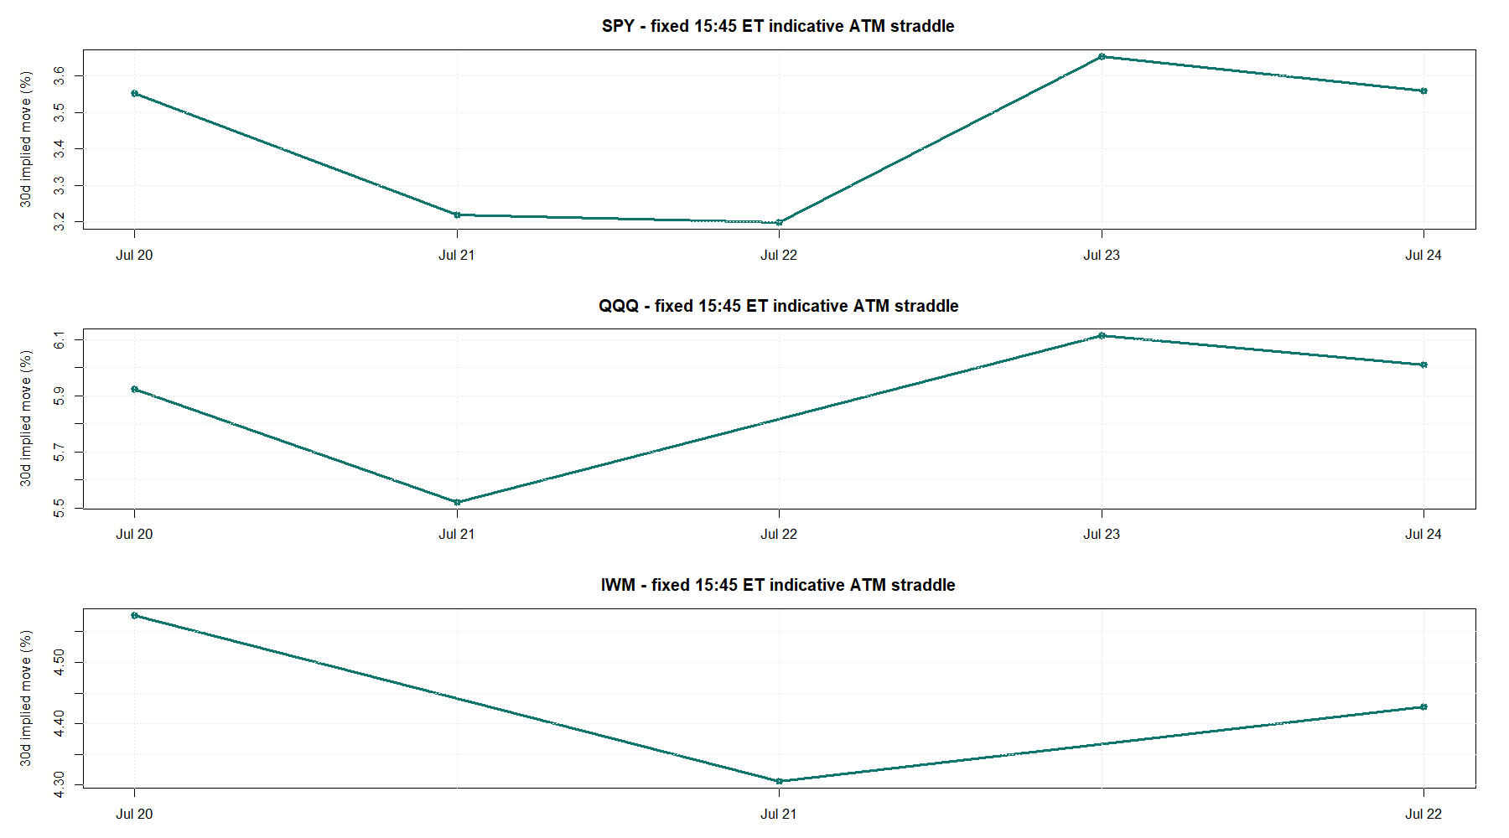
The constructed values look coherent where both legs exist
Teaching point
A plausible-looking line is not enough.
Sparse missing legs make the feature operationally undefined on some days.
Integrity precedes predictiveness.
D42
6
Notes:
DECISION D42 — VISUAL READOUT DOES NOT OVERRIDE COVERAGE
Observation
Where both indicative legs exist, the normalized measure is numerically coherent: SPY is complete, QQQ has one gap, and IWM has two gaps.
Why the stop still matters
A visually smooth or economically plausible subset does not make missing decision rows safe. Any fill rule would become a new representation choice requiring its own frozen justification and confirmation data.
Boundary
No future realized volatility, return direction, VIX control, model, or PnL appears on these tapes.
Conversation: codex://threads/019f741e-615f-7fd0-90f7-edce12b5cb66
[Sources]
- C:/Users/Franc/OneDrive/Documents/Francis/Peltata Project/Time-Series-Modeling-Gen5/runs/research_workbench/gen54_ml_decision_engine/g54_options_o0_20260726/visuals/o0_implied_move_tapes.png
- C:/Users/Franc/OneDrive/Documents/Francis/Peltata Project/Time-Series-Modeling-Gen5/runs/research_workbench/gen54_ml_decision_engine/g54_options_o0_20260726/o0_implied_move_measure.csv
[/Sources]

Slide 7
DECISION
STOP O0.
Keep O1 closed.
What would reopen the lane?
• A defensible historical contract catalog
• A denser/official OPRA feed
• Or a newly frozen missing-data construction
None is assumed here.
No outcome join • no model • no trading claim
D42
Notes:
DECISION D42 — O1 REMAINS CLOSED
Decision
Record STOP_O0_RECONSTRUCTION. Do not test the implied-move proxy against future volatility on this five-session, incomplete indicative surface.
What the POC accomplished
It proved contract access, feed entitlement, raw-underlying alignment, same-strike same-expiry selection, formula construction, and auditable missing-leg detection. It also falsified the assumption that the current retail feed can supply the frozen final-bar measure reliably across all three ETFs.
Possible future reopeners
A defensible expired-contract catalog, OPRA access or another suitably dense equivalent feed, or a separate theory-first contract for a different pricing timestamp/missing-data representation. Each would be a new gate, not a rescue on these inspected rows.
Find in chat: Okay, sounds good. Proceed
Conversation: codex://threads/019f741e-615f-7fd0-90f7-edce12b5cb66
[Sources]
- C:/Users/Franc/OneDrive/Documents/Francis/Peltata Project/Time-Series-Modeling-Gen5/runs/research_workbench/gen54_ml_decision_engine/g54_options_o0_20260726/o0_report.md
- C:/Users/Franc/OneDrive/Documents/Francis/Peltata Project/Time-Series-Modeling-Gen5/docs/GEN5_4_OPTIONS_IMPLIED_MOVE_O0_O1_CONTRACT.md
- C:/Users/Franc/OneDrive/Documents/Francis/Peltata Project/Time-Series-Modeling-Gen5/docs/GEN5_1_POC_PROGRESS_LOG.md
[/Sources]

