Slide 1
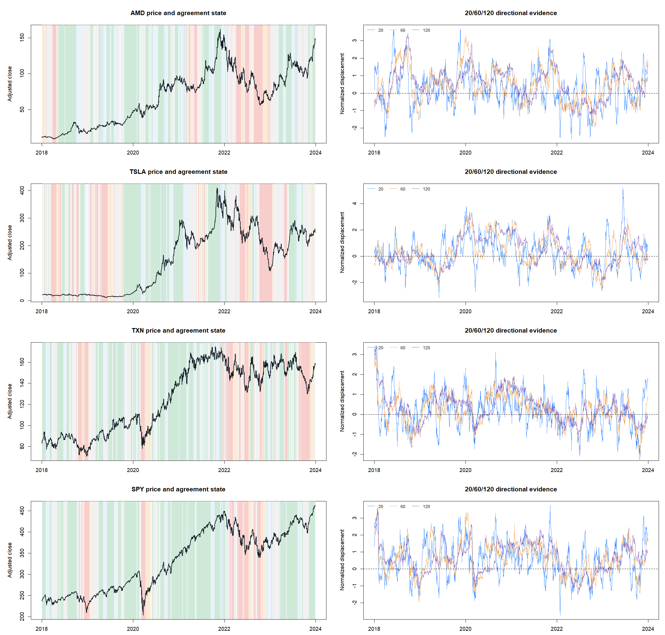
HYP-REG-10.1
Multi-horizon agreement
was coherent—but mistimed
A fixed 20 / 60 / 120-session direction state passed construction, then failed as a FULL_UP entry gate on SMA8/14.
DEVELOPMENT_REUSED_WINDOW · 2018–2023 · 2024+ SEALED
Notes:
Open with the tension: a useful measurement is not automatically a useful trading gate. This deck preserves both lessons.
[Sources]
- C:/Users/Franc/OneDrive/Documents/Francis/Peltata Project/Time-Series-Modeling-Gen5/docs/GEN5_HYP_REG_10_1_MULTI_HORIZON_AGREEMENT_CONTRACT.md
- C:/Users/Franc/OneDrive/Documents/Francis/Peltata Project/Time-Series-Modeling-Gen5/runs/research_workbench/operator_hypothesis_lab/hyp_reg_10_1_multi_horizon_agreement_20260816/hyp_reg_10_1_report.md

Slide 2
RESEARCH BOUNDARY
The question was narrow—and frozen before returns
Can cross-scale directional agreement improve only fresh entries in an unchanged parent?
Frozen surface
Literature gives the broad motivation: an asset’s own past return can contain trend information. Our exact 20/60/120 state is an operator-designed measurement, not a published trading rule.
24 stocks + SPY / QQQ
2018-01-02 → 2023-12-29
Adjusted daily OHLCV
No horizon or threshold search
No ATR join · no leverage
2024+ never opened
The reused window is an educational development surface—not fresh OOS evidence.
02
Notes:
The literature citation supports the premise of time-series momentum. Be explicit that this particular state machine was designed here and frozen before strategy outcomes.
[Sources]
- https://pages.stern.nyu.edu/~lpederse/papers/TimeSeriesMomentum.pdf
- C:/Users/Franc/OneDrive/Documents/Francis/Peltata Project/Time-Series-Modeling-Gen5/docs/GEN5_HYP_REG_10_1_MULTI_HORIZON_AGREEMENT_CONTRACT.md
- C:/Users/Franc/OneDrive/Documents/Francis/Peltata Project/Time-Series-Modeling-Gen5/docs/GEN5_TREND_INDICATOR_POC_ROADMAP.md

Slide 3
CONSTRUCTION
Each horizon asks: how large was the move relative to its own noise?
R: signed displacement
Rₕ(t) = log(Pₜ / Pₜ₋ₕ)
How far price moved over h completed sessions.
Vₕ(t) = sd[Δ log(P)] × √h
V: realized noise
The same move is less impressive when day-to-day variation is large.
Zₕ(t) = Rₕ(t) / Vₕ(t)
Sₕ(t) = sign(Zₕ(t))
Z: dimensionless direction
Scale-comparable across assets; sign supplies the state.
03
Notes:
Teach the normalization plainly: it is a signal-to-noise description, not a forecast probability or a p-value.
[Sources]
- C:/Users/Franc/OneDrive/Documents/Francis/Peltata Project/Time-Series-Modeling-Gen5/docs/GEN5_HYP_REG_10_1_MULTI_HORIZON_AGREEMENT_CONTRACT.md

Slide 4
INTERPRETATION
Three horizons are three lenses—not three independent votes
All windows end at today’s close and share observations.
120 sessions
60 sessions
20 sessions
t − 120
t − 60
t − 20
t
Agreement means the current path points the same way at several scales. It does not multiply statistical confidence by three.
04
Notes:
This distinction matters. Nested horizons are correlated summaries of one price path. Full agreement is a descriptive state, not three independent pieces of evidence.
[Sources]
- C:/Users/Franc/OneDrive/Documents/Francis/Peltata Project/Time-Series-Modeling-Gen5/docs/GEN5_HYP_REG_10_1_MULTI_HORIZON_AGREEMENT_CONTRACT.md
- https://pages.stern.nyu.edu/~lpederse/papers/TimeSeriesMomentum.pdf

Slide 5
STATE TAXONOMY
Five states preserve direction and short-horizon opposition
State
S20
S60
S120
Plain-English reading
FULL_UP
+
+
+
Entry-eligible
SHORT_OPPOSES_UP
−
+
+
Pullback inside up context
MIXED
varies
varies
varies
No clean consensus
SHORT_OPPOSES_DOWN
+
−
−
Bounce inside down context
FULL_DOWN
−
−
−
Aligned down
SHORT_JOINS_UP / DOWN marks one-day descriptive transitions; it never triggers this strategy.
05
Notes:
The taxonomy keeps potentially useful information that a binary up/down toggle would discard. Only FULL_UP was authorized as a fresh-entry gate.
[Sources]
- C:/Users/Franc/OneDrive/Documents/Francis/Peltata Project/Time-Series-Modeling-Gen5/docs/GEN5_HYP_REG_10_1_MULTI_HORIZON_AGREEMENT_CONTRACT.md

Slide 6
VALIDATION DESIGN
Construction had to pass before the strategy was allowed to speak
STAGE A
STAGE B
Does the indicator behave as defined?
Does FULL_UP improve one unchanged decision?
• complete causal coverage
• seeded path recovery
• price-scale invariance
• append invariance
• exact sign / transition semantics
• usable real-panel occupancy
• same SMA8/14 parent
• fresh cross only; next-open entry
• rejected entries skipped, never deferred
• 5 bp primary / 10 bp stress
• buy-hold and cash baselines
• 200 circular timing controls
Passing Stage A licenses a strategy test—not a promotion.
06
Notes:
This sequencing prevents a malformed indicator from being judged by a lucky strategy outcome. Stage B asks a decision-specific question because state persistence is not the only possible form of utility.
[Sources]
- C:/Users/Franc/OneDrive/Documents/Francis/Peltata Project/Time-Series-Modeling-Gen5/docs/GEN5_HYP_REG_10_1_MULTI_HORIZON_AGREEMENT_CONTRACT.md
- C:/Users/Franc/OneDrive/Documents/Francis/Peltata Project/Time-Series-Modeling-Gen5/docs/GEN5_TREND_INDICATOR_POC_ROADMAP.md

Slide 7
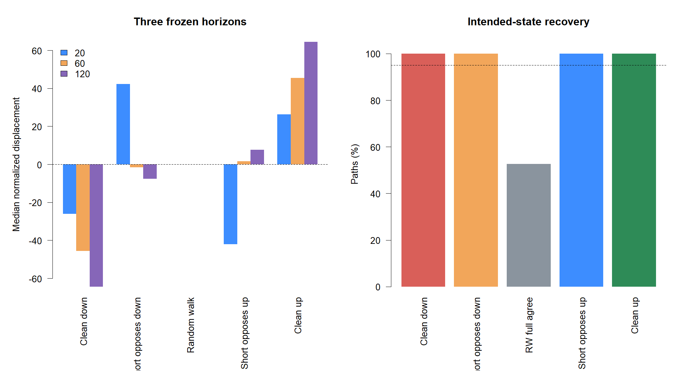
STAGE A EVIDENCE
Seeded paths recovered every intended directional state
100%
Clean up / down and both short-opposition families landed in their intended state.
Random walks fully agreed only 52.5% of the time—confirmation that agreement is not automatic.
07
Notes:
The huge normalized values on nearly deterministic synthetic paths are expected; these paths test sign and state semantics, not realistic return magnitudes.
[Sources]
- C:/Users/Franc/OneDrive/Documents/Francis/Peltata Project/Time-Series-Modeling-Gen5/runs/research_workbench/operator_hypothesis_lab/hyp_reg_10_1_multi_horizon_agreement_20260816/hyp_reg_10_1_synthetic_summary.csv
- C:/Users/Franc/OneDrive/Documents/Francis/Peltata Project/Time-Series-Modeling-Gen5/runs/research_workbench/operator_hypothesis_lab/hyp_reg_10_1_multi_horizon_agreement_20260816/visuals/synthetic_calibration.png

Slide 8
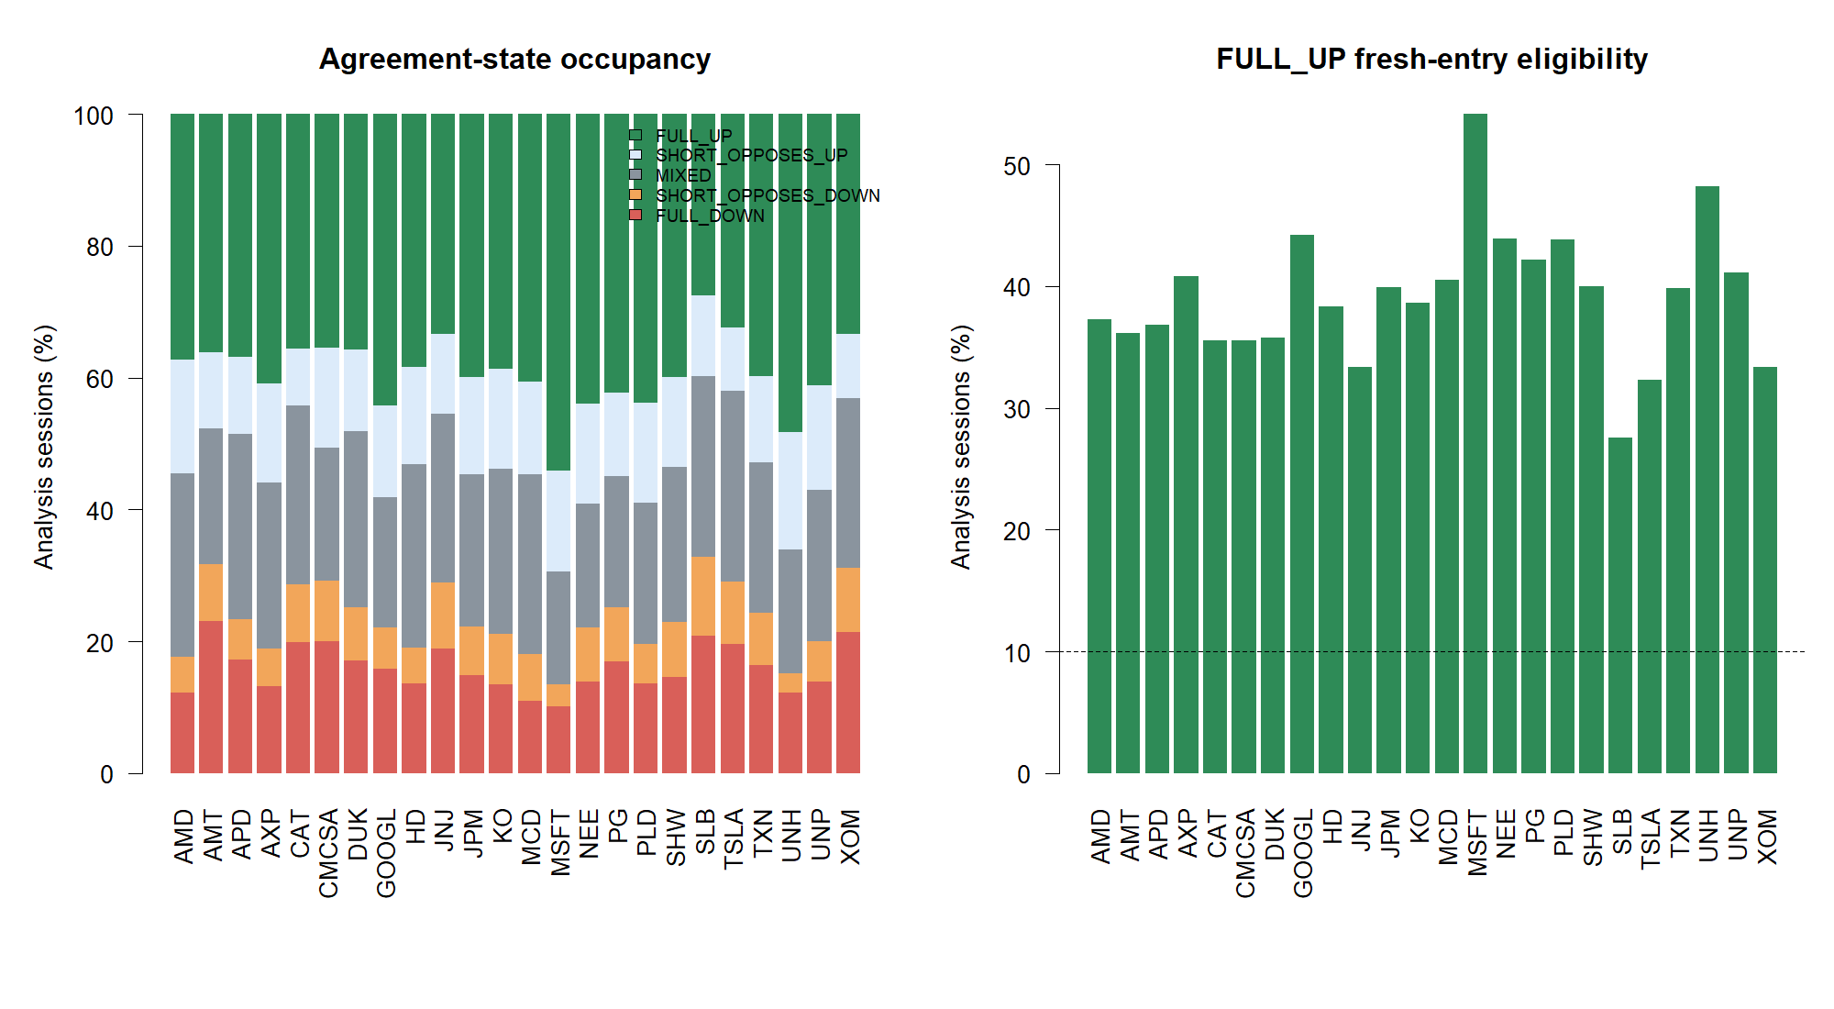
STAGE A EVIDENCE
The state was measurable and usable across every primary stock
7 / 7
construction gates passed
24 / 24
stocks cleared state and policy usability
Median FULL_UP eligibility: 39.2% of sessions
08
Notes:
The indicator did not fail because it was too rare or undefined. It produced all required states and enough FULL_UP sessions to test the policy fairly.
[Sources]
- C:/Users/Franc/OneDrive/Documents/Francis/Peltata Project/Time-Series-Modeling-Gen5/runs/research_workbench/operator_hypothesis_lab/hyp_reg_10_1_multi_horizon_agreement_20260816/hyp_reg_10_1_stage_a_gates.csv
- C:/Users/Franc/OneDrive/Documents/Francis/Peltata Project/Time-Series-Modeling-Gen5/runs/research_workbench/operator_hypothesis_lab/hyp_reg_10_1_multi_horizon_agreement_20260816/hyp_reg_10_1_state_diagnostics.csv
- C:/Users/Franc/OneDrive/Documents/Francis/Peltata Project/Time-Series-Modeling-Gen5/runs/research_workbench/operator_hypothesis_lab/hyp_reg_10_1_multi_horizon_agreement_20260816/visuals/state_usability.png

Slide 9
MEASUREMENT BEHAVIOR
The tapes reveal persistence, opposition, and rapid state switching
Read the background first
Green: FULL_UP
Red: FULL_DOWN
Blue: short opposes up
Orange: short opposes down
Gray: mixed
Then read the three Z lines: the state changes when one or more signs cross zero—not when magnitude reaches a fitted threshold.
09
Notes:
Use TSLA to show long aligned stretches and TXN/SPY to show frequent transitions. This is descriptive tape reading, not cherry-picked performance evidence.
[Sources]
- C:/Users/Franc/OneDrive/Documents/Francis/Peltata Project/Time-Series-Modeling-Gen5/runs/research_workbench/operator_hypothesis_lab/hyp_reg_10_1_multi_horizon_agreement_20260816/visuals/representative_measurement_tapes.png
- C:/Users/Franc/OneDrive/Documents/Francis/Peltata Project/Time-Series-Modeling-Gen5/docs/GEN5_HYP_REG_10_1_MULTI_HORIZON_AGREEMENT_CONTRACT.md

Slide 10
STRATEGY CONTACT
FULL_UP changed admission only; exits remained untouched
1
Observe
At the close, SMA8 crosses above SMA14.
2
Classify
Use only information through that close; state must be FULL_UP.
3
Enter
Buy next open at 1×. A rejected cross is skipped—not queued.
4
Exit
Sell next open after the unchanged SMA8-below-SMA14 cross.
No magnitude threshold · no join-event entry · no candidate-driven exit · no sizing change
10
Notes:
The only experimental difference is whether a fresh parent entry is admitted. This isolates timing from exit and sizing changes.
[Sources]
- C:/Users/Franc/OneDrive/Documents/Francis/Peltata Project/Time-Series-Modeling-Gen5/docs/GEN5_HYP_REG_10_1_MULTI_HORIZON_AGREEMENT_CONTRACT.md

Slide 11
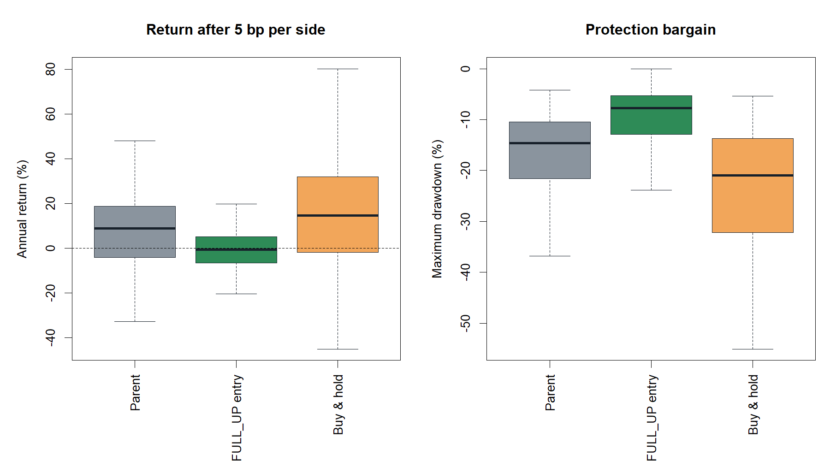
STAGE B EVIDENCE
Lower drawdown came with destroyed return and Sharpe
8.95% → −0.68%
median annual return
−14.59% → −7.69%
median maximum drawdown
0.642 → −0.203
median Sharpe
11
Notes:
Drawdown improved because exposure collapsed to about 17.5%, but the cost was a negative median return and negative Sharpe. Protection alone does not satisfy the bargain.
[Sources]
- C:/Users/Franc/OneDrive/Documents/Francis/Peltata Project/Time-Series-Modeling-Gen5/runs/research_workbench/operator_hypothesis_lab/hyp_reg_10_1_multi_horizon_agreement_20260816/hyp_reg_10_1_policy_panel.csv
- C:/Users/Franc/OneDrive/Documents/Francis/Peltata Project/Time-Series-Modeling-Gen5/runs/research_workbench/operator_hypothesis_lab/hyp_reg_10_1_multi_horizon_agreement_20260816/visuals/policy_performance.png

Slide 12
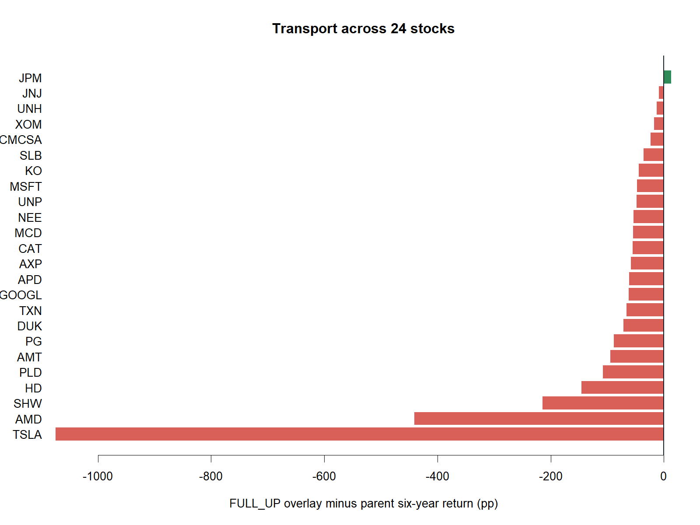
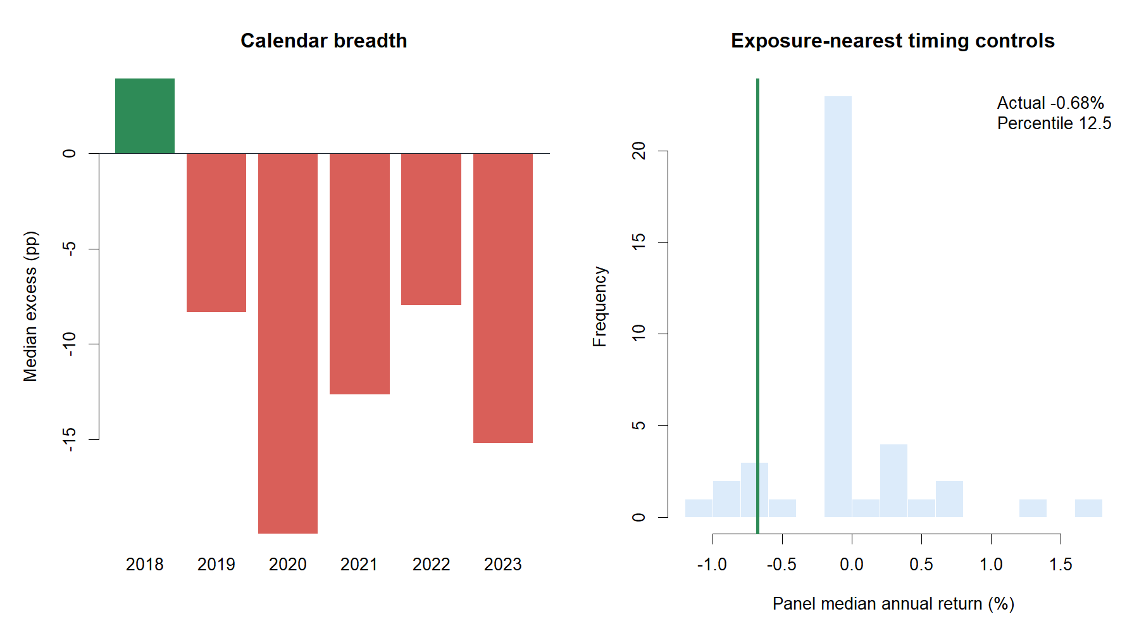
STAGE B EVIDENCE
The failure transported across assets, years, and timing controls
1 / 24 assets
improved
1 / 6 years
improved
Actual timing: 12.5th percentile
12
Notes:
This is the decisive evidence. Even after comparing only with controls of similar exposure, the actual FULL_UP dates were unusually poor rather than unusually good.
[Sources]
- C:/Users/Franc/OneDrive/Documents/Francis/Peltata Project/Time-Series-Modeling-Gen5/runs/research_workbench/operator_hypothesis_lab/hyp_reg_10_1_multi_horizon_agreement_20260816/hyp_reg_10_1_asset_summary.csv
- C:/Users/Franc/OneDrive/Documents/Francis/Peltata Project/Time-Series-Modeling-Gen5/runs/research_workbench/operator_hypothesis_lab/hyp_reg_10_1_multi_horizon_agreement_20260816/hyp_reg_10_1_year_summary.csv
- C:/Users/Franc/OneDrive/Documents/Francis/Peltata Project/Time-Series-Modeling-Gen5/runs/research_workbench/operator_hypothesis_lab/hyp_reg_10_1_multi_horizon_agreement_20260816/hyp_reg_10_1_placebo_readout.csv
- C:/Users/Franc/OneDrive/Documents/Francis/Peltata Project/Time-Series-Modeling-Gen5/runs/research_workbench/operator_hypothesis_lab/hyp_reg_10_1_multi_horizon_agreement_20260816/visuals/asset_breadth.png
- C:/Users/Franc/OneDrive/Documents/Francis/Peltata Project/Time-Series-Modeling-Gen5/runs/research_workbench/operator_hypothesis_lab/hyp_reg_10_1_multi_horizon_agreement_20260816/visuals/calendar_and_controls.png

Slide 13
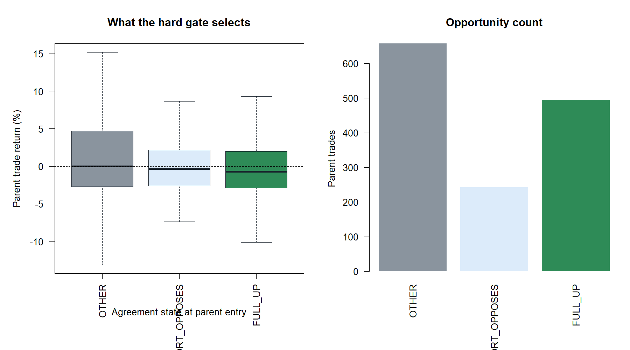
TRADE AUDIT
Parent trades entered during FULL_UP were the weakest group
FULL_UP entries
495 trades
42.4% hit rate
−0.71% median trade
Other states
899 trades combined
Higher hit rates
Positive or near-zero median
Full alignment appears late: it often admits after momentum is already mature.
13
Notes:
The trade audit gives the behavioral explanation. FULL_UP is descriptive alignment, but for a fresh crossover entry it may be confirmation that arrives after much of the move.
[Sources]
- C:/Users/Franc/OneDrive/Documents/Francis/Peltata Project/Time-Series-Modeling-Gen5/runs/research_workbench/operator_hypothesis_lab/hyp_reg_10_1_multi_horizon_agreement_20260816/hyp_reg_10_1_entry_state_audit.csv
- C:/Users/Franc/OneDrive/Documents/Francis/Peltata Project/Time-Series-Modeling-Gen5/runs/research_workbench/operator_hypothesis_lab/hyp_reg_10_1_multi_horizon_agreement_20260816/visuals/entry_state_audit.png
- C:/Users/Franc/OneDrive/Documents/Francis/Peltata Project/Time-Series-Modeling-Gen5/runs/research_workbench/operator_hypothesis_lab/hyp_reg_10_1_multi_horizon_agreement_20260816/visuals/representative_strategy_tapes.png

Slide 14
DECISION
Keep the measurement; stop the policy; continue the roadmap
STOP
What remains valuable
• causal, scale-free cross-horizon state ledger
• explicit opposition and join semantics
• a clear example of ‘describes well’ ≠ ‘routes well’
• reusable measurement tapes
3 / 9 strategy gates passed
Do not rescue by tuning horizons, magnitude thresholds, majority-up rules, assets, ATR%, exits, leverage, or confirmation.
Next: discuss T4 causal change-point onset.
Post-series bookmark: if T1–T5 yield no promotion, open a literature-first HMM discussion—never retrospective smoothed states presented as live-known regimes.
14
Notes:
Close with disciplined progress: T3 answered its question cleanly. The HMM item is only a bookmark; literature inventory, state-count discipline, causal filtering, and held-out validation must be discussed before any implementation.
[Sources]
- C:/Users/Franc/OneDrive/Documents/Francis/Peltata Project/Time-Series-Modeling-Gen5/runs/research_workbench/operator_hypothesis_lab/hyp_reg_10_1_multi_horizon_agreement_20260816/hyp_reg_10_1_report.md
- C:/Users/Franc/OneDrive/Documents/Francis/Peltata Project/Time-Series-Modeling-Gen5/docs/GEN5_HYP_REG_10_1_MULTI_HORIZON_AGREEMENT_CONTRACT.md
- C:/Users/Franc/OneDrive/Documents/Francis/Peltata Project/Time-Series-Modeling-Gen5/docs/GEN5_TREND_INDICATOR_POC_ROADMAP.md

