Slide 1
EDGE DISCOVERY LAB · BREADTH REPLICATION
Rule 201 Reclaim
129
The pilot hump is cohort-sensitive.
instruments
enrolled
The 88-stock balanced core does not reproduce the ten-stock day-five median. Attention stocks carry most of the visible temporary recovery.
WIDE-ATLAS REPLICATION COMPLETE · NO EDGE CLAIM
Post-2023 data remain sealed
Notes:
This sequel asks whether the ten-stock pilot's visible five-session recovery hump survives a preregistered breadth expansion. The central result is cohort sensitivity, not edge promotion.
[Sources]
- Local report: runs/research_workbench/edge_discovery_lab/edl_ms_01_rule201_wide_atlas_20260830/report.md
- Local frozen run specification: runs/research_workbench/edge_discovery_lab/edl_ms_01_rule201_wide_atlas_20260830/run_spec.csv
- Local pilot-versus-wide comparison: runs/research_workbench/edge_discovery_lab/edl_ms_01_rule201_wide_atlas_20260830/pilot_vs_wide_comparison.csv
[/Sources]

Slide 2
EDGE DISCOVERY LAB · EDL-MS-01
One frozen rule enters four visibly separate cohorts
Definitions are inherited from the pilot; only representation changes.
88
16
15
10
core stocks
attention stocks
equity ETFs
non-equity ETFs
8 per GICS sector
separate challenger cohort
broad and sector controls
rates, commodities, FX
UNCHANGED EVENT GEOMETRY
REPRESENTATION GUARDRAILS
Daily low / prior close from −12% through −8%.
All 129 stay enrolled—including six with no band event.
Triggered proxy at or below −10%; strong CLV ≥ .75; weak CLV ≤ .25.
Seven later listings retain shorter available histories; none are outcome-dropped.
Completed signal close → next-open entry → sessions 0–10.
Stocks and ETFs are separated before any cohort readout.
Adjusted daily · 2018–2023 TRAIN · descriptive only
02
Notes:
The primary replication is the balanced 88-stock core. The attention and ETF cohorts are separate challengers and controls. Zero-event instruments remain in the enrolled-symbol ledger.
[Sources]
- Local frozen run specification: runs/research_workbench/edge_discovery_lab/edl_ms_01_rule201_wide_atlas_20260830/run_spec.csv
- Local enrolled-symbol counts: runs/research_workbench/edge_discovery_lab/edl_ms_01_rule201_wide_atlas_20260830/symbol_event_counts.csv
- Local coverage ledger: runs/research_workbench/edge_discovery_lab/edl_ms_01_rule201_wide_atlas_20260830/coverage_ledger.csv
[/Sources]

Slide 3
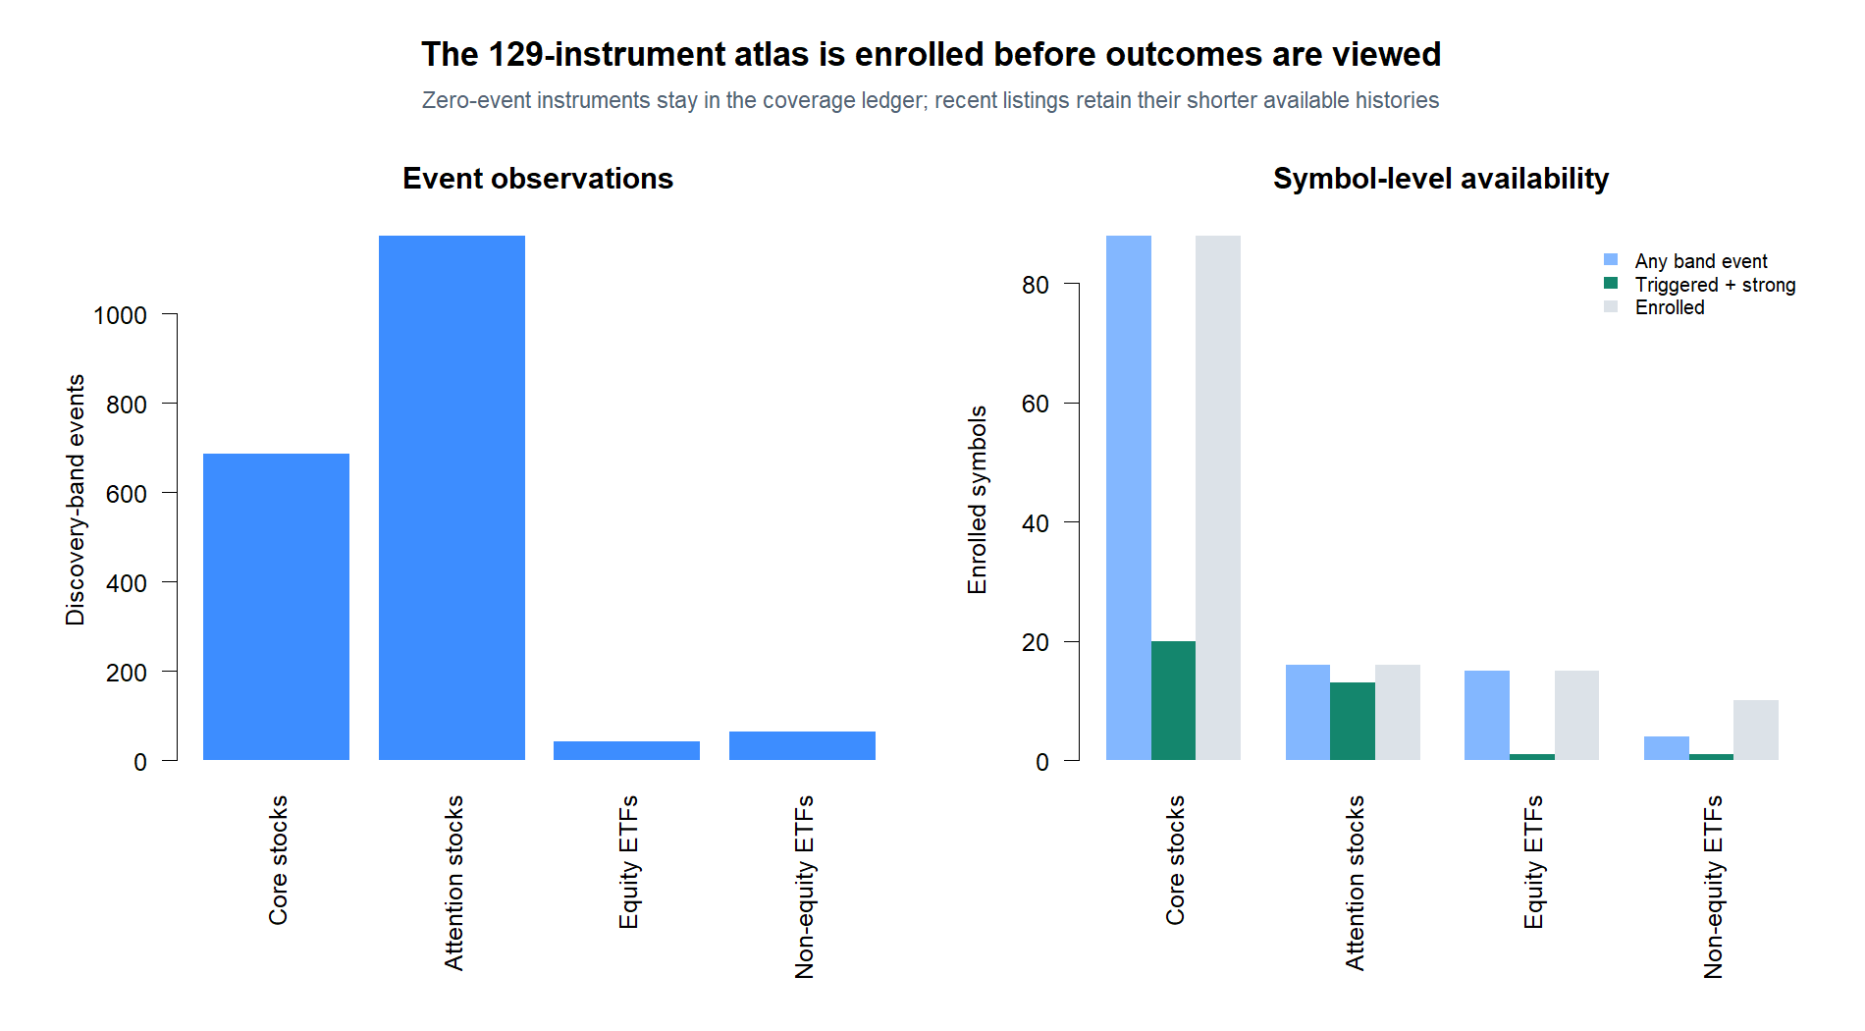
EDGE DISCOVERY LAB · EDL-MS-01
Breadth adds observations, but the target event stays sparse
The attention cohort generates far more severe daily-low events than the balanced core.
Adjusted daily · 2018–2023 TRAIN · descriptive only
03
Notes:
Every core and attention stock has at least one discovery-band event, but only 20 of 88 core stocks and 13 of 16 attention stocks have a triggered/strong-reclaim event. ETF target cells are especially thin.
[Sources]
- Local enrolled-symbol counts: runs/research_workbench/edge_discovery_lab/edl_ms_01_rule201_wide_atlas_20260830/symbol_event_counts.csv
- Local coverage ledger: runs/research_workbench/edge_discovery_lab/edl_ms_01_rule201_wide_atlas_20260830/coverage_ledger.csv
[/Sources]

Slide 4
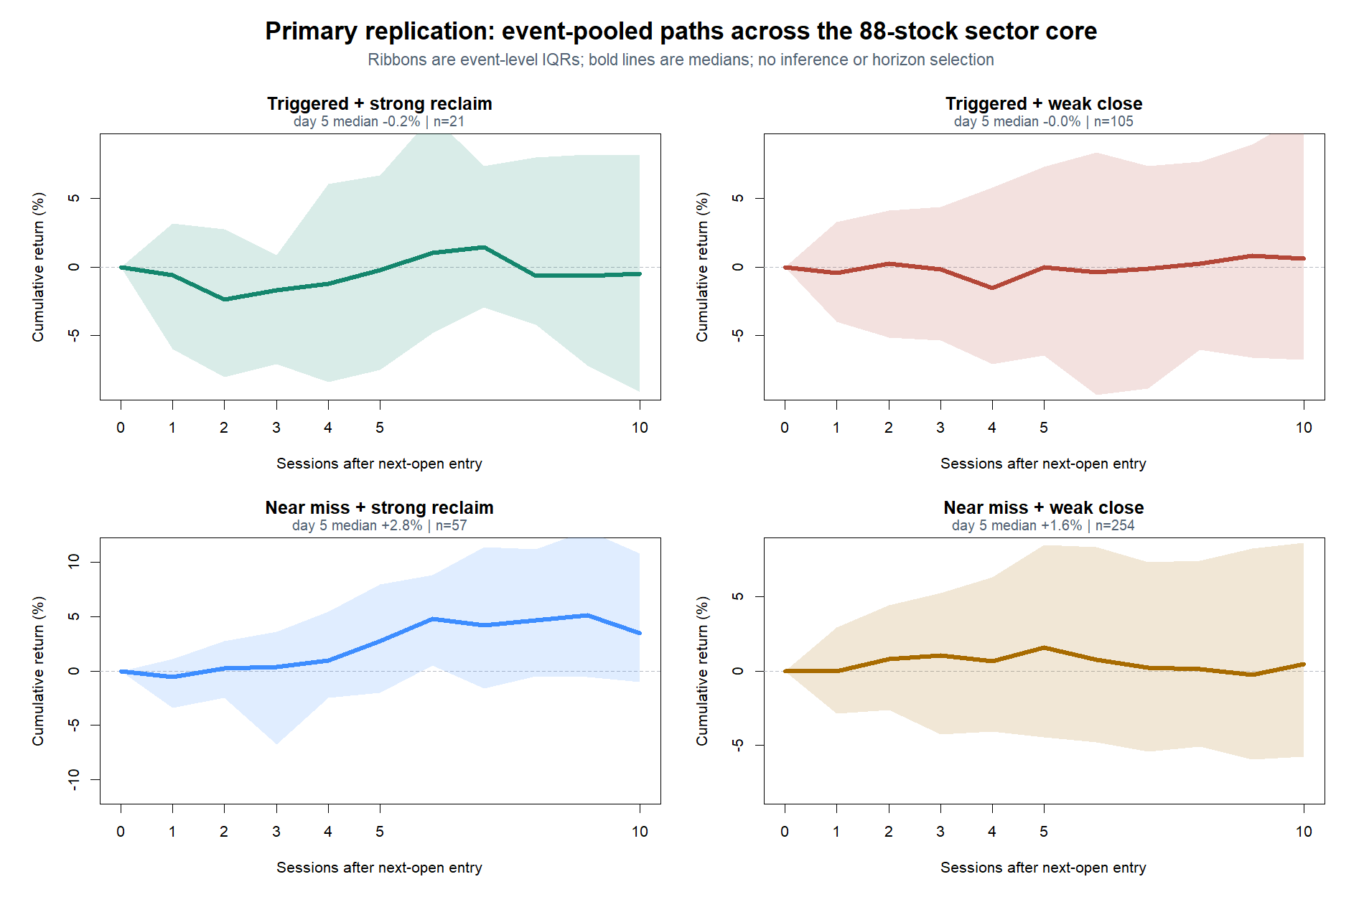
EDGE DISCOVERY LAB · EDL-MS-01
The 88-stock core does not reproduce the pilot's day-five hump
Primary event-pooled replication: medians with event-level interquartile ribbons.
−0.24%
triggered + strong
day-five median
21
events across
20 eligible symbols
Mechanism clue: a down-then-recovery shape remains, but not the pilot median at session five.
Adjusted daily · 2018–2023 TRAIN · descriptive only
04
Notes:
The pilot ten-stock triggered/strong group had a positive 3.72 percent day-five median. The balanced core's comparable event-pooled median is negative 0.24 percent across 21 events and negative 0.48 percent at day ten.
[Sources]
- Local event-pooled paths: runs/research_workbench/edge_discovery_lab/edl_ms_01_rule201_wide_atlas_20260830/pooled_path_summary.csv
- Local pilot-versus-wide comparison: runs/research_workbench/edge_discovery_lab/edl_ms_01_rule201_wide_atlas_20260830/pilot_vs_wide_comparison.csv
[/Sources]

Slide 5
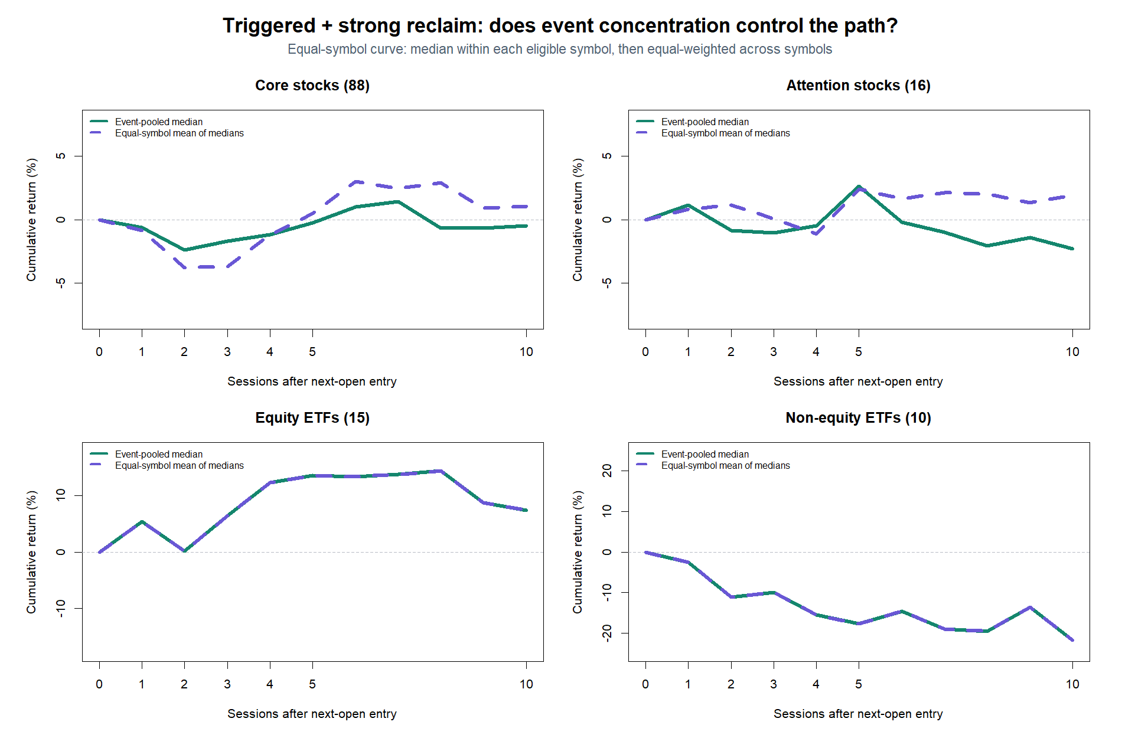
EDGE DISCOVERY LAB · EDL-MS-01
Equal-symbol weighting reveals who controls the apparent path
Solid = event-pooled median; dashed = equal mean of within-symbol medians.
+0.51%
core day five
equal-symbol mean
47 / 68
all-stock target events
come from attention names
The mild core signal is not the same phenomenon as the attention-stock hump.
Adjusted daily · 2018–2023 TRAIN · descriptive only
05
Notes:
Within each eligible symbol, the median path is computed first; those symbol medians are then averaged equally. This prevents event-rich names from mechanically dominating the curve. ETF panels each have only one target event and therefore identical pooled and equal-symbol lines.
[Sources]
- Local equal-symbol paths: runs/research_workbench/edge_discovery_lab/edl_ms_01_rule201_wide_atlas_20260830/equal_symbol_path_summary.csv
- Local event-pooled paths: runs/research_workbench/edge_discovery_lab/edl_ms_01_rule201_wide_atlas_20260830/pooled_path_summary.csv
- Local enrolled-symbol counts: runs/research_workbench/edge_discovery_lab/edl_ms_01_rule201_wide_atlas_20260830/symbol_event_counts.csv
[/Sources]

Slide 6
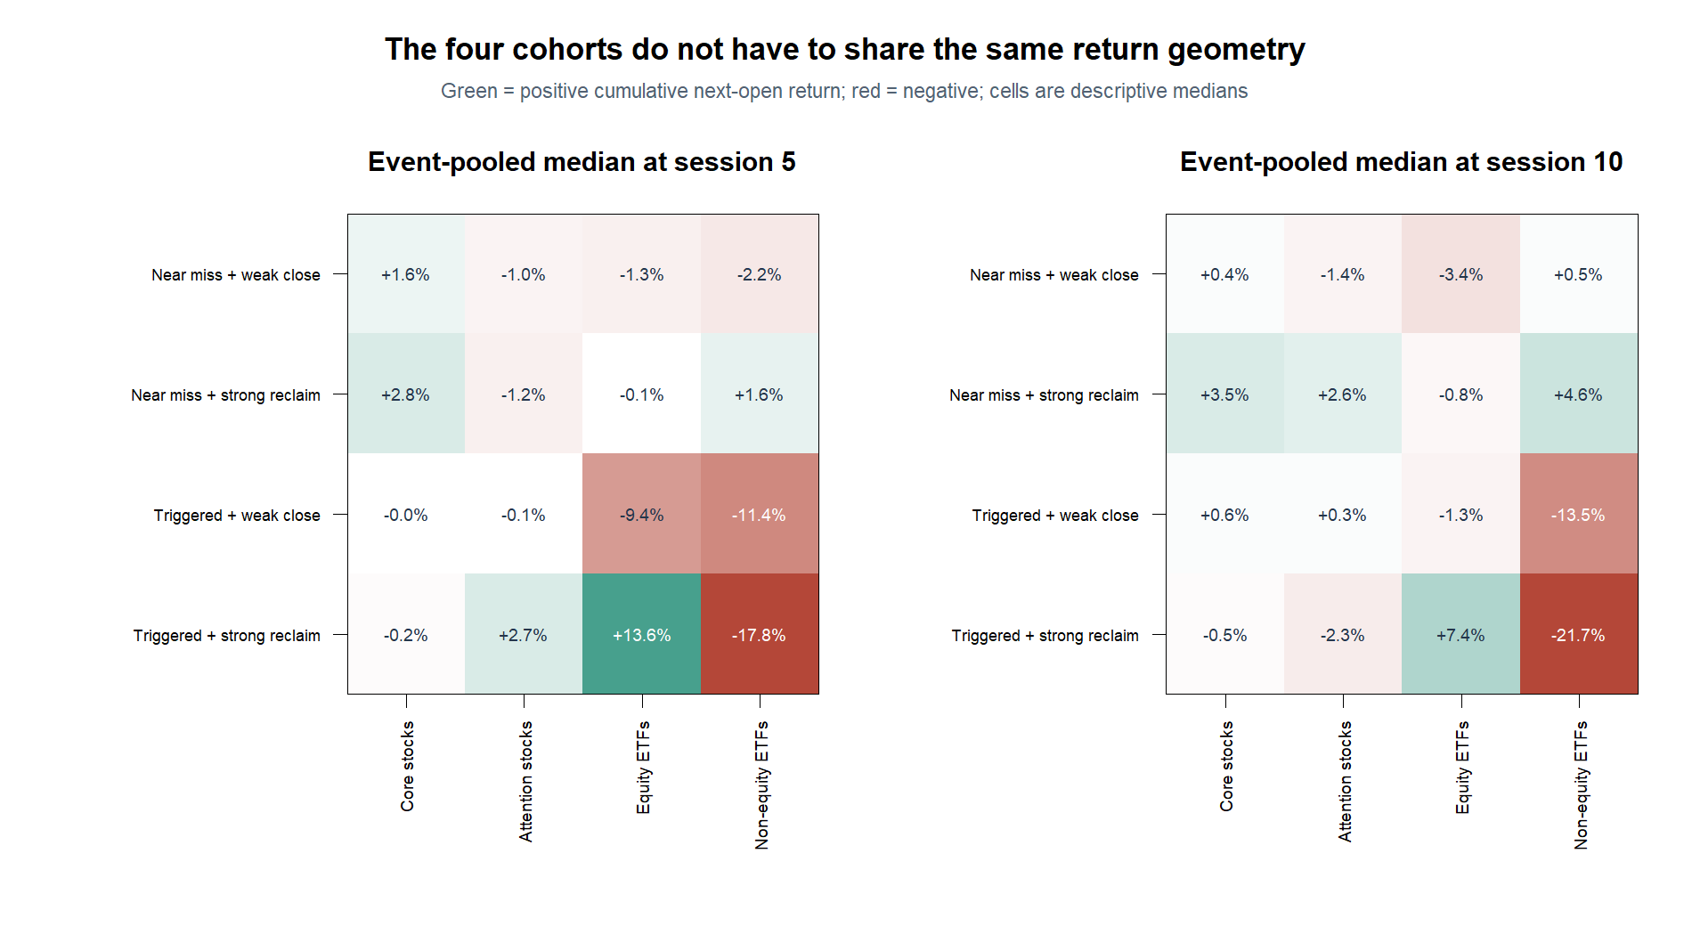
EDGE DISCOVERY LAB · EDL-MS-01
Cohort separation matters more than the threshold label alone
Day-five and day-ten medians expose different return geometry across the same four event states.
+2.65%
attention-stock target
day-five median
ETF warning
Triggered + strong cells contain one event in each ETF cohort. Their ±10–20% values are examples, not cohort estimates.
Adjusted daily · 2018–2023 TRAIN · descriptive only
06
Notes:
The attention-stock triggered/strong group has a positive 2.65 percent day-five median and a negative 2.28 percent day-ten median. The ETF target cells are visually extreme because each cohort contains one eligible event, so they must not be interpreted as stable estimates.
[Sources]
- Local event-pooled paths: runs/research_workbench/edge_discovery_lab/edl_ms_01_rule201_wide_atlas_20260830/pooled_path_summary.csv
- Local enrolled-symbol counts: runs/research_workbench/edge_discovery_lab/edl_ms_01_rule201_wide_atlas_20260830/symbol_event_counts.csv
[/Sources]

Slide 7
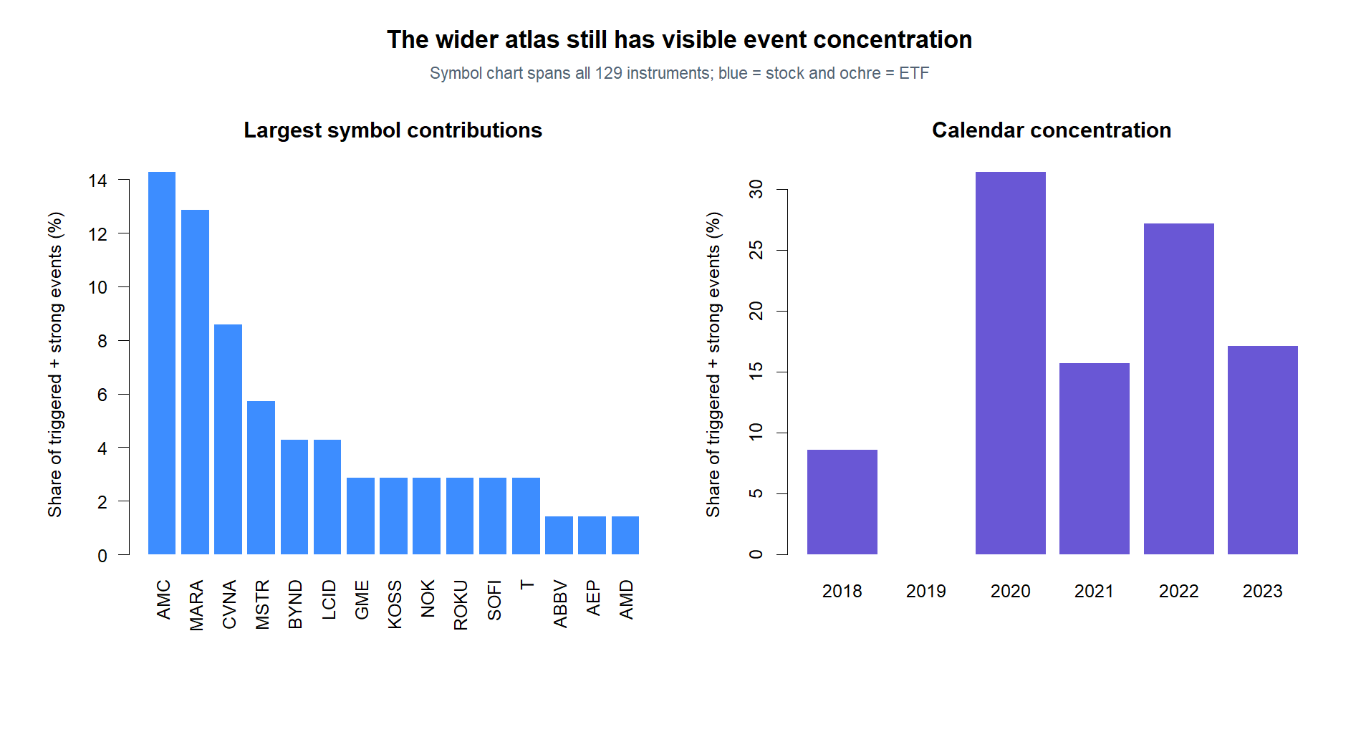
EDGE DISCOVERY LAB · EDL-MS-01
The wider atlas reduces one-name dependence, not calendar clustering
Triggered + strong events remain concentrated in attention names and stress-heavy years.
AMC · MARA · CVNA
three largest symbol
contributions
2020 + 2022
supply most target
events
Breadth changes the diagnosis: concentration is now a cohort-and-era question, not just AMC/CVNA.
Adjusted daily · 2018–2023 TRAIN · descriptive only
07
Notes:
AMC, MARA, and CVNA are the three largest individual contributors. Calendar concentration remains strongest in 2020 and 2022. The wider atlas therefore reduces the original pilot's two-name dependence but does not remove cohort and era dependence.
[Sources]
- Local enrolled-symbol counts: runs/research_workbench/edge_discovery_lab/edl_ms_01_rule201_wide_atlas_20260830/symbol_event_counts.csv
- Local report: runs/research_workbench/edge_discovery_lab/edl_ms_01_rule201_wide_atlas_20260830/report.md
[/Sources]

Slide 8
EDGE DISCOVERY LAB · EDL-MS-01
Breadth falsifies universality and sharpens the next question
This is a successful learning result: the visible path has a location, not yet an edge.
WHAT DID NOT SURVIVE
WHAT REMAINS INTERESTING
A broad Rule 201 × reclaim rebound.
A temporary-recovery shape in attention stocks.
Core 88: −0.24% event-pooled median at day five.
Attention cohort: +2.65% median at day five, negative by day ten.
Only 21 target events across 20 core symbols.
Core equal-symbol view is mildly positive, but sparse.
ETF target cells are too thin to adjudicate anything.
The mechanism now points to cohort/era conditions upstream of the rule.
NEXT OPERATOR GATE
Explain or predeclare a falsification of the attention-stock distinction—or pause the daily lane before opening intraday data.
Adjusted daily · 2018–2023 TRAIN · descriptive only
08
Notes:
This closes the breadth replication without selecting a horizon or promoting a rule. A subsequent slice could inspect an upstream explanation for attention-stock behavior or freeze a falsification of the cohort distinction. Either intraday branch remains separately gated.
[Sources]
- Local report: runs/research_workbench/edge_discovery_lab/edl_ms_01_rule201_wide_atlas_20260830/report.md
- Local event-pooled paths: runs/research_workbench/edge_discovery_lab/edl_ms_01_rule201_wide_atlas_20260830/pooled_path_summary.csv
- Local equal-symbol paths: runs/research_workbench/edge_discovery_lab/edl_ms_01_rule201_wide_atlas_20260830/equal_symbol_path_summary.csv
- Local pilot-versus-wide comparison: runs/research_workbench/edge_discovery_lab/edl_ms_01_rule201_wide_atlas_20260830/pilot_vs_wide_comparison.csv
[/Sources]

