Slide 1
TRAIN-ONLY EVIDENCE
11 AUG 2026
HYP-MOM-04.2 Feature Atlas
Notes:
This deck documents the derivative HYP-MOM-04.2 lane. The feature atlas was frozen before the run, and the reserved 2021-2023 OOS period remained unqueried.
[Sources]
- C:/Users/Franc/OneDrive/Documents/Francis/Peltata Project/Time-Series-Modeling-Gen5/operator_hypothesis_lab/docs/HYP_MOM_04_2_FEATURE_ATLAS_CONTRACT.md
- C:/Users/Franc/OneDrive/Documents/Francis/Peltata Project/Time-Series-Modeling-Gen5/runs/research_workbench/operator_hypothesis_lab/hyp_mom_04_2_feature_atlas_train_20260811/REPORT.md

Slide 2
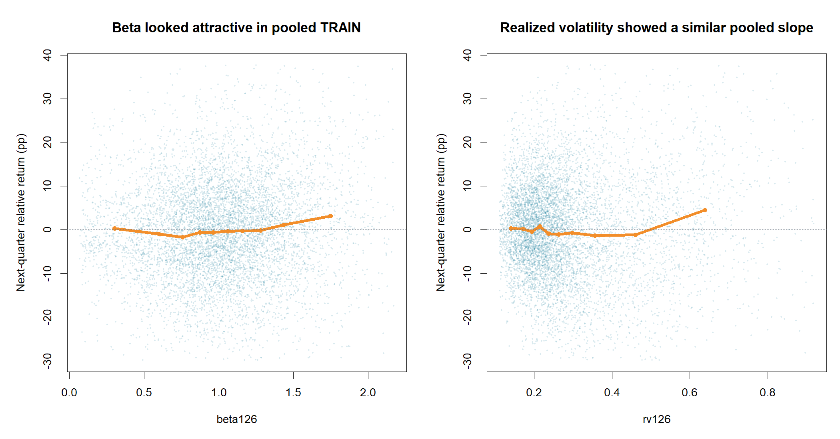
Scatterplots reveal shape—not transport
7,208 stock-quarter points Orange line = pooled decile means Beta and 126-day volatility bend upward in the highest deciles. Classic momentum was nearly flat. The catch: all those dots still span only 15 market quarters.
Display: 1st–99th percentile axes. Statistics: all finite observations.
2
Notes:
The scatter view is intentionally descriptive. It helps reveal curvature, thresholds, outliers, and non-monotonicity. It does not create thousands of independent temporal tests because stocks in one quarter share the same environment.
[Sources]
- C:/Users/Franc/OneDrive/Documents/Francis/Peltata Project/Time-Series-Modeling-Gen5/runs/research_workbench/operator_hypothesis_lab/hyp_mom_04_2_feature_atlas_train_20260811/hyp_mom_04_2_feature_panel.csv
- C:/Users/Franc/OneDrive/Documents/Francis/Peltata Project/Time-Series-Modeling-Gen5/runs/research_workbench/operator_hypothesis_lab/hyp_mom_04_2_feature_atlas_train_20260811/visuals/scatter_spotlight_risk.png
- C:/Users/Franc/OneDrive/Documents/Francis/Peltata Project/Time-Series-Modeling-Gen5/runs/research_workbench/operator_hypothesis_lab/hyp_mom_04_2_feature_atlas_train_20260811/hyp_mom_04_2_feature_scorecard.csv

Slide 3
The atlas widens theory while keeping the search finite
Momentum level · 7 1–12 month return, 12-to-1 momentum, acceleration, positive-month share
Trend quality · 5 ATR-scaled slopes, R², 63/126-session path efficiency
Trend state · 5 SMA structure, distance above anchors, proximity to highs
Path / drawdown · 4 Current and maximum drawdown, recovery, short extension
Risk · 5 Realized and downside volatility, ATR, volatility regime ratio
Participation · 3 Volume trend, up-volume share, price/volume correlation
Relative strength · 4 Beta, market-relative, residual and sector-relative momentum
Search control · 9 Eight Ridge baskets plus one fixed-sign composite—no subset mining
3
Notes:
All 33 features were causal at signal-quarter close and derived from adjusted daily OHLCV. Raw values support human plots; rank-normalized within-quarter values enter the models.
[Sources]
- C:/Users/Franc/OneDrive/Documents/Francis/Peltata Project/Time-Series-Modeling-Gen5/operator_hypothesis_lab/docs/HYP_MOM_04_2_FEATURE_ATLAS_CONTRACT.md
- C:/Users/Franc/OneDrive/Documents/Francis/Peltata Project/Time-Series-Modeling-Gen5/runs/research_workbench/operator_hypothesis_lab/hyp_mom_04_2_feature_atlas_train_20260811/hyp_mom_04_2_feature_dictionary.csv
- C:/Users/Franc/OneDrive/Documents/Francis/Peltata Project/Time-Series-Modeling-Gen5/runs/research_workbench/operator_hypothesis_lab/hyp_mom_04_2_feature_atlas_train_20260811/hyp_mom_04_2_candidate_registry.csv

Slide 4
Selection happens inside TRAIN before any reserved evidence
OBSERVE
REHEARSE
VALIDATE
33-feature atlas Scatter, deciles, per-quarter IC and redundancy across all 15 TRAIN quarters.
Nested inner search Nine frozen candidates; Ridge lambda selected only from earlier quarters.
Two outer blocks Six untouched TRAIN quarters plus a 200-draw full-search null.
Reserved 2021–2023 OOS: never queried
4
Notes:
Outer fold 1 trains on nine quarters and validates three. Outer fold 2 trains on twelve and validates three. Basket and lambda choice are repeated inside each outer-training window. The full-search permutation repeats that complete selection procedure.
[Sources]
- C:/Users/Franc/OneDrive/Documents/Francis/Peltata Project/Time-Series-Modeling-Gen5/operator_hypothesis_lab/docs/HYP_MOM_04_2_FEATURE_ATLAS_CONTRACT.md
- C:/Users/Franc/OneDrive/Documents/Francis/Peltata Project/Time-Series-Modeling-Gen5/runs/research_workbench/operator_hypothesis_lab/hyp_mom_04_2_feature_atlas_train_20260811/hyp_mom_04_2_inner_details.csv
- C:/Users/Franc/OneDrive/Documents/Francis/Peltata Project/Time-Series-Modeling-Gen5/runs/research_workbench/operator_hypothesis_lab/hyp_mom_04_2_feature_atlas_train_20260811/hyp_mom_04_2_full_search_permutation.csv

Slide 5
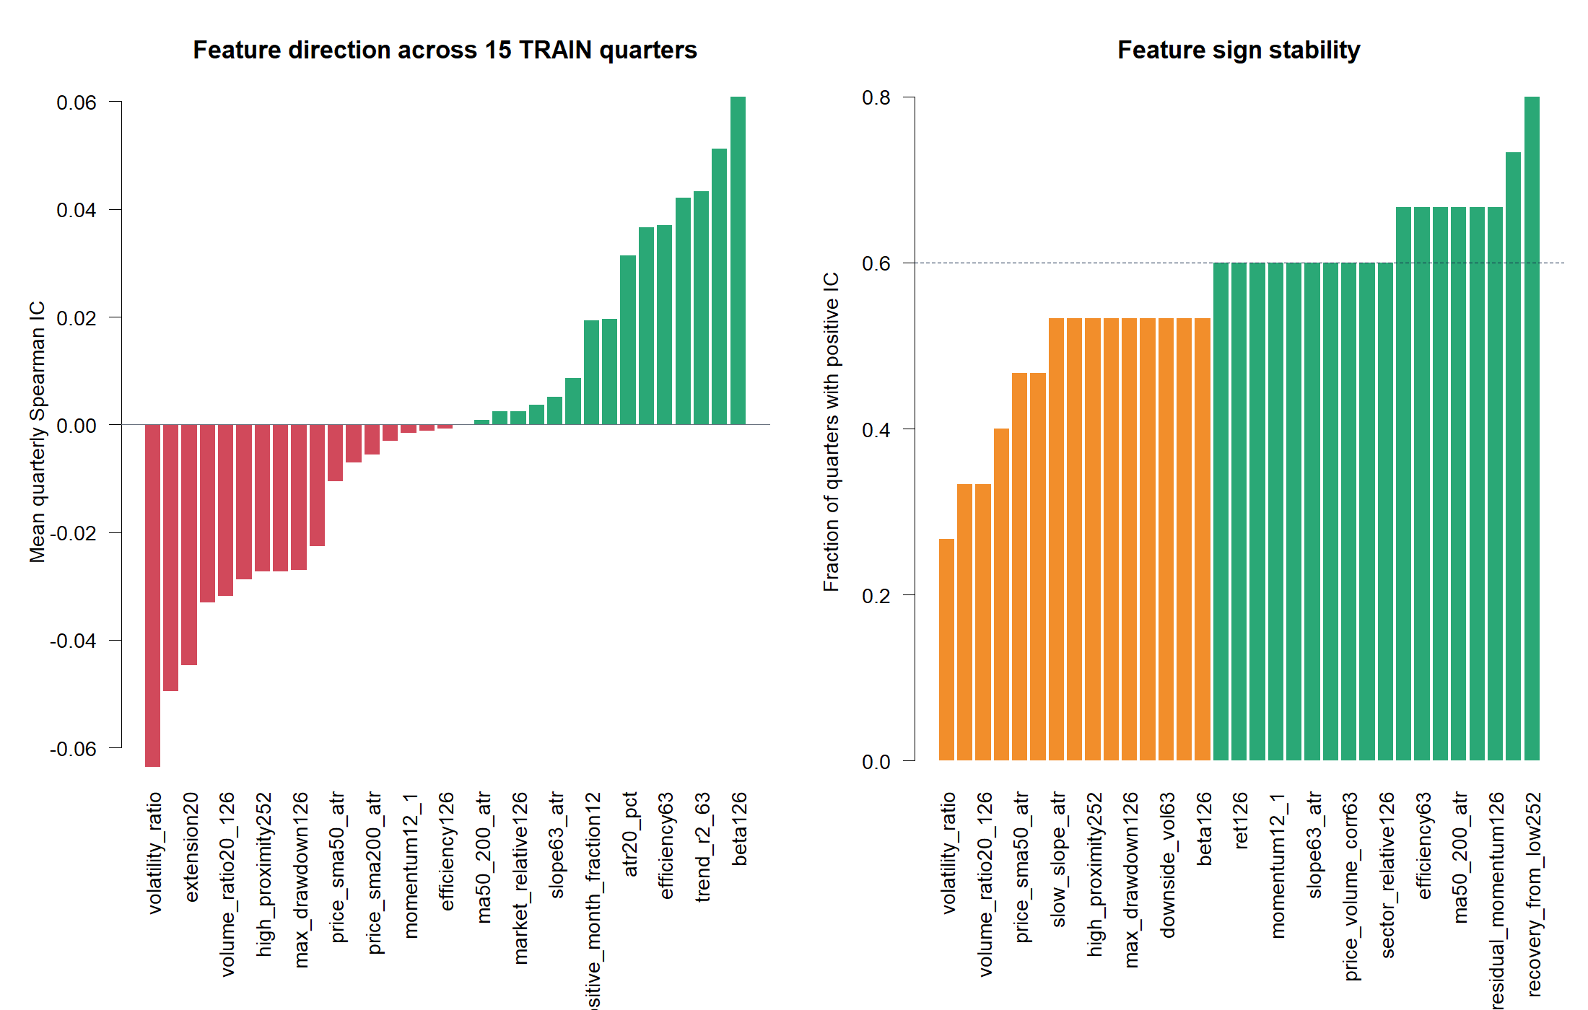
Pooled averages favored risk—not classic momentum
BETA · +0.061 MEAN IC Only 8 of 15 quarters were positive.
RECOVERY · 12 OF 15 POSITIVE But mean IC was only +0.037.
12–1 MOMENTUM · ~0 MEAN IC Sign frequency alone did not create magnitude.
5
Notes:
The feature scorecard is descriptive across all 15 TRAIN quarters. Beta had the largest mean IC, while recovery from the 252-session low had the highest positive-quarter fraction. Neither fact is sufficient for promotion.
[Sources]
- C:/Users/Franc/OneDrive/Documents/Francis/Peltata Project/Time-Series-Modeling-Gen5/runs/research_workbench/operator_hypothesis_lab/hyp_mom_04_2_feature_atlas_train_20260811/hyp_mom_04_2_feature_scorecard.csv
- C:/Users/Franc/OneDrive/Documents/Francis/Peltata Project/Time-Series-Modeling-Gen5/runs/research_workbench/operator_hypothesis_lab/hyp_mom_04_2_feature_atlas_train_20260811/visuals/feature_scorecard.png

Slide 6
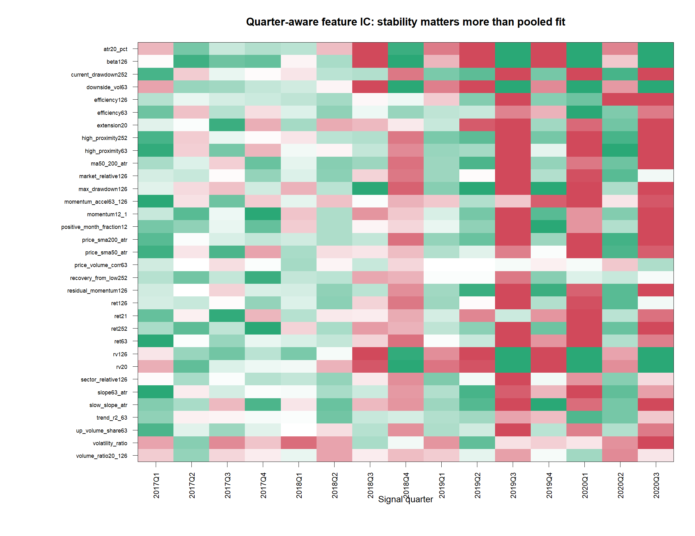
Feature direction changed with the market quarter
Green and red alternate within the same rows. Risk, trend and momentum relationships were episodic—not stable laws. That instability is invisible in one pooled scatter cloud.
15
21
independent market quarters
highly redundant feature pairs
6
Notes:
Each cell is one feature's Spearman rank correlation with next-quarter relative return in one signal quarter. The heatmap is clipped to ±0.25 for color readability, but the CSV retains exact values.
[Sources]
- C:/Users/Franc/OneDrive/Documents/Francis/Peltata Project/Time-Series-Modeling-Gen5/runs/research_workbench/operator_hypothesis_lab/hyp_mom_04_2_feature_atlas_train_20260811/hyp_mom_04_2_feature_quarterly_ic.csv
- C:/Users/Franc/OneDrive/Documents/Francis/Peltata Project/Time-Series-Modeling-Gen5/runs/research_workbench/operator_hypothesis_lab/hyp_mom_04_2_feature_atlas_train_20260811/hyp_mom_04_2_redundancy_pairs.csv
- C:/Users/Franc/OneDrive/Documents/Francis/Peltata Project/Time-Series-Modeling-Gen5/runs/research_workbench/operator_hypothesis_lab/hyp_mom_04_2_feature_atlas_train_20260811/visuals/feature_quarterly_ic_heatmap.png

Slide 7
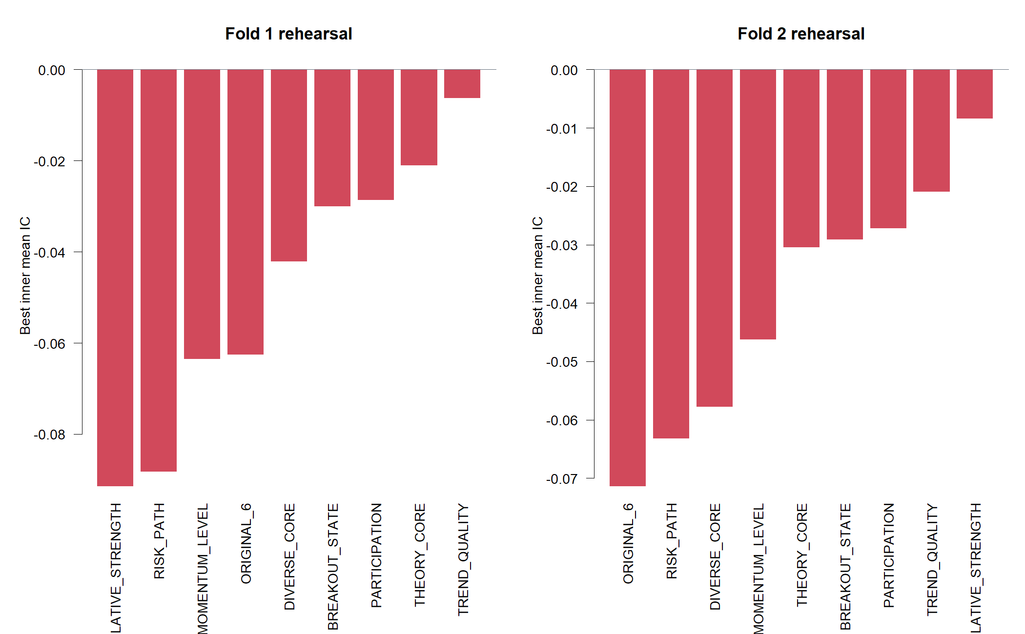
Every predefined basket rehearsed below zero
FOLD 1 Trend quality · λ 100 Best inner mean IC: –0.0063
FOLD 2 Relative strength · λ 10 Best inner mean IC: –0.0084
NO STABLE WINNER Changing basket + negative rehearsal = no promotion case
7
Notes:
The chart shows the best lambda for each frozen candidate in each outer rehearsal. Even the selected candidate was negative on average in the earlier inner folds. Selection still proceeds mechanically so the outer block can measure the whole procedure.
[Sources]
- C:/Users/Franc/OneDrive/Documents/Francis/Peltata Project/Time-Series-Modeling-Gen5/runs/research_workbench/operator_hypothesis_lab/hyp_mom_04_2_feature_atlas_train_20260811/hyp_mom_04_2_inner_summary.csv
- C:/Users/Franc/OneDrive/Documents/Francis/Peltata Project/Time-Series-Modeling-Gen5/runs/research_workbench/operator_hypothesis_lab/hyp_mom_04_2_feature_atlas_train_20260811/hyp_mom_04_2_outer_selections.csv
- C:/Users/Franc/OneDrive/Documents/Francis/Peltata Project/Time-Series-Modeling-Gen5/runs/research_workbench/operator_hypothesis_lab/hyp_mom_04_2_feature_atlas_train_20260811/visuals/predefined_basket_competition.png

Slide 8
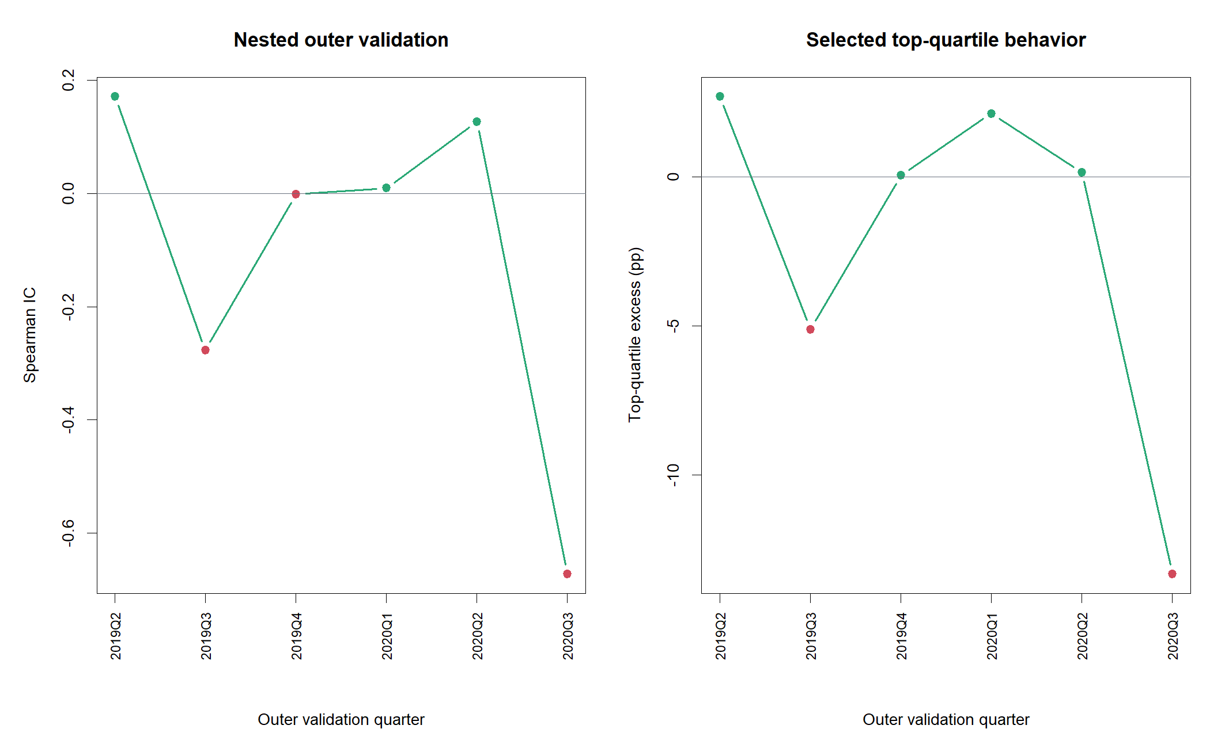
The nested procedure failed where transport mattered
Only 3 of 6 outer quarters had positive IC. 2020Q3 overwhelmed earlier gains: IC –0.673 and top-quartile excess –13.34 pp.
–0.107
–2.23 pp
mean outer IC
mean top-quartile excess
8
Notes:
The outer metrics concatenate the two untouched three-quarter validation blocks. The mean outer IC was -0.1071. Mean top-quartile relative return was -2.227 percentage points per quarter.
[Sources]
- C:/Users/Franc/OneDrive/Documents/Francis/Peltata Project/Time-Series-Modeling-Gen5/runs/research_workbench/operator_hypothesis_lab/hyp_mom_04_2_feature_atlas_train_20260811/hyp_mom_04_2_outer_metrics.csv
- C:/Users/Franc/OneDrive/Documents/Francis/Peltata Project/Time-Series-Modeling-Gen5/runs/research_workbench/operator_hypothesis_lab/hyp_mom_04_2_feature_atlas_train_20260811/visuals/nested_outer_validation.png

Slide 9
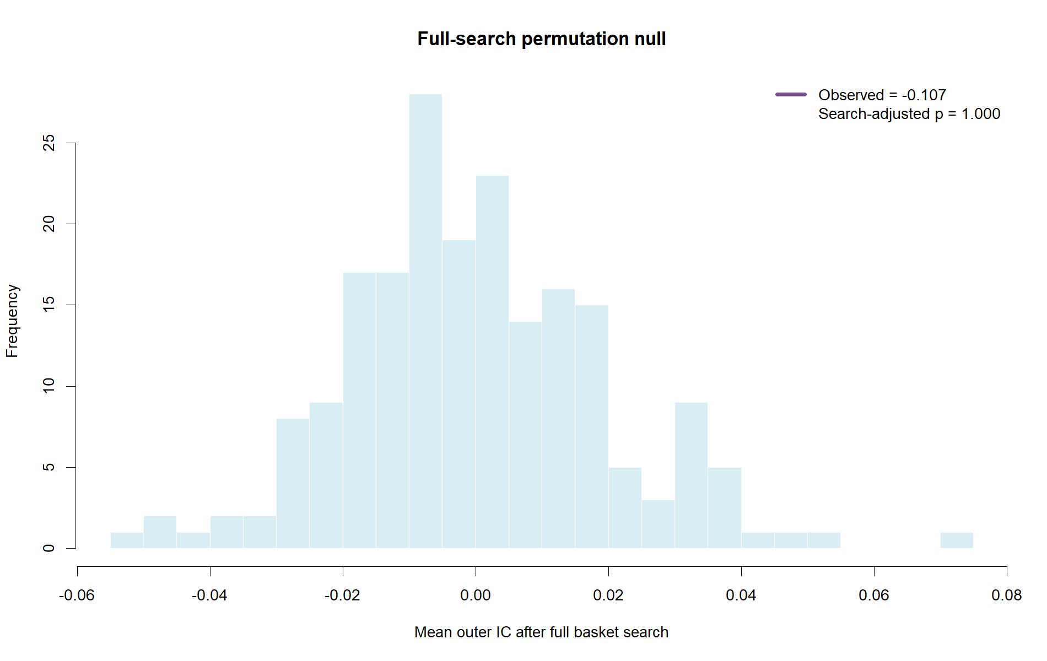
STOP before OOS: the search underperformed noise
The observed mean outer IC sat below every full-search permutation draw. Six of nine TRAIN gates failed. No feature family or basket earned access to reserved evidence. Useful next questions require a new frozen lane—not a rescue tweak.
1.000
0
search-adjusted p
OOS observations queried
9
Notes:
Each null draw shuffled the target within quarter and repeated basket and lambda selection before outer scoring. The observed statistic was -0.1071; every null draw was greater or equal, producing p=1.000. The authoritative status is STOP_TRAIN_GATES_FAILED_OOS_NOT_RUN.
[Sources]
- C:/Users/Franc/OneDrive/Documents/Francis/Peltata Project/Time-Series-Modeling-Gen5/runs/research_workbench/operator_hypothesis_lab/hyp_mom_04_2_feature_atlas_train_20260811/hyp_mom_04_2_full_search_permutation.csv
- C:/Users/Franc/OneDrive/Documents/Francis/Peltata Project/Time-Series-Modeling-Gen5/runs/research_workbench/operator_hypothesis_lab/hyp_mom_04_2_feature_atlas_train_20260811/hyp_mom_04_2_train_gates.csv
- C:/Users/Franc/OneDrive/Documents/Francis/Peltata Project/Time-Series-Modeling-Gen5/runs/research_workbench/operator_hypothesis_lab/hyp_mom_04_2_feature_atlas_train_20260811/status.txt
- C:/Users/Franc/OneDrive/Documents/Francis/Peltata Project/Time-Series-Modeling-Gen5/runs/research_workbench/operator_hypothesis_lab/hyp_mom_04_2_feature_atlas_train_20260811/visuals/full_search_permutation.png

