Slide 1
LIT-MR-06.1 | 30 JUL 2026
Buy-on-gap
intraday reversion
Chan's plain-English Chapter 4 rule, rebuilt around a signal we can actually observe before we trade.
Notes:
This deck treats Example 4.1 as a textbook exercise, then makes one necessary causal translation: the official open may finish the signal, but it cannot also be a fill obtained after observing that signal.
[Sources]
- C:/Users/Franc/OneDrive/Documents/Francis/Trading Literature/Algorithmic Trading - Winning Strategies and Their Rationale 2013.pdf — Example 4.1, printed pp. 93-96; PDF pp. 111-114
- C:/Users/Franc/OneDrive/Documents/Francis/Peltata Project/Time-Series-Modeling-Gen5/literature_studies/docs/GEN5_LIT_MR_06_1_CAUSAL_BUY_ON_GAP_POC_CONTRACT.md

Slide 2
Chan buys a sharp gap inside a positive trend
The rule asks for an unusually weak open, but only while price remains above a lagged moving average. It then ranks the deepest qualifying gaps.
GAP
TREND
RANK
Open below yesterday's low
by more than 1 × σ90
Current open remains above
the lagged 20-session MA
Buy up to 10 deepest gaps
Exit the same day at close
2
Notes:
Chan's code computes a 90-day standard deviation of close-to-close returns, compares the current open with the prior low, applies a 20-day moving-average filter, ranks the qualifying gaps, and holds to the close.
The source reports 8.7% APR and 1.5 Sharpe for May 11, 2006-April 24, 2012. It also discloses survivorship bias and excludes costs. Those figures are source context, not Gen5 authority.
[Sources]
- C:/Users/Franc/OneDrive/Documents/Francis/Trading Literature/Algorithmic Trading - Winning Strategies and Their Rationale 2013.pdf — printed pp. 93-95; PDF pp. 111-113
- C:/Users/Franc/OneDrive/Documents/Francis/Peltata Project/Time-Series-Modeling-Gen5/literature_studies/docs/GEN5_LITERATURE_SOURCE_LEDGER.md

Slide 3
Three lagged quantities define the daily candidate set
Every threshold is known at 09:31: prior low and closes come from completed sessions; the current input is only the official open.
g = O / L₋₁ − 1
g < −σ₉₀
O > MA₂₀
Overnight gap
Current open versus prior low
Volatility-scaled shock
σ uses 90 lagged close returns
Positive-trend filter
MA uses 20 prior closes
3
Notes:
The gap is g_i,t = O_i,t / L_i,t-1 - 1. Sigma90 is the standard deviation of the 90 close-to-close returns ending at t-1. MA20 is the mean of the 20 closes ending at t-1.
The phrase 'lagged' matters: neither today's close nor today's low can enter candidate formation.
[Sources]
- C:/Users/Franc/OneDrive/Documents/Francis/Trading Literature/Algorithmic Trading - Winning Strategies and Their Rationale 2013.pdf — printed pp. 93-94; PDF pp. 111-112
- C:/Users/Franc/OneDrive/Documents/Francis/Peltata Project/Time-Series-Modeling-Gen5/literature_studies/docs/GEN5_LIT_MR_06_1_CAUSAL_BUY_ON_GAP_POC_CONTRACT.md — Source proposition and primary causal translation

Slide 4
The official-open fill is not executable
The source fills at the same price that completes its signal. Gen5 preserves that curve only as a noncausal reference and delays the executable entry.
09:30
09:31
09:32
Official open forms
Signal is not yet complete
Observe completed first minute
Rank candidates
Use next minute-bar open
Commit closing-auction exit
4
Notes:
Chan explicitly notes that the official open cannot be known and then received as a subsequent fill. He suggests pre-open venue data as an approximation, while warning that venue prices can differ from the consolidated open.
Gen5's primary estimand waits until 09:31, then uses the 09:32 one-minute bar open. The adjusted daily close is a historical closing-print proxy under an assumed precommitted closing order.
[Sources]
- C:/Users/Franc/OneDrive/Documents/Francis/Trading Literature/Algorithmic Trading - Winning Strategies and Their Rationale 2013.pdf — printed pp. 95-96; PDF pp. 113-114
- https://docs.alpaca.markets/us/reference/stockbarsingle-1
- https://docs.alpaca.markets/docs/orders-at-alpaca
- C:/Users/Franc/OneDrive/Documents/Francis/Peltata Project/Time-Series-Modeling-Gen5/literature_studies/docs/GEN5_LIT_MR_06_1_CAUSAL_BUY_ON_GAP_POC_CONTRACT.md

Slide 5
Sparse signals keep their cash sleeves
Each selected stock receives one tenth of starting-day capital. Fewer than ten candidates means lower exposure—not hidden rescaling.
1 / 10
C / O₀₉:₃₂ − 1
10 / 20 bp
Fixed sleeve per stock
Unused sleeves remain cash
Causal gross return
Entry after signal; close exit
Primary / stress round trip
Deducted per selected stock
5
Notes:
Daily portfolio return equals one tenth times the sum of selected stock returns. The denominator remains ten even when only one stock qualifies.
This preserves Chan's cash-sleeve semantics and prevents a rare single-stock event from being represented as 100% invested.
[Sources]
- C:/Users/Franc/OneDrive/Documents/Francis/Trading Literature/Algorithmic Trading - Winning Strategies and Their Rationale 2013.pdf — printed p. 94; PDF p. 112
- C:/Users/Franc/OneDrive/Documents/Francis/Peltata Project/Time-Series-Modeling-Gen5/literature_studies/docs/GEN5_LIT_MR_06_1_CAUSAL_BUY_ON_GAP_POC_CONTRACT.md — Primary causal translation

Slide 6
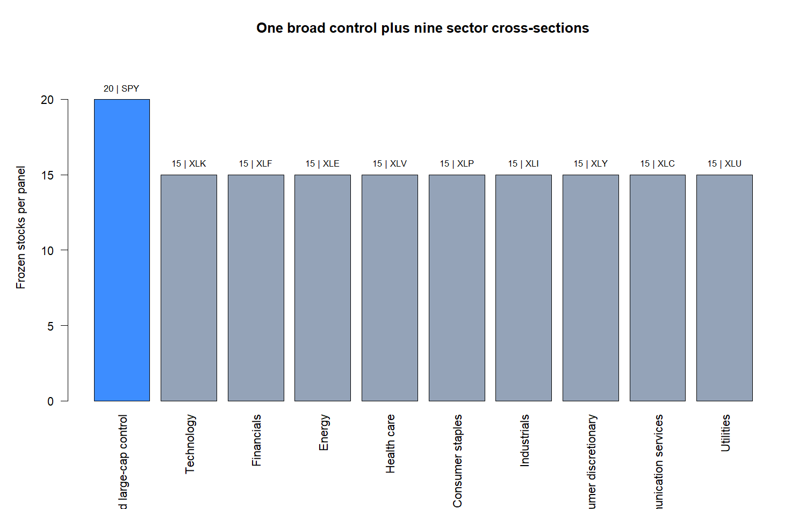
Ten panels test breadth—not ten independent ideas
The canonical broad panel keeps the source's cross-sectional spirit.
Nine sector panels ask whether a more homogeneous peer group changes the signal's behavior.
Membership is static and survivor-biased. Every panel is published; none may be swapped after outcomes.
6
Notes:
The atlas includes a 20-stock broad control and nine 15-stock sector panels: technology, financials, energy, health care, consumer staples, industrials, consumer discretionary, communication services, and utilities.
Current static survivors are not point-in-time index memberships. The atlas is a pedagogical breadth test and does not support a historical-index performance claim.
[Sources]
- C:/Users/Franc/OneDrive/Documents/Francis/Peltata Project/Time-Series-Modeling-Gen5/literature_studies/docs/GEN5_LIT_MR_06_1_CAUSAL_BUY_ON_GAP_POC_CONTRACT.md — Frozen atlas and interpretation boundary
- C:/Users/Franc/OneDrive/Documents/Francis/Peltata Project/Time-Series-Modeling-Gen5/runs/research_workbench/literature_grounded/lit_mr_06_1_buy_on_gap_20260730_v2/visuals/mr06_atlas_design.png — project-generated from the frozen registry

Slide 7
Eight gates separate mechanics, evidence, and tradability
A positive return is insufficient. The lane must first be causal and covered, then survive support, uncertainty, opportunity-cost, random-control, friction, and concentration tests.
G1–G2
G3–G7
G8
Integrity + timing
≥95% selected-entry coverage
Support + positive return
CI, benchmark, random control
Positive stress return
≤50% from one symbol
7
Notes:
Exact gates: (1) all integrity/timing checks; (2) at least 95% entry coverage; (3) at least 60 stock-events and 30 portfolio days; (4) positive primary-cost mean event return; (5) one-sided 90% block-bootstrap lower bound above zero; (6) positive matched-benchmark excess; (7) observed portfolio mean above random-control p90; (8) positive stress cumulative return and no more than 50% of positive gross P&L from one symbol.
The gates are Gen5 design, not claims from Chan.
[Sources]
- C:/Users/Franc/OneDrive/Documents/Francis/Peltata Project/Time-Series-Modeling-Gen5/literature_studies/docs/GEN5_LIT_MR_06_1_CAUSAL_BUY_ON_GAP_POC_CONTRACT.md — Eight TRAIN gates

Slide 8
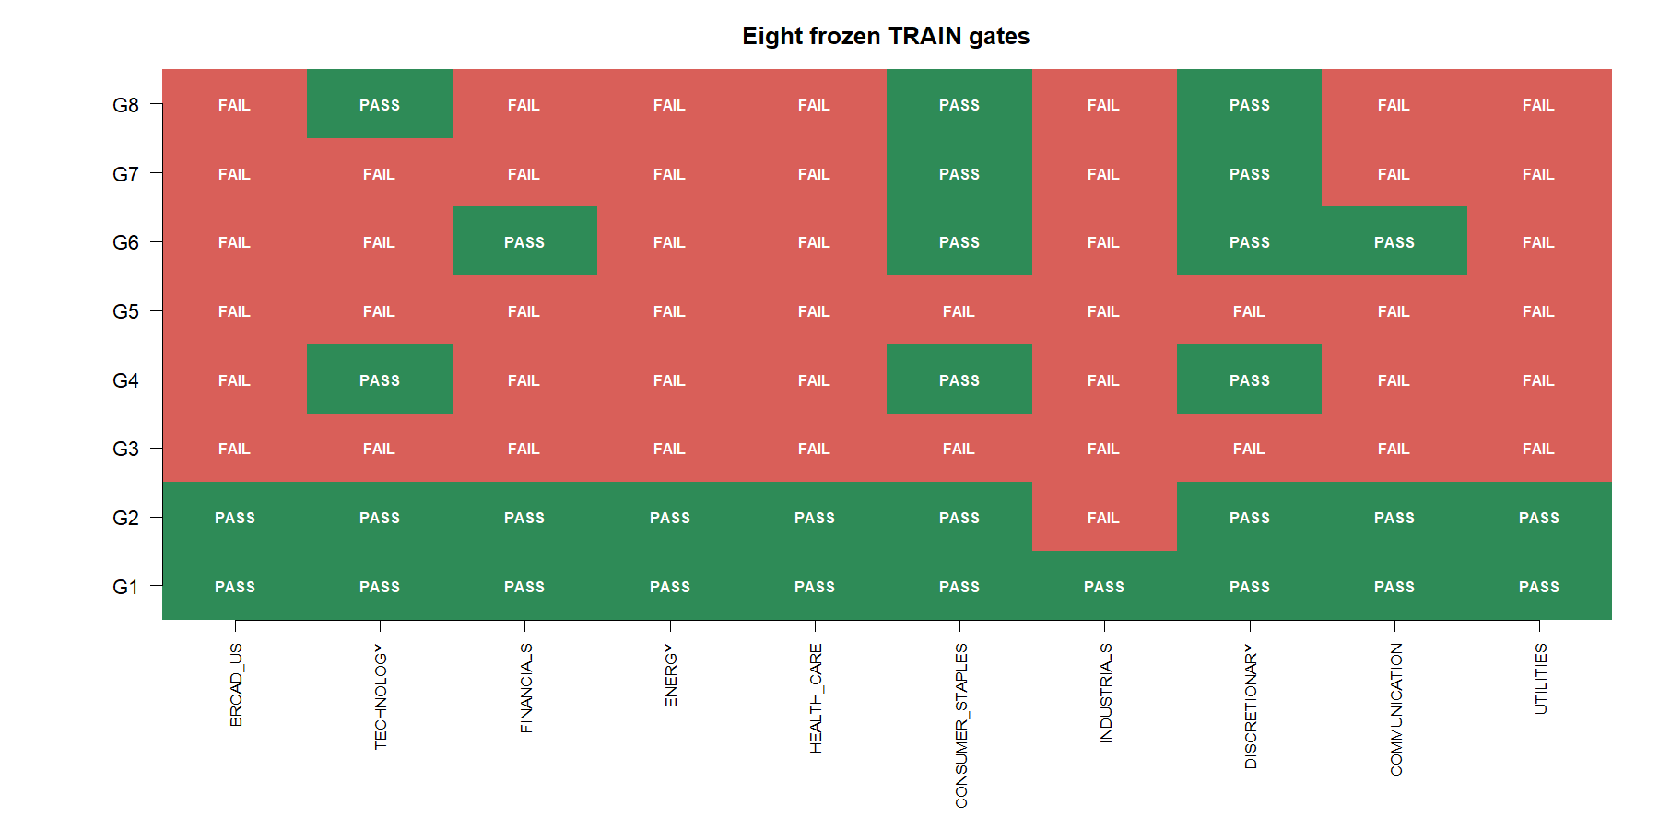
No panel earned all eight TRAIN gates
8
Notes:
All 145 frozen identities had at least 90% TRAIN daily coverage after the same-issuer FB-to-META alias correction. Nine panels had at least 95% selected-entry coverage; industrials had 91.7%.
Every panel failed the support gate. Consumer staples and discretionary were closest at six of eight, but both failed the uncertainty gate.
[Sources]
- C:/Users/Franc/OneDrive/Documents/Francis/Peltata Project/Time-Series-Modeling-Gen5/runs/research_workbench/literature_grounded/lit_mr_06_1_buy_on_gap_20260730_v2/atlas_gates.csv
- C:/Users/Franc/OneDrive/Documents/Francis/Peltata Project/Time-Series-Modeling-Gen5/runs/research_workbench/literature_grounded/lit_mr_06_1_buy_on_gap_20260730_v2/daily_coverage.csv
- C:/Users/Franc/OneDrive/Documents/Francis/Peltata Project/Time-Series-Modeling-Gen5/runs/research_workbench/literature_grounded/lit_mr_06_1_buy_on_gap_20260730_v2/visuals/mr06_gate_heatmap.png

Slide 9
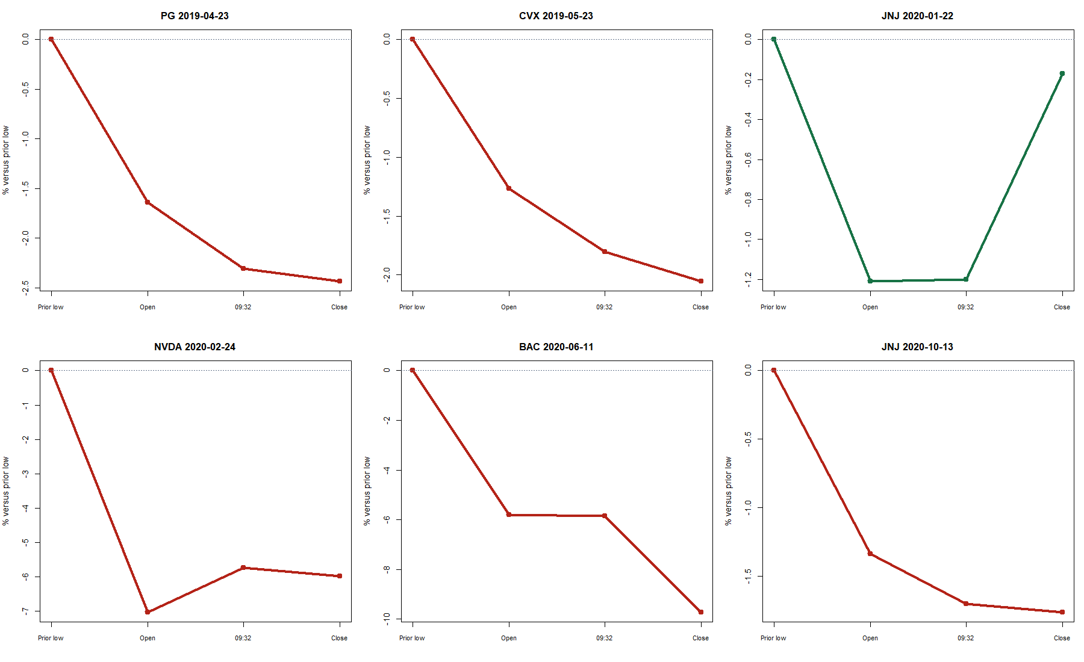
The same rule can rebound—or keep falling
9
Notes:
Each panel normalizes four prices to the prior low: prior low, current open, 09:32 entry, and close. Green paths recovered after entry; red paths continued lower.
This tape is the most direct explanation of the 42.1% canonical directional accuracy: the negative gap did not reliably mark the day's low.
[Sources]
- C:/Users/Franc/OneDrive/Documents/Francis/Peltata Project/Time-Series-Modeling-Gen5/runs/research_workbench/literature_grounded/lit_mr_06_1_buy_on_gap_20260730_v2/selected_event_tape.csv
- C:/Users/Franc/OneDrive/Documents/Francis/Peltata Project/Time-Series-Modeling-Gen5/runs/research_workbench/literature_grounded/lit_mr_06_1_buy_on_gap_20260730_v2/visuals/mr06_representative_events.png

Slide 10
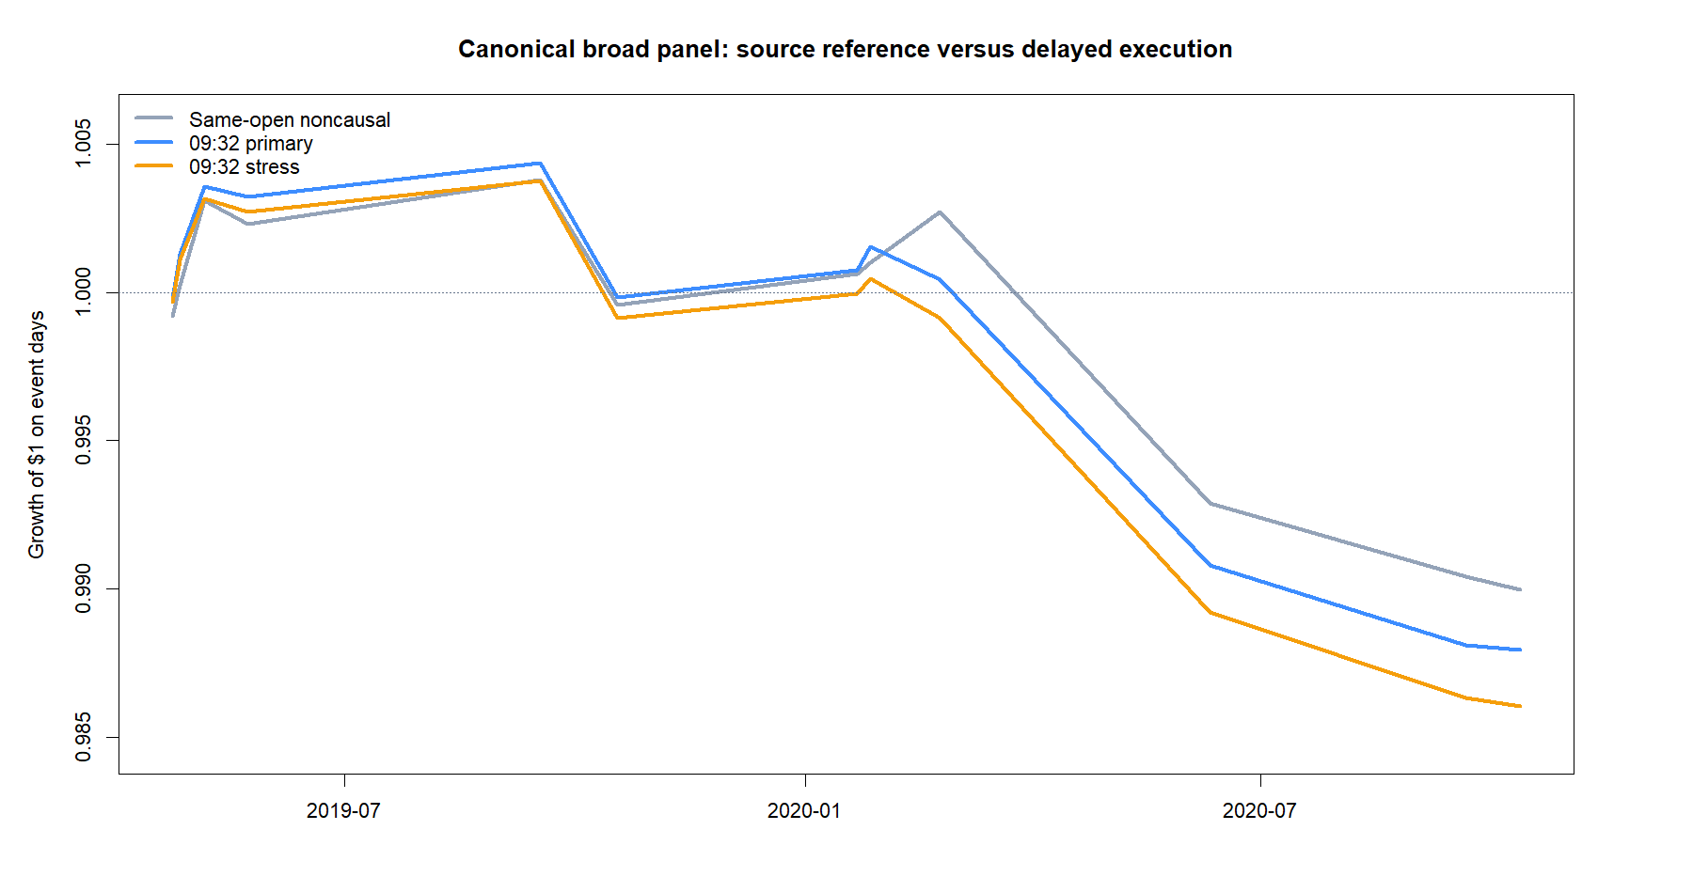
Delayed entry weakens the canonical broad panel
10
Notes:
Canonical broad panel: 19 stock-events across 12 portfolio days; 2/8 gates. Primary cumulative return was -1.21%, stress -1.39%, maximum drawdown -1.64%, and stock-event hit/up-down accuracy 42.1%.
The source-style same-open diagnostic was also negative here. The delayed curve is the only one eligible for gates.
[Sources]
- C:/Users/Franc/OneDrive/Documents/Francis/Peltata Project/Time-Series-Modeling-Gen5/runs/research_workbench/literature_grounded/lit_mr_06_1_buy_on_gap_20260730_v2/atlas_summary.csv
- C:/Users/Franc/OneDrive/Documents/Francis/Peltata Project/Time-Series-Modeling-Gen5/runs/research_workbench/literature_grounded/lit_mr_06_1_buy_on_gap_20260730_v2/portfolio_day_tape.csv
- C:/Users/Franc/OneDrive/Documents/Francis/Peltata Project/Time-Series-Modeling-Gen5/runs/research_workbench/literature_grounded/lit_mr_06_1_buy_on_gap_20260730_v2/visuals/mr06_canonical_equity.png

Slide 11
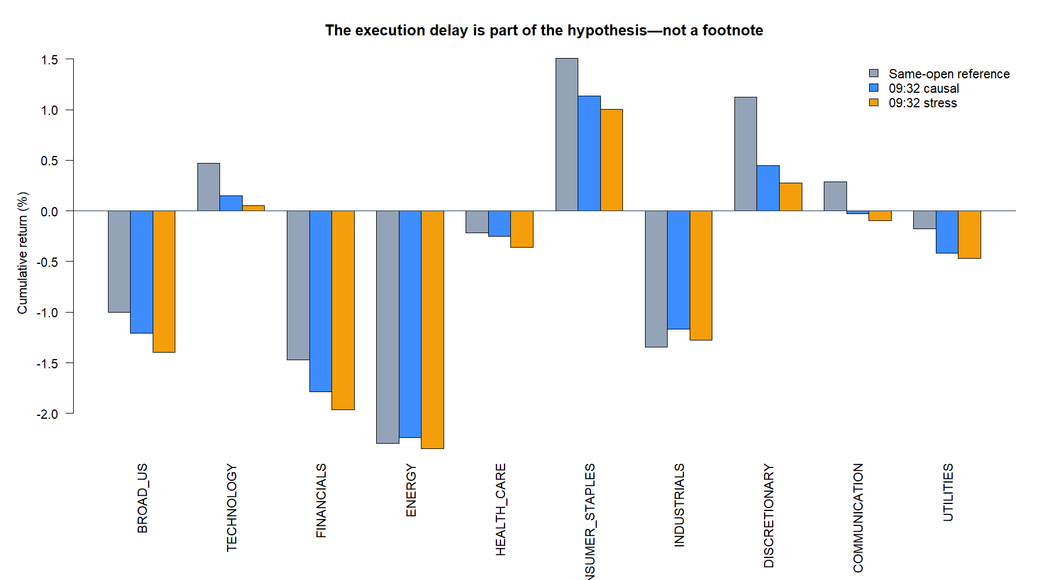
Execution timing materially changes several panels
11
Notes:
The gray series buys at the same official open that forms the signal and is labeled NONCAUSAL_REFERENCE. Blue and amber use the delayed 09:32 entry with 10/20 bp round-trip costs.
The comparison shows why timing belongs in the hypothesis definition. Consumer staples and discretionary remained positive after the delay, while the canonical broad panel did not.
[Sources]
- C:/Users/Franc/OneDrive/Documents/Francis/Peltata Project/Time-Series-Modeling-Gen5/runs/research_workbench/literature_grounded/lit_mr_06_1_buy_on_gap_20260730_v2/atlas_summary.csv
- C:/Users/Franc/OneDrive/Documents/Francis/Peltata Project/Time-Series-Modeling-Gen5/runs/research_workbench/literature_grounded/lit_mr_06_1_buy_on_gap_20260730_v2/visuals/mr06_source_vs_causal.png
- C:/Users/Franc/OneDrive/Documents/Francis/Peltata Project/Time-Series-Modeling-Gen5/literature_studies/docs/GEN5_LIT_MR_06_1_CAUSAL_BUY_ON_GAP_POC_CONTRACT.md

Slide 12
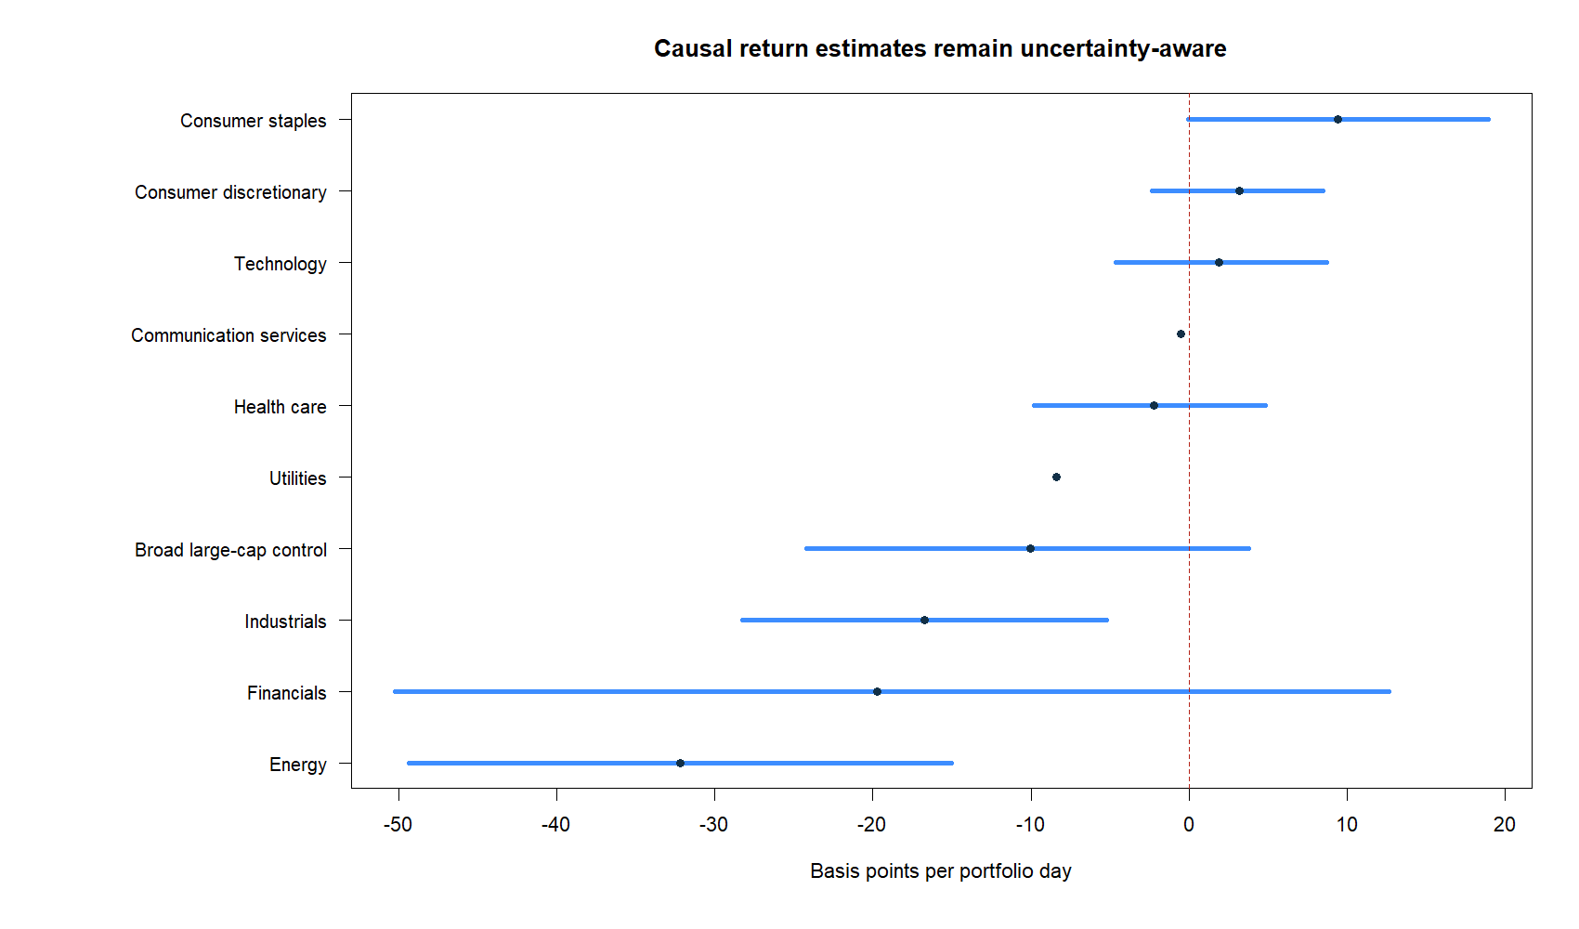
Positive point estimates never cleared uncertainty
Consumer staples and discretionary stayed positive after the delay.
But their one-sided 90% lower bounds remained below zero.
Every panel also missed support: only 5–19 stock-events and 5–14 portfolio days.
12
Notes:
Consumer staples and discretionary had positive primary-cost point estimates. Their one-sided 90% lower bounds were -0.07 bp and -2.34 bp per portfolio day, respectively.
Small sample support is the dominant limitation: panels produced only 5-19 stock-events and 5-14 portfolio days against frozen minima of 60 and 30.
[Sources]
- C:/Users/Franc/OneDrive/Documents/Francis/Peltata Project/Time-Series-Modeling-Gen5/runs/research_workbench/literature_grounded/lit_mr_06_1_buy_on_gap_20260730_v2/atlas_summary.csv
- C:/Users/Franc/OneDrive/Documents/Francis/Peltata Project/Time-Series-Modeling-Gen5/runs/research_workbench/literature_grounded/lit_mr_06_1_buy_on_gap_20260730_v2/visuals/mr06_return_intervals.png

Slide 13
The closest panels are observations—not nominees
Staples and discretionary looked economically better than the other panels, but both lacked support and a positive uncertainty bound. DEVELOPMENT therefore stays sealed.
6 / 8
6 / 8
0 / 10
Consumer staples
+1.13% primary; q05 −0.07 bp
Consumer discretionary
+0.45% primary; q05 −2.34 bp
Full TRAIN passes
No 2021–2023 outcome query
13
Notes:
Consumer staples passed integrity, coverage, positive mean event return, positive benchmark excess, random-control separation, and friction/concentration. It failed support and the bootstrap lower-bound gate.
Consumer discretionary passed the same six gates and failed the same two.
Calling either a winner would turn a predeclared conjunction into an ex-post weighted score.
[Sources]
- C:/Users/Franc/OneDrive/Documents/Francis/Peltata Project/Time-Series-Modeling-Gen5/runs/research_workbench/literature_grounded/lit_mr_06_1_buy_on_gap_20260730_v2/atlas_summary.csv
- C:/Users/Franc/OneDrive/Documents/Francis/Peltata Project/Time-Series-Modeling-Gen5/runs/research_workbench/literature_grounded/lit_mr_06_1_buy_on_gap_20260730_v2/atlas_gates.csv

Slide 14
TEXTBOOK EXERCISE COMPLETE | DEVELOPMENT REMAINS SEALED
We learned the rule.
We did not promote a strategy.
The causal implementation is now concrete and reusable. Preserve the 0/10 TRAIN result, keep DEVELOPMENT sealed, and move to the next textbook exercise without rescue tuning.
Notes:
The educational result is substantial: the plain-English rule, lagged statistics, official-open problem, sparse sleeve accounting, delayed minute entry, controls, directional accuracy, and gate logic are now operational.
The research conclusion is narrower: no frozen panel earned OOS. This does not prove that every buy-on-gap strategy is false; it says this specific source-faithful causal translation did not earn promotion in this TRAIN packet.
[Sources]
- C:/Users/Franc/OneDrive/Documents/Francis/Peltata Project/Time-Series-Modeling-Gen5/runs/research_workbench/literature_grounded/lit_mr_06_1_buy_on_gap_20260730_v2/lit_mr_06_1_train_report.md
- C:/Users/Franc/OneDrive/Documents/Francis/Peltata Project/Time-Series-Modeling-Gen5/literature_studies/docs/GEN5_LIT_MR_06_1_CAUSAL_BUY_ON_GAP_POC_CONTRACT.md

