Slide 1
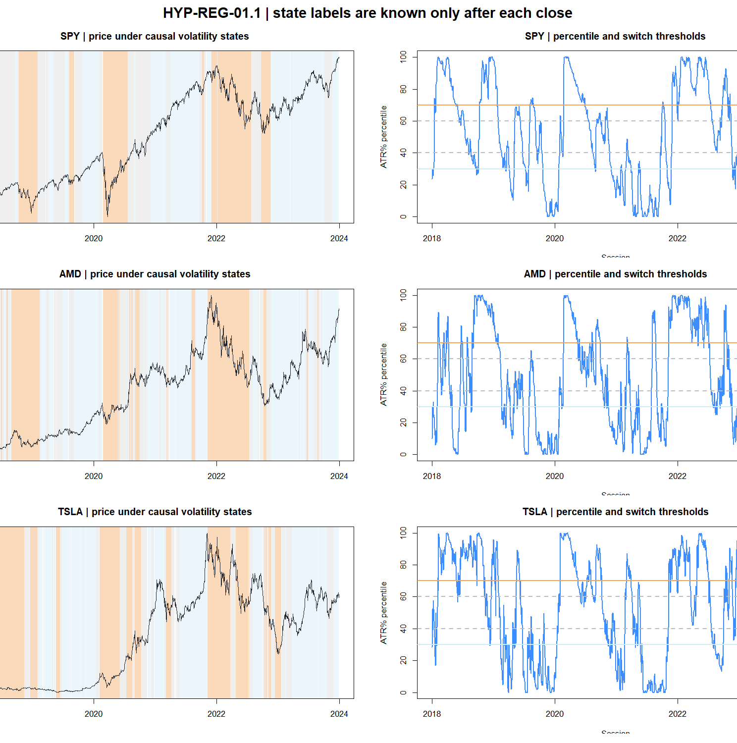
HYP-REG-01.1
ATR% can classify tomorrow’s movement magnitude
A strategy-independent volatility-regime diagnostic across 26 assets · 2018–2023 development evidence
No P&L · no direction · no 2024+ data
1
Notes:
Open by separating the sensor from any trading rule. This deck asks only whether the state label forecasts directionless future movement.
[Sources]
- docs/GEN5_HYP_REG_01_1_ATR_PERCENT_VOLATILITY_POC_CONTRACT.md
- C:/Users/Franc/OneDrive/Documents/Francis/Peltata Project/Time-Series-Modeling-Gen5/runs/research_workbench/operator_hypothesis_lab/hyp_reg_01_1_atr_percent_20260814/hyp_reg_01_1_daily_state_ledger.csv

Slide 2
We validated a sensor—not a trading rule
AUTHORITY BOUNDARY
What the filter may learn
What remains prohibited
How large today’s range is relative to the asset’s own history
Strategy return, P&L, Sharpe, drawdown, or hit rate
Entry, exit, allocation, leverage, or strategy switching
Whether that magnitude tends to persist for 1, 5, or 20 sessions
Any observation on or after 2024-01-02
Whether low, medium, and high labels remain stable across assets
Threshold or asset selection after seeing outcomes
2
Notes:
Stress that a coherent volatility forecast is necessary but not sufficient for a useful trading gate.
[Sources]
- docs/GEN5_HYP_REG_01_1_ATR_PERCENT_VOLATILITY_POC_CONTRACT.md

Slide 3
Every label is causal and every target starts tomorrow
MEASUREMENT CHAIN
1 · Capture the range
2 · Normalize the scale
3 · Rank against history
TRₜ = max(H−L, |H−Cₜ₋₁|, |L−Cₜ₋₁|)
ATR%ₜ = 100 × ATR₁₄,ₜ / Cₜ
Pₜ = rank of ATR%ₜ vs prior 252
True Range preserves both the session’s high–low movement and overnight gaps.
Dividing by close removes dollar-price scale; Wilder smoothing reduces one-bar noise.
The current observation is excluded. Low and high therefore mean relative to the asset itself.
t−252 … t−1
close t
t+1
…
t+h
STATE KNOWN
DIRECTIONLESS TARGET
3
Notes:
Explain that a state dated t is not allowed to explain movement inside t. The first target observation is t+1.
[Sources]
- docs/GEN5_HYP_REG_01_1_ATR_PERCENT_VOLATILITY_POC_CONTRACT.md

Slide 4
Hysteresis turns a noisy percentile into durable states
OPERATIONAL SWITCH
LOW
Enter LOW below 30; leave only above 40
30
40
Remain MEDIUM between transition zones
MEDIUM
60
70
Enter HIGH above 70; leave only below 60
HIGH
The gap between entry and exit thresholds behaves like a thermostat: it prevents boundary chatter without rewriting history.
4
Notes:
Use the thermostat analogy. Hysteresis is a deterministic state machine, not a retroactive smoother.
[Sources]
- docs/GEN5_HYP_REG_01_1_ATR_PERCENT_VOLATILITY_POC_CONTRACT.md

Slide 5
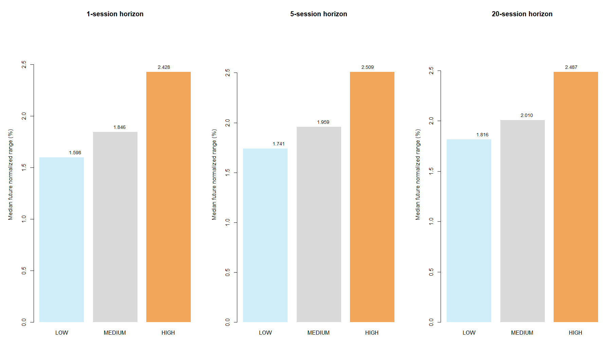
Future movement is ordered low → medium → high
PRIMARY PREDICTIVE RESULT
0.409 → 0.514
median Spearman from H1 to H20
26 / 26
assets: HIGH range > LOW range
Non-overlapping samples preserve the horizon’s effective observation count.
5
Notes:
The state ordering is not a return claim. The bars show subsequent normalized True Range only.
[Sources]
- C:/Users/Franc/OneDrive/Documents/Francis/Peltata Project/Time-Series-Modeling-Gen5/runs/research_workbench/operator_hypothesis_lab/hyp_reg_01_1_atr_percent_20260814/hyp_reg_01_1_panel_state_prediction.csv
- C:/Users/Franc/OneDrive/Documents/Francis/Peltata Project/Time-Series-Modeling-Gen5/runs/research_workbench/operator_hypothesis_lab/hyp_reg_01_1_atr_percent_20260814/hyp_reg_01_1_panel_predictive_summary.csv

Slide 6
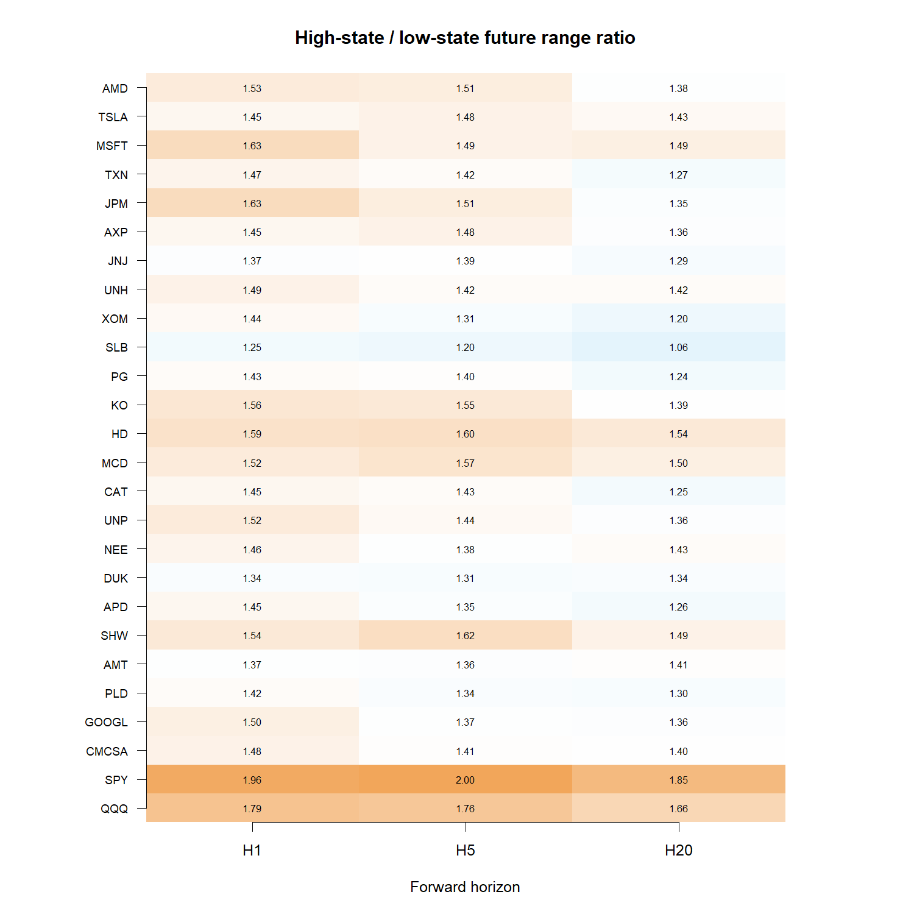
The separation transports across all 26 assets
CROSS-ASSET PORTABILITY
Every cell exceeds 1.0
The effect is not confined to AMD, TSLA, SPY, or another high-beta subgroup.
Observed range: 1.06× to 2.00×
6
Notes:
The heatmap uses non-overlapping observations. Ratios compare each asset with itself, so price scale and baseline volatility do not create the separation.
[Sources]
- C:/Users/Franc/OneDrive/Documents/Francis/Peltata Project/Time-Series-Modeling-Gen5/runs/research_workbench/operator_hypothesis_lab/hyp_reg_01_1_atr_percent_20260814/hyp_reg_01_1_asset_state_prediction.csv

Slide 7
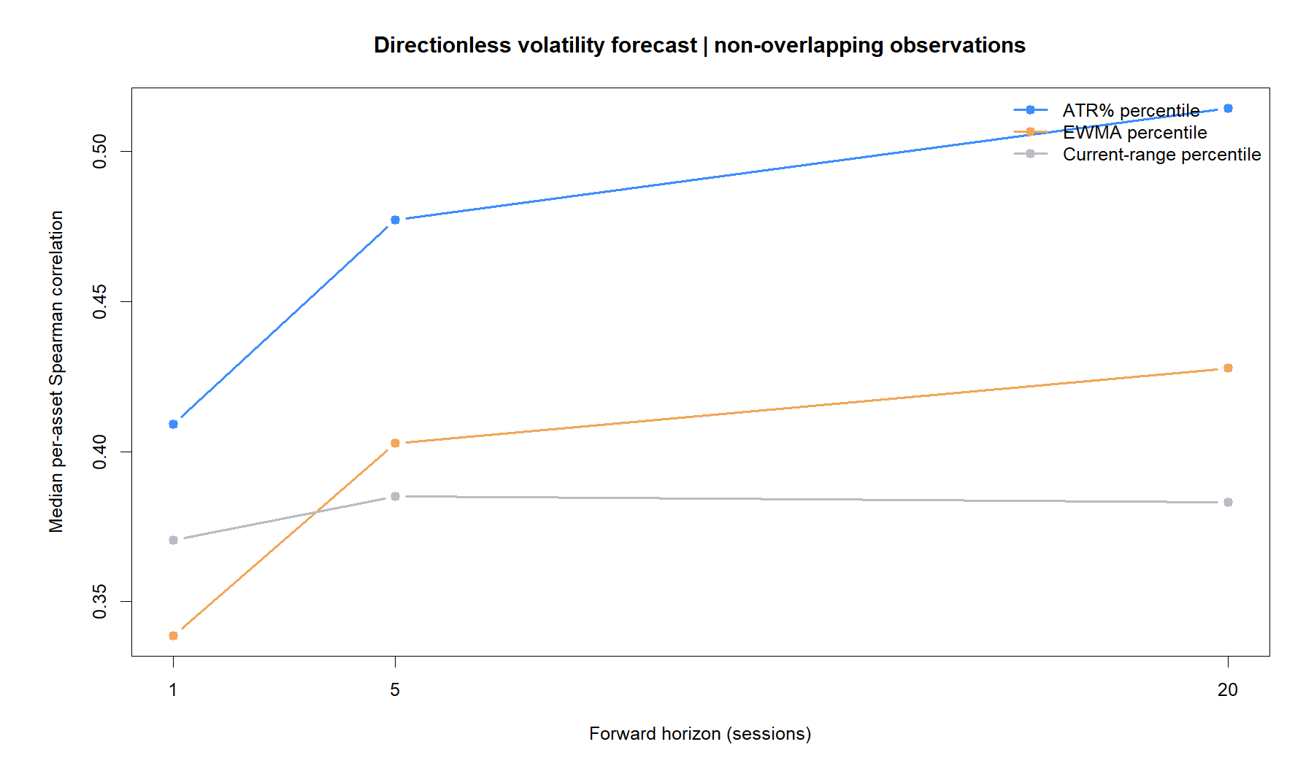
ATR% carries more persistence than both fixed benchmarks
BENCHMARK DISCIPLINE
ATR% leads at H1, H5, and H20
At H20:
0.514 ATR%
0.428 EWMA
0.383 current range
The benchmarks were frozen before execution; this is comparison, not a winner-search loop.
7
Notes:
ATR smoothing adds information beyond one recent range observation. EWMA remains a benchmark rather than an alternate promoted filter.
[Sources]
- C:/Users/Franc/OneDrive/Documents/Francis/Peltata Project/Time-Series-Modeling-Gen5/runs/research_workbench/operator_hypothesis_lab/hyp_reg_01_1_atr_percent_20260814/hyp_reg_01_1_panel_predictive_summary.csv

Slide 8
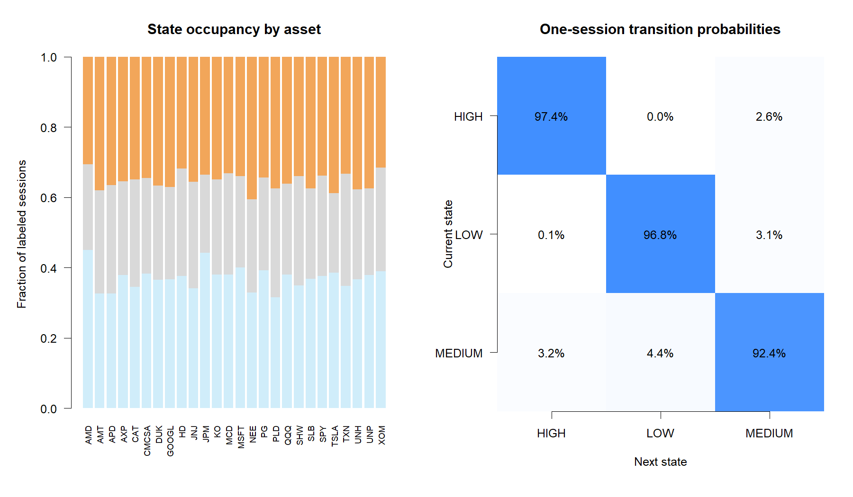
States persist without becoming permanent
SWITCH QUALITY
10.4
median switches per year
11 sessions
median state-run duration
2.5%
one-session reversal share
Colors: LOW light blue · MEDIUM gray · HIGH orange
8
Notes:
High diagonal transition probabilities and low one-session reversal share show that hysteresis suppresses chatter while preserving switches.
[Sources]
- C:/Users/Franc/OneDrive/Documents/Francis/Peltata Project/Time-Series-Modeling-Gen5/runs/research_workbench/operator_hypothesis_lab/hyp_reg_01_1_atr_percent_20260814/hyp_reg_01_1_state_transitions.csv
- C:/Users/Franc/OneDrive/Documents/Francis/Peltata Project/Time-Series-Modeling-Gen5/runs/research_workbench/operator_hypothesis_lab/hyp_reg_01_1_atr_percent_20260814/hyp_reg_01_1_panel_state_dynamics.csv

Slide 9
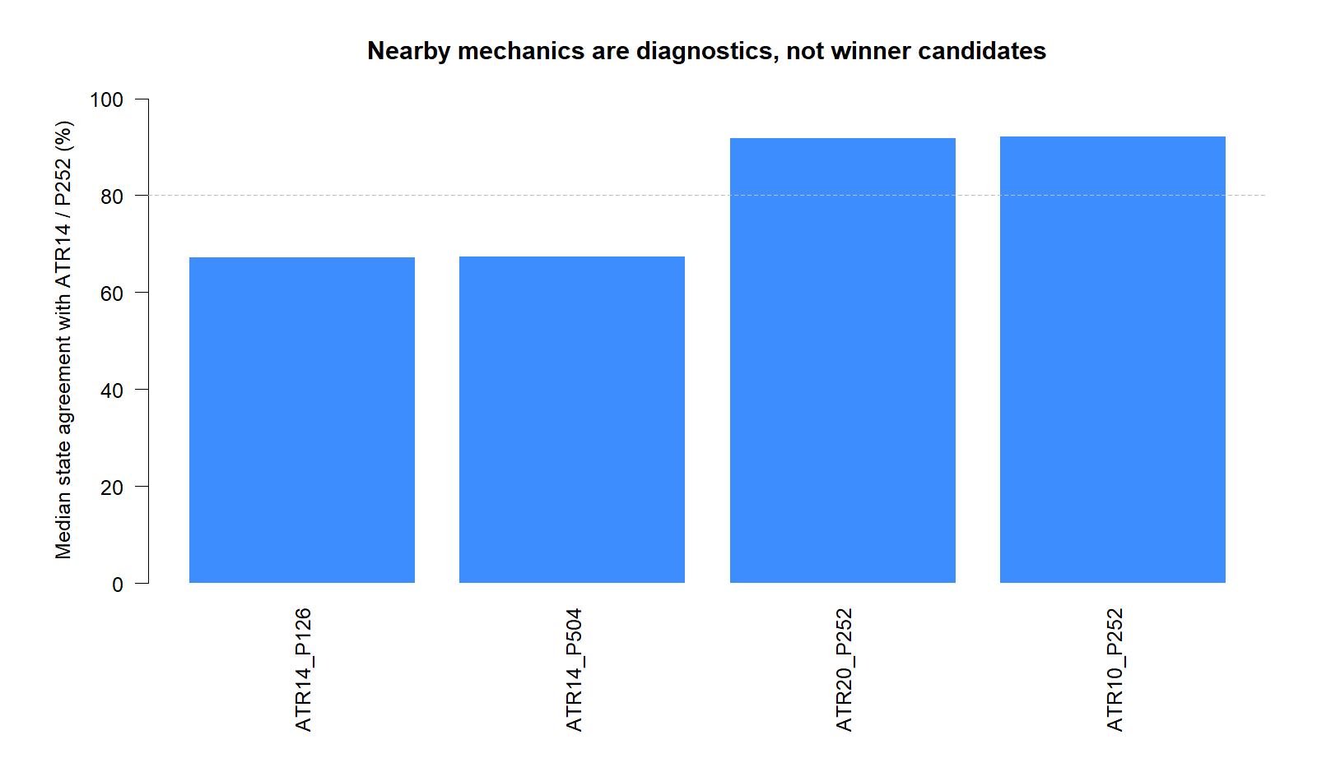
ATR length is robust; historical memory is consequential
SENSITIVITY WITHOUT SELECTION
≈92% agreement
ATR10 and ATR20 retain nearly all primary labels.
≈67% agreement
A 126- or 504-session memory changes about one-third of states. Keep P252 frozen in any overlay.
9
Notes:
This is the principal caution from the diagnostic: volatility state is relative to a chosen historical memory. Do not later choose that memory using P&L.
[Sources]
- C:/Users/Franc/OneDrive/Documents/Francis/Peltata Project/Time-Series-Modeling-Gen5/runs/research_workbench/operator_hypothesis_lab/hyp_reg_01_1_atr_percent_20260814/hyp_reg_01_1_sensitivity_panel.csv

Slide 10
Pass the classifier; stop before strategy gating
DECISION BOUNDARY
PASS
The next question must be frozen separately
ATR% percentile predicts future directionless range, transports across all 26 assets, and creates stable states.
Candidate overlay
Suppress new momentum entries in LOW; allow MEDIUM and HIGH; leave existing exits unchanged.
Required controls: unchanged strategy + exposure-matched placebo. No threshold, memory, asset, or state-combination search.
2024+ remains sealed
10
Notes:
Close with the distinction between diagnostic promotion and trading promotion. The classifier passed; strategy utility remains untested.
[Sources]
- operator_hypothesis_lab/docs/HYP_REG_01_1_ATR_PERCENT_VOLATILITY_RESULTS.md
- docs/GEN5_HYP_REG_01_1_ATR_PERCENT_VOLATILITY_POC_CONTRACT.md

