Slide 1
EDGE PROMOTION
From return geometry to candidate edge
Promotion huddle and falsification roadmap
Incremental timing • frozen hypotheses • untouched transport • executable decisions
1
Notes:
This deck begins a new research volume. The 123-slide descriptive microscope is frozen; subsequent huddles and promotion slices belong here. The opening question is whether any broad descriptive behavior predicts a better executable decision in untouched data.
[Sources]
- Codex thread 01a0226e-2fa2-7222-a6d9-79ab971ac616 (2026-08-27), operator–Codex huddle immediately following the full-vocabulary atlas closeout.
- operator_hypothesis_lab/presentations/tsla_descriptive_microscope_evidence.pptx, especially slides 105 and 114–123.
- operator_hypothesis_lab/docs/RETURN_GEOMETRY_WIDE_ATLAS_2018_2023.md
[/Sources]

Slide 2
PROMOTION BOUNDARY
The atlas has earned behavior—not edge
FOUND
Broad conditional return geometry
129 instruments; many states
LEARNS
Scale and filters discriminate
rebound, continuation, exhaustion
DOES NOT EARN
A prospective trading rule
timing and baseline unresolved
Where we stand
The atlas is a discovery surface. Promotion begins only after one hypothesis is frozen before new data.
Return geometry | promotion huddle | 2026-08-27
2
Notes:
Cross-asset breadth and a broad plateau make the behavior worth investigating, but all cells remain discovery evidence because the same historical period informed the atlas and our attention. A candidate must be stated prospectively before later data are opened.
[Sources]
- Codex thread 01a0226e-2fa2-7222-a6d9-79ab971ac616 (2026-08-27), operator–Codex huddle immediately following the full-vocabulary atlas closeout.
- operator_hypothesis_lab/presentations/tsla_descriptive_microscope_evidence.pptx, especially slides 105 and 114–123.
- operator_hypothesis_lab/docs/RETURN_GEOMETRY_WIDE_ATLAS_2018_2023.md
[/Sources]

Slide 3
NESTED WINDOWS
An early rebound echoes through longer cumulative windows
DAYS 1–10
Rebound occurs once
example: rally in sessions 6–10
DAYS 1–20
The same rebound remains inside
plus sessions 11–20
DAYS 1–100
The same rebound still remains inside
plus sessions 11–100
Nested-window consequence
A rally ending by day 10 can influence every cumulative forward cell whose horizon is at least 10 sessions.
Return geometry | cumulative versus incremental timing
3
Notes:
Cumulative future returns are nested: R(1:100) = R(1:10) + R(11:100). If the signal is related only to R(1:10), that covariance is still carried inside R(1:20), R(1:50), and R(1:100). Later independent noise may attenuate the correlation, but it does not mechanically erase the early contribution. This is why an early 5–10-session rebound can remain visible at 100.
[Sources]
- Codex thread 01a0226e-2fa2-7222-a6d9-79ab971ac616 (2026-08-27), operator–Codex huddle immediately following the full-vocabulary atlas closeout.
- operator_hypothesis_lab/presentations/tsla_descriptive_microscope_evidence.pptx, especially slides 105 and 114–123.
[/Sources]

Slide 4
INCREMENTAL TIMING
Incremental blocks reveal when the return arrives
CUMULATIVE
R(1:100)
contains every earlier block
INCREMENTAL
R(1:5), R(6:10), …
each interval measured once
FALSIFIES DURATION
Only early blocks respond
the long plateau is an echo
Promotion condition
If later blocks retain conditional excess return, the signal has genuine duration rather than inherited history.
Return geometry | first recommended falsification slice
4
Notes:
Recommended blocks for the first anatomy pass: sessions 1–5, 6–10, 11–20, 21–40, 41–60, and 61–100 after the signal anchor. The first purpose is descriptive falsification of duration, not parameter selection or a trading backtest.
[Sources]
- Codex thread 01a0226e-2fa2-7222-a6d9-79ab971ac616 (2026-08-27), operator–Codex huddle immediately following the full-vocabulary atlas closeout.
- operator_hypothesis_lab/presentations/tsla_descriptive_microscope_evidence.pptx, especially slides 105 and 114–123.
- operator_hypothesis_lab/docs/OWN_ASSET_RETURN_GEOMETRY_WORKFLOW_ROADMAP.md
[/Sources]

Slide 5
ACTIONABILITY
A genuine 100-session effect can be actionable
YES—IF
New excess return keeps accruing
not merely an embedded early rebound
TIME SCALE
Roughly four to five months
a medium-term tactical position
STILL TEST
Net value versus the baseline
risk, costs, and opportunity cost
Important distinction
A long horizon is not disqualifying. Weak conditional improvement—or permanent market exposure—is.
Return geometry | medium-term interpretation
5
Notes:
If later non-overlapping blocks continue to earn conditional return beyond the unconditional and state-only baselines, a 100-session holding concept is potentially actionable. It would be a medium-term tactical trade, not a swing trade. Actionability still depends on execution timing, drawdown, capital efficiency, turnover, and whether the rule meaningfully differs from always being long.
[Sources]
- Codex thread 01a0226e-2fa2-7222-a6d9-79ab971ac616 (2026-08-27), operator–Codex huddle immediately following the full-vocabulary atlas closeout.
[/Sources]

Slide 6
BASELINES
A long-horizon rule must beat the right baseline
DRIFT
Unconditional future return
would the asset rise anyway?
STATE
State-only future return
does prior loss add information?
EXPOSURE
Matched long exposure
do repeated signals become buy-and-hold?
Executable edge
Conditional net return must improve the decision after next-open timing, overlap, costs, and capital use.
Return geometry | economic falsification
6
Notes:
A daily signal with a 100-session holding period can generate many overlapping positions and near-continuous market exposure. Compare it with unconditional drift, the same regime without the prior-loss condition, and matched long exposure. Data-snooping controls become relevant once variants are compared or performance is ranked.
[Sources]
- Codex thread 01a0226e-2fa2-7222-a6d9-79ab971ac616 (2026-08-27), operator–Codex huddle immediately following the full-vocabulary atlas closeout.
- Halbert White (2000), A Reality Check for Data Snooping, https://doi.org/10.1111/1468-0262.00152
- Bailey et al., The Probability of Backtest Overfitting, https://www.davidhbailey.com/dhbpapers/backtest-prob.pdf
- Bailey and López de Prado, The Deflated Sharpe Ratio, https://papers.ssrn.com/sol3/papers.cfm?abstract_id=2460551
[/Sources]

Slide 7
PROMOTION LADDER
Promotion happens one frozen gate at a time
BEHAVIOR
Describe the complete surface
complete in the closed deck
CANDIDATE
Freeze signal, target, and failure rule
next research gate
EDGE
Untouched net decision improvement
later—not yet earned
Recommended next slice
Use the original 20-session prior anchor and decompose future returns before opening post-2023 data.
Return geometry | next research volume
7
Notes:
The promotion ladder is behavior → candidate signal → predictive signal → tradeable edge → deployable system. This introductory deck stops at the candidate-design gate. The next technical slice should preserve the original 20-session prior anchor and measure non-overlapping future blocks under the pre-existing filters and baselines.
[Sources]
- Codex thread 01a0226e-2fa2-7222-a6d9-79ab971ac616 (2026-08-27), operator–Codex huddle immediately following the full-vocabulary atlas closeout.
- operator_hypothesis_lab/docs/RETURN_GEOMETRY_WIDE_ATLAS_2018_2023.md
- operator_hypothesis_lab/docs/OWN_ASSET_RETURN_GEOMETRY_WORKFLOW_ROADMAP.md
[/Sources]

Slide 8
FROZEN MICROSCOPE
One narrow slice asks when the rebound arrives
ANCHOR
20 prior sessions
negative cumulative log return
STATE
Signed ER20 down
known at the anchor
FUTURE
Six disjoint blocks
sessions 1 through 100
Primary surface
88 full-history stocks, equal-sector weighted. All 129 assets remain diagnostic; post-2023 stays sealed.
Return geometry | incremental forward decomposition
8
Notes:
This slide freezes the only outcome subset under the microscope. The primary state is signed ER20 DOWN_TREND at a 20-session negative-prior anchor. The 88-stock GICS core forms the equal-sector headline; other cohorts cannot alter it.
[Sources]
- Codex thread 01a0226e-2fa2-7222-a6d9-79ab971ac616 (2026-08-27), operator-authorized incremental forward-return decomposition slice.
- runs/research_workbench/operator_hypothesis_lab/return_geometry_incremental_forward_decomposition_20260827/run_spec.csv
- operator_hypothesis_lab/docs/RETURN_GEOMETRY_EDGE_PROMOTION_HUDDLE.md
[/Sources]

Slide 9
MEASUREMENT CONTRACT
Every block uses the same historical anchors
COMMON SAMPLE
Complete 100-session path
prevents block-to-block sample drift
INCREMENTAL
1–5 / 6–10 / … / 61–100
six blocks sum exactly to R(1:100)
COMPARE
Cumulative + drift
one unfiltered-loss comparator
Frozen rule
Duration survives only if at least 2 of 3 late blocks retain negative sector breadth and positive drift-adjusted return.
Return geometry | common-sample timing test
9
Notes:
All blocks are evaluated on anchors that have the full subsequent 100 sessions available. The construction audit verifies that the six incremental returns sum to R(1:100) with maximum absolute error below 7e-16 and reproduces shared cumulative cells below 6e-16.
[Sources]
- Codex thread 01a0226e-2fa2-7222-a6d9-79ab971ac616 (2026-08-27), operator-authorized incremental forward-return decomposition slice.
- runs/research_workbench/operator_hypothesis_lab/return_geometry_incremental_forward_decomposition_20260827/run_spec.csv
- runs/research_workbench/operator_hypothesis_lab/return_geometry_incremental_forward_decomposition_20260827/decomposition_checks.csv
[/Sources]

Slide 10
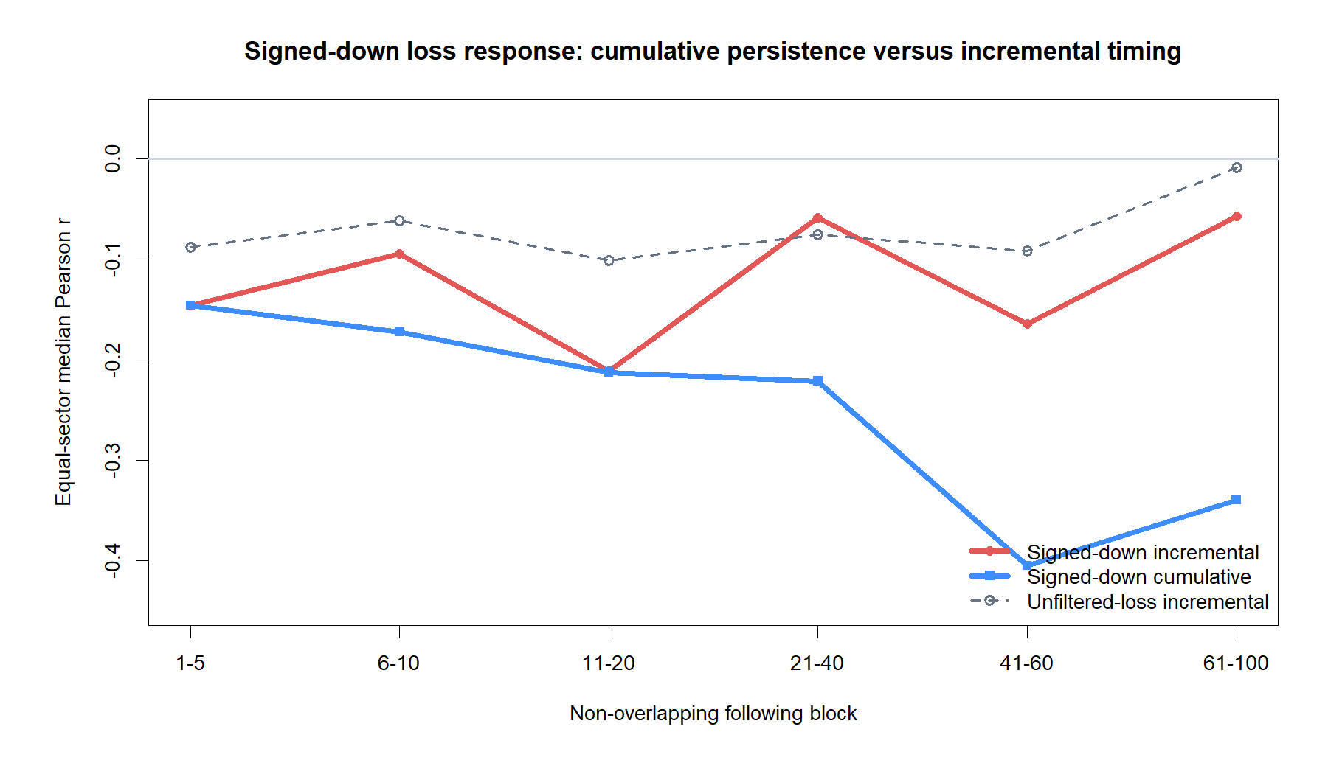
TIMING RESULT
Cumulative strength hides a non-uniform response
Return geometry | equal-sector timing
10
Notes:
The cumulative line remains strongly negative because it carries earlier blocks. The incremental line shows where new covariance arrives: it is negative in every block, but its strength is uneven. The 41-60 block is especially distinct; the 61-100 block is weak and the unfiltered-loss comparator is near zero there.
[Sources]
- Codex thread 01a0226e-2fa2-7222-a6d9-79ab971ac616 (2026-08-27), operator-authorized incremental forward-return decomposition slice.
- runs/research_workbench/operator_hypothesis_lab/return_geometry_incremental_forward_decomposition_20260827/equal_sector_block_summary.csv
- runs/research_workbench/operator_hypothesis_lab/return_geometry_incremental_forward_decomposition_20260827/report.md
- runs/research_workbench/operator_hypothesis_lab/return_geometry_incremental_forward_decomposition_20260827/visuals/cumulative_vs_incremental_correlation.png
[/Sources]

Slide 11
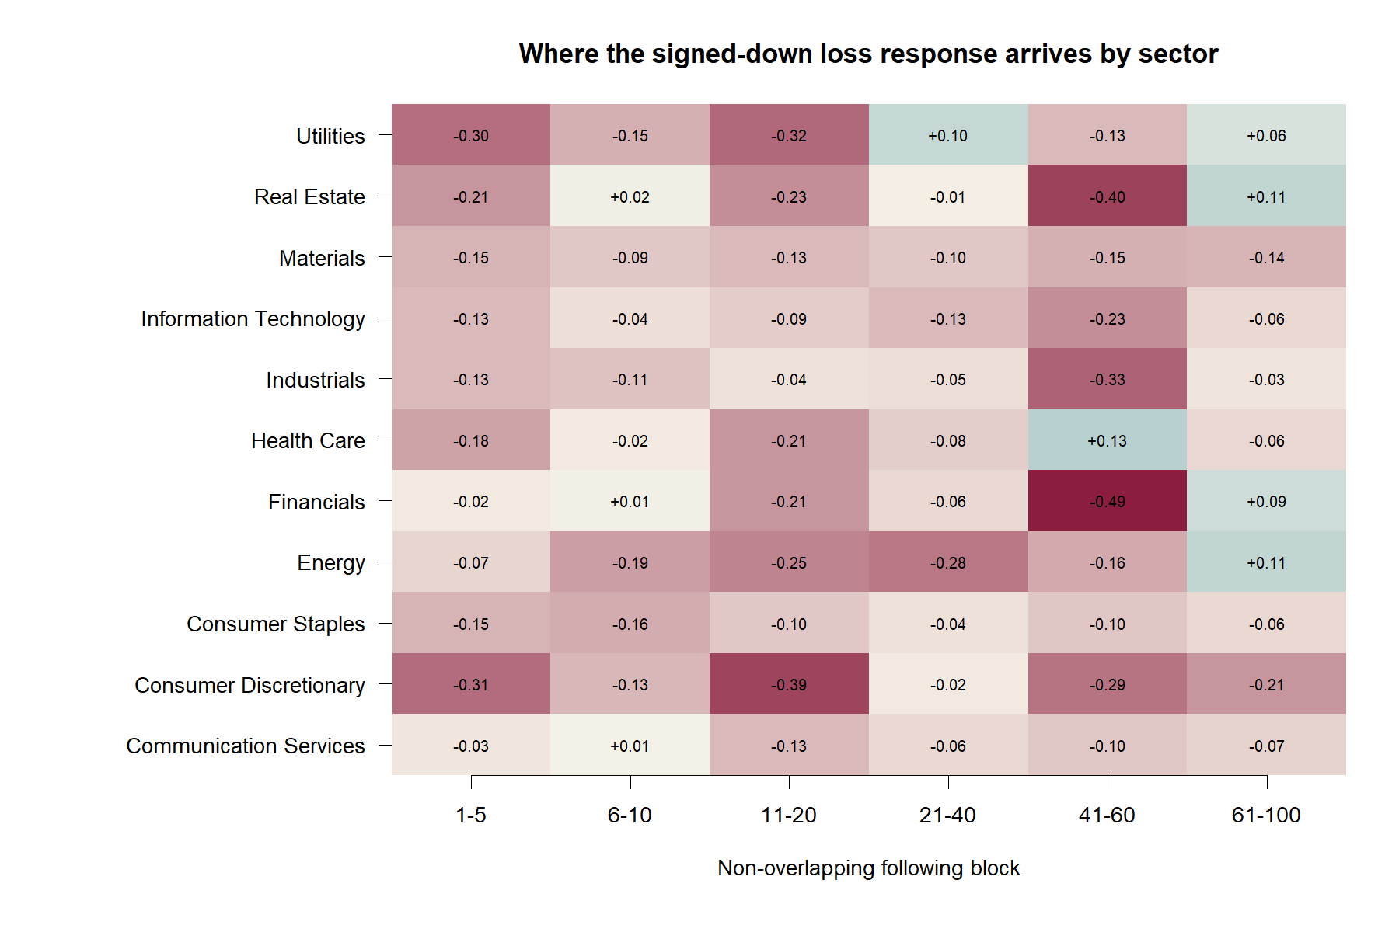
SECTOR BREADTH
The response stays broad through sessions 41–60
Return geometry | sector timing map
11
Notes:
Ten of 11 sector medians are negative in both 21-40 and 41-60. Breadth falls to 7 of 11 in 61-100, where Utilities, Real Estate, Financials, and Energy turn positive. This is broad morphology with real heterogeneity, not a universal asset law.
[Sources]
- Codex thread 01a0226e-2fa2-7222-a6d9-79ab971ac616 (2026-08-27), operator-authorized incremental forward-return decomposition slice.
- runs/research_workbench/operator_hypothesis_lab/return_geometry_incremental_forward_decomposition_20260827/core_sector_block_summary.csv
- runs/research_workbench/operator_hypothesis_lab/return_geometry_incremental_forward_decomposition_20260827/equal_sector_block_summary.csv
- runs/research_workbench/operator_hypothesis_lab/return_geometry_incremental_forward_decomposition_20260827/visuals/incremental_sector_heatmap.png
[/Sources]

Slide 12
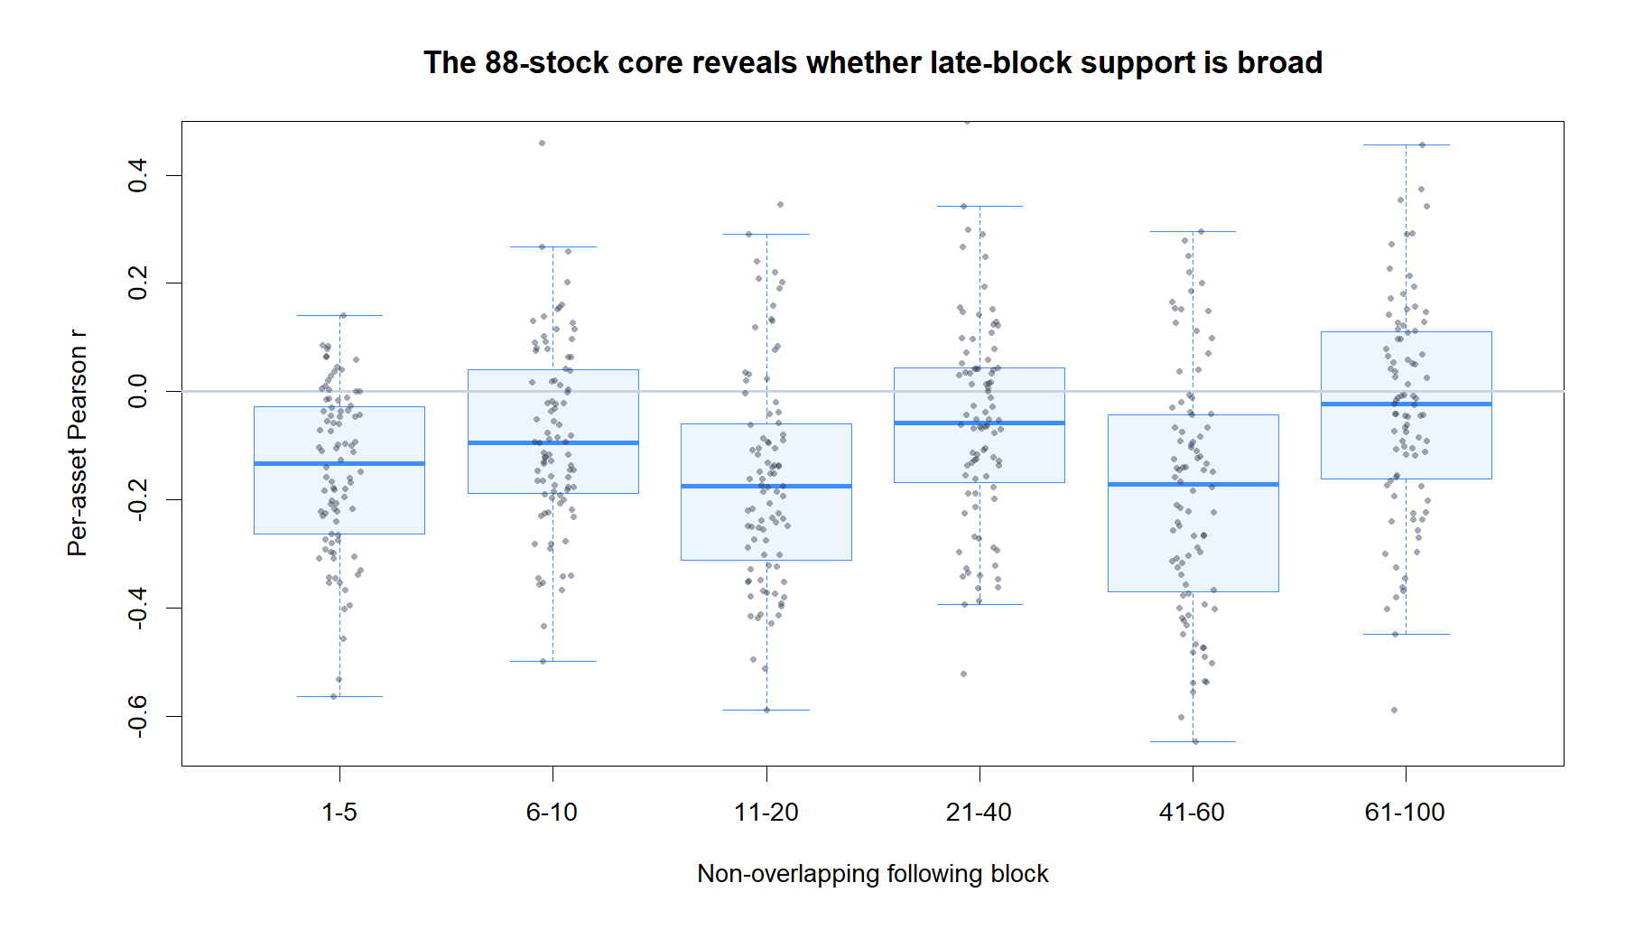
CROSS-ASSET SHAPE
Late support is broad—but visibly heterogeneous
Return geometry | 88-stock core distribution
12
Notes:
The asset distributions show why the equal-sector median should not be read as a universal prediction. The median is negative through 41-60, while individual assets span both signs. The 61-100 median approaches zero and its interquartile range crosses well into positive territory.
[Sources]
- Codex thread 01a0226e-2fa2-7222-a6d9-79ab971ac616 (2026-08-27), operator-authorized incremental forward-return decomposition slice.
- runs/research_workbench/operator_hypothesis_lab/return_geometry_incremental_forward_decomposition_20260827/asset_block_metrics.csv
- runs/research_workbench/operator_hypothesis_lab/return_geometry_incremental_forward_decomposition_20260827/equal_sector_block_summary.csv
- runs/research_workbench/operator_hypothesis_lab/return_geometry_incremental_forward_decomposition_20260827/visuals/incremental_asset_distribution.png
[/Sources]

Slide 13
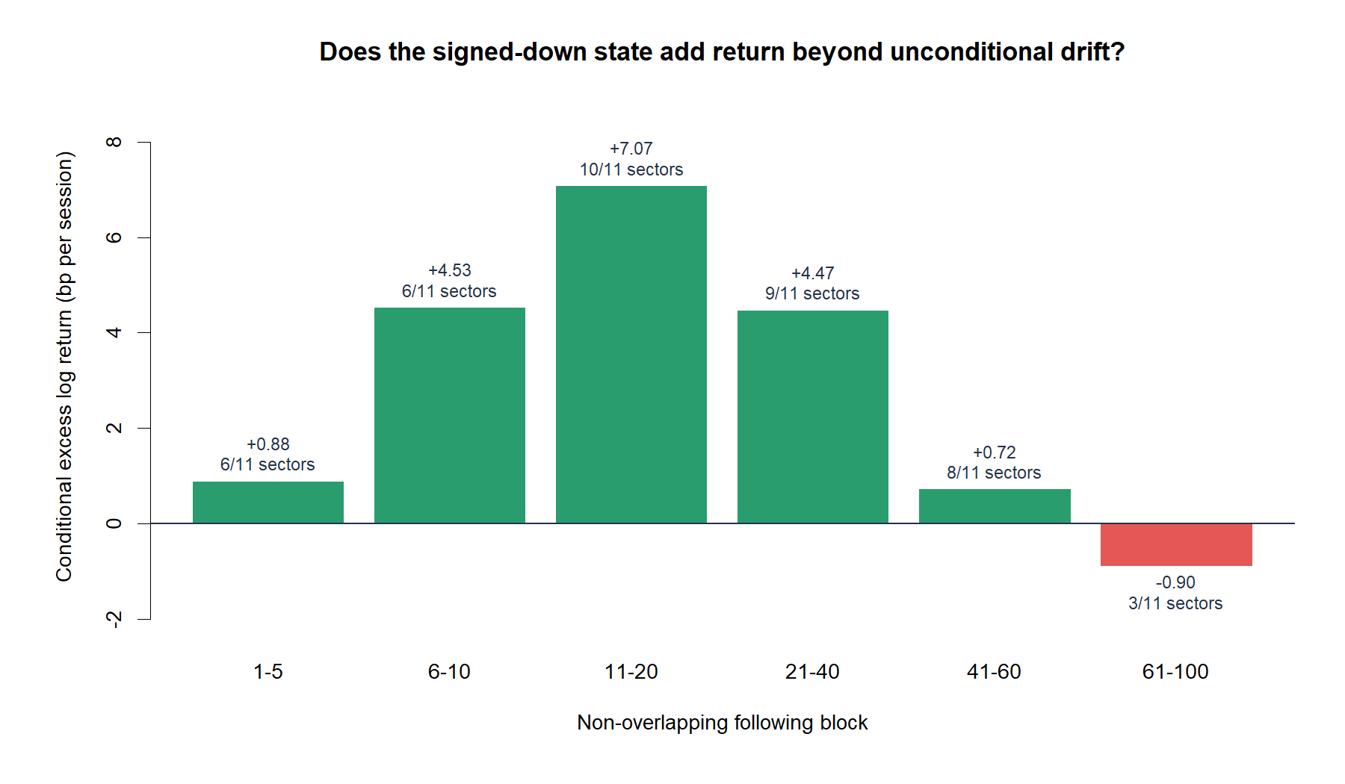
DRIFT-ADJUSTED ACCRUAL
Return advantage fades after session 60
Return geometry | conditional minus unconditional drift
13
Notes:
Drift-adjusted return is positive from sessions 1 through 60, peaking at 7.07 bp per session in 11-20 and remaining 4.47 bp in 21-40. It falls to 0.72 bp in 41-60 and turns negative at -0.90 bp in 61-100; only 3 of 11 sector medians remain positive in that final block. This is descriptive and not cost-, overlap-, or path-adjusted.
[Sources]
- Codex thread 01a0226e-2fa2-7222-a6d9-79ab971ac616 (2026-08-27), operator-authorized incremental forward-return decomposition slice.
- runs/research_workbench/operator_hypothesis_lab/return_geometry_incremental_forward_decomposition_20260827/equal_sector_block_summary.csv
- runs/research_workbench/operator_hypothesis_lab/return_geometry_incremental_forward_decomposition_20260827/report.md
- runs/research_workbench/operator_hypothesis_lab/return_geometry_incremental_forward_decomposition_20260827/visuals/incremental_excess_bp_per_session.png
[/Sources]

Slide 14
SLICE DECISION
Duration survives to 60 sessions—not to 100
FOUND
Late incremental support
21–40 and 41–60 pass
FADES
Final block loses accrual
61–100 = −0.90 bp/session
DOES NOT EARN
A holding rule
overlap and time transport unresolved
STOP
Freeze this timing morphology. Do not retune blocks or open post-2023 outcomes until the next gate is designed.
Return geometry | incremental timing decision
14
Notes:
The predeclared descriptive rule required at least two of three late blocks to have negative equal-sector correlation, at least 7 of 11 negative sector medians, and positive drift-adjusted return per session. The 21-40 and 41-60 blocks pass; 61-100 fails on drift-adjusted accrual. Preserve LATE_INCREMENTAL_DURATION_RETAINS_DESCRIPTIVE_SUPPORT without converting it into a 60-session holding recommendation.
[Sources]
- Codex thread 01a0226e-2fa2-7222-a6d9-79ab971ac616 (2026-08-27), operator-authorized incremental forward-return decomposition slice.
- runs/research_workbench/operator_hypothesis_lab/return_geometry_incremental_forward_decomposition_20260827/report.md
- runs/research_workbench/operator_hypothesis_lab/return_geometry_incremental_forward_decomposition_20260827/late_block_readout.csv
- runs/research_workbench/operator_hypothesis_lab/return_geometry_incremental_forward_decomposition_20260827/status.csv
[/Sources]

Slide 15
EXECUTABLE TRANSLATION
A frozen rule asks whether geometry becomes a trade
SIGNAL
Signed ER20 down
at completed close t
SEVERITY
Bottom 20% of prior losses
causal, asset-specific
UNIVERSE
All 129 atlas instruments
88-stock core is headline
TRAIN only
2018–2023 mechanics study. Post-2023 outcomes remain sealed.
Return geometry | next-open rule translation
15
Notes:
All 129 instruments in the wide atlas are processed wherever the causal history requirement is met. The 88 figure is not a reduced universe: it is the full-history stock core spanning 11 GICS sectors and supplies the equal-sector headline. The remaining 41 instruments stay visible as attention, equity-ETF, and non-equity diagnostic cohorts.
[Sources]
- Codex thread 01a0226e-2fa2-7222-a6d9-79ab971ac616 (2026-08-28), operator-authorized bottom-20% next-open rule translation.
- runs/research_workbench/operator_hypothesis_lab/return_geometry_next_open_rule_translation_20260828/run_spec.csv
- runs/research_workbench/operator_hypothesis_lab/return_geometry_next_open_rule_translation_20260828/candidate_coverage.csv
[/Sources]

Slide 16
EXECUTION CONTRACT
The rule is causal, non-overlapping, and next-open
ENTRY
Open t+1
after completed signal close
EXIT
Open t+21
20 held sessions
POSITION
One per asset
intervening signals ignored
Frozen mechanics
100 prior negative observations • causal 20th percentile • 10 bp round trip
Return geometry | executable mechanics
16
Notes:
The severity threshold uses only an asset's previous negative 20-session returns; the current observation is excluded. A qualifying close-t signal enters at adjusted open t+1 and exits at adjusted open t+21. Only one position may be active per asset, and a signal observed at the close of the exit session may seed the next trade.
[Sources]
- runs/research_workbench/operator_hypothesis_lab/return_geometry_next_open_rule_translation_20260828/run_spec.csv
- runs/research_workbench/operator_hypothesis_lab/return_geometry_next_open_rule_translation_20260828/rule_translation_checks.csv
- operator_hypothesis_lab/docs/RETURN_GEOMETRY_NEXT_OPEN_RULE_TRANSLATION_2018_2023.md
[/Sources]

Slide 17
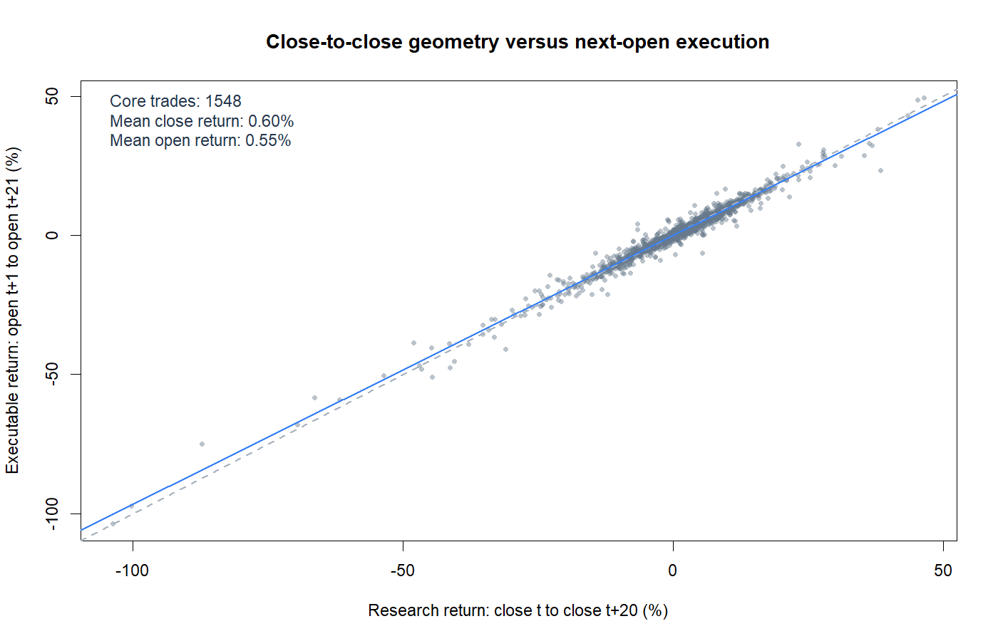
CLOCK TRANSLATION
Next-open timing preserves almost all of the return
Return geometry | close-to-close versus open-to-open
17
Notes:
For the 88-stock core, the same events average +0.60% close-to-close and +0.55% gross open-to-open. The roughly -0.04 percentage-point translation loss is real but small, so the TRAIN outcome is not explained by moving the trade clock to executable opens.
[Sources]
- runs/research_workbench/operator_hypothesis_lab/return_geometry_next_open_rule_translation_20260828/trade_summary.csv
- runs/research_workbench/operator_hypothesis_lab/return_geometry_next_open_rule_translation_20260828/visuals/close_to_open_translation.png
- Codex thread 01a0226e-2fa2-7222-a6d9-79ab971ac616 (2026-08-28), executable TRAIN rule discussion.
[/Sources]

Slide 18
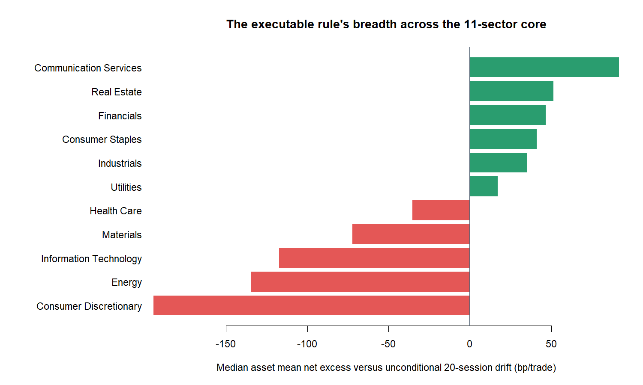
SECTOR BREADTH
Only six of eleven sectors clear ordinary drift
Return geometry | median asset net excess by sector
18
Notes:
The frozen breadth gate required at least 7 of 11 sectors to have positive median asset net excess over the same-asset unconditional 20-session open-to-open drift baseline. Only 6 pass. Communication Services is strongest; Consumer Discretionary is weakest.
[Sources]
- runs/research_workbench/operator_hypothesis_lab/return_geometry_next_open_rule_translation_20260828/core_sector_summary.csv
- runs/research_workbench/operator_hypothesis_lab/return_geometry_next_open_rule_translation_20260828/train_mechanics_gates.csv
- runs/research_workbench/operator_hypothesis_lab/return_geometry_next_open_rule_translation_20260828/visuals/core_sector_net_excess.png
- Codex thread 01a0226e-2fa2-7222-a6d9-79ab971ac616 (2026-08-28), executable TRAIN rule discussion.
[/Sources]

Slide 19
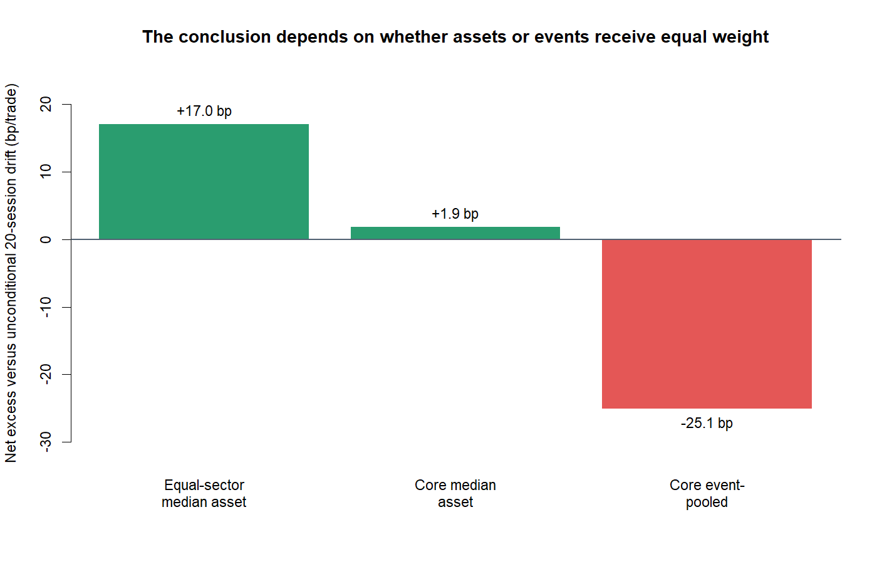
AGGREGATION
A typical asset looks positive—but pooled events do not
Return geometry | three aggregation lenses
19
Notes:
The equal-sector median asset earns +16.7 bp net excess per trade and the median core asset is barely positive at +1.9 bp. But the event-pooled core mean is -25.1 bp. That sign conflict means the result depends materially on whether assets, sectors, or events receive equal weight.
[Sources]
- runs/research_workbench/operator_hypothesis_lab/return_geometry_next_open_rule_translation_20260828/equal_sector_summary.csv
- runs/research_workbench/operator_hypothesis_lab/return_geometry_next_open_rule_translation_20260828/trade_summary.csv
- runs/research_workbench/operator_hypothesis_lab/return_geometry_next_open_rule_translation_20260828/visuals/core_aggregation_lenses.png
- Codex thread 01a0226e-2fa2-7222-a6d9-79ab971ac616 (2026-08-28), executable TRAIN rule discussion.
[/Sources]

Slide 20
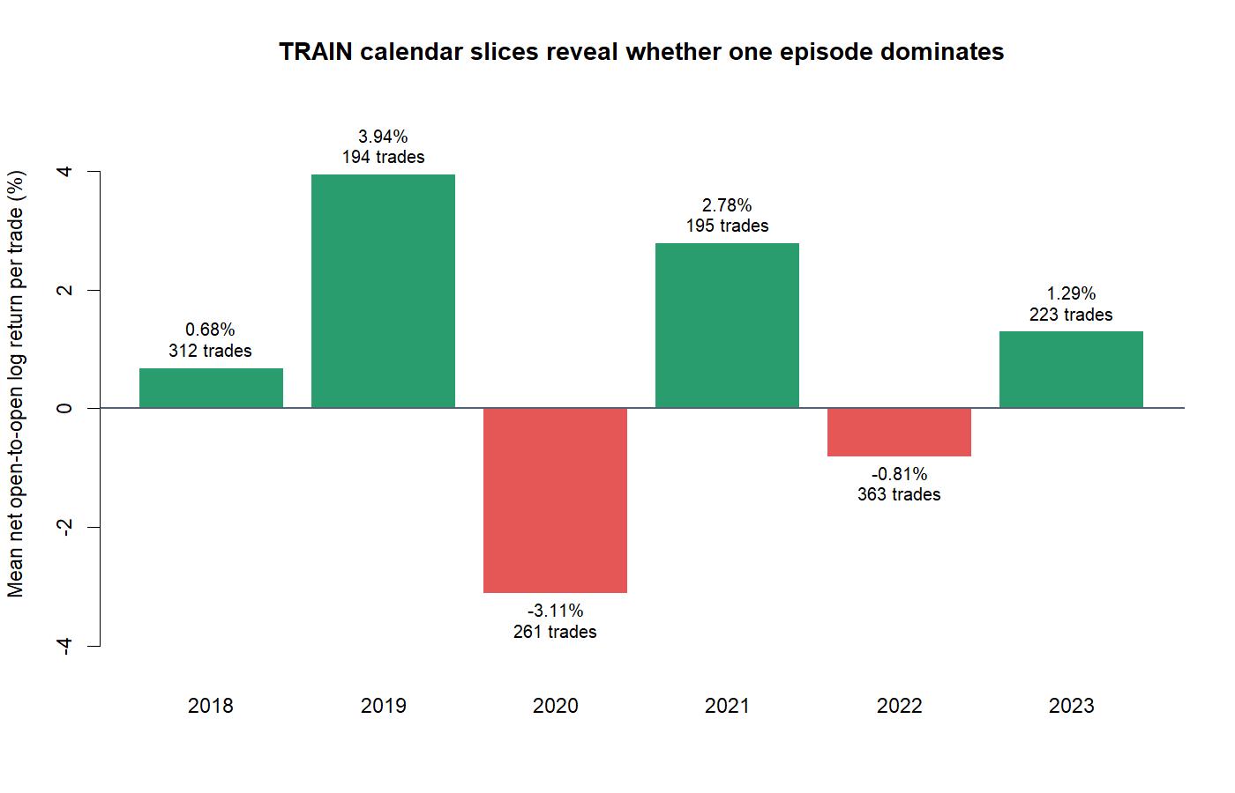
CALENDAR STABILITY
Strong years coexist with two material losing years
Return geometry | core event-pooled net return by year
20
Notes:
The TRAIN mechanics are not temporally stable: 2019 and 2021 are strongly positive, while 2020 and 2022 are negative. This calendar view is descriptive and does not create a new year filter.
[Sources]
- runs/research_workbench/operator_hypothesis_lab/return_geometry_next_open_rule_translation_20260828/core_year_summary.csv
- runs/research_workbench/operator_hypothesis_lab/return_geometry_next_open_rule_translation_20260828/visuals/core_yearly_net_return.png
- Codex thread 01a0226e-2fa2-7222-a6d9-79ab971ac616 (2026-08-28), executable TRAIN rule discussion.
[/Sources]

Slide 21
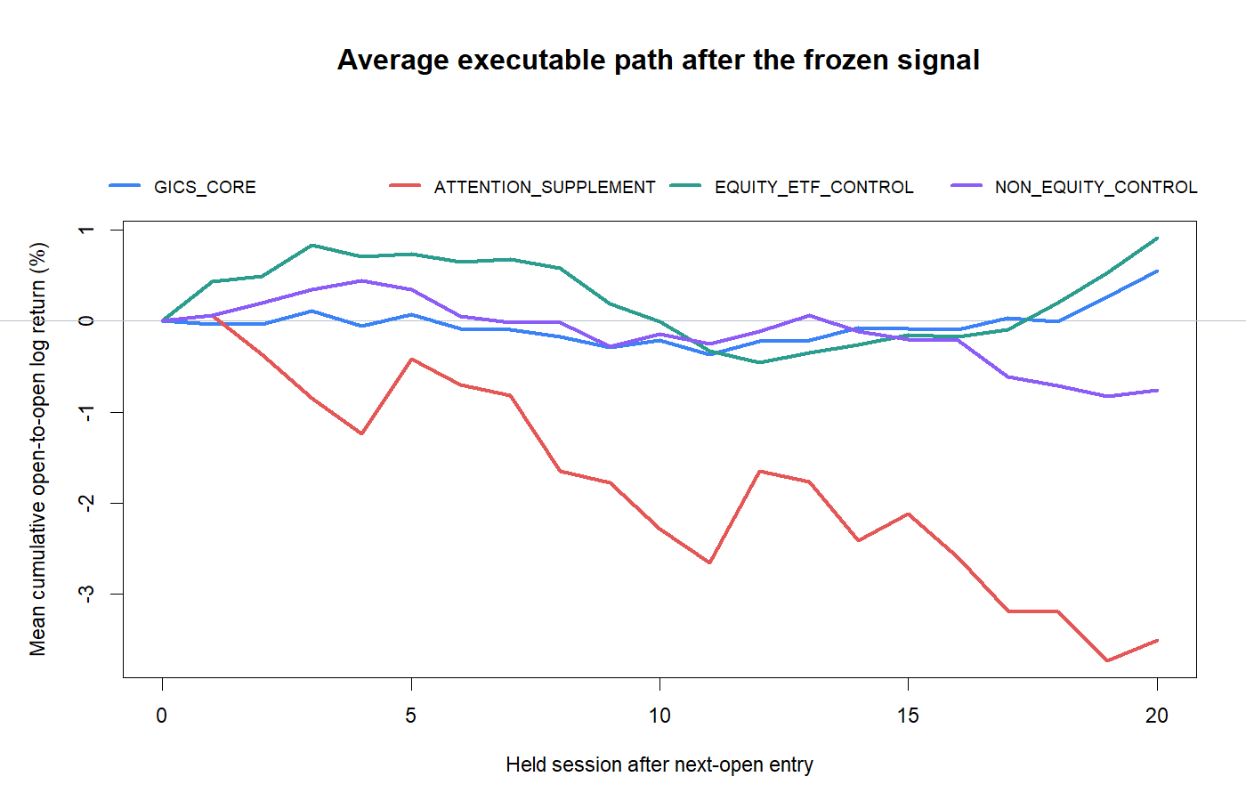
COHORT PATHS
The attention cohort keeps falling after entry
Return geometry | mean cumulative trade path by cohort
21
Notes:
Cohort paths reveal that the atlas is not behaviorally homogeneous. The 88-stock GICS core and equity ETFs stabilize above zero on average, while the attention cohort continues declining after entry. The non-equity controls remain weak.
[Sources]
- runs/research_workbench/operator_hypothesis_lab/return_geometry_next_open_rule_translation_20260828/trade_path_summary.csv
- runs/research_workbench/operator_hypothesis_lab/return_geometry_next_open_rule_translation_20260828/cohort_summary.csv
- runs/research_workbench/operator_hypothesis_lab/return_geometry_next_open_rule_translation_20260828/visuals/mean_trade_path_by_cohort.png
- Codex thread 01a0226e-2fa2-7222-a6d9-79ab971ac616 (2026-08-28), executable TRAIN rule discussion.
[/Sources]

Slide 22
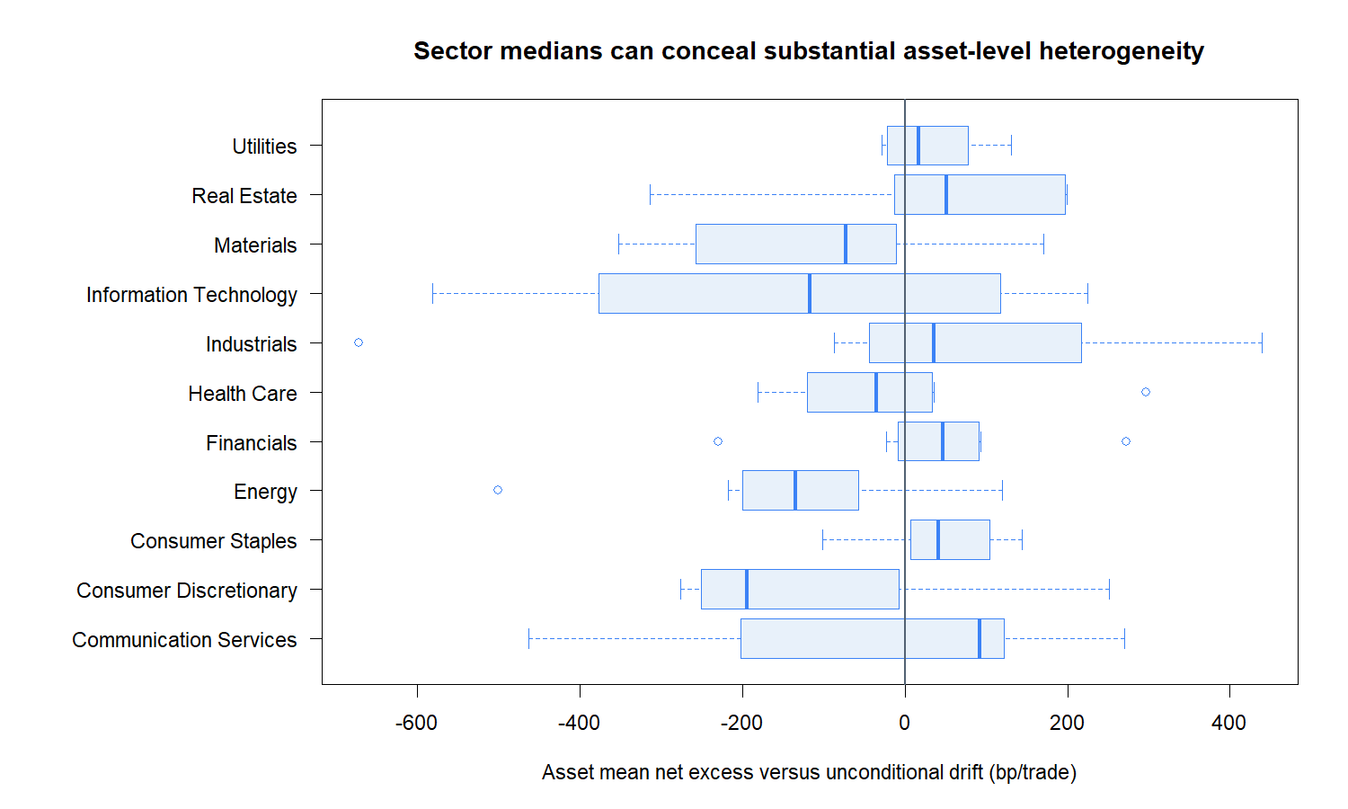
ASSET HETEROGENEITY
Sector medians conceal wide asset dispersion
Return geometry | core asset net excess distribution
22
Notes:
Even within sectors, asset-level outcomes span both signs. This dispersion is why a positive equal-sector median is not enough to promote the rule and why the breadth gate was frozen before seeing the result.
[Sources]
- runs/research_workbench/operator_hypothesis_lab/return_geometry_next_open_rule_translation_20260828/asset_summary.csv
- runs/research_workbench/operator_hypothesis_lab/return_geometry_next_open_rule_translation_20260828/core_sector_summary.csv
- runs/research_workbench/operator_hypothesis_lab/return_geometry_next_open_rule_translation_20260828/visuals/core_asset_excess_distribution.png
- Codex thread 01a0226e-2fa2-7222-a6d9-79ab971ac616 (2026-08-28), executable TRAIN rule discussion.
[/Sources]

Slide 23
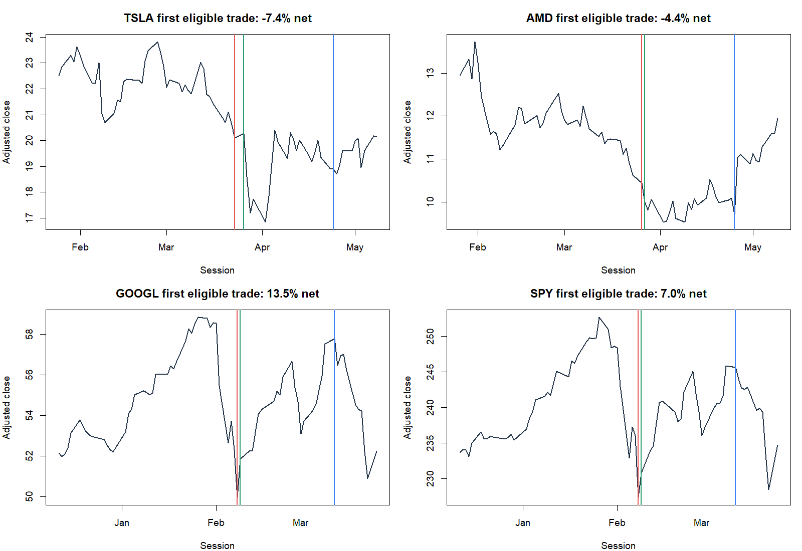
REPRESENTATIVE TAPES
The rule produces rebounds—and continued declines
Return geometry | deterministic representative trades
23
Notes:
These are the first eligible deterministic trades for TSLA, AMD, GOOGL, and SPY—not chosen winners. Red marks the qualifying signal close, green the next-open entry, and blue the 20-session exit. The panels make the rule's heterogeneous path behavior directly inspectable.
[Sources]
- runs/research_workbench/operator_hypothesis_lab/return_geometry_next_open_rule_translation_20260828/primary_trade_ledger.csv
- runs/research_workbench/operator_hypothesis_lab/return_geometry_next_open_rule_translation_20260828/visuals/representative_trade_tapes.png
- Codex thread 01a0226e-2fa2-7222-a6d9-79ab971ac616 (2026-08-28), executable TRAIN rule discussion.
[/Sources]

Slide 24
TRAIN DECISION
The rule stops before OOS
TRANSLATES
Clock change is small
+0.60% close vs +0.55% open
FAILS
Sector breadth
6 of 11 versus 7 required
CONFLICTS
Event weighting
−25.1 bp versus drift
STOP OOS
Do not tune percentile, ER cutoff, hold, overlap, costs, or universe. Post-2023 stays sealed.
Return geometry | executable TRAIN decision
24
Notes:
The frozen TRAIN rule does not retain mechanical support. It activates all 129 atlas instruments and 88 of 88 core stocks, so coverage is not the problem. It fails only the predeclared sector-breadth gate, but the event-pooled negative excess and strong cohort/calendar heterogeneity reinforce the STOP. No post-2023 outcomes were opened.
[Sources]
- runs/research_workbench/operator_hypothesis_lab/return_geometry_next_open_rule_translation_20260828/status.csv
- runs/research_workbench/operator_hypothesis_lab/return_geometry_next_open_rule_translation_20260828/train_mechanics_gates.csv
- runs/research_workbench/operator_hypothesis_lab/return_geometry_next_open_rule_translation_20260828/report.md
- operator_hypothesis_lab/docs/RETURN_GEOMETRY_NEXT_OPEN_RULE_TRANSLATION_2018_2023.md
[/Sources]

Slide 25
APPLICABILITY LAB
A failed universal rule opens a conditional question
CONSTANT
Frozen rule and trades
outcome remains drift-adjusted
QUESTION
Where did it work?
causal state at signal close
BOUNDARY
Visual research only
no gate, model, or p-values
TRAIN only
1,548 core events • 2,221 atlas events • post-2023 outcomes remain sealed
Return geometry | upstream feature exploration
25
Notes:
This slice does not alter or rescue the stopped rule. It treats the existing TRAIN events as a laboratory for asking whether clean, causal descriptions of the shock environment visibly discriminate future drift-adjusted outcomes. The point is to learn what a usable feature relationship would look like before fitting a classifier or designing a gate.
[Sources]
- Codex task 01a0226e-2fa2-7222-a6d9-79ab971ac616 (2026-08-28), operator-approved applicability feature exploration.
- runs/research_workbench/operator_hypothesis_lab/return_geometry_applicability_feature_atlas_20260828/run_spec.csv
- runs/research_workbench/operator_hypothesis_lab/return_geometry_applicability_feature_atlas_20260828/status.csv
- operator_hypothesis_lab/docs/RETURN_GEOMETRY_APPLICABILITY_FEATURE_ATLAS_2018_2023.md
[/Sources]

Slide 26
FEATURE CONTRACT I
Three features describe the loss and its peer context
RELATIVE LOSS
Asset minus seven peers
focal stock excluded
PEER BREADTH
Fraction of peers down
same prior-20 window
DOLLAR VOLUME
Event versus prior 126
median ratio in log space
Causal windows
All values exist by signal close; zero-volume rows are excluded—not treated as liquid zeros.
Return geometry | shock participation and activity
26
Notes:
Sector-relative loss distinguishes an idiosyncratic drop from a common sector move. Peer negative breadth measures participation without including the focal stock. Abnormal dollar volume asks whether the shock arrived with unusually high trading activity relative to its own prior 126-session baseline.
[Sources]
- Codex task 01a0226e-2fa2-7222-a6d9-79ab971ac616 (2026-08-28), operator-approved applicability feature exploration.
- runs/research_workbench/operator_hypothesis_lab/return_geometry_applicability_feature_atlas_20260828/run_spec.csv
- runs/research_workbench/operator_hypothesis_lab/return_geometry_applicability_feature_atlas_20260828/feature_construction_checks.csv
- Lo and MacKinlay (1990), doi:10.1093/rfs/3.2.175.
- Campbell, Grossman, and Wang (1993), doi:10.2307/2118454.
- Hameed and Mian (2015), doi:10.1017/S0022109014000404.
- operator_hypothesis_lab/docs/RETURN_GEOMETRY_APPLICABILITY_FEATURE_ATLAS_2018_2023.md
[/Sources]

Slide 27
FEATURE CONTRACT II
Impact, market stress, and pretrend complete the atlas
PRICE IMPACT
|return| per dollar volume
event versus prior 126
SPY STRESS
Causal RV20 percentile
current value excluded
PRETREND
126-session return / vol
ending before loss window
Minimal proxies
OHLCV cannot reveal latent information or institutional liquidity; these are disciplined approximations.
Return geometry | liquidity and temporal context
27
Notes:
Price-impact shock is an Amihud-style OHLCV proxy normalized to the asset's own prior state. SPY volatility percentile asks whether broad market stress conditions the outcome. Pre-shock normalized trend separates a loss after a strong longer trend from a loss after a weak or negative longer trend. These are minimal measurement devices, not mechanistic identifications.
[Sources]
- Codex task 01a0226e-2fa2-7222-a6d9-79ab971ac616 (2026-08-28), operator-approved applicability feature exploration.
- runs/research_workbench/operator_hypothesis_lab/return_geometry_applicability_feature_atlas_20260828/run_spec.csv
- runs/research_workbench/operator_hypothesis_lab/return_geometry_applicability_feature_atlas_20260828/feature_construction_checks.csv
- Amihud (2002), doi:10.1016/S1386-4181(01)00024-6.
- Nagel (2012), doi:10.1093/rfs/hhs066.
- Moskowitz, Ooi, and Pedersen (2012), doi:10.1016/j.jfineco.2011.11.003.
- operator_hypothesis_lab/docs/RETURN_GEOMETRY_APPLICABILITY_FEATURE_ATLAS_2018_2023.md
[/Sources]

Slide 28
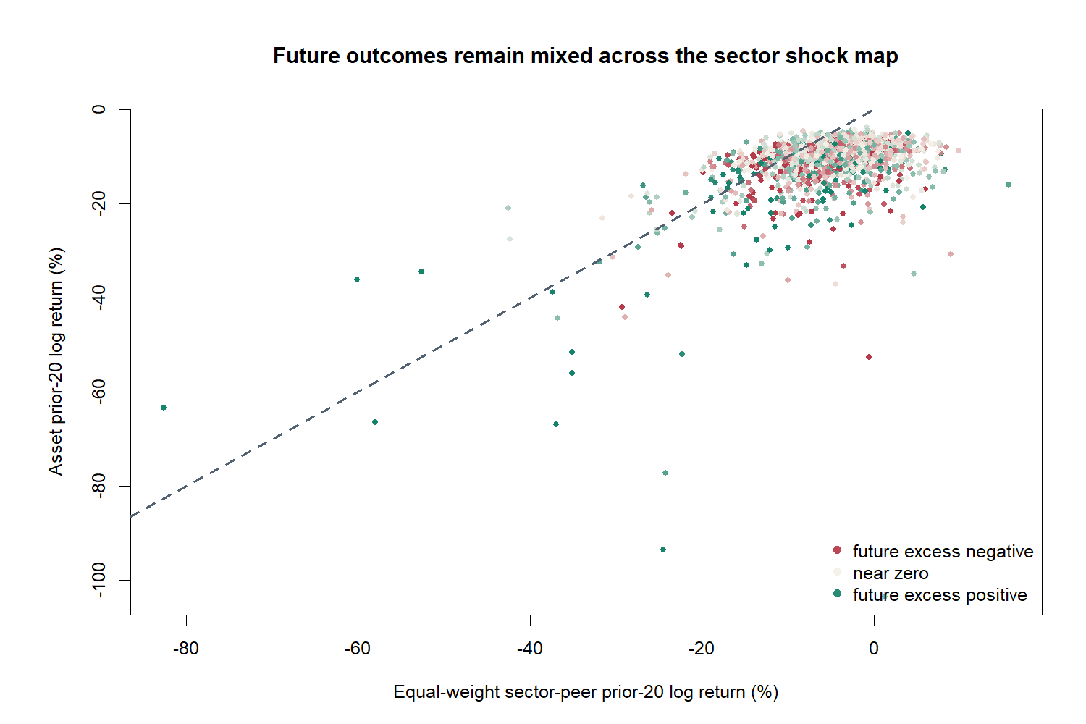
SECTOR SHOCK MAP
Shared selloffs do not separate future outcomes
Return geometry | focal loss versus peer loss
28
Notes:
If common sector selloffs were obviously safer rebound environments, positive future outcomes would cluster in a coherent region of the map. They do not. Extreme focal underperformance does contain positive examples, but negative and positive outcomes remain intermingled.
[Sources]
- Codex task 01a0226e-2fa2-7222-a6d9-79ab971ac616 (2026-08-28), operator-approved applicability feature exploration.
- runs/research_workbench/operator_hypothesis_lab/return_geometry_applicability_feature_atlas_20260828/visuals/sector_shock_map.png
- runs/research_workbench/operator_hypothesis_lab/return_geometry_applicability_feature_atlas_20260828/feature_summary.csv
- runs/research_workbench/operator_hypothesis_lab/return_geometry_applicability_feature_atlas_20260828/asset_balanced_binned_profiles.csv
- operator_hypothesis_lab/docs/RETURN_GEOMETRY_APPLICABILITY_FEATURE_ATLAS_2018_2023.md
[/Sources]

Slide 29
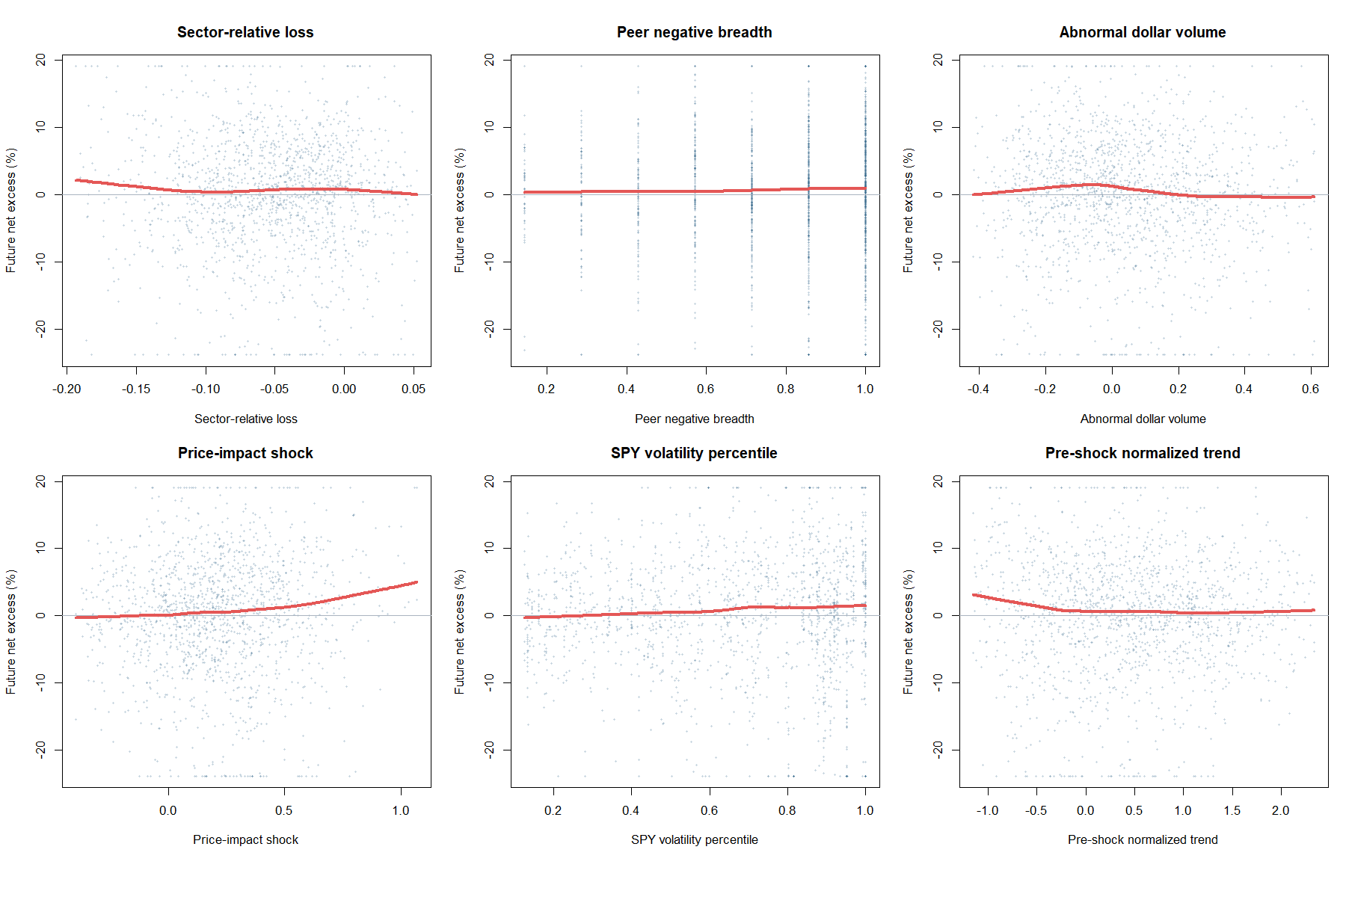
SCATTER SANITY CHECK
The raw relationships are weak and visibly noisy
Return geometry | six event-level feature views
29
Notes:
The event-level clouds do not show a clean threshold or linear separator. The smooths are descriptive only. Display axes are clipped to the 2.5th and 97.5th percentiles; all events remain in the numerical summaries.
[Sources]
- Codex task 01a0226e-2fa2-7222-a6d9-79ab971ac616 (2026-08-28), operator-approved applicability feature exploration.
- runs/research_workbench/operator_hypothesis_lab/return_geometry_applicability_feature_atlas_20260828/visuals/feature_scatter_sanity_checks.png
- runs/research_workbench/operator_hypothesis_lab/return_geometry_applicability_feature_atlas_20260828/feature_summary.csv
- runs/research_workbench/operator_hypothesis_lab/return_geometry_applicability_feature_atlas_20260828/asset_balanced_binned_profiles.csv
- operator_hypothesis_lab/docs/RETURN_GEOMETRY_APPLICABILITY_FEATURE_ATLAS_2018_2023.md
[/Sources]

Slide 30
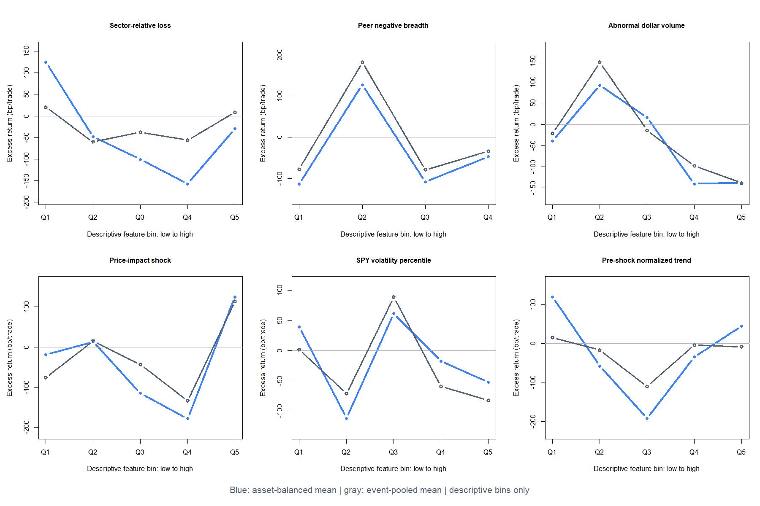
BINNED PROFILES
Every candidate is nonmonotone
Return geometry | asset-balanced versus event-pooled
30
Notes:
Blue gives each asset equal weight; gray pools events. No feature improves steadily from low to high. Sector-relative loss, peer breadth, price impact, market volatility, and pretrend contain reversals of sign. High abnormal-volume bins are negative under both aggregation lenses.
[Sources]
- Codex task 01a0226e-2fa2-7222-a6d9-79ab971ac616 (2026-08-28), operator-approved applicability feature exploration.
- runs/research_workbench/operator_hypothesis_lab/return_geometry_applicability_feature_atlas_20260828/visuals/asset_balanced_binned_profiles.png
- runs/research_workbench/operator_hypothesis_lab/return_geometry_applicability_feature_atlas_20260828/feature_summary.csv
- runs/research_workbench/operator_hypothesis_lab/return_geometry_applicability_feature_atlas_20260828/asset_balanced_binned_profiles.csv
- operator_hypothesis_lab/docs/RETURN_GEOMETRY_APPLICABILITY_FEATURE_ATLAS_2018_2023.md
[/Sources]

Slide 31
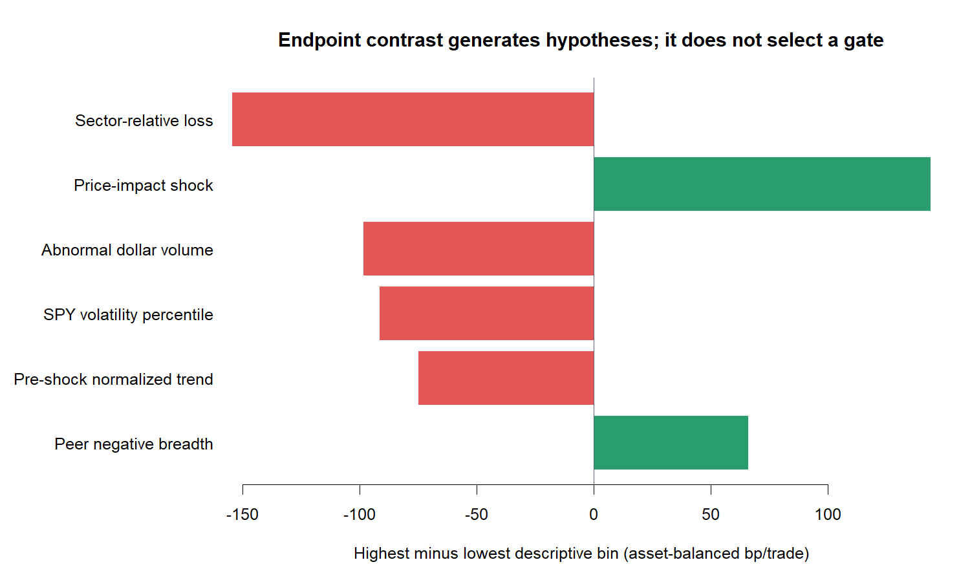
POST-HOC CONTRAST
Large endpoint contrasts are clues—not rankings
Return geometry | highest minus lowest descriptive bin
31
Notes:
The chart orders endpoint contrasts only; it does not rank feature quality. Price impact has the largest positive high-minus-low contrast, but its underlying profile jumps from a deeply negative fourth bin to a positive fifth bin. Sector-relative loss has the reverse endpoint sign while event-level correlation is near zero. Endpoint discontinuity is a reason for caution.
[Sources]
- Codex task 01a0226e-2fa2-7222-a6d9-79ab971ac616 (2026-08-28), operator-approved applicability feature exploration.
- runs/research_workbench/operator_hypothesis_lab/return_geometry_applicability_feature_atlas_20260828/visuals/feature_descriptive_rank.png
- runs/research_workbench/operator_hypothesis_lab/return_geometry_applicability_feature_atlas_20260828/feature_summary.csv
- runs/research_workbench/operator_hypothesis_lab/return_geometry_applicability_feature_atlas_20260828/asset_balanced_binned_profiles.csv
- operator_hypothesis_lab/docs/RETURN_GEOMETRY_APPLICABILITY_FEATURE_ATLAS_2018_2023.md
[/Sources]

Slide 32
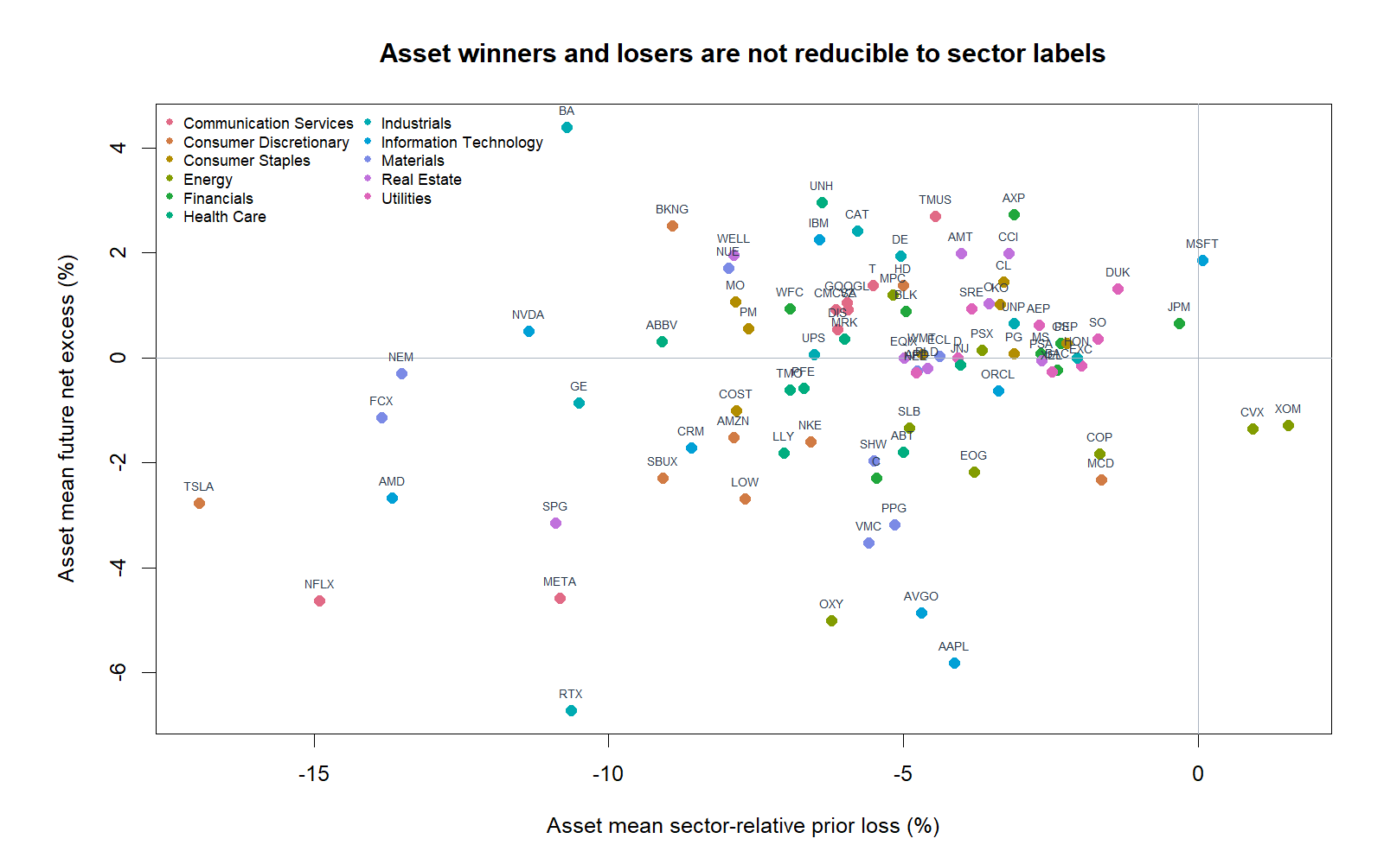
ASSET CHARACTERIZATION
Sector labels do not partition winners from losers
Return geometry | asset means within the balanced core
32
Notes:
Assets with positive and negative mean outcomes are intermingled within sectors. This argues against using the observed sector labels themselves as an upstream filter and motivates any later test to hold out both assets and sectors.
[Sources]
- Codex task 01a0226e-2fa2-7222-a6d9-79ab971ac616 (2026-08-28), operator-approved applicability feature exploration.
- runs/research_workbench/operator_hypothesis_lab/return_geometry_applicability_feature_atlas_20260828/visuals/asset_characterization_map.png
- runs/research_workbench/operator_hypothesis_lab/return_geometry_applicability_feature_atlas_20260828/feature_summary.csv
- runs/research_workbench/operator_hypothesis_lab/return_geometry_applicability_feature_atlas_20260828/asset_balanced_binned_profiles.csv
- operator_hypothesis_lab/docs/RETURN_GEOMETRY_APPLICABILITY_FEATURE_ATLAS_2018_2023.md
[/Sources]

Slide 33
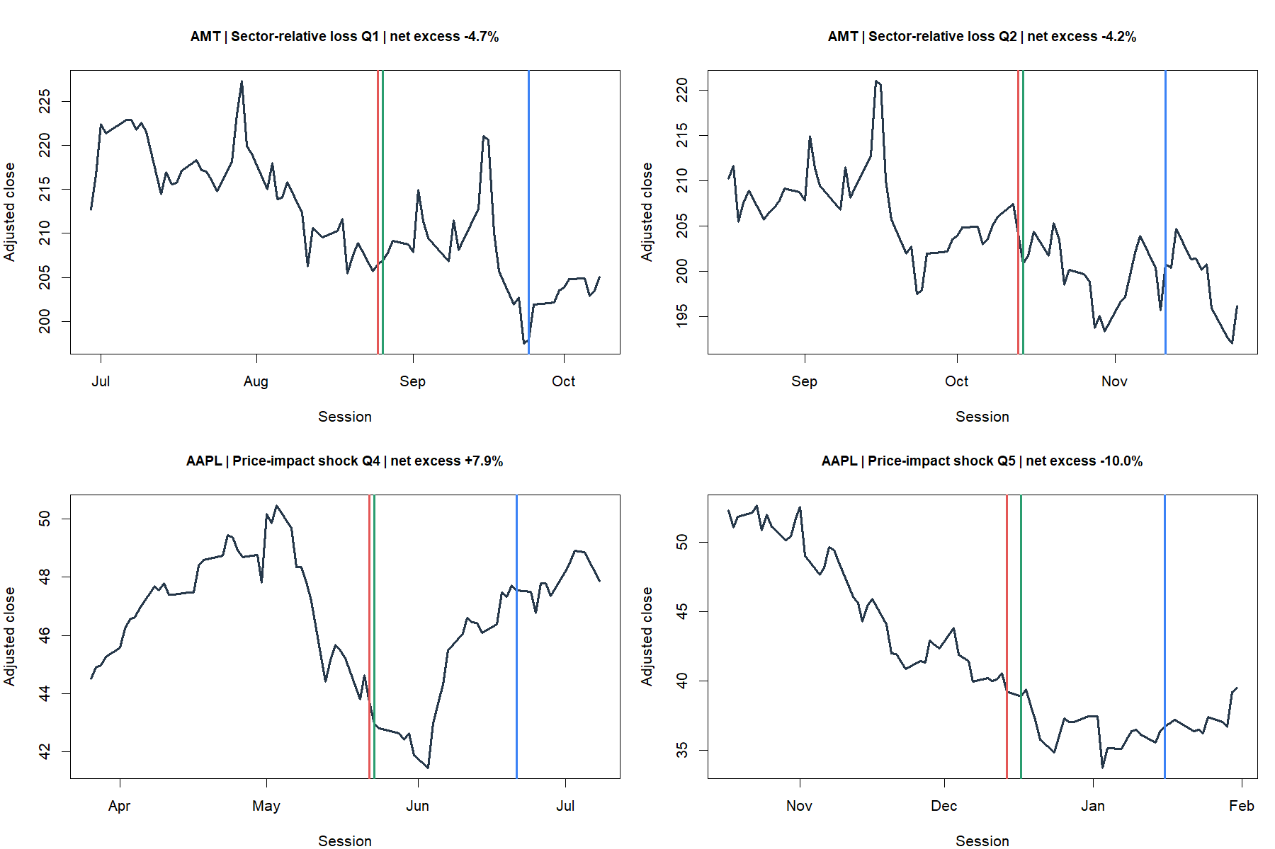
MATCHED TRADE TAPES
Adjacent feature states can still lead to opposite paths
Return geometry | examples selected without outcome
33
Notes:
Pairs are selected within the same asset, in adjacent feature bins, by the smallest difference in prior-20 loss severity. Future outcomes are never used to select the examples. Red is signal close, green entry, and blue exit. The tapes make the residual heterogeneity concrete rather than proving a bin effect.
[Sources]
- Codex task 01a0226e-2fa2-7222-a6d9-79ab971ac616 (2026-08-28), operator-approved applicability feature exploration.
- runs/research_workbench/operator_hypothesis_lab/return_geometry_applicability_feature_atlas_20260828/visuals/representative_matched_trade_pairs.png
- runs/research_workbench/operator_hypothesis_lab/return_geometry_applicability_feature_atlas_20260828/feature_summary.csv
- runs/research_workbench/operator_hypothesis_lab/return_geometry_applicability_feature_atlas_20260828/asset_balanced_binned_profiles.csv
- operator_hypothesis_lab/docs/RETURN_GEOMETRY_APPLICABILITY_FEATURE_ATLAS_2018_2023.md
[/Sources]

Slide 34
INITIAL READOUT
No feature earns a clean permission rule
NOT CONFIRMED
Shared-selloff thesis
sector map remains mixed
NEGATIVE CLUE
High abnormal volume
both top bins below drift
POST-HOC CLUES
Two endpoint islands
relative loss and price impact
No selection
SPY volatility alternates • pretrend is U-shaped • sector loss and breadth are redundant (rho 0.672)
Return geometry | descriptive applicability result
34
Notes:
The result is not a null in the sense of 'nothing learned.' It rejects several simple stories and narrows the shape of any future hypothesis. But none of the observed shapes can responsibly become a gate from this same data: the prominent candidates are nonmonotone endpoint islands discovered after inspection.
[Sources]
- Codex task 01a0226e-2fa2-7222-a6d9-79ab971ac616 (2026-08-28), operator-approved applicability feature exploration.
- runs/research_workbench/operator_hypothesis_lab/return_geometry_applicability_feature_atlas_20260828/feature_interpretation.csv
- runs/research_workbench/operator_hypothesis_lab/return_geometry_applicability_feature_atlas_20260828/feature_spearman_correlation.csv
- runs/research_workbench/operator_hypothesis_lab/return_geometry_applicability_feature_atlas_20260828/report.md
- operator_hypothesis_lab/docs/RETURN_GEOMETRY_APPLICABILITY_FEATURE_ATLAS_2018_2023.md
[/Sources]

Slide 35
FEATURE DECISION
Freeze this atlas before testing a narrow shape
COMPLETE
Descriptive atlas
13 construction checks pass
UNSELECTED
Feature and threshold
no model or multiplicity test
NEXT—IF OPENED
Hold out assets + sectors
predeclare one or two shapes
OOS sealed
Do not open post-2023, optimize bins, combine features, or call endpoint islands an edge.
Return geometry | applicability feature boundary
35
Notes:
Status: DESCRIPTIVE_FEATURE_ATLAS_COMPLETE_NO_GATE_SELECTED. A defensible next slice would select at most one or two precise shapes before inspecting new groups, then test cross-asset and cross-sector transport. Temporal confirmation should remain later so the present TRAIN data cannot silently design and confirm the same rule.
[Sources]
- Codex task 01a0226e-2fa2-7222-a6d9-79ab971ac616 (2026-08-28), operator-approved applicability feature exploration.
- runs/research_workbench/operator_hypothesis_lab/return_geometry_applicability_feature_atlas_20260828/status.csv
- runs/research_workbench/operator_hypothesis_lab/return_geometry_applicability_feature_atlas_20260828/feature_construction_checks.csv
- runs/research_workbench/operator_hypothesis_lab/return_geometry_applicability_feature_atlas_20260828/report.md
- operator_hypothesis_lab/docs/RETURN_GEOMETRY_APPLICABILITY_FEATURE_ATLAS_2018_2023.md
[/Sources]

Slide 36
VETO LAB
One visual clue becomes one frozen veto
CLUE
Top two volume bins
both below ordinary drift
TEST
One causal threshold
no feature combination
CONSTANT
Underlying rule
trades, timing, costs unchanged
TRAIN only
1,548 core events • 88 stocks • 11 sectors • post-2023 outcomes remain sealed
Return geometry | abnormal-volume mechanism
36
Notes:
The prior feature atlas did not earn a general permission rule, but it did reveal one visually coherent negative clue: the two highest abnormal-dollar-volume bins were below drift. This slice maps that exact clue to one frozen causal veto. It does not retune the stopped rebound rule or search multiple thresholds.
[Sources]
- Codex task 01a0226e-2fa2-7222-a6d9-79ab971ac616 (2026-08-28), operator-approved abnormal-volume veto falsification.
- runs/research_workbench/operator_hypothesis_lab/return_geometry_abnormal_volume_veto_20260828/run_spec.csv
- runs/research_workbench/operator_hypothesis_lab/return_geometry_abnormal_volume_veto_20260828/status.csv
- operator_hypothesis_lab/docs/RETURN_GEOMETRY_ABNORMAL_VOLUME_VETO_2018_2023.md
[/Sources]

Slide 37
CAUSAL CONTRACT
High abnormal volume means: do not take this rebound
FEATURE
20-day / prior 126
median dollar volume ratio
CAUSAL RANK
Up to 504 prior days
252-day minimum history
VETO
Percentile at least 60%
top two of five bins
Rule unchanged
Signed-down • bottom-q20 prior loss • next-open • 20 held sessions • non-overlap • 10 bp
Return geometry | frozen veto definition
37
Notes:
Daily abnormal dollar volume is the log ratio of the current 20-session median dollar volume to the median over the preceding 126 sessions. Each daily value is ranked only against strictly prior feature values. The 60th-percentile boundary was frozen before this run because it translates the atlas's top-two-of-five-bin clue directly into one veto.
[Sources]
- Codex task 01a0226e-2fa2-7222-a6d9-79ab971ac616 (2026-08-28), operator-approved abnormal-volume veto falsification.
- runs/research_workbench/operator_hypothesis_lab/return_geometry_abnormal_volume_veto_20260828/run_spec.csv
- runs/research_workbench/operator_hypothesis_lab/return_geometry_abnormal_volume_veto_20260828/construction_checks.csv
- operator_hypothesis_lab/docs/RETURN_GEOMETRY_ABNORMAL_VOLUME_VETO_2018_2023.md
[/Sources]

Slide 38
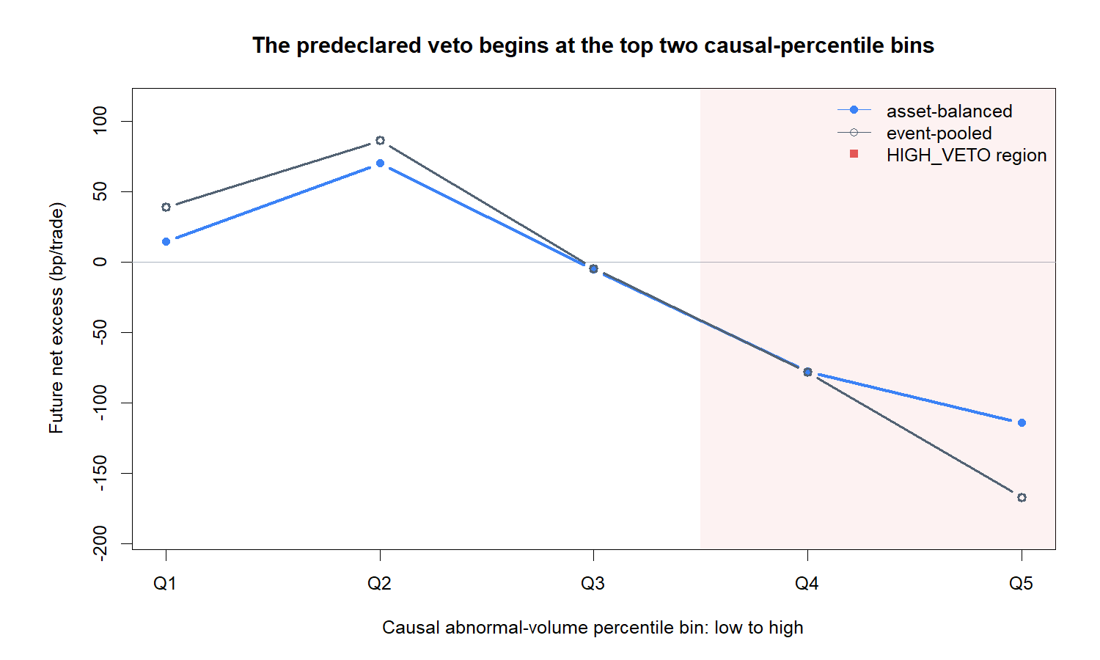
CAUSAL PROFILE
The veto starts where outcomes turn adverse
Return geometry | causal abnormal-volume percentile
38
Notes:
The causal percentile profile preserves the atlas shape: low and middle abnormal-volume states are near or above drift, while the predeclared high-veto region—the top two bins—is negative. This is descriptive continuity, not independent confirmation.
[Sources]
- Codex task 01a0226e-2fa2-7222-a6d9-79ab971ac616 (2026-08-28), operator-approved abnormal-volume veto falsification.
- runs/research_workbench/operator_hypothesis_lab/return_geometry_abnormal_volume_veto_20260828/visuals/causal_percentile_profile.png
- runs/research_workbench/operator_hypothesis_lab/return_geometry_abnormal_volume_veto_20260828/report.md
- operator_hypothesis_lab/docs/RETURN_GEOMETRY_ABNORMAL_VOLUME_VETO_2018_2023.md
[/Sources]

Slide 39
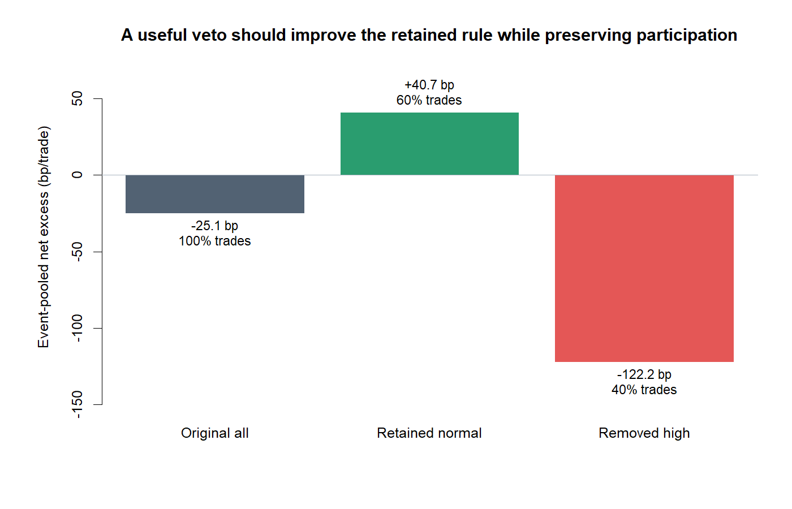
RULE COMPARISON
The veto removes the losing subset and keeps 60%
Return geometry | original, retained, and removed
39
Notes:
Across core events, the original rule is -25 bp/trade versus drift. Retained normal-volume events are +41 bp/trade; removed high-volume events are -122 bp/trade. The retained share is 59.6%. This is the strongest practical separation in the slice, but all values remain internal to TRAIN.
[Sources]
- Codex task 01a0226e-2fa2-7222-a6d9-79ab971ac616 (2026-08-28), operator-approved abnormal-volume veto falsification.
- runs/research_workbench/operator_hypothesis_lab/return_geometry_abnormal_volume_veto_20260828/visuals/veto_rule_comparison.png
- runs/research_workbench/operator_hypothesis_lab/return_geometry_abnormal_volume_veto_20260828/report.md
- operator_hypothesis_lab/docs/RETURN_GEOMETRY_ABNORMAL_VOLUME_VETO_2018_2023.md
[/Sources]

Slide 40
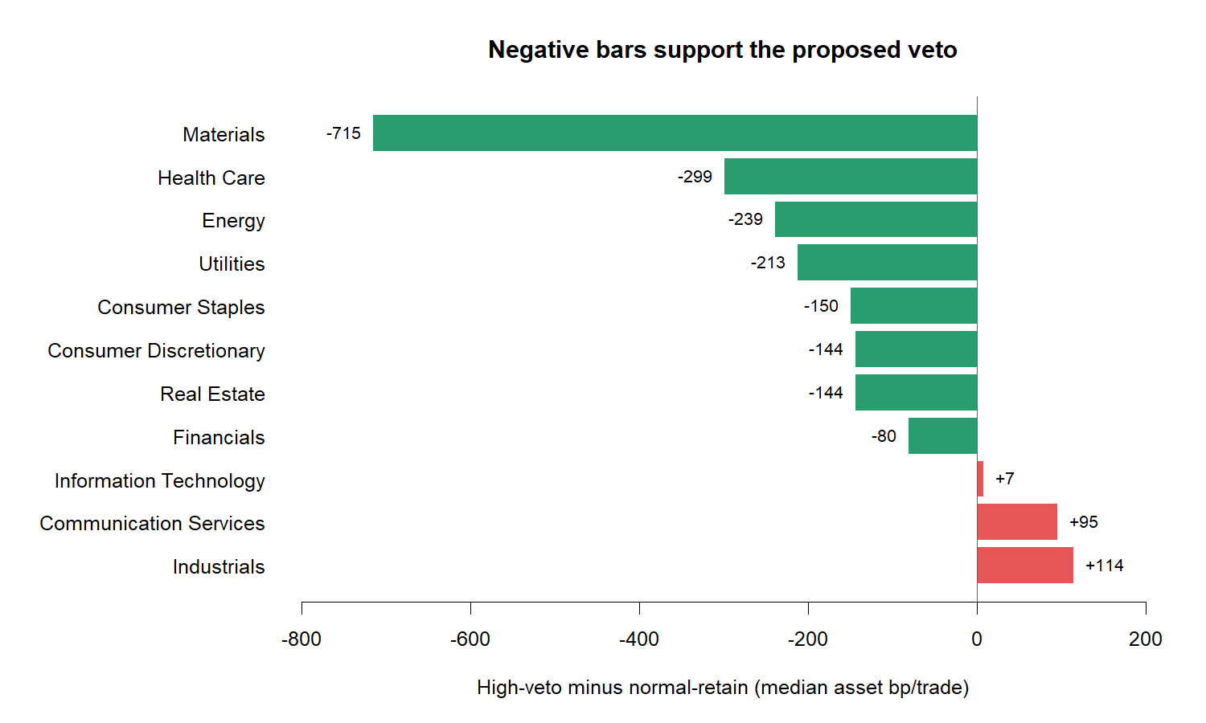
SECTOR TRANSPORT
Eight of eleven sector medians favor the veto
Return geometry | median asset contrast by sector
40
Notes:
Eight sector medians are negative, meeting the frozen 7-of-11 breadth check. Information Technology is approximately flat; Communication Services and Industrials reverse. Sector breadth supports a broad mechanism while preserving visible heterogeneity.
[Sources]
- Codex task 01a0226e-2fa2-7222-a6d9-79ab971ac616 (2026-08-28), operator-approved abnormal-volume veto falsification.
- runs/research_workbench/operator_hypothesis_lab/return_geometry_abnormal_volume_veto_20260828/visuals/sector_veto_contrasts.png
- runs/research_workbench/operator_hypothesis_lab/return_geometry_abnormal_volume_veto_20260828/report.md
- operator_hypothesis_lab/docs/RETURN_GEOMETRY_ABNORMAL_VOLUME_VETO_2018_2023.md
[/Sources]

Slide 41
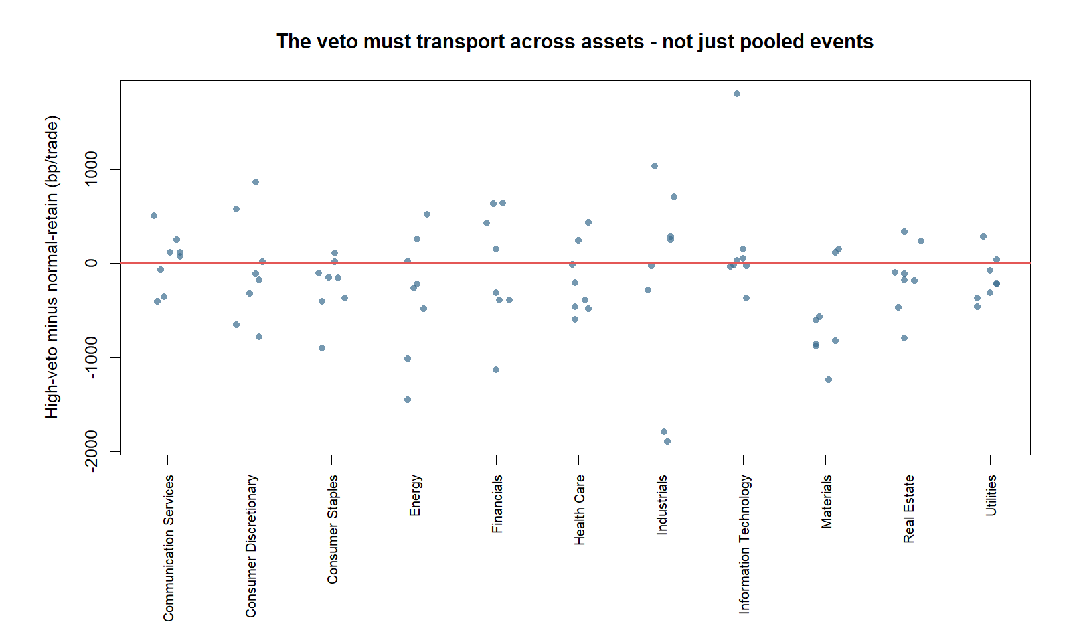
ASSET TRANSPORT
Fifty-five of eighty-eight stocks favor the veto
Return geometry | per-asset contrast distribution
41
Notes:
The asset-balanced contrast is -160 bp/trade and 55 of 88 comparable assets are negative, clearing the frozen 60% breadth threshold. The wide dispersion is crucial: the veto is not universal, even within sectors that support it on median.
[Sources]
- Codex task 01a0226e-2fa2-7222-a6d9-79ab971ac616 (2026-08-28), operator-approved abnormal-volume veto falsification.
- runs/research_workbench/operator_hypothesis_lab/return_geometry_abnormal_volume_veto_20260828/visuals/asset_veto_contrast_distribution.png
- runs/research_workbench/operator_hypothesis_lab/return_geometry_abnormal_volume_veto_20260828/report.md
- operator_hypothesis_lab/docs/RETURN_GEOMETRY_ABNORMAL_VOLUME_VETO_2018_2023.md
[/Sources]

Slide 42
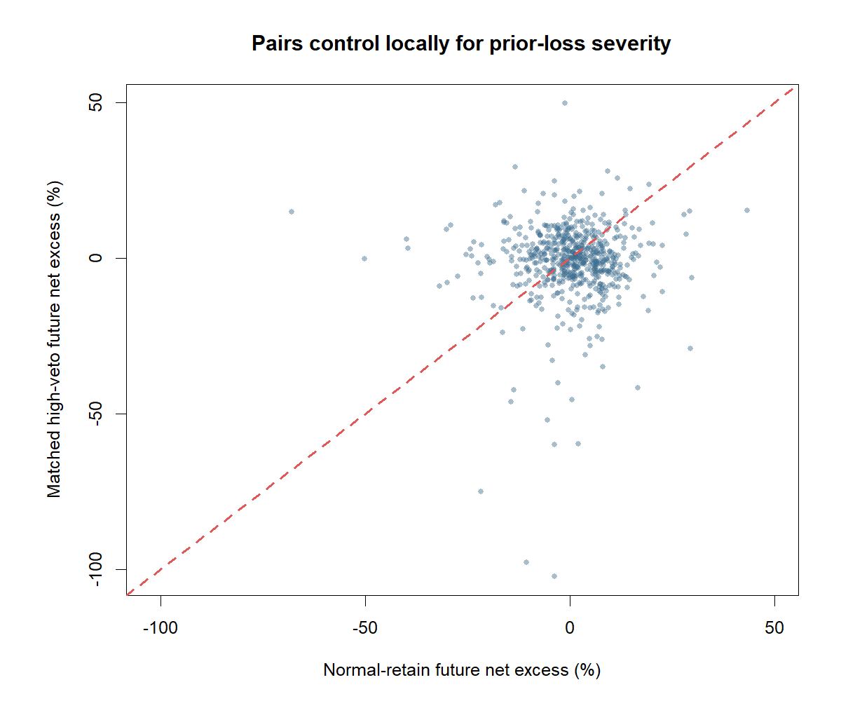
SEVERITY CONTROL
The gap survives same-asset, closest-loss matching
Return geometry | outcome-blind matched pairs
42
Notes:
Each high-veto event is matched within the same asset to the unused normal-volume event with the closest prior-20 loss severity. Outcomes never enter matching. The paired high-minus-normal contrast is -179 bp/trade, so simple loss-severity imbalance is not enough to explain the separation.
[Sources]
- Codex task 01a0226e-2fa2-7222-a6d9-79ab971ac616 (2026-08-28), operator-approved abnormal-volume veto falsification.
- runs/research_workbench/operator_hypothesis_lab/return_geometry_abnormal_volume_veto_20260828/visuals/severity_matched_outcomes.png
- runs/research_workbench/operator_hypothesis_lab/return_geometry_abnormal_volume_veto_20260828/report.md
- operator_hypothesis_lab/docs/RETURN_GEOMETRY_ABNORMAL_VOLUME_VETO_2018_2023.md
[/Sources]

Slide 43
COHORT DIAGNOSTIC
The sign extends beyond the balanced stock core
GICS CORE
-160 bp/trade
62.5% negative breadth
ATTENTION
-538 bp/trade
69.2% negative breadth
CONTROLS
ETFs -52 • non-equity -69
both 60%+ negative breadth
Not confirmation
All four cohorts share the same discovery era and cannot validate temporal transport.
Return geometry | same-era transport only
43
Notes:
Every eligible atlas cohort has a negative asset-balanced high-minus-normal contrast: GICS core -160 bp/trade, attention supplement -538, equity ETF controls -52, and non-equity controls -69. This is encouraging structural transport, but the cohorts are exposed to the same dates and were part of the same discovery ledger, so they are diagnostic—not independent replication.
[Sources]
- Codex task 01a0226e-2fa2-7222-a6d9-79ab971ac616 (2026-08-28), operator-approved abnormal-volume veto falsification.
- runs/research_workbench/operator_hypothesis_lab/return_geometry_abnormal_volume_veto_20260828/cohort_veto_diagnostics.csv
- runs/research_workbench/operator_hypothesis_lab/return_geometry_abnormal_volume_veto_20260828/status.csv
- operator_hypothesis_lab/docs/RETURN_GEOMETRY_ABNORMAL_VOLUME_VETO_2018_2023.md
[/Sources]

Slide 44
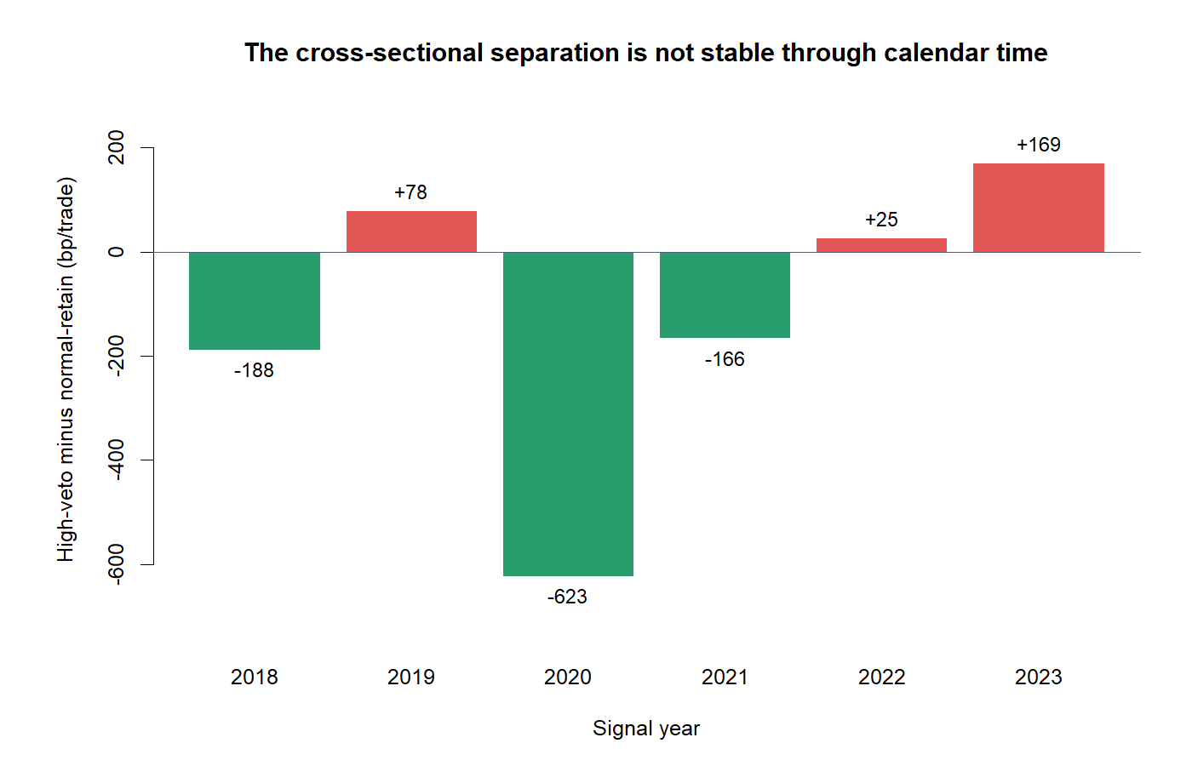
CALENDAR STABILITY
Only three of six years support the veto
Return geometry | asset-balanced contrast by signal year
44
Notes:
The veto direction holds in 2018, 2020, and 2021, but reverses in 2019, 2022, and 2023. The 2020 contrast is especially large, and the latest TRAIN year reverses. Calendar stability was diagnostic rather than a retroactively substituted gate; it qualifies the seven frozen cross-sectional passes and blocks a clean promotion claim.
[Sources]
- Codex task 01a0226e-2fa2-7222-a6d9-79ab971ac616 (2026-08-28), operator-approved abnormal-volume veto falsification.
- runs/research_workbench/operator_hypothesis_lab/return_geometry_abnormal_volume_veto_20260828/visuals/year_veto_contrasts.png
- runs/research_workbench/operator_hypothesis_lab/return_geometry_abnormal_volume_veto_20260828/report.md
- operator_hypothesis_lab/docs/RETURN_GEOMETRY_ABNORMAL_VOLUME_VETO_2018_2023.md
[/Sources]

Slide 45
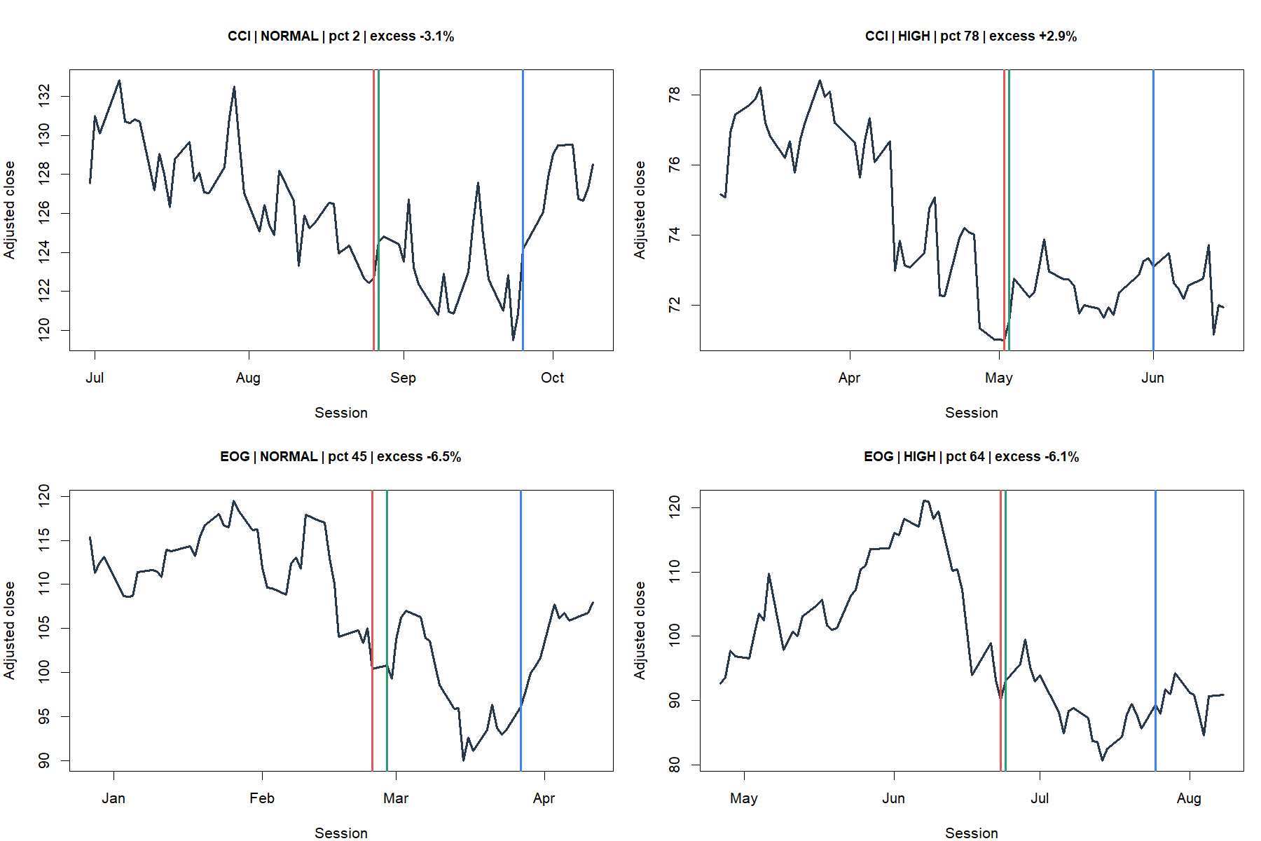
MATCHED TRADE TAPES
Similar losses can lead to very different paths
Return geometry | examples selected without outcome
45
Notes:
Representative pairs are selected by same asset and smallest prior-loss-severity distance, with controls not reused and outcomes excluded. Red is signal close, green next-open entry, and blue exit. The tapes expose residual heterogeneity and should not be read as proof of the average effect.
[Sources]
- Codex task 01a0226e-2fa2-7222-a6d9-79ab971ac616 (2026-08-28), operator-approved abnormal-volume veto falsification.
- runs/research_workbench/operator_hypothesis_lab/return_geometry_abnormal_volume_veto_20260828/visuals/representative_veto_trade_tapes.png
- runs/research_workbench/operator_hypothesis_lab/return_geometry_abnormal_volume_veto_20260828/report.md
- operator_hypothesis_lab/docs/RETURN_GEOMETRY_ABNORMAL_VOLUME_VETO_2018_2023.md
[/Sources]

Slide 46
VETO DECISION
Cross-sectional support meets temporal instability
PASSES
Seven frozen checks
-160 bp asset-balanced
IMPROVES
Retained event mean
-25 to +41 bp/trade
BRAKE
Only 3 of 6 years
2023 reverses
STOP BEFORE OOS
Do not tune 60%, combine features, select years or sectors, or open post-2023 outcomes.
Return geometry | qualified TRAIN stop
46
Notes:
Status: TRAIN_VOLUME_VETO_CROSS_SECTIONAL_SUPPORT_TEMPORALLY_UNSTABLE_STOP_BEFORE_OOS. The veto is the first feature in this lane to behave like a plausible failure-state discriminator: it transports across assets, sectors, matched loss severity, and diagnostic cohorts while preserving 59.6% of events. But only three of six calendar years agree, and 2023 reverses. This is not a promoted edge and does not automatically open OOS.
[Sources]
- Codex task 01a0226e-2fa2-7222-a6d9-79ab971ac616 (2026-08-28), operator-approved abnormal-volume veto falsification.
- runs/research_workbench/operator_hypothesis_lab/return_geometry_abnormal_volume_veto_20260828/status.csv
- runs/research_workbench/operator_hypothesis_lab/return_geometry_abnormal_volume_veto_20260828/train_veto_gates.csv
- runs/research_workbench/operator_hypothesis_lab/return_geometry_abnormal_volume_veto_20260828/temporal_diagnostic.csv
- runs/research_workbench/operator_hypothesis_lab/return_geometry_abnormal_volume_veto_20260828/report.md
- operator_hypothesis_lab/docs/RETURN_GEOMETRY_ABNORMAL_VOLUME_VETO_2018_2023.md
[/Sources]

