Slide 1
OPERATOR HYPOTHESIS LAB | DISCOVERY 01
Two consecutive
green gap-ups
HYP-MOM-01.1 | causal five-session discovery POC
Notes:
This opens the Operator Hypothesis Lab with one minimal operator-origin proposition. The deck teaches the exact timing, shows the reused-window evidence, and closes with disciplined questions rather than a promoted rule.
[Sources]
- C:\Users\Franc\OneDrive\Documents\Francis\Peltata Project\Time-Series-Modeling-Gen5\operator_hypothesis_lab\docs\HYP_MOM_01_1_TWO_GREEN_GAP_UPS_DISCOVERY_CONTRACT.md
- C:\Users\Franc\OneDrive\Documents\Francis\Peltata Project\Time-Series-Modeling-Gen5\runs\research_workbench\operator_hypothesis_lab\hyp_mom_01_1_two_green_gap_ups_discovery_20260803\hyp_mom_01_1_report.md

Slide 2
The rule waits for two completed candles, then enters next open
Both pattern sessions must satisfy Gap up: Open[i] > Close[i−1] and Green: Close[i] > Open[i].
t−1
t
After close
t+1 open
t+6 open
First green
gap-up closes
Second green
gap-up closes
Signal becomes
observable
Enter long
with full capital
Exit after five
open-to-open intervals
No minimum gap, body, volume, trend, sector, or market filter
2
Notes:
The second candle's color is not known until its close, so a next-open entry is the clean causal translation. Entering earlier would use unfinished information. Five holding intervals means entry at t+1 open and exit at t+6 open.
[Sources]
- C:\Users\Franc\OneDrive\Documents\Francis\Peltata Project\Time-Series-Modeling-Gen5\operator_hypothesis_lab\docs\HYP_MOM_01_1_TWO_GREEN_GAP_UPS_DISCOVERY_CONTRACT.md

Slide 3
Discovery permits reuse; validation does not
The evidence label determines what we are allowed to learn and claim.
DISCOVERY
REPLICATION
VALIDATION
REUSED WINDOW
FROZEN NEXT
UNTOUCHED
2021–2023
22 frozen stocks
Learn mechanics and tails
Distinct data
Predeclared rule
No winner rescue
Few survivors
Fresh assets or time
Stronger claims begin
3
Notes:
This deck is Discovery only. The familiar 2021–2023 window lets us move quickly and inspect behavior, but the rule cannot become validated by repeatedly reusing it. A later replication must freeze the follow-up before querying distinct data.
[Sources]
- C:\Users\Franc\OneDrive\Documents\Francis\Peltata Project\Time-Series-Modeling-Gen5\operator_hypothesis_lab\docs\HYP_MOM_01_1_TWO_GREEN_GAP_UPS_DISCOVERY_CONTRACT.md
- C:\Users\Franc\OneDrive\Documents\Francis\Peltata Project\Time-Series-Modeling-Gen5\operator_hypothesis_lab\README.md

Slide 4
A majority of winning trades did not create positive expectancy
The rule fired often enough to study, yet ordinary controls were unfavorable.
821
52.6%
−0.018%
1 / 22
executed trades
primary hit rate
mean trade return
beat buy-and-hold
1,163 signals; 342 ignored while invested
Median trade +0.16%; modest wins were common
The losing tail outweighed the win majority
Median random percentile was only 34%
4
Notes:
The pooled mean primary-cost trade return is −0.0178%, essentially flat but slightly negative, while the median trade is +0.1566% and 52.6% of trades win. The mismatch is distributional: a small number of larger losses offset the more frequent modest winners. Only NEE beat buy-and-hold.
[Sources]
- C:\Users\Franc\OneDrive\Documents\Francis\Peltata Project\Time-Series-Modeling-Gen5\runs\research_workbench\operator_hypothesis_lab\hyp_mom_01_1_two_green_gap_ups_discovery_20260803\hyp_mom_01_1_pooled_summary.csv
- C:\Users\Franc\OneDrive\Documents\Francis\Peltata Project\Time-Series-Modeling-Gen5\runs\research_workbench\operator_hypothesis_lab\hyp_mom_01_1_two_green_gap_ups_discovery_20260803\hyp_mom_01_1_asset_summary.csv
- C:\Users\Franc\OneDrive\Documents\Francis\Peltata Project\Time-Series-Modeling-Gen5\runs\research_workbench\operator_hypothesis_lab\hyp_mom_01_1_two_green_gap_ups_discovery_20260803\hyp_mom_01_1_executed_trades.csv

Slide 5
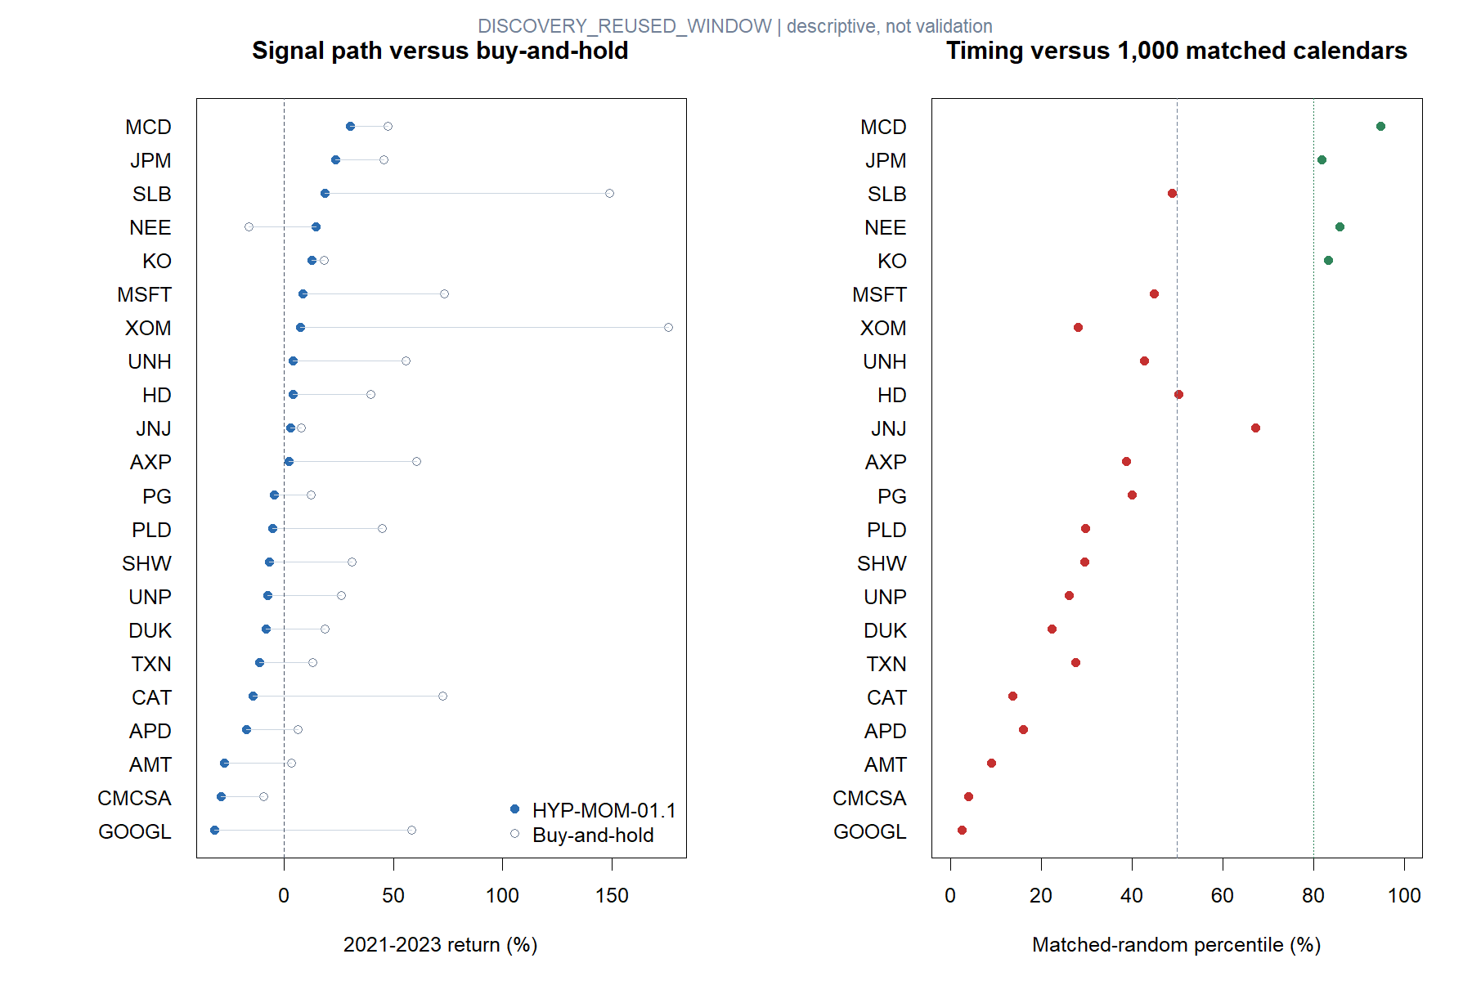
Across assets, the signal calendar usually lagged ownership and randomness
5
Notes:
Eleven of twenty-two asset paths were positive, but only NEE exceeded buy-and-hold. Four assets reached at least the 80th matched-random percentile; the cross-sectional median was 34.25%. This is broad evidence against a generic timing advantage in the inspected window.
[Sources]
- C:\Users\Franc\OneDrive\Documents\Francis\Peltata Project\Time-Series-Modeling-Gen5\runs\research_workbench\operator_hypothesis_lab\hyp_mom_01_1_two_green_gap_ups_discovery_20260803\hyp_mom_01_1_pooled_summary.csv
- C:\Users\Franc\OneDrive\Documents\Francis\Peltata Project\Time-Series-Modeling-Gen5\runs\research_workbench\operator_hypothesis_lab\hyp_mom_01_1_two_green_gap_ups_discovery_20260803\hyp_mom_01_1_asset_summary.csv
- C:\Users\Franc\OneDrive\Documents\Francis\Peltata Project\Time-Series-Modeling-Gen5\runs\research_workbench\operator_hypothesis_lab\hyp_mom_01_1_two_green_gap_ups_discovery_20260803\visuals\asset_return_and_random_control.png

Slide 6
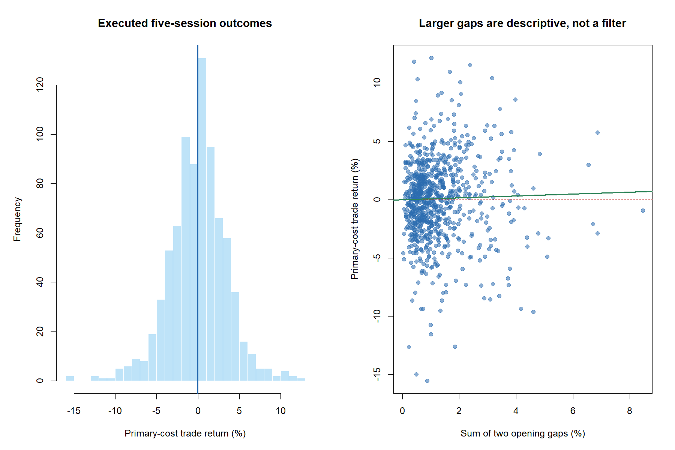
The loss tail mattered more than the slight winner majority
6
Notes:
The return distribution is centered close to zero with outcomes spanning roughly −15.5% to +12.2%. The exploratory regression line relating the sum of the two gaps to subsequent return is shallow and descriptive. It is not authority to install a minimum gap filter.
[Sources]
- C:\Users\Franc\OneDrive\Documents\Francis\Peltata Project\Time-Series-Modeling-Gen5\runs\research_workbench\operator_hypothesis_lab\hyp_mom_01_1_two_green_gap_ups_discovery_20260803\hyp_mom_01_1_executed_trades.csv
- C:\Users\Franc\OneDrive\Documents\Francis\Peltata Project\Time-Series-Modeling-Gen5\runs\research_workbench\operator_hypothesis_lab\hyp_mom_01_1_two_green_gap_ups_discovery_20260803\visuals\trade_distribution_and_gap_relationship.png

Slide 7
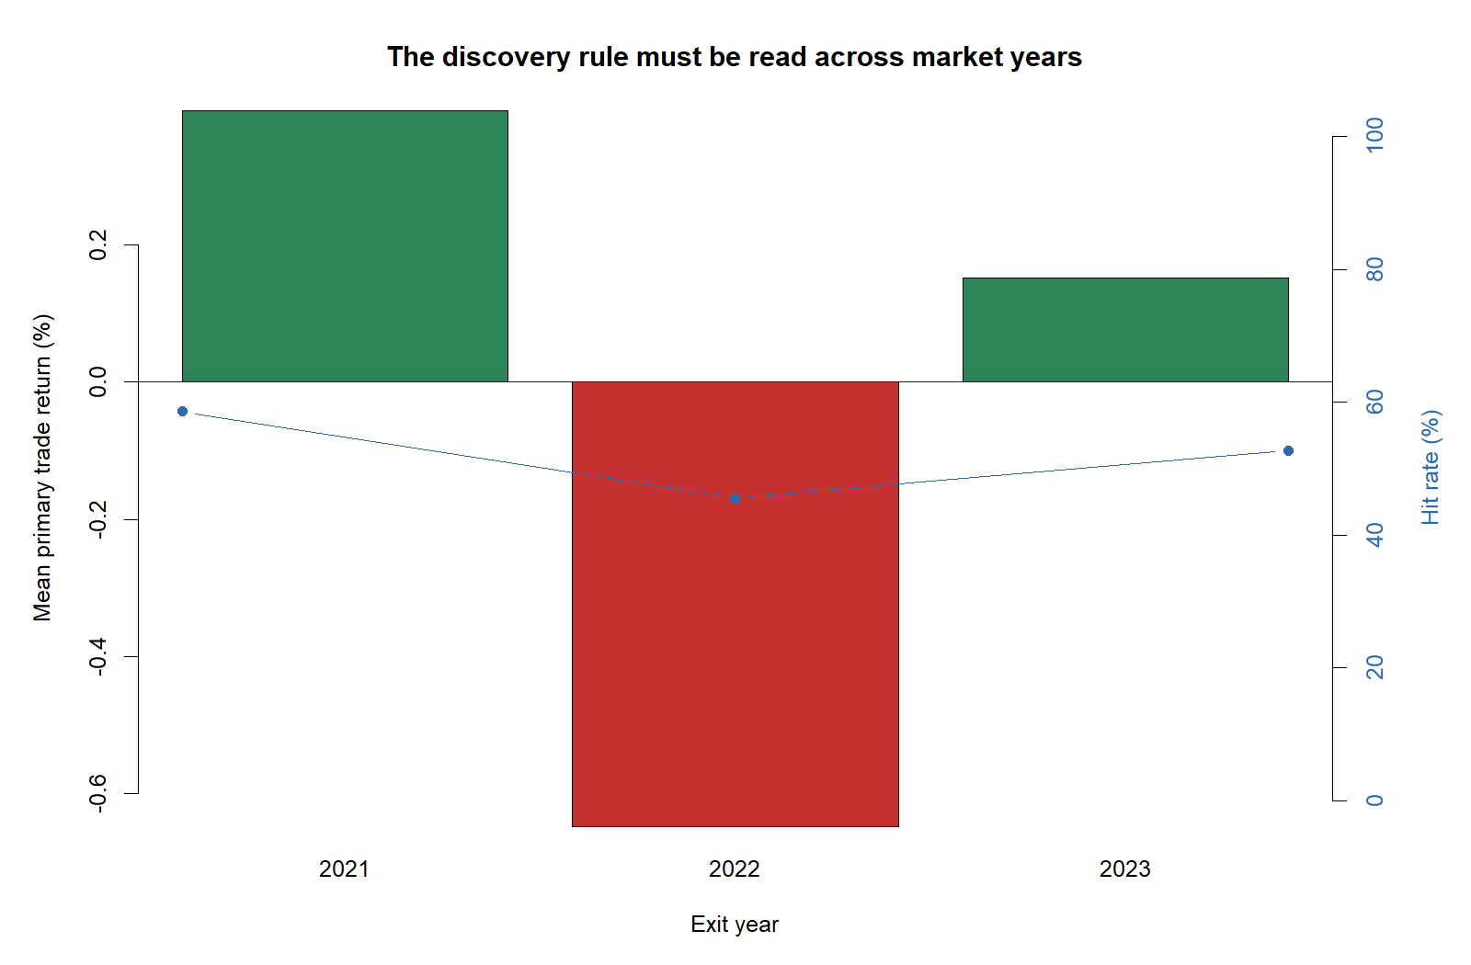
The same pattern behaved differently in 2021, 2022, and 2023
2021
+0.40% mean trade
58.6% hit rate
2022
−0.65% mean trade
45.6% hit rate
2023
+0.15% mean trade
52.7% hit rate
This looks regime-sensitive, but the inspected years cannot be mined into a filter.
7
Notes:
All 22 assets contributed trades in each year. The rule was positive in 2021, negative in 2022, and mildly positive in 2023. This motivates a future question about environment dependence, but choosing a regime filter on these same years would be post-hoc.
[Sources]
- C:\Users\Franc\OneDrive\Documents\Francis\Peltata Project\Time-Series-Modeling-Gen5\runs\research_workbench\operator_hypothesis_lab\hyp_mom_01_1_two_green_gap_ups_discovery_20260803\hyp_mom_01_1_calendar_years.csv
- C:\Users\Franc\OneDrive\Documents\Francis\Peltata Project\Time-Series-Modeling-Gen5\runs\research_workbench\operator_hypothesis_lab\hyp_mom_01_1_two_green_gap_ups_discovery_20260803\visuals\calendar_year_trade_behavior.png

Slide 8
PATH AUDIT
Five assets reveal five
different failure and
survivor stories
Read the blue strategy path against gray ownership; shaded blocks are executed trades.
8
Notes:
The following examples were selected by a frozen, outcome-aware manifest before individual paths were inspected: cross-sectional medoid, highest return, lowest return, highest random percentile, and highest trade count. They are descriptive examples, not frequency estimates or nominees.
[Sources]
- C:\Users\Franc\OneDrive\Documents\Francis\Peltata Project\Time-Series-Modeling-Gen5\operator_hypothesis_lab\docs\HYP_MOM_01_1_TWO_GREEN_GAP_UPS_DISCOVERY_CONTRACT.md
- C:\Users\Franc\OneDrive\Documents\Francis\Peltata Project\Time-Series-Modeling-Gen5\runs\research_workbench\operator_hypothesis_lab\hyp_mom_01_1_two_green_gap_ups_discovery_20260803\hyp_mom_01_1_asset_tape_manifest.csv

Slide 9
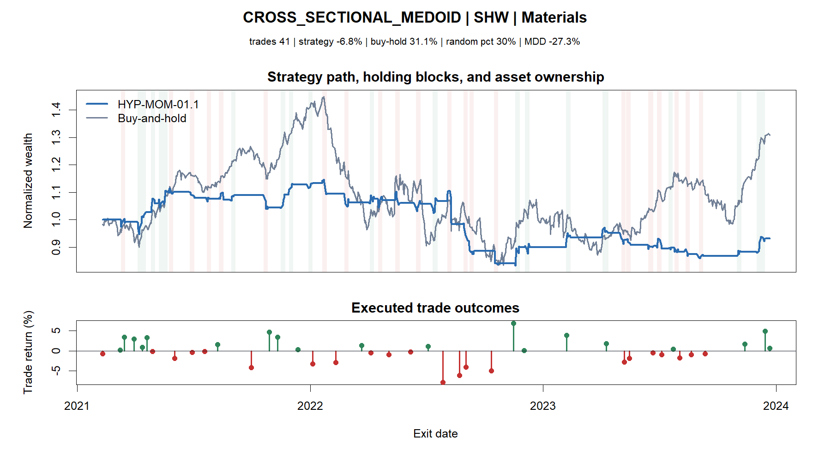
The typical path lost money while the underlying stock recovered
9
Notes:
SHW is the robust multivariate medoid. Its strategy path lost 6.8% while buy-and-hold gained 31.1%, and it sat at the 30th matched-random percentile. The path repeatedly captured small gains but suffered larger clustered losses.
[Sources]
- C:\Users\Franc\OneDrive\Documents\Francis\Peltata Project\Time-Series-Modeling-Gen5\runs\research_workbench\operator_hypothesis_lab\hyp_mom_01_1_two_green_gap_ups_discovery_20260803\hyp_mom_01_1_asset_tape_manifest.csv
- C:\Users\Franc\OneDrive\Documents\Francis\Peltata Project\Time-Series-Modeling-Gen5\runs\research_workbench\operator_hypothesis_lab\hyp_mom_01_1_two_green_gap_ups_discovery_20260803\hyp_mom_01_1_asset_summary.csv
- C:\Users\Franc\OneDrive\Documents\Francis\Peltata Project\Time-Series-Modeling-Gen5\runs\research_workbench\operator_hypothesis_lab\hyp_mom_01_1_two_green_gap_ups_discovery_20260803\visuals\asset_tape_01_cross_sectional_medoid_shw.png

Slide 10
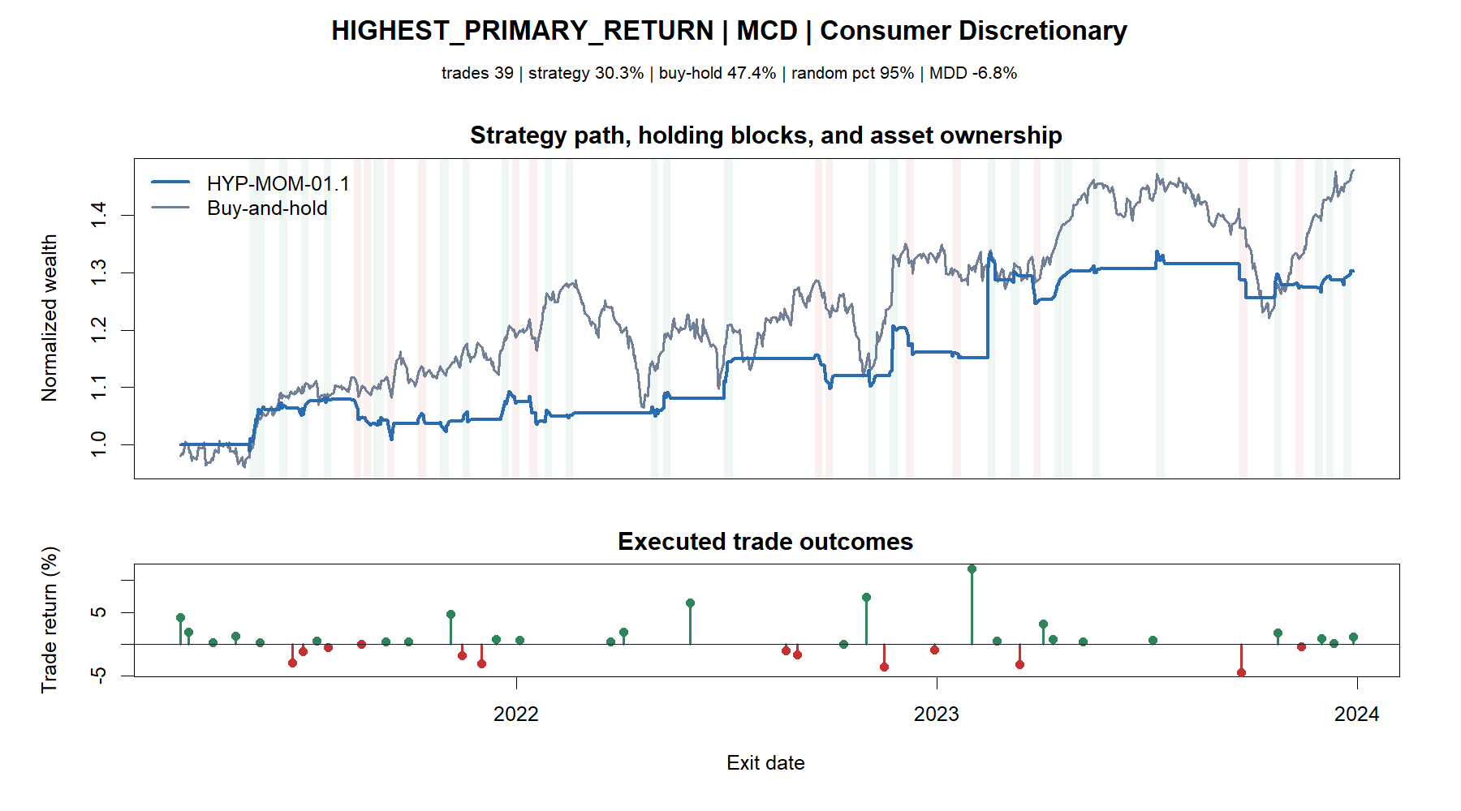
The strongest endpoint still trailed simply owning MCD
10
Notes:
MCD was the highest primary-return asset at +30.3% with a 95th random percentile and shallow −6.8% drawdown. Buy-and-hold still earned +47.4%. This is an interesting survivor, not incremental ownership evidence.
[Sources]
- C:\Users\Franc\OneDrive\Documents\Francis\Peltata Project\Time-Series-Modeling-Gen5\runs\research_workbench\operator_hypothesis_lab\hyp_mom_01_1_two_green_gap_ups_discovery_20260803\hyp_mom_01_1_asset_tape_manifest.csv
- C:\Users\Franc\OneDrive\Documents\Francis\Peltata Project\Time-Series-Modeling-Gen5\runs\research_workbench\operator_hypothesis_lab\hyp_mom_01_1_two_green_gap_ups_discovery_20260803\hyp_mom_01_1_asset_summary.csv
- C:\Users\Franc\OneDrive\Documents\Francis\Peltata Project\Time-Series-Modeling-Gen5\runs\research_workbench\operator_hypothesis_lab\hyp_mom_01_1_two_green_gap_ups_discovery_20260803\visuals\asset_tape_02_highest_primary_return_mcd.png

Slide 11
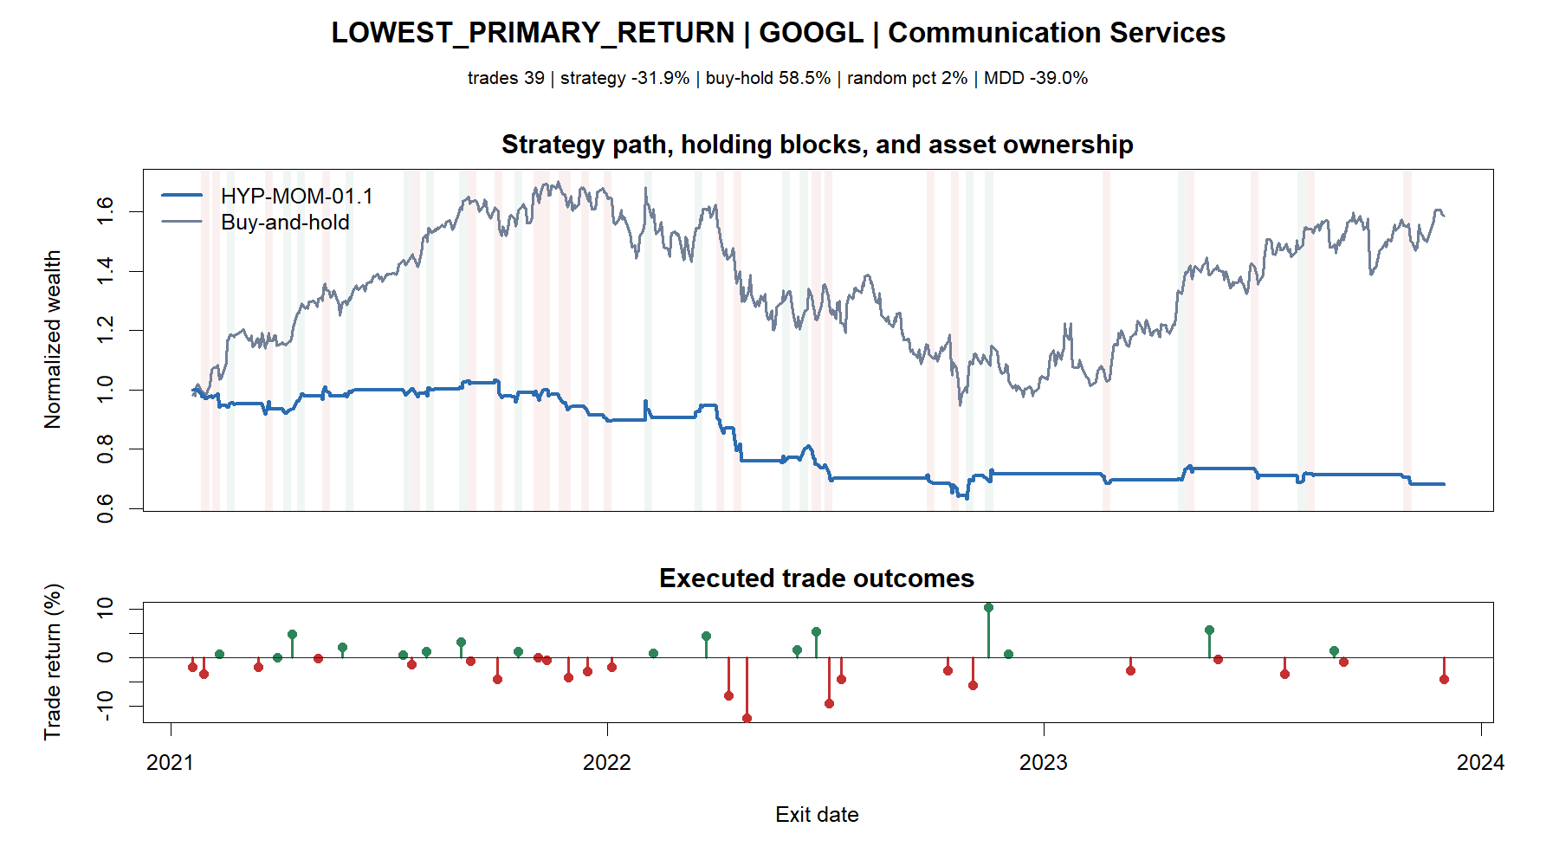
GOOGL turned a strong ownership period into a large strategy loss
11
Notes:
GOOGL was the lowest strategy path: −31.9% versus +58.5% buy-and-hold, 2nd random percentile, and −39.0% drawdown. Its losses clustered around the 2022 decline while the rule largely failed to capture the later recovery.
[Sources]
- C:\Users\Franc\OneDrive\Documents\Francis\Peltata Project\Time-Series-Modeling-Gen5\runs\research_workbench\operator_hypothesis_lab\hyp_mom_01_1_two_green_gap_ups_discovery_20260803\hyp_mom_01_1_asset_tape_manifest.csv
- C:\Users\Franc\OneDrive\Documents\Francis\Peltata Project\Time-Series-Modeling-Gen5\runs\research_workbench\operator_hypothesis_lab\hyp_mom_01_1_two_green_gap_ups_discovery_20260803\hyp_mom_01_1_asset_summary.csv
- C:\Users\Franc\OneDrive\Documents\Francis\Peltata Project\Time-Series-Modeling-Gen5\runs\research_workbench\operator_hypothesis_lab\hyp_mom_01_1_two_green_gap_ups_discovery_20260803\visuals\asset_tape_03_lowest_primary_return_googl.png

Slide 12
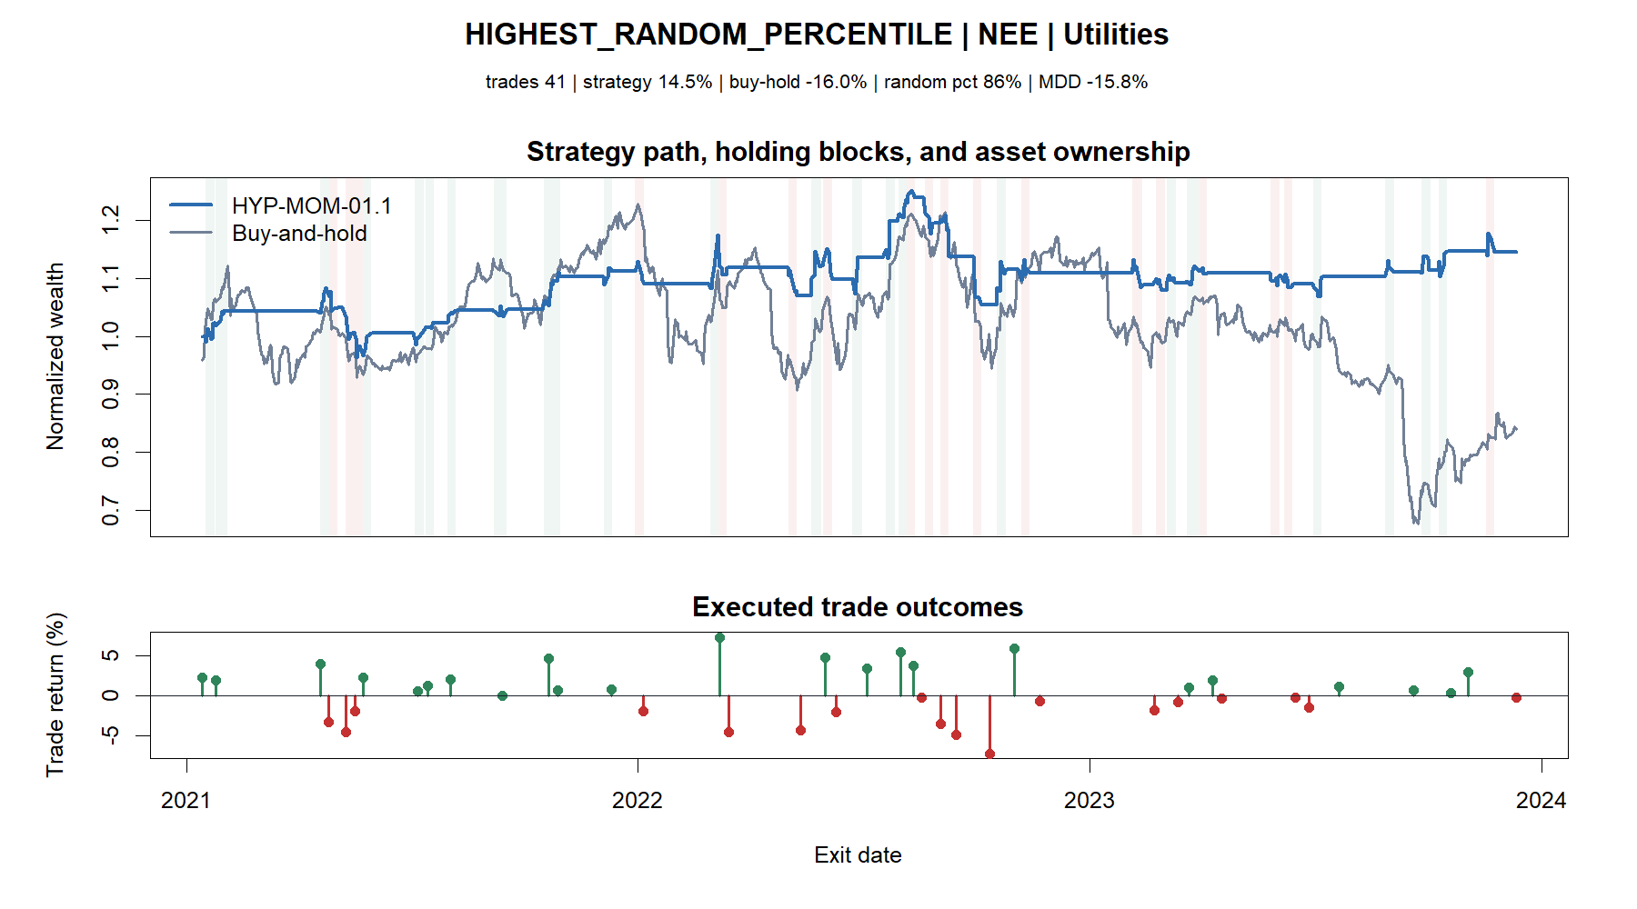
NEE is the lone buy-and-hold exception—and therefore only a question
12
Notes:
NEE returned +14.5% while buy-and-hold lost 16.0% and reached the 86th random percentile. It was the only asset to beat ownership. Because it was found inside inspected Discovery data, it cannot be nominated; it motivates a question about defensive or loss-avoidance behavior.
[Sources]
- C:\Users\Franc\OneDrive\Documents\Francis\Peltata Project\Time-Series-Modeling-Gen5\runs\research_workbench\operator_hypothesis_lab\hyp_mom_01_1_two_green_gap_ups_discovery_20260803\hyp_mom_01_1_asset_tape_manifest.csv
- C:\Users\Franc\OneDrive\Documents\Francis\Peltata Project\Time-Series-Modeling-Gen5\runs\research_workbench\operator_hypothesis_lab\hyp_mom_01_1_two_green_gap_ups_discovery_20260803\hyp_mom_01_1_asset_summary.csv
- C:\Users\Franc\OneDrive\Documents\Francis\Peltata Project\Time-Series-Modeling-Gen5\runs\research_workbench\operator_hypothesis_lab\hyp_mom_01_1_two_green_gap_ups_discovery_20260803\visuals\asset_tape_04_highest_random_percentile_nee.png

Slide 13
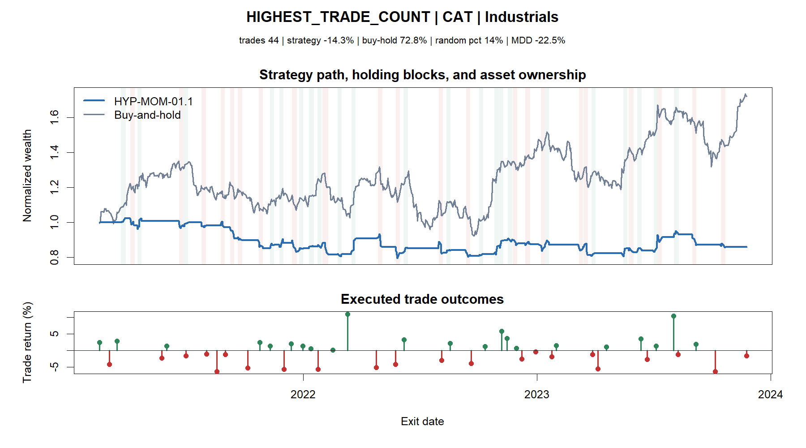
More signals did not help CAT
13
Notes:
CAT had the most executed trades at 44. The strategy lost 14.3% while buy-and-hold gained 72.8%, and its timing was at the 14th random percentile. Signal abundance is not evidence quality.
[Sources]
- C:\Users\Franc\OneDrive\Documents\Francis\Peltata Project\Time-Series-Modeling-Gen5\runs\research_workbench\operator_hypothesis_lab\hyp_mom_01_1_two_green_gap_ups_discovery_20260803\hyp_mom_01_1_asset_tape_manifest.csv
- C:\Users\Franc\OneDrive\Documents\Francis\Peltata Project\Time-Series-Modeling-Gen5\runs\research_workbench\operator_hypothesis_lab\hyp_mom_01_1_two_green_gap_ups_discovery_20260803\hyp_mom_01_1_asset_summary.csv
- C:\Users\Franc\OneDrive\Documents\Francis\Peltata Project\Time-Series-Modeling-Gen5\runs\research_workbench\operator_hypothesis_lab\hyp_mom_01_1_two_green_gap_ups_discovery_20260803\visuals\asset_tape_05_highest_trade_count_cat.png

Slide 14
INDIVIDUAL TRADES
A completed bullish pattern
did not guarantee immediate
follow-through
The entry is always the triangle after the two blue pattern sessions.
14
Notes:
The trade examples are frozen as best, worst, median, largest peak-to-exit giveback, and largest trough-to-exit recovery. The next two slides emphasize the best, worst, and median cases.
[Sources]
- C:\Users\Franc\OneDrive\Documents\Francis\Peltata Project\Time-Series-Modeling-Gen5\operator_hypothesis_lab\docs\HYP_MOM_01_1_TWO_GREEN_GAP_UPS_DISCOVERY_CONTRACT.md
- C:\Users\Franc\OneDrive\Documents\Francis\Peltata Project\Time-Series-Modeling-Gen5\runs\research_workbench\operator_hypothesis_lab\hyp_mom_01_1_two_green_gap_ups_discovery_20260803\hyp_mom_01_1_trade_tape_manifest.csv

Slide 15
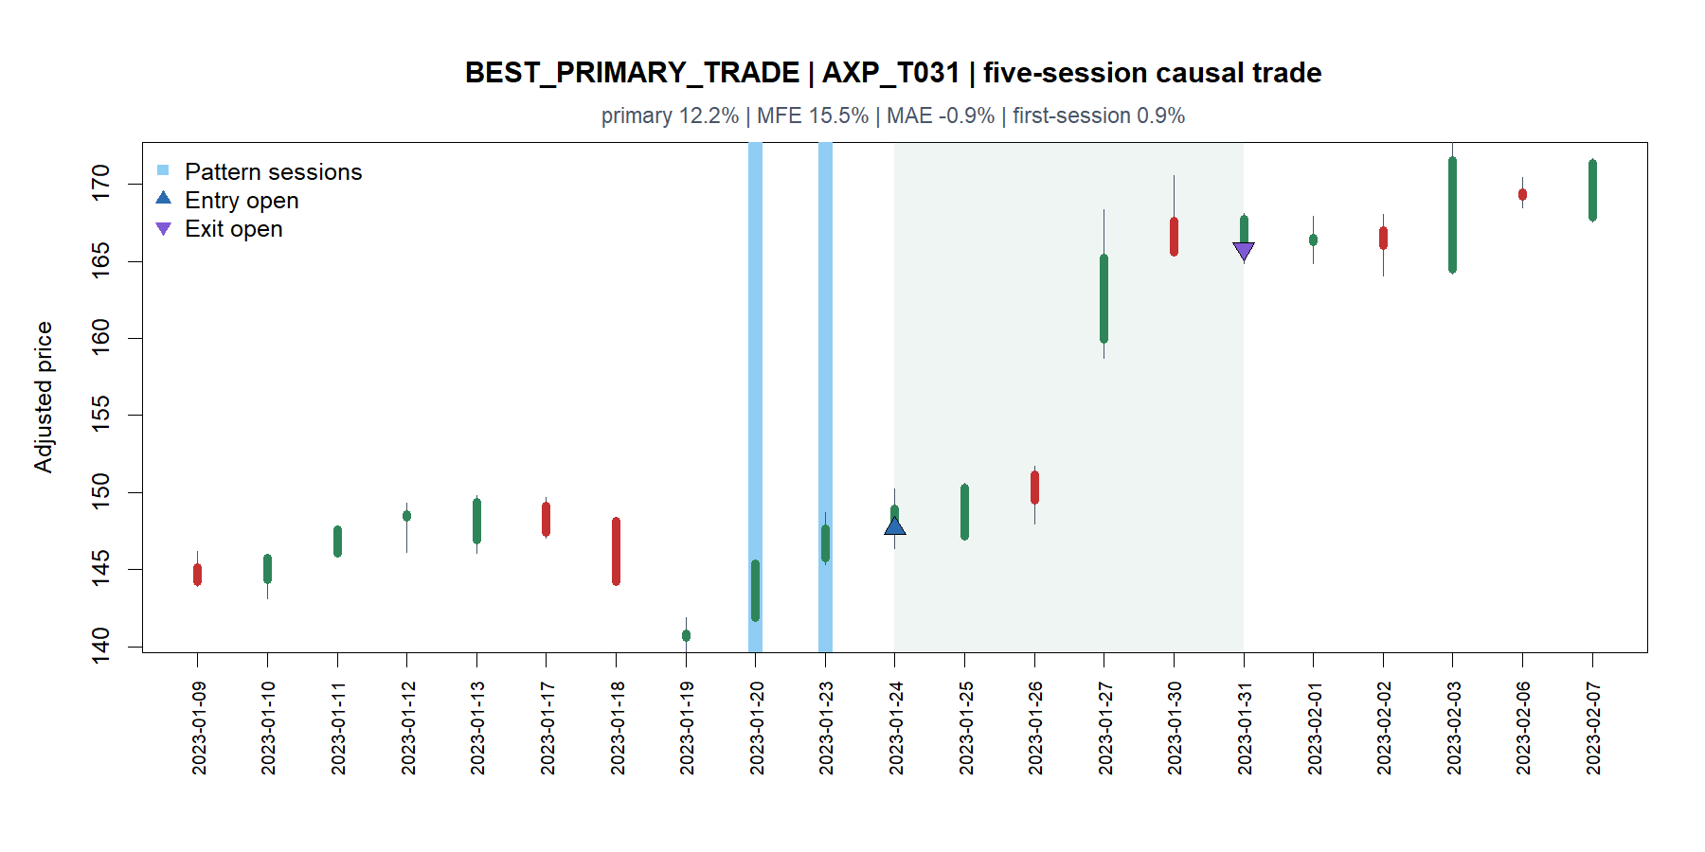
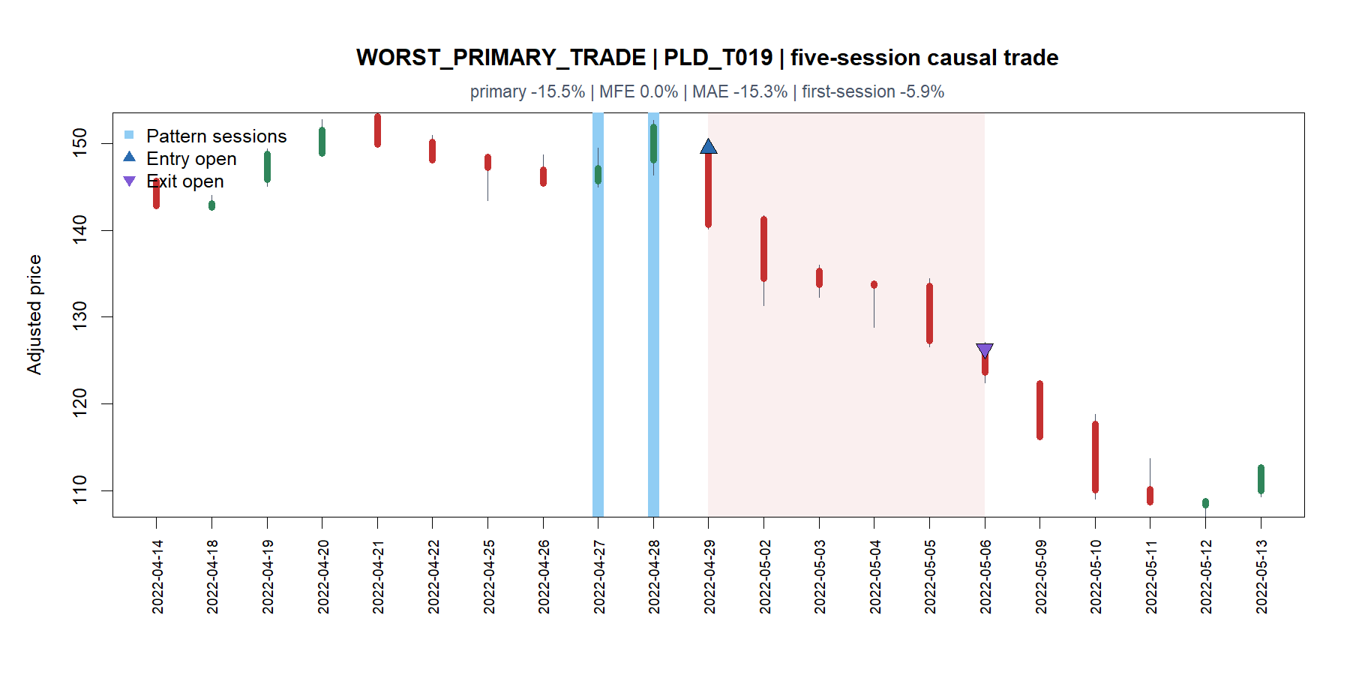
The same setup preceded both a +12.2% jump and a −15.5% collapse
15
Notes:
AXP's January 2023 example continued almost immediately and finished +12.2%. PLD's April 2022 example fell 5.9% on the first session, never traded above entry during the hold, and exited −15.5%. This is the tail asymmetry hidden by the overall hit rate.
[Sources]
- C:\Users\Franc\OneDrive\Documents\Francis\Peltata Project\Time-Series-Modeling-Gen5\runs\research_workbench\operator_hypothesis_lab\hyp_mom_01_1_two_green_gap_ups_discovery_20260803\hyp_mom_01_1_trade_tape_manifest.csv
- C:\Users\Franc\OneDrive\Documents\Francis\Peltata Project\Time-Series-Modeling-Gen5\runs\research_workbench\operator_hypothesis_lab\hyp_mom_01_1_two_green_gap_ups_discovery_20260803\hyp_mom_01_1_executed_trades.csv
- C:\Users\Franc\OneDrive\Documents\Francis\Peltata Project\Time-Series-Modeling-Gen5\runs\research_workbench\operator_hypothesis_lab\hyp_mom_01_1_two_green_gap_ups_discovery_20260803\visuals\trade_tape_01_best_primary_trade_axp.png
- C:\Users\Franc\OneDrive\Documents\Francis\Peltata Project\Time-Series-Modeling-Gen5\runs\research_workbench\operator_hypothesis_lab\hyp_mom_01_1_two_green_gap_ups_discovery_20260803\visuals\trade_tape_02_worst_primary_trade_pld.png

Slide 16
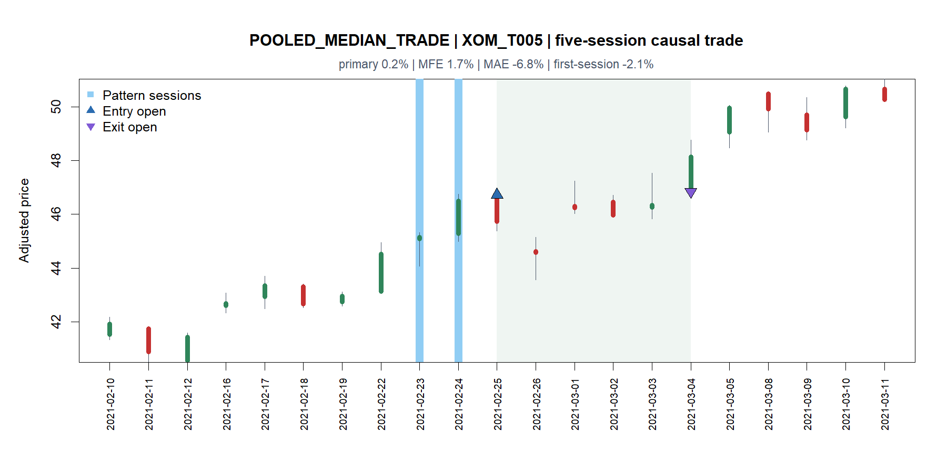
The median trade recovered from early weakness to finish nearly flat
XOM median example
• First session: −2.1%
• Maximum adverse excursion: −6.8%
• Exit return after costs: +0.2%
A fixed five-session exit tolerated substantial interim pain for almost no endpoint gain.
This motivates exit-path questions; it does not choose a stop.
16
Notes:
The pooled median primary return is +0.1566%. This XOM example fell sharply after entry, recovered, and exited nearly flat. Discovery may compare path behavior and formulate an exit question, but it may not install a stop after viewing these same outcomes.
[Sources]
- C:\Users\Franc\OneDrive\Documents\Francis\Peltata Project\Time-Series-Modeling-Gen5\runs\research_workbench\operator_hypothesis_lab\hyp_mom_01_1_two_green_gap_ups_discovery_20260803\hyp_mom_01_1_trade_tape_manifest.csv
- C:\Users\Franc\OneDrive\Documents\Francis\Peltata Project\Time-Series-Modeling-Gen5\runs\research_workbench\operator_hypothesis_lab\hyp_mom_01_1_two_green_gap_ups_discovery_20260803\hyp_mom_01_1_executed_trades.csv
- C:\Users\Franc\OneDrive\Documents\Francis\Peltata Project\Time-Series-Modeling-Gen5\runs\research_workbench\operator_hypothesis_lab\hyp_mom_01_1_two_green_gap_ups_discovery_20260803\visuals\trade_tape_03_pooled_median_trade_xom.png

Slide 17
The raw rule is weak, but it taught us exactly what to ask next
1
Exit-path hypothesis
3
Pattern-strength hypothesis
Does early failure or giveback contain information before day five?
Do gap and candle structure matter after multiplicity is controlled?
2
Environment hypothesis
Current decision
Why did 2022 and most high-beta paths fail while NEE avoided losses?
DISCOVERY COMPLETE
NO PROMOTION AUTHORITY
2024+ remains sealed
Discuss one question before freezing any 01.2 variant or replication.
17
Notes:
The rule is not promising as a generic five-session entry policy in the inspected discovery window. The productive outcome is narrower: we now know the failure is driven by tail asymmetry, year dependence, and large cross-asset heterogeneity. The operator should choose one theoretical question before any additional testing.
[Sources]
- C:\Users\Franc\OneDrive\Documents\Francis\Peltata Project\Time-Series-Modeling-Gen5\runs\research_workbench\operator_hypothesis_lab\hyp_mom_01_1_two_green_gap_ups_discovery_20260803\hyp_mom_01_1_report.md
- C:\Users\Franc\OneDrive\Documents\Francis\Peltata Project\Time-Series-Modeling-Gen5\runs\research_workbench\operator_hypothesis_lab\hyp_mom_01_1_two_green_gap_ups_discovery_20260803\hyp_mom_01_1_pooled_summary.csv
- C:\Users\Franc\OneDrive\Documents\Francis\Peltata Project\Time-Series-Modeling-Gen5\runs\research_workbench\operator_hypothesis_lab\hyp_mom_01_1_two_green_gap_ups_discovery_20260803\hyp_mom_01_1_asset_summary.csv
- C:\Users\Franc\OneDrive\Documents\Francis\Peltata Project\Time-Series-Modeling-Gen5\operator_hypothesis_lab\docs\HYP_MOM_01_1_TWO_GREEN_GAP_UPS_DISCOVERY_CONTRACT.md

