Slide 1
GEN5 LITERATURE-GROUNDED POC | 28 JUL 2026
L1 sector reversal stops at TRAIN
A simple long-short rule failed before later evidence was opened.
Notes:
Open with the decision, not the mechanics. The useful result is that the staged contract prevented an unpromising TRAIN effect from becoming a full backtest story.
[Sources]
- C:/Users/Franc/OneDrive/Documents/Francis/Peltata Project/Time-Series-Modeling-Gen5/docs/GEN5_L1_LONG_SHORT_SECTOR_REVERSAL_POC_CONTRACT.md
- C:/Users/Franc/OneDrive/Documents/Francis/Peltata Project/Time-Series-Modeling-Gen5/runs/research_workbench/retail_quant_mechanisms/l1_sector_reversal_20260728/l1_report.md

Slide 2
The rule was simple enough to falsify
Every fifth session, rank nine sector ETFs by trailing five-session return. Buy the two losers, short the two winners, and hold from the following open for five sessions.
2 + 2
5 / 5
100% / 0%
Two equal-weight longs Two equal-weight shorts
Five-session lookback Five-session holding period
Gross exposure / net dollar exposure
2
Notes:
The formula deliberately omits volatility scaling, beta fitting, stop losses, regimes, and parameter search.
[Sources]
- C:/Users/Franc/OneDrive/Documents/Francis/Peltata Project/Time-Series-Modeling-Gen5/docs/GEN5_L1_LONG_SHORT_SECTOR_REVERSAL_POC_CONTRACT.md
- Ernest P. Chan, Algorithmic Trading (2013), printed pp. 6-7 and 102-106.
- Michael L. Halls-Moore, Successful Algorithmic Trading, printed pp. 16-20.

Slide 3
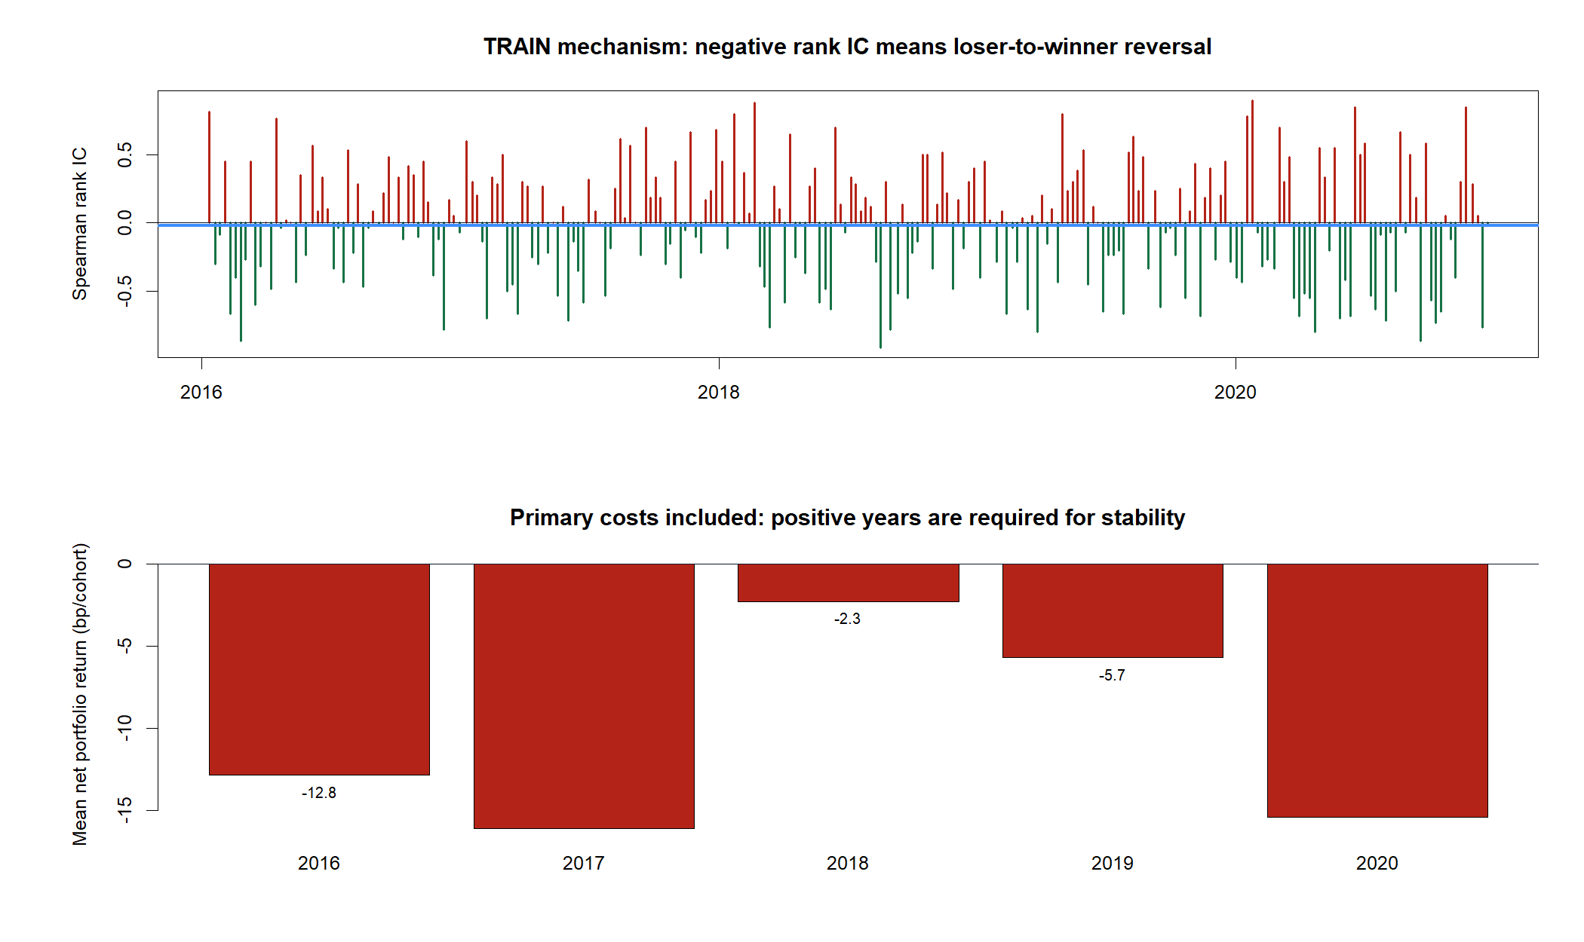
TRAIN showed no reliable reversal edge
250 nonoverlapping cohorts Mean rank IC: -0.0188 95% interval: [-0.0704, 0.0321] Mean net return: -10.47 bp per cohort All five TRAIN years were negative after primary costs.
3
Notes:
Negative IC is in the hypothesized direction, but the interval crosses zero. Economic results were negative in every TRAIN year after 5 bp one-way entry and exit costs.
[Sources]
- C:/Users/Franc/OneDrive/Documents/Francis/Peltata Project/Time-Series-Modeling-Gen5/runs/research_workbench/retail_quant_mechanisms/l1_sector_reversal_20260728/l1_train_bootstrap_summary.csv
- C:/Users/Franc/OneDrive/Documents/Francis/Peltata Project/Time-Series-Modeling-Gen5/runs/research_workbench/retail_quant_mechanisms/l1_sector_reversal_20260728/l1_train_year_summary.csv
- C:/Users/Franc/OneDrive/Documents/Francis/Peltata Project/Time-Series-Modeling-Gen5/runs/research_workbench/retail_quant_mechanisms/l1_sector_reversal_20260728/visuals/l1_train_stability.png
- Ernest P. Chan, Algorithmic Trading (2013), printed pp. 133-136 on horizon-specific, nonoverlapping tests.

Slide 4
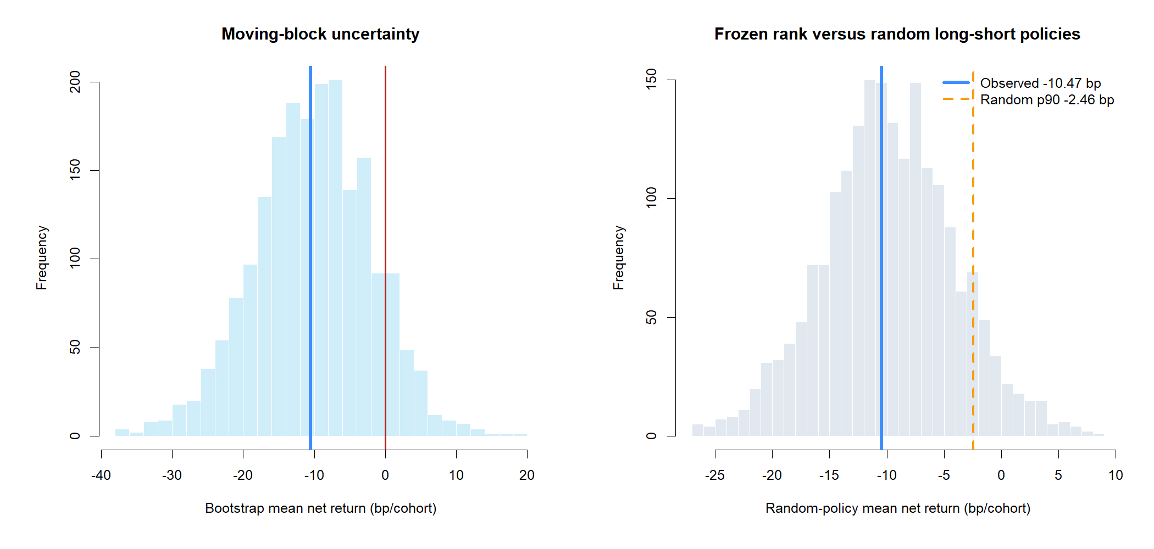
The frozen rank underperformed random policies
The observed rule sat inside a wide uncertainty band and below the p90 of 2,000 random long-short policies. It did not isolate a useful ranking mechanism.
-10.47 bp
-2.46 bp
Observed mean net return
Random-policy p90
4
Notes:
The randomized control preserves each cohort's realized cross-section while removing the frozen loser/winner labels. The observed rank was worse than the random p90 threshold.
[Sources]
- C:/Users/Franc/OneDrive/Documents/Francis/Peltata Project/Time-Series-Modeling-Gen5/runs/research_workbench/retail_quant_mechanisms/l1_sector_reversal_20260728/l1_train_bootstrap_draws.csv
- C:/Users/Franc/OneDrive/Documents/Francis/Peltata Project/Time-Series-Modeling-Gen5/runs/research_workbench/retail_quant_mechanisms/l1_sector_reversal_20260728/l1_train_random_policy_distribution.csv
- C:/Users/Franc/OneDrive/Documents/Francis/Peltata Project/Time-Series-Modeling-Gen5/runs/research_workbench/retail_quant_mechanisms/l1_sector_reversal_20260728/visuals/l1_train_resampling.png
- C:/Users/Franc/OneDrive/Documents/Francis/Peltata Project/Time-Series-Modeling-Gen5/docs/GEN5_L1_LONG_SHORT_SECTOR_REVERSAL_POC_CONTRACT.md

Slide 5
Absolute direction also missed the baseline
The relative spread prediction and absolute up/down prediction were scored separately. Long selections rose more often than shorts fell, but the combined classifier was no better than chance.
48.7%
56.2%
41.2%
Raw and balanced directional accuracy
Long selections that subsequently rose
Short selections that subsequently fell
5
Notes:
A profitable spread can exist even when both legs move in the same absolute direction. Here neither the relative spread hit rate (49.6%) nor the combined absolute classifier supported the hypothesis.
[Sources]
- C:/Users/Franc/OneDrive/Documents/Francis/Peltata Project/Time-Series-Modeling-Gen5/runs/research_workbench/retail_quant_mechanisms/l1_sector_reversal_20260728/l1_train_direction_scorecard.csv
- C:/Users/Franc/OneDrive/Documents/Francis/Peltata Project/Time-Series-Modeling-Gen5/runs/research_workbench/retail_quant_mechanisms/l1_sector_reversal_20260728/l1_train_direction_confusion.csv
- Ernest P. Chan, Algorithmic Trading (2013), printed p. 134 on sign-based prediction.

Slide 6
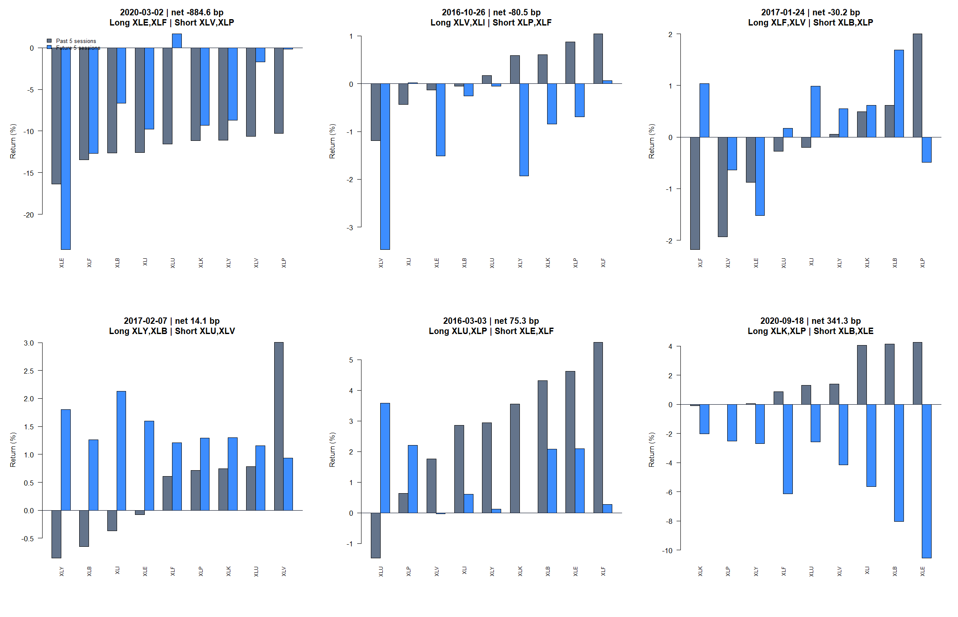
Representative tapes reveal unstable outcomes
Large wins and losses both occurred, but they did not form a repeatable, cost-aware distribution. The cohort - not its four ETF legs - is the independent trade unit.
-884.6 bp
+341.3 bp
Worst representative cohort
Best representative cohort
6
Notes:
The panels span the cohort-return distribution. Gray bars are the ranking window; blue bars are the following five-session outcome.
[Sources]
- C:/Users/Franc/OneDrive/Documents/Francis/Peltata Project/Time-Series-Modeling-Gen5/runs/research_workbench/retail_quant_mechanisms/l1_sector_reversal_20260728/l1_train_cohorts.csv
- C:/Users/Franc/OneDrive/Documents/Francis/Peltata Project/Time-Series-Modeling-Gen5/runs/research_workbench/retail_quant_mechanisms/l1_sector_reversal_20260728/l1_train_panel.csv
- C:/Users/Franc/OneDrive/Documents/Francis/Peltata Project/Time-Series-Modeling-Gen5/runs/research_workbench/retail_quant_mechanisms/l1_sector_reversal_20260728/visuals/l1_representative_cohorts.png
- Michael L. Halls-Moore, Successful Algorithmic Trading, printed pp. 109-111 on trade- and bar-level evaluation.

Slide 7
The correct output is STOP
Integrity passed, but every substantive TRAIN gate failed. The contract therefore withheld DEVELOPMENT, CONFIRMATION, Sharpe, drawdown, trade PnL, and equity replay.
1 / 6
5 / 6
0
TRAIN gates passed Integrity only
TRAIN gates failed Mechanism not admitted
Later partitions opened No performance claims
7
Notes:
This is a structural NOT_RUN, not missing reporting. Later outcome functions were not called after the L1A failure.
[Sources]
- C:/Users/Franc/OneDrive/Documents/Francis/Peltata Project/Time-Series-Modeling-Gen5/runs/research_workbench/retail_quant_mechanisms/l1_sector_reversal_20260728/l1_gate_summary.csv
- C:/Users/Franc/OneDrive/Documents/Francis/Peltata Project/Time-Series-Modeling-Gen5/runs/research_workbench/retail_quant_mechanisms/l1_sector_reversal_20260728/l1_run_spec.csv
- C:/Users/Franc/OneDrive/Documents/Francis/Peltata Project/Time-Series-Modeling-Gen5/runs/research_workbench/retail_quant_mechanisms/l1_sector_reversal_20260728/l1_integrity_audit.csv
- C:/Users/Franc/OneDrive/Documents/Francis/Peltata Project/Time-Series-Modeling-Gen5/docs/GEN5_L1_LONG_SHORT_SECTOR_REVERSAL_POC_CONTRACT.md

Slide 8
DECISION
Do not rescue L1.
Preserve DEVELOPMENT and CONFIRMATION. Return to literature for a genuinely different mechanism - not a nearby horizon, filter, or universe tweak.
Notes:
The next research gate belongs to the operator. A separately frozen momentum POC remains a serious candidate, but this deck does not open it.
[Sources]
- C:/Users/Franc/OneDrive/Documents/Francis/Peltata Project/Time-Series-Modeling-Gen5/docs/GEN5_L1_LONG_SHORT_SECTOR_REVERSAL_POC_CONTRACT.md
- C:/Users/Franc/OneDrive/Documents/Francis/Peltata Project/Time-Series-Modeling-Gen5/runs/research_workbench/retail_quant_mechanisms/l1_sector_reversal_20260728/l1_report.md
- C:/Users/Franc/OneDrive/Documents/Francis/Peltata Project/Time-Series-Modeling-Gen5/docs/GEN5_LITERATURE_SOURCE_LEDGER.md

