Slide 1
OPERATOR HYPOTHESIS LAB • REUSED-WINDOW DISCOVERY
15
HYP-MOM-05.1
Ordered triple-SMA
pullback and reclaim
>
30
>
45
A causal 15 / 30 / 45 trend rule tested across a frozen 122-stock atlas at 1× and fixed-quantity 1.8× leverage.
12 AUG 2026
Notes:
Purpose: explain the frozen rule, its execution assumptions, the wide-atlas result, and the resulting STOP state.
[Sources]
- C:/Users/Franc/OneDrive/Documents/Francis/Peltata Project/Time-Series-Modeling-Gen5/operator_hypothesis_lab/docs/HYP_MOM_05_1_TRIPLE_SMA_PULLBACK_CONTRACT.md
- C:/Users/Franc/OneDrive/Documents/Francis/Peltata Project/Time-Series-Modeling-Gen5/runs/research_workbench/operator_hypothesis_lab/hyp_mom_05_1_triple_sma_pullback_wide_discovery_20260812/hyp_mom_05_1_run_spec.csv

Slide 2
Trend permission is separate from pullback timing
TREND STATE
SMAₙ(t) = (1/n) Σᵢ₌₀ⁿ⁻¹ Close(t−i)
CAUSAL STATE MACHINE
Ordered(t) = [SMA₁₅ > SMA₃₀ > SMA₄₅]
1
Initial entry
Fresh ordered-stack activation and close > SMA30; buy next open.
The stack is evidence of a rising multi-speed trend. It grants permission; it is not itself the exit trigger.
2
Exit
Close ≤ SMA30; sell next open. Losing stack order alone does not exit.
3
Re-entry
After an exit, close must freshly reclaim SMA30 while the stack is ordered.
Signals use completed closes; orders occur at the next session's open.
02
Notes:
The exit design intentionally tolerates temporary loss of stack ordering. Post-exit re-entry is stricter than a new stack activation: it requires a fresh SMA30 reclaim while ordered.
[Sources]
- C:/Users/Franc/OneDrive/Documents/Francis/Peltata Project/Time-Series-Modeling-Gen5/operator_hypothesis_lab/docs/HYP_MOM_05_1_TRIPLE_SMA_PULLBACK_CONTRACT.md
- C:/Users/Franc/OneDrive/Documents/Francis/Peltata Project/Time-Series-Modeling-Gen5/operator_hypothesis_lab/R/hyp_mom_05_1_triple_sma_pullback.R

Slide 3
The test makes timing, debt, and comparators explicit
CAUSAL BOUNDARY
FIXED-QUANTITY LEVERAGE
• Start each asset in cash
• No warm-start positions
• Liquidate at the final discovery open
• Reinvest prior trade equity
• Never access 2024+ confirmation
Gross₀ = L × Equity₀
Debt₀ = (L − 1) × Equity₀
Shares = Gross₀(1 − c) / EntryOpen
Debtₜ₊₁ = Debtₜ(1 + rdaily)
Equityₜ = Shares × Openₜ − Debtₜ
Primary friction
Stress
Comparators
5 bp one-way + 6% annual debt
10 bp one-way + 10% annual debt
Cash, buy & hold, SMA30-only, ordered-stack only, and 500 exposure-matched circular shifts
1.8× is not a daily-reset leveraged return series.
03
Notes:
Debt compounds once per open-to-open interval. Position quantity stays fixed during a trade. A 30% maintenance-equity proxy is reported, but no broker-specific liquidation is simulated.
[Sources]
- C:/Users/Franc/OneDrive/Documents/Francis/Peltata Project/Time-Series-Modeling-Gen5/operator_hypothesis_lab/docs/HYP_MOM_05_1_TRIPLE_SMA_PULLBACK_CONTRACT.md
- C:/Users/Franc/OneDrive/Documents/Francis/Peltata Project/Time-Series-Modeling-Gen5/operator_hypothesis_lab/R/hyp_mom_05_1_triple_sma_pullback.R
- C:/Users/Franc/OneDrive/Documents/Francis/Peltata Project/Time-Series-Modeling-Gen5/runs/research_workbench/operator_hypothesis_lab/hyp_mom_05_1_triple_sma_pullback_wide_discovery_20260812/hyp_mom_05_1_integrity.csv

Slide 4
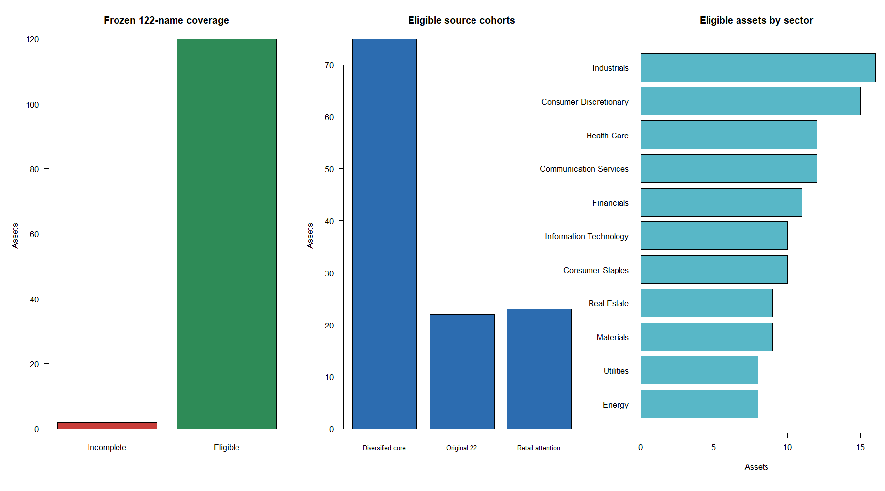
The refreshed atlas retained 120 of 122 stocks
APHA and SNE remained incomplete after refresh and were excluded; no replacements were introduced.
04
Notes:
The global stale labels arise from the deliberately bounded 2023 endpoint. APHA and SNE retained partial-history/refresh-needed warnings after the authorized refresh; neither entered analysis.
[Sources]
- C:/Users/Franc/OneDrive/Documents/Francis/Peltata Project/Time-Series-Modeling-Gen5/runs/research_workbench/operator_hypothesis_lab/hyp_mom_05_1_triple_sma_pullback_wide_discovery_20260812/hyp_mom_05_1_run_spec.csv
- C:/Users/Franc/OneDrive/Documents/Francis/Peltata Project/Time-Series-Modeling-Gen5/runs/research_workbench/operator_hypothesis_lab/hyp_mom_05_1_triple_sma_pullback_wide_discovery_20260812/hyp_mom_05_1_coverage.csv
- C:/Users/Franc/OneDrive/Documents/Francis/Peltata Project/Time-Series-Modeling-Gen5/runs/research_workbench/operator_hypothesis_lab/hyp_mom_05_1_triple_sma_pullback_wide_discovery_20260812/hyp_mom_05_1_integrity.csv
- C:/Users/Franc/OneDrive/Documents/Francis/Peltata Project/Time-Series-Modeling-Gen5/runs/research_workbench/operator_hypothesis_lab/hyp_mom_05_1_triple_sma_pullback_wide_discovery_20260812/hyp_mom_05_1_query_health.csv

Slide 5
The 15 / 30 / 45 rule was broadly negative
Across 120 eligible assets and 1,099 completed trades at each leverage, the strategy was usually out of the market—and usually wrong when it re-entered.
−3.4%
29.3%
10 / 120
Median total return • 1×
Median hit rate • 1×
Above 80th timing percentile
1.8× did not rescue the rule
Median return fell to −7.8% and median maximum drawdown deepened to −25.6%, versus −15.1% at 1×.
05
Notes:
Top-line medians are equal-asset descriptive summaries, not a portfolio replay. The 1× median Sharpe was -0.094 and median exposure was 11.1%.
[Sources]
- C:/Users/Franc/OneDrive/Documents/Francis/Peltata Project/Time-Series-Modeling-Gen5/runs/research_workbench/operator_hypothesis_lab/hyp_mom_05_1_triple_sma_pullback_wide_discovery_20260812/hyp_mom_05_1_panel_summary.csv
- C:/Users/Franc/OneDrive/Documents/Francis/Peltata Project/Time-Series-Modeling-Gen5/runs/research_workbench/operator_hypothesis_lab/hyp_mom_05_1_triple_sma_pullback_wide_discovery_20260812/hyp_mom_05_1_run_spec.csv

Slide 6
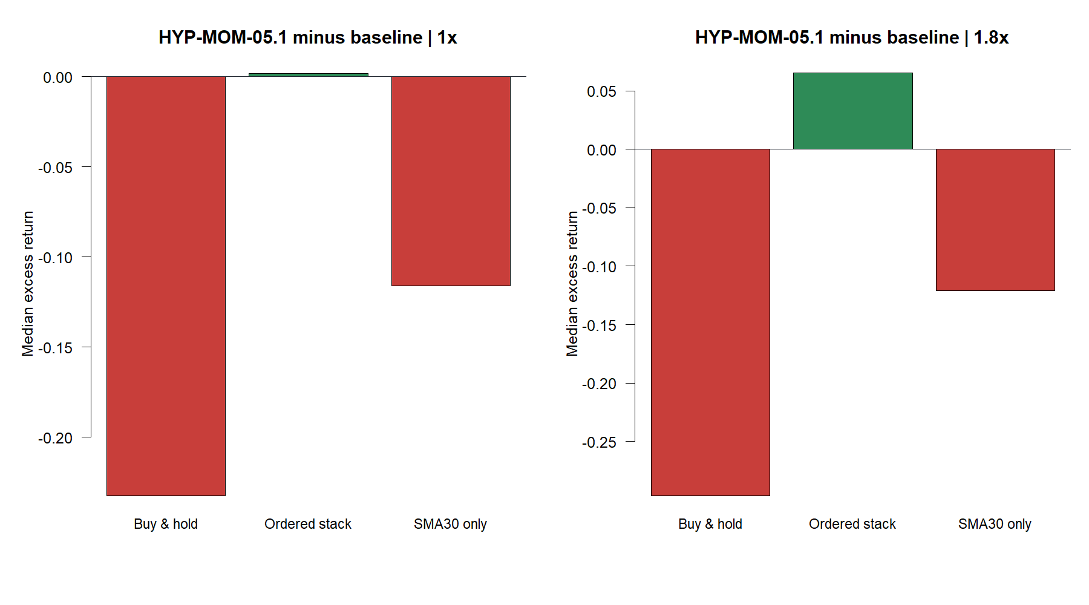
The hybrid lagged ownership and SMA30-only
Only the comparison with an ordered-stack-only policy was close at 1×; at 1.8× the hybrid beat that baseline because it spent less time exposed—not because its timing became strong.
06
Notes:
Median H05.1 excess return at 1×: -23.5 pp versus buy-and-hold, -11.9 pp versus SMA30-only, and -0.09 pp versus ordered-stack-only. At 1.8× it was +6.1 pp versus ordered-stack-only while remaining negative in absolute terms.
[Sources]
- C:/Users/Franc/OneDrive/Documents/Francis/Peltata Project/Time-Series-Modeling-Gen5/runs/research_workbench/operator_hypothesis_lab/hyp_mom_05_1_triple_sma_pullback_wide_discovery_20260812/hyp_mom_05_1_baseline_comparisons.csv

Slide 7
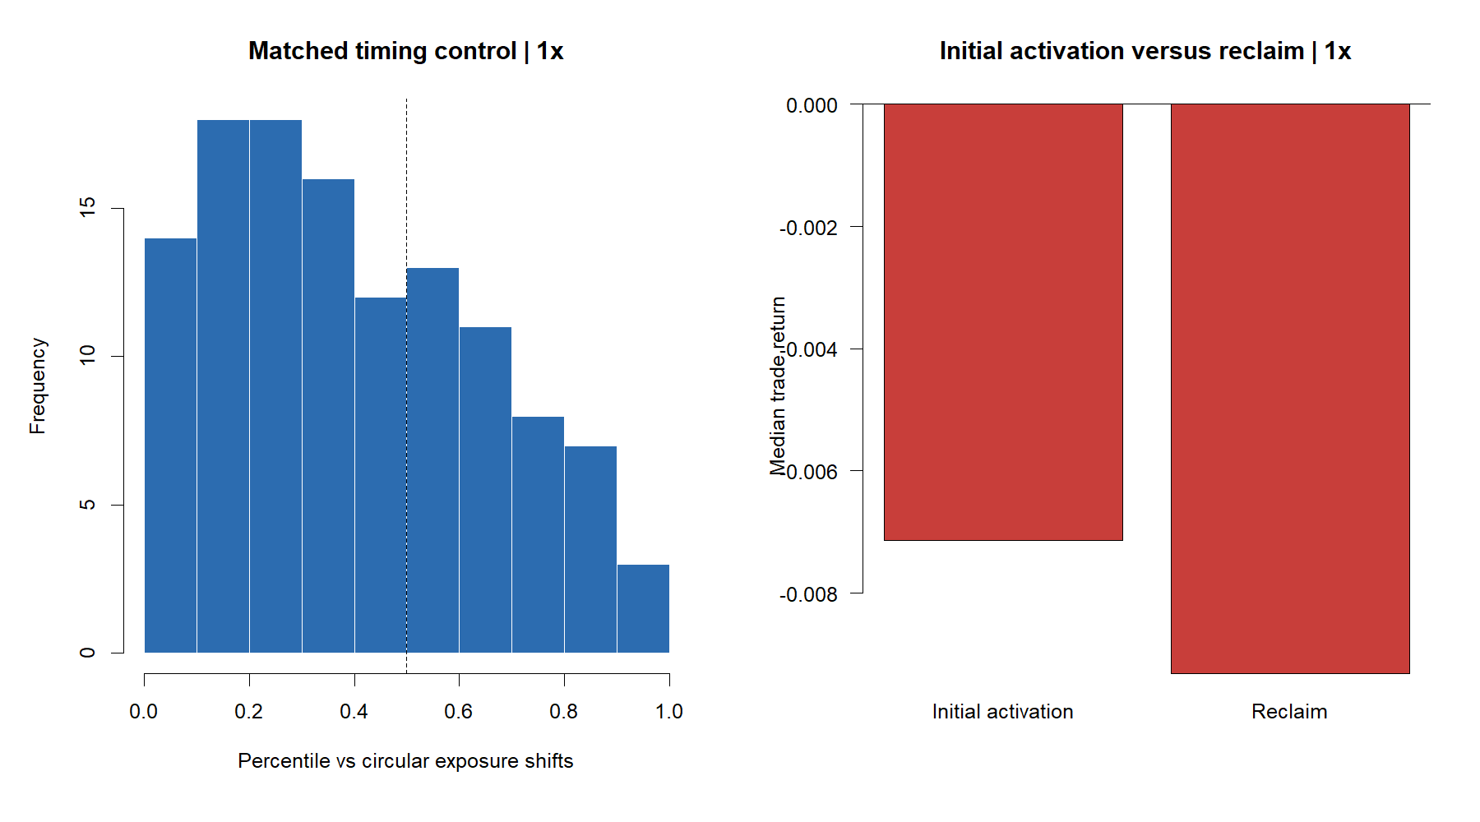
Repeated SMA30 reclaims became a whipsaw engine
979 of 1,099 trades were reclaims. Their median hold was 3 sessions, median return was −0.93%, and 83.3% of each asset's trades were typically ≤20 sessions.
07
Notes:
Initial activations also had negative median return (-0.71%) but held longer (16.5 sessions) and won more often (43.3%). Reclaims dominated count and had a 29.1% pooled hit rate.
[Sources]
- C:/Users/Franc/OneDrive/Documents/Francis/Peltata Project/Time-Series-Modeling-Gen5/runs/research_workbench/operator_hypothesis_lab/hyp_mom_05_1_triple_sma_pullback_wide_discovery_20260812/hyp_mom_05_1_entry_summary.csv
- C:/Users/Franc/OneDrive/Documents/Francis/Peltata Project/Time-Series-Modeling-Gen5/runs/research_workbench/operator_hypothesis_lab/hyp_mom_05_1_triple_sma_pullback_wide_discovery_20260812/hyp_mom_05_1_panel_summary.csv
- C:/Users/Franc/OneDrive/Documents/Francis/Peltata Project/Time-Series-Modeling-Gen5/runs/research_workbench/operator_hypothesis_lab/hyp_mom_05_1_triple_sma_pullback_wide_discovery_20260812/hyp_mom_05_1_trades.csv

Slide 8
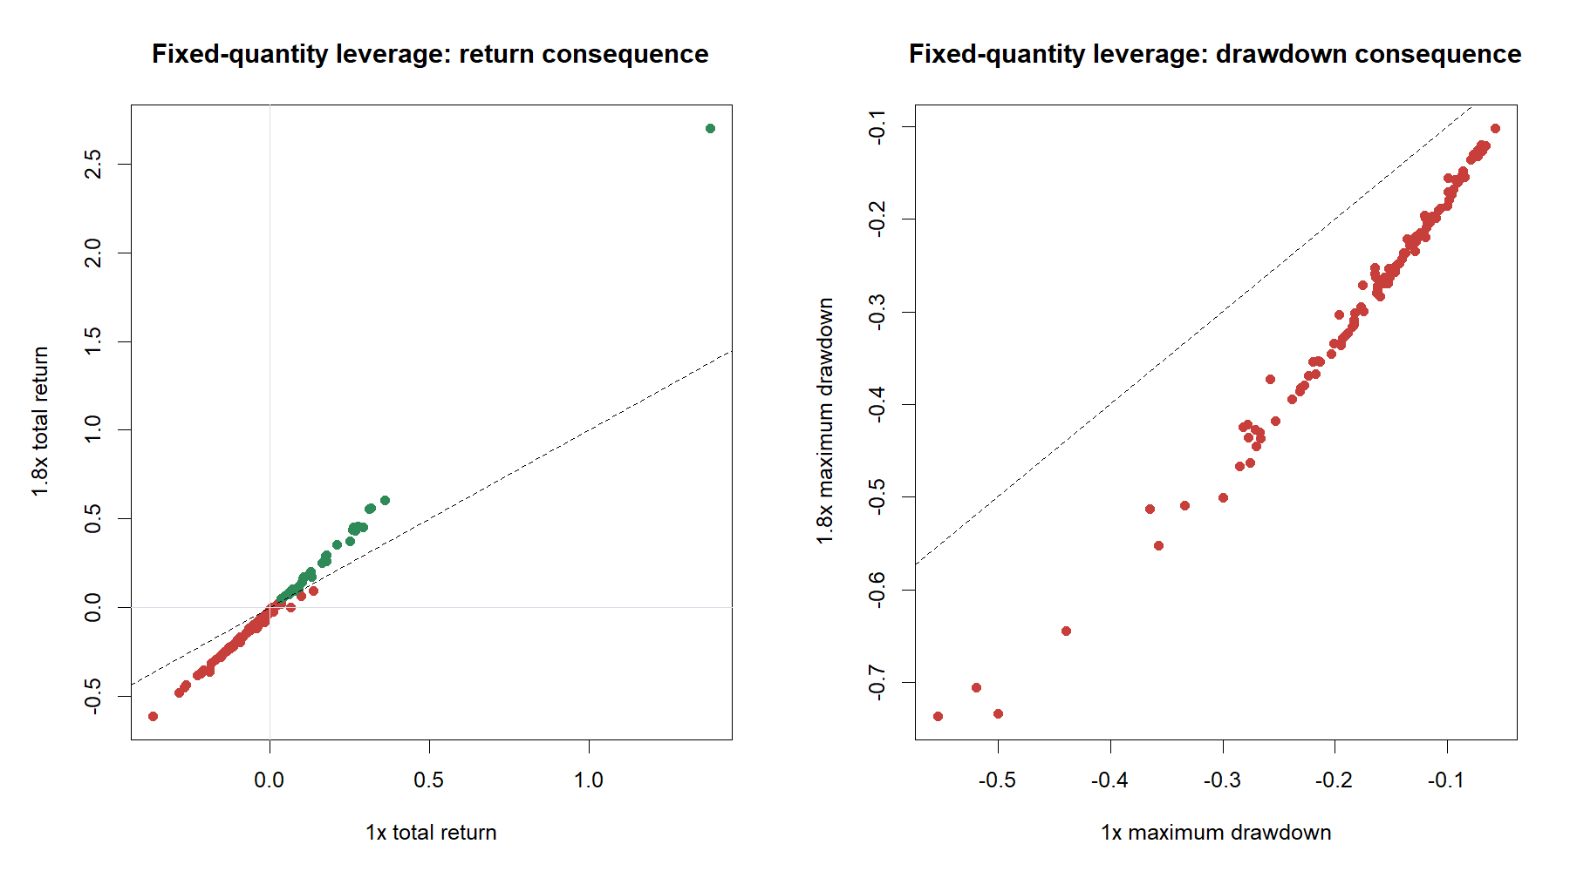
Fixed debt amplified a weak timing rule
No asset breached the 30% maintenance proxy and none reached nonpositive equity—but that does not make 1.8× attractive. Median return and drawdown both worsened, and financing added a median 1.44% of starting wealth in cost.
08
Notes:
The scatter uses fixed trade quantity and compounding debt. META is the large positive outlier; several weak names approach -70% 1.8x drawdowns.
[Sources]
- C:/Users/Franc/OneDrive/Documents/Francis/Peltata Project/Time-Series-Modeling-Gen5/runs/research_workbench/operator_hypothesis_lab/hyp_mom_05_1_triple_sma_pullback_wide_discovery_20260812/hyp_mom_05_1_leverage_comparisons.csv
- C:/Users/Franc/OneDrive/Documents/Francis/Peltata Project/Time-Series-Modeling-Gen5/runs/research_workbench/operator_hypothesis_lab/hyp_mom_05_1_triple_sma_pullback_wide_discovery_20260812/hyp_mom_05_1_panel_summary.csv
- C:/Users/Franc/OneDrive/Documents/Francis/Peltata Project/Time-Series-Modeling-Gen5/runs/research_workbench/operator_hypothesis_lab/hyp_mom_05_1_triple_sma_pullback_wide_discovery_20260812/hyp_mom_05_1_asset_policy_summary.csv

Slide 9
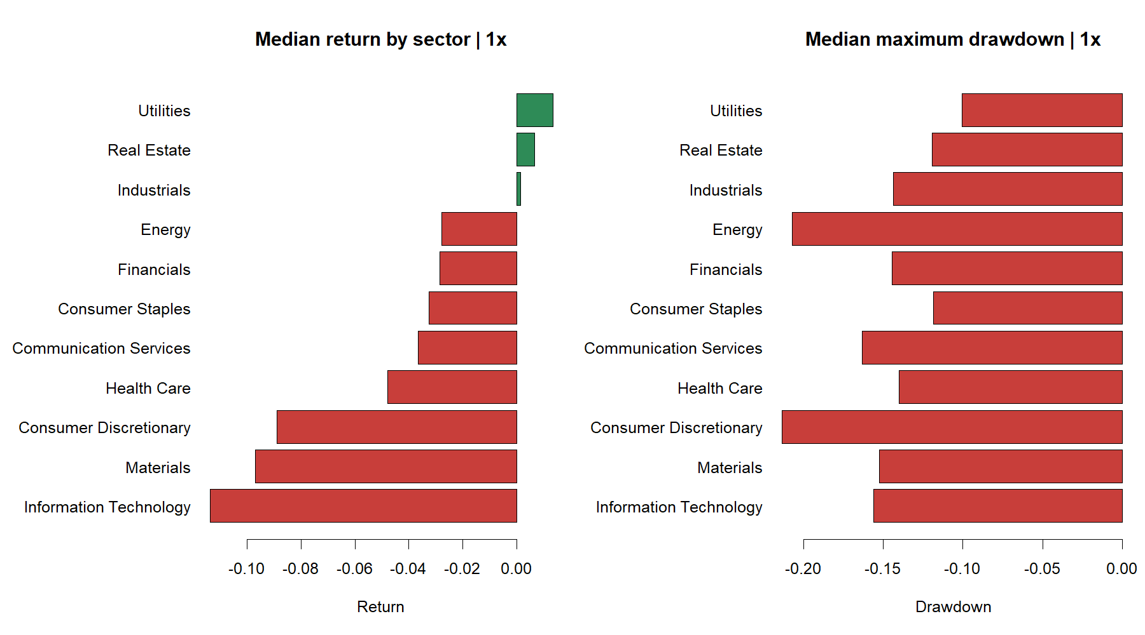
The weakness was broad, not confined to meme stocks
Utilities, real estate, and industrials were modestly positive at the median; eight of eleven sectors were negative. This is descriptive breadth, not a sector-selection license.
09
Notes:
The frozen atlas deliberately spans 11 sectors and includes both diversified-core and 2020 retail-attention cohorts. No sector was selected or excluded after results.
[Sources]
- C:/Users/Franc/OneDrive/Documents/Francis/Peltata Project/Time-Series-Modeling-Gen5/runs/research_workbench/operator_hypothesis_lab/hyp_mom_05_1_triple_sma_pullback_wide_discovery_20260812/hyp_mom_05_1_sector_summary.csv

Slide 10
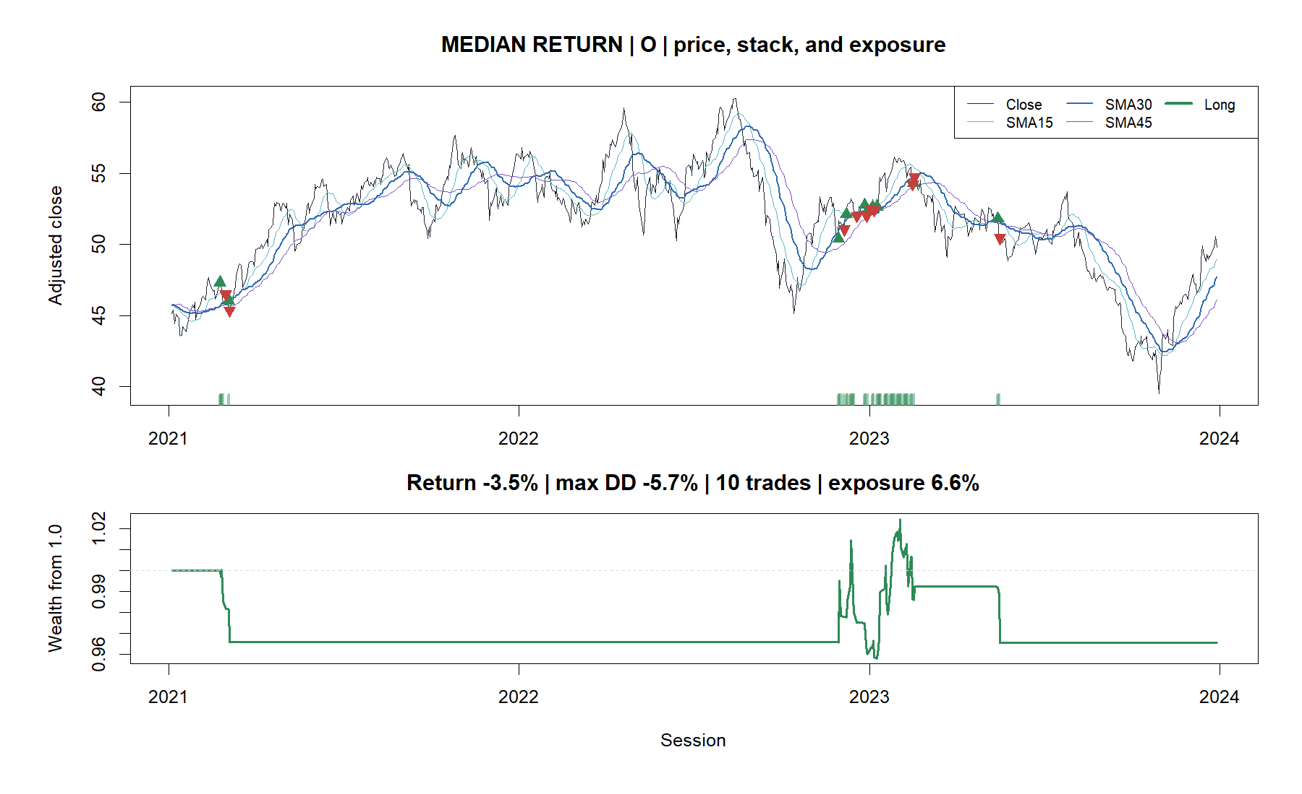
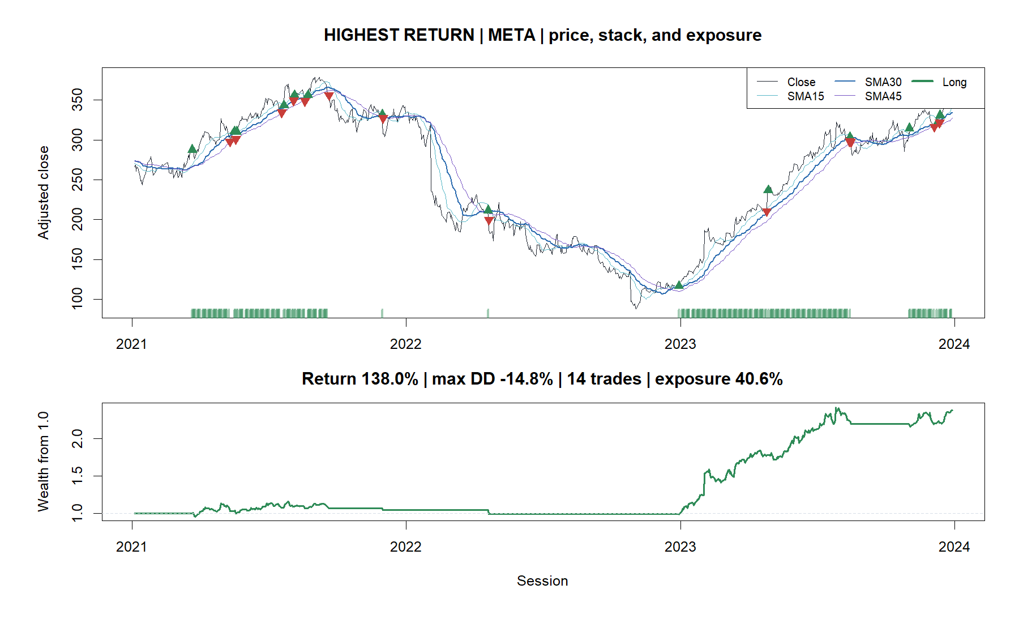
O sat mostly in cash; META captured trend bursts
O: −3.5%, 10 trades, 6.6% exposure
META: +138.0%, 14 trades, 40.6% exposure
10
Notes:
These are selected for behavioral coverage, not as evidence of asset selection. O is nearest the panel median return; META is the maximum-return case.
[Sources]
- C:/Users/Franc/OneDrive/Documents/Francis/Peltata Project/Time-Series-Modeling-Gen5/runs/research_workbench/operator_hypothesis_lab/hyp_mom_05_1_triple_sma_pullback_wide_discovery_20260812/hyp_mom_05_1_tape_manifest.csv
- C:/Users/Franc/OneDrive/Documents/Francis/Peltata Project/Time-Series-Modeling-Gen5/runs/research_workbench/operator_hypothesis_lab/hyp_mom_05_1_triple_sma_pullback_wide_discovery_20260812/hyp_mom_05_1_daily_paths.csv

Slide 11
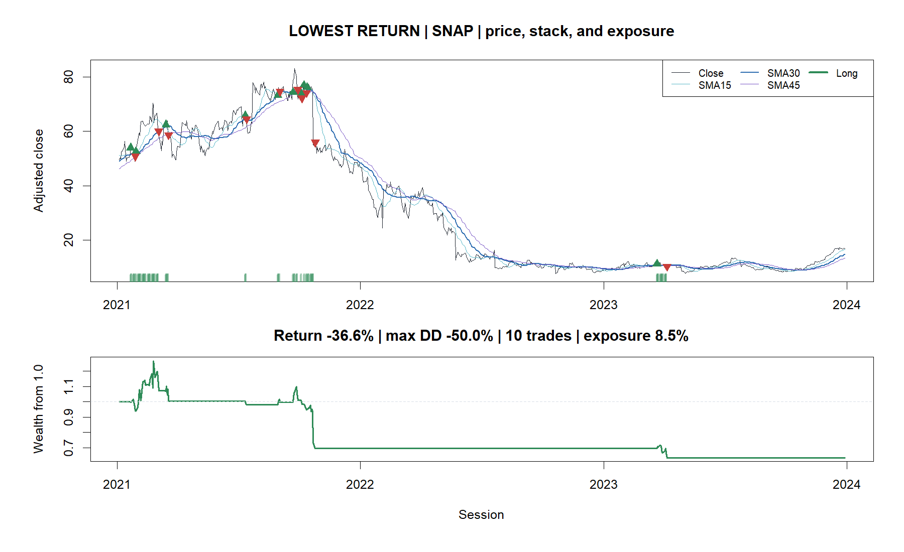
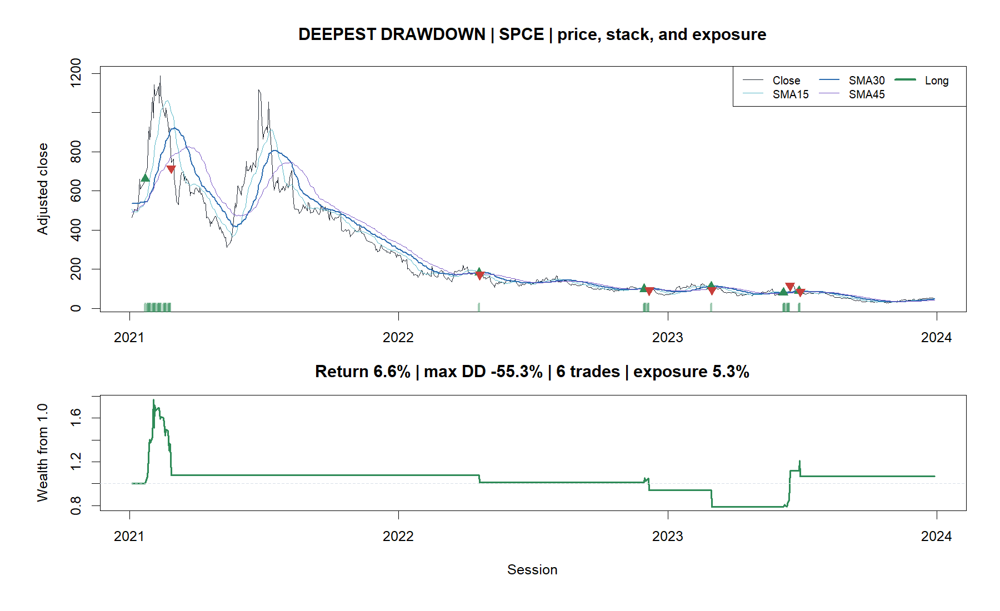
SNAP and SPCE expose hidden path risk
SNAP: −36.6%; repeated trend failure
SPCE: +6.6% final return; −55.3% max drawdown
11
Notes:
SNAP is the minimum-return case. SPCE has the deepest 1x drawdown even though its final return is positive, illustrating why terminal P&L cannot substitute for bar-by-bar risk.
[Sources]
- C:/Users/Franc/OneDrive/Documents/Francis/Peltata Project/Time-Series-Modeling-Gen5/runs/research_workbench/operator_hypothesis_lab/hyp_mom_05_1_triple_sma_pullback_wide_discovery_20260812/hyp_mom_05_1_tape_manifest.csv
- C:/Users/Franc/OneDrive/Documents/Francis/Peltata Project/Time-Series-Modeling-Gen5/runs/research_workbench/operator_hypothesis_lab/hyp_mom_05_1_triple_sma_pullback_wide_discovery_20260812/hyp_mom_05_1_daily_paths.csv

Slide 12
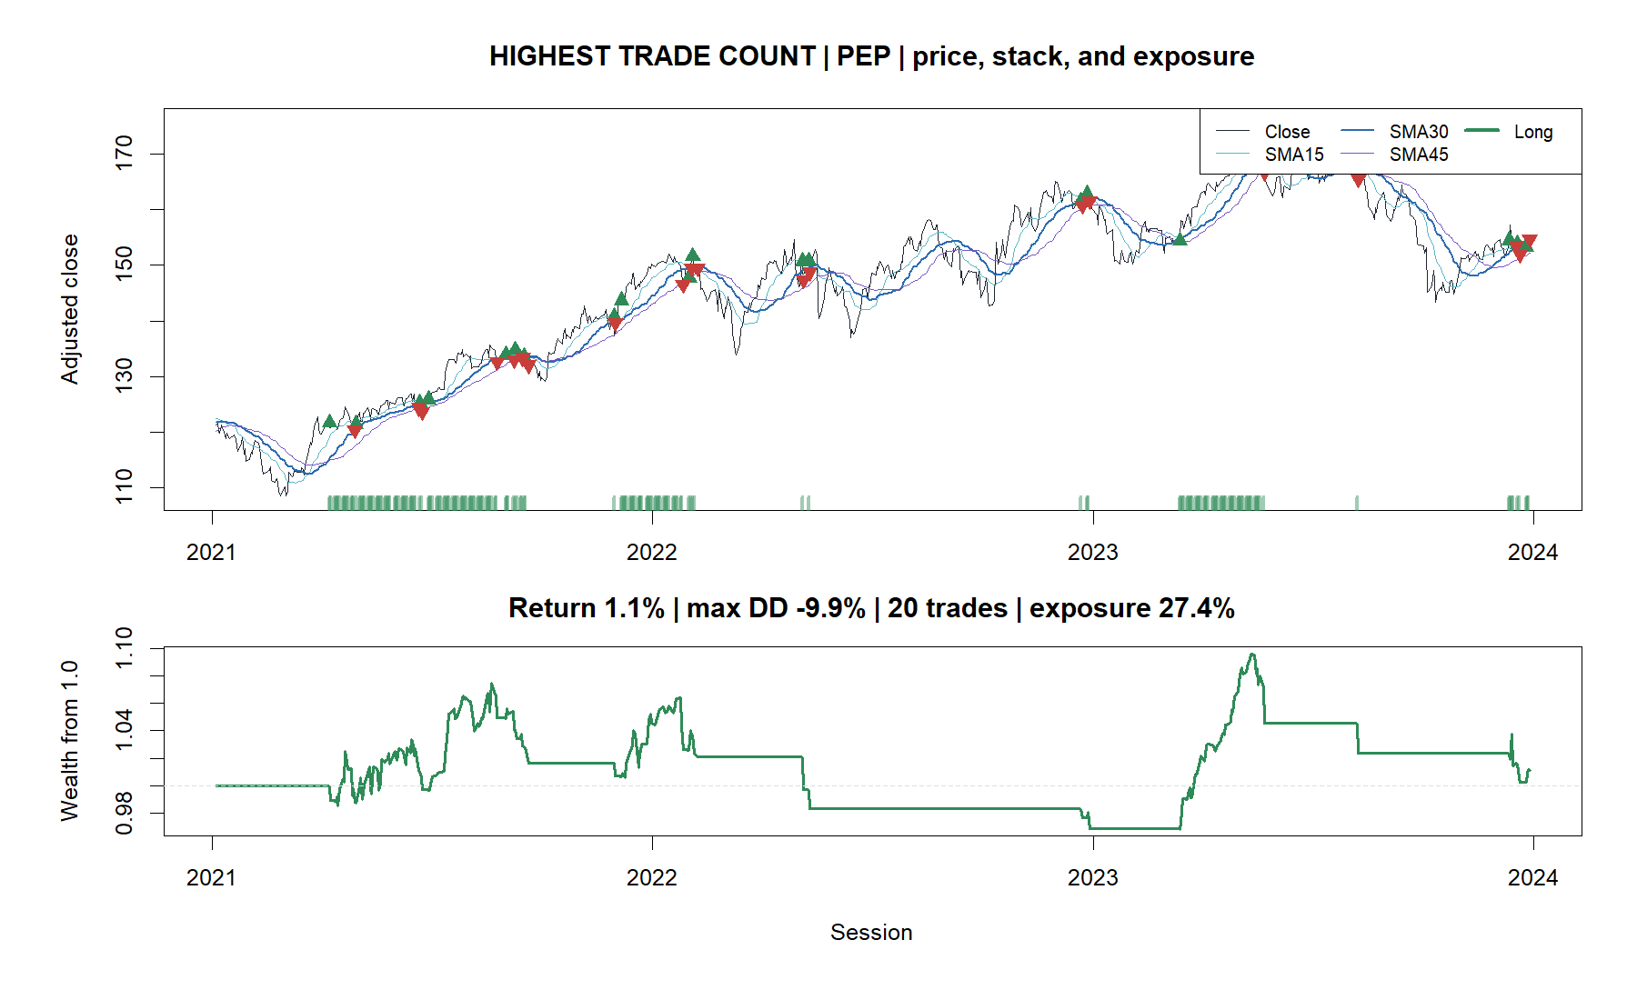
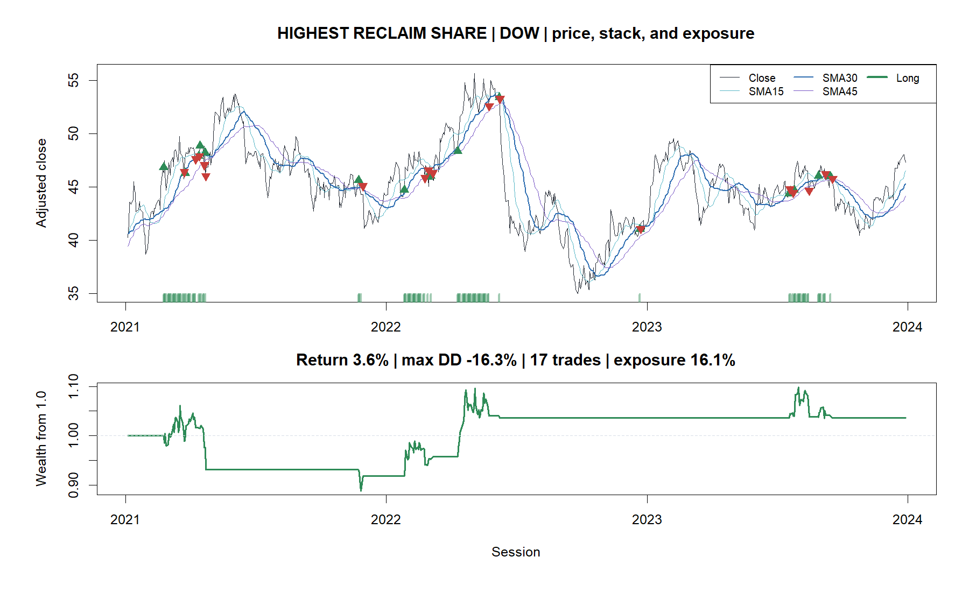
Frequent reclaims added activity without a durable edge
PEP: 20 trades; +1.1% total return
DOW: 17 trades; +3.6% total return
12
Notes:
PEP has the highest trade count. DOW is the highest-reclaim-share case after enforcing distinct tape identities. Both show repeated short trades around the medium average.
[Sources]
- C:/Users/Franc/OneDrive/Documents/Francis/Peltata Project/Time-Series-Modeling-Gen5/runs/research_workbench/operator_hypothesis_lab/hyp_mom_05_1_triple_sma_pullback_wide_discovery_20260812/hyp_mom_05_1_tape_manifest.csv
- C:/Users/Franc/OneDrive/Documents/Francis/Peltata Project/Time-Series-Modeling-Gen5/runs/research_workbench/operator_hypothesis_lab/hyp_mom_05_1_triple_sma_pullback_wide_discovery_20260812/hyp_mom_05_1_trades.csv

Slide 13
Set down 05.1; preserve the re-entry lesson
DECISION
WIDE DISCOVERY COMPLETE
NO PROMOTION AUTHORITY
WHAT THE EXERCISE TAUGHT US
1 Trend-stack activation is not enough
2 Immediate SMA30 reclaim is low-quality evidence
3 Low exposure can improve drawdown while still destroying relative return
4 Fixed debt amplifies a weak timing rule; it does not repair it
This precise rule does not warrant confirmation access, live leverage, sector selection, or parameter tuning.
A future lane may ask a new theory-first question about reclaim confirmation or persistence—but only under a new frozen identifier and distinct evidence.
13
Notes:
Recommended STOP. Any delay, confirmation, volatility filter, slope rule, or moving-average change is a substantive new mechanic, not a reactive tweak inside HYP-MOM-05.1.
[Sources]
- C:/Users/Franc/OneDrive/Documents/Francis/Peltata Project/Time-Series-Modeling-Gen5/operator_hypothesis_lab/docs/HYP_MOM_05_1_TRIPLE_SMA_PULLBACK_CONTRACT.md
- C:/Users/Franc/OneDrive/Documents/Francis/Peltata Project/Time-Series-Modeling-Gen5/runs/research_workbench/operator_hypothesis_lab/hyp_mom_05_1_triple_sma_pullback_wide_discovery_20260812/hyp_mom_05_1_panel_summary.csv
- C:/Users/Franc/OneDrive/Documents/Francis/Peltata Project/Time-Series-Modeling-Gen5/runs/research_workbench/operator_hypothesis_lab/hyp_mom_05_1_triple_sma_pullback_wide_discovery_20260812/hyp_mom_05_1_entry_summary.csv
- C:/Users/Franc/OneDrive/Documents/Francis/Peltata Project/Time-Series-Modeling-Gen5/runs/research_workbench/operator_hypothesis_lab/hyp_mom_05_1_triple_sma_pullback_wide_discovery_20260812/hyp_mom_05_1_baseline_comparisons.csv

