Slide 1
OPERATOR HYPOTHESIS LAB · ONE-ASSET MICROSCOPE
NVDA
microscope
30m
+
1D
From the intraday return clock to causal rules and cross-asset mechanism tests.
Research posture
Observe first. Separate descriptive clues, executable TRAIN translation, and one-shot confirmation.
RESEARCH DECK · DAILY CONFIRMATION STOP · INTRADAY OPENING RULE STOP
Notes:
This deck begins the NVDA one-asset microscope and records the first two views: unconditional intraday clock behavior and the established daily return-geometry template.
[Sources]
- Local descriptive packet: runs/research_workbench/operator_hypothesis_lab/nvda_intraday_clock_descriptive_20260831/report.md
- Local daily microscope packet: runs/research_workbench/operator_hypothesis_lab/nvda_daily_return_microscope_20260831/report.md
[/Sources]

Slide 2
OPERATOR HYPOTHESIS LAB · NVDA MICROSCOPE
One asset is a legitimate research object
What specialization buys
What specialization costs
A focused view of NVDA’s own liquidity, attention, overnight, and time-of-day structure.
Greater risk that a pattern describes one historical path rather than a durable mechanism.
A tractable laboratory for operator-facing visual sanity checks.
No cross-asset breadth to rescue weak causal reasoning.
A strategy may trade one asset if its validation remains honest and causal.
Untouched time, realistic execution, and explicit baselines become even more important.
The design target is not asset-agnosticism. It is falsifiable specialization.
Descriptive research · adjusted bars · frozen 2018–2023 window
02
Notes:
A one-asset strategy is not methodologically disqualified. It simply cannot borrow confidence from universality; the evidence must come from causal construction, stability over time, execution realism, and untouched confirmation.
[Sources]
- Local descriptive packet: runs/research_workbench/operator_hypothesis_lab/nvda_intraday_clock_descriptive_20260831/report.md
- Local daily microscope packet: runs/research_workbench/operator_hypothesis_lab/nvda_daily_return_microscope_20260831/report.md
[/Sources]

Slide 3
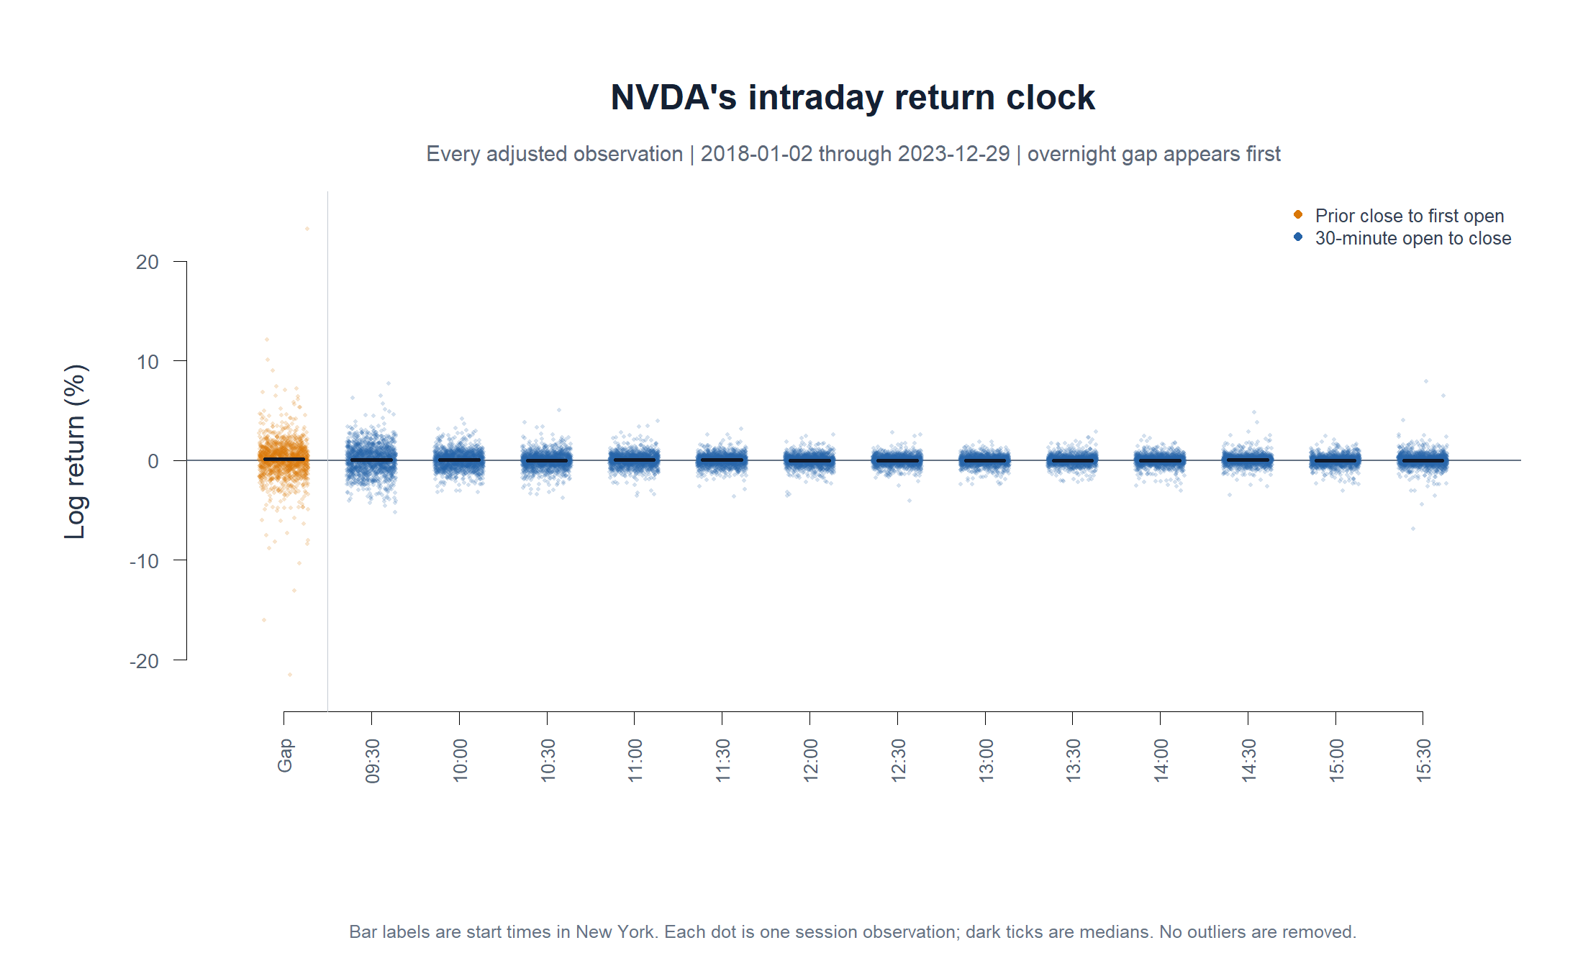
OPERATOR HYPOTHESIS LAB · NVDA MICROSCOPE
The first microscope: NVDA’s return clock
How to read it
Each dot is one observed return.
The overnight gap sits left of the first bar.
Median ticks are tiny relative to the tails.
No filter, model, or trade rule is present.
Descriptive research · adjusted bars · frozen 2018–2023 window
03
Notes:
This is the unconditional distribution of NVDA returns by clock position. It is a map of where variation lives, not evidence that any position is predictable.
[Sources]
- Local descriptive packet: runs/research_workbench/operator_hypothesis_lab/nvda_intraday_clock_descriptive_20260831/report.md
- Local run specification: runs/research_workbench/operator_hypothesis_lab/nvda_intraday_clock_descriptive_20260831/run_spec.csv
[/Sources]

Slide 4
OPERATOR HYPOTHESIS LAB · NVDA MICROSCOPE
The clock is structured—even before prediction
1,499
19,415
1,490
2024+
sessions
30-minute bars
overnight gaps
intraday unread
Frozen research window
Regular-session observations
Valid close-to-open observations
Daily confirmation is documented later
Visible pattern
What remains unknown
The overnight gap has the broadest return distribution.
Whether prior information predicts which tail will occur.
The first 30 minutes are the widest regular-session bar; midday compresses; the close widens again.
Whether any conditional difference survives costs and untouched time.
Descriptive research · adjusted bars · frozen 2018–2023 window
04
Notes:
The distribution changes across the clock. That justifies conditioning questions, but it does not yet justify a trading action.
[Sources]
- Local descriptive packet: runs/research_workbench/operator_hypothesis_lab/nvda_intraday_clock_descriptive_20260831/report.md
- Local run specification: runs/research_workbench/operator_hypothesis_lab/nvda_intraday_clock_descriptive_20260831/run_spec.csv
[/Sources]

Slide 5
SECOND MICROSCOPE
Move up one level:
daily return geometry
The same frozen 2018–2023 NVDA history is viewed through prior-versus-forward cumulative log returns, then split by path efficiency, volatility, direction, and prior-return sign.
Fixed horizons: 1, 2, 3, 4, 5, 10, 15, 20, 25 sessions
05
Notes:
This section reuses the predeclared atlas vocabulary. It does not choose new horizons after seeing NVDA.
[Sources]
- Local daily microscope packet: runs/research_workbench/operator_hypothesis_lab/nvda_daily_return_microscope_20260831/report.md
- Frozen own-asset atlas packet: runs/research_workbench/operator_hypothesis_lab/own_asset_return_geometry_atlas_20260826/report.md
[/Sources]

Slide 6
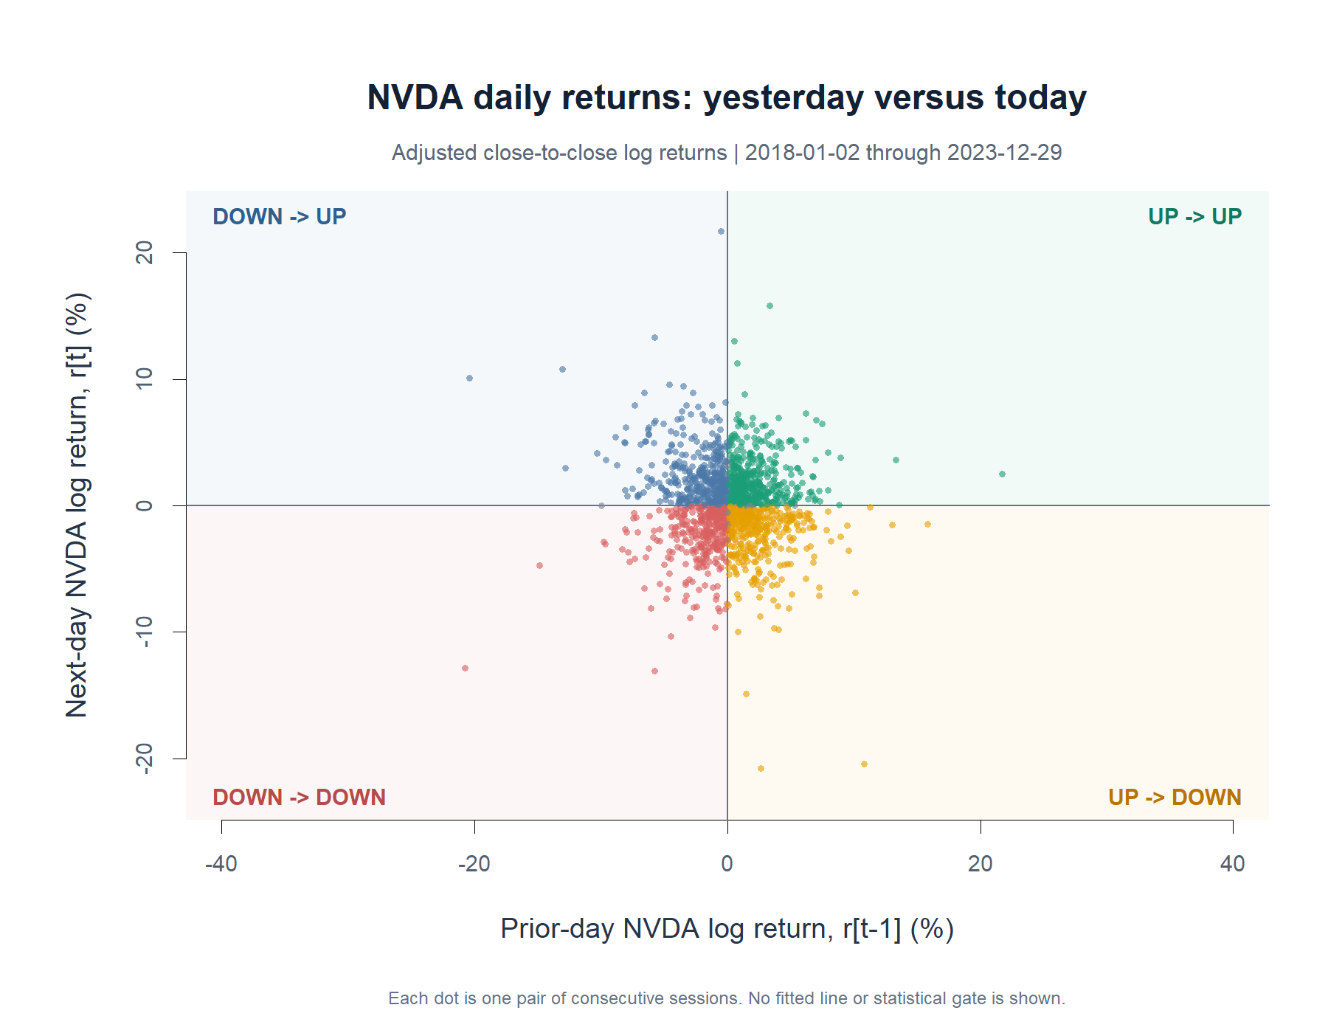
OPERATOR HYPOTHESIS LAB · NVDA MICROSCOPE
Adjacent daily returns mostly form a cloud
First reading
−0.075
unfiltered 1×1 Pearson r
A slight adjacent-day reversal tilt.
Large tails exist in every directional quadrant.
The cloud alone is not a rule.
Descriptive research · adjusted bars · frozen 2018–2023 window
06
Notes:
The adjacent-session view is visually noisy, with a small negative Pearson correlation. The next question is whether longer windows or causal states reveal coherent regions.
[Sources]
- Local daily microscope packet: runs/research_workbench/operator_hypothesis_lab/nvda_daily_return_microscope_20260831/report.md
- Local 1x1 state summary: runs/research_workbench/operator_hypothesis_lab/nvda_daily_return_microscope_20260831/nvda_one_by_one_state_summary.csv
[/Sources]

Slide 7
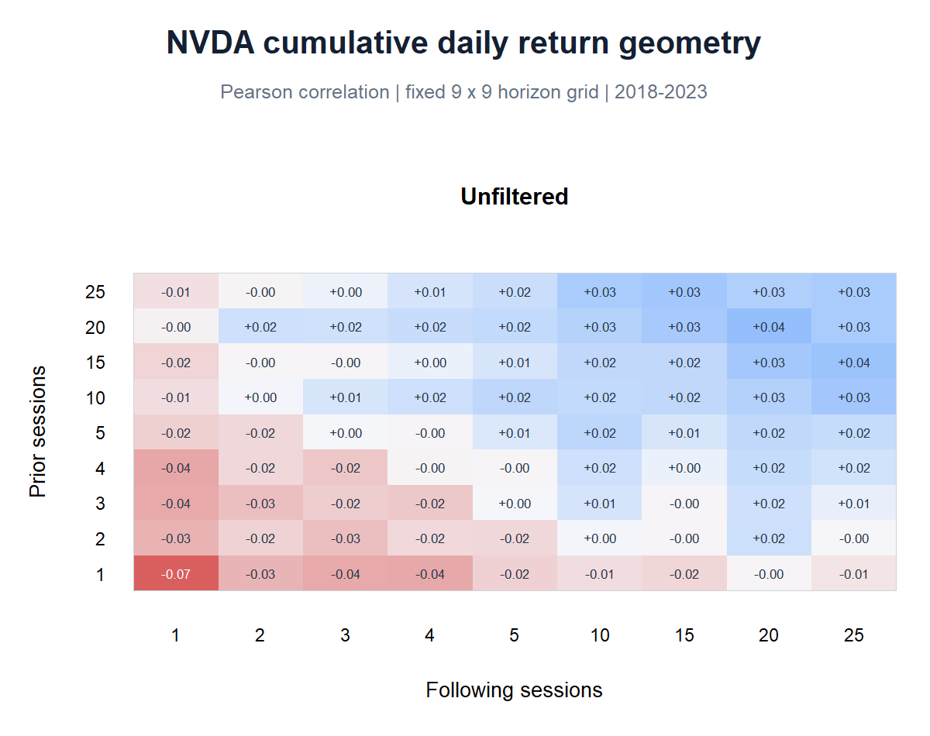
OPERATOR HYPOTHESIS LAB · NVDA MICROSCOPE
The unfiltered surface is weak and mixed
Geometry, not a winner cell
Short prior windows lean slightly negative into short forward windows.
Longer prior and forward windows drift mildly positive.
Magnitude is small without a state split.
This is a descriptive map. No multiplicity claim is made.
Descriptive research · adjusted bars · frozen 2018–2023 window
07
Notes:
The full surface prevents us from over-reading the adjacent-day point. Without state conditioning, the grid remains close to zero and changes sign gradually across horizons.
[Sources]
- Frozen NVDA state grid: runs/research_workbench/operator_hypothesis_lab/nvda_daily_return_microscope_20260831/nvda_state_grid_cells.csv
- Local daily microscope packet: runs/research_workbench/operator_hypothesis_lab/nvda_daily_return_microscope_20260831/report.md
[/Sources]

Slide 8
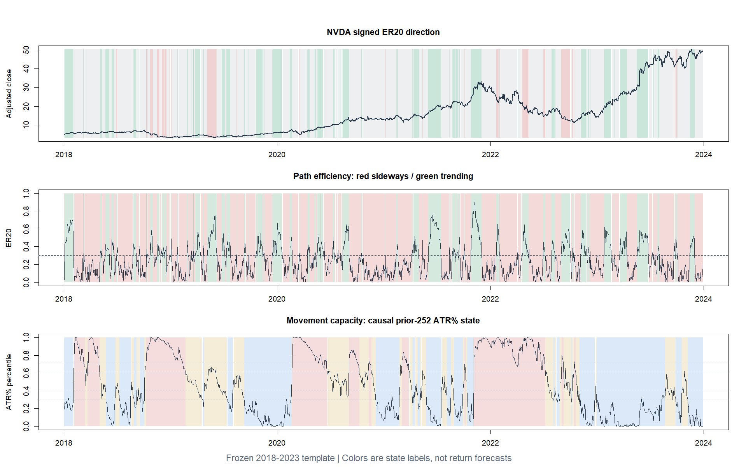
OPERATOR HYPOTHESIS LAB · NVDA MICROSCOPE
The filters are observable states—not forecasts
Vocabulary
ER20: sideways vs efficient path
ATR%: low, medium, high volatility
Signed ER20: down, sideways, up
Each label is assigned from information available at the anchor session.
Descriptive research · adjusted bars · frozen 2018–2023 window
08
Notes:
The state-band plot is the sanity check: the numerical filters should correspond to recognizable price-path and volatility regimes. They remain descriptive labels, not forecasts.
[Sources]
- Frozen own-asset atlas packet: runs/research_workbench/operator_hypothesis_lab/own_asset_return_geometry_atlas_20260826/report.md
- Frozen NVDA state grid: runs/research_workbench/operator_hypothesis_lab/nvda_daily_return_microscope_20260831/nvda_state_grid_cells.csv
[/Sources]

Slide 9
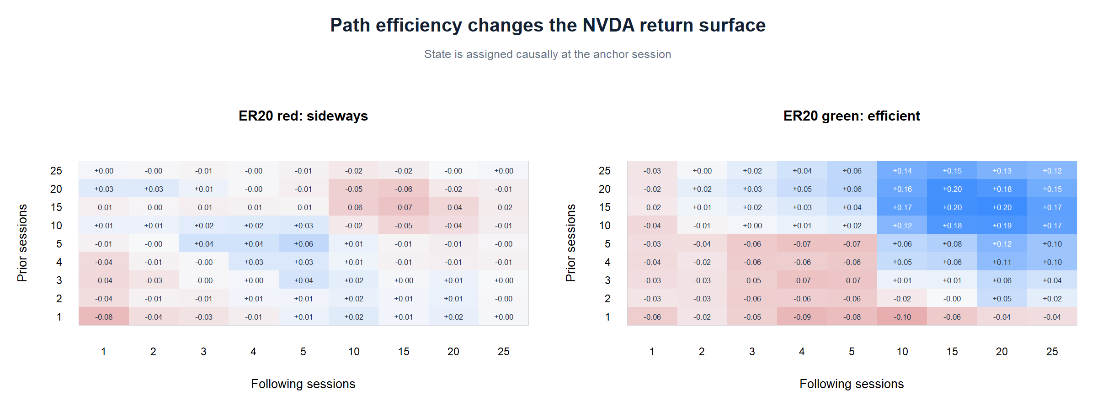
OPERATOR HYPOTHESIS LAB · NVDA MICROSCOPE
ER20 separates two different surfaces
Visual clue
Sideways: correlations stay near zero with mild negative longer-forward patches.
Efficient: a positive long-prior / long-forward region appears.
ER20 alone does not say whether the efficient path is up or down.
Descriptive research · adjusted bars · frozen 2018–2023 window
09
Notes:
The efficient-state heatmap contains a coherent positive region at longer horizons, while the sideways state remains flatter. Direction is still aggregated here, so signed ER20 is needed next.
[Sources]
- Frozen NVDA state grid: runs/research_workbench/operator_hypothesis_lab/nvda_daily_return_microscope_20260831/nvda_state_grid_cells.csv
- Local daily microscope packet: runs/research_workbench/operator_hypothesis_lab/nvda_daily_return_microscope_20260831/report.md
[/Sources]

Slide 10
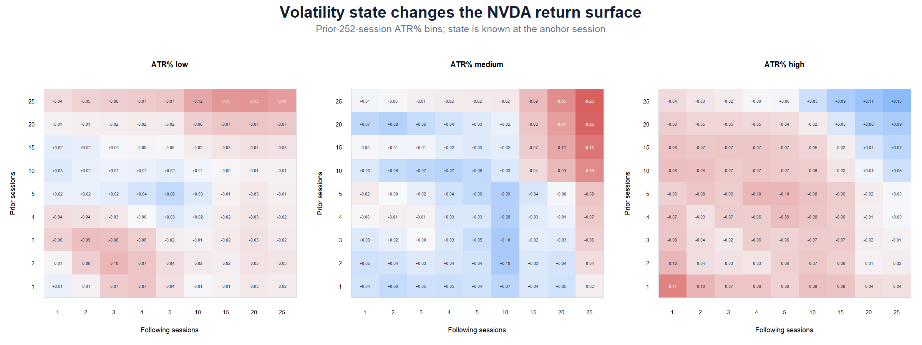
OPERATOR HYPOTHESIS LAB · NVDA MICROSCOPE
ATR% reveals a sharp short-horizon contrast
1×1 Pearson r
+0.013
low
+0.043
medium
−0.174
high
High volatility concentrates the adjacent-day reversal clue.
Longer-horizon geometry still changes sign; this is not a universal reversal label.
Descriptive research · adjusted bars · frozen 2018–2023 window
10
Notes:
At the adjacent-day point, low and medium ATR states are near zero to slightly positive, while the high ATR state is materially more negative. Across longer windows, the surface remains mixed.
[Sources]
- Local 1x1 state summary: runs/research_workbench/operator_hypothesis_lab/nvda_daily_return_microscope_20260831/nvda_one_by_one_state_summary.csv
- Frozen NVDA state grid: runs/research_workbench/operator_hypothesis_lab/nvda_daily_return_microscope_20260831/nvda_state_grid_cells.csv
[/Sources]

Slide 11
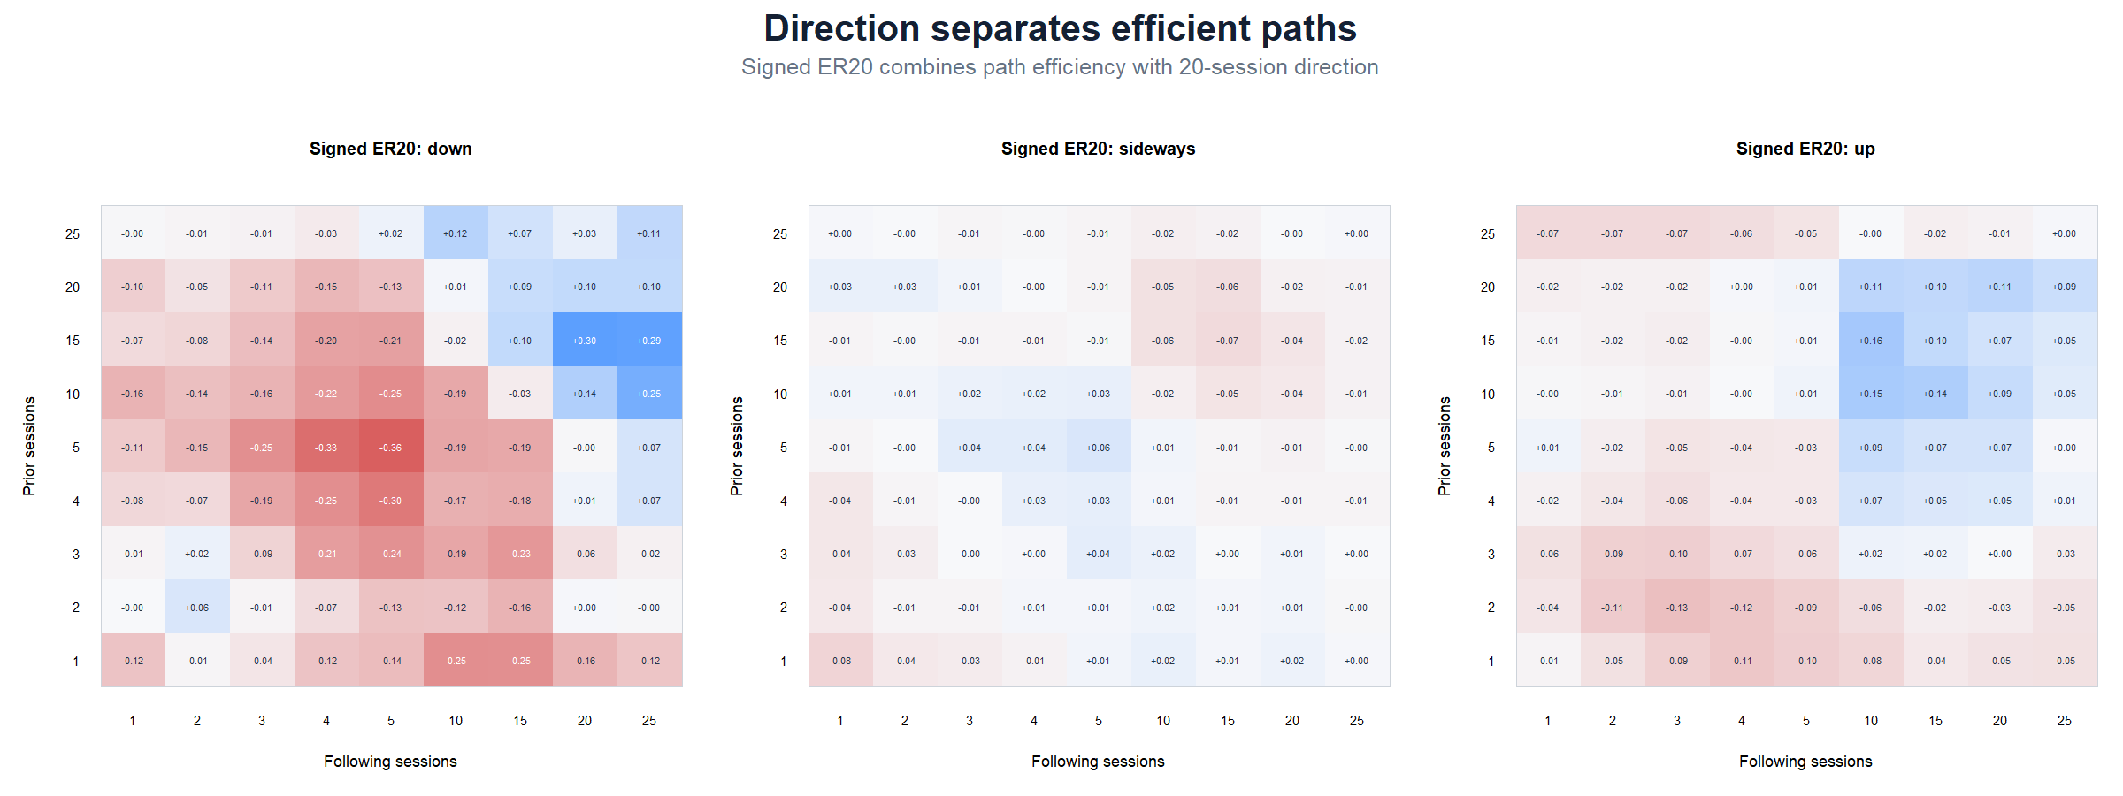
OPERATOR HYPOTHESIS LAB · NVDA MICROSCOPE
Direction explains part of the efficient-state mixture
Down state
Strongest negative short/mid-horizon region.
Long forward windows turn positive for some prior windows.
Up state
Smaller short-horizon reversal and modest long-forward continuation patches.
Descriptive research · adjusted bars · frozen 2018–2023 window
11
Notes:
Signed ER20 shows that efficient up and efficient down paths should not be aggregated. The down state carries the strongest negative short-horizon dependence and a later positive region; the up state is milder.
[Sources]
- Frozen NVDA state grid: runs/research_workbench/operator_hypothesis_lab/nvda_daily_return_microscope_20260831/nvda_state_grid_cells.csv
- Local 1x1 state summary: runs/research_workbench/operator_hypothesis_lab/nvda_daily_return_microscope_20260831/nvda_one_by_one_state_summary.csv
[/Sources]

Slide 12
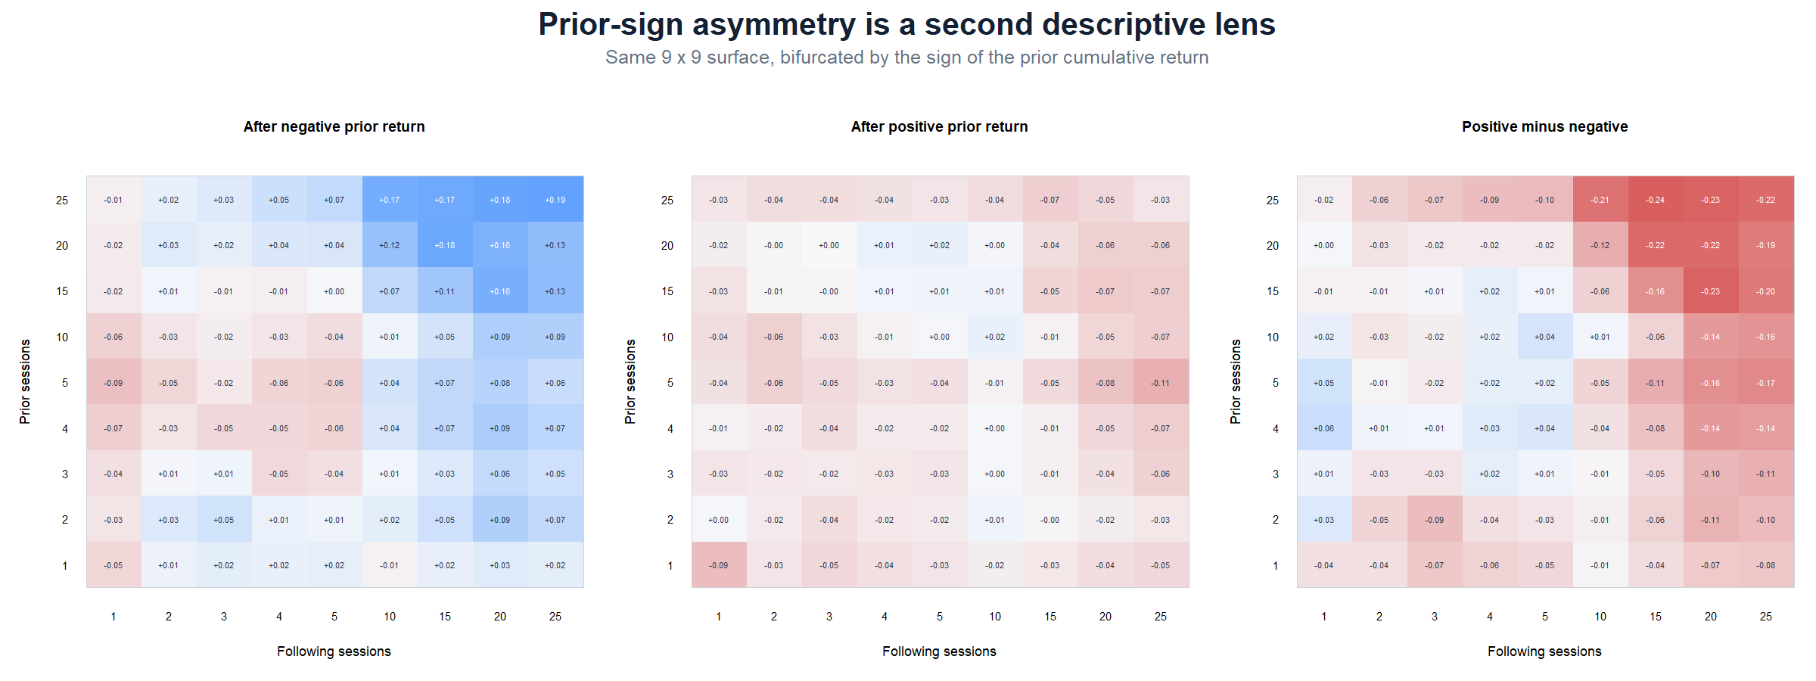
OPERATOR HYPOTHESIS LAB · NVDA MICROSCOPE
Prior-return sign changes the long-horizon story
Descriptive contrast
After negative long-window returns, forward long-window correlations become positive.
After positive priors, the same region is mostly mild negative.
The negative delta at long-long cells reads more like rebound asymmetry than classical continuation.
Descriptive research · adjusted bars · frozen 2018–2023 window
12
Notes:
The positive-minus-negative panel asks whether the same prior magnitude has different forward dependence depending on its sign. For NVDA, the long-horizon contrast leans toward stronger rebound-like behavior after negative priors.
[Sources]
- Frozen NVDA prior-sign grid: runs/research_workbench/operator_hypothesis_lab/nvda_daily_return_microscope_20260831/nvda_prior_sign_cells.csv
- Local daily microscope packet: runs/research_workbench/operator_hypothesis_lab/nvda_daily_return_microscope_20260831/report.md
[/Sources]

Slide 13
OPERATOR HYPOTHESIS LAB · NVDA MICROSCOPE
Daily states can cleanly condition intraday returns
Primary next slice
Separate later experiment
Completed daily state at t−1
Completed intraday window
↓
↓
Today’s overnight gap + each 30-minute bar
Later bars in the same session
Causal at the open
Requires a separately declared bar window
Directly answers whether the return clock differs by known regime
Strictly prevents later bars from entering the state
Descriptive research · adjusted bars · frozen 2018–2023 window
13
Notes:
Daily ATR% and ER can be used as causal gates for intraday outcomes when they are computed through the prior completed session. This is the clean recommended first conditioning experiment.
[Sources]
- Local descriptive packet: runs/research_workbench/operator_hypothesis_lab/nvda_intraday_clock_descriptive_20260831/report.md
- Local daily microscope packet: runs/research_workbench/operator_hypothesis_lab/nvda_daily_return_microscope_20260831/report.md
[/Sources]

Slide 14
OPERATOR HYPOTHESIS LAB · NVDA MICROSCOPE
Do not mechanically multiply ER20 by 13
A daily 20-session ER asks about roughly one trading month. A 260-bar ER asks about a different object: the path through thousands of within-session micro-moves.
Recommended sequence
1
Use prior-day daily ATR% / ER20 / signed ER20 to split the existing gap-and-clock plot.
2
Only if that view is informative, open a distinct intraday-state experiment with a small predeclared window set and strict bar timing.
3
Keep every first plot descriptive; promote only a concrete causal pattern to a falsification slice.
CURRENT STATUS: OPENING-RESPONSE CONDITIONING ADDED ON SLIDES 29–34
Descriptive research · adjusted bars · frozen 2018–2023 window
14
Notes:
Mechanical scaling assumes that the daily and intraday paths are the same object. They are not. The first clean test is to hold the daily state definition fixed and ask whether the intraday outcome distribution changes.
[Sources]
- Local descriptive packet: runs/research_workbench/operator_hypothesis_lab/nvda_intraday_clock_descriptive_20260831/report.md
- Local daily microscope packet: runs/research_workbench/operator_hypothesis_lab/nvda_daily_return_microscope_20260831/report.md
- Frozen NVDA state grid: runs/research_workbench/operator_hypothesis_lab/nvda_daily_return_microscope_20260831/nvda_state_grid_cells.csv
[/Sources]

Slide 15
THIRD MICROSCOPE
Can the geometry survive
executable timing?
Two fixed 20/20 clues are converted into next-open, open-to-open rules. The purpose is not to optimize them; it is to see which descriptive pattern remains visible after causal timing, no-overlap, costs, and simple controls.
2018–2023 TRAIN only · one-shot confirmation follows
15
Notes:
This section translates two already-observed NVDA 20/20 geometry clues into executable rules without changing the horizon or searching thresholds. It is a TRAIN construction test, not confirmation.
[Sources]
- Local executable proto-rule packet: runs/research_workbench/operator_hypothesis_lab/nvda_daily_proto_rules_20260831/report.md
- Local proto-rule summary: runs/research_workbench/operator_hypothesis_lab/nvda_daily_proto_rules_20260831/rule_summary.csv
[/Sources]

Slide 16
OPERATOR HYPOTHESIS LAB · NVDA PROTO-RULES
Two clues, two frozen rule translations
Efficient-up continuation
Calm-pullback rebound
At close t
At close t
R20 > 0 AND ER20 ≥ 0.30
R20 < 0 AND ATR% state = LOW or MEDIUM
Thesis
Thesis
An efficient upward path may continue after the signal is observable.
A loss in a non-high-volatility environment may be more recoverable than one inside a volatility shock.
Both: enter next open · exit open t+21 · 20 open-to-open intervals · no overlapping positions · 10 bps round trip
Descriptive research · adjusted bars · frozen 2018–2023 window
16
Notes:
The rules differ only in their causal entry condition. Timing, holding period, overlap policy, and cost are held fixed so the translation comparison remains intelligible.
[Sources]
- Local executable proto-rule packet: runs/research_workbench/operator_hypothesis_lab/nvda_daily_proto_rules_20260831/report.md
- Local proto-rule summary: runs/research_workbench/operator_hypothesis_lab/nvda_daily_proto_rules_20260831/rule_summary.csv
[/Sources]

Slide 17
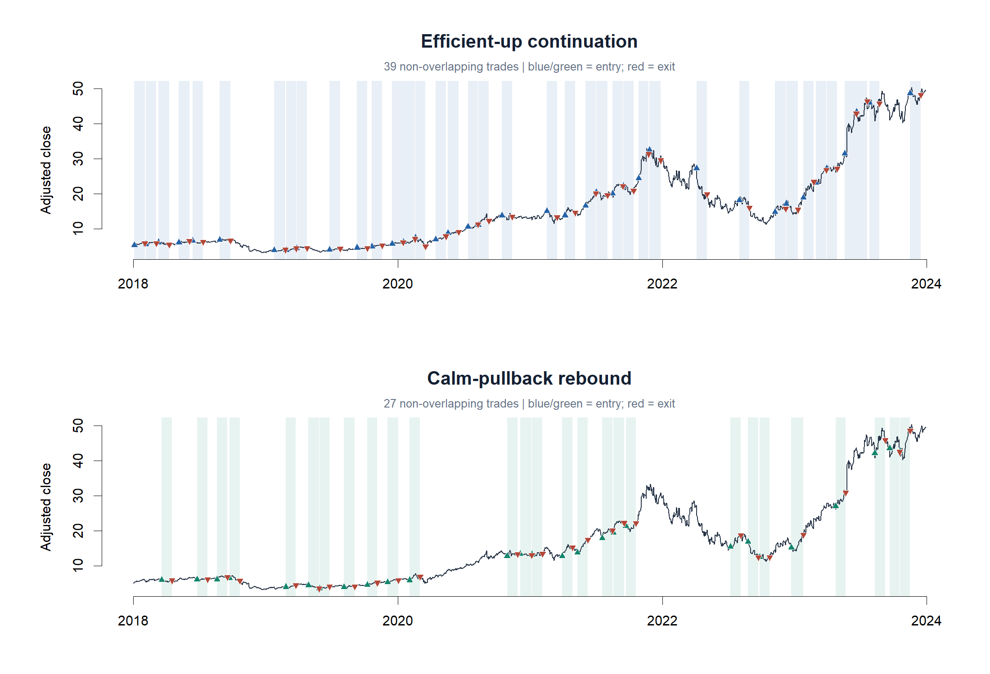
OPERATOR HYPOTHESIS LAB · NVDA PROTO-RULES
The rules select visibly different parts of NVDA history
Descriptive research · adjusted bars · frozen 2018–2023 window
17
Notes:
The price overlays are a sanity check on participation. Efficient-up continuation is active during many rising paths but also remains exposed to the 2022 breakdown. Calm-pullback rebound fires after losses only when the prior ATR-percent state is not high.
[Sources]
- Local executable proto-rule packet: runs/research_workbench/operator_hypothesis_lab/nvda_daily_proto_rules_20260831/report.md
- Local non-overlapping trade ledger: runs/research_workbench/operator_hypothesis_lab/nvda_daily_proto_rules_20260831/trade_ledger.csv
[/Sources]

Slide 18
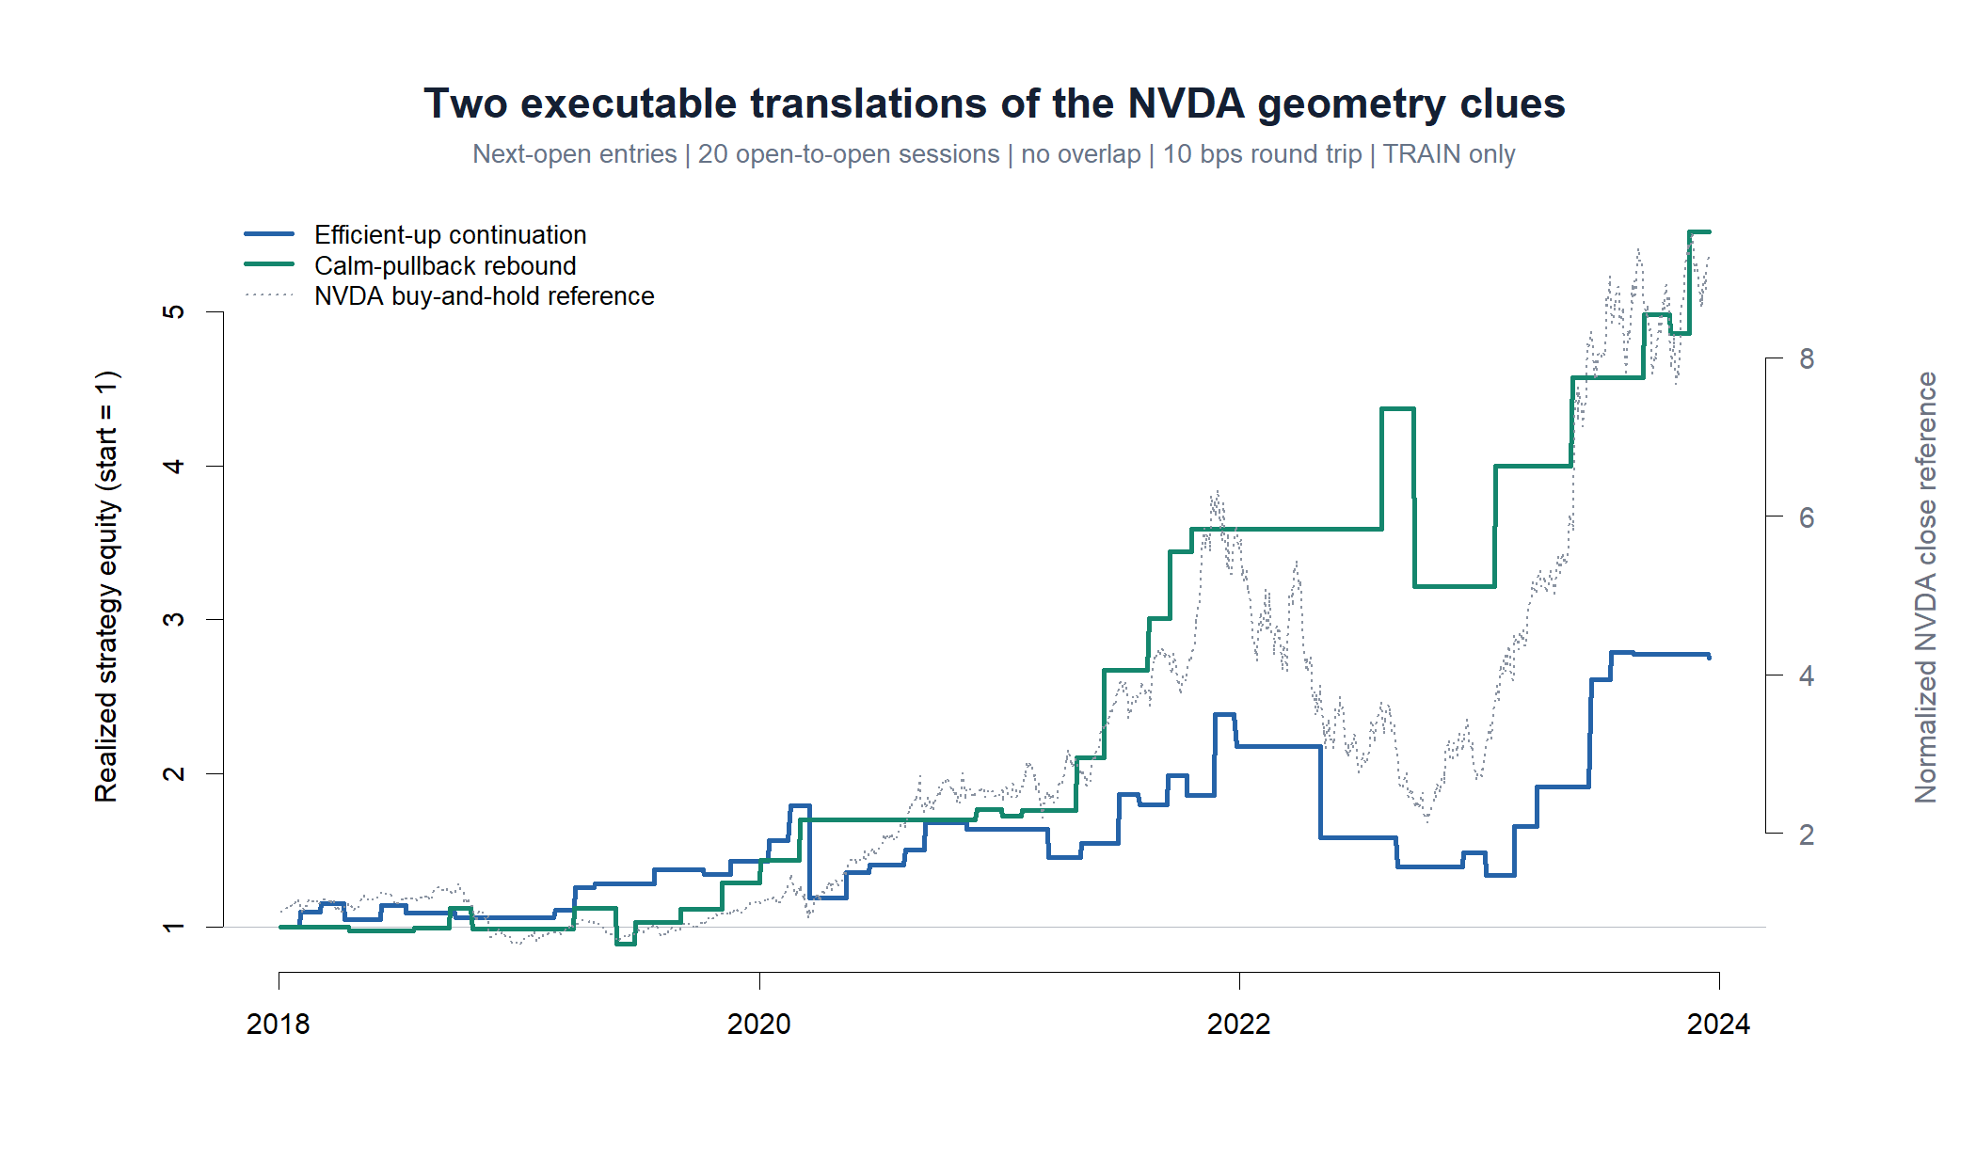
OPERATOR HYPOTHESIS LAB · NVDA PROTO-RULES
Only the rebound clears the narrow TRAIN translation gate
Efficient-up continuation
39 trades
2.59% mean net
61.5% profitable · −0.29 pp vs drift
STOP: weaker than unconditional drift and all three simple controls.
Calm-pullback rebound
27 trades
6.33% mean net
74.1% profitable · +3.45 pp vs drift
PASS TRAIN translation only—not confirmation and not edge authority.
Descriptive research · adjusted bars · frozen 2018–2023 window
18
Notes:
The continuation rule averages 2.59% net versus 2.88% unconditional gross drift. The rebound rule averages 6.33% net and exceeds drift by 3.45 percentage points. Realized equity is shown only when trades exit; the dotted buy-and-hold line uses a separate right axis and is a visual context reference, not a matched-risk baseline.
[Sources]
- Local proto-rule summary: runs/research_workbench/operator_hypothesis_lab/nvda_daily_proto_rules_20260831/rule_summary.csv
- Local executable proto-rule packet: runs/research_workbench/operator_hypothesis_lab/nvda_daily_proto_rules_20260831/report.md
[/Sources]

Slide 19
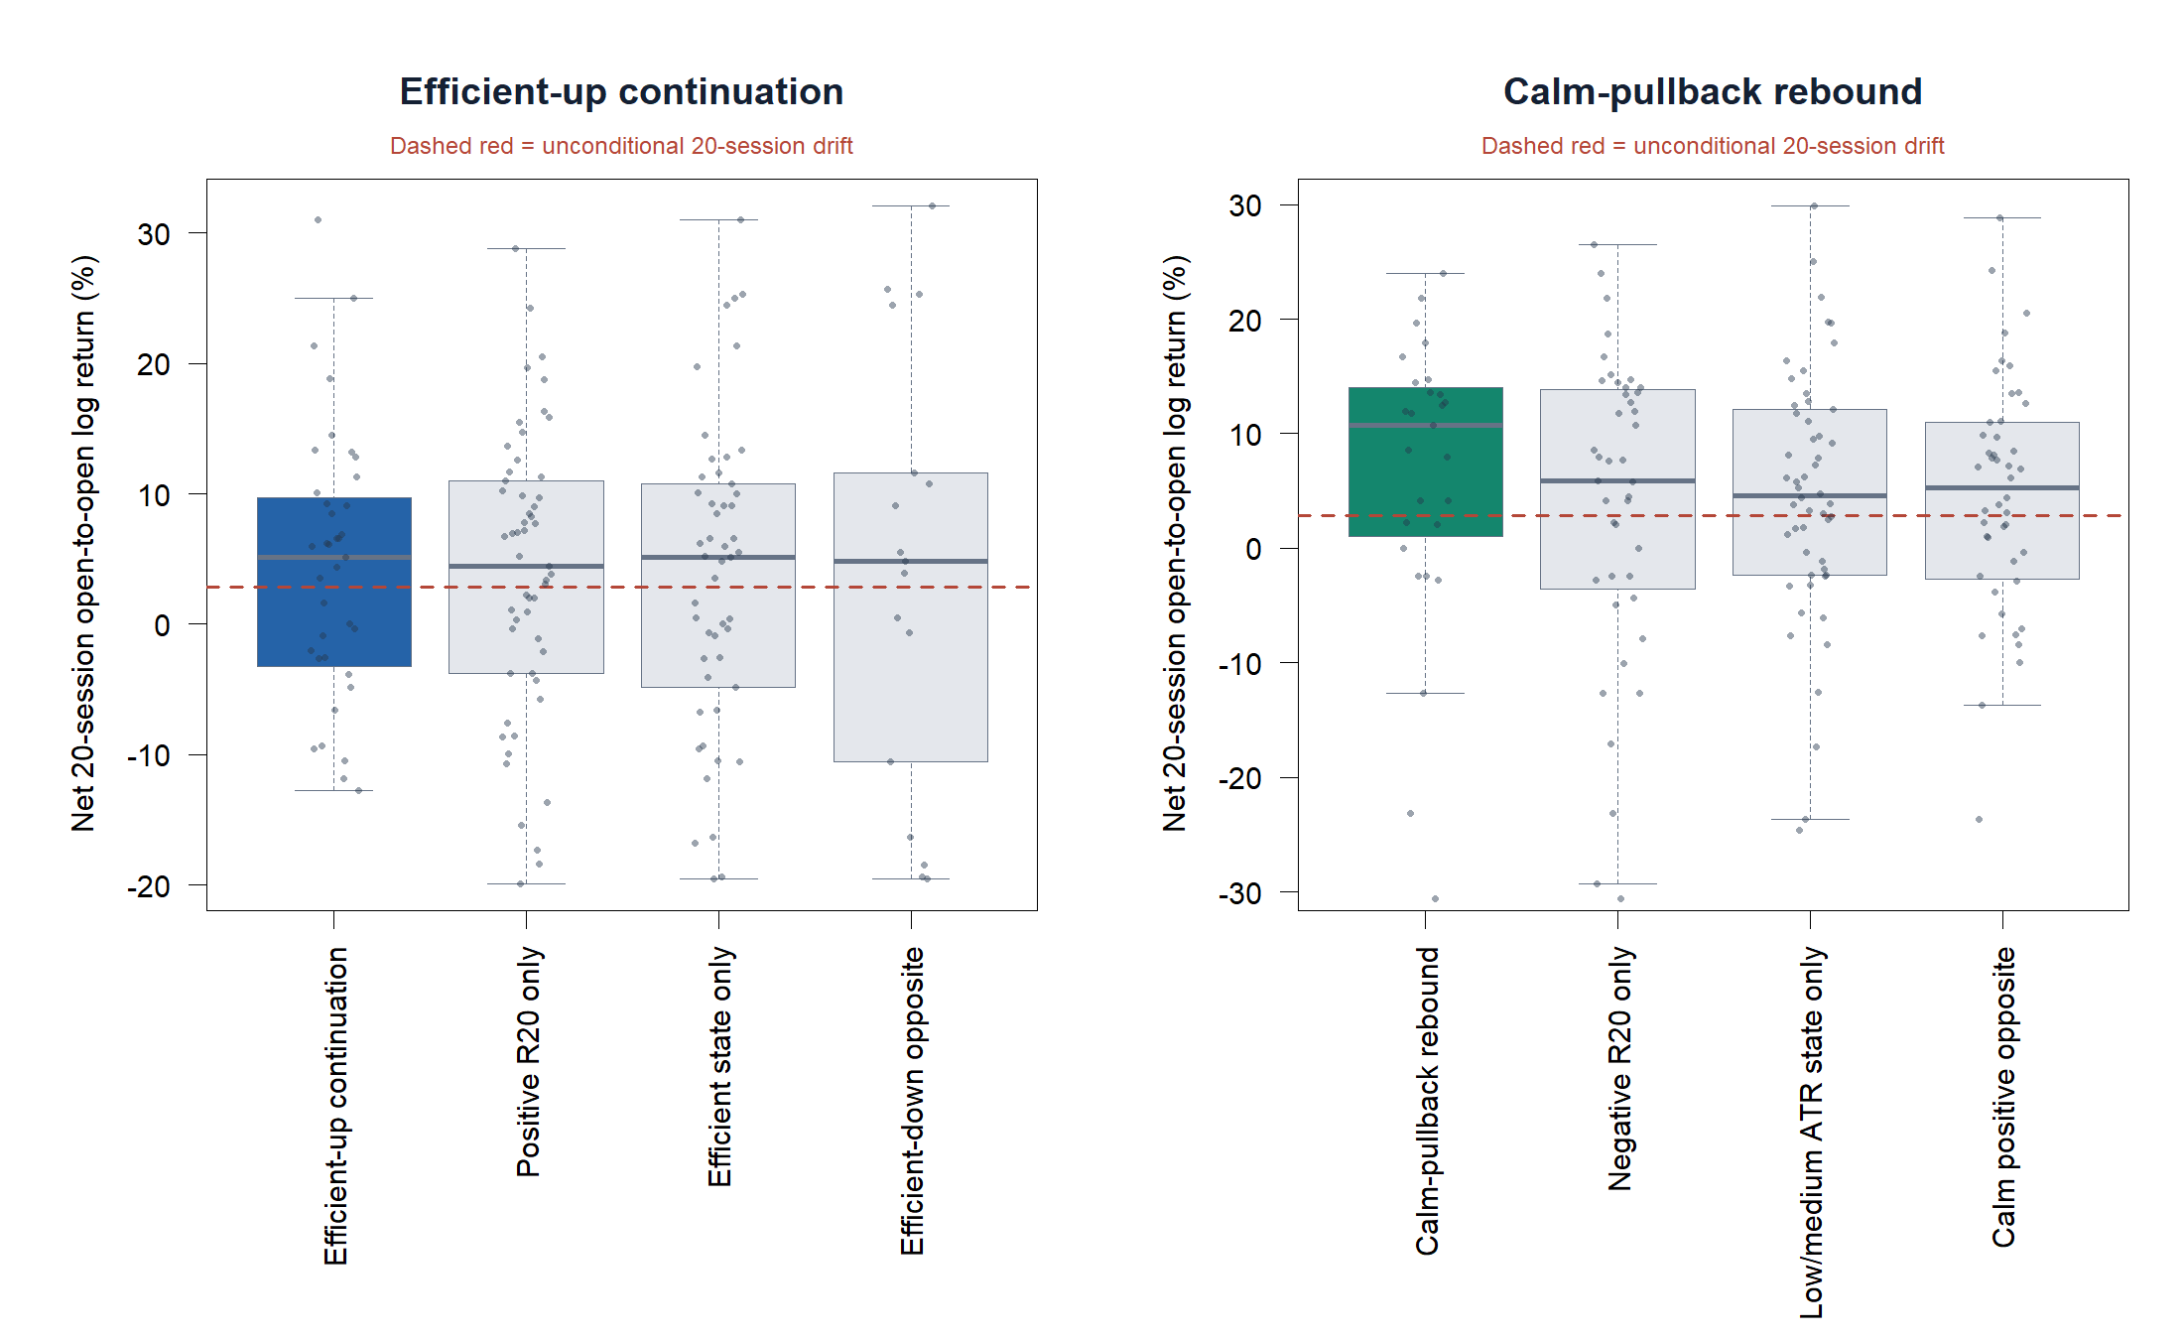
OPERATOR HYPOTHESIS LAB · NVDA PROTO-RULES
The joint rebound condition adds discrimination
Mean net return
6.33%
joint rebound
4.53%
ATR state only
3.85%
same calm state after gains
2.77%
negative R20 only
The sign and volatility state work better together than either alone in TRAIN.
Descriptive research · adjusted bars · frozen 2018–2023 window
19
Notes:
The primary rebound rule has a higher mean and median than negative-R20-only, low/medium-ATR-only, and the positive-R20 opposite inside the same ATR states. This is the strongest reason to retain it as a confirmation candidate, while recognizing that all comparisons come from the discovery sample.
[Sources]
- Local proto-rule summary: runs/research_workbench/operator_hypothesis_lab/nvda_daily_proto_rules_20260831/rule_summary.csv
- Local non-overlapping trade ledger: runs/research_workbench/operator_hypothesis_lab/nvda_daily_proto_rules_20260831/trade_ledger.csv
[/Sources]

Slide 20
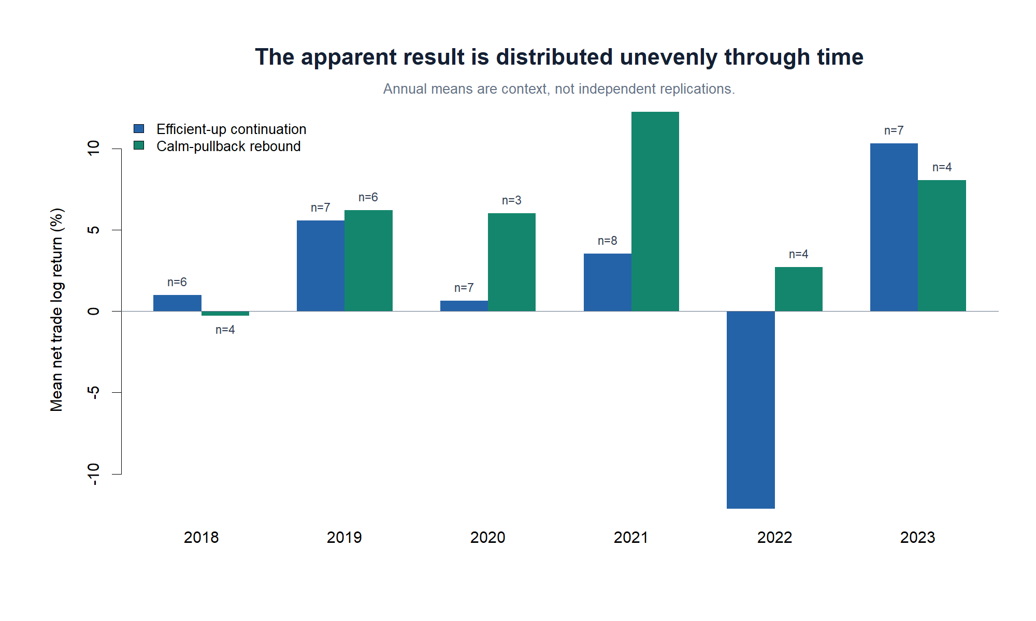
OPERATOR HYPOTHESIS LAB · NVDA PROTO-RULES
Calendar slices reveal the burden of one-asset evidence
What matters
Continuation suffers a concentrated 2022 failure.
Rebound is positive in five of six years, but 2018 is approximately flat.
Only 3–6 rebound trades appear in any year.
Years are context, not independent replications. The next honest evidence must come from untouched time.
Descriptive research · adjusted bars · frozen 2018–2023 window
20
Notes:
The annual view helps detect whether a full-period mean is carried by one isolated episode. Rebound is not purely a single-year artifact, but the yearly samples are tiny and correlated; they do not replace OOS confirmation.
[Sources]
- Local proto-rule annual context: runs/research_workbench/operator_hypothesis_lab/nvda_daily_proto_rules_20260831/calendar_summary.csv
- Local proto-rule summary: runs/research_workbench/operator_hypothesis_lab/nvda_daily_proto_rules_20260831/rule_summary.csv
[/Sources]

Slide 21
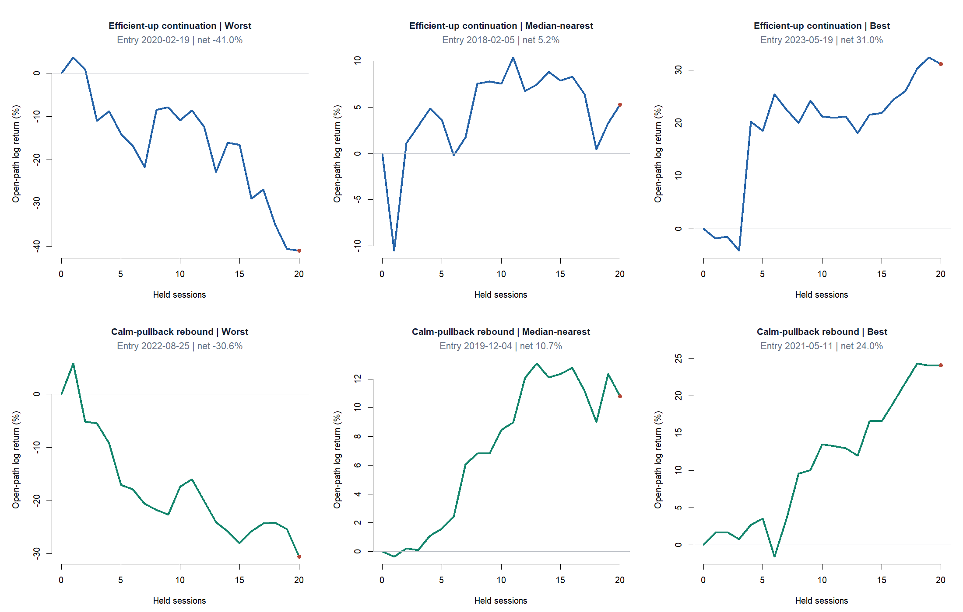
OPERATOR HYPOTHESIS LAB · NVDA PROTO-RULES
Representative paths keep the trade-level reality visible
Descriptive research · adjusted bars · frozen 2018–2023 window
21
Notes:
The representative tapes show that neither rule creates a smooth conditional path. The continuation worst case loses roughly 41%, and the rebound worst case loses roughly 31%. The median rebound path is more consistent with the original thesis: an initially quiet path that develops into a recovery across the holding window.
[Sources]
- Local non-overlapping trade ledger: runs/research_workbench/operator_hypothesis_lab/nvda_daily_proto_rules_20260831/trade_ledger.csv
- Local executable proto-rule packet: runs/research_workbench/operator_hypothesis_lab/nvda_daily_proto_rules_20260831/report.md
[/Sources]

Slide 22
OPERATOR HYPOTHESIS LAB · NVDA PROTO-RULES
One rule stops; one earns untouched confirmation
STOP
RETAIN
Efficient-up continuation
Calm-pullback rebound
The exact ER20-plus-positive-R20 translation adds no incremental value in TRAIN.
The joint loss-plus-not-high-ATR rule clears drift and its simple controls in TRAIN.
What this does—and does not—mean
It proves the descriptive rebound clue can survive next-open timing, costs, and no-overlap construction.
It does not prove generalization, robustness to nearby definitions, capacity, or live edge.
NEXT GATE: freeze this exact rule, then read the untouched 2024+ period once—without rescue tuning.
Descriptive research · adjusted bars · frozen 2018–2023 window
22
Notes:
The next methodological gate is a one-shot confirmation of the frozen calm-pullback rebound rule on untouched 2024+ data. Any later robustness or neighboring-definition work must be declared separately and cannot rewrite the original confirmation result.
[Sources]
- Local executable proto-rule packet: runs/research_workbench/operator_hypothesis_lab/nvda_daily_proto_rules_20260831/report.md
- Local proto-rule summary: runs/research_workbench/operator_hypothesis_lab/nvda_daily_proto_rules_20260831/rule_summary.csv
- Local non-overlapping trade ledger: runs/research_workbench/operator_hypothesis_lab/nvda_daily_proto_rules_20260831/trade_ledger.csv
[/Sources]

Slide 23
FOURTH MICROSCOPE
The candidate meets
untouched time
The calm-pullback rebound rule is read once on 2024-01-02 through 2026-06-23. The signal, ATR% states, timing, 20-session hold, no-overlap rule, 10-bps cost, controls, and gates remain exactly frozen.
This period is now evidence—not a new tuning surface.
23
Notes:
This is the irreversible confirmation read. The exact TRAIN-selected candidate is evaluated on the previously sealed period. A failure stops the exact rule without rescue tuning.
[Sources]
- Local one-shot confirmation report: runs/research_workbench/operator_hypothesis_lab/nvda_daily_proto_rule_confirmation_20260831/report.md
- Predeclared confirmation gates: runs/research_workbench/operator_hypothesis_lab/nvda_daily_proto_rule_confirmation_20260831/confirmation_gates.csv
- Explicit-as-of query health: runs/research_workbench/operator_hypothesis_lab/nvda_daily_proto_rule_confirmation_20260831/query_health.csv
[/Sources]

Slide 24
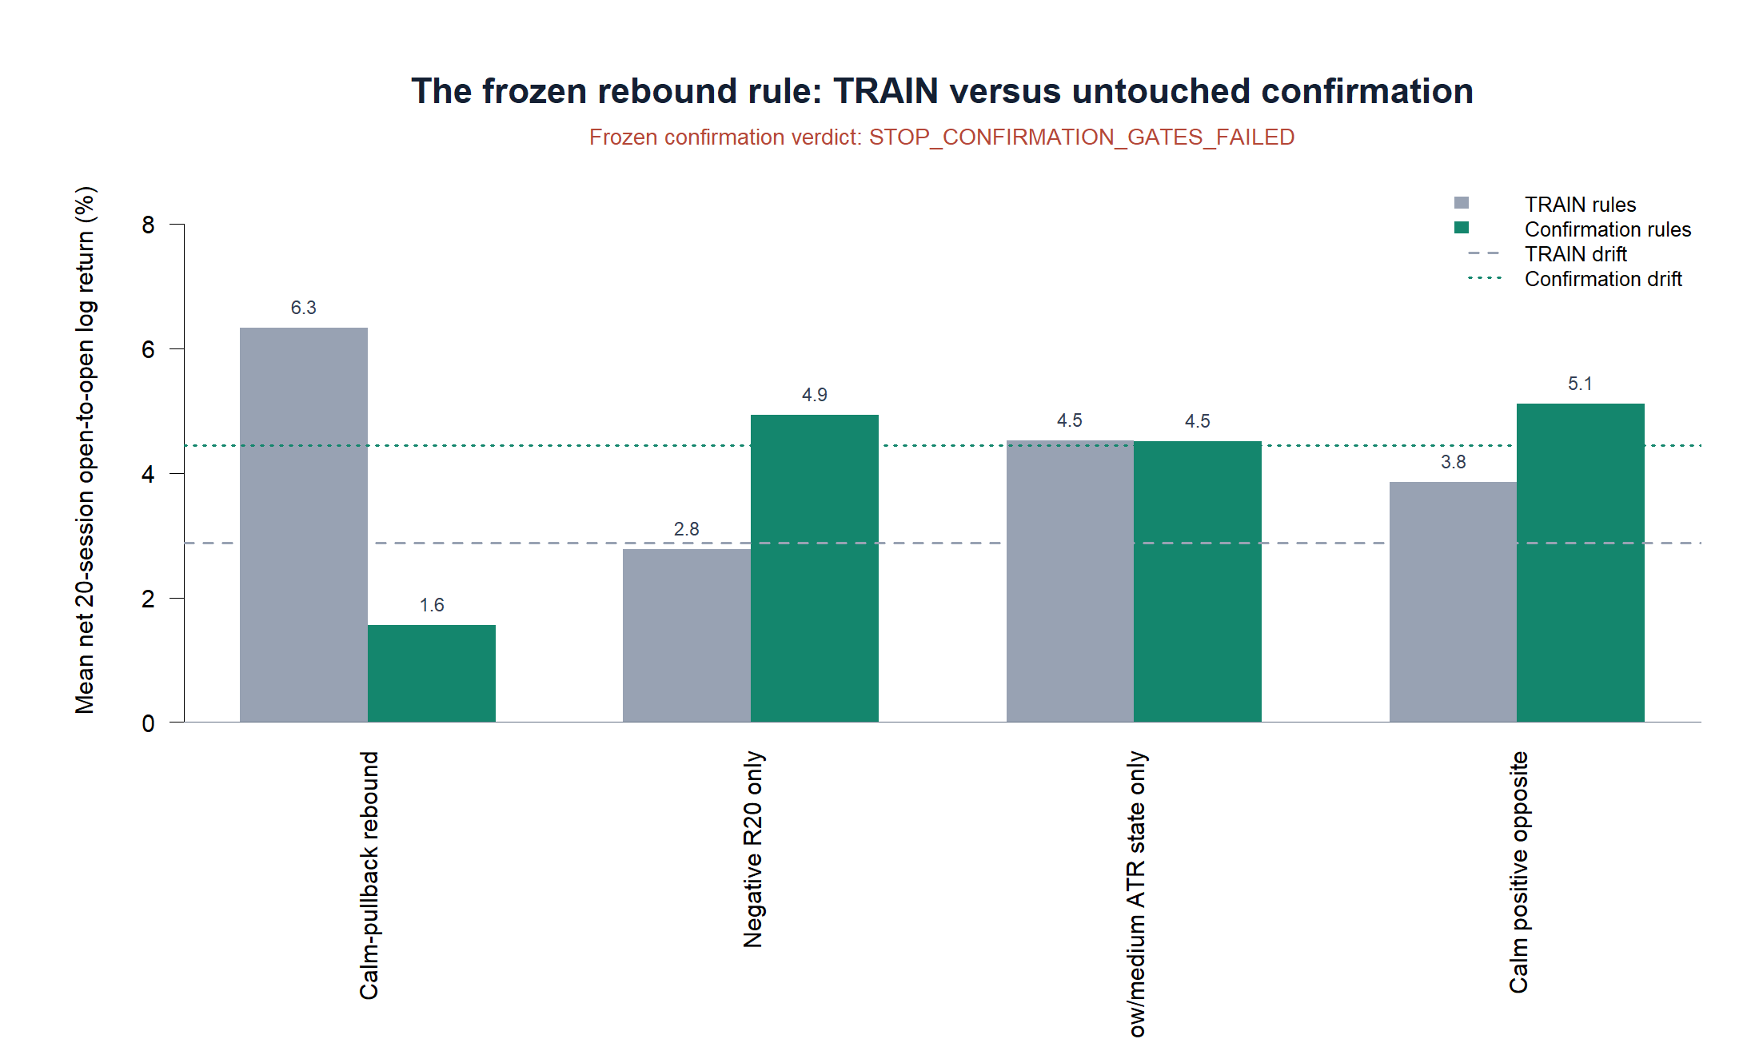
OPERATOR HYPOTHESIS LAB · NVDA CONFIRMATION
The TRAIN advantage does not replicate
STOP
1.56%
confirmation mean net
9 trades; minimum gate was 10
−2.88 pp versus 4.44% unconditional drift
Below every ingredient control; strongest = 5.12%
One-shot untouched time · adjusted daily bars · frozen 2024-01-02–2026-06-23
24
Notes:
TRAIN showed a 6.33% mean net return for the joint condition. Untouched confirmation produced 1.56%, below 4.44% unconditional gross drift and below all three frozen controls. The exact rule therefore fails confirmation.
[Sources]
- Local one-shot confirmation report: runs/research_workbench/operator_hypothesis_lab/nvda_daily_proto_rule_confirmation_20260831/report.md
- Predeclared confirmation gates: runs/research_workbench/operator_hypothesis_lab/nvda_daily_proto_rule_confirmation_20260831/confirmation_gates.csv
- Frozen confirmation rule summary: runs/research_workbench/operator_hypothesis_lab/nvda_daily_proto_rule_confirmation_20260831/rule_summary.csv
[/Sources]

Slide 25
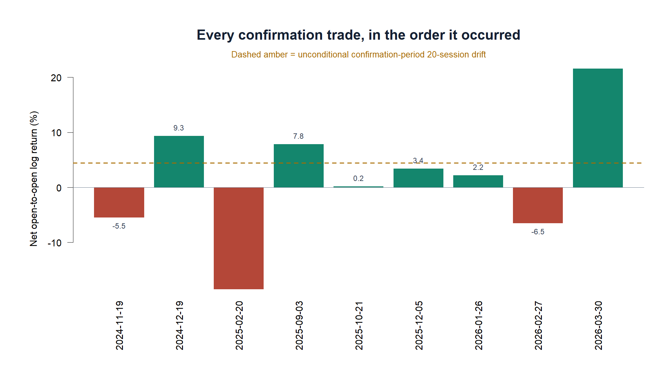
OPERATOR HYPOTHESIS LAB · NVDA CONFIRMATION
A positive median is not enough to beat the baseline
What survived
+2.19%
median net
6 / 9
profitable trades
What failed
The sequence's average was too weak to overcome ordinary NVDA drift or the simpler controls.
One-shot untouched time · adjusted daily bars · frozen 2024-01-02–2026-06-23
25
Notes:
The rule was right more often than wrong and had a positive median, but those facts are subordinate to the economic comparison. The average result lagged what NVDA produced unconditionally over the same 20-session horizon.
[Sources]
- Untouched-period trade ledger: runs/research_workbench/operator_hypothesis_lab/nvda_daily_proto_rule_confirmation_20260831/confirmation_trade_ledger.csv
- Frozen confirmation rule summary: runs/research_workbench/operator_hypothesis_lab/nvda_daily_proto_rule_confirmation_20260831/rule_summary.csv
- Predeclared confirmation gates: runs/research_workbench/operator_hypothesis_lab/nvda_daily_proto_rule_confirmation_20260831/confirmation_gates.csv
[/Sources]

Slide 26
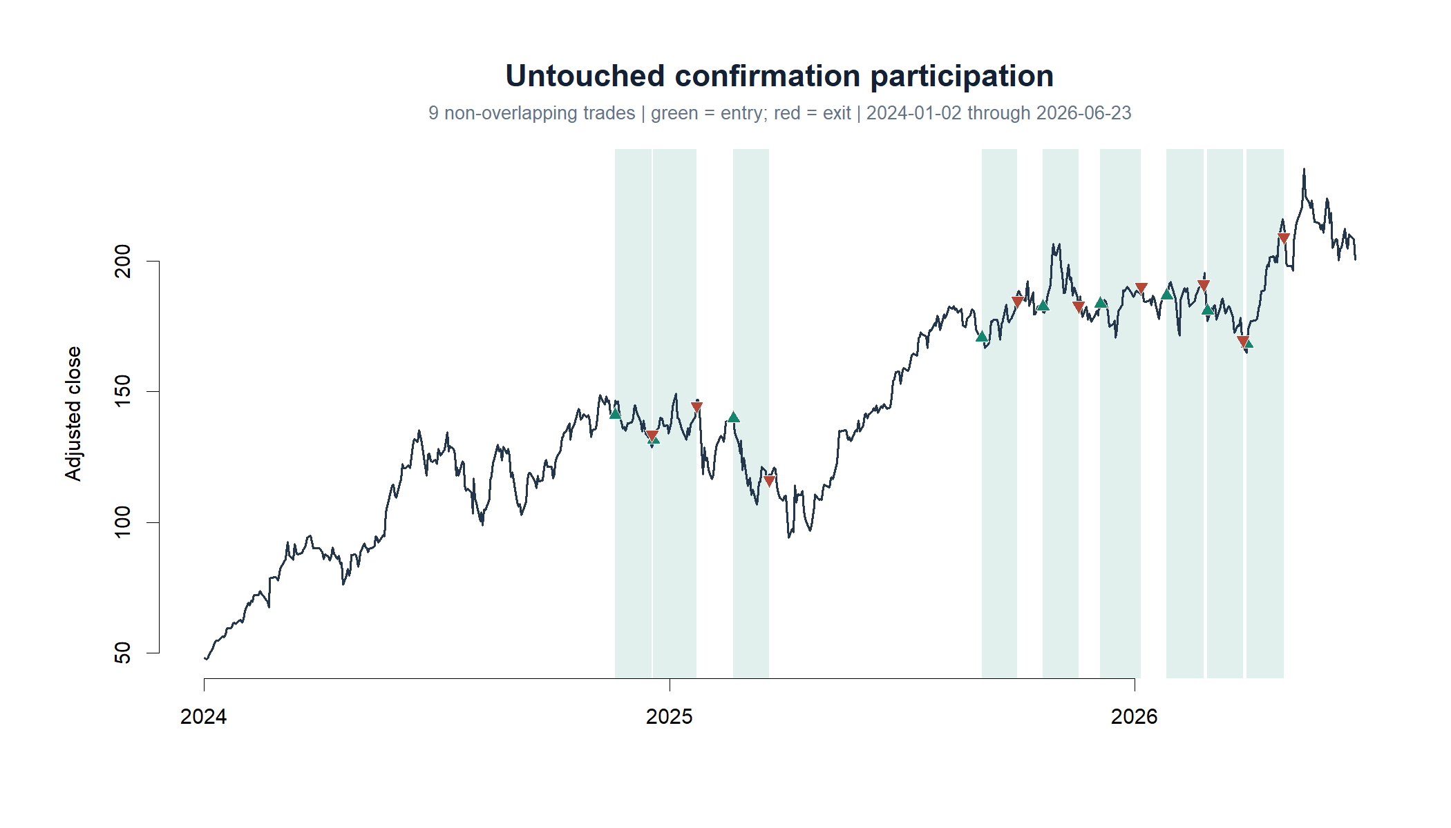
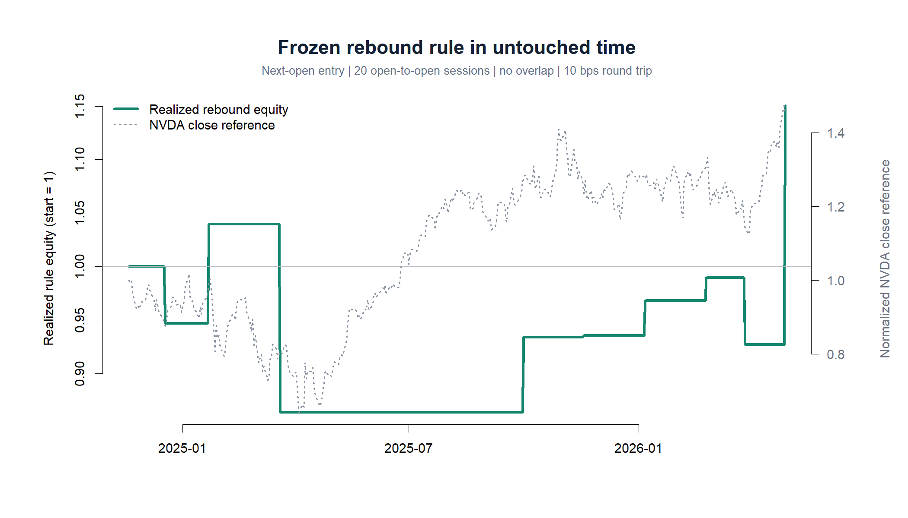
OPERATOR HYPOTHESIS LAB · NVDA CONFIRMATION
Participation was sparse—and the path depended on late winners
The rule spent much of 2025 underwater, then recovered on a +21.6% late trade. A final equity level above 1 does not establish incremental edge.
One-shot untouched time · adjusted daily bars · frozen 2024-01-02–2026-06-23
26
Notes:
The participation chart shows only nine non-overlapping entries. The realized-equity path remained below its starting level through much of the confirmation period before a late large winner. This visual reinforces why the drift and ingredient-control comparisons are decisive.
[Sources]
- Untouched-period trade ledger: runs/research_workbench/operator_hypothesis_lab/nvda_daily_proto_rule_confirmation_20260831/confirmation_trade_ledger.csv
- Frozen confirmation rule summary: runs/research_workbench/operator_hypothesis_lab/nvda_daily_proto_rule_confirmation_20260831/rule_summary.csv
[/Sources]

Slide 27
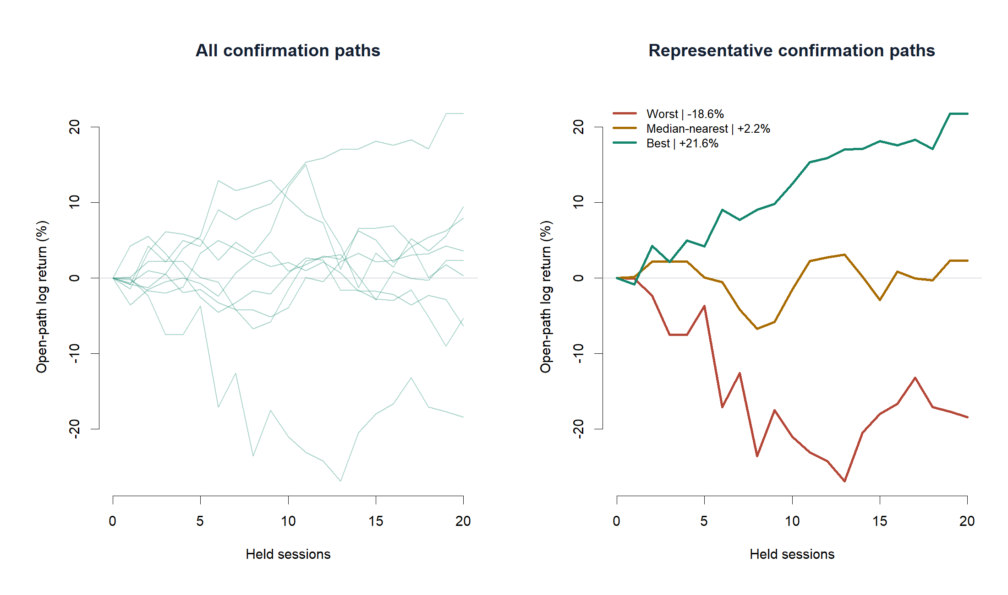
OPERATOR HYPOTHESIS LAB · NVDA CONFIRMATION
The trade paths do not reveal a stable rebound shape
One-shot untouched time · adjusted daily bars · frozen 2024-01-02–2026-06-23
27
Notes:
The all-path panel shows considerable dispersion rather than a repeated recovery trajectory. The worst trade lost 18.6%, the median-nearest trade gained 2.2%, and the best gained 21.6%. These are descriptive trade tapes, not independent confirmations.
[Sources]
- Untouched-period trade ledger: runs/research_workbench/operator_hypothesis_lab/nvda_daily_proto_rule_confirmation_20260831/confirmation_trade_ledger.csv
- Local one-shot confirmation report: runs/research_workbench/operator_hypothesis_lab/nvda_daily_proto_rule_confirmation_20260831/report.md
[/Sources]

Slide 28
OPERATOR HYPOTHESIS LAB · NVDA CONFIRMATION
The exact calm-pullback rebound rule stops
STOP_CONFIRMATION_GATES_FAILED
Predeclared gates
What we learned
FAIL
Minimum sample
9 trades; required 10
A descriptive clue can survive TRAIN execution and still vanish in new time.
FAIL
Beat drift
1.56% vs 4.44%
PASS
Positive median
+2.19%
Win rate and median can look encouraging while average opportunity cost is unfavorable.
PASS
Majority profitable
66.7%
FAIL
Beat each control
strongest control 5.12%
No rescue tuning. Any future variation must be declared as a new hypothesis and cannot overwrite this result.
One-shot untouched time · adjusted daily bars · frozen 2024-01-02–2026-06-23
28
Notes:
The exact one-asset rule is stopped. The confirmation period has now been consumed and cannot be reused as untouched evidence. A later variation may be researched only as a new hypothesis with a newly protected confirmation boundary.
[Sources]
- Predeclared confirmation gates: runs/research_workbench/operator_hypothesis_lab/nvda_daily_proto_rule_confirmation_20260831/confirmation_gates.csv
- Local one-shot confirmation report: runs/research_workbench/operator_hypothesis_lab/nvda_daily_proto_rule_confirmation_20260831/report.md
- Explicit-as-of query health: runs/research_workbench/operator_hypothesis_lab/nvda_daily_proto_rule_confirmation_20260831/query_health.csv
[/Sources]

Slide 29
FIFTH MICROSCOPE
After the opening bar,
what happens next?
At 10:00 ET, the first 30-minute return is complete and therefore observable. The remaining 10:00-to-16:00 return is still ahead. This section asks whether the first move carries directional information into that tradable remainder.
1,487 full sessions · 12 early closes excluded · no rule or P&L
29
Notes:
The causal clock is fixed before looking at outcomes: use the completed 09:30-10:00 log return as the predictor and the 10:00-16:00 log return as the outcome. Only full 13-bar sessions are eligible.
[Sources]
- Local intraday opening-response report: runs/research_workbench/operator_hypothesis_lab/nvda_intraday_opening_response_20260831/report.md
- Opening-response construction checks: runs/research_workbench/operator_hypothesis_lab/nvda_intraday_opening_response_20260831/source_checks.csv
- Local descriptive packet: runs/research_workbench/operator_hypothesis_lab/nvda_intraday_clock_descriptive_20260831/report.md
[/Sources]

Slide 30
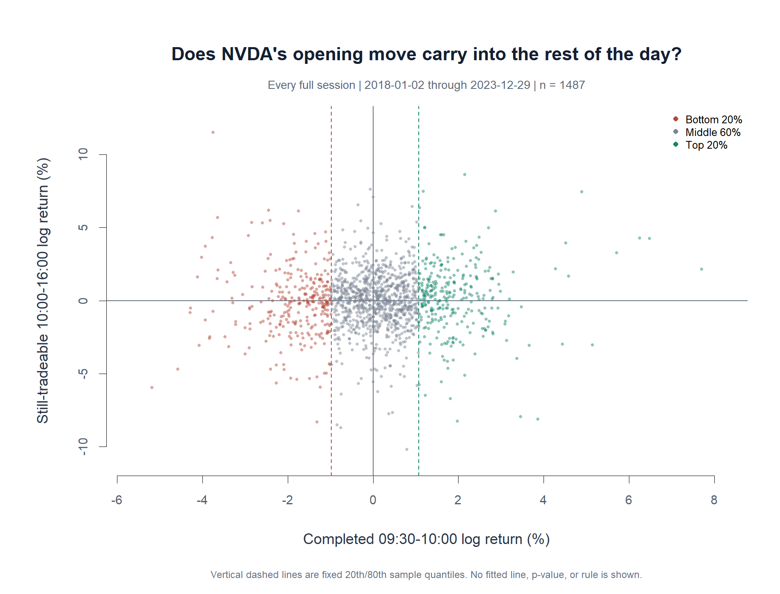
OPERATOR HYPOTHESIS LAB · NVDA INTRADAY OPENING RESPONSE
The opening bar carries only a weak unconditional signal
+0.050
Pearson correlation
−0.979%
+1.070%
sample-wide 20th / 80th cutoffs
The cloud dominates the relationship.
The tails lean slightly in the direction of the opening move.
Descriptive research · 1,487 full sessions · frozen 2018-01-02–2023-12-29
30
Notes:
The unfiltered opening-to-remainder Pearson correlation is +0.050. The vertical lines are the single sample-wide 20th and 80th percentile cutoffs. They are descriptive bins, not yet causal rolling thresholds.
[Sources]
- Local intraday opening-response report: runs/research_workbench/operator_hypothesis_lab/nvda_intraday_opening_response_20260831/report.md
- Full-session causal ledger: runs/research_workbench/operator_hypothesis_lab/nvda_intraday_opening_response_20260831/session_ledger.csv
- Opening-bin and prior-state summaries: runs/research_workbench/operator_hypothesis_lab/nvda_intraday_opening_response_20260831/opening_bin_summary.csv
[/Sources]

Slide 31
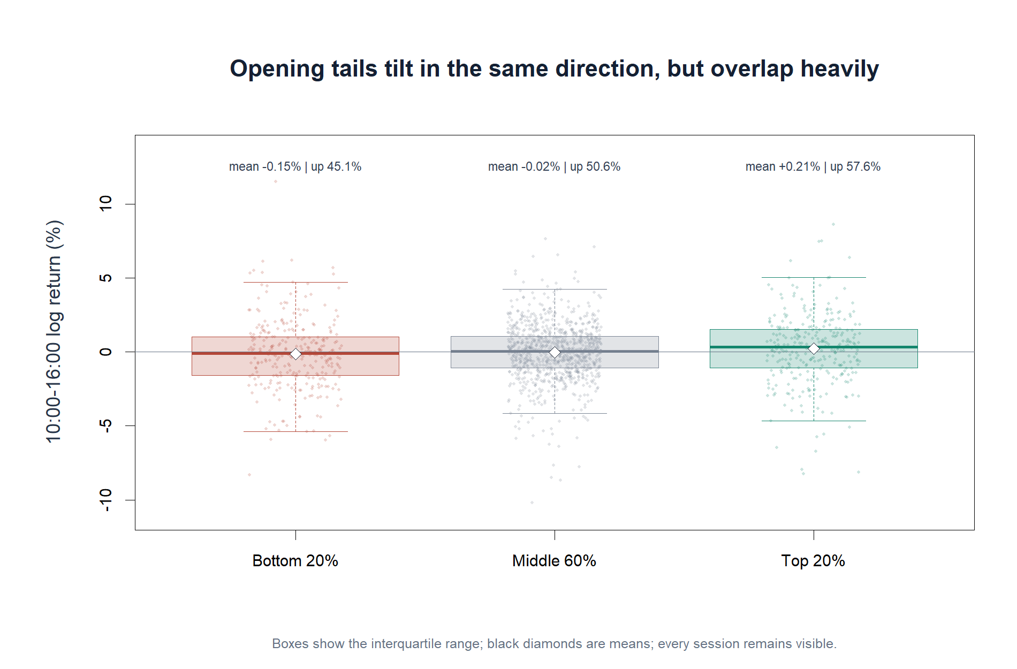
OPERATOR HYPOTHESIS LAB · NVDA INTRADAY OPENING RESPONSE
Tail averages separate, but individual outcomes overlap heavily
Descriptive research · 1,487 full sessions · frozen 2018-01-02–2023-12-29
31
Notes:
Bottom-20% opening sessions average -0.15% over the remainder with 45.1% positive outcomes. Middle-60% sessions average -0.02% with 50.6% positive. Top-20% sessions average +0.21% with 57.6% positive. The heavy overlap is the central caution.
[Sources]
- Local intraday opening-response report: runs/research_workbench/operator_hypothesis_lab/nvda_intraday_opening_response_20260831/report.md
- Opening-bin and prior-state summaries: runs/research_workbench/operator_hypothesis_lab/nvda_intraday_opening_response_20260831/opening_bin_summary.csv
[/Sources]

Slide 32
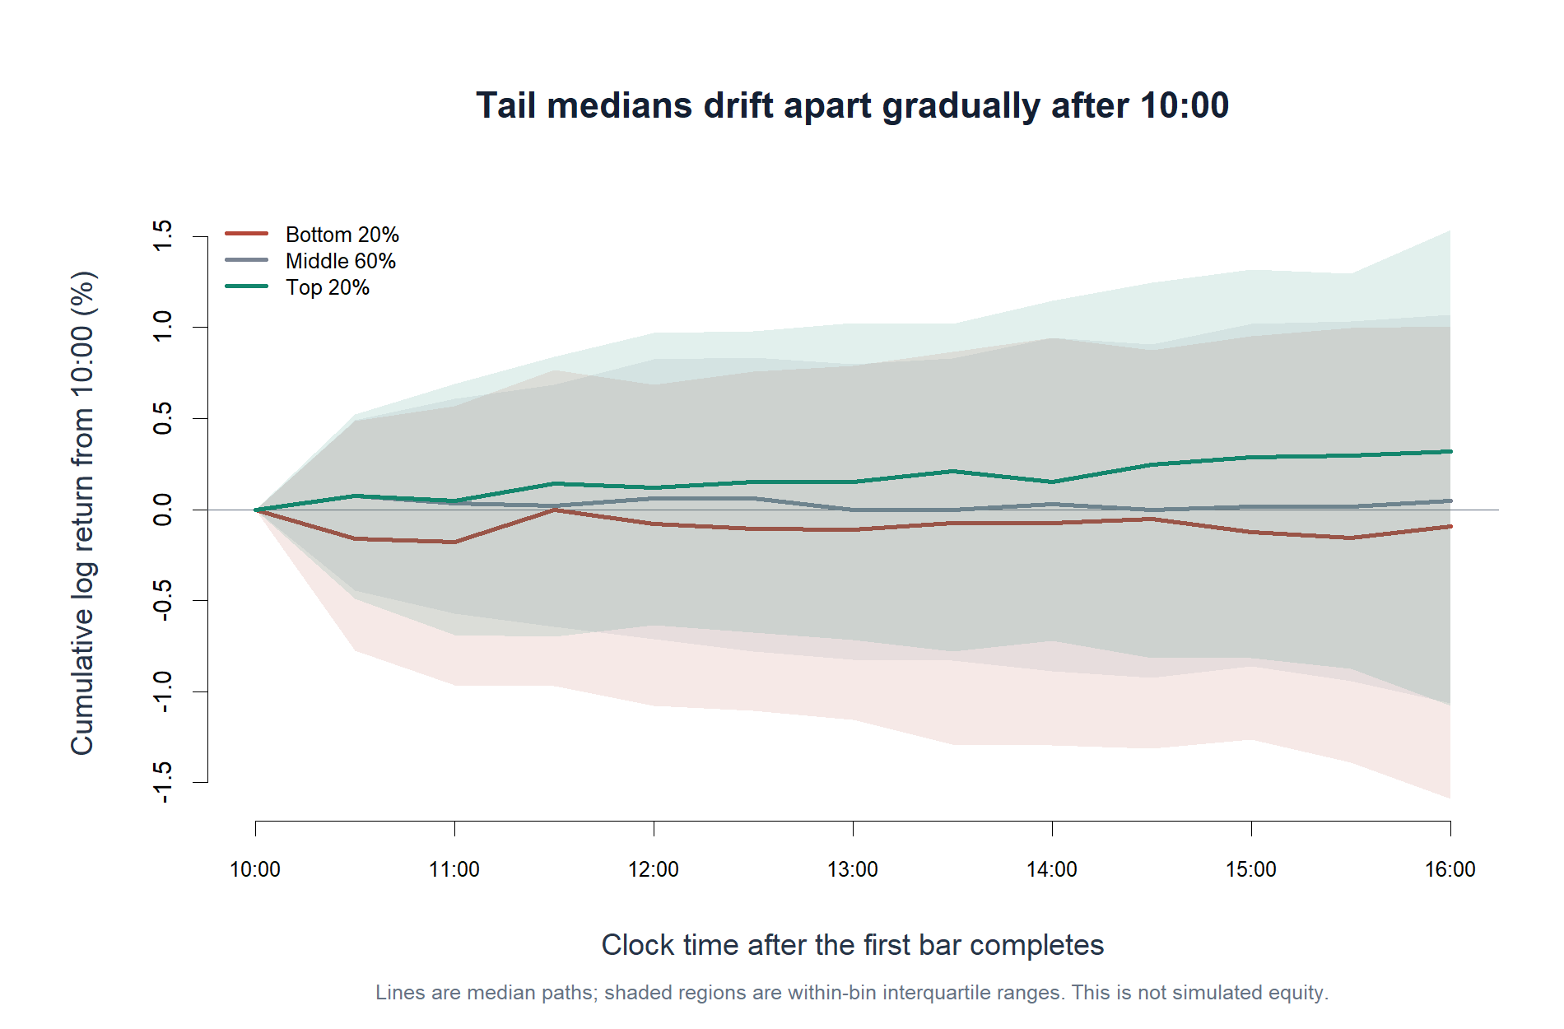
OPERATOR HYPOTHESIS LAB · NVDA INTRADAY OPENING RESPONSE
The directional tilt develops gradually after 10:00
Descriptive research · 1,487 full sessions · frozen 2018-01-02–2023-12-29
32
Notes:
The median paths separate gradually rather than through one isolated bar. Top-tail sessions end with a positive median remainder, while bottom-tail sessions end slightly negative. Interquartile bands remain broad and overlapping; this is a conditional path summary, not an equity curve.
[Sources]
- Local intraday opening-response report: runs/research_workbench/operator_hypothesis_lab/nvda_intraday_opening_response_20260831/report.md
- Full-session causal ledger: runs/research_workbench/operator_hypothesis_lab/nvda_intraday_opening_response_20260831/session_ledger.csv
[/Sources]

Slide 33
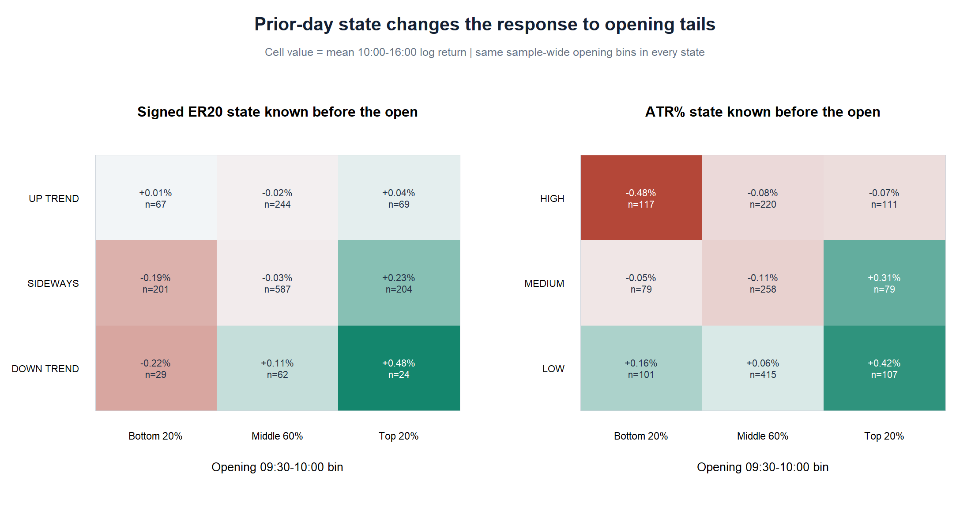
OPERATOR HYPOTHESIS LAB · NVDA INTRADAY OPENING RESPONSE
Prior-day ATR% is the clearest descriptive discriminator
Top 20% opening
+0.38%
LOW / MEDIUM ATR%
61.8% up · n=186
−0.07%
HIGH ATR%
50.5% up · n=111
Bottom-20% opening inside HIGH ATR% averages −0.48%; only 39.3% finish the remainder positive.
Descriptive research · 1,487 full sessions · frozen 2018-01-02–2023-12-29
33
Notes:
The cleanest long-side descriptive contrast is a top-20% opening after a prior-day LOW or MEDIUM ATR-percent state: +0.377% mean remainder, +0.519% median, 61.8% positive, n=186. The same opening tail in HIGH ATR% averages -0.072% with 50.5% positive, n=111. Signed-ER20 down plus a top-tail opening averages +0.48% but has only 24 observations and is not promoted here.
[Sources]
- Local intraday opening-response report: runs/research_workbench/operator_hypothesis_lab/nvda_intraday_opening_response_20260831/report.md
- Opening-bin and prior-state summaries: runs/research_workbench/operator_hypothesis_lab/nvda_intraday_opening_response_20260831/opening_bin_summary.csv
- Descriptive candidate contrasts: runs/research_workbench/operator_hypothesis_lab/nvda_intraday_opening_response_20260831/descriptive_candidate_contrasts.csv
[/Sources]

Slide 34
OPERATOR HYPOTHESIS LAB · NVDA INTRADAY OPENING RESPONSE
ATR% conditions a candidate for the next TRAIN test
Descriptive candidate
Recommended causal translation
Before the open
Compute the opening-tail cutoff from the prior 252 full sessions only.
Prior-day ATR% = LOW or MEDIUM
If the first bar clears that cutoff and yesterday's ATR% was not HIGH, enter at 10:00 and exit at 16:00.
At 10:00
Opening return is in its positive tail
Compare with opening-tail-only, ATR-state-only, HIGH-ATR opposite, and unconditional 10:00-to-close controls.
Observed remainder: +0.38% mean · +0.52% median · 61.8% up · n=186
THIS TRANSLATION IS EXECUTED ON SLIDES 35–41
Descriptive research · 1,487 full sessions · frozen 2018-01-02–2023-12-29
34
Notes:
The current +1.070% cutoff was computed from the entire descriptive sample and therefore must not be used retrospectively as though it had been known each day. The next section converts the same rank concept into a rolling prior-252-session threshold and tests the 10:00-to-close long rule with the predeclared ingredient controls.
[Sources]
- Local intraday opening-response report: runs/research_workbench/operator_hypothesis_lab/nvda_intraday_opening_response_20260831/report.md
- Descriptive candidate contrasts: runs/research_workbench/operator_hypothesis_lab/nvda_intraday_opening_response_20260831/descriptive_candidate_contrasts.csv
- Opening-response construction checks: runs/research_workbench/operator_hypothesis_lab/nvda_intraday_opening_response_20260831/source_checks.csv
- Frozen causal rule specification: runs/research_workbench/operator_hypothesis_lab/nvda_intraday_opening_rule_20260831/run_spec.csv
[/Sources]

Slide 35
SIXTH MICROSCOPE
Can the clue survive
causal timing?
At 10:00, compare the completed opening return with a threshold learned from the prior 252 full sessions. Trade only when yesterday's ATR% was LOW or MEDIUM; exit at 16:00. The rule must beat every simpler control after 10 bps round trip.
TRAIN only · 2024+ intraday data remain unread
35
Notes:
This is a new causal TRAIN hypothesis, not a continuation of the retrospective bin. The current opening is compared with the prior 252 complete openings only; the ATR-percent state comes from the preceding completed daily session; the position begins at 10:00 and ends at 16:00.
[Sources]
- Frozen causal rule specification: runs/research_workbench/operator_hypothesis_lab/nvda_intraday_opening_rule_20260831/run_spec.csv
- Causal construction checks: runs/research_workbench/operator_hypothesis_lab/nvda_intraday_opening_rule_20260831/construction_checks.csv
[/Sources]

Slide 36
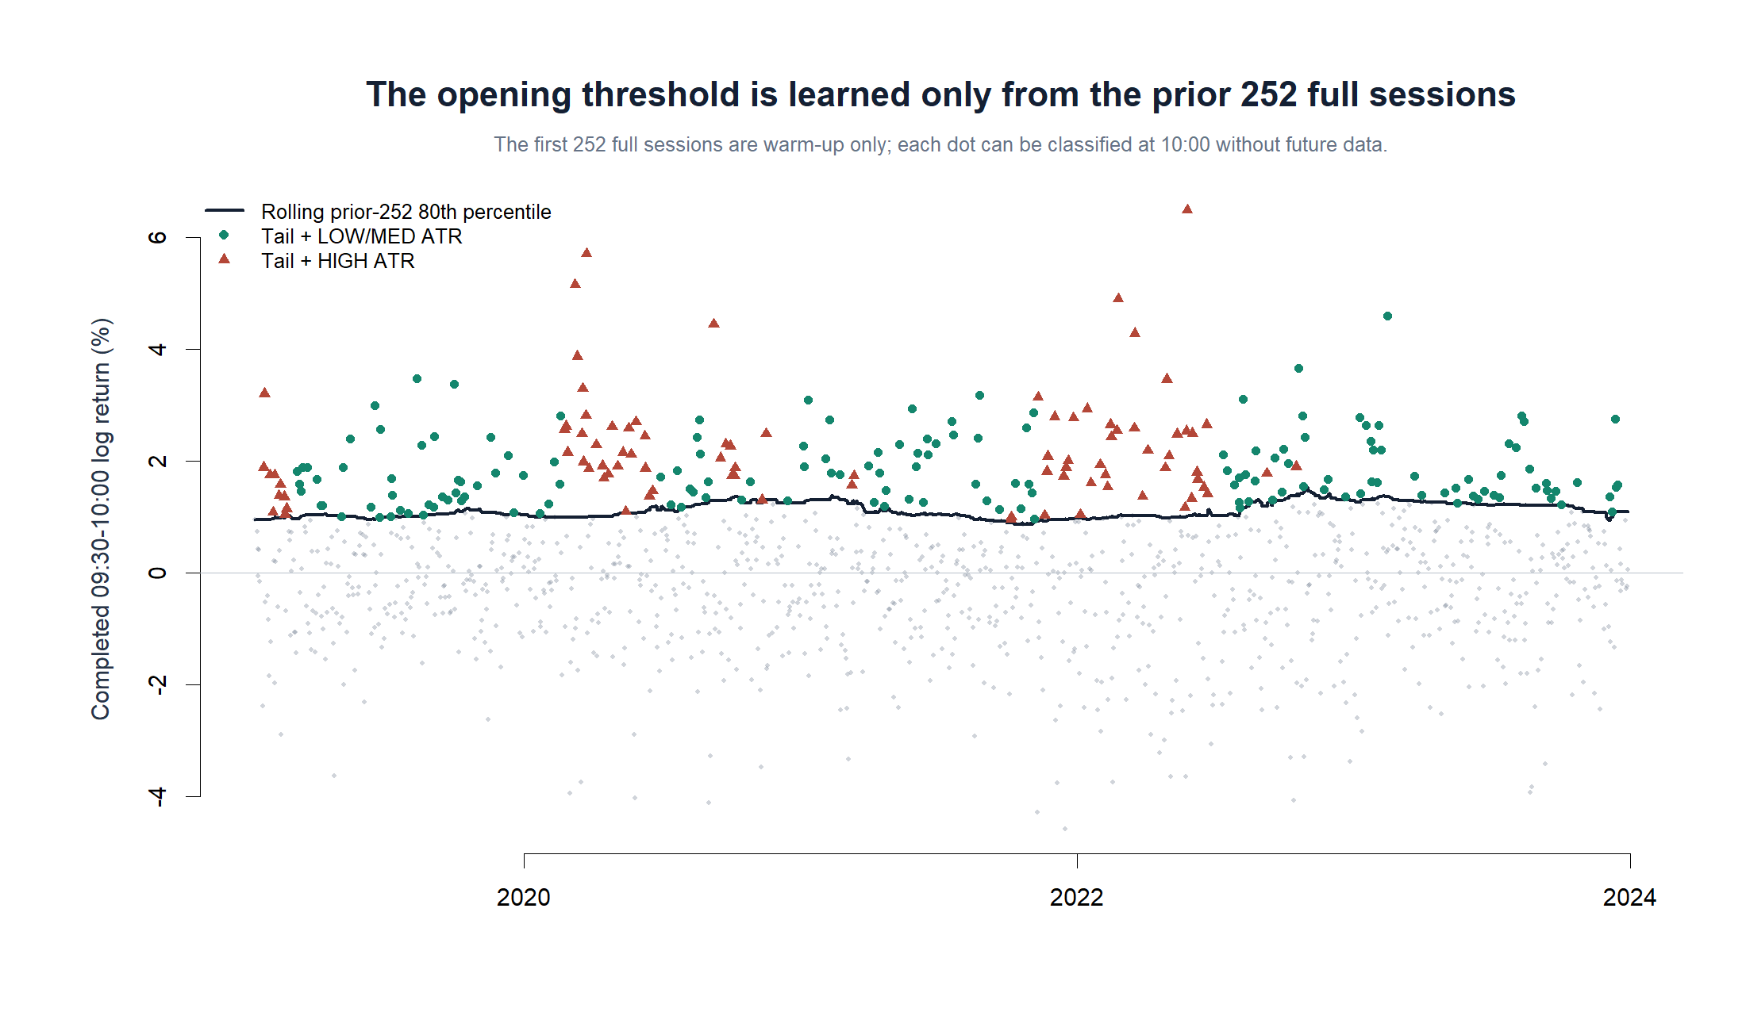
OPERATOR HYPOTHESIS LAB · NVDA INTRADAY OPENING RULE
Every signal is knowable at 10:00 without future data
Causal TRAIN translation · 2019-01-11–2023-12-29 after prior-252-session warm-up
36
Notes:
The first 252 full sessions are warm-up only. Beginning 2019-01-11, each opening return is compared with the prior 252 complete openings using a type-8 80th percentile. Green dots meet the opening threshold after a LOW or MEDIUM prior-day ATR-percent state; red triangles meet the same threshold after HIGH ATR-percent.
[Sources]
- Frozen causal rule specification: runs/research_workbench/operator_hypothesis_lab/nvda_intraday_opening_rule_20260831/run_spec.csv
- Causal construction checks: runs/research_workbench/operator_hypothesis_lab/nvda_intraday_opening_rule_20260831/construction_checks.csv
- Causal same-day trade ledger: runs/research_workbench/operator_hypothesis_lab/nvda_intraday_opening_rule_20260831/trade_ledger.csv
[/Sources]

Slide 37
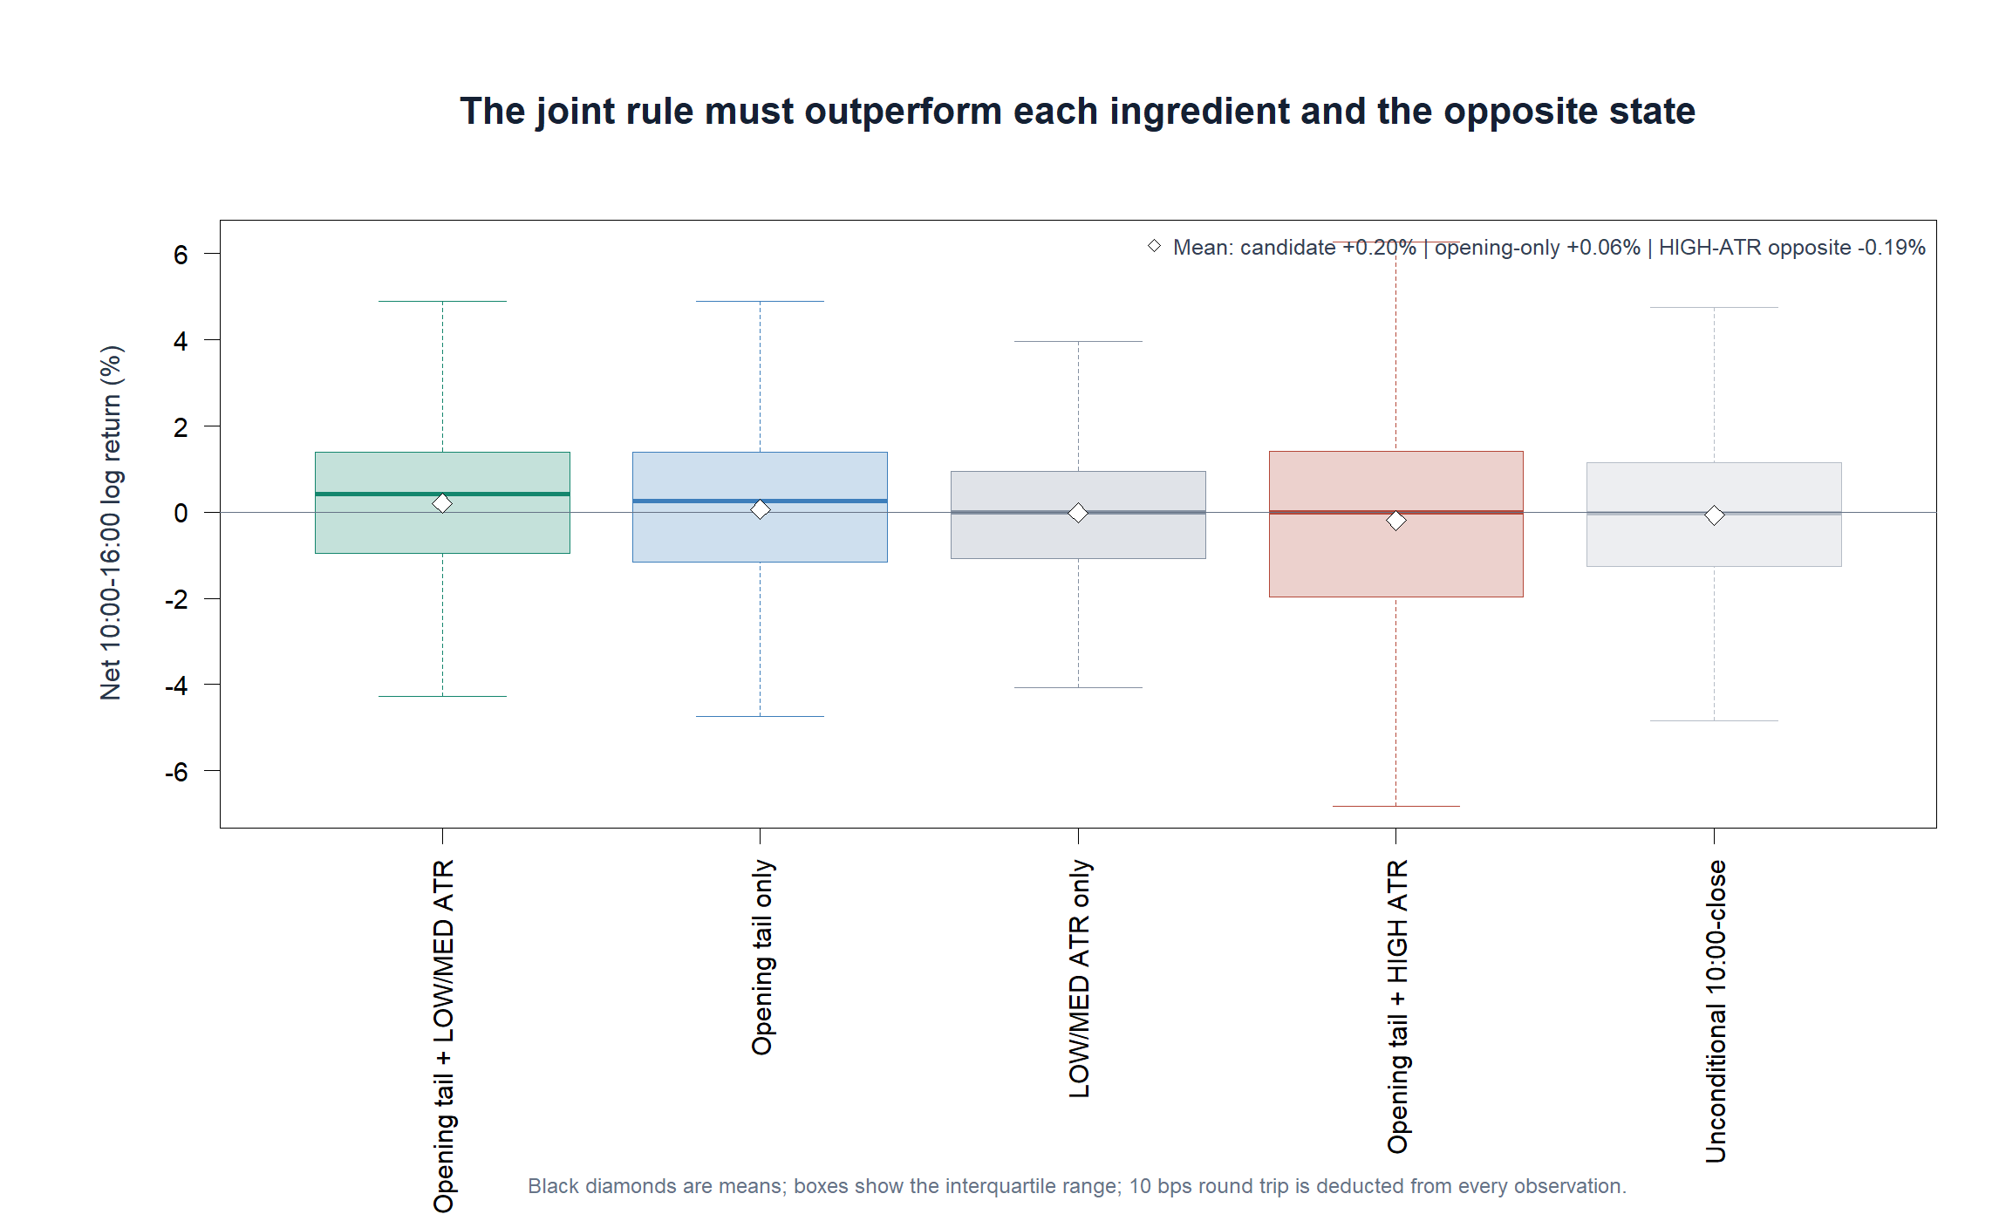
OPERATOR HYPOTHESIS LAB · NVDA INTRADAY OPENING RULE
ATR% performs real discrimination inside TRAIN
Causal TRAIN translation · 2019-01-11–2023-12-29 after prior-252-session warm-up
37
Notes:
The candidate produces 157 trades with +0.204% mean net, +0.430% median net, and 59.9% profitable. Opening-tail-only produces +0.062% mean net. LOW/MEDIUM-ATR-only produces -0.019%. The same opening tail after HIGH ATR produces -0.192%. Unconditional 10:00-to-close after costs produces -0.068%. The candidate clears every aggregate and simpler-control gate.
[Sources]
- Causal intraday opening-rule TRAIN report: runs/research_workbench/operator_hypothesis_lab/nvda_intraday_opening_rule_20260831/report.md
- Candidate and control summary: runs/research_workbench/operator_hypothesis_lab/nvda_intraday_opening_rule_20260831/rule_summary.csv
- Causal same-day trade ledger: runs/research_workbench/operator_hypothesis_lab/nvda_intraday_opening_rule_20260831/trade_ledger.csv
[/Sources]

Slide 38
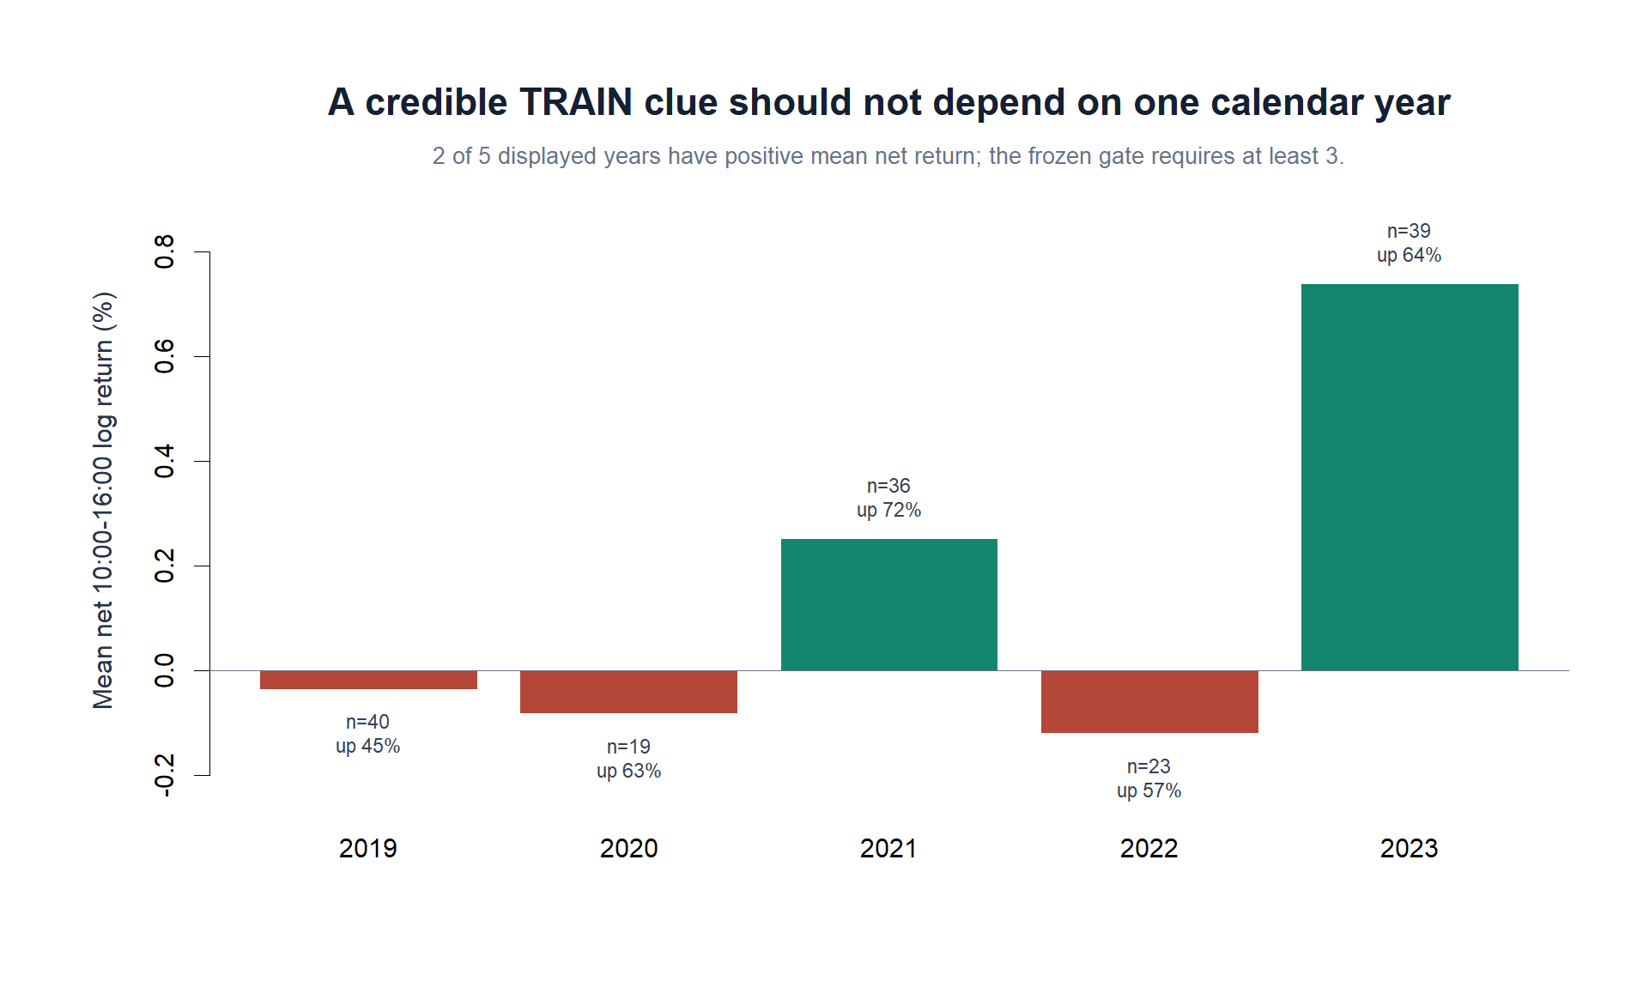
OPERATOR HYPOTHESIS LAB · NVDA INTRADAY OPENING RULE
The aggregate result fails temporal breadth
2 / 5
positive years
Gate required at least 3
89.9%
of cumulative net log return came from 2023
2019, 2020, and 2022 had negative mean net returns.
Causal TRAIN translation · 2019-01-11–2023-12-29 after prior-252-session warm-up
38
Notes:
Only 2021 and 2023 have positive annual mean net return; the frozen calendar-breadth gate requires at least three positive years. The 2023 candidate trades contribute 0.2876 of the total 0.3201 cumulative net log return, or 89.9%. The failure is not weak sample size or weak aggregate economics; it is concentration in late sample time.
[Sources]
- Candidate calendar summary: runs/research_workbench/operator_hypothesis_lab/nvda_intraday_opening_rule_20260831/calendar_summary.csv
- Frozen TRAIN gates: runs/research_workbench/operator_hypothesis_lab/nvda_intraday_opening_rule_20260831/train_gates.csv
- Causal intraday opening-rule TRAIN report: runs/research_workbench/operator_hypothesis_lab/nvda_intraday_opening_rule_20260831/report.md
[/Sources]

Slide 39
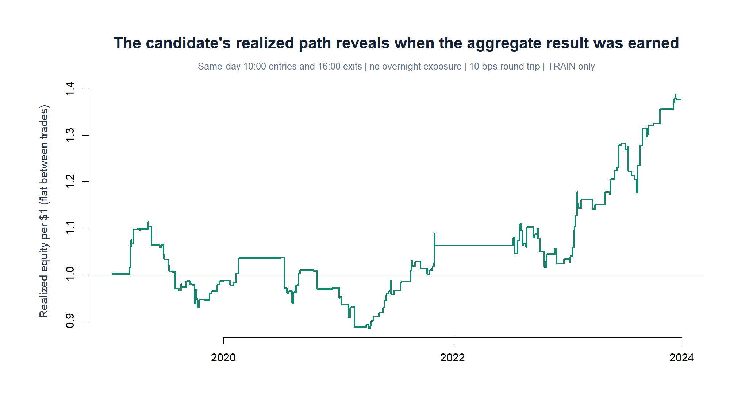
OPERATOR HYPOTHESIS LAB · NVDA INTRADAY OPENING RULE
Most realized gains arrive late in the sample
Causal TRAIN translation · 2019-01-11–2023-12-29 after prior-252-session warm-up
39
Notes:
Sequential same-day candidate trades compound $1 to about $1.38 after 10 bps round trip, but the path spends much of 2019-2022 around or below its start and rises sharply in 2023. This is a realized TRAIN path, not confirmation and not deployable authority.
[Sources]
- Causal intraday opening-rule TRAIN report: runs/research_workbench/operator_hypothesis_lab/nvda_intraday_opening_rule_20260831/report.md
- Causal same-day trade ledger: runs/research_workbench/operator_hypothesis_lab/nvda_intraday_opening_rule_20260831/trade_ledger.csv
- Candidate calendar summary: runs/research_workbench/operator_hypothesis_lab/nvda_intraday_opening_rule_20260831/calendar_summary.csv
[/Sources]

Slide 40
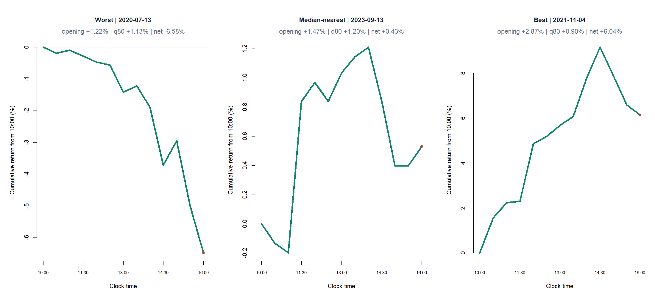
OPERATOR HYPOTHESIS LAB · NVDA INTRADAY OPENING RULE
A positive typical trade still contains severe same-day risk
Causal TRAIN translation · 2019-01-11–2023-12-29 after prior-252-session warm-up
40
Notes:
The worst candidate day loses 6.58% net from 10:00 to 16:00; the median-nearest day gains 0.43%; the best gains 6.04% net. These tapes make the distribution concrete and show that the filter does not imply low-volatility trades even when the prior-day ATR-percent state is LOW or MEDIUM.
[Sources]
- Causal same-day trade ledger: runs/research_workbench/operator_hypothesis_lab/nvda_intraday_opening_rule_20260831/trade_ledger.csv
- Causal intraday opening-rule TRAIN report: runs/research_workbench/operator_hypothesis_lab/nvda_intraday_opening_rule_20260831/report.md
[/Sources]

Slide 41
OPERATOR HYPOTHESIS LAB · NVDA INTRADAY OPENING RULE
The mechanism is promising; the exact rule still stops
STOP_TRAIN_TRANSLATION_GATES_FAILED
Frozen gates
What survives the STOP
PASS
Support
157 trades; minimum 100
PASS
Positive mean
+0.204% net
A strong opening behaves differently after calm versus HIGH-ATR prior days.
PASS
Typical trade
+0.430% median; 59.9% up
The joint filter beats both ingredients, the opposite state, and drift inside TRAIN.
PASS
Beat controls
strongest control +0.062%
FAIL
Calendar breadth
2 positive years; required 3
The exact rule cannot advance because its gains are concentrated in 2023. No threshold, state, clock, or cost rescue is allowed from this packet.
Causal TRAIN translation · 2019-01-11–2023-12-29 after prior-252-session warm-up
41
Notes:
Four of five predeclared TRAIN gates pass. The calendar-breadth gate fails, so the exact rule stops and 2024+ intraday data remain unread. The scientifically useful residue is the signed ATR-state contrast: top-tail openings continue after LOW/MEDIUM ATR but fade after HIGH ATR. That mechanism can motivate a separately declared future study, but this parameterization cannot be rescue-tuned.
[Sources]
- Frozen TRAIN gates: runs/research_workbench/operator_hypothesis_lab/nvda_intraday_opening_rule_20260831/train_gates.csv
- Candidate and control summary: runs/research_workbench/operator_hypothesis_lab/nvda_intraday_opening_rule_20260831/rule_summary.csv
- Candidate calendar summary: runs/research_workbench/operator_hypothesis_lab/nvda_intraday_opening_rule_20260831/calendar_summary.csv
- Causal intraday opening-rule TRAIN report: runs/research_workbench/operator_hypothesis_lab/nvda_intraday_opening_rule_20260831/report.md
[/Sources]

Slide 42
SEVENTH MICROSCOPE
Does the mechanism
travel?
Repeat the same causal opening-tail / prior-day ATR contrast across a pre-existing 26-asset atlas and three eras. This is a mechanism-replication test, not a strategy backtest and not a search for favorable symbols.
NVDA excluded · its 2024+ intraday confirmation window remains unread
42
Notes:
The exact NVDA rule stopped, but its ATR-dependent response suggested a separately declared mechanism question. This section asks whether that response appears broadly across assets and eras. NVDA is excluded so its later period remains available for a separate one-asset confirmation decision.
[Sources]
- Frozen cross-asset mechanism specification: runs/research_workbench/operator_hypothesis_lab/intraday_opening_atr_atlas_20260901/run_spec.csv
- Cross-asset construction checks: runs/research_workbench/operator_hypothesis_lab/intraday_opening_atr_atlas_20260901/construction_checks.csv
- Causal intraday opening-rule TRAIN report: runs/research_workbench/operator_hypothesis_lab/nvda_intraday_opening_rule_20260831/report.md
[/Sources]

Slide 43
OPERATOR HYPOTHESIS LAB · CROSS-ASSET OPENING MECHANISM
Breadth is tested without changing the original mechanism
Frozen causal question
Evidence boundary
At 10:00
26 pre-existing stocks and ETFs; no symbol was added because it looked favorable.
Opening return clears its own prior-252-session 80th percentile
Causal 30-minute outcomes span 2018–2025, with 2017 used only for warm-up.
Compare
Mean 10:00-to-close response after HIGH versus LOW/MEDIUM prior-day ATR%
Pass requires at least 60% negative assets, a negative median contrast, and the same sign in every era.
Negative HIGH-minus-LOW/MED supports the mechanism
No costs, portfolio construction, or trade authority
Mechanism replication · 26 non-NVDA assets · causal outcomes through 2025
43
Notes:
The mechanism is unchanged from the NVDA clue: each asset uses its own causal prior-252 opening threshold, the ATR-percent state comes from the prior completed session, and the outcome is the still-tradeable 10:00-to-close log return. The atlas and gates were frozen before inspecting the result.
[Sources]
- Frozen cross-asset mechanism specification: runs/research_workbench/operator_hypothesis_lab/intraday_opening_atr_atlas_20260901/run_spec.csv
- Cross-asset construction checks: runs/research_workbench/operator_hypothesis_lab/intraday_opening_atr_atlas_20260901/construction_checks.csv
- Cross-asset mechanism-replication report: runs/research_workbench/operator_hypothesis_lab/intraday_opening_atr_atlas_20260901/report.md
[/Sources]

Slide 44
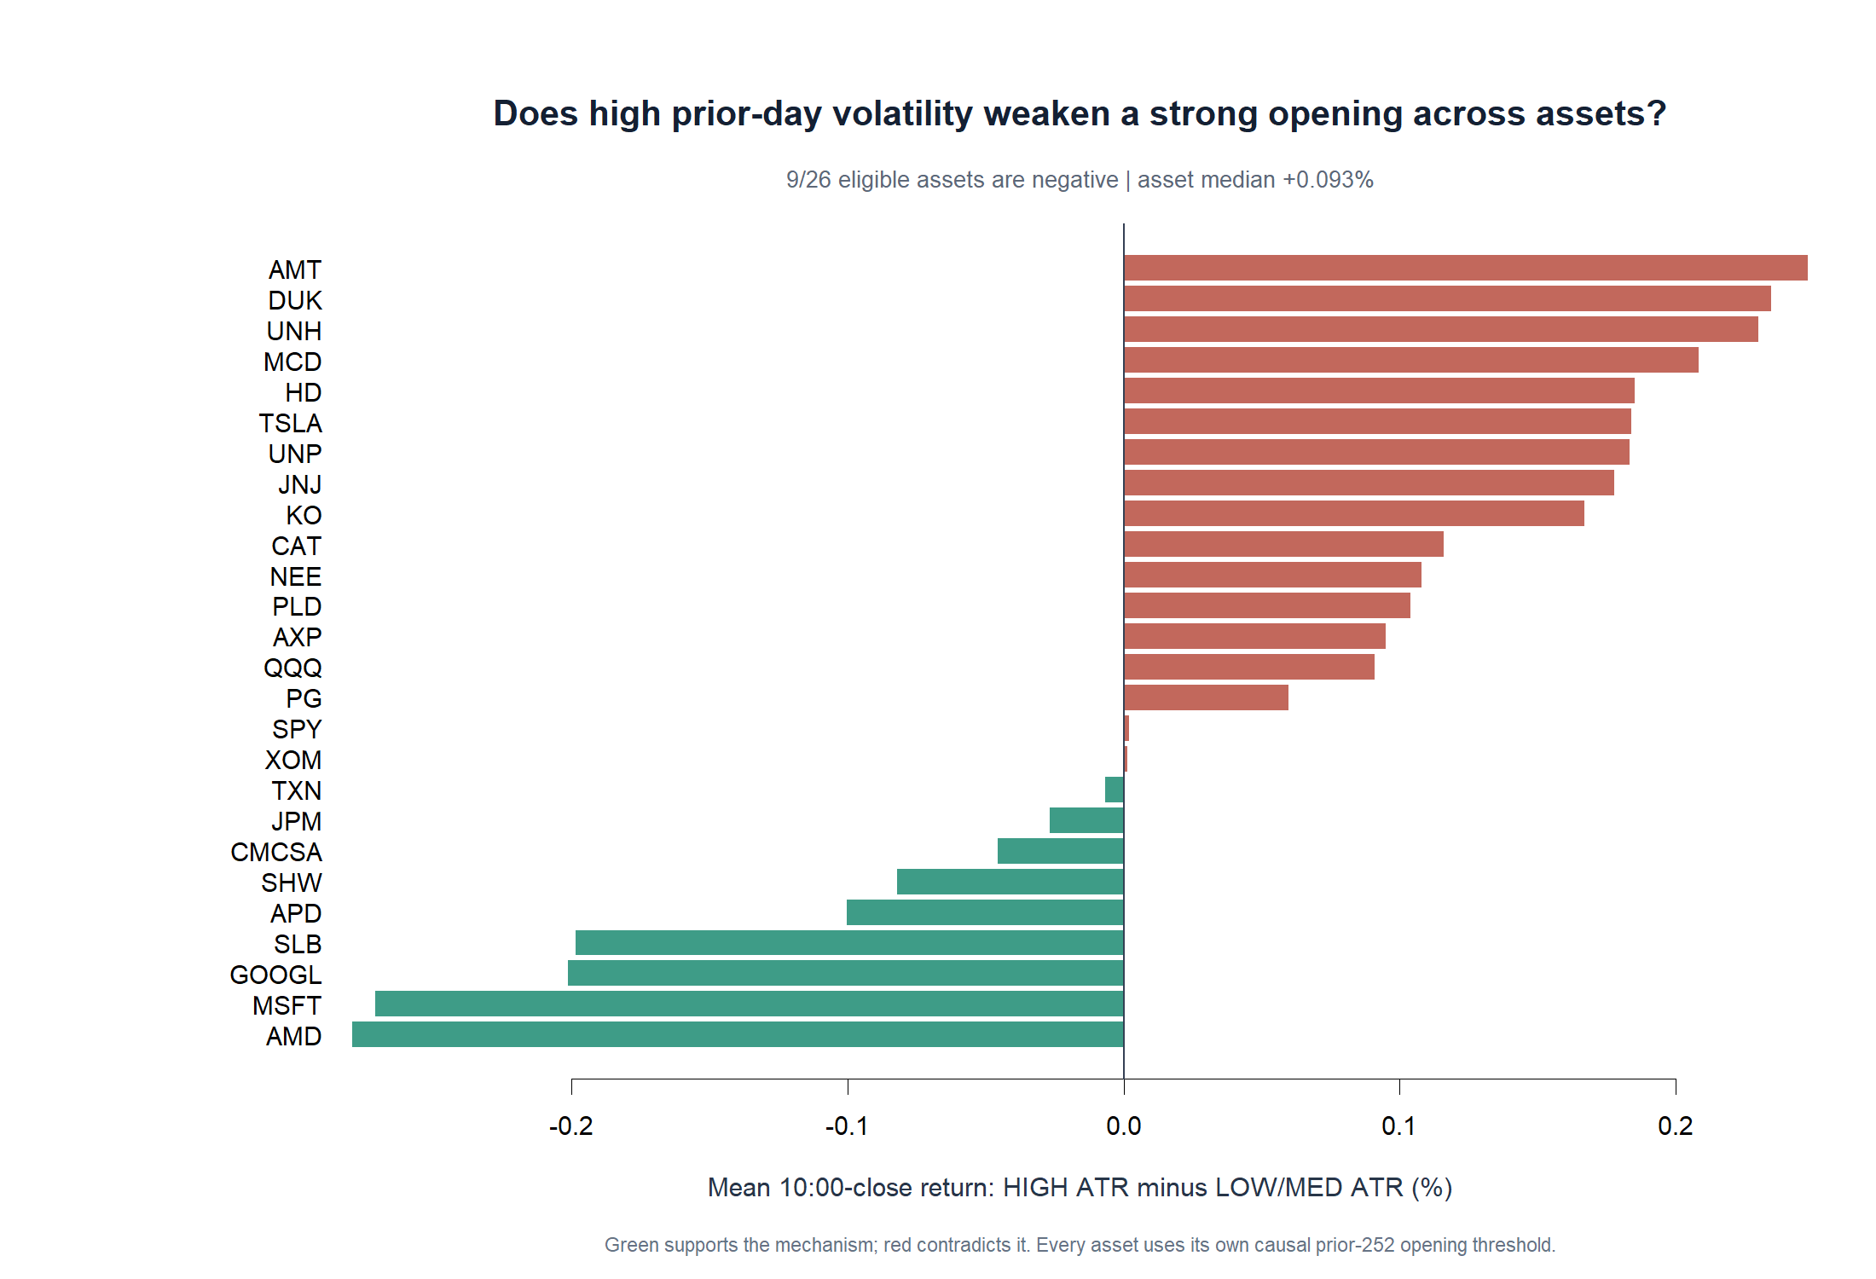
OPERATOR HYPOTHESIS LAB · CROSS-ASSET OPENING MECHANISM
The NVDA direction is a minority pattern across assets
9 / 26
assets support the sign
Frozen gate required 60%
+0.093%
median asset contrast
The typical asset continues more—not less—after a HIGH-ATR strong opening.
Mechanism replication · 26 non-NVDA assets · causal outcomes through 2025
44
Notes:
Only nine of 26 eligible assets have a negative HIGH-minus-LOW/MED response. The asset-median contrast is +0.093%, the opposite of the proposed mechanism. All 26 assets satisfy the predeclared support requirement, so this is a behavioral failure rather than a sample-coverage failure.
[Sources]
- Asset-level mechanism summary: runs/research_workbench/operator_hypothesis_lab/intraday_opening_atr_atlas_20260901/asset_summary.csv
- Frozen mechanism-replication gates: runs/research_workbench/operator_hypothesis_lab/intraday_opening_atr_atlas_20260901/mechanism_gates.csv
- Cross-asset mechanism-replication report: runs/research_workbench/operator_hypothesis_lab/intraday_opening_atr_atlas_20260901/report.md
[/Sources]

Slide 45
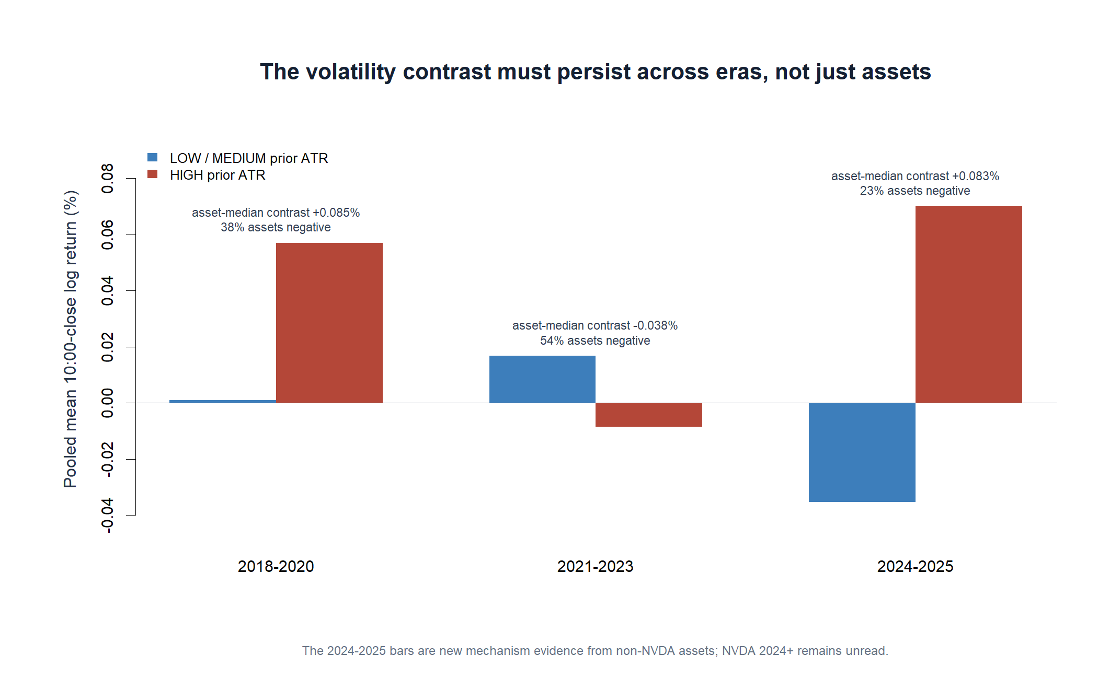
OPERATOR HYPOTHESIS LAB · CROSS-ASSET OPENING MECHANISM
The one supportive era does not persist
2018–20
+0.085% median contrast
2021–23
−0.038% median contrast
2024–25
+0.083% median contrast
The clue is time-local, not era-stable.
Mechanism replication · 26 non-NVDA assets · causal outcomes through 2025
45
Notes:
The asset-median contrast is negative only during 2021-2023, and even there just 53.8% of assets are negative. It is positive in 2018-2020 and again in the newly added 2024-2025 period. This fails the predeclared every-era sign gate and shows that the apparent mechanism is time-local.
[Sources]
- Era-level mechanism summary: runs/research_workbench/operator_hypothesis_lab/intraday_opening_atr_atlas_20260901/era_summary.csv
- Frozen mechanism-replication gates: runs/research_workbench/operator_hypothesis_lab/intraday_opening_atr_atlas_20260901/mechanism_gates.csv
- Cross-asset mechanism-replication report: runs/research_workbench/operator_hypothesis_lab/intraday_opening_atr_atlas_20260901/report.md
[/Sources]

Slide 46
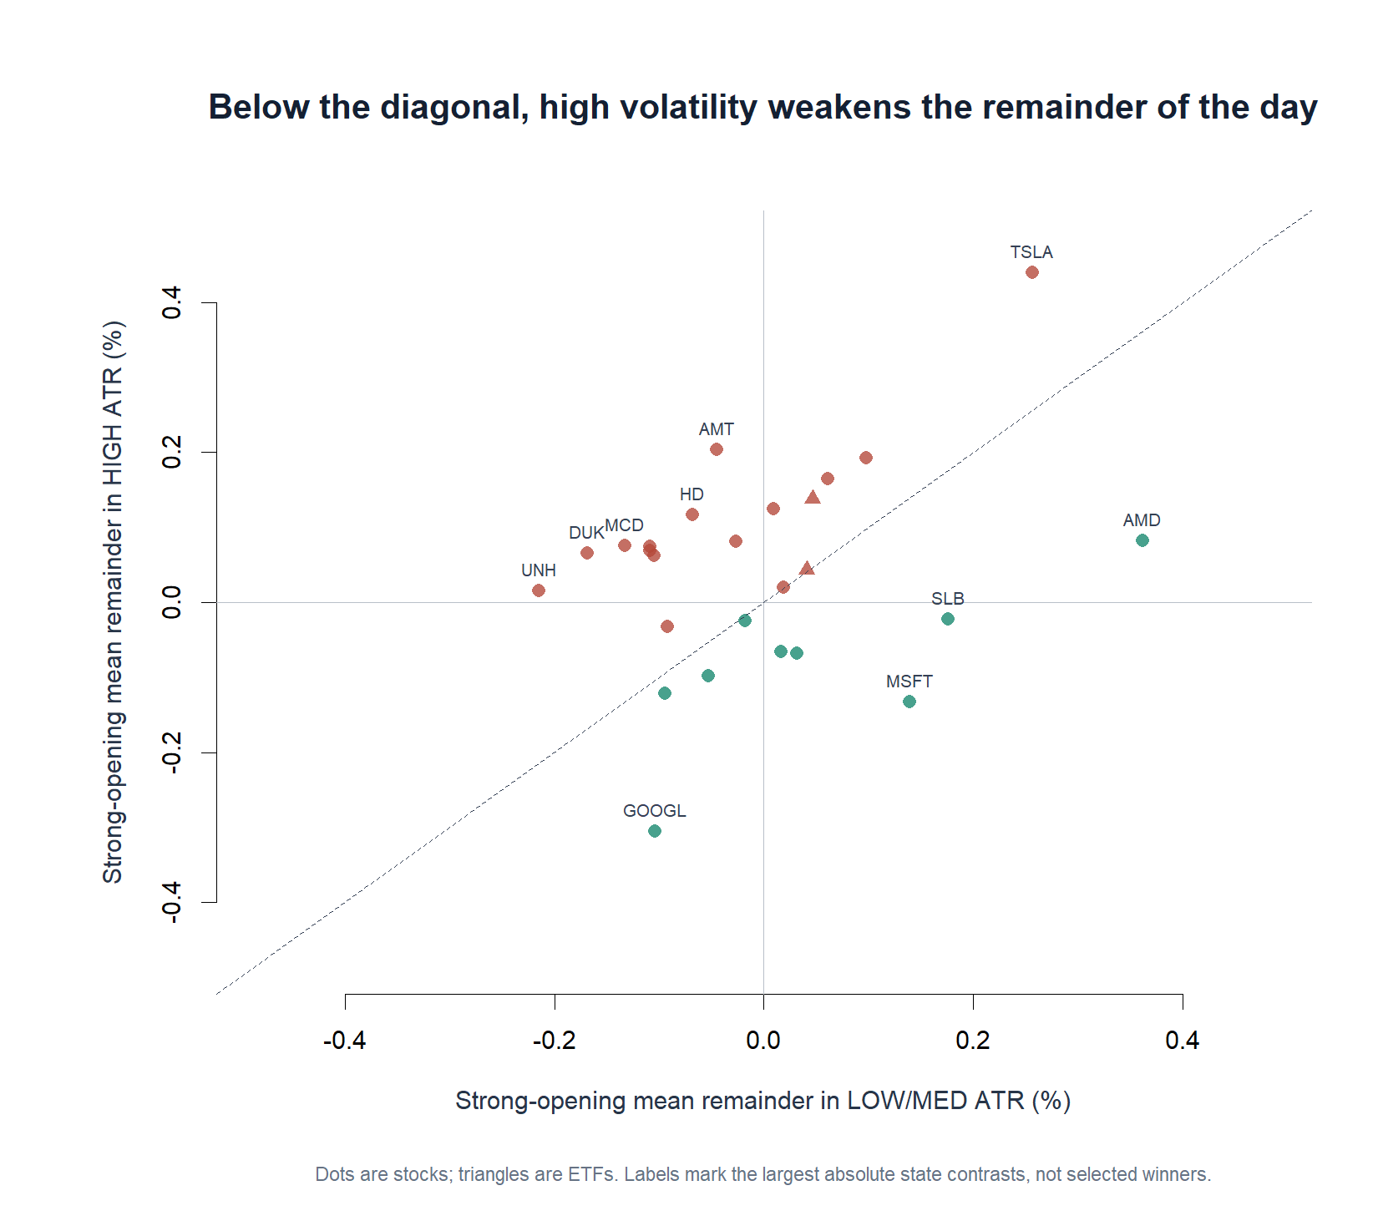
OPERATOR HYPOTHESIS LAB · CROSS-ASSET OPENING MECHANISM
Assets occupy different response geometries
How to read it
Below the diagonal supports weaker continuation in HIGH ATR.
Above it contradicts that mechanism.
Large labels mark contrast magnitude—not chosen winners.
AMD, MSFT, and GOOGL look different from TSLA, AMT, and HD—but this atlas cannot convert that post-hoc split into a rule.
Mechanism replication · 26 non-NVDA assets · causal outcomes through 2025
46
Notes:
This map retains both state-conditioned means instead of collapsing each asset to one contrast. Points below the diagonal support the proposed mechanism; points above it contradict it. The labeled assets have the largest absolute contrasts, which exposes heterogeneity but does not authorize choosing those symbols after seeing the outcome.
[Sources]
- Asset-level mechanism summary: runs/research_workbench/operator_hypothesis_lab/intraday_opening_atr_atlas_20260901/asset_summary.csv
- Cross-asset mechanism-replication report: runs/research_workbench/operator_hypothesis_lab/intraday_opening_atr_atlas_20260901/report.md
[/Sources]

Slide 47
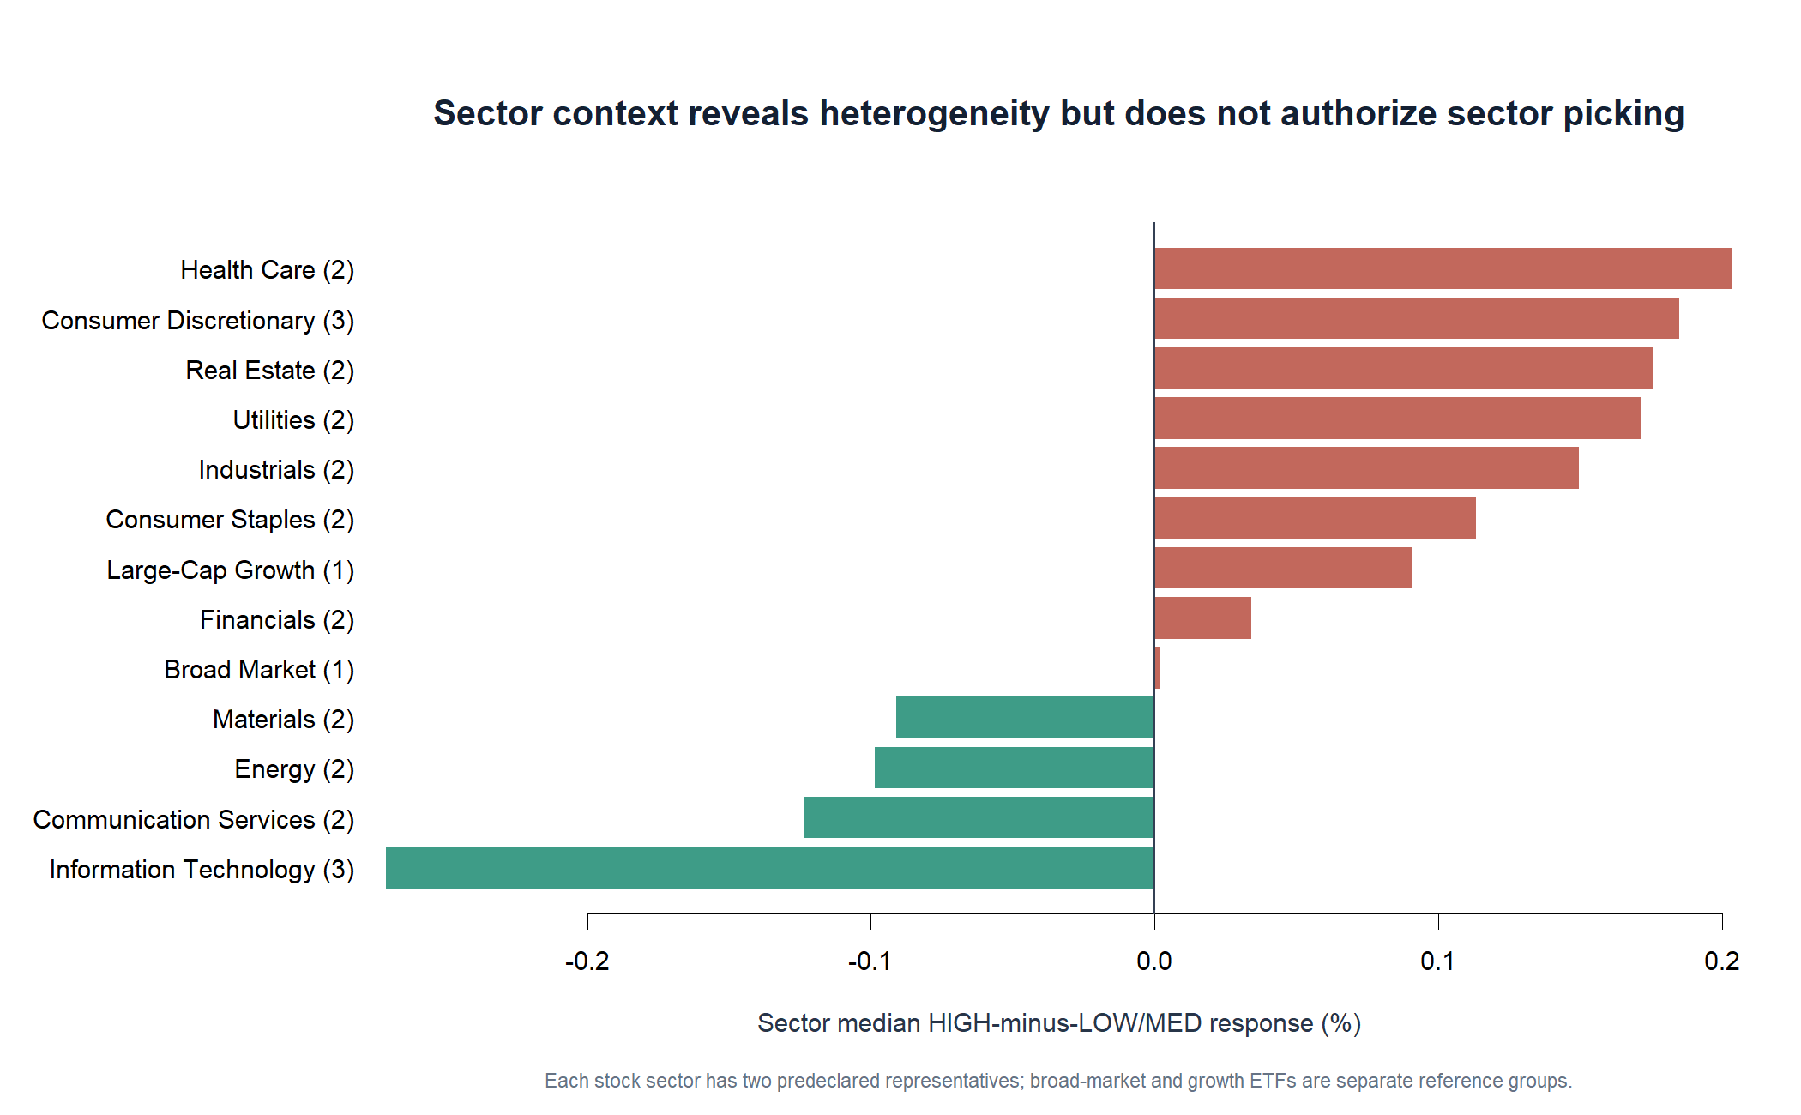
OPERATOR HYPOTHESIS LAB · CROSS-ASSET OPENING MECHANISM
Sector structure is a clue, not a permission slip
Pockets of support
Technology, communication services, materials, and part of energy lean negative.
But most groups have only two representatives, and the sector split was not a selection rule.
This can motivate a new predeclared sector hypothesis; it cannot rescue the broad mechanism.
Mechanism replication · 26 non-NVDA assets · causal outcomes through 2025
47
Notes:
Technology and communication-services representatives are uniformly negative in this atlas, while many defensive and consumer groups are positive. Those differences are scientifically useful for hypothesis generation, but the groups are small and were not predeclared as a selection rule. The broad mechanism remains stopped.
[Sources]
- Sector context summary: runs/research_workbench/operator_hypothesis_lab/intraday_opening_atr_atlas_20260901/sector_summary.csv
- Asset-level mechanism summary: runs/research_workbench/operator_hypothesis_lab/intraday_opening_atr_atlas_20260901/asset_summary.csv
- Cross-asset mechanism-replication report: runs/research_workbench/operator_hypothesis_lab/intraday_opening_atr_atlas_20260901/report.md
[/Sources]

Slide 48
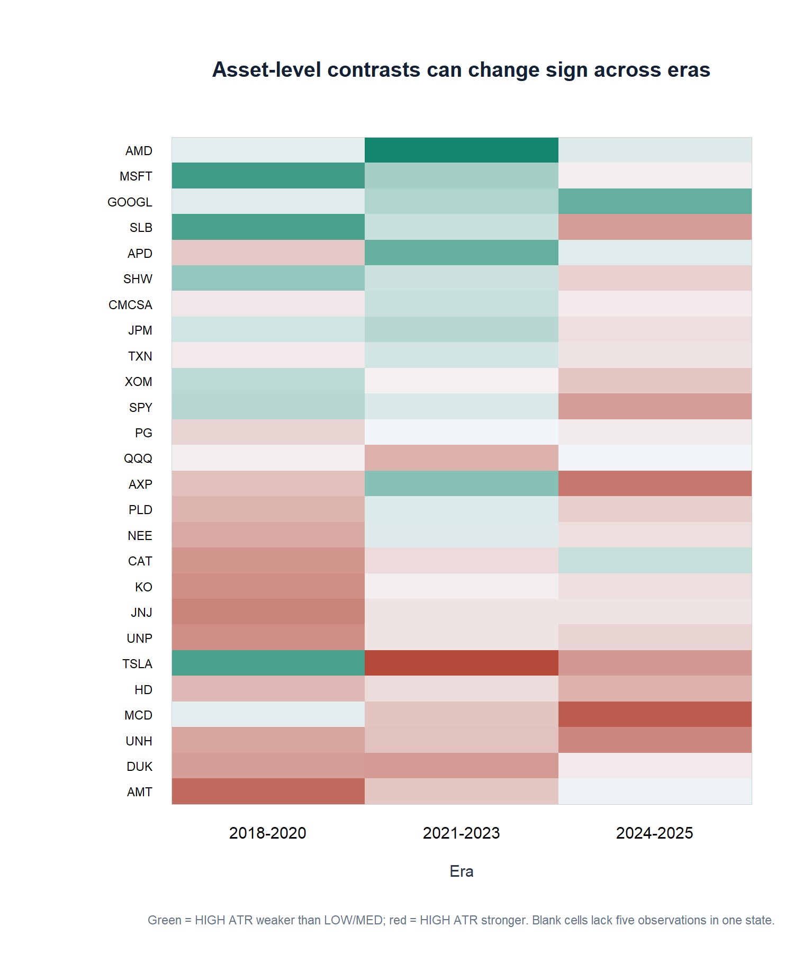
OPERATOR HYPOTHESIS LAB · CROSS-ASSET OPENING MECHANISM
Even supportive assets can change sign through time
The instability is two-dimensional
Across rows: assets disagree about the sign.
Across columns: the same asset can reverse between eras.
A broad static ATR gate therefore lacks transportability.
A future niche study must predeclare both the universe and the time-validation design.
Mechanism replication · 26 non-NVDA assets · causal outcomes through 2025
48
Notes:
The heatmap makes the failure visible at the asset-era level. Some assets have negative contrasts in one era and positive contrasts in another. This rules out treating prior-day ATR as a broad, static permission gate for strong-opening continuation without a newly declared universe and validation design.
[Sources]
- Era-level mechanism summary: runs/research_workbench/operator_hypothesis_lab/intraday_opening_atr_atlas_20260901/era_summary.csv
- Asset-level mechanism summary: runs/research_workbench/operator_hypothesis_lab/intraday_opening_atr_atlas_20260901/asset_summary.csv
- Cross-asset mechanism-replication report: runs/research_workbench/operator_hypothesis_lab/intraday_opening_atr_atlas_20260901/report.md
[/Sources]

Slide 49
OPERATOR HYPOTHESIS LAB · CROSS-ASSET OPENING MECHANISM
The broad mechanism stops; NVDA remains separate
STOP_MECHANISM_REPLICATION_GATES_FAILED
Frozen gates
What survives the STOP
PASS
Asset support
26 eligible; minimum 24
FAIL
Median contrast
+0.093%; required negative
The NVDA result is not evidence for an asset-agnostic ATR gate.
FAIL
Asset breadth
34.6% negative; required 60%
Technology and communication pockets can motivate a new, predeclared niche hypothesis.
FAIL
Era stability
negative only in 2021–2023
FAIL
HIGH-ATR fade
+0.040% pooled; required nonpositive
NVDA's 2024+ data remain unread. The one-asset thesis may still be tested on its own terms, but it cannot borrow confidence from this atlas.
Mechanism replication · 26 non-NVDA assets · causal outcomes through 2025
49
Notes:
Only the support gate passes. The median asset contrast, asset breadth, every-era sign, and pooled HIGH-ATR fade gates all fail. The broad mechanism therefore stops. This does not retroactively answer the separate single-NVDA confirmation question, because NVDA was excluded and its 2024+ intraday data remain unread.
[Sources]
- Frozen mechanism-replication gates: runs/research_workbench/operator_hypothesis_lab/intraday_opening_atr_atlas_20260901/mechanism_gates.csv
- Asset-level mechanism summary: runs/research_workbench/operator_hypothesis_lab/intraday_opening_atr_atlas_20260901/asset_summary.csv
- Era-level mechanism summary: runs/research_workbench/operator_hypothesis_lab/intraday_opening_atr_atlas_20260901/era_summary.csv
- Cross-asset mechanism-replication report: runs/research_workbench/operator_hypothesis_lab/intraday_opening_atr_atlas_20260901/report.md
[/Sources]

Slide 50
EIGHTH MICROSCOPE
Can a daily leverage reset
leave a closing footprint?
NVDL was a 1.5x daily NVDA fund throughout 2023. If its exposure adjustment matters, a large NVDA day should look different specifically near the close—not merely at arbitrary earlier clocks.
2023 only · exact 5-minute bars · no strategy or 2024+ NVDA outcome
50
Notes:
This opens a separate structural-microstructure microscope. The hypothesized mechanism is scheduled daily exposure adjustment, not a generic momentum rule. The study deliberately uses 2023 only, leaving the earlier NVDA 2024+ confirmation boundary untouched.
[Sources]
- Frozen 2023-only five-minute specification: runs/research_workbench/operator_hypothesis_lab/nvda_letf_close_pressure_20260901/run_spec.csv
- SEC EDGAR 2023 NVDL series record (GraniteShares 1.5x Long NVDA Daily ETF): https://www.sec.gov/Archives/edgar/data/1689873/000149315223032890/0001493152-23-032890-index.html
- Federal Reserve, Are Concerns About Leveraged ETFs Overblown?: https://www.federalreserve.gov/econres/feds/are-concerns-about-leveraged-etfs-overblown.htm
[/Sources]

Slide 51
OPERATOR HYPOTHESIS LAB · NVDA / NVDL CLOSE PRESSURE
The clock test separates pressure from ordinary momentum
Frozen causal question
Point-in-time correction
Signal
NVDL's 2023 objective was 1.5x—not the 2x objective shown on today's product page.
NVDA log return from the prior regular-session close to a completed 12:00, 14:00, or 15:30 anchor
The change to 2x occurred in January 2024, outside this sample.
Outcome
The next 30 minutes at every clock
Tracking residual is therefore NVDL minus 1.5x NVDA on identical clock intervals.
A closing mechanism should distinguish 15:30 from the earlier controls
No AUM or shares-outstanding reconstruction yet
Descriptive mechanism POC · exact adjusted SIP 5-minute bars · 2023 only
51
Notes:
The point-in-time fund objective is a hard data contract. SEC records identify NVDL as GraniteShares 1.5x Long NVDA Daily ETF in 2023; the revised January 2024 prospectus identifies the later 2x objective and notes the prior 1.5x name. Using the current 2x label in 2023 would manufacture tracking error.
[Sources]
- Frozen 2023-only five-minute specification: runs/research_workbench/operator_hypothesis_lab/nvda_letf_close_pressure_20260901/run_spec.csv
- SEC EDGAR 2023 NVDL series record (GraniteShares 1.5x Long NVDA Daily ETF): https://www.sec.gov/Archives/edgar/data/1689873/000149315223032890/0001493152-23-032890-index.html
- SEC EDGAR January 2024 revised prospectus (2x; previously 1.5x): https://www.sec.gov/Archives/edgar/data/1689873/000149315224003271/form497.htm
- Causal construction checks: runs/research_workbench/operator_hypothesis_lab/nvda_letf_close_pressure_20260901/construction_checks.csv
[/Sources]

Slide 52
OPERATOR HYPOTHESIS LAB · NVDA / NVDL CLOSE PRESSURE
Sparse ETF trading reduces the sample—but is never filled
177
487
78.8%
0
15:30 pairs
clock rows
anchor coverage
future bars
Exact synchronized sessions
Across all three anchors
1,773 / 2,250 NVDL opportunities
No NVDA 2024+ data read
Admission rule
Both NVDA and NVDL must print the exact anchor, local-control, and outcome bars.
This protects timing, but exact-bar admission may favor more actively traded NVDL sessions.
No previous-tick carry-forward converts a stale ETF price into a synchronized observation.
The packet is descriptive; coverage is not treated as a representative population claim.
Descriptive mechanism POC · exact adjusted SIP 5-minute bars · 2023 only
52
Notes:
NVDA has complete required anchor coverage, while NVDL has 1,773 exact required bars out of 2,250 opportunities during the study. The analysis retains 177 exact 15:30 pairs and 487 total clock rows. This avoids artificial interpolation, while transparently narrowing the claim to sessions with synchronized ETF prints.
[Sources]
- Causal construction checks: runs/research_workbench/operator_hypothesis_lab/nvda_letf_close_pressure_20260901/construction_checks.csv
- Synchronized exact-bar ledger: runs/research_workbench/operator_hypothesis_lab/nvda_letf_close_pressure_20260901/synchronized_clock_panel.csv
- Alpaca historical stock bars API: https://docs.alpaca.markets/us/reference/stockbarsingle-1
[/Sources]

Slide 53
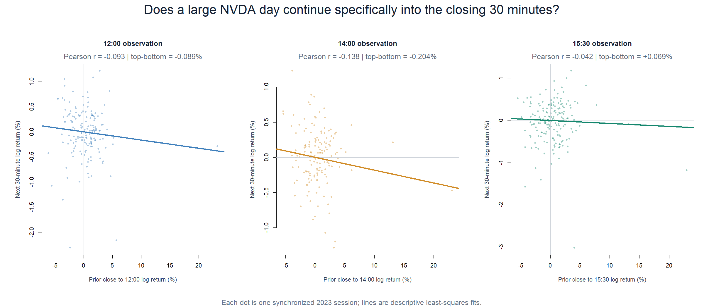
OPERATOR HYPOTHESIS LAB · NVDA / NVDL CLOSE PRESSURE
The predicted same-direction close continuation is absent
15:30
−0.042
Pearson correlation
+0.068
Spearman correlation
The cloud is effectively flat. A positive top-minus-bottom quintile contrast (+0.069%) does not create a monotone close-pressure relationship.
Descriptive mechanism POC · exact adjusted SIP 5-minute bars · 2023 only
53
Notes:
The primary descriptive relationship is slightly negative by Pearson and only slightly positive by Spearman at 15:30. The top-minus-bottom quintile mean is +0.069%, but individual outcomes overlap heavily and the fitted slope remains negative. The predeclared same-direction continuation clue is therefore not present.
[Sources]
- Clock-specific continuation summary: runs/research_workbench/operator_hypothesis_lab/nvda_letf_close_pressure_20260901/clock_summary.csv
- Synchronized exact-bar ledger: runs/research_workbench/operator_hypothesis_lab/nvda_letf_close_pressure_20260901/synchronized_clock_panel.csv
- Local NVDA/NVDL close-pressure report: runs/research_workbench/operator_hypothesis_lab/nvda_letf_close_pressure_20260901/report.md
[/Sources]

Slide 54
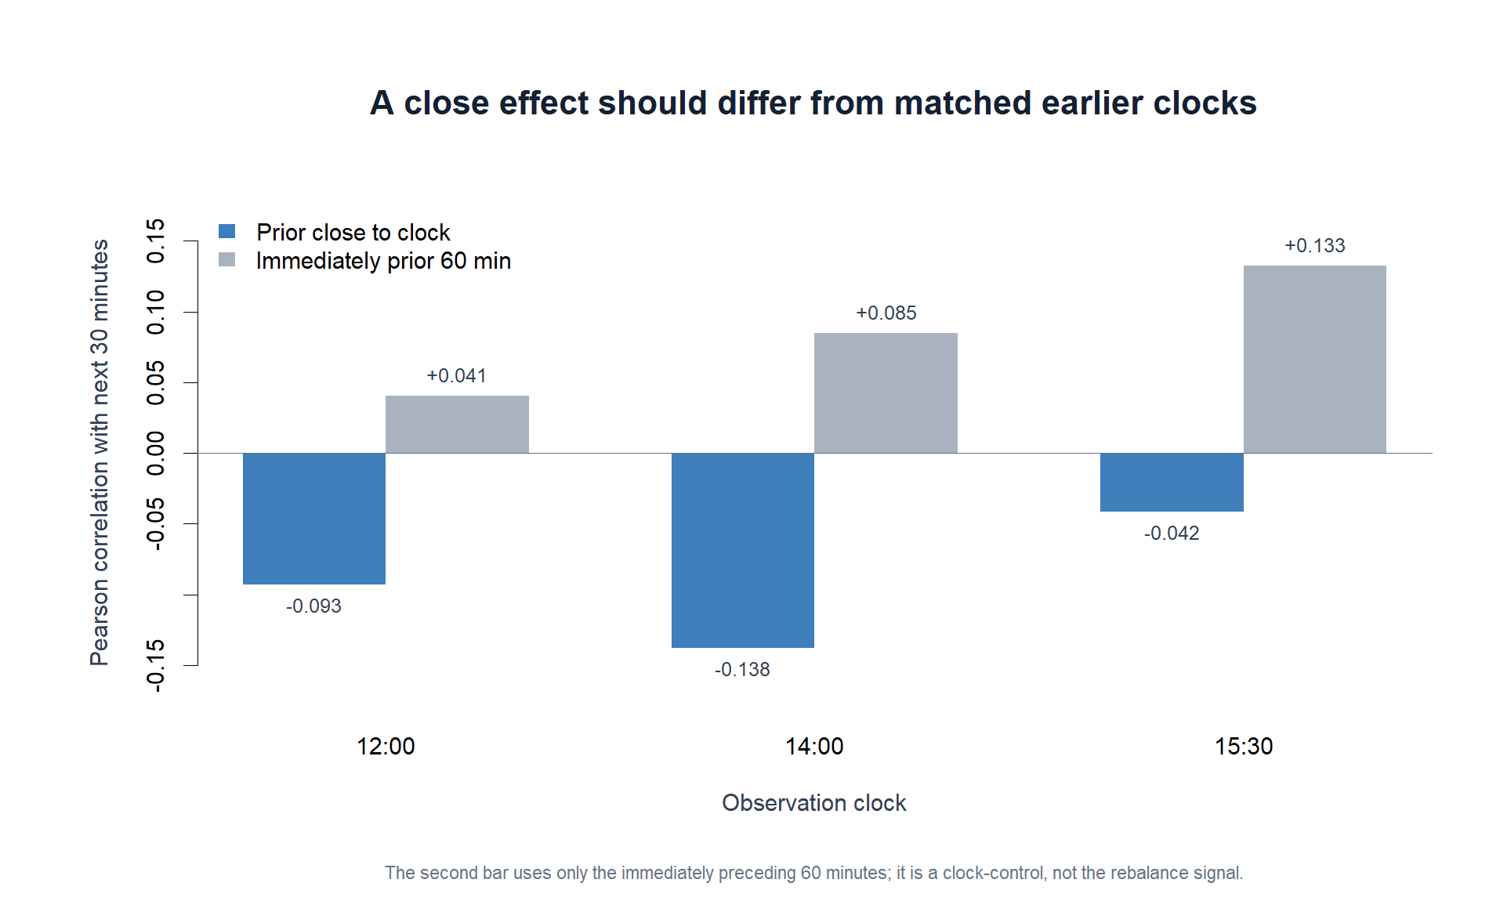
OPERATOR HYPOTHESIS LAB · NVDA / NVDL CLOSE PRESSURE
The close favors local momentum—not the reset signal
Two different predictors
Prior close → clock is the leveraged-reset mechanism signal.
Immediately prior 60 min is an ordinary local momentum control.
The control rises from +0.041 to +0.133. Interesting—but it is a different hypothesis and is not promoted here.
Descriptive mechanism POC · exact adjusted SIP 5-minute bars · 2023 only
54
Notes:
Clock matching prevents us from mistaking generic intraday momentum for the proposed daily-reset mechanism. The prior-close signal is negative at all three clocks. The immediately prior 60-minute return has an increasingly positive descriptive correlation with the next 30 minutes, reaching +0.133 at 15:30. That is a separately testable local-momentum clue, not evidence for NVDL-induced pressure.
[Sources]
- Clock-specific continuation summary: runs/research_workbench/operator_hypothesis_lab/nvda_letf_close_pressure_20260901/clock_summary.csv
- Local NVDA/NVDL close-pressure report: runs/research_workbench/operator_hypothesis_lab/nvda_letf_close_pressure_20260901/report.md
[/Sources]

Slide 55
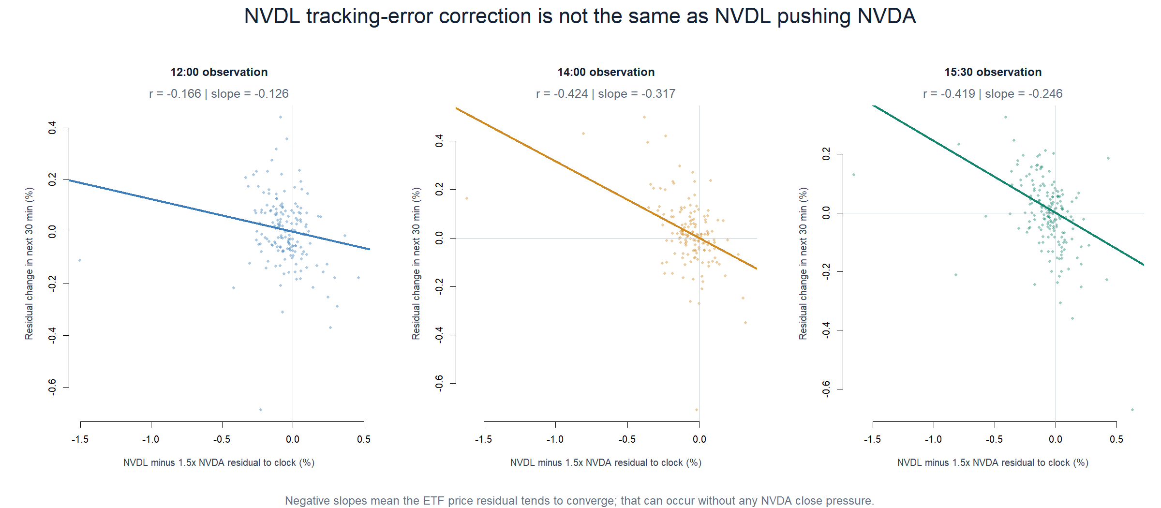
OPERATOR HYPOTHESIS LAB · NVDA / NVDL CLOSE PRESSURE
NVDL's own tracking residual does converge
15:30 residual
−0.419
correlation with correction
−0.246
descriptive slope
This says stale ETF-relative pricing tends to correct. It does not say NVDL buying or selling moved NVDA.
Descriptive mechanism POC · exact adjusted SIP 5-minute bars · 2023 only
55
Notes:
After correcting the historical leverage factor to 1.5x, NVDL's relative-price residual shows clear descriptive convergence at 14:00 and 15:30. This is a coherent ETF-pricing behavior. It is intentionally separated from the underlying-pressure thesis: residual correction can occur entirely through NVDL repricing toward NVDA.
[Sources]
- Point-in-time 1.5x tracking-residual summary: runs/research_workbench/operator_hypothesis_lab/nvda_letf_close_pressure_20260901/tracking_residual_summary.csv
- Synchronized exact-bar ledger: runs/research_workbench/operator_hypothesis_lab/nvda_letf_close_pressure_20260901/synchronized_clock_panel.csv
- SEC EDGAR 2023 NVDL series record (GraniteShares 1.5x Long NVDA Daily ETF): https://www.sec.gov/Archives/edgar/data/1689873/000149315223032890/0001493152-23-032890-index.html
- SEC EDGAR January 2024 revised prospectus (2x; previously 1.5x): https://www.sec.gov/Archives/edgar/data/1689873/000149315224003271/form497.htm
[/Sources]

Slide 56
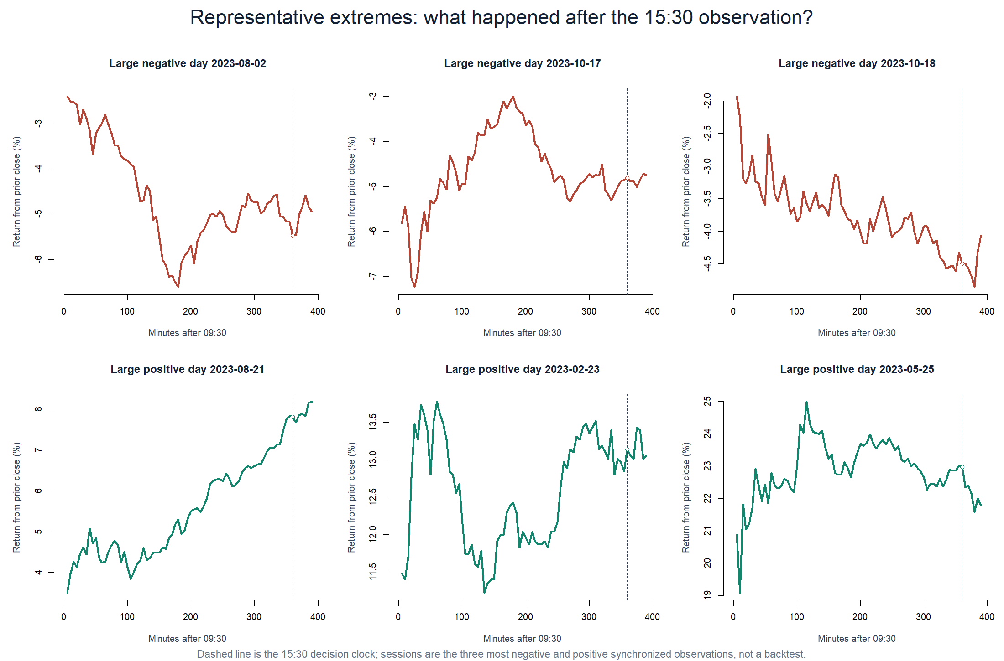
OPERATOR HYPOTHESIS LAB · NVDA / NVDL CLOSE PRESSURE
Extreme days do not share one closing response
Path-level reality
Some large down days rebound after 15:30; another continues lower before recovering.
One large up day extends; another fades sharply into the close.
The examples explain why a small quintile difference and a flat cloud can coexist.
Descriptive mechanism POC · exact adjusted SIP 5-minute bars · 2023 only
56
Notes:
The six most extreme synchronized 15:30 observations show heterogeneous closing paths. They are descriptive examples, not selected trades. The paths make the central result intuitive: extreme daily movement does not map to one reliable final-30-minute direction in this sample.
[Sources]
- Synchronized exact-bar ledger: runs/research_workbench/operator_hypothesis_lab/nvda_letf_close_pressure_20260901/synchronized_clock_panel.csv
- Local NVDA/NVDL close-pressure report: runs/research_workbench/operator_hypothesis_lab/nvda_letf_close_pressure_20260901/report.md
[/Sources]

Slide 57
OPERATOR HYPOTHESIS LAB · NVDA / NVDL CLOSE PRESSURE
The pressure thesis stops at the first microscope
STOP_NO_SAME_DIRECTION_NVDA_CLOSE_FOOTPRINT
What the slice established
What deserves its own next question
PASS
Causal timing
three exact completed clocks
PASS
Point-in-time fund
1.5x objective in 2023
Local 60-minute momentum strengthens toward the close, but was only a control here.
PASS
Clock controls
12:00 and 14:00 matched
STOP
NVDA continuation
15:30 Pearson −0.042
NVDL residual convergence may support a fund-pricing study, not an NVDA-pressure strategy.
CLUE
ETF convergence
residual correlation −0.419
Do not reconstruct AUM for this formulation. Freeze a new slice around one surviving clue.
Descriptive mechanism POC · exact adjusted SIP 5-minute bars · 2023 only
57
Notes:
The exact daily-reset pressure thesis stops at the descriptive stage: there is no positive monotone relationship between the NVDA daily move and its final 30 minutes. The study did uncover two distinct clues—a local momentum control and ETF residual convergence—but neither is promoted automatically. Each would require a newly frozen hypothesis and untouched evidence boundary.
[Sources]
- Local NVDA/NVDL close-pressure report: runs/research_workbench/operator_hypothesis_lab/nvda_letf_close_pressure_20260901/report.md
- Clock-specific continuation summary: runs/research_workbench/operator_hypothesis_lab/nvda_letf_close_pressure_20260901/clock_summary.csv
- Point-in-time 1.5x tracking-residual summary: runs/research_workbench/operator_hypothesis_lab/nvda_letf_close_pressure_20260901/tracking_residual_summary.csv
- Causal construction checks: runs/research_workbench/operator_hypothesis_lab/nvda_letf_close_pressure_20260901/construction_checks.csv
- Federal Reserve, Are Concerns About Leveraged ETFs Overblown?: https://www.federalreserve.gov/econres/feds/are-concerns-about-leveraged-etfs-overblown.htm
[/Sources]

