Slide 1
OPERATOR HYPOTHESIS LAB | DIAGNOSTIC ATLAS 01
What changes the odds
after two green gap-ups?
HYP-MOM-01.1 | discovery diagnostics, not a new strategy
Notes:
This atlas keeps the original two-green-gap-up strategy mechanically unchanged and asks which observable features describe stronger or weaker outcomes. It is a reused-window discovery audit, not promotion evidence.
[Sources]
- C:\Users\Franc\OneDrive\Documents\Francis\Peltata Project\Time-Series-Modeling-Gen5\operator_hypothesis_lab\docs\HYP_MOM_01_1_DIAGNOSTIC_ATLAS_01_CONTRACT.md
- C:\Users\Franc\OneDrive\Documents\Francis\Peltata Project\Time-Series-Modeling-Gen5\operator_hypothesis_lab\docs\HYP_MOM_01_1_DIAGNOSTIC_ATLAS_01_RESULTS.md

Slide 2
Seven question families were frozen before outcomes were inspected
PATTERN
ASSET TREND
PRIOR RETURN
Gap and candle-body strength
scaled to recent volatility
Below, recent reclaim, or
established above SMA200
20, 60, and 120-session
lookback momentum
CONFIRMATION
MARKET
PATH
Streak length, relative volume,
distance from 60-day high
SPY SMA200 state and
SPY 60-session momentum
Day 1-4 state and return
remaining to fixed day-five exit
All cells remain visible; no post-hoc winning cell becomes a rule.
2
Notes:
The registry predeclares the primary diagnostic questions. Continuous feature correlations and representative tapes complement the grouped views. Every result remains descriptive because the same exploratory data was reused.
[Sources]
- C:\Users\Franc\OneDrive\Documents\Francis\Peltata Project\Time-Series-Modeling-Gen5\operator_hypothesis_lab\registries\hyp_mom_01_1_diagnostic_atlas_01_registry.csv
- C:\Users\Franc\OneDrive\Documents\Francis\Peltata Project\Time-Series-Modeling-Gen5\operator_hypothesis_lab\docs\HYP_MOM_01_1_DIAGNOSTIC_ATLAS_01_CONTRACT.md

Slide 3
Volatility scaling makes candle requirements comparable across assets
Lagged volatility
Body strength
σ₂₀,t−1 = SD(rₜ₋₂₀, …, rₜ₋₁)
bᵢ = (Closeᵢ / Openᵢ − 1) / σ₂₀,i−1
Gap strength
Two-session composites
gᵢ = (Openᵢ / Closeᵢ₋₁ − 1) / σ₂₀,i−1
G = gₜ₋₁ + gₜ
B = bₜ₋₁ + bₜ
Strict lagging prevents the signal candles from defining their own scale.
3
Notes:
A one-percent gap is not equally unusual for every stock. Dividing each gap and body by the strictly lagged 20-session return volatility expresses pattern size in recent-volatility units without leaking either signal candle into the denominator. The atlas uses two-session sums as the primary composites.
[Sources]
- C:\Users\Franc\OneDrive\Documents\Francis\Peltata Project\Time-Series-Modeling-Gen5\operator_hypothesis_lab\docs\HYP_MOM_01_1_DIAGNOSTIC_ATLAS_01_CONTRACT.md
- C:\Users\Franc\OneDrive\Documents\Francis\Peltata Project\Time-Series-Modeling-Gen5\operator_hypothesis_lab\registries\hyp_mom_01_1_diagnostic_atlas_01_registry.csv

Slide 4
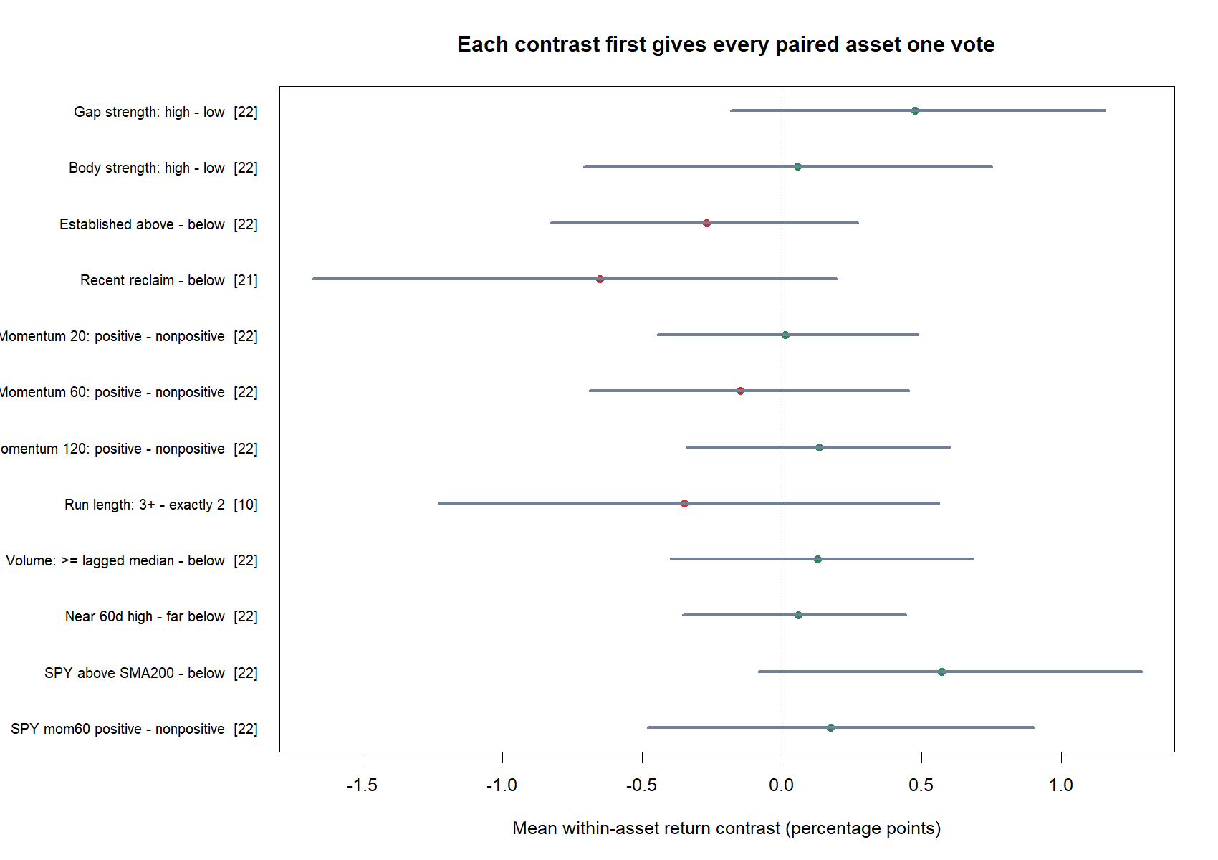
No proposed condition produced stable, broad asset-level separation
4
Notes:
Each point is the mean of within-asset group differences, so assets with many trades do not dominate. The horizontal intervals are 2,000 asset-level bootstrap intervals and are descriptive, not p-values. Every interval crosses zero; the SPY SMA200 contrast is the largest coherent point estimate.
[Sources]
- C:\Users\Franc\OneDrive\Documents\Francis\Peltata Project\Time-Series-Modeling-Gen5\runs\research_workbench\operator_hypothesis_lab\hyp_mom_01_1_diagnostic_atlas_01_20260803\hyp_mom_01_1_da_asset_contrasts.csv
- C:\Users\Franc\OneDrive\Documents\Francis\Peltata Project\Time-Series-Modeling-Gen5\runs\research_workbench\operator_hypothesis_lab\hyp_mom_01_1_diagnostic_atlas_01_20260803\visuals\asset_paired_contrast_forest.png

Slide 5
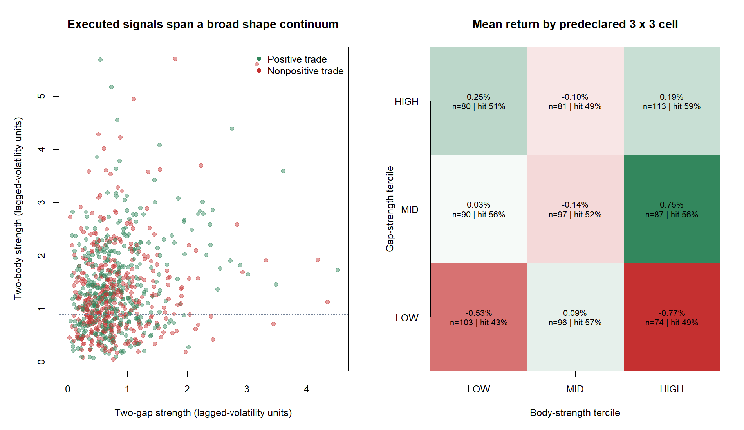
Larger gaps looked better, but the full gap-body surface was not monotonic
5
Notes:
High-gap trades had a pooled mean 0.50 percentage points above low-gap trades, but only eleven of twenty-two within-asset contrasts were positive. The best pooled cell was middle-gap/high-body, not high/high, and low-gap/high-body was the worst. This irregular surface argues against selecting a threshold from these cells.
[Sources]
- C:\Users\Franc\OneDrive\Documents\Francis\Peltata Project\Time-Series-Modeling-Gen5\runs\research_workbench\operator_hypothesis_lab\hyp_mom_01_1_diagnostic_atlas_01_20260803\hyp_mom_01_1_da_executed_trades.csv
- C:\Users\Franc\OneDrive\Documents\Francis\Peltata Project\Time-Series-Modeling-Gen5\runs\research_workbench\operator_hypothesis_lab\hyp_mom_01_1_diagnostic_atlas_01_20260803\hyp_mom_01_1_da_asset_contrasts.csv
- C:\Users\Franc\OneDrive\Documents\Francis\Peltata Project\Time-Series-Modeling-Gen5\runs\research_workbench\operator_hypothesis_lab\hyp_mom_01_1_diagnostic_atlas_01_20260803\visuals\gap_body_strength_atlas.png

Slide 6
Pattern intensity is a useful measurement—not yet an entry filter
+0.48 pp
11 / 22
+0.06 pp
13 / 22
gap high − low
gap breadth
body high − low
body rank sign
Equal-asset mean contrast; interval −0.18 to +1.15 pp
Only half the assets favored the high-gap tercile
Equal-asset mean contrast; interval −0.71 to +0.75 pp
Positive per-asset rank correlation in thirteen assets
Future test, if chosen: freeze one monotonic strength score—not the best 3×3 cell.
6
Notes:
Gap magnitude has the most encouraging asset-level point estimate among the pattern features, but its breadth is exactly half the universe and its interval is wide. Body magnitude is weaker. A legitimate later experiment would predeclare a monotonic composite based on mechanism, rather than mine this grid for the winning cell.
[Sources]
- C:\Users\Franc\OneDrive\Documents\Francis\Peltata Project\Time-Series-Modeling-Gen5\runs\research_workbench\operator_hypothesis_lab\hyp_mom_01_1_diagnostic_atlas_01_20260803\hyp_mom_01_1_da_asset_contrasts.csv
- C:\Users\Franc\OneDrive\Documents\Francis\Peltata Project\Time-Series-Modeling-Gen5\runs\research_workbench\operator_hypothesis_lab\hyp_mom_01_1_diagnostic_atlas_01_20260803\hyp_mom_01_1_da_correlation_summary.csv
- C:\Users\Franc\OneDrive\Documents\Francis\Peltata Project\Time-Series-Modeling-Gen5\operator_hypothesis_lab\docs\HYP_MOM_01_1_DIAGNOSTIC_ATLAS_01_RESULTS.md

Slide 7
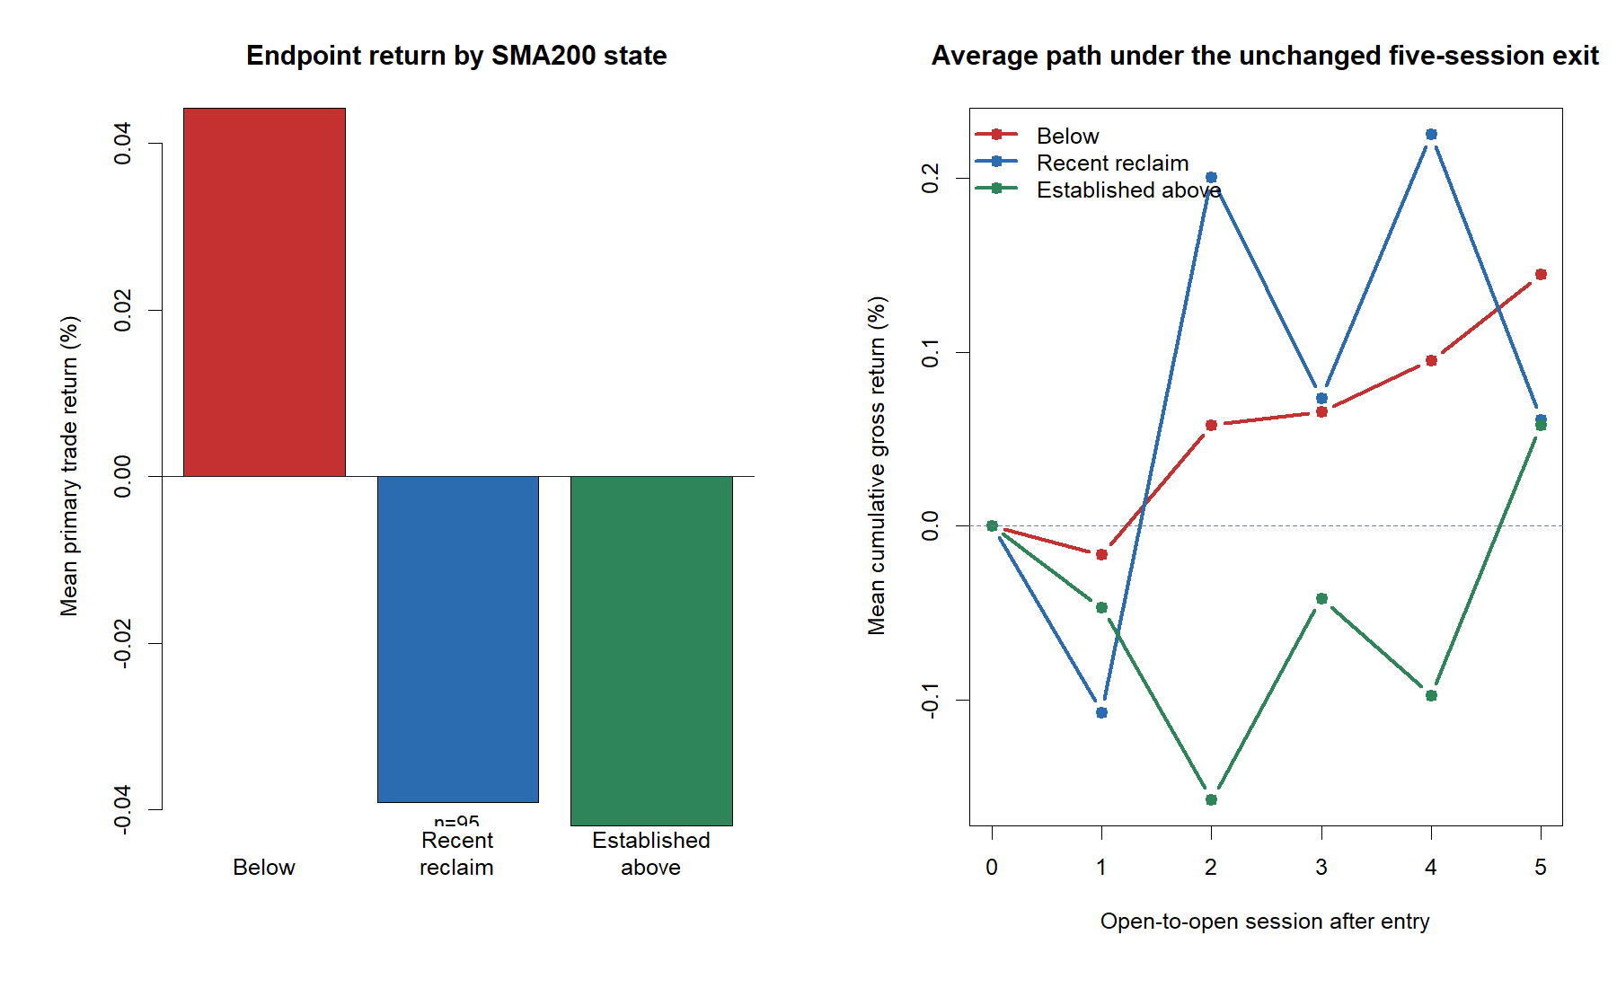
The signal did not improve when the stock was already above SMA200
7
Notes:
Trades below the asset's SMA200 had the highest pooled mean, but also the widest tails. Established-above minus below was negative in fourteen of twenty-two assets; recent reclaim minus below was negative in fourteen of twenty-one. This does not support an above-SMA momentum permission. The below-anchor result may be rebound-like, but it is not a selected reversal rule.
[Sources]
- C:\Users\Franc\OneDrive\Documents\Francis\Peltata Project\Time-Series-Modeling-Gen5\runs\research_workbench\operator_hypothesis_lab\hyp_mom_01_1_diagnostic_atlas_01_20260803\hyp_mom_01_1_da_asset_contrasts.csv
- C:\Users\Franc\OneDrive\Documents\Francis\Peltata Project\Time-Series-Modeling-Gen5\runs\research_workbench\operator_hypothesis_lab\hyp_mom_01_1_diagnostic_atlas_01_20260803\hyp_mom_01_1_da_executed_trades.csv
- C:\Users\Franc\OneDrive\Documents\Francis\Peltata Project\Time-Series-Modeling-Gen5\runs\research_workbench\operator_hypothesis_lab\hyp_mom_01_1_diagnostic_atlas_01_20260803\visuals\slow_anchor_state_behavior.png

Slide 8
ASSET TREND STATES
The same two-candle signal
appeared in three distinct
trend contexts
Representative paths are frozen medoid-return examples within each state—not hand-picked winners.
8
Notes:
The next three slides make the state definitions tangible. Established above means the stock is above SMA200 now and was also above twenty sessions earlier. Recent reclaim means it is above now but was below twenty sessions earlier. Below anchor means it is below SMA200 at signal time.
[Sources]
- C:\Users\Franc\OneDrive\Documents\Francis\Peltata Project\Time-Series-Modeling-Gen5\operator_hypothesis_lab\docs\HYP_MOM_01_1_DIAGNOSTIC_ATLAS_01_CONTRACT.md
- C:\Users\Franc\OneDrive\Documents\Francis\Peltata Project\Time-Series-Modeling-Gen5\runs\research_workbench\operator_hypothesis_lab\hyp_mom_01_1_diagnostic_atlas_01_20260803\hyp_mom_01_1_da_tape_manifest.csv

Slide 9
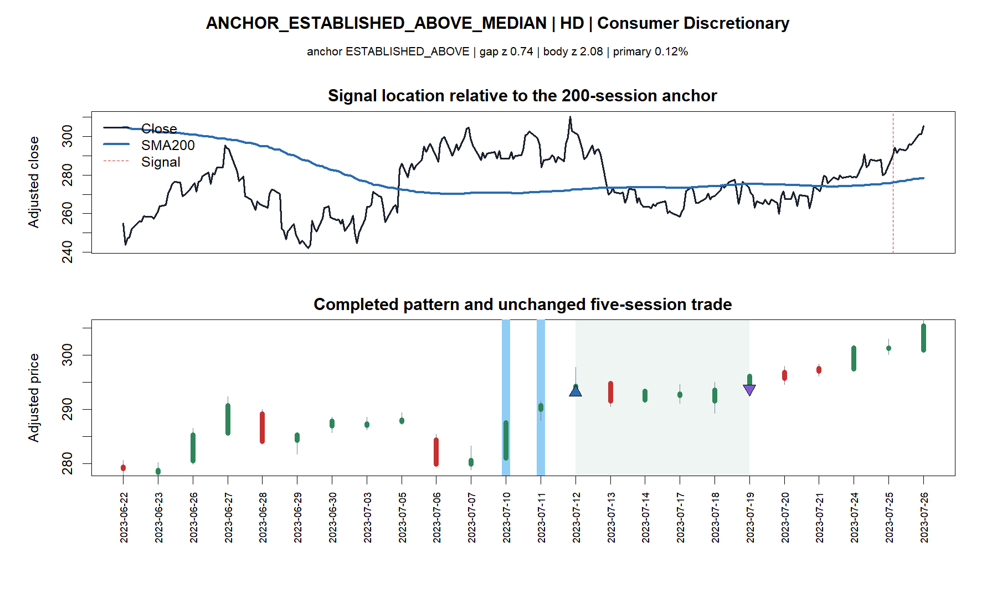
Established-above: the pattern occurred inside a mature uptrend
9
Notes:
HD is the frozen medoid-return established-above example. The asset was already above its slow anchor before the signal; the five-session result is representative of that state's central trade rather than evidence that the state works.
[Sources]
- C:\Users\Franc\OneDrive\Documents\Francis\Peltata Project\Time-Series-Modeling-Gen5\runs\research_workbench\operator_hypothesis_lab\hyp_mom_01_1_diagnostic_atlas_01_20260803\hyp_mom_01_1_da_executed_trades.csv
- C:\Users\Franc\OneDrive\Documents\Francis\Peltata Project\Time-Series-Modeling-Gen5\runs\research_workbench\operator_hypothesis_lab\hyp_mom_01_1_diagnostic_atlas_01_20260803\hyp_mom_01_1_da_tape_manifest.csv
- C:\Users\Franc\OneDrive\Documents\Francis\Peltata Project\Time-Series-Modeling-Gen5\runs\research_workbench\operator_hypothesis_lab\hyp_mom_01_1_diagnostic_atlas_01_20260803\visuals\diagnostic_tape_01_anchor_established_above_median_hd.png

Slide 10
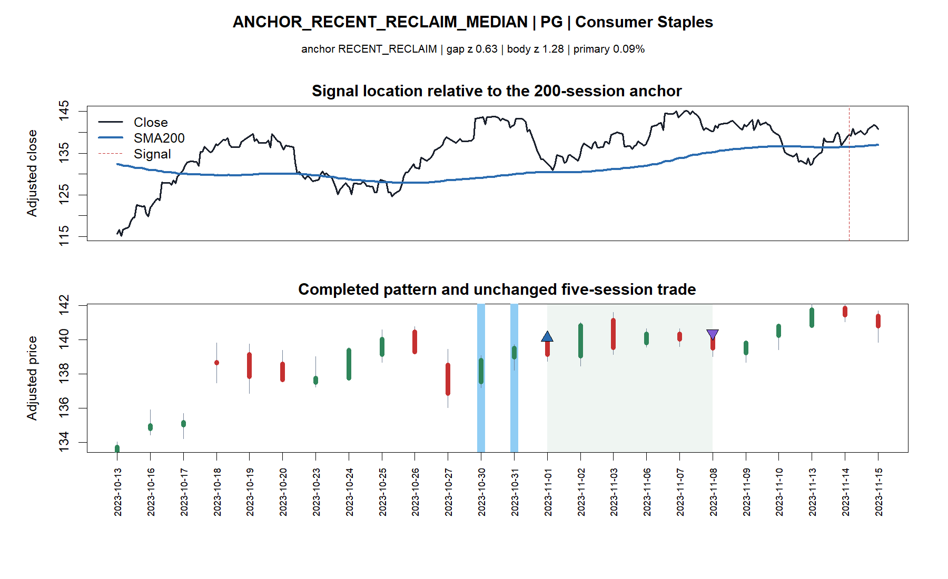
Recent reclaim: the signal followed a transition across the anchor
10
Notes:
PG is the frozen medoid-return recent-reclaim example. The state tests the operator's pivot hypothesis: current price is above SMA200 but was below it twenty sessions earlier. Its aggregate outcomes were not better than below-anchor outcomes.
[Sources]
- C:\Users\Franc\OneDrive\Documents\Francis\Peltata Project\Time-Series-Modeling-Gen5\runs\research_workbench\operator_hypothesis_lab\hyp_mom_01_1_diagnostic_atlas_01_20260803\hyp_mom_01_1_da_executed_trades.csv
- C:\Users\Franc\OneDrive\Documents\Francis\Peltata Project\Time-Series-Modeling-Gen5\runs\research_workbench\operator_hypothesis_lab\hyp_mom_01_1_diagnostic_atlas_01_20260803\hyp_mom_01_1_da_tape_manifest.csv
- C:\Users\Franc\OneDrive\Documents\Francis\Peltata Project\Time-Series-Modeling-Gen5\runs\research_workbench\operator_hypothesis_lab\hyp_mom_01_1_diagnostic_atlas_01_20260803\visuals\diagnostic_tape_02_anchor_recent_reclaim_median_pg.png

Slide 11
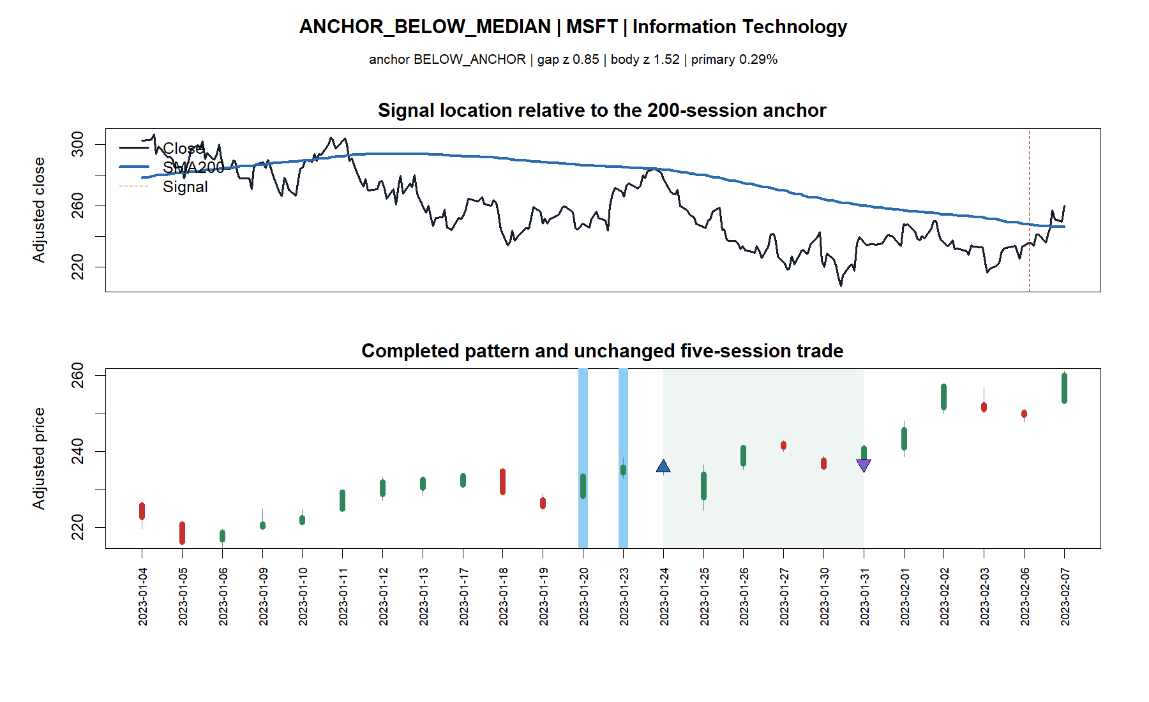
Below anchor: the pattern can be a bounce inside a weak regime
11
Notes:
MSFT is the frozen medoid-return below-anchor example. Below-anchor trades had wider gains and losses, consistent with a more volatile rebound context. That tail width prevents interpreting the slightly higher pooled mean as a clean reversal edge.
[Sources]
- C:\Users\Franc\OneDrive\Documents\Francis\Peltata Project\Time-Series-Modeling-Gen5\runs\research_workbench\operator_hypothesis_lab\hyp_mom_01_1_diagnostic_atlas_01_20260803\hyp_mom_01_1_da_executed_trades.csv
- C:\Users\Franc\OneDrive\Documents\Francis\Peltata Project\Time-Series-Modeling-Gen5\runs\research_workbench\operator_hypothesis_lab\hyp_mom_01_1_diagnostic_atlas_01_20260803\hyp_mom_01_1_da_tape_manifest.csv
- C:\Users\Franc\OneDrive\Documents\Francis\Peltata Project\Time-Series-Modeling-Gen5\runs\research_workbench\operator_hypothesis_lab\hyp_mom_01_1_diagnostic_atlas_01_20260803\visuals\diagnostic_tape_03_anchor_below_median_msft.png

Slide 12
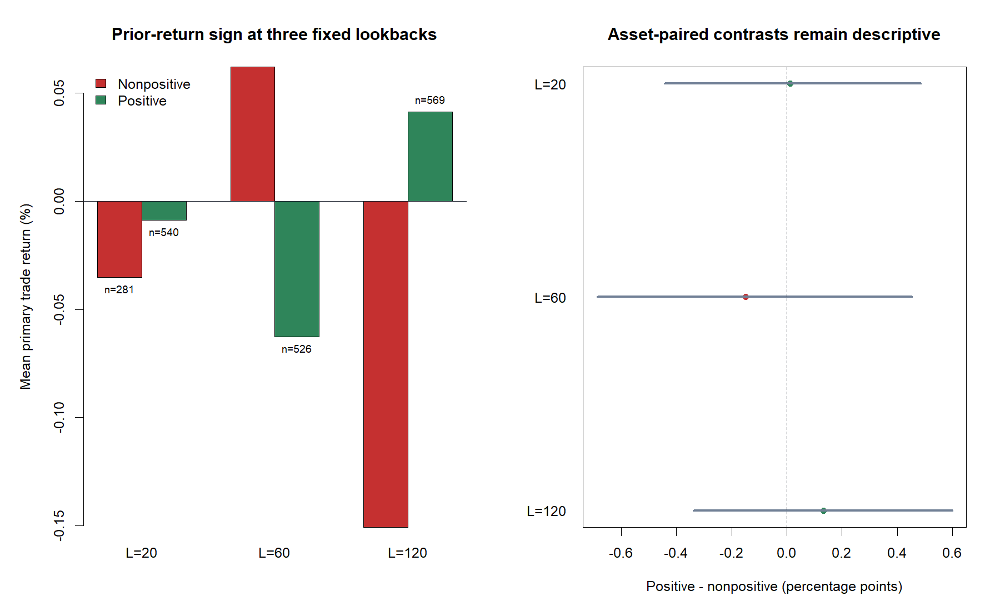
Positive prior return was not a dependable confirmation across 20, 60, or 120 sessions
12
Notes:
Twenty-session positive momentum was nearly neutral relative to nonpositive momentum; sixty-session positive momentum was directionally worse; 120-session positive momentum was directionally better but only ten of twenty-two assets agreed. Continuous per-asset rank correlations were also weak or negative. Adding an L lookback therefore did not sharpen this pattern in the reused window.
[Sources]
- C:\Users\Franc\OneDrive\Documents\Francis\Peltata Project\Time-Series-Modeling-Gen5\runs\research_workbench\operator_hypothesis_lab\hyp_mom_01_1_diagnostic_atlas_01_20260803\hyp_mom_01_1_da_asset_contrasts.csv
- C:\Users\Franc\OneDrive\Documents\Francis\Peltata Project\Time-Series-Modeling-Gen5\runs\research_workbench\operator_hypothesis_lab\hyp_mom_01_1_diagnostic_atlas_01_20260803\hyp_mom_01_1_da_correlation_summary.csv
- C:\Users\Franc\OneDrive\Documents\Francis\Peltata Project\Time-Series-Modeling-Gen5\runs\research_workbench\operator_hypothesis_lab\hyp_mom_01_1_diagnostic_atlas_01_20260803\visuals\lookback_momentum_behavior.png

Slide 13
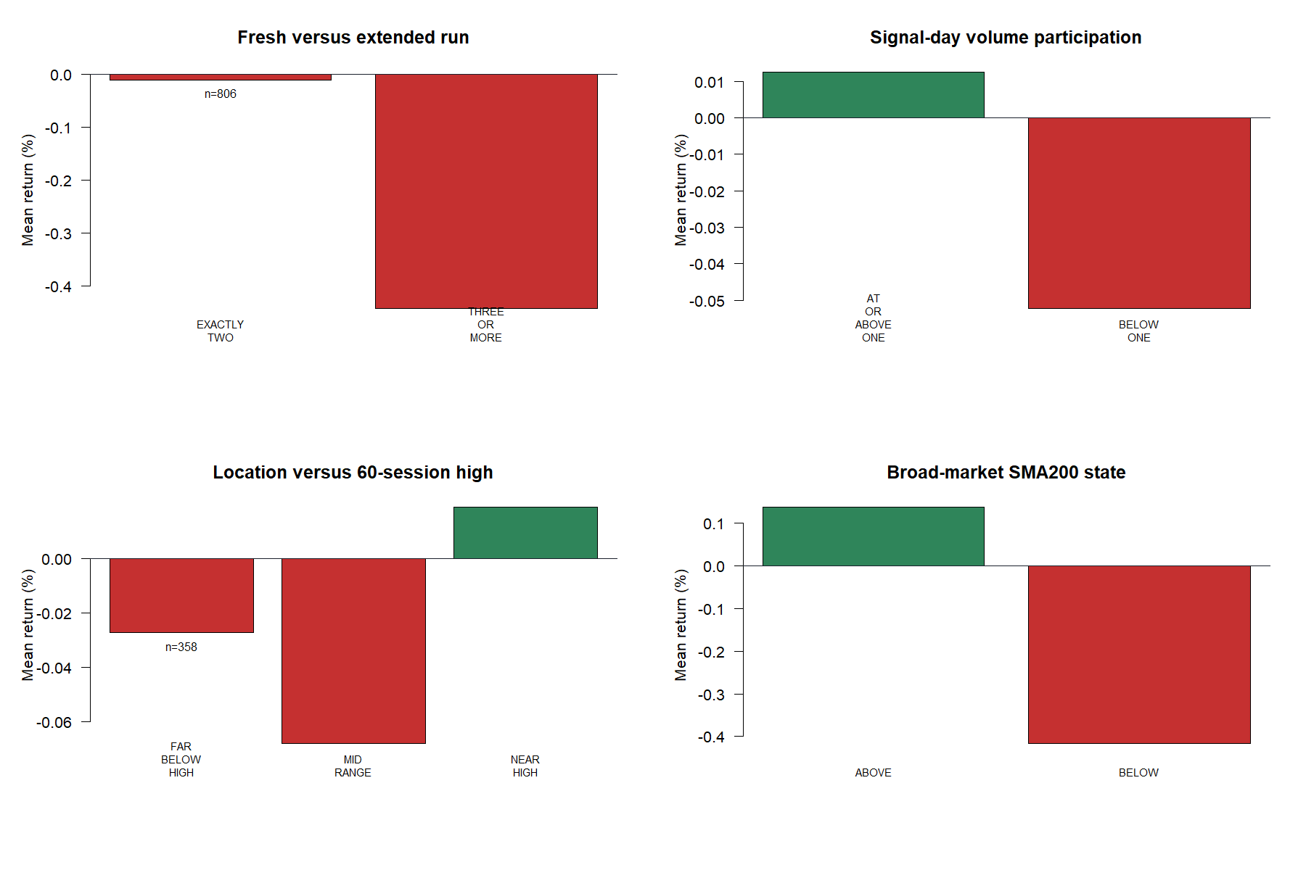
Secondary asset context added little; the market anchor stood out
13
Notes:
Only fifteen trades extended to three or more qualifying sessions, so streak length is too sparse to interpret. Above-median volume and proximity to the 60-day high produced small, unstable differences with about half the assets agreeing. These should not be stacked into a multi-filter rule.
[Sources]
- C:\Users\Franc\OneDrive\Documents\Francis\Peltata Project\Time-Series-Modeling-Gen5\runs\research_workbench\operator_hypothesis_lab\hyp_mom_01_1_diagnostic_atlas_01_20260803\hyp_mom_01_1_da_asset_contrasts.csv
- C:\Users\Franc\OneDrive\Documents\Francis\Peltata Project\Time-Series-Modeling-Gen5\runs\research_workbench\operator_hypothesis_lab\hyp_mom_01_1_diagnostic_atlas_01_20260803\hyp_mom_01_1_da_executed_trades.csv
- C:\Users\Franc\OneDrive\Documents\Francis\Peltata Project\Time-Series-Modeling-Gen5\runs\research_workbench\operator_hypothesis_lab\hyp_mom_01_1_diagnostic_atlas_01_20260803\visuals\secondary_context_behavior.png

Slide 14
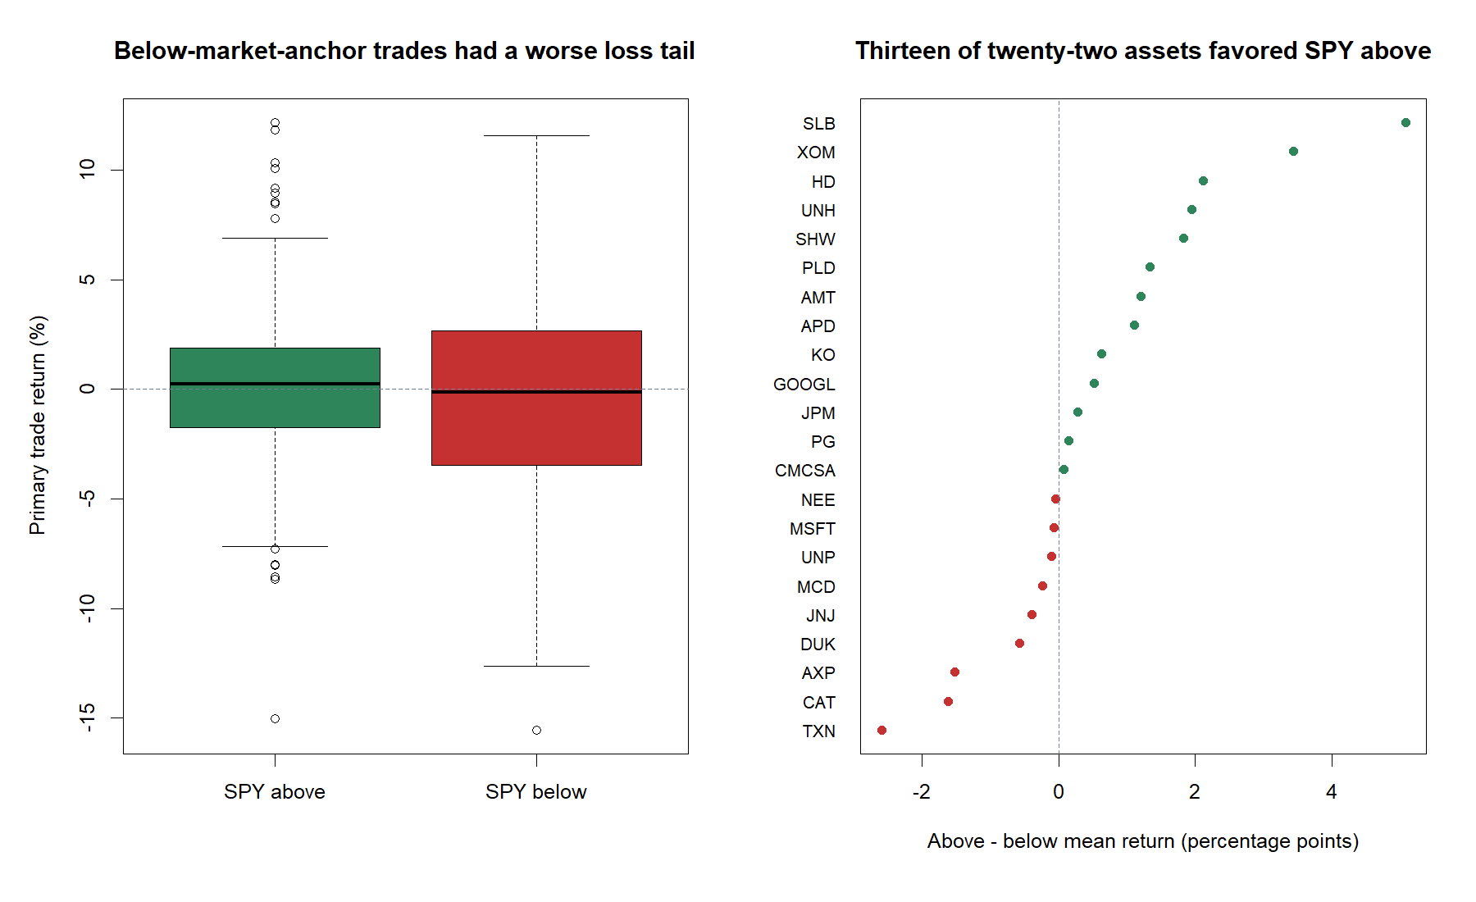
The clearest coherent question came from the market—not the stock
14
Notes:
When SPY was above SMA200, pooled mean trade return was +0.137%; below it was −0.417%. Thirteen of twenty-two assets favored the above state, and the equal-asset contrast was +0.571 percentage points with a bootstrap interval from −0.083 to +1.286. The below state also had a materially worse loss tail. This is the most coherent later replication candidate, but the interval crosses zero and 2022 may confound the result.
[Sources]
- C:\Users\Franc\OneDrive\Documents\Francis\Peltata Project\Time-Series-Modeling-Gen5\runs\research_workbench\operator_hypothesis_lab\hyp_mom_01_1_diagnostic_atlas_01_20260803\hyp_mom_01_1_da_asset_contrasts.csv
- C:\Users\Franc\OneDrive\Documents\Francis\Peltata Project\Time-Series-Modeling-Gen5\runs\research_workbench\operator_hypothesis_lab\hyp_mom_01_1_diagnostic_atlas_01_20260803\hyp_mom_01_1_da_executed_trades.csv
- C:\Users\Franc\OneDrive\Documents\Francis\Peltata Project\Time-Series-Modeling-Gen5\runs\research_workbench\operator_hypothesis_lab\hyp_mom_01_1_diagnostic_atlas_01_20260803\visuals\spy_sma200_tail_and_asset_breadth.png

Slide 15
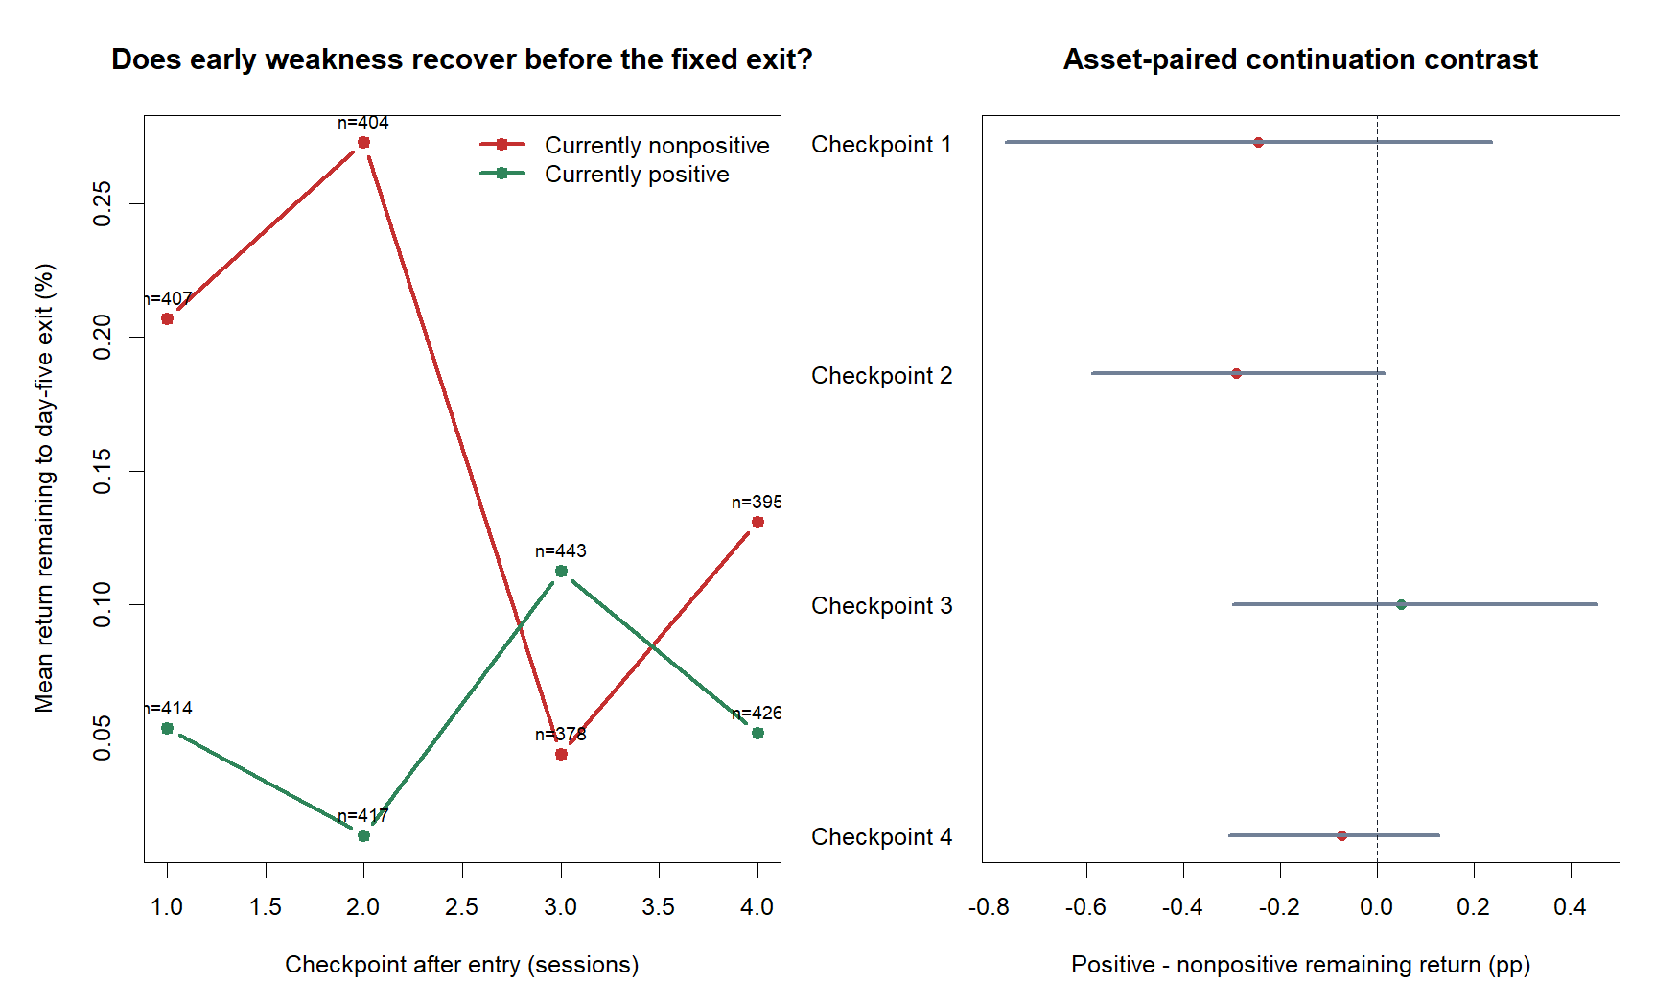
Early losers partially recovered—yet remained losers by the fixed exit
15
Notes:
Trades nonpositive after one or two sessions had more average return remaining than trades already positive, suggesting a simple early stop would forfeit some recovery. But that recovery was insufficient: their mean final returns remained −1.12% after day one and −1.56% after day two. This is a risk-versus-expectancy tradeoff, not evidence for either a stop or averaging down.
[Sources]
- C:\Users\Franc\OneDrive\Documents\Francis\Peltata Project\Time-Series-Modeling-Gen5\runs\research_workbench\operator_hypothesis_lab\hyp_mom_01_1_diagnostic_atlas_01_20260803\hyp_mom_01_1_da_checkpoint_summary.csv
- C:\Users\Franc\OneDrive\Documents\Francis\Peltata Project\Time-Series-Modeling-Gen5\runs\research_workbench\operator_hypothesis_lab\hyp_mom_01_1_diagnostic_atlas_01_20260803\hyp_mom_01_1_da_checkpoint_contrasts.csv
- C:\Users\Franc\OneDrive\Documents\Francis\Peltata Project\Time-Series-Modeling-Gen5\runs\research_workbench\operator_hypothesis_lab\hyp_mom_01_1_diagnostic_atlas_01_20260803\visuals\checkpoint_remaining_return.png

Slide 16
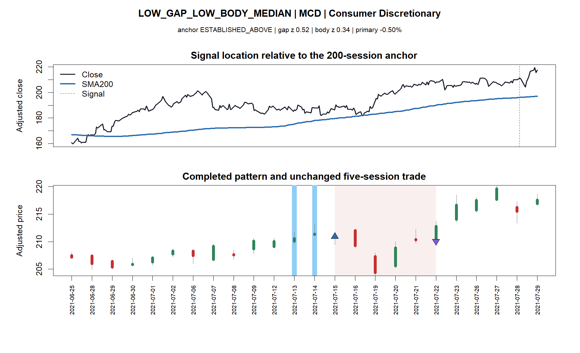
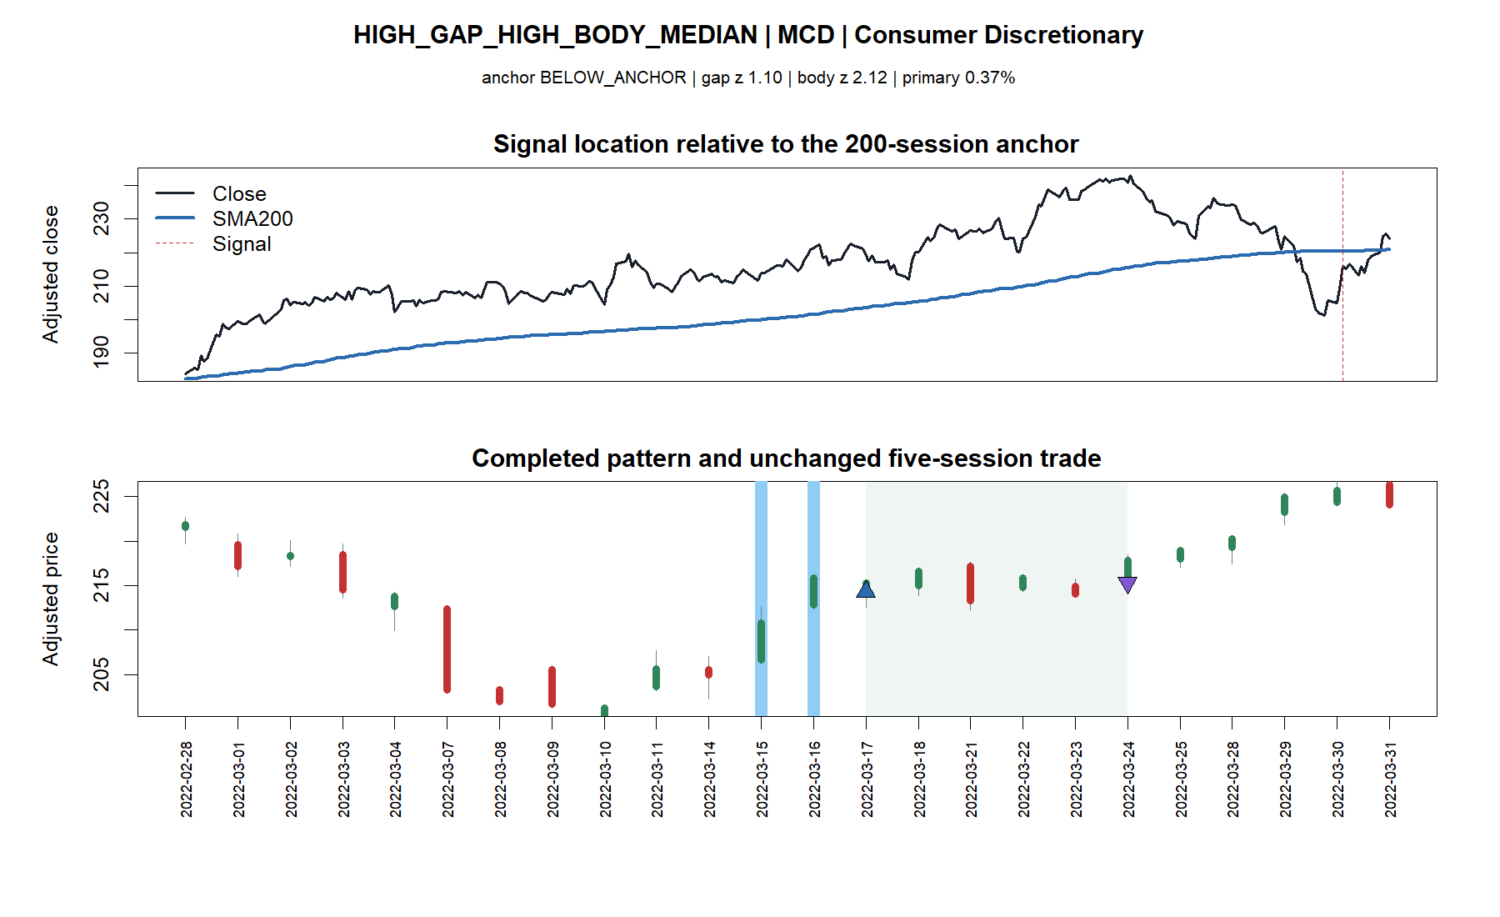
Similar pattern categories still contained very different five-session paths
16
Notes:
These MCD examples are frozen medoid-return trades inside the low-gap/low-body and high-gap/high-body cells. They provide intuition for the normalized pattern measurements but do not establish a monotonic outcome relationship; the aggregate 3×3 surface remained irregular.
[Sources]
- C:\Users\Franc\OneDrive\Documents\Francis\Peltata Project\Time-Series-Modeling-Gen5\runs\research_workbench\operator_hypothesis_lab\hyp_mom_01_1_diagnostic_atlas_01_20260803\hyp_mom_01_1_da_executed_trades.csv
- C:\Users\Franc\OneDrive\Documents\Francis\Peltata Project\Time-Series-Modeling-Gen5\runs\research_workbench\operator_hypothesis_lab\hyp_mom_01_1_diagnostic_atlas_01_20260803\hyp_mom_01_1_da_tape_manifest.csv
- C:\Users\Franc\OneDrive\Documents\Francis\Peltata Project\Time-Series-Modeling-Gen5\runs\research_workbench\operator_hypothesis_lab\hyp_mom_01_1_diagnostic_atlas_01_20260803\visuals\diagnostic_tape_04_low_gap_low_body_median_mcd.png
- C:\Users\Franc\OneDrive\Documents\Francis\Peltata Project\Time-Series-Modeling-Gen5\runs\research_workbench\operator_hypothesis_lab\hyp_mom_01_1_diagnostic_atlas_01_20260803\visuals\diagnostic_tape_05_high_gap_high_body_median_mcd.png

Slide 17
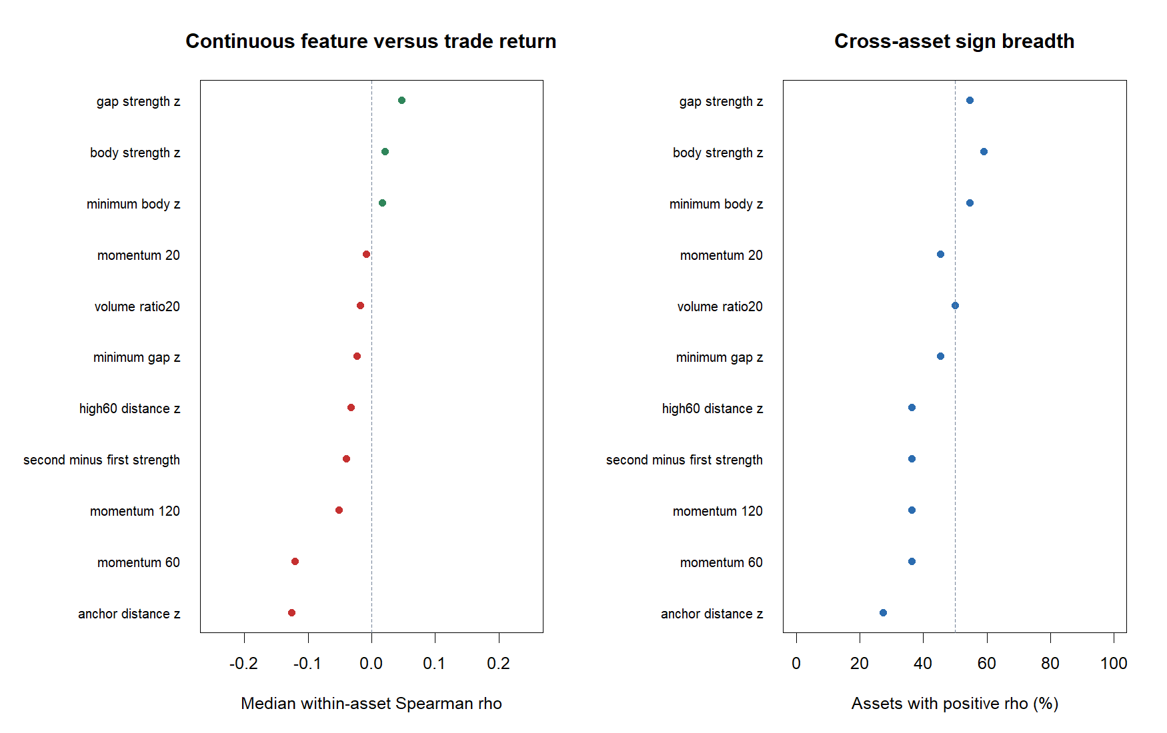
Continuous ranks confirm that the grouped stories are weak and asset-dependent
17
Notes:
Per-asset Spearman correlations avoid letting arbitrary tercile cutoffs create the entire story. Median correlations were close to zero for gap and body strength, negative for asset anchor distance and the three lookback returns, and heterogeneous across assets. These are descriptive associations, not independent significance tests.
[Sources]
- C:\Users\Franc\OneDrive\Documents\Francis\Peltata Project\Time-Series-Modeling-Gen5\runs\research_workbench\operator_hypothesis_lab\hyp_mom_01_1_diagnostic_atlas_01_20260803\hyp_mom_01_1_da_correlation_summary.csv
- C:\Users\Franc\OneDrive\Documents\Francis\Peltata Project\Time-Series-Modeling-Gen5\runs\research_workbench\operator_hypothesis_lab\hyp_mom_01_1_diagnostic_atlas_01_20260803\visuals\continuous_feature_asset_correlations.png

Slide 18
Discovery ends with one credible replication question—not a pile of filters
RECOMMENDED NEXT QUESTION
NOT SELECTED
Does a frozen SPY-above-SMA200 market permission improve HYP-MOM-01.1 on distinct data?
• Asset SMA200 permission
• 20/60/120-day positive return
• Best gap/body grid cell
• Volume or 60-day-high stack
• Reactive early stop
Reason: clearest tail separation, largest coherent contrast, and 13/22 asset breadth.
Current status: DIAGNOSTIC COMPLETE | NO STRATEGY PROMOTION | 2024+ SEALED
18
Notes:
The atlas answers the operator's questions without manufacturing a strategy. The market-anchor condition is the only candidate with a coherent mechanism and broad enough separation to justify a predeclared test on distinct data. Pattern strength is a serious alternative only if reduced to one monotonic, theory-led score. Nothing here authorizes a 01.2 variant yet.
[Sources]
- C:\Users\Franc\OneDrive\Documents\Francis\Peltata Project\Time-Series-Modeling-Gen5\operator_hypothesis_lab\docs\HYP_MOM_01_1_DIAGNOSTIC_ATLAS_01_RESULTS.md
- C:\Users\Franc\OneDrive\Documents\Francis\Peltata Project\Time-Series-Modeling-Gen5\runs\research_workbench\operator_hypothesis_lab\hyp_mom_01_1_diagnostic_atlas_01_20260803\hyp_mom_01_1_da_asset_contrasts.csv
- C:\Users\Franc\OneDrive\Documents\Francis\Peltata Project\Time-Series-Modeling-Gen5\operator_hypothesis_lab\docs\HYP_MOM_01_1_DIAGNOSTIC_ATLAS_01_CONTRACT.md

