Slide 1
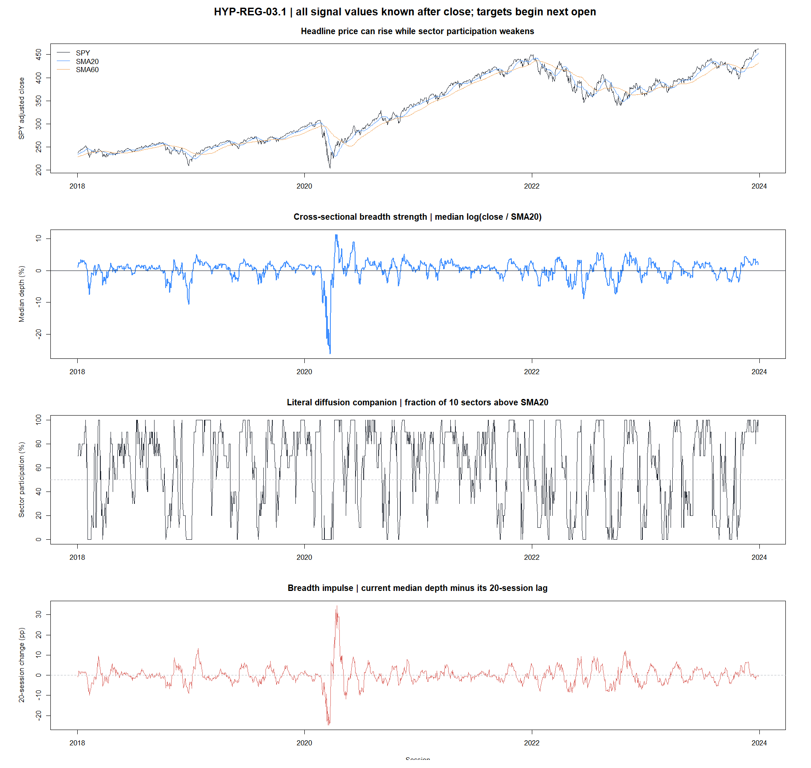
HYP-REG-03.1
Breadth found a one-month clue—not a general trend regime
Cross-sectional sector participation · causal sensor diagnostic · 2018–2023
STOP · no ATR join or strategy overlay
1
Notes:
Open with the honest result: cross-sectional participation contains a useful H20 clue, but the frozen implementation fails as a broad multi-horizon direction classifier.
[Sources]
- docs/GEN5_HYP_REG_03_CROSS_SECTIONAL_BREADTH_TREND_CONTRACT.md
- C:/Users/Franc/OneDrive/Documents/Francis/Peltata Project/Time-Series-Modeling-Gen5/runs/research_workbench/operator_hypothesis_lab/hyp_reg_03_1_cross_sectional_breadth_20260814/hyp_reg_03_report.md
- docs/GEN5_4_DECISION_DIALOGUE_INDEX.md#d130--test-market-breadth-as-a-causal-cross-sectional-trend-sensor

Slide 2
The comment describes a multidimensional regime map
CONCEPTUAL TRANSLATION
Market breadth asks whether many assets participate—not merely whether the cap-weighted index rises.
Breadth / diffusion
Volatility structure
Intraday persistence
Cross-sectional participation
% above an anchor
rotation and deterioration
Magnitude and stress
spot / term structure
calm vs transition vs stress
Continuation vs reversal
within-session behavior
trending vs choppy
This POC opens only breadth. The other axes remain separate hypotheses so a failure is interpretable.
2
Notes:
The Reddit comment argues against one lagging bullish/bearish toggle and proposes multiple uncorrelated axes. We adopt that philosophy but isolate breadth first. The operator supplied the text verbatim in chat, so no blocked-page content was inferred.
[Sources]
- https://www.reddit.com/r/algotrading/comments/1rvfy12/comment/oawke1k/
- docs/GEN5_4_DECISION_DIALOGUE_INDEX.md#d130--test-market-breadth-as-a-causal-cross-sectional-trend-sensor
- https://www.spglobal.com/market-intelligence/en/news-insights/articles/2025/6/bad-breadth-concerns-rise-as-sp-500-set-to-recover-tarifftriggered-losses-90308072

Slide 3
Ten sector tapes become three interpretable measurements
FROZEN ESTIMANDS
For sector i, after close t
qᵢ,ₜ = log(Cᵢ,ₜ / SMA₂₀,ᵢ,ₜ)
Strength
Bₜ = medianᵢ(qᵢ,ₜ)
continuous distance from each sector's anchor
Participation
Pₜ = meanᵢ 1[qᵢ,ₜ ≥ 0]
literal fraction of sectors above SMA20
Decay / impulse
Dₜ = Bₜ − Bₜ₋₂₀
is breadth strengthening or deteriorating?
Signal at close t → target begins next open → H = 5, 20, 63 → horizon-spaced observations
3
Notes:
The median depth avoids letting one extreme sector dominate. P is easier to explain but moves in coarse 10-point increments with only ten sectors. D directly tests the operator's concern about decaying participation while price still rises.
[Sources]
- docs/GEN5_HYP_REG_03_CROSS_SECTIONAL_BREADTH_TREND_CONTRACT.md
- https://www.spglobal.com/spdji/en/documents/commentary/market-commentary-sp-kensho-new-economies-2024-q1.pdf

Slide 4
The sector proxy avoids a hidden survivor-bias trap
PROFESSIONAL PUSHBACK
Rejected shortcut
Frozen proxy
Use today's S&P 500 members historically. That leaks future survival and membership into earlier dates.
Ten long-lived sector ETFs. XLC excluded because its 2018 launch/reclassification creates a structural break.
Eight conjunctive gates
Evidence boundary
association + cross-target breadth
balanced UP and DOWN recognition
2018–2023 diagnostic
2024+ sealed
no strategy outcomes
all 8 gates required
quintile ordering + calendar stability
circular timing controls + hidden deterioration
4
Notes:
The proxy changes the claim: this is sector breadth, not exact constituent breadth. The gates demand more than a positive point estimate because common market cycles can make many targets appear predictive together.
[Sources]
- docs/GEN5_HYP_REG_03_CROSS_SECTIONAL_BREADTH_TREND_CONTRACT.md
- operator_hypothesis_lab/registries/hyp_reg_03_1_cross_sectional_breadth_registry.csv
- C:/Users/Franc/OneDrive/Documents/Francis/Peltata Project/Time-Series-Modeling-Gen5/runs/research_workbench/operator_hypothesis_lab/hyp_reg_03_1_cross_sectional_breadth_20260814/hyp_reg_03_gates.csv

Slide 5
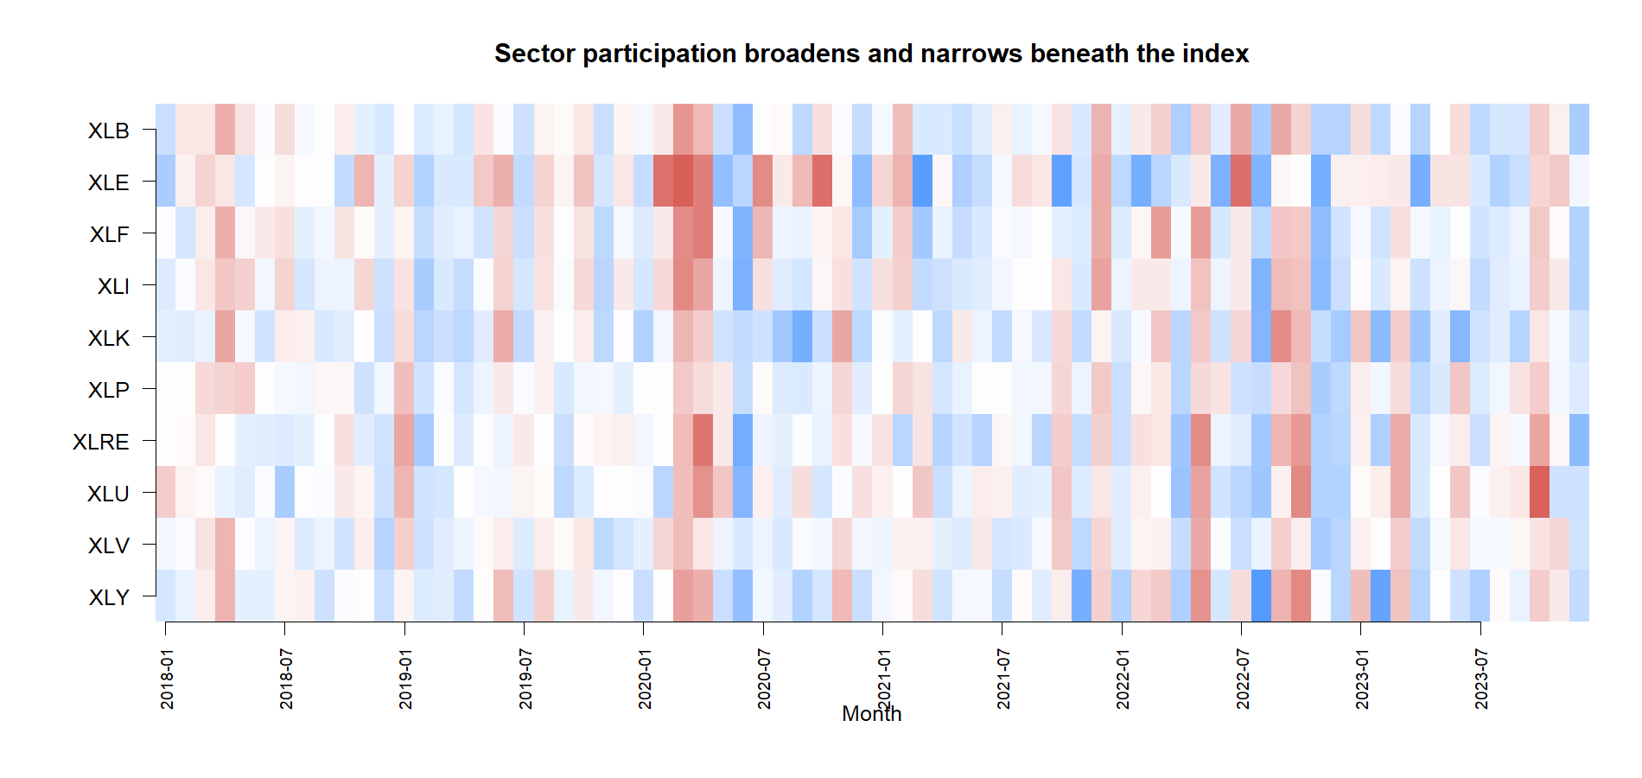
Breadth really does broaden and narrow beneath SPY
SIGNAL ANATOMY
Read the columns
Blue
many sectors above anchor
Red
many sectors below anchor
Mixed columns expose rotation that a single SPY line compresses away.
5
Notes:
This is the descriptive win: the proxy produces a distinct cross-sectional tape. The remaining question is whether that tape transports into future direction strongly and stably enough to serve as a regime axis.
[Sources]
- C:/Users/Franc/OneDrive/Documents/Francis/Peltata Project/Time-Series-Modeling-Gen5/runs/research_workbench/operator_hypothesis_lab/hyp_reg_03_1_cross_sectional_breadth_20260814/hyp_reg_03_daily_signal.csv
- C:/Users/Franc/OneDrive/Documents/Francis/Peltata Project/Time-Series-Modeling-Gen5/runs/research_workbench/operator_hypothesis_lab/hyp_reg_03_1_cross_sectional_breadth_20260814/visuals/sector_depth_heatmap.png

Slide 6
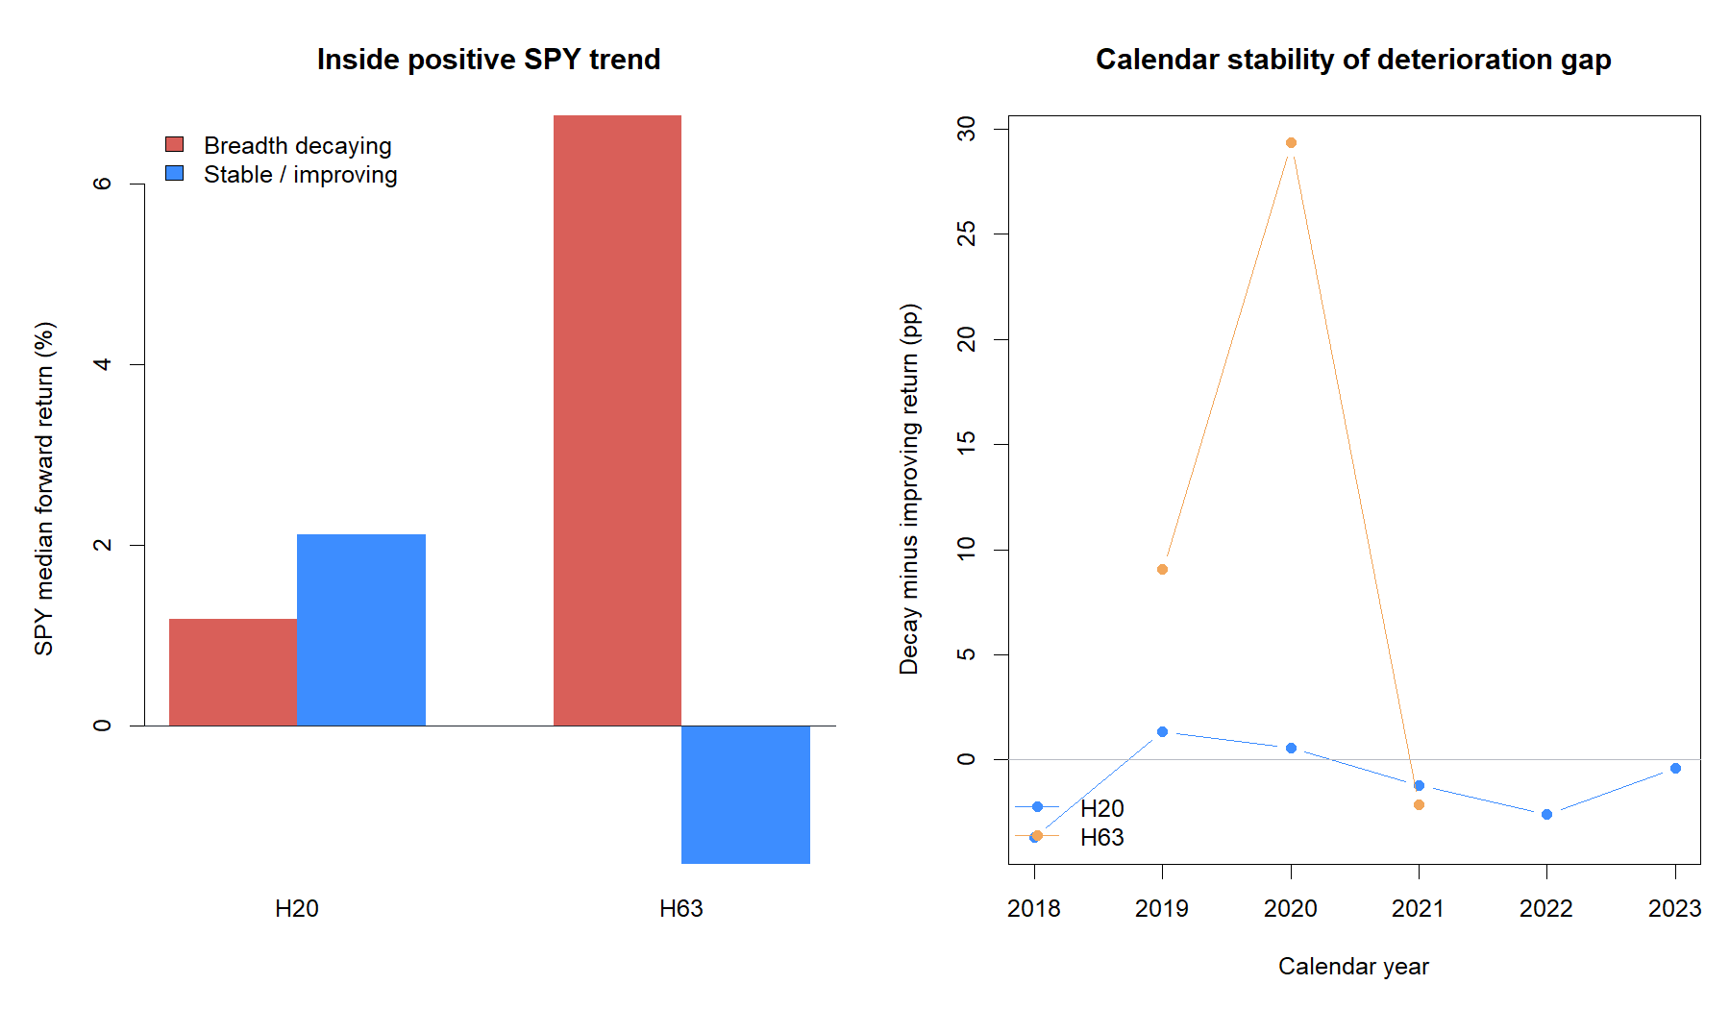
A one-month hidden-deterioration clue appears
USEFUL CLUE—NOT PROMOTION
19 / 26
targets with positive H20 association
+1.78%
median H20 top-minus-bottom quintile
−0.94 pp
H20 decay gap inside positive SPY trend
But H20 balanced accuracy is 0.502 and actual timing ranks only at the 56th control percentile.
6
Notes:
The hidden-deterioration audit conditions on SPY's own SMA20/SMA60 trend being positive. At H20, breadth decay is associated with lower—not necessarily negative—future SPY return. This is a relative warning clue, not a short signal.
[Sources]
- C:/Users/Franc/OneDrive/Documents/Francis/Peltata Project/Time-Series-Modeling-Gen5/runs/research_workbench/operator_hypothesis_lab/hyp_reg_03_1_cross_sectional_breadth_20260814/hyp_reg_03_hidden_deterioration.csv
- C:/Users/Franc/OneDrive/Documents/Francis/Peltata Project/Time-Series-Modeling-Gen5/runs/research_workbench/operator_hypothesis_lab/hyp_reg_03_1_cross_sectional_breadth_20260814/hyp_reg_03_panel_summary.csv
- C:/Users/Franc/OneDrive/Documents/Francis/Peltata Project/Time-Series-Modeling-Gen5/runs/research_workbench/operator_hypothesis_lab/hyp_reg_03_1_cross_sectional_breadth_20260814/hyp_reg_03_circular_readout.csv

Slide 7
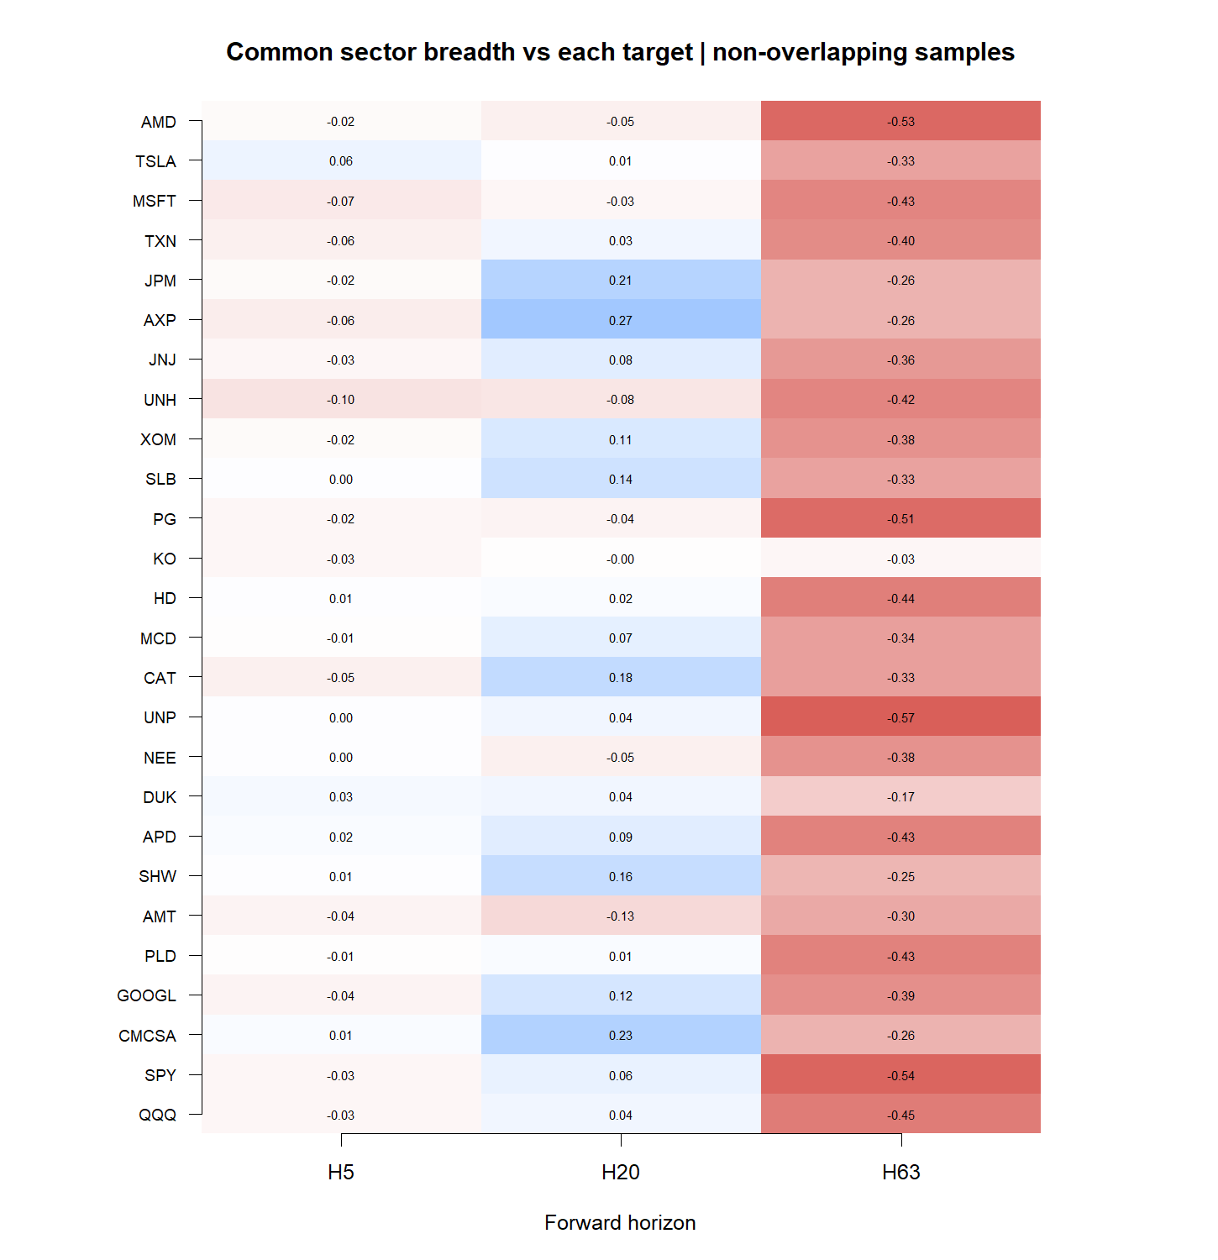
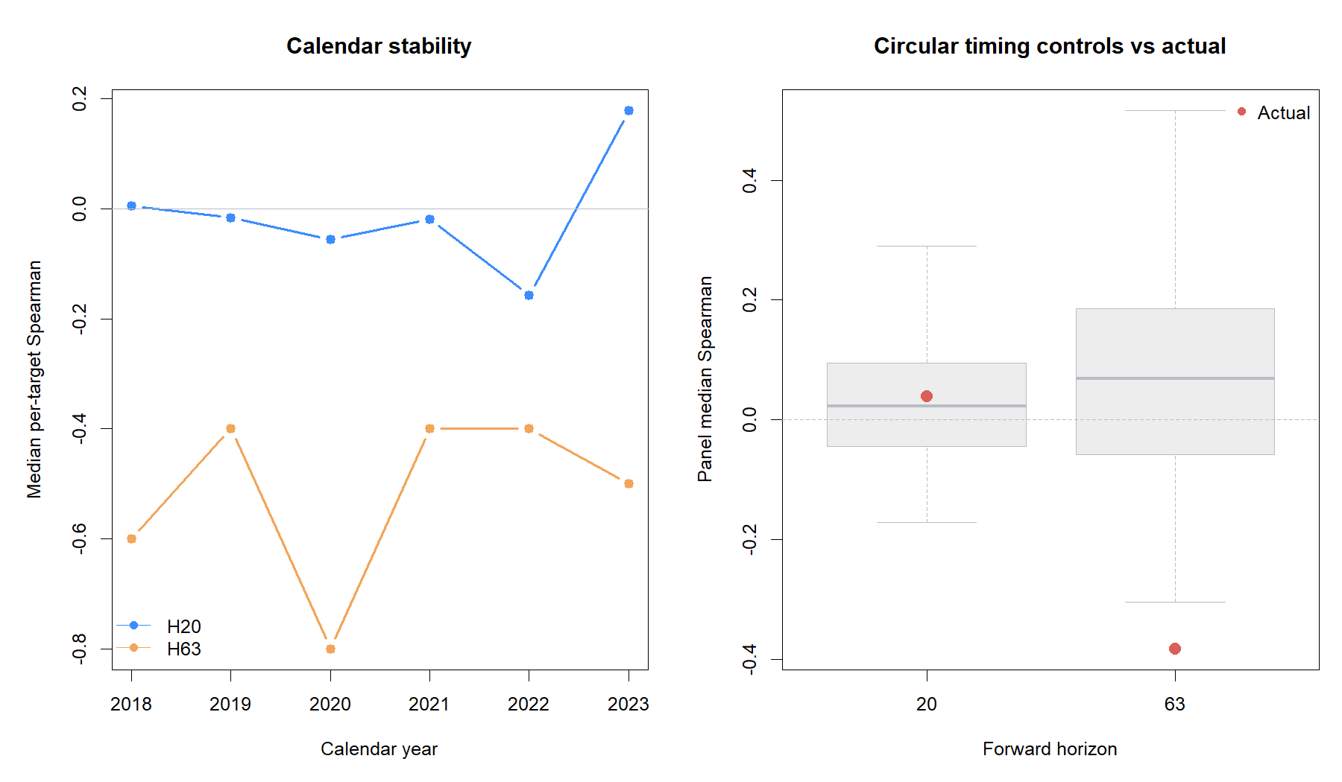
The clue does not survive a quarter or the timing falsification
WHY THE CLASSIFIER STOPS
H63 median Spearman
−0.382
0 / 26 targets positive
0th control percentile
7
Notes:
A valid multi-horizon direction sensor should not reverse across every target at H63. The circular control also shows the actual H20 alignment is ordinary rather than exceptional. We do not invert H63 after seeing this result.
[Sources]
- C:/Users/Franc/OneDrive/Documents/Francis/Peltata Project/Time-Series-Modeling-Gen5/runs/research_workbench/operator_hypothesis_lab/hyp_reg_03_1_cross_sectional_breadth_20260814/hyp_reg_03_asset_summary.csv
- C:/Users/Franc/OneDrive/Documents/Francis/Peltata Project/Time-Series-Modeling-Gen5/runs/research_workbench/operator_hypothesis_lab/hyp_reg_03_1_cross_sectional_breadth_20260814/hyp_reg_03_calendar_panel.csv
- C:/Users/Franc/OneDrive/Documents/Francis/Peltata Project/Time-Series-Modeling-Gen5/runs/research_workbench/operator_hypothesis_lab/hyp_reg_03_1_cross_sectional_breadth_20260814/hyp_reg_03_circular_readout.csv
- C:/Users/Franc/OneDrive/Documents/Francis/Peltata Project/Time-Series-Modeling-Gen5/runs/research_workbench/operator_hypothesis_lab/hyp_reg_03_1_cross_sectional_breadth_20260814/hyp_reg_03_gates.csv

Slide 8
Preserve the insight; reject this implementation as a regime axis
DECISION BOUNDARY
1 / 8
What carries forward
gates passed
Breadth is a real cross-sectional measurement family
The one-month decay clue is worth remembering
STOP_CROSS_SECTIONAL_BREADTH_
GATES_FAILED_NO_JOINT_FILTER
This ten-sector/SMA20 score is not a general classifier
No ATR join, strategy overlay, tuning, inversion, or confirmation
VIX structure and intraday persistence remain unopened lanes
2024+ remained sealed
A future breadth study needs a new measurement hypothesis and fresh evidence—not a rescue edit.
8
Notes:
Close by separating the field from this implementation. The POC validates that sector participation can differ from index price, but it fails the predeclared standards for a deployable direction axis.
[Sources]
- operator_hypothesis_lab/docs/HYP_REG_03_1_CROSS_SECTIONAL_BREADTH_RESULTS.md
- docs/GEN5_4_DECISION_DIALOGUE_INDEX.md#d130--test-market-breadth-as-a-causal-cross-sectional-trend-sensor
- https://www.spglobal.com/spdji/en/documents/commentary/market-commentary-sp-kensho-new-economies-2024-q1.pdf
- https://www.spglobal.com/market-intelligence/en/news-insights/articles/2025/6/bad-breadth-concerns-rise-as-sp-500-set-to-recover-tarifftriggered-losses-90308072

