Slide 1
OPERATOR HYPOTHESIS LAB
TSLA descriptive
microscope
From visual intuition to measured daily-return dependence
Adjusted daily TSLA | 2018-2023 | Descriptive research only
Notes:
Introduce this as a running laboratory notebook, not a strategy pitch.
[Sources]
- operator_hypothesis_lab/docs/TSLA_LAGGED_DAILY_RETURN_SCATTER_2018_2023.md
- operator_hypothesis_lab/docs/TSLA_ER20_PATH_REGIME_BANDS_2018_2023.md
[/Sources]

Slide 2
TSLA DESCRIPTIVE MICROSCOPE
The lane starts with description, not strategy
See
Start with raw price and return geometry before deciding what relationship ought to exist.
Name
Separate direction, magnitude, path shape, and volatility so one visual impression does not stand in for all four.
Measure
Quantify one frozen relationship at a time; only later ask whether a finding predicts, trades, or transports.
Adjusted daily TSLA | 2018-2023
2
Notes:
The learning objective is bottom-up hypothesis formation. The order is observation, definition, measurement, then falsification.
[Sources]
- User-directed research workflow in this task
- docs/GEN5_1_POC_PROGRESS_LOG.md entries 186-188
[/Sources]

Slide 3
TSLA DESCRIPTIVE MICROSCOPE
One question, one fixed sample
r[t] = log(C[t] / C[t-1])
Fixed boundaries
Asset
TSLA
Each row pairs yesterday's adjusted close-to-close log return with today's.
Price
Alpaca SIP adjusted daily close
Target sessions
2018-01-02 through 2023-12-29
Search
No alternate lag or horizon
1,509
Trading
No policy or performance calculation
consecutive-session pairs
Confirmation
No post-2023 data read
Adjusted daily TSLA | 2018-2023
3
Notes:
Explain the definition before showing any statistic. The sample is the exact scatterplot surface from the prior slice.
[Sources]
- runs/research_workbench/operator_hypothesis_lab/tsla_lagged_return_dependence_statistics_20260825/run_spec.csv
- runs/research_workbench/operator_hypothesis_lab/tsla_lagged_return_dependence_statistics_20260825/pair_checks.csv
[/Sources]

Slide 4
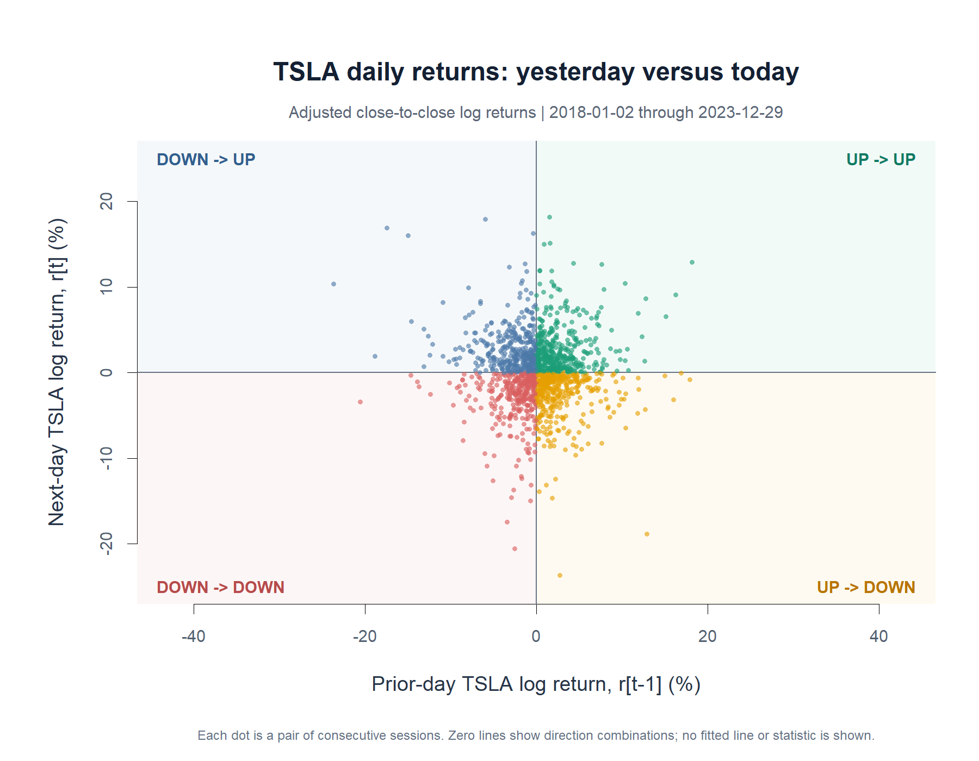
TSLA DESCRIPTIVE MICROSCOPE
The raw cloud has no clear directional structure
First look: no fitted line, correlation, p-value, binning, or outlier removal.
Adjusted daily TSLA | 2018-2023
4
Notes:
The eye sees a dense cloud around zero and observations in all four quadrants. This slide preserves the pre-statistics view.
[Sources]
- runs/research_workbench/operator_hypothesis_lab/tsla_lagged_daily_return_scatter_20260824/visuals/tsla_t_minus_1_vs_t_daily_log_return_scatter.png
- operator_hypothesis_lab/docs/TSLA_LAGGED_DAILY_RETURN_SCATTER_2018_2023.md
[/Sources]

Slide 5
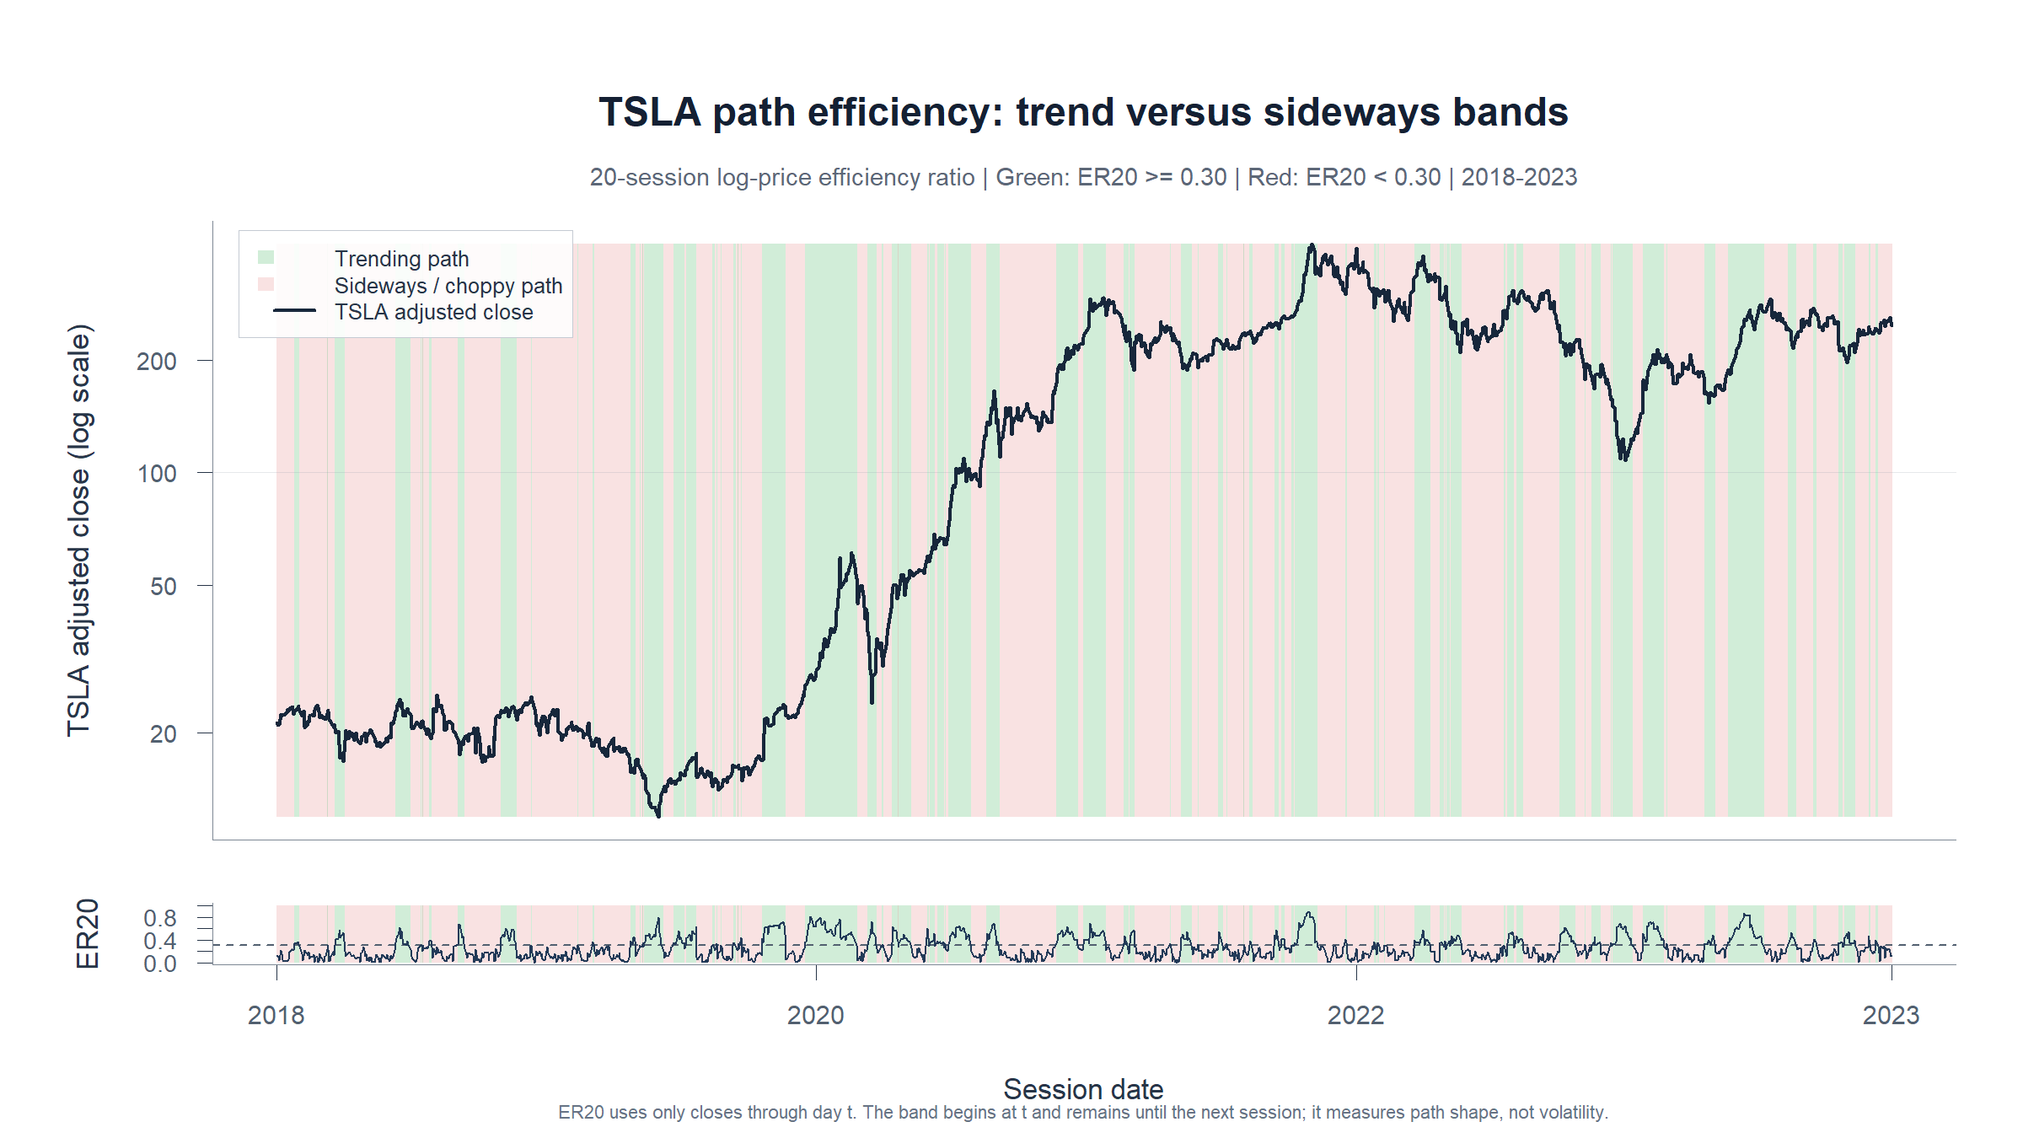
TSLA DESCRIPTIVE MICROSCOPE
ER20 labels path shape—not volatility
How
Absolute 20-session endpoint displacement divided by the total log-price path traveled.
Read
Green recognizes efficient rises and declines. Red marks a locally choppy path. Daily thresholding is visibly flickery near transitions.
Descriptive state—not a future-return claim
Adjusted daily TSLA | 2018-2023
5
Notes:
ER20 asks whether the trailing path was efficient. It ignores bullish versus bearish direction and does not measure volatility.
[Sources]
- runs/research_workbench/operator_hypothesis_lab/tsla_efficiency_ratio_regime_bands_20260824/visuals/tsla_er20_path_regime_bands.png
- operator_hypothesis_lab/docs/TSLA_ER20_PATH_REGIME_BANDS_2018_2023.md
[/Sources]

Slide 6
MEASUREMENT PASS
A visual cloud asks one
precise next question
Does r[t-1] contain measurable information about r[t]?
Primary: signed linear dependence. Diagnostics: rank, sign, outliers, annual stability, and absolute-return persistence.
6
Notes:
The primary estimand is frozen before reading the result: Pearson correlation, equivalently the OLS slope in r[t] = alpha + beta r[t-1] + error.
[Sources]
- scripts/inspect/run_tsla_lagged_return_dependence_statistics.R
- runs/research_workbench/operator_hypothesis_lab/tsla_lagged_return_dependence_statistics_20260825/run_spec.csv
[/Sources]

Slide 7
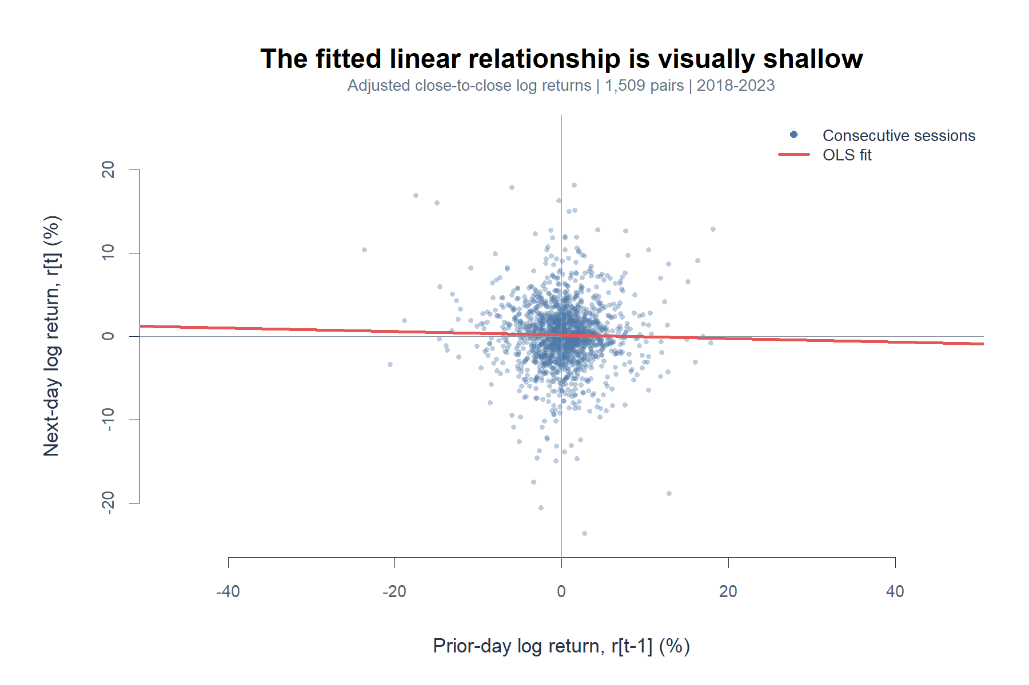
TSLA DESCRIPTIVE MICROSCOPE
Signed dependence is effectively zero
-0.021
Pearson correlation
[-0.073, +0.028]
95% block-bootstrap interval
0.044%
R-squared: variance explained
Adjusted daily TSLA | 2018-2023
7
Notes:
The interval includes zero and the fitted line explains roughly four hundredths of one percent of next-day return variation. HAC slope p-value is 0.451.
[Sources]
- runs/research_workbench/operator_hypothesis_lab/tsla_lagged_return_dependence_statistics_20260825/primary_statistics.csv
- runs/research_workbench/operator_hypothesis_lab/tsla_lagged_return_dependence_statistics_20260825/block_bootstrap_intervals.csv
- runs/research_workbench/operator_hypothesis_lab/tsla_lagged_return_dependence_statistics_20260825/visuals/tsla_signed_return_dependence_fitted_scatter.png
[/Sources]

Slide 8
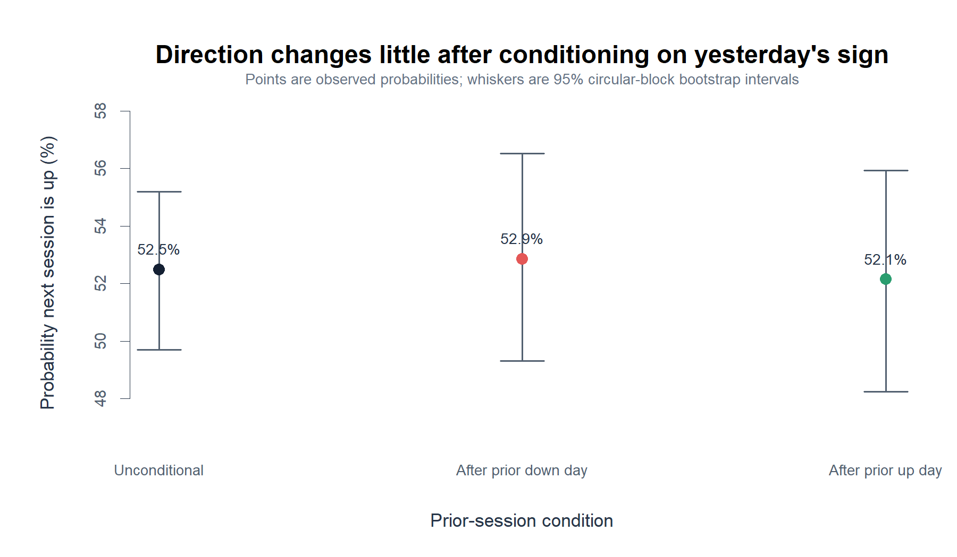
TSLA DESCRIPTIVE MICROSCOPE
Yesterday's sign barely changes tomorrow's odds
52.9%
up after a prior down day
52.1%
up after a prior up day
Difference: -0.7 percentage points
95% interval: -5.8 to +4.2 pp
Adjusted daily TSLA | 2018-2023
8
Notes:
A binary direction view reaches the same conclusion as the continuous-return view. The conditional probabilities are nearly identical and their difference interval crosses zero.
[Sources]
- runs/research_workbench/operator_hypothesis_lab/tsla_lagged_return_dependence_statistics_20260825/direction_transition_probabilities.csv
- runs/research_workbench/operator_hypothesis_lab/tsla_lagged_return_dependence_statistics_20260825/direction_transition_difference.csv
- runs/research_workbench/operator_hypothesis_lab/tsla_lagged_return_dependence_statistics_20260825/visuals/tsla_direction_transition_probabilities.png
[/Sources]

Slide 9
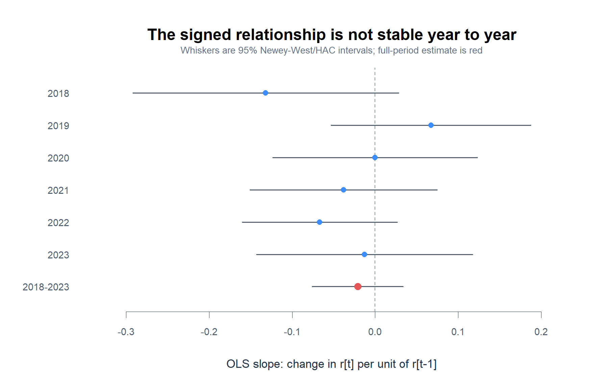
TSLA DESCRIPTIVE MICROSCOPE
The signed result stays weak under obvious checks
Rank check
Spearman rho = -0.004
95% block interval: -0.054 to +0.044
Outlier check
Pearson changes from -0.021 to -0.008 after fixed 1%/99% winsorization.
Every annual HAC interval crosses zero.
Adjusted daily TSLA | 2018-2023
9
Notes:
Annual point estimates change sign, but none of the annual HAC intervals excludes zero. Rank correlation and the fixed winsor sensitivity are also near zero.
[Sources]
- runs/research_workbench/operator_hypothesis_lab/tsla_lagged_return_dependence_statistics_20260825/annual_stability.csv
- runs/research_workbench/operator_hypothesis_lab/tsla_lagged_return_dependence_statistics_20260825/outlier_sensitivity.csv
- runs/research_workbench/operator_hypothesis_lab/tsla_lagged_return_dependence_statistics_20260825/block_bootstrap_intervals.csv
[/Sources]

Slide 10
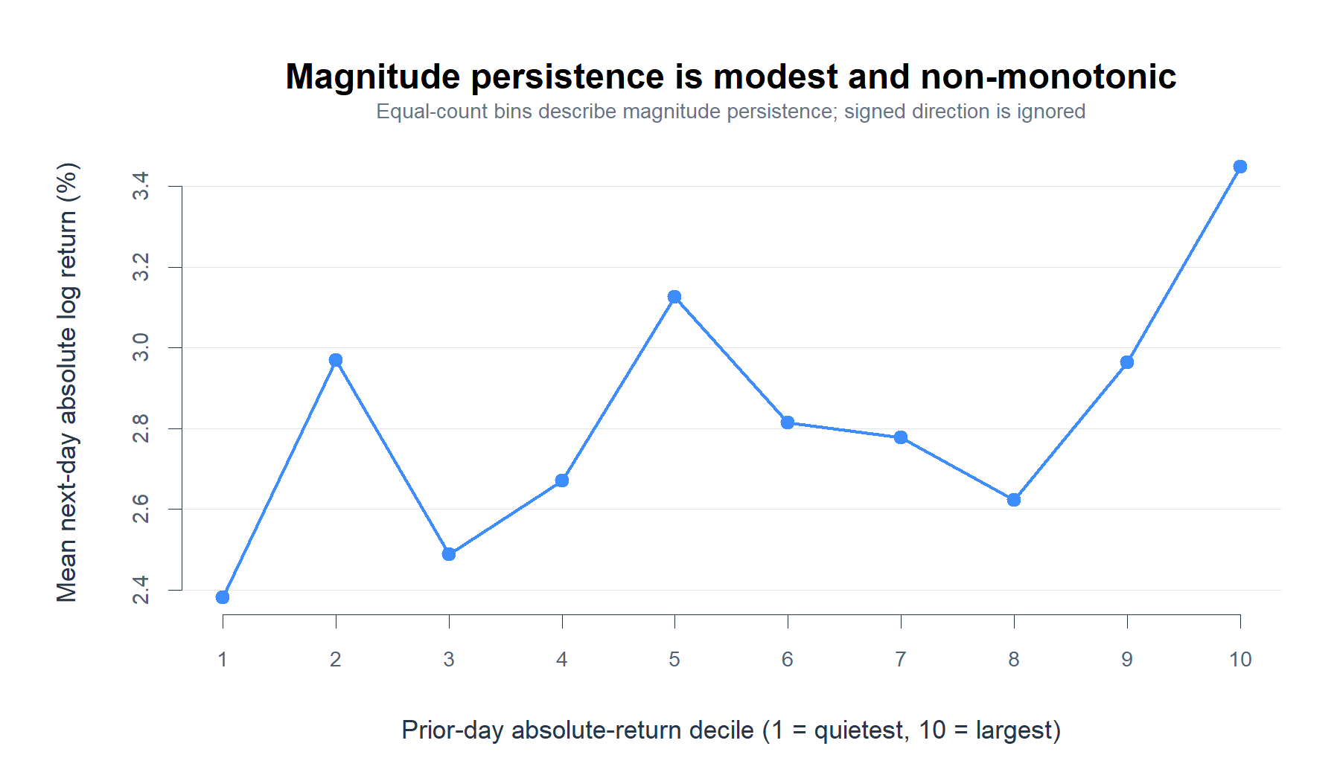
TSLA DESCRIPTIVE MICROSCOPE
Magnitude persistence is modest—and different
+0.107
Pearson correlation of |r[t-1]| and |r[t]|
95% block interval
+0.033 to +0.168
Caution
The decile pattern is not monotonic; rank correlation is only +0.053 and its interval crosses zero. This is a clue about turbulence—not direction.
Adjusted daily TSLA | 2018-2023
10
Notes:
Absolute and squared returns show positive linear dependence, but the equal-count deciles are jagged and the absolute-return rank interval includes zero. Treat this as modest magnitude persistence and a separate future question.
[Sources]
- runs/research_workbench/operator_hypothesis_lab/tsla_lagged_return_dependence_statistics_20260825/primary_statistics.csv
- runs/research_workbench/operator_hypothesis_lab/tsla_lagged_return_dependence_statistics_20260825/block_bootstrap_intervals.csv
- runs/research_workbench/operator_hypothesis_lab/tsla_lagged_return_dependence_statistics_20260825/absolute_return_deciles.csv
[/Sources]

Slide 11
TSLA DESCRIPTIVE MICROSCOPE
What survives this first measurement pass
SIGNED RETURN
No measurable adjacent-session continuation or reversal
Pearson -0.021; direction difference -0.7 pp
PATH SHAPE
ER20 usefully describes trend versus chop
Direction-agnostic, lagging, and flickery near transitions
RETURN MAGNITUDE
A modest persistence clue remains
Absolute-return Pearson +0.107; non-monotonic diagnostic pattern
Next narrow question
Does yesterday's return magnitude forecast tomorrow's magnitude on a separately frozen surface?
Adjusted daily TSLA | 2018-2023
11
Notes:
Close by separating what was learned. The signed-return question stops descriptively; ER20 remains a descriptive lens; magnitude persistence is the only new clue and requires its own predeclared test before any strategy interpretation.
[Sources]
- operator_hypothesis_lab/docs/TSLA_LAGGED_DAILY_RETURN_SCATTER_2018_2023.md
- operator_hypothesis_lab/docs/TSLA_ER20_PATH_REGIME_BANDS_2018_2023.md
- runs/research_workbench/operator_hypothesis_lab/tsla_lagged_return_dependence_statistics_20260825/report.md
[/Sources]

Slide 12
HORIZON GRID
What if one session is simply
too noisy?
Aggregate the past. Aggregate the future. Keep the boundary clean.
Predeclared prior and forward horizons: 1, 2, 3, 4, 5, 10, 15, 20, and 25 sessions. No cell becomes a strategy.
12
Notes:
This section asks whether aggregating sessions reveals signed dependence hidden by the adjacent-session view.
[Sources]
- scripts/inspect/run_tsla_cumulative_return_horizon_grid.R
- runs/research_workbench/operator_hypothesis_lab/tsla_cumulative_return_horizon_grid_20260825/run_spec.csv
[/Sources]

Slide 13
TSLA DESCRIPTIVE MICROSCOPE
A fixed 9 x 9 surface tests aggregation
R-(p) versus R+(f)
Fixed boundaries
Asset
TSLA
The prior window ends at the anchor close. The forward window begins after it—no return interval appears on both sides.
Bars
Alpaca SIP adjusted daily close
Horizons
1, 2, 3, 4, 5, 10, 15, 20, 25
Sample
2018-01-02 through 2023-12-29
81
Uncertainty
Overlap-aware Newey-West / HAC
predeclared horizon pairs
Multiplicity
BH-FDR plus Bonferroni across 81 cells
Adjusted daily TSLA | 2018-2023
13
Notes:
Define the information boundary first: cumulative prior return ends at the anchor close and cumulative forward return begins from that close.
[Sources]
- runs/research_workbench/operator_hypothesis_lab/tsla_cumulative_return_horizon_grid_20260825/run_spec.csv
- runs/research_workbench/operator_hypothesis_lab/tsla_cumulative_return_horizon_grid_20260825/grid_checks.csv
[/Sources]

Slide 14
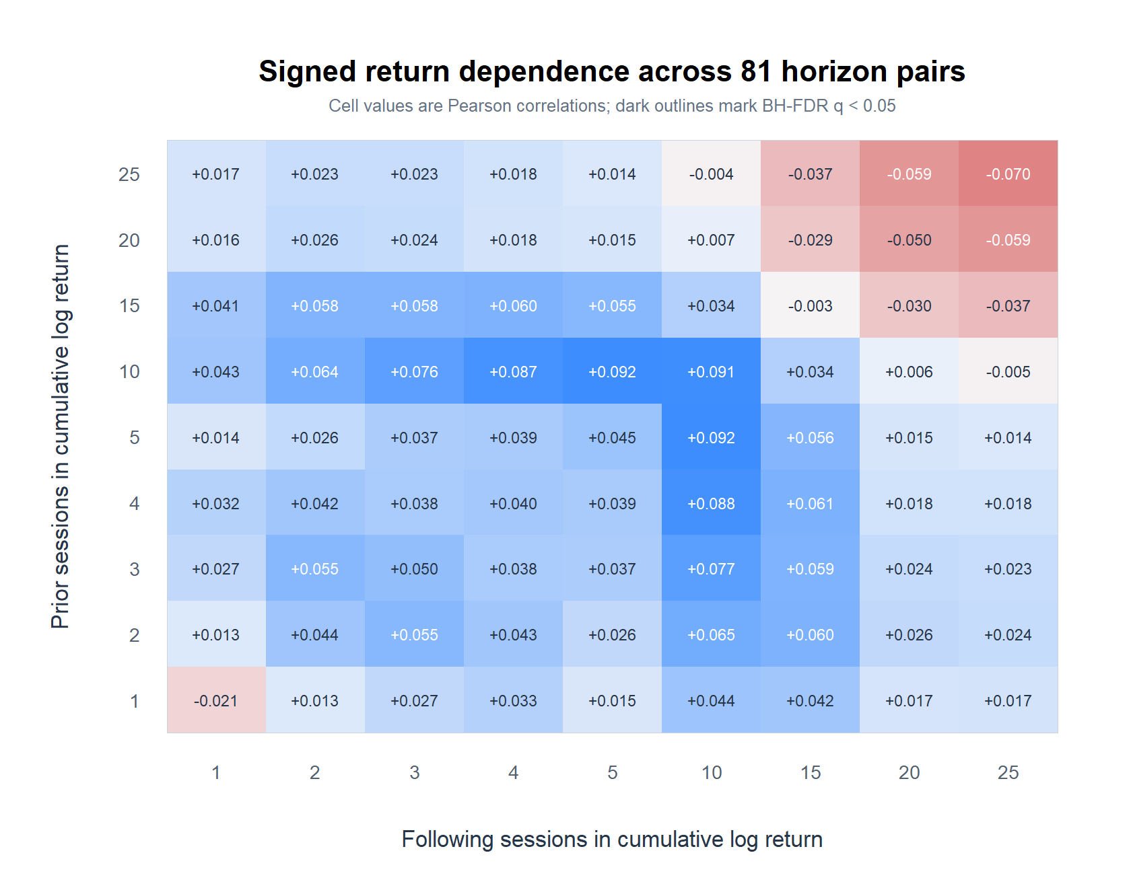
TSLA DESCRIPTIVE MICROSCOPE
Aggregation reveals a weak 5–10-session ridge
Pearson correlation matrix; no BH-FDR q-value is below 0.05.
Adjusted daily TSLA | 2018-2023
14
Notes:
The positive region is coherent rather than a single isolated cell, but its magnitude is small and this nested grid is highly dependent.
[Sources]
- runs/research_workbench/operator_hypothesis_lab/tsla_cumulative_return_horizon_grid_20260825/pearson_correlation_matrix.csv
- runs/research_workbench/operator_hypothesis_lab/tsla_cumulative_return_horizon_grid_20260825/slope_bh_q_value_matrix.csv
- runs/research_workbench/operator_hypothesis_lab/tsla_cumulative_return_horizon_grid_20260825/visuals/tsla_cumulative_return_pearson_heatmap.png
[/Sources]

Slide 15
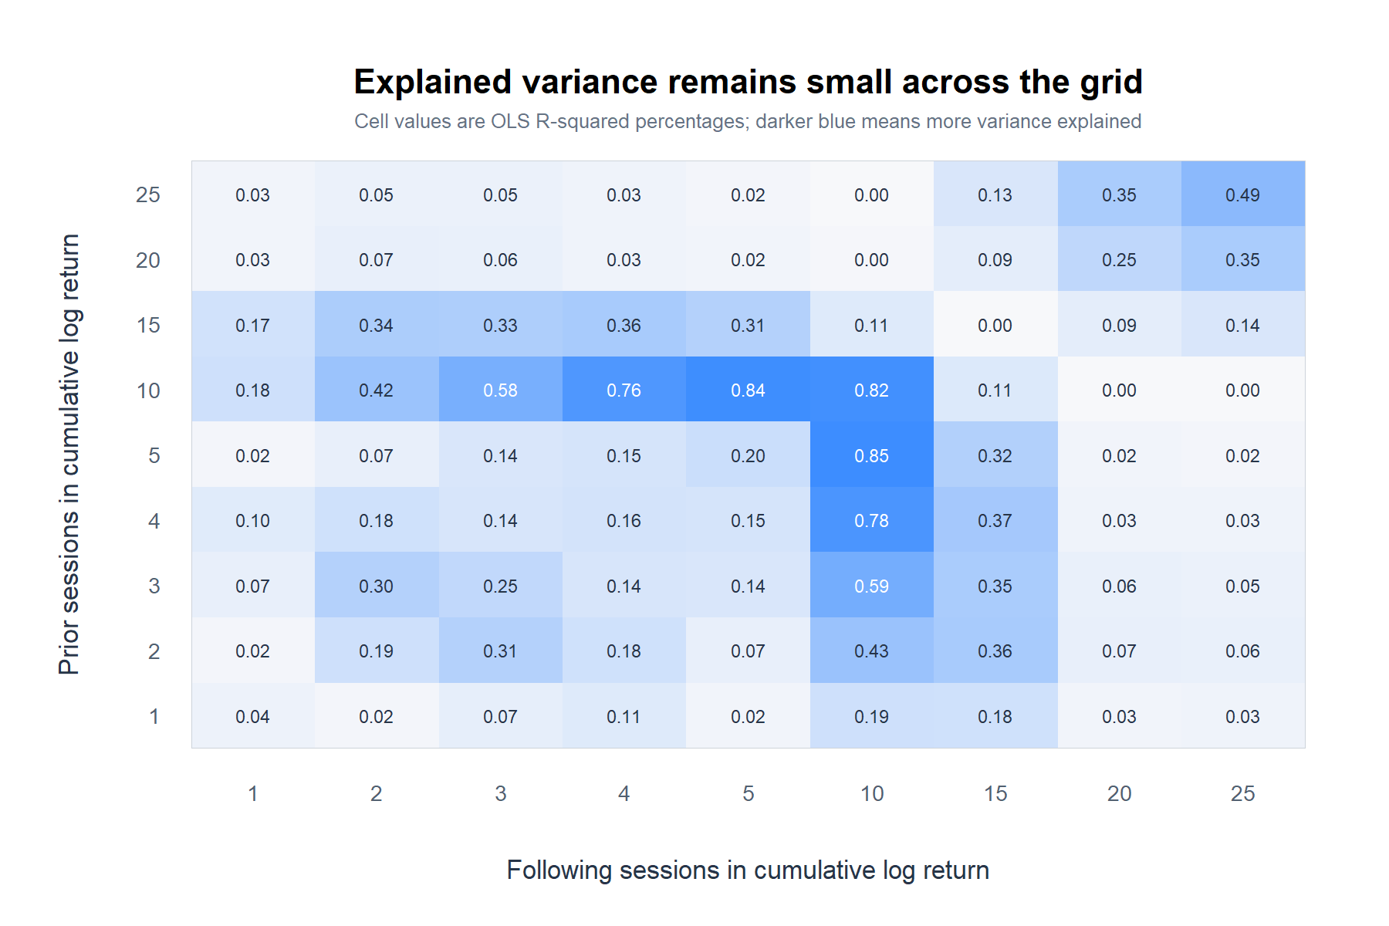
TSLA DESCRIPTIVE MICROSCOPE
The ridge is weak and statistically unresolved
+0.092
largest Pearson: 5 prior / 10 forward
[-0.003, +0.188]
95% overlap-aware HAC interval
0.852%
maximum R-squared across 81 cells
Adjusted daily TSLA | 2018-2023
15
Notes:
The strongest point estimate explains less than one percent of forward-return variance, and its overlap-aware interval includes zero. Its BH q-value is 0.660.
[Sources]
- runs/research_workbench/operator_hypothesis_lab/tsla_cumulative_return_horizon_grid_20260825/horizon_grid_statistics.csv
- runs/research_workbench/operator_hypothesis_lab/tsla_cumulative_return_horizon_grid_20260825/r_squared_percent_matrix.csv
- runs/research_workbench/operator_hypothesis_lab/tsla_cumulative_return_horizon_grid_20260825/visuals/tsla_cumulative_return_r_squared_heatmap.png
[/Sources]

Slide 16
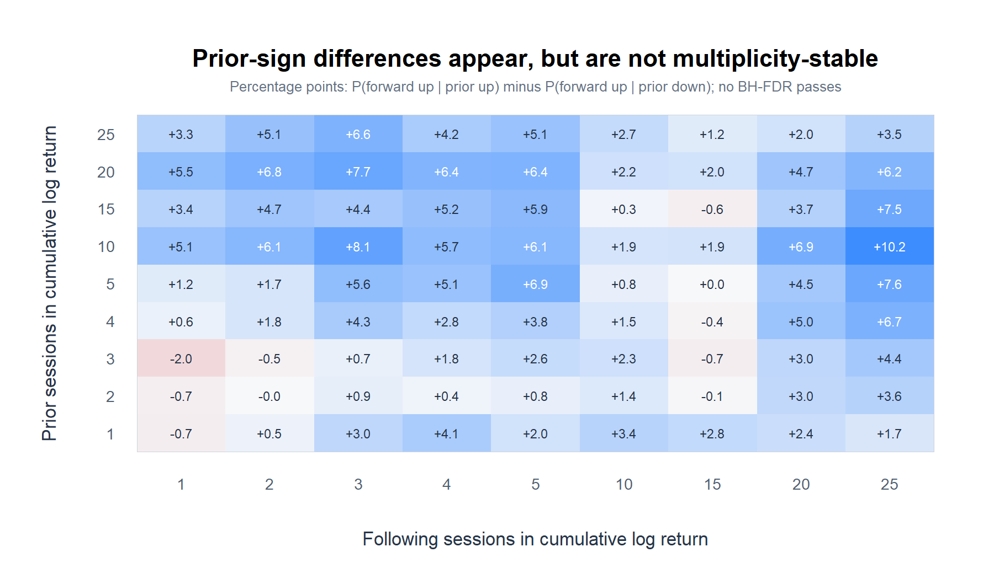
TSLA DESCRIPTIVE MICROSCOPE
Direction differences also fail the 81-cell scan
+8.1 pp
largest raw-sign difference with p < 0.05
0 / 81
direction cells with BH-FDR q < 0.05
Best raw direction p = 0.025 at 10 prior / 3 forward.
BH q = 0.554; nested horizons share data.
Adjusted daily TSLA | 2018-2023
16
Notes:
Several direction differences are positive, but the best raw p-value becomes q=0.554 after the 81-cell scan. None survives BH-FDR or Bonferroni.
[Sources]
- runs/research_workbench/operator_hypothesis_lab/tsla_cumulative_return_horizon_grid_20260825/direction_difference_pp_matrix.csv
- runs/research_workbench/operator_hypothesis_lab/tsla_cumulative_return_horizon_grid_20260825/horizon_grid_statistics.csv
- runs/research_workbench/operator_hypothesis_lab/tsla_cumulative_return_horizon_grid_20260825/visuals/tsla_cumulative_return_direction_difference_heatmap.png
[/Sources]

Slide 17
TSLA DESCRIPTIVE MICROSCOPE
What survives the aggregation pass
GRID PATTERN
A coherent positive ridge appears near 5–10 sessions
Max Pearson +0.092 at 5 prior / 10 forward
UNCERTAINTY
Every signed-return interval still includes zero
0/81 BH-FDR or Bonferroni passes
DIRECTION
Probability shifts are larger but not multiplicity-stable
Best raw p=0.025; BH q=0.554
Next narrow question
Does the 5–10-session ridge deserve one frozen replication, or does this descriptive lane stop here?
Adjusted daily TSLA | 2018-2023
17
Notes:
Close by separating the descriptive pattern from evidence strength. The ridge is worth naming, but this scan does not establish predictive authority.
[Sources]
- runs/research_workbench/operator_hypothesis_lab/tsla_cumulative_return_horizon_grid_20260825/report.md
- runs/research_workbench/operator_hypothesis_lab/tsla_cumulative_return_horizon_grid_20260825/cells_ranked_by_absolute_correlation.csv
[/Sources]

Slide 18
REGIME CONDITIONING
What if aggregation mixes
incompatible path states?
Use the ER20 color already known at the anchor close.
Red and green inherit the prior POC's fixed 20-session metric and 0.30 cutoff. No threshold search.
18
Notes:
This section asks whether aggregating red and green path states washes out different prior-versus-forward return relationships.
[Sources]
- operator_hypothesis_lab/docs/TSLA_ER20_PATH_REGIME_BANDS_2018_2023.md
- scripts/inspect/run_tsla_er20_conditioned_return_horizon_grid.R
[/Sources]

Slide 19
TSLA DESCRIPTIVE MICROSCOPE
Condition on ER20 before reading the future
State[t] then R+(f)
Fixed conditioning
Metric
20-session log-price ER
The anchor is labeled from closes through t. Prior return ends at t; following return begins after t.
Red
ER20 < 0.30 (sideways)
Green
ER20 >= 0.30 (trending)
Timing
State known at anchor close t
2
Surface
Same 81 horizon pairs
fixed path states
Caution
ER20 and prior return share trailing price data
Adjusted daily TSLA | 2018-2023
19
Notes:
The timing is causal: ER20 at the anchor uses closes through that anchor only. One pre-2018 anchor from the aggregate grid is uncolored and excluded.
[Sources]
- runs/research_workbench/operator_hypothesis_lab/tsla_er20_conditioned_return_horizon_grid_20260825/run_spec.csv
- runs/research_workbench/operator_hypothesis_lab/tsla_er20_conditioned_return_horizon_grid_20260825/grid_checks.csv
- operator_hypothesis_lab/docs/TSLA_ER20_PATH_REGIME_BANDS_2018_2023.md
[/Sources]

Slide 20
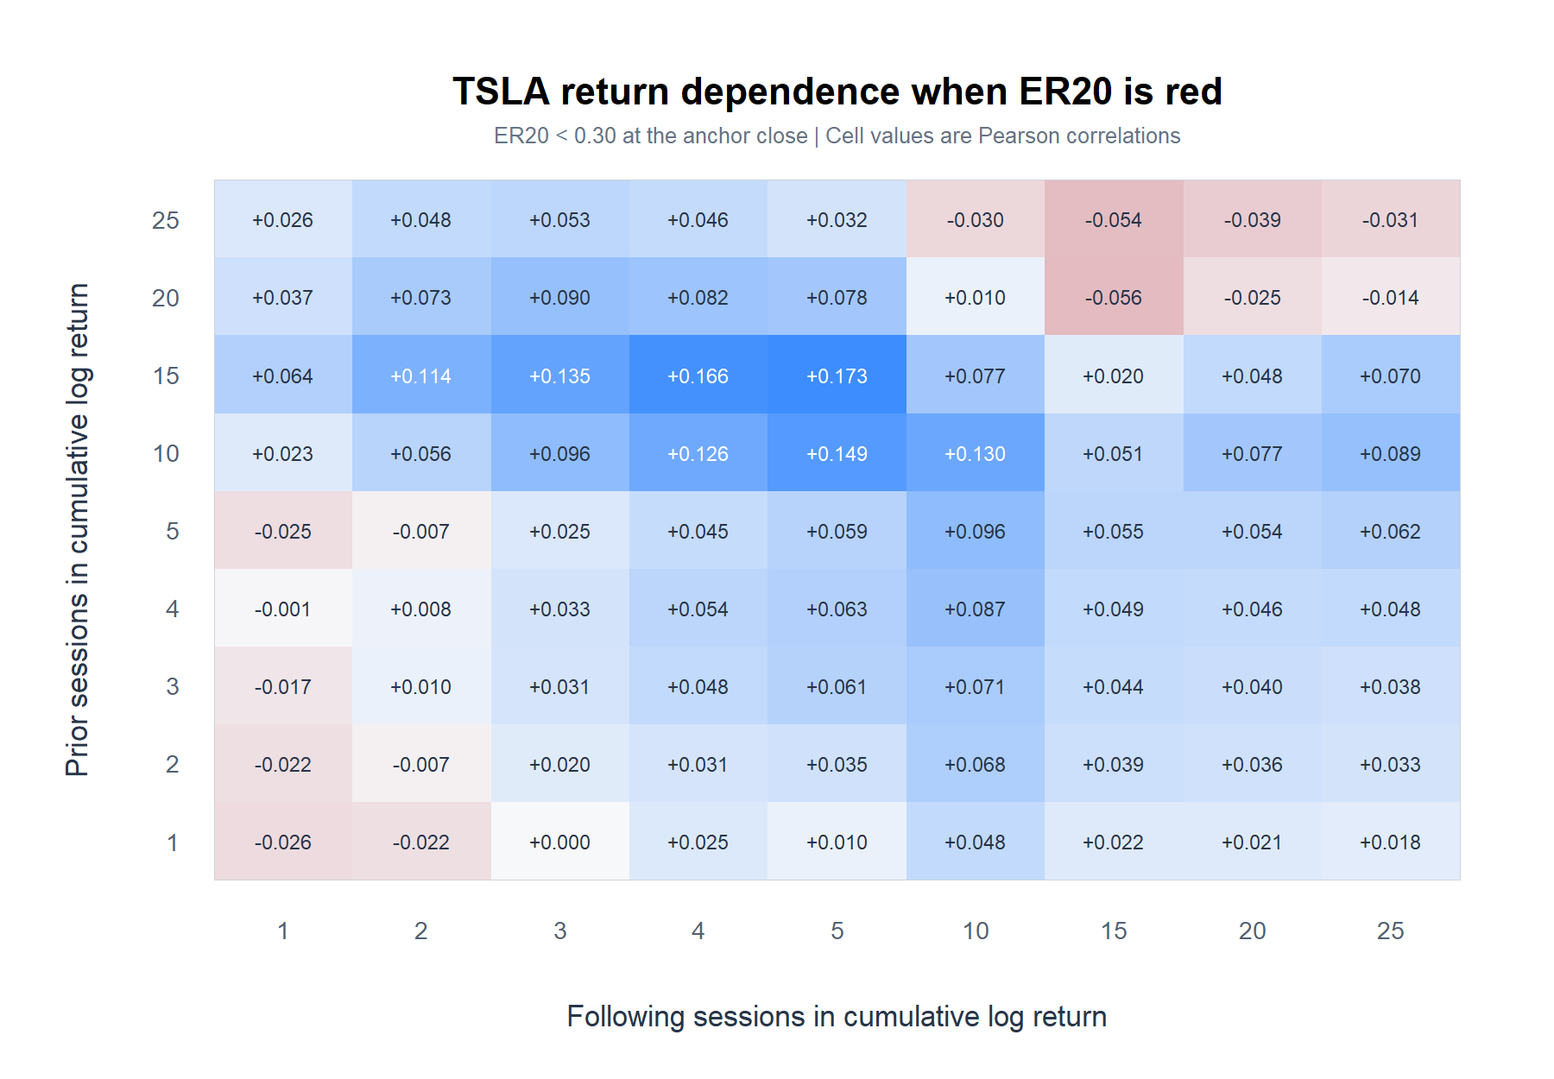
TSLA DESCRIPTIVE MICROSCOPE
Red ER20 states expose a positive island
Red/sideways matrix; strongest cell +0.173 at 15 prior / 5 forward.
Adjusted daily TSLA | 2018-2023
20
Notes:
Red states show a coherent positive island centered around 10 to 15 prior sessions and 3 to 10 forward sessions. The largest cell has an overlap-aware interval that still includes zero.
[Sources]
- runs/research_workbench/operator_hypothesis_lab/tsla_er20_conditioned_return_horizon_grid_20260825/red_sideways_pearson_matrix.csv
- runs/research_workbench/operator_hypothesis_lab/tsla_er20_conditioned_return_horizon_grid_20260825/conditioned_horizon_grid_statistics.csv
- runs/research_workbench/operator_hypothesis_lab/tsla_er20_conditioned_return_horizon_grid_20260825/visuals/tsla_red_sideways_pearson_heatmap.png
[/Sources]

Slide 21
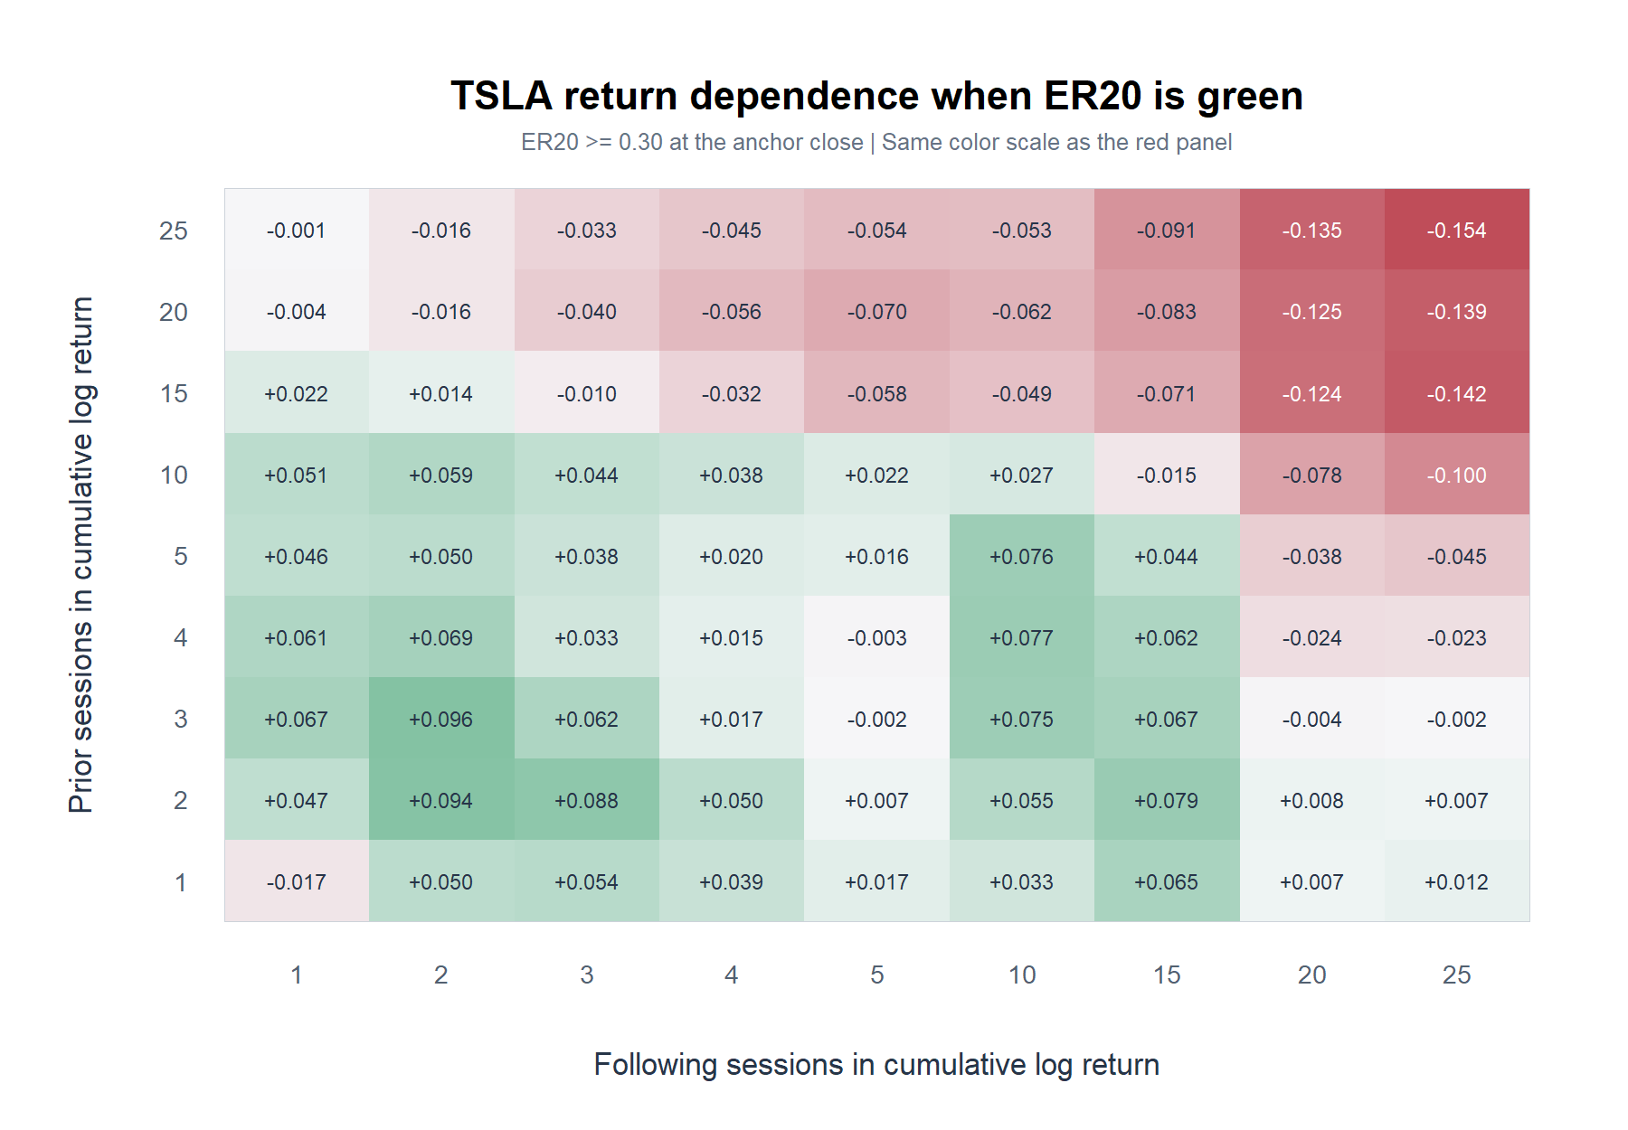
TSLA DESCRIPTIVE MICROSCOPE
Green ER20 states suppress the positive island
Green/trending matrix; long/long cells turn negative; strongest absolute cell -0.154.
Adjusted daily TSLA | 2018-2023
21
Notes:
Green states retain small positive short-horizon patches, but the red medium-horizon island is muted or reversed and the long-prior/long-forward corner becomes negative.
[Sources]
- runs/research_workbench/operator_hypothesis_lab/tsla_er20_conditioned_return_horizon_grid_20260825/green_trending_pearson_matrix.csv
- runs/research_workbench/operator_hypothesis_lab/tsla_er20_conditioned_return_horizon_grid_20260825/conditioned_horizon_grid_statistics.csv
- runs/research_workbench/operator_hypothesis_lab/tsla_er20_conditioned_return_horizon_grid_20260825/visuals/tsla_green_trending_pearson_heatmap.png
[/Sources]

Slide 22
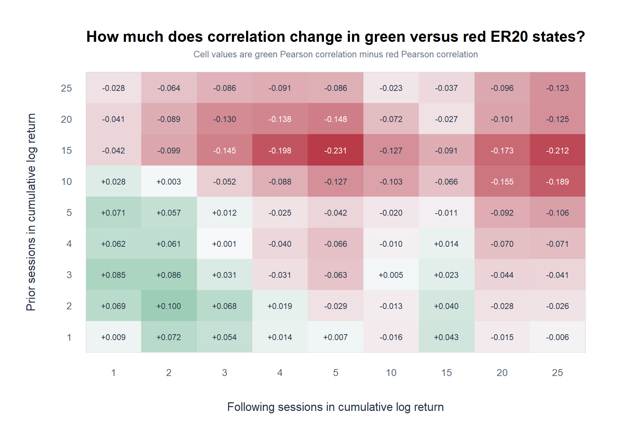
TSLA DESCRIPTIVE MICROSCOPE
The state split is coherent, but unresolved
-0.231
largest correlation change: 15 prior / 5 forward
p = 0.029
raw HAC slope-interaction test
0 / 81
interaction cells with BH-FDR q < 0.05
Adjusted daily TSLA | 2018-2023
22
Notes:
The largest raw regime contrast is at 15 prior and 5 forward: red correlation +0.173 versus green -0.058, a -0.231 difference. Its slope interaction has raw HAC p=0.029 but BH q=0.919; no interaction survives the grid scan.
[Sources]
- runs/research_workbench/operator_hypothesis_lab/tsla_er20_conditioned_return_horizon_grid_20260825/green_minus_red_pearson_matrix.csv
- runs/research_workbench/operator_hypothesis_lab/tsla_er20_conditioned_return_horizon_grid_20260825/regime_comparison_statistics.csv
- runs/research_workbench/operator_hypothesis_lab/tsla_er20_conditioned_return_horizon_grid_20260825/slope_interaction_bh_q_value_matrix.csv
- runs/research_workbench/operator_hypothesis_lab/tsla_er20_conditioned_return_horizon_grid_20260825/visuals/tsla_green_minus_red_pearson_heatmap.png
[/Sources]

Slide 23
TSLA DESCRIPTIVE MICROSCOPE
ER20 changes the map, but not the evidentiary stop
RED MAP
A positive island appears around 10–15 prior / 3–10 forward
Max +0.173 at 15 prior / 5 forward
GREEN MAP
The same island is muted or reversed; long/long turns negative
15 / 5 = -0.058; 25 / 25 = -0.154
UNCERTAINTY
No regime-specific or interaction result survives the scan
0/81 red; 0/81 green; 0/81 interactions
Next narrow question
Freeze 15-prior / 5-forward for separate replication—or first test a regime filter less entangled with prior return?
Adjusted daily TSLA | 2018-2023
23
Notes:
Conditioning changes the descriptive map in a coherent way, but the finding remains exploratory. ER20 is built from the same trailing path as the prior-return variable, so a less mechanically entangled filter would be a useful comparison.
[Sources]
- runs/research_workbench/operator_hypothesis_lab/tsla_er20_conditioned_return_horizon_grid_20260825/report.md
- runs/research_workbench/operator_hypothesis_lab/tsla_er20_conditioned_return_horizon_grid_20260825/conditioned_horizon_grid_statistics.csv
- runs/research_workbench/operator_hypothesis_lab/tsla_er20_conditioned_return_horizon_grid_20260825/regime_comparison_statistics.csv
[/Sources]

Slide 24
VOLATILITY CONDITIONING
Does movement capacity separate
continuation from reversal?
Reuse the accepted ATR% state already known at the anchor close.
LOW, MEDIUM, and HIGH inherit HYP-REG-01.1's fixed causal classifier. No threshold search.
24
Notes:
This section asks whether signed-return dependence changes with movement capacity, using the already accepted ATR-percent classifier rather than designing new bins from this result.
[Sources]
- operator_hypothesis_lab/docs/GEN5_HYP_REG_01_1_ATR_PERCENT_VOLATILITY_RESULTS.md
- operator_hypothesis_lab/docs/TSLA_ATRP_CONDITIONED_RETURN_HORIZON_GRID_2018_2023.md
[/Sources]

Slide 25
TSLA DESCRIPTIVE MICROSCOPE
Condition on accepted ATR% before reading the future
State[t] then R+(f)
Fixed conditioning
Metric
Wilder ATR14 / close
ATR% state is assigned at anchor close t. Prior return ends at t; following return begins after t. It measures capacity—not direction.
Memory
Prior 252 completed sessions
States
LOW / MEDIUM / HIGH
Hysteresis
30/40 and 60/70 gates
3
Timing
Known at anchor close t
accepted volatility states
Surface
Same 81 horizon pairs
Adjusted daily TSLA | 2018-2023
25
Notes:
The state definition is reused exactly: Wilder ATR14 divided by close, current ATR-percent ranked against the prior 252 completed observations, and the accepted 30/40–60/70 hysteresis. State t is known before future returns begin.
[Sources]
- runs/research_workbench/operator_hypothesis_lab/tsla_atrp_conditioned_return_horizon_grid_20260825/run_spec.csv
- runs/research_workbench/operator_hypothesis_lab/tsla_atrp_conditioned_return_horizon_grid_20260825/source_checks.csv
- runs/research_workbench/operator_hypothesis_lab/hyp_reg_01_1_atr_percent_20260814/hyp_reg_01_1_daily_state_ledger.csv
[/Sources]

Slide 26
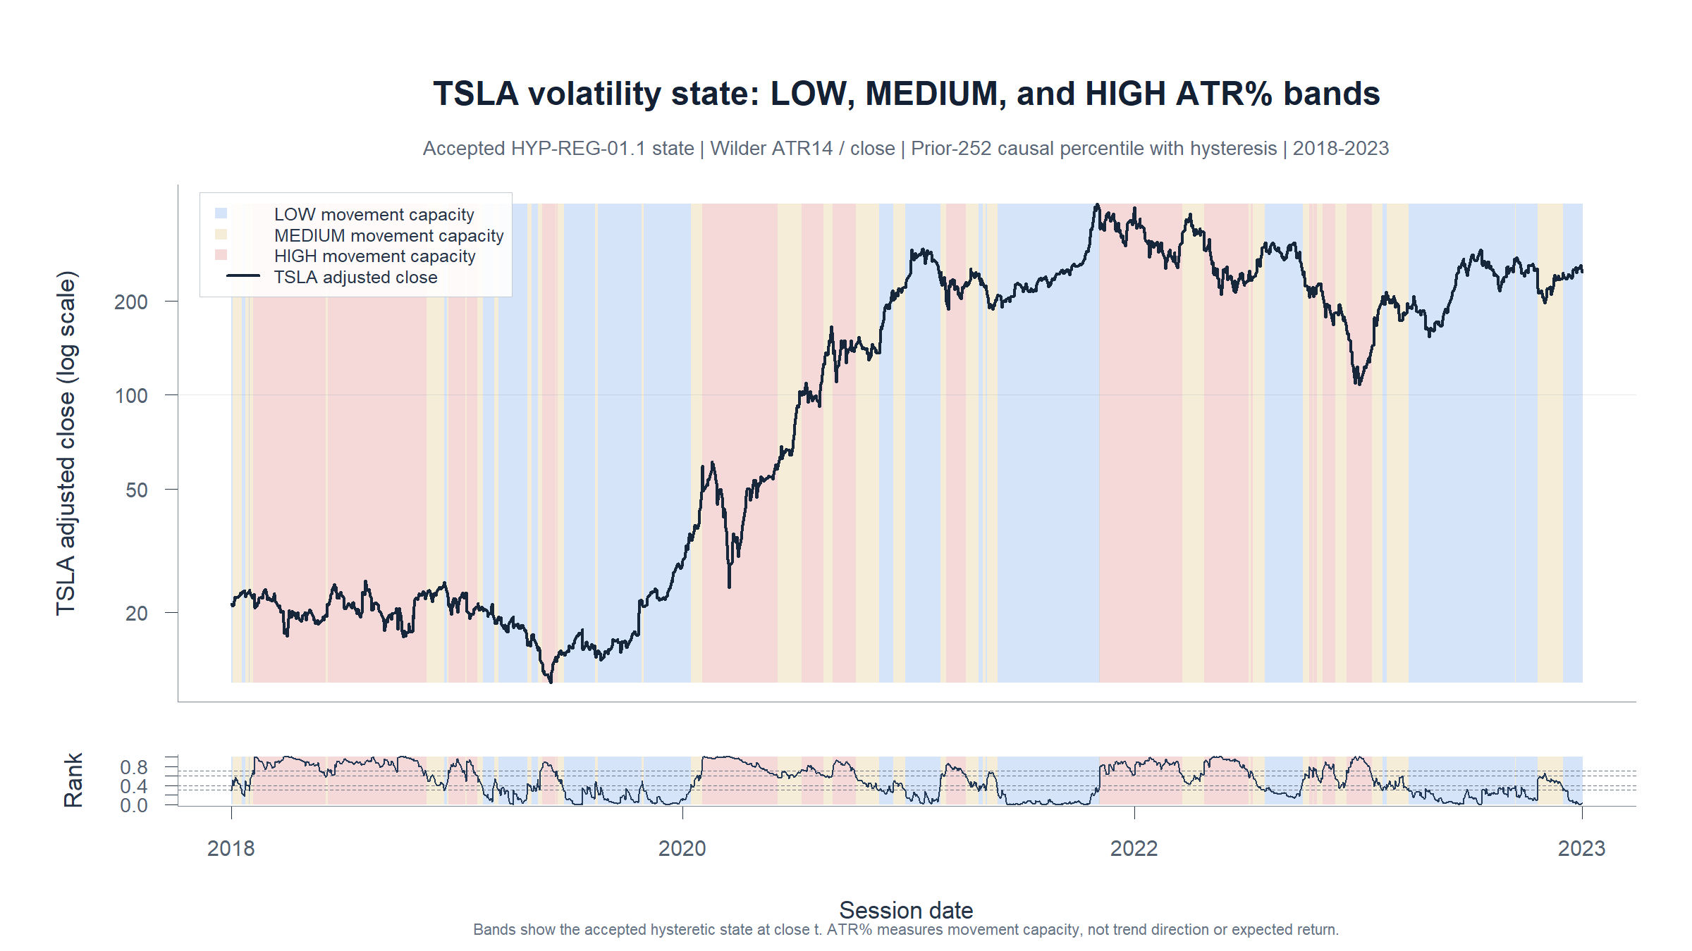
TSLA DESCRIPTIVE MICROSCOPE
ATR% shows movement capacity—not direction
How
Accepted state uses Wilder ATR14 / close, ranked against the prior 252 completed ATR% observations.
Read
Blue marks LOW, gold MEDIUM, and red HIGH movement capacity. Price and the causal trailing ATR% rank are shown together.
Descriptive state—not a future-return claim
Adjusted daily TSLA | 2018-2023
26
Notes:
This companion view makes the accepted volatility classifier visible in price time. Blue, gold, and red mean LOW, MEDIUM, and HIGH movement capacity; they do not mean bearish, neutral, and bullish. The lower panel shows the causal trailing ATR-percent rank and accepted hysteretic state at each close.
[Sources]
- runs/research_workbench/operator_hypothesis_lab/tsla_atrp_conditioned_return_horizon_grid_20260825/visuals/tsla_atrp_state_price_bands.png
- runs/research_workbench/operator_hypothesis_lab/tsla_atrp_conditioned_return_horizon_grid_20260825/tsla_atrp_state_chart_ledger.csv
- runs/research_workbench/operator_hypothesis_lab/tsla_atrp_conditioned_return_horizon_grid_20260825/tsla_atrp_state_spans.csv
- runs/research_workbench/operator_hypothesis_lab/hyp_reg_01_1_atr_percent_20260814/hyp_reg_01_1_daily_state_ledger.csv
[/Sources]

Slide 27
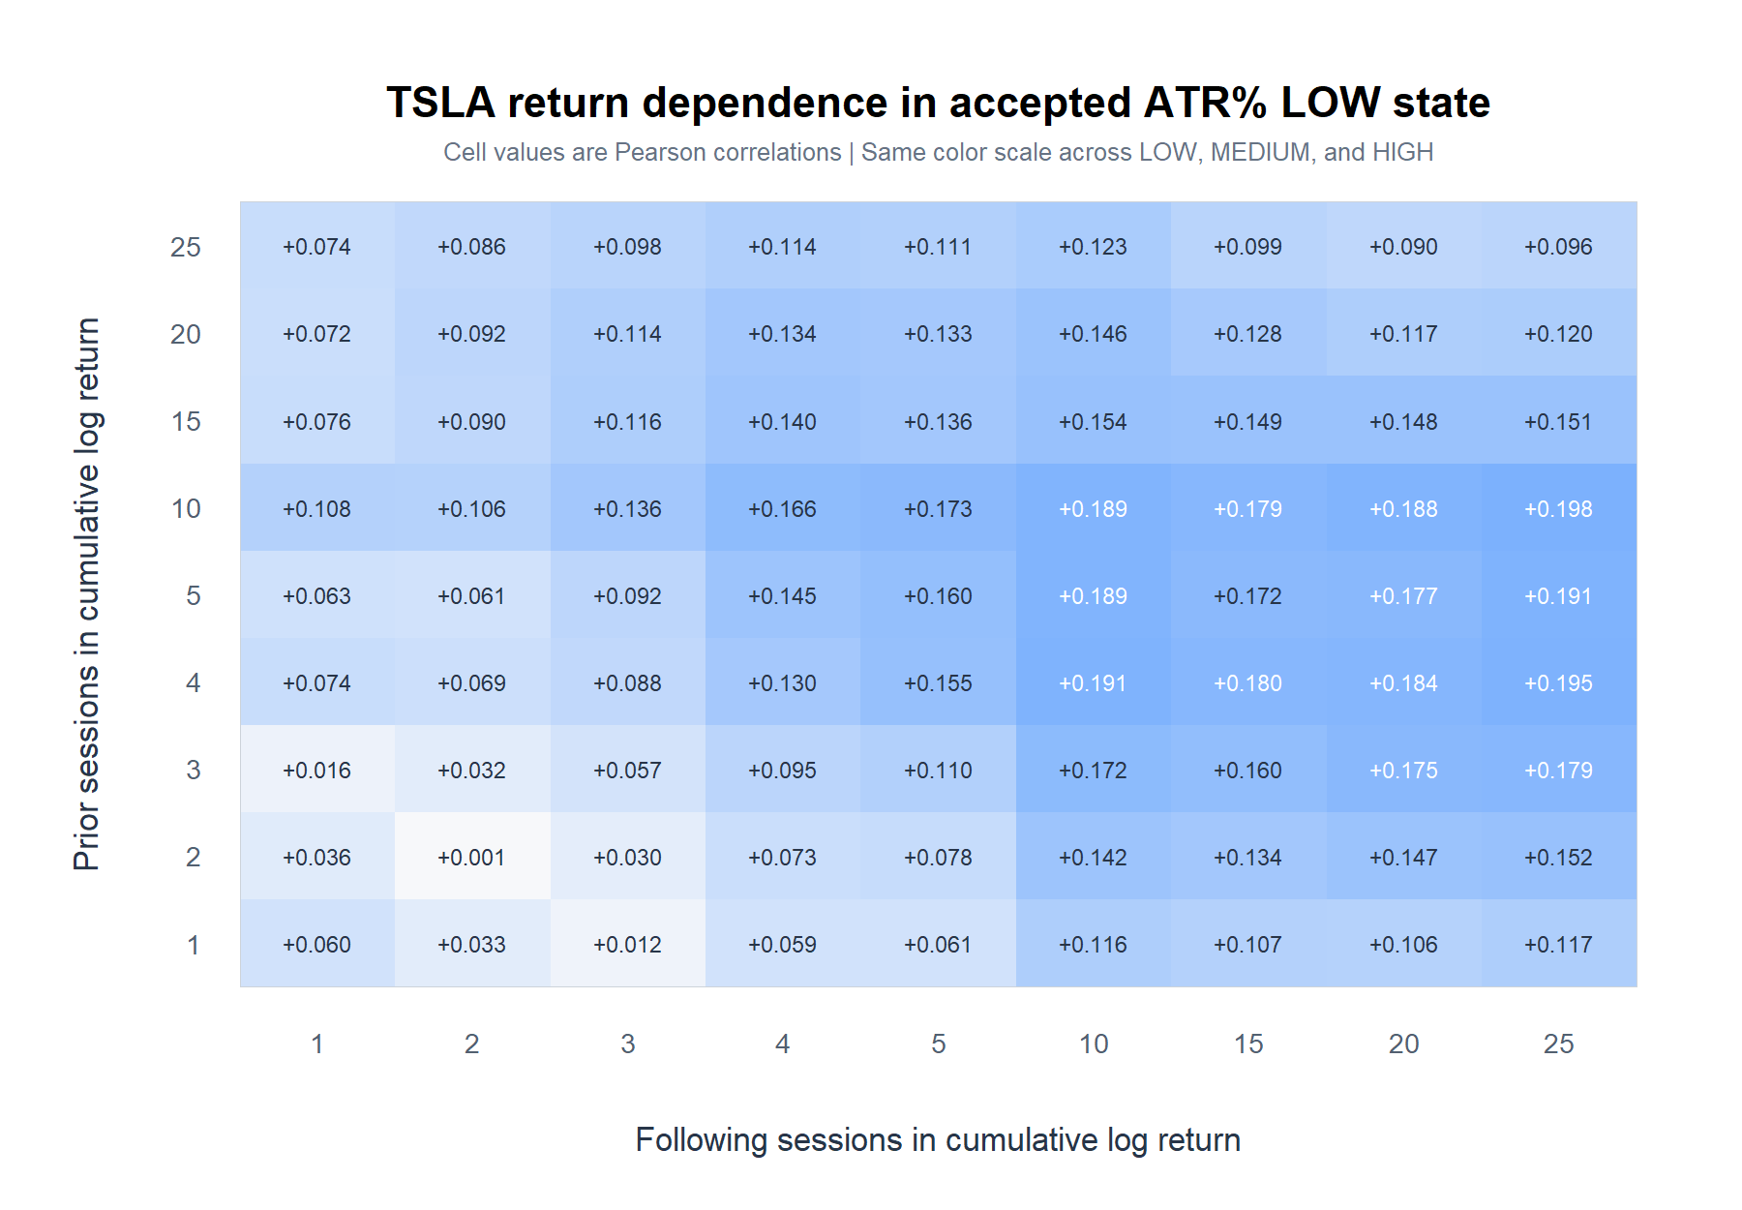
TSLA DESCRIPTIVE MICROSCOPE
LOW ATR% is broadly positive, but no cell passes
All 81 cells positive; strongest +0.198 at 10 prior / 25 forward; 0/81 within-state BH passes.
Adjusted daily TSLA | 2018-2023
27
Notes:
LOW ATR-percent anchors produce positive point estimates throughout the grid, but the strongest cell's interval crosses zero and no LOW cell survives the within-state scan.
[Sources]
- runs/research_workbench/operator_hypothesis_lab/tsla_atrp_conditioned_return_horizon_grid_20260825/low_pearson_matrix.csv
- runs/research_workbench/operator_hypothesis_lab/tsla_atrp_conditioned_return_horizon_grid_20260825/conditioned_horizon_grid_statistics.csv
- runs/research_workbench/operator_hypothesis_lab/tsla_atrp_conditioned_return_horizon_grid_20260825/visuals/tsla_atrp_low_pearson_heatmap.png
[/Sources]

Slide 28
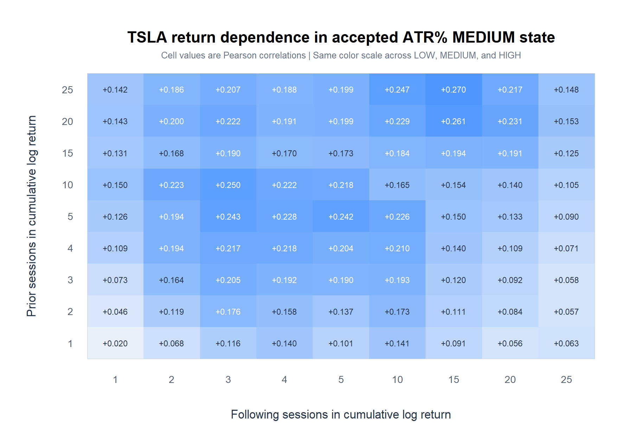
TSLA DESCRIPTIVE MICROSCOPE
MEDIUM ATR% contains the stable continuation island
All 81 cells positive; 21/81 within-state BH passes; strict survivors cluster at 5–10 prior / 2–3 forward.
Adjusted daily TSLA | 2018-2023
28
Notes:
MEDIUM ATR-percent anchors show the most statistically stable continuation pattern. Under the strict correction across all 486 tests, the 5/3, 10/2, and 10/3 cells remain.
[Sources]
- runs/research_workbench/operator_hypothesis_lab/tsla_atrp_conditioned_return_horizon_grid_20260825/medium_pearson_matrix.csv
- runs/research_workbench/operator_hypothesis_lab/tsla_atrp_conditioned_return_horizon_grid_20260825/conditioned_horizon_grid_statistics.csv
- runs/research_workbench/operator_hypothesis_lab/tsla_atrp_conditioned_return_horizon_grid_20260825/visuals/tsla_atrp_medium_pearson_heatmap.png
[/Sources]

Slide 29
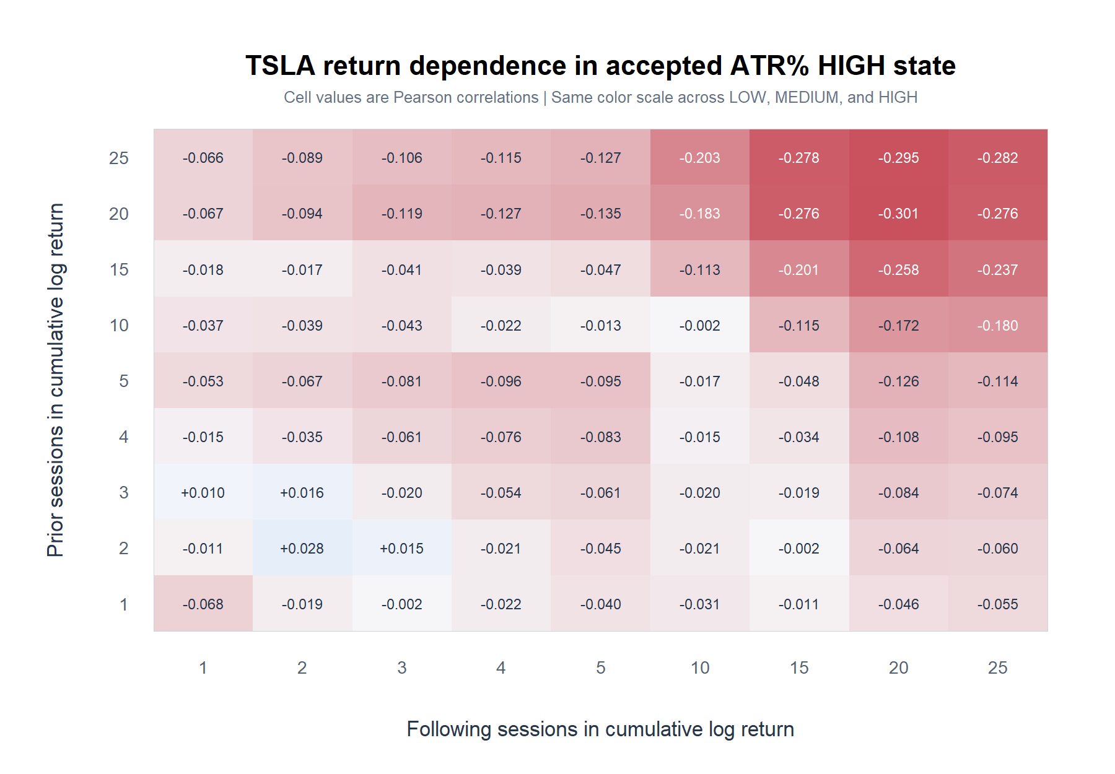
TSLA DESCRIPTIVE MICROSCOPE
HIGH ATR% flips the surface toward reversal
77/81 cells negative; strongest -0.301 at 20 prior / 20 forward; 0/81 within-state BH passes.
Adjusted daily TSLA | 2018-2023
29
Notes:
HIGH ATR-percent anchors reverse the sign of the broad surface, especially at longer horizons. The most extreme cell is visually strong but its dependence-robust interval still crosses zero.
[Sources]
- runs/research_workbench/operator_hypothesis_lab/tsla_atrp_conditioned_return_horizon_grid_20260825/high_pearson_matrix.csv
- runs/research_workbench/operator_hypothesis_lab/tsla_atrp_conditioned_return_horizon_grid_20260825/conditioned_horizon_grid_statistics.csv
- runs/research_workbench/operator_hypothesis_lab/tsla_atrp_conditioned_return_horizon_grid_20260825/visuals/tsla_atrp_high_pearson_heatmap.png
[/Sources]

Slide 30
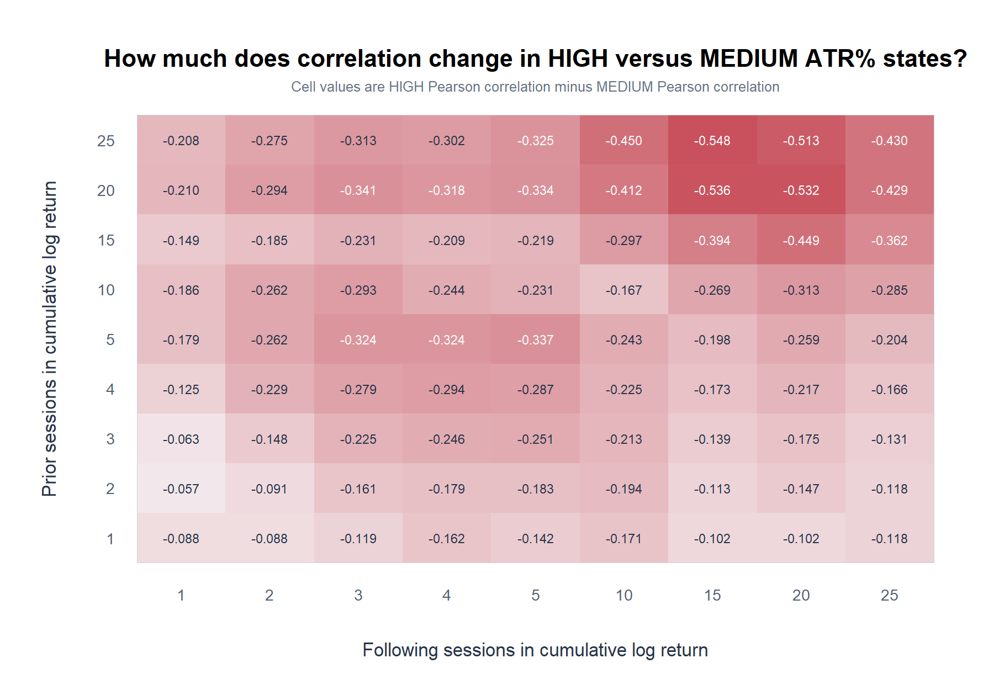
TSLA DESCRIPTIVE MICROSCOPE
HIGH and MEDIUM contain direct state differences
-0.548
largest correlation change: 25 prior / 15 forward
q = 0.038
within HIGH-minus-MEDIUM family
3 / 243
pairwise cells surviving strict omnibus BH
Adjusted daily TSLA | 2018-2023
30
Notes:
The largest correlation contrast is -0.548 at 25 prior and 15 forward; its within-family interaction q is 0.038 but strict omnibus q is 0.081. Three smaller HIGH-minus-MEDIUM interactions survive the omnibus correction.
[Sources]
- runs/research_workbench/operator_hypothesis_lab/tsla_atrp_conditioned_return_horizon_grid_20260825/high_minus_medium_pearson_difference_matrix.csv
- runs/research_workbench/operator_hypothesis_lab/tsla_atrp_conditioned_return_horizon_grid_20260825/pairwise_state_comparison_statistics.csv
- runs/research_workbench/operator_hypothesis_lab/tsla_atrp_conditioned_return_horizon_grid_20260825/high_minus_medium_interaction_bh_q_matrix.csv
- runs/research_workbench/operator_hypothesis_lab/tsla_atrp_conditioned_return_horizon_grid_20260825/visuals/tsla_atrp_high_minus_medium_pearson_heatmap.png
[/Sources]

Slide 31
TSLA DESCRIPTIVE MICROSCOPE
ATR% changes the map—and leaves a replication candidate
LOW MAP
All cells are positive, but none survive the within-state scan
Max +0.198; 0/81 BH passes
MEDIUM MAP
A continuation island survives around 5–10 prior / 2–3 forward
21/81 family; 3 strict omnibus passes
HIGH MAP
The surface broadly reverses, especially at longer horizons
77/81 negative; max |r| = 0.301
Bookmarked next questions
Replicate ATR% on a frozen sample. Then split green ER20 into up/down direction and test external market context.
Adjusted daily TSLA | 2018-2023
31
Notes:
The ATR-percent split is the clearest conditional map in this descriptive lane and is partially multiplicity-robust, but it is still a same-sample replication candidate rather than a trading rule. The ER20 direction split and external-context filter are bookmarked, not opened here.
[Sources]
- runs/research_workbench/operator_hypothesis_lab/tsla_atrp_conditioned_return_horizon_grid_20260825/report.md
- runs/research_workbench/operator_hypothesis_lab/tsla_atrp_conditioned_return_horizon_grid_20260825/conditioned_horizon_grid_statistics.csv
- runs/research_workbench/operator_hypothesis_lab/tsla_atrp_conditioned_return_horizon_grid_20260825/pairwise_state_comparison_statistics.csv
[/Sources]

Slide 32
EXTERNAL MARKET CONTEXT
Can SPY movement capacity organize TSLA returns?
Use SPY's accepted ATR% state at the same TSLA anchor close.
TSLA, sample, return windows, and uncertainty stay fixed. No threshold search.
32
Notes:
This section changes one authority only. TSLA still supplies every prior and following return. SPY supplies the already accepted causal ATR-percent state at the anchor close.
[Sources]
- runs/research_workbench/operator_hypothesis_lab/tsla_spy_atrp_conditioned_return_horizon_grid_20260825/run_spec.csv
- runs/research_workbench/operator_hypothesis_lab/hyp_reg_01_1_atr_percent_20260814/hyp_reg_01_1_daily_state_ledger.csv
[/Sources]

Slide 33
TSLA DESCRIPTIVE MICROSCOPE
Condition on SPY ATR% before reading TSLA's future
SPY state → TSLA future
Fixed conditioning
Metric
Wilder ATR14 / SPY close
SPY labels anchor close t. TSLA prior return ends at t; TSLA following return begins after t.
Memory
Prior 252 completed sessions
States
LOW / MEDIUM / HIGH
Hysteresis
30/40 and 60/70 gates
3
Timing
Known at anchor close t
accepted external states
Surface
Same 81 horizon pairs
Adjusted daily TSLA | 2018-2023
33
Notes:
The SPY classifier is reused exactly: Wilder ATR14 divided by adjusted close, prior-252 causal percentile, and 30/40 plus 60/70 hysteresis. No state definition or horizon changes after seeing TSLA returns.
[Sources]
- runs/research_workbench/operator_hypothesis_lab/tsla_spy_atrp_conditioned_return_horizon_grid_20260825/run_spec.csv
- runs/research_workbench/operator_hypothesis_lab/tsla_spy_atrp_conditioned_return_horizon_grid_20260825/source_checks.csv
- runs/research_workbench/operator_hypothesis_lab/hyp_reg_01_1_atr_percent_20260814/hyp_reg_01_1_daily_state_ledger.csv
[/Sources]

Slide 34
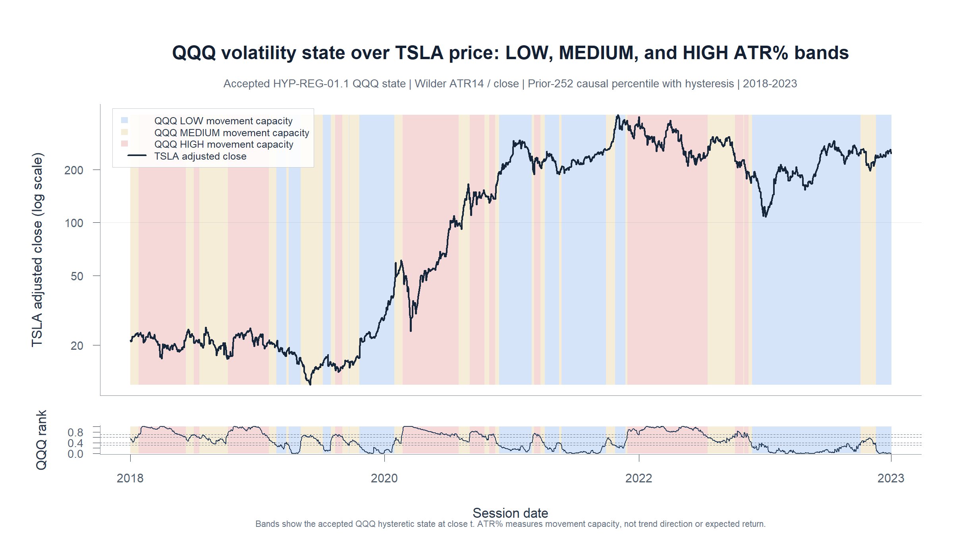
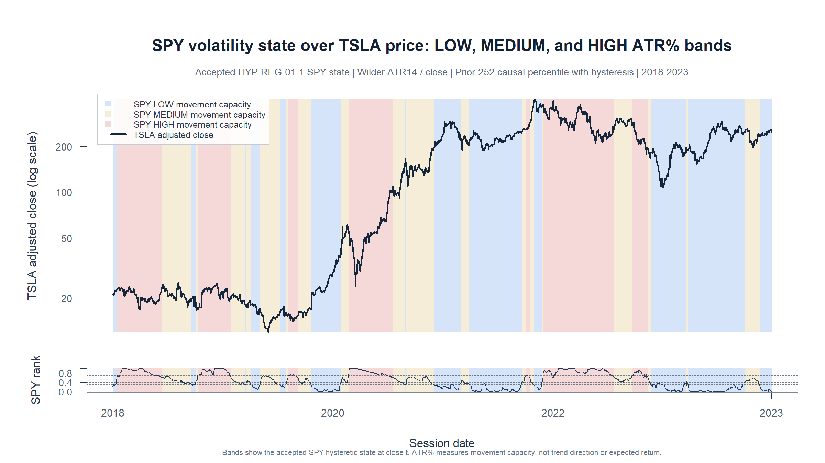
TSLA DESCRIPTIVE MICROSCOPE
SPY ATR% supplies context—not TSLA direction
How
Accepted SPY state uses Wilder ATR14 / close, ranked against the prior 252 completed SPY ATR% observations.
Read
Bands are SPY states over TSLA price. Blue LOW and red HIGH describe movement capacity—not bullish or bearish calls.
Descriptive state—not a future-return claim
Adjusted daily TSLA | 2018-2023
34
Notes:
The price stays TSLA, while every colored band and the lower-panel percentile come from SPY. This visual checks alignment in time; it does not claim that SPY state causes TSLA returns.
[Sources]
- runs/research_workbench/operator_hypothesis_lab/tsla_spy_atrp_conditioned_return_horizon_grid_20260825/visuals/tsla_spy_atrp_state_price_bands.png
- runs/research_workbench/operator_hypothesis_lab/tsla_spy_atrp_conditioned_return_horizon_grid_20260825/tsla_spy_atrp_state_chart_ledger.csv
- runs/research_workbench/operator_hypothesis_lab/tsla_spy_atrp_conditioned_return_horizon_grid_20260825/tsla_spy_atrp_state_spans.csv
- runs/research_workbench/operator_hypothesis_lab/hyp_reg_01_1_atr_percent_20260814/hyp_reg_01_1_daily_state_ledger.csv
[/Sources]

Slide 35
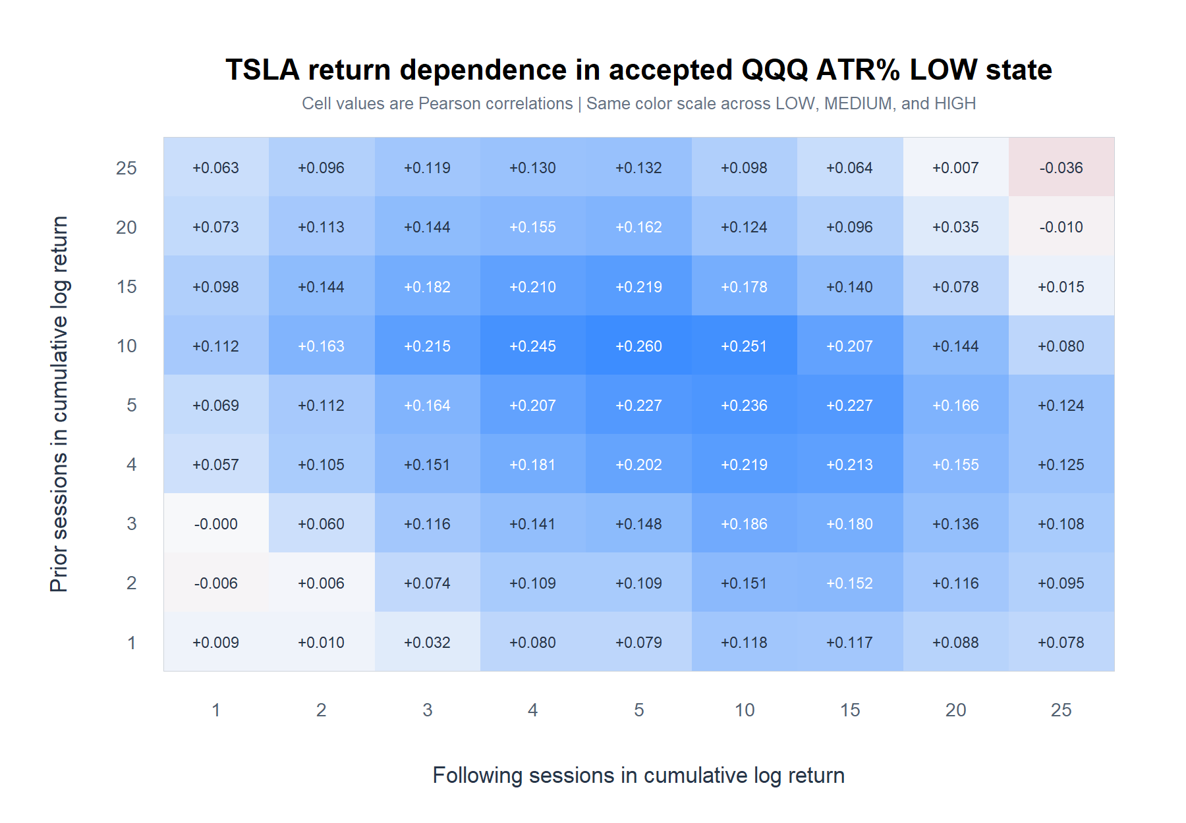
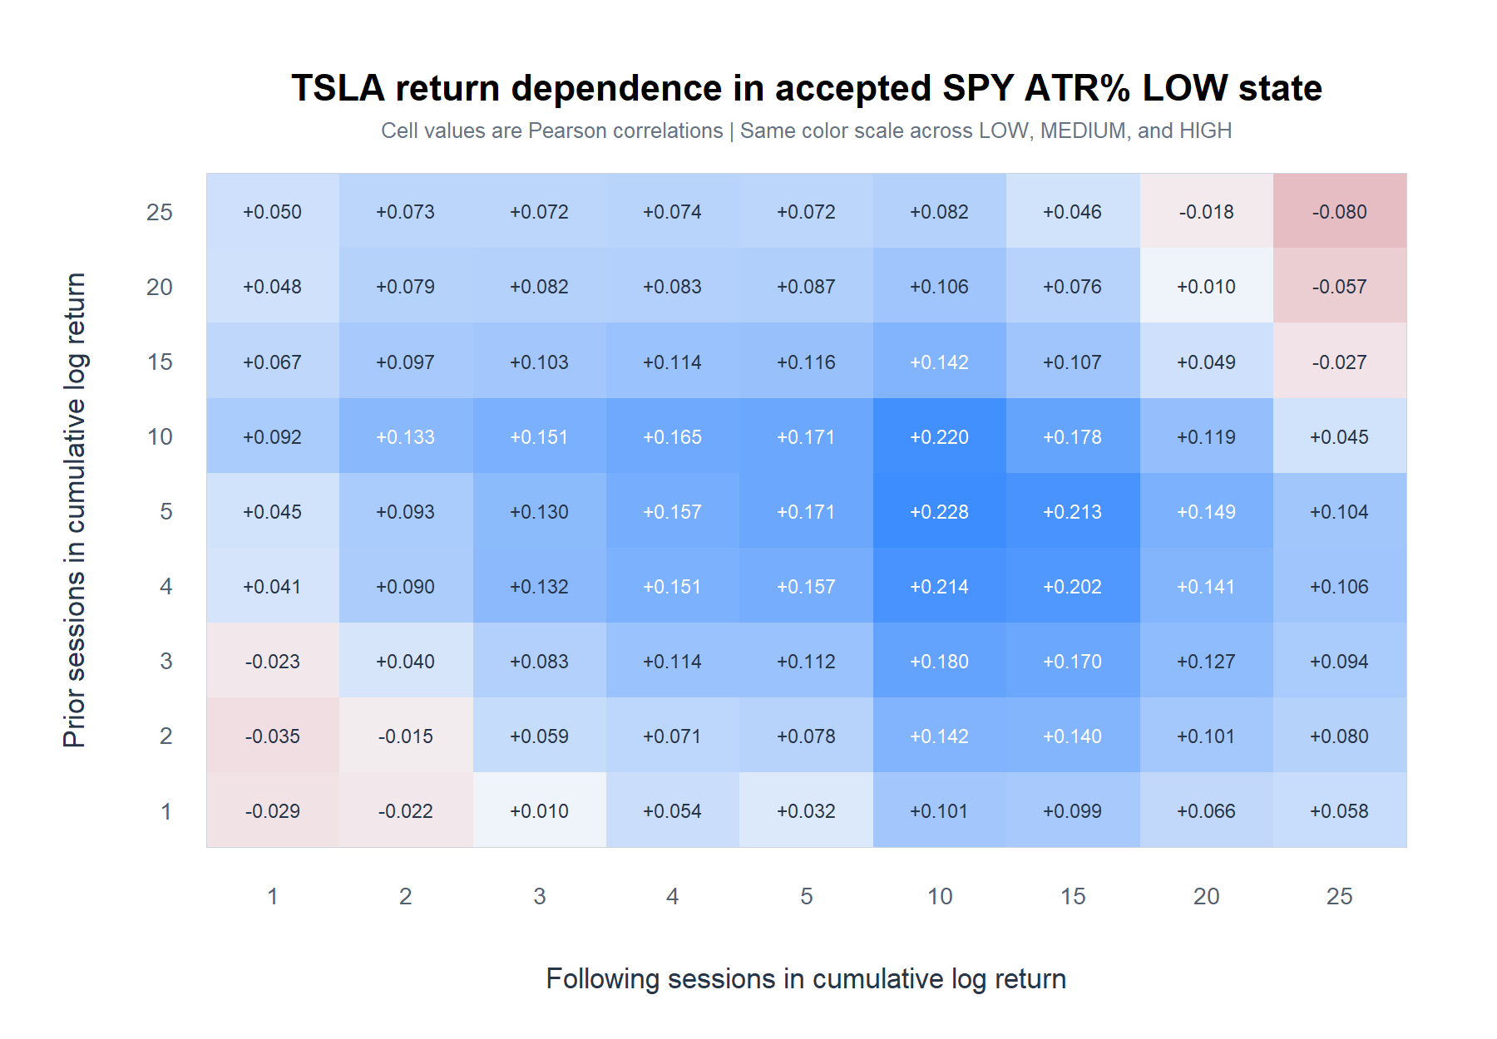
TSLA DESCRIPTIVE MICROSCOPE
SPY LOW reveals TSLA continuation
72/81 cells positive; strongest +0.228 at 5 prior / 10 forward; 0/81 within-state BH passes.
Adjusted daily TSLA | 2018-2023
35
Notes:
SPY LOW ATR-percent sessions contain the clearest TSLA continuation geometry. The pattern is broad, but no single within-state cell survives its 81-cell BH-FDR family.
[Sources]
- runs/research_workbench/operator_hypothesis_lab/tsla_spy_atrp_conditioned_return_horizon_grid_20260825/visuals/tsla_spy_atrp_low_pearson_heatmap.png
- runs/research_workbench/operator_hypothesis_lab/tsla_spy_atrp_conditioned_return_horizon_grid_20260825/conditioned_horizon_grid_statistics.csv
[/Sources]

Slide 36
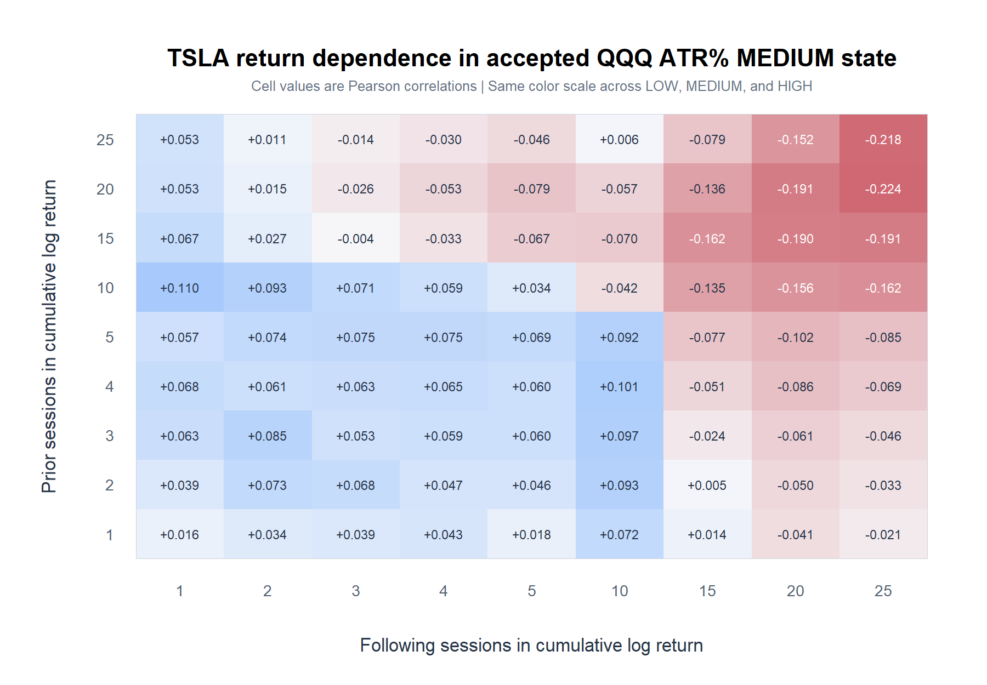
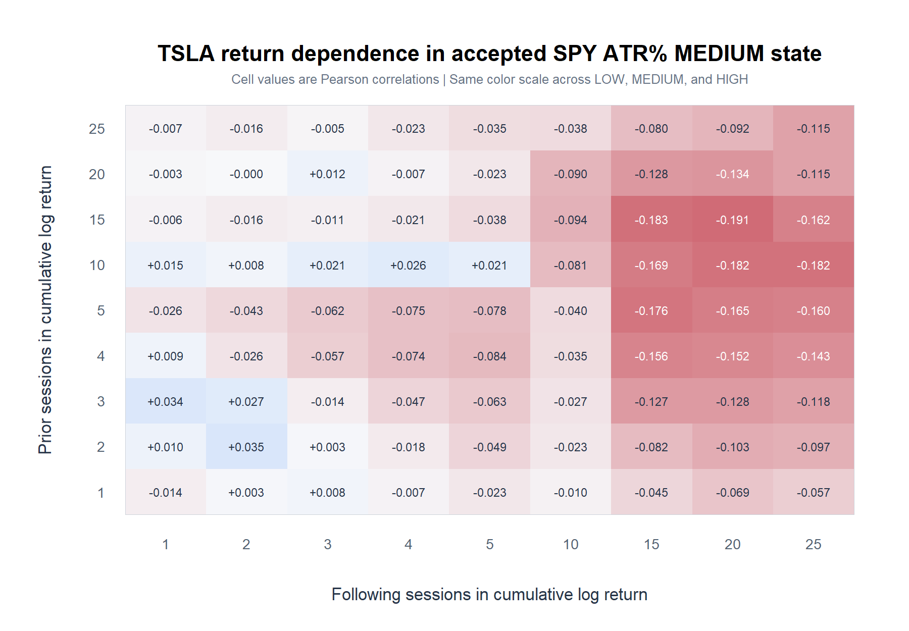
TSLA DESCRIPTIVE MICROSCOPE
SPY MEDIUM turns long-forward returns negative
67/81 cells negative; strongest -0.191 at 15 prior / 20 forward; 0/81 within-state BH passes.
Adjusted daily TSLA | 2018-2023
36
Notes:
SPY MEDIUM ATR-percent sessions reverse the long-forward portion of the TSLA map. This differs sharply from TSLA's own MEDIUM state, which held the earlier positive continuation island.
[Sources]
- runs/research_workbench/operator_hypothesis_lab/tsla_spy_atrp_conditioned_return_horizon_grid_20260825/visuals/tsla_spy_atrp_medium_pearson_heatmap.png
- runs/research_workbench/operator_hypothesis_lab/tsla_spy_atrp_conditioned_return_horizon_grid_20260825/conditioned_horizon_grid_statistics.csv
- runs/research_workbench/operator_hypothesis_lab/tsla_spy_atrp_conditioned_return_horizon_grid_20260825/own_vs_external_atrp_map_summary.csv
[/Sources]

Slide 37
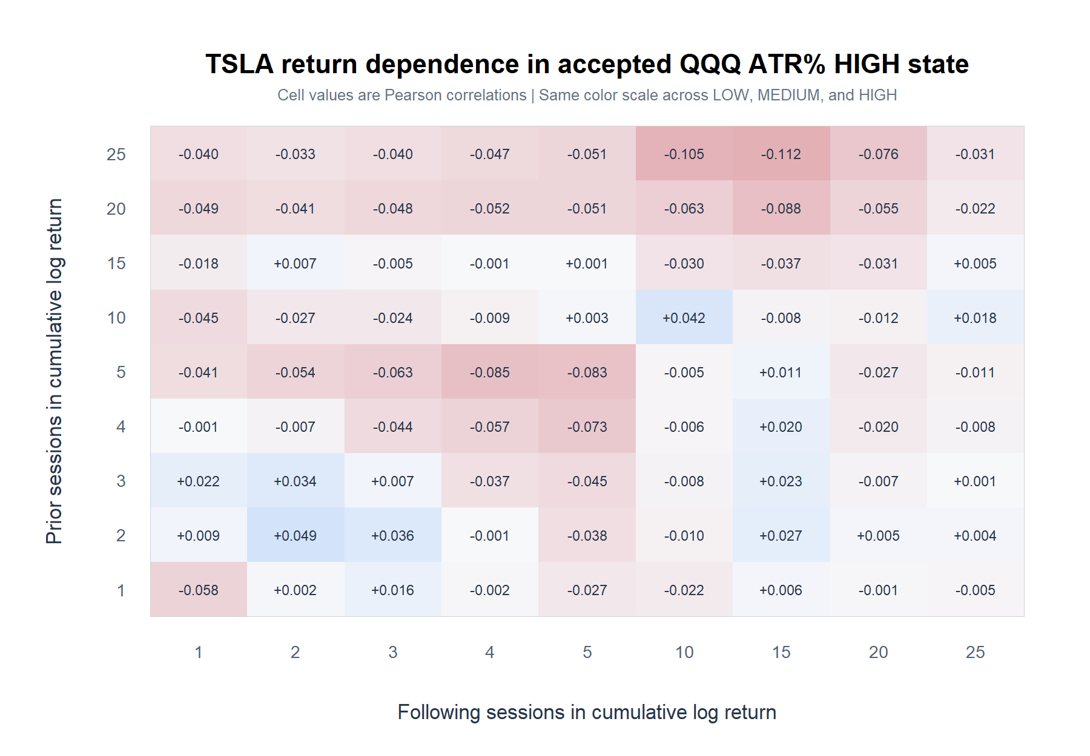
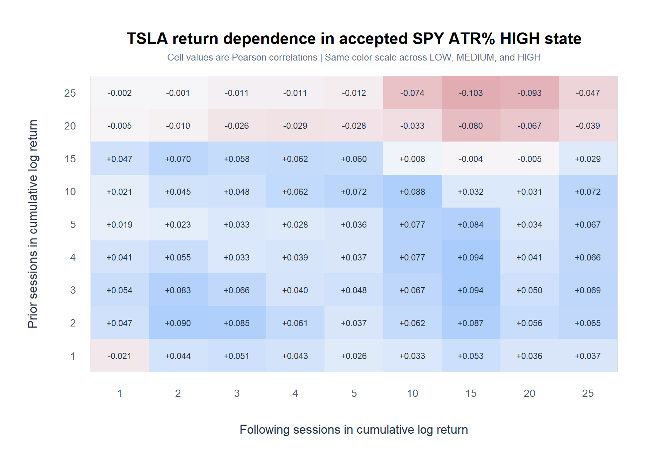
TSLA DESCRIPTIVE MICROSCOPE
SPY HIGH leaves a mild TSLA surface
60/81 cells positive; max |r| = 0.103 at 25 prior / 15 forward; 0/81 within-state BH passes.
Adjusted daily TSLA | 2018-2023
37
Notes:
SPY HIGH ATR-percent does not reproduce the broad reversal seen under TSLA's own HIGH ATR-percent state. Most cells are mildly positive, with a small negative corner at the longest prior horizons.
[Sources]
- runs/research_workbench/operator_hypothesis_lab/tsla_spy_atrp_conditioned_return_horizon_grid_20260825/visuals/tsla_spy_atrp_high_pearson_heatmap.png
- runs/research_workbench/operator_hypothesis_lab/tsla_spy_atrp_conditioned_return_horizon_grid_20260825/conditioned_horizon_grid_statistics.csv
- runs/research_workbench/operator_hypothesis_lab/tsla_spy_atrp_conditioned_return_horizon_grid_20260825/own_vs_external_atrp_map_summary.csv
[/Sources]

Slide 38
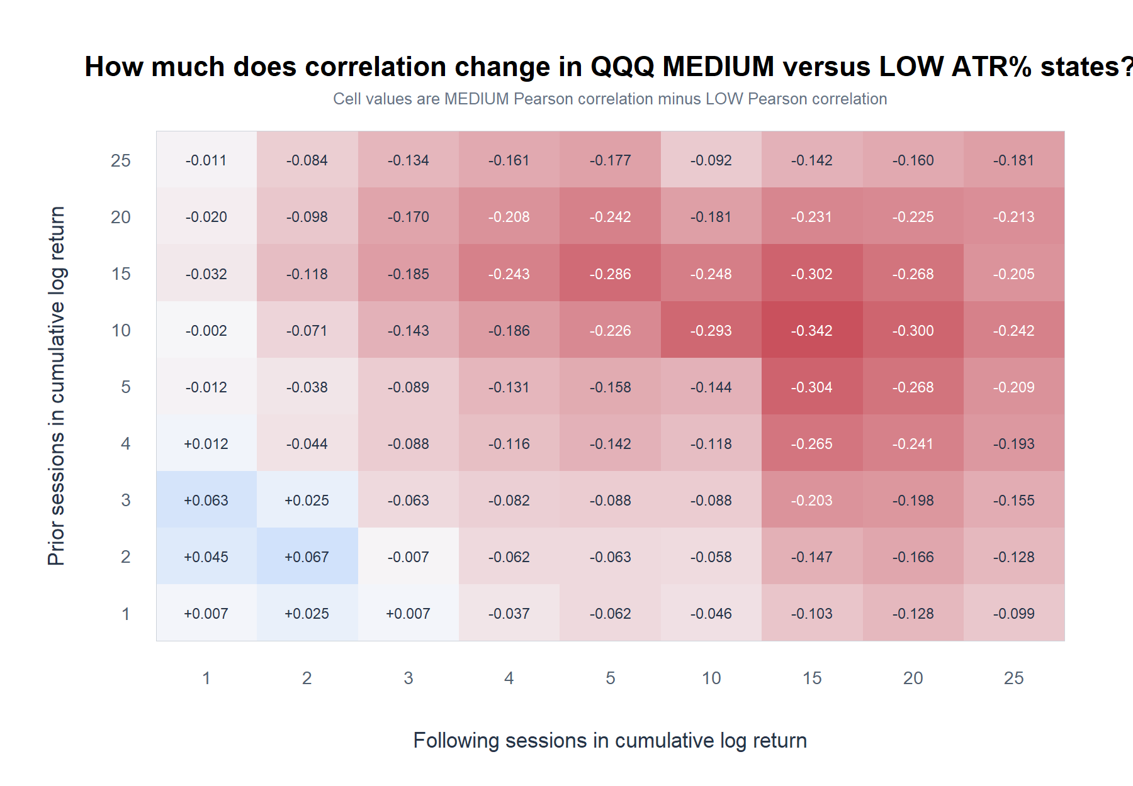
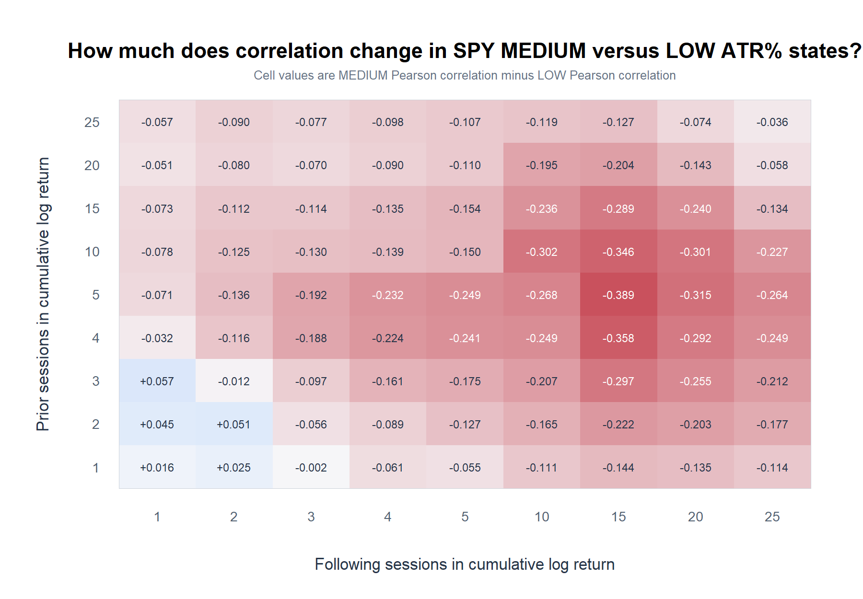
TSLA DESCRIPTIVE MICROSCOPE
SPY LOW versus MEDIUM is the clearest contrast
-0.389
largest correlation change: 5 prior / 15 forward
q = 0.016
within MEDIUM-minus-LOW family
0 / 243
pairwise cells surviving strict omnibus BH
Adjusted daily TSLA | 2018-2023
38
Notes:
The largest direct contrast is LOW continuation versus MEDIUM reversal at 5 prior and 15 forward sessions. Three neighboring MEDIUM-minus-LOW interactions survive their 81-cell family correction, but no pairwise interaction survives the stricter 486-test omnibus correction.
[Sources]
- runs/research_workbench/operator_hypothesis_lab/tsla_spy_atrp_conditioned_return_horizon_grid_20260825/visuals/tsla_spy_atrp_medium_minus_low_pearson_heatmap.png
- runs/research_workbench/operator_hypothesis_lab/tsla_spy_atrp_conditioned_return_horizon_grid_20260825/pairwise_state_comparison_statistics.csv
[/Sources]

Slide 39
TSLA DESCRIPTIVE MICROSCOPE
External context changes the map—but confirms no edge
SPY LOW MAP
Broadly preserves the positive continuation geometry
72/81 same sign vs own LOW; mean r +0.091
SPY MEDIUM MAP
Reverses the own-asset MEDIUM interpretation
14/81 same sign; mean r -0.058
SPY HIGH MAP
Mild and mixed—not broad TSLA reversal
25/81 same sign; mean r +0.031
What this earns
External context is a promising descriptive axis. Next: brainstorm cross-sectional cues; keep replication and strategy gates closed.
Adjusted daily TSLA | 2018-2023
39
Notes:
External SPY conditioning is coherent enough to justify more descriptive cross-sectional brainstorming, but it does not confirm an edge. LOW is the most portable geometry; MEDIUM changes almost completely; HIGH keeps a related ordering while most signs shift.
[Sources]
- runs/research_workbench/operator_hypothesis_lab/tsla_spy_atrp_conditioned_return_horizon_grid_20260825/own_vs_external_atrp_map_summary.csv
- runs/research_workbench/operator_hypothesis_lab/tsla_spy_atrp_conditioned_return_horizon_grid_20260825/report.md
- runs/research_workbench/operator_hypothesis_lab/tsla_atrp_conditioned_return_horizon_grid_20260825/conditioned_horizon_grid_statistics.csv
[/Sources]

Slide 40
QUASI-EXTERNAL MARKET CONTEXT
Can QQQ movement capacity organize TSLA returns?
Use QQQ's accepted ATR% state at the same TSLA anchor close.
TSLA, sample, return windows, and uncertainty stay fixed. QQQ is quasi-external; no threshold search.
40
Notes:
[Sources]
Internal Gen5 packet: runs/research_workbench/operator_hypothesis_lab/tsla_qqq_atrp_conditioned_return_horizon_grid_20260825/
Internal Gen5 note: operator_hypothesis_lab/docs/TSLA_QQQ_ATRP_CONDITIONED_RETURN_HORIZON_GRID_2018_2023.md

Slide 41
TSLA DESCRIPTIVE MICROSCOPE
Condition on QQQ ATR% to read TSLA's future
QQQ state → TSLA future
Fixed conditioning
Metric
Wilder ATR14 / QQQ close
QQQ labels anchor close t. TSLA prior return ends at t; TSLA following return begins after t.
Memory
Prior 252 completed sessions
States
LOW / MEDIUM / HIGH
Hysteresis
30/40 and 60/70 gates
3
Timing
Known at anchor close t
accepted external states
Surface
Same 81 horizon pairs
Adjusted daily TSLA | 2018-2023
41
Notes:
[Sources]
Internal Gen5 packet: runs/research_workbench/operator_hypothesis_lab/tsla_qqq_atrp_conditioned_return_horizon_grid_20260825/
Internal Gen5 note: operator_hypothesis_lab/docs/TSLA_QQQ_ATRP_CONDITIONED_RETURN_HORIZON_GRID_2018_2023.md

Slide 42
TSLA DESCRIPTIVE MICROSCOPE
QQQ ATR% supplies context—not TSLA direction
How
Accepted QQQ state uses Wilder ATR14 / close, ranked against the prior 252 completed QQQ ATR% observations.
Read
Bands are QQQ states over TSLA price. Blue LOW and red HIGH describe movement capacity—not bullish or bearish calls.
Descriptive state—not a future-return claim
Adjusted daily TSLA | 2018-2023
42
Notes:
[Sources]
Internal Gen5 packet: runs/research_workbench/operator_hypothesis_lab/tsla_qqq_atrp_conditioned_return_horizon_grid_20260825/
Internal Gen5 note: operator_hypothesis_lab/docs/TSLA_QQQ_ATRP_CONDITIONED_RETURN_HORIZON_GRID_2018_2023.md

Slide 43
TSLA DESCRIPTIVE MICROSCOPE
QQQ LOW reveals broad TSLA continuation
77/81 cells positive; strongest +0.260 at 10 prior / 5 forward; family q = 0.051, so 0/81 passes.
Adjusted daily TSLA | 2018-2023
43
Notes:
[Sources]
Internal Gen5 packet: runs/research_workbench/operator_hypothesis_lab/tsla_qqq_atrp_conditioned_return_horizon_grid_20260825/
Internal Gen5 note: operator_hypothesis_lab/docs/TSLA_QQQ_ATRP_CONDITIONED_RETURN_HORIZON_GRID_2018_2023.md

Slide 44
TSLA DESCRIPTIVE MICROSCOPE
QQQ MEDIUM weakens at longer horizons
44/81 cells positive; long/long cells turn negative; strongest -0.224 at 20 prior / 25 forward; 0/81 passes.
Adjusted daily TSLA | 2018-2023
44
Notes:
[Sources]
Internal Gen5 packet: runs/research_workbench/operator_hypothesis_lab/tsla_qqq_atrp_conditioned_return_horizon_grid_20260825/
Internal Gen5 note: operator_hypothesis_lab/docs/TSLA_QQQ_ATRP_CONDITIONED_RETURN_HORIZON_GRID_2018_2023.md

Slide 45
TSLA DESCRIPTIVE MICROSCOPE
QQQ HIGH leaves a mild negative TSLA surface
59/81 cells negative; max |r| = 0.112 at 25 prior / 15 forward; 0/81 within-state BH passes.
Adjusted daily TSLA | 2018-2023
45
Notes:
[Sources]
Internal Gen5 packet: runs/research_workbench/operator_hypothesis_lab/tsla_qqq_atrp_conditioned_return_horizon_grid_20260825/
Internal Gen5 note: operator_hypothesis_lab/docs/TSLA_QQQ_ATRP_CONDITIONED_RETURN_HORIZON_GRID_2018_2023.md

Slide 46
TSLA DESCRIPTIVE MICROSCOPE
QQQ LOW versus MEDIUM is the clearest contrast
-0.342
largest correlation change: 10 prior / 15 forward
q = 0.274
within MEDIUM-minus-LOW family
0 / 243
pairwise cells surviving strict omnibus BH
Adjusted daily TSLA | 2018-2023
46
Notes:
[Sources]
Internal Gen5 packet: runs/research_workbench/operator_hypothesis_lab/tsla_qqq_atrp_conditioned_return_horizon_grid_20260825/
Internal Gen5 note: operator_hypothesis_lab/docs/TSLA_QQQ_ATRP_CONDITIONED_RETURN_HORIZON_GRID_2018_2023.md

Slide 47
TSLA DESCRIPTIVE MICROSCOPE
QQQ reshapes TSLA returns—but leaves no edge
QQQ LOW MAP
Preserves the broad continuation geometry
77/81 positive; 77/81 same sign vs own; mean r +0.123
QQQ MEDIUM MAP
Weakens own-asset MEDIUM; long horizons turn negative
44/81 positive; 44/81 same sign vs own; mean r -0.010
QQQ HIGH MAP
Mild negative map; closer to TSLA-own HIGH than SPY HIGH
59/81 negative; 63/81 same sign vs own; mean r -0.022
What this earns
QQQ is a coherent quasi-external axis—not independent evidence. Next: frozen QQQ/SPY lead–lag grid; keep strategy gates closed.
Adjusted daily TSLA | 2018-2023
47
Notes:
[Sources]
Internal Gen5 packet: runs/research_workbench/operator_hypothesis_lab/tsla_qqq_atrp_conditioned_return_horizon_grid_20260825/
Internal Gen5 note: operator_hypothesis_lab/docs/TSLA_QQQ_ATRP_CONDITIONED_RETURN_HORIZON_GRID_2018_2023.md
Internal Gen5 comparison packet: runs/research_workbench/operator_hypothesis_lab/tsla_atrp_conditioned_return_horizon_grid_20260825/
Internal Gen5 comparison packet: runs/research_workbench/operator_hypothesis_lab/tsla_spy_atrp_conditioned_return_horizon_grid_20260825/

Slide 48
CROSS-ASSET PRIOR RETURNS
Can prior market return foreshadow TSLA?
Compare QQQ and SPY return windows ending at the TSLA anchor close.
Same TSLA target, sample, horizons, timing boundary, and uncertainty. No relative-strength model.
48
Notes:
[Sources]
Internal Gen5 packet: runs/research_workbench/operator_hypothesis_lab/tsla_qqq_spy_prior_return_horizon_grid_20260825/
Internal Gen5 note: operator_hypothesis_lab/docs/TSLA_QQQ_SPY_PRIOR_RETURN_HORIZON_GRID_2018_2023.md

Slide 49
TSLA DESCRIPTIVE MICROSCOPE
Prior market return ends before TSLA's future begins
QQQ / SPY R−(p) → TSLA R+(f)
Fixed cross-asset surface
Predictors
QQQ and SPY
The market-return window ends at anchor close t. TSLA's following return begins after t—no return interval appears on both sides.
Prior windows
1, 2, 3, 4, 5, 10, 15, 20, 25
Target
Following TSLA cumulative log return
Timing
Known at anchor close t
2
Uncertainty
Overlap-aware Newey-West / HAC
separate prior-return authorities
Multiplicity
81 each; 162 pooled BH tests
Adjusted daily TSLA | 2018-2023
49
Notes:
[Sources]
Internal Gen5 packet: runs/research_workbench/operator_hypothesis_lab/tsla_qqq_spy_prior_return_horizon_grid_20260825/
Internal Gen5 note: operator_hypothesis_lab/docs/TSLA_QQQ_SPY_PRIOR_RETURN_HORIZON_GRID_2018_2023.md

Slide 50
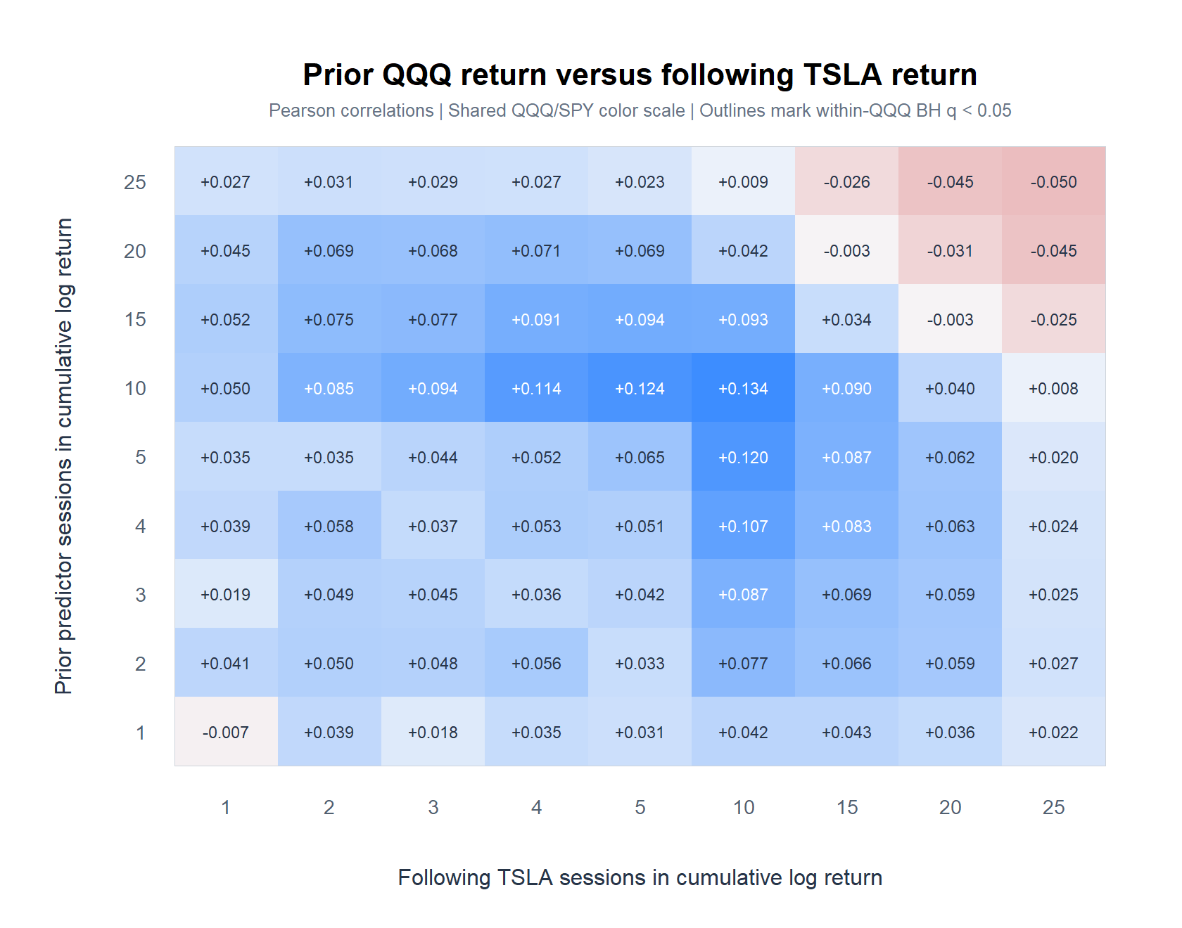
TSLA DESCRIPTIVE MICROSCOPE
Prior QQQ return reveals a medium-horizon island
72/81 cells positive; strongest +0.134 at 10 prior / 10 forward; family q = 0.361, so 0/81 passes.
Adjusted daily TSLA | 2018-2023
50
Notes:
[Sources]
Internal Gen5 packet: runs/research_workbench/operator_hypothesis_lab/tsla_qqq_spy_prior_return_horizon_grid_20260825/
Internal Gen5 note: operator_hypothesis_lab/docs/TSLA_QQQ_SPY_PRIOR_RETURN_HORIZON_GRID_2018_2023.md

Slide 51
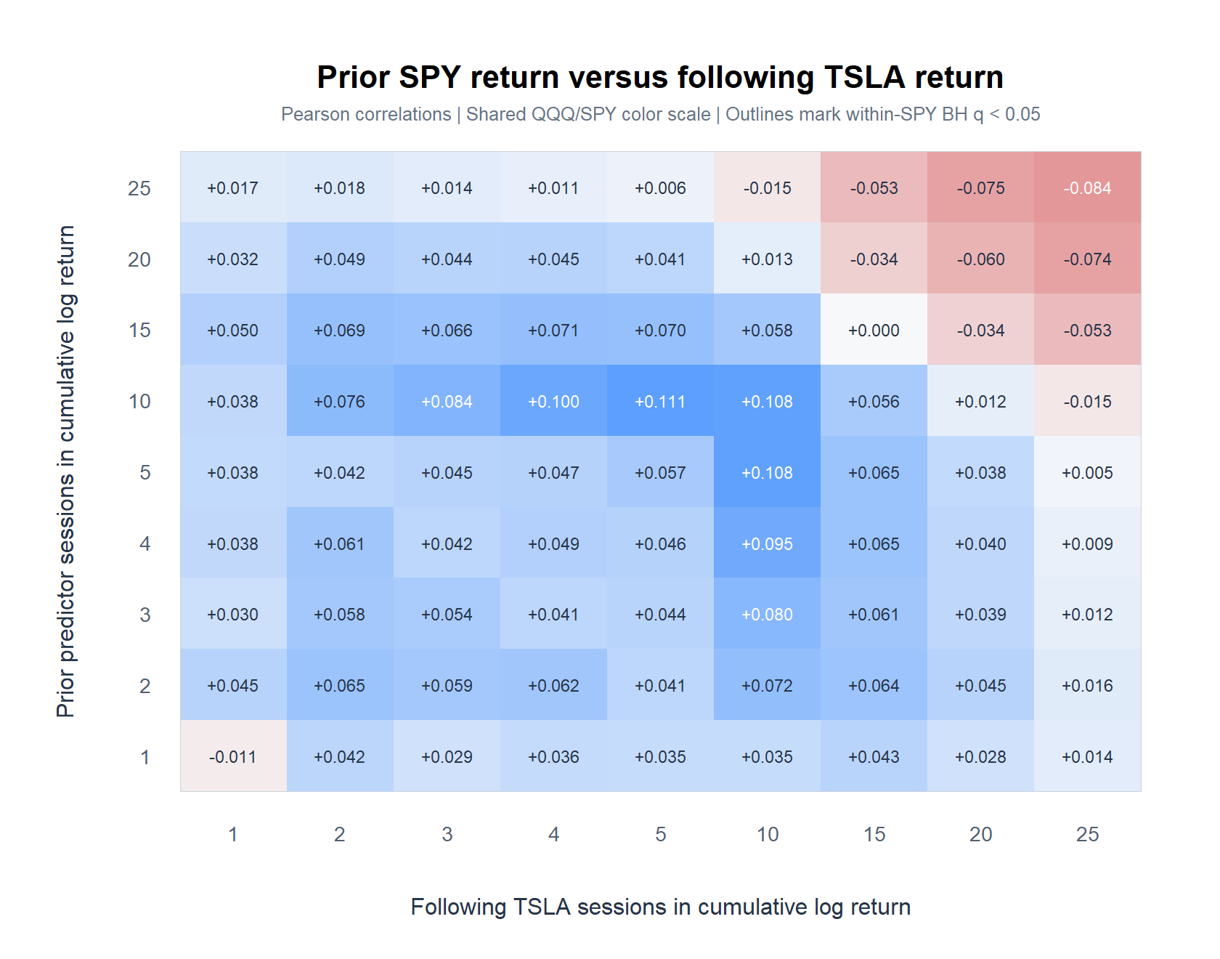
TSLA DESCRIPTIVE MICROSCOPE
Prior SPY return traces the same, weaker island
70/81 cells positive; strongest +0.111 at 10 prior / 5 forward; family q = 0.662, so 0/81 passes.
Adjusted daily TSLA | 2018-2023
51
Notes:
[Sources]
Internal Gen5 packet: runs/research_workbench/operator_hypothesis_lab/tsla_qqq_spy_prior_return_horizon_grid_20260825/
Internal Gen5 note: operator_hypothesis_lab/docs/TSLA_QQQ_SPY_PRIOR_RETURN_HORIZON_GRID_2018_2023.md

Slide 52
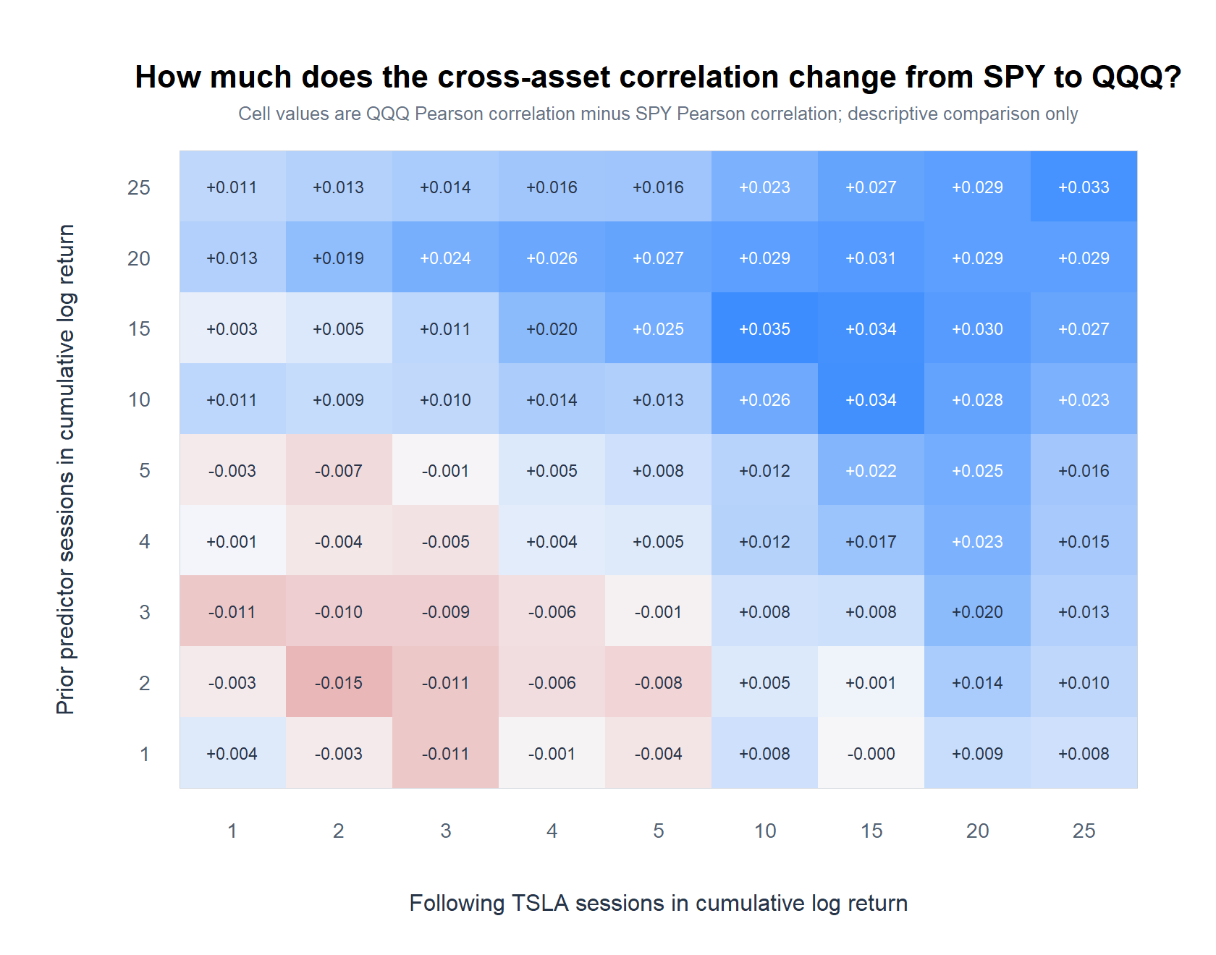
TSLA DESCRIPTIVE MICROSCOPE
QQQ and SPY maps differ only modestly
+0.035
largest QQQ-minus-SPY change: 15 prior / 10 forward
79 / 81
cells with the same correlation sign
r = 0.947
cellwise correlation between the two maps
Adjusted daily TSLA | 2018-2023
52
Notes:
[Sources]
Internal Gen5 packet: runs/research_workbench/operator_hypothesis_lab/tsla_qqq_spy_prior_return_horizon_grid_20260825/
Internal Gen5 note: operator_hypothesis_lab/docs/TSLA_QQQ_SPY_PRIOR_RETURN_HORIZON_GRID_2018_2023.md

Slide 53
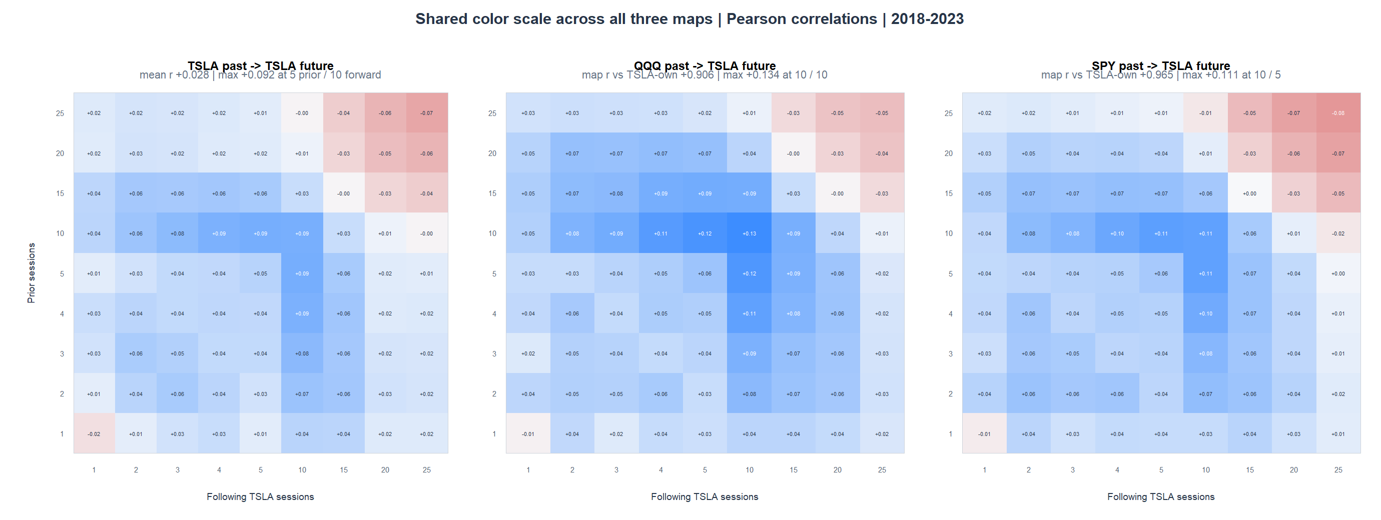
TSLA DESCRIPTIVE MICROSCOPE
QQQ and SPY largely reproduce TSLA's own horizon map
Map correlation vs TSLA-own: QQQ +0.906, SPY +0.965; no external BH survivor.
Adjusted daily TSLA | 2018-2023
53
Notes:
[Sources]
Internal Gen5 packet: runs/research_workbench/operator_hypothesis_lab/tsla_qqq_spy_prior_return_horizon_grid_20260825/
Internal Gen5 note: operator_hypothesis_lab/docs/TSLA_QQQ_SPY_PRIOR_RETURN_HORIZON_GRID_2018_2023.md
Internal Gen5 own-return baseline packet: runs/research_workbench/operator_hypothesis_lab/tsla_cumulative_return_horizon_grid_20260825/
[/Sources]

Slide 54
TSLA DESCRIPTIVE MICROSCOPE
External prior returns reveal shared geometry—not a lead
QQQ PRIOR MAP
Positive island peaks around 5–10 prior / 5–10 forward
72/81 positive; max r +0.134; 0/81 family passes
SPY PRIOR MAP
Nearly the same surface, with slightly weaker point estimates
70/81 positive; max r +0.111; 0/81 family passes
TSLA-OWN BASELINE
The same island already exists in TSLA's own prior-return map
QQQ/own map r +0.906; SPY/own r +0.965
What this earns
Shared trend geometry is a useful clue, but no distinct external lead or multiplicity survivor is established. Keep the strategy gate closed.
Adjusted daily TSLA | 2018-2023
54
Notes:
[Sources]
Internal Gen5 packet: runs/research_workbench/operator_hypothesis_lab/tsla_qqq_spy_prior_return_horizon_grid_20260825/
Internal Gen5 note: operator_hypothesis_lab/docs/TSLA_QQQ_SPY_PRIOR_RETURN_HORIZON_GRID_2018_2023.md
Internal Gen5 comparison packet: runs/research_workbench/operator_hypothesis_lab/tsla_return_horizon_grid_20260824/

Slide 55
SIGN ASYMMETRY
Does the aggregate map mix losses and gains?
Split the same signed prior return at zero—without changing its scale.
Same TSLA sample, horizons, timing, ER20, and ATR% states. No rule or post-2023 data.
55
Notes:
This section asks whether pooling negative and positive prior returns hides a branch-specific relationship with future TSLA return.
[Sources]
- scripts/inspect/run_tsla_prior_return_sign_asymmetry.R
- operator_hypothesis_lab/docs/TSLA_PRIOR_RETURN_SIGN_ASYMMETRY_2018_2023.md
[/Sources]

Slide 56
TSLA DESCRIPTIVE MICROSCOPE
Loss and gain branches share one signed return scale
X < 0 versus X > 0
Fixed asymmetry surface
Branches
Negative and positive
Negative values stay negative. A joint interaction model allows both the intercept and slope to differ across the two branches.
Prior windows
1, 2, 3, 4, 5, 10, 15, 20, 25
Target
Following TSLA cumulative log return
Timing
Known at anchor close t
6
Uncertainty
Overlap-aware Newey-West / HAC
fixed conditioning surfaces
Multiplicity
81 / 162 / 243 direct BH tests
Adjusted daily TSLA | 2018-2023
56
Notes:
The split is descriptive, not a trading signal. Keeping the signed scale preserves the distinction between a rebound slope and sign persistence.
[Sources]
- runs/research_workbench/operator_hypothesis_lab/tsla_prior_return_sign_asymmetry_20260825/run_spec.csv
- runs/research_workbench/operator_hypothesis_lab/tsla_prior_return_sign_asymmetry_20260825/family_checks.csv
- runs/research_workbench/operator_hypothesis_lab/tsla_prior_return_sign_asymmetry_20260825/report.md
[/Sources]

Slide 57
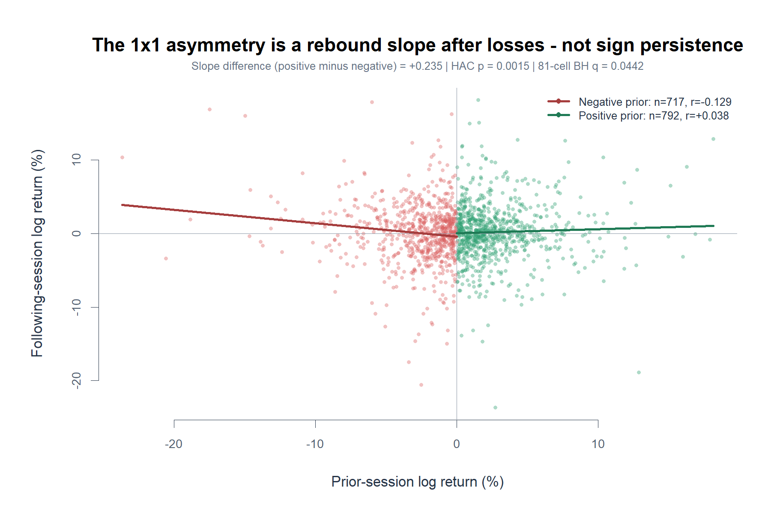
TSLA DESCRIPTIVE MICROSCOPE
The 1×1 survivor is rebound geometry after losses
Negative slope −0.182 vs positive +0.053; difference +0.235, 81-cell BH q=0.044. Up odds: 52.9% vs 52.1%.
Adjusted daily TSLA | 2018-2023
57
Notes:
The negative branch slopes downward: more severe prior losses are associated with stronger next-session rebound. This is not continuation and not a sign-based win-rate edge.
[Sources]
- runs/research_workbench/operator_hypothesis_lab/tsla_prior_return_sign_asymmetry_20260825/one_by_one_branch_summary.csv
- runs/research_workbench/operator_hypothesis_lab/tsla_prior_return_sign_asymmetry_20260825/one_by_one_asymmetry_test.csv
- runs/research_workbench/operator_hypothesis_lab/tsla_prior_return_sign_asymmetry_20260825/visuals/tsla_one_by_one_prior_sign_split_scatter.png
[/Sources]

Slide 58
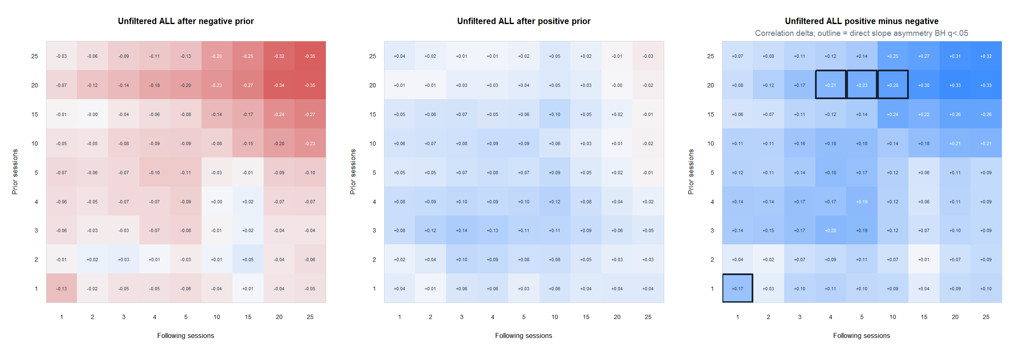
TSLA DESCRIPTIVE MICROSCOPE
Four unfiltered cells survive the BH asymmetry scan
1/1 and a 20-prior / 4–10-forward cluster survive; negative branches reverse while positive branches stay near zero.
Adjusted daily TSLA | 2018-2023
58
Notes:
Four of 81 direct slope-interaction tests pass BH. The 20-session cells are nested and should be read as one descriptive cluster, not three independent discoveries.
[Sources]
- runs/research_workbench/operator_hypothesis_lab/tsla_prior_return_sign_asymmetry_20260825/unfiltered_branch_statistics.csv
- runs/research_workbench/operator_hypothesis_lab/tsla_prior_return_sign_asymmetry_20260825/unfiltered_asymmetry_tests.csv
- runs/research_workbench/operator_hypothesis_lab/tsla_prior_return_sign_asymmetry_20260825/visuals/tsla_unfiltered_prior_sign_heatmaps.png
[/Sources]

Slide 59
TSLA DESCRIPTIVE MICROSCOPE
Positive minus negative detects a kink—not a spread
b+ − b−
How to read the blue cells
Negative branch
b− < 0: deeper loss → stronger rebound
Compare two conditional slopes. Like an asymmetric spring, deeper losses can create rebound pressure while larger gains add little information.
Positive branch
b+ ≈ 0: gain size → little information
Difference
b+ − b− > 0: sign changes the mapping
Not a trade
No realized returns are being subtracted
1
Candidate use
Score loss severity only inside X < 0
hinge at prior return = 0
Guardrail
Slope asymmetry ≠ positive expectancy
Adjusted daily TSLA | 2018-2023
59
Notes:
Positive-minus-negative does not subtract two realized returns. It compares the positive-branch slope with the negative-branch slope. In the current survivors, b− < 0 and b+ is near zero, so loss severity contains information only after losses. A future long-only implementation would score loss severity inside X < 0 and act only if the full conditional forecast clears drift, costs, and a safety margin. The intercept matters: slope asymmetry alone does not imply positive expectancy.
[Sources]
- scripts/inspect/run_tsla_prior_return_sign_asymmetry.R
- runs/research_workbench/operator_hypothesis_lab/tsla_prior_return_sign_asymmetry_20260825/unfiltered_branch_statistics.csv
- runs/research_workbench/operator_hypothesis_lab/tsla_prior_return_sign_asymmetry_20260825/unfiltered_asymmetry_tests.csv
- operator_hypothesis_lab/docs/TSLA_PRIOR_RETURN_SIGN_ASYMMETRY_2018_2023.md
- Current Codex task, operator/assistant exchange dated 2026-08-26: ‘Positive minus negative as a kink detector.’
[/Sources]

Slide 60
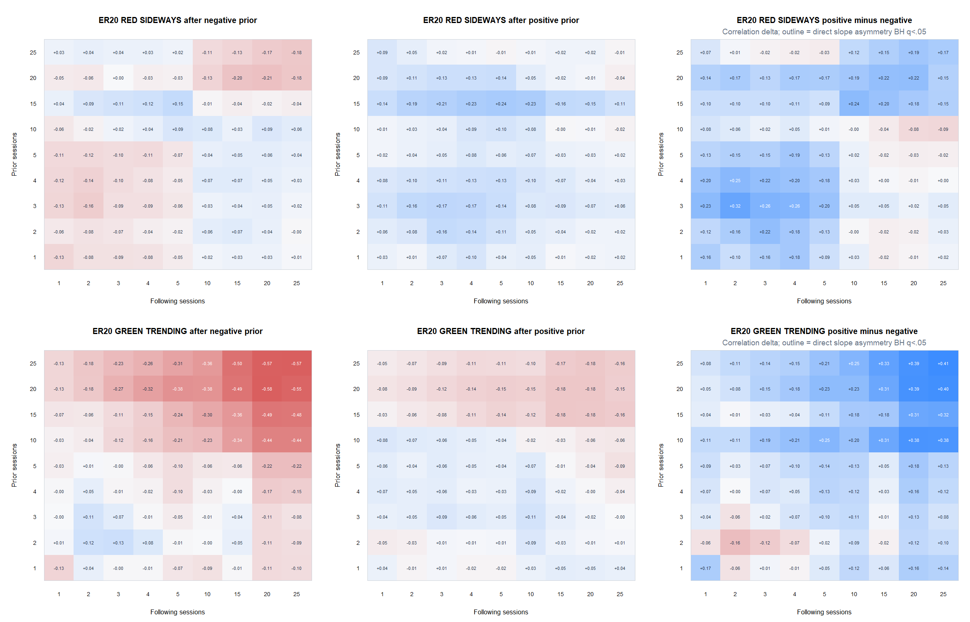
TSLA DESCRIPTIVE MICROSCOPE
ER20 reorganizes the branches, but no asymmetry survives
0/162 direct slope interactions pass BH; ER20 and prior return share trailing TSLA path data.
Adjusted daily TSLA | 2018-2023
60
Notes:
The ER20 split produces different-looking surfaces but no multiplicity survivor. ER20 is also not independent of the predictor because both use trailing TSLA prices.
[Sources]
- runs/research_workbench/operator_hypothesis_lab/tsla_prior_return_sign_asymmetry_20260825/er20_branch_statistics.csv
- runs/research_workbench/operator_hypothesis_lab/tsla_prior_return_sign_asymmetry_20260825/er20_asymmetry_tests.csv
- runs/research_workbench/operator_hypothesis_lab/tsla_prior_return_sign_asymmetry_20260825/visuals/tsla_er20_prior_sign_heatmaps.png
[/Sources]

Slide 61
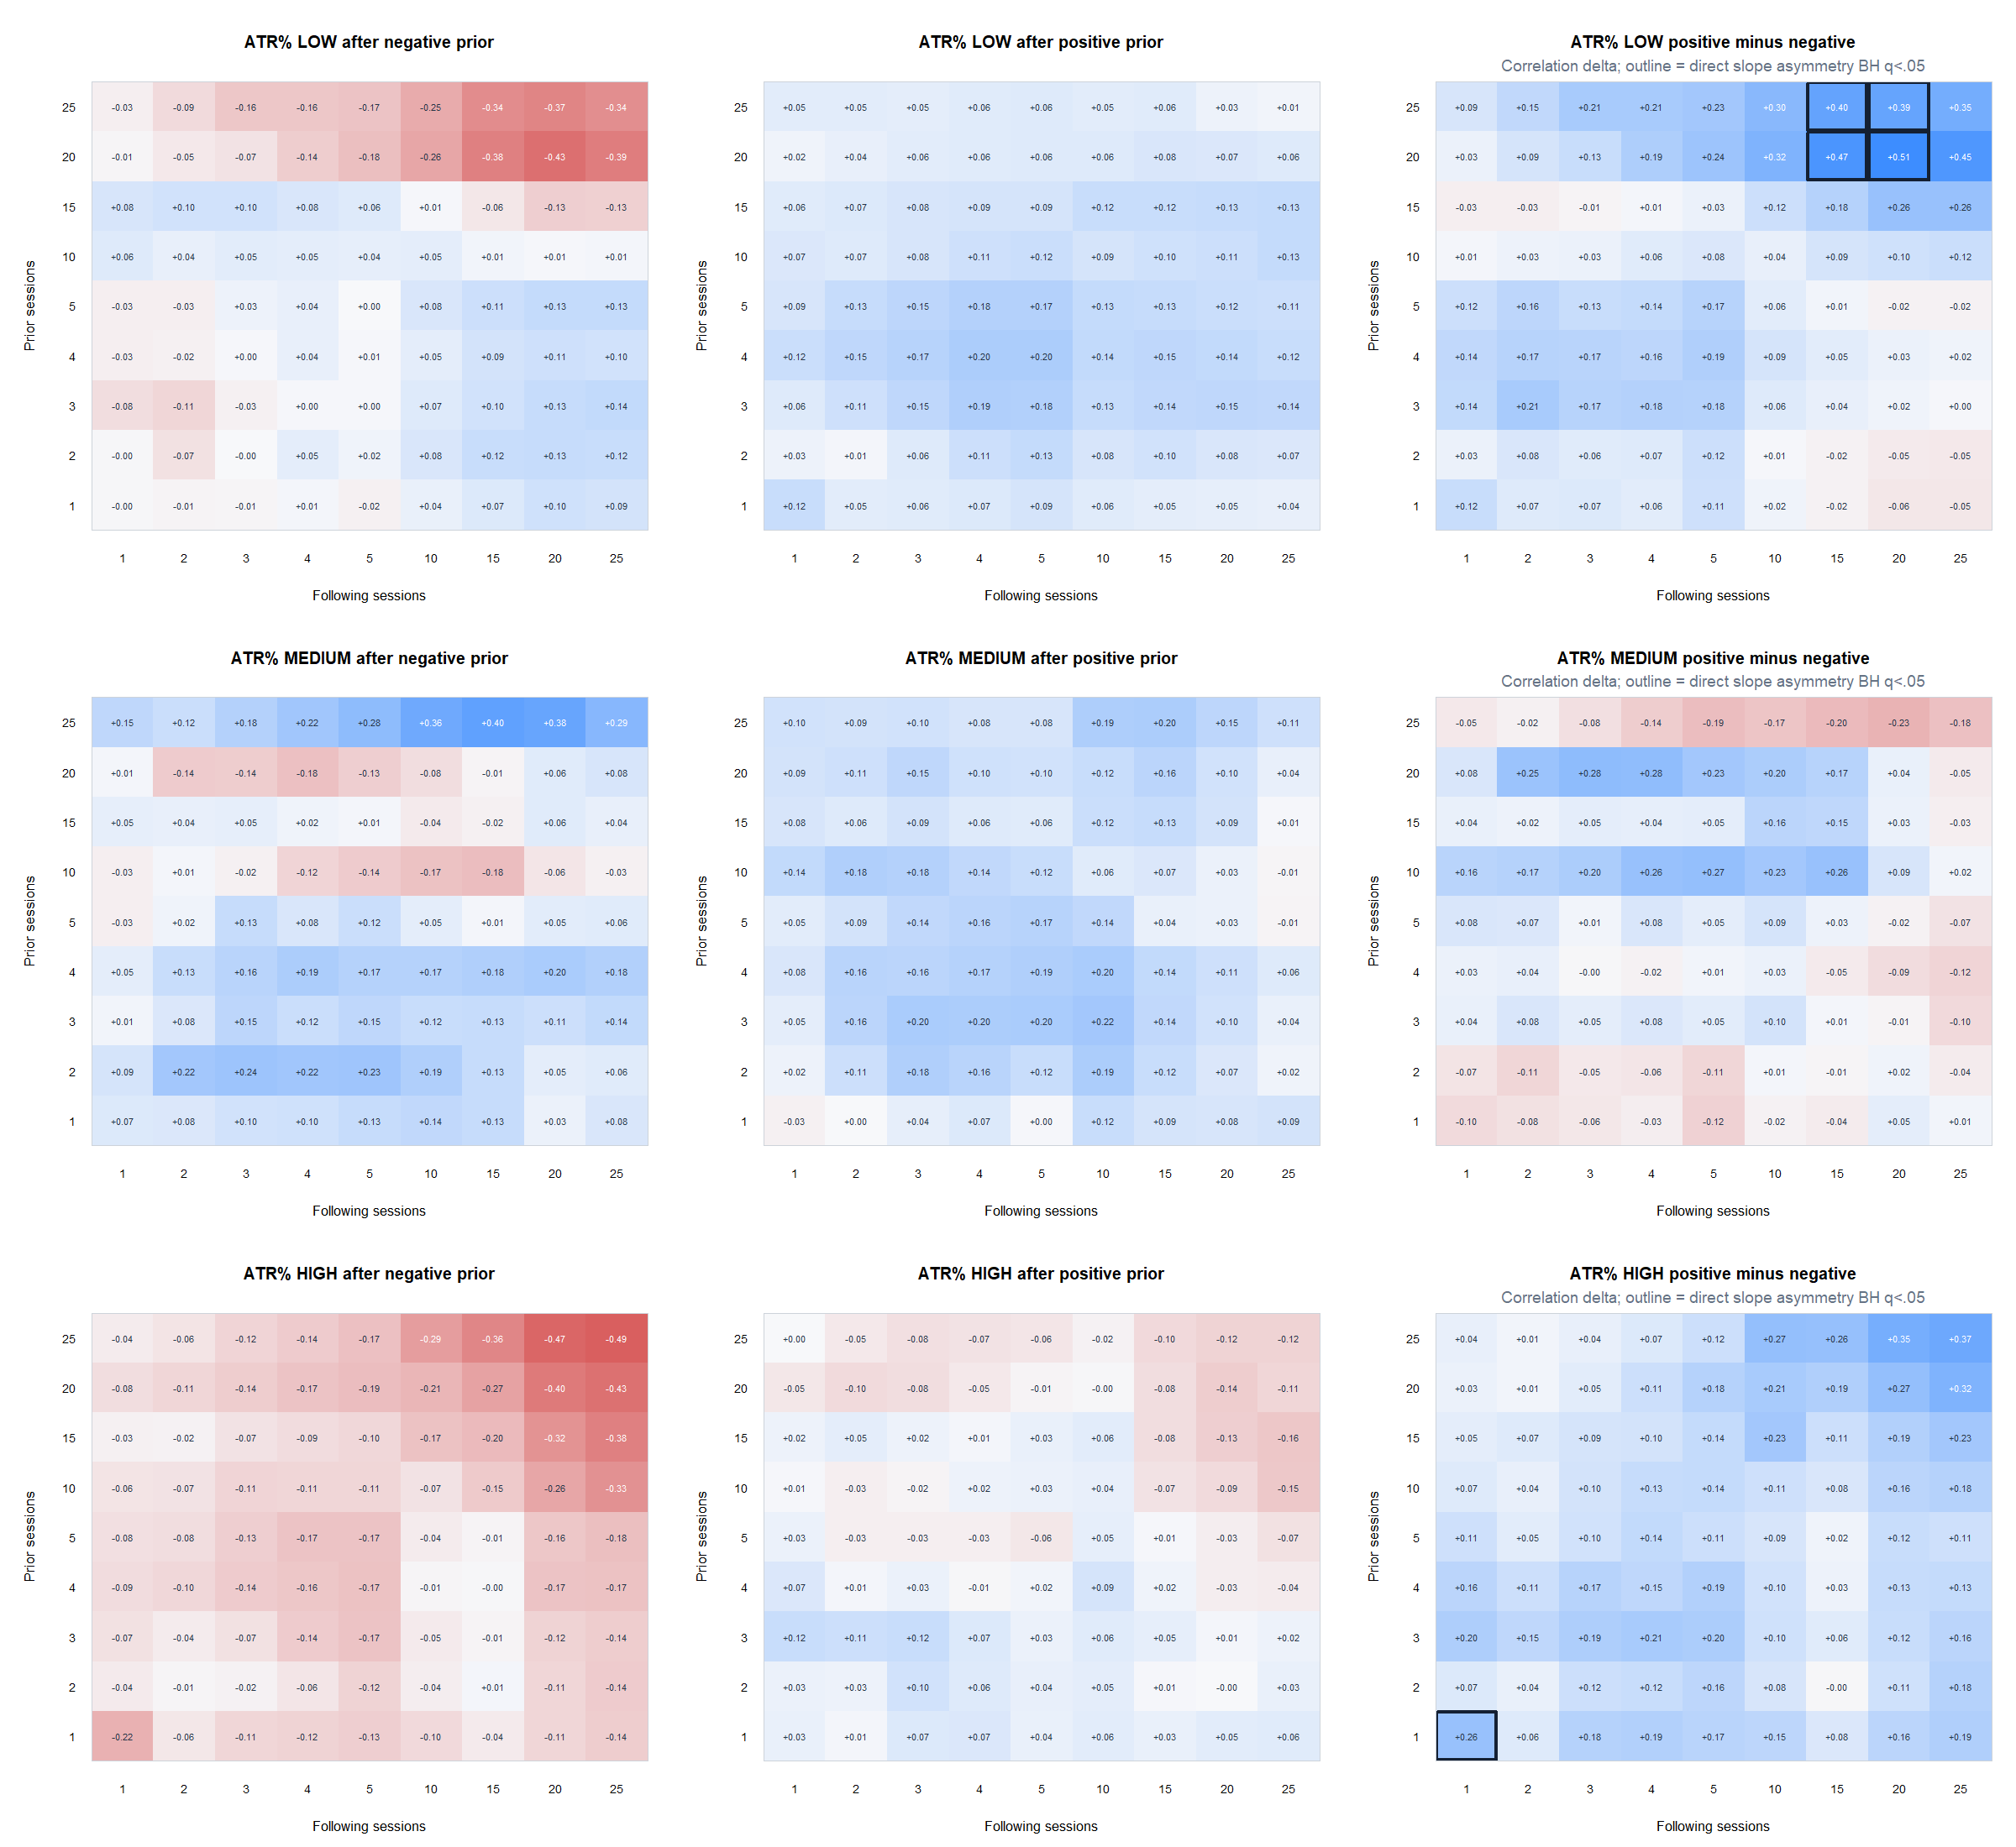
TSLA DESCRIPTIVE MICROSCOPE
ATR% isolates two clusters—but not a rule
HIGH 1/1 plus LOW 20–25 prior / 15–20 forward: 5/243 pass BH. LOW loss branches have only 165–167 observations.
Adjusted daily TSLA | 2018-2023
61
Notes:
ATR percent identifies a high-volatility adjacent-session survivor and a low-volatility long-horizon cluster. The long-horizon negative branches are relatively small and need outlier and temporal-stability checks.
[Sources]
- runs/research_workbench/operator_hypothesis_lab/tsla_prior_return_sign_asymmetry_20260825/atrp_branch_statistics.csv
- runs/research_workbench/operator_hypothesis_lab/tsla_prior_return_sign_asymmetry_20260825/atrp_asymmetry_tests.csv
- runs/research_workbench/operator_hypothesis_lab/tsla_prior_return_sign_asymmetry_20260825/visuals/tsla_atrp_prior_sign_heatmaps.png
[/Sources]

Slide 62
TSLA DESCRIPTIVE MICROSCOPE
The split reveals rebound geometry—not momentum
ADJACENT
Rebound slope after losses—not sign persistence
q=0.044; up odds 52.9% after loss vs 52.1% after gain
UNFILTERED 9×9
Coherent 20-prior / 4–10-forward rebound cluster
4/81 BH passes; nested horizons share data
REGIME SPLITS
ER20 none; ATR% HIGH 1×1 plus LOW long-horizon cluster
0/162 ER20; 5/243 ATR%
What this earns
A novel in-sample asymmetry worth frozen sensitivity—not a trading rule. Keep the strategy gate closed.
Adjusted daily TSLA | 2018-2023
62
Notes:
The result earns a narrow confirmation step, not strategy construction. Freeze the surviving cells and inspect outlier dependence and temporal stability before reading economic meaning into them.
[Sources]
- runs/research_workbench/operator_hypothesis_lab/tsla_prior_return_sign_asymmetry_20260825/report.md
- operator_hypothesis_lab/docs/TSLA_PRIOR_RETURN_SIGN_ASYMMETRY_2018_2023.md
[/Sources]

Slide 63
TREND DIRECTION
Can path efficiency also reveal direction?
Retain the sign of the same 20-session efficiency score.
Same TSLA sample, window, cutoff, and causal timing. No return-grid conditioning yet.
63
Notes:
This section completes the earlier direction-agnostic ER20 lens by retaining the sign of its net displacement. It measures state behavior only.
[Sources]
- operator_hypothesis_lab/docs/TSLA_SIGNED_ER20_TREND_DIRECTION_2018_2023.md
- runs/research_workbench/operator_hypothesis_lab/tsla_signed_er20_trend_direction_20260826/run_spec.csv
[/Sources]

Slide 64
TSLA DESCRIPTIVE MICROSCOPE
Signed ER20 turns one path score into three states
net move / total path
Fixed direction surface
Window
20 sessions
The numerator keeps direction; the denominator penalizes churn. Taking the absolute value reproduces ER20 exactly.
Up state
signed ER20 ≥ +0.30
Sideways
between −0.30 and +0.30
Down state
signed ER20 ≤ −0.30
3
Timing
Known at close t
up / sideways / down states
Search
None
Adjusted daily TSLA | 2018-2023
64
Notes:
Signed ER20 is bounded from minus one to plus one. Sign supplies direction and magnitude supplies path efficiency. It is not independent of ER20 because its absolute value is ER20.
[Sources]
- operator_hypothesis_lab/R/tsla_signed_er20_direction.R
- runs/research_workbench/operator_hypothesis_lab/tsla_signed_er20_trend_direction_20260826/run_spec.csv
- operator_hypothesis_lab/docs/TSLA_SIGNED_ER20_TREND_DIRECTION_2018_2023.md
[/Sources]

Slide 65
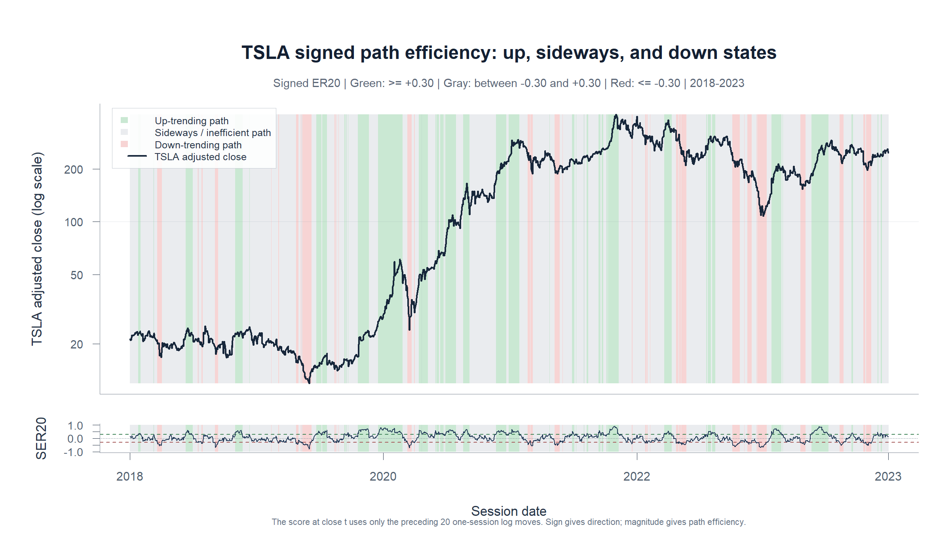
TSLA DESCRIPTIVE MICROSCOPE
Signed ER20 separates direction without a crossover
How
Net 20-session log displacement divided by the total path traveled; sign is retained.
Read
Green marks efficient rises, red efficient declines, and gray an inefficient path. Down states are visibly shorter on TSLA.
Descriptive state—not a future-return claim
Adjusted daily TSLA | 2018-2023
65
Notes:
The neutral band absorbs every observed direction reversal, so no session jumps directly from up trend to down trend or vice versa. The chart also shows that down states are less prevalent and shorter than up states on this TSLA sample.
[Sources]
- runs/research_workbench/operator_hypothesis_lab/tsla_signed_er20_trend_direction_20260826/visuals/tsla_signed_er20_direction_bands.png
- runs/research_workbench/operator_hypothesis_lab/tsla_signed_er20_trend_direction_20260826/state_occupancy.csv
- runs/research_workbench/operator_hypothesis_lab/tsla_signed_er20_trend_direction_20260826/state_duration_summary.csv
- operator_hypothesis_lab/docs/TSLA_SIGNED_ER20_TREND_DIRECTION_2018_2023.md
[/Sources]

Slide 66
TSLA DESCRIPTIVE MICROSCOPE
Direction is readable—but still flickery
STATE MAP
Green up, gray sideways, red down
1,509 causal daily labels
CHURN CONTROL
Every direction reversal crosses the neutral band
0 direct up/down flips; 10.3% daily transition rate
LIMIT
Down states are brief and boundaries still flicker
12.1% occupancy; median span 2 sessions
What this earns
Freeze as the template's direction baseline—not a predictor. Parameter search waits until after the multi-asset atlas.
Adjusted daily TSLA | 2018-2023
66
Notes:
The fixed state is adequate as a reusable descriptive baseline, but its brief down spans and one-session boundary states remain visible limitations. The next methodological step is to apply this unchanged state to the existing return surfaces; parameter and time-window selection remain deferred.
[Sources]
- runs/research_workbench/operator_hypothesis_lab/tsla_signed_er20_trend_direction_20260826/state_occupancy.csv
- runs/research_workbench/operator_hypothesis_lab/tsla_signed_er20_trend_direction_20260826/state_duration_summary.csv
- runs/research_workbench/operator_hypothesis_lab/tsla_signed_er20_trend_direction_20260826/state_quality_summary.csv
- operator_hypothesis_lab/docs/TSLA_SIGNED_ER20_TREND_DIRECTION_2018_2023.md
- operator_hypothesis_lab/docs/OWN_ASSET_RETURN_GEOMETRY_WORKFLOW_ROADMAP.md
[/Sources]

Slide 67
RETURN GEOMETRY
What changes when direction meets the return grid?
Apply the frozen three-state label to the existing 9 × 9 surface.
Same data, horizons, uncertainty, and sign branches. No tuning or later-period data.
67
Notes:
This section applies the already-demonstrated signed ER20 state without changing its window or cutoff. It preserves the return grid and prior-sign split from the preceding sections.
[Sources]
- operator_hypothesis_lab/docs/TSLA_SIGNED_ER20_CONDITIONED_RETURN_GEOMETRY_2018_2023.md
- runs/research_workbench/operator_hypothesis_lab/tsla_signed_er20_conditioned_grid_20260826/run_spec.csv
[/Sources]

Slide 68
TSLA DESCRIPTIVE MICROSCOPE
Direction partly determines prior-return sign
p=20 shares the numerator
Fixed conditioning surface
States
UP / SIDEWAYS / DOWN
At p=20, prior return and signed ER20 use the same displacement. Opposite-sign trend branches cannot exist.
Grid
9 prior × 9 following
Branch floor
n ≥ 30 per sign
Structural NE
UP-negative; DOWN-positive at p=20
171
Uncertainty
Overlap-aware HAC
estimable sign-branch contrasts
Multiplicity
Family + global BH
Adjusted daily TSLA | 2018-2023
68
Notes:
NE means not estimable, not no effect. At prior horizon 20 the signed state and the prior-return sign share the exact numerator. Opposite-sign branch counts also fall below 30 at nearby horizons.
[Sources]
- runs/research_workbench/operator_hypothesis_lab/tsla_signed_er20_conditioned_grid_20260826/run_spec.csv
- runs/research_workbench/operator_hypothesis_lab/tsla_signed_er20_conditioned_grid_20260826/sign_asymmetry_estimability_summary.csv
- runs/research_workbench/operator_hypothesis_lab/tsla_signed_er20_conditioned_grid_20260826/visuals/tsla_signed_er20_prior_sign_minimum_n_heatmaps.png
- operator_hypothesis_lab/docs/TSLA_SIGNED_ER20_CONDITIONED_RETURN_GEOMETRY_2018_2023.md
[/Sources]

Slide 69
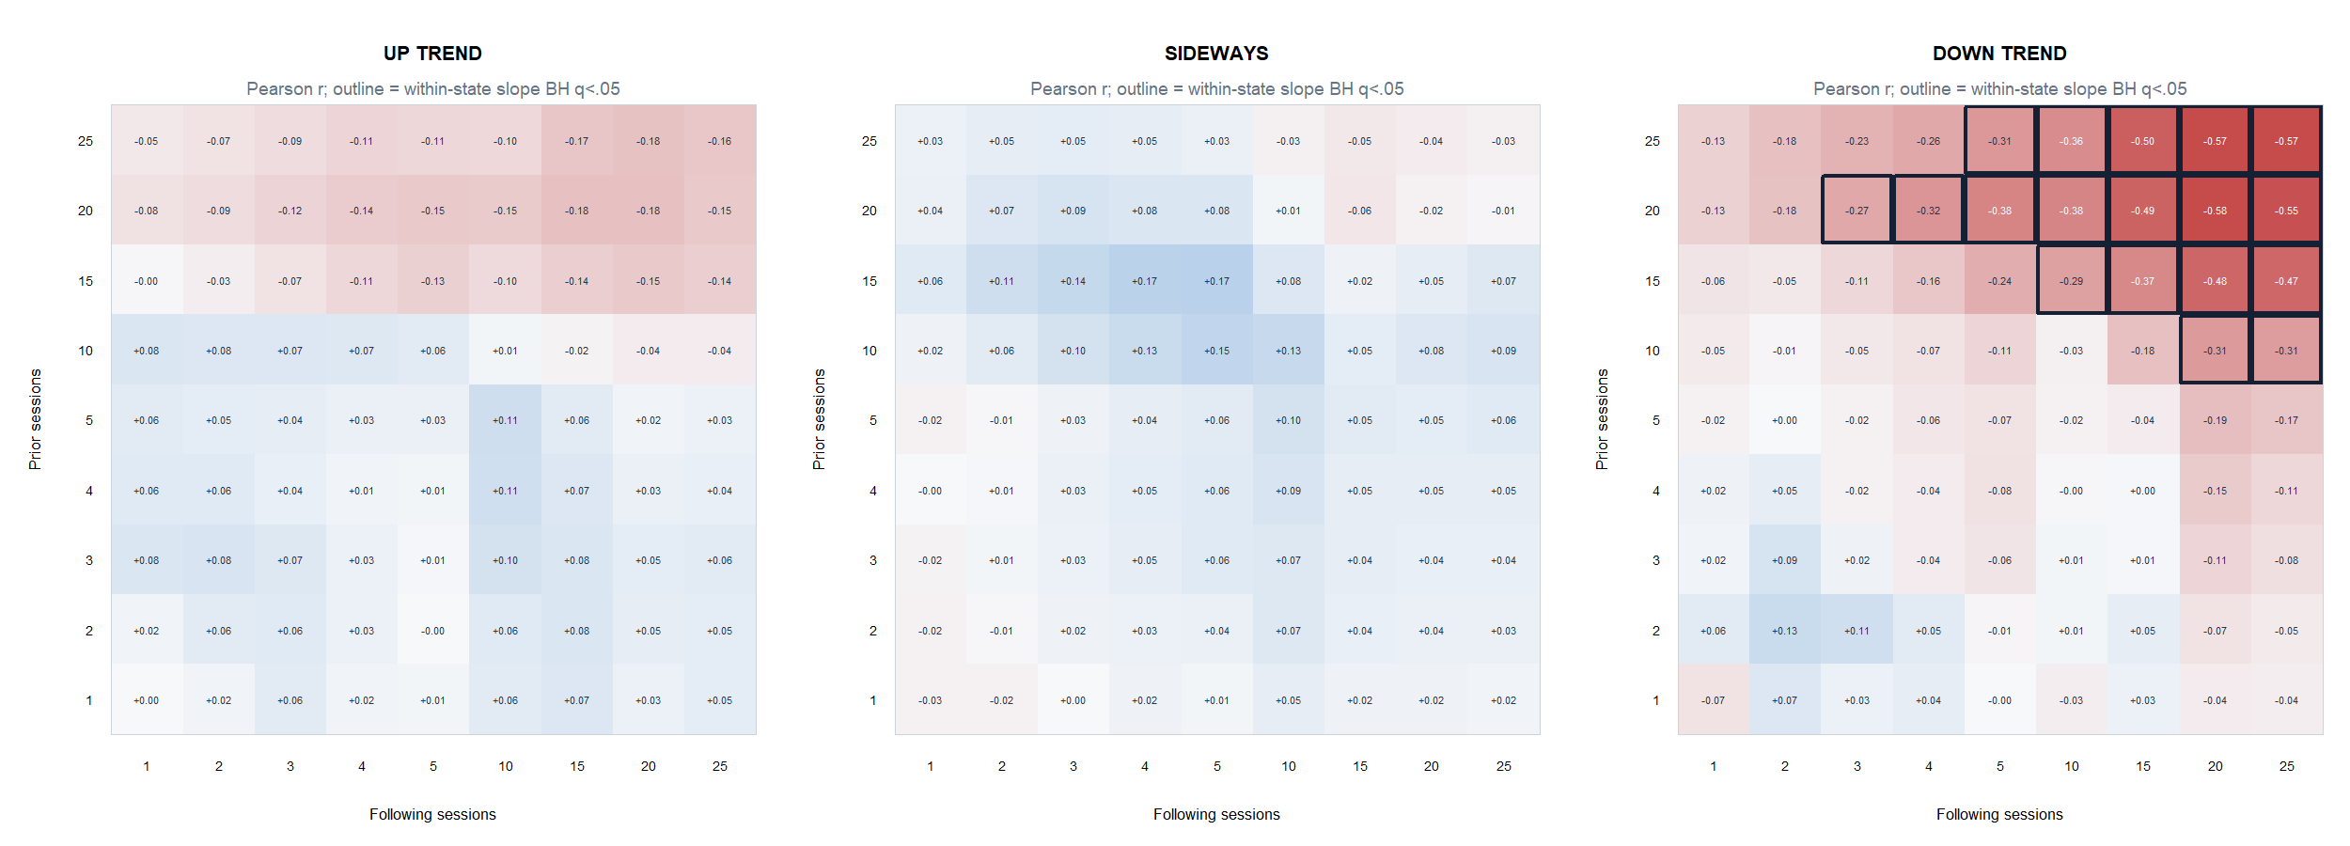
TSLA DESCRIPTIVE MICROSCOPE
DOWN states reveal a broad rebound island
DOWN: 18/81 within-state BH passes; UP and SIDEWAYS: 0/81. Strongest p20→f20 r = −0.576.
Adjusted daily TSLA | 2018-2023
69
Notes:
The negative DOWN-state correlations mean deeper completed declines align with stronger subsequent rebounds. At p20/f20 the mean following return is positive 5.61% and the following return is positive 61.2% of the time; this is not downside continuation.
[Sources]
- runs/research_workbench/operator_hypothesis_lab/tsla_signed_er20_conditioned_grid_20260826/visuals/tsla_signed_er20_state_pearson_heatmaps.png
- runs/research_workbench/operator_hypothesis_lab/tsla_signed_er20_conditioned_grid_20260826/state_grid_statistics.csv
- runs/research_workbench/operator_hypothesis_lab/tsla_signed_er20_conditioned_grid_20260826/state_family_bh_pass_summary.csv
[/Sources]

Slide 70
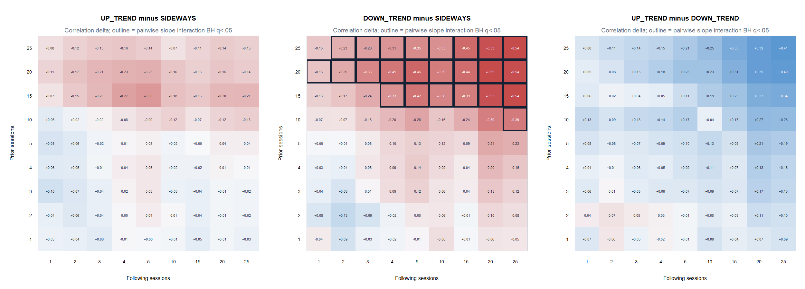
TSLA DESCRIPTIVE MICROSCOPE
DOWN differs sharply from SIDEWAYS
DOWN−SIDEWAYS: 24/81 pairwise BH passes; strongest correlation delta −0.551 at p20→f20.
Adjusted daily TSLA | 2018-2023
70
Notes:
Only DOWN-minus-SIDEWAYS has family-level survivors. The pairwise interaction model compares OLS slopes with overlap-aware HAC; the visible values are descriptive correlation deltas.
[Sources]
- runs/research_workbench/operator_hypothesis_lab/tsla_signed_er20_conditioned_grid_20260826/visuals/tsla_signed_er20_state_difference_heatmaps.png
- runs/research_workbench/operator_hypothesis_lab/tsla_signed_er20_conditioned_grid_20260826/state_pair_comparison_statistics.csv
- runs/research_workbench/operator_hypothesis_lab/tsla_signed_er20_conditioned_grid_20260826/state_comparison_family_bh_pass_summary.csv
[/Sources]

Slide 71
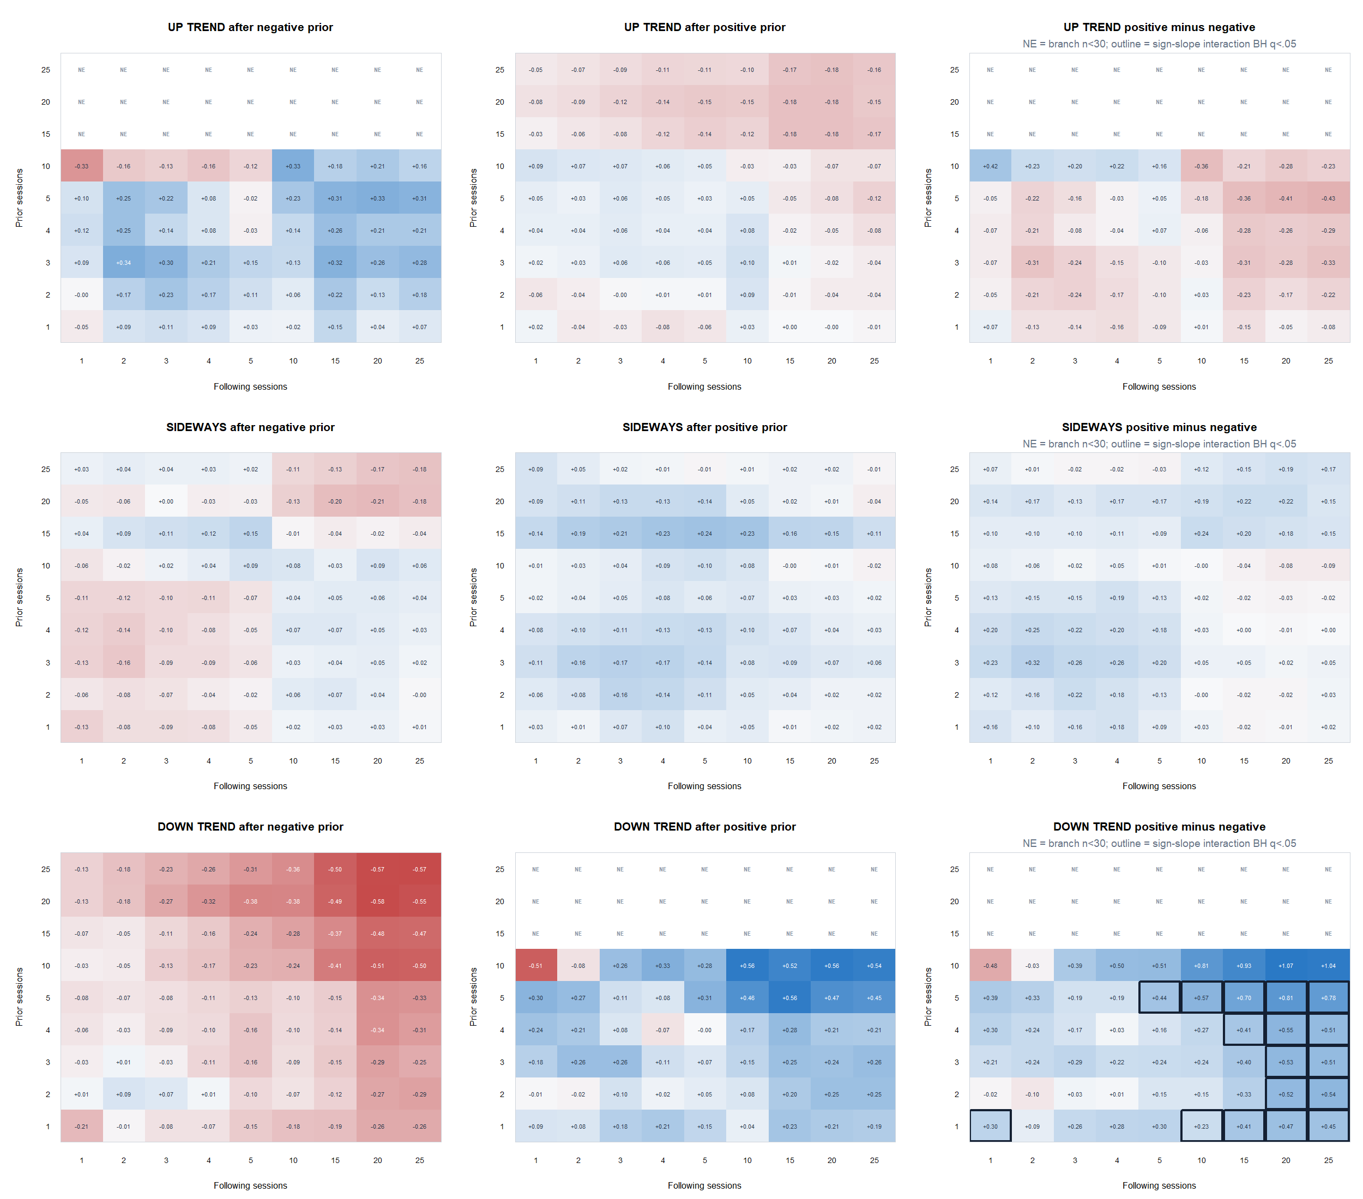
TSLA DESCRIPTIVE MICROSCOPE
Short-prior asymmetry concentrates in DOWN states
17 DOWN interactions pass BH at prior 1–5; p5→f20 correlation delta +0.812. NE marks branch n<30.
Adjusted daily TSLA | 2018-2023
71
Notes:
At DOWN p5/f20, negative-prior Pearson is -0.341 and positive-prior Pearson is +0.471. Both branches have positive mean following returns; the interaction is a slope difference, not a realized-return spread.
[Sources]
- runs/research_workbench/operator_hypothesis_lab/tsla_signed_er20_conditioned_grid_20260826/visuals/tsla_signed_er20_prior_sign_heatmaps.png
- runs/research_workbench/operator_hypothesis_lab/tsla_signed_er20_conditioned_grid_20260826/state_prior_sign_asymmetry_statistics.csv
- runs/research_workbench/operator_hypothesis_lab/tsla_signed_er20_conditioned_grid_20260826/sign_asymmetry_estimability_summary.csv
[/Sources]

Slide 72
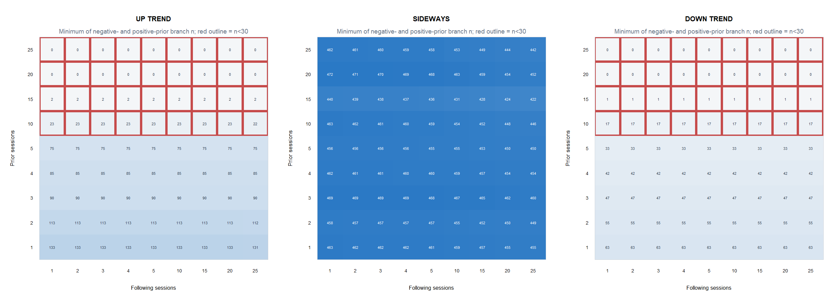
TSLA DESCRIPTIVE MICROSCOPE
The filter makes some sign branches unobservable
At p20, UP has no negative-prior observations and DOWN no positive-prior observations; nearby horizons are sparse.
Adjusted daily TSLA | 2018-2023
72
Notes:
This slide is the main selection-geometry safeguard. Red outlines mean fewer than 30 observations in the smaller sign branch. These cells are excluded from direct sign-interaction estimation and BH correction.
[Sources]
- runs/research_workbench/operator_hypothesis_lab/tsla_signed_er20_conditioned_grid_20260826/visuals/tsla_signed_er20_prior_sign_minimum_n_heatmaps.png
- runs/research_workbench/operator_hypothesis_lab/tsla_signed_er20_conditioned_grid_20260826/state_prior_sign_asymmetry_statistics.csv
- runs/research_workbench/operator_hypothesis_lab/tsla_signed_er20_conditioned_grid_20260826/grid_checks.csv
[/Sources]

Slide 73
TSLA DESCRIPTIVE MICROSCOPE
Direction exposes rebound—not trend continuation
AGGREGATE
DOWN long-prior rebound island
18/81 BH; p20→f20 r −0.576
BRANCH KINK
DOWN short-prior slope split
17 BH; p5→f20 delta r +0.812
DEPENDENCE
Filter and predictor share the path
p20 opposite-sign branches are structurally empty
What this earns
Freeze the DOWN-rebound shape for cross-asset transport—no tuning and no trading rule.
Adjusted daily TSLA | 2018-2023
73
Notes:
This is a successful descriptive filter application. The unexpected result is rebound geometry inside trending-down paths, not continuation inside trending-up paths. The next gate is a frozen workflow template and predeclared asset transport, not parameter tuning.
[Sources]
- operator_hypothesis_lab/docs/TSLA_SIGNED_ER20_CONDITIONED_RETURN_GEOMETRY_2018_2023.md
- runs/research_workbench/operator_hypothesis_lab/tsla_signed_er20_conditioned_grid_20260826/global_bh_pass_summary.csv
- runs/research_workbench/operator_hypothesis_lab/tsla_signed_er20_conditioned_grid_20260826/grid_checks.csv
- operator_hypothesis_lab/docs/OWN_ASSET_RETURN_GEOMETRY_WORKFLOW_ROADMAP.md
[/Sources]

Slide 74
CROSS-ASSET TRANSPORT
Does the TSLA rebound shape survive transport?
Run the same signed-ER20 microscope across a predeclared 30-asset atlas.
Atlas first. Finer horizons wait until cross-asset morphology gives us a reason to zoom.
74
Notes:
This section answers the sequencing question by transporting the frozen TSLA microscope before adding 6–9-session horizons. The aim is morphology, not a strategy or performance claim.
[Sources]
- operator_hypothesis_lab/docs/OWN_ASSET_RETURN_GEOMETRY_ATLAS_2018_2023.md
- runs/research_workbench/operator_hypothesis_lab/own_asset_return_geometry_atlas_20260826/run_spec.csv
[/Sources]

Slide 75
OWN-ASSET RETURN ATLAS
Atlas first—transport the frozen microscope unchanged
30 assets / 6 behavior groups
Frozen transport contract
Sample
Adjusted daily, 2018–2023
The basket spans high-beta names, mature growth, cyclicals, defensives, equity ETFs, and non-equity proxies.
Horizons
1,2,3,4,5,10,15,20,25
Conditioning
signed ER20 + ER20 + ATR%
Frozen cells
7 TSLA-discovered comparisons
29
Inference
HAC + fixed-family BH
non-TSLA transport assets
No refinement
6–9 sessions not searched
30 assets | adjusted daily | 2018–2023
75
Notes:
The atlas and inferential cells were fixed before examining cross-asset outcomes. Complete grids are descriptive; formal inference is limited to seven TSLA-discovered comparisons.
[Sources]
- operator_hypothesis_lab/registries/own_asset_return_geometry_atlas.csv
- runs/research_workbench/operator_hypothesis_lab/own_asset_return_geometry_atlas_20260826/run_spec.csv
- runs/research_workbench/operator_hypothesis_lab/own_asset_return_geometry_atlas_20260826/atlas_checks.csv
[/Sources]

Slide 76
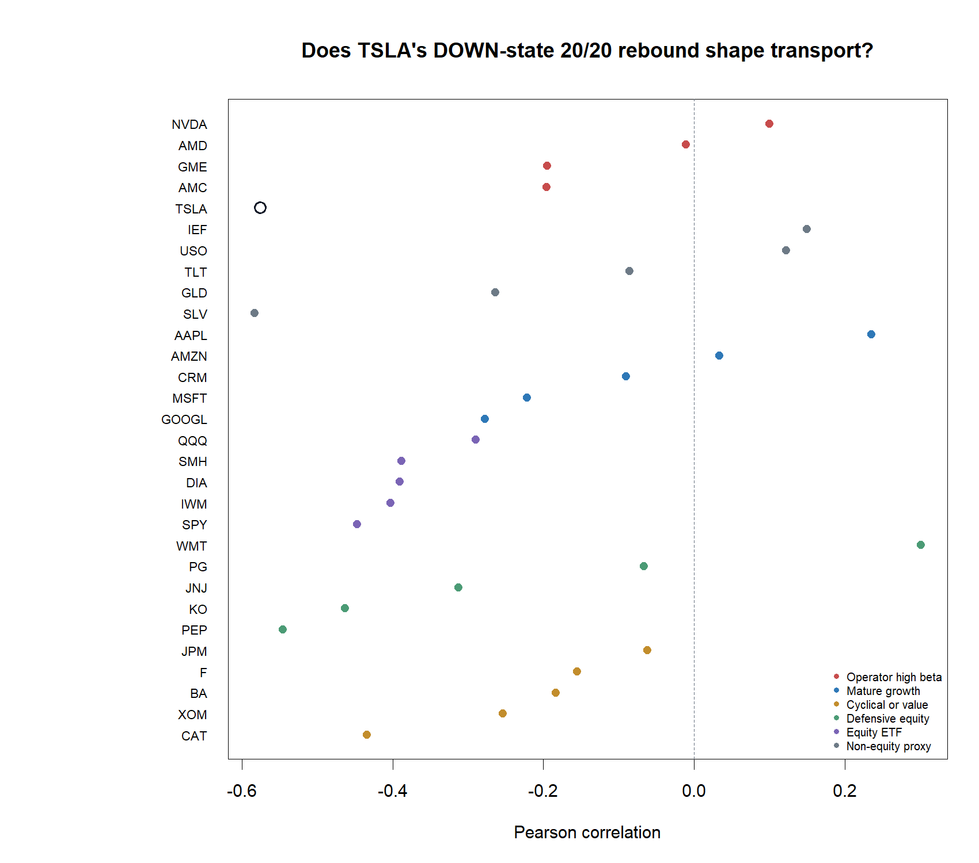
OWN-ASSET RETURN ATLAS
The frozen DOWN p20→f20 cell transports broadly
23/29 transport assets are negative; median Pearson r = −0.196. Twelve survive fixed-family BH.
30 assets | adjusted daily | 2018–2023
76
Notes:
The direction of the TSLA finding repeats in 23 of 29 transport assets. This is breadth evidence for the morphology, not a trading rule.
[Sources]
- runs/research_workbench/operator_hypothesis_lab/own_asset_return_geometry_atlas_20260826/visuals/signed_er20_down_p20_f20_asset_effects.png
- runs/research_workbench/operator_hypothesis_lab/own_asset_return_geometry_atlas_20260826/frozen_replication_summary.csv
- runs/research_workbench/operator_hypothesis_lab/own_asset_return_geometry_atlas_20260826/frozen_replication_inference.csv
[/Sources]

Slide 77
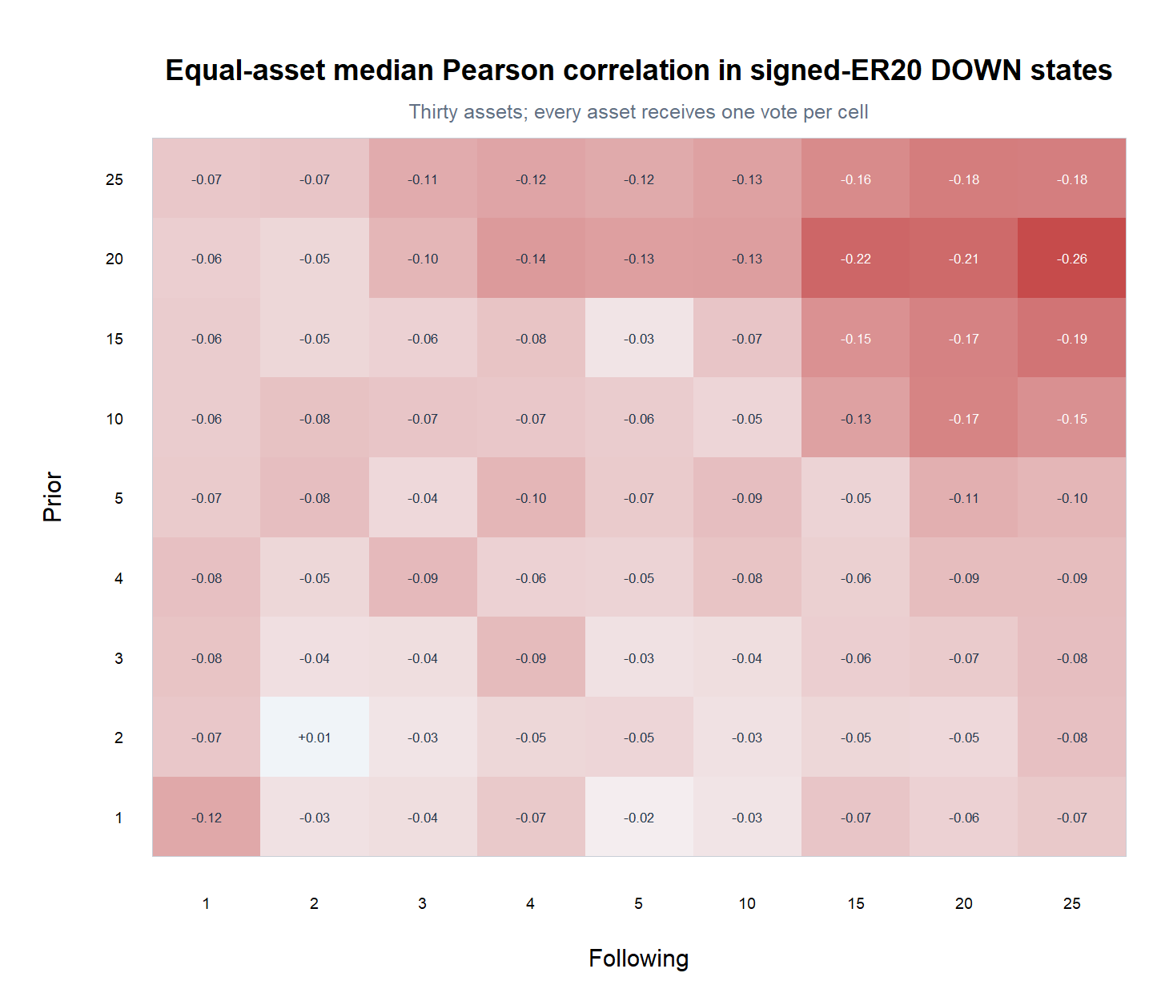
OWN-ASSET RETURN ATLAS
Rebound spans the 15–25-session neighborhood
Every equal-asset median in the 15/20/25 × 15/20/25 corner is negative; 70%–83% of assets agree per cell.
30 assets | adjusted daily | 2018–2023
77
Notes:
The cross-asset median surface shows a broad long-prior, long-following negative island. That argues against a cell-specific accident and points to the 15–25-session neighborhood if later refinement is authorized.
[Sources]
- runs/research_workbench/operator_hypothesis_lab/own_asset_return_geometry_atlas_20260826/visuals/signed_er20_down_equal_asset_median_heatmap.png
- runs/research_workbench/operator_hypothesis_lab/own_asset_return_geometry_atlas_20260826/equal_asset_cell_summary.csv
[/Sources]

Slide 78
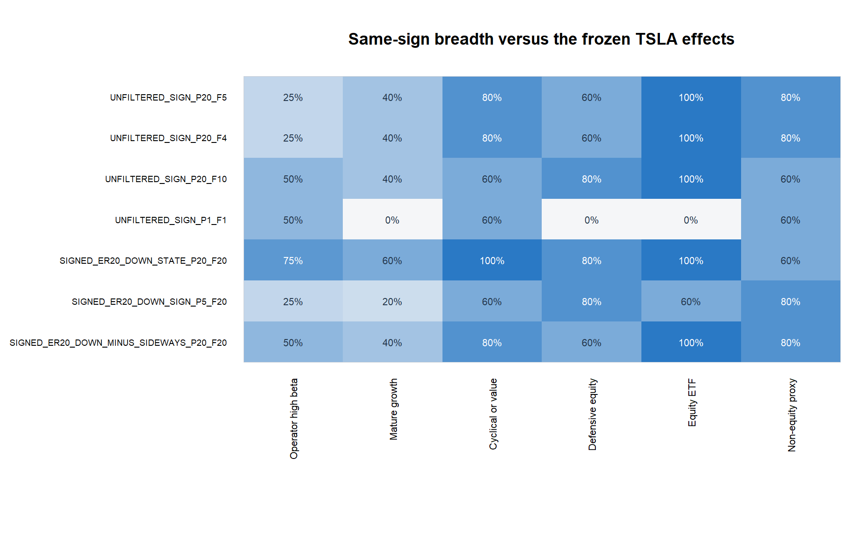
OWN-ASSET RETURN ATLAS
Every behavior group leans toward rebound
All six group medians are negative at DOWN p20→f20; strength varies, but no group reverses the sign.
30 assets | adjusted daily | 2018–2023
78
Notes:
The effect is not confined to operator favorites or high-beta equities. All six behavior groups have negative median correlation at the frozen DOWN p20/f20 cell.
[Sources]
- runs/research_workbench/operator_hypothesis_lab/own_asset_return_geometry_atlas_20260826/visuals/frozen_replication_group_breadth.png
- runs/research_workbench/operator_hypothesis_lab/own_asset_return_geometry_atlas_20260826/frozen_replication_group_summary.csv
[/Sources]

Slide 79
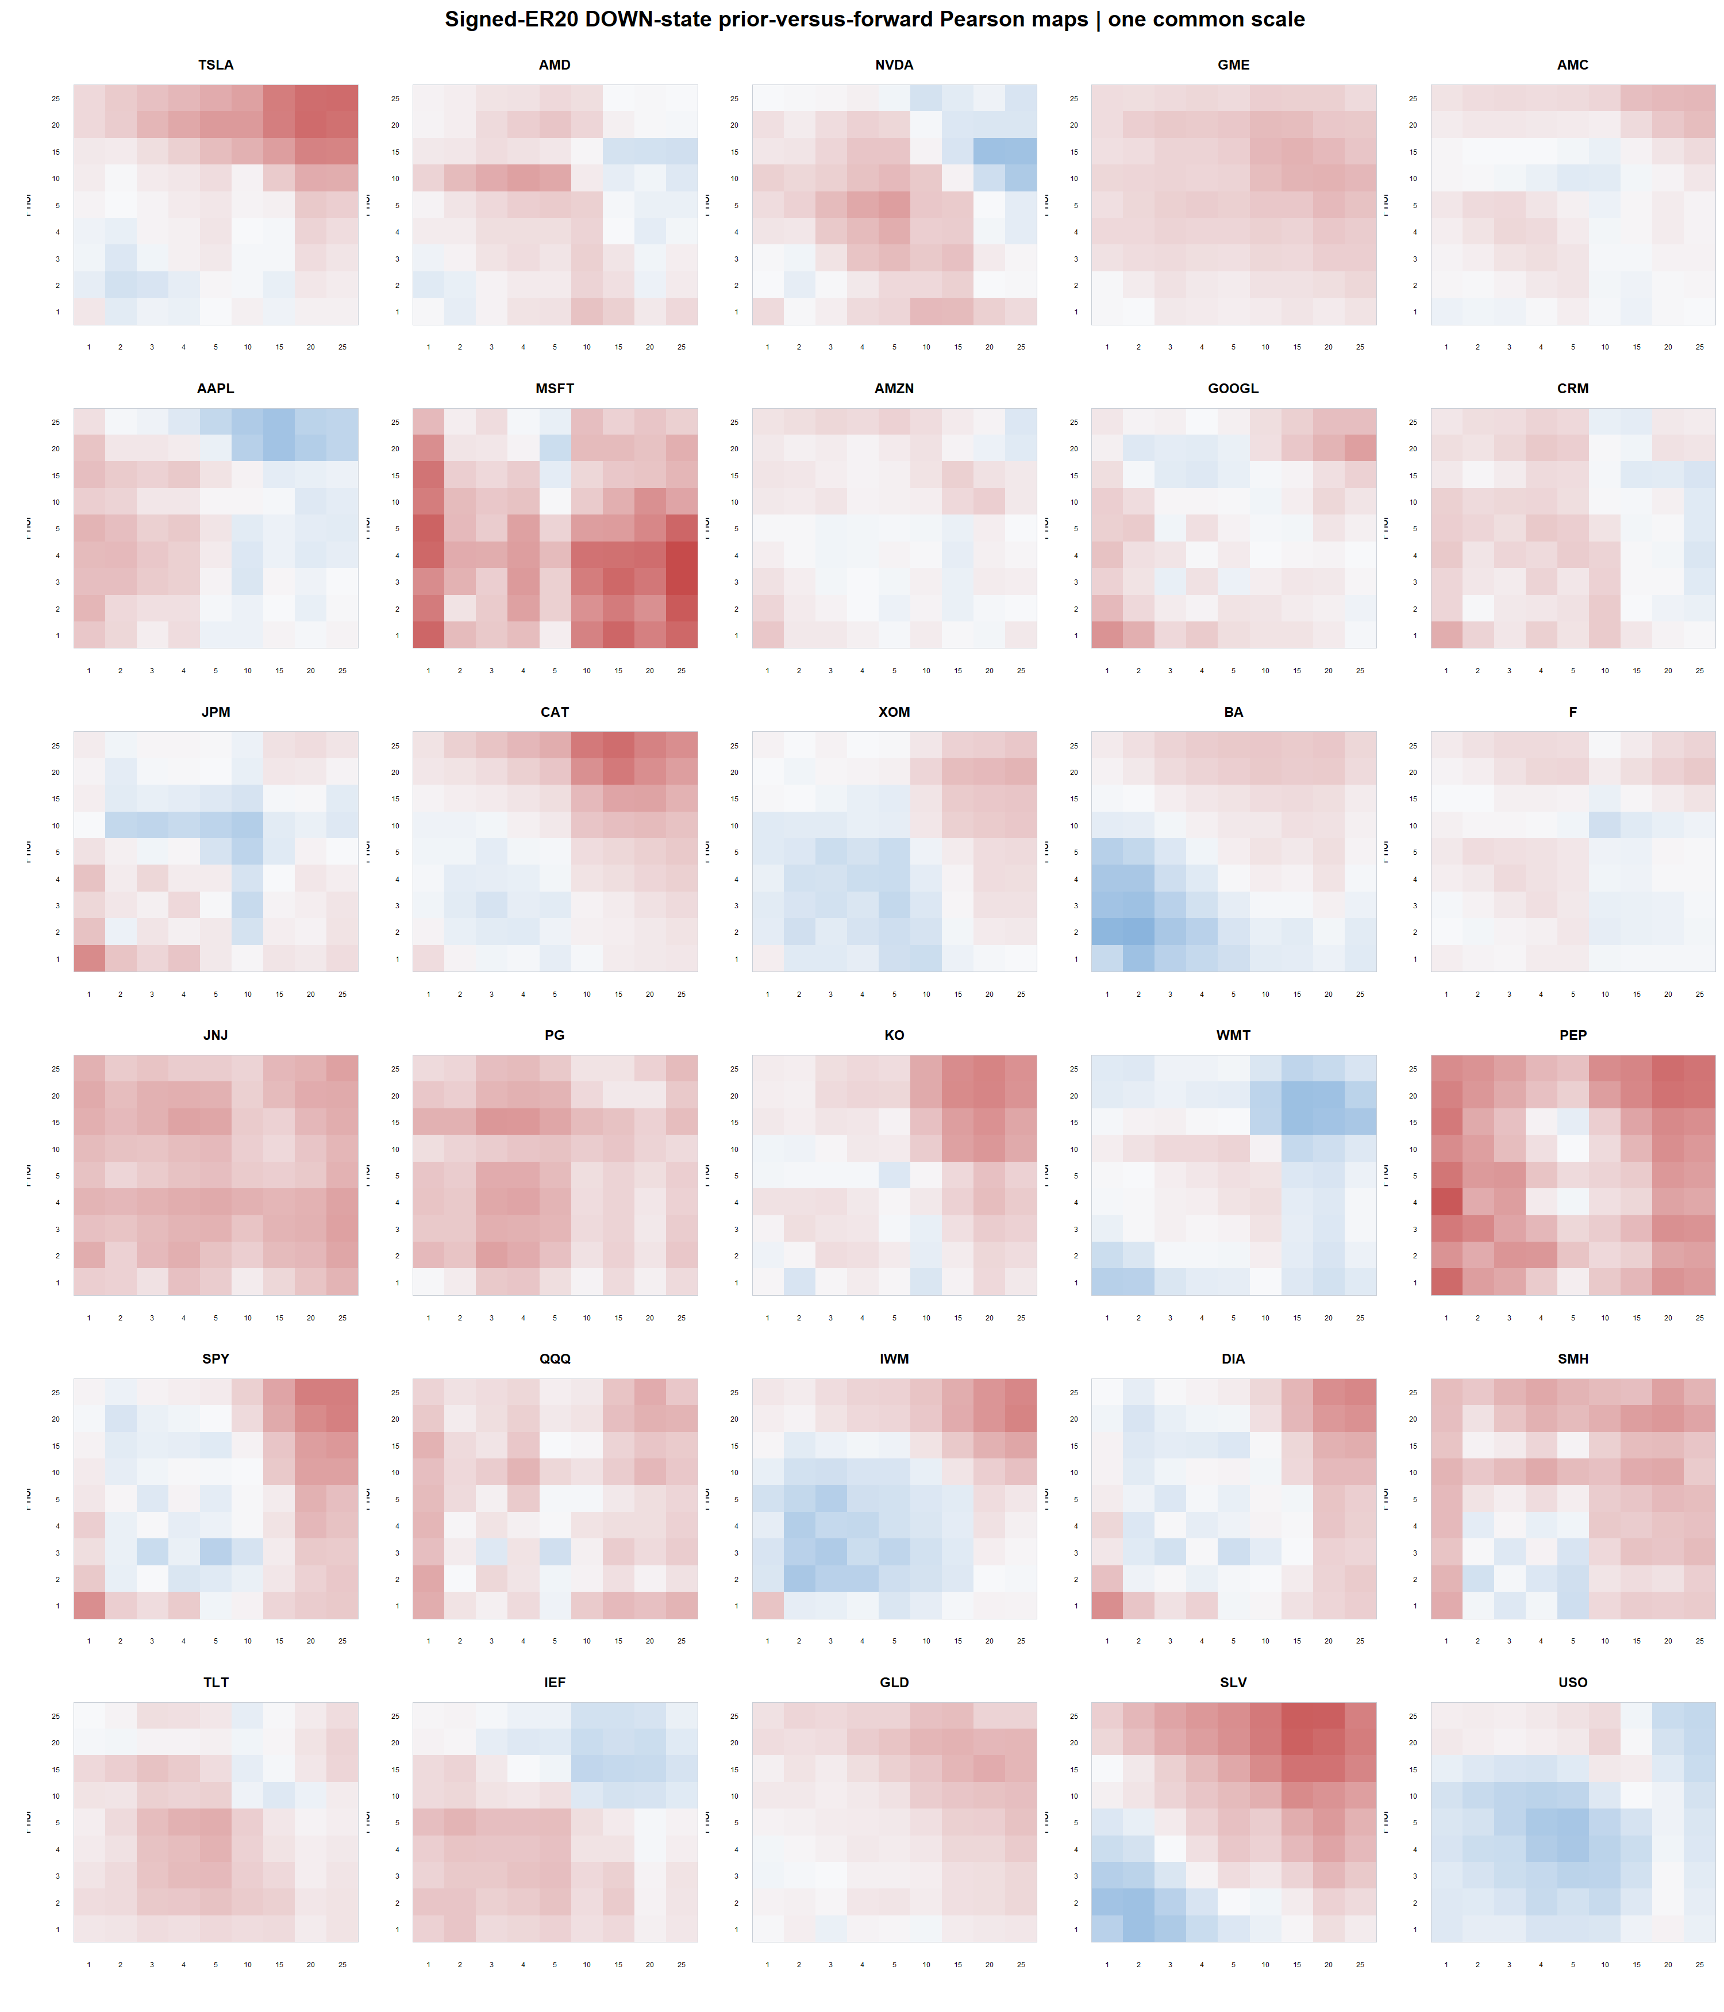
OWN-ASSET RETURN ATLAS
Thirty maps repeat the corner—but differ locally
The long-horizon red corner recurs across many assets, while local surface shape remains heterogeneous.
30 assets | adjusted daily | 2018–2023
79
Notes:
This contact sheet is a morphology check. It shows recurring long-horizon rebound geometry without pretending every asset has the same map or effect size.
[Sources]
- runs/research_workbench/operator_hypothesis_lab/own_asset_return_geometry_atlas_20260826/visuals/signed_er20_down_asset_heatmap_atlas.png
- runs/research_workbench/operator_hypothesis_lab/own_asset_return_geometry_atlas_20260826/asset_state_grid_cells.csv
- runs/research_workbench/operator_hypothesis_lab/own_asset_return_geometry_atlas_20260826/asset_map_similarity_to_tsla.csv
[/Sources]

Slide 80
OWN-ASSET RETURN ATLAS
What transports—and what does not
TRANSPORTS
DOWN long-prior rebound geometry
23/29 negative; median r −0.196
WEAKENS
Unfiltered 1×1 sign kink
0 raw passes; 27.6% same sign
HETEROGENEITY
Maps differ in strength and detail
all 6 group medians still negative
What this earns
Keep the broad DOWN-rebound morphology; retire any universal sign-kink interpretation.
30 assets | adjusted daily | 2018–2023
80
Notes:
The atlas separates the robust descriptive shape from the TSLA-local wrinkle. The DOWN-state long-horizon rebound transports; the unfiltered 1x1 sign kink does not.
[Sources]
- runs/research_workbench/operator_hypothesis_lab/own_asset_return_geometry_atlas_20260826/frozen_replication_summary.csv
- runs/research_workbench/operator_hypothesis_lab/own_asset_return_geometry_atlas_20260826/frozen_replication_group_summary.csv
- operator_hypothesis_lab/docs/OWN_ASSET_RETURN_GEOMETRY_ATLAS_2018_2023.md
[/Sources]

Slide 81
OWN-ASSET RETURN ATLAS
Why breadth is still not an edge
state and predictor share the path
Evidence boundary
What we have
cross-asset morphology
Signed ER20 defines DOWN using the same trailing displacement used by the p20 prior return. Selection geometry can amplify the pattern.
What we lack
later-time confirmation
Also absent
expectancy, costs, execution
Mechanical caveat
p20 displacement is shared
0
Interpretation
descriptive dependence
trading claims authorized
Next authority
operator opens next gate
30 assets | adjusted daily | 2018–2023
81
Notes:
Breadth strengthens the case that the morphology is real in-sample, but it does not resolve shared-path conditioning, same-date dependence, later-time stability, or realizable returns.
[Sources]
- runs/research_workbench/operator_hypothesis_lab/own_asset_return_geometry_atlas_20260826/report.md
- runs/research_workbench/operator_hypothesis_lab/own_asset_return_geometry_atlas_20260826/tsla_parity_checks.csv
- operator_hypothesis_lab/docs/OWN_ASSET_RETURN_GEOMETRY_ATLAS_2018_2023.md
[/Sources]

Slide 82
OWN-ASSET RETURN ATLAS
Decision: stop before adding 6–9 sessions
NOW
Frozen atlas is complete
broad transport demonstrated
NOT YET
6–9-session local zoom
not motivated by atlas shape
NEXT GATE
confirm or refine 15–25
with a frozen, later-time design
What this earns
Atlas first was the right order. Any finer search should target the transported 15–25-session neighborhood.
30 assets | adjusted daily | 2018–2023
82
Notes:
The atlas gives no special reason to add 6–9-session horizons. If the operator opens refinement, the evidence-backed target is the broad 15–25-session neighborhood, ideally with a frozen later-time increment before strategy work.
[Sources]
- operator_hypothesis_lab/docs/OWN_ASSET_RETURN_GEOMETRY_ATLAS_2018_2023.md
- operator_hypothesis_lab/docs/OWN_ASSET_RETURN_GEOMETRY_WORKFLOW_ROADMAP.md
- runs/research_workbench/operator_hypothesis_lab/own_asset_return_geometry_atlas_20260826/equal_asset_cell_summary.csv
[/Sources]

Slide 83
BEHAVIORAL CATALOG
What else can this microscope reveal?
Treat return geometry as a four-archetype behavioral vocabulary—not a search for one recurring cell.
The atlas has already populated several archetypes. The next slides show what was observed and what remains absent.
83
Notes:
The frozen atlas can be read as a behavioral microscope. Prior-return sign and the within-branch slope define four archetypes, while the existing state filters change which archetype is most prevalent.
[Sources]
- operator_hypothesis_lab/docs/OWN_ASSET_RETURN_GEOMETRY_ATLAS_2018_2023.md
- runs/research_workbench/operator_hypothesis_lab/return_geometry_behavior_catalog_20260826/report.md
[/Sources]

Slide 84
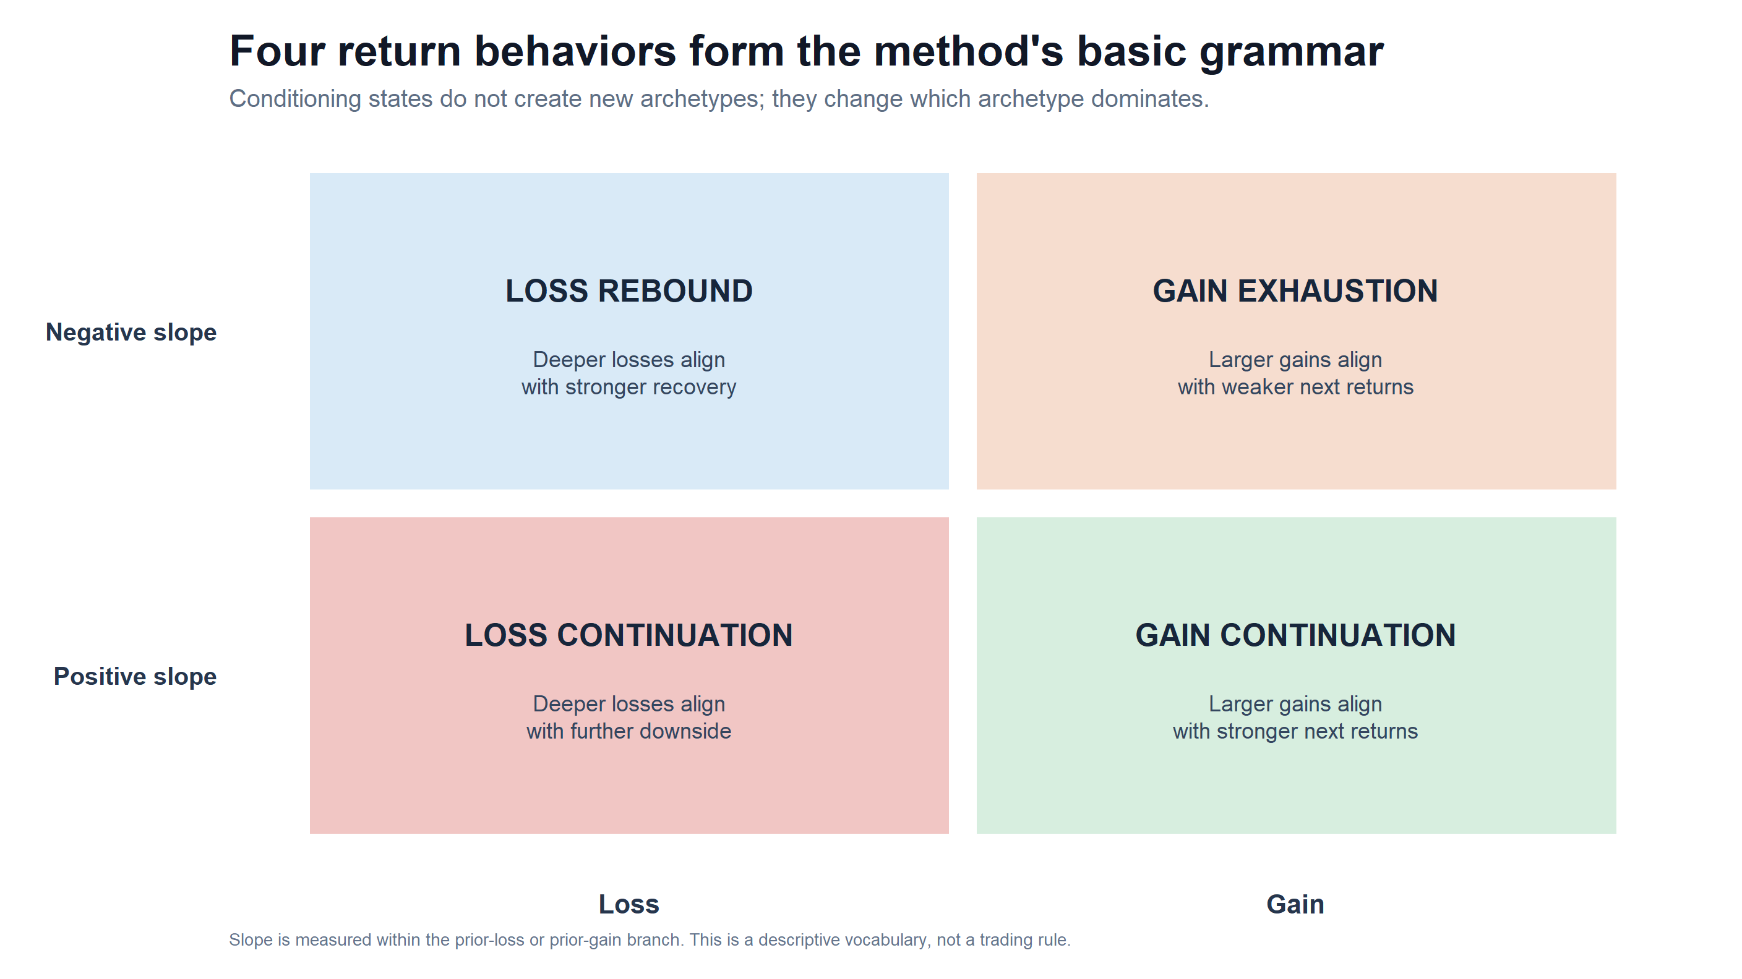
RETURN BEHAVIOR CATALOG
The microscope can express four return behaviors
Prior sign and within-branch slope define the archetype; conditioning changes its prevalence.
30 assets | adjusted daily | 2018–2023
84
Notes:
This grammar prevents the investigation from repeatedly renaming whichever cell looks interesting. A positive slope means continuation within that sign branch; a negative slope means reversal within that branch.
[Sources]
- runs/research_workbench/operator_hypothesis_lab/return_geometry_behavior_catalog_20260826/visuals/behavior_archetype_grammar.png
- runs/research_workbench/operator_hypothesis_lab/return_geometry_behavior_catalog_20260826/behavior_catalog_state_summary.csv
- runs/research_workbench/operator_hypothesis_lab/own_asset_return_geometry_atlas_20260826/asset_prior_sign_cells.csv
[/Sources]

Slide 85
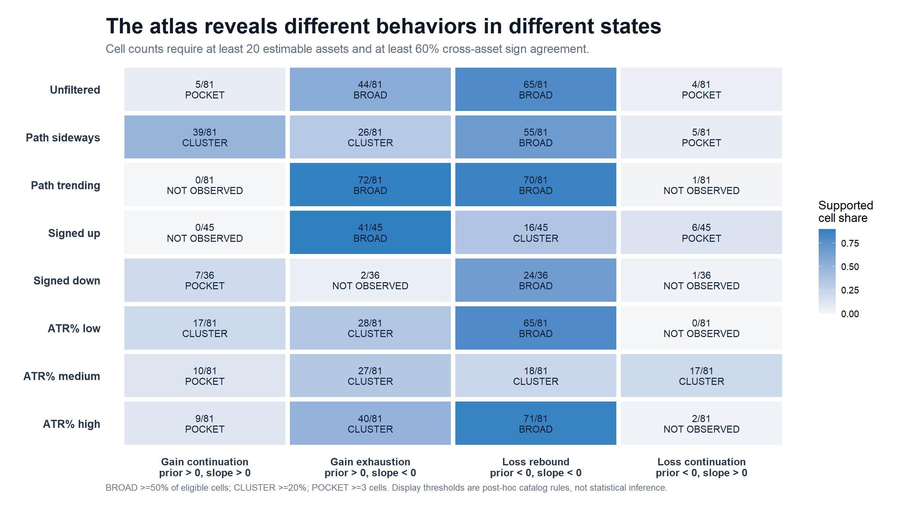
RETURN BEHAVIOR CATALOG
Conditioning changes which behavior dominates
Loss rebound is broad; gain exhaustion dominates trending/up states; gain continuation clusters in sideways paths.
30 assets | adjusted daily | 2018–2023
85
Notes:
A supported cell requires at least 20 estimable assets and at least 60 percent same-sign breadth. These are post-hoc display rules for cataloging the inspected atlas, not inferential thresholds.
[Sources]
- runs/research_workbench/operator_hypothesis_lab/return_geometry_behavior_catalog_20260826/visuals/behavior_state_catalog.png
- runs/research_workbench/operator_hypothesis_lab/return_geometry_behavior_catalog_20260826/behavior_catalog_state_summary.csv
- runs/research_workbench/operator_hypothesis_lab/own_asset_return_geometry_atlas_20260826/asset_prior_sign_cells.csv
[/Sources]

Slide 86
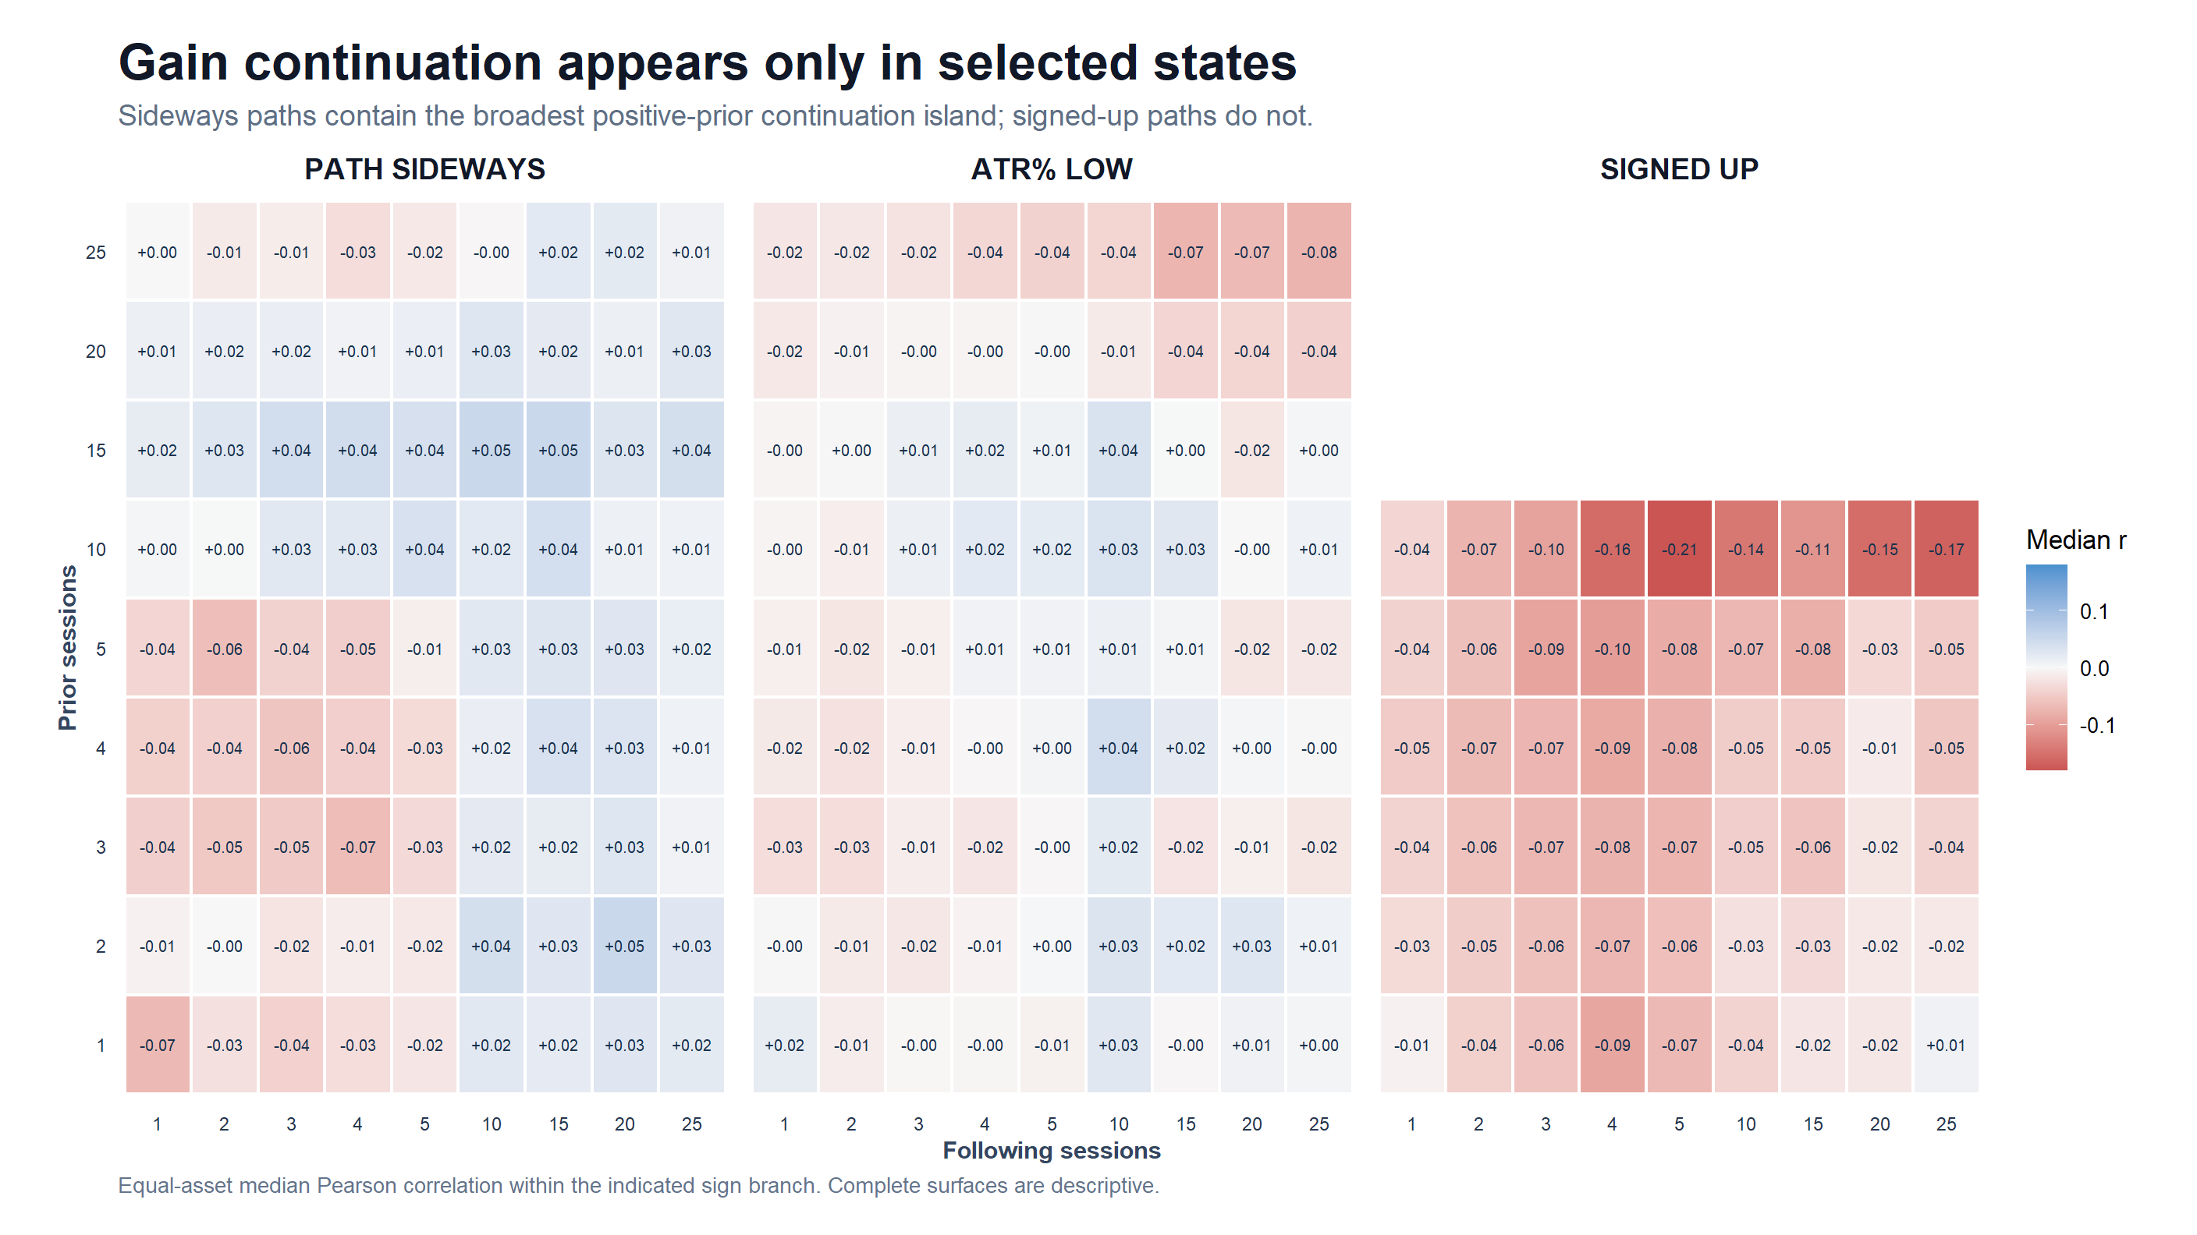
RETURN BEHAVIOR CATALOG
Momentum-like continuation is conditional—not universal
Sideways: 39/81 supported cells; ATR low: 17/81; signed up: 0/45.
30 assets | adjusted daily | 2018–2023
86
Notes:
The classical momentum-like branch is visible, but not where a simple trending-up intuition would put it. It clusters most strongly in path-sideways observations and more modestly in low ATR percent; the signed-up state instead leans toward gain exhaustion.
[Sources]
- runs/research_workbench/operator_hypothesis_lab/return_geometry_behavior_catalog_20260826/visuals/gain_continuation_state_heatmaps.png
- runs/research_workbench/operator_hypothesis_lab/return_geometry_behavior_catalog_20260826/behavior_catalog_state_summary.csv
- runs/research_workbench/operator_hypothesis_lab/own_asset_return_geometry_atlas_20260826/asset_prior_sign_cells.csv
[/Sources]

Slide 87
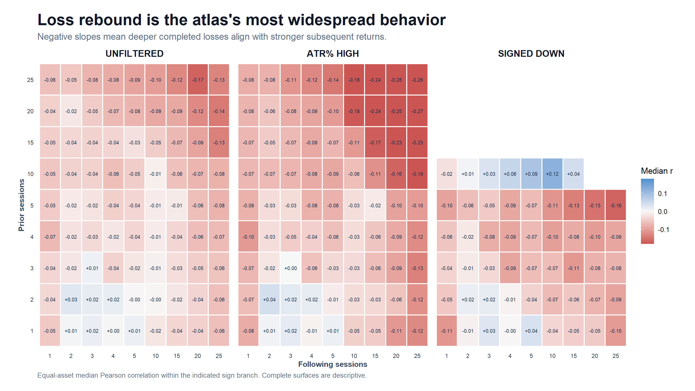
RETURN BEHAVIOR CATALOG
Loss rebound is broader than the DOWN 20→20 cell
Loss rebound is broad unfiltered and strongest in high-volatility and signed-down long-horizon cells.
30 assets | adjusted daily | 2018–2023
87
Notes:
The atlas-wide catalog dims the spotlight on one TSLA-discovered cell. Loss rebound is a broad family of geometry across several states, although signed-down maps retain structural blanks where conditioning and prior sign cannot coexist.
[Sources]
- runs/research_workbench/operator_hypothesis_lab/return_geometry_behavior_catalog_20260826/visuals/loss_rebound_state_heatmaps.png
- runs/research_workbench/operator_hypothesis_lab/return_geometry_behavior_catalog_20260826/behavior_catalog_state_summary.csv
- runs/research_workbench/operator_hypothesis_lab/own_asset_return_geometry_atlas_20260826/asset_prior_sign_cells.csv
[/Sources]

Slide 88
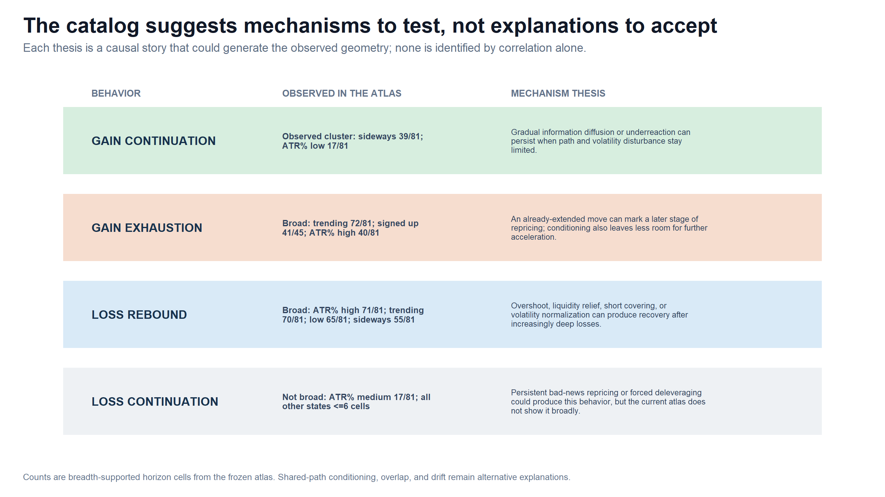
RETURN BEHAVIOR CATALOG
Mechanism stories become hypotheses to falsify
The geometry organizes candidate explanations; correlation alone cannot identify the mechanism.
30 assets | adjusted daily | 2018–2023
88
Notes:
Information diffusion, extension, overshoot, liquidity relief, volatility normalization, and forced deleveraging are candidate mechanisms only. Shared-path selection, overlap, drift, and common shocks remain competing explanations.
[Sources]
- runs/research_workbench/operator_hypothesis_lab/return_geometry_behavior_catalog_20260826/visuals/behavior_mechanism_theses.png
- runs/research_workbench/operator_hypothesis_lab/return_geometry_behavior_catalog_20260826/behavior_catalog_state_summary.csv
- runs/research_workbench/operator_hypothesis_lab/own_asset_return_geometry_atlas_20260826/asset_prior_sign_cells.csv
[/Sources]

Slide 89
RETURN BEHAVIOR CATALOG
The microscope catalogs behavior—not edge
METHOD
Four branch archetypes
same engine, different states
OBSERVED
Continuation is conditional
sideways + low ATR%
BOUNDARY
Mechanisms remain hypotheses
no causal or trading authority
What this earns
Freeze this catalog as the method’s descriptive vocabulary; future tests name one behavior, one state, and one horizon neighborhood.
30 assets | adjusted daily | 2018–2023
89
Notes:
The catalog is a naming and discrimination layer. It earns clearer hypothesis generation, not a strategy. Any next confirmation should predeclare one archetype, one state, and one horizon neighborhood rather than search the complete atlas again.
[Sources]
- operator_hypothesis_lab/docs/OWN_ASSET_RETURN_GEOMETRY_ATLAS_2018_2023.md
- operator_hypothesis_lab/docs/OWN_ASSET_RETURN_GEOMETRY_WORKFLOW_ROADMAP.md
- runs/research_workbench/operator_hypothesis_lab/return_geometry_behavior_catalog_20260826/behavior_catalog_state_summary.csv
[/Sources]

Slide 90
FINE-GRID TOPOLOGY
Is the rebound a real neighborhood—or a 20-session artifact?
Resolve the transported loss-rebound region from 10 to 30 sessions, one session at a time.
Same 30 assets. Same 2018–2023 data. Negative-prior branch only. No new inference or trading test.
90
Notes:
The coarse atlas earned one finer descriptive slice. The question is topological: bounded island, exact-window artifact, or broad open surface. The slice does not search for a tradable parameter.
[Sources]
- operator_hypothesis_lab/docs/OWN_ASSET_RETURN_GEOMETRY_REBOUND_TOPOLOGY_2018_2023.md
- runs/research_workbench/operator_hypothesis_lab/return_geometry_rebound_topology_20260827/run_spec.csv
[/Sources]

Slide 91
FINE-GRID TOPOLOGY
The slice changes resolution—not the question
LOCKED
30 assets + six groups
2018–2023 daily bars
PRIMARY
Signed-ER20 DOWN losses
10–30 by 10–30 grid
CONTROLS
Unfiltered + ATR%-high
no p-values or BH scan
What remains fixed
Coarse 10/15/20/25 anchors must reproduce exactly; neighboring cells are morphology, not independent tests.
30 assets | adjusted daily | 2018–2023
91
Notes:
Only the horizon resolution changes. The primary state and two comparators were declared before the surface was interpreted, and the old coarse cells serve as an exact parity check.
[Sources]
- runs/research_workbench/operator_hypothesis_lab/return_geometry_rebound_topology_20260827/run_spec.csv
- runs/research_workbench/operator_hypothesis_lab/return_geometry_rebound_topology_20260827/topology_checks.csv
- operator_hypothesis_lab/registries/own_asset_return_geometry_atlas.csv
[/Sources]

Slide 92
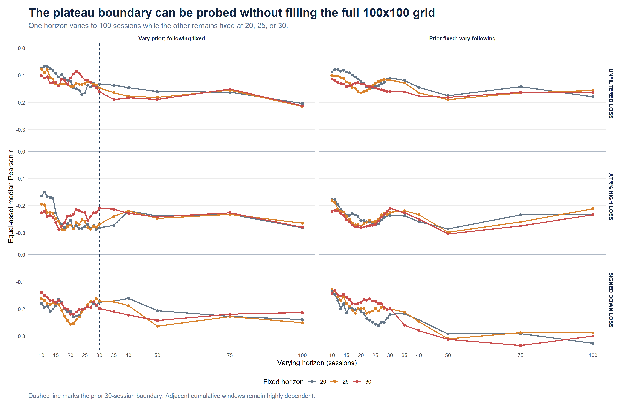
FINE-GRID TOPOLOGY
Fine resolution reveals an open rebound surface
Strong cells form connected regions across all three negative-prior views—not a bounded 20→20 island.
30 assets | adjusted daily | 2018–2023
92
Notes:
Black outlines mark the predeclared strong-cell rule. The signed-down component spans 414 cells and touches every edge of the inspected 10–30 grid.
[Sources]
- runs/research_workbench/operator_hypothesis_lab/return_geometry_rebound_topology_20260827/visuals/fine_grid_equal_asset_median_surfaces.png
- runs/research_workbench/operator_hypothesis_lab/return_geometry_rebound_topology_20260827/equal_asset_fine_grid_summary.csv
- runs/research_workbench/operator_hypothesis_lab/return_geometry_rebound_topology_20260827/topology_summary.csv
[/Sources]

Slide 93

FINE-GRID TOPOLOGY
The shape is shared across assets—not carried by one name
At least 70% of assets are negative in most signed-down and ATR%-high cells.
30 assets | adjusted daily | 2018–2023
93
Notes:
Cross-asset breadth is the guard against a single-name color patch. It does not turn common calendar observations into independent evidence.
[Sources]
- runs/research_workbench/operator_hypothesis_lab/return_geometry_rebound_topology_20260827/visuals/fine_grid_cross_asset_breadth_surfaces.png
- runs/research_workbench/operator_hypothesis_lab/return_geometry_rebound_topology_20260827/equal_asset_fine_grid_summary.csv
- runs/research_workbench/operator_hypothesis_lab/return_geometry_rebound_topology_20260827/topology_summary.csv
[/Sources]

Slide 94

FINE-GRID TOPOLOGY
Window 20 sits inside the curve
Holding one horizon at 20 produces broad curves, not a singular notch at the signed-ER measurement window.
30 assets | adjusted daily | 2018–2023
94
Notes:
The signed-down prior-20 row median differs from adjacent rows by only -0.0036; its following-20 column differs from adjacent columns by -0.0099. That reduces, but does not eliminate, shared-path coupling concern.
[Sources]
- runs/research_workbench/operator_hypothesis_lab/return_geometry_rebound_topology_20260827/visuals/p20_topology_cross_sections.png
- runs/research_workbench/operator_hypothesis_lab/return_geometry_rebound_topology_20260827/equal_asset_fine_grid_summary.csv
- runs/research_workbench/operator_hypothesis_lab/return_geometry_rebound_topology_20260827/topology_summary.csv
[/Sources]

Slide 95

FINE-GRID TOPOLOGY
Group maps reveal meaningful heterogeneity
Equity ETFs and defensive equities are darkest; five-name groups remain exploratory representation.
30 assets | adjusted daily | 2018–2023
95
Notes:
The group maps preserve identity rather than pooling everything into one result. Five assets per group are enough to show heterogeneity, not to estimate an asset-class population.
[Sources]
- runs/research_workbench/operator_hypothesis_lab/return_geometry_rebound_topology_20260827/visuals/signed_down_behavior_group_surfaces.png
- runs/research_workbench/operator_hypothesis_lab/return_geometry_rebound_topology_20260827/equal_asset_fine_grid_summary.csv
- runs/research_workbench/operator_hypothesis_lab/return_geometry_rebound_topology_20260827/topology_summary.csv
[/Sources]

Slide 96

FINE-GRID TOPOLOGY
Coverage—not the hottest cell—defines the finding
Strong-cell coverage: 66% unfiltered, 95% ATR%-high, and 94% signed-down.
30 assets | adjusted daily | 2018–2023
96
Notes:
Every largest strong component touches the grid boundary. The correct label is open plateau or ridge; 20→26 and 18→24 are descriptive extrema, not selected parameters.
[Sources]
- runs/research_workbench/operator_hypothesis_lab/return_geometry_rebound_topology_20260827/visuals/topology_coverage_summary.png
- runs/research_workbench/operator_hypothesis_lab/return_geometry_rebound_topology_20260827/equal_asset_fine_grid_summary.csv
- runs/research_workbench/operator_hypothesis_lab/return_geometry_rebound_topology_20260827/topology_summary.csv
[/Sources]

Slide 97
FINE-GRID TOPOLOGY
Decision: freeze one open plateau—then stop
FOUND
Open rebound plateau
not a 20-session island
EARNS
Less coupling concern
same geometry across windows
DOES NOT EARN
A chosen horizon or rule
no edge or causality claim
Next gate belongs to the operator
Choose temporal transport of one frozen neighborhood summary or a separately predeclared atlas-breadth expansion. Do not chase the open boundary.
30 assets | adjusted daily | 2018–2023
97
Notes:
The fine grid answers the approved question: the transported rebound is a broad open surface rather than an exact-window island. The current 30 assets are sufficient for that diagnosis, but not for population-level asset-class claims. No later data, horizon extension, breadth expansion, or rule is opened here.
[Sources]
- operator_hypothesis_lab/docs/OWN_ASSET_RETURN_GEOMETRY_REBOUND_TOPOLOGY_2018_2023.md
- operator_hypothesis_lab/docs/OWN_ASSET_RETURN_GEOMETRY_WORKFLOW_ROADMAP.md
- runs/research_workbench/operator_hypothesis_lab/return_geometry_rebound_topology_20260827/topology_summary.csv
[/Sources]

Slide 98
BOUNDARY PROBE
How far does the cumulative rebound plateau extend?
Probe sparse 35 / 40 / 50 / 75 / 100-session checkpoints—without filling a new grid.
Same 30 assets. Same 2018–2023 data. Same loss branch and states. No holding-period test.
98
Notes:
The fine-grid result was open at 30, so this slice asks a narrow boundary question. Sparse checkpoints protect the operator from turning one descriptive plateau into a dense endpoint search.
[Sources]
- operator_hypothesis_lab/docs/OWN_ASSET_RETURN_GEOMETRY_REBOUND_BOUNDARY_PROBE_2018_2023.md
- runs/research_workbench/operator_hypothesis_lab/return_geometry_rebound_boundary_probe_20260827/run_spec.csv
[/Sources]

Slide 99
BOUNDARY PROBE
The probe extends the boundary—not the search surface
LOCKED
30 assets + six groups
2018–2023 daily bars
PRIMARY
Signed-ER20 DOWN losses
negative-prior branch
CROSSHAIR
vary one horizon to 100
other fixed at 20 / 25 / 30
What this does not test
147 unique pairs. Same display rules. No inference, later data, endpoint selection, edge, or holding-period claim.
30 assets | adjusted daily | 2018–2023
99
Notes:
The union contains 147 unique prior/following pairs. Both orientations are measured: vary prior with following fixed, and vary following with prior fixed. Shared 10–30 cells must match the preceding packet exactly.
[Sources]
- runs/research_workbench/operator_hypothesis_lab/return_geometry_rebound_boundary_probe_20260827/probe_registry.csv
- runs/research_workbench/operator_hypothesis_lab/return_geometry_rebound_boundary_probe_20260827/boundary_probe_checks.csv
- operator_hypothesis_lab/registries/own_asset_return_geometry_atlas.csv
[/Sources]

Slide 100
BOUNDARY PROBE
The cumulative relationship stays open through 100
All 18 anchor paths remain strong at every outer checkpoint; no decay boundary appears.
30 assets | adjusted daily | 2018–2023
100
Notes:
Every condition, orientation, and fixed-anchor path remains breadth-supported and strong at 35, 40, 50, 75, and 100 sessions. This is one cumulative morphology result, not 18 independent discoveries.
[Sources]
- runs/research_workbench/operator_hypothesis_lab/return_geometry_rebound_boundary_probe_20260827/visuals/boundary_equal_asset_cross_sections.png
- runs/research_workbench/operator_hypothesis_lab/return_geometry_rebound_boundary_probe_20260827/equal_asset_boundary_cross_sections.csv
- runs/research_workbench/operator_hypothesis_lab/return_geometry_rebound_boundary_probe_20260827/boundary_summary.csv
[/Sources]

Slide 101
BOUNDARY PROBE
Breadth stays high through 100
At 100, 83–93% of assets remain negative across every condition and orientation.
30 assets | adjusted daily | 2018–2023
101
Notes:
The breadth view guards against one or two names driving the equal-asset median. Same-date observations remain dependent, so breadth does not create independent time experiments.
[Sources]
- runs/research_workbench/operator_hypothesis_lab/return_geometry_rebound_boundary_probe_20260827/visuals/boundary_cross_asset_breadth.png
- runs/research_workbench/operator_hypothesis_lab/return_geometry_rebound_boundary_probe_20260827/equal_asset_boundary_cross_sections.csv
- runs/research_workbench/operator_hypothesis_lab/return_geometry_rebound_boundary_probe_20260827/boundary_summary.csv
[/Sources]

Slide 102
BOUNDARY PROBE
Signed-down rebound stays strong to 100
At following = 100, median r is −0.29 to −0.33 for prior anchors 20 / 25 / 30.
30 assets | adjusted daily | 2018–2023
102
Notes:
The signed-down boundary matrix remains strong in both orientations. The most negative outer values occur when the prior anchor stays at 20–30 and cumulative following return expands to 100.
[Sources]
- runs/research_workbench/operator_hypothesis_lab/return_geometry_rebound_boundary_probe_20260827/visuals/signed_down_outer_checkpoint_matrix.png
- runs/research_workbench/operator_hypothesis_lab/return_geometry_rebound_boundary_probe_20260827/equal_asset_boundary_cross_sections.csv
- runs/research_workbench/operator_hypothesis_lab/return_geometry_rebound_boundary_probe_20260827/boundary_summary.csv
[/Sources]

Slide 103
BOUNDARY PROBE
Behavior groups remain visibly heterogeneous
Equity ETFs are darkest; non-equity proxies weaken when the future window expands.
30 assets | adjusted daily | 2018–2023
103
Notes:
At the 100-session signed-down boundary, equity-ETF group medians are about -0.58 to -0.67. Non-equity proxy medians are only about -0.03 to -0.06 when the following horizon expands. Five-name groups remain descriptive.
[Sources]
- runs/research_workbench/operator_hypothesis_lab/return_geometry_rebound_boundary_probe_20260827/visuals/signed_down_group_boundary_cross_sections.png
- runs/research_workbench/operator_hypothesis_lab/return_geometry_rebound_boundary_probe_20260827/equal_asset_boundary_cross_sections.csv
- runs/research_workbench/operator_hypothesis_lab/return_geometry_rebound_boundary_probe_20260827/boundary_summary.csv
[/Sources]

Slide 104
BOUNDARY PROBE
Observation support remains usable at 100
Signed-down median branch count is 121 when prior expands and 146–154 when future expands.
30 assets | adjusted daily | 2018–2023
104
Notes:
Longer windows reduce the number of completed observations, especially after signed-down filtering, but the descriptive support guardrails remain satisfied through 100 sessions.
[Sources]
- runs/research_workbench/operator_hypothesis_lab/return_geometry_rebound_boundary_probe_20260827/visuals/boundary_sample_support.png
- runs/research_workbench/operator_hypothesis_lab/return_geometry_rebound_boundary_probe_20260827/equal_asset_boundary_cross_sections.csv
- runs/research_workbench/operator_hypothesis_lab/return_geometry_rebound_boundary_probe_20260827/boundary_summary.csv
[/Sources]

Slide 105
BOUNDARY PROBE
Decision: open through 100—duration unknown
FOUND
Open through 100
cumulative relation persists
EARNS
One boundary conclusion
not a selected endpoint
DOES NOT EARN
A 100-session hold
no edge or causality claim
Next gate: incremental return blocks
Decompose sessions 1–20, 21–40, 41–60, and 61–100. Ask when the response accrues—not which cumulative endpoint looks hottest.
30 assets | adjusted daily | 2018–2023
105
Notes:
A 100-session cumulative future return includes every earlier return block. Persistence at 100 may mean that a rebound happened early and remains embedded in the total; it does not show that new return continues for 100 sessions. Incremental blocks are the clean next measurement.
[Sources]
- operator_hypothesis_lab/docs/OWN_ASSET_RETURN_GEOMETRY_REBOUND_BOUNDARY_PROBE_2018_2023.md
- operator_hypothesis_lab/docs/OWN_ASSET_RETURN_GEOMETRY_WORKFLOW_ROADMAP.md
- runs/research_workbench/operator_hypothesis_lab/return_geometry_rebound_boundary_probe_20260827/boundary_summary.csv
[/Sources]

Slide 106
WIDE ATLAS
Does the plateau survive real sector breadth?
Freeze 129 instruments, all nine filters, and a coarse 20–100-session grid.
Primary headline: 88 stocks, eight in each of 11 GICS sectors, equal-sector weighted.
106
Notes:
This slice opens breadth, not another horizon search. The attention sleeve and controls are retained as challengers, while the full-history 88-stock core determines the equal-sector headline.
[Sources]
- operator_hypothesis_lab/docs/RETURN_GEOMETRY_WIDE_ATLAS_2018_2023.md
- operator_hypothesis_lab/registries/return_geometry_wide_atlas.csv
[/Sources]

Slide 107
WIDE ATLAS
The wider atlas is balanced before results are read
CORE
88 stocks
11 sectors × 8 names
CHALLENGE
16 attention names
separate sleeve—not a sector
CONTROLS
25 liquid proxies
15 equity ETFs + 10 non-equity
Frozen grid
Prior and following = 20 / 25 / 30 / 35 / 40 / 50 / 75 / 100. All nine existing filter states; no per-asset selection.
129 instruments | adjusted daily | 2018–2023
107
Notes:
GICS supplies the 11-sector top-level taxonomy. These are frozen current research labels, not point-in-time constituent histories. Only the core enters equal-sector aggregation.
[Sources]
- operator_hypothesis_lab/registries/return_geometry_wide_atlas.csv
- runs/research_workbench/operator_hypothesis_lab/return_geometry_wide_atlas_20260827/run_spec.csv
- https://www.spglobal.com/spdji/en/landing/topic/gics/
- https://www.spglobal.com/spdji/en/documents/methodologies/methodology-gics.pdf?force_download=true
[/Sources]

Slide 108
WIDE ATLAS
Coverage is complete where the headline is formed
129/129
88/88
74,304
analyzable
core full-history
asset-state cells
10 partial-history attention names
Refreshed once; no pre-listing rows exist. Every history reaches 2023, and none enters equal-sector weighting.
12 / 12 integrity checks pass • original 30-name overlap reproduces below 5e−16
129 instruments | adjusted daily | 2018–2023
108
Notes:
The remaining provider WARN labels are structural IPO/first-trade partial histories in the attention sleeve. A refresh was attempted and returned no earlier bars. The equal-sector core is fully covered.
[Sources]
- runs/research_workbench/operator_hypothesis_lab/return_geometry_wide_atlas_20260827/coverage_ledger.csv
- runs/research_workbench/operator_hypothesis_lab/return_geometry_wide_atlas_20260827/wide_atlas_query_merge_summary.csv
- runs/research_workbench/operator_hypothesis_lab/return_geometry_wide_atlas_20260827/wide_atlas_checks.csv
- runs/research_workbench/operator_hypothesis_lab/return_geometry_wide_atlas_20260827/original_atlas_parity.csv
[/Sources]

Slide 109

WIDE ATLAS
The signed-down plateau survives the full coarse surface
Every one of 64 equal-sector cells is negative; this is a broad surface—not a selected endpoint.
129 instruments | adjusted daily | 2018–2023
109
Notes:
The primary surface takes the median loss-branch correlation within each sector and then the median across 11 sectors. All 64 cells remain negative. This is one dependent morphology, not 64 independent confirmations.
[Sources]
- runs/research_workbench/operator_hypothesis_lab/return_geometry_wide_atlas_20260827/visuals/equal_sector_signed_er20_down_trend_heatmap.png
- runs/research_workbench/operator_hypothesis_lab/return_geometry_wide_atlas_20260827/equal_sector_cell_summary.csv
- operator_hypothesis_lab/docs/RETURN_GEOMETRY_WIDE_ATLAS_2018_2023.md
[/Sources]

Slide 110

WIDE ATLAS
Sector breadth holds through 75—and nearly through 100
11 / 11 sector medians are negative through 75; 10 / 11 at 100, with Health Care ≈ +0.01.
129 instruments | adjusted daily | 2018–2023
110
Notes:
The 100-session Health Care exception is useful: broad transport is not the same thing as a universal law. Consumer Discretionary, Materials, Industrials, and Utilities are especially negative at 100.
[Sources]
- runs/research_workbench/operator_hypothesis_lab/return_geometry_wide_atlas_20260827/visuals/signed_down_sector_diagonal.png
- runs/research_workbench/operator_hypothesis_lab/return_geometry_wide_atlas_20260827/sector_horizon_diagonal.csv
- runs/research_workbench/operator_hypothesis_lab/return_geometry_wide_atlas_20260827/headline_signed_down_diagonal.csv
[/Sources]

Slide 111

WIDE ATLAS
The template discriminates among regime states
Trending / ATR-high / signed-down are strongest; signed-up losses are structurally sparse at short horizons.
129 instruments | adjusted daily | 2018–2023
1 1 1
Notes:
This view prevents the study from becoming a signed-down-only story. Unfiltered loss rebound remains visible, ATR-high is stronger than low/medium, and the signed-up negative-prior branch is sparse because the state and branch are mechanically discordant.
[Sources]
- runs/research_workbench/operator_hypothesis_lab/return_geometry_wide_atlas_20260827/visuals/all_states_equal_sector_diagonal.png
- runs/research_workbench/operator_hypothesis_lab/return_geometry_wide_atlas_20260827/equal_sector_horizon_diagonal.csv
- operator_hypothesis_lab/docs/RETURN_GEOMETRY_WIDE_ATLAS_2018_2023.md
[/Sources]

Slide 112


WIDE ATLAS
Challenge cohorts preserve useful heterogeneity
Equity ETFs are strongest; non-equity proxies start near zero.
Attention breadth rises from 56% at 20 to 75% at 100—still not uniform.
129 instruments | adjusted daily | 2018–2023
112
Notes:
The attention sleeve is deliberately secondary and heterogeneous. Its median moves from -0.105 at 20 to -0.295 at 100, but several names retain opposite signs. Non-equity controls remain much weaker than equities.
[Sources]
- runs/research_workbench/operator_hypothesis_lab/return_geometry_wide_atlas_20260827/visuals/signed_down_cohort_diagonal.png
- runs/research_workbench/operator_hypothesis_lab/return_geometry_wide_atlas_20260827/visuals/signed_down_attention_diagonal.png
- runs/research_workbench/operator_hypothesis_lab/return_geometry_wide_atlas_20260827/cohort_horizon_diagonal.csv
- runs/research_workbench/operator_hypothesis_lab/return_geometry_wide_atlas_20260827/asset_horizon_diagonal.csv
[/Sources]

Slide 113
WIDE ATLAS
WIDE ATLAS
Broad transport survives; edge remains unopened
FOUND
Sector-wide plateau
64 / 64 primary cells negative
LEARNS
Real heterogeneity
Health Care flat at 100; controls differ
DOES NOT EARN
A strategy or duration
no edge, causality, or 100-session hold
Next clean gate
Decompose non-overlapping future blocks—or freeze one compact summary for untouched-time transport. Stop expanding horizons at 100.
129 instruments | adjusted daily | 2018–2023
113
Notes:
This breadth slice weakens a TSLA-only, five-name-group, or single-sector explanation. Cumulative overlapping returns still hide when the rebound accrues. The operator must open the next gate explicitly.
[Sources]
- operator_hypothesis_lab/docs/RETURN_GEOMETRY_WIDE_ATLAS_2018_2023.md
- operator_hypothesis_lab/docs/OWN_ASSET_RETURN_GEOMETRY_WORKFLOW_ROADMAP.md
- runs/research_workbench/operator_hypothesis_lab/return_geometry_wide_atlas_20260827/wide_atlas_status.csv
- runs/research_workbench/operator_hypothesis_lab/return_geometry_wide_atlas_20260827/report.md
[/Sources]

Slide 114
FULL VOCABULARY
The atlas deserves a complete view
Restore the original short horizons and show every frozen filter on both prior-sign branches.
No new asset, filter, or endpoint was chosen after looking at the results.
114
Notes:
This section is a completeness layer. It restores the original 1/2/3/4/5/10/15/20/25 horizons, retains the coarse extension through 100, and treats both prior-sign branches symmetrically.
[Sources]
- runs/research_workbench/operator_hypothesis_lab/return_geometry_wide_atlas_full_vocabulary_20260827/run_spec.csv
- operator_hypothesis_lab/docs/RETURN_GEOMETRY_WIDE_ATLAS_2018_2023.md
[/Sources]

Slide 115
FULL VOCABULARY
The full vocabulary is frozen before comparison
HORIZONS
15 × 15
1,2,3,4,5,10,15,20,25,30,35,40,50,75,100
FILTERS
9 states
Unfiltered • ER20 • ATR% • signed ER20
BRANCHES
2 prior signs
Rebound / continuation • continuation / exhaustion
Complete surface
261,225 asset-state-horizon rows; identical assets, bars, filters, and 2018–2023 window.
129 instruments | 15 horizons | 9 filters | 2 branches | 2018–2023
115
Notes:
The state vocabulary is unchanged. Negative-prior correlations can express loss rebound or loss continuation; positive-prior correlations can express gain continuation or gain exhaustion.
[Sources]
- runs/research_workbench/operator_hypothesis_lab/return_geometry_wide_atlas_full_vocabulary_20260827/run_spec.csv
- runs/research_workbench/operator_hypothesis_lab/return_geometry_wide_atlas_full_vocabulary_20260827/wide_atlas_checks.csv
[/Sources]

Slide 116



FULL VOCABULARY
Loss branch | unfiltered and ER20
Shared scale: burgundy = negative correlation • cream = near zero • teal = positive correlation
All observations
ER20 sideways
ER20 trending — stronger rebound
129 instruments | 15 horizons | 9 filters | 2 branches | 2018–2023
116
Notes:
This is the negative-prior branch. Negative correlation means larger preceding losses are associated with stronger following cumulative returns; positive correlation would indicate loss continuation.
[Sources]
- runs/research_workbench/operator_hypothesis_lab/return_geometry_wide_atlas_full_vocabulary_20260827/equal_sector_cell_summary.csv
- runs/research_workbench/operator_hypothesis_lab/return_geometry_wide_atlas_full_vocabulary_20260827/visuals/equal_sector_unfiltered_all_heatmap.png
- runs/research_workbench/operator_hypothesis_lab/return_geometry_wide_atlas_full_vocabulary_20260827/visuals/equal_sector_er20_red_sideways_heatmap.png
- runs/research_workbench/operator_hypothesis_lab/return_geometry_wide_atlas_full_vocabulary_20260827/visuals/equal_sector_er20_green_trending_heatmap.png
[/Sources]

Slide 117



FULL VOCABULARY
Loss branch | ATR% states
Shared scale: burgundy = negative correlation • cream = near zero • teal = positive correlation
ATR% low
ATR% medium
ATR% high — stronger rebound
129 instruments | 15 horizons | 9 filters | 2 branches | 2018–2023
117
Notes:
All three volatility states are shown on the same scale. ATR-high is emphasized only because the complete surface reveals stronger negative dependence there.
[Sources]
- runs/research_workbench/operator_hypothesis_lab/return_geometry_wide_atlas_full_vocabulary_20260827/equal_sector_cell_summary.csv
- runs/research_workbench/operator_hypothesis_lab/return_geometry_wide_atlas_full_vocabulary_20260827/visuals/equal_sector_atrp_low_heatmap.png
- runs/research_workbench/operator_hypothesis_lab/return_geometry_wide_atlas_full_vocabulary_20260827/visuals/equal_sector_atrp_medium_heatmap.png
- runs/research_workbench/operator_hypothesis_lab/return_geometry_wide_atlas_full_vocabulary_20260827/visuals/equal_sector_atrp_high_heatmap.png
[/Sources]

Slide 118



FULL VOCABULARY
Loss branch | signed ER20 states
Shared scale: burgundy = negative correlation • cream = near zero • teal = positive correlation
Signed ER20 up — sparse at short horizons
Signed ER20 sideways
Signed ER20 down — clearest rebound
129 instruments | 15 horizons | 9 filters | 2 branches | 2018–2023
118
Notes:
The up-state loss branch is mechanically sparse at short horizons because a positive path state and negative cumulative prior return are discordant. The sparse region is retained rather than imputed.
[Sources]
- runs/research_workbench/operator_hypothesis_lab/return_geometry_wide_atlas_full_vocabulary_20260827/equal_sector_cell_summary.csv
- runs/research_workbench/operator_hypothesis_lab/return_geometry_wide_atlas_full_vocabulary_20260827/visuals/equal_sector_signed_er20_up_trend_heatmap.png
- runs/research_workbench/operator_hypothesis_lab/return_geometry_wide_atlas_full_vocabulary_20260827/visuals/equal_sector_signed_er20_sideways_heatmap.png
- runs/research_workbench/operator_hypothesis_lab/return_geometry_wide_atlas_full_vocabulary_20260827/visuals/equal_sector_signed_er20_down_trend_heatmap.png
[/Sources]

Slide 119



FULL VOCABULARY
Gain branch | unfiltered and ER20
Shared scale: burgundy = negative correlation • cream = near zero • teal = positive correlation
All observations
ER20 sideways
ER20 trending
129 instruments | 15 horizons | 9 filters | 2 branches | 2018–2023
119
Notes:
This is the positive-prior branch. Positive correlation indicates gain continuation; negative correlation indicates gain exhaustion. The same assets and horizon grid are used as on the loss branch.
[Sources]
- runs/research_workbench/operator_hypothesis_lab/return_geometry_wide_atlas_full_vocabulary_20260827/equal_sector_cell_summary.csv
- runs/research_workbench/operator_hypothesis_lab/return_geometry_wide_atlas_full_vocabulary_20260827/visuals/equal_sector_gain_unfiltered_all_heatmap.png
- runs/research_workbench/operator_hypothesis_lab/return_geometry_wide_atlas_full_vocabulary_20260827/visuals/equal_sector_gain_er20_red_sideways_heatmap.png
- runs/research_workbench/operator_hypothesis_lab/return_geometry_wide_atlas_full_vocabulary_20260827/visuals/equal_sector_gain_er20_green_trending_heatmap.png
[/Sources]

Slide 120



FULL VOCABULARY
Gain branch | ATR% states
Shared scale: burgundy = negative correlation • cream = near zero • teal = positive correlation
ATR% low
ATR% medium
ATR% high
129 instruments | 15 horizons | 9 filters | 2 branches | 2018–2023
120
Notes:
The gain branch is shown without selecting a favorable volatility state. The slide is descriptive and uses one shared scale across all three panels.
[Sources]
- runs/research_workbench/operator_hypothesis_lab/return_geometry_wide_atlas_full_vocabulary_20260827/equal_sector_cell_summary.csv
- runs/research_workbench/operator_hypothesis_lab/return_geometry_wide_atlas_full_vocabulary_20260827/visuals/equal_sector_gain_atrp_low_heatmap.png
- runs/research_workbench/operator_hypothesis_lab/return_geometry_wide_atlas_full_vocabulary_20260827/visuals/equal_sector_gain_atrp_medium_heatmap.png
- runs/research_workbench/operator_hypothesis_lab/return_geometry_wide_atlas_full_vocabulary_20260827/visuals/equal_sector_gain_atrp_high_heatmap.png
[/Sources]

Slide 121



FULL VOCABULARY
Gain branch | signed ER20 states
Shared scale: burgundy = negative correlation • cream = near zero • teal = positive correlation
Signed ER20 up
Signed ER20 sideways
Signed ER20 down — sparse at short horizons
129 instruments | 15 horizons | 9 filters | 2 branches | 2018–2023
121
Notes:
The down-state gain branch is mechanically sparse at short horizons because a negative path state and positive cumulative prior return are discordant. Missing cells remain visible.
[Sources]
- runs/research_workbench/operator_hypothesis_lab/return_geometry_wide_atlas_full_vocabulary_20260827/equal_sector_cell_summary.csv
- runs/research_workbench/operator_hypothesis_lab/return_geometry_wide_atlas_full_vocabulary_20260827/visuals/equal_sector_gain_signed_er20_up_trend_heatmap.png
- runs/research_workbench/operator_hypothesis_lab/return_geometry_wide_atlas_full_vocabulary_20260827/visuals/equal_sector_gain_signed_er20_sideways_heatmap.png
- runs/research_workbench/operator_hypothesis_lab/return_geometry_wide_atlas_full_vocabulary_20260827/visuals/equal_sector_gain_signed_er20_down_trend_heatmap.png
[/Sources]

Slide 122
FULL VOCABULARY
The filters discriminate the two branches differently
Same horizons and filters on both branches; colors use the shared diverging scale.
Loss branch: short cells mix; rebound strengthens in trending / ATR-high / signed-down
Gain branch: sideways favors continuation; trending favors exhaustion
129 instruments | 15 horizons | 9 filters | 2 branches | 2018–2023
122
Notes:
Equal-horizon diagonals compress the complete grids only for comparison. They are not a parameter recommendation. The full 15-by-15 panels on the preceding slides remain the authoritative completeness view.
[Sources]
- runs/research_workbench/operator_hypothesis_lab/return_geometry_wide_atlas_full_vocabulary_20260827/full_state_vocabulary_summary.csv
- runs/research_workbench/operator_hypothesis_lab/return_geometry_wide_atlas_full_vocabulary_20260827/visuals/all_states_equal_sector_diagonal.png
- runs/research_workbench/operator_hypothesis_lab/return_geometry_wide_atlas_full_vocabulary_20260827/visuals/all_states_equal_sector_gain_diagonal.png
[/Sources]

Slide 123
FULL VOCABULARY
FULL VOCABULARY
The broader view strengthens interpretation
FOUND
A complete reference surface
short and long horizons coexist
LEARNS
Scale and filters both matter
short sign flips; branch states differ
DOES NOT EARN
A chosen cell, filter, or rule
no edge, causality, or hold period
Next clean gate
Freeze this as the descriptive reference. Incremental-return timing or untouched-time transport still requires a separate gate.
129 instruments | 15 horizons | 9 filters | 2 branches | 2018–2023
123
Notes:
Completeness protects against a curated story: all states and both sign branches are visible. The strongest discriminators can now be discussed in context, but no cell or state is promoted into a rule.
[Sources]
- runs/research_workbench/operator_hypothesis_lab/return_geometry_wide_atlas_full_vocabulary_20260827/report.md
- runs/research_workbench/operator_hypothesis_lab/return_geometry_wide_atlas_full_vocabulary_20260827/full_state_vocabulary_summary.csv
- operator_hypothesis_lab/docs/RETURN_GEOMETRY_WIDE_ATLAS_2018_2023.md
[/Sources]

