Slide 1
LITERATURE-GROUNDED STRATEGY RESEARCH | 30 JUL 2026
LIT-MOM-01.1
interday momentum
Reconstruct Chan's full Chapter 6 workflow: screen lookback and holding horizons in TRAIN, freeze one rule, then test the causal swing strategy out of sample.
Notes:
This deck treats Example 6.1 as a two-stage research exercise. The 250/25 rule is a literature-selected example, not an arbitrary starting parameter and not automatically the selected SHY rule.
[Sources]
- C:/Users/Franc/OneDrive/Documents/Francis/Trading Literature/Algorithmic Trading - Winning Strategies and Their Rationale 2013.pdf — printed pages 135–139; PDF pages 153–157
- C:/Users/Franc/OneDrive/Documents/Francis/Peltata Project/Time-Series-Modeling-Gen5/literature_studies/docs/GEN5_LIT_MOM_01_1_INTERDAY_TIME_SERIES_MOMENTUM_POC_CONTRACT.md
- C:/Users/Franc/OneDrive/Documents/Francis/Peltata Project/Time-Series-Modeling-Gen5/literature_studies/docs/GEN5_LIT_MOM_01_1_INTERDAY_MOMENTUM_RESULTS.md

Slide 2
Chan screens horizons before he trades 250/25
For every lookback L and holding period H, compare the sign and magnitude of the past L-session return with the next H-session return. Only after seeing the TRAIN table does Example 6.1 choose a practical rule.
49 cells
Freeze one
Trade OOS
L,H in {1,5,10,25,60,120,250}
Correlation, p-value, support
Select inside TRAIN only
No OOS horizon shopping
Daily 1/H sleeves
Next-open causal execution
2
Notes:
The first stage is a 7-by-7 table of past/future return correlations. Chan then narrows the candidates and chooses 250/25 for the worked TU example. The POC preserves that sequence and freezes a deterministic TRAIN-only selection rule before examining OOS.
[Sources]
- C:/Users/Franc/OneDrive/Documents/Francis/Trading Literature/Algorithmic Trading - Winning Strategies and Their Rationale 2013.pdf — printed pages 136–138; PDF pages 154–156
- C:/Users/Franc/OneDrive/Documents/Francis/Peltata Project/Time-Series-Modeling-Gen5/literature_studies/docs/GEN5_LIT_MOM_01_1_INTERDAY_TIME_SERIES_MOMENTUM_POC_CONTRACT.md
- C:/Users/Franc/OneDrive/Documents/Francis/Peltata Project/Time-Series-Modeling-Gen5/runs/research_workbench/literature_grounded/lit_mom_01_1_interday_momentum_20260730_v6/lit_mom_01_1_train_horizon_screen.csv
- C:/Users/Franc/OneDrive/Documents/Francis/Peltata Project/Time-Series-Modeling-Gen5/runs/research_workbench/literature_grounded/lit_mom_01_1_interday_momentum_20260730_v6/lit_mom_01_1_selected_candidate.csv

Slide 3
Spacing choices trade sample size for independence
STEP_L directly answers a distinct-formation-episode question: one phase never reuses an L-session lookback. But H outcomes can still overlap—and, when H < L, an outcome can enter the next lookback. Daily execution is a separate choice.
step min(L,H)
step L
step L+H
Chan prose / shorter leg non-overlap
Most supported pairs
Distinct formation chunks
H may overlap; phase matters
No raw interval reused
Strongest separation; fewest pairs
3
Notes:
CHAN_MIN_STEP advances by min(L,H), which preserves more pairs and makes the shorter leg non-overlapping. STEP_L is a useful Gen5 diagnostic for distinct formation episodes, but it does not make observations fully independent: H outcomes can overlap, and when H<L a future outcome can enter the next formation window. A fixed STEP_L partition also depends on its starting phase. L+H is the strongest raw-interval separation but is often too sparse.
[Sources]
- C:/Users/Franc/OneDrive/Documents/Francis/Trading Literature/Algorithmic Trading - Winning Strategies and Their Rationale 2013.pdf — printed pages 135–136; PDF pages 153–154
- C:/Users/Franc/OneDrive/Documents/Francis/Peltata Project/Time-Series-Modeling-Gen5/literature_studies/docs/GEN5_LIT_MOM_01_1_INTERDAY_TIME_SERIES_MOMENTUM_POC_CONTRACT.md
- C:/Users/Franc/OneDrive/Documents/Francis/Peltata Project/Time-Series-Modeling-Gen5/literature_studies/docs/GEN5_LIT_MOM_01_1_INTERDAY_MOMENTUM_RESULTS.md

Slide 4
250/25 is an informed choice—not a magic optimum
Chan's TU table leaves several plausible cells. He favors a roughly 12-month signal with a roughly one-month hold: a practical correlation/p-value compromise and a direct bridge to the cited time-series-momentum literature.
250
25
not unique
About 12 trading months
Past-return sign
About one trading month
Shorter practical hold
Other shortlisted cells exist
The table precedes the example
4
Notes:
The TU screening table highlights multiple plausible combinations, including 60/10, 60/25, 250/10, 250/25, 250/60, and 250/120. Chan prefers reasonably short holding periods and implements 250/25. The cited Moskowitz, Ooi, and Pedersen paper also emphasizes a 12-month lookback with a one-month holding convention.
[Sources]
- C:/Users/Franc/OneDrive/Documents/Francis/Trading Literature/Algorithmic Trading - Winning Strategies and Their Rationale 2013.pdf — printed page 137 and Example 6.1 on page 138; PDF pages 155–156
- https://pages.stern.nyu.edu/~lpederse/papers/TimeSeriesMomentum.pdf
- C:/Users/Franc/OneDrive/Documents/Francis/Peltata Project/Time-Series-Modeling-Gen5/literature_studies/docs/GEN5_LITERATURE_SOURCE_LEDGER.md

Slide 5
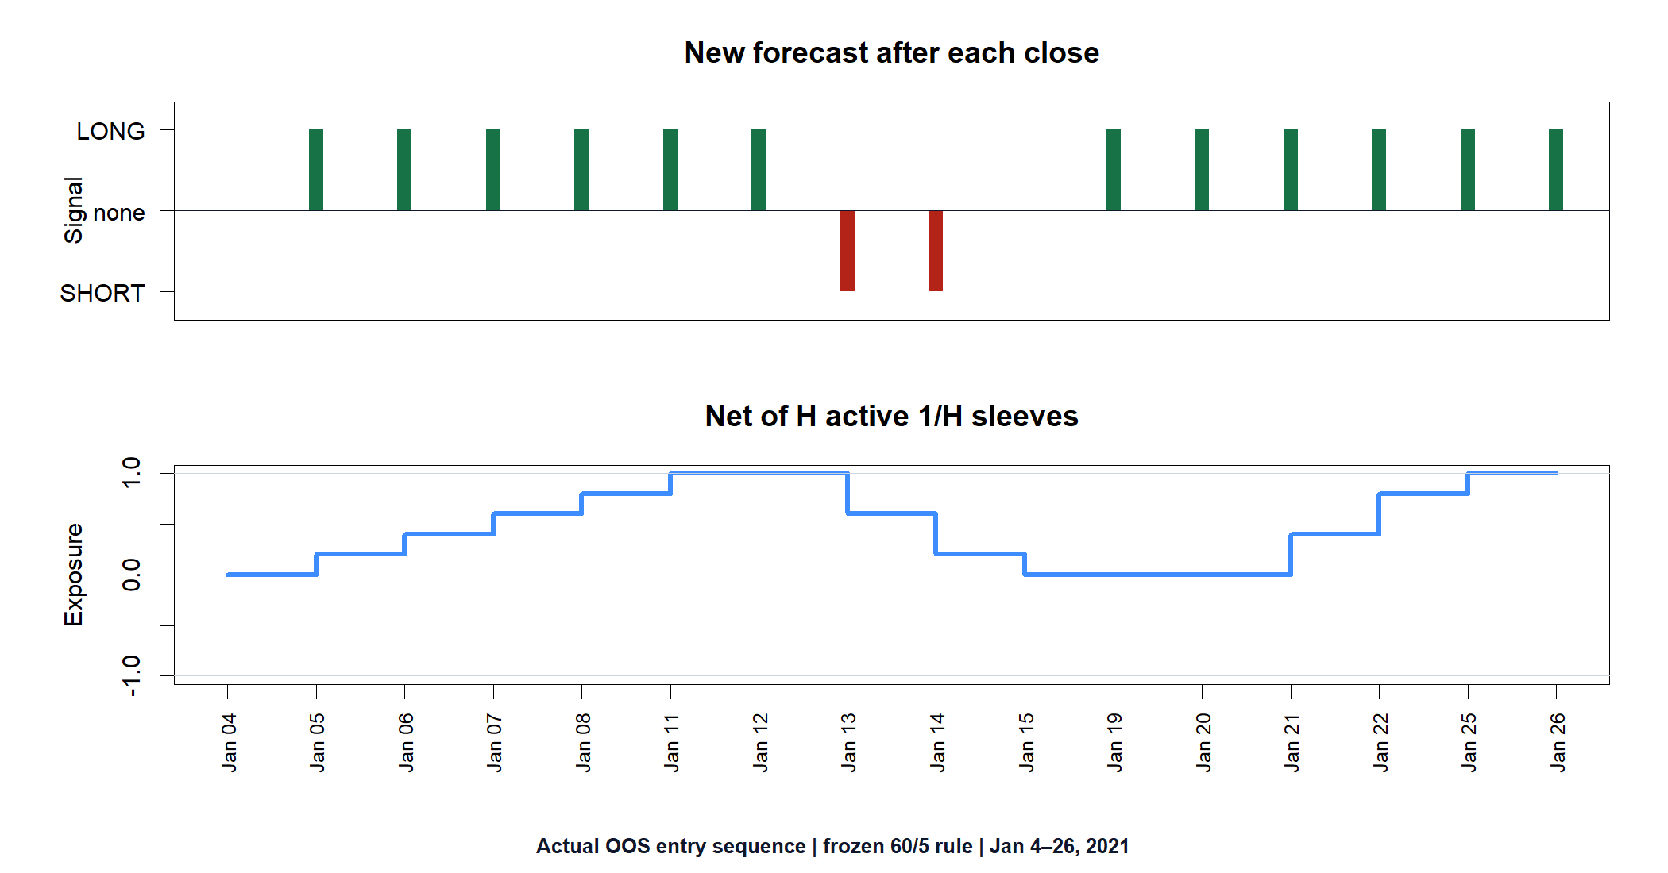
Every close creates a new forecast—and one new sleeve
sₜ = sign(Cₜ / Cₜ₋ₗ − 1)
After each close, recompute s_t from the newest L-session window.
At next open, add one sleeve of size 1/H.
Each sleeve exits H opens after its own entry.
wₜ = (1/H) Σₕ₌₁ᴴ sₜ₋ₕ
Repeated signs are correlated updates—not independent confirmation.
A reversal adds an opposing sleeve while older sleeves age out.
5
Notes:
The key correction is that the strategy does not spread one Day-0 forecast across H entries. It recalculates after every close. Each resulting signal starts one new 1/H sleeve at the next open, and each sleeve has its own H-session life. Adjacent L-session signals share L-1 observations, so repeated signs are highly correlated updates rather than independent confirmations.
[Sources]
- C:/Users/Franc/OneDrive/Documents/Francis/Trading Literature/Algorithmic Trading - Winning Strategies and Their Rationale 2013.pdf — printed pages 138–139; PDF pages 156–157
- C:/Users/Franc/OneDrive/Documents/Francis/Peltata Project/Time-Series-Modeling-Gen5/literature_studies/docs/GEN5_LIT_MOM_01_1_INTERDAY_TIME_SERIES_MOMENTUM_POC_CONTRACT.md
- C:/Users/Franc/OneDrive/Documents/Francis/Peltata Project/Time-Series-Modeling-Gen5/runs/research_workbench/literature_grounded/lit_mom_01_1_interday_momentum_20260730_v6/development_completed_sleeves.csv
- C:/Users/Franc/OneDrive/Documents/Francis/Peltata Project/Time-Series-Modeling-Gen5/runs/research_workbench/literature_grounded/lit_mom_01_1_interday_momentum_20260730_v6/development_bar_replay.csv
- C:/Users/Franc/OneDrive/Documents/Francis/Peltata Project/Time-Series-Modeling-Gen5/literature_studies/scripts/render_gen5_lit_mom_01_1_revisit_audit.R

Slide 6
SHY is a retail proxy—not the TU future
The source instrument is the two-year Treasury-note future. SHY is the closest Alpaca-tradable daily ETF maturity proxy available inside the opened provider scope, but its duration, roll, financing, tax, and short-borrow mechanics differ.
TU future
SHY ETF
POC only
Chan's instrument
Leveraged futures economics
1–3 year Treasury basket
Adjusted daily retail bars
Borrow not proven
No live or leverage authority
6
Notes:
Using SHY answers whether the textbook workflow transfers to an accessible ETF proxy. It does not reproduce TU contract rolls or futures capital efficiency, and adjusted bars cannot prove historical borrow availability for short sleeves.
[Sources]
- C:/Users/Franc/OneDrive/Documents/Francis/Trading Literature/Algorithmic Trading - Winning Strategies and Their Rationale 2013.pdf — printed pages 138–139; PDF pages 156–157
- C:/Users/Franc/OneDrive/Documents/Francis/Peltata Project/Time-Series-Modeling-Gen5/literature_studies/docs/GEN5_LIT_MOM_01_1_INTERDAY_TIME_SERIES_MOMENTUM_POC_CONTRACT.md
- C:/Users/Franc/OneDrive/Documents/Francis/Peltata Project/Time-Series-Modeling-Gen5/runs/research_workbench/literature_grounded/lit_mom_01_1_interday_momentum_20260730_v6/lit_mom_01_1_frozen_contract.csv
- C:/Users/Franc/OneDrive/Documents/Francis/Peltata Project/Time-Series-Modeling-Gen5/runs/research_workbench/literature_grounded/lit_mom_01_1_interday_momentum_20260730_v6/lit_mom_01_1_workbench_query_manifest.csv

Slide 7
The book supplies the screen; the POC supplies transparent gates
Chan motivates the horizon correlation and trading mechanics. The six conjunctive thresholds below are our predeclared research controls, not claims about what the book prescribes.
G1–G3
G4–G5
G6
Integrity; selected r>0 and p≤0.10
≥20 screen pairs; ≥40 pairs/sleeves
Direction accuracy >50%
Net return >0; adjusted Sharpe >0
Stress return >0
At least 3 positive TRAIN years
7
Notes:
The gates distinguish source mechanics from project safeguards. All six must pass before the single frozen DEVELOPMENT replay is allowed. The nominal p-value is a screening statistic across 49 related tests, not multiplicity-adjusted proof; OOS is the real falsification surface.
[Sources]
- C:/Users/Franc/OneDrive/Documents/Francis/Peltata Project/Time-Series-Modeling-Gen5/literature_studies/docs/GEN5_LIT_MOM_01_1_INTERDAY_TIME_SERIES_MOMENTUM_POC_CONTRACT.md
- C:/Users/Franc/OneDrive/Documents/Francis/Peltata Project/Time-Series-Modeling-Gen5/runs/research_workbench/literature_grounded/lit_mom_01_1_interday_momentum_20260730_v6/lit_mom_01_1_train_gate_summary.csv
- C:/Users/Franc/OneDrive/Documents/Francis/Peltata Project/Time-Series-Modeling-Gen5/runs/research_workbench/literature_grounded/lit_mom_01_1_interday_momentum_20260730_v6/lit_mom_01_1_train_horizon_screen.csv

Slide 8
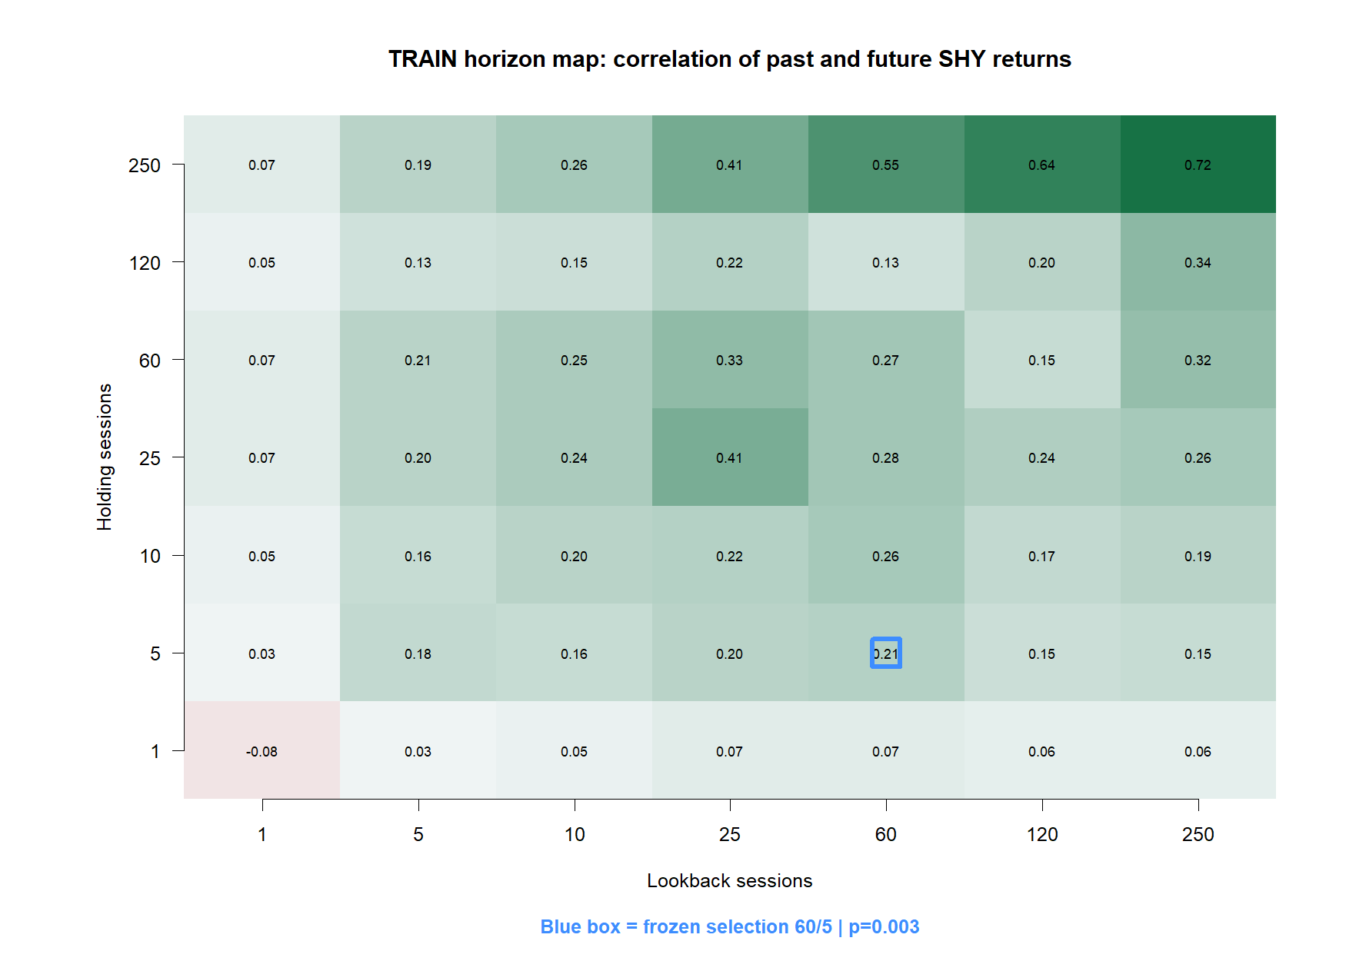
TRAIN selected 60/5 from the frozen 49-cell horizon screen
8
Notes:
The deterministic rule ranked supported swing candidates by the Pearson t-statistic, after requiring at least 20 sparse pairs and a holding period of at least five sessions. It selected 60/5 with n=201, correlation 0.2084, nominal p=0.0030, and 60.2% sign accuracy. High-correlation cells with too little support were not eligible.
[Sources]
- C:/Users/Franc/OneDrive/Documents/Francis/Peltata Project/Time-Series-Modeling-Gen5/literature_studies/docs/GEN5_LIT_MOM_01_1_INTERDAY_TIME_SERIES_MOMENTUM_POC_CONTRACT.md
- C:/Users/Franc/OneDrive/Documents/Francis/Peltata Project/Time-Series-Modeling-Gen5/runs/research_workbench/literature_grounded/lit_mom_01_1_interday_momentum_20260730_v6/lit_mom_01_1_train_horizon_screen.csv
- C:/Users/Franc/OneDrive/Documents/Francis/Peltata Project/Time-Series-Modeling-Gen5/runs/research_workbench/literature_grounded/lit_mom_01_1_interday_momentum_20260730_v6/lit_mom_01_1_selected_candidate.csv
- C:/Users/Franc/OneDrive/Documents/Francis/Peltata Project/Time-Series-Modeling-Gen5/runs/research_workbench/literature_grounded/lit_mom_01_1_interday_momentum_20260730_v6/visuals/lit_mom_01_1_train_horizon_map.png

Slide 9
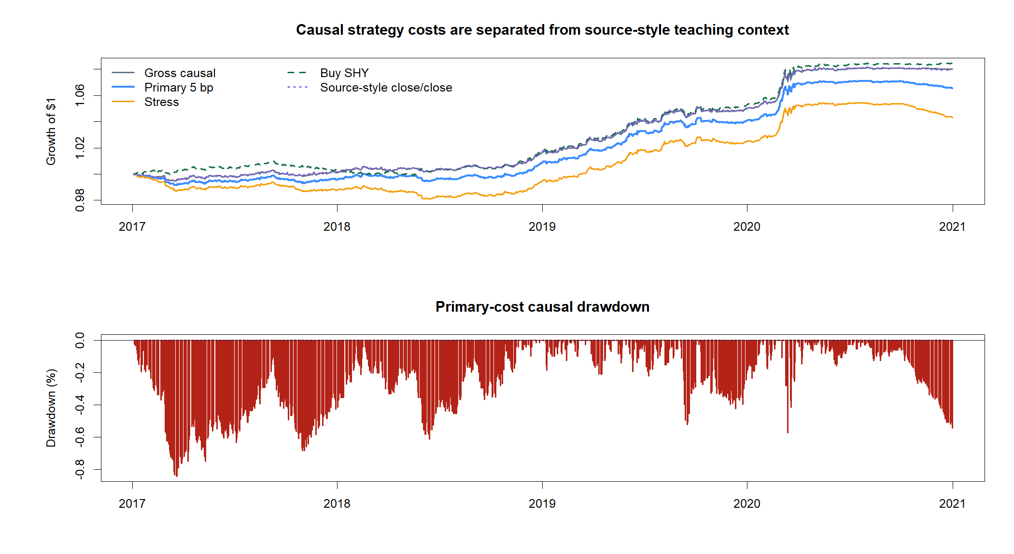
The selected 60/5 rule cleared every TRAIN gate
2017–2020 looked unusually clean: all six gates passed, including direction, ordinary costs, stress costs, and calendar stability. That earned exactly one frozen OOS replay—not an alpha claim.
+6.55%
1.55
Primary-cost TRAIN
Max drawdown −0.84%
Autocorrelation-adjusted
TRAIN Sharpe
9
Notes:
TRAIN primary-cost cumulative return was 6.55%, adjusted Sharpe 1.55, and maximum drawdown 0.84%. Stress return was 4.29%, three of four calendar years were positive, and 982 sleeves completed. These results passed the frozen gates and authorized DEVELOPMENT.
[Sources]
- C:/Users/Franc/OneDrive/Documents/Francis/Peltata Project/Time-Series-Modeling-Gen5/literature_studies/docs/GEN5_LIT_MOM_01_1_INTERDAY_MOMENTUM_RESULTS.md
- C:/Users/Franc/OneDrive/Documents/Francis/Peltata Project/Time-Series-Modeling-Gen5/runs/research_workbench/literature_grounded/lit_mom_01_1_interday_momentum_20260730_v6/train_performance_metrics.csv
- C:/Users/Franc/OneDrive/Documents/Francis/Peltata Project/Time-Series-Modeling-Gen5/runs/research_workbench/literature_grounded/lit_mom_01_1_interday_momentum_20260730_v6/lit_mom_01_1_train_gate_summary.csv
- C:/Users/Franc/OneDrive/Documents/Francis/Peltata Project/Time-Series-Modeling-Gen5/runs/research_workbench/literature_grounded/lit_mom_01_1_interday_momentum_20260730_v6/visuals/train_equity_drawdown.png

Slide 10
FROZEN OOS DEVELOPMENT | 2021–2023
Now ask whether
60/5 survives
No horizon, threshold, cost, instrument, or direction is reselected after seeing DEVELOPMENT. The sealed 2024+ CONFIRMATION window remains untouched.
Notes:
All TRAIN gates passed, so the POC opened the one predeclared 2021–2023 DEVELOPMENT replay with the same 60/5 rule and a flat start. No OOS promotion gate was invented after inspection.
[Sources]
- C:/Users/Franc/OneDrive/Documents/Francis/Peltata Project/Time-Series-Modeling-Gen5/literature_studies/docs/GEN5_LIT_MOM_01_1_INTERDAY_TIME_SERIES_MOMENTUM_POC_CONTRACT.md
- C:/Users/Franc/OneDrive/Documents/Francis/Peltata Project/Time-Series-Modeling-Gen5/literature_studies/docs/GEN5_LIT_MOM_01_1_INTERDAY_MOMENTUM_RESULTS.md
- C:/Users/Franc/OneDrive/Documents/Francis/Peltata Project/Time-Series-Modeling-Gen5/runs/research_workbench/literature_grounded/lit_mom_01_1_interday_momentum_20260730_v6/lit_mom_01_1_run_spec.csv

Slide 11
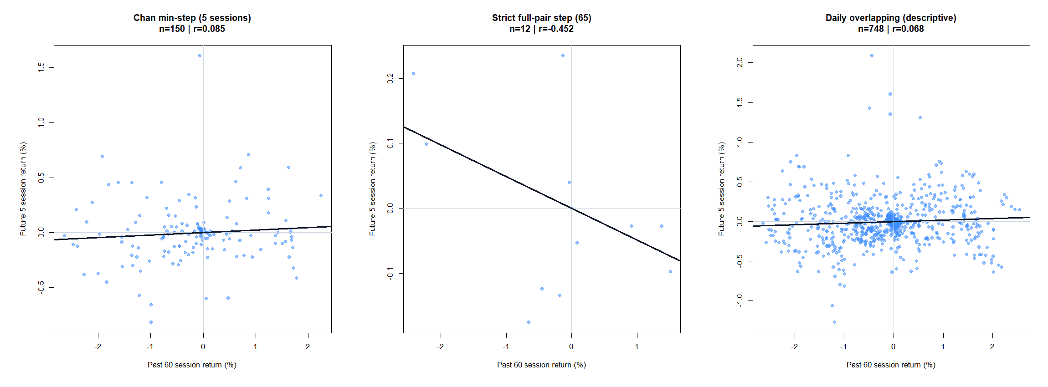
The TRAIN predictive relationship weakened out of sample
11
Notes:
In DEVELOPMENT, the Chan min-step correlation fell to 0.0846 with nominal p=0.303 and sign accuracy 44%. The strict 65-session view had only 12 observations and negative correlation. The daily-overlapping view is descriptive because adjacent labels heavily reuse observations.
[Sources]
- C:/Users/Franc/OneDrive/Documents/Francis/Peltata Project/Time-Series-Modeling-Gen5/literature_studies/docs/GEN5_LIT_MOM_01_1_INTERDAY_MOMENTUM_RESULTS.md
- C:/Users/Franc/OneDrive/Documents/Francis/Peltata Project/Time-Series-Modeling-Gen5/runs/research_workbench/literature_grounded/lit_mom_01_1_interday_momentum_20260730_v6/development_correlation_summary.csv
- C:/Users/Franc/OneDrive/Documents/Francis/Peltata Project/Time-Series-Modeling-Gen5/runs/research_workbench/literature_grounded/lit_mom_01_1_interday_momentum_20260730_v6/development_direction_confusion.csv
- C:/Users/Franc/OneDrive/Documents/Francis/Peltata Project/Time-Series-Modeling-Gen5/runs/research_workbench/literature_grounded/lit_mom_01_1_interday_momentum_20260730_v6/visuals/development_correlation_views.png

Slide 12
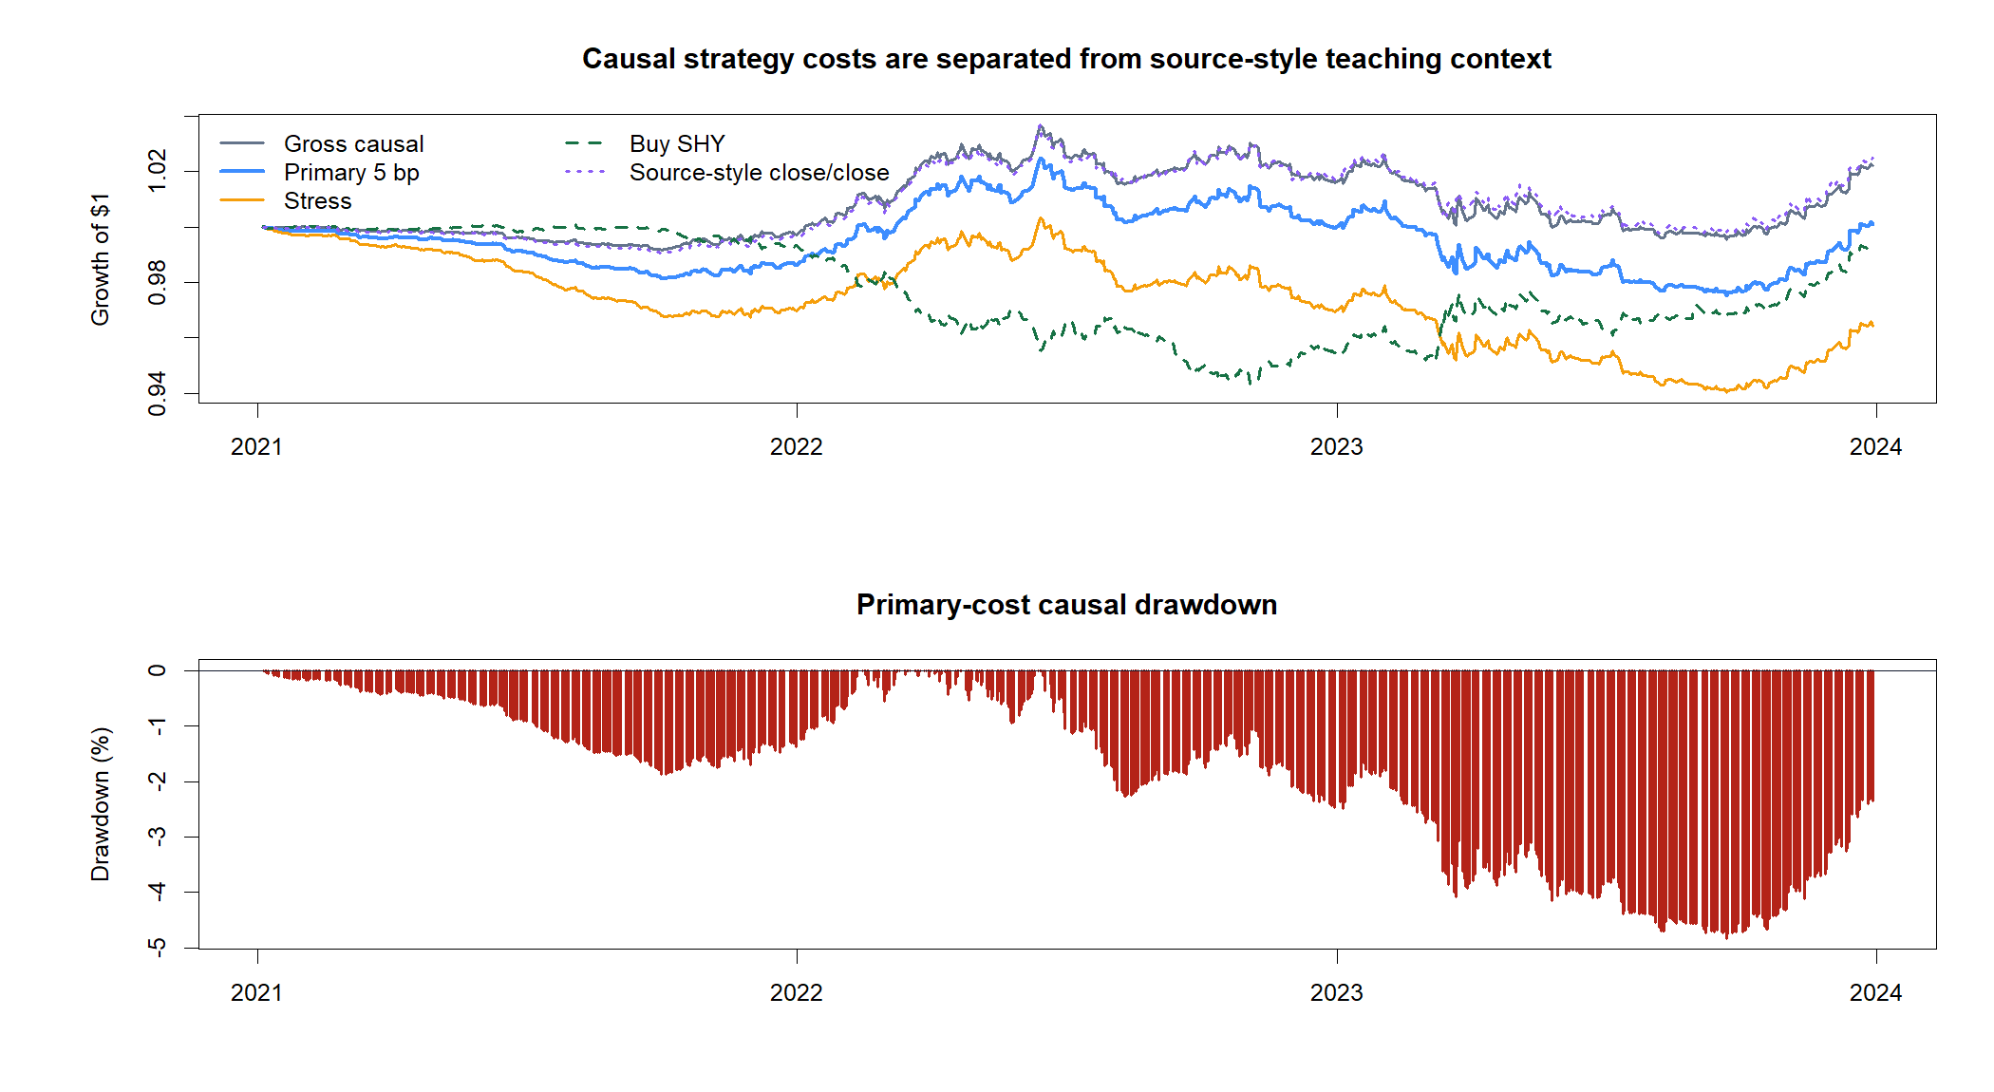
Gross movement existed; ordinary costs consumed almost all of it
12
Notes:
The 2021–2023 gross strategy gained 2.22%, but primary-cost cumulative return was only 0.09%, adjusted Sharpe 0.03, and maximum drawdown 4.84%. Stress return was negative 3.56%. The result is economically flat under the ordinary cost convention and negative under stress.
[Sources]
- C:/Users/Franc/OneDrive/Documents/Francis/Peltata Project/Time-Series-Modeling-Gen5/literature_studies/docs/GEN5_LIT_MOM_01_1_INTERDAY_MOMENTUM_RESULTS.md
- C:/Users/Franc/OneDrive/Documents/Francis/Peltata Project/Time-Series-Modeling-Gen5/runs/research_workbench/literature_grounded/lit_mom_01_1_interday_momentum_20260730_v6/development_performance_metrics.csv
- C:/Users/Franc/OneDrive/Documents/Francis/Peltata Project/Time-Series-Modeling-Gen5/runs/research_workbench/literature_grounded/lit_mom_01_1_interday_momentum_20260730_v6/development_bar_replay.csv
- C:/Users/Franc/OneDrive/Documents/Francis/Peltata Project/Time-Series-Modeling-Gen5/runs/research_workbench/literature_grounded/lit_mom_01_1_interday_momentum_20260730_v6/visuals/development_equity_drawdown.png

Slide 13
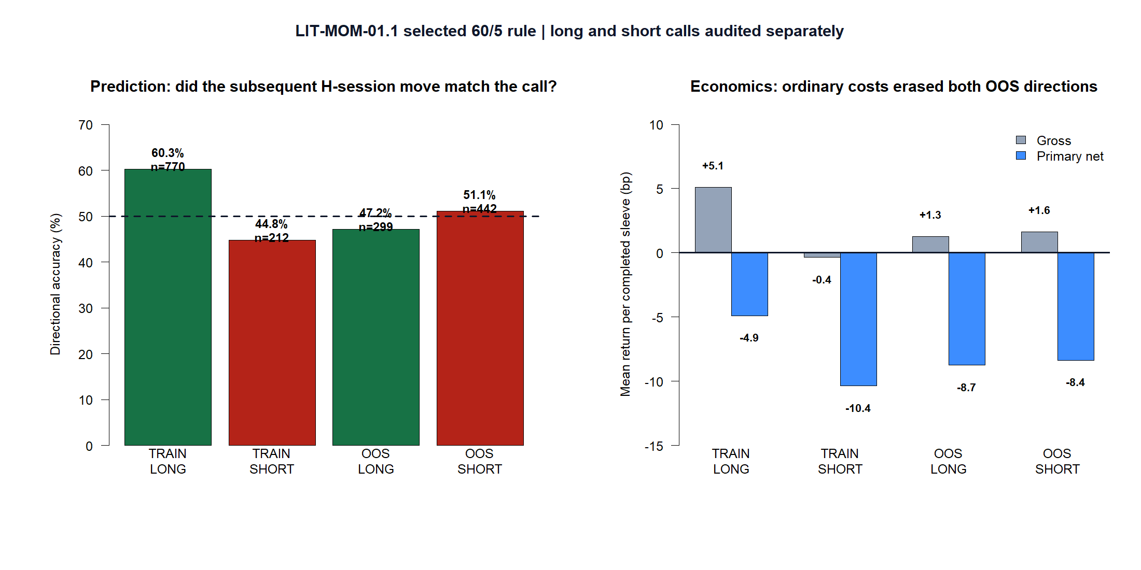
TRAIN’s long-side signal did not survive OOS—or ordinary costs
13
Notes:
TRAIN was asymmetric: 770 long sleeves were 60.3% directionally correct and averaged +5.1 bp gross, while 212 short sleeves were 44.8% correct and slightly negative gross. In OOS, long accuracy fell to 47.2%; short accuracy was 51.1%. Both directions were mildly positive gross but averaged about -8 to -9 bp after the frozen primary round-trip cost. This is why direction prediction and implementable P&L must be audited separately.
[Sources]
- C:/Users/Franc/OneDrive/Documents/Francis/Peltata Project/Time-Series-Modeling-Gen5/literature_studies/docs/GEN5_LIT_MOM_01_1_INTERDAY_MOMENTUM_RESULTS.md
- C:/Users/Franc/OneDrive/Documents/Francis/Peltata Project/Time-Series-Modeling-Gen5/runs/research_workbench/literature_grounded/lit_mom_01_1_interday_momentum_20260730_v6/train_completed_sleeves.csv
- C:/Users/Franc/OneDrive/Documents/Francis/Peltata Project/Time-Series-Modeling-Gen5/runs/research_workbench/literature_grounded/lit_mom_01_1_interday_momentum_20260730_v6/development_completed_sleeves.csv
- C:/Users/Franc/OneDrive/Documents/Francis/Peltata Project/Time-Series-Modeling-Gen5/literature_studies/scripts/render_gen5_lit_mom_01_1_revisit_audit.R

Slide 14
TEXTBOOK EXERCISE COMPLETE | RESEARCH DECISION
The workflow worked.
The edge did not persist.
Keep 250/25 as the canonical literature example and 60/5 as the frozen SHY result. Record the OOS falsification, stop before CONFIRMATION, and move to the next Chapter 6 exercise without reactive retuning.
Notes:
The important success is methodological: the POC reproduced Chan's horizon-screening logic, distinguished sparse inference from daily sleeve trading, and produced a causal OOS test. The strong TRAIN pattern did not survive economically. The recommended decision is STOP before sealed CONFIRMATION, with no post-hoc horizon rescue.
[Sources]
- C:/Users/Franc/OneDrive/Documents/Francis/Peltata Project/Time-Series-Modeling-Gen5/literature_studies/docs/GEN5_LIT_MOM_01_1_INTERDAY_MOMENTUM_RESULTS.md
- C:/Users/Franc/OneDrive/Documents/Francis/Peltata Project/Time-Series-Modeling-Gen5/literature_studies/docs/GEN5_LIT_MOM_01_1_INTERDAY_TIME_SERIES_MOMENTUM_POC_CONTRACT.md
- C:/Users/Franc/OneDrive/Documents/Francis/Peltata Project/Time-Series-Modeling-Gen5/runs/research_workbench/literature_grounded/lit_mom_01_1_interday_momentum_20260730_v6/lit_mom_01_1_report.md

