Slide 1
49 L/H cells per asset | fixed-H compounding | 2021-2023 retrospective
LIT-MOM-01.2
Single-position interday momentum: SHY mechanics tutorial plus a 22-stock horizon-selection atlas
Notes:
LIT-MOM-01.2 changes only the capital-deployment rule. It first demonstrates the mechanics on SHY, then repeats the complete per-asset 49-cell TRAIN selector across a frozen 22-stock sector-balanced atlas. Every 2021-2023 result is retrospective exploration rather than fresh out-of-sample confirmation.
[Sources]
- C:/Users/Franc/OneDrive/Documents/Francis/Trading Literature/Algorithmic Trading - Winning Strategies and Their Rationale 2013.pdf - printed pages 135-139; PDF pages 153-157
- C:/Users/Franc/OneDrive/Documents/Francis/Peltata Project/Time-Series-Modeling-Gen5/literature_studies/docs/GEN5_LIT_MOM_01_2_SINGLE_POSITION_RETROSPECTIVE_CONTRACT.md
- C:/Users/Franc/OneDrive/Documents/Francis/Peltata Project/Time-Series-Modeling-Gen5/literature_studies/docs/GEN5_LIT_MOM_01_2_STOCK_ATLAS_01_RETROSPECTIVE_CONTRACT.md
- C:\Users\Franc\OneDrive\Documents\Francis\Peltata Project\Time-Series-Modeling-Gen5\runs\research_workbench\literature_grounded\lit_mom_01_2_single_position_retrospective_20260802/lit_mom_01_2_report.md
- C:\Users\Franc\OneDrive\Documents\Francis\Peltata Project\Time-Series-Modeling-Gen5\runs\research_workbench\literature_grounded\lit_mom_01_2_stock_atlas_01_retrospective_20260802/stock_atlas_01_report.md

Slide 2
Same hypothesis; one substantive execution change
The experiment isolates a simple operator question: what happens when each accepted signal owns the whole account for H sessions instead of entering one 1/H sleeve every day?
KEEP
CHANGE
PROTECT
Signal + selector
49 L/H cells; TRAIN only
Capital rule
One non-overlapping full position
Evidence boundary
Retrospective, not confirmation
2
Notes:
This is a version-worthy mechanic change, hence 01.2. Horizon selection remains open and TRAIN-only. The selected policy then runs as one fixed-quantity trade at a time, with no pyramiding and no intra-trade rebalance. Reusing the known 2021-2023 window is allowed for learning, but the label must remain retrospective exploration.
[Sources]
- C:/Users/Franc/OneDrive/Documents/Francis/Peltata Project/Time-Series-Modeling-Gen5/literature_studies/docs/GEN5_LIT_MOM_01_2_SINGLE_POSITION_RETROSPECTIVE_CONTRACT.md
- C:\Users\Franc\OneDrive\Documents\Francis\Peltata Project\Time-Series-Modeling-Gen5\runs\research_workbench\literature_grounded\lit_mom_01_2_single_position_retrospective_20260802/lit_mom_01_2_run_spec.csv
- C:\Users\Franc\OneDrive\Documents\Francis\Peltata Project\Time-Series-Modeling-Gen5\runs\research_workbench\literature_grounded\lit_mom_01_2_single_position_retrospective_20260802/lit_mom_01_2_integrity_audit.csv

Slide 3
Three spacing views keep dependence visible
The selector uses Chan's shorter-leg step. Two diagnostics deliberately trade observations for separation. They are inference views only; execution still recalculates causally at each eligible decision.
min(L,H)
L
L+H
PRIMARY
201 TRAIN pairs at 60/5
DISTINCT FORMATION
17 pairs; phase audit retained
STRICT
16 pairs; no raw interval reused
3
Notes:
CHAN_MIN_STEP=min(L,H) is the primary view because it preserves the most observations while preventing overlap in the shorter leg. STEP_L directly addresses distinct formation episodes, but H can overlap and the answer depends on phase. L+H is the strongest raw-interval separation and the sparsest sensitivity. These are not three separate strategies.
[Sources]
- C:/Users/Franc/OneDrive/Documents/Francis/Trading Literature/Algorithmic Trading - Winning Strategies and Their Rationale 2013.pdf - printed pages 135-139; PDF pages 153-157
- C:/Users/Franc/OneDrive/Documents/Francis/Peltata Project/Time-Series-Modeling-Gen5/literature_studies/docs/GEN5_LIT_MOM_01_2_SINGLE_POSITION_RETROSPECTIVE_CONTRACT.md
- C:\Users\Franc\OneDrive\Documents\Francis\Peltata Project\Time-Series-Modeling-Gen5\runs\research_workbench\literature_grounded\lit_mom_01_2_single_position_retrospective_20260802/train_inference_summary.csv
- C:\Users\Franc\OneDrive\Documents\Francis\Peltata Project\Time-Series-Modeling-Gen5\runs\research_workbench\literature_grounded\lit_mom_01_2_single_position_retrospective_20260802/train_step_l_phase_offsets.csv

Slide 4
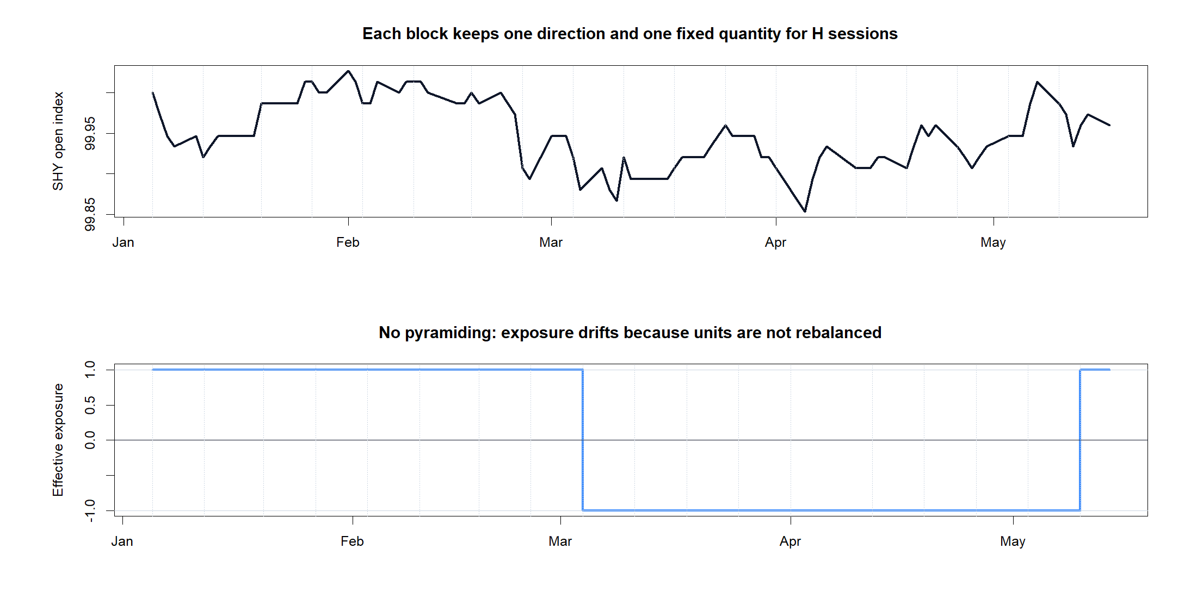
One signal owns the account for exactly H opens
s_t = sign(C_t / C_(t-L) - 1)
After close t, enter s_t at the next open.
Set entry notional from current equity; freeze quantity.
Hold exactly H open-to-open intervals.
Exit; a new signal may re-enter at that same open.
E_(k+1) = E_k + trade P&L - costs
No pyramiding. No intra-trade rebalance.
The next trade reinvests the account's current equity.
4
Notes:
The quantity is chosen once at entry and held fixed, so effective exposure drifts slightly as price and equity move. After H open-to-open intervals, the position exits. If the preceding close produced another signal, the next trade may enter at that same open. Each next trade sizes from current equity, so gains and losses are reinvested.
[Sources]
- C:/Users/Franc/OneDrive/Documents/Francis/Peltata Project/Time-Series-Modeling-Gen5/literature_studies/docs/GEN5_LIT_MOM_01_2_SINGLE_POSITION_RETROSPECTIVE_CONTRACT.md
- C:/Users/Franc/OneDrive/Documents/Francis/Peltata Project/Time-Series-Modeling-Gen5/literature_studies/R/gen5_lit_mom_01_2_single_position_poc.R
- C:\Users\Franc\OneDrive\Documents\Francis\Peltata Project\Time-Series-Modeling-Gen5\runs\research_workbench\literature_grounded\lit_mom_01_2_single_position_retrospective_20260802/retrospective_trades.csv
- C:\Users\Franc\OneDrive\Documents\Francis\Peltata Project\Time-Series-Modeling-Gen5\runs\research_workbench\literature_grounded\lit_mom_01_2_single_position_retrospective_20260802\visuals/retrospective_trade_tape.png

Slide 5
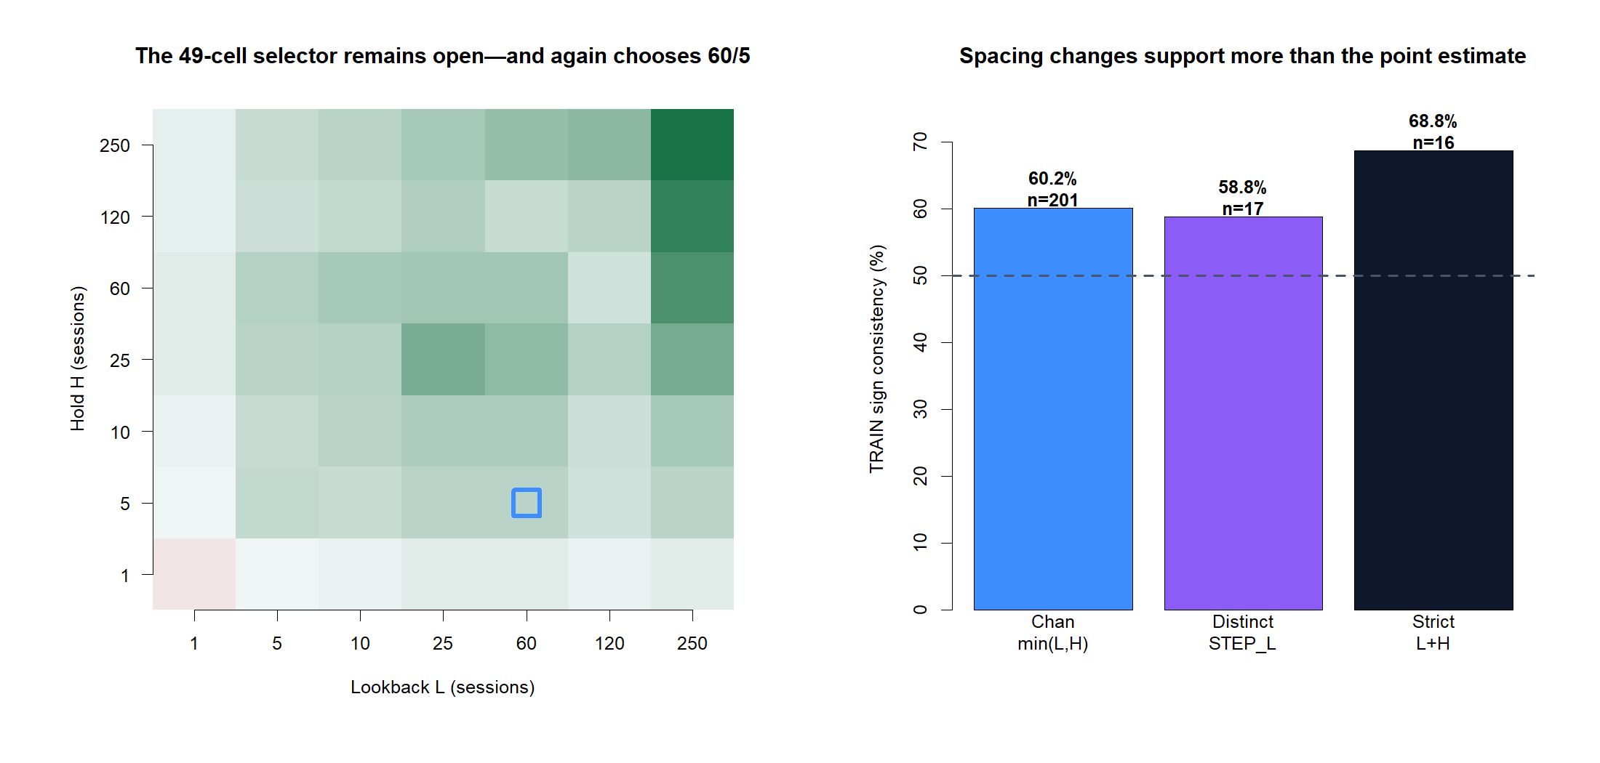
The open 49-cell TRAIN search again selects 60/5
5
Notes:
The full 7-by-7 horizon grid stayed open. The frozen selection rule again chose L=60 and H=5 using TRAIN only. At 60/5, the primary view had r=0.208, naive p=0.003, and 60.2% sign consistency. The point estimates remained positive in the two sparser TRAIN views, but their sample sizes were only 17 and 16.
[Sources]
- C:/Users/Franc/OneDrive/Documents/Francis/Peltata Project/Time-Series-Modeling-Gen5/literature_studies/docs/GEN5_LIT_MOM_01_2_SINGLE_POSITION_RETROSPECTIVE_CONTRACT.md
- C:\Users\Franc\OneDrive\Documents\Francis\Peltata Project\Time-Series-Modeling-Gen5\runs\research_workbench\literature_grounded\lit_mom_01_2_single_position_retrospective_20260802/lit_mom_01_2_train_horizon_screen.csv
- C:\Users\Franc\OneDrive\Documents\Francis\Peltata Project\Time-Series-Modeling-Gen5\runs\research_workbench\literature_grounded\lit_mom_01_2_single_position_retrospective_20260802/lit_mom_01_2_selected_candidate.csv
- C:\Users\Franc\OneDrive\Documents\Francis\Peltata Project\Time-Series-Modeling-Gen5\runs\research_workbench\literature_grounded\lit_mom_01_2_single_position_retrospective_20260802\visuals/lit_mom_01_2_horizon_and_spacing.png

Slide 6
RETROSPECTIVE EXPLORATION | NOT FRESH OOS
Now ask what the simpler execution actually did
Replay the selected 60/5 policy through 2021-2023 as one fully invested block at a time. Preserve causality, costs, and compounding - but do not call the known window new confirmation.
Notes:
This transition is the central evidence boundary. The selected policy is causally replayed, but the 2021-2023 period had already been inspected during LIT-MOM-01.1. Therefore the run is useful for learning about execution mechanics, not for upgrading the strategy's evidential status.
[Sources]
- C:/Users/Franc/OneDrive/Documents/Francis/Peltata Project/Time-Series-Modeling-Gen5/literature_studies/docs/GEN5_LIT_MOM_01_2_SINGLE_POSITION_RETROSPECTIVE_CONTRACT.md
- C:\Users\Franc\OneDrive\Documents\Francis\Peltata Project\Time-Series-Modeling-Gen5\runs\research_workbench\literature_grounded\lit_mom_01_2_single_position_retrospective_20260802/lit_mom_01_2_run_spec.csv
- C:\Users\Franc\OneDrive\Documents\Francis\Peltata Project\Time-Series-Modeling-Gen5\runs\research_workbench\literature_grounded\lit_mom_01_2_single_position_retrospective_20260802/lit_mom_01_2_report.md

Slide 7
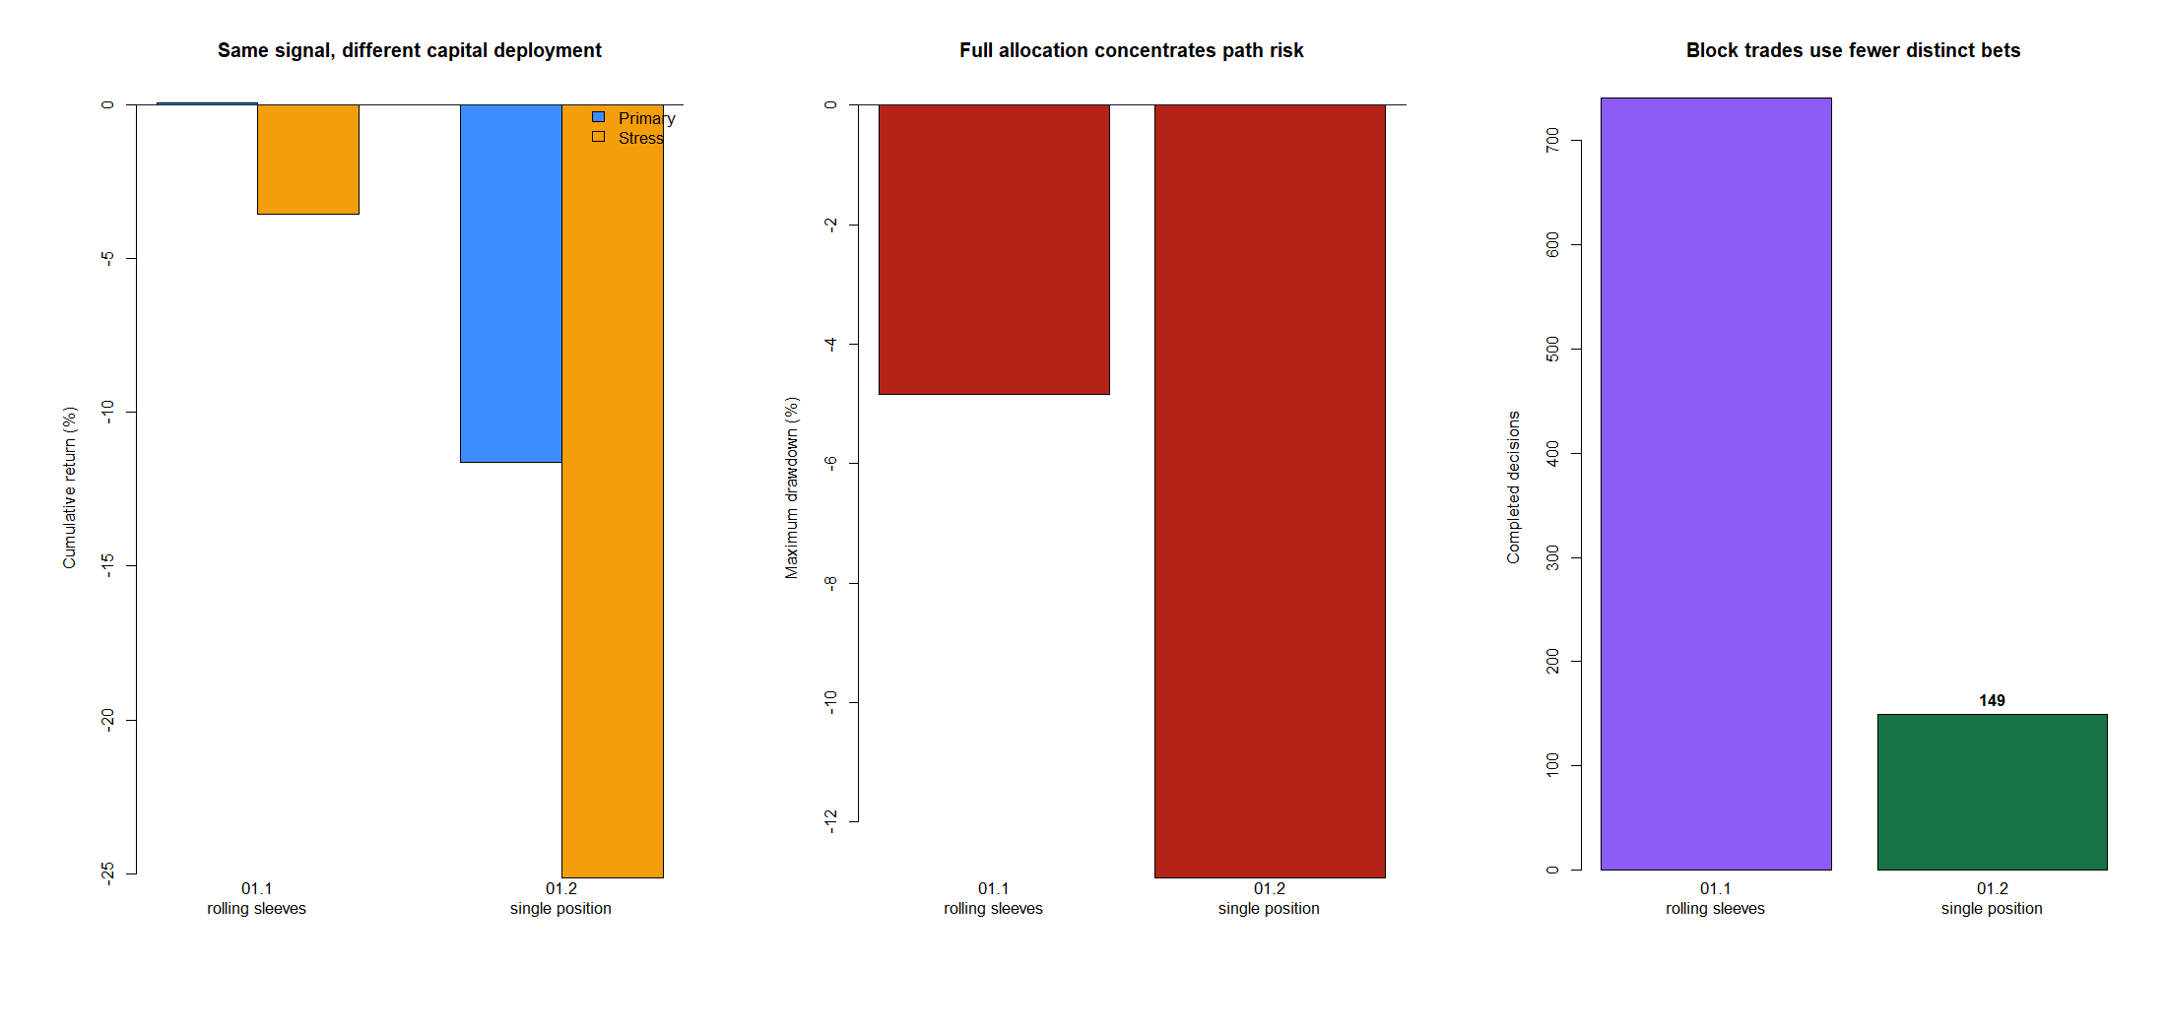
The SHY tutorial was mechanically clear - and cost-fragile
SHY's 60/5 path gained +2.60% gross but lost 11.61% after literal 5 bp-per-side exits and re-entries. The comparison also changes turnover accounting: 01.1 costs aggregate exposure changes, so it is not a pure concentration test.
+2.60%
-11.61%
01.2 GROSS
149 block trades
01.2 PRIMARY
5 bp per side
7
Notes:
The SHY tutorial retained the full open horizon search and selected 60/5. It completed 149 fixed-quantity trades: +2.60% gross, -11.61% primary, -25.15% stress, and -12.94% primary maximum drawdown. Retrospective long/short accuracy was 56.5%/50.6%, but both directions lost about 8 bp per trade after primary costs. The 01.1 and 01.2 cost conventions differ and that caveat is part of the result.
[Sources]
- C:\Users\Franc\OneDrive\Documents\Francis\Peltata Project\Time-Series-Modeling-Gen5\runs\research_workbench\literature_grounded\lit_mom_01_2_single_position_retrospective_20260802/retrospective_performance_metrics.csv
- C:\Users\Franc\OneDrive\Documents\Francis\Peltata Project\Time-Series-Modeling-Gen5\runs\research_workbench\literature_grounded\lit_mom_01_2_single_position_retrospective_20260802/retrospective_direction_audit.csv
- C:\Users\Franc\OneDrive\Documents\Francis\Peltata Project\Time-Series-Modeling-Gen5\runs\research_workbench\literature_grounded\lit_mom_01_2_single_position_retrospective_20260802/lit_mom_01_2_variant_comparison.csv
- C:\Users\Franc\OneDrive\Documents\Francis\Peltata Project\Time-Series-Modeling-Gen5\runs\research_workbench\literature_grounded\lit_mom_01_2_single_position_retrospective_20260802\visuals/lit_mom_01_2_variant_comparison.png

Slide 8
22 STOCKS | 11 SECTORS | 1,078 TRAIN CELLS
SHY is the tutorial - not the research destination
Now repeat the complete process across a frozen diverse panel: all 49 L/H cells in each stock's TRAIN data, one per-stock winner frozen, then one known-window replay under the same 01.2 execution.
Notes:
The operator clarified that SHY is only the minimal mechanics POC. The substantive atlas repeats the entire per-asset horizon-selection process across the pre-existing 22-stock, eleven-sector registry, without choosing a common horizon or a retrospective winner.
[Sources]
- C:/Users/Franc/OneDrive/Documents/Francis/Peltata Project/Time-Series-Modeling-Gen5/literature_studies/docs/GEN5_LIT_MOM_01_2_STOCK_ATLAS_01_RETROSPECTIVE_CONTRACT.md
- C:/Users/Franc/OneDrive/Documents/Francis/Peltata Project/Time-Series-Modeling-Gen5/literature_studies/registries/gen5_lit_mom_01_1_stock_atlas_01_registry.csv
- C:\Users\Franc\OneDrive\Documents\Francis\Peltata Project\Time-Series-Modeling-Gen5\runs\research_workbench\literature_grounded\lit_mom_01_2_stock_atlas_01_retrospective_20260802/stock_atlas_01_report.md

Slide 9
Each asset gets its own full TRAIN search and frozen replay
The atlas reuses a panel selected for sector breadth, economic diversity, liquidity, and history before 01.2 outcomes. Every stock advances its highest TRAIN t-statistic row for retrospective learning - even if that best row is weak or negative.
UNIVERSE
TRAIN
REPLAY
22 stocks
Exactly two per sector
49 L/H cells each
1,078 total rows
One frozen winner each
Known 2021-2023 window
9
Notes:
Each stock independently evaluates all 49 L/H combinations in TRAIN and freezes the maximum correlation t-statistic subject to H at least five and minimum support. Because this is retrospective process exploration rather than gate admission, all 22 selected rows are replayed. A 'winner' means the deterministic maximum, not evidence that the row is promising.
[Sources]
- C:/Users/Franc/OneDrive/Documents/Francis/Peltata Project/Time-Series-Modeling-Gen5/literature_studies/docs/GEN5_LIT_MOM_01_2_STOCK_ATLAS_01_RETROSPECTIVE_CONTRACT.md
- C:\Users\Franc\OneDrive\Documents\Francis\Peltata Project\Time-Series-Modeling-Gen5\runs\research_workbench\literature_grounded\lit_mom_01_2_stock_atlas_01_retrospective_20260802/stock_atlas_01_train_horizon_screen.csv
- C:\Users\Franc\OneDrive\Documents\Francis\Peltata Project\Time-Series-Modeling-Gen5\runs\research_workbench\literature_grounded\lit_mom_01_2_stock_atlas_01_retrospective_20260802/stock_atlas_01_selected_horizons.csv

Slide 10
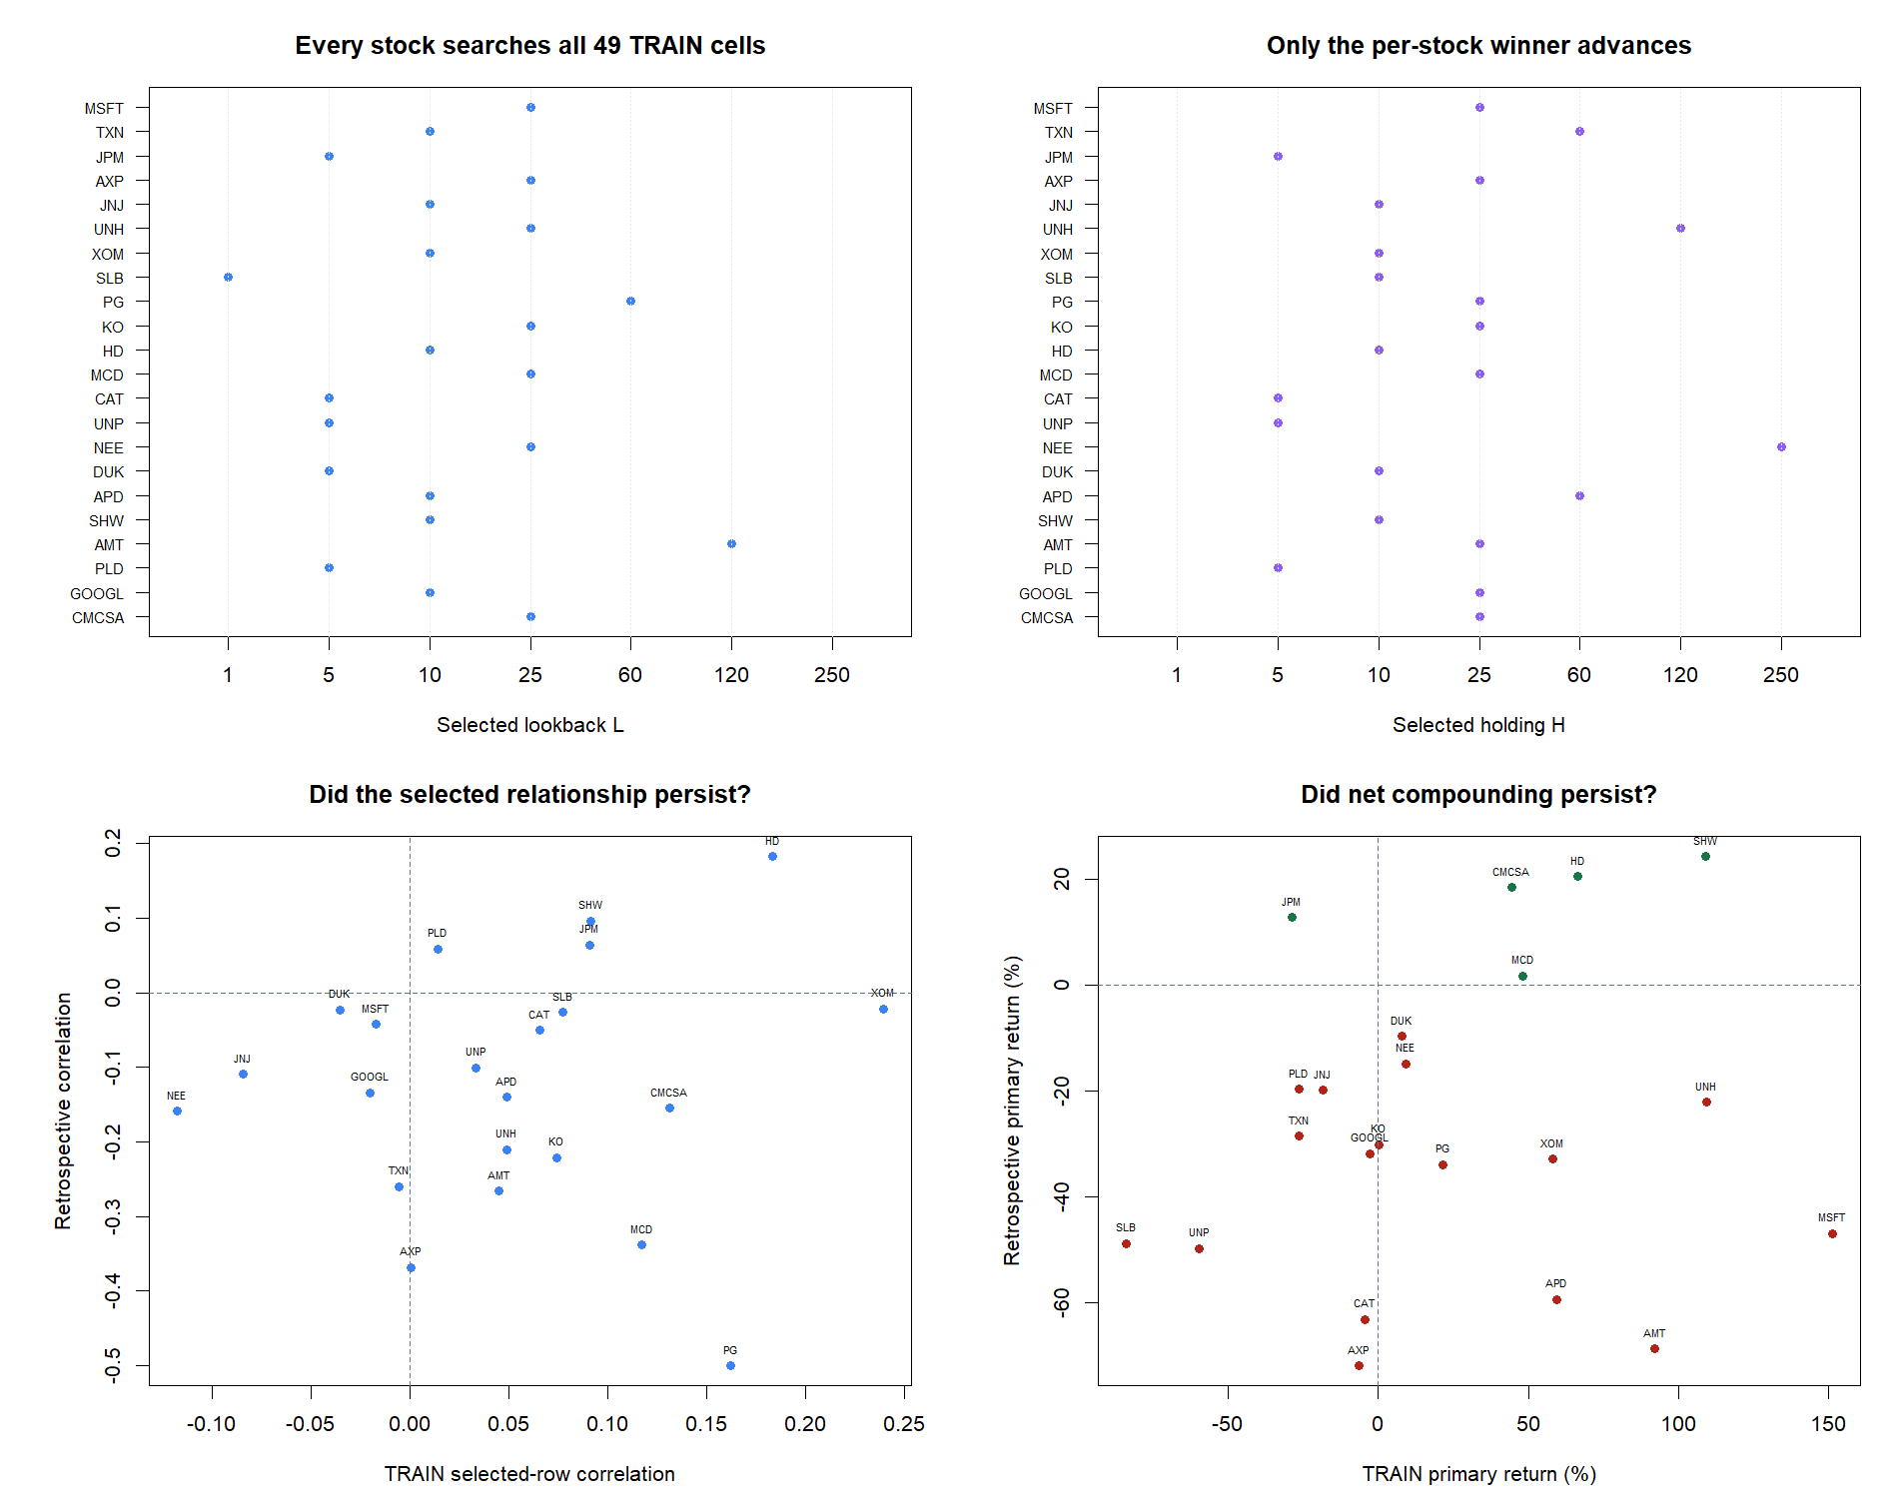
Horizon choices varied - and most selected relationships weakened
10
Notes:
The most common selected pair was 25/25 in five stocks, followed by 10/10 and 5/5 in four stocks each. Sixteen of 22 selected rows had positive TRAIN correlation, but only four had positive retrospective correlation. Eighteen had above-50% TRAIN sign consistency, while only eight stayed above 50% retrospectively.
[Sources]
- C:\Users\Franc\OneDrive\Documents\Francis\Peltata Project\Time-Series-Modeling-Gen5\runs\research_workbench\literature_grounded\lit_mom_01_2_stock_atlas_01_retrospective_20260802/stock_atlas_01_selected_horizons.csv
- C:\Users\Franc\OneDrive\Documents\Francis\Peltata Project\Time-Series-Modeling-Gen5\runs\research_workbench\literature_grounded\lit_mom_01_2_stock_atlas_01_retrospective_20260802/stock_atlas_01_summary.csv
- C:\Users\Franc\OneDrive\Documents\Francis\Peltata Project\Time-Series-Modeling-Gen5\runs\research_workbench\literature_grounded\lit_mom_01_2_stock_atlas_01_retrospective_20260802\visuals/stock_atlas_01_selection_and_continuity.png

Slide 11
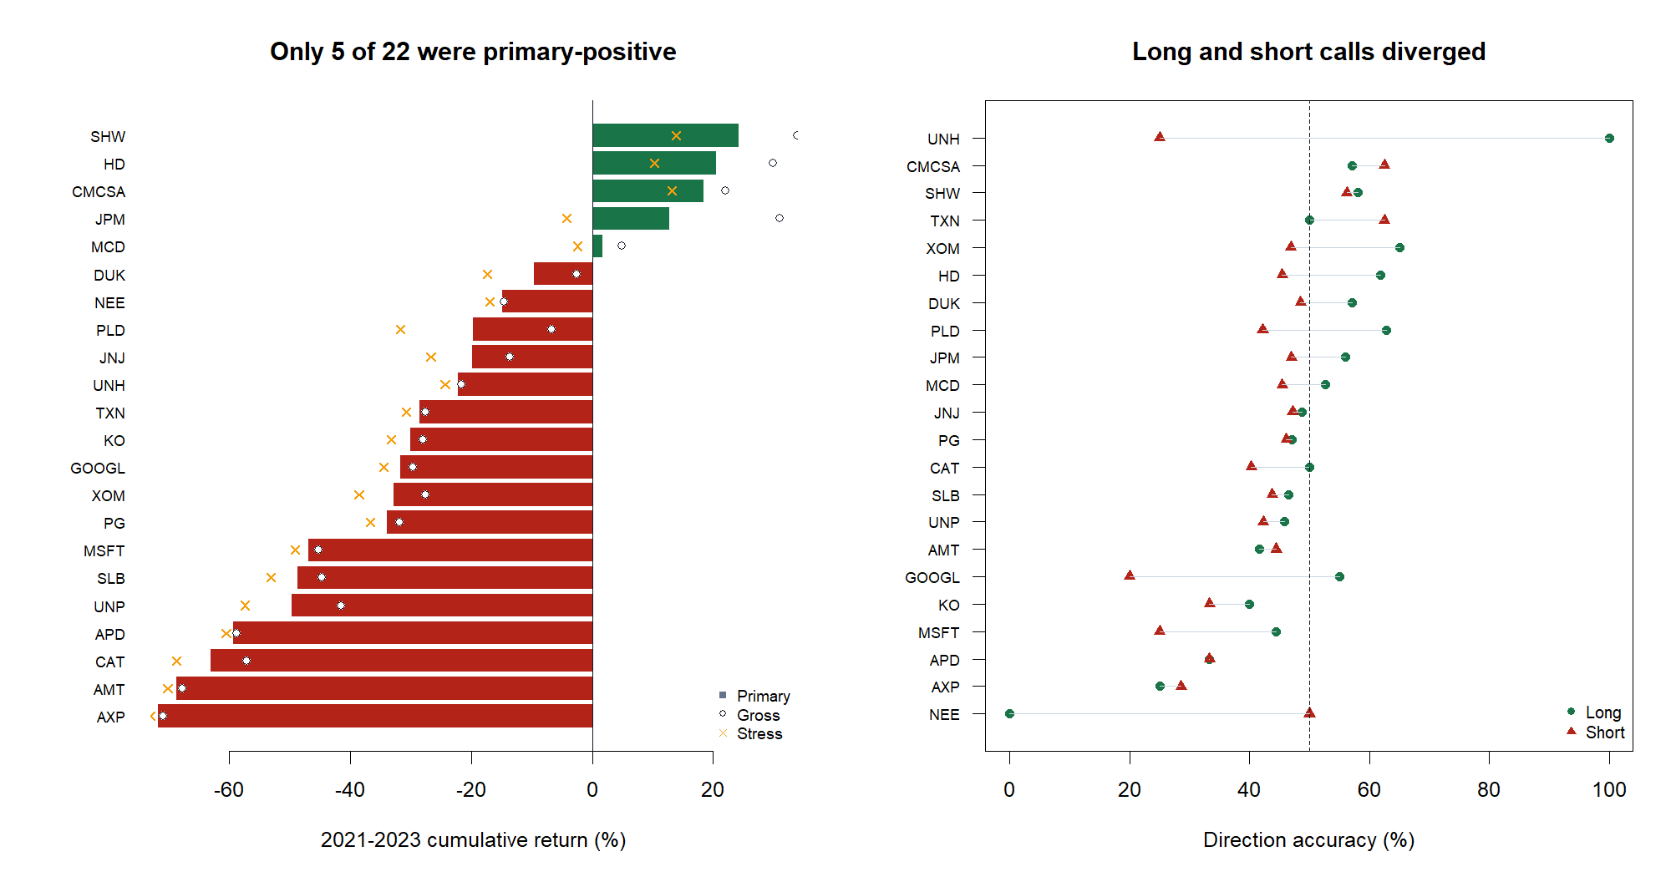
Only 5 of 22 were primary-positive; up/down quality also varied by side
11
Notes:
Only five assets were positive gross and primary, and three remained positive under stress. Median primary return was -29.31%, mean -26.09%, and worst drawdown -80.77%. Long and short accuracy often diverged; sparse direction counts can create extreme percentages and must not be read as precise probabilities. The five positive endpoints are displayed because every asset is displayed, not because they are nominations.
[Sources]
- C:\Users\Franc\OneDrive\Documents\Francis\Peltata Project\Time-Series-Modeling-Gen5\runs\research_workbench\literature_grounded\lit_mom_01_2_stock_atlas_01_retrospective_20260802/stock_atlas_01_batch_summary.csv
- C:\Users\Franc\OneDrive\Documents\Francis\Peltata Project\Time-Series-Modeling-Gen5\runs\research_workbench\literature_grounded\lit_mom_01_2_stock_atlas_01_retrospective_20260802/stock_atlas_01_summary.csv
- C:\Users\Franc\OneDrive\Documents\Francis\Peltata Project\Time-Series-Modeling-Gen5\runs\research_workbench\literature_grounded\lit_mom_01_2_stock_atlas_01_retrospective_20260802/stock_atlas_01_retrospective_direction_audit.csv
- C:\Users\Franc\OneDrive\Documents\Francis\Peltata Project\Time-Series-Modeling-Gen5\runs\research_workbench\literature_grounded\lit_mom_01_2_stock_atlas_01_retrospective_20260802\visuals/stock_atlas_01_return_and_direction.png

Slide 12
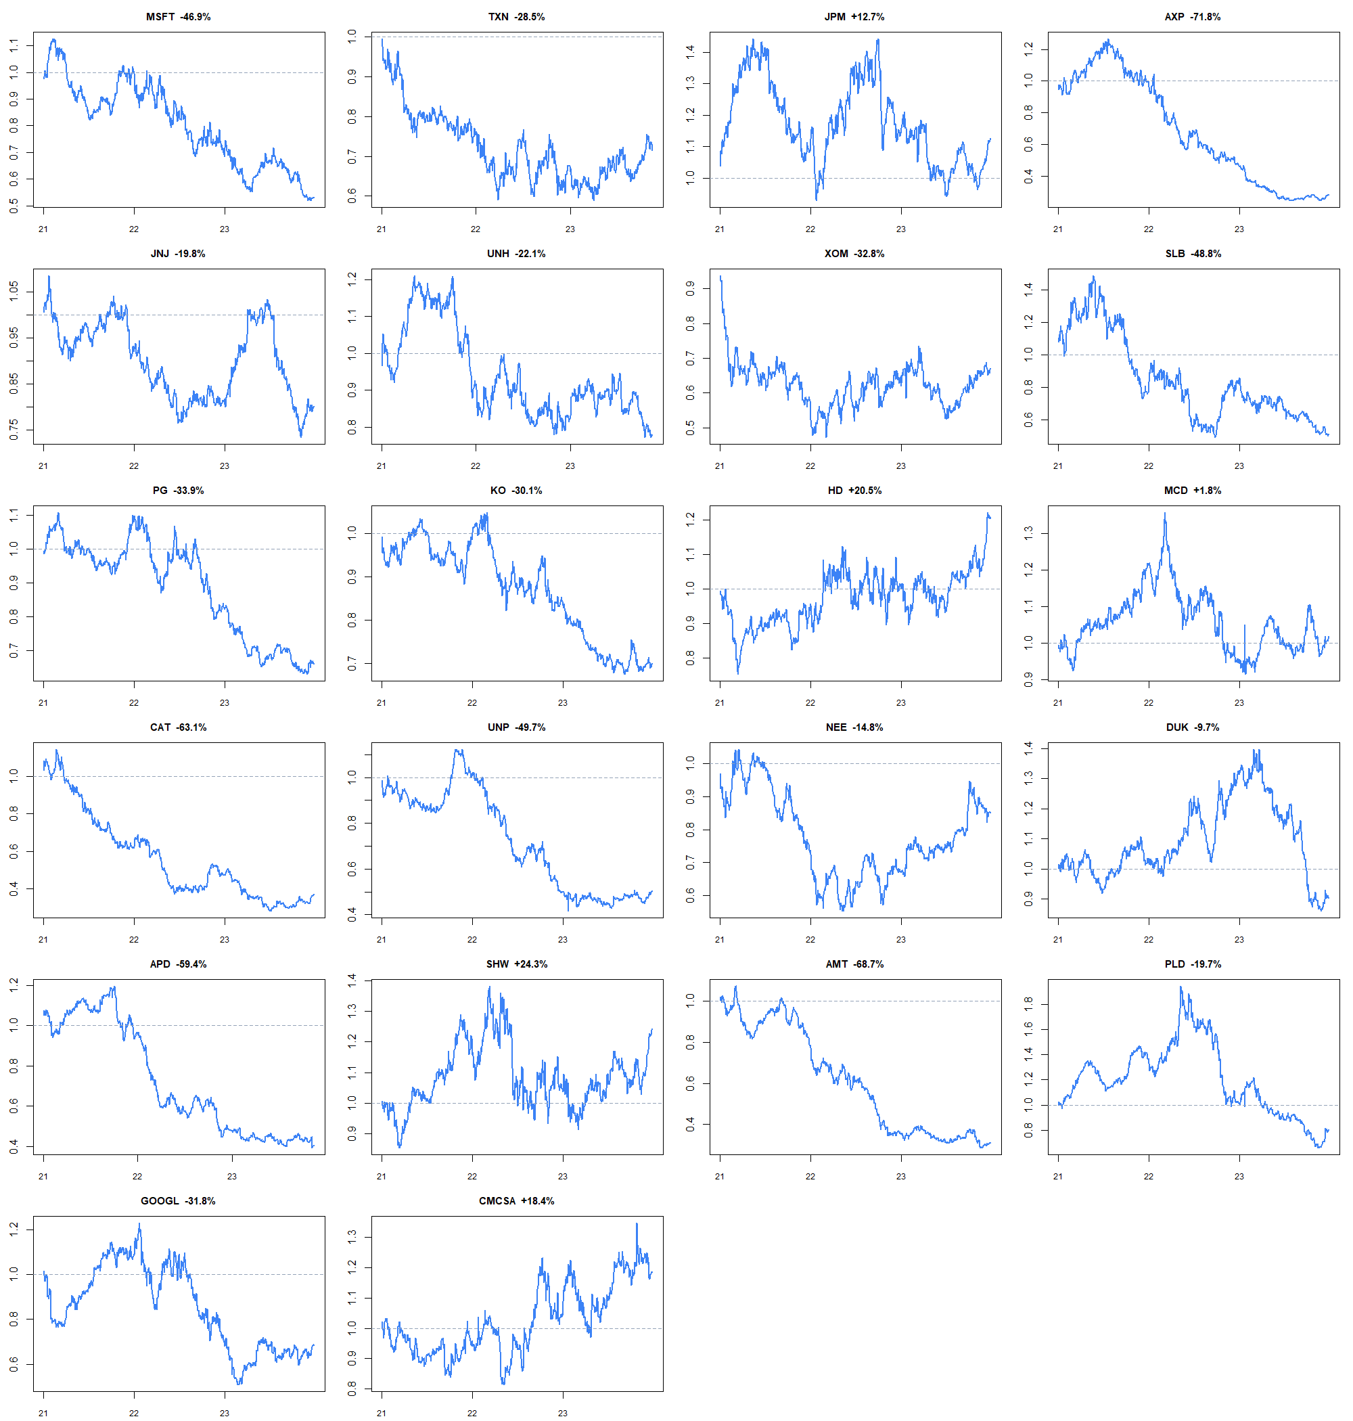
All 22 primary-cost paths stay visible - no winner is selected
12
Notes:
The small multiples prevent the five positive endpoints from hiding path risk. Several assets suffered deep persistent losses; even positive endpoints had substantial drawdowns. These are independent hypothetical one-dollar replays, not a combined portfolio.
[Sources]
- C:\Users\Franc\OneDrive\Documents\Francis\Peltata Project\Time-Series-Modeling-Gen5\runs\research_workbench\literature_grounded\lit_mom_01_2_stock_atlas_01_retrospective_20260802/stock_atlas_01_retrospective_bar_replay.csv
- C:\Users\Franc\OneDrive\Documents\Francis\Peltata Project\Time-Series-Modeling-Gen5\runs\research_workbench\literature_grounded\lit_mom_01_2_stock_atlas_01_retrospective_20260802/stock_atlas_01_summary.csv
- C:\Users\Franc\OneDrive\Documents\Francis\Peltata Project\Time-Series-Modeling-Gen5\runs\research_workbench\literature_grounded\lit_mom_01_2_stock_atlas_01_retrospective_20260802\visuals/stock_atlas_01_primary_equity_paths.png

Slide 13
The implementation worked: 1,078 TRAIN cells, 22 frozen winners, 220 integrity passes. The evidence did not generalize: 5 primary-positive and 3 stress-positive paths, with a -29.31% median primary return. Keep 2024+ sealed.
Keep the atlas as breadth evidence. Do not select the best known-window stock or form a portfolio.
The broad answer is still mostly no.
Notes:
The intended process is now implemented: per-asset open horizon selection followed by a frozen execution replay across a diverse panel. The result is concrete but not promising. Do not choose SHW or HD, remove shorts, net same-direction re-entry, pool a portfolio, or query 2024+ without a separately frozen operator decision.
[Sources]
- C:\Users\Franc\OneDrive\Documents\Francis\Peltata Project\Time-Series-Modeling-Gen5\runs\research_workbench\literature_grounded\lit_mom_01_2_stock_atlas_01_retrospective_20260802/stock_atlas_01_report.md
- C:/Users/Franc/OneDrive/Documents/Francis/Peltata Project/Time-Series-Modeling-Gen5/literature_studies/docs/GEN5_LIT_MOM_01_2_STOCK_ATLAS_01_RETROSPECTIVE_CONTRACT.md
- C:\Users\Franc\OneDrive\Documents\Francis\Peltata Project\Time-Series-Modeling-Gen5\runs\research_workbench\literature_grounded\lit_mom_01_2_stock_atlas_01_retrospective_20260802/stock_atlas_01_batch_summary.csv
- C:\Users\Franc\OneDrive\Documents\Francis\Peltata Project\Time-Series-Modeling-Gen5\runs\research_workbench\literature_grounded\lit_mom_01_2_stock_atlas_01_retrospective_20260802/stock_atlas_01_integrity_audit.csv
- C:\Users\Franc\OneDrive\Documents\Francis\Peltata Project\Time-Series-Modeling-Gen5\runs\research_workbench\literature_grounded\lit_mom_01_2_single_position_retrospective_20260802/lit_mom_01_2_report.md

