Slide 1
GEN5.4 • THEORY → MEASUREMENT → MODEL GATE
Cross-sectional asset
selection
A concise pivot deck • leakage-safe POC ladder • first X0/X1 evidence
01
Notes:
OPENING — CROSS-SECTIONAL ASSET SELECTION
Purpose
Record the pivot from a five-name conditional-exposure experiment to a wider cross-sectional ranking question, then document the first leakage-safe universe and measurement packet.
Conversation: codex://threads/019f741e-615f-7fd0-90f7-edce12b5cb66
Find in chat: reset and just like doing the approach from a wider perspective
Related artifact: docs/GEN5_4_CROSS_SECTIONAL_ASSET_SELECTION_POC_PLAN.md
Boundary: research and evidence only; no live authority.

Slide 2
Gen5.4 is widening the question
Rank a broad historical cross-section—without forcing a trade.
The new research question
Model fitting
Can same-date, point-in-time evidence identify which eligible assets will outperform the equal-weight universe over an executable horizon?
waits for
stable primitive evidence
D15/02
Notes:
DECISION D15 — CROSS-SECTIONAL RESET
Decision
Replace the narrow prospective-discovery claim with a pooled cross-sectional question over a frozen, diverse candidate panel.
Why
A wider panel supplies contemporaneous comparisons across assets and groups. It does not manufacture independence across dates or remove survivorship risk.
Conversation: codex://threads/019f741e-615f-7fd0-90f7-edce12b5cb66
Find in chat: 20 or 30 diverse assets
Artifact: docs/GEN5_4_CROSS_SECTIONAL_ASSET_SELECTION_POC_PLAN.md
Status: accepted research direction.

Slide 3
SESSION 5
The narrow basket becomes evidence;
the wider panel becomes the research question.
Universe integrity • relative target • cross-sectional ranks • cash gate • falsification
S5/03
Notes:
SESSION 5 — WIDE-UNIVERSE CROSS-SECTIONAL DESIGN
The prior five-name STOPs remain valid. This session asks a different question: whether relationships repeat across a wider set of contemporaneously eligible assets.
Conversation: codex://threads/019f741e-615f-7fd0-90f7-edce12b5cb66
Find in chat: approach from a wider perspective
Boundary: prior OOS results are not reinterpreted or rescued.

Slide 4
A cross-sectional engine still separates four decisions
1 Exposure permission
2 Asset ranking
Should a long-only portfolio take risk at all?
Which eligible names are strongest relative to the same-date universe?
3 Holding horizon
4 Portfolio policy
Does the score match a next-open, five-session exposure?
Can top-K selection survive turnover, concentration, and costs?
D16/04
Notes:
DECISION D16 — TWO-STAGE LONG-ONLY ARCHITECTURE
Decision
Keep exposure permission separate from cross-sectional asset ranking. Relative winners can still have negative absolute returns.
Why
A ranking model always names a winner. Cash/no-trade must remain a first-class competitor before a relative score becomes a long recommendation.
Conversation: codex://threads/019f741e-615f-7fd0-90f7-edce12b5cb66
Find in chat: Relative outperformance is not automatically a long-entry signal
Status: architecture principle; no portfolio policy is authorized.

Slide 5
The first wide panel is fixed, diverse, and explicitly imperfect
FIRST
SECOND
THIRD
24 ranked stocks
across six groups
6 market/risk anchors
for benchmarks only
Daily eligibility
uses trailing data
Fixed-panel POC: coverage and liquidity are auditable; survivorship remains a declared limitation.
D17/05
Notes:
DECISION D17 — FIXED PANEL AND POINT-IN-TIME ELIGIBILITY
Ranked candidates
24 long-history liquid stocks across semiconductors, platforms/media, high-beta special situations, defensive consumer/health, financials, and energy/industrials.
Context anchors
SPY, QQQ, IWM, SMH, TLT, and GLD are benchmark/context inputs, not ranked candidates.
Daily eligibility
Price at least $5, trailing 60-session median dollar volume at least $20 million, complete backward-looking features, and at least 20 eligible candidates on the same date.
Limitation
The names are frozen and survived into the research era. This is not a complete point-in-time US securities master.
Conversation: codex://threads/019f741e-615f-7fd0-90f7-edce12b5cb66
Find in chat: universe construction
Artifact: C:/Users/Franc/OneDrive/Documents/Francis/Peltata Project/Time-Series-Modeling-Gen5/runs/research_workbench/gen54_ml_decision_engine/g54_xs_20260719x0x1/xs_candidate_registry.csv

Slide 6
The target asks who wins—and whether winning is worth owning
At each after-close decision:
DECIDE
EXECUTE
1. observe through close t
2. screen point-in-time eligibility
3. execute at open t+1
4. measure at open t+6
5. compare with same-date equal weight
after close t
open t+1
hold → measure at open t+6
Primary: h5 relative return. Secondary: raw h5 return. Relative leadership never overrides cash/no-trade.
D18/06
Notes:
DECISION D18 — EXECUTION-ALIGNED CROSS-SECTIONAL TARGET
Primary label
Asset open(t+6) / open(t+1) - 1, minus the same-date equal-weight eligible-universe return over the identical interval.
Secondary control
Raw h5 open-to-open return preserves the absolute long-only question.
Validation
Twenty quarterly OOS authorities from 2020Q1 through 2024Q4; eight preceding TRAIN quarters remain reserved by contract; boundary-crossing labels are excluded.
Conversation: codex://threads/019f741e-615f-7fd0-90f7-edce12b5cb66
Find in chat: primary prediction target
Artifact: C:/Users/Franc/OneDrive/Documents/Francis/Peltata Project/Time-Series-Modeling-Gen5/runs/research_workbench/gen54_ml_decision_engine/g54_xs_20260719x0x1/xs_run_spec.csv

Slide 7
The POC ladder delays complexity until each layer earns it
X0 + X1
X2 + X3
X4 + X5
Universe integrity +
no-model measurement
Pooled linear ranker +
fixed nonlinear challenger
Top-K policy, costs +
fresh forward confirmation
Autonomous boundary: complete X0/X1 only. Model, portfolio policy, and live advice remain closed.
PLAN/07
Notes:
MINIMAL POC LADDER
X0 — Universe integrity
Coverage, role balance, point-in-time eligibility, and survivor limitation.
X1 — No-model measurement
Seven predeclared OHLCV primitives; same-date ranks; h5 relative outcomes; quarterly stability and group-concentration gates.
X2 — Pooled linear ranker
Only after at least two economically distinct primitives pass X1.
X3 — Fixed nonlinear challenger
Only after the linear lane establishes useful ranking and calibration evidence.
X4 — Long-only top-K policy
Add exposure permission, turnover, costs, and concentration without model retuning.
X5 — Fresh forward confirmation
Use 2026Q3 onward; prior windows are development evidence.
Conversation: codex://threads/019f741e-615f-7fd0-90f7-edce12b5cb66
Find in chat: plan a series of minimal proof of concepts

Slide 8
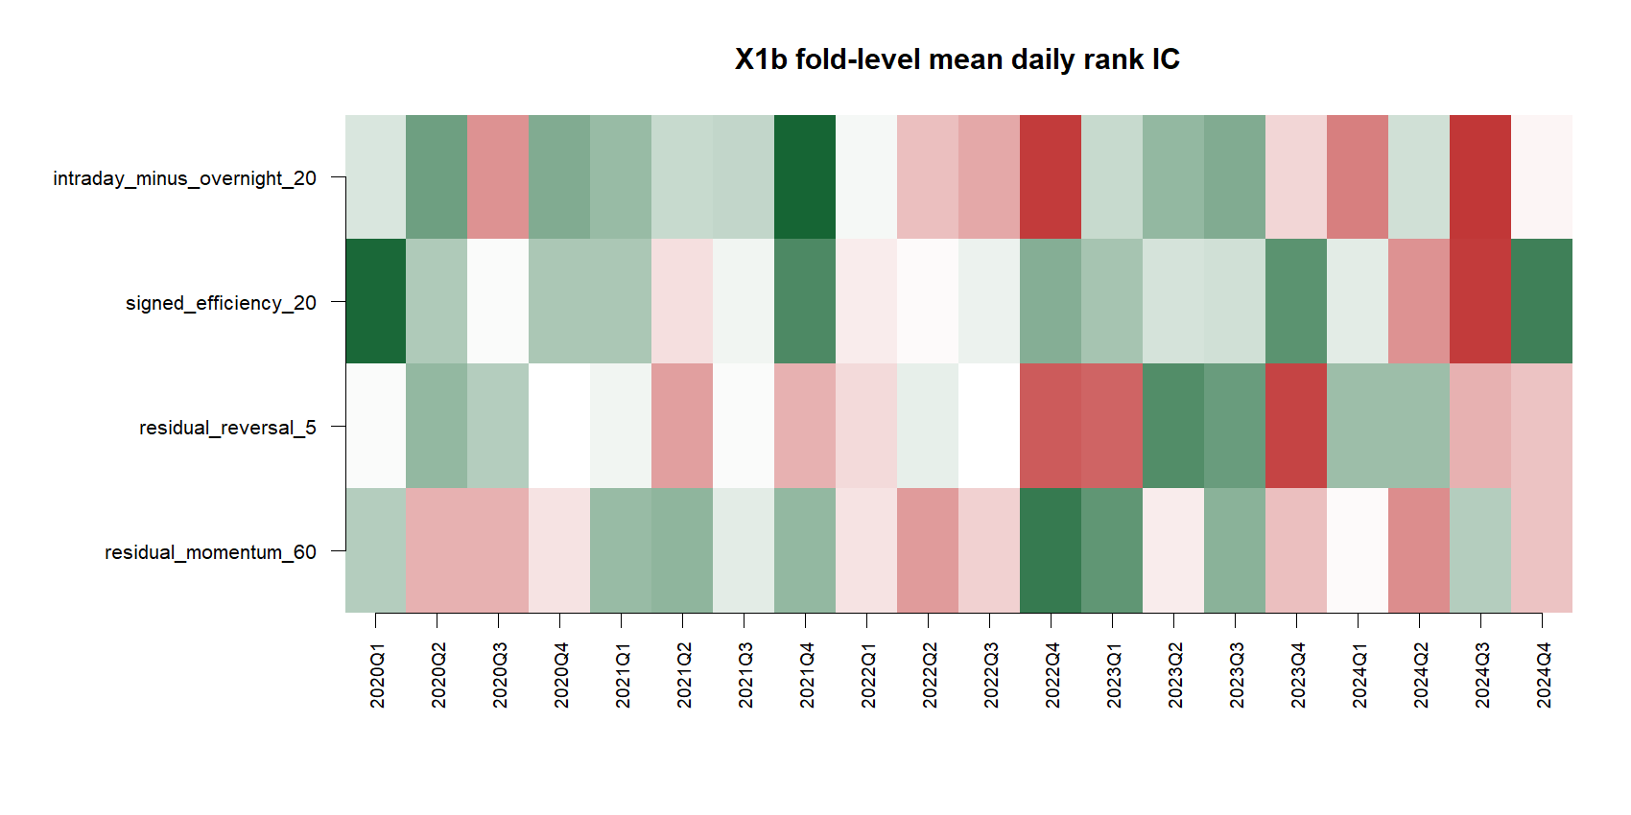
X0 passed: all 24 candidates support the fixed-panel audit
X0/08
Notes:
POC X0 — UNIVERSE INTEGRITY PASS
Evidence
61,620 adjusted-daily SIP bars across 30 declared symbols. All 24 ranked candidates passed the fixed-panel coverage check. The contemporaneous eligible count stayed at or above the frozen minimum after warm-up.
Refresh transparency
The initial cache-only attempt lacked some declared symbols. The affected adjusted-daily histories were refreshed from Alpaca and the packet was rerun before interpretation.
Conversation: codex://threads/019f741e-615f-7fd0-90f7-edce12b5cb66
Find in chat: Do we have enough assets to extract signal from noise
Plots: C:/Users/Franc/OneDrive/Documents/Francis/Peltata Project/Time-Series-Modeling-Gen5/runs/research_workbench/gen54_ml_decision_engine/g54_xs_20260719x0x1/visuals/xs_eligible_count.png and xs_coverage_heatmap.png
Manifest: C:/Users/Franc/OneDrive/Documents/Francis/Peltata Project/Time-Series-Modeling-Gen5/runs/research_workbench/gen54_ml_decision_engine/g54_xs_20260719x0x1/xs_universe_manifest.csv

Slide 9
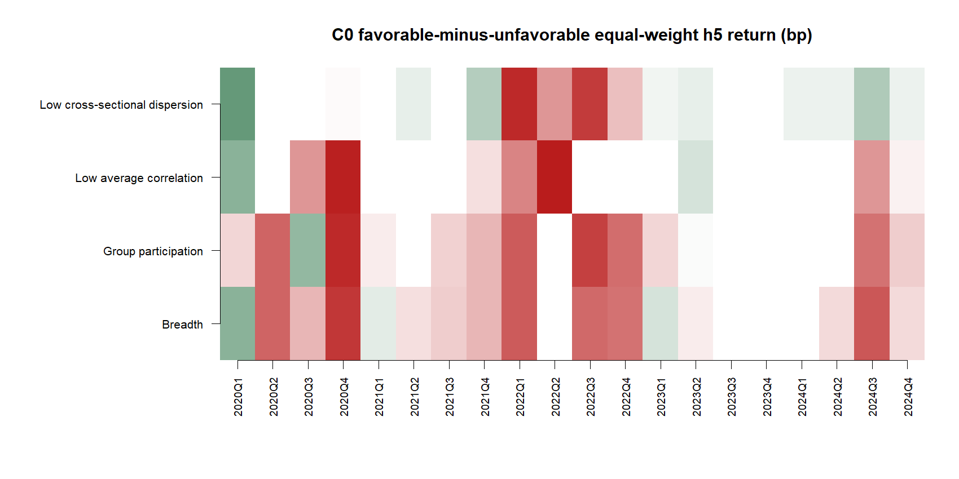
X1 found one stable primitive—not enough for a model
X1/09
Notes:
POC X1 — NO-MODEL MEASUREMENT AUDIT
Frozen primitives
20- and 60-session momentum, market-relative 20-session momentum, group-relative 20-session momentum, 60-session drawdown resilience, low 20-session volatility, and 5-versus-prior-60-session dollar-volume participation.
Pass rule
Positive pooled daily rank IC, positive pooled top-minus-bottom h5 return, at least 12 of 20 positive-IC folds, at least 12 of 20 positive-ordering folds, and no group above 50% of top selections.
Readout
Only group-relative 20-session momentum passed every standalone gate.
Report: C:/Users/Franc/OneDrive/Documents/Francis/Peltata Project/Time-Series-Modeling-Gen5/runs/research_workbench/gen54_ml_decision_engine/g54_xs_20260719x0x1/xs_report.md
Conversation: codex://threads/019f741e-615f-7fd0-90f7-edce12b5cb66
Find in chat: all data that we have available

Slide 10
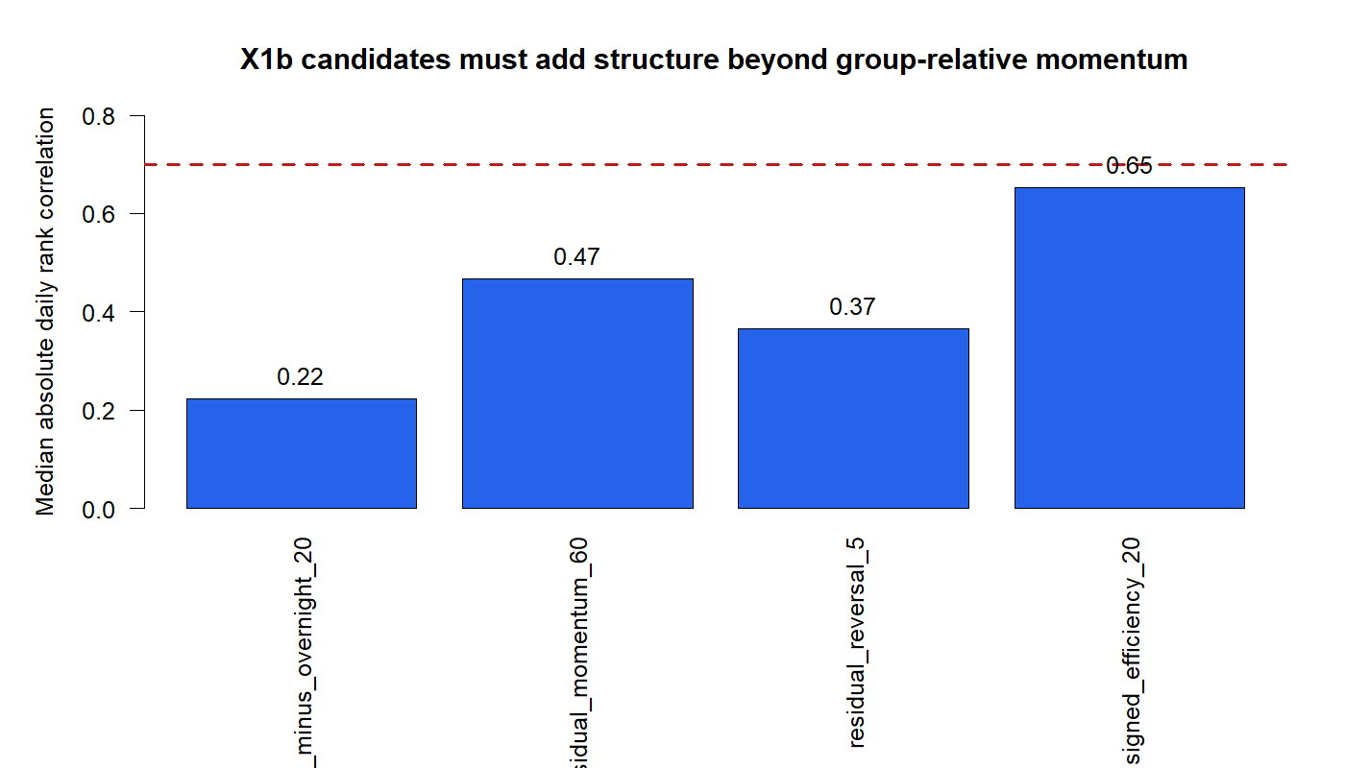
The wider universe solved breadth—not signal quality
OVERALL: STOP BEFORE MODEL FIT
PASS 24 / 24 coverage
PASS 6 / 6 leakage checks
PASS Group-relative 20 only
REVIEW Momentum 60: concentrated
STOP Five remaining primitives
Model fits: 0
D19/10
Notes:
DECISION D19 — X0/X1 STOP BEFORE MODEL FIT
Why STOP
The protocol required at least two economically distinct standalone primitives before combination design. Only group-relative 20-session momentum passed every gate.
Important nuance
Momentum 60 had positive pooled IC, 14/20 positive IC folds, 14/20 positive ordering folds, and +61.0 bp pooled top-minus-bottom separation. It failed the predeclared group-concentration cap: 67.3% versus 50%.
Other readouts
Low-volatility ordering was negative. Participation had negative pooled IC. Widening the cross-section therefore improved measurement legitimacy but did not create a robust multivariate information set.
Conversation: codex://threads/019f741e-615f-7fd0-90f7-edce12b5cb66
Find in chat: autonomously run as large a chunk
Report: C:/Users/Franc/OneDrive/Documents/Francis/Peltata Project/Time-Series-Modeling-Gen5/runs/research_workbench/gen54_ml_decision_engine/g54_xs_20260719x0x1/xs_report.md
Status: STOP_BEFORE_MODEL_FIT; model_fit_count = 0.

Slide 11
Decision record and evidence artifacts
1
D15–D18 — cross-sectional POC charter
docs/GEN5_4_CROSS_SECTIONAL_ASSET_SELECTION_POC_PLAN.md
2
D19 — X0/X1 measurement packet
runs/.../g54_xs_20260719x0x1/xs_report.md
3
GEN5_4_DECISION_DIALOGUE_INDEX.md
Codex deep link, exact Find-in-chat phrases, compact decisions
4
GEN5_1_POC_PROGRESS_LOG.md
Cumulative POC question, artifacts, readout, and STOP state
5
GEN5_4_ML_DECISION_ENGINE_PLAN.md
Prior supervised lineage and wide-pool absolute-target evidence
6
AGENTS.md
WFA-first • explicit as-of • no-trade • no live change
Speaker notes carry conversation bookmarks, decisions, evidence paths, and research boundaries.
IDX/11
Notes:
PROVENANCE INDEX
Conversation: codex://threads/019f741e-615f-7fd0-90f7-edce12b5cb66
Find in chat: slight pivot in direction
Plan: docs/GEN5_4_CROSS_SECTIONAL_ASSET_SELECTION_POC_PLAN.md
Decision index: docs/GEN5_4_DECISION_DIALOGUE_INDEX.md
Progress log: docs/GEN5_1_POC_PROGRESS_LOG.md
Packet: C:/Users/Franc/OneDrive/Documents/Francis/Peltata Project/Time-Series-Modeling-Gen5/runs/research_workbench/gen54_ml_decision_engine/g54_xs_20260719x0x1
Boundary: concise visible narrative; longer decision rationale remains navigable through notes and the dialogue index.

Slide 12
The next gate is information—not a cleverer ranker
FIRST
SECOND
THIRD
Keep the wide panel
and h5 target contract
Accept the X1 STOP;
do not fit one primitive
Add one distinct family
or revise universe logic
Recommended next session: choose one point-in-time feature family that can supply an independent cross-sectional signal.
G/12
Notes:
NEXT OPERATOR GATE — SECOND INDEPENDENT INFORMATION FAMILY
Recommended direction
Keep X0's wide panel, the same-date rank architecture, h5 execution-aligned relative target, and cash/no-trade separation. Do not loosen the concentration cap or fit a model around the single passing primitive.
Candidate next families
1. Point-in-time filing and earnings-change features from an official structured source.
2. Revision-safe macro/credit context shared across the cross-section.
3. A separately justified universe rule with historical membership evidence.
Alpaca boundary
Alpaca adjusted daily bars support the panel. Alpaca does not document the structured fundamentals/estimate-revision surface needed for the strongest first candidate.
Conversation: codex://threads/019f741e-615f-7fd0-90f7-edce12b5cb66
Find in chat: non-price-related data
Status: operator decision required before X2 or a new data-family POC.

Slide 13
SESSION 6
The ranking layer advances;
the exposure layer does not.
Residual structure • path quality • TRAIN-only context • separate falsifiers
S6/13
Notes:
SESSION 6 - OHLCV-ONLY X1B AND C0
Purpose
Extend the no-model measurement ladder with four economically interpretable ranking primitives and four separately judged exposure-permission conditions.
Conversation: codex://threads/019f741e-615f-7fd0-90f7-edce12b5cb66
Find in chat: X1B and C0 test
Artifact: docs/GEN5_4_CROSS_SECTIONAL_ASSET_SELECTION_POC_PLAN.md
Boundary: research evidence only; no model, top-K policy, replay, or live authority.

Slide 14
X1b and C0 ask different questions - and must pass separately
X1b RANKING
REDUNDANCY
C0 PERMISSION
Four residual / path primitives
vs relative h5 outcomes
At most 0.70 rank correlation +
fold / concentration gates
Four TRAIN-threshold states
vs absolute basket h5 outcomes
Promotion requires one distinct X1b primitive AND one C0 condition. No model, top-K policy, or replay.
D22/14
Notes:
DECISION D22 - LEAKAGE-SAFE X1B / C0 CONTRACT
X1b primitives
Residual momentum 60; residual reversal 5; signed efficiency 20; intraday-minus-overnight 20. Residuals use a 126-session regression on SPY and leave-one-out group peers, fitted only on prior sessions.
X1b gates
Positive pooled daily rank IC; positive pooled top-minus-bottom h5 relative return; at least 12 of 20 positive-IC folds; at least 12 of 20 positive-ordering folds; no group above 50% of top selections; median absolute daily rank correlation with group-relative 20 no greater than 0.70.
C0 conditions
Breadth 60; group participation 60; inverse average correlation 60; inverse cross-sectional dispersion 20. Every fold freezes its favorable threshold from TRAIN only, then evaluates absolute equal-weight basket h5 returns in OOS.
C0 gates
Positive pooled favorable-minus-unfavorable separation; positive in at least 12 of 20 folds; favorable share between 25% and 75%.
Conversation: codex://threads/019f741e-615f-7fd0-90f7-edce12b5cb66
Find in chat: X1B and C0 test
Artifact: C:/Users/Franc/OneDrive/Documents/Francis/Peltata Project/Time-Series-Modeling-Gen5/runs/research_workbench/gen54_ml_decision_engine/g54_xs_x1b_c0_20260719/x1b_c0_run_spec.csv

Slide 15
X1b adds one distinct ranking primitive
X1b/15
Notes:
POC X1B - NO-MODEL RANKING EXTENSION
Promoted
Intraday-minus-overnight 20 passed every frozen gate: pooled daily rank IC 0.005595; positive IC in 12/20 folds; positive ordering in 12/20 folds; pooled top-minus-bottom h5 relative separation +8.2 basis points; maximum group share 47.6%; redundancy correlation 0.22.
Stopped
Residual momentum 60: IC 0.00927, 9/20 IC folds, 13/20 ordering folds, +23.3 bp, maximum group share 60.9%, redundancy 0.47.
Residual reversal 5: IC -0.00485, 12/20 IC folds, 7/20 ordering folds, -4.2 bp, maximum group share 45.8%, redundancy 0.37.
Signed efficiency 20: IC 0.02812, 15/20 IC folds, 13/20 ordering folds, +24.9 bp, maximum group share 51.2%, redundancy 0.65. It narrowly failed the frozen 50% concentration cap and is not rescued post hoc.
Conversation: codex://threads/019f741e-615f-7fd0-90f7-edce12b5cb66
Find in chat: more sophisticated approach with your guidance
Report: C:/Users/Franc/OneDrive/Documents/Francis/Peltata Project/Time-Series-Modeling-Gen5/runs/research_workbench/gen54_ml_decision_engine/g54_xs_x1b_c0_20260719/x1b_c0_report.md

Slide 16
C0 fails the separate exposure-permission gate
C0/16
Notes:
POC C0 - EXPOSURE-PERMISSION AUDIT
All four conditions stopped
Breadth 60: positive separation in 3/20 folds; pooled separation -141.3 bp; favorable share 57.7%.
Group participation 60: 2/20; -157.4 bp; favorable share 65.7%.
Low average correlation 60: 2/20; -151.1 bp; favorable share 61.0%.
Low cross-sectional dispersion 20: 9/20; -23.8 bp; favorable share 39.7%.
Interpretation
These intuitive market-internal conditions did not identify OOS periods with better absolute five-session equal-weight basket returns. The sign is not reversed and thresholds are not retuned after seeing OOS.
Leakage protection
Each fold's threshold came only from its preceding TRAIN window. All nine leakage / authority checks passed.
Conversation: codex://threads/019f741e-615f-7fd0-90f7-edce12b5cb66
Find in chat: X1B and C0 test
Report: C:/Users/Franc/OneDrive/Documents/Francis/Peltata Project/Time-Series-Modeling-Gen5/runs/research_workbench/gen54_ml_decision_engine/g54_xs_x1b_c0_20260719/x1b_c0_report.md

Slide 17
Selection improved - but long-entry permission remains unproven
OVERALL: STOP BEFORE TWO-STAGE DESIGN
PASS 9 / 9 leakage checks
PASS Intraday-minus-overnight 20
REVIEW Signed efficiency: 51.2% group
STOP 4 / 4 C0 conditions
STOP No demonstrator or model
Model fits: 0
D23/17
Notes:
DECISION D23 - X1B PASSES ONE PRIMITIVE; C0 STOPS THE LAYER
Readout
The ranking side now has two distinct standalone primitives: the earlier group-relative 20-session momentum and the newly promoted intraday-minus-overnight 20 primitive. That is useful evidence, but it does not authorize long exposure.
Why the overall state remains STOP
The predeclared two-stage demonstrator required both a distinct X1b ranking primitive and a passing C0 exposure-permission condition. C0 produced zero promotions, so no rule combination, model, top-K policy, replay, or live advice was run.
Methodological discipline
Do not reverse C0 signs, loosen the signed-efficiency concentration cap, or select a favorable fold subset after observing these results. A new exposure target, horizon, or independent context family requires a new theory-first design session.
Conversation: codex://threads/019f741e-615f-7fd0-90f7-edce12b5cb66
Find in chat: more sophisticated approach with your guidance
Report: C:/Users/Franc/OneDrive/Documents/Francis/Peltata Project/Time-Series-Modeling-Gen5/runs/research_workbench/gen54_ml_decision_engine/g54_xs_x1b_c0_20260719/x1b_c0_report.md
Status: STOP_BEFORE_TWO_STAGE_RULES_DESIGN; model_fit_count = 0.

